Slide 1
ECEN 615
Methods of Electric Power
Systems Analysis
Lecture 10: Advanced Power Flow
Prof. Tom Overbye
Dept. of Electrical and Computer Engineering
Texas A&M University
overbye@tamu.edu

Slide 2
Announcements
Start reading Chapter 7 (the term reliability is now often used instead of security)
Homework 3 is due on Thursday Sept 29

Slide 3
Sparse Vector Methods
Sparse vector methods are useful for cases in solving Ax=b in which
  A is sparse, b is sparse, only certain elements of x are needed
In these right circumstances sparse vector methods can result in extremely fast solutions!
A common example is to find selected elements of the inverse of A, such as diagonal elements.
Often times multiple solutions with varying b values are required
  A only needs to be factored once, with its factored form used many times
Key reference is
  W.F. Tinney, V. Brandwajn, and S.M. Chan, "Sparse Vector Methods", IEEE Transactions on Power Apparatus and Systems, vol. PAS-104, no. 2, February 1985, pp. 295-300
2

Slide 4
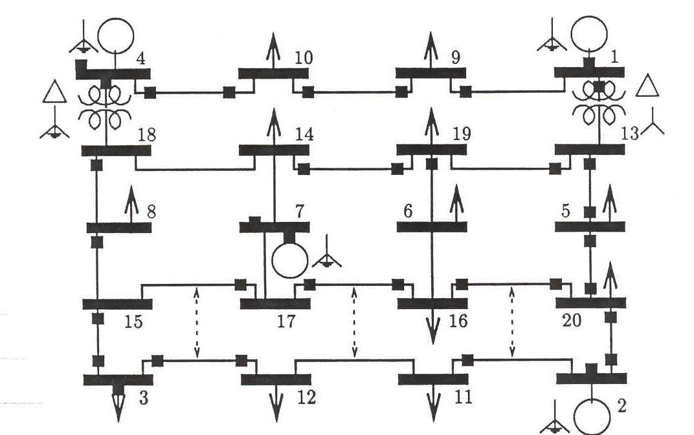
20 Bus Example
3

Slide 5
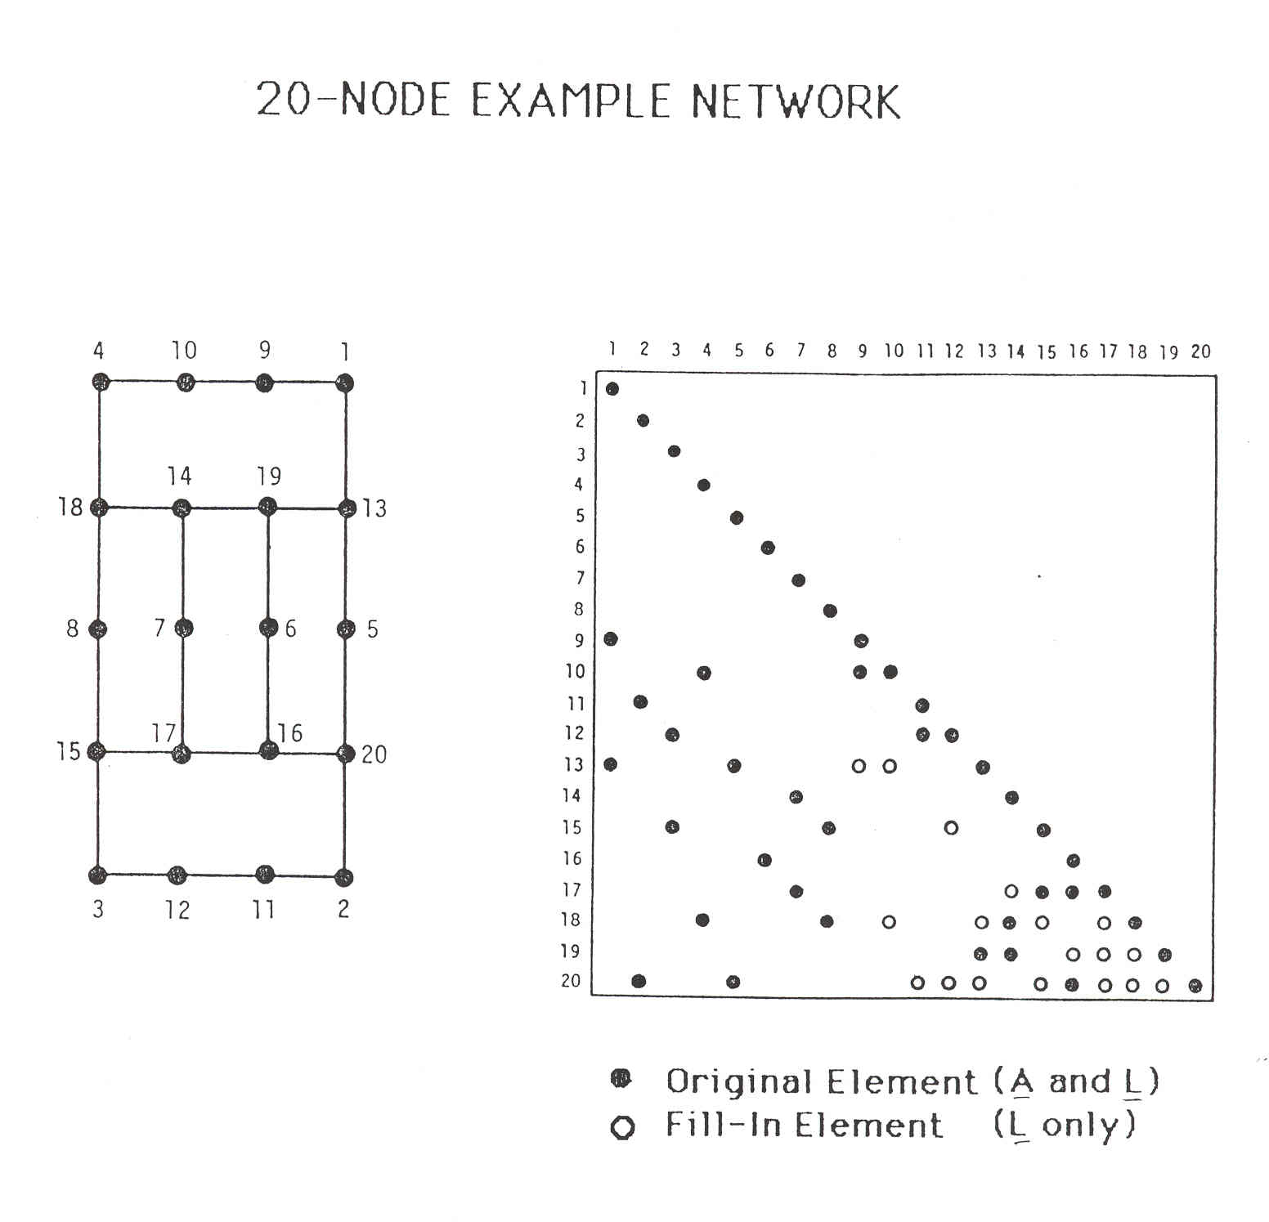
20 Bus Example
Only showing L
4

Slide 6
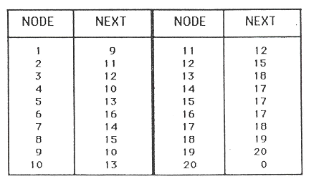
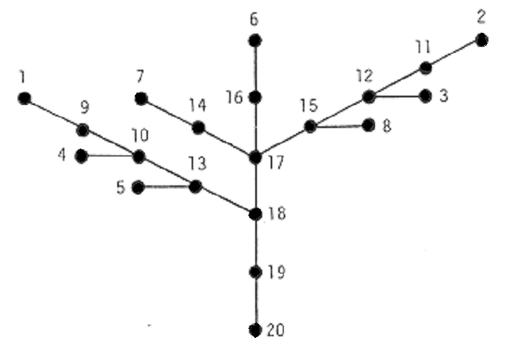
20 Bus Example
5

Slide 7
20 Bus Example
Suppose we wish to evaluate a sparse vector with the nonzero elements for components 2, 6, 7, and 12
From the path table or path graph, we obtain the following factorization paths (f.p.)
This gives the following path elements
6

Slide 8
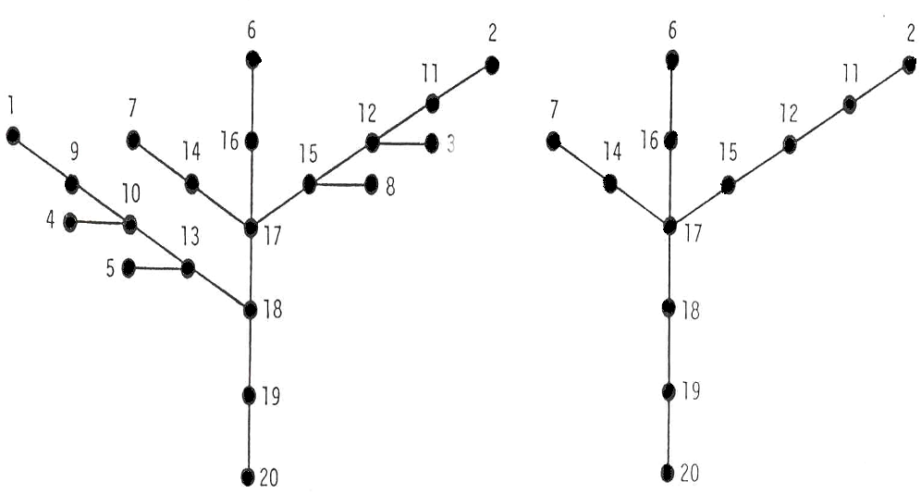
20 Bus Example
Full path
Desired subset
7

Slide 9
Remarks
Since various permutations may be used to order a particular path subgroup, a precedence rule is introduced to make the ordering valid
This involves some sorting operation; for the FF, the order value of a node cannot be computed until the order values of all lower numbered nodes are defined
The order of processing branches above a junction node is arbitrary; for each branch, however, the precedence rule in force applies
We can paraphrase this statement as: perform first everything above the junction point using the precedence ordering in each branch
8

Slide 10
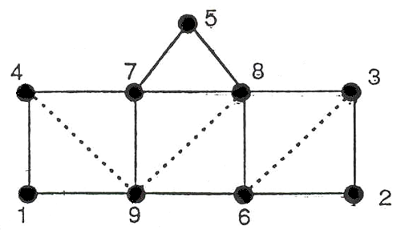
Nine Bus Example
We next consider the example of the 9-bus network shown below
For the given ordering, the sparsity structure leads to the following path graph and the table
9

Slide 11
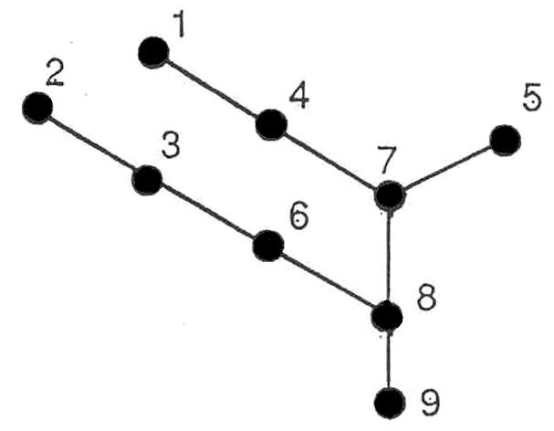
Nine Bus Example
k | p(k)
1 2 3 4 5 6 7 8 9 | 4 3 6 7 7 8 8 9 0
10

Slide 12
Nine Bus Example
Suppose next we are interested in the value determination of only component, node 1
  That is, calculating a diagonal of the inverse of the original matrix
FF involves going down the path from 1-4-7-8-9, and the FB requires coming back up, 9-8-7-4-1
This example makes evident the savings in operations we may realize from the effective use of a sparse vector scheme
11

Slide 13
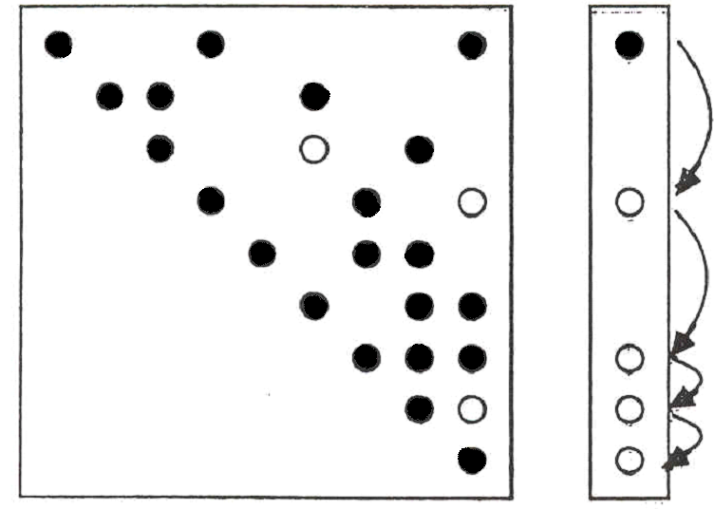
Nine Bus Example
12

Slide 14
Example Application
In ongoing geomagnetic disturbance modeling work we need to determine the sensitivity of the results to the assumed substation grounding resistance
  Since the induced voltages are quasi-dc, the network is modeled by setting up the conductance matrix G = R⁻¹
  Initial work focused on calculating the driving point impedance values, which required knowing diagonal elements of R, which were easily calculated with sparse vector methods
  But R_{ii} depends on the assumed grounding values are nearby substations, so we need to determine this impact as well; so we’d like small blocks of the inverse of R, which will require using the unions of the factorization paths to get some R_{ij}
13

Slide 15
Ordering for Shorter Paths, Computational Complexity
The paper 1990 IEEE Transactions on Power Systems paper “Partitioned Sparse A⁻¹ Methods” (by Alvarado, Yu and Betancourt) they introduce ordering methods for decreasing the length of the factorization paths
Factorization paths also indicate the degree to which parallel processing could be used in solving Ax = b by LU factorization
  Operations in the various paths could be performed in parallel
The computational complexity of doing an FF/FB is O(n^{0.5})
  F. Safdarian, Z. Mao, W. Jang, and T. J. Overbye, “Power System Sparse Matrix Statistics,” IEEE Texas Power and Energy Conference, College Station, TX, February 2022
14

Slide 16
Computation with Complex and Blocked Matrices
In the previous analysis we have implicitly assumed that the values involved were real numbers (stored as singles or doubles in memory)
Nothing in the previous analysis prevents using other data structures for analysis
  Complex numbers would be needed if factoring the bus admittance matrix (Y_{bus}); this is directly supported in some programming languages and can be easily added to others; all values are complex numbers
  Two by two block matrices are common for power flow Jacobian factorization; for this we use 2 by 2 blocks in the matrices and 2 by 1 blocks in the vectors
15

Slide 17
2 by 2 Block Matrix Computation
By treating our data structures as two by two blocks, we reduce the computation required to add fills substantially
  Half the number of rows, and four times fewer elements
Overall computation is reduced somewhat since we have four times fewer elements, but we do have more computation per element
16

Slide 18
2 by 2 Block Matrix Example
In the backward substitution we had
For i := n downto 1 Do Begin
k = rowPerm[i];
p1 := rowDiag[k].next;
While p1 <> nil Do Begin
bvector[k] = bvector[k] – p1.value*bvector[p1.col];
p1 := p1.next;
End;
bvector[k] := bvector[k]/rowDiag[k].value;
End;
17

Slide 19
2 by 2 Block Matrix Example
We replace the scalar bvector entries by objects with fields .r and .i (for the real and imaginary parts) and we replace the p1.value field with four fields .ul, .ur, .ll and .lr corresponding to the upper left, upper right, lower left and lower right values.
The first multiply goes from
bvector[k] = bvector[k] – p1.value*bvector[p1.col]
to
18

Slide 20
2 by 2 Block Matrix Example
The second numeric calculation changes from
bvector[k] := bvector[k]/rowDiag[k].value
To
Which can be coded by directly doing the inverse as
19

Slide 21
Sparse Matrix and Vector Method Summary
Previous slides have presented sparse matrix and sparse vector methods commonly used in power system and some circuit analysis applications
These methods are widely used, and have the ability to substantially speed up power system computations
They will be applied as necessary throughout the remainder of the course
We’ll now move on to some more advanced power flow topics, sensitivity analysis, and contingency analysis
20

Slide 22
Modeling Transformers with Off-Nominal Taps and Phase Shifts
If transformers have a turns ratio that matches the ratio of the per unit voltages than transformers are modeled in a manner similar to transmission lines.
However, it is common for transformers to have a variable tap ratio; this is known as an “off-nominal” tap ratio
  The off-nominal tap is t, initially we’ll consider it a real number
  We’ll cover phase shifters shortly in which t is complex
21

Slide 23
Transformer Representation
The one–line diagram of a branch with a variable tap transformer
The network representation of a branch with off–nominal turns ratio transformer is
k
m
t :1
k
the tap is on
the side of bus k
22

Slide 24
Transformer Nodal Equations
From the network representation
Also
23

Slide 25
Transformer Nodal Equations
We may rewrite these two equations as
Y_{bus} is still symmetric here (though this will change with phase shifters)
This approach was first presented in F.L. Alvarado, “Formation of Y-Node using the Primitive Y-Node Concept,” IEEE Trans. Power App. and Syst., December 1982
24

Slide 26
The π-Equivalent Circuit for a Transformer Branch
k
m
25

Slide 27
Variable Tap Voltage Control
A transformer with a variable tap, i.e., the variable t is not constant, may be used to control the voltage at either the bus on the side of the tap or at the bus on the side away from the tap
This constitutes an example of single criterion control since we adjust a single control variable (i.e., the transformer tap t) to achieve a specified criterion: the maintenance of a constant voltage at a designated bus
Names for this type of control are on-load tap changer (LTC) transformer or tap changing under load (TCUL)
Usually on low side; there may also be taps on high side that can be adjusted when it is de-energized
26

Slide 28
Variable Tap Voltage Control
An LTC is a discrete control, often with 32 incremental steps of 0.625% each, giving an automatic range of ± 10%
It follows from the π – equivalent model for the transformer that the transfer admittance between the buses of the transformer branch and the contribution to the self admittance at the bus away from the tap explicitly depend on t
However, the tap changes in discrete steps; there is also a built-in time delay in how fast they respond
Voltage regulators are devices with a unity nominal ratio, and then a similar tap range
27

Slide 29
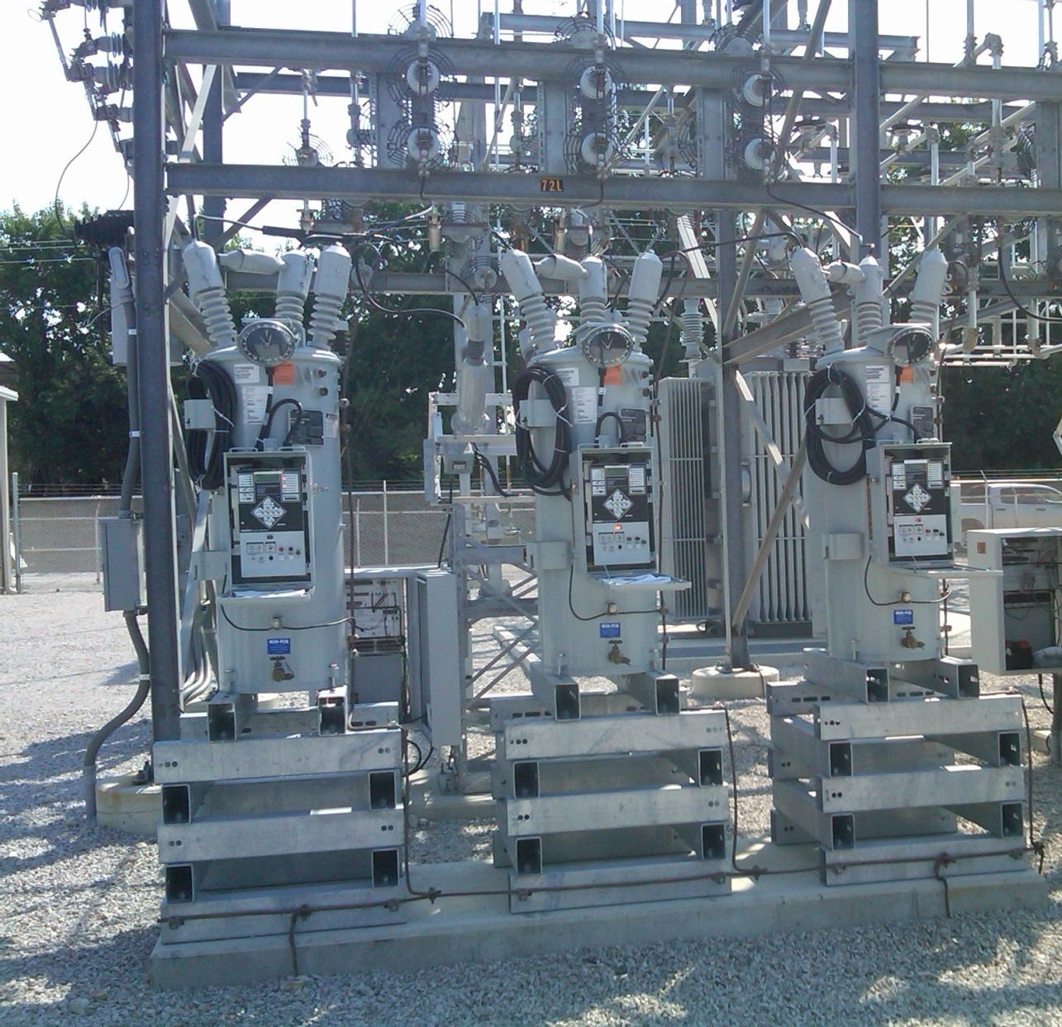
Ameren Champaign (IL) Test Facility Voltage Regulators
These are connected on the low side of a 69/12.4 kV
transformer; each phase can be regulated separately
28

Slide 30
Variable Tap Voltage Control in the Power Flow
LTCs (or voltage regulators) can be directly included
in the power flow equations by modifying the
Y_{bus} entries; that is by scaling the terms by 1, 1/t or 1/t² as appropriate
If t is fixed then there is no change in the number of equations
If t is variable, such as to enforce a voltage equality, then it can be included either by adding an additional equation and variable (t) directly, or by doing an “outer loop” calculation in which t is varied outside of the NR solution
  The outer loop is used in PowerWorld because of limit issues
29

Slide 31
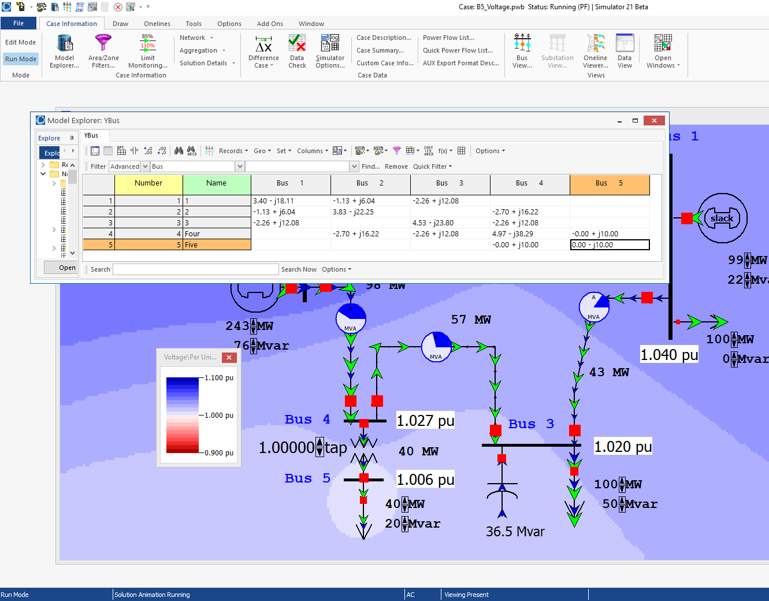
Five Bus PowerWorld Example
With an impedance
of j0.1 pu between
buses 4 and 5, the
y node primitive
with t=1.0 is
If t=1.1 then it is
PowerWorld Case: B5_Voltage
30

Slide 32
Circulating Reactive Power
Unbalanced transformer taps can cause large amounts of reactive power to circulate, increasing power system losses and overloading transformers
PowerWorld Case:
Bus3CirculatingVars
31

Slide 33
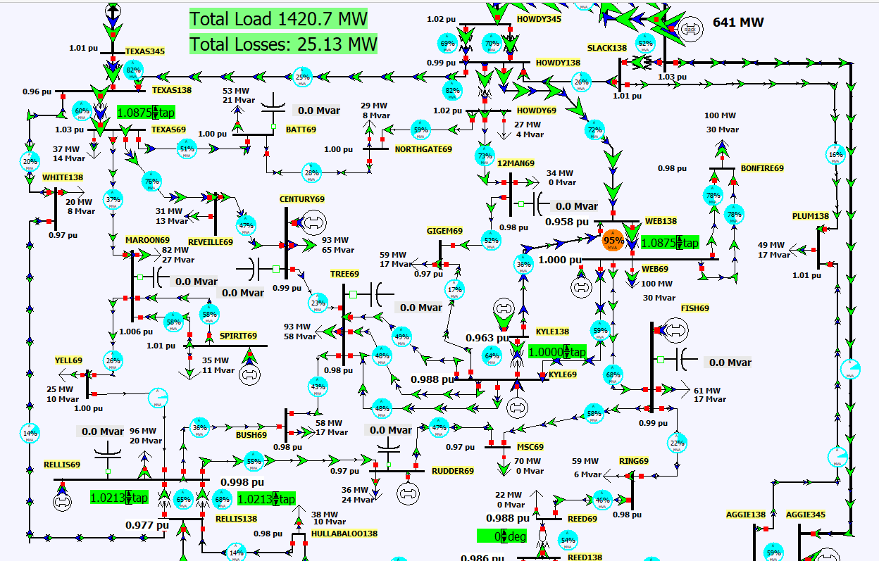
LTC Tap Coordination
Changing tap ratios can affect the voltages and var flow at nearby buses; hence coordinated control is needed
PowerWorld
Case: Aggieland37_LTC
32

Slide 34
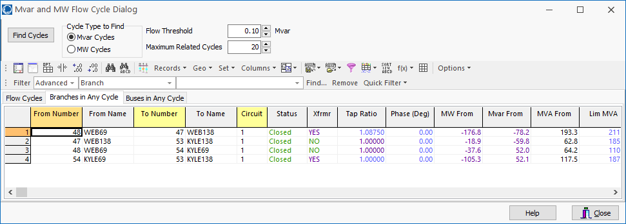
Auto Detection of Circulating Reactive or Real Power
Select Tools, Connections, Find Circulating MW or Mvar Flows to do an automatic determination of the circulating power in a case
33

Slide 35
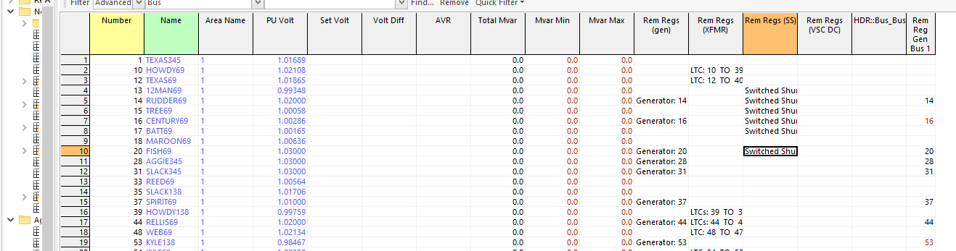
Coordinated Reactive Control
A number of different devices may be doing automatic reactive power control. They must be considered in some control priority
  One example would be 1) generator reactive power, 2) switched shunts, 3) LTCs
You can see the active controls in PowerWorld with Case Information, Solution Details, Remotely Regulated Buses
34

Slide 36
Coordinated Reactive Control
The challenge with implementing tap control in the power flow is it is quite common for at least some of the taps to reach their limits
  Keeping in mind a large case may have thousands of LTCs!
If this control was directly included in the power flow equations then every time a limit was encountered the Jacobian would change
  Also taps are discrete variables, so voltages must be a range
Doing an outer loop control can more directly include the limit impacts; often time sensitivity values are used
We’ll return to this once we discuss sparse matrices and sensitivity calculations
35

Slide 37
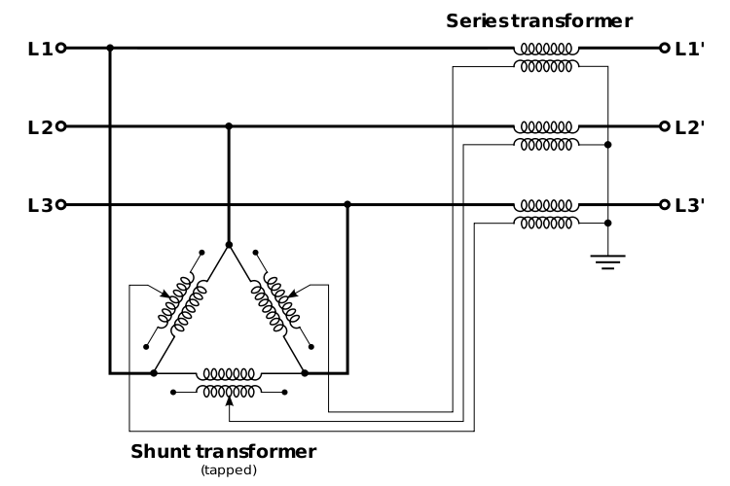
Phase-Shifting Transformers
Phase shifters are transformers in which the phase angle across the transformer can be varied in order to
control real power flow
  Sometimes they are called phase angle regulators (PARs)
  Quadrature booster (evidently British though I’ve never heard this term)
They are constructed
by include a delta-
connected winding
that introduces a 90º
phase shift that is added
to the output voltage
Image: http://en.wikipedia.org/wiki/Quadrature_booster
36

Slide 38
Phase-Shifter Model
We develop the mathematical model of a phase shifting transformer as a first step toward our study of its simulation
Let buses k and m be the terminals of the phase–shifting transformer, then define the phase shift angle as Φ_{km}
The latter differs from an off–nominal turns ratio LTC transformer in that its tap ratio is a complex quantity, i.e., a complex number, t_{km}∠Φ_{km}
The phase shift angle is a discrete value, with one degree a typical increment
37

Slide 39
Phase-Shifter Model
For a phase shifter located on the branch (k, m), the admittance matrix representation is obtained analogously to that for the LTC
Note, if there is a phase shift then Y_{bus} is no longer symmetric!! In a large case there are almost always some phase shifters. Y-Δ transformers also introduce a phase shift that is often not modeled
38

Slide 40
Integrated Phase-Shifter Control
Phase shifters are usually used to control the real power flow on a device
Similar to LTCs, phase-shifter control can either be directly integrated into the power flow equations (adding an equation for the real power flow equality constraint, and a variable for the phase shifter value), or they can be handled in with an outer loop approach
As was the case with LTCs, limit enforcement often makes the outer loop approach preferred
Coordinated control is needed when there are multiple, close by phase shifters
39

Slide 41
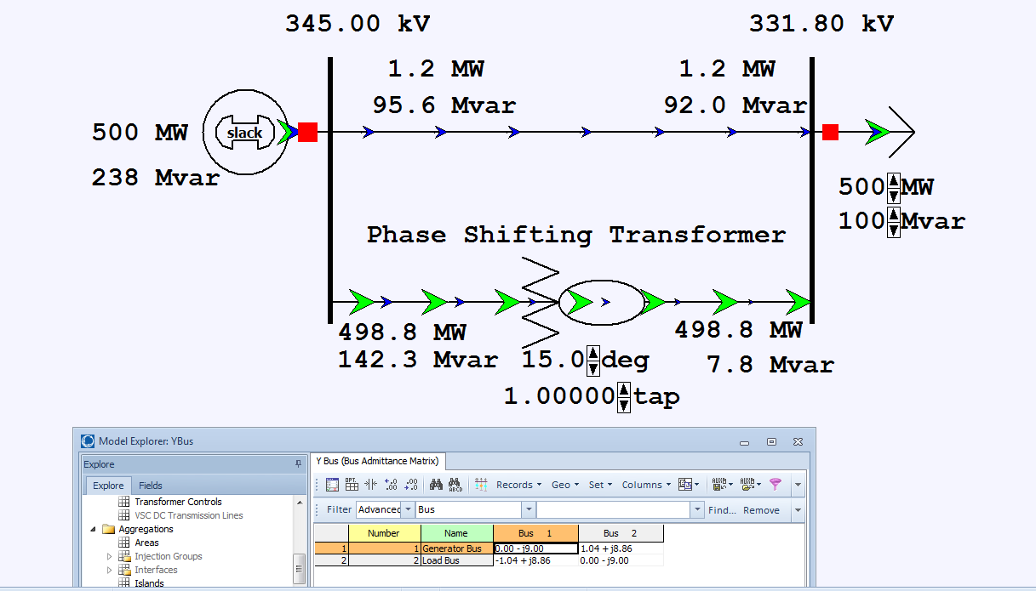
Two Bus Phase Shifter Example
Top line has
x=0.2 pu, while
the phase shifter
has x=0.25 pu.
PowerWorld Case: B2PhaseShifter
40

Slide 42
Aggieland37 With Phase Shifters
PowerWorld Case: Aggieland37_PhaseShifter
41

