Slide 1
ECEN 615
Methods of Electric Power
Systems Analysis
Lecture 11: Advanced Power Flow
Prof. Tom Overbye
Dept. of Electrical and Computer Engineering
Texas A&M University
overbye@tamu.edu

Slide 2
Announcements
Start reading Chapter 7 (the term reliability is now often used instead of security)
Homework 3 is due today
Homework 4 should be done before the first exam, but need not be turned in
Exam 1 is during class on Oct 13
  Closed book, notes. One 8.5 by 11 inch notesheet and calculators allowed
  Distance education students should make arrangements with Sanjana with HonorLock one approach
  Exam 1 from 2020 is available in Canvas; solutions will be posted as we get closer in

Slide 3
In the News: Hurricane Recovery
On Tuesday Hurricane Ian caused a nation-wide blackout in Cuba, and then yesterday made landfall in Florida as a Category 4 storm
Large hurricanes essentially always cause power outages, with problems occurring throughout the system (end users, distribution, transmission, sometimes generation)
However, they usually don’t cause larger blackouts (outside of the storm path) because the utilities have time to prepare
Currently about 2.5 million people in Florida about out, with real-time data available at poweroutage.us/
Utilities have lots of experience with restoration, and crews from across the country are helping in Florida
2

Slide 4
In the News: Transmission Line Permitting
As of today (9/29/22) Congress is set to pass a continuing resolution (CR) bill to fund the government for a few months. What will not be included in that bill is overhaul of energy permitting, which includes new transmission lines
In the US the Tenth Amendment ensures the states have many powers,
  “The powers not delegated to the United States by the Constitution, nor prohibited by it to the States, are reserved to the States respectively, or to the people.”
  Prior to the Civil War the common grammar was, “The United States are” whereas after the Civil it changed to, “The United States is…”
States have the final authority on permitting of transmission lines, which often cross state boundaries and usually have varying benefits
3

Slide 5
In the News: Transmission Line Permitting, cont.
With the growth in renewable generation (primarily wind and solar), lots of new transmission lines will be needed
The US Federal Energy Regulatory Commission (FERC) has oversight over regional transmission planning, the allocation of costs, generator interconnection and extreme weather protection
  Most of Texas is an exception since we have our own grid
  State utility commissions issue permits for electric transmission under the Federal Power Act
The Energy Policy Act of 2005 required DOE to determine National Interest Transmission Corridors, but this does not include route-specific designations that could be approved that the federal level
4

Slide 6
Aggieland37 With Phase Shifters
PowerWorld Case: Aggieland37_PhaseShifter
5

Slide 7
Large Case Phase Shifter Limits and Step Size
6

Slide 8
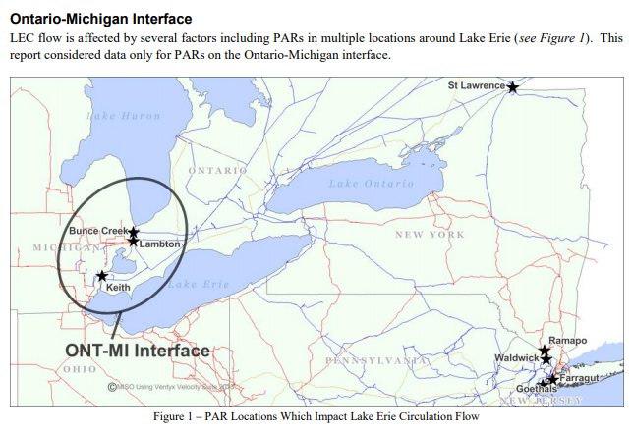
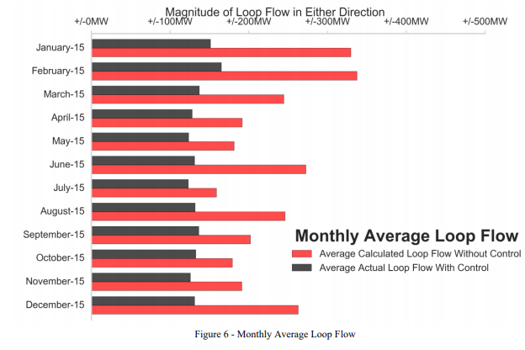
Example of Phase Shifters in Practice
The below report mentions issues associated with the Ontario-Michigan PARs
https://www.nyiso.com/public/webdocs/markets_operations/committees/bic_miwg/meeting_materials/2017-02-28/2016%20Ontario-Michigan%20Interface%20PAR%20Evaluation%20Final%20Report.pdf
7

Slide 9
Impedance Correction Tables
With taps the impedance of the transformer changes; sometimes the changes are relatively minor and sometimes they are dramatic
  A unity turns ratio phase shifter is a good example with essentially no impedance when the phase shift is zero
  Often modeled with piecewise linear function with impedance correction varying with tap ratio or phase shift
  Next lines give several examples, with format being (phase shift or tap ratio, impedance correction)
    (-60,1), (0,0.01), (60,1)
    (-25,2.43),(0,1),(25,2.43)
    (0.941,0.5), (1.04,1), (1.15,2.45)
    (0.937,1.64), (1,1), (1.1, 1.427)
8

Slide 10
Three-Winding Transformers
Three-winding transformers are very common, with the third winding called the tertiary
  The tertiary is often a delta winding
Three-winding transformers have various benefits
  Providing station service
  Place for a capacitor connection
  Reduces third-harmonics
  Allows for three different transmission level voltages
  Better handling of fault current
9

Slide 11
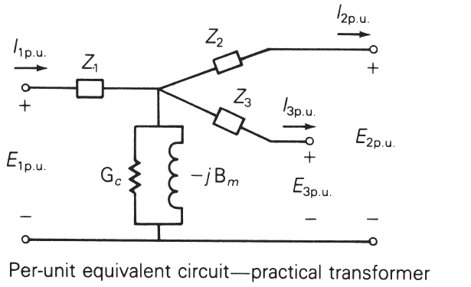
Three-Winding Transformers
Usually modeled in the power flow with a star equivalent; the internal “star” bus does not really exist
Star bus is often given a voltage of 1.0 or 999 kV
Impedances calculated using the wye-delta transform can result in negative resistance (about 900 out of 97,000 in EI model)
The winding impedances are measured between the windings with one winding shorted and the other open; for example Z₁₂ is measured from 1 with winding 2 shorted, 3 open
Image from Power System Analysis and Design, by Glover, Overbye, Birchfield and Sarma 7th Edition
10

Slide 12
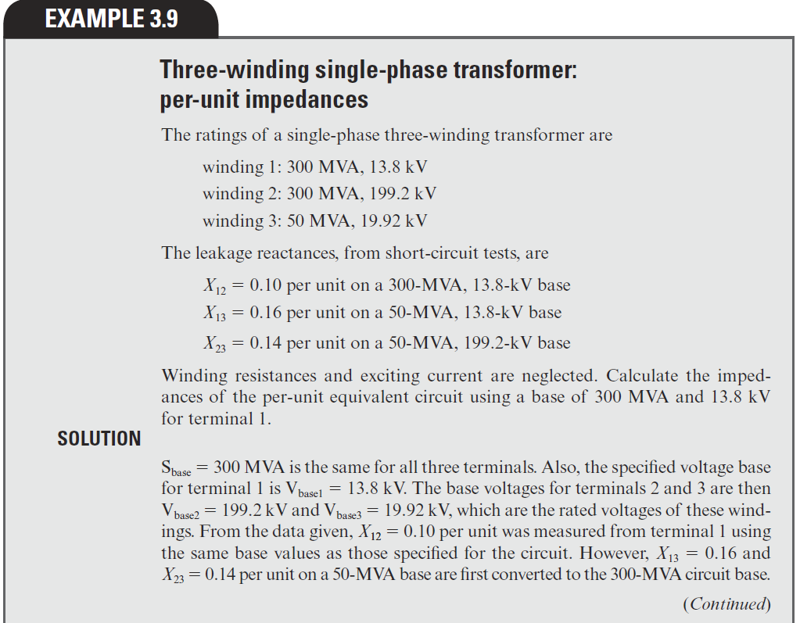
Three-Winding Transformer Example
Z₁₂ = Z₁ + Z₂
Z₁₃ = Z₁ + Z₃
Z₂₃ = Z₂ + Z₃
Hence
Z₁=0.5(Z₁₂+Z₁₃-Z₂₃)
Z₂=0.5(Z₁₂+Z₂₃-Z₁₃)
Z₃=0.5(Z₁₃+Z₂₃-Z₁₂)
Image from Power System Analysis and Design, by Glover, Overbye, Birchfield, and Sarma 7th Edition
11

Slide 13
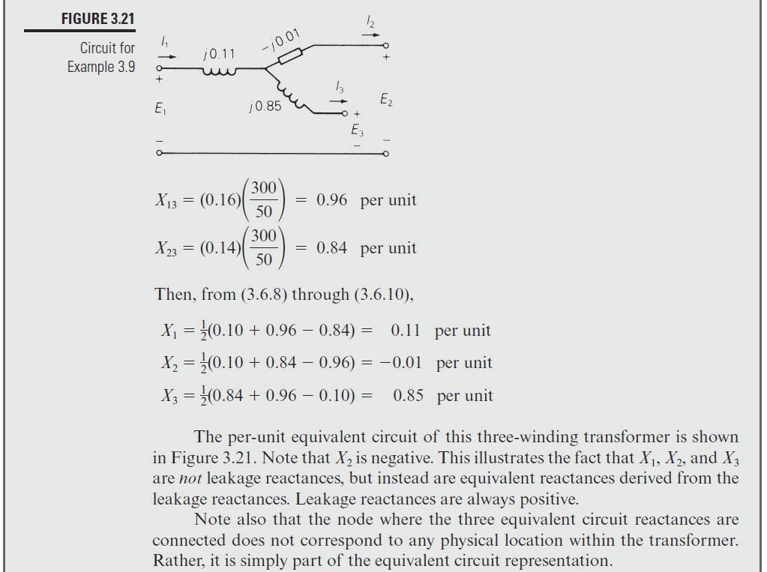
Three-Winding Transformer Example, cont.
Image from Power System Analysis and Design, by Glover, Overbye, Birchfield and Sarma 7th Edition
12

Slide 14
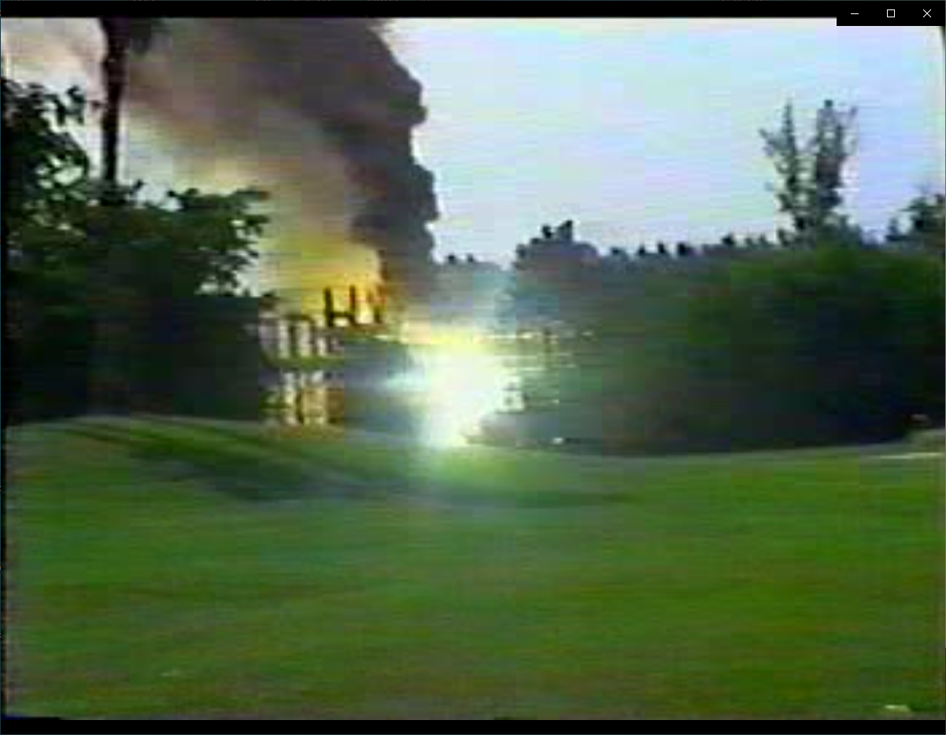
When Transformers go Bad
13

Slide 15
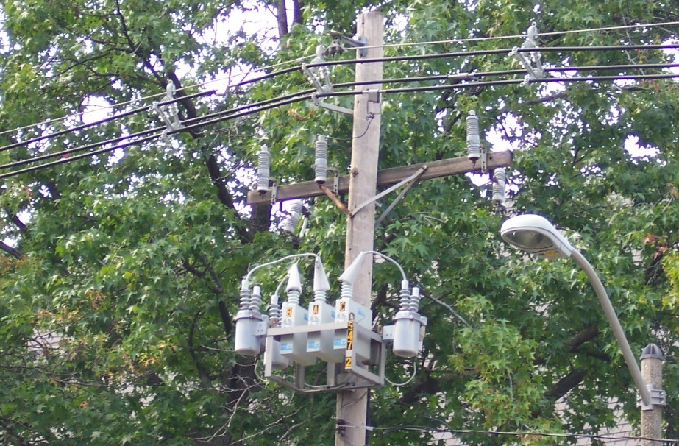
Switched Shunts and SVCs
Switched capacitors and
sometimes reactors are
widely used at both the
transmission and
distribution levels to
supply or (for reactors)
absorb discrete amounts of reactive power
Static var compensators (SVCs) are also used to supply continuously varying amounts of reactive power
In the power flow SVCs are sometimes represented as PV buses with zero real power
14

Slide 16
Switched Shunt Control
The status of switched shunts can be handled in an outer loop algorithm, similar to what is done for LTCs and phase shifters
  Because they are discrete they need to regulate a value to a voltage range
Switches shunts often have multiple levels that need to be simulated
Switched shunt control also interacts with the LTC and PV control
The power flow modeling needs to take into account the control time delays associated with the various devices
15

Slide 17
Switched Shunt System Design
Because switched shunts tend to have a local impact, there needs to be a coordinated design in their implementation at the transmission level
  Shunt capacitors used to raise the voltage, shunt reactors used to lower the voltage; used with LTCs and gens
Often in the transmission system they are switched manually by a system operator
The size and number of banks depends
  Change in the system voltages caused by bank switching
  The availability of different sizes
  Cost for the associated switchgear and protection system
16

Slide 18
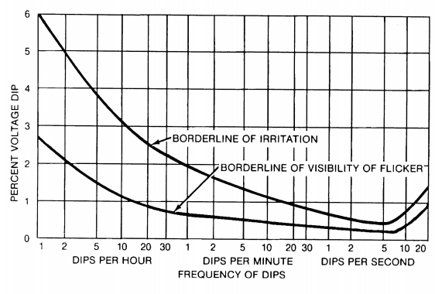
Switched Shunt Sizing
A goal with switched shunt sizing is to avoid human irritation caused by excessive changes in lighting
IEEE Std 1453-2015 gives guidance on the percentage of voltage changes as a
function of time; Table 3
of the standard suggests
keeping the voltage
changes below about 3%
We determine analytic
methods to calculate this
percentage later in the semester
Image from IEEE Std. 1453-2015, “IEEE Recommended Practice for Measurement and Limits of Voltage Fluctuations
and Associated Light Flicker on AC Power Systems”
17

Slide 19
Dynamic Reactive Capability
Switched shunts are often used to maintain adequate dynamic reactive power from generators and SVCs
FERC Order 827 (from June 2016, titled “Reactive Power Requirements for Non-Synchronous Generation”) states that the power factor of generators should be between 0.95 leading to 0.95 lagging
  Hence the absolute value of the Mvar output of the machines should be no more than 31% of the MW output
  Often a value substantially better for reactive reserves
Switched shunts are used to keep the generator power factor within this range
18

Slide 20
Area Interchange Control
The purpose of area interchange control is to regulate or control the interchange of real power between specified areas of the network
Under area interchange control, the mutually exclusive subnetworks, the so-called areas, that make up a power system need to be explicitly represented
These areas may be particular subnetworks of a power grid or may represent various interconnected systems
The specified net power out of each area is controlled by the generators within the area
A power flow may have many more areas than balancing authority areas
19

Slide 21
Area Interchange Control
The net power interchange for an area is the algebraic sum of all its tie line real power flows
We denote the real power flow across the tie line from bus k to bus m by P_{km}
We use the convention that P_{km} > 0 if power leaves node k and P_{km} ≤ 0 otherwise
Thus the net area interchange S_{i} of area i is positive (negative) if area i exports (imports)
Consider the two areas i and j that are directly connected by the single tie line (k, m) with the node k in area i and the node m in area j
20

Slide 22
Net Power Interchange
Then, for the complex power interchange S_{i}, we have a sum in which P_{km} appears with a positive sign; for the area j power interchange it appears with a negative sign
Area i
Area j
k
m
P_{km}
Area i exports P_{km} and Area j imports P_{km}
21

Slide 23
Net Power Interchange
Since each tie line flow appears twice in the net interchange equations, it follows that if the power system as a distinct areas, then
Consequently, the specification of S_{i} for a collection of (a-1) areas determines the system interchange; we must leave the interchange for one area unspecified
  This is usually (but not always) the area with the system slack bus
22

Slide 24
Modeling Area Interchange
Area interchange is usually modeled using an outer loop control
The net generation imbalance for an area can be handled using several different approach
  Specify a single area slack bus, and the entire generation change is picked up by this bus; this may work if the interchange difference is small
  Pick up the change at a set of generators in the area using constant participation factors; each generator gets a share
  Use some sort of economic dispatch algorithm, so how generation is picked up depends on an assumed cost curve
  Min/max limits need to be enforced
23

Slide 25
Including Impact on Losses
A change in the generation dispatch can also change the system losses. These incremental impacts need to be included in an area interchange algorithm
We’ll discuss the details of these calculations later in the course when we consider sensitivity analysis
24

Slide 26
Example Large System Areas
Each oval corresponds to a power flow area with the size proportional to the area’s generation
25

Slide 27
Generator Volt/Reactive Control
Simplest situation is a single generator at a bus regulating its own terminal
  Either PV, modeled as a voltage magnitude constraint, or as a PQ with reactive power fixed at a limit value. If PQ the reactive power limits can vary with the generator MW output
Next simplest is multiple generators at a bus. Obviously they need to be regulating the bus to the same voltage magnitude
  From a power flow solution perspective, it is similar to a single generator, with limits being the total of the individual units
  Options for allocation of vars among generators; this can affect the transient stability results
26

Slide 28
Generator Voltage Control
This example
uses the case
PSC_37Bus
with a voltage
contour. Try
varying the
voltage
setpoint for
the generator
at PEAR69
27

Slide 29
Generator Remote Bus Voltage Control
Next complication is generators at a single bus regulating a remote bus; usually this is the high side of their generator step-up (GSU) transformer
  When multiple generators regulate a single point their exciters need to have a dual input
  This can be implemented in the power flow for the generators at bus j regulating the voltage at bus k by changing the bus j voltage constraint equation to be
  (however, this does create a zero on the diagonal of the Jacobian)
  Helps with power system voltage stability
28

Slide 30
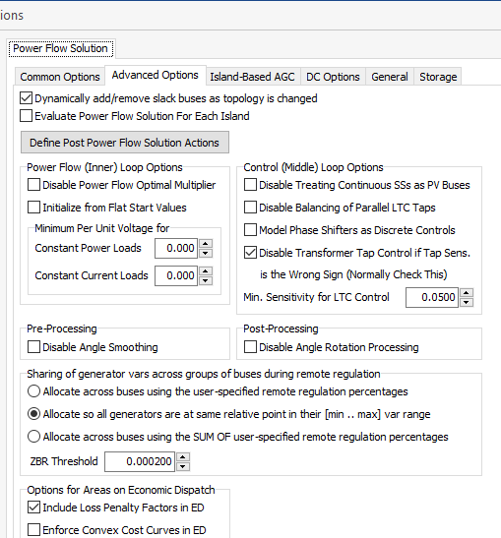
Reactive Power Sharing Options
Different software
packages use
different approaches
for allocating
the reactive power;
PowerWorld has
several options.
29

Slide 31
Reactive Power Sharing
In this example, case PSC_37Bus_Varsharing,
the two generators at
Elm345 are jointly controlling Elms138
30

Slide 32
Generator Remote Bus Voltage Control
The next complication is to have the generators at multiple buses doing coordinated voltage control
  Controlled bus may or may not be one of the terminal buses
There must be an a priori decision about how much reactive power is supplied by each bus; example allocations are a fixed percentage or placing all generators at the same place in their regulation range
Implemented by designating one bus as the master; this bus models the voltage constraint
All other buses are treated as PQ, with the equation including a percent of the total reactive power output of all the controlling bus generators
31

Slide 33
Remote and Coordinated Var Control Example
Here the generators at Elm345 and the one at Birch69 are jointly controlling the voltage at the Lemon138 bus.
Case is PSC_37Bus_Varsharing_MultipleBuses
32

Slide 34
Power Flow Topology Processing
Commercial power flow software must have algorithms to determine the number of asynchronous, interconnected systems in the model
  These separate systems are known as Islands
  In large system models such as the Eastern Interconnect it is common to have multiple islands in the base case (one recent EI model had nine islands)
  Islands can also form unexpectedly as a result of contingencies
  Power can be transferred between islands using dc lines
  Each island must have a slack bus
33

Slide 35
Power Flow Topology Processing
Anytime a status change occurs the power flow must perform topology processing to determine whether there are either 1) new islands or 2) islands have merged
Determination is needed to determine whether the island is “viable.” That is, could it truly function as an independent system, or should the buses just be marked as dead
  A quite common occurrence is when a single load or generator is isolated; in the case of a load it can be immediately killed; generators are more tricky
34

Slide 36
Topology Processing Algorithm
Since topology processing is performed often, it must be quick (order n ln(n))!
Simple, yet quick topology processing algoritm
  Set all buses as being in their own island (equal to bus number)
  Set ChangeInIslandStatus true
  While ChangeInIslandStatus Do
    Go through all the in-service lines, setting the islands for each of the buses to be the smaller island number; if the island numbers are different set ChangeInIslandStatus true
  Determine which islands are viable, assigning a slack bus as necessary
This algorithm does depend on the depth of the system
35

Slide 37

Example of Island Formation
This option allows some islands
to not have a power flow solution
Splitting large systems requires a careful consideration of the flow on the island tie-lines as they are opened
36

Slide 38
Bus Branch versus Node Breaker
Due to a variety of issues during the 1970’s and 1980’s the real-time operations and planning stages of power systems adopted different modeling approaches
Real-Time Operations
Use detailed node/breaker model
EMS system as a set of integrated applications and processes
Real-time operating system
Real-time databases
Planning
Use simplified bus/branch model
PC approach
Use of files
Stand-alone applications
  Entire data sets and software tools developed around these two distinct power system models
37

Slide 39
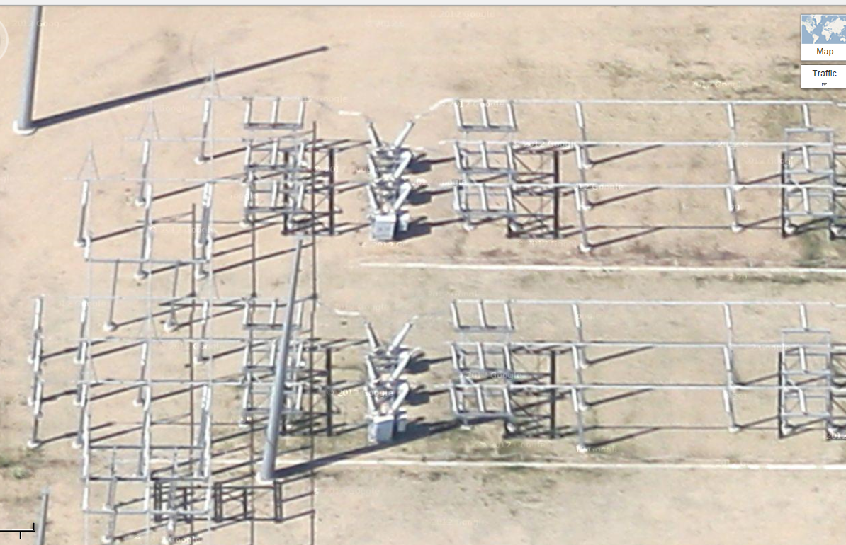
Google View of a 345 kV Substation
38

Slide 40
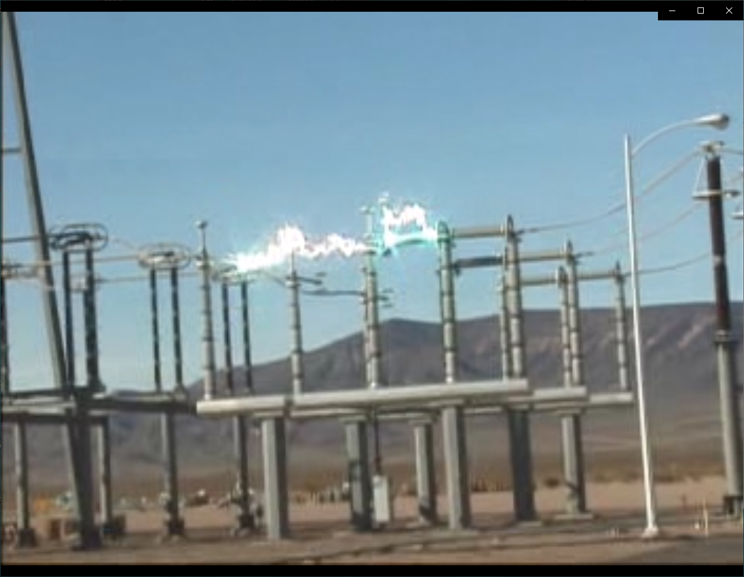
Example of Using a Disconnect to Break Load Current
39

Slide 41
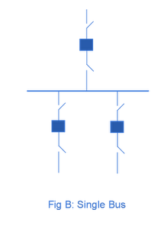
Substation Configurations
Several different substation breaker/disconnect configurations are common:
Single bus: simple but a fault
any where requires taking out the
entire substation; also doing breaker
or disconnect maintenance requires
taking out the associated line
Source: http://www.skm-eleksys.com/2011/09/substation-bus-schemes.html
40

Slide 42
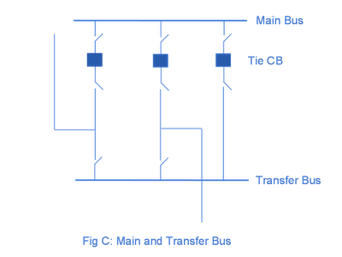
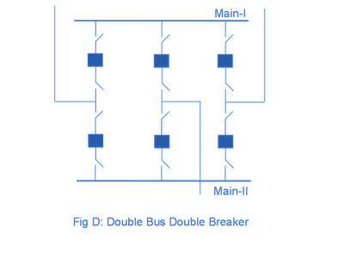
Substation Configurations, cont.
Main and Transfer Bus:
Now the breakers can be taken
out for maintenance without
taking out a line, but protection
is more difficult, and a fault
on one line will take out at least two
Double Bus Breaker:
Now each line is fully protected
when a breaker is out, so high
reliability, but more costly
Source: http://www.skm-eleksys.com/2011/09/substation-bus-schemes.html
41

Slide 43
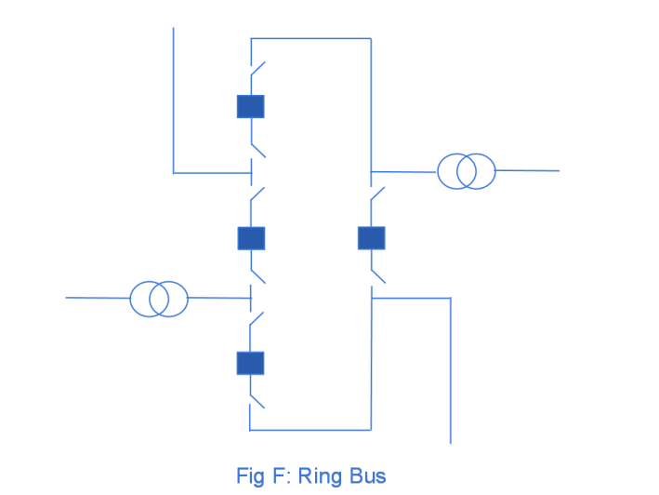
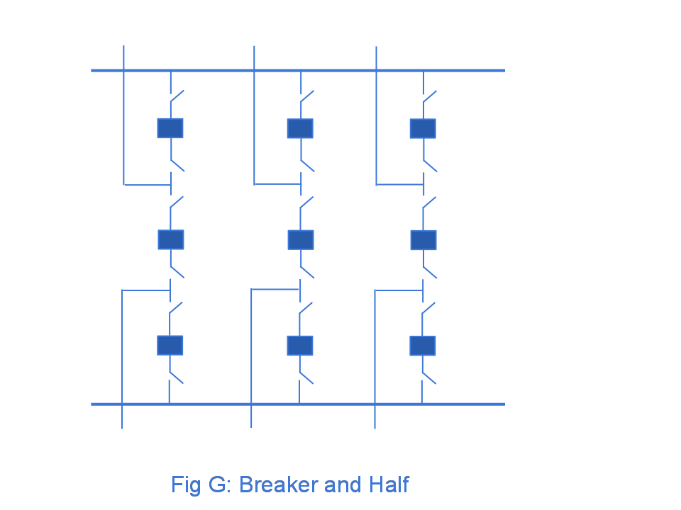
Ring Bus, Breaker and Half
As the name implies with a ring
bus the breakers form a ring;
number of breakers is same as
number of devices; any breaker can
be removed for maintenance
The breaker and half has two buses
and uses three breakers for two
devices; both breakers and buses
can be removed for maintenance
Source: http://www.skm-eleksys.com/2011/09/substation-bus-schemes.html
42

Slide 44
EMS and Planning Models
EMS Model
  Used for real-time operations
  Called full topology model
  Has node-breaker detail
Planning Model
  Used for off-line analysis
  Called consolidated model by PowerWorld
  Has bus/branch detail
-30 MW
-18 Mvar
50 MW
20 Mvar
-30 MW
-18 Mvar
10 MW
3 Mvar
10 MW
3 Mvar
-40 MW
-10 Mvar
10 MW
5 Mvar
-40 MW
-10 Mvar
10 MW
5 Mvar
43

Slide 45
Node-Breaker Consolidation
One approach to modeling systems with large numbers of ZBRs (zero branch reactances, such as from circuit breakers) is to just assume a small reactance and solve
  This results in lots of buses and branches, resulting in a much larger problem
  This can cause numerical problems in the solution
The alterative is to consolidate the nodes that are connected by ZBRs into a smaller number of buses
  After solution all nodes have the same voltage; use logic to determine the device flows
44

Slide 46
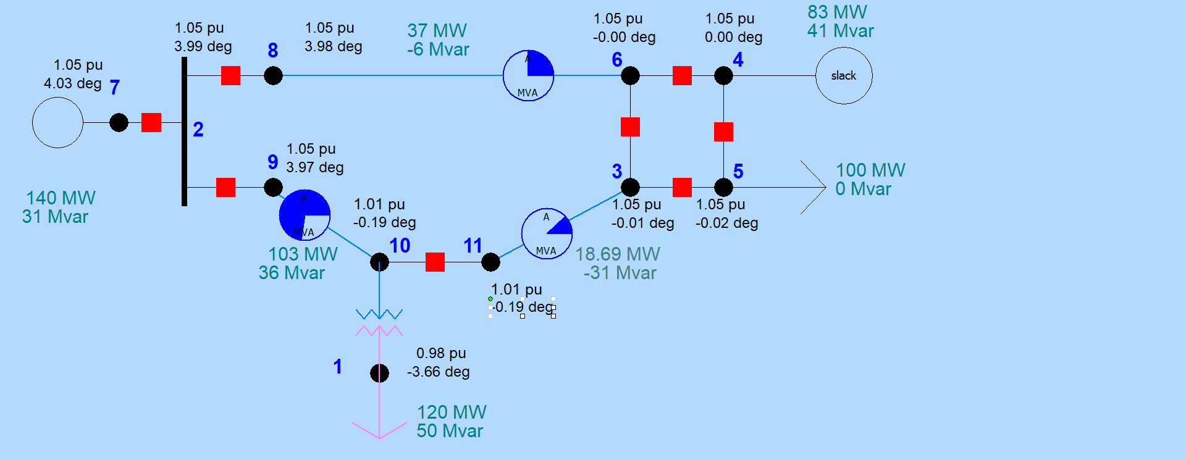
Node-Breaker Example
Case name is FT_11Node. PowerWorld consolidates nodes (buses) into super buses; available in the Model Explorer: Solution, Details, Superbuses.
45

Slide 47
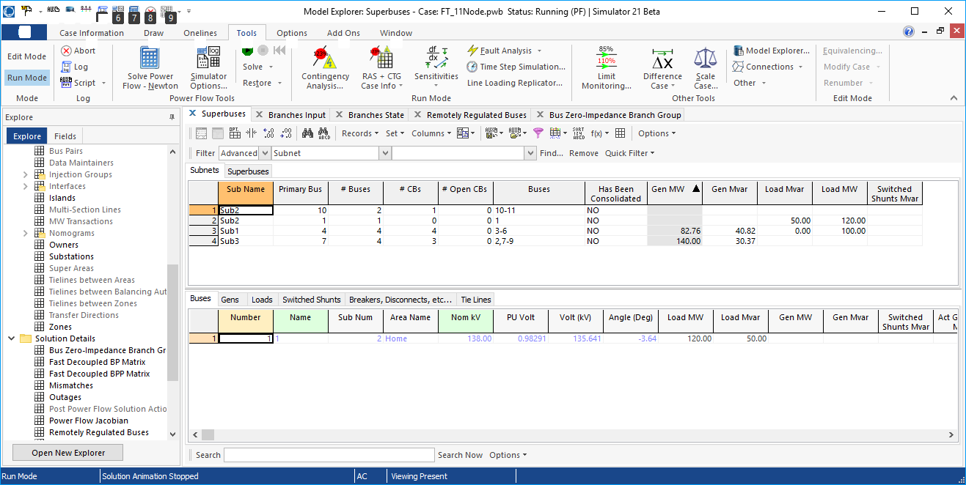
Node-Breaker Example
Note there is ambiguity on how much power is flowing in each device in the ring bus (assuming each device really has essentially no impedance)
46

Slide 48
Contingency Analysis
Contingency analysis is the process of checking the impact of statistically likely contingencies
  Example contingencies include the loss of a generator, the loss of a transmission line or the loss of all transmission lines in a common corridor
  Statistically likely contingencies can be quite involved, and might include automatic or operator actions, such as switching load
Reliable power system operation requires that the system be able to operate with no unacceptable violations even when these contingencies occur
  N-1 reliable operation considers the loss of any single element
47

Slide 49
Contingency Analysis
Of course this process can be automated with the usual approach of first defining a contingency set, and then sequentially applying the contingencies and checking for violations
  This process can naturally be done in parallel
  Contingency sets can get quite large, especially if one considers N-2 (outages of two elements) or N-1-1 (initial outage, followed by adjustment, then second outage
The assumption is usually most contingencies will not cause problems, so screening methods can be used to quickly eliminate many contingencies
  We’ll cover these later
48

Slide 50
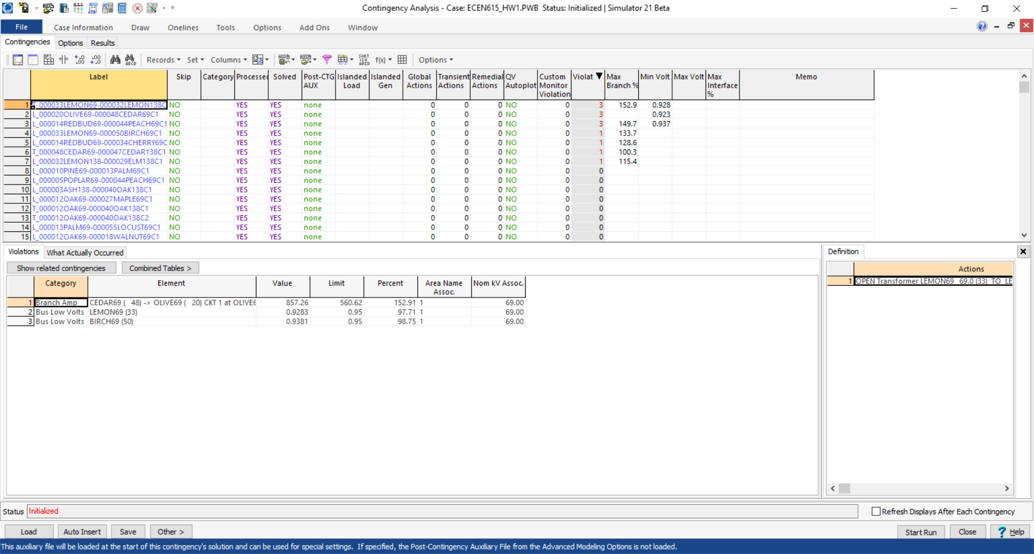
Contingency Analysis in PowerWorld
Automated using the Contingency Analysis tool
49

Slide 51
Power System Control and Sensitivities
A major issue with power system operation is the limited capacity of the transmission system
  lines/transformers have limits (usually thermal)
  no direct way of controlling flow down a transmission line (e.g., there are no valves to close to limit flow)
  open transmission system access associated with industry restructuring is stressing the system in new ways
We need to indirectly control transmission line flow by changing the generator outputs
Similar control issues with voltage
50

Slide 52
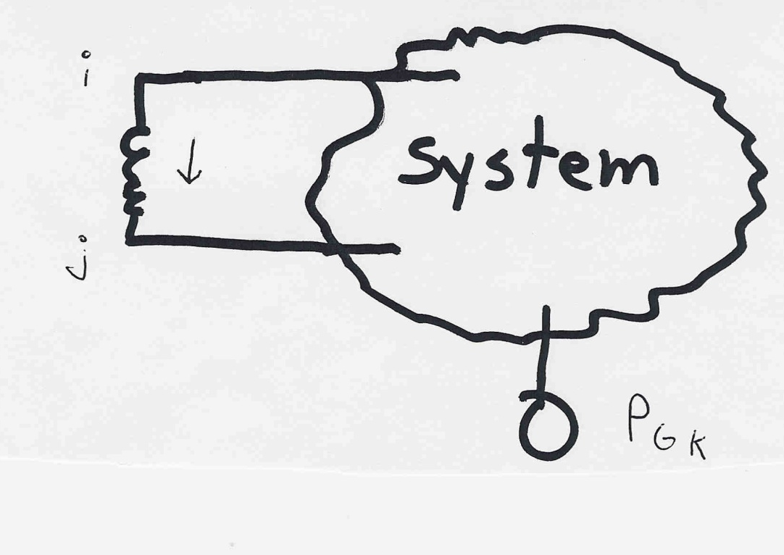
Indirect Transmission Line Control
What we would like to determine is how a change in generation at bus k affects the power flow on a line from bus i to bus j.
The assumption is
that the change
in generation is
absorbed by the
slack bus
51

Slide 53
Power Flow Simulation - Before
One way to determine the impact of a generator change is to compare a before/after power flow.
For example below is a three bus case with an overload
52

Slide 54
Power Flow Simulation - After
Increasing the generation at bus 3 by 95 MW (and hence decreasing it at bus 1 by a corresponding amount), results in a 30.3 MW drop in the MW flow on the line from bus 1 to 2, and a 64.7 MW drop
on the flow from 1 to 3.
Expressed as a
percent,
30.3/95 =32% and
64.7/95=68%
53

Slide 55
Analytic Calculation of Sensitivities
Calculating control sensitivities by repeat power flow solutions is tedious and would require many power flow solutions. An alternative approach is to analytically calculate these values
54

Slide 56
Analytic Sensitivities
55

