Slide 1
ECEN 615
Methods of Electric Power
Systems Analysis
Lecture 12: Voltage Control, Topology Processing
Prof. Tom Overbye
Dept. of Electrical and Computer Engineering
Texas A&M University
overbye@tamu.edu

Slide 2
Announcements
Read Chapter 7 (the term reliability is now often used instead of security)
Homework 4 should be done before the first exam, but need not be turned in
Exam 1 is during class on Oct 13
  Closed book, notes. One 8.5 by 11 inch notesheet and calculators allowed
  Distance education students should make arrangements with Sanjana with HonorLock one approach
  Exam 1 from 2020 is available in Canvas; solutions will be posted as we get closer in

Slide 3
Hurricane Ian Update
As of Monday morning the number of people without electricity in Florida has dropped to 600,000 (from 2.6 million last week)
One of the reasons for this relatively quick recovery is over the last several years the Florida utilities have spent billions strengthening their grid, particularly the transmission line
  Examples include replacing wooden poles with ones made of concrete or steel, putting transformers on higher ground, burying more of the distribution system
  Florida Power and Light said they did not lose a single transmission structure after losing more than 100 during Hurricane Wilma in 2005 (a Category 3 hurricane)

Slide 4
Generator Volt/Reactive Control
Simplest situation is a single generator at a bus regulating its own terminal
  Either PV, modeled as a voltage magnitude constraint, or as a PQ with reactive power fixed at a limit value. If PQ the reactive power limits can vary with the generator MW output
Next simplest is multiple generators at a bus. Obviously they need to be regulating the bus to the same voltage magnitude
  From a power flow solution perspective, it is similar to a single generator, with limits being the total of the individual units
  Options for allocation of vars among generators; this can affect the transient stability results
3

Slide 5
Generator Voltage Control
This example
uses the case
PSC_37Bus
with a voltage
contour. Try
varying the
voltage
setpoint for
the generator
at PEAR69
4

Slide 6
Generator Remote Bus Voltage Control
The next complication is generators at a single bus regulating a remote bus; usually this is the high side of their generator step-up (GSU) transformer
  When multiple generators regulate a single point their exciters need to have a dual input
  This can be implemented in the power flow for the generators at bus j regulating the voltage at bus k by changing the bus j voltage constraint equation to be
  (however, this does create a zero on the diagonal of the Jacobian)
  Helps with power system voltage stability
5

Slide 7
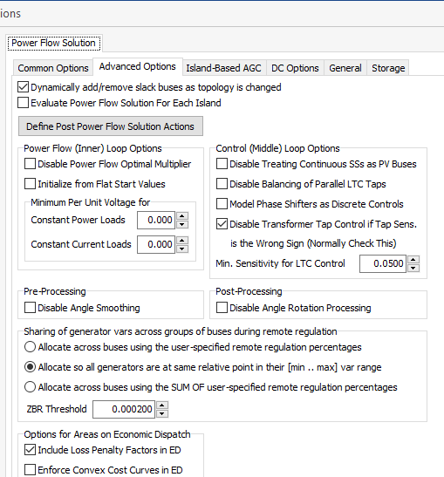
Reactive Power Sharing Options
Different software
packages use
different approaches
for allocating
the reactive power;
PowerWorld has
several options.
6

Slide 8
Reactive Power Sharing
In this example, case PSC_37Bus_Varsharing,
the two generators at
Elm345 are jointly controlling Elms138
7

Slide 9
Generator Remote Bus Voltage Control
The next complication is to have the generators at multiple buses doing coordinated voltage control
  Controlled bus may or may not be one of the terminal buses
There must be an a priori decision about how much reactive power is supplied by each bus; example allocations are a fixed percentage or placing all generators at the same place in their regulation range
Implemented by designating one bus as the master; this bus models the voltage constraint
All other buses are treated as PQ, with the equation including a percent of the total reactive power output of all the controlling bus generators
8

Slide 10
Remote and Coordinated Var Control Example
Here the generators at Elm345 and the one at Birch69 are jointly controlling the voltage at the Lemon138 bus.
Case is PSC_37Bus_Varsharing_MultipleBuses
9

Slide 11
Power Flow Topology Processing
Commercial power flow software must have algorithms to determine the number of asynchronous, interconnected systems in the model
  These separate systems are known as Islands
  In large system models such as the Eastern Interconnect it is common to have multiple islands in the base case (one recent EI model had nine islands)
  Islands can also form unexpectedly as a result of contingencies
  Power can be transferred between islands using dc lines
  Each island must have a slack bus
10

Slide 12
Power Flow Topology Processing
Anytime a status change occurs the power flow must perform topology processing to determine whether there are either 1) new islands or 2) islands have merged
Determination is needed to determine whether the island is “viable.” That is, could it truly function as an independent system, or should the buses just be marked as dead
  A quite common occurrence is when a single load or generator is isolated; in the case of a load it can be immediately killed; generators are more tricky
11

Slide 13
Topology Processing Algorithm
Since topology processing is performed often, it must be quick (order n ln(n))!
Simple, yet quick topology processing algoritm
  Set all buses as being in their own island (equal to bus number)
  Set ChangeInIslandStatus true
  While ChangeInIslandStatus Do
    Go through all the in-service lines, setting the islands for each of the buses to be the smaller island number; if the island numbers are different set ChangeInIslandStatus true
  Determine which islands are viable, assigning a slack bus as necessary
This algorithm does depend on the depth of the system
12

Slide 14

Example of Island Formation
This option allows some islands
to not have a power flow solution
Splitting large systems requires a careful consideration of the flow on the island tie-lines as they are opened
13

Slide 15
Bus Branch versus Node Breaker
Due to a variety of issues during the 1970’s and 1980’s the real-time operations and planning stages of power systems adopted different modeling approaches
Real-Time Operations
Use detailed node/breaker model
EMS system as a set of integrated applications and processes
Real-time operating system
Real-time databases
Planning
Use simplified bus/branch model
PC approach
Use of files
Stand-alone applications
  Entire data sets and software tools developed around these two distinct power system models
14

Slide 16
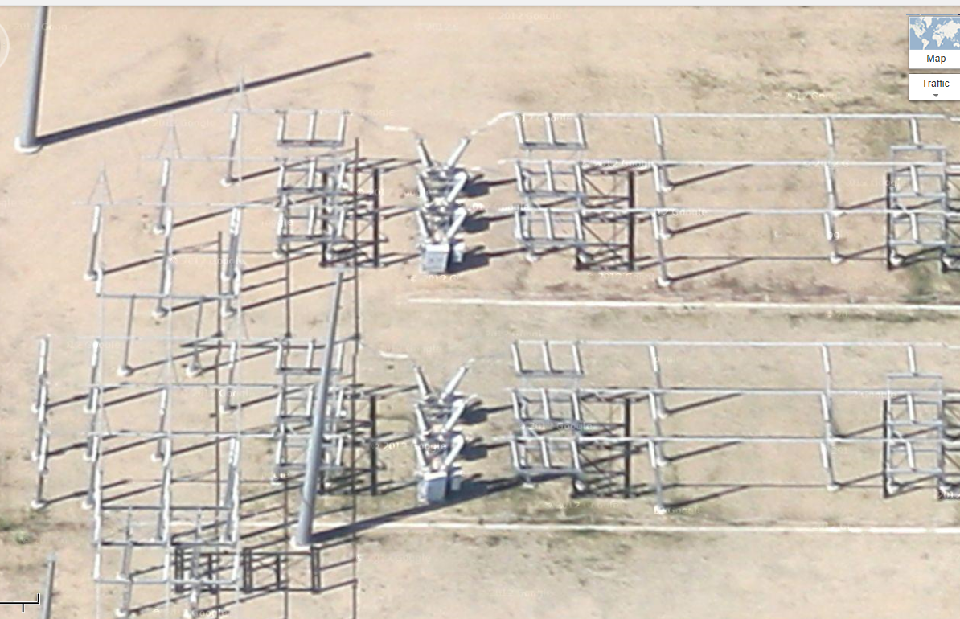
Google View of a 345 kV Substation
15

Slide 17
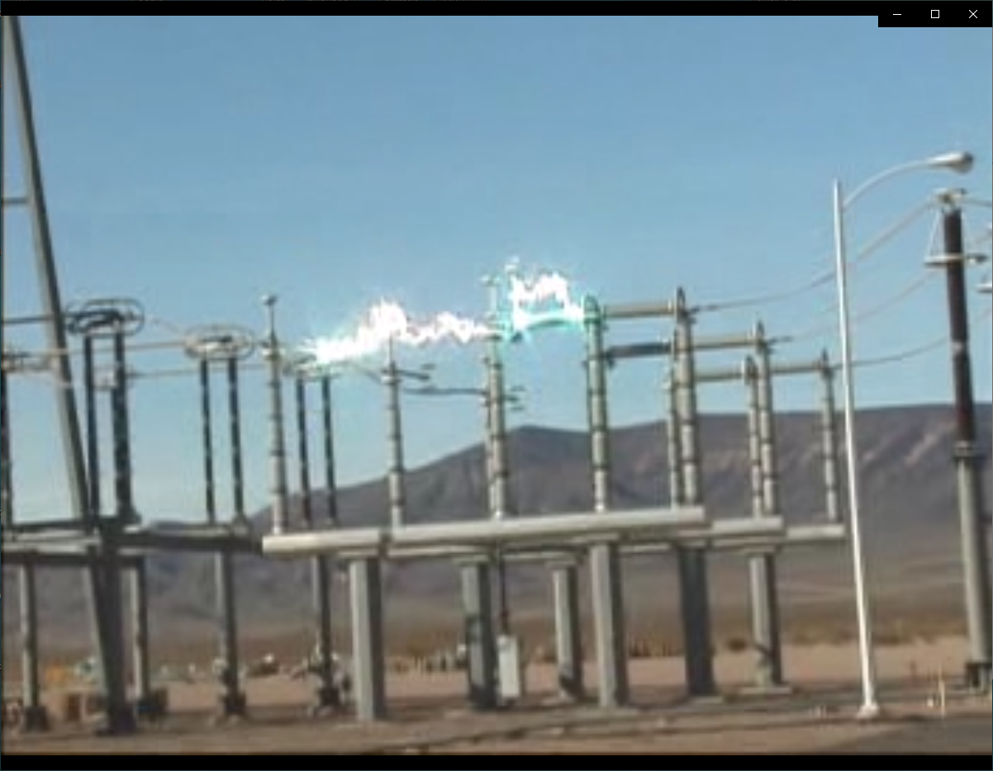
Example of Using a Disconnect to Break Load Current
16

Slide 18
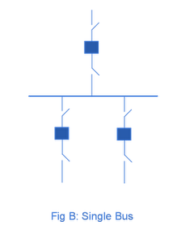
Substation Configurations
Several different substation breaker/disconnect configurations are common:
Single bus: simple but a fault
anywhere requires taking out the
entire substation; also doing breaker
or disconnect maintenance requires
taking out the associated line
Source: http://www.skm-eleksys.com/2011/09/substation-bus-schemes.html
17

Slide 19
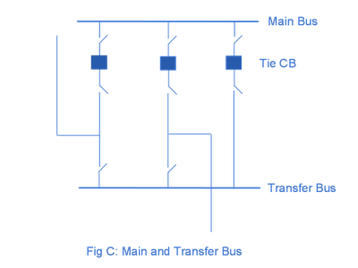
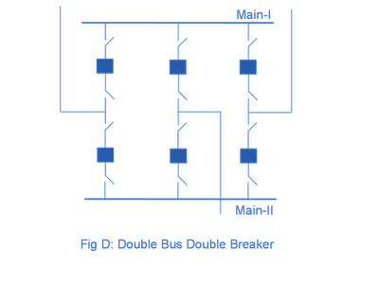
Substation Configurations, cont.
Main and Transfer Bus:
Now the breakers can be taken
out for maintenance without
taking out a line, but protection
is more difficult, and a fault
on one line will take out at least two
Double Bus Breaker:
Now each line is fully protected
when a breaker is out, so high
reliability, but more costly
Source: http://www.skm-eleksys.com/2011/09/substation-bus-schemes.html
18

Slide 20
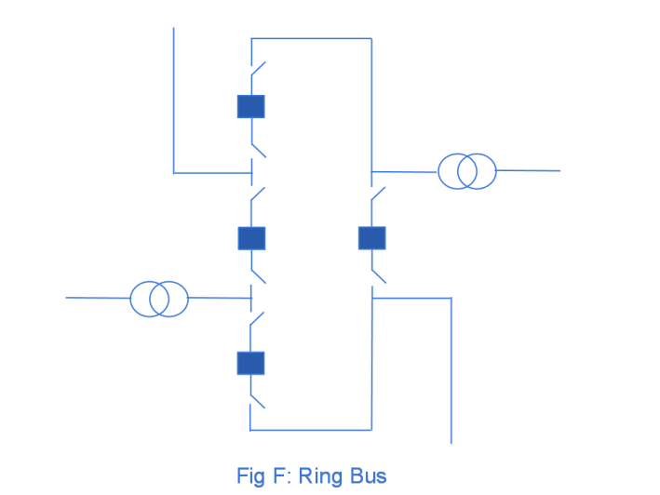
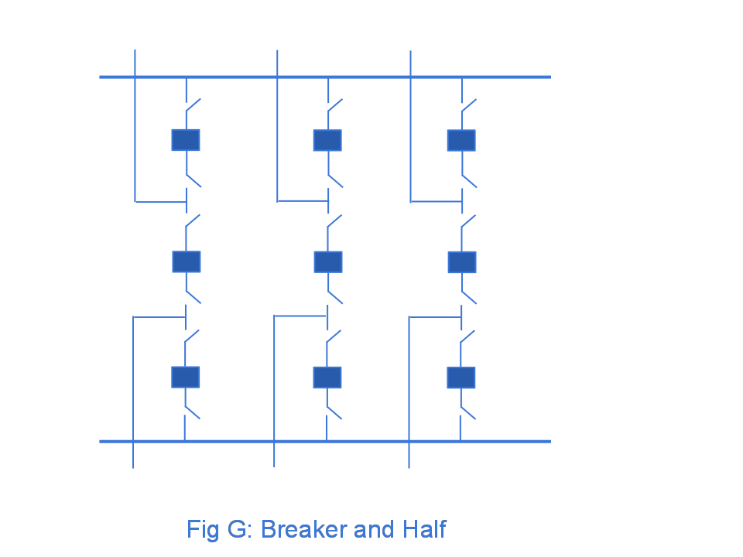
Ring Bus, Breaker and Half
As the name implies with a ring
bus the breakers form a ring;
number of breakers is same as
number of devices; any breaker can
be removed for maintenance
The breaker and half has two buses
and uses three breakers for two
devices; both breakers and buses
can be removed for maintenance
Source: http://www.skm-eleksys.com/2011/09/substation-bus-schemes.html
19

Slide 21
EMS and Planning Models
EMS Model
  Used for real-time operations
  Called full topology model
  Has node-breaker detail
Planning Model
  Used for off-line analysis
  Called consolidated model by PowerWorld
  Has bus/branch detail
-30 MW
-18 Mvar
50 MW
20 Mvar
-30 MW
-18 Mvar
10 MW
3 Mvar
10 MW
3 Mvar
-40 MW
-10 Mvar
10 MW
5 Mvar
-40 MW
-10 Mvar
10 MW
5 Mvar
20

Slide 22
Node-Breaker Consolidation
One approach to modeling systems with large numbers of ZBRs (zero branch reactances, such as from circuit breakers) is to just assume a small reactance and solve
  This results in lots of buses and branches, resulting in a much larger problem
  This can cause numerical problems in the solution
The alterative is to consolidate the nodes that are connected by ZBRs into a smaller number of buses
  After solution all nodes have the same voltage; use logic to determine the device flows
21

Slide 23
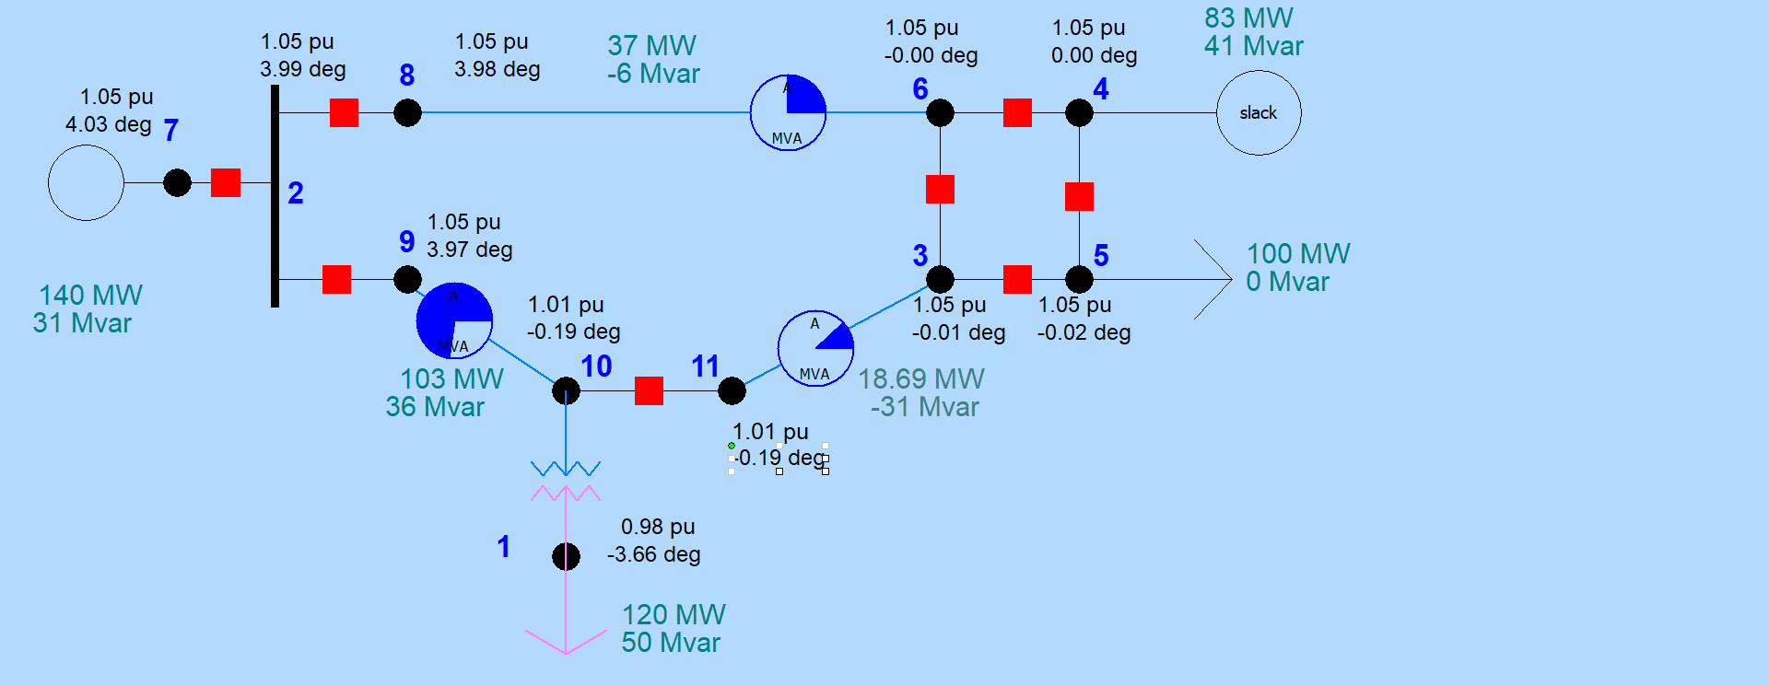
Node-Breaker Example
Case name is FT_11Node. PowerWorld consolidates nodes (buses) into super buses; available in the Model Explorer: Solution, Details, Superbuses.
22

Slide 24
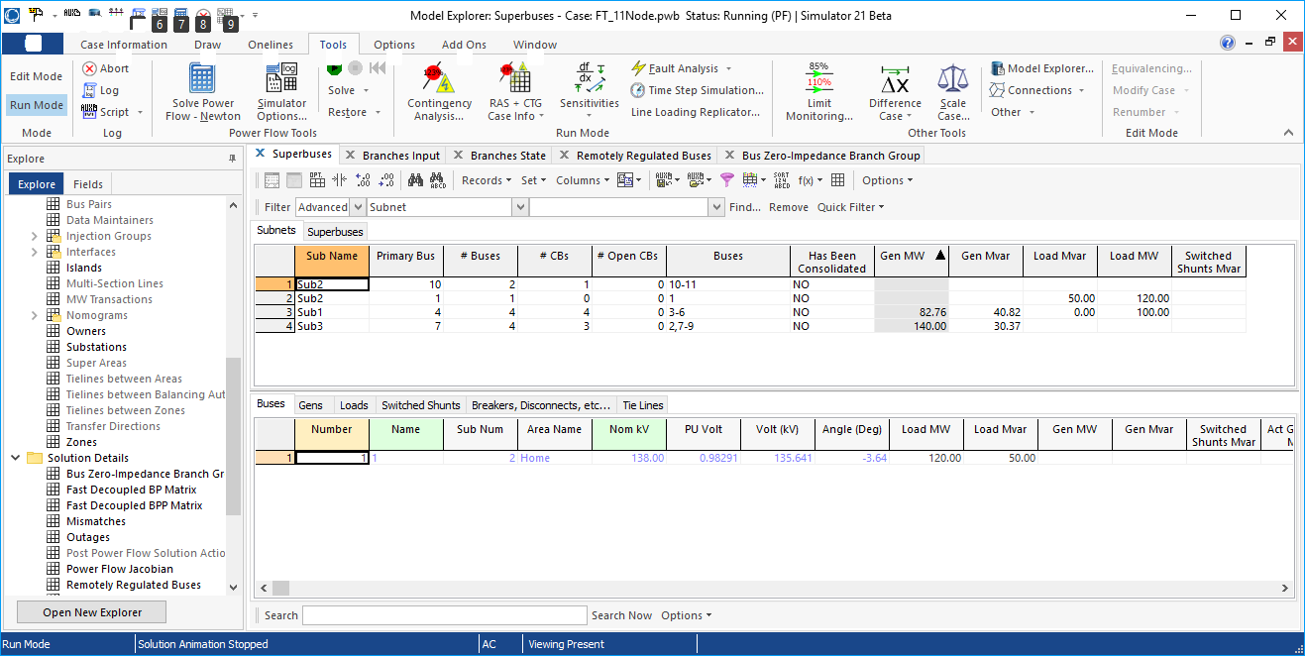
Node-Breaker Example
Note there is ambiguity on how much power is flowing in each device in the ring bus (assuming each device really has essentially no impedance)
23

Slide 25
Contingency Analysis
Contingency analysis is the process of checking the impact of statistically likely contingencies
  Example contingencies include the loss of a generator, the loss of a transmission line or the loss of all transmission lines in a common corridor
  Statistically likely contingencies can be quite involved, and might include automatic or operator actions, such as switching load
Reliable power system operation requires that the system be able to operate with no unacceptable violations even when these contingencies occur
  N-1 reliable operation considers the loss of any single element
24

Slide 26
Contingency Analysis
Of course this process can be automated with the usual approach of first defining a contingency set, and then sequentially applying the contingencies and checking for violations
  This process can naturally be done in parallel
  Contingency sets can get quite large, especially if one considers N-2 (outages of two elements) or N-1-1 (initial outage, followed by adjustment, then second outage
The assumption is usually most contingencies will not cause problems, so screening methods can be used to quickly eliminate many contingencies
  We’ll cover these later
25

Slide 27
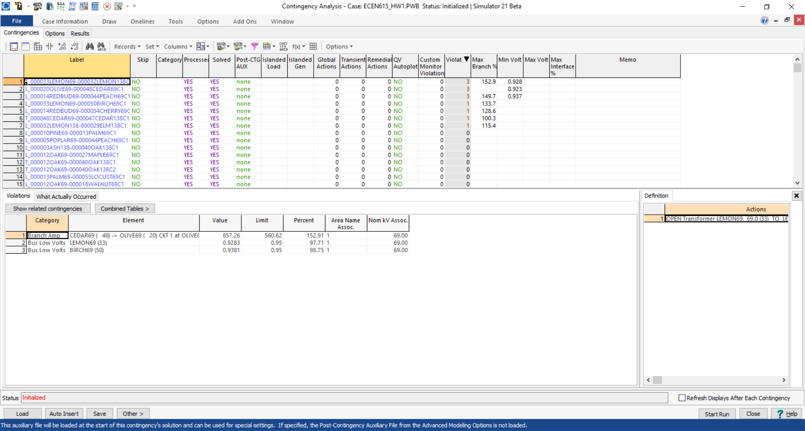
Contingency Analysis in PowerWorld
Automated using the Contingency Analysis tool
26

