Slide 1
ECEN 615
Methods of Electric Power
Systems Analysis
Lecture 13: Power Flow Sensitivities
Prof. Tom Overbye
Dept. of Electrical and Computer Engineering
Texas A&M University
overbye@tamu.edu

Slide 2
Announcements
Read Chapter 7
Homework 4 should be done before the first exam, but need not be turned in
Exam 1 is during class on Oct 13
  Closed book, notes. One 8.5 by 11 inch notesheet and calculators allowed
  Distance education students should make arrangements with Sanjana with HonorLock one approach
  Exam 1 from 2020 is available in Canvas; solutions will be posted as we get closer in

Slide 3
Power Flow Sensitivity Analysis
The idea of power flow sensitivity analysis is to get an estimate of how some set of values would change with respect to a change in a set of control values
  Need to keep in mind which control responses are implicitly modeled, such as P and Q changes at the slack, Q at PV buses
The approach works by linearizing a system about an operating point; its usefulness depends on the validity of this approximation
Sensitivities are widely used in power system analysis, with some algorithms doing sequential linearizations
  They are most valid for real power, less useful for reactive power
2

Slide 4
Analysis Example: Available Transfer Capability
The power system available transfer capability or ATC is defined as the maximum additional MW that can be transferred between two specific areas, while meeting all the specified pre- and post-contingency system conditions
ATC impacts measurably the market outcomes and system reliability and, therefore, the ATC values impact the system and market behavior
Total transfer capability (TTC )
  Amount of real power that can be transmitted across an interconnected transmission network in a reliable manner, including considering contingencies
ATC is the amount that is actually available; we’ll just look at TTC
  A useful reference on ATC is Available Transfer Capability Definitions and Determination from NERC, June 1996 (available online)
3

Slide 5
Total Transfer Capability (TTC) Evaluation
Goal is
to load
the lines
up to
their limits,
though only
when also
considering
contingencies
for the base case j = 0 and each contingency case
j = 1,2 … , J
4

Slide 6
Conceptual Solution Algorithm
Solve the initial power flow, corresponding to the initial system dispatch (i.e., existing commitments); set the change in transfer Δt⁽⁰⁾ = 0, k=0; set step size δ; j is used to indicate either the base case (j=0) or a contingency, j= 1,2,3…J
Compute Δt^{(k+1)} = Δt^{(k)} + δ
Solve the power flow for the new Δt^{(k+1)}
Check for limit violations: if violation is found
set U^{j}_{m,n} = Δt^{(k)} and stop; else set k=k+1, and goto 2
5

Slide 7
Conceptual Solution Algorithm, cont.
This algorithm is applied for the base case (j=0) and each specified contingency case, j=1,2,..J
The final TTC, U_{m,n} is then determined by
This algorithm can be easily performed on parallel processors since each contingency evaluation is independent of the others
6

Slide 8
Five Bus Example: Reference
PowerWorld Case: B5_DistFact
7

Slide 9
Five Bus Example: Reference
 |  |  |  |  | ( MW )
 | 1 | 2 | 0 | 6.25 | 150
 | 1 | 3 | 0 | 12.5 | 400
 | 1 | 4 | 0 | 12.5 | 150
 | 2 | 3 | 0 | 12.5 | 150
 | 3 | 4 | 0 | 12.5 | 150
 | 4 | 5 | 0 | 10 | 1,000
8

Slide 10
Five Bus Example
We evaluate U_{2,3} using the previous procedure
  Gradually increase generation at Bus 2 and load at Bus 3
We consider the base case and the single contingency with line 2 outaged (between 1 and 3): J = 1
Simulation results show for the base case that
And for the contingency that
Hence
9

Slide 11
Five Bus: Maximum Base Case Transfer
10

Slide 12
Five Bus: Maximum Contingency Transfer
11

Slide 13
Computational Considerations
Obviously such a brute force approach can run into computational issues with large systems
Consider the following situation:
  10 iterations for each case
  6,000 contingencies
  2 seconds to solve each power flow
It will take over 33 hours to compute a single UTC for the specified transfer direction from m to n.
Consequently, there is an acute need to develop fast tools that can provide satisfactory estimates
12

Slide 14
Sensitivity Problem Formulation
Denote the system state by
Denote the conditions corresponding to the existing commitment/dispatch by s⁽⁰⁾, p⁽⁰⁾ and f⁽⁰⁾ so that
Define the angle difference as
The V values
are the voltage
magnitudes
the power flow equations
line real power flow vector
13

Slide 15
Sensitivity Problem Formulation
g includes the real and reactive
power balance equations
14

Slide 16
Sensitivity Problem Formulation
For a small change, Δp, that moves the injection from p⁽⁰⁾ to p⁽⁰⁾ + Δp , we have a corresponding change in the state Δx with
We then apply a first order Taylor’s series expansion
15

Slide 17
Sensitivity Problem Formulation
We consider this to be a “small signal” change, so we can neglect the higher order terms (h.o.t.) in the expansion
Hence we should still be satisfying the power balance equations with this perturbation; so
16

Slide 18
Sensitivity Problem Formulation
Also, from the power flow equations, we obtain
and then just the power flow Jacobian
17

Slide 19
Sensitivity Problem Formulation
With the standard assumption that the power flow Jacobian is nonsingular, then
We can then compute the change in the line real power flow vector
18

Slide 20
Sensitivity Comments
Sensitivities can easily be calculated even for large systems
  If Δp is sparse (just a few injections) then we can use a fast forward; if sensitivities on a subset of lines are desired, we could also use a fast backward
Sensitivities are dependent upon the operating point
  They also include the impact of marginal losses
Sensitivities could easily be expanded to include additional variables in x (such as phase shifter angle), or additional equations, such as reactive power flow
19

Slide 21
Sensitivity Comments, cont.
Sensitivities are used in the optimal power flow; in that context a common application is to determine the sensitivities of an overloaded line to injections at all the buses
In the below equation, how could we quickly get these values?
  A useful reference is O. Alsac, J. Bright, M. Prais, B. Stott, “Further Developments in LP-Based Optimal Power Flow,” IEEE. Trans. on Power Systems, August 1990, pp. 697-711; especially see equation 3.
20

Slide 22
Sensitivity Example in PowerWorld
Open case B5_DistFact and then Select Tools, Sensitivities, Flow and Voltage Sensitivities
  Select Single Meter, Multiple Transfers, Buses page
  Select the Device Type (Line/XFMR), Flow Type (MW), then select the line (from Bus 2 to Bus 3)
  Click Calculate Sensitivities; this shows impact of a single injection going to the slack bus (Bus 1)
  For our example of a transfer from 2 to 3 the value is the result we get for bus 2 (0.5440) minus the result for bus 3
  (-0.1808) = 0.7248
  With a flow of 118 MW, we would hit the 150 MW limit
  with (150-118)/0.7248 =44.1MW, close to the limit we
  found of 45MW
21

Slide 23
Sensitivity Example in PowerWorld
If we change the conditions to the anticipated maximum loading (changing the load at 2 from 118 to 118+44=162 MW) and we re-evaluate the sensitivity we note it has changed little
(from -0.7248 to -0.7241)
  Hence a linear approximation (at least for this scenario) could be justified
With what we know so far, to handle the contingency situation, we would have to simulate the contingency, and reevaluate the sensitivity values
  We’ll be developing a quicker (but more approximate) approach next
22

Slide 24
Linearized Sensitivity Analysis
By using the approximations from the fast decoupled power flow we can get sensitivity values that are independent of the current state. That is, by using the B’ and B’’ matrices
For the real power line flow we can approximate
23

Slide 25
Linearized Sensitivity Analysis
Also, for each line 
and so,
24

Slide 26
Sensitivity Analysis: Recall the Matrix Notation
The series admittance of line  is g +jb and we define
We define the L×N incidence matrix
where the component j of a_{i} is nonzero whenever line _{i} is coincident with node j. Hence A is quite sparse, with at most two nonzeros per row
25

Slide 27
Linearized Active Power Flow Model
Under these assumptions the change in the real power line flows are given as
The constant matrix
is called the injection shift factor matrix (ISF)
26

Slide 28
Injection Shift Factors (ISFs)
The element in row  and column n of  is called the injection shift factor (ISF) of line  with respect to the injection at node n
  Absorbed at the slack bus, so it is slack bus dependent
Terms generation shift factor (GSF) and load shift factor (LSF) are also used (such as by NERC)
  Same concept, just a variation in the sign whether it is a generator or a load
  Sometimes the associated element is not a single line, but rather a combination of lines (an interface)
Terms used in North America are defined in the NERC glossary (http://www.nerc.com/files/glossary_of_terms.pdf)
27

Slide 29
ISF Interpretation
slack
node
is the fraction of the additional 1 MW injection at node n that goes though line 
28

Slide 30
ISF Properties
By definition, depends on the location of the slack bus
By definition, for since the injection and withdrawal buses are identical in this case and, consequently, no flow arises on any line 
The magnitude of is at most 1 since
Note, this is strictly true only for the linear (lossless) case. In the nonlinear case, it is possible that a transaction decreases losses. Hence a 1 MW injection could change a line flow by more than 1 MW.
29

Slide 31
Five Bus Example Reference
30

Slide 32
Five Bus ISF, Line 4, Bus 2 (to Slack)
31

Slide 33
Five Bus Example
The row of A correspond to the lines and transformers, the columns correspond to the non-slack buses (buses 2 to 5); for each line there
is a 1 at one end, a -1 at the other end (hence an assumed sign convention!).
Here we put a 1 for the lower numbered bus, so positive flow is assumed from the lower numbered bus to the higher number
32

Slide 34
Five Bus Example
With bus 1 as the slack, the buses (columns) go for 2 to 5
33

Slide 35
Five Bus Example Comments
At first glance the numerically determined value of (128-118)/20=0.5 does not match closely with the analytic value of 0.5455; however, in doing the subtraction we are losing numeric accuracy
  Adding more digits helps (128.40 – 117.55)/20 = 0.5425
The previous matrix derivation isn’t intended for actual computation;  is a full matrix so we would seldom compute all of its values
Sparse vector methods can be used if we are only interested in the ISFs for certain lines and certain buses
34

Slide 36
Distribution Factors and Basic Transactions
Various additional distribution factors may be defined
  power transfer distribution factor (PTDF)
  line outage distribution factor (LODF)
  line addition distribution factor (LADF)
  outage transfer distribution factor (OTDF)
These factors may be derived from the ISFs making judicious use of the superposition principle
A basic transaction involves the
transfer of a specified amount of
power t from an injection node m
to a withdrawal node n
A basic transaction: w = (m,n,t)
35

Slide 37
Definition: PTDF
NERC defines a PTDF as
  “In the pre-contingency configuration of a system under study, a measure of the responsiveness or change in electrical loadings on transmission system Facilities due to a change in electric power transfer from one area to another, expressed in percent (up to 100%) of the change in power transfer”
  Transaction dependent
We’ll use the notation to indicate the PTDF on line  with respect to basic transaction w
In the lossless formulation presented here (and commonly used) it is slack bus independent
36

Slide 38
PTDFs
Note, the PTDF is independent of the amount Δt; which is often expressed as a percent
37

Slide 39
PTDF Evaluation
Defined in terms of
the injection shift
factors (ISFs);
the slack bus
dependence in
each cancels out
The PTDFs to the
slack bus are the
ISFs
38

Slide 40
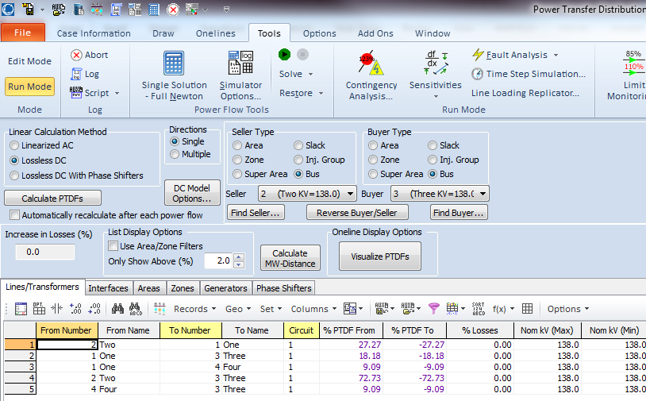
Calculating PTDFs in PowerWorld
PowerWorld provides a number of options for calculating and visualizing PTDFs
  Select Tools, Sensitivities, Power Transfer Distribution Factors (PTDFs)
Results are shown for the five bus case for the
Bus 2 to Bus 3 transaction
There is a button to visualize the PTDFs
39

Slide 41
Five Bus PTDF Visualization
PowerWorld Case:
B5_DistFact_PTDF
40

Slide 42
Nine Bus PTDF Example
Display shows the PTDFs
for a basic transaction
from Bus A to Bus I. Note that 100% of the transaction leaves Bus A
and 100% arrives at Bus I
PowerWorld Case:
B9_PTDF
41

Slide 43
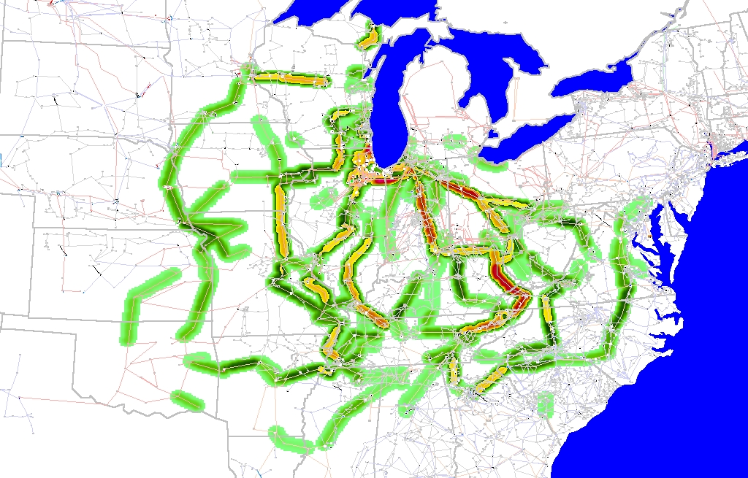
Eastern Interconnect Example: Wisconsin Utility to TVA PTDFs
In this example multiple generators
contribute for both
the seller and the buyer
Contours show lines that would carry at least 2% of a power transfer from Wisconsin to TVA
42

