Slide 1
ECEN 615
Methods of Electric Power
Systems Analysis
Lecture 14: Power Flow Sensitivities, August 14, 2003 Blackout
Prof. Tom Overbye
Dept. of Electrical and Computer Engineering
Texas A&M University
overbye@tamu.edu

Slide 2
Announcements
Read Chapter 7

Slide 3
Definition: PTDF
NERC defines a PTDF as
  “In the pre-contingency configuration of a system under study, a measure of the responsiveness or change in electrical loadings on transmission system Facilities due to a change in electric power transfer from one area to another, expressed in percent (up to 100%) of the change in power transfer”
  Transaction dependent
We’ll use the notation to indicate the PTDF on line  with respect to basic transaction w
In the lossless formulation presented here (and commonly used) it is slack bus independent
2

Slide 4
PTDFs
Note, the PTDF is independent of the amount Δt; which is often expressed as a percent
3

Slide 5
PTDF Evaluation
Defined in terms of
the injection shift
factors (ISFs);
the slack bus
dependence in
each cancels out
The PTDFs to the
slack bus are the
ISFs
4

Slide 6
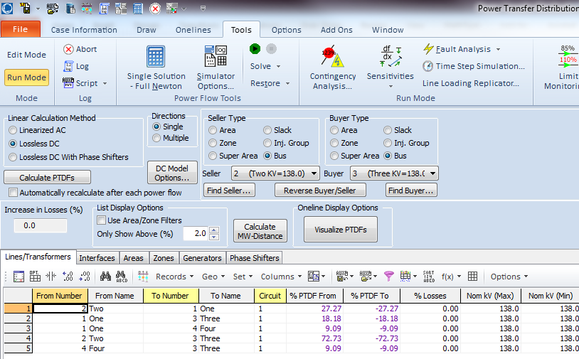
Calculating PTDFs in PowerWorld
PowerWorld provides a number of options for calculating and visualizing PTDFs
  Select Tools, Sensitivities, Power Transfer Distribution Factors (PTDFs)
Results are shown for the five bus case for the
Bus 2 to Bus 3 transaction
There is a button to visualize the PTDFs
5

Slide 7
Five Bus PTDF Visualization
PowerWorld Case:
B5_DistFact_PTDF
6

Slide 8
Nine Bus PTDF Example
Display shows the PTDFs
for a basic transaction
from Bus A to Bus I. Note that 100% of the transaction leaves Bus A
and 100% arrives at Bus I
PowerWorld Case:
B9_PTDF
7

Slide 9
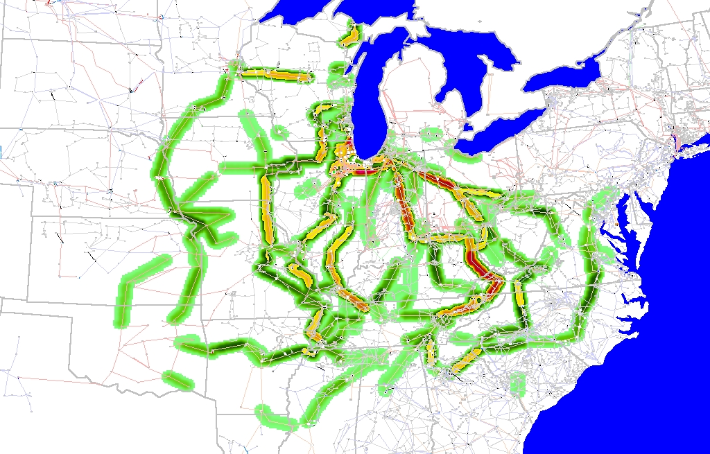
Eastern Interconnect Example: Wisconsin Utility to TVA PTDFs
In this example multiple generators
contribute for both
the seller and the buyer
Contours show lines that would carry at least 2% of a power transfer from Wisconsin to TVA
8

Slide 10
Line Outage Distribution Factors (LODFs)
Power system operation is practically always limited by contingencies, with line outages comprising a large number of the contingencies
Desire is to determine the impact of a line outage (either a transmission line or a transformer) on other system real power flows without having to explicitly solve the power flow for the contingency
These values are provided by the LODFs
The LODF is the percentage of the pre-outage real power line flow on line k that is redistributed to line  as a result of the outage of line k
9

Slide 11
LODFs
outaged
base case
outage case
Best reference is Chapter 7 of the course book
10

Slide 12
LODF Evaluation
We simulate the impact of the outage of line k by adding the basic transaction
and selecting Δt_{k} in such a way that the flows on the dashed lines become exactly zero
In general this Δt_{k} is not equal to the original line flow
11

Slide 13
LODF Evaluation
We select Δt_{k} to be such that
where Δƒ _{k} is the active power flow change on the line k due to the transaction w_{k}
The line k flow from basic transaction w_{k} depends on its PTDF
it follows that
12

Slide 14
LODF Evaluation
For the rest of the network the impacts of the outage of line k are the same as the impacts of the additional basic transaction w_{k}
Therefore, by definition the LODF is
Recall that k is the line
being outaged
13

Slide 15
Five Bus Example
Assume we wish to calculate the values for the outage of line 4 (between buses 2 and 3); this is line k
Say we wish to know the change in flow on the line
3 (Buses 3 to 4). PTDFs for
a transaction from 2 to 3 are 0.7273 on line 4 and 0.0909
on line 3
PowerWorld Case:
B5_DistFact_LODF
14

Slide 16
Five Bus Example
Hence we get
15

Slide 17
Five Bus Example Compensated
Here is the system with the compensation added to Bus 2 and removed at Bus 3; we are canceling
the impact of the Line 4 flow for the reset of the network.
16

Slide 18
Five Bus Example
Below is the network with the line actually outaged
The Line 3 flow changed
from 63 MW to 106 MW,
an increase of 43 MW,
matching the LODF value
17

Slide 19
Developing a Critical Eye
In looking at the below formula you need to be thinking about what conditions will cause the formula to fail
Here the obvious situation is when the denominator is zero
That corresponds to a situation in which the contingency causes system islanding
  An example is line 6 (between buses 4 and 5)
  Impact modeled by injections at the buses within each viable island
18

Slide 20
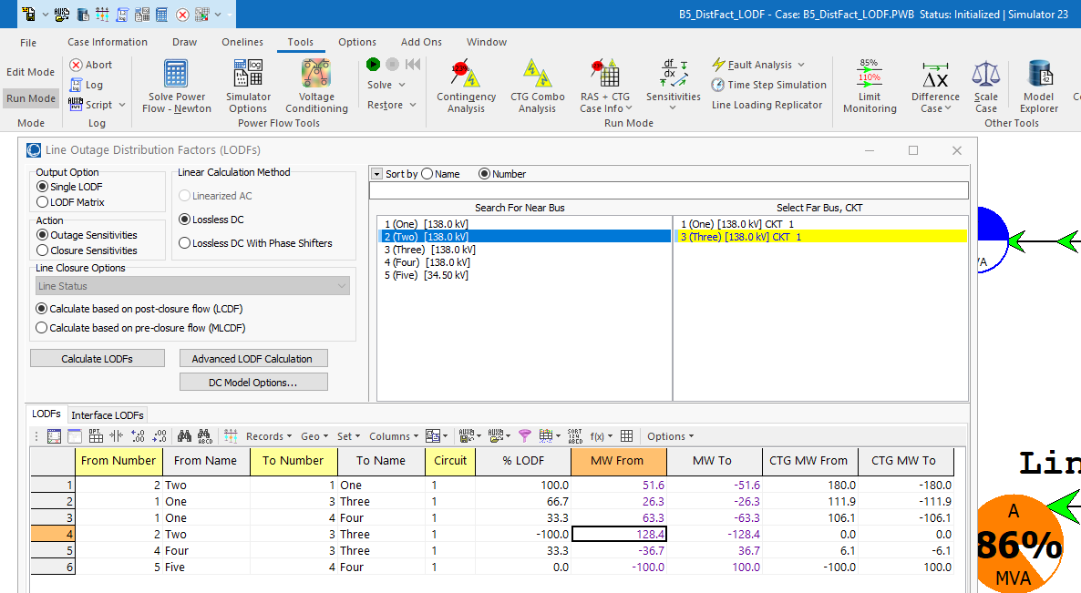
Calculating LODFs in PowerWorld
Select Tools, Sensitivities, Line Outage Distribution Factors
  Select the Line
  using the dialogs
  on the right, and
  click
  Calculate LODFs;
  the image shows
  values for Line 4
  for the
  B5_DistFact_LODF
  case
19

Slide 21
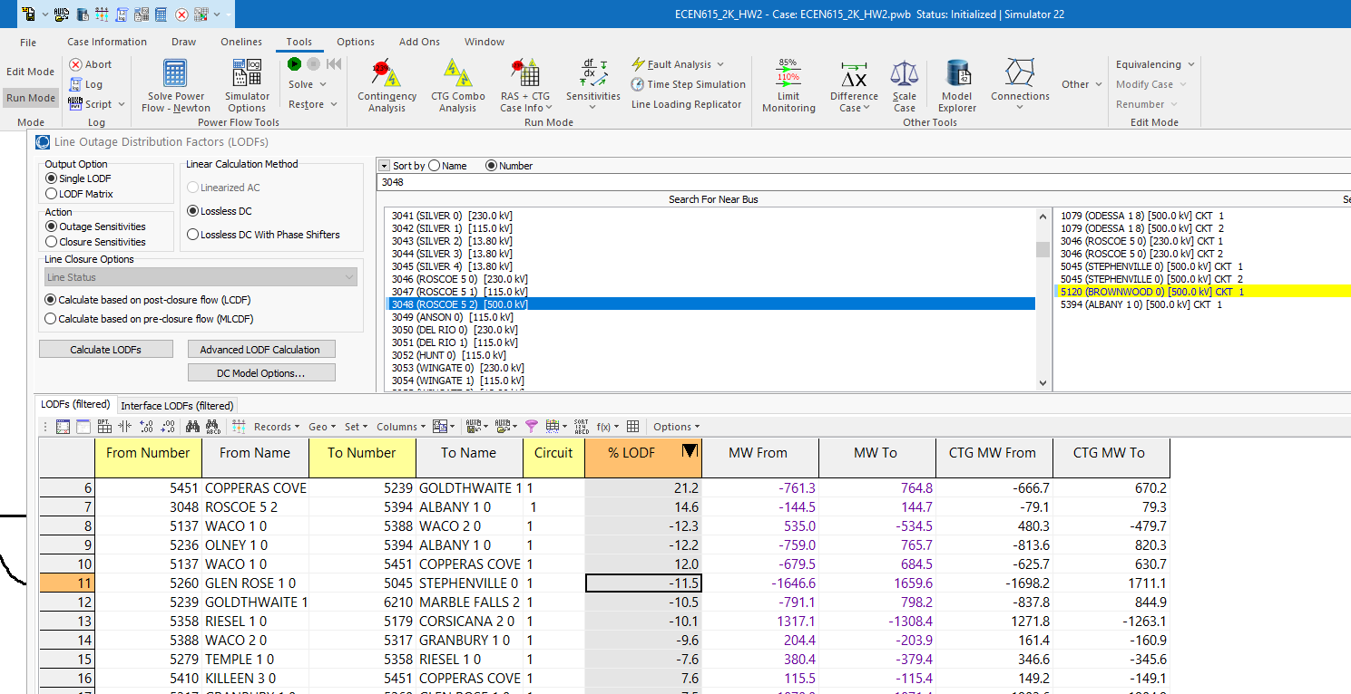
2000 Bus LODF Example
LODF is for line between 3048 and 5120; values will
be proportional to the PTDF values; case is ECEN615_2K_HW2
20

Slide 22
2000 Bus LODF Example
Image visualizes the PTDFs between buses 3048 and 5120
21

Slide 23
Multiple Line LODFs
LODFs can also be used to represent multiple device contingencies, but it is usually more involved than just adding the effects of the single device LODFs
Assume a simultaneous outage of lines k₁ and k₂
Now setup two transactions, w_{k1} (with value Δt_{k1})and w_{k2} (with value Δt_{k2}) so
22

Slide 24
Multiple Line LODFs
Hence we can calculate the simultaneous impact of multiple outages; details for the derivation are given in
C. Davis, T.J. Overbye, "Linear Analysis of Multiple Outage Interaction," Proc. 42nd HICSS, 2009
Equation for the change in flow on line  for the outage of lines k₁ and k₂ is
23

Slide 25
Multiple Line LODFs
Example: Earlier five bus case, outage of Lines 2 and 5 to flow on Line 4.
24

Slide 26
Multiple Line LODFs
Line 4 flow goes from 117.5 MW to 118.0 MW
25

Slide 27
Line Closure Distribution Factors (LCDFs)
Closed line
base case
line k addition case
26

Slide 28
LCDF Definition
The line closure distribution factor (LCDF), LCDF_{,k}, for the closure of line k (or its addition if it does not already exist) is the portion of the line active power flow on line k that is distributed to line  due to the closure of line k
Since line k is currently open, the obvious question is, "what flow on line k?"
Answer (in a dc power flow sense) is the flow that will occur when the line is closed (which we do not know)
27

Slide 29
LCDF Evaluation
We simulate the impact of the closure of line k by imposing the additional basic transaction
on the base case network and we select Δt_{k} so that
28

Slide 30
LCDF Evaluation
For the other parts of the network, the impacts of the addition of line k are the same as the impacts of adding the basic transaction w_{k}
Therefore, the definition is
The post-closure flow ƒ_{k} is determined (in a dc power flow sense) as the flow that would occur from the angle difference divided by
(1 + )
29

Slide 31
Outage Transfer Distribution Factor
The outage transfer distribution factor (OTDF) is defined as the PTDF with the line k outaged
The OTDF applies only to the post-contingency configuration of the system since its evaluation explicitly considers the line k outage
This is a quite important value since power system operation is usually contingency constrained
30

Slide 32
Outage Transfer Distribution Factor (OTDF)
outaged
line
31

Slide 33
OTDF Evaluation
=
+
32

Slide 34
OTDF Evaluation
Since
and
then
so that
33

Slide 35
Five Bus Example
Say we would like to know the PTDF on line 1 for a transaction between buses 2 and 3 with line 2 out
34

Slide 36
Five Bus Example
Hence we want to calculate these values without having to explicitly outage line 2
Hence the
value we
are looking
for is 0.2
(20%)
35

Slide 37
Five Bus Example
Evaluating: the PTDF for the bus 2 to 3 transaction on line 1 is 0.2727; it is 0.1818 on line 2 (from buses 1 to 3); the LODF is on line 1 for the outage of line 2 is -0.4
Hence
For line 4 (buses 2 to 3) the value is
36

Slide 38
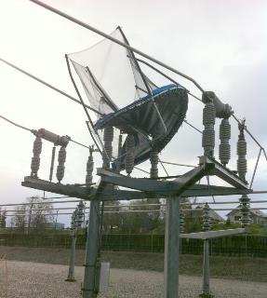
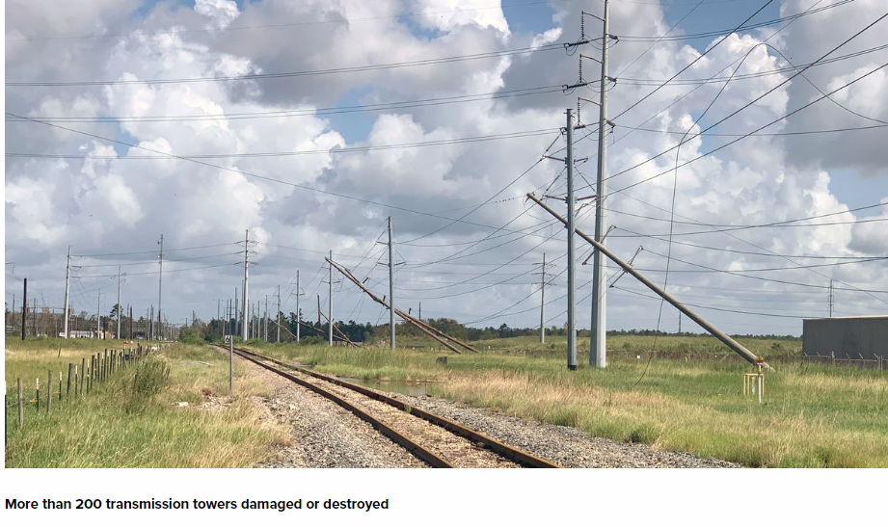
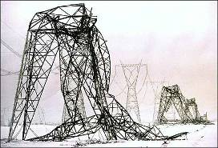
Blackouts
Blackouts are costly, with some estimates of costs above $100 billion per year.
But blackouts are not created equal. Some are unavoidable due to large scale system damage (hurricanes, tornados and ice storms). Most are local, distribution issues.
Right image source: entergynewsroom.com (Hurricane Laura damage)
37

Slide 39
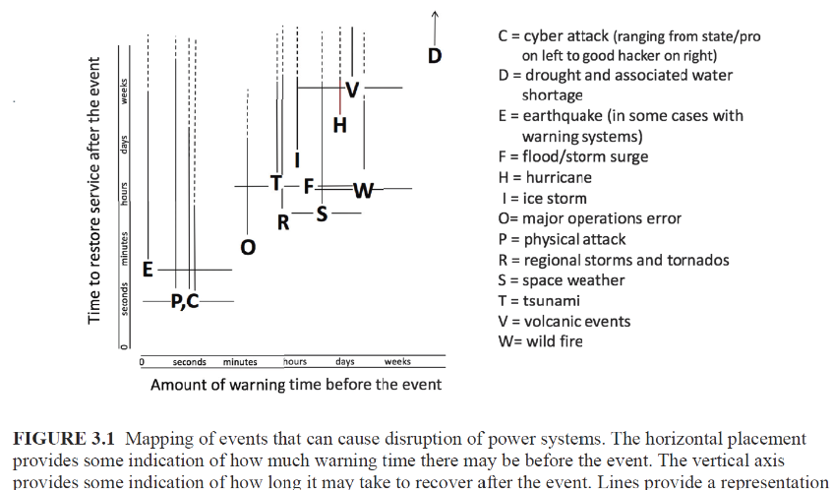
Some Electric Grid Risks
Image Source: Enhancing the Resilience of the Nation’s Electricity System, US National Academies Press, 2017
38

Slide 40

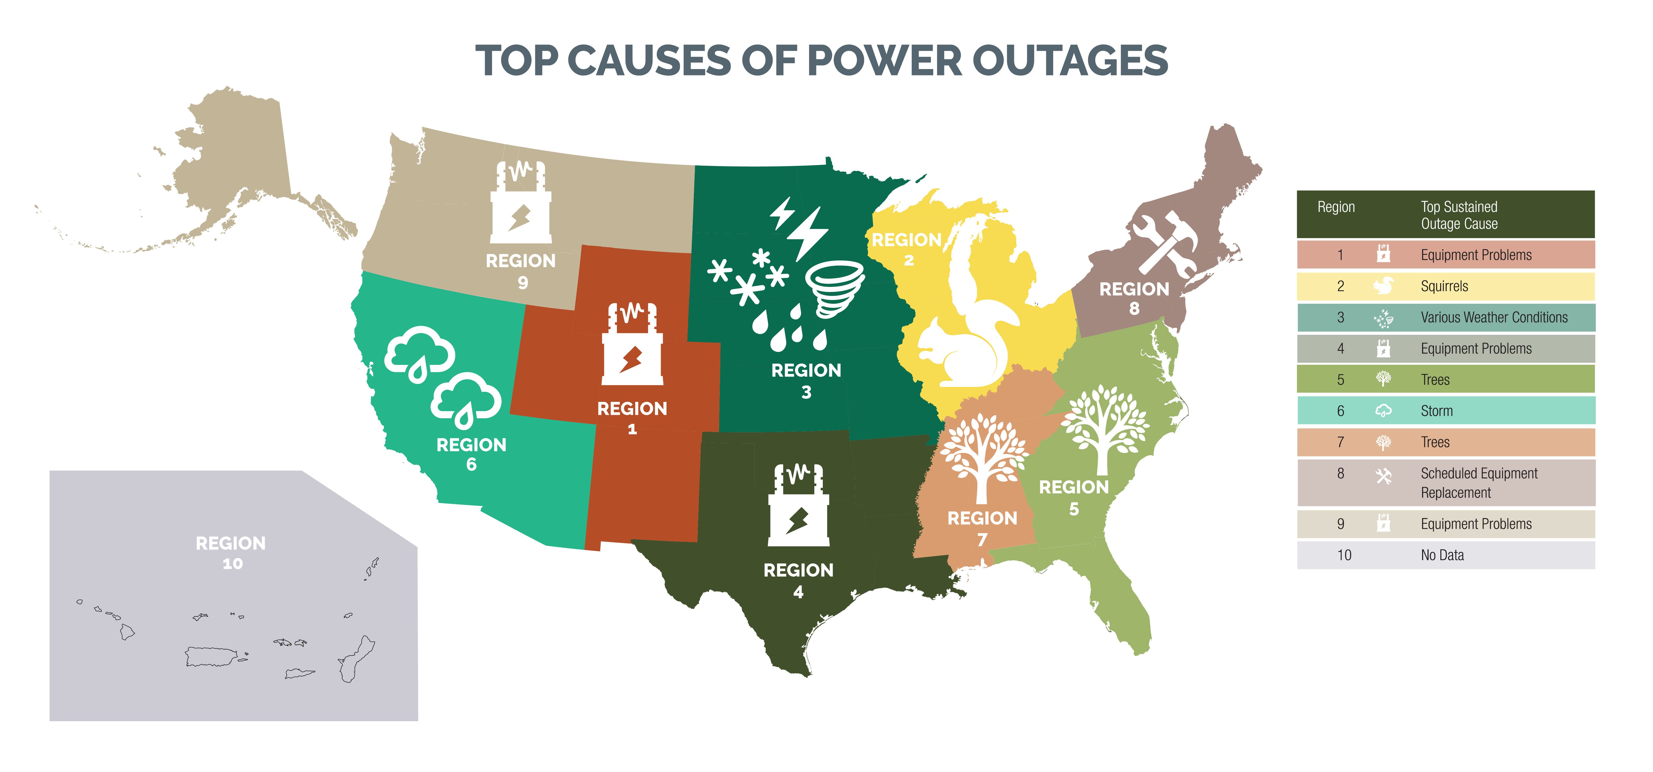
The Real Cause of Most Blackouts!
But mostly only the small ones in the distribution system
Image source: publicpower.org
39
Photo source: http://save-the-squirrels.com

Slide 41
High-Impact, Low-Frequency Events
In order to enhance electric grid resiliency, we need to consider the almost unthinkable events
These include what the
North American Electric
Reliability Corporation
(NERC) calls High-Impact,
Low-Frequency Events
(HILFs); others call them
black sky days
  Large-scale, potentially long duration blackouts
  HILFs identified by NERC were 1) a coordinated cyber, physical or blended attacks, 2) pandemics, 3) geomagnetic disturbances (GMDs), and 4) HEMPs
Image Source: NERC, 2012
40

Slide 42
Avoidable Transmission Level Blackouts
Many major blackouts can be prevented.
Time frames of the blackouts, minutes to hours, allow for human intervention
  Tokyo 1987 (20 minutes), WECC 1996 (six minutes), Eastern Interconnect 2003 (about an hour), Italy 2003 (25 minutes), India 2012 (affecting 600 million people), South America (2019)
And of course many are prevented, and hence do not make the news. For example, near voltage collapse in Delmarva Peninsula, 1999.
The 2021 Texas event, which we’ll cover later, was caused by a generator capacity shortage not the transmission system
41

Slide 43
Going Back in Time
The August 14th 2003 blackout is rapidly moving from being a “recent event” into history; yet it still has much to teach us
  IEEE Power and Energy Magazine will have a special edition on blackouts in 2023 for the 20th year anniversary
This talk is about the past and the future: what can we learn from the past to help us prepare for the future
  But not so much about what are the immediate lessons from the Blackout since many recommendations have already been put into practice.
The blackout final report is very readable and available by googling “August 14 2003 Blackout Report”
42

Slide 44
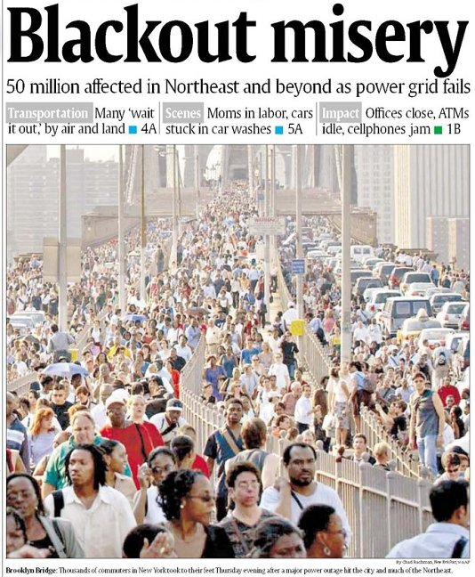
In contrasting numbers, the
August 14, 2003 Blackout hit about 50 million people,
while Hurricane Ian (2022) caused power outages affecting perhaps 2.7 million. The 2021 Texas blackout affected more than 10 million people with at least some outages at a time when temperatures were quite low.
43

Slide 45
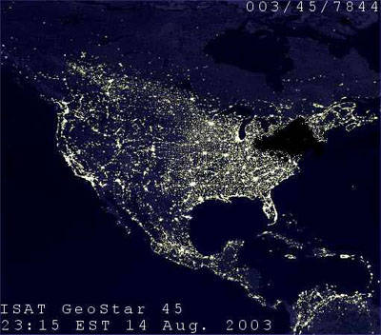
August 14, 2003 Hoax Image
This image was widely circulated
immediately after the blackout, even appearing for a time on a DOE website. It was quickly shown to be a hoax.
What might immediately give it away?
44

Slide 46
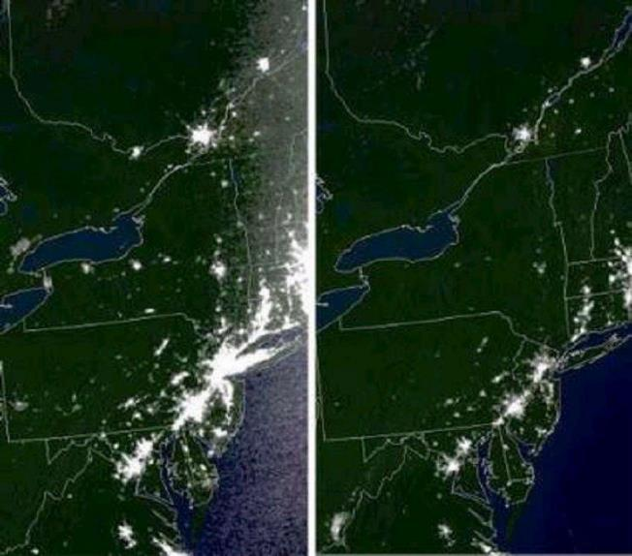
Actual Before and After Images
45

Slide 47
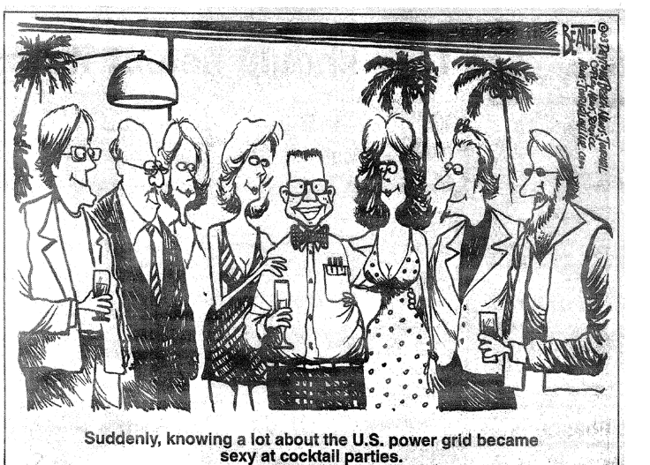
My Favorite August 14, 2003 Cartoon
46

Slide 48
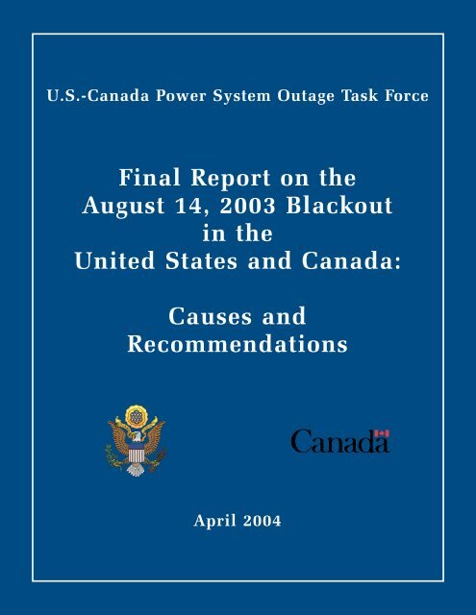
Causes of the Blackout
Blackout Final Report listed four causes
  FirstEnergy (FE) did not understand inadequacies of their system, particularly with respect to voltage instability.
  Inadequate situational awareness by FE
  FE failed to adequately manage their tree growth
  Failure of the grid reliability organizations (primarily
  MISO) to provide effective diagnostic support
Human/cyber interactions played a key role
47

Slide 49
We’ve Come Quite a Ways Since 2003
Report included 46 recommendations, many of which have dramatically changed the operation of the interconnected power grid
  Thirteen were focused on physical and cyber security
Focus here is what can 8/14/03 teach us to help with the grid in 2022 (and beyond)
Need to keep in mind economic impact of 8/14/03 was above $5 billion; yearly impact of blackouts could be above $100 billion
48

Slide 50
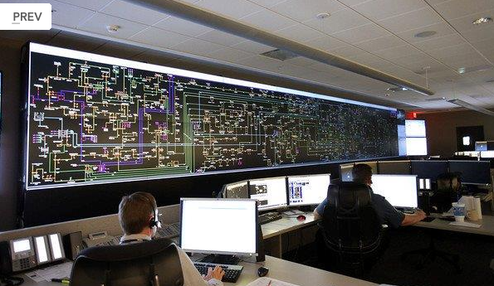
First Energy Control Center, Recent (2013)
Image Source: www.wksu.org/news/story/365
49

Slide 51

My Involvement in Blackout Investigation
I spend a lot of time talking to reporters on 8/14 to 8/16, before I knew what happened
Tasked by DOE to do onsite visit to FE on 8/19 to 8/21 with Doug Wiegmann; did a similar visit to MISO the next week (right as classes were starting for us at UIUC)
Did return visit in Oct with many
others involved in the investigation;
we also then talked with Cinergy
Many folks played far larger roles;
I was only involved extensively
early on
50

Slide 52
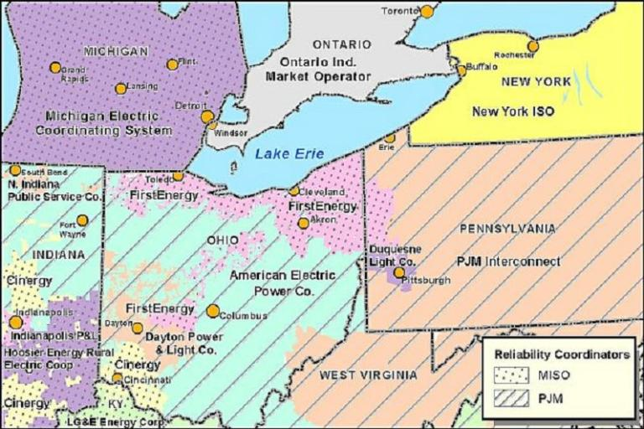
Footprints of Reliability Coordinators in Midwest
51

Slide 53
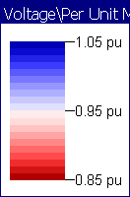
August 13, 2003
It is important to realize that immediately before the blackout few people thought the system was on the verge of a catastrophe.
NERC 2003 Summer
Assessment did not
list Ohio as an area
of particular concern
NERC 2003 Summer Assessment is available at http://www.nerc.com/files/summer2003.pdf
52

Slide 54
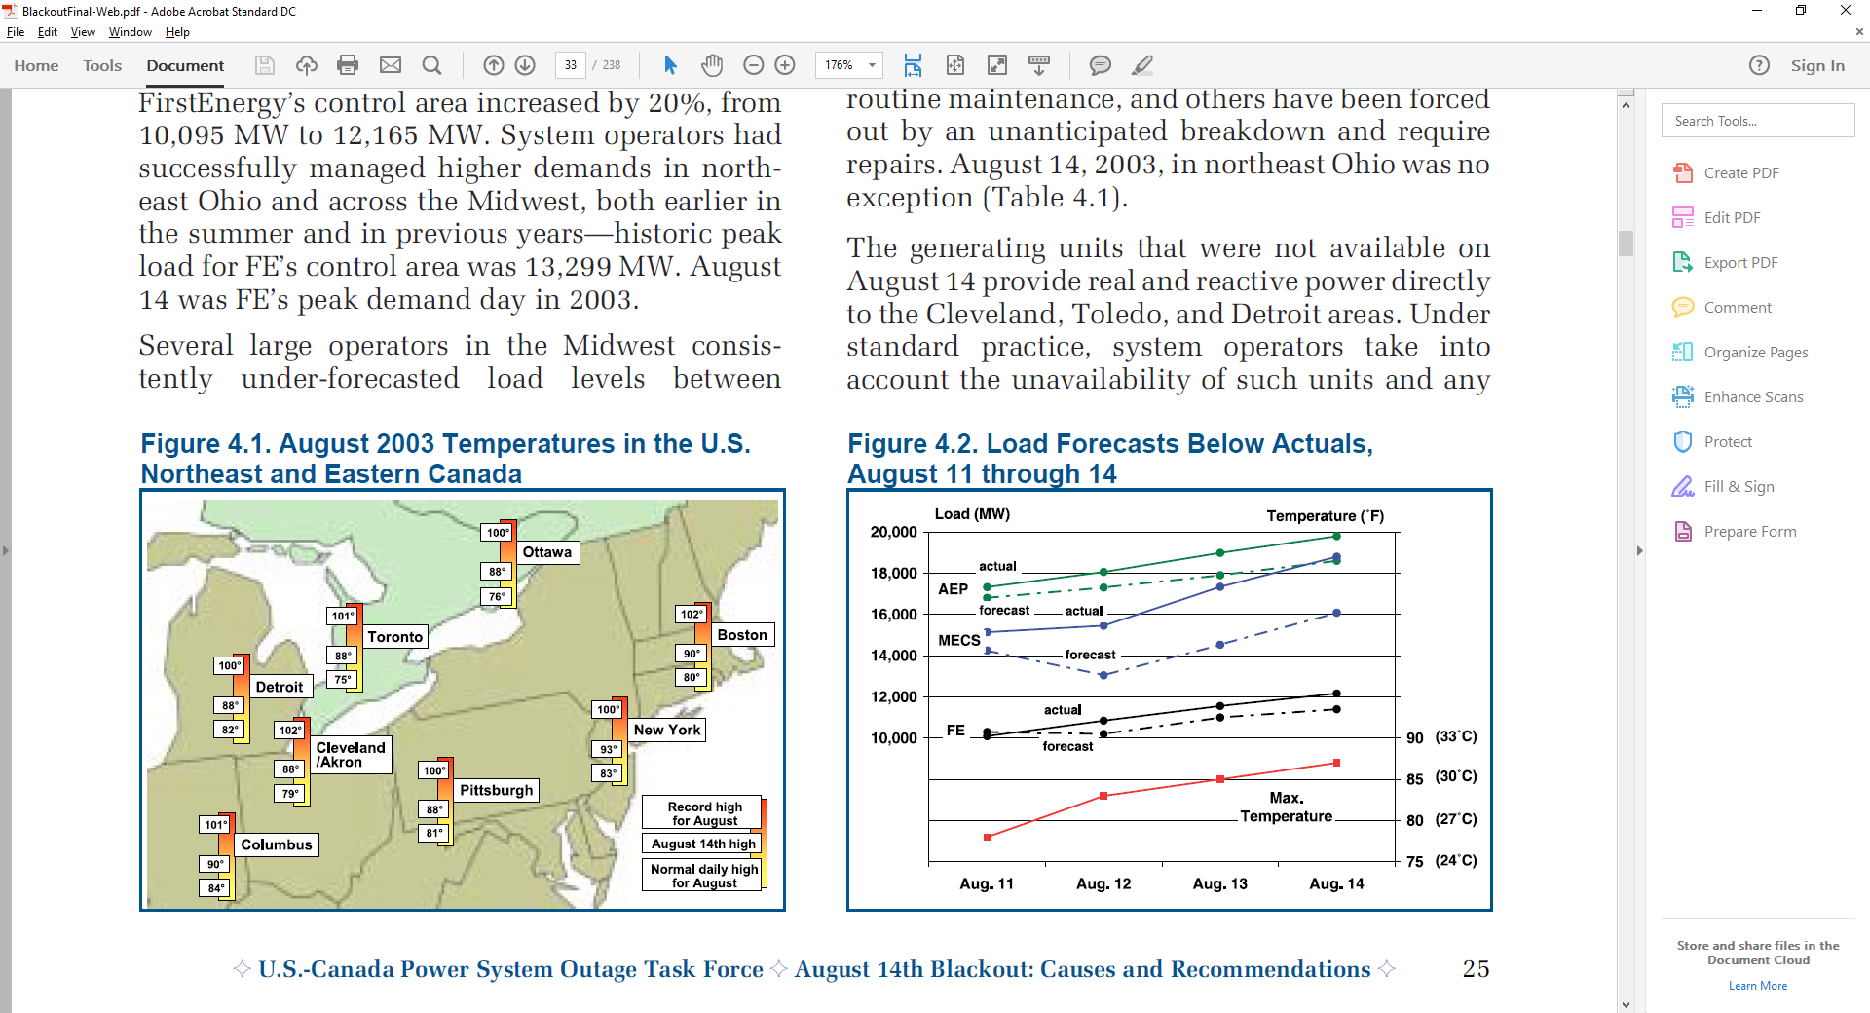
August 14, 2003: Pre-blackout (before 14:30 EDT)
It had mostly been a normal summer day at First Energy
  Most generation was available though the 883 MW Davis-Besse Nuclear unit was on a long-term outage
  At 13:31 EDT the Eastlake 5 unit (a 597 MW plant on Lake Erie) tripped when the operator tried to up is reactive output, but this was not seen as a severe event
It had been a busy day at
MISO, with their reliability
coordinators dealing with a
small outage in Indiana
around noon
  Their state estimator failed at
  1215 EDT but no one knew
53

Slide 55
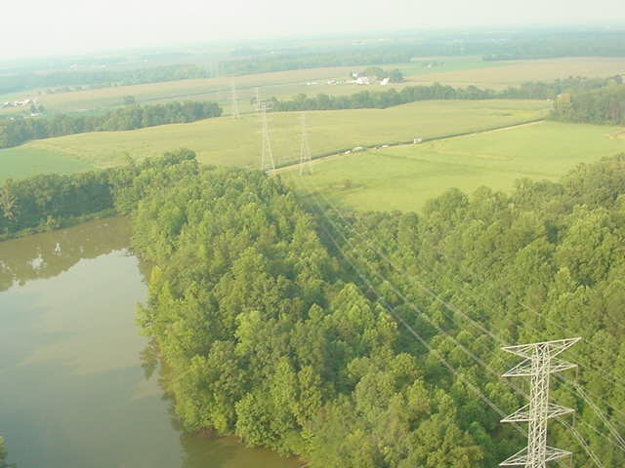
Cinergy Bedford-Columbus 345 kV Line Tree Contact at 12:08 EDT
54

Slide 56
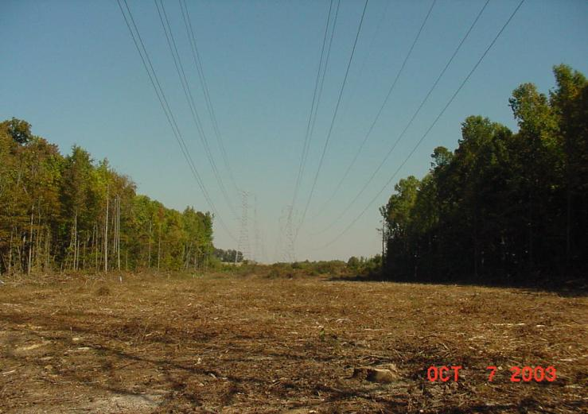
Trees were Finally “Trimmed” Two Months Later
55

