Slide 1
ECEN 615
Methods of Electric Power
Systems Analysis
Lecture 15: August 14, 2003 Blackout
Prof. Tom Overbye
Dept. of Electrical and Computer Engineering
Texas A&M University
overbye@tamu.edu

Slide 2
Announcements
Read Chapter 11
Start reading Chapter 9
Homework 5 is due on Oct 27, 2022

Slide 3
Going Back in Time
The August 14th 2003 blackout is rapidly moving from being a “recent event” into history; yet it still has much to teach us.
This talk is about the past and the future: what can we learn from the past to help us prepare for the future
  But not so much about what are the immediate lessons from the Blackout since many recommendations have already been put into practice.
The blackout final report is very readable and available by googling “August 14 2003 Blackout Report”
2

Slide 4
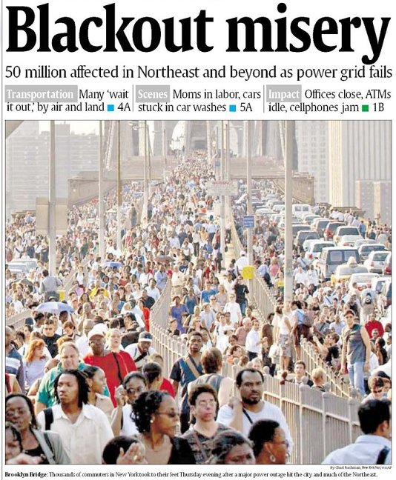
In contrasting
numbers, the
August 14 2003
Blackout hit about
50 million people,
while Hurricane
Irene (2011) caused power outages affecting perhaps seven or
eight million.
3

Slide 5
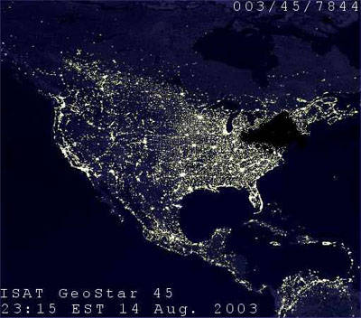
August 14, 2003 Hoax Image
This image was
widely circulated
immediately after
the blackout, even
appearing for a
time on a DOE
website. It was
quickly shown
to be a hoax.
What might
immediately give it
away?
4

Slide 6
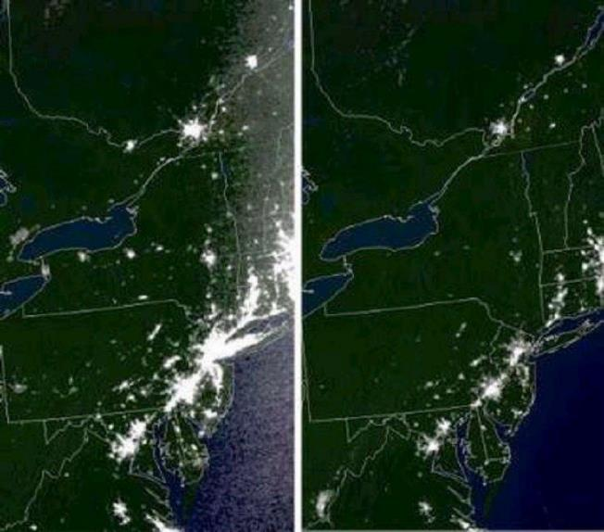
Actual Before and After Images
5

Slide 7
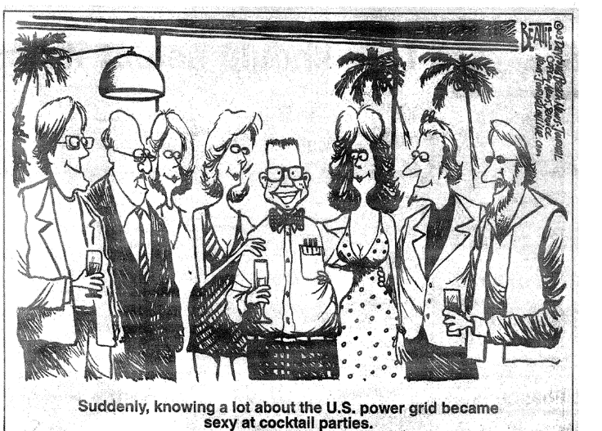
My Favorite August 14, 2003 Cartoon
6

Slide 8
Causes of the Blackout
Blackout Final Report listed four causes
  FirstEnergy (FE) did not understand inadequacies of their system, particularly with respect to voltage instability.
  Inadequate situational awareness by FE
  FE failed to adequately manage their tree growth
  Failure of the grid reliability organizations (primarily MISO) to provide effective diagnostic support
Human/cyber interactions played a key role
7

Slide 9
We’ve Come Quite a Ways Since 2003
Report included 46 recommendations, many of which have dramatically changed the operation of the interconnected power grid
  Thirteen were focused on physical and cyber security
Focus of talk is what can 8/14/03 teach us to help with the grid in 2022
Need to keep in mind economic impact of 8/14/03 was above $5 billion; yearly impact of blackouts could be above $100 billion
8

Slide 10
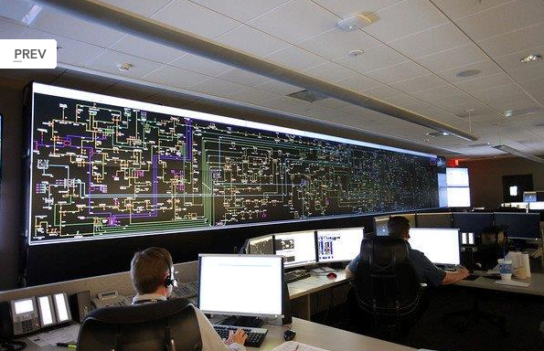
First Energy Control Center, More Recent (2013)
Image Source: www.wksu.org/news/story/365
9

Slide 11

My Involvement in Blackout Investigation
I spend a lot of time talking to reporters on 8/14 to 8/16, before I knew what happened
Tasked by DOE to do onsite visit to FE on 8/19 to 8/21 with Doug Wiegmann; did similar visit to MISO the next week.
Did return visit in Oct
Many folks played far
larger roles; I was only
involved extensively early
on
10

Slide 12
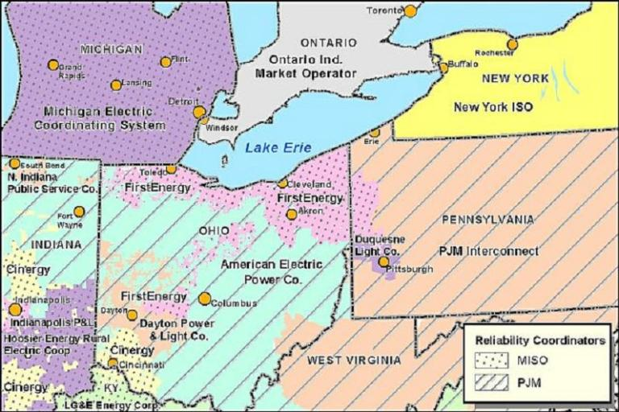
Footprints of Reliability Coordinators in Midwest
In 2003 the Ohio portion of First Energy was in MISO; they have since moved to being in PJM.
11

Slide 13
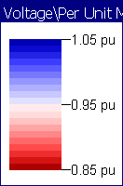
August 13, 2003
It is important to realize that immediately before the blackout few people thought the system was on the verge of a catastrophe.
NERC 2003 Summer
Assessment did not
list Ohio as an area
of particular concern
NERC 2003 Summer Assessment is available at http://www.nerc.com/files/summer2003.pdf
12

Slide 14
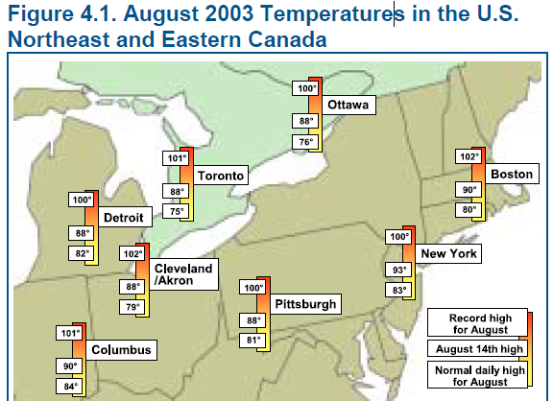
August 14, 2003: Pre-blackout (before 14:30 EDT)
It had mostly been a normal summer day at First Energy
  Most generation was available though the 883 MW Davis-Besse Nuclear unit was on a long-term outage
  At 13:31 EDT the Eastlake 5 unit (a 597 MW plant on Lake Erie) tripped when the operator tried to up is reactive output, but this was not seen as a severe event
It had been a busy day at MISO, with
their reliability coordinators dealing
with a relatively small outage in Indiana
around noon
  Their state estimator failed at 1215 EDT but
  no one know this
13

Slide 15
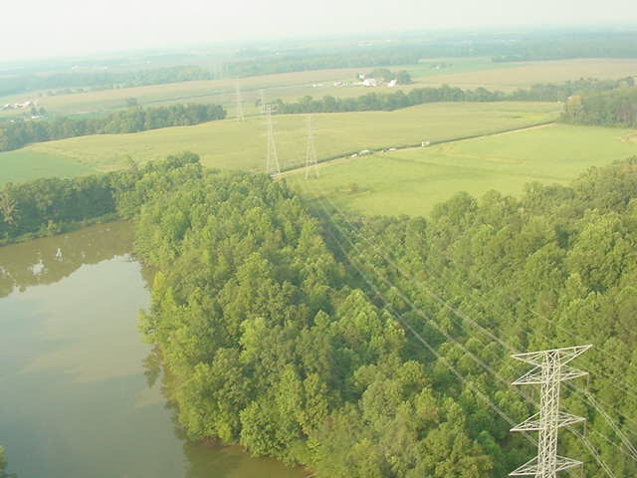
Cinergy Bedford-Columbus 345 kV Line Tree Contact at 12:08 EDT
14

Slide 16
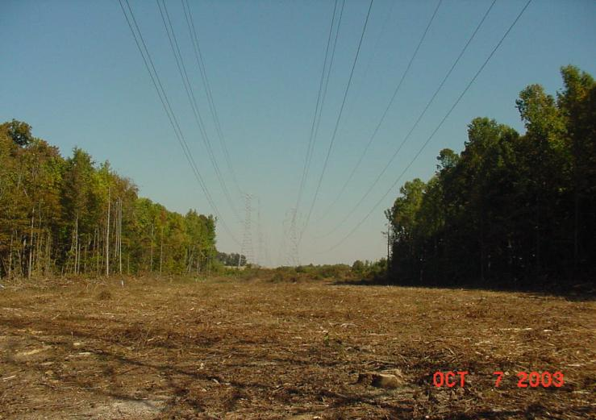
Trees were Finally “Trimmed” Two Months Later
15

Slide 17
At 14:27 EDT Star-South Canton 345 kV Line Trips and Recloses
Star-South Canton is a tie between AEP & FE
FE missed seeing this event since their alarms had hung several minutes earlier (14:14)
    Line was back in service so it appeared normal in SCADA
    FE IT folks knew about computer problems
AEP called FE at 14:32 to check on event; FE says they saw nothing. A repeat call by AEP to FE at 15:19 also discusses event indicating ground current was detected.
16

Slide 18
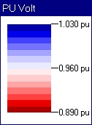
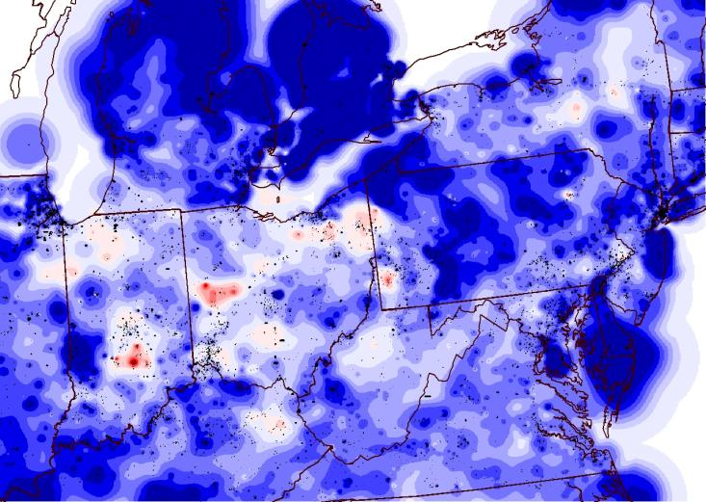
Estimated High Level Voltage Profile at 15:00 EDT
17

Slide 19
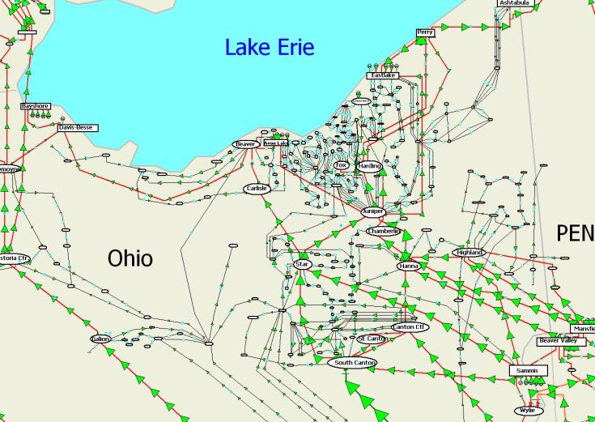
Estimated Flows in Northeast Ohio at
15:00 EDT on August 14th 2003
Chamberlin-Harding
345 kV Line trips at 15:05, an event
that was missed by
both FE and MISO
18

Slide 20
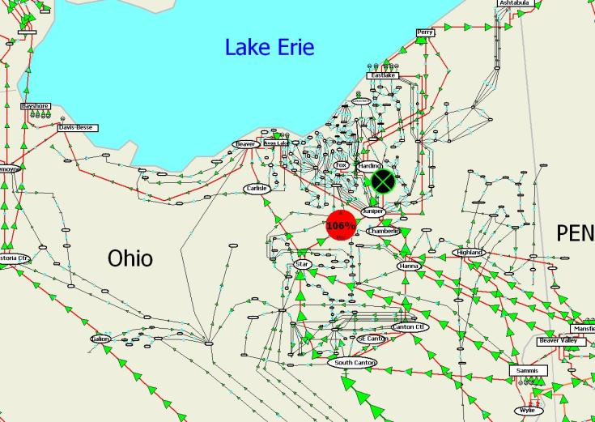
Estimated Flows in Northeast Ohio at 15:06 EDT
19

Slide 21
Line Outage Distribution Factors (LODFs)
LODFs are used to approximate the change in the flow on one line caused by the outage of a second line
  Typically they are only used to determine the change in the MW flow
  LODFs are used extensively in real-time operations
  LODFs are state-independent (calculated using dc power flow approximations) but do dependent on the assumed network topology
  Below value tells change of real power flow on line  for the assumed outage of line k; ƒ_{k}⁰ is (obviously) pre-contingent
20

Slide 22
Flowgates
The real-time loading of the power grid is accessed via “flowgates”
A flowgate “flow” is the real power flow on one or more transmission element for either base case conditions or a single contingency
  Contingent flows are determined using LODFs
Flowgates can be used as proxies for other types of limits, such as voltage or stability limits
Flowgates in 2003 were calculated using a spreadsheet
21

Slide 23
Flowgate #2265
Flowgate 2265 monitors the flow on FE’s Star-Juniper 345 kV line for contingent loss of the Hanna-Juniper 345 Line
  normally the LODF for this flowgate is 0.361
  flowgate has a limit of 1080 MW
  at 15:05 EDT the flow as 517 MW on Star-Juniper, 1004 MW on Hanna-Juniper, giving a flowgate value of 520+0.361*1007=884 (82%)
  Chamberlin-Harding 345 opened at 15:05; FE and MISO all missed seeing this
Information on PJM’s current flowgates is available at
www.pjm.com/markets-and-operations/etools/oasis/atc-information
22

Slide 24
The Bad LODF that Maybe Blacked Out the Northeast
At 15:06 EDT (after loss of Chamberlin-Harding 345) #2265 has an incorrect value because its LODF was not automatically updated.
  Value should be 633+0.463*1174=1176 (109%)
  Value was 633 + 0.361*1174=1057 (98%)
At 15:32 the flowgate’s contingent line opened, causing the flowgate to again show the correct value, about 107%
23

Slide 25
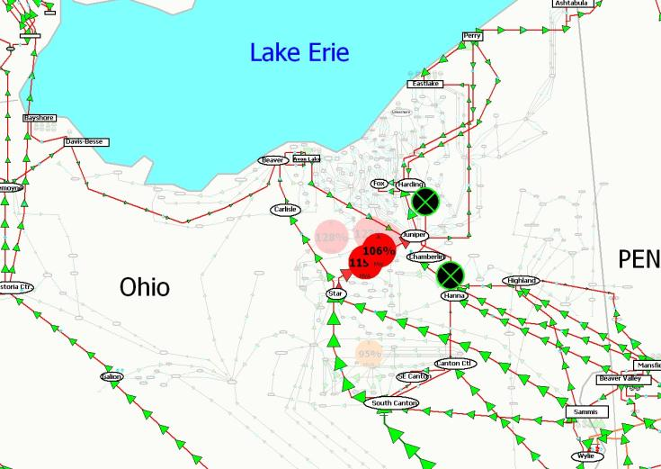
Flows at 15:33 EDT
24

Slide 26
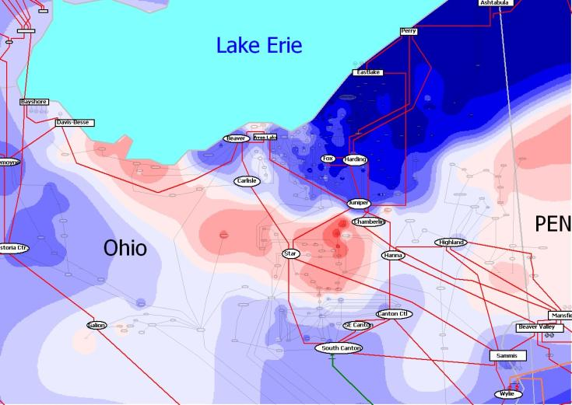
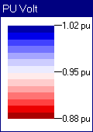
Estimated Northeast Ohio 138 kV Voltage Contour: 15:33 EDT
25

Slide 27
IT Issues
MISO RCs had gotten many hundreds of “alarms”
Contingency analysis results were giving pages of violations.
SE would fail because of severe system stress
Inadequate procedures for dealing with SE failure.
FE control center would get “many phone calls;” information was not effectively shared.
26

Slide 28
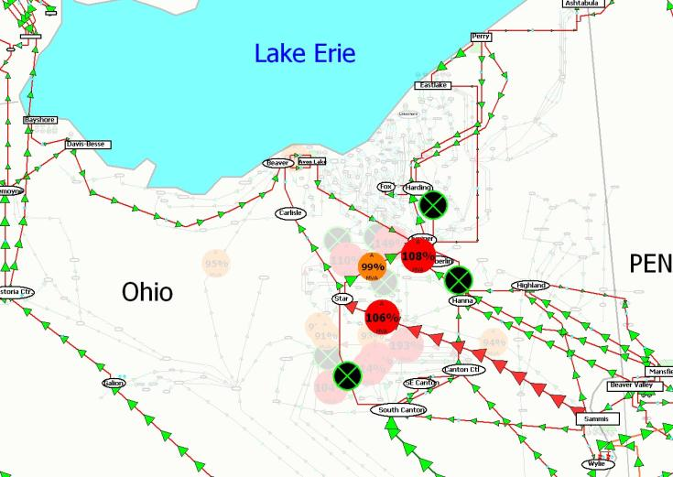
Estimated Flows in Northeast Ohio at
15:46 EDT on August 14th 2003
27

Slide 29
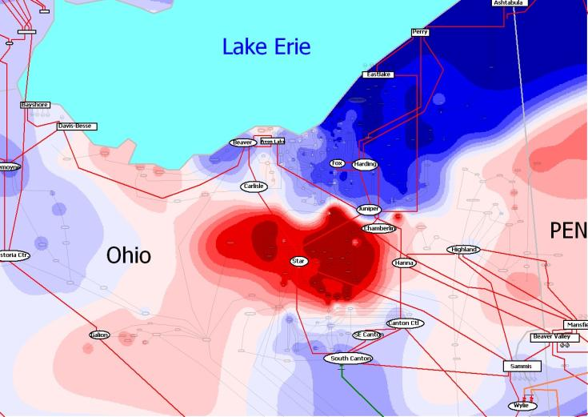
Estimated Northeast Ohio 138 kV Voltage Contour: 15:46 EDT
28

Slide 30
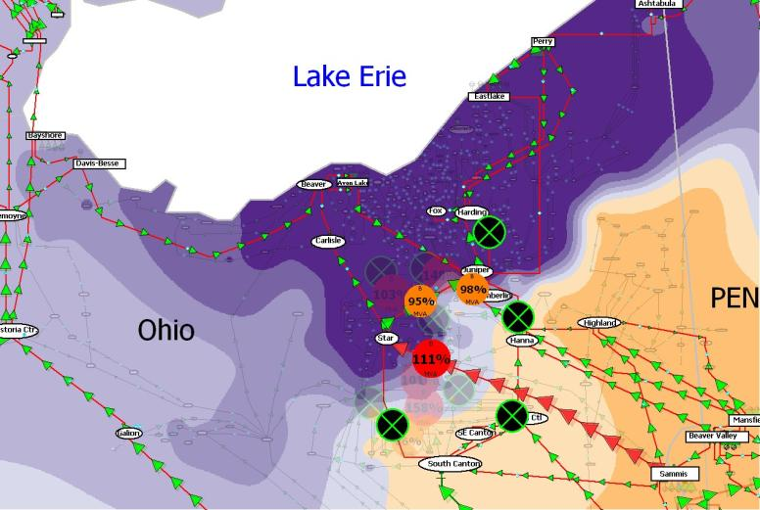
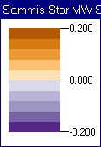
What Could Have Been Done?
Sammis-Star Flow Sensitivities
DOE/NERC
report said
about
1500 MW
of load
shed would
have been
needed
29

Slide 31
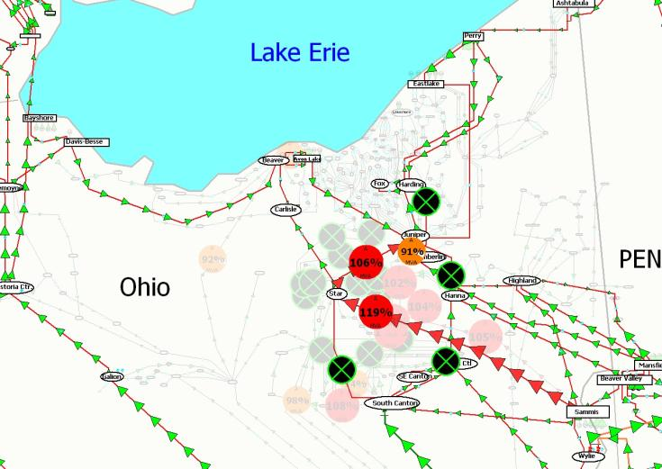
Estimated Flows in Northeast Ohio at
16:05 EDT on August 14th 2003
30

Slide 32
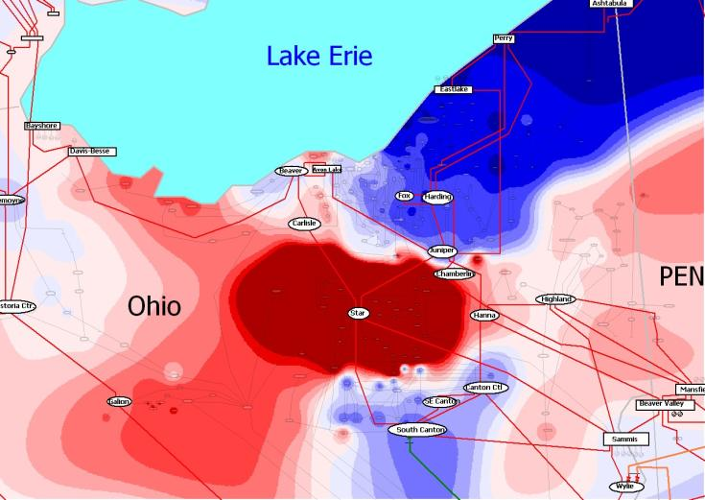
Estimated Northeast Ohio 138 kV Voltage Contour: 16:05 EDT
31

Slide 33
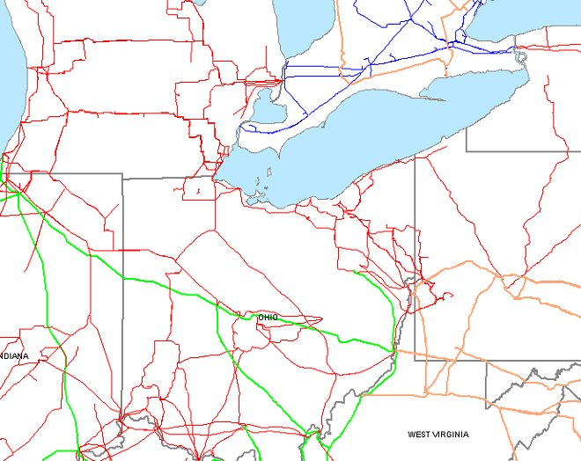
Path to Cleveland Blocked after Loss of Sammis-Star 16:05:57
Remaining
Paths
Image Source: August 14
2003 Blackout Final Report
32

Slide 34
345 kV Lines Trip Across Ohio to West at 16:09
ONTARIO
33

Slide 35
Generation Trips 16:09:08 – 16:10:27
ONTARIO
Image Source: August 14 2003 Blackout Final Report
34

Slide 36
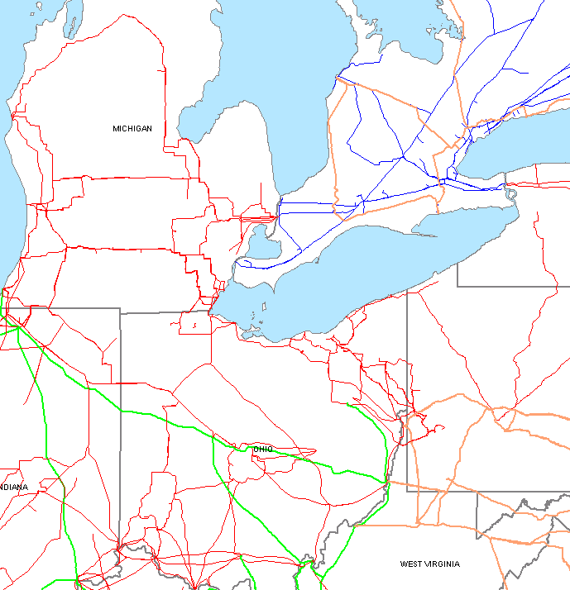
Parts of Ohio/Michigan Served Only from Ontario after 16:10:37
Image Source: August 14
2003 Blackout Final Report
35

Slide 37
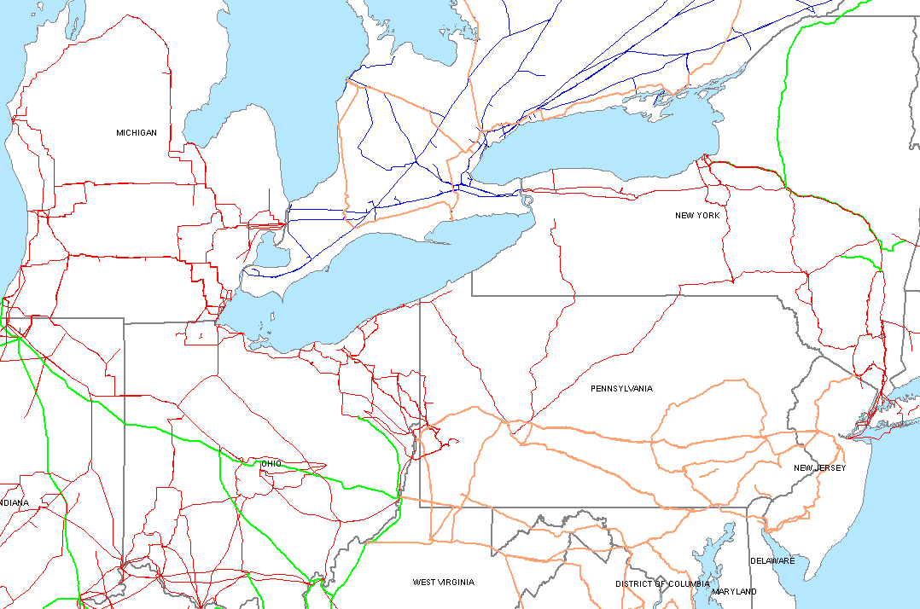
Major Power Reversal: 16:10:38
Image Source: August 14
2003 Blackout Final Report
36

Slide 38
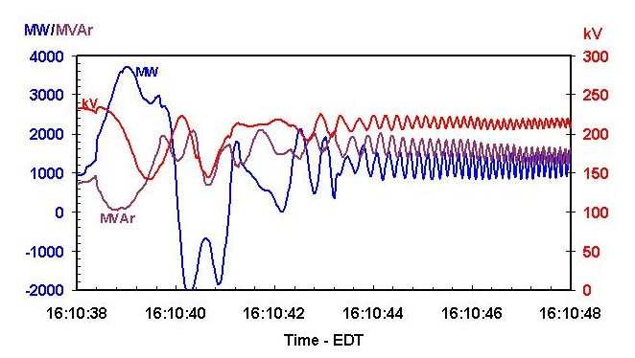
Ontario/Michigan Interface Flows and Voltage
Image Source: August 14 2003 Blackout Final Report
37

Slide 39
Ties from PJM to New York Open: 16:10:44 (North Ohio Black)
Image Source: August 14 2003 Blackout Final Report
38

Slide 40
System Islands Break Up and Collapse: 16:10-16:13
Image Source: August 14 2003 Blackout Final Report
Some Local Load Interrupted
Areas Affected by the Blackout
Service maintained
in some area
39

Slide 41
Are DC LODFs Accurate? August 14th Crash Test
Here are some results from August 14th
The results are actually quite good, especially considering the extreme system contingencies
Time | Contingency | Element | LODF | ΔMW (pred) | ΔMW (act)
15:05 | Chamberlin-Harding 345 | Hanna-Juniper 345 | 0.362 | 179 | 176
15:32 | Hanna-Juniper 345 | Star-Juniper 345 | 0.465 | 545 | 527
15:46 | CantonCentral-Cloverdale 138 | Sammis-Star 345 | 0.164 | 48 | 54
15:46 | same | Cloverdale-Star 138 | 0.234 | 68 | 64
16:06 | Sammis-Star 345 Star-Urban 138 W.Canton-Dale 138 | Star-Juniper 345 | numerous | 517 | 676
16:06 | same | Ashtabula-Perry 345 | numerous | 319 | 408
40

