Slide 1
ECEN 615 Methods of Electric Power Systems Analysis
Lecture 16: Least Squares, Singular Value Decomposition (SVD), and State Estimation
Prof. Tom Overbye
Dept. of Electrical and Computer Engineering
Texas A&M University
overbye@tamu.edu

Slide 2
Announcements
Read Chapter 9
Homework 5 is due on Tuesday Nov 1, 2022

Slide 3
Forward and Inverse Problems
In science and engineering analysis we are often dealing with two classes of problems
Forward or direct problems; we’re using a model with inputs to determine a set of outputs; power flow is an example of a forward problem
Inverse problems are the opposite: we’re using a set of outputs, perhaps coupled with a model, to determine a set of inputs; power system state estimation is an example of an inverse problem
Both forward and inverse problems can be linear or nonlinear
Inverse problems can present many challenges including whether there are enough observations of sufficient quality to obtain an answer
2

Slide 4
Least Squares
So far we have considered the solution of Ax = b in which A is a square matrix; as long as A is nonsingular there is a single solution
That is, we have the same number of equations (m) as unknowns (n)
This is a forward problem
Many problems are overdetermined in which there more equations than unknowns (m > n)
Overdetermined systems are usually inconsistent, in which no value of x exactly solves all the equations
Underdetermined systems have more unknowns than equations (m < n); they never have a unique solution but are usually consistent
3

Slide 5
Method of Least Squares
The least squares method is a solution approach for determining an approximate solution for an overdetermined system
If the system is inconsistent, then not all of the equations can be exactly satisfied
The difference for each equation between its exact solution and the estimated solution is known as the error
Least squares seeks to minimize the sum of the squares of the errors
Weighted least squares allows differ weights for the equations
4

Slide 6
Least Squares Solution History
The method of least squares developed from trying to estimate actual values from a number of measurements
Several persons in the 1700's, starting with Roger Cotes in 1722, presented methods for trying to decrease model errors from using multiple measurements
Legendre presented a formal description of the method in 1805; evidently Gauss claimed he did it in 1795
Method is widely used in power systems, with state estimation the best known application, dating from Fred Schweppe's work around 1970
Fred also did a lot of work associated with locational marginal prices (LMPs)
He was a professor at MIT who died in 1988 at age 54
5

Slide 7
Initial State Estimation Paper
It was a three part paper with part two focused on an approximate model and part three on implementation

Slide 8
Least Squares and Sparsity
In many contexts least squares is applied to problems that are not sparse. For example, using a number of measurements to optimally determine a few values
Regression analysis is a common example, in which a line or other curve is fit to potentially many points)
Each measurement impacts each model value
In the classic power system application of state estimation the system is sparse, with measurements only directly influencing a few states
Power system analysis classes have tended to focus on solution methods aimed at sparse systems; we'll consider both sparse and nonsparse solution methods
7

Slide 9
Least Squares Problem
Consider
or
8

Slide 10
Least Squares Solution
We write (a^{i})^{T} for the row i of A and a^{i} is a column vector
Here, m ≥ n and the solution we are seeking is that which minimizes Ax - b_{p}, where p denotes some norm
Since usually an overdetermined system has no exact solution, the best we can do is determine an x that minimizes the desired norm.
9

Slide 11
Choice of p
We discuss the choice of p in terms of a specific example
Consider the equation Ax = b with
(hence three equations and one unknown)
We consider three possible choices for p:
10

Slide 12
Choice of p
(i) p = 1
(ii) p = 2
(iii) p = ∞
11

Slide 13
The Least Squares Problem
In general, is not differentiable for p = 1 or p = ∞
The choice of p = 2 (Euclidean norm) has become well established given its least-squares fit interpretation
The problem is tractable for two major reasons
First, the function is differentiable
12

Slide 14
The Least Squares Problem, cont.
Second, the Euclidean norm is preserved under orthogonal transformations: with Q an arbitrary orthogonal matrix; that is, Q satisfies
13

Slide 15
The Least Squares Problem, cont.
We introduce next the basic underlying assumption: A is full rank, i.e., the columns of A constitute a set of linearly independent vectors
This assumption implies that the rank of A is n because n ≤ m since we are dealing with an overdetermined system
Fact: The least squares solution x* satisfies
14

Slide 16
Proof
Since by definition the least squares solution x* minimizes at the optimum, the derivative of this function zero:
15

Slide 17
Implications
This underlying assumption implies that
Therefore, the fact that A^{T}A is positive definite (p.d.) follows from considering any x ≠ 0 and evaluating
which is the definition of a p.d. matrix
We use the shorthand A^{T}A > 0 for A^{T}A being a symmetric, positive definite matrix
16

Slide 18
Implications
The underlying assumption that A is full rank and therefore A^{T}A is p.d. implies that there exists a unique least squares solution
Note: we use the inverse in a conceptual, rather than a computational, sense
The below formulation is known as the normal equations, with the solution conceptually straightforward
17

Slide 19
Example: Curve Fitting
Say we wish to fit five points to a polynomial curve of the form
This can be written as
Here we are solving for x
18

Slide 20
Example: Curve Fitting
Say the points are t =[0,1,2,3,4] and y = [0,2,4,5,4]. Then
19

Slide 21
Implications
An important implication of positive definiteness is that we can factor A^{T}A since A^{T}A > 0
The expression A^{T}A = G^{T}G is called the Cholesky factorization of the symmetric positive definite matrix A^{T}A
20

Slide 22
A Least Squares Solution Algorithm
Step 1: Compute the lower triangular part of A^{T}A
Step 2: Obtain the Cholesky Factorization
Step 3: Compute
Step 4: Solve for y using forward substitution in
and for x using backward substitution in
Note, our standard LU factorization approach would work; we can just solve it twice as fast by taking advantage of it being a symmetric matrix
21

Slide 23
Practical Considerations
The two key problems that arise in practice with the triangularization procedure are:
First, while A maybe sparse, A^{T}A is much less sparse and consequently requires more computing resources for the solution
In particular, with A^{T}A second neighbors are now connected! Large networks are still sparse, just not as sparse
Second, A^{T}A may actually be numerically less well-conditioned than A
22

Slide 24
Loss of Sparsity Example
Assume the B matrix for a network is
Then B^{T}B is
Second neighbors are now connected!
23

Slide 25
Singular Value Decomposition
Traditionally power system analysis has mostly been focused on the sparse matrices associated with the electric grid; there was not much signal analysis
This is rapidly changing as the power industry get more signals and need to extract information from them, with PMUs one example
This data is often presented in the form of a matrix, for example with the rows being sample points
A key technique for extracting information from matrices is known as the singular value decomposition
24

Slide 26
Matrix Singular Value Decomposition (SVD)
The SVD is a factorization of a matrix that generalizes the eigendecomposition to any m by n matrix to produce where S is a diagonal matrix of the singular values, and U and V are orthogonal matrices
The singular values are non-negative real numbers that can be used to indicate the major components of a matrix (the gist is they provide a way to decrease the rank of a matrix
A key application is image compression
The original concept is more than 100 years old, but has founds lots of recent applications
25

Slide 27
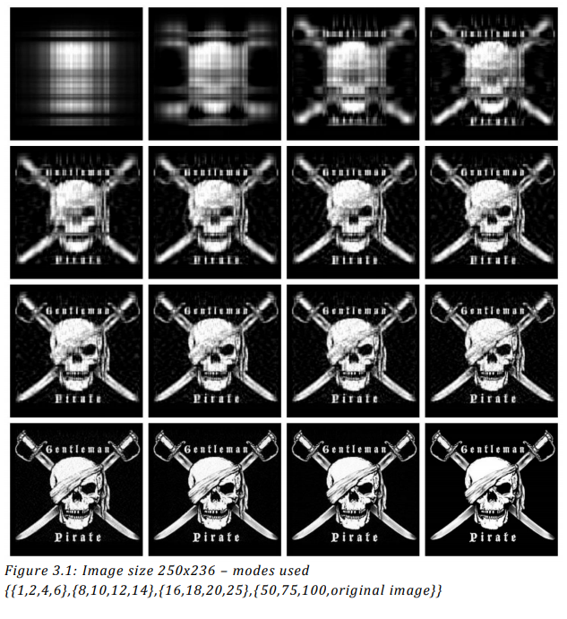
Aside: SVD Image Compression Example
Images can be represented with matrices. When an SVD is applied and only the largest singular values are retained the image is compressed.
Image Source: www.math.utah.edu/~goller/F15_M2270/BradyMathews_SVDImage.pdf
26

Slide 28
An SVD Application, the Pseudoinverse of a Matrix
The pseudoinverse of a matrix generalizes concept of a matrix inverse to an m by n matrix, m >= n
Specifically this is a Moore-Penrose Matrix Inverse
Notation for the pseudoinverse of A is A⁺
Satisfies AA⁺A = A
If A is a square matrix, then A⁺ = A⁻¹
Quite useful for solving the least squares problem since the least squares solution of Ax = b is x = A⁺ b
Can be calculated using an SVD
27

Slide 29
Pseudoinverse Least Squares Matrix Example
Assume we wish to fit a line (mx + b = y) to three data points: (1,1), (2,4), (6,4)
Two unknowns, m and b; hence x = [m b]^{T}
Setup in form of Ax = b
28

Slide 30
Aside: Pseudoinverse Least Squares Matrix Example
In an economy SVD the Σ matrix has dimensions of m by m if m < n or n by n if n < m
Doing an economy SVD
Computing the pseudoinverse
29

Slide 31
Least Squares Matrix Pseudoinverse Example, cont.
Computing x = [m b]^{T} gives
With the pseudoinverse approach we immediately see the sensitivity of the elements of x to the elements of b
New values of m and b can be readily calculated if y changes
Computationally the SVD is order mn²+n³ (with n < m)
Often n is much less than m, so the result tends to scale linearly with m
30

Slide 32
SVD and Principal Component Analysis (PCA)
The previous image compression example demonstrates PCA, which reduces dimensionality
Extracting the principal components
The principal components are associated with the largest singular values
This helps to extract the key features of the data and removes redundancy
PCA is a statistical method for reducing the dimensionality of a dataset
One example of PCA is facial recognition; another is market research
PCA is starting to be more widely used in power system analysis, particularly when doing signal analysis
In electrical engineering a signal is defined as any time-varying quantity, which hopefully contains some information
31

Slide 33
Numerical Conditioning
To understand the point on numerical ill-conditioning, we need to introduce terminology
We define the norm of a matrix to be
This is the maximum singular value of B
32

Slide 34
Numerical Conditioning Example
Say we have the matrix
What value of x with a norm of 1 that maximizes ?
What value of x with a norm of 1 that minimizes ?
33

Slide 35
Numerical Conditioning
Keep in mind the eigenvalues of a p.d. matrix are positive
i.e., λ_{i} is a root of the polynomial
In other words, the ₂ norm of B is the square root of the largest eigenvalue of B^{T}B
34

Slide 36
Numerical Conditioning
The conditioning number of a matrix B is defined as
A well–conditioned matrix has a small value of close to 1; the larger the value of , the more pronounced the ill-conditioning
35

Slide 37
Power System State Estimation (SE)
The need is because in power system operations there is a desire to do “what if” studies based upon the actual “state” of the electric grid
An example is an online power flow or contingency analysis
Overall goal of SE is to come up with a power flow model for the present "state" of the power system based on the actual system measurements
SE assumes the topology and parameters of the transmission network are mostly known
Measurements from SCADA and increasingly PMUs
Overview is given in ECEN 615; much more details are provided in 614
Prof Ali Abur has done a lot of work in state estimation; he was at TAMU from 1985 to 2005, and is now at Northeastern University
36

Slide 38
Power System State Estimation
Problem can be formulated in a nonlinear, weighted least squares form as where J(x) is the scalar cost function, x are the state variables (primarily bus voltage magnitudes and angles), z_{i} are the m measurements, f(x) relates the states to the measurements and σ_{i} is the assumed standard deviation for each measurement
37

Slide 39
Assumed Error
Hence the goal is to decrease the error between the measurements and the assumed model states x
The σ_{i} term weighs the various measurements, recognizing that they can have vastly different assumed errors
Measurement error is assumed Gaussian (whether it is or not is another question); outliers (bad measurements) are often removed
38

Slide 40
State Estimation for Linear Functions
First we’ll consider the linear problem. That is where
Let R be defined as the diagonal matrix of the variances (square of the standard deviations) for each of the measurements
39

Slide 41
State Estimation for Linear Functions
We then differentiate J(x) w.r.t. x to determine the value of x that minimizes this function
40

Slide 42
Simple DC System Example
Say we have a two bus power system that we are solving using the dc approximation. Say the line’s per unit reactance is j0.1. Say we have power measurements at both ends of the line. For simplicity assume R=I. We would then like to estimate the bus angles. Then
We have a problem since H^{T}H is singular. This is because of lack of an angle reference.
41

Slide 43
Simple DC System Example, cont.
Say we directly measure θ₁ (with a PMU) to be zero; set this as the third measurement. Then
Note that the angles are in radians
42

Slide 44
Nonlinear Formulation
A regular ac power system is nonlinear, so we need to use an iterative solution approach. This is similar to the Newton power flow. Here assume m measurements and n state variables (usually bus voltage magnitudes and angles) Then the Jacobian is the H matrix
43

Slide 45
Measurement Example
Assume we measure the real and reactive power flowing into one end of a transmission line; then the z_{i}-f_{i}(x) functions for these two are
Two measurements for four unknowns
Other measurements, such as the flow at the other end, and voltage magnitudes, add redundancy
44

Slide 46
SE Iterative Solution Algorithm
We then make an initial guess of x, x⁽⁰⁾ and iterate, calculating Δx each iteration
This is exactly the least squares form developed earlier with H^{T}R⁻¹H an n by n matrix. This could be solved with Gaussian elimination, but this isn't preferred because the problem is often ill-conditioned
Keep in mind that H is no longer constant, but varies as x changes, and is often ill-conditioned
45

Slide 47
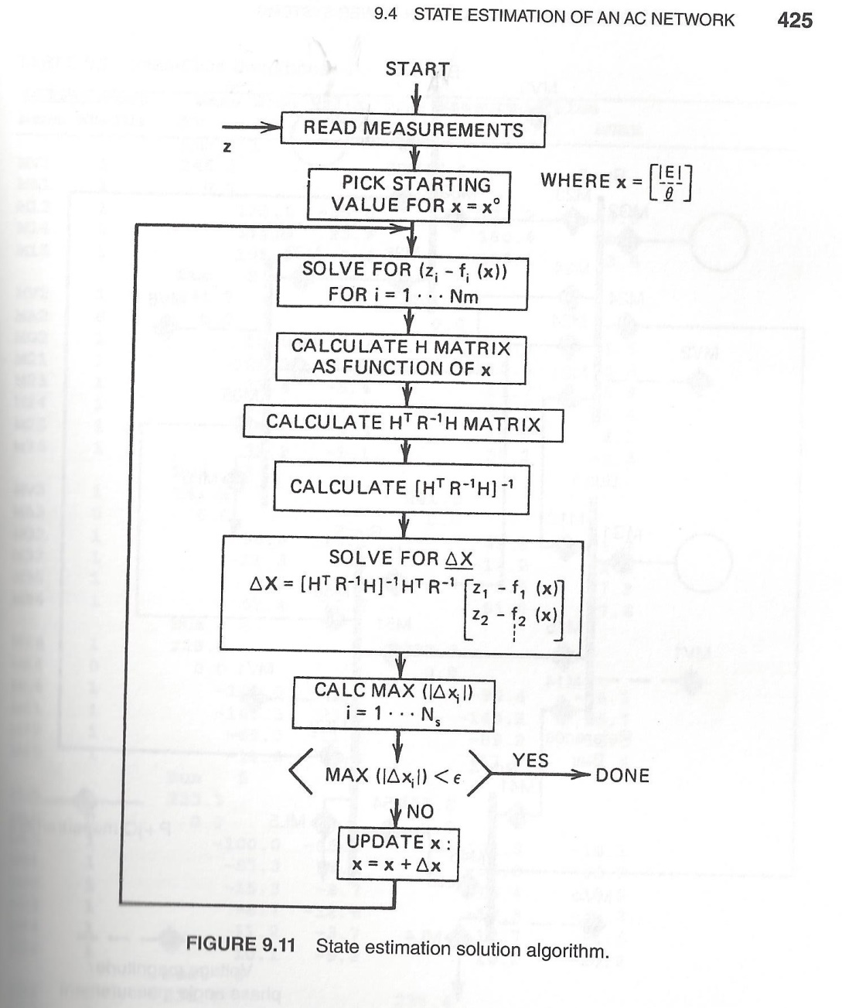
Nonlinear SE Solution Algorithm, Book Figure 9.11
46

