Slide 1
ECEN 615 Methods of Electric Power Systems Analysis
Lecture 17: State Estimation
Prof. Tom Overbye
Dept. of Electrical and Computer Engineering
Texas A&M University
overbye@tamu.edu

Slide 2
Announcements
Read Chapter 9
Skim Chapters 3, 4 and 5
Starting reading Chapter 8
The classic book in this area is Power System State Estimation: Theory and Implementation by Ali Abur and Antonio Gomez-Exposito (2004)
Homework 5 is due today
Homework 6 is due on Thursday Nov 10

Slide 3
State Estimation for Linear Functions
First we’ll consider the linear problem. That is where
Let R be defined as the diagonal matrix of the variances (square of the standard deviations) for each of the measurements
2

Slide 4
State Estimation for Linear Functions
We then differentiate J(x) w.r.t. x to determine the value of x that minimizes this function
3

Slide 5
Simple DC System Example
Say we have a two bus power system that we are solving using the dc approximation. Say the line’s per unit reactance is j0.1. Say we have power measurements at both ends of the line. For simplicity assume R=I. We would then like to estimate the bus angles. Then
We have a problem since H^{T}H is singular. This is because of lack of an angle reference.
4

Slide 6
Simple DC System Example, cont.
Say we directly measure θ₁ (with a PMU) to be zero; set this as the third measurement. Then
Note that the angles are in radians
5

Slide 7
Nonlinear Formulation
A regular ac power system is nonlinear, so we need to use an iterative solution approach. This is similar to the Newton power flow. Here assume m measurements and n state variables (usually bus voltage magnitudes and angles) Then the Jacobian is the H matrix
6

Slide 8
Measurement Example
Assume we measure the real and reactive power flowing into one end of a transmission line; then the z_{i}-f_{i}(x) functions for these two are
Two measurements for four unknowns
Other measurements, such as the flow at the other end, and voltage magnitudes, add redundancy
7

Slide 9
SE Iterative Solution Algorithm
We then make an initial guess of x, x⁽⁰⁾ and iterate, calculating Δx each iteration
This is exactly the least squares form developed earlier with H^{T}R⁻¹H an n by n matrix. This could be solved with Gaussian elimination, but this isn't preferred because the problem is often ill-conditioned
Keep in mind that H is no longer constant, but varies as x changes, and is often ill-conditioned
8

Slide 10
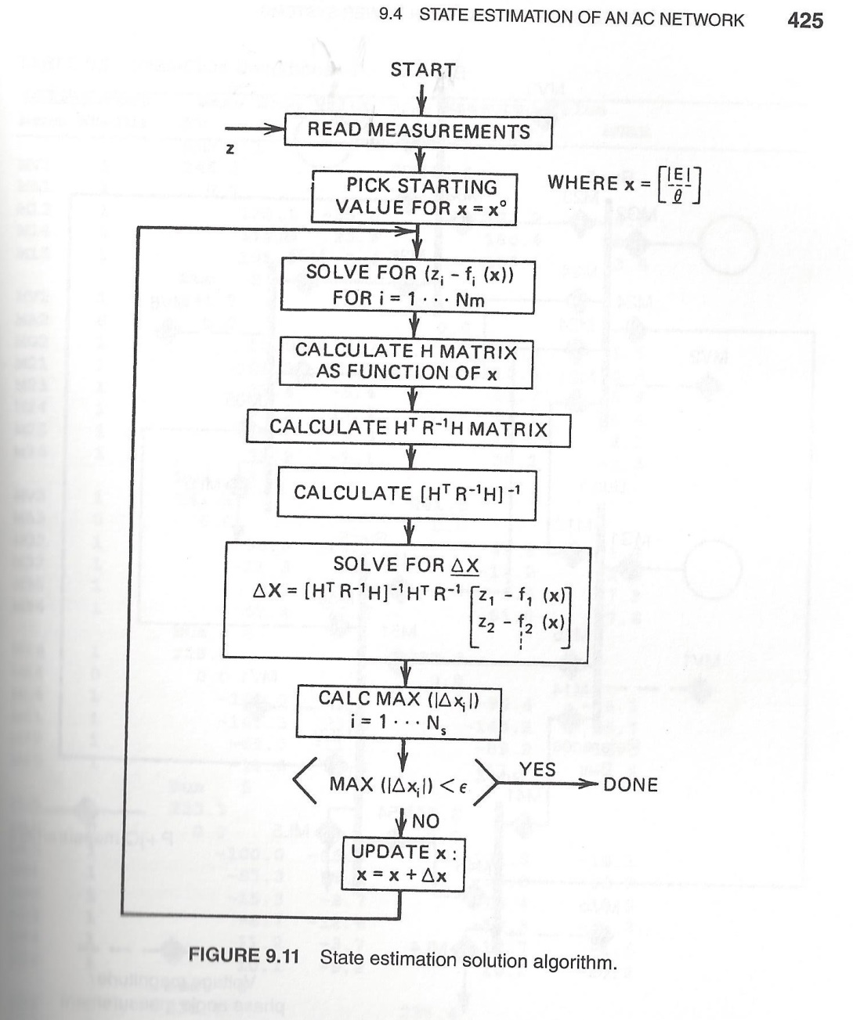
Nonlinear SE Solution Algorithm, Book Figure 9.11
9

Slide 11
Example: Two Bus Case
Assume a two bus case with a generator supplying a load through a single line with x=0.1 pu. Assume measurements of the p/q flow on both ends of the line (into line positive), and the voltage magnitude at both the generator and the load end. So B₁₂ = B₂₁=10.0
We need to assume a reference angle unless we directly measuring phase
10

Slide 12
Example: Two Bus Case
Let
We assume an angle reference of θ₁=0
11

Slide 13
Example: Two Bus Case
With a flat start guess we get
12

Slide 14
Example: Two Bus Case
13

Slide 15
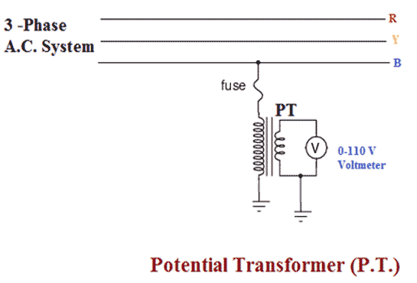
Electric Grid Measurements
The two major types of measurements are voltages and currents
The challenge for both types are doing these measurements at the high electric grid voltage levels
Potential transformers (PTs) are used to measure voltage, using a transformer sometimes with a set of series capacitors to drop the voltage
Image source: www.electrical4u.com/instrument-transformers/
14

Slide 16
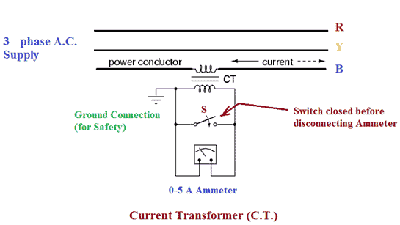
Electric Grid Measurements
Current transformers (CTs) are used to measure current, with the primary often consisting of the transmission wire itself; the secondary then has its number of turns set to give a specified current (say 5A) at a specified line current
Many CTs are used in the protection system so these need to be calibrated to correctly measure fault current; others are used to give more accurate load current values
All meters have errors
Image source: www.electrical4u.com/instrument-transformers/
15

Slide 17
Phasor Measurement Units (PMUs)
All AC signals have a magnitude and phase. It is very easy to measure the phase angle differences between local signals (e.g., at an electrical substation)
These differences are used to calculate power values
However, it had been challenging to measure phase angle differences between signals at different locations
This requires access to a precise time source
At 60 Hz one cycle takes 16.67 ms, which means one degree takes 46 μs.
16

Slide 18
Phasor Measurement Units (PMUs)
Widespread access to precise time became available in the 1980’s when civilian use of the GPS was allowed
PMUs use the GPS signals to determine the phase angles of voltages and currents (relative to some global reference)
The inputs to PMUs come from the CTs and PTs
PMUs sample the system at rates on the order of 30 times per second
PMU values are being used in SE algorithms
17

Slide 19
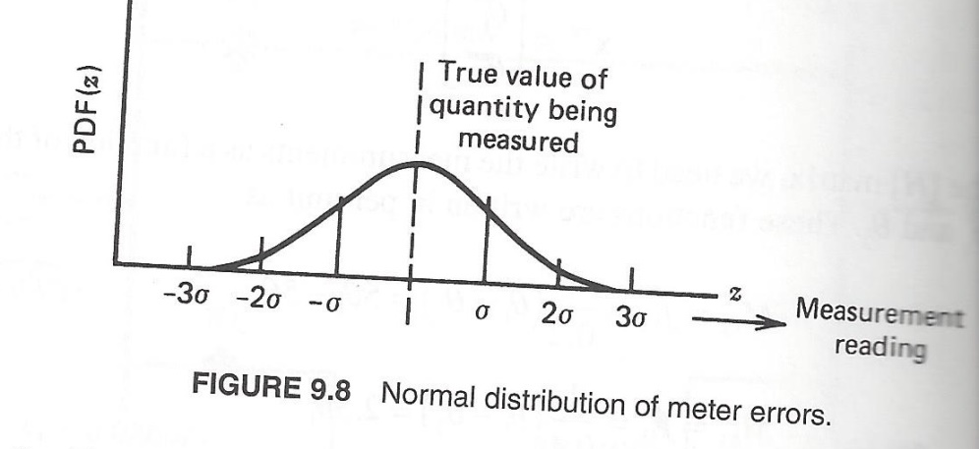
Assumed SE Measurement Accuracy
The assumed measurement standard deviations can have a significant impact on the resultant solution, or even whether the SE converges
The assumption is a Gaussian (normal) distribution of the error with no bias
18

Slide 20
SE Observability
In order to estimate all n states we need at least n measurements. However, where the measurements are located is also important, a topic known as observability
In order for a power system to be fully observable usually we need to have a measurement available no more than one bus away
At buses we need to have at least measurements on all the injections into the bus except one (including loads and gens)
Loads are usually flows on feeders, or the flow into a transmission to distribution transformer
Generators are sometimes just injections from the generator step-up transformer (GSU)
19

Slide 21
Pseudo Measurements
Pseudo measurements are used at buses in which there is no load or generation; that is, the net injection into the bus is know with high accuracy to be zero
In order to enforce the net power balance at a bus we need to include an explicit net injection measurement
To increase observability sometimes estimated values are used for loads, shunts and generator outputs
These “measurements” are represented as having a higher much standard deviation
20

Slide 22
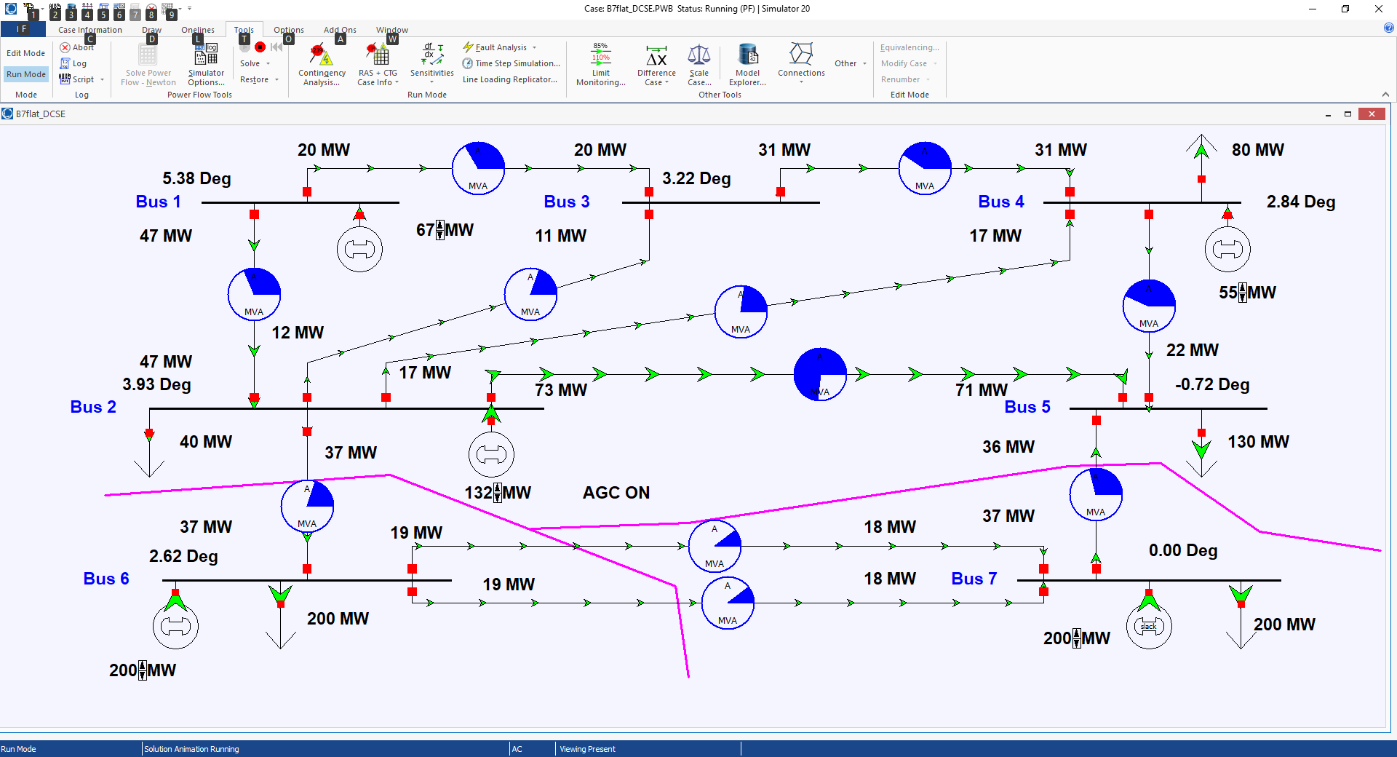
SE Observability Example
21

Slide 23
SE Bad Data Detection
The quality of the measurements available to an SE can vary widely, and sometimes the SE model itself is wrong. Causes include
Modeling Errors: perhaps the assumed system topology is incorrect, or the assumed parameters for a transmission line or transformer could be wrong
Data Errors: measurements may be incorrect because of in correct data specifications, like the CT ratios or even flipped positive and negative directions
Transducer Errors: the transductors may be failing or may have bias errors
Sampling Errors: SCADA does not read all values simultaneously and power systems are dynamic
22

Slide 24
SE Bad Data Detection
The challenge for SE is to determine when there is likely a bad measurement (or multiple ones), and then to determine the particular bad measurements
J(x) is random number, with a probability density function (PDF) known as a chi-squared distribution, χ²(K), where K is the degrees of freedom, K=m-n
It can be shown the expected mean for J(x) is K, with a standard deviation of
Values of J(x) outside of several standard deviations indicate possible bad measurements, with the measurement residuals used to track down the likely bad measurements
SE can be re-run without the bad measurements
23

Slide 25
QR Factorization
Used in SE since it handles ill-conditioned m by n matrices (with m >= n)
Can be used with sparse matrices
We will first split the R⁻¹ matrix
QR factorization represents the m by n H' matrix as with Q an m by m orthonormal matrix and U an upper triangular matrix (most books use Q R but we use U to avoid confusion with the previous R)
24

Slide 26
Orthonormal Matrices
The term orthogonal is used with vectors to indicate their dot product is zero (i.e., they are perpendicular to each other)
Orthonormal is used to indicate they are orthogonal and each has unit length (magnitude of 1)
The definition of an orthogonal matrix is Q^{T}Q = I
This implies its inverse always exists
Its determinant is 1
They can be used for transformations such as an angular rotation
25

Slide 27
QR Factorization
If then
But since Q is an orthonormal matrix,
Hence we have
Q is an m by m matrix
26

Slide 28
QR Factorization
When factored the U matrix (i.e., what most call the R matrix ) will be an m by n upper triangular matrix
Several methods are available including the Householder method and the Givens method
Givens is preferred when dealing with sparse matrices
A good reference is Gene H. Golub and Charles F. Van Loan, “Matrix Computations,” third edition, Johns Hopkins University Press, 1996
27

Slide 29
Givens Algorithm for Factoring a Matrix A
The Givens algorithm works by pre-multiplying the initial matrix, A, by a series of matrices and their transposes, starting with G₁G₁^{T}
If A is m by n, then each G is an m by m matrix
The algorithm proceeds column by column, sequentially zeroing out elements in the lower triangle of A, starting at the bottom of each column
If A is sparse, then we can take advantage of sparsity going up the column
28

