Slide 1
ECEN 615
Methods of Electric Power
Systems Analysis
Lecture 18: QR, Equivalents
Prof. Tom Overbye
Dept. of Electrical and Computer Engineering
Texas A&M University
overbye@tamu.edu

Slide 2
Announcements
Skim Chapters 3, 4 and 5
Starting reading Chapter 8
Homework 6 is due Thursday Nov 10

Slide 3
QR Factorization
Used in SE since it handles ill-conditioned m by n matrices (with m >= n)
Can be used with sparse matrices
We will first split the R⁻¹ matrix
QR factorization represents the m by n H' matrix as
with Q an m by m orthonormal matrix and U an upper triangular matrix (most books use Q R but we use U to avoid confusion with the previous R)
2

Slide 4
Orthonormal Matrices
The term orthogonal is used with vectors to indicate their dot product is zero (i.e., they are perpendicular to each other)
Orthonormal is used to indicate they are orthogonal and each has unit length (magnitude of 1)
The definition of an orthogonal matrix is Q^{T}Q = I
  This implies its inverse always exists
Its determinant is 1
They can be used for transformations such as an angular rotation
3

Slide 5
QR Factorization
If then
But since Q is an orthonormal matrix,
Hence we have
Q is an m by m
matrix
4

Slide 6
QR Factorization
When factored the U matrix (i.e., what most call the R matrix ) will be an m by n upper triangular matrix
Several methods are available including the Householder method and the Givens method
Givens is preferred when dealing with sparse matrices
A good reference is Gene H. Golub and Charles F. Van Loan, “Matrix Computations,” third edition, Johns Hopkins University Press, 1996
5

Slide 7
Givens Algorithm for Factoring a Matrix A
The Givens algorithm works by pre-multiplying the initial matrix, A, by a series of matrices and their transposes, starting with G₁G₁^{T}
  If A is m by n, then each G is an m by m matrix
The algorithm proceeds column by column, sequentially zeroing out elements in the lower triangle of A, starting at the bottom of each column
If A is sparse,
then we can take
advantage of
sparsity going up
the column
6

Slide 8
Givens Algorithm
To zero out element A[i,j], with i > j we first solve with a=A[k,j], b= A[i,j]
A numerically safe algorithm is
To zero out an element
we need a non-zero
pivot element in column j;
assume this row as k.
7

Slide 9
Givens G Matrix
The orthogonal G(i,k,θ) matrix is then
Premultiplication by G(i,k,θ)^{T} is a rotation by θ radians in the (i,k) coordinate plane
As noted, to zero out an
element we need a non-zero
pivot element in column j;
assume this row as k. Row
k here is the first non-zero
above row i.
8

Slide 10
Small Givens Example
Let
First we zero out A[4,1], a=1, b=2 giving s= 0.8944,
c=-0.4472
First start in column j=1; we will
zero out A[4,1] with i=4, k=2
9

Slide 11
Small Givens Example
Next zero out A[2,1] with a=4, b=-2.236, giving c= -0.8729, s=0.4880
Next zero out A[4,2] with a=5, b=-0.447, c=0.996, s=0.089
k=1 with A[k,j]=4
j=2, k=3 with A[k,j]=5
10

Slide 12
Small Givens Example
Next zero out A[3,2] with a=0.195, b=5.02, c=-0.039, s=0.999
Also we have
j=2, k=2 with A[k,j]=0.195
11

Slide 13
Start of Givens for SE Example
Starting with the H matrix we get
To zero out H'[5,1]=1 we have b=100, a=-1000,
giving c=0.995, s=0.0995
Here the column (j) is 1, while
i is 5 and k is 4.
12

Slide 14
Start of Givens for SE Example
Which gives
The next rotation would be to zero out element [4,1], continuing until all the elements in the lower triangle have been reduced
13

Slide 15
Givens Comments
For a full matrix, Givens is O(mn²) since each element in the lower triangle needs to be zeroed O(nm), and each operation is O(n)
Computation can be drastically reduced for a sparse matrix since we only need to zero out the elements that are initially non-zero, and any that become non-zero (i.e., the fills)
  Also, for each multiply we only need to deal with the nonzeros in the impacted row
Givens rotation is commonly used to solve the SE
14

Slide 16
Power System Equivalents
No electric grid model is ever going to completely represent a real electric grid
  “All models are wrong but some models are useful”
A key modeling consideration is how much of the electric grid to represent
  For large-scale systems the distribution system is usually equivalenced at some point; this has few system level ramifications if it is radial; if it is networked then there are potential issues
  At the transmission level either the full interconnect is represented or it is equivalenced
  In an SE model in large grids (like the Eastern Interconnect) it is always an electrical equivalent
15

Slide 17
Kron Reduction, Ward Equivalents
For decades power system network models have been equivalenced using the approach originally presented by J.B. Ward in 1949 AIEE paper “Equivalent Circuits for Power-Flow Studies”
  Paper’s single reference is to 1939 book by Gabriel Kron, so this is also known as Kron’s reduction or a Ward equivalent
System buses are partitioned into a study system (s) to be retained and an external system (e) to be eliminated; buses in study system that connect to the external are known as boundary buses
16

Slide 18
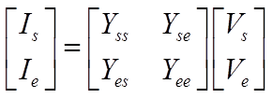

Ward Equivalents
The Ward approach is based on the below relationship
No impact on study, non-boundary buses
Equivalent is created by doing a partial factorization of the Y_{bus}
  Computationally efficient
17

Slide 19
Other Types of Equivalents
There are many different methods available for creating power system equivalents
  A classic paper is by S. Deckmann, et. al., “Studies on Power System Load Flow Equivalencing,” IEEE Transactions Power App. And Syst., Nov/Dec 1980
  Companion paper covers numerical testing of equivalents
The major equivalencing types are
  Ward-Type Equivalence: this is what we’ll be covering, with the major differences associated with how the generator buses and equivalent loads are represented
  REI Equivalents: All boundary buses connect to one “REI” bus
  Linearized Methods: Linearize about an operating point
  Others: PTDF-based, backbone type
18

Slide 20
Equivalent System Properties
An equivalent is usually created from a larger model
  In the Eastern Interconnect there are full grid models that are used for wide-area planning, these are equivalenced for real-time usage or more specialized studies
The equivalent is usually smaller and less detailed
  Solves quicker
  Requires less storage
  Requires less up-to-date data
Equivalences contain fictitious elements
  This can make modeling/updating more difficult
The equivalent only approximates the behavior of the original
19

Slide 21
Study vs External System
The key decision in creating an equivalent is to divide the system into a study portion that is represented in detail, and an external portion that is represented by the equivalent
The two systems are joined at boundary buses, which are part of the study subsystem
How this is done is application specific; for example:
  for real-time use it does not make sense to retain significant portions of the grid for which there is no real-time information
  for contingency analysis the impact of the contingency is localized
  for planning the new system additions have localized impacts
20

Slide 22
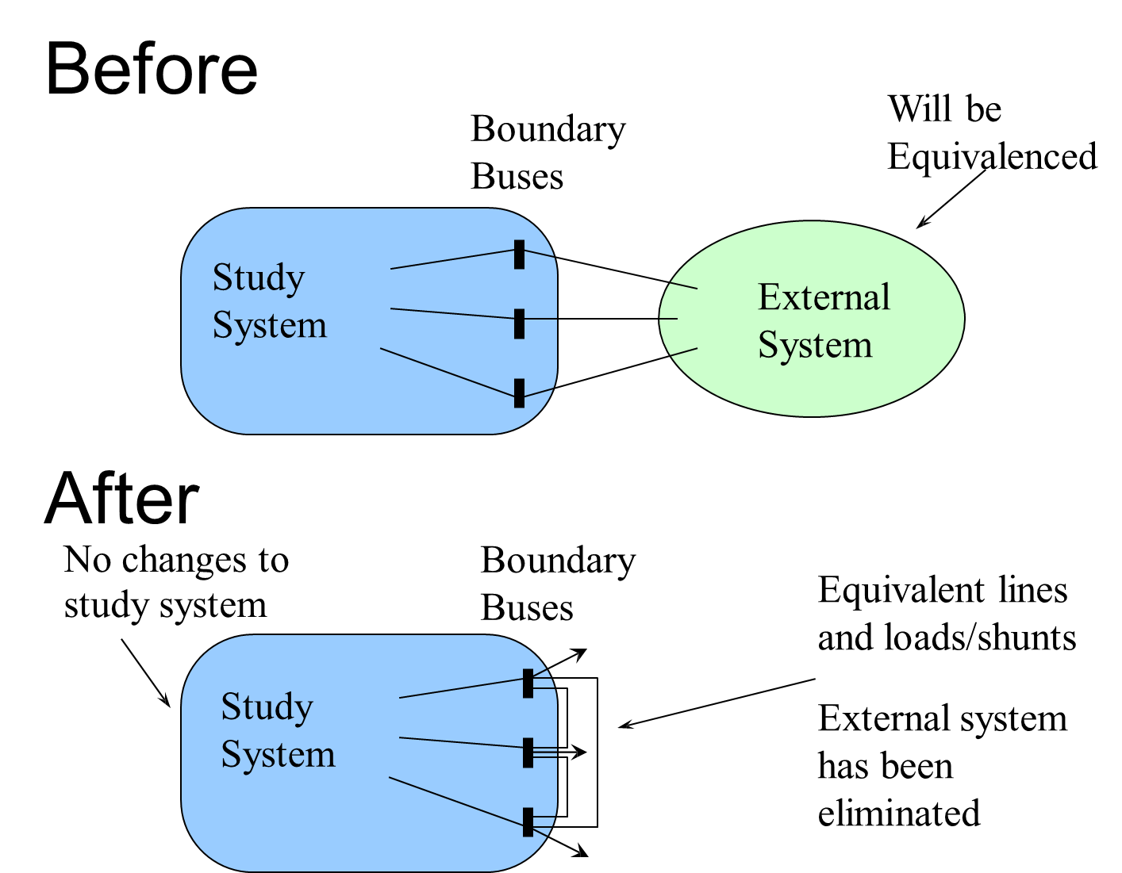
Ward Type Equivalencing
21

Slide 23
Ward Type Equivalencing Considerations
The Ward equivalent is calculated by doing a partial factorization of the Y_{bus}
  The equivalent buses are numbered before the study buses
  As the equivalent buses are eliminated their first neighbors are joined together
  At the end, many of the boundary buses are connected
  This can GREATLY decrease the sparsity of the system
  Buses with different voltages can be directly connected
22

Slide 24
Ward Type Equivalencing Considerations
At the end of the Ward process often many of the new equivalent lines have high impedances
  Often there is an impedance threshold, and lines with impedances above this value are eliminated
The equivalent lines may have unusual values, including negative resistances
Load and generation is represented as equivalent current injections or shunts; sometimes these values are converted back to constant power
Consideration needs to be given to loss of reactive support; the equivalent embeds the present load and generation values
23

Slide 25
B7Flat_Eqv Example
In this example the B7Flat_Eqv case is reduced, eliminating buses 1, 3 and 4. The study system is then 2, 5, 6, 7, with buses 2 and 5 the boundary buses
For ease of comparison
system is modeled
unloaded
24

Slide 26
B7Flat_Eqv Example
Original Y_{bus}
25

Slide 27
B7Flat_Eqv Example
Note Y_{es}=Y_{se}'
if no phase
shifters
26

Slide 28
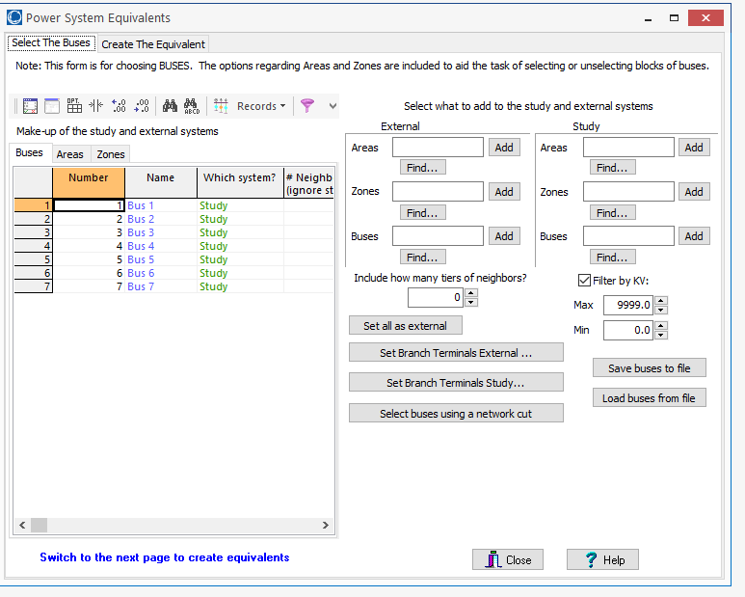
Equivalencing in PowerWorld
Open a case and solve it; then select Edit Mode, Tools, Equivalencing; this displays the Power System Equivalents Form
Next step is then to divide the buses into the study system and
the external system; buses can be loaded from a text file as well
27

Slide 29
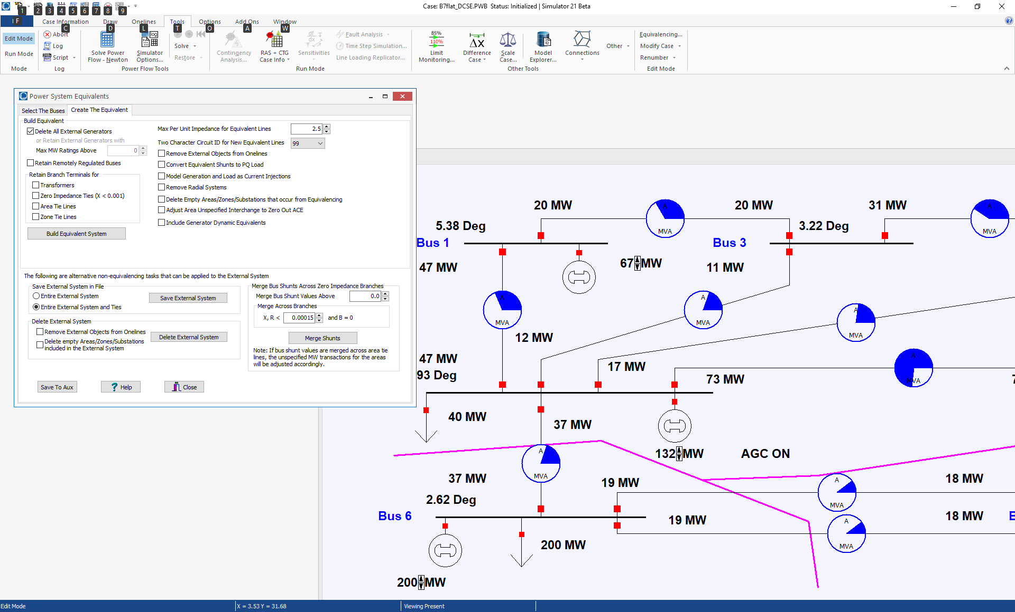
Equivalencing in PowerWorld
Then go to the Create The Equivalent page, select the desired options and select Build Equivalent System
Maximum
impedance
lines to retain
’99’ or ‘EQ’
are common
circuit values
for equivalent
lines
Click to create the equivalent
Removes equivalenced objects from the oneline
28

Slide 30
Small System Equivalent Example
Example shows the creation of an equivalent for Aggieland37 example
First example is simple, just removing
WHITE138 (bus 3); note TEXAS138 is now directly joined to RELLIS138..
Case is Aggieland37
29

Slide 31
Small System Equivalent Example
Only bus 3 was removed; the new equivalent line was auto-inserted.
Don’t save the equivalent with the same name as the original, unless you want to lose the
original
30

Slide 32
Small System Equivalent Example
Now remove buses at WHITE138 and TEXAS and RELLIS (1, 3, 12, 40, 41, 44); set Max Per Unit Impedance for
Equivalent Lines to 99
(per unit) to retain all lines.
Again use the auto-insert to
show the equivalent lines.
31

Slide 33
Small System Equivalent Example
Now set the Max Per Unit Impedance for Equivalent Lines to 2.5.
32

Slide 34
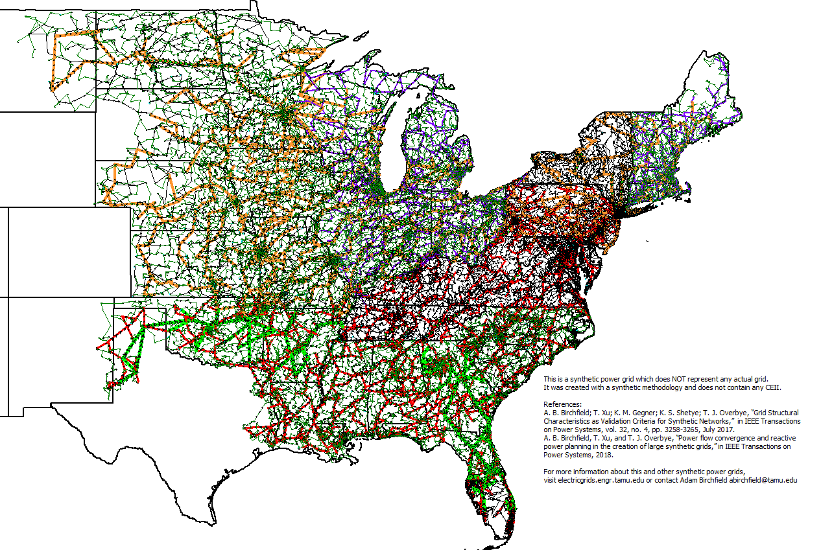
Large System Example: 70K Case
Original System has 70,000 buses and 71,343 lines
33

Slide 35
Large System Example: 70K Case
Just retain the Oklahoma Area; now 1591 buses and 1745 lines (deleting ones above 2.5 pu impedance)
When equivalencing so many buses it is best to first close the oneline. Then reopen the oneline and select Onelines, List Display, Unlinked Display Objects and use the button on this display to delete them.
34

Slide 36
Grid Equivalent Examples
A 2016 EI case had about 350 lines with a circuit ID of ’99’ and about 60 with ‘EQ’ (out of a total of 102,000)
  Both WECC and the EI use ’99’ or ‘EQ’ circuit IDs to indicate equivalent lines
  One would expect few equivalent lines in interconnect wide models
A 12 year old EI case had about 1633 lines with a circuit ID of ’99’ and 400 with ‘EQ’ (out of a total of 65673)
A 12 year old case with about 5000 buses and 5000 lines had 600 equivalent lines
35

