Slide 1
ECEN 615 Methods of Electric Power Systems Analysis
Lecture 2: Power Systems Overview
Prof. Tom Overbye
Dept. of Electrical and Computer Engineering
Texas A&M University
overbye@tamu.edu

Slide 2
Announcements
Start reading Chapters 1 to 3 from the book (mostly background material)
Exam 1 is moved to Oct 13 (Oct 10 and 11 are fall break)
We’ll be using PowerWorld Simulator fairly extensively in this class, both the educational and professional versions
Download the free 42 bus educational versions of PowerWorld Simulator at
https://www.powerworld.com/gloveroverbyesarma

Slide 3
The Technical Literature
As a graduate student you should get in the habit of reading many technical papers, including all the ones mentioned in these notes
Papers are divided into 1) journal papers and 2) conference papers, with journal papers usually undergoing more review and of high quality
There are LOTs of exceptions
Key journals in our area are from IEEE Power and Energy Society (PES); PSCC is a top conference
I read papers by looking at 1) title, 2) abstract, 3) summary, 4) results, 5) intro, 6) the rest; many papers never make it beyond step 1 or 2.
You should also be reading a variety of books, not use ones directly in the electric power area

Slide 4
Learning to Write Well
Writing is a key skill for engineers, especially for students with advanced degrees
If you write poorly people will ignore your work!
If you are not currently a good technical writer, use your time at TAMU to learn how to write well!!
There are lots of good resources available to help you improve your writing. Books I’ve found helpful are
Zinsser, “On Writing Well: The Classic Guide to Writing Nonfiction”
Strunk and White, “The Elements of Style”
Alred, Oliu, Brusaw, “The Handbook of Technical Writing”
TAMU Writing Center, writingcenter.tamu.edu/

Slide 5
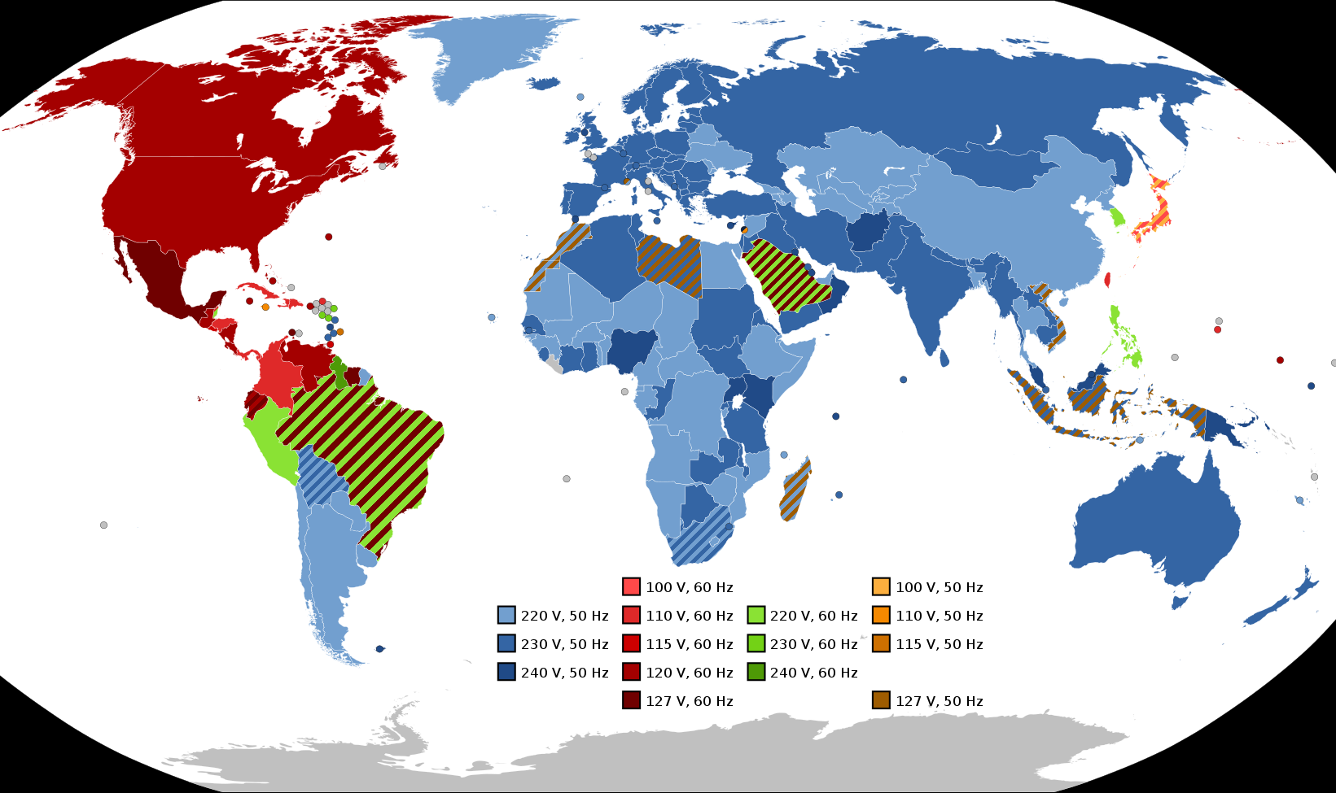
Electric Frequencies and Residential Voltages Worldwide
In the US the supplied residential voltage should be 120 V, with a 5% range allowed
Image Source: en.wikipedia.org/wiki/Mains_electricity_by_country#/media/File:World_Map_of_Mains_Voltages_and_Frequencies,_Detailed.svg

Slide 6
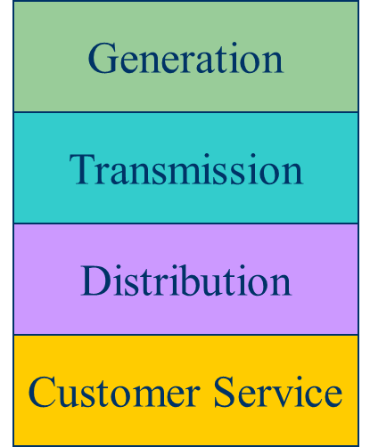
Historical Electric Utility Organization
Traditionally electric utilities were vertical monopolies; within a particular geographic market, they had an exclusive franchise
This has changed in many places around the country
In return for this exclusive franchise, the utility had the obligation to serve all
existing and future customers at rates determined jointly by utility and regulators.

Slide 7
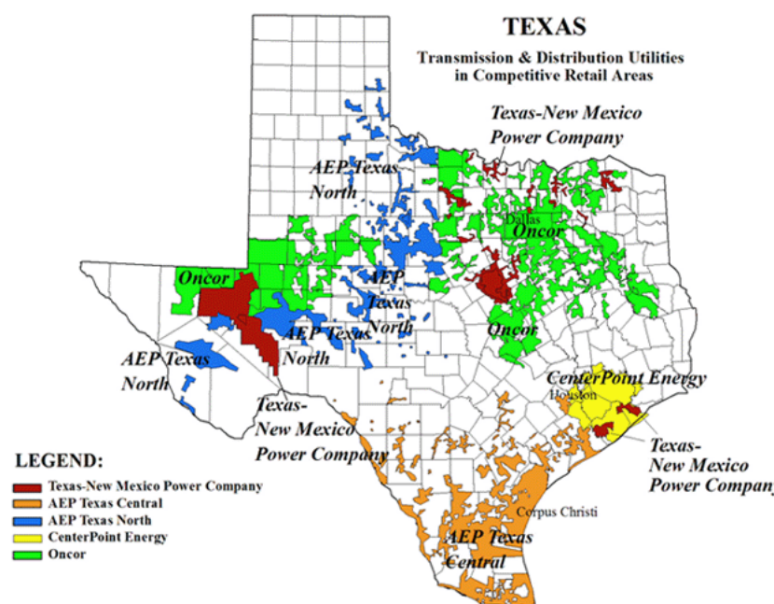
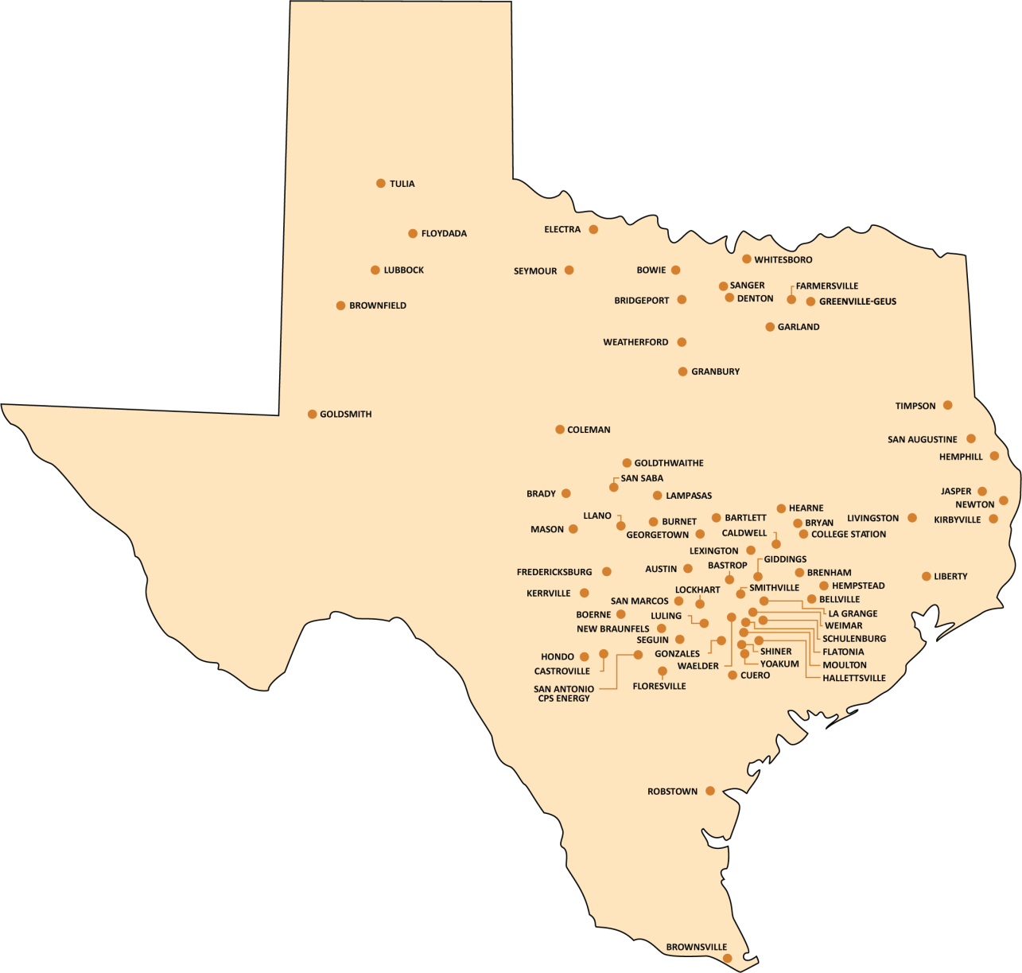
Electric Utilities in Texas (IOUs and Municipals)

Slide 8
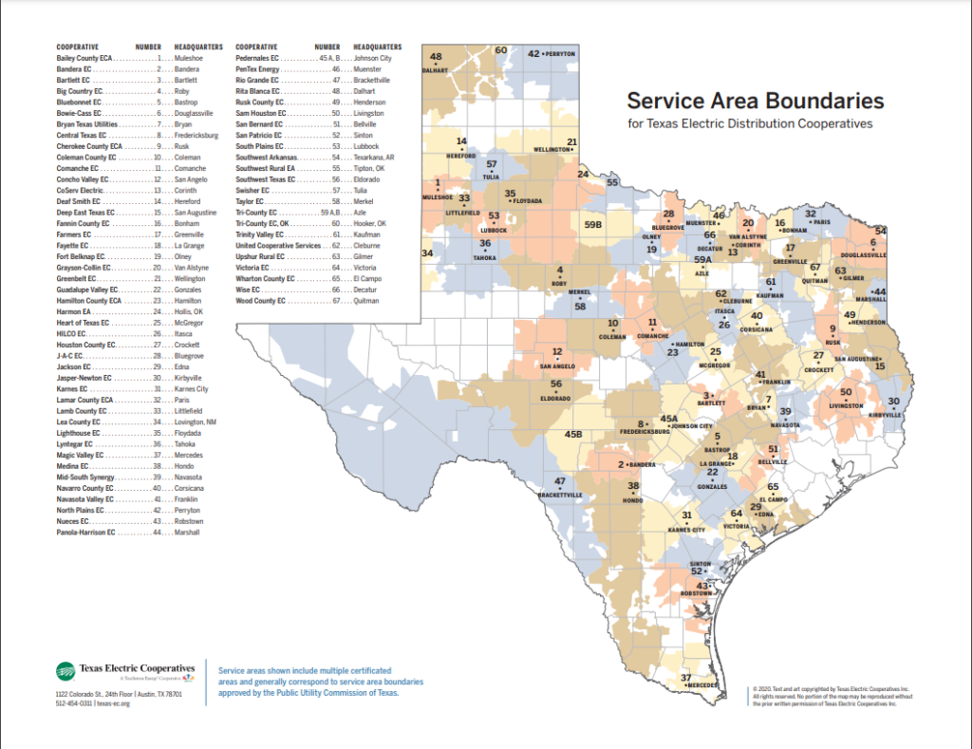
Electric Utilities in Texas (Coops)

Slide 9
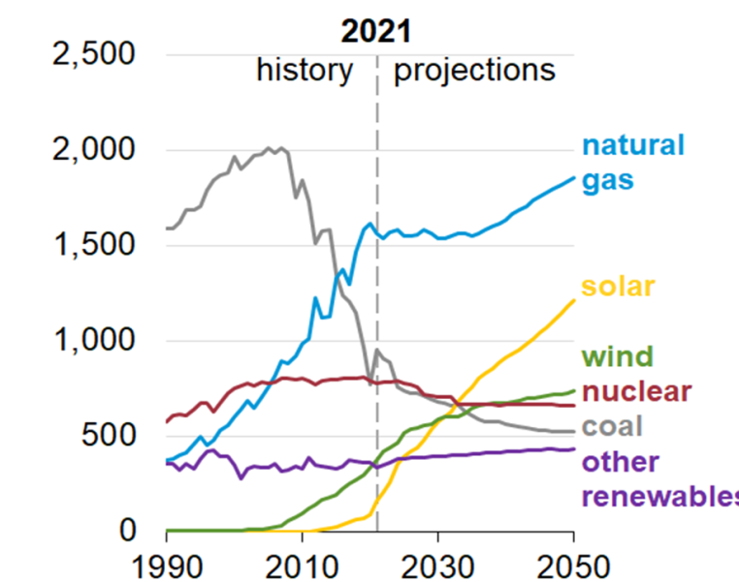
Generation
Natural Gas (38.4%) and coal (21.3%) are most common sources, followed by nuclear (18.6%), wind (9.7), hydro (6.4%), solar (4.2%)
Wood is 0.9%, geothermal 0.4%
Coal was at least 50% of the total up to 2007
New construction mostly wind, solar and natural gas (with wind and solar energy costs now quite low)
US Generator Capacity Additions
Sources are by energy (not capacity), 4/2021-3/2022; source US EIA

Slide 10
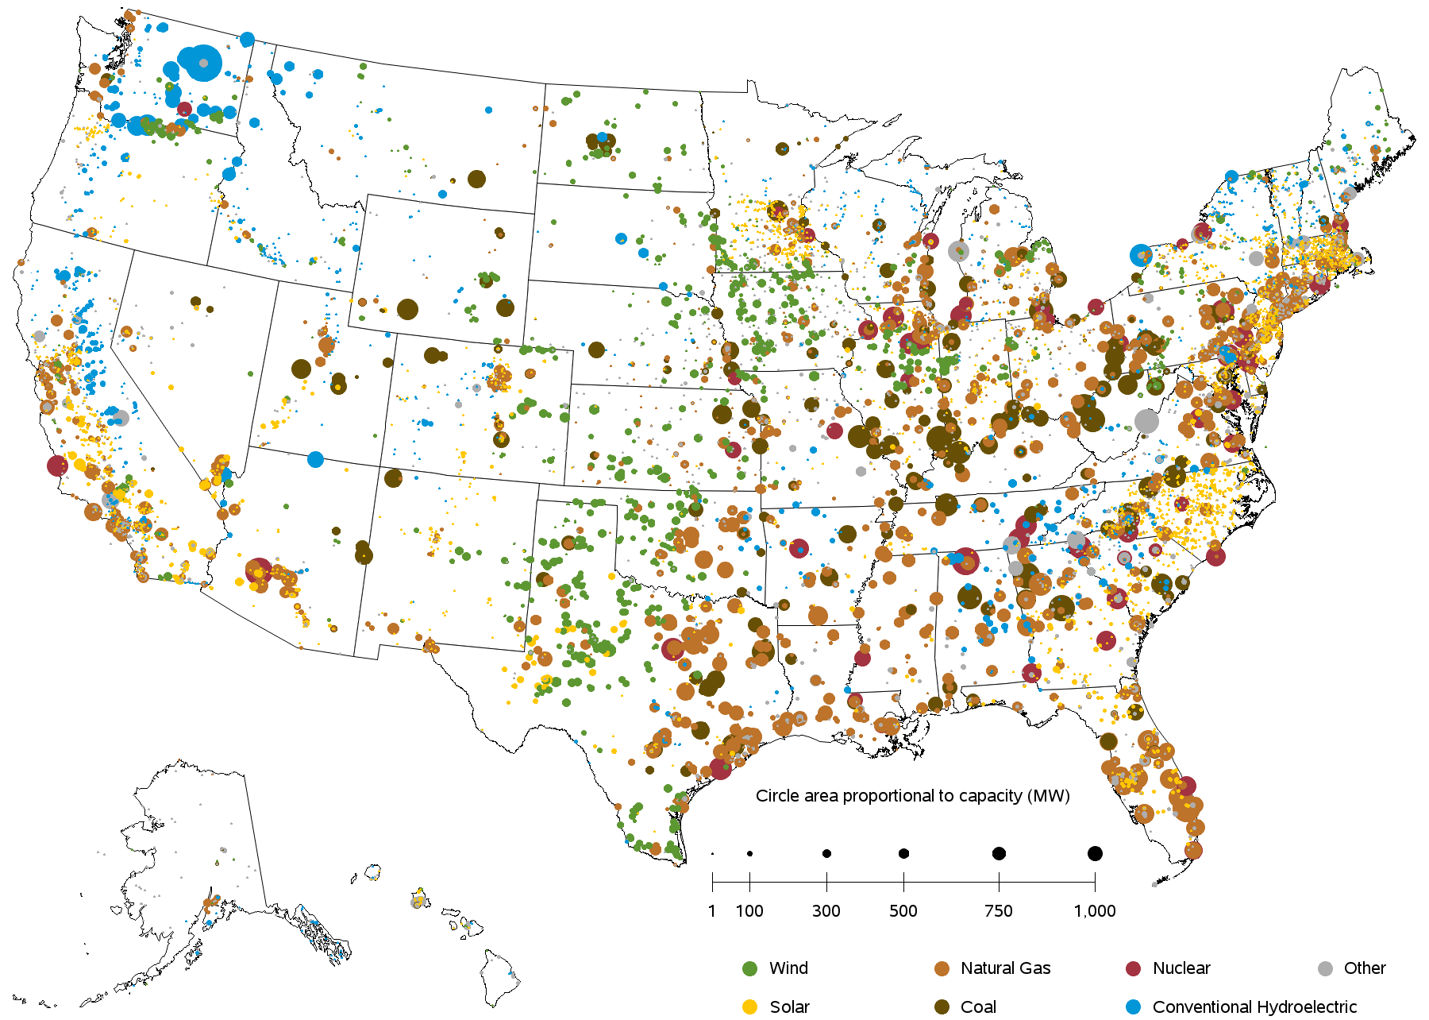
US Generation (July 2021) by Fuel Type
Image Source: www.eia.gov/electricity/data/eia860m/

Slide 11
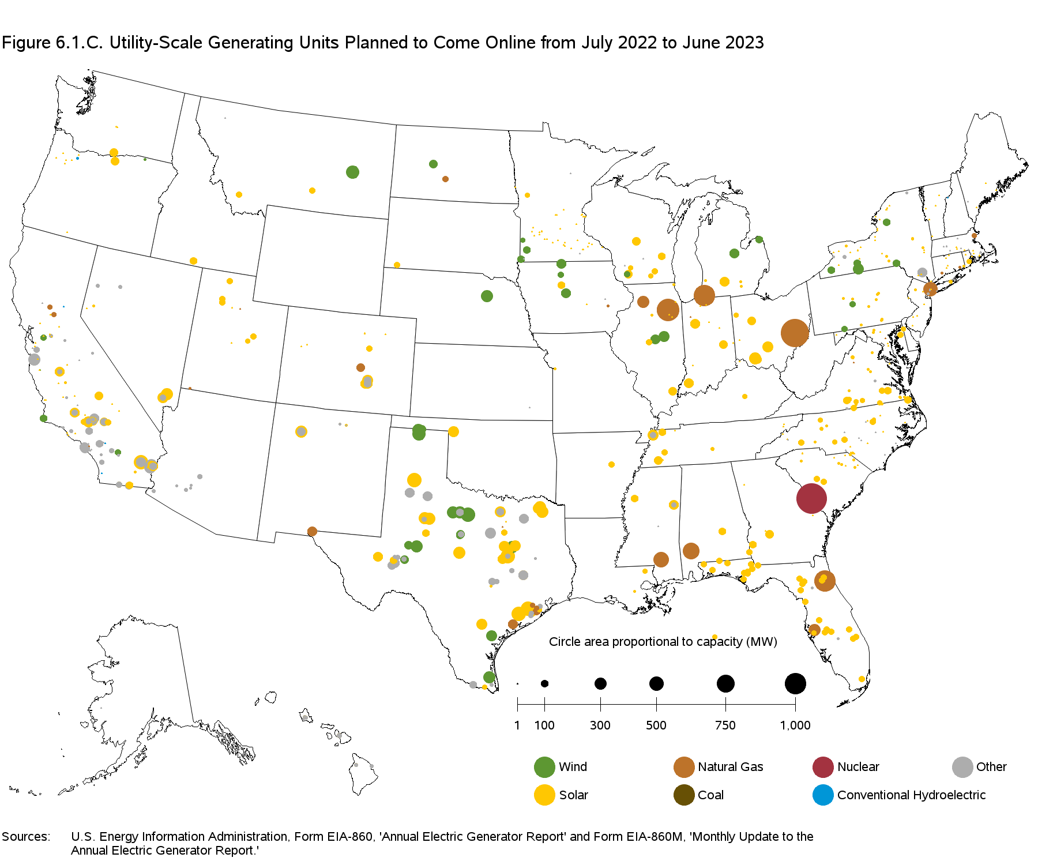
Planned New Generation July 2022 to June 2023
Sources: EIA Electricity Monthly

Slide 12
The World: Electricity Consumption by Source

Slide 13
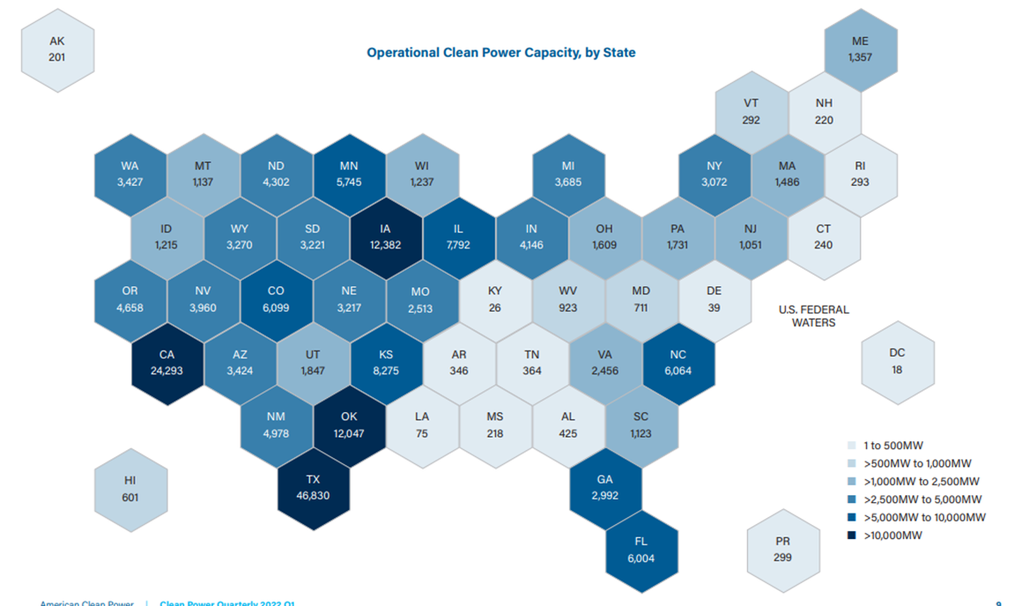
US Wind and Solar Capacity by State
Total US capacity at the end of 2021 was about 139 GW of wind and 63 GW of solar (compared to a total US capacity of about 1000 GW)
Source: Clean Power Quarterly, 1st Quarter 2022

Slide 14
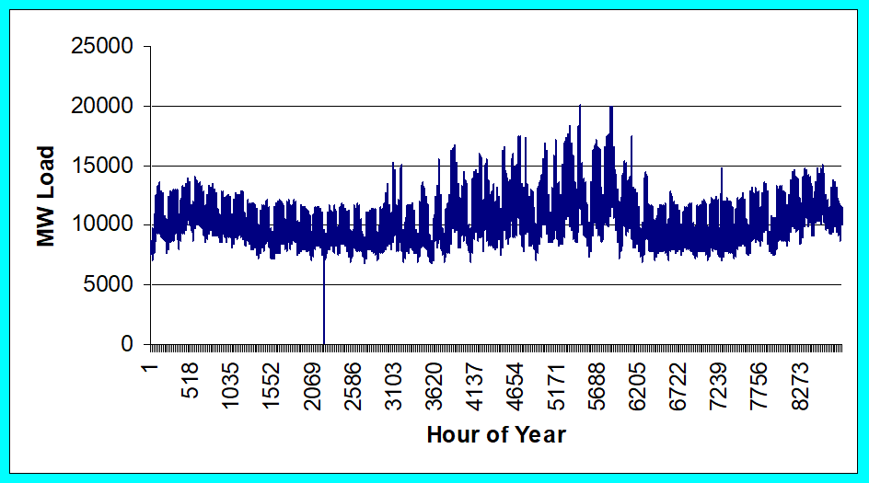
Loads
Can range in size from less than one watt to 10’s of MW.
Loads are usually aggregated.
The aggregate load changes with time, with strong daily, weekly and seasonal cycles.
ComEd Yearly Load

Slide 15
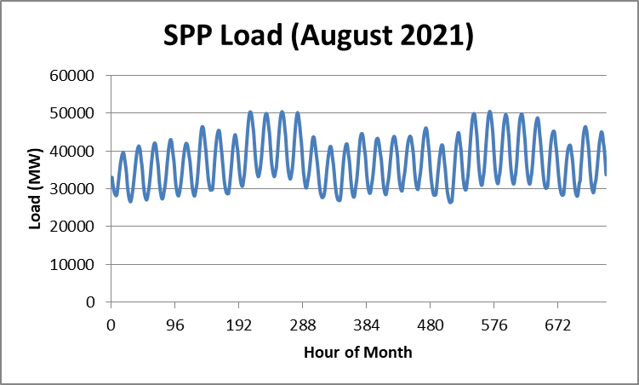
Example: Southwest Power Pool Monthly Load
SPP Load Data Source: marketplace.spp.org

Slide 16
Load Models
Ultimate goal is to supply loads with electricity at constant frequency and voltage
Electrical characteristics of individual loads matter, but usually they can only be estimated
actual loads are constantly changing, consisting of a large number of individual devices
only limited network observability of load characteristics
Aggregate models are typically used for analysis
Two common models
constant power: S_{i} = P_{i} + jQ_{i}
constant impedance: S_{i} = |V|² / Z_{i}
The ZIP model combines constant impedance, current and power (P)

Slide 17
Transmission and Distribution
Goal is to move electric power from generation to load with low losses.
Less losses at higher voltages (S=VI* and I²R losses), but more difficult to insulate.
Typical high voltage transmission voltages are 765, 500, 345, 230, 161, 138 and 69 kV.
Lower voltage lines are used for distribution (12.4 or 13.8 kV).
Typical losses are about 3 to 5% in transmission and 10 to 15% in the distribution system.

Slide 18
Transmission & Distribution
Transmission
networked connections
power can be supplied from multiple sources
typically higher voltages, above 100 kV
mostly overhead, with some underground in urban areas
Often source of large-scale blackouts
Distribution
radial connections
power moves in one direction only
typically lower voltages, below 100 kV
the source of most black-outs, but these are local
Most new construction is underground, especially in suburban and urban locations

Slide 19
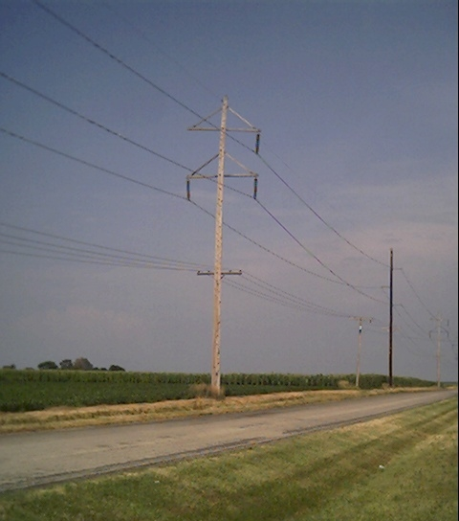
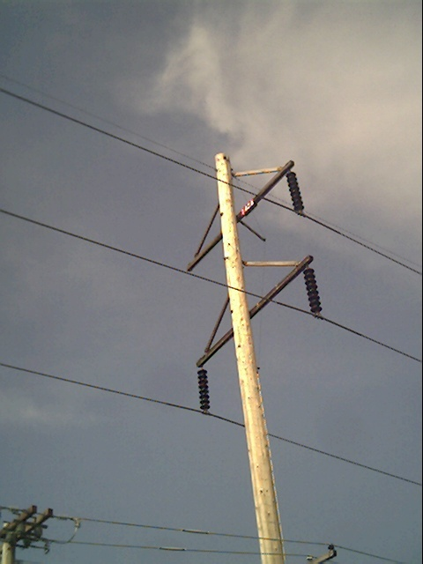
Three Phase Transmission Line

Slide 20
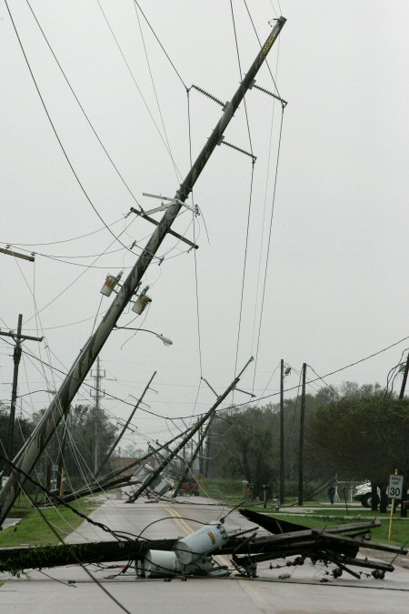
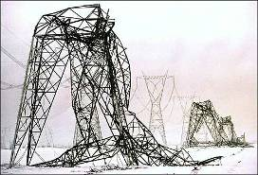
Transmission Lines and the Elements
Quebec Ice Storm
Hurricane Ike in Beaumont, Tx

Slide 21
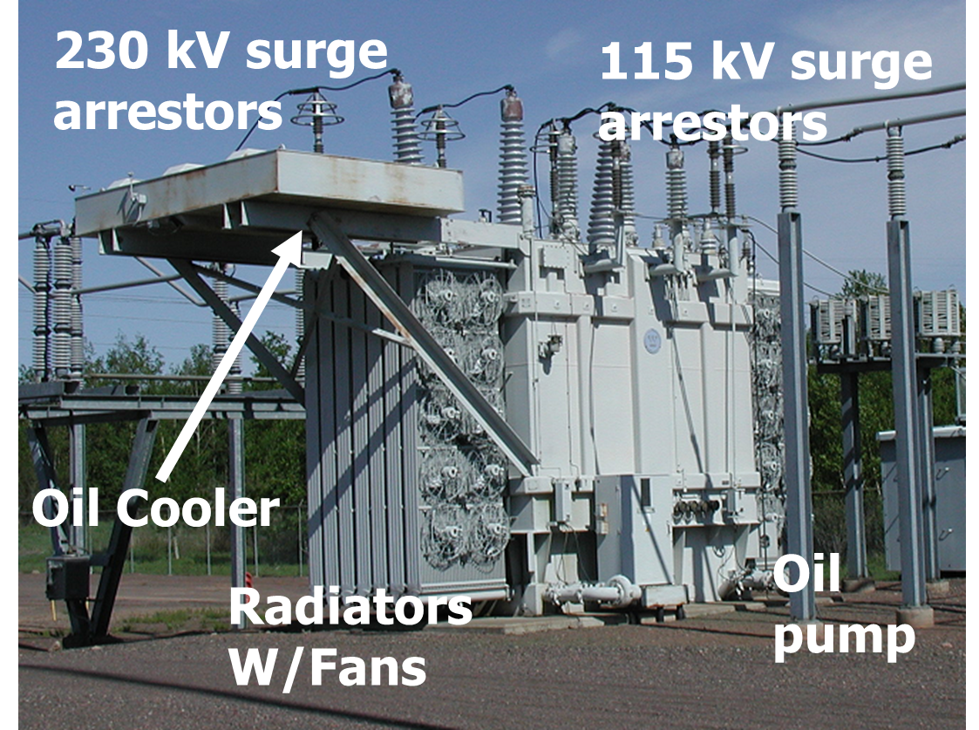
Transformers
Transformers provide an easily means for changing ac voltage levels
Power flow through transformers is bi-directional
Heating is a major concern that can quickly lead to loss of transformer life (and occasionally explosions!)
High voltage transformers (say 230 kV and up) are large, heavy, and difficult to replace

Slide 22
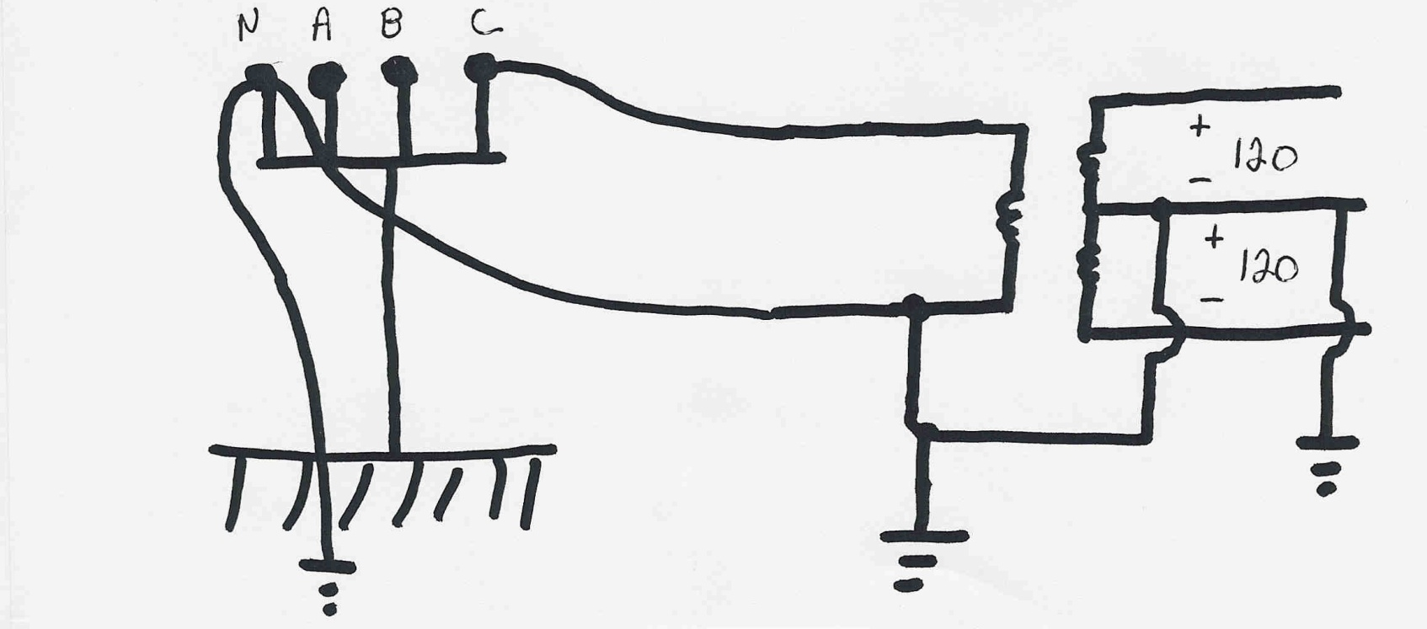
Residential Distribution Transformers
Residential single phase electric service uses a center tapped transformer to provide 240/120 volt service; a separate ground is used for safety

Slide 23
Per Unit Calculations
A key problem in analyzing power systems is the large number of transformers.
It would be very difficult to continually have to refer impedances to the different sides of the transformers
This problem is avoided by a normalization of all variables.
This normalization is known as per unit analysis
This is covered in ECEN 460; slides from 2017 are available on my website at overbye.engr.tamu.edu/course-2/

Slide 24
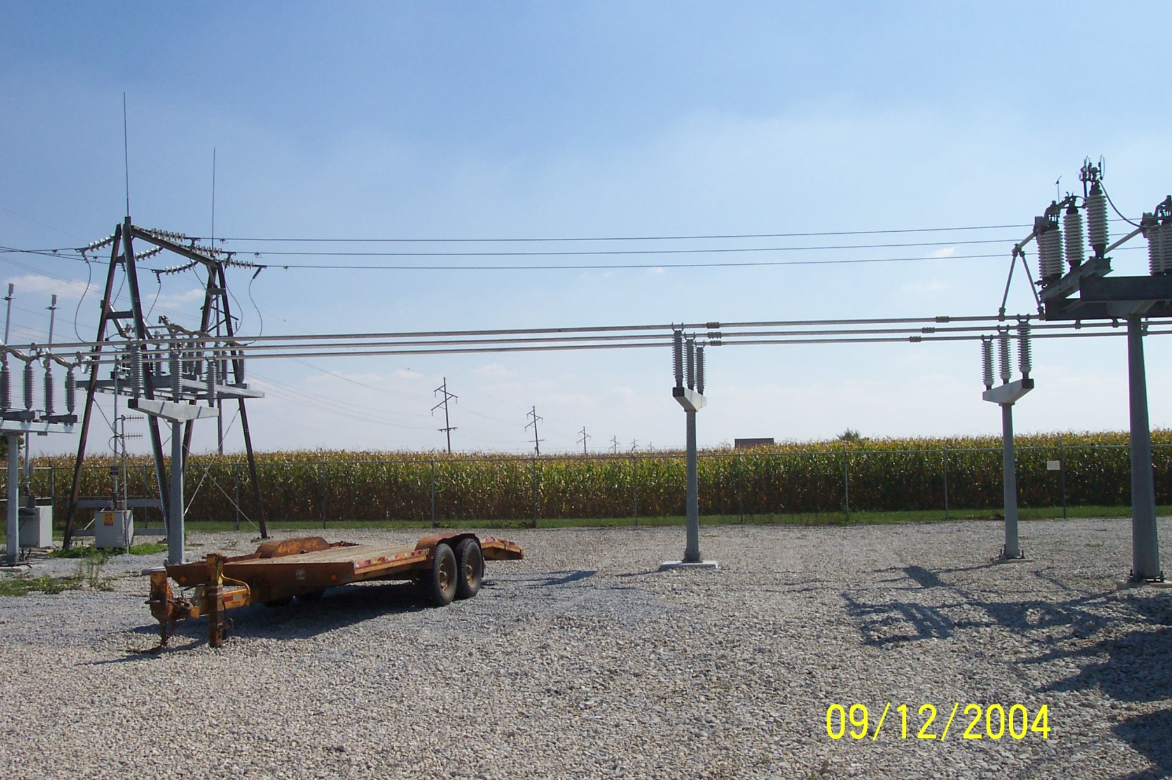
Components Join Together at a Bus

Slide 25
Energy Economics
Electric generating technologies involve a tradeoff between fixed costs (costs to build them) and operating costs
Nuclear and solar high fixed costs, but low operating costs (though cost of solar has decreased substantially recently)
Natural gas/oil have low fixed costs but can have higher operating costs (dependent upon fuel prices)
Coal, wind, hydro are in between
Also the units capacity factor is important to determining the ultimate cost of electricity

Slide 26
Natural Gas Prices 1997 to 2022
Marginal cost for natural gas fired electricity price
in $/MWh is about 7-10 times gas price; Henry Hub is a gas pipeline located in Erath, Louisiana.
https://www.eia.gov/dnav/ng/hist/rngwhhdW.htm

Slide 27
Average Cost of Small Residential Solar
This does not include tax credits; individual prices do vary of course.
Image source: homeguide.com/costs/solar-panel-cost

Slide 28
Economies of Scale with Renewable Generation
Large-scale electric grids developed because of the economies of scale with generation
It made more sense economically to have large generators further from the load rather than everyone having a generator at their house
This has partially changed with renewable generation, but perhaps less than people realize
Larger-scale wind is much more cost effective than smaller turbines
With solar the issue is more complicated
Utility scale solar tends to be much less expensive (see right image)
Image source: www.seia.org/research-resources/solar-market-insight-report-2022-q2

Slide 29
Solar Economies of Scale: Installations by Type
This rapid growth solar is causing modifications to some of the techniques that we’ll be talking about in 615
Image source: ww.seia.org/solar-industry-research-data

Slide 30
Brief History of Electric Power
First real practical uses of electricity began with the telegraph (1860's) and then arc lighting in the 1870’s
Early 1880’s – Edison introduced Pearl Street dc system in Manhattan supplying 59 customers
1884 – Sprague produces practical dc motor
1885 – invention of transformer
Mid 1880’s – Westinghouse/Tesla introduce rival ac system
Late 1880’s – Tesla invents ac induction motor
1893 – Three-phase transmission line at 2.3 kV

Slide 31
History, cont’d
1896 – ac lines deliver electricity from hydro generation at Niagara Falls to Buffalo, 20 miles away; also 30kV line in Germany
Early 1900’s – Private utilities supply all customers in area (city); recognized as a natural monopoly; states step in to begin regulation
By 1920’s – Large interstate holding companies control most electricity systems
1935 – Congress passes Public Utility Holding Company Act to establish national regulation, breaking up large interstate utilities (repealed 2005)
This gave rise to electric utilities that only operated in one state
1935/6 – Rural Electrification Act brought electricity to rural areas
1930’s – Electric utilities established as vertical monopolies

