Slide 1
ECEN 615
Methods of Electric Power
Systems Analysis
Lecture 20: Voltage Stability, Economic Dispatch, Unit Commitment
Prof. Tom Overbye
Dept. of Electrical and Computer Engineering
Texas A&M University
overbye@tamu.edu

Slide 2
Announcements
Starting reading Chapter 8
Homework 6 is now due on Thursday Nov 17 but it counts as two regular homeworks.
Economic dispatch is covered in Chapter 3, and Unit Commitment is in Chapter 4
We’ll be hosting the 2022 Resilient Electric Consortium of North America Symposium (RECONS 2022) on Thursday Nov 17, 2022 at CIR. All 615 students are invited (with a regular class at 8am that day)
Register here: smartgridcenter.tamu.edu/index.php/recons-2022/
  For free registration use the code TAMURECONS22
1

Slide 3
Power System Voltage Stability
Voltage Stability: The ability to maintain system voltage so that both power and voltage are controllable. System voltage responds as expected (i.e., an increase in load causes proportional decrease in voltage).
Voltage Instability: Inability to maintain system voltage. System voltage and/or power become uncontrollable. System voltage does not respond as expected.
Voltage Collapse: Process by which voltage instability leads to unacceptably low voltages in a significant portion of the system; typically results in loss of system load.
2

Slide 4
Voltage Stability
Two good references are
  P. Kundur, et. al., “Definitions and Classification of Power System Stability,” IEEE Trans. on Power Systems, pp. 1387-1401, August 2004.
  T. Van Cutsem, “Voltage Instability: Phenomena, Countermeasures, and Analysis Methods,” Proc. IEEE, February 2000, pp. 208-227.
Classified by either size of disturbance or duration
  Small or large disturbance: small disturbance is just perturbations about an equilibrium point (power flow)
  Short-term (several seconds) or long-term (many seconds to minutes) (covered in ECEN 667)
3

Slide 5
Small Disturbance Voltage Stability
Small disturbance voltage stability can be assessed using a power flow (maximum loadability)
Depending on the assumed load model, the power flow can have multiple (or no) solutions
PV curve is created by plotting power versus voltage
Assume V_{slack}=1.0
Where B is the line susceptance =-10,
V∠θ is the load voltage
4

Slide 6
Small Disturbance Voltage Stability
Question: how do the power flow solutions vary as the load is changed?
A Solution: Calculate a series of power flow solutions for various load levels and see how they change
Power flow Jacobian
5

Slide 7
Maximum Loadability When Power Flow Jacobian is Singular
An important paper considering this was by Sauer and Pai from IEEE Trans. Power Systems in Nov 1990, “Power system steady-state stability and the load-flow Jacobian”
Other earlier papers were looking at the characteristics of multiple power flow solutions
The power flow Jacobian depends on the assumed load model (we’ll see the impact in a few slides)
6

Slide 8
Small Disturbance Voltage Collapse
At constant frequency (e.g., 60 Hz) the complex power transferred down a transmission line is S=VI*
  V is phasor voltage, I is phasor current
  This is the reason for using a high voltage grid
Line real power losses are given by RI² and reactive power losses by XI²
  R is the line’s resistance, and X its reactance; for a high voltage line X >> R
Increased reactive power tends to drive down the voltage, which increases the current, which further increases the reactive power losses
7

Slide 9
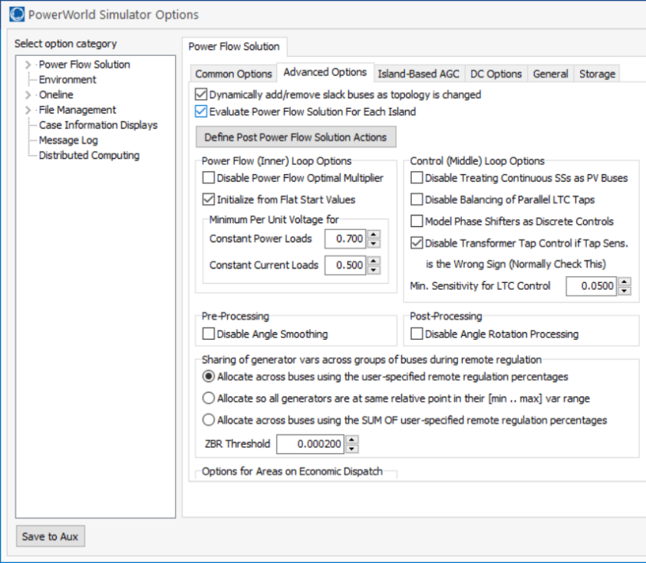
PowerWorld Two Bus Example
Commercial power flow software usually auto converts constant power loads at low voltages; set these fields to zero to disable this conversion
8

Slide 10
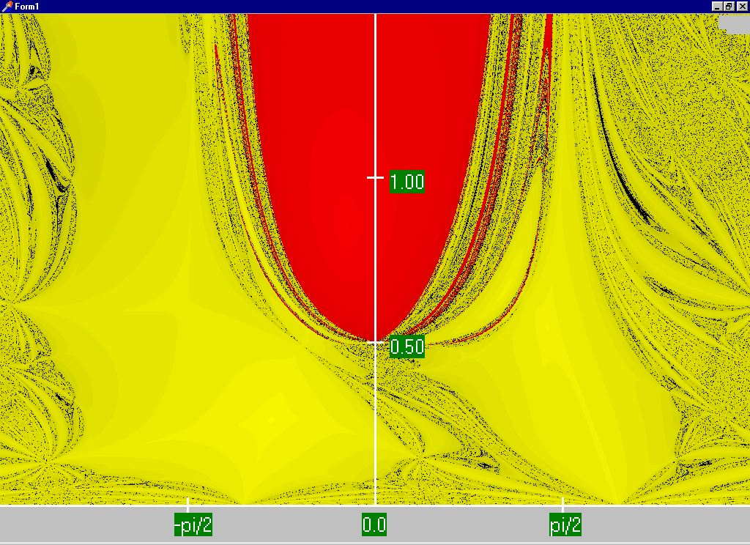
Power Flow Region of Convergence
Convergence
regions with
P=100 MW,
Q=0 Mvar
9

Slide 11
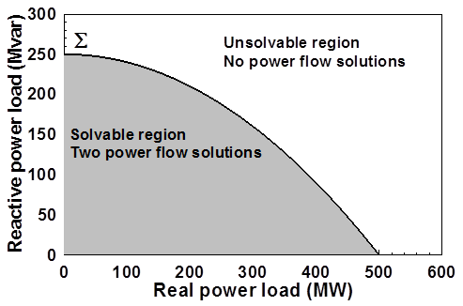
Load Parameter Space Representation
With a constant power model there is a maximum loadability surface, Σ
  Defined as point in which the power flow Jacobian is singular
  For the lossless two bus system it can be determined as
10

Slide 12
Load Model Impact
With a static load model regardless of the voltage dependency the same PV curve is traced
  But whether a point of maximum loadability exists depends on the assumed load model
    If voltage exponent is > 1 then multiple solutions do not exist (see B.C. Lesieutre, P.W. Sauer and M.A. Pai “Sufficient conditions on static load models for network solvability,”NAPS 1992, pp. 262-271)
Change load to constant impedance; hence it becomes a linear model
11

Slide 13
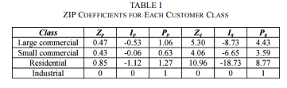
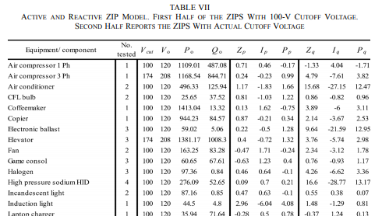
ZIP Model Coefficients
One popular static load model is the ZIP; lots of papers on the “correct” amount of each type
Table 1 from M. Diaz-Aguilo, et. al., “Field-Validated Load Model for the Analysis of CVR in Distribution Secondary Networks: Energy Conservation,” IEEE Trans. Power Delivery, Oct. 2013
12
Table 7 from A, Bokhari, et. al., “Experimental Determination of the ZIP Coefficients for Modern Residential, Commercial, and Industrial Loads,” IEEE Trans. Power Delivery, June. 2014

Slide 14
Application: Conservation Voltage Reduction (CVR)
If the “steady-state” load has a true dependence on voltage, then a change (usually a reduction) in the voltage should result in a total decrease in energy consumption
If an “optimal” voltage could be determined, then this could result in a net energy savings
Some challenges are 1) the voltage profile across a feeder is not constant, 2) the load composition is constantly changing, 3) a decrease in power consumption might result in a decrease in useable output from the load, and 4) loads are dynamic and an initial decrease might be balanced by a later increase
13

Slide 15
Determining a Metric to Voltage Collapse
The goal of much of the voltage stability work was to determine an easy to calculate metric (or metrics) of the current operating point to voltage collapse
  PV and QV curves (or some combination) can determine such a metric along a particular path
  Goal was to have a path independent metric.
  The closest boundary point was considered,
  but this could be quite misleading
  if the system was not going to
  move in that direction
  Any linearization about the current operating point (i.e., the Jacobian) does not consider important nonlinearities like generators hitting their reactive power limits
14

Slide 16
Determining a Metric to Voltage Collapse
A paper by Dobson in 1992 (see below) noted that at a saddle node bifurcation, in which the power flow Jacobian is singular, that
  The right eigenvector associated with the Jacobian zero eigenvalue tells the direction in state space of the voltage collapse
  The left eigenvector associated with the Jacobian zero eigenvalue gives the normal in parameter space to the boundary Σ. This can then be used to estimate the minimum distance in parameter space to bifurcation.
I. Dobson, “Observations on the Geometry of Saddle Node Bifurcation and Voltage Collapse in Electrical Power
Systems,” IEEE Trans. Circuits and Systems, March 1992
15

Slide 17
Determining a Metric to Voltage Collapse Example
For the previous two bus example we had
16

Slide 18
Determining a Metric to Voltage Collapse Example
Calculating the right and left eigenvectors associated with the zero eigenvalue we get
The left eigenvector is telling the best way to vary the P and Q to restore solveability
17

Slide 19
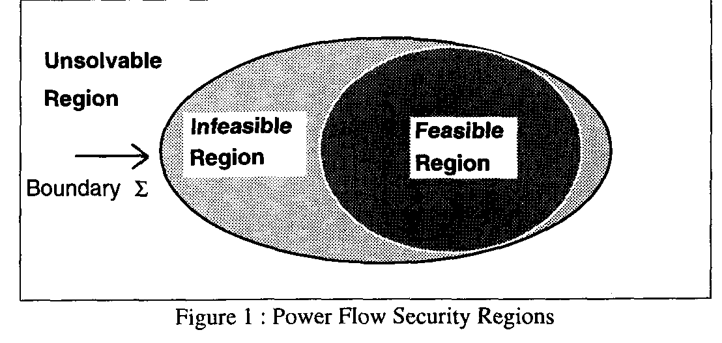
Quantifying Power Flow Unsolvability
Since lack of power flow convergence can be a major problem, it would be nice to have a measure to quantify the degree of unsolvability of a power flow
  And then figure out the best way to restore solvabiblity
T.J. Overbye, “A Power Flow Measure for Unsolvable Cases,” IEEE Trans. Power Systems, August 1994
18

Slide 20
Aside: Power Flow using the Optimal Multiplier
Classic reference on power flow optimal multiplier is S. Iwamoto, Y. Tamura, “A Load Flow Calculation Method for Ill-Conditioned Power Systems,” IEEE Trans. Power App. and Syst., April 1981
Another paper is J.E. Tate, T.J. Overbye, “A Comparison of the Optimal Multiplier in Power and Rectangular Coordinates,” IEEE Trans. Power Systems, Nov. 2005
Key idea is once NR method has selected a direction, we can analytically determine the distance to move in that direction to minimize the norm of the mismatch
  Goal is to help with stressed power systems
19

Slide 21
Aside: Power Flow using the Optimal Multiplier
Consider an n bus power system with f(x) = S where S is the vector of the constant real and reactive power load minus generation at all buses except the slack, x is the vector of the bus voltages in rectangular coordinates:
V_{i} = e_{i} + jf_{i,} and f is the function of the power balance constraints
20

Slide 22
Aside: Power Flow using the Optimal Multiplier
With a standard NR approach we would get
If we are close enough to the solution the iteration converges quickly, but if the system is heavily loaded it can diverge
Optimal multiplier approach modifies the iteration as
21

Slide 23
Aside: Power Flow using the Optimal Multiplier
The scalar μ is chosen to minimize the norm of the mismatch F in direction Δx
Paper by Iwamoto, Y. Tamura from 1981 shows μ can be computed analytically with little additional calculation when rectangular voltages are used
Determination of μ involves solving a cubic equation, which gives either three real solutions, or one real and two imaginary solutions
22

Slide 24
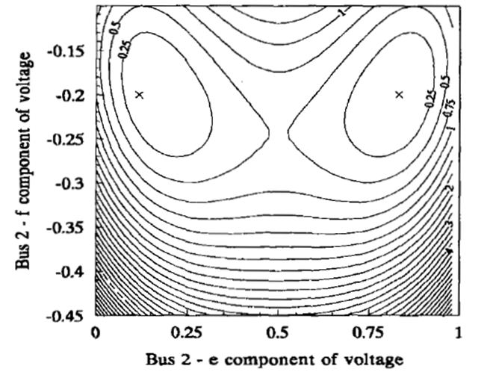
Aside: Power Flow using the Optimal Multiplier
A 1989 PICA paper by Iba (“A Method for Finding a Pair of Multiple Load Flow Solutions in Bulk Power Systems”) showed that NR tends to converge along line joining the high and a low voltage solution
  However there are some model restrictions,
  particularly associated with the load model
We are currently doing research looking
at whether this can be used to restore
a power flow that has converged to
an alternative solution
23

Slide 25
Quantifying Power Flow Unsolvability
To setup the problem, first consider the power flow iteration without and with the optimal multiplier
24

Slide 26
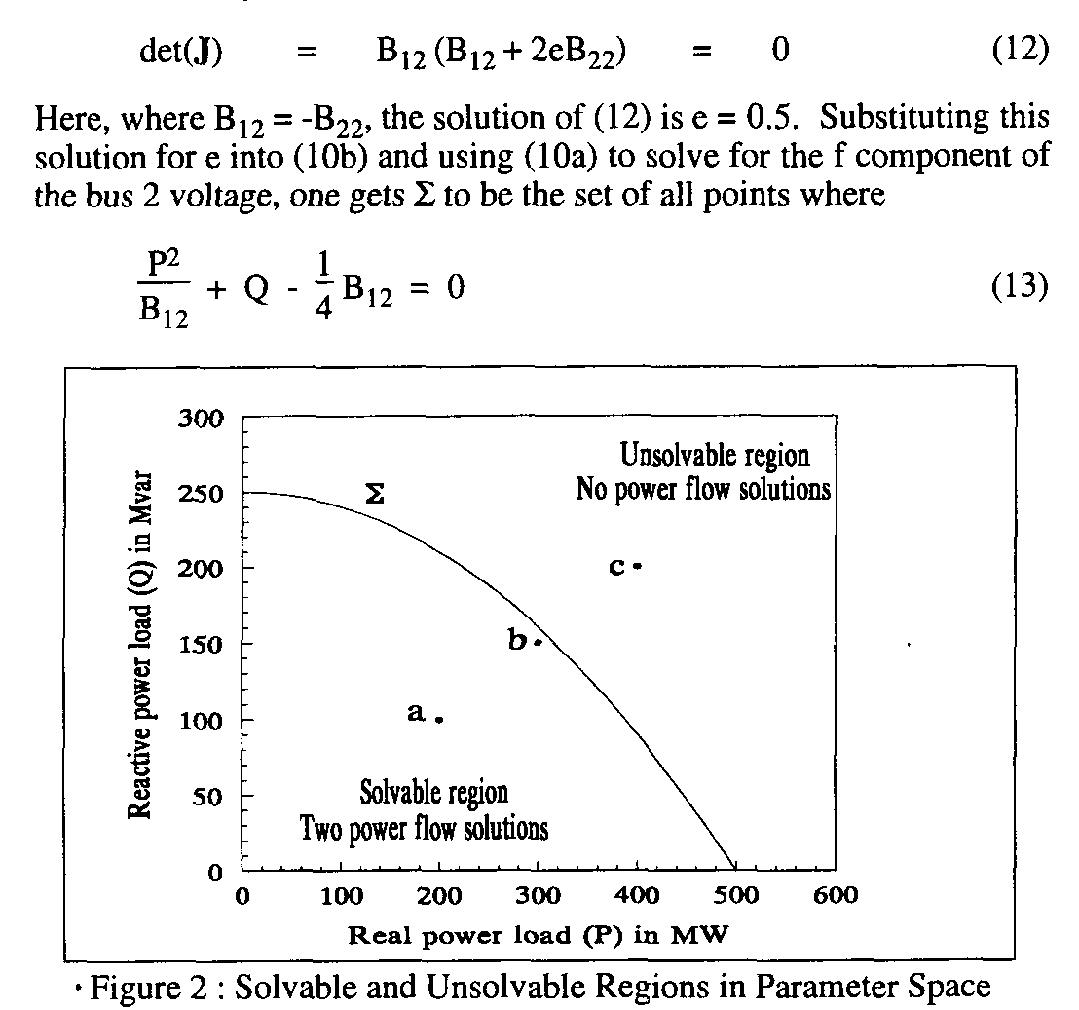
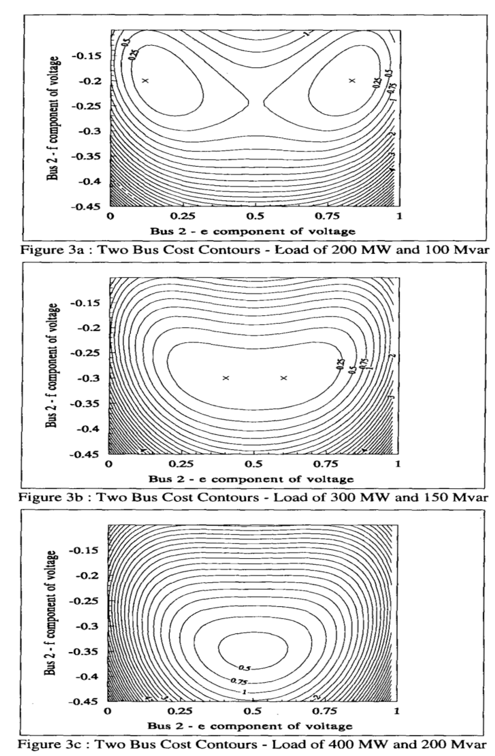
Quantifying Power Flow Unsolvability
25

Slide 27
Quantifying Power Flow Unsolvability
However, when there is no solution the standard power flow would diverge. But the approach with the optimal multiplier tends to point in the direction of minimizing F(x^{k+1}). That is,
26

Slide 28
Quantifying Power Flow Unsolvability
The only way we cannot reduce the cost function some would be if the two directions were perpendicular, hence with a zero dot product. So
27

Slide 29
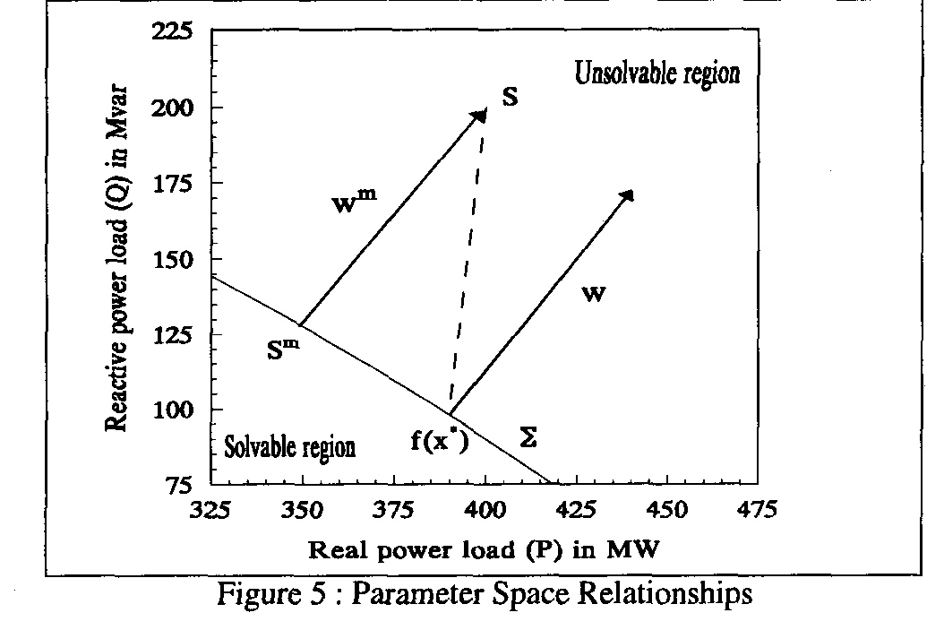
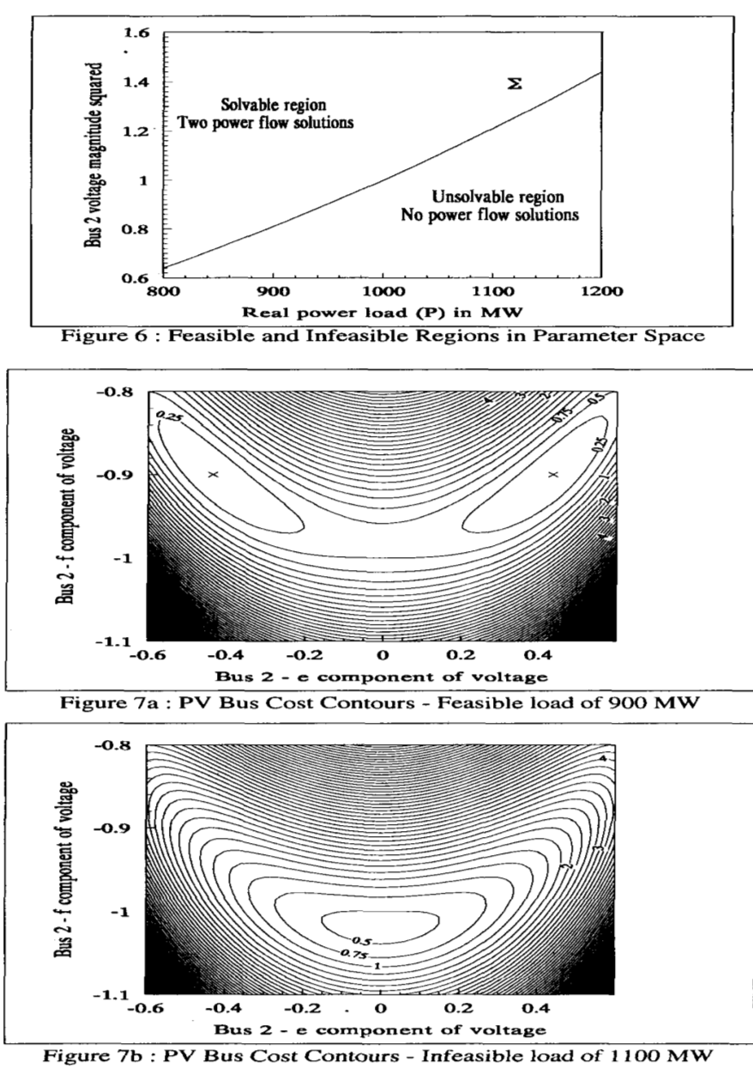
Quantifying Power Flow Unsolvability
If Σ were flat then w is parallel to w^{m}
28

Slide 30
Quantifying Power Flow Unsolvability
The left eigenvector associated with the zero eigenvalue of the Jacobian (defined as w^{i*}) is perpendicular to Σ (as noted in the early 1992 Dobson paper)
We can get the closest point on the Σ just by iterating, updating the S Vector as
(here S is the initial power injection, x^{i*} a boundary solution)
Converges when
29

Slide 31
Challenges
The key issues is actual power systems are quite complex, with many nonlinearities. For example, generators hitting reactive power limits, switched shunts, LTCs, phase shifters, etc.
Practically people would like to know how far some system parameters can be changed before running into some sort of limit violation, or maximum loadability.
  The system is changing in a particular direction, such as a power transfer; this often includes contingency analysis
Line limits and voltage magnitudes are considered
  Lower voltage lines tend to be thermally constrained
Solution is to just to trace out the PV or QV curves
30

Slide 32
PV and QV Analysis in PowerWorld
Requires setting up what is known in PowerWorld as an injection group
  An injection group specifies a set of objects, such as generators and loads, that can inject or absorb power
  Injection groups can be defined by selecting Case Information, Aggregation, Injection Groups
The PV and/or QV analysis then varies the injections in the injection group, tracing out the PV curve
This allows optional consideration of contingencies
The PV tool can be displayed by selecting Add-Ons, PV
31

Slide 33
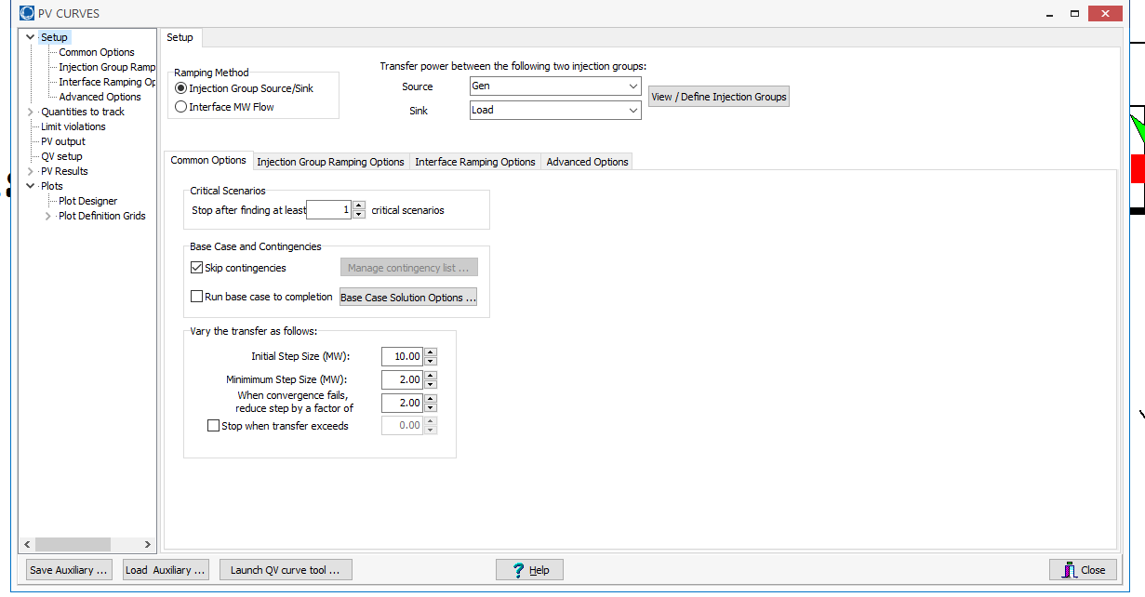
PV and QV Analysis in PowerWorld:
Two Bus Example
Setup page defines the source and sink and step size
32

Slide 34
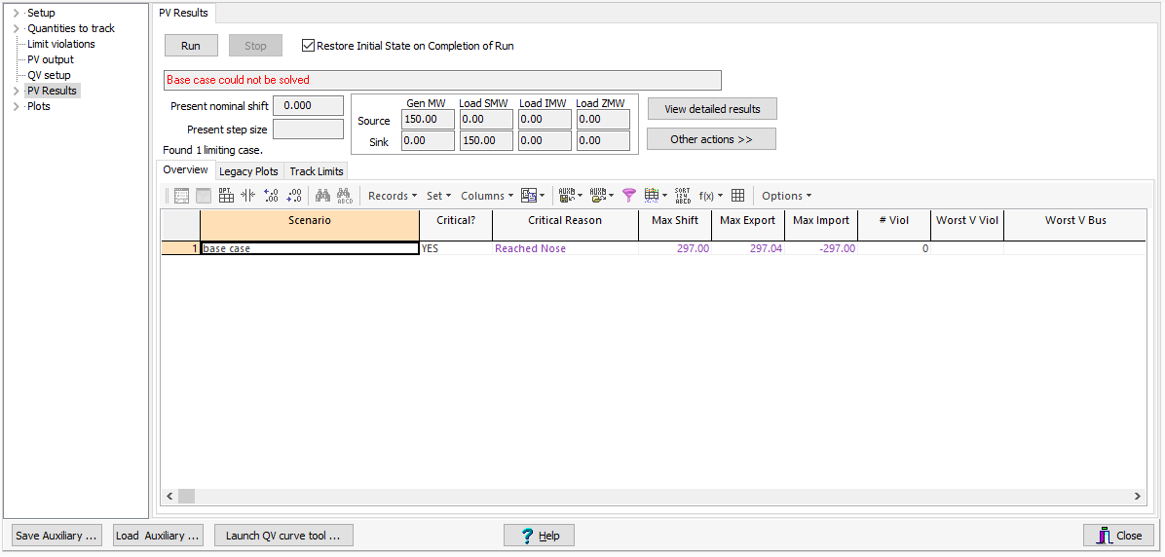
PV and QV Analysis in PowerWorld:
Two Bus Example
The PV Results Page does the actual solution
  Plots can be defined to show the results
  Other Actions, Restore initial state restores the pre-study state
Click the Run button
to run the PV analysis;
Check the Restore
Initial State on
Completion of Run to
restore the pre-PV
state (by default it is
not restored)
33

Slide 35
PV and QV Analysis in PowerWorld:
Two Bus Example
34

Slide 36
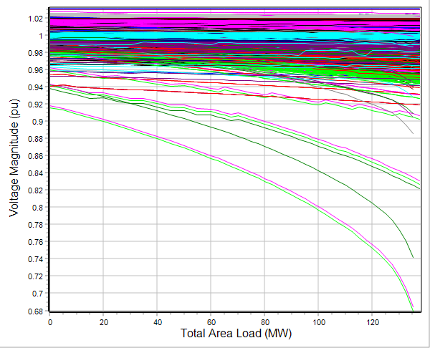
PV and QV Analysis in PowerWorld:
37 Bus Example
Usually other limits also need to be considered in
doing a realistic PV analysis
35

Slide 37
Power System Economic Dispatch
Generators can have vastly different incremental operational costs
  Some are essentially free or low cost (wind, solar, hydro, nuclear)
  Because of the large amount of natural gas generation, electricity prices are very dependent on natural gas prices
Economic dispatch is concerned with determining the best dispatch for generators without changing their commitment
Unit commitment focuses on optimization over several days. It is discussed in Chapter 4 of the book, but will just be briefly covered here
36

Slide 38
Unit Commitment: Quick Coverage (Chapter 4)
Unit commitment is used to determine which generator units should be committed to meet the load
The electric load varies substantially so there is almost always more generator capacity available than load
Units have availability constraints
  Minimum up time, time to start, cost to start
  Minimum down time, time to shutdown, cost to shutdown
  Ramp rates, minimum MW output
  Scheduled and unscheduled outages
System constraints including load, reserve, emissions, network
37

Slide 39
Solving Unit Commitment
Unit commitment involves a potentially large number of integer and continuous variables
  Not just the status of each unit, but also the amount of time it has been in a particular state (i.e., off or on)
Solved for a set of discrete time periods, which at each time period there are lots of different potential states
Solution approaches include
  Dynamic programming
  Lagrangian relaxation
  Mixed Integer Programming (currently state-of-the-art)
38

Slide 40
Longer Term Optimization: Quicker Coverage (Chapter 5)
Longer term optimization is a key consideration in hydro systems with significant reservoir storage
  Use the water when it is the most valuable taking into account potentially many other constraints
Generator maintenance scheduling
Building generation often involves large upfront capital costs to create an asset that will last 20 to 40 years; long-term contracts provide a way to share the risk
Take-or-pay contracts obligate a purchaser to purchase so much of a product over a given time period
39

Slide 41
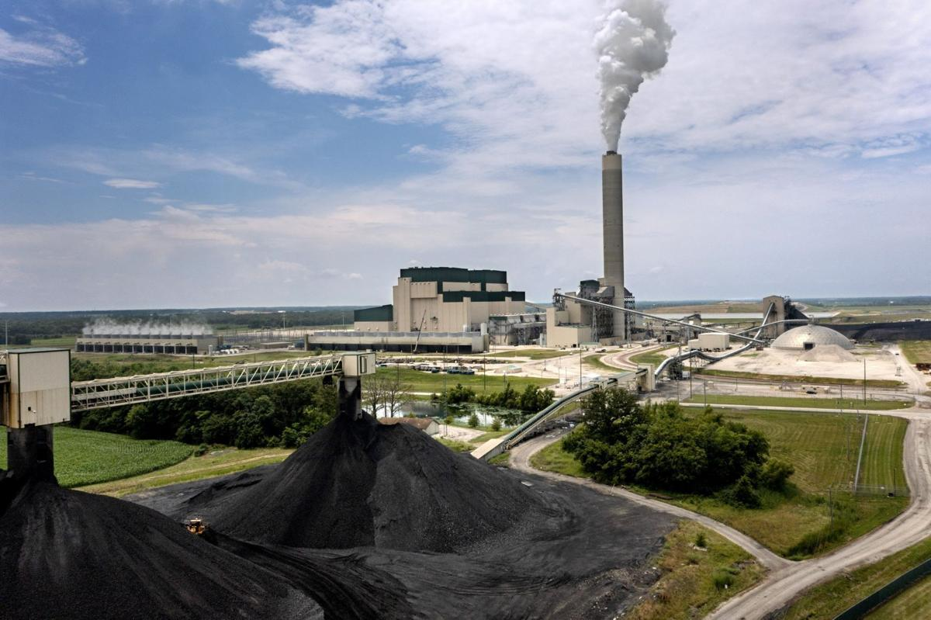
Example: Prairie State Energy Campus
The Prairie State Energy Campus (PSEC) is a 1600 MW coal plant in Southern Illinois with its own coal mine
that opened in 2012
  It is owned by municipals and coops (my former
  coop got >60% of the energy from PSEC)
  While relatively efficient, it is one of the US’s
  largest sources of CO2 emissions
  It cost an estimate $4 billion to build; if it sells
  its power at $30/MWh then maximum yearly
  income would be $30*1600*8760=$420 million
Illinois’s new clean energy law requires PSEC to reduce carbon emissions by 45% by 1/1/35 and be 100% carbon free by the end of 2045
Image: Pantagraph.com
40

