Slide 1
ECEN 615
Methods of Electric Power
Systems Analysis
Lecture 21: Economic Dispatch,
Optimal Power Flow, Linear Programming
Prof. Tom Overbye
Dept. of Electrical and Computer Engineering
Texas A&M University
overbye@tamu.edu

Slide 2
Announcements
Read Chapter 8
Read the Chapter 3 appendices (3A covers optimization with constraints, 3B covers linear programming, 3D covers dynamic programming, and 3E convex optimization
An excellent book on optimization is Linear and Nonlinear Programming by Luenberger and Ye (the 5th edition came out in 2021)
Homework 6 is now due on Thursday Nov 17 but it counts as two regular homeworks.
1

Slide 3
Power System Economic Dispatch
Generators can have vastly different incremental operational costs
  Some are essentially free or low cost (wind, solar, hydro, nuclear)
  Because of the large amount of natural gas generation, electricity prices are very dependent on natural gas prices
Economic dispatch is concerned with determining the best dispatch for generators without changing their commitment
Unit commitment focuses on optimization over several days. It is discussed in Chapter 4 of the book and was briefly covered last lecture
2

Slide 4
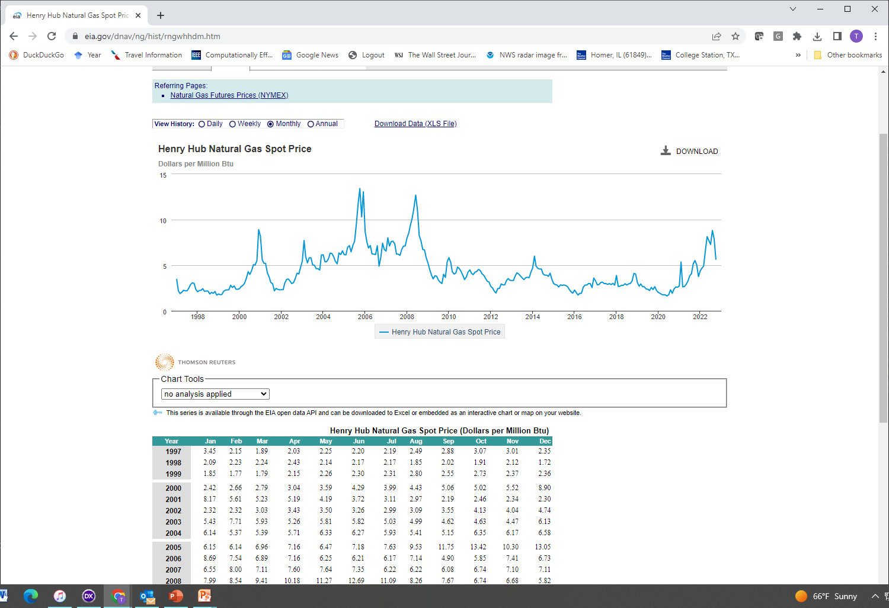
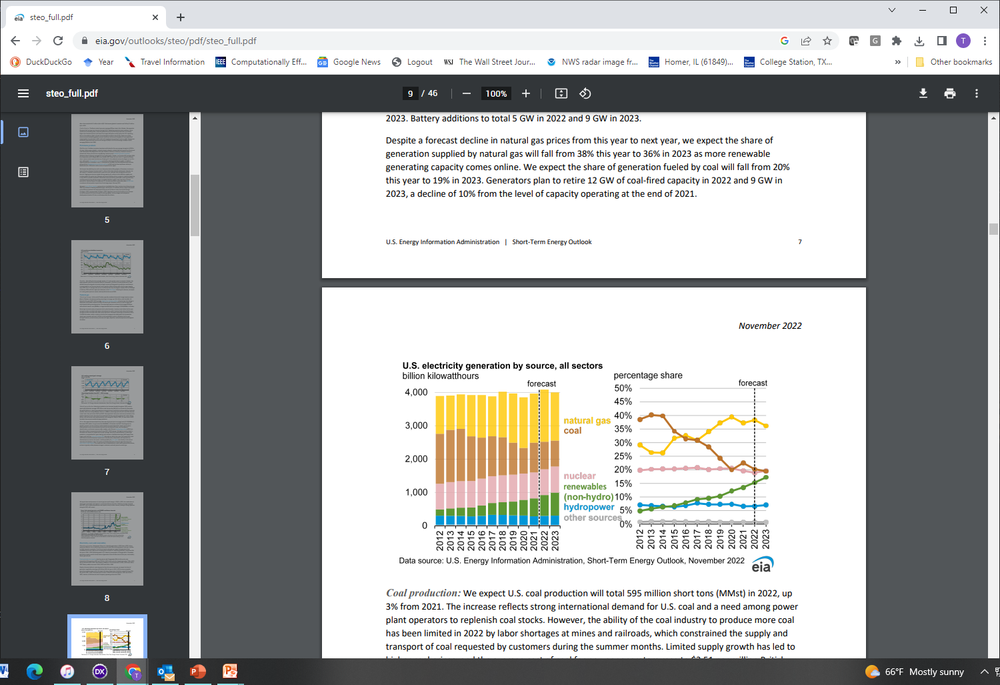
Variation in Natural Gas Prices and Generation Sources
Source: www.eia.gov/dnav/ng/hist/rngwhhdm.htm
3

Slide 5
Power System Economic Dispatch
Economic dispatch is formulated as a constrained minimization
  The cost function is often total generation cost in an area
  Single equality constraint is the real power balance equation
Solved by setting up the Lagrangian (with P_{D} the load and P_{L} the losses, which are a function the generation)
A necessary condition for a minimum is that the gradient is zero. Without losses this occurs when all generators are dispatched at the same marginal cost (except when they hit a limit)
4

Slide 6
Power System Economic Dispatch
If losses are neglected then there is a single marginal cost (lambda); if losses are included then each bus could have a different marginal cost
5

Slide 7
Economic Dispatch Penalty Factors
The penalty factor
at the slack bus is
always unity!
6

Slide 8
Economic Dispatch Example
Case is GOS_Example6_22; use Power Flow Solution
Options, Advanced Options to set Penalty Factors
7

Slide 9
Optimal Power Flow (OPF)
OPF functionally combines the power flow with economic dispatch
SCOPF adds in contingency analysis
Goal of OPF and SCOPF is to minimize a cost function, such as operating cost, taking into account realistic equality and inequality constraints
Equality constraints
  bus real and reactive power balance
  generator voltage setpoints
  area MW interchange
8

Slide 10
OPF, cont.
Inequality constraints
  transmission line/transformer/interface flow limits
  generator MW limits
  generator reactive power capability curves
  bus voltage magnitudes (not yet implemented in Simulator OPF)
Available Controls
  generator MW outputs
  transformer taps and phase angles
  reactive power controls

Slide 11
Two Example OPF Solution Methods
Non-linear approach using Newton’s method
  handles marginal losses well, but is relatively slow and has problems determining binding constraints
  Generation costs (and other costs) represented by quadratic or cubic functions
Linear Programming
  fast and efficient in determining binding constraints, but can have difficulty with marginal losses.
  used in PowerWorld Simulator
  generation costs (and other costs) represented by piecewise linear functions
Both can be implemented using an ac or dc power flow
10

Slide 12
OPF and SCOPF Current Status
OPF (really SCOPF) is currently an area of active research, with ARPA-E having an SCOPF competition (see gocompetition.energy.gov)
A 2016 National Academies Press report, titled “Analytic Research Foundations for the Next-Generation Electric Grid,” recommended improved AC OPF models
  I would recommend reading this report; it provides good background on power systems include OPF
  It is available for free at www.nap.edu/catalog/21919/analytic-research-foundations-for-the-next-generation-electric-grid
11

Slide 13
OPF and SCOPF History
A nice OPF history from Dec 2012 is provided by the below link, and briefly summarized here
Prior to digital computers economic dispatch was solved by hand and the power flow with network analyzers
Digital power flow developed in late 50’s to early 60’s
First OPF formulations in the 1960’s
  J. Carpienterm, “Contribution e l’étude do Dispatching Economique,” Bulletin Society Francaise Electriciens, 1962
  H.W. Dommel, W.F. Tinney, “Optimal power flow solutions,” IEEE Trans. Power App. and Systems, Oct. 1968
    “Only a small extension of the power flow program is required”
https://www.ferc.gov/sites/default/files/2020-05/acopf-1-history-formulation-testing.pdf (by M Cain, R. O’Neill, A. Castillo)
12

Slide 14
OPF and SCOPF History
A linear programming (LP) approach was presented by Stott and Hobson in 1978
  B. Stott, E. Hobson, “Power System Security Control Calculations using Linear Programming,” (Parts 1 and 2) IEEE Trans. Power App and Syst., Sept/Oct 1978
Optimal Power Flow By Newton’s Method
  D.I. Sun, B. Ashley, B. Brewer, B.A. Hughes, and W.F. Tinney, "Optimal Power Flow by Newton Approach", IEEE Trans. Power App and Syst., October 1984
Follow-up LP OPF paper in 1990
  O. Alsac, J. Bright, M. Prais, B. Stott, “Further Developments in LP-based Optimal Power Flow,” IEEE Trans. Power Systems, August 1990
13

Slide 15
OPF and SCOPF History
Critique of OPF Algorithms
  W.F. Tinney, J.M. Bright, K.D. Demaree, B.A. Hughes, “Some Deficiencies in Optimal Power Flow,” IEEE Trans. Power Systems, May 1988
Hundreds of other papers on OPF
Comparison of ac and dc optimal power flow methods
  T.J. Overbye, X. Cheng, Y. San, “A Comparison of the AC and DC Power Flow Models for LMP Calculations,” Proc. 37th Hawaii International Conf. on System Sciences, 2004
14

Slide 16
Key SCOPF Application: Locational Marginal Prices (LMPs)
The locational marginal price (LMP) tells the cost of providing electricity to a given location (bus) in the system
Concept introduced by Schweppe in 1985
  F.C. Schweppe, M. Caramanis, R. Tabors, “Evaluation of Spot Price Based Electricity Rates,” IEEE Trans. Power App and Syst., July 1985
LMPs are a direct result of an SCOPF, and are widely used in many electricity markets worldwide
15

Slide 17
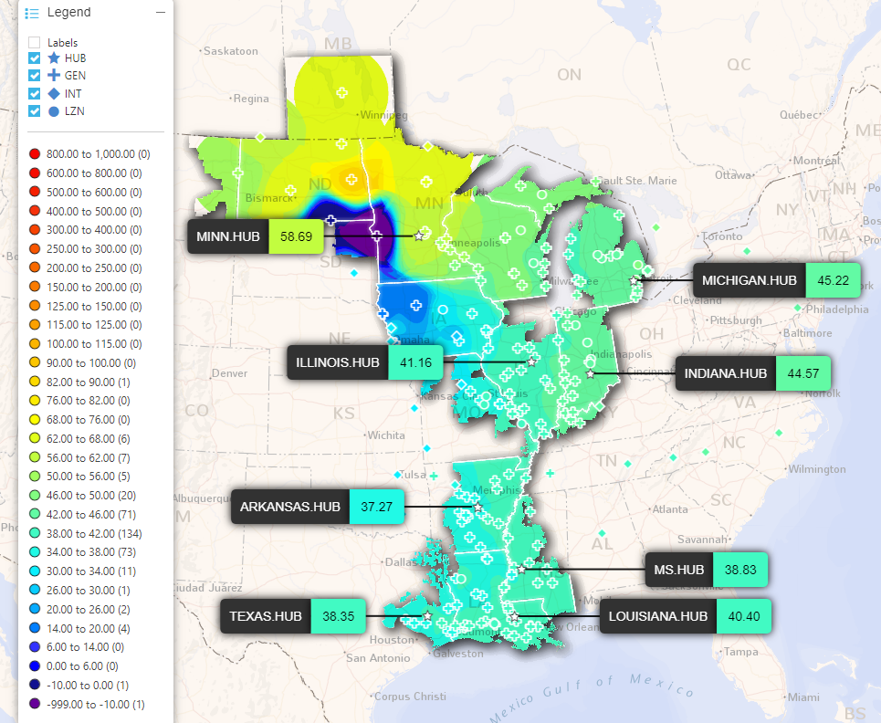
Example MISO LMP Contour, 11/11/2022
LMPs are now widely visualized
using color contours; the first use of LMP color contours was presented in [1]
[1] T.J. Overbye, R.P. Klump, J.D. Weber, “A Virtual Environment for Interactive Visualization of Power System Economic and Security Information,” IEEE PES 1999 Summer Meeting, Edmonton, AB, Canada, July 1999
Image: api.misoenergy.org/MISORTWD/lmpcontourmap.html
16

Slide 18
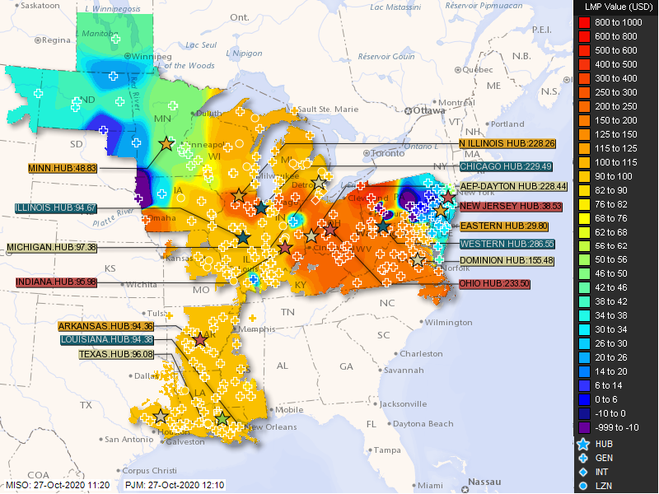
Example LMP Contour: 10/27/2020
Note the
wide range
in LMPs
including
some negative
values!
This is just
the real-time
market; most
electricity
is not traded
here.
17

Slide 19
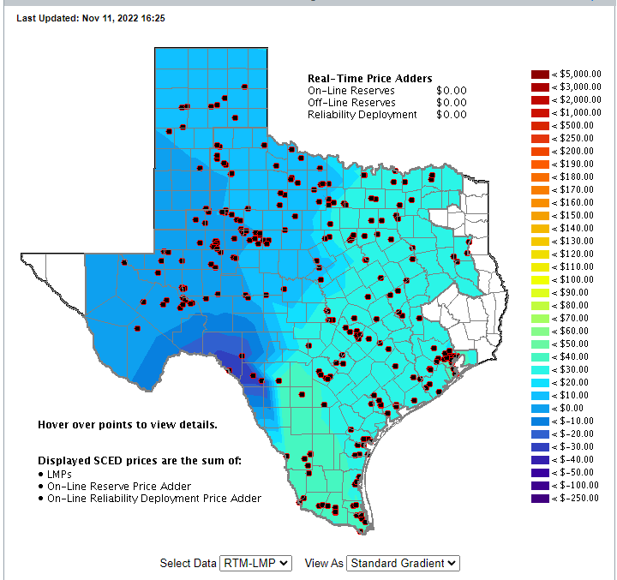
ERCOT LMPs, Nov 11, 2022 at 4:25 pm
18

Slide 20
OPF Problem Formulation
The OPF is usually formulated as a minimization with equality and inequality constraints
where x is a vector of dependent variables (such as the bus voltage magnitudes and angles), u is a vector of the control variables, F(x,u) is the scalar objective function, g is a set of equality constraints (e.g., the power balance equations) and h is a set of inequality
constraints (such as line flows)
19

Slide 21
Two Bus with Unconstrained Line
With no overloads the OPF matches
the economic
dispatch
Transmission line is not overloaded
Marginal cost of supplying power to each bus (locational marginal costs)
20

Slide 22
Two Bus with Constrained Line
With the line loaded to its limit, additional load at Bus A must be supplied locally, causing the marginal costs to diverge.
21

Slide 23
Three Bus (B3) Example
Consider a three bus case (Bus 1 is system slack), with all buses connected through 0.1 pu reactance lines, each with a 100 MVA limit
Let the generator marginal costs be
  Bus 1: 10 $ / MWhr; Range = 0 to 400 MW
  Bus 2: 12 $ / MWhr; Range = 0 to 400 MW
  Bus 3: 20 $ / MWhr; Range = 0 to 400 MW
Assume a single 180 MW load at bus 2
22

Slide 24
B3 with Line Limits NOT Enforced
Line between
Bus 1and Bus 3
is overloaded;
all buses have
the same
marginal cost
23

Slide 25
B3 with Line Limits Enforced
LP OPF changes
generation to
remove violation.
Bus marginal
costs are now
different.
24

Slide 26
Verify Bus 3 Marginal Cost
One additional MW
of load at bus 3
raised total cost by
14 $/hr, as G2 went
up by 2 MW and G1
went down by 1MW
25

Slide 27
Why is bus 3 LMP = $14 /MWh
All lines have equal impedance. Power flow in a simple network distributes inversely to impedance of path.
  For bus 1 to supply 1 MW to bus 3, 2/3 MW would take direct path from 1 to 3, while 1/3 MW would “loop around” from 1 to 2 to 3.
  Likewise, for bus 2 to supply 1 MW to bus 3, 2/3MW would go from 2 to 3, while 1/3 MW would go from 2 to 1to 3.
26

Slide 28
Why is bus 3 LMP $ 14 / MWh, cont’d
With the line from 1 to 3 limited, no additional power flows are allowed on it.
To supply 1 more MW to bus 3 we need
  ΔP_{G1} + ΔP_{G2} = 1 MW
  2/3 Δ P_{G1} + 1/3 Δ P_{G2} = 0; (no more flow on 1-3)
Solving requires we up P_{G2} by 2 MW and drop P_{G1} by 1 MW -- a net increase of $24 – $10 = $14.
27

Slide 29
Both lines into Bus 3 Congested
For bus 3 loads
above 200 MW,
the load must be
supplied locally.
Then what if the
bus 3 generator
opens?
28

Slide 30
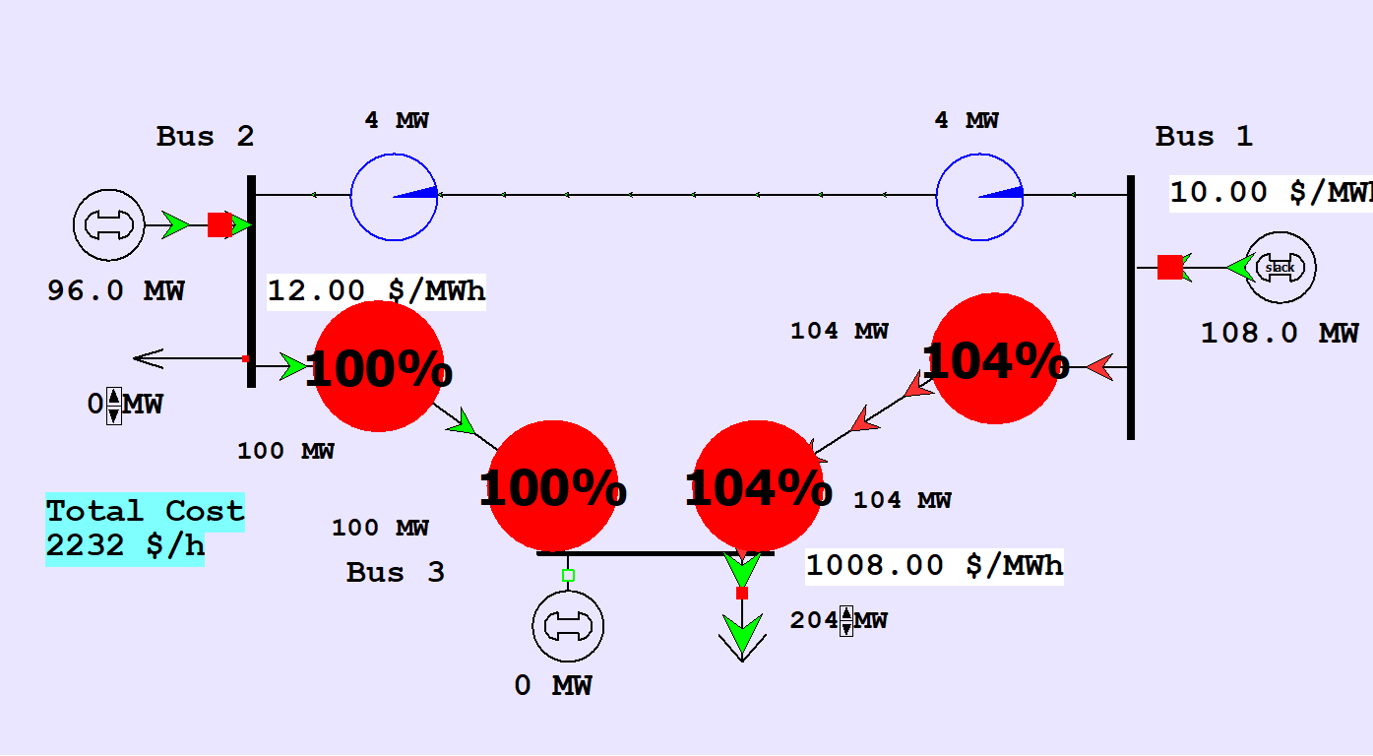
Both lines into Bus 3 Congested
An infeasible example can be created by opening the generator at Bus 3 with the Bus 3 load above 200 MW. There is no way to serve the load without overloading a transmission line.
29

Slide 31
LP OPF Solution Method
There are different OPF solution techniques. One common approach uses linear programming (LP)
The LP approach iterates between
  solving a full ac or dc power flow solution
    enforces real/reactive power balance at each bus
    enforces generator reactive limits
    system controls are assumed fixed
    takes into account non-linearities
  solving a primal LP
    changes system controls to enforce linearized constraints while minimizing cost
30

Slide 32
Quick Coverage of Linear Programming
LP is probably the most widely used mathematical programming technique
It is used to solve linear, constrained minimization (or maximization) problems in which the objective function and the constraints can be written as linear functions
31

Slide 33
Example Problem 1
Assume that you operate a lumber mill which makes both construction-grade and finish-grade boards from the logs it receives. Suppose it takes 2 hours to rough-saw and 3 hours to plane each 1000 board feet of construction-grade boards. Finish-grade boards take 2 hours to rough-saw and 5 hours to plane for each 1000 board feet. Assume that the saw is available 8 hours per day, while the plane is available 15 hours per day. If the profit per 1000 board feet is $100 for construction-grade and $120 for finish-grade, how many board feet of each should you make per day to maximize your profit?
32

Slide 34
Problem 1 Setup
Notice that all of the equations are linear, but they are inequality, as opposed to equality, constraints; we are seeking to determine the values of x₁ and x₂
33

Slide 35
Example Problem 2 (Nutritionist Problem)
A nutritionist is planning a meal with 2 foods: A and B. Each ounce of A costs $ 0.20, and has 2 units of fat, 1 of carbohydrate, and 4 of protein. Each ounce of B costs $0.25, and has 3 units of fat, 3 of carbohydrate, and 3 of protein. Provide the least cost meal which has no more than 20 units of fat, but with at least 12 units of carbohydrates and 24 units of protein.
34

