Slide 1
ECEN 615
Methods of Electric Power
Systems Analysis
Lecture 22: Linear Programming,
Optimal Power Flow,
Prof. Tom Overbye
Dept. of Electrical and Computer Engineering
Texas A&M University
overbye@tamu.edu

Slide 2
Announcements
Read Chapter 8
Read the Chapter 3 appendices (3A covers optimization with constraints, 3B covers linear programming, 3D covers dynamic programming, and 3E convex optimization
An excellent book on optimization is Linear and Nonlinear Programming by Luenberger and Ye (the 5th edition came out in 2021)
Homework 6 is due today
Exam 2 is on Thursday Dec 1 during class (for the on campus students); it will be comprehensive, but with more emphasis on the material after the first exam
1

Slide 3
Quick Coverage of Linear Programming
LP is probably the most widely used mathematical programming technique
It is used to solve linear, constrained minimization (or maximization) problems in which the objective function and the constraints can be written as linear functions
2

Slide 4
Example Problem 1 (mentioned in Lecture 21)
Assume that you operate a lumber mill which makes both construction-grade and finish-grade boards from the logs it receives. Suppose it takes 2 hours to rough-saw and 3 hours to plane each 1000 board feet of construction-grade boards. Finish-grade boards take 2 hours to rough-saw and 5 hours to plane for each 1000 board feet. Assume that the saw is available 8 hours per day, while the plane is available 15 hours per day. If the profit per 1000 board feet is $100 for construction-grade and $120 for finish-grade, how many board feet of each should you make per day to maximize your profit?
3

Slide 5
Problem 1 Setup
Notice that all of the equations are linear, but they are inequality, as opposed to equality, constraints; we are seeking to determine the values of x₁ and x₂
4

Slide 6
Example Problem 2 (Nutritionist Problem)
A nutritionist is planning a meal with 2 foods: A and B. Each ounce of A costs $ 0.20, and has 2 units of fat, 1 of carbohydrate, and 4 of protein. Each ounce of B costs $0.25, and has 3 units of fat, 3 of carbohydrate, and 3 of protein. Provide the least cost meal which has no more than 20 units of fat, but with at least 12 units of carbohydrates and 24 units of protein.
5

Slide 7
Problem 2 Setup
Again all of the equations are linear, but they are inequality, as opposed to equality, constraints; we are again seeking to determine the values of x₁ and x₂; notice there are also more constraints than solution variables
6

Slide 8
Three Bus Case Formulation
For the earlier three bus system given the initial condition of an overloaded transmission line, minimize the cost of generation such that the change in generation
is zero, and the flow
on the line between
buses 1 and 3 is not
violating its limit
Can be setup consider-
ing the change in
generation, (ΔP_{G1}, ΔP_{G2}, ΔP_{G3})
7

Slide 9
Three Bus Case Problem Setup
Line flow constraint
Power balance constraint
8

Slide 10
LP Standard Form
Maximum problems can be treated as minimizing the negative
The previous examples were not in this form!
9

Slide 11
Replacing Inequality Constraints with Equality Constraints
The LP standard form does not allow inequality constraints
Inequality constraints can be replaced with equality constraints through the introduction of slack variables, each of which must be greater than or equal to zero
Slack variables have no cost associated with them; they merely tell how far a constraint is from being binding, which will occur when its slack variable is zero
10

Slide 12
Lumber Mill Example with Slack Variables
Let the slack variables be x₃ and x₄, so
Minimize the negative
11

Slide 13
LP Definitions
This is a key LP concept!
A_{B} is called the basis matrix
12

Slide 14
Fundamental LP Theorem
Given an LP in standard form with A of rank m then
  If there is a feasible solution, there is a basic feasible solution
  If there is an optimal, feasible solution, then there is an optimal, basic feasible solution
Note, there could be a LARGE number of basic, feasible solutions
  Simplex algorithm determines the optimal,
  basic feasible solution usually very quickly
13

Slide 15
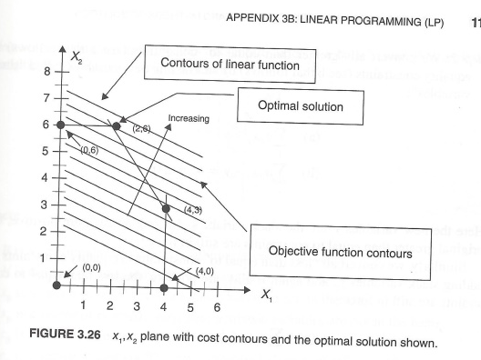
LP Graphical Interpretation
The LP constraints define a polyhedron in the solution space
  This is a polytope if the polyhedron is bounded and nonempty
  The basic, feasible
  solutions are
  vertices of this
  polyhedron
  With the linear cost
  function the solution
  will be at one of
  vertices
A polyhedron can be unbounded
Image: Figure 3.26 from course text
14

Slide 16
Simplex Algorithm
The key is to move intelligently from one basic feasible solution (i.e., a vertex) to another, with the goal of continually decreasing the cost function
The algorithm does this by determining the “best” variable to bring into the basis; this requires that another variable exit the basis, while always retaining a basic, feasible solution
This is called pivoting
15

Slide 17
Determination of Variable to Enter the Basis
To determine which non-basic variable should enter the basis (i.e., one which currently 0), look at how the cost function changes w.r.t. to a change in a non-basic variable (i.e., one that is currently zero)
Elements of x_{n} are all zero, but we are looking to change one to decrease the cost
16

Slide 18
Determination of Variable to Enter the Basis, cont.
Define the reduced (or relative) cost coefficients as
Elements of this vector tell how the cost function will change for a change in a currently non-basic variable
The variable to enter the basis is usually the one with the most negative relative cost
If all the relative costs are nonnegative then we are at an optimal solution
r is an n-m dimensional
row vector
17

Slide 19
Determination of Variable to Exit Basis
The new variable entering the basis, say a position j, causes the values of all the other basic variables to change. In order to retain a basic, feasible solution, we need to insure no basic variables become negative. The change in the basic variables is given by
18

Slide 20
Determination of Variable to Exit Basis, cont.
19

Slide 21
Canonical Form
The Simplex Method works by having the problem in what is known as canonical form
Canonical form is defined as having the m basic variables with the property that each appears in only one equation, its coefficient in that equation is unity, and none of the other basic variables appear in the same equation
Sometime canonical form is readily apparent
Note that with x₃ and x₄ as basic variables A_{B} is the identity matrix
20

Slide 22
Canonical Form
Other times canonical form is achieved by initially adding artificial variables to get an initial solution
Example of the nutrition problem in canonical form with slack and artificial variables (denoted as y) used to get an initial basic feasible solution
Note that with y₁, y₂, and y₃ as basic variables A_{B} is the identity matrix
21

Slide 23
LP Tableau
With the system in canonical form, the Simplex solution process can be illustrated by forming what is known as the LP tableau
  Initially this corresponds to the A matrix, with a column appended to include the b vector, and a row added to give the relative cost coefficients; the last element is the negative of the cost function value
  Define the tableau as Y, with elements Y_{ij}
  In canonical form the last column of the tableau gives the values of the basic variables
During the solution the tableau is updated by pivoting
22

Slide 24
LP Tableau for the Nutrition Problem with Artificial Variables
When in canonical form the relative costs vector is
The initial tableau for the artificial problem is then
Note the last column gives the values of the basic variables
23

Slide 25
LP Tableau Pivoting
Pivoting is used to move from one basic feasible solution to another
  Select the pivot column (i.e., the variable coming into the basis, say q) as the one with the most negative relative cost
  Select the pivot row (i.e., the variable going out of the basis) as the one with the smallest ratio of x_{i}/Y_{iq} for Y_{iq} >0; define this as row p (x_{i} is given in the last column)
24

Slide 26
LP Tableau Pivoting for Nutrition Problem
Starting at
Pivot on column q=2; for row get minimum of {20/3, 12/3, 24/3), which is row p=2
25

Slide 27
LP Tableau Pivoting
Pivoting on element Y_{pq} is done by
  First dividing row p by Y_{pq} to change the pivot element to unity.
  Then subtracting from the k^{th} row Y_{kq}/Y_{pq} times the p^{th} row for all rows with Y_{kq} <> 0
I’m only showing
fractions with two
ROD digits
26

Slide 28
LP Tableau Pivoting, Example, cont.
Next pivot on column 1, row 3
Which gives
27

Slide 29
LP Tableau Pivoting, Example, cont.
Next pivot on column 3, row 1
Which gives
Since there are no
negative relative
costs we are done (with getting a starting solution)
28

Slide 30
LP Tableau Full Problem
The tableau from the end of the artificial problem is used as the starting point for the actual solution
  Remove the artificial variables
  Update the relative costs with the costs from the original problem and update the bottom right-hand corner value
Since none of the relative costs are negative we are done with x₁=4, x₂=2.7 and x₃=4
29

Slide 31
Marginal Costs of Constraint Enforcement in LP
The marginal costs will be used to determine the OPF locational marginal costs (LMPs)
30

Slide 32
Nutrition Problem Marginal Costs
In this problem we had basic variables 1, 2, 3; nonbasic variables of 4 and 5
There is no marginal cost with the first constraint since it is not binding; values tell how cost changes if the b values were changed
31

Slide 33
Lumber Mill Example Solution
Economic interpretation of λ is the profit is increased by
35 for every hour we up the first constraint (the saw) and
by 10 for every hour we up the second constraint (plane)
32

Slide 34
Complications
Often variables are not limited to being ≥ 0
  Variables with just a single limit can be handled by substitution; for example if x ≥ 5 then x-5=z ≥ 0
  Bounded variables, high ≥ x ≥ 0 can be handled with a slack variable so x + y = high, and x,y ≥ 0
Unbounded conditions need to be detected (i.e., unable to pivot); also the solution set could be null
33

Slide 35
Complications
Degenerate Solutions
  Occur when there are less than m basic variables > 0
  When this occurs the variable entering the basis could also have a value of zero; it is possible to cycle, anti-cycling techniques could be used
Nonlinear cost functions
  Nonlinear cost functions could be approximated by assuming a piecewise linear cost function
Integer variables
  Sometimes some variables must be integers; known as integer programming; we’ll discuss after some power examples
34

Slide 36
LP Optimal Power Flow
LP OPF was introduced in
  B. Stott, E. Hobson, “Power System Security Control Calculations using Linear Programming,” (Parts 1 and 2) IEEE Trans. Power App and Syst., Sept/Oct 1978
  O. Alsac, J. Bright, M. Prais, B. Stott, “Further Developments in LP-based Optimal Power Flow,” IEEE Trans. Power Systems, August 1990
It is a widely used technique, particularly for real power optimization; it is the technique used in PowerWorld
35

Slide 37
LP Optimal Power Flow
Idea is to iterate between solving the power flow, and solving an LP with just a selected number of constraints enforced
The power flow (which could be ac or dc) enforces the standard power flow constraints
The LP equality constraints include enforcing area interchange, while the inequality constraints include enforcing line limits; controls include changes in generator outputs
LP results are transferred to the power flow, which is then resolved
36

Slide 38
LP OPF Introductory Example
In PowerWorld load the B3LP case and then display the LP OPF Dialog (select Add-Ons, OPF Case Info, OPF Options and Results)
Use Solve LP OPF to
solve the OPF, initially
with no line limits
enforced; this is similar
to economic dispatch
with a single power
balance equality constraint
The LP results are available
from various pages on the dialog
37

Slide 39
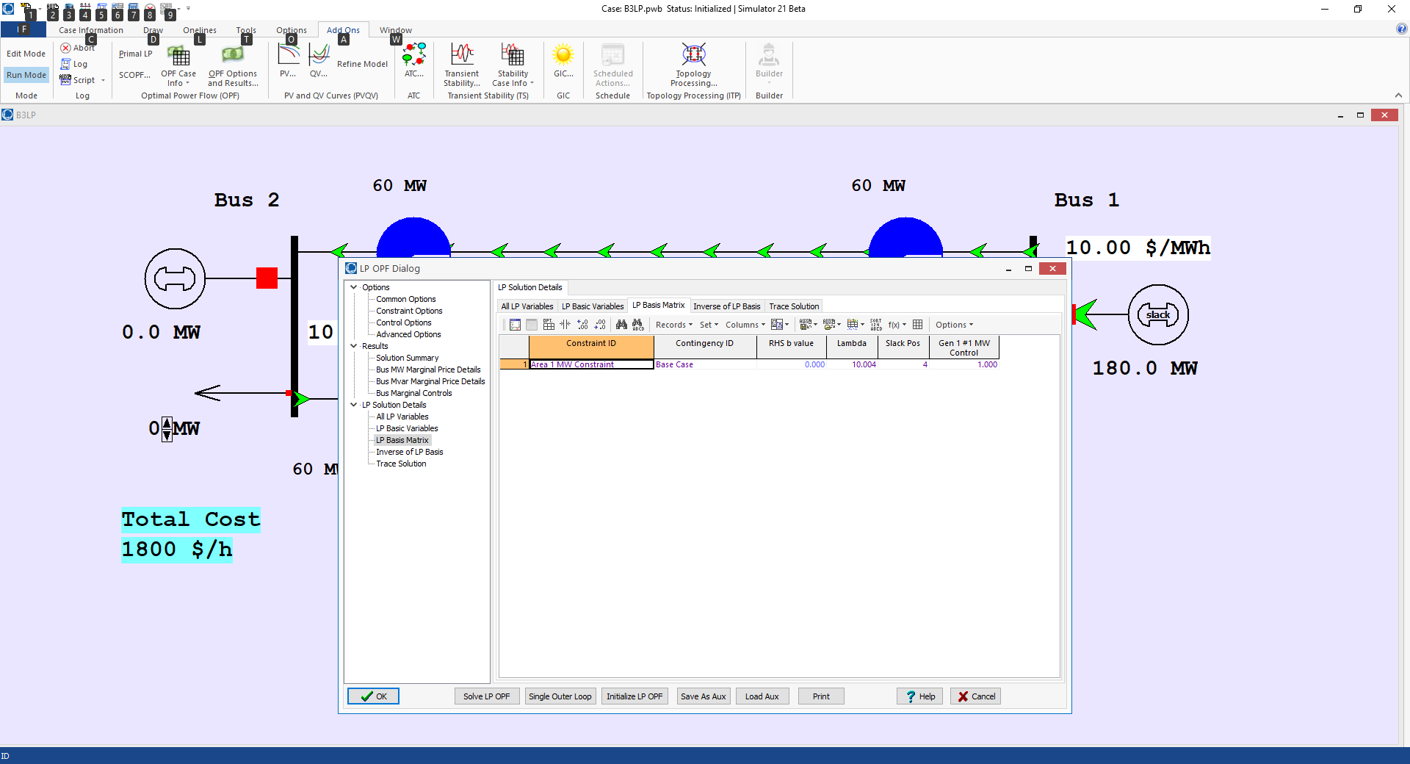
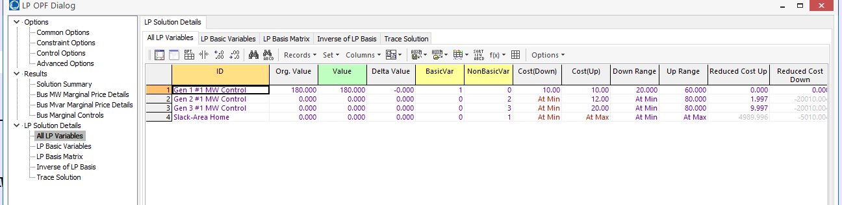
LP OPF Introductory Example, cont
38

Slide 40
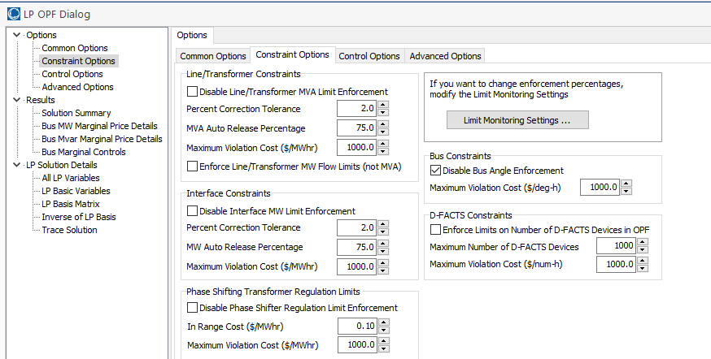
LP OPF Introductory Example, cont
On use Options, Constraint Options to enable the enforcement of the Line/Transformer MVA limits
39

Slide 41
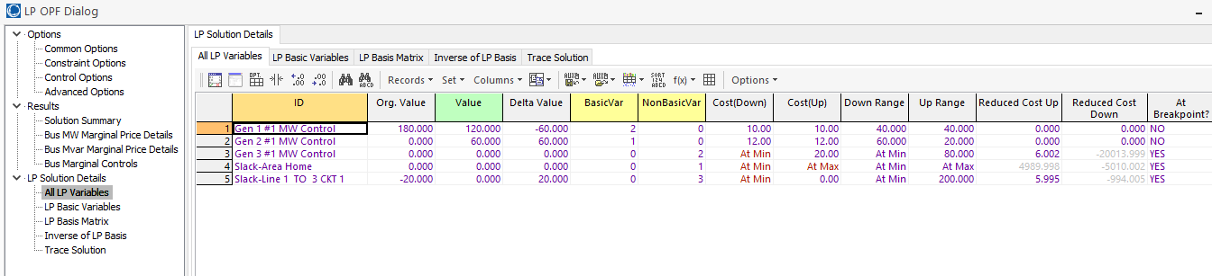
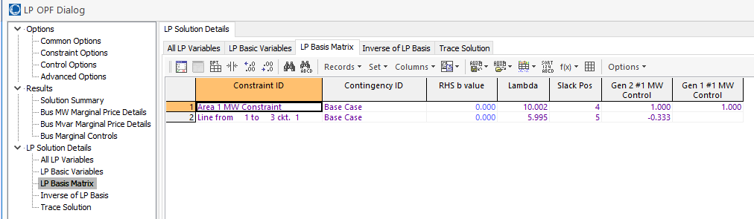
LP OPF Introductory Example, cont.
40

Slide 42
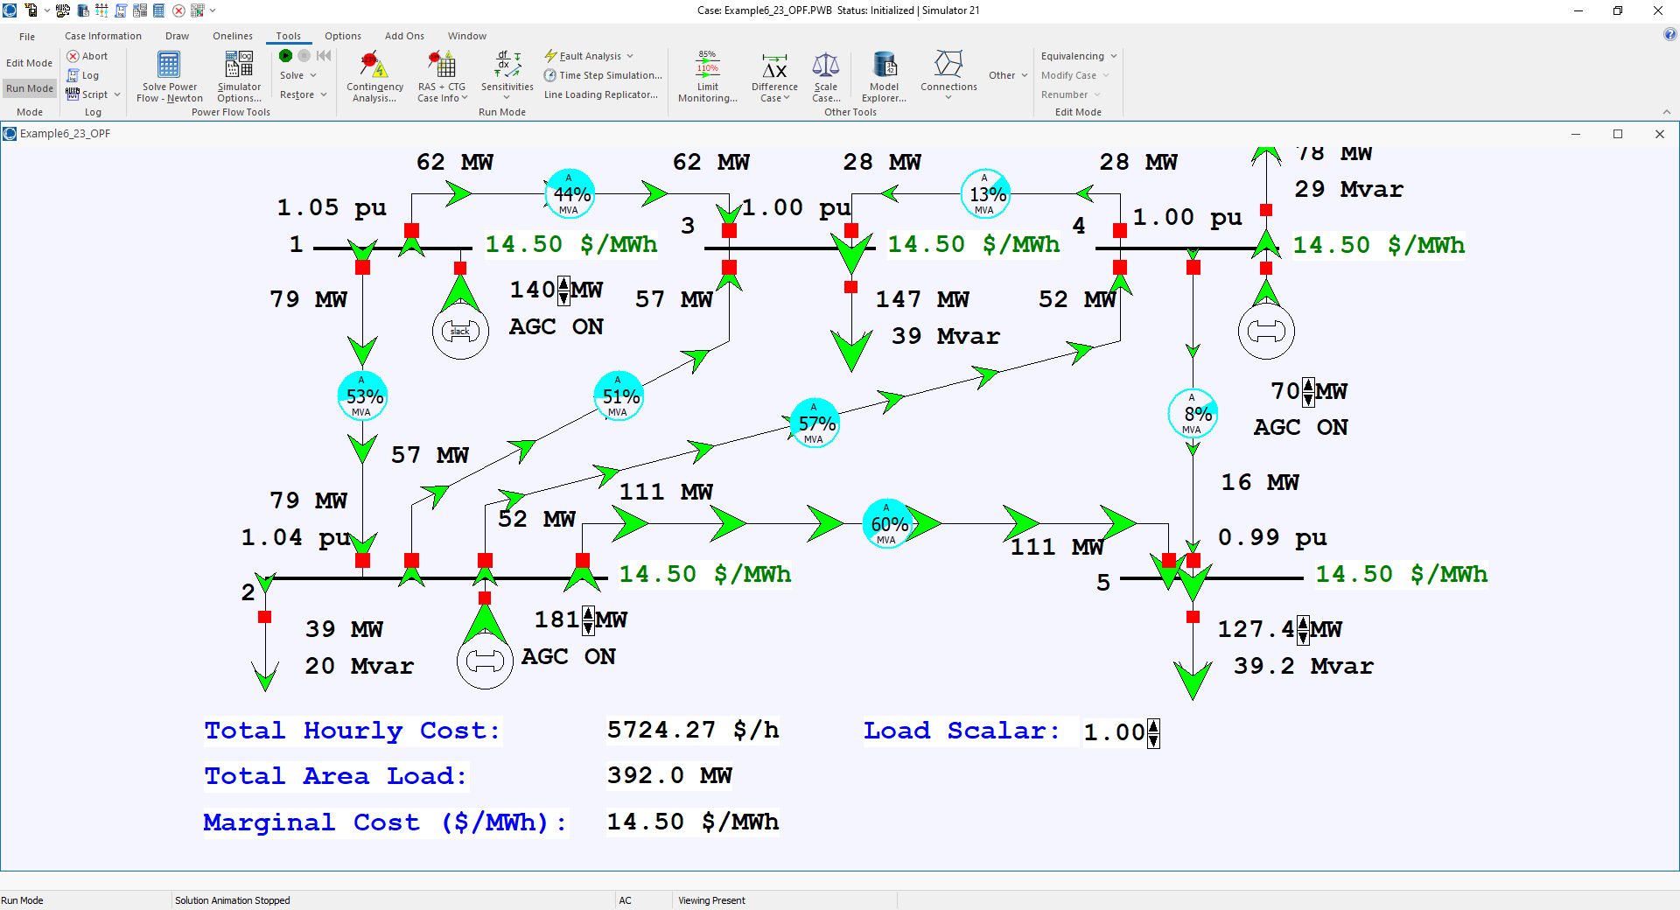
Example 6_23 Optimal Power Flow
On the Options, Environment
page the simulation can be set to solve an OPF when simulating
Open the case Example6_23_OPF. In this example the load is gradually increased
41

Slide 43
Locational Marginal Costs (LMPs)
In an OPF solution, the bus LMPs tell the marginal cost of supplying electricity to that bus
The term “congestion” is used to indicate when there are elements (such as transmission lines or transformers) that are at their limits; that is, the constraint is binding
Without losses and without congestion, all the LMPs would be the same
Congestion or losses causes unequal LMPs
LMPs are often shown using color contours; a challenge is to select the right color range!
42

Slide 44
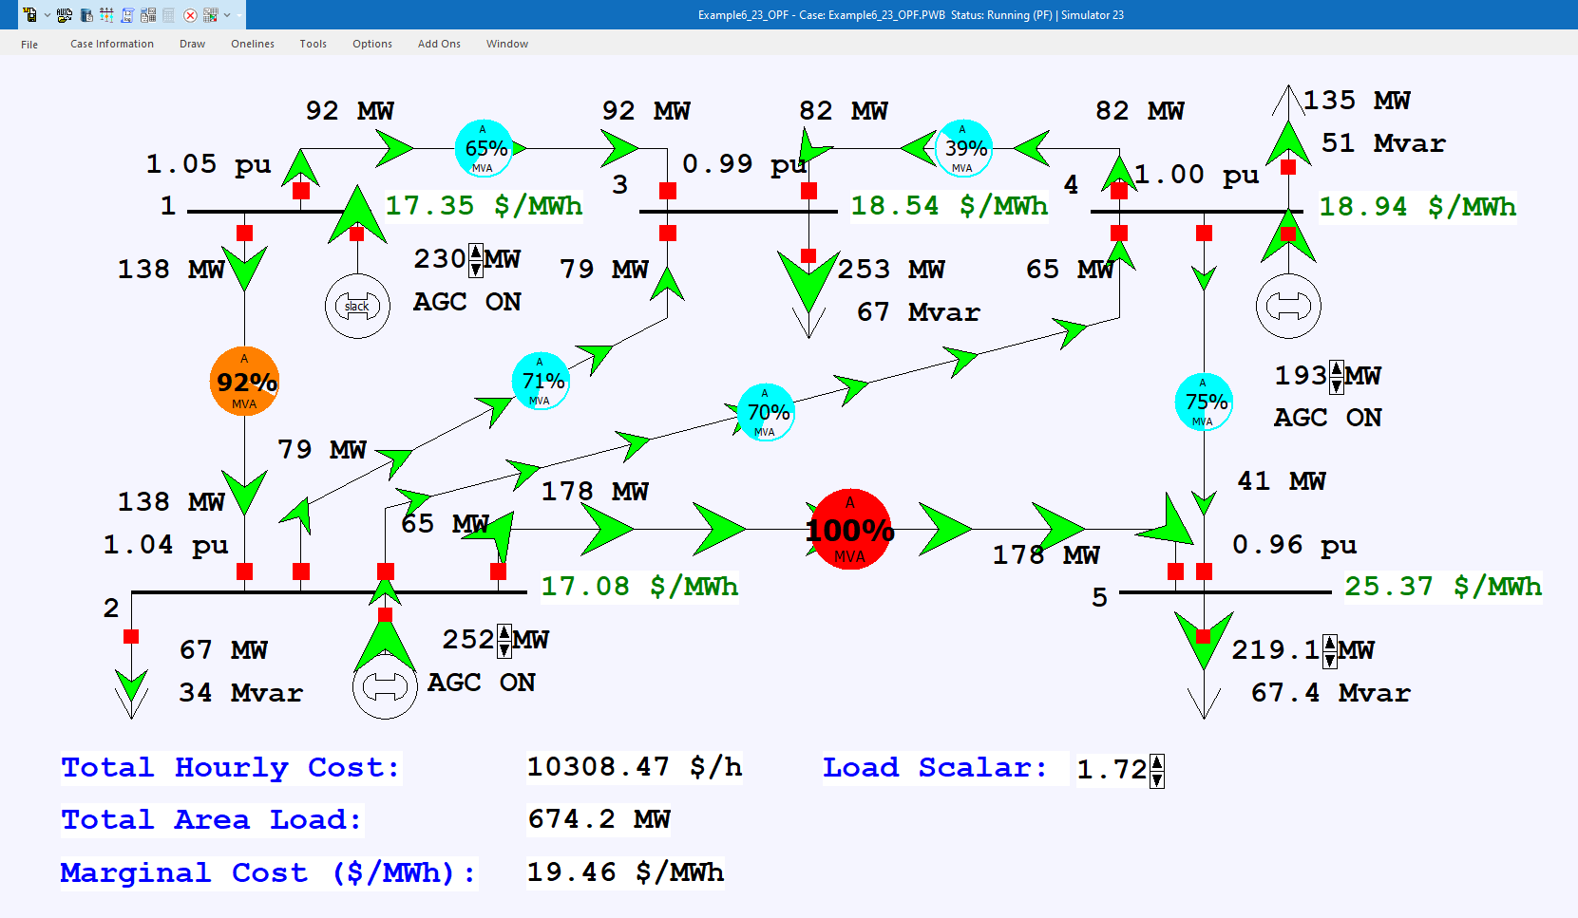
Example 6_23 Optimal Power Flow with Load Scale = 1.72
43

Slide 45
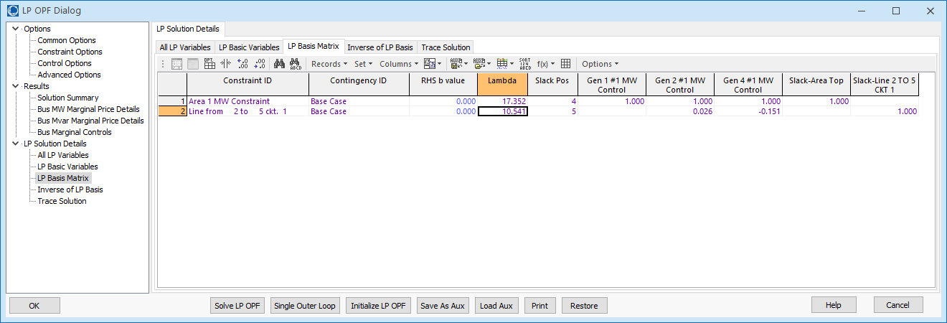
Example 6_23 Optimal Power Flow with Load Scale = 1.72
LP Sensitivity Matrix (A Matrix)
The first row is the power balance constraint, while the second row is the line flow constraint. The matrix only has the line flows that are being enforced.
44

Slide 46
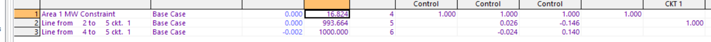
Example 6_23 Optimal Power Flow with Load Scale = 1.82
This situation is infeasible, at least with available controls. There is a solution because the OPF is allowing one of the constraints to violate (at high cost)
45

Slide 47
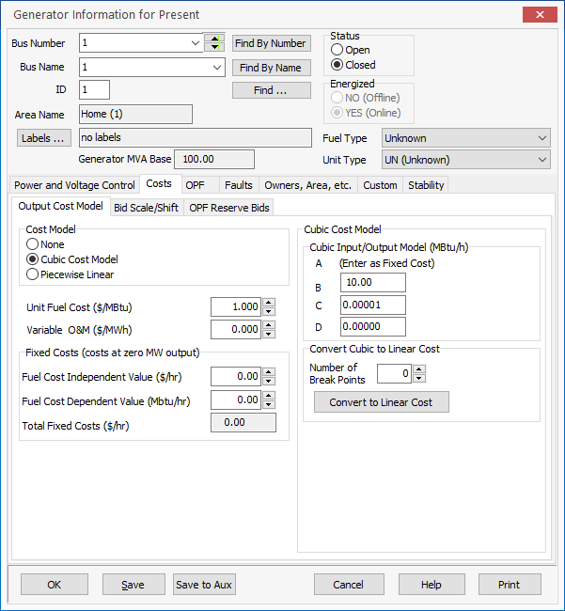
Generator Cost Curve Modeling
LP algorithms require linear cost curves, with piecewise linear curves used to approximate a nonlinear cost function
Two common ways
of entering cost
information are
  Quadratic function
  Piecewise linear curve
The PowerWorld OPF
supports both types
46

Slide 48
Security Constrained OPF
Security constrained optimal power flow (SCOPF) is similar to OPF except it also includes contingency constraints
  Again the goal is to minimize some objective function, usually the current system cost, subject to a variety of equality and inequality constraints
  This adds significantly more computation, but is required to simulate how the system is actually operated (with N-1 reliability)
A common solution is to alternate between solving a power flow and contingency analysis, and an LP
47

Slide 49
Security Constrained OPF, cont.
With the inclusion of contingencies, there needs to be a distinction between what control actions must be done pre-contingent, and which ones can be done post-contingent
  The advantage of post-contingent control actions is they would only need to be done in the unlikely event the contingency actually occurs
Pre-contingent control actions are usually done for line overloads, while post-contingent control actions are done for most reactive power control and generator outage re-dispatch
48

Slide 50
SCOPF Example
We’ll again consider Example 6_23, except now it has been enhanced to include contingencies and we’ve also greatly increased the capacity on the line between buses 4 and 5; named Bus5_SCOPF_DC
Original with line 4-5 limit of 60 MW with 2-5 out
Modified with line 4-5 limit of 200 MVA with 2-5 out
49

Slide 51
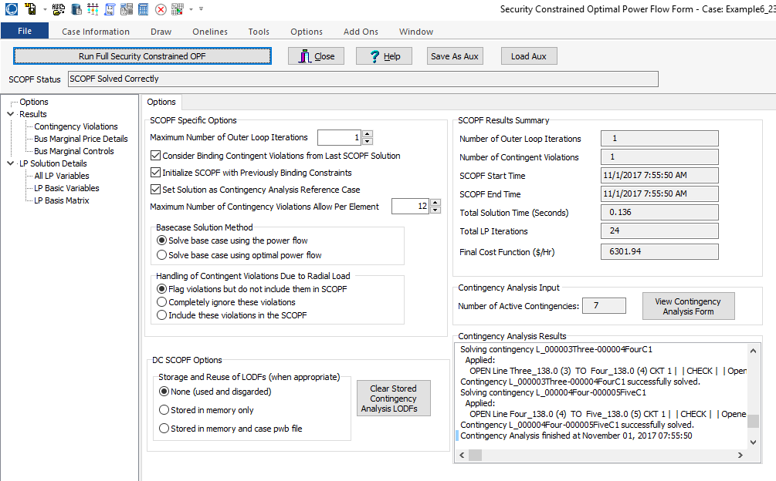
PowerWorld SCOPF Application
Just click the button to solve
Number of times
to redo contingency
analysis
50

Slide 52
LP OPF and SCOPF Issues
The LP approach is widely used for the OPF and SCOPF, particularly when implementing a dc power flow approach
A key issue is determining the number of binding constraints to enforce in the LP tableau
  Enforcing too many is time-consuming, enforcing too few results in excessive iterations
The LP approach is limited by the degree of linearity in the power system
  Real power constraints are fairly linear, reactive power constraints much less so
51

