Slide 1
ECEN 615
Methods of Electric Power
Systems Analysis
Lecture 23: Optimal Power Flow,
Electricity Markets
Prof. Tom Overbye
Dept. of Electrical and Computer Engineering
Texas A&M University
overbye@tamu.edu

Slide 2
Announcements
Read Chapter 8
Homework 7 is assigned today but does not need to be turned in. Rather it should be finished before the second exame
Exam 2 is on Thursday Dec 1 during class (for the on campus students); it will be comprehensive, but with more emphasis on the material after the first exam
On Nov 18, 2022 DOE issued FOA 2740 (BIL – Grid Resilience and Innovation Partnerships [GRIP]) providing 3.9 billion in total funding through 40 to 100 awards; the goal is to make the electric grid more resilient
1

Slide 3
LP Optimal Power Flow
LP OPF was introduced in
  B. Stott, E. Hobson, “Power System Security Control Calculations using Linear Programming,” (Parts 1 and 2) IEEE Trans. Power App and Syst., Sept/Oct 1978
  O. Alsac, J. Bright, M. Prais, B. Stott, “Further Developments in LP-based Optimal Power Flow,” IEEE Trans. Power Systems, August 1990
It is a widely used technique, particularly for real power optimization; it is the technique used in PowerWorld
2

Slide 4
LP Optimal Power Flow
Idea is to iterate between solving the power flow, and solving an LP with just a selected number of constraints enforced
The power flow (which could be ac or dc) enforces the standard power flow constraints
The LP equality constraints include enforcing area interchange, while the inequality constraints include enforcing line limits; controls include changes in generator outputs
LP results are transferred to the power flow, which is then resolved
3

Slide 5
LP OPF Introductory Example
In PowerWorld load the B3LP case and then display the LP OPF Dialog (select Add-Ons, OPF Case Info, OPF Options and Results)
Use Solve LP OPF to
solve the OPF, initially
with no line limits
enforced; this is similar
to economic dispatch
with a single power
balance equality constraint
The LP results are available
from various pages on the dialog
4

Slide 6
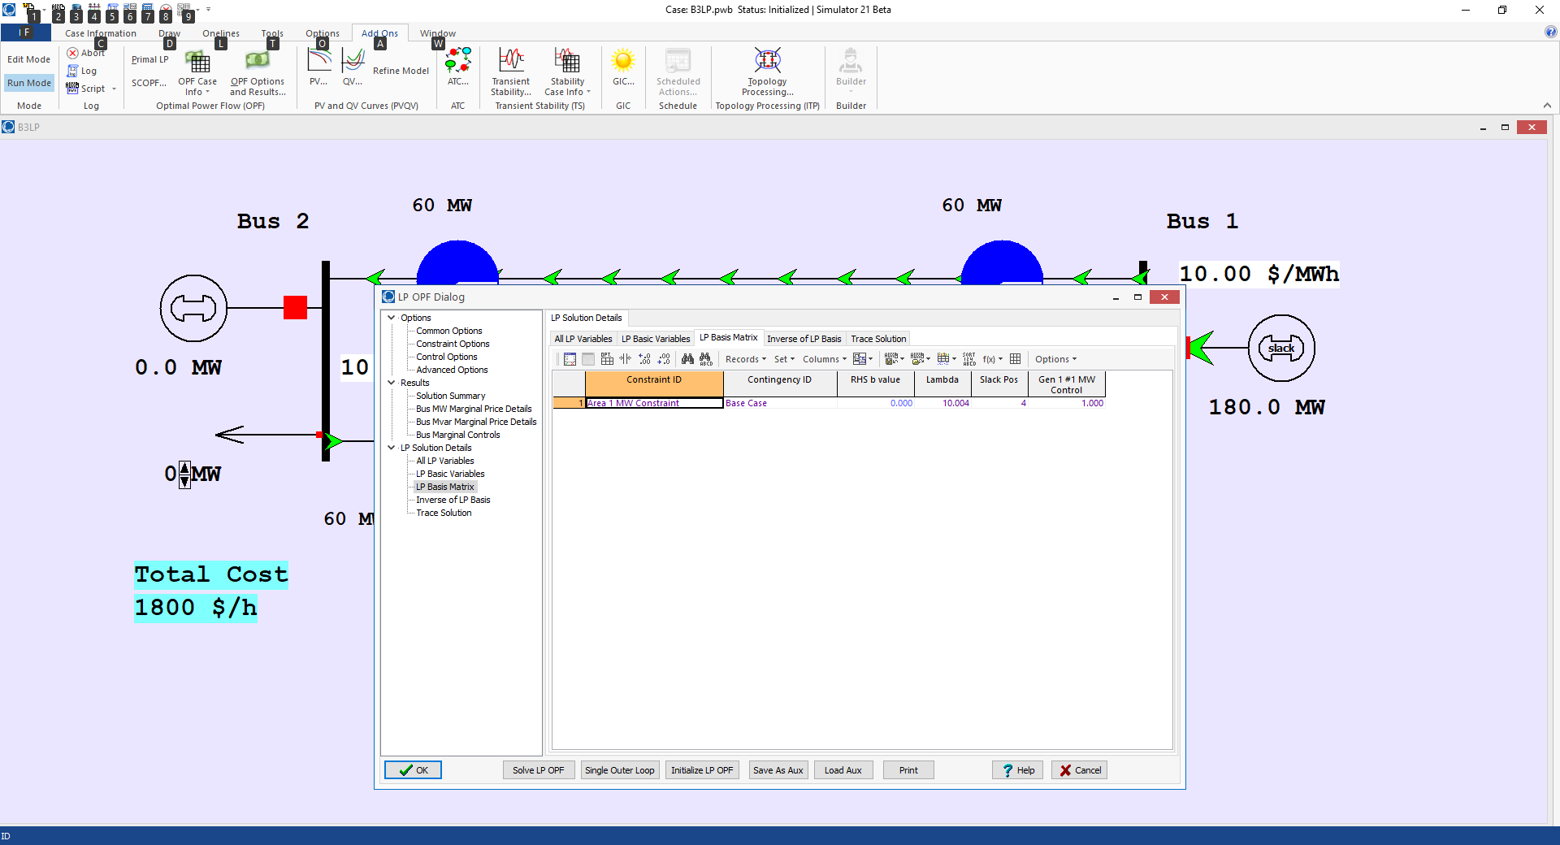
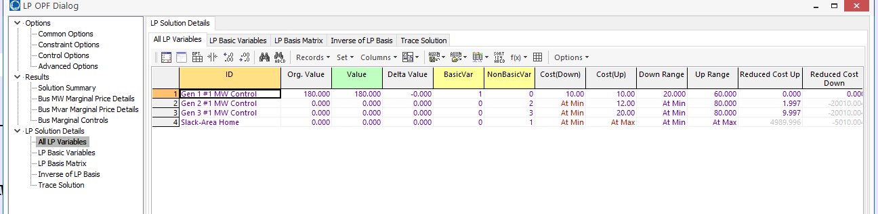
LP OPF Introductory Example, cont
5

Slide 7
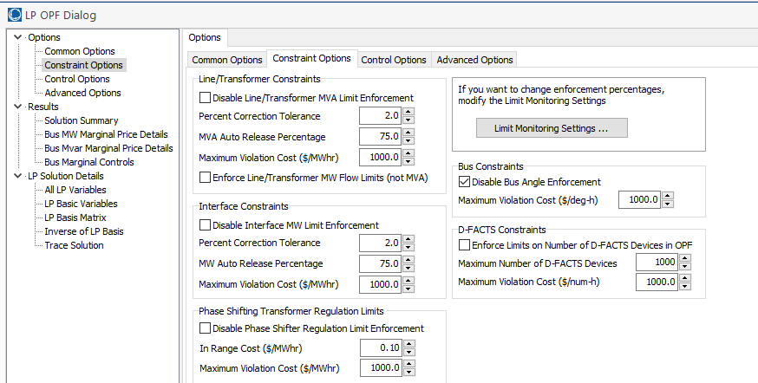
LP OPF Introductory Example, cont
On use Options, Constraint Options to enable the enforcement of the Line/Transformer MVA limits
6

Slide 8
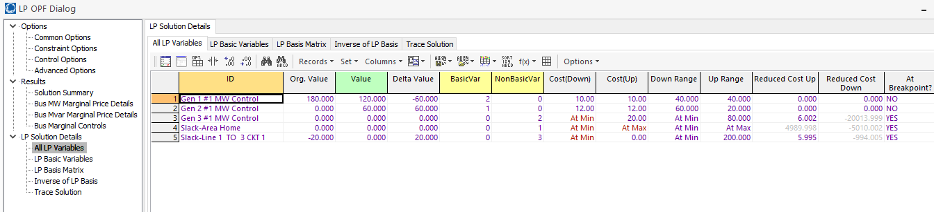
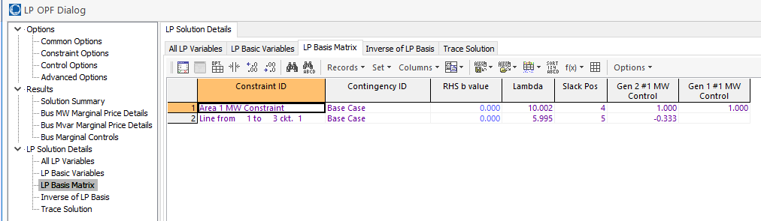
LP OPF Introductory Example, cont.
7

Slide 9
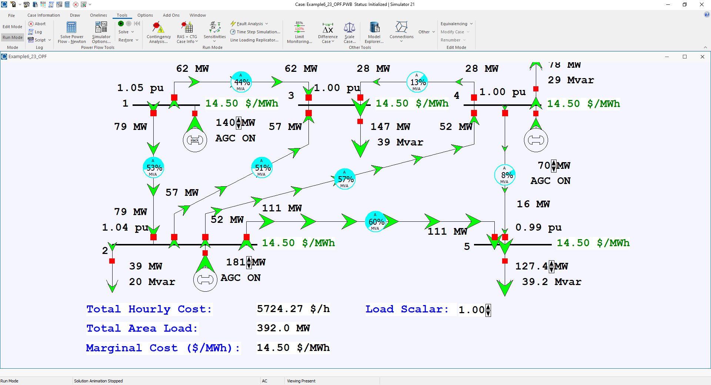
Example 6_23 Optimal Power Flow
On the Options, Environment
page the simulation can be set to solve an OPF when simulating
Open the case Example6_23_OPF. In this example the load is gradually increased
8

Slide 10
Locational Marginal Costs (LMPs)
In an OPF solution, the bus LMPs tell the marginal cost of supplying electricity to that bus
The term “congestion” is used to indicate when there are elements (such as transmission lines or transformers) that are at their limits; that is, the constraint is binding
Without losses and without congestion, all the LMPs would be the same
Congestion or losses causes unequal LMPs
LMPs are often shown using color contours; a challenge is to select the right color range!
9

Slide 11
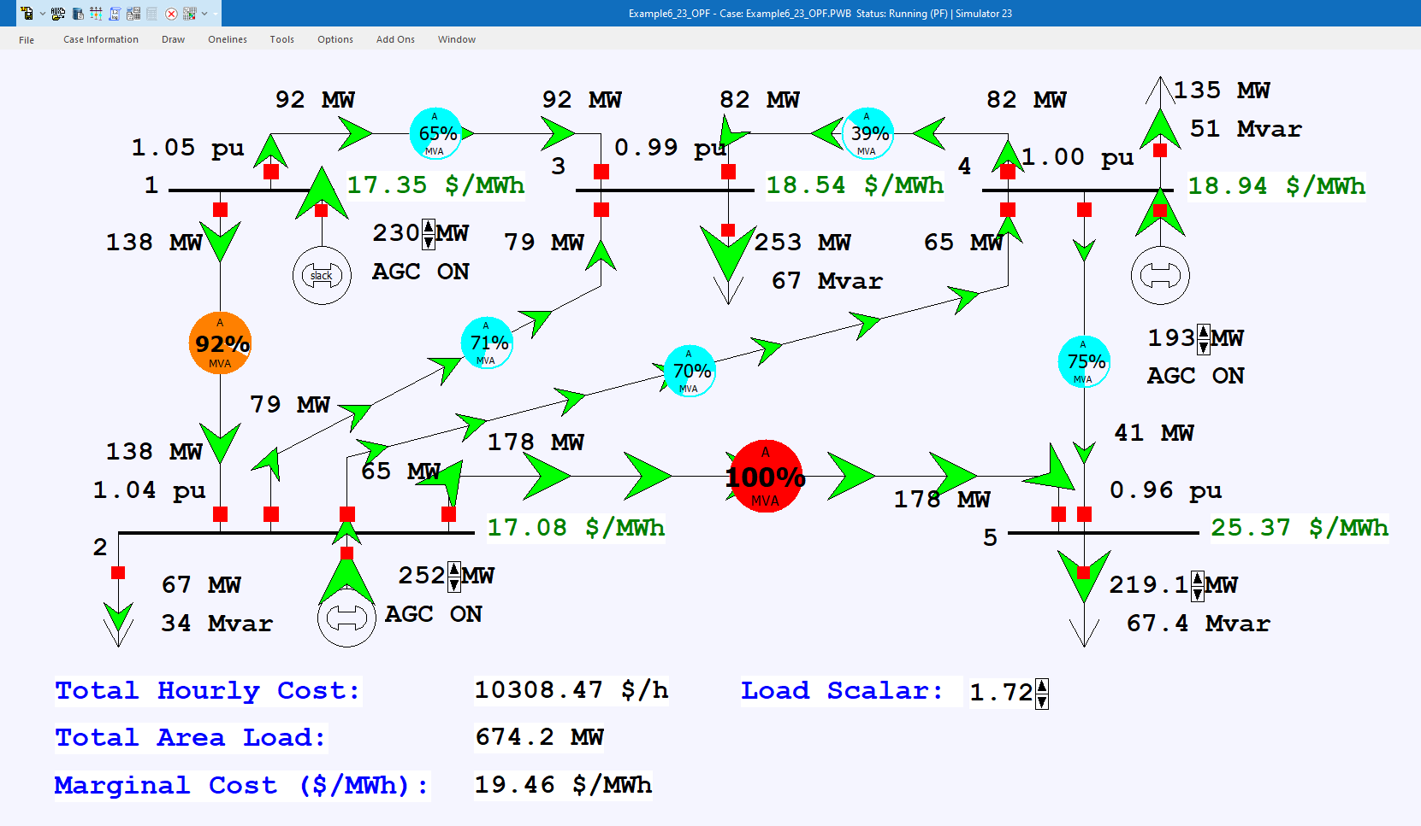
Example 6_23 Optimal Power Flow with Load Scale = 1.72
10

Slide 12
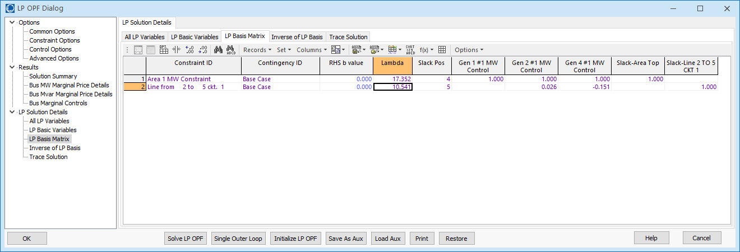
Example 6_23 Optimal Power Flow with Load Scale = 1.72
LP Sensitivity Matrix (A Matrix)
The first row is the power balance constraint, while the second row is the line flow constraint. The matrix only has the line flows that are being enforced.
11

Slide 13
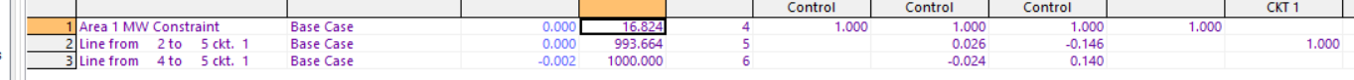
Example 6_23 Optimal Power Flow with Load Scale = 1.82
This situation is infeasible, at least with available controls. There is a solution because the OPF is allowing one of the constraints to violate (at high cost)
12

Slide 14
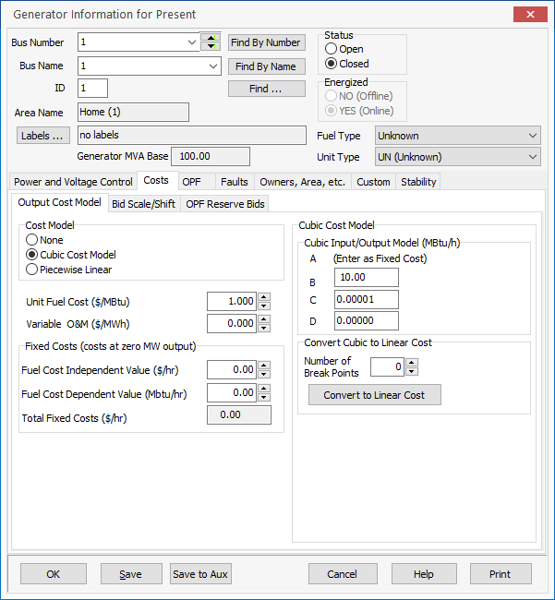
Generator Cost Curve Modeling
LP algorithms require linear cost curves, with piecewise linear curves used to approximate a nonlinear cost function
Two common ways
of entering cost
information are
  Quadratic function
  Piecewise linear curve
The PowerWorld OPF
supports both types
13

Slide 15
Security Constrained OPF
Security constrained optimal power flow (SCOPF) is similar to OPF except it also includes contingency constraints
  Again the goal is to minimize some objective function, usually the current system cost, subject to a variety of equality and inequality constraints
  This adds significantly more computation, but is required to simulate how the system is actually operated (with N-1 reliability)
A common solution is to alternate between solving a power flow and contingency analysis, and an LP
14

Slide 16
Security Constrained OPF, cont.
With the inclusion of contingencies, there needs to be a distinction between what control actions must be done pre-contingent, and which ones can be done post-contingent
  The advantage of post-contingent control actions is they would only need to be done in the unlikely event the contingency actually occurs
Pre-contingent control actions are usually done for line overloads, while post-contingent control actions are done for most reactive power control and generator outage re-dispatch
15

Slide 17
SCOPF Example
We’ll again consider Example 6_23, except now it has been enhanced to include contingencies and we’ve also greatly increased the capacity on the line between buses 4 and 5; named Bus5_SCOPF_DC
Original with line 4-5 limit of 60 MW with 2-5 out
Modified with line 4-5 limit of 200 MVA with 2-5 out
16

Slide 18
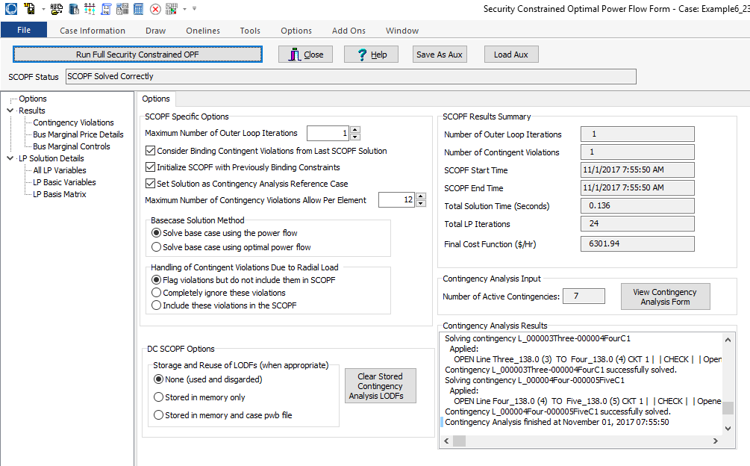
PowerWorld SCOPF Application
Just click the button to solve
Number of times
to redo contingency
analysis
17

Slide 19
LP OPF and SCOPF Issues
The LP approach is widely used for the OPF and SCOPF, particularly when implementing a dc power flow approach
A key issue is determining the number of binding constraints to enforce in the LP tableau
  Enforcing too many is time-consuming, enforcing too few results in excessive iterations
The LP approach is limited by the degree of linearity in the power system
  Real power constraints are fairly linear, reactive power constraints much less so
18

Slide 20
OPF Solution by Newton’s Method
An alternative to using the LP approach is to use Newton’s method, in which all the equations are solved simultaneously
A key paper in area is
  D.I. Sun, B. Ashley, B. Brewer, B.A. Hughes, and W.F. Tinney, "Optimal Power Flow by Newton Approach", IEEE Trans. Power App and Syst., October 1984
Problem is
For simplicity x represents all the variables and we can use h to impose limits on individual variables
19

Slide 21
OPF Solution by Newton’s Method
During the solution the inequality constraints are either binding (=0) or nonbinding (<0)
  The nonbinding constraints do not impact the final solution
We’ll modify the problem to split the h vector into the binding constraints, h₁ and the nonbinding constraints, h₂
20

Slide 22
OPF Solution by Newton’s Method
To solve first define the Lagrangian
A necessary condition for a minimum is that the gradient is zero
Both μ and λ are Lagrange Multipliers
21

Slide 23
OPF Solution by Newton’s Method
Solve using Newton’s method. To do this we need to define the Hessian matrix
Because this is a second order method, as opposed to a first order linearization, it can better handle system nonlinearities
22

Slide 24
OPF Solution by Newton’s Method
Solution is then via the standard Newton’s method. That is
No iteration is needed for a quadratic function with linear constraints
23

Slide 25
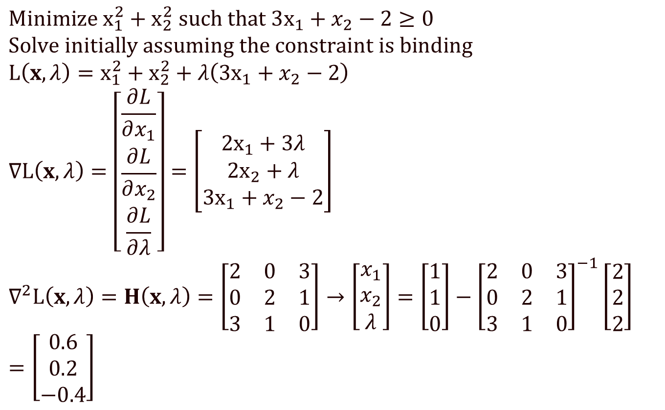
Example: Solve
$$\text{Minimize} {\text{x}}_{1}^{2}+x_{2}^{2} \text{such} \text{that}\text{ 3}{\text{x}}_{1}+x_{2}−2≥0 \\ \text{Solve} \text{initially} \text{assuming} \text{the} \text{constraint} \text{is} \text{binding} \\ L\left(x,λ\right)=x_{1}^{2}+x_{2}^{2}+λ\left(\text{3}{\text{x}}_{1}+x_{2}−2\right) \\ ∇L\left(x,λ\right)=\left[\begin{matrix}\frac{∂L}{∂x_{1}} \\ \frac{∂L}{∂x_{2}} \\ \frac{∂L}{∂λ}\end{matrix}\right]=\left[\begin{matrix}2x_{1}+3λ \\ 2x_{2}+λ \\ \text{3}{\text{x}}_{1}+x_{2}−2\end{matrix}\right] \\ ∇^{2}L\left(x,λ\right)=H\left(x,λ\right)=\left[\begin{matrix}2 & 0 & 3 \\ 0 & 2 & 1 \\ 3 & 1 & 0\end{matrix}\right]→\left[\begin{matrix}x_{1} \\ x_{2} \\ λ\end{matrix}\right]=\left[\begin{matrix}1 \\ 1 \\ 0\end{matrix}\right]−{\left[\begin{matrix}2 & 0 & 3 \\ 0 & 2 & 1 \\ 3 & 1 & 0\end{matrix}\right]}^{−1}\left[\begin{matrix}2 \\ 2 \\ 2\end{matrix}\right]=\left[\begin{matrix}0.6 \\ 0.2 \\ −0.4\end{matrix}\right]$$
No iteration is needed so any “guess” is fine. Pick (1,1,0)
Because λ is positive the constraint is binding
24

Slide 26
Newton OPF Comments
The Newton OPF has the advantage of being better able to handle system nonlinearities
There is still the issue of having to deal with determining which constraints are binding
The Newton OPF needs to implement second order derivatives plus all the complexities of the power flow solution
  The power flow starts off simple, but can rapidly get complex when dealing with actual systems
There is still the issue of handling integer variables
25

Slide 27
Mixed-Integer Programming
A mixed-integer program (MIP) is an optimization problem of the form
26

Slide 28
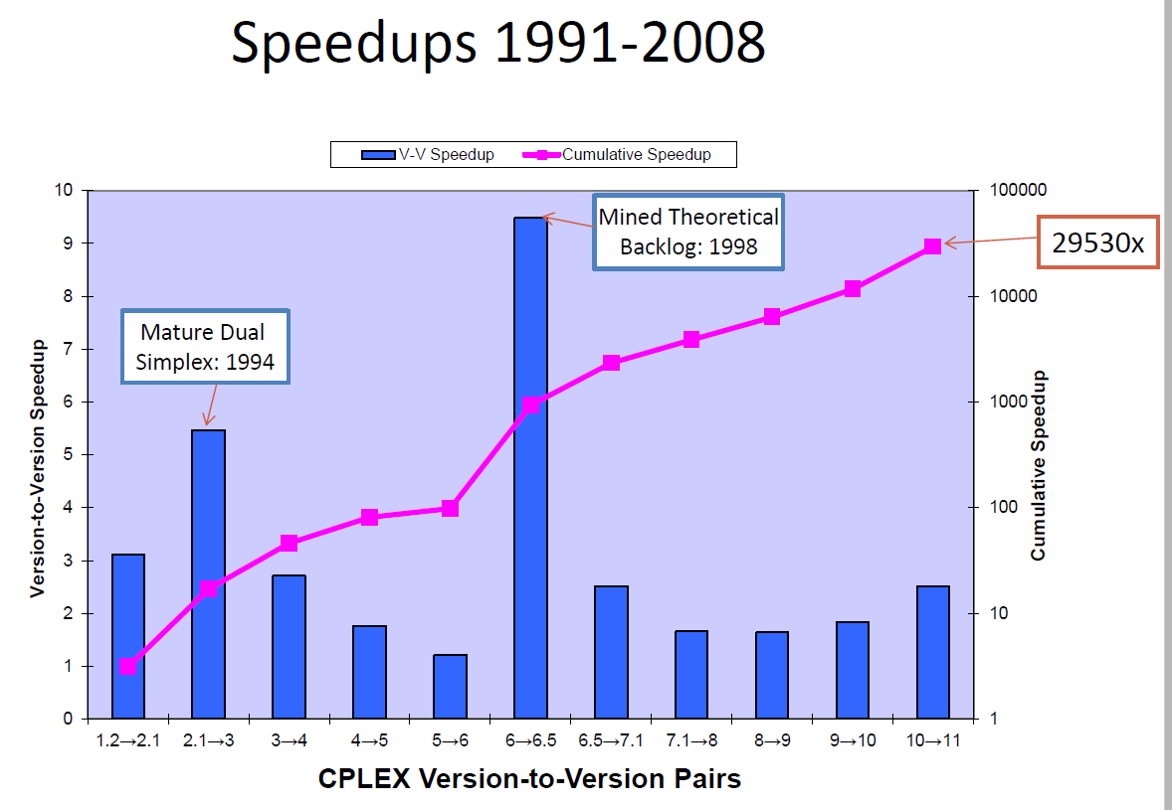
Mixed-Integer Programming
The advances in the algorithms have been substantial
Speedups from 2009 to 2015 were
about a factor
of 30
Notes are partially based on a presentation at Feb 2015 US National Academies Analytic Foundations of the Next Generation Grid by Robert Bixby from Gurobi Optimization titled “Advances in Mixed-Integer Programming and the Impact on Managing Electrical Power Grids”
27

Slide 29
Mixed-Integer Programming
Suppose you were given the following choices?
  Solve a MIP with today’s solution technology on a 1991 machine
  Solve a MIP with a 1991 solution on a machine from today?
The answer is to choose option 1, by a factor of approximately 300
This leads to the current debate of whether the OPF (and SCOPF) should be solved using generic solvers or more customized code (which could also have quite good solvers!)
Notes are partially based on a presentation at Feb 2015 US National Academies Analytic Foundations of the Next Generation Grid by Robert Bixby from Gurobi Optimization titled “Advances in Mixed-Integer Programming and the Impact on Managing Electrical Power Grids”
28

Slide 30
More General Solvers Overview
OPF is currently an area of active research
Many formulations and solution methods exist…
  As do many tools for highly complex, large-scale computing!
While many options exist, some may work better for certain problems or with certain programs you already use
Consider experimenting with a new language/solver!
  Gurobi and CPLEX are two well-known commercial optimization solvers/packages for linear programming (LP), quadratic programming (QP), quadratically constrained programming (QCP), and the mixed integer (MI) counterparts of LP/QP/QCP
  Gurobi and CPLEX are accessible through object-oriented interfaces (C++, Java, Python, C), matrix-oriented interfaces (MATLAB) and other modeling languages (AMPL, GAMS)
29

Slide 31
DC OPF and SCOPF
Solving a full ac OPF or SCOPF on a large system is difficult, so most electricity markets actually use the more approximate, but much simpler DCOPF, in which a dc power flow is used
  The DC power flow used has extensions to approximate the impact of losses
PowerWorld includes this option in the Options, Power Flow Solution, DC Options
30

Slide 32
Example 6_13 DC SCOPF: Load Scalar at 1.20
Now there is not an unenforceable constraint on the line between 4-5 (for the line 2-5 contingency) because the reactive losses are ignored
31

Slide 33
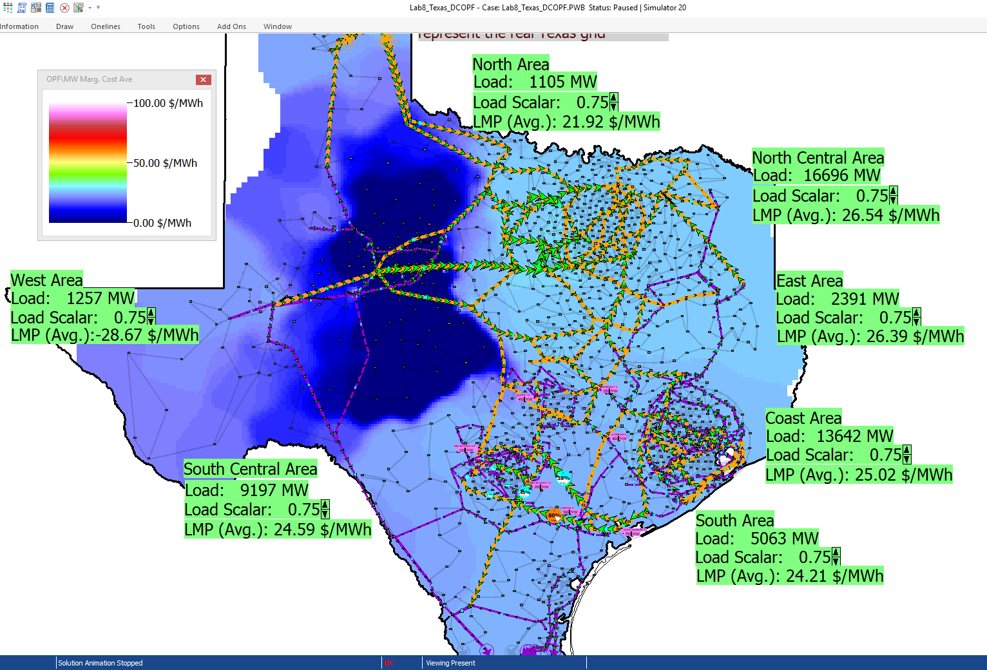
2000 Bus Texas Synthetic DC OPF Example
This system does a DC OPF solution, with the ability to change the load in the areas
The quite low LMPs
are actually due to a
constraint on a single
230/115 kV transformer
32

Slide 34
June 1998 Heat Storm: Two Constraints Caused a Price Spike
Price of electricity
in Central Illinois went
to $7500 per MWh!
Since 1998 new transmission has been added to the grid to help alleviate these constraints
Colored areas could NOT sell into Midwest because of
constraints on a line in Northern Wisconsin and on a
Transformer in Ohio
33

Slide 35
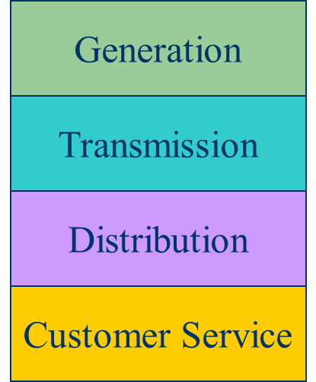
Electricity Markets History
For decades electric utilities operated as vertical monopolies, with their rates set by state regulators
Utilities had an obligation to serve
and customers had no choice
  There was little third party generation
Major change in US occurred in 1992
with the National Energy Policy Act
that mandated utilities provide
“nondiscriminatory” access to the high
voltage grid
Goal was to setup true competition in generation
34

Slide 36
Markets Versus Centralized Planning
With the vertically integrated utility, a small number of entities (typically utilities) did most of the planning
  For example, which new generators and/or lines to build
  Planning was coordinated and governed by regulators
  Regulators needed to know the utilities actual costs so they could provide them with a fixed rate of return
With markets the larger number of participants often make individual decisions in reaction to prices
  For example, whether to build new generation
  Generator owners in general to not need to reveal their true costs; rather they make offers into the market
35

Slide 37
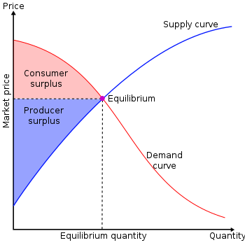
Overall Goal
Goal is to maximize the economic surplus (or total welfare), which is the sum of the consumer surplus and the producer surplus (i.e., their profit)
Generation owners have to
decide their offer prices
If their price is too high, they
are not selected to generate
At the wholesale level, the
consumers often just see a
price, though there can be price
responsive load bids
Image Source: en.wikipedia.org/wiki/Economic_surplus#/media/File:Economic-surpluses.svg
36

Slide 38
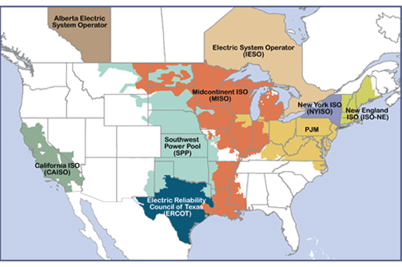
Electricity Markets Today in North America
Starting in about 1995 electricity markets gradually started to develop, both in the US and elsewhere
In North America
more than 60% of the
load is supplied via
wholesale electricity
markets; markets differ
but they all have certain
common features
  The terms regional transmission organizations (RTOs) and independent system operators (ISOs) are used (RTOs are more functionality and most are actually RTOs
Image source: www.ferc.gov/industries-data/electric/power-sales-and-markets/rtos-and-isos
37

Slide 39
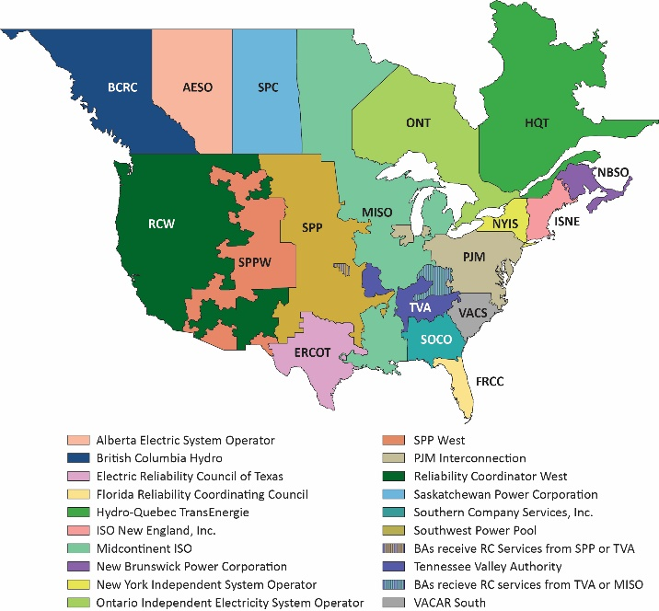
Aside: NERC Reliability Coordinators (RCs)
As noted in NERC
IRO-001-1, “Reliability Coordinators must have the authority, plans and agreements in place to immediately direct reliability entities within the Reliability Coordinator Areas to re-dispatch generation, reconfigure transmission, or reduce load to mitigate critical conditions to return the system to a reliable state.”
38

Slide 40
Electricity Markets Common Features
Day ahead market – this is needed because time is required to make decisions about committing generators
  Generation owners submit offers for how much generation they can supply and at what price; accepted offers are binding
Real-time energy market – needed because day ahead forecasts are never perfect, and unexpected events can occur
Co-optimization with other “ancillary services” such as reserves
The source for much of this material “Analytic Research Foundations for the Next-Generation Electric
Grid” (Chapter 2), The National Academies Press, 2016 (free download available)
39

Slide 41
Electricity Markets Common Features
Pricing is done using locational marginal prices, determined by an SCOPF
  Most markets include a marginal losses component
LMP markets are designed to send transparent price signals so people can make short and long-term decisions
  Generators are free to offer their electricity at whatever price they desire; they do not have to reveal their “true” costs
  Most of the times markets work as planned (competitive prices)
  During times of shortages (scarcity) there are limits on LMPs; ERCOT’s had been $9000/MWh prior to Uri; now it is $5000/MWh
  Markets are run by independent system operators (ISOs)
40

Slide 42
LMP Energy Markets
In an LMP energy market the generation is paid the LMP at the bus, and the loads pay the LMP at the bus
  This is done in both the day ahead market and in the real-time market (which makes up the differences between actual and the day ahead)
The generator surplus (profit) is the difference between the LMP and the actual cost of generation
Generators that offer too high are not selected to run, and hence make no profit
A key decision for the generation owners is what values to offer
41

Slide 43
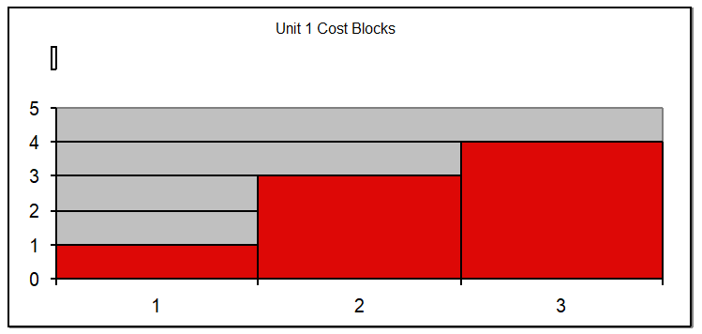
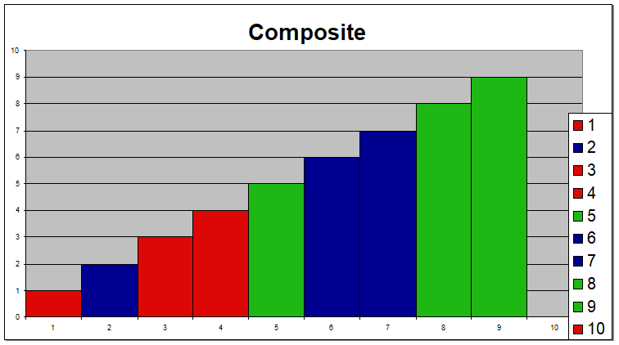
Generator Offers
Generator offers are given in piecewise linear curves; that is, a fixed $/MWh for so much power for a time period
In the absence of constraints (congestion) the ISO would just select the lowest offers to meet the anticipated load
Actual dispatch is determined using an SCOPF
42

Slide 44
General Guidelines
Generators with high fixed costs and low operating costs (e.g., wind, solar, nuclear) benefit from running many hours
  Usually they should submit offers close to their marginal costs
  Wind (and some others) receive a production tax credit (PTC) for their first ten years of operation
    $23/MWh for systems starting construction before 1/1/2017
    $18/MWh 2017, $14/MWh in 2018, $10/MWh in 2019
    It was suppose to end in 2019, but was extended in 12/2019 through 2020 at $15MWh
    Then it got extended through the end of 2021 at $18/MWh
    On 8/16/22 President Biden signed the Inflation Reduction Act of 2022 that extended the PTC through at least 2024 and provides 100% for certain projects
  Generators with low fixed costs and high operating cost can do fine operating fewer hours (at higher prices)
43

Slide 45
Auctions
In its simplest form, an auction is a mechanism of allocating scarce goods based upon competition
  a seller wishes to obtain as much money as possible, and a buyer wants to pay as little as necessary.
An auction is usually considered efficient if resources accrue to those who value them most highly
Auctions can be either one-sided with a single monopolist seller/buyer or a double auction with multiple parties in each category
  bid to buy, offer to sell
Most people’s experience is with one-side auctions with one seller and multiple buyers
44

Slide 46
Auctions, cont.
Electricity markets can be one-sided, with the ISO functioning as a monopolist buyer, while multiple generating companies make offers to sell their generation, or two-sided with load participation
Auctions provide mechanisms for participants to reveal their true costs while satisfying their desires to buy low and/or sell high.
Auctions differ on the price participants receive and the information they see along the way
45

Slide 47
Types of Single-Sided Auctions with Multiple Buyers, One Seller
Simultaneous auctions
  English (ascending price to buy)
  Dutch (descending price to buy)
Sealed-bid auctions (all participants submit offers simultaneously)
  First price sealed bid (pay highest price if one, discriminatory prices if multiple)
  Vickrey (uniform second price) (pay the second highest price if one, all pay highest losing price if many); this approach gives people incentive to bid their true value
46

Slide 48
Uniform Price Auctions: Multiple Sellers, One Buyer
Uniform price auctions are sealed offer auctions in which sellers make simultaneous decisions (done when submitting offers).
Generators are paid the last accepted offer
Provides incentive to offer at marginal cost since higher values cause offers to be rejected
  reigning price should match marginal cost
Price caps are needed to prevent prices from rising up to infinity during shortages
Some generators offering above their marginal costs are needed to cover their fixed costs
47

Slide 49
What to Offer Example
Below example shows 3 generator case, in which the bus 2 generator can vary its offer to maximize profit
Note, this example makes the unrealistic assumption that the other generators do not vary their offers in response
48

Slide 50
Horizontal Market Power
One issue is whether a particular group of generators has market power
Market power is the antithesis of competition
    It is the ability of a particular group of sellers to maintain prices above competitive levels, usually by withholding supply
  The extreme case is a single supplier of a product (i.e., a monopoly)
  In the short run what a monopolistic producer can charge depends upon the price elasticity of the demand
  Sometimes market power can result in decreased prices in the long-term by quickening the entry of new players or new innovation
49

Slide 51
Market Power and Scarcity Rents
A generator owner exercises market power when it is unwilling to make energy available at a price that is equal to that unit’s variable cost of production, even thought there is currently unloaded generation capacity (i.e., there is no scarcity).
Scarcity rents occur when the level of electric demand is such that there is little, if any, unused capacity
Scarcity rents are used to recover fixed costs
50

