Slide 1
ECEN 615
Methods of Electric Power
Systems Analysis
Lecture 25: Auctions, Electric Grid Resiliency
Prof. Tom Overbye
Dept. of Electrical and Computer Engineering
Texas A&M University
overbye@tamu.edu

Slide 2
Security Constrained OPF
Security constrained optimal power flow (SCOPF) is similar to OPF except it also includes contingency constraints
  Again the goal is to minimize some objective function, usually the current system cost, subject to a variety of equality and inequality constraints
  This adds significantly more computation, but is required to simulate how the system is actually operated (with N-1 reliability)
A common solution is to alternate between solving a power flow and contingency analysis, and an LP
1

Slide 3
Security Constrained OPF, cont.
With the inclusion of contingencies, there needs to be a distinction between what control actions must be done pre-contingent, and which ones can be done post-contingent
  The advantage of post-contingent control actions is they would only need to be done in the unlikely event the contingency actually occurs
Pre-contingent control actions are usually done for line overloads, while post-contingent control actions are done for most reactive power control and generator outage re-dispatch
2

Slide 4
SCOPF Example
We’ll again consider Example 6_23, except now it has been enhanced to include contingencies and we’ve also greatly increased the capacity on the line between buses 4 and 5; named Bus5_SCOPF_DC
Original with line 4-5 limit of 60 MW with 2-5 out
Modified with line 4-5 limit of 200 MVA with 2-5 out
3

Slide 5
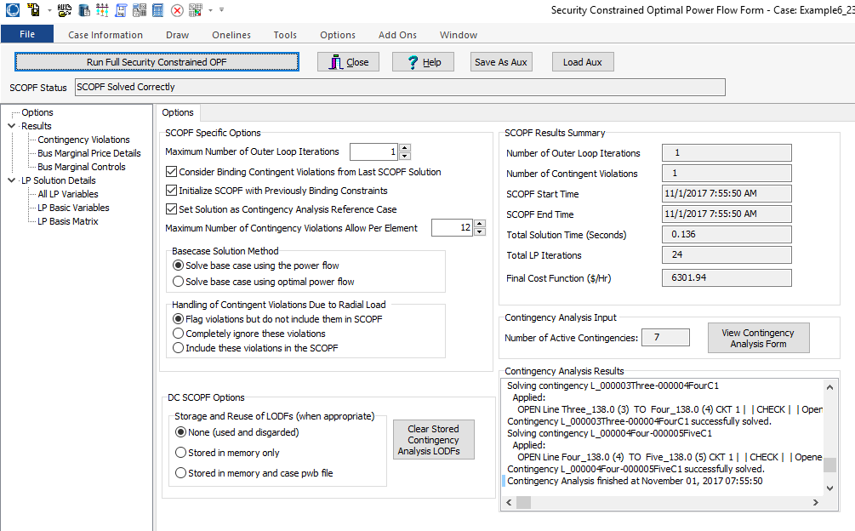
PowerWorld SCOPF Application
Just click the button to solve
Number of times
to redo contingency
analysis
4

Slide 6
Auctions
In its simplest form, an auction is a mechanism of allocating scarce goods based upon competition
  a seller wishes to obtain as much money as possible, and a buyer wants to pay as little as necessary.
An auction is usually considered efficient if resources accrue to those who value them most highly
Auctions can be either one-sided with a single monopolist seller/buyer or a double auction with multiple parties in each category
  bid to buy, offer to sell
Most people’s experience is with one-side auctions with one seller and multiple buyers
5

Slide 7
Auctions, cont.
Electricity markets can be one-sided, with the ISO functioning as a monopolist buyer, while multiple generating companies make offers to sell their generation, or two-sided with load participation
Auctions provide mechanisms for participants to reveal their true costs while satisfying their desires to buy low and/or sell high.
Auctions differ on the price participants receive and the information they see along the way
6

Slide 8
Types of Single-Sided Auctions with Multiple Buyers, One Seller
Simultaneous auctions
  English (ascending price to buy)
  Dutch (descending price to buy)
Sealed-bid auctions (all participants submit offers simultaneously)
  First price sealed bid (pay highest price if one, discriminatory prices if multiple)
  Vickrey (uniform second price) (pay the second highest price if one, all pay highest losing price if many); this approach gives people incentive to bid their true value
7

Slide 9
Uniform Price Auctions: Multiple Sellers, One Buyer
Uniform price auctions are sealed offer auctions in which sellers make simultaneous decisions (done when submitting offers).
Generators are paid the last accepted offer
Provides incentive to offer at marginal cost since higher values cause offers to be rejected
  reigning price should match marginal cost
Price caps are needed to prevent prices from rising up to infinity during shortages
Some generators offering above their marginal costs are needed to cover their fixed costs
8

Slide 10
What to Offer Example
Below example shows 3 generator case, in which the bus 2 generator can vary its offer to maximize profit
Note, this example makes the unrealistic assumption that the other generators do not vary their offers in response
9

Slide 11
Horizontal Market Power
One issue is whether a particular group of generators has market power
Market power is the antithesis of competition
    It is the ability of a particular group of sellers to maintain prices above competitive levels, usually by withholding supply
  The extreme case is a single supplier of a product (i.e., a monopoly)
  In the short run what a monopolistic producer can charge depends upon the price elasticity of the demand
  Sometimes market power can result in decreased prices in the long-term by quickening the entry of new players or new innovation
10

Slide 12
Market Power and Scarcity Rents
A generator owner exercises market power when it is unwilling to make energy available at a price that is equal to that unit’s variable cost of production, even thought there is currently unloaded generation capacity (i.e., there is no scarcity).
Scarcity rents occur when the level of electric demand is such that there is little, if any, unused capacity
Scarcity rents are used to recover fixed costs
11

Slide 13
High-Impact, Low-Frequency Events
Growing concern to consider what the NERC calls calls High-Impact,
Low-Frequency Events
(HILFs); others call them
black sky days
  Large-scale, potentially long duration blackouts
  HILFs identified by NERC
  were 1) a coordinated cyber,
  physical or blended attacks, 2) pandemics, 3) geomagnetic disturbances (GMDs), and 4) HEMPs
The next several slides will consider some challenges in this area including some coverage of Winter Storm Uri
Image Source: NERC, 2012
12

Slide 14
Reliability and Resiliency
Keeping the lights on involves designing and operating the electric grid with a goal of simultaneously increasing two related but ultimately different concepts: reliability and resiliency
Reliability: suitable or fit to be relied on: dependable
  One of the key benefits of interconnected electric grids
Resiliency: an ability to recover from or adjust easily to misfortune or change
  A key focus of electric grid protection systems almost from day one, but there is a more recent focus on acknowledging that large-scale blackouts cannot be totally prevented, so we must be able to bounce back
13
13

Slide 15
What is Grid Resilience?
Merriam Webster Dictionary (resilience in general)
  “An ability to recover from or adjust easily to misfortune or change”
EPRI & North American Transmission Forum (NATF)
  The ability of the system and its components (… equipment and human …) to minimize damage and improve recovery from non-routine disruptions, including High Impact, Low Frequency (HILF) events, in a reasonable amount of time”
These definitions are from the 53rd North American Power Symposium keynote address by Dan Smith of Lower Colorado River Authority, Nov/2021

Slide 16
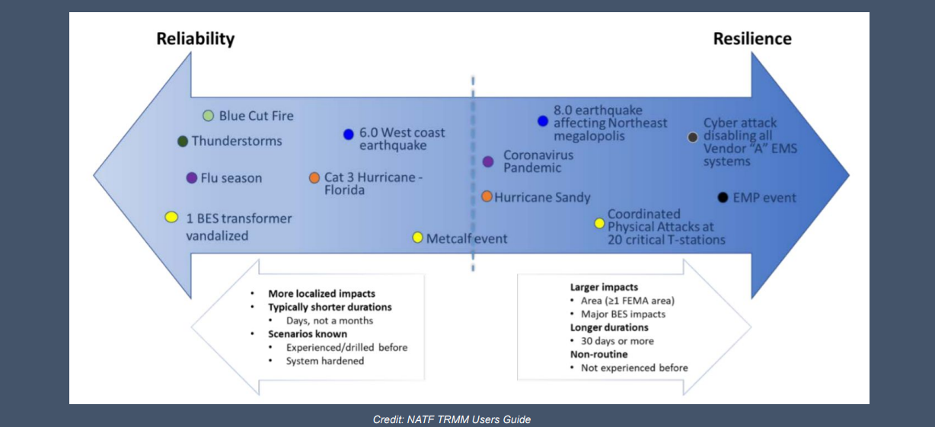
Reliability – Resilience Continuum
Slide is from the 53rd North American Power Symposium keynote address by Dan Smith of Lower Colorado River Authority, November 2021; credit NATF

Slide 17
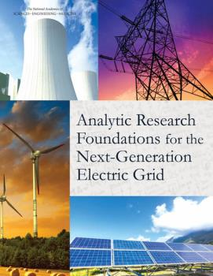
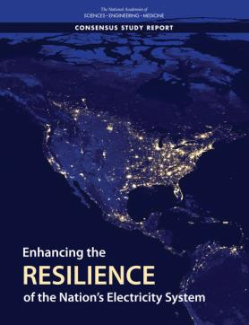
Several Recent Reports on Resiliency
Analytic Research Foundations for the Next-Generation Electric Grid, 2016
  Make everything as simple as possible but not simpler [maybe from Einstein]
Enhancing the Resilience of the Nation’s Electricity System, 2017
US Department of Energy Transmission Innovation Symposium, May 2021
  www.energy.gov/oe/transmission-innovation-symposium
Focus here is on resiliency

Slide 18
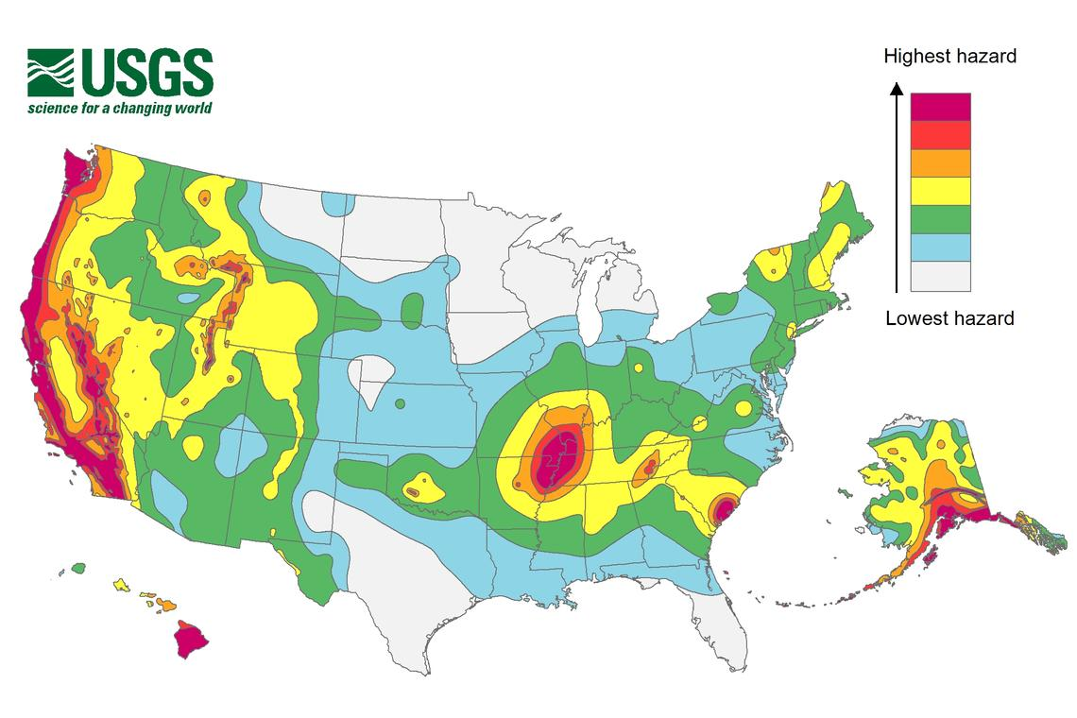
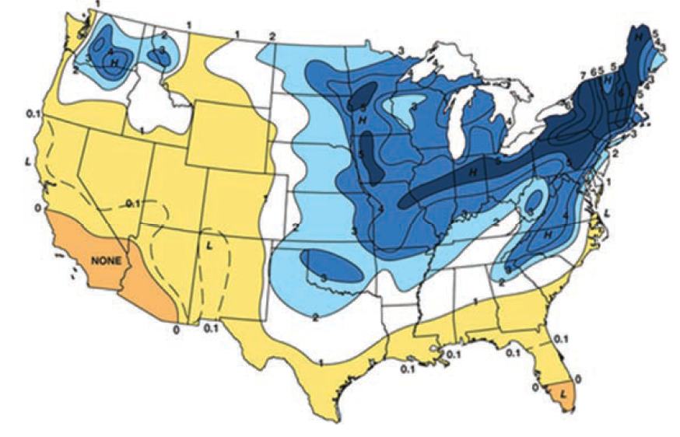
Resilient to What?
A key question on resiliency is to determine the likely threats
  Some are geographic, and may are hard to quantify
Earthquake Risk
Freezing Rain Risk
Source: Enhancing the Resilience of the Nation’s Electricity System, 2017

Slide 19
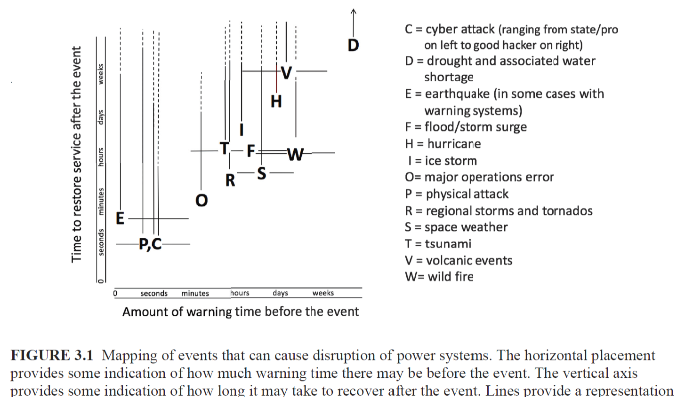
Some Electric Grid Risks
This image does not mention cold weather, though it is discussed in the 2017 report
Source: Enhancing the Resilience of the Nation’s Electricity System, 2017

Slide 20
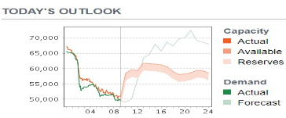
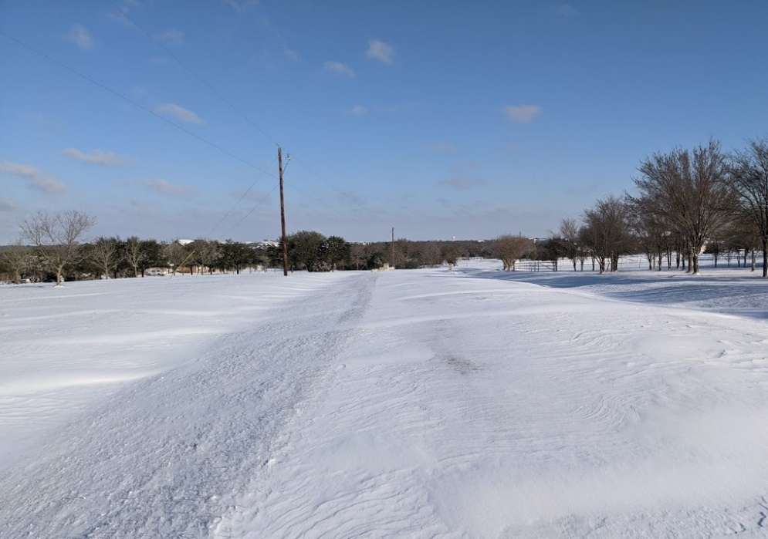
Texas Near Blackout, February 2021
Unfortunately, electric grids often make the news for all the wrong reasons!
Starting on Feb 14, 2021 statewide
Texas had temperatures much
below avg., though not record cold
  In College Station on Feb 15 is low was 9°F and very windy (and 5°F on Feb 16); avg. high is 65°F and low of 45°F
  Our record low is -3°F (1/31/1949), our
  coldest February temperature was 5°F
  (2/5/1951) and last single digit was 9°F
  (12/22/1989)
This stressed many infrastructures
including the ERCOT electric grid

Slide 21
Zoomed View of Generation Sources, 2021

Slide 22
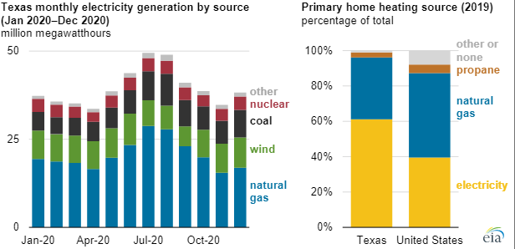
Texas Generation and Home Heating Sources
Texas population is growing, increasing 16% from 25.1 million in 2010 to 29.2 million on 2020
Image Source: www.eia.gov/todayinenergy/detail.php?id=47116

Slide 23
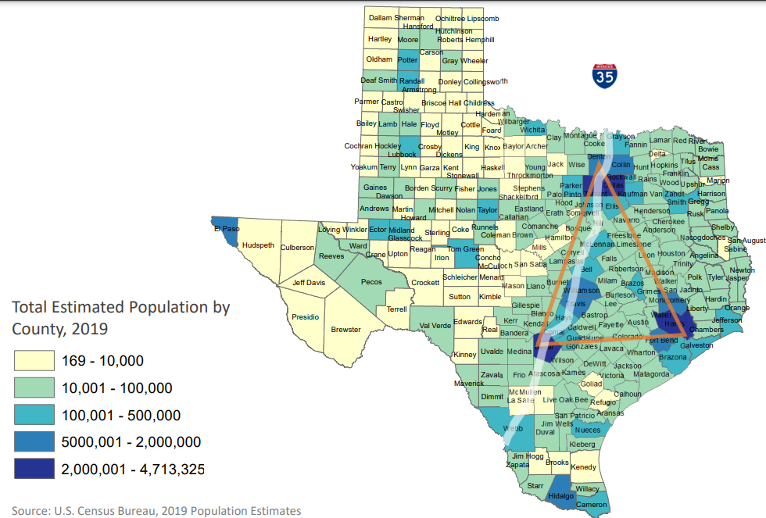
Texas Population Density
85% of population is along or east of the I35 corridor (DFW to Waco to Austin to San Antonio to Laredo)

Slide 24
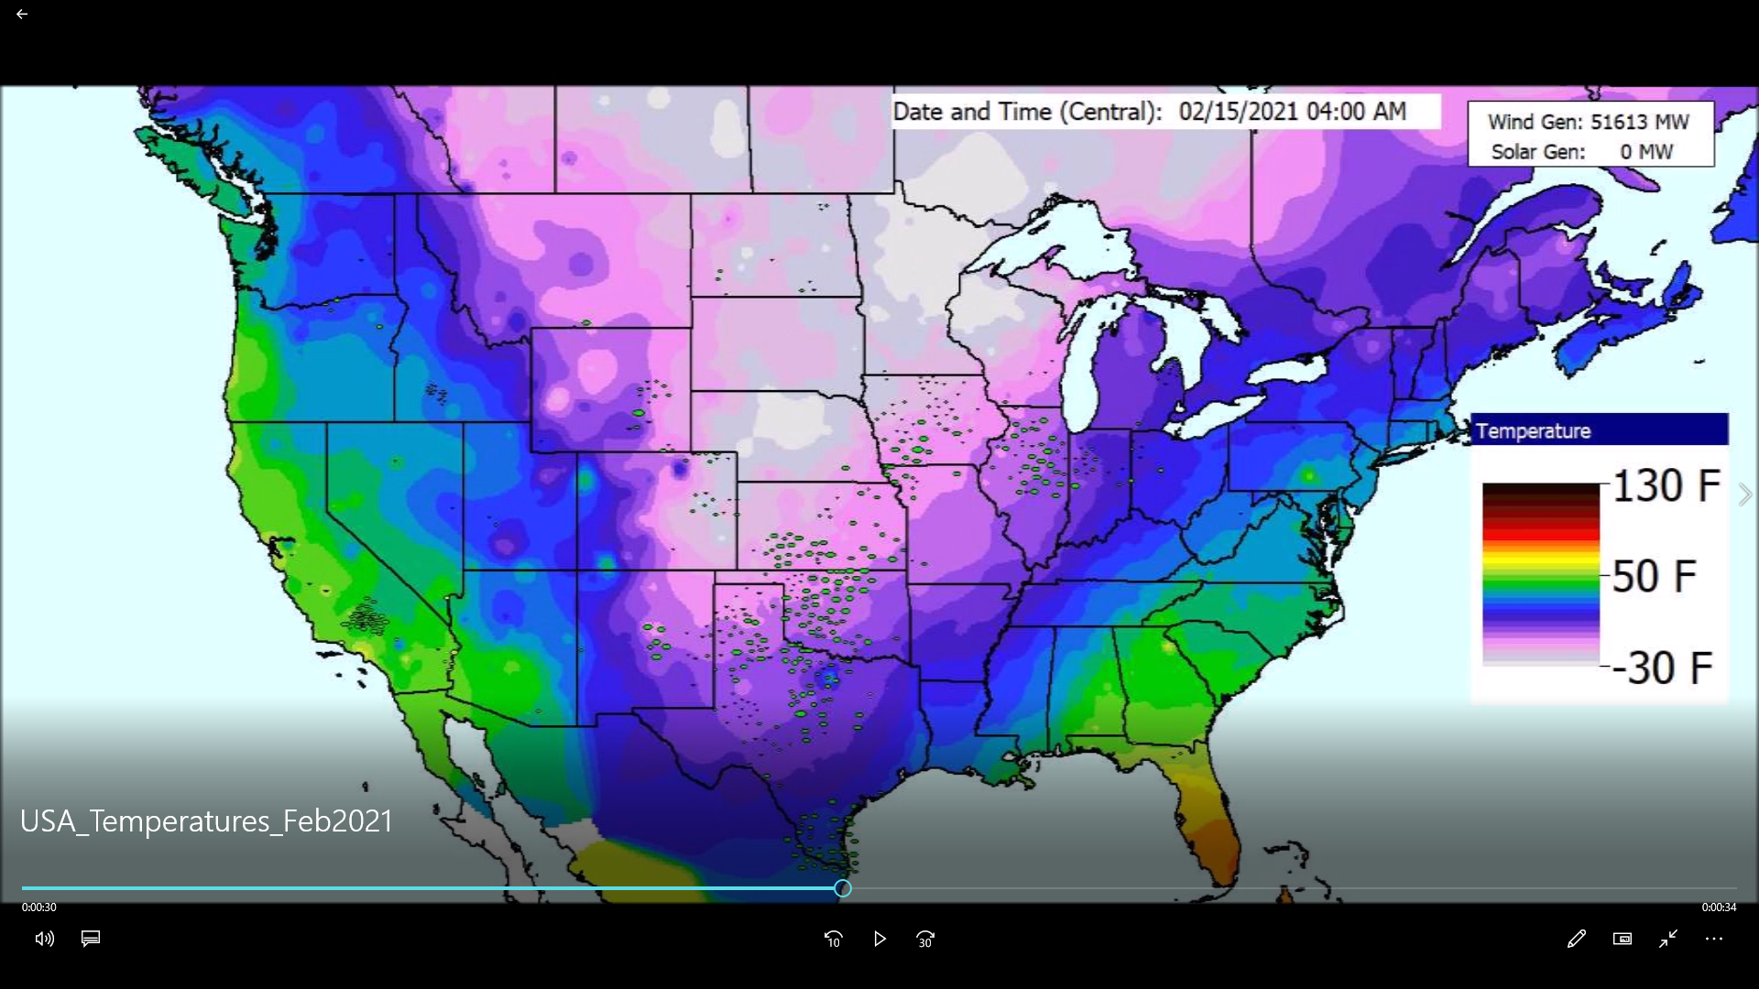
Visualization of Temperatures, Feb 11 to 18, 2021

Slide 25
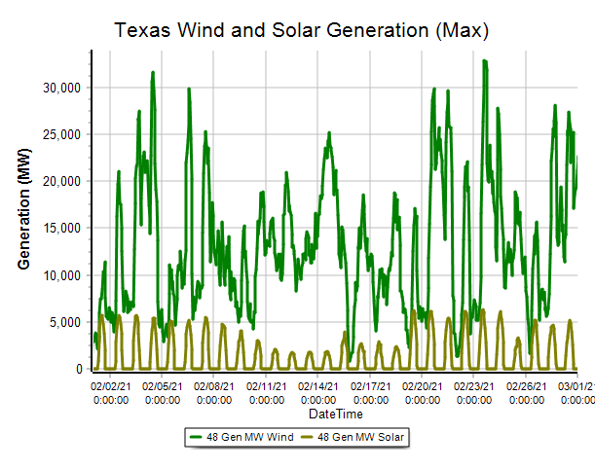
Texas Wind and Solar Max Gen Based on Weather
This does not account for cold weather failures

Slide 26
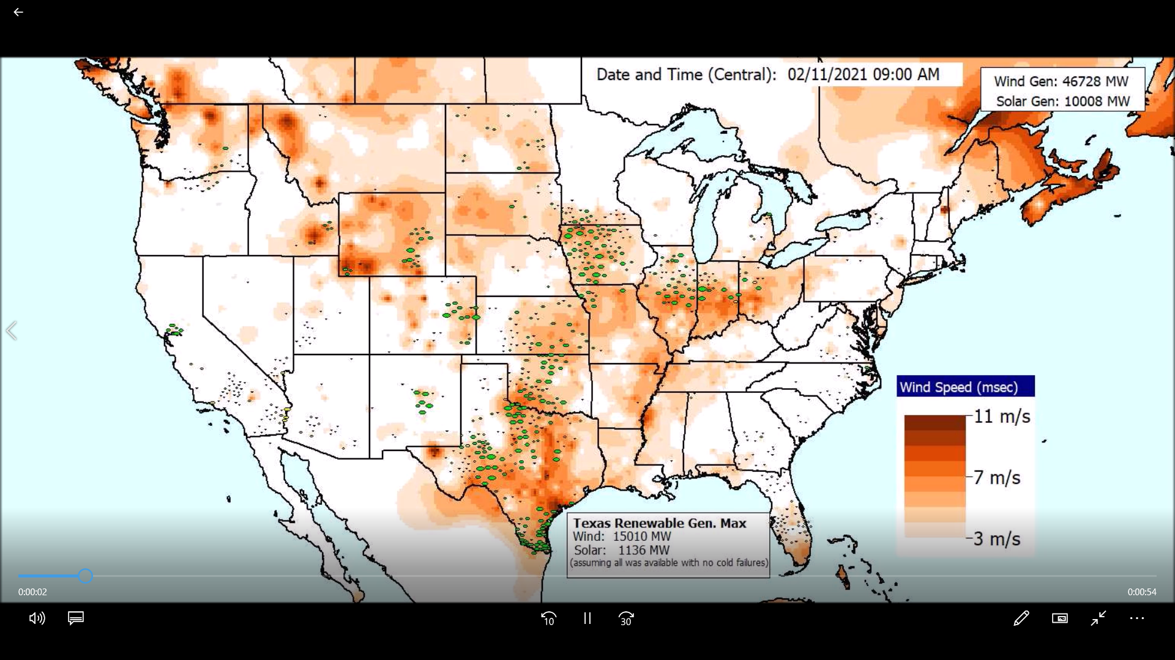
Visualization of Wind Speed, Feb 11 to 18, 2021

Slide 27
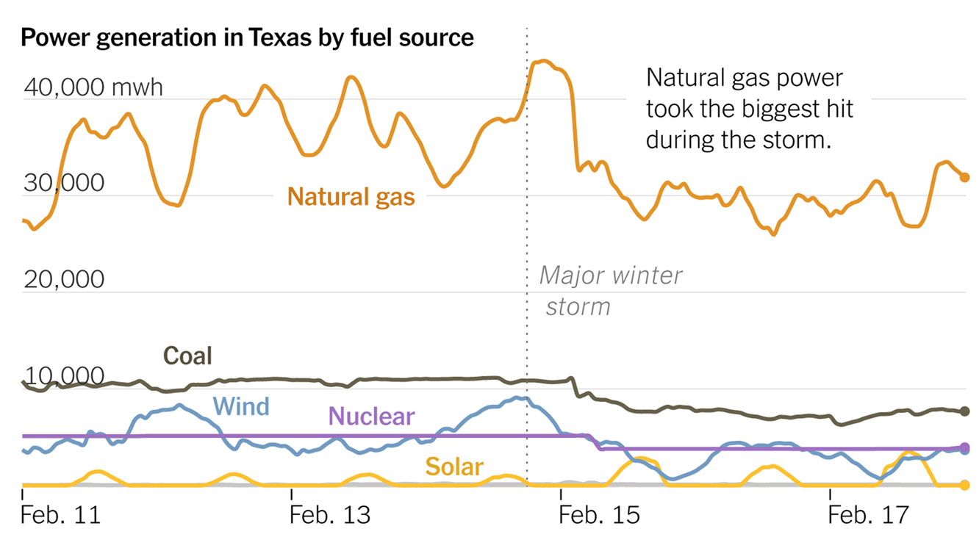
ERCOT Generation Feb 11-18, 2021
Image source: New York Times, Feb 23, 2021

Slide 28
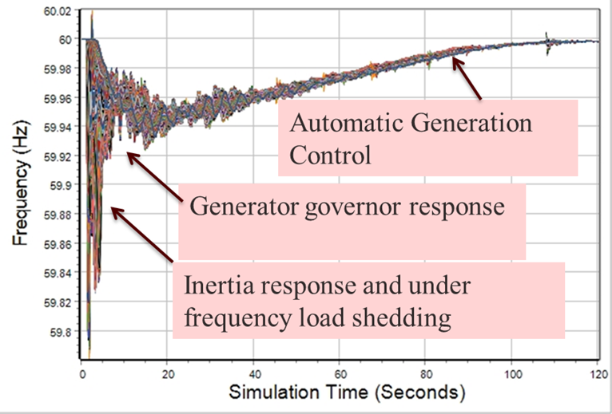
Quick Aside: Power System Dynamic Response to Load/Gen Mismatch
An electric grid frequency is constantly changing, but it usually within a few mHz of desired (e.g., 60 Hz)
Too much generation
increases the frequency
and too little decreases it
All grid elements have
the same average frequency
but during disturbances the
frequency can oscillate

Slide 29
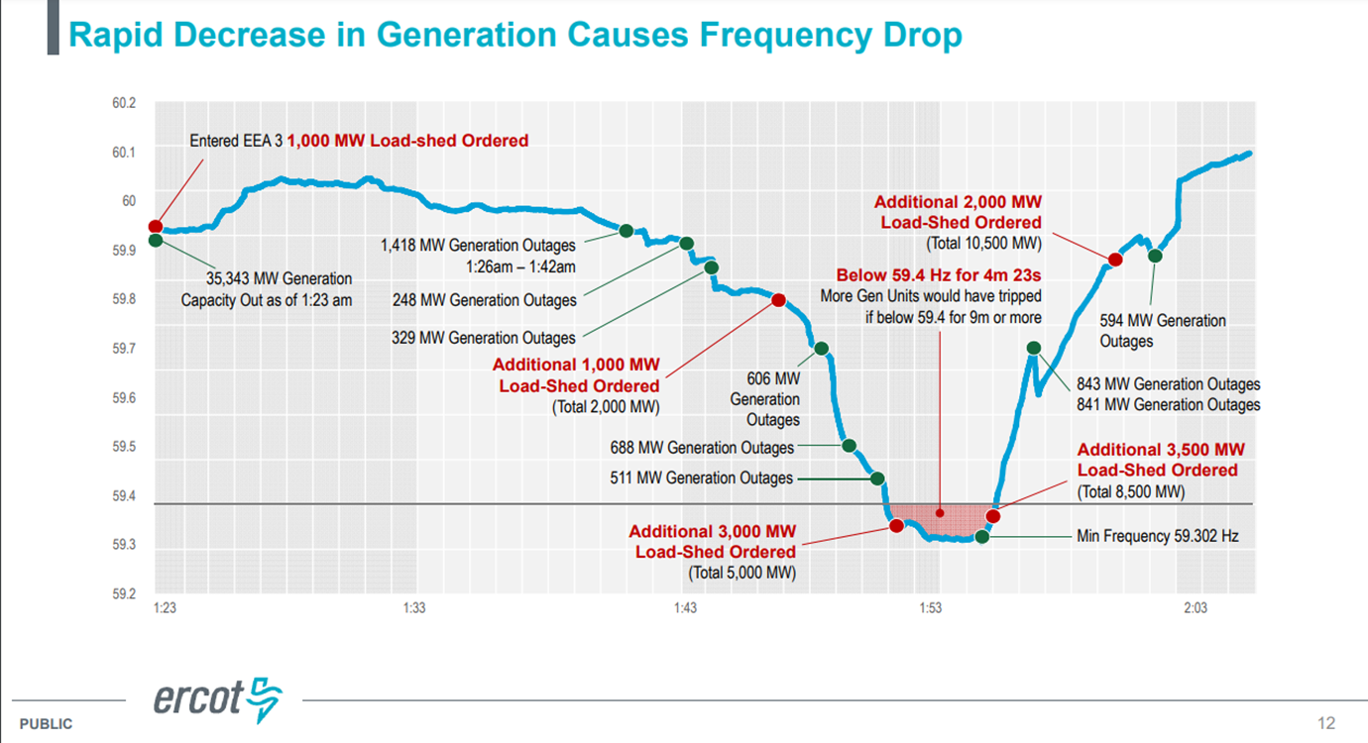
ERCOT Frequency, Feb 15, 2021
Image source: ERCOT Presentation by Bill Magness, February 25, 2021

Slide 30
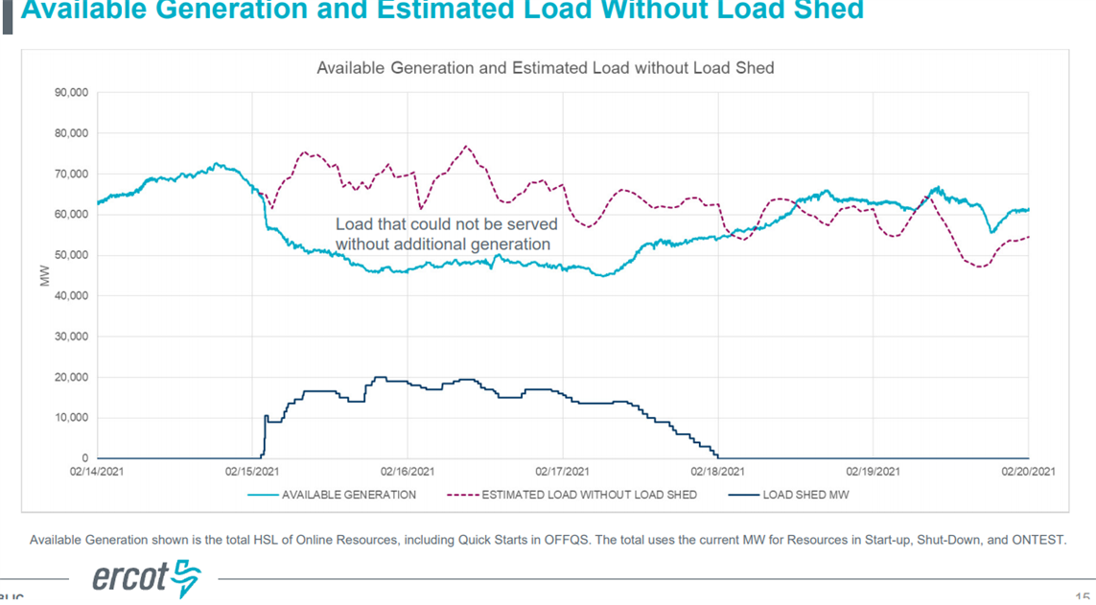
ERCOT Load Shed and Rotating Blackouts
The vast majority of the lost load was due to load shed and then rotating blackouts
At the time the ERCOT peak load had been 74.8 GW (summer); winter peak of 69.2 GW was set on 2/14/21 (previous winter peak was 65.9 GW). A new peak of 80 GW was set on 7/20/22.
Image source: ERCOT Presentation by Bill Magness, February 25, 2021

Slide 31

How can Grids Cascade?
ERCOT reported that they were minutes away from a catastrophic blackout that would have taken down the entire grid, requiring many days to restore
Grids can cascade due to a number of different reasons with many related to the transmission grid flows and voltages
For ERCOT the situation was the
prolonged (minutes) low frequency
would have result in generators
tripping due to under frequency
resulting in a cascading collapse
in the frequency and hence the entire system

Slide 32
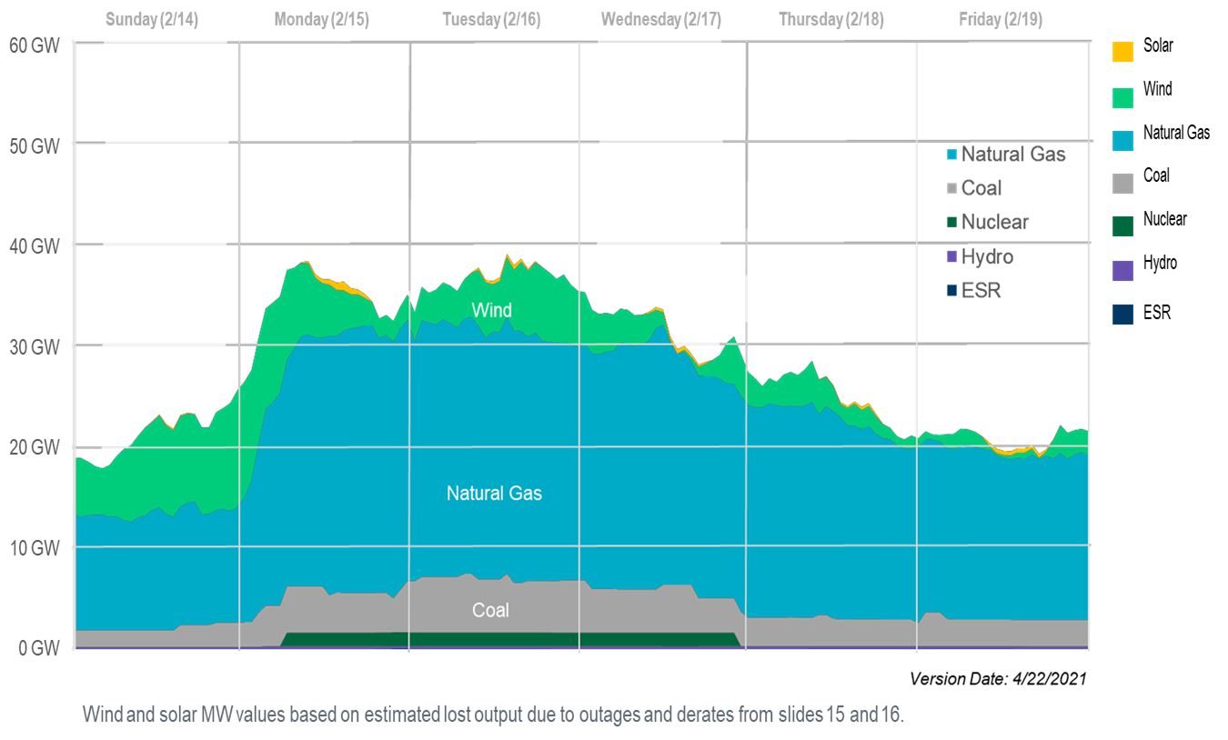
How Much Generation was Lost?
This slide correctly recognizes that much of the wind capacity that was not available due to the cold, would not have been generating much because of low wind.

Slide 33
Winterizing Wind Turbines
In general wind turbines can operate in quite low temperatures
However, most of the wind turbines in Texas were not configured with the systems needed to deal with low temperatures
  They mostly were not available because of turbine blade icing
Wind turbines can be winterized with systems such as heated blades or coatings; packages can also be installed to protect the gearbox and motors, such as adding heating to the nacelle

Slide 34
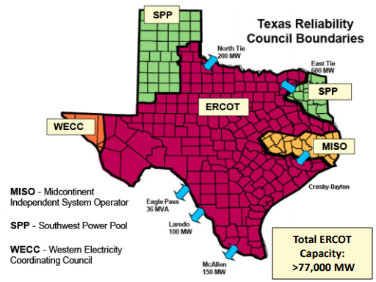
Background: Why is ERCOT Separate?
ERCOT operates asynchronous from the rest of North America, but has high voltage dc (HVDC) ties with the Eastern Interconnect and Mexico
The advantage is ERCOT avoids some federal
regulation. The legal basis for
this is complex, based on
the US Constitution, the Federal
Power Act, the 5/4/76 midnight
connection, other legislation,
court rulings, and FERC decisions
Image Source: aect.net/documents/2017/AECT%20LSB%20012617.pdf

Slide 35
Joining the East and West Grids
In 2020 we did a research project for SPP looking at an ac interconnection of the East and West grids
  This did not include ERCOT, but did include parts of Texas
There are nine locations where the grids are close and could be tied together
The study required lots of dynamic simulations using
quite detailed full system models (transient stability level, 110,000 buses)
The result was there are no show stoppers to doing this, and there could be good benefits!
We have just started (Fall 2022) a follow-up project, looking more at the economic benefits

Slide 36
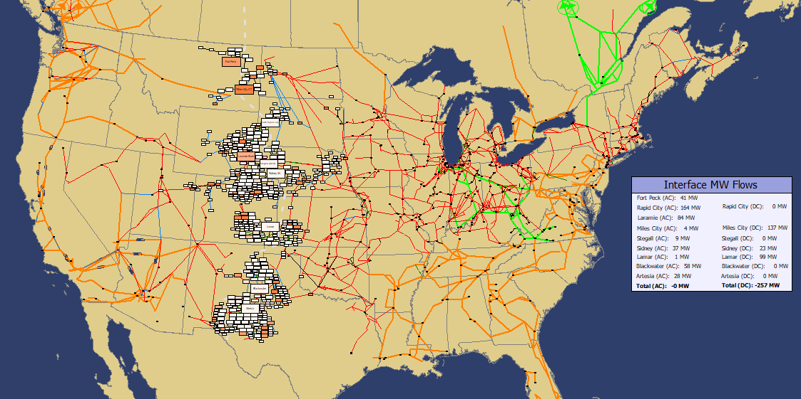
East-West Combined Grid
The study included Canada but we did not consider any ac interconnections between the grids in Canada; the grids were connected at nine points from Montana to New Mexico

Slide 37
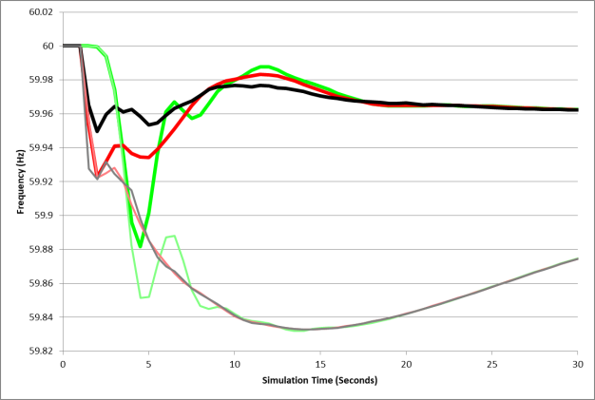
WECC Frequency Response: With and Without the AC Interconnection
The graph compares the frequency response for three WECC buses for a severe contingency with the interface (thick lines) and without (thin lines)

Slide 38
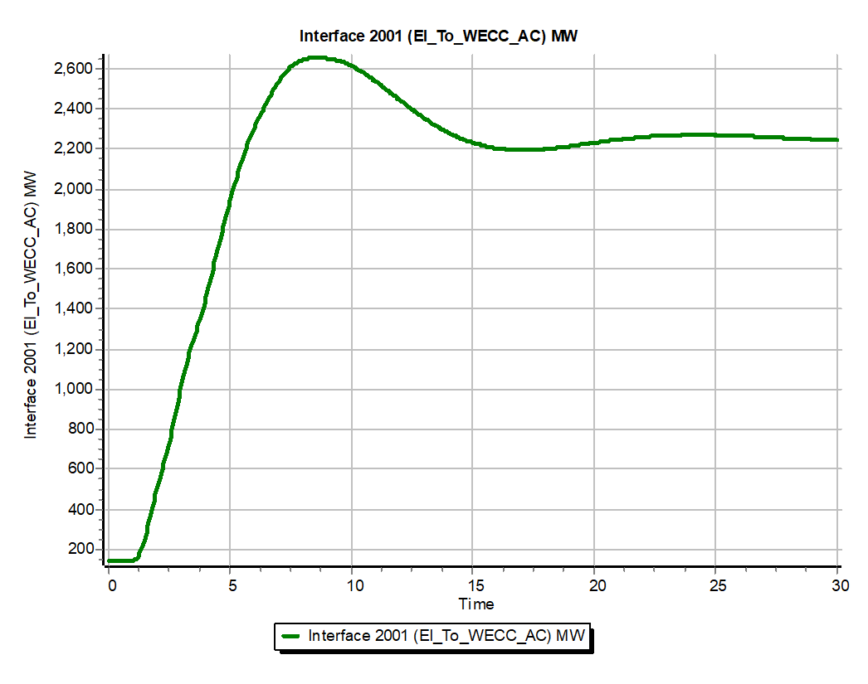
AC-Tie Interface, Severe Contingency
The large, and seemingly persistent, change in the interface flow required the need for modeling the system’s longer term AGC response.

Slide 39
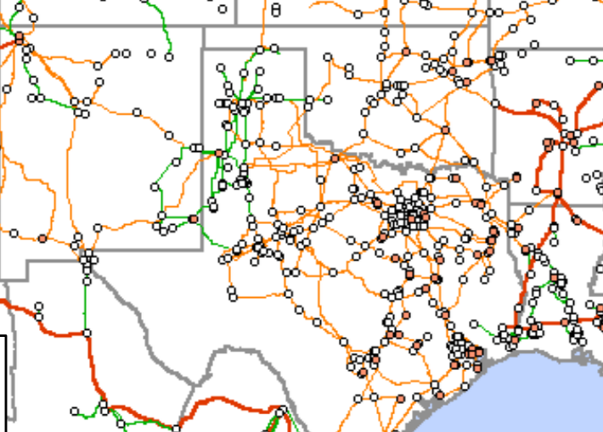
ERCOT-East-West Transmission
Orange is 345 kV, Red is 500 kV
An ac interconnection would probably be the least expensive approach to greatly increase the ERCOT import/export capability, assuming it did not change the current regulation approach

Slide 40
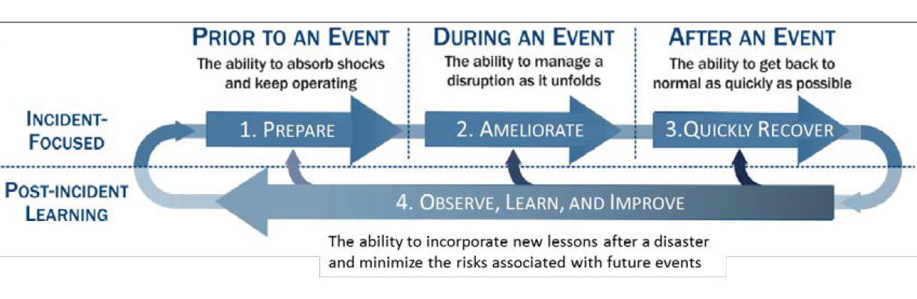
Back to General Resilience: The Four Stage Process
This is presented as Figure 1.2a in the National Academies’ Enhancing the Resilience of the Nation’s Electricity System report (2017), and is originally from
S.E. Flynn, “America the resilient: Defying terrorism and mitigating
natural disasters.” Foreign Affairs, vol. 87: 2–8 (2008) and as illustrated by the National Infrastructure Advisory Council (NIAC) in 2010.

Slide 41
How to Approach HILF Events
The goal in studying HILFs is seldom to replicate a specific event
  Many have not occurred, and within each class there can be great variability (e.g., a physical attack)
Nor is it to ensure there is no loss of service
Rather, it is to be broadly prepared, and to be able to do at least a reasonable cost/benefit analysis
HILF simulations can help in preparing for the unexpected
Several techniques, such as improved control room rare event situational awareness and better black start procedures, are generally applicable

Slide 42
HILF Two Main Categories
HILF events can be divided into two broad categories: 1) those not caused by human agents, and 2) those caused by human agents
Modeling the non-human events is somewhat easier because the goal is to (at least generally) replicate what has occurred, or what could occur
With human agent events the challenge is to protect the grid from potential events, without exposing vulnerabilities to an adversary or giving out potential mechanisms of attack
Synthetic grids are good for both

Slide 43
82,000 Bus Synthetic Grid
The different colors indicate different nominal kV voltages, with green 765, orange 500, red 345, blue 230, black lower.
We hope to develop models for other countries and are in the process of adding additional detail; creating realistic synthetic grids is challenging since real grids involve lots of engineering

Slide 44
Resilience and Grid Size
There is no optimal ac grid size for resiliency
  Larger grids can share resources, particularly during emergencies, and can provide access to larger power markets
  But larger grids also open up the risk to cascading outages, potentially causing large scale blacks
  The world’s largest grids are 1) State Grid of China (900 GW), 2) Continental Europe (850 GW), 3) North American Eastern Interconnect (650 GW)
Probably the most effective approach is to have grids the can flexibly breakup into smaller grids (known as adaptive islanding

Slide 45
General Grid Resilience Comments
Understanding resilience requires considering how grids will respond to particular disturbances
Substantially changing the topologies of existing grids is usually not an option
Simplistic studies of how a grid disturbance could cascade often lead to incorrect conclusions
  Sequential power flows, sequentially taking out overloaded devices are not particularly helpful
Full detail models of large-scale actual grids including the protection system usually don’t exist and modeling them would requiring knowing the associated remedial action schemes

Slide 46
Resiliency and Renewables
As renewables make up an increasing percentage of our generation, there is growing concern about outlier weather events that could curtail large amounts of generation
  A traditional droughts can impact hydro and the cooling on some thermal units
  “Wind droughts” can impact wind energy production; Europe experienced a partial wind drought in late 2021
  Unusually long periods of cloudy weather negatively impact solar power generation
Fuel source diversity can help, and can additional transmission to help with geographic diversity

Slide 47
Resiliency and Coupled Infrastructures
As our societies become more dependent on electricity, short and small duration blackouts become more concerning, and large-scale, long duration outages can be catastrophic
There are many couplings between electric grids and other infrastructures such as natural gas, water, cyber, and increasing transportation
These couples need to be more fully considered in electric grid resiliency modeling and simulation

Slide 48
Some Specific Recommendations to Enhance Resilience
A “visioning” process is needed to imaging and assessing plausible high impact events
The electric grid operators need to do exercises to better simulate high impact scenarios
More physical components are needed, including replacement transformers and backup power
More research, development and demonstration is needed, including a focus on cyber and HILFs
Resilience groups are needed throughout the industry and government to raise awareness
Source: National Academies 2017 “Enhancing the Resilience of the Nation’s Electricity System”
47

