Slide 1
ECEN 615
Methods of Electric Power
Systems Analysis
Lecture 3:Per Unit, Ybus, Power Flow
Prof. Tom Overbye
Dept. of Electrical and Computer Engineering
Texas A&M University
overbye@tamu.edu

Slide 2
Announcements
Exam 1 is moved to Oct 13 (Oct 10 and 11 are fall break)
Homework 1 is assigned today. It is due on Thursday September 8
ERCOT is having a Virtual College Day on September 16 at
930am (Central Time); details at ERCOT.COM/CAREERS
  To register you can go to www.ercot.com/careers/edp

Slide 3

ERCOT Virtual College Day
To register you can go to
www.ercot.com/careers/edp

Slide 4
Brief History of Electric Power
First real practical uses of electricity began with the telegraph (1860's) and then arc lighting in the 1870’s
Early 1880’s – Edison introduced Pearl Street dc system in Manhattan supplying 59 customers
1884 – Sprague produces practical dc motor
1885 – invention of transformer
Mid 1880’s – Westinghouse/Tesla introduce rival ac system
Late 1880’s – Tesla invents ac induction motor
1893 – Three-phase transmission line at 2.3 kV

Slide 5
History, cont’d
1896 – ac lines deliver electricity from hydro generation at Niagara Falls to Buffalo, 20 miles away; also 30kV line in Germany
Early 1900’s – Private utilities supply all customers in area (city); recognized as a natural monopoly; states step in to begin regulation
By 1920’s – Large interstate holding companies control most electricity systems
1935 – Congress passes Public Utility Holding Company Act to establish national regulation, breaking up large interstate utilities (repealed 2005)
    This gave rise to electric utilities that only operated in one state
1935/6 – Rural Electrification Act brought electricity to rural areas
1930’s – Electric utilities established as vertical monopolies

Slide 6
History, cont’d
Frequency standardized in the 1930’s
During 1940’s to 1960’s utilities gradually interconnected their systems so by 1970 transmission lines crisscrossed North America, with voltages up to 765 kV
1970’s brought inflation, increased fossil-fuel prices, calls for conservation and growing environmental concerns
Increasing rates replaced decreasing ones
As a result, U.S. Congress passed Public Utilities Regulator Policies Act (PURPA) in 1978, which mandated utilities must purchase power from independent generators located in their service territory (modified 2005)
PURPA introduced some competition

Slide 7
History, cont’d
Major opening of industry to competition occurred as a result of National Energy Policy Act of 1992
This act mandated that utilities provide “nondiscriminatory” access to the high voltage transmission
Goal was to set up true competition in generation
Result over the last few years has been a dramatic restructuring of electric utility industry (for better or worse!)
Energy Bill 2005 repealed PUHCA; modified PURPA
Electric grid restructuring took place in the 1990’s into the 2000’s
  Goal has been to reduce rates through the introduction of competition and consumer choice

Slide 8
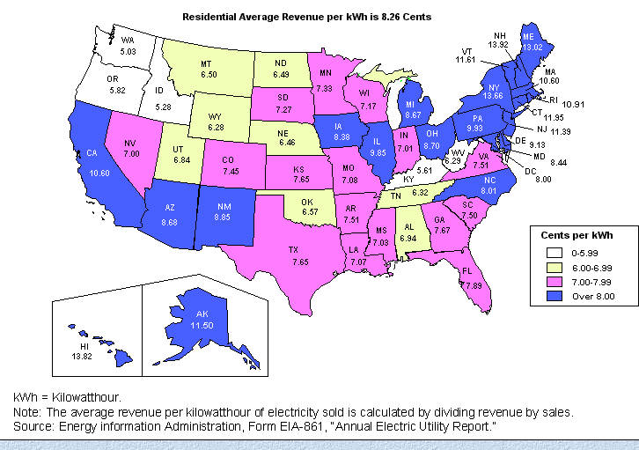
Historical State Variation in Electric Rates

Slide 9

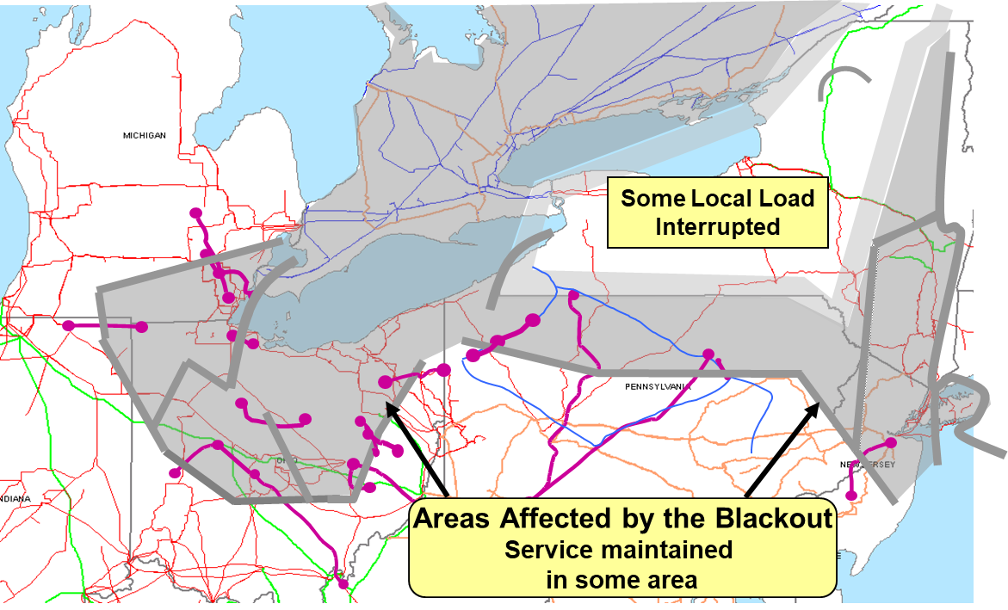
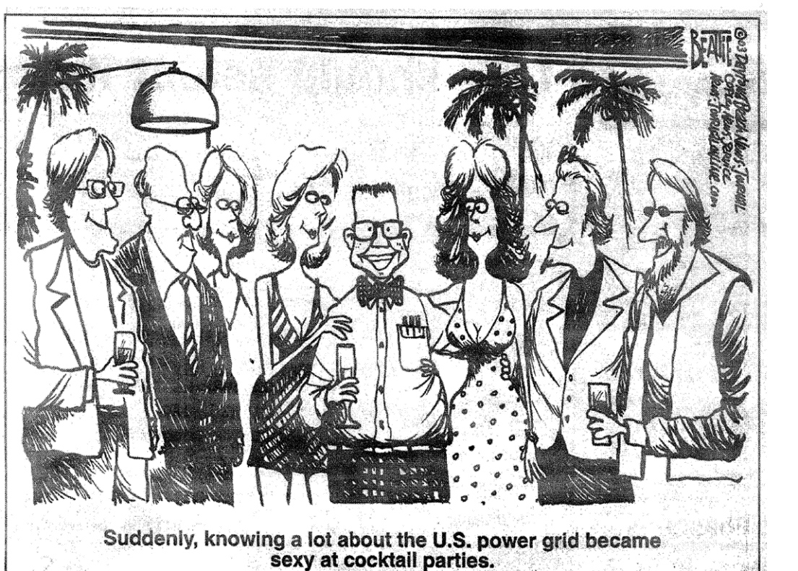
August 14th, 2003 Blackout
Above image from energy.gov, August 14, 2003
Blackout Final Report
I will talk about this event and the 2021 Texas one later in the semester

Slide 10

345 kV+ Transmission Growth at a Glance (From Jay Caspary)

Slide 11
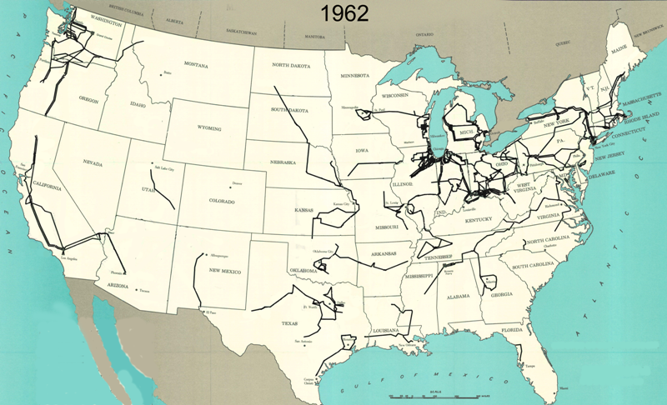
345 kV+ Transmission Growth at a Glance (From Jay Caspary)

Slide 12
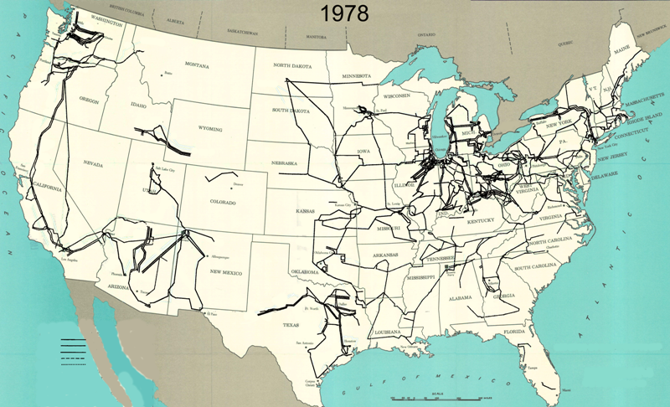
345 kV+ Transmission Growth at a Glance (From Jay Caspary)

Slide 13
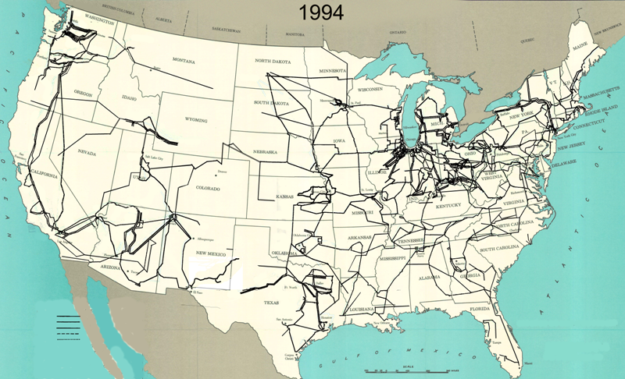
345 kV+ Transmission Growth at a Glance (From Jay Caspary)

Slide 14

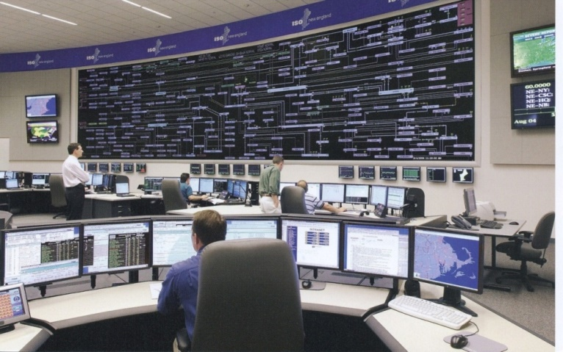
The Smart Grid
The term “Smart Grid” dates officially to the 2007 “Energy Independence and Security Act”, Title 13 (“Smart Grid”)
  Use of digital information and control techniques
  Dynamic grid optimization with cyber-security
  Deployment of distributed resources including
  Customer participation and smart appliances
  Integration of storage including PHEVs
  Development of interoperability standards

Slide 15
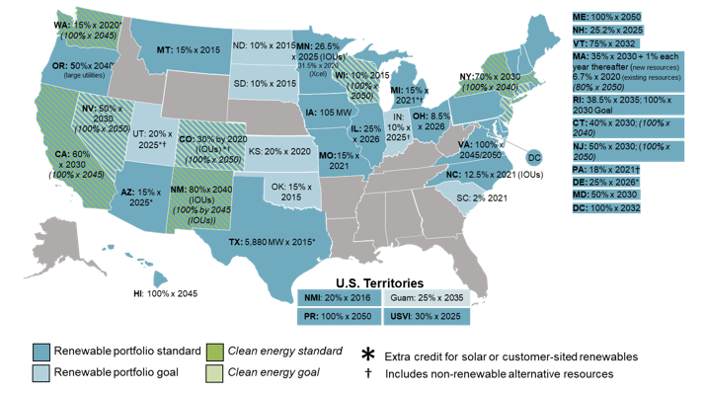
Renewable Portfolio Standards (September 2020)
TX is now 10 GW by 2025
which we’ve met several times over; CA is 60% by 2030 and 100% by 2045
Image source: http://www.dsireusa.org/
See also www.ncsl.org/research/energy/renewable-portfolio-standards.aspx

Slide 16
Interconnected Power System
Basic Characteristics
Three – phase AC systems:
  generation and transmission equipment is usually three phase
  industrial loads are three phase
  residential and commercial loads are single phase and distributed equally among the phases; consequently, a balanced three – phase system results
Synchronous machines have traditionally generated electricity, though this is rapidly changing with the addition of more inverter-connected generation (such as solar and most wind)
Interconnection transmits power over a wider region with subsystems operating at different voltage levels

Slide 17
Quick Review of Per Unit (From Undergrad Class)
A key problem in analyzing power systems is the large number of transformers.
  It would be very difficult to continually have to refer impedances to the different sides of the transformers
This problem is avoided by a normalization of all variables.
This normalization is known as per unit analysis.

Slide 18
Per Unit Conversion Procedure, Single-Phase
Pick a 1φ VA base for the entire system, S_{B}
Pick a voltage base for each different voltage level, V_{B}. Voltage bases are related by transformer turns ratios. Voltages are line to neutral.
Calculate the impedance base, Z_{B}= (V_{B})²/S_{B}
Calculate the current base, I_{B} = V_{B}/Z_{B}
Convert actual values to per unit
Note, per unit conversion on affects magnitudes, not the angles. Also, per unit quantities no longer have units (i.e., a voltage is 1.0 p.u., not 1 p.u. volts)

Slide 19
Per Unit Solution Procedure
Convert to per unit (p.u.) (many problems are already in per unit)
Solve
Convert back to actual as necessary

Slide 20
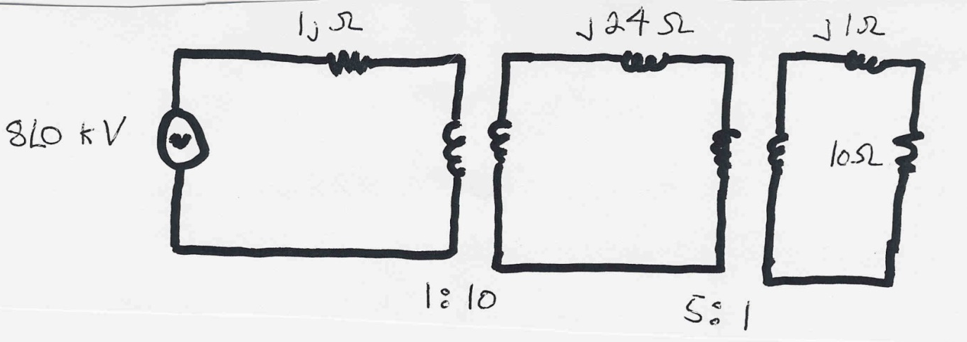
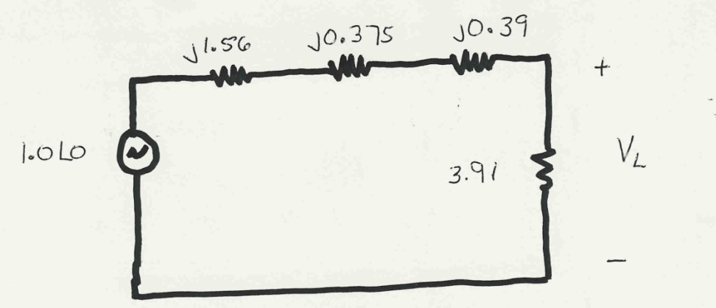
Per Unit Example
Solve for the current, load voltage and load power in the circuit shown
below using per unit analysis with an S_{B} of 100 MVA, and
voltage bases of 8 kV, 80 kV and 16 kV
Same circuit, with
values expressed
in per unit.

Slide 21
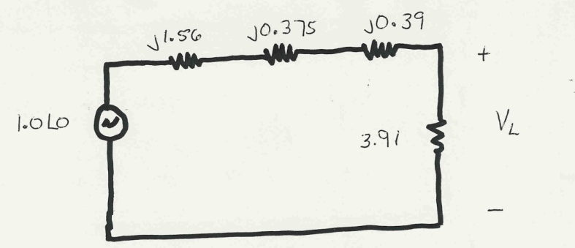
Per Unit Example, cont’d

Slide 22
Per Unit Example, cont’d
To convert back to actual values just multiply the per unit values by their per unit base

Slide 23
Procedure for Balanced Three-Phase Circuits
Procedure is very similar to 1φ except we use a 3φ VA base, and use line to line voltage bases
Pick a 3φ VA base for the entire system,
Pick a voltage base for each different voltage level, V_{B}. Voltages are line to line.
Calculate the impedance base
Exactly the same impedance bases as with single phase!

Slide 24
Three-Phase Per Unit, cont'd
Calculate the current base, I_{B}
Convert actual values to per unit

Slide 25

Three-Phase Per Unit Example
Solve for the current, load voltage and load power in the previous circuit, assuming a 3φ power base of 300 MVA, and line to line voltage bases of 13.8 kV, 138 kV and 27.6 kV (square root of 3 larger than the 1φ example voltages). Also assume the generator is Y-connected so its line to line voltage is 13.8 kV.
Convert to per unit
as before. Note the
system is exactly the
same!

Slide 26
Three-Phase Per Unit Example, cont.
Again, analysis is exactly the same!

Slide 27
Three-Phase Per Unit Example, cont'd
Differences appear when we convert back to actual values

Slide 28
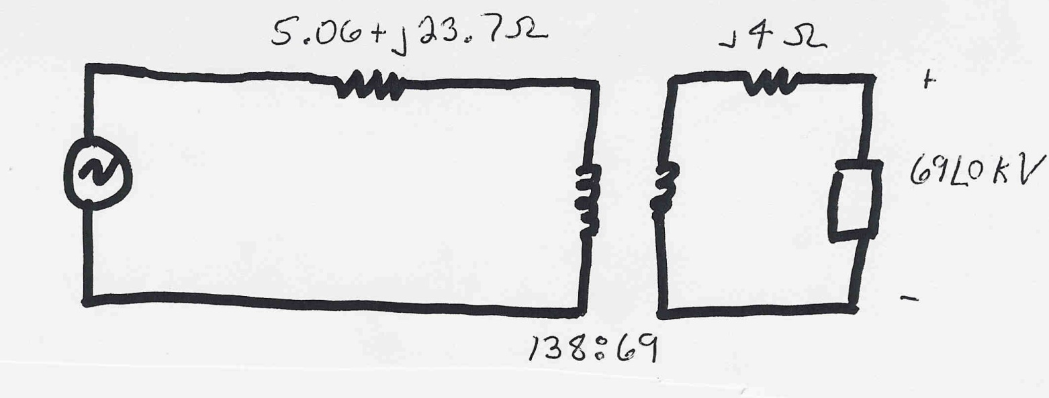
Three-Phase Per Unit Example 2
Assume a 3φ load of 100+j50 MVA with V_{LL} of 69 kV is connected to a source through the below network:
What is the supply current and complex power?
Answer: I=467 amps, S = 103.3 + j76.0 MVA

Slide 29
Power Flow Analysis
We now have the necessary models to start to develop the power system analysis tools
The most common power system analysis tool is the power flow (also known sometimes as the load flow)
  power flow determines how the power flows in a network
  also used to determine all bus voltages and all currents
  because of constant power models, power flow is a nonlinear analysis technique
  power flow is a steady-state analysis tool

Slide 30
Linear versus Nonlinear Systems
A function H is linear if
H(α₁μ₁ + α₂μ₂) = α₁H(μ₁) + α₂H(μ₂)
That is
1) the output is proportional to the input
2) the principle of superposition holds
Linear Example: y = H(x) = c x
y = c(x₁+x₂) = cx₁ + c x₂
Nonlinear Example: y = H(x) = c x²
y = c(x₁+x₂)² ≠ (cx₁)² + (c x₂)²

Slide 31
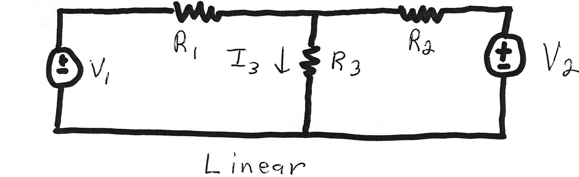
Linear Power System Elements

Slide 32
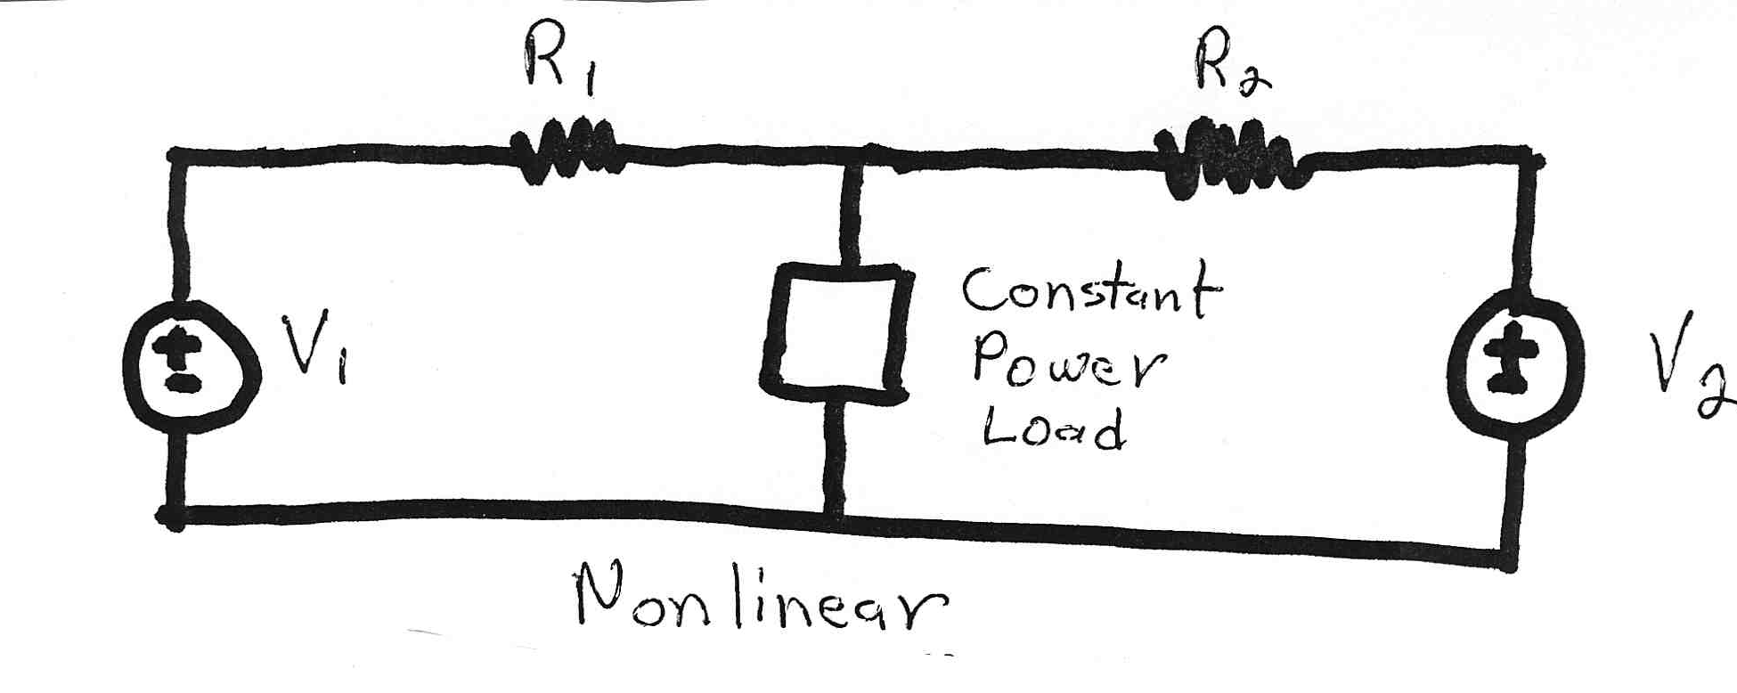
Nonlinear System Example
Constant power loads and generator injections are nonlinear and hence systems with these elements can not be analyzed by superposition
Nonlinear problems can be very difficult to solve,
and usually require an iterative approach

Slide 33
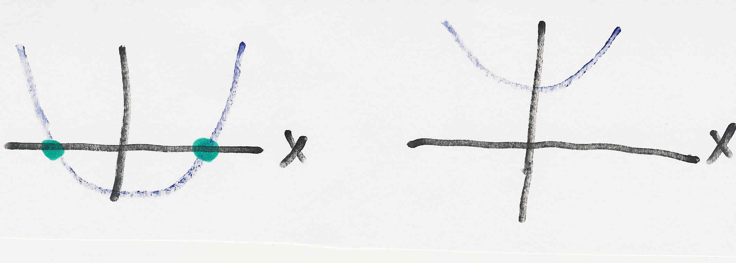
Nonlinear Systems May Have Multiple Solutions or No Solution
Example 1: x² - 2 = 0 has solutions x = ±1.414…
Example 2: x² + 2 = 0 has no real solution
f(x) = x² - 2
f(x) = x² + 2
two solutions where f(x) = 0
no solution f(x) = 0

Slide 34
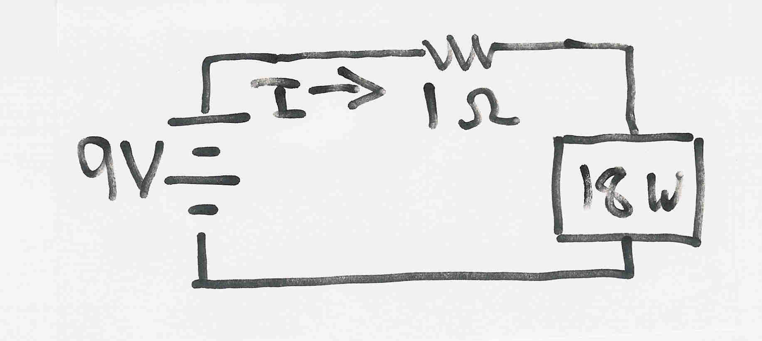
Multiple Solution Example
The dc system shown below has two solutions:
where the 18 watt
load is a resistive
load
What is the
maximum
P_{Load}?

Slide 35
Bus Admittance Matrix or Y_{bus}
First step in solving the power flow is to create what is known as the bus admittance matrix, often call the Y_{bus}.
The Y_{bus} gives the relationships between all the bus current injections, I, and all the bus voltages, V,
I = Y_{bus} V
The Y_{bus} is developed by applying KCL at each bus in the system to relate the bus current injections, the bus voltages, and the branch impedances and admittances

Slide 36
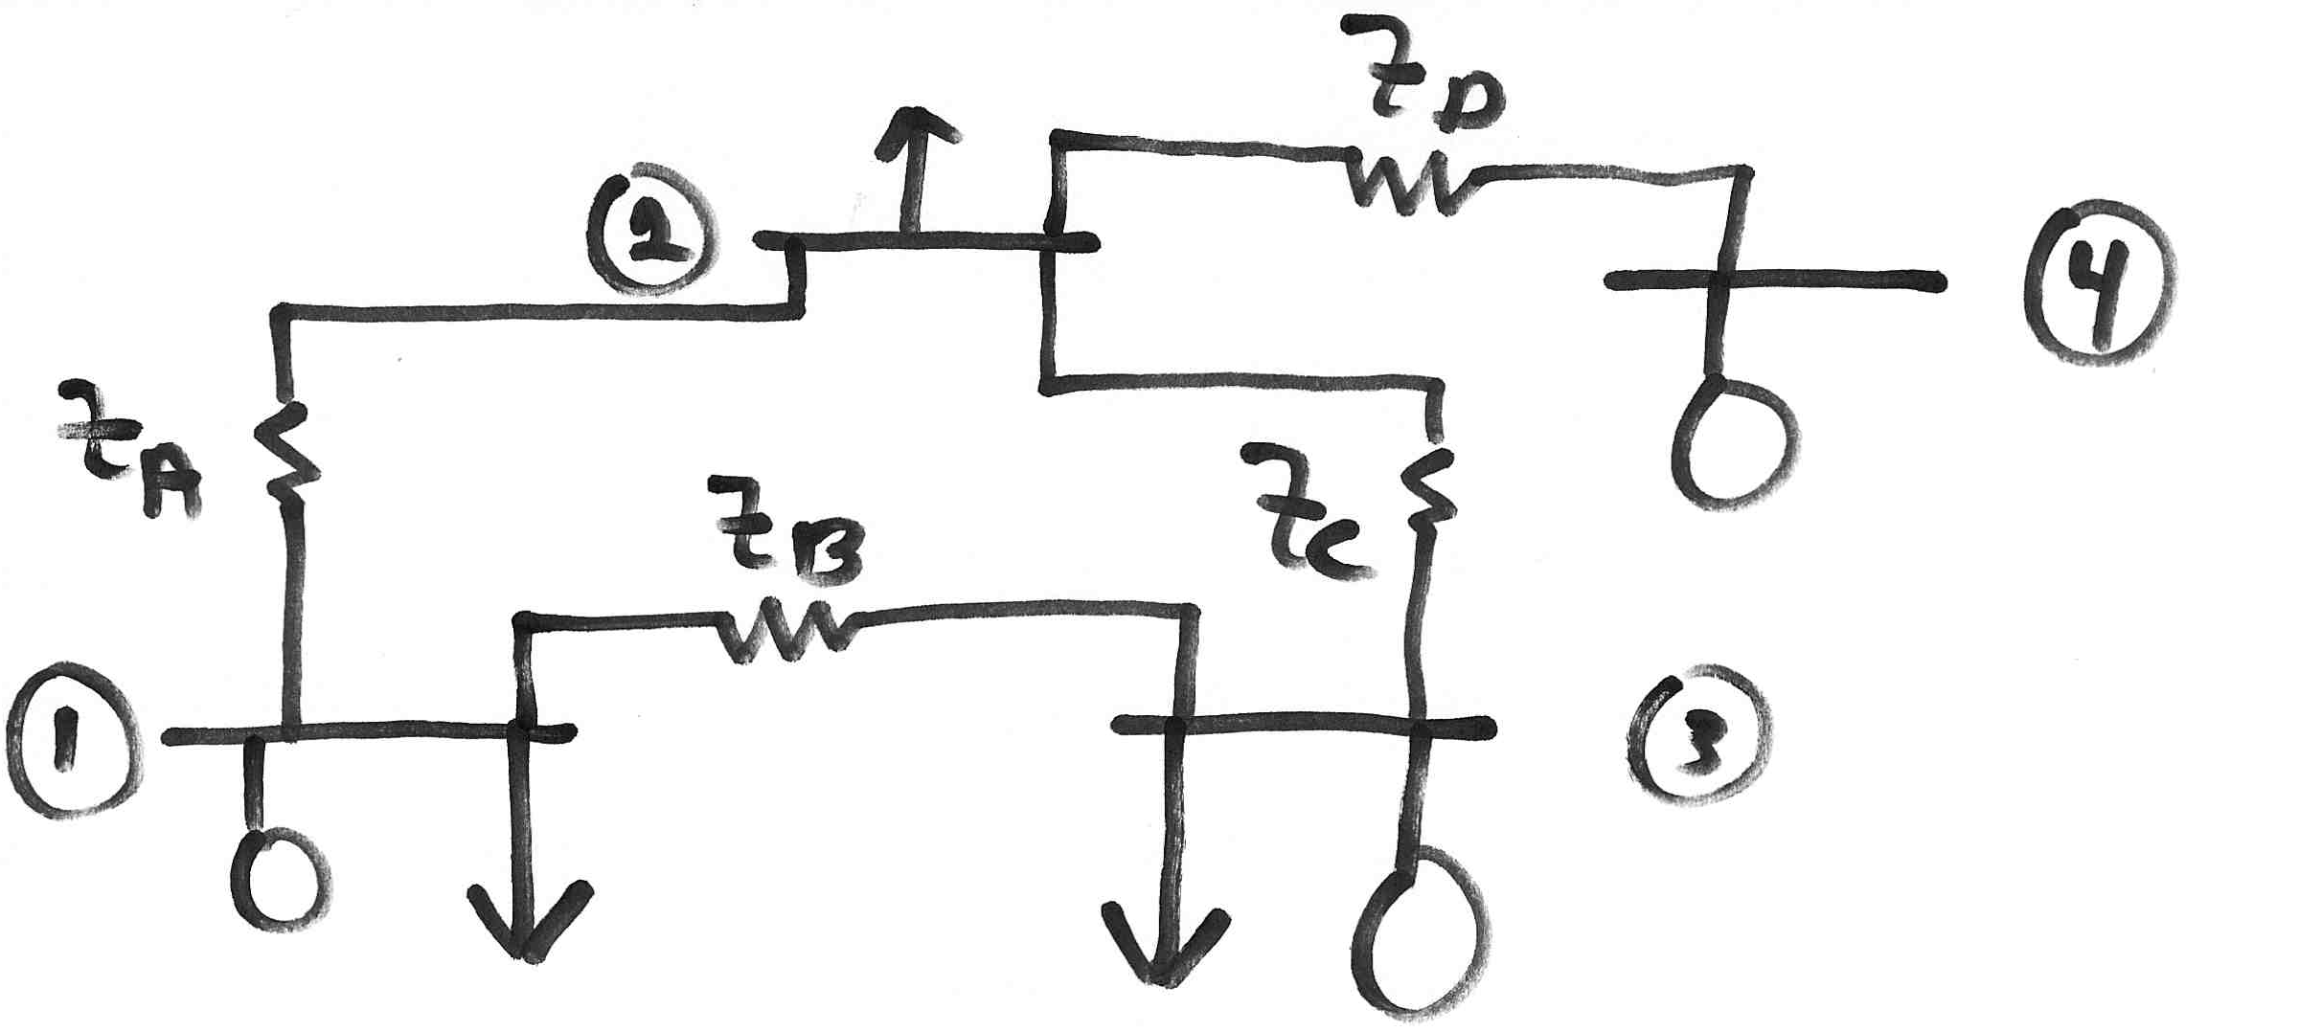
Y_{bus} Example
Determine the bus admittance matrix for the network shown below, assuming the current injection at each bus i is I_{i} = I_{Gi} - I_{Di} where I_{Gi} is the current injection into the bus from the generator and I_{Di} is the current flowing into the load

Slide 37
Y_{bus} Example, cont’d

Slide 38
Y_{bus} Example, cont’d
For a system with n buses the Y_{bus} is an n by n symmetric matrix (i.e., one where A_{ij} = A_{ji}); however this will not be true in general when we consider phase shifting transformers

Slide 39
Y_{bus} General Form
The diagonal terms, Y_{ii}, are the self admittance terms, equal to the sum of the admittances of all devices incident to bus i.
The off-diagonal terms, Y_{ij}, are equal to the negative of the sum of the admittances joining the two buses.
With large systems Y_{bus} is a sparse matrix (that is, most entries are zero)
Shunt terms, such as with the π line model, only affect the diagonal terms.

