Slide 1
ECEN 615
Methods of Electric Power
Systems Analysis
Lecture 4: Power Flow
Prof. Tom Overbye
Dept. of Electrical and Computer Engineering
Texas A&M University
overbye@tamu.edu

Slide 2
Announcements
Exam 1 is moved to Oct 13 (Oct 10 and 11 are fall break)
Homework 1 is now due on Tuesday September 13
ERCOT is having a Virtual College Day on September 16 at
930am (Central Time); details at ERCOT.COM/CAREERS
  To register you can go to www.ercot.com/careers/edp

Slide 3

ERCOT Virtual College Day
To register you can go to
www.ercot.com/careers/edp

Slide 4
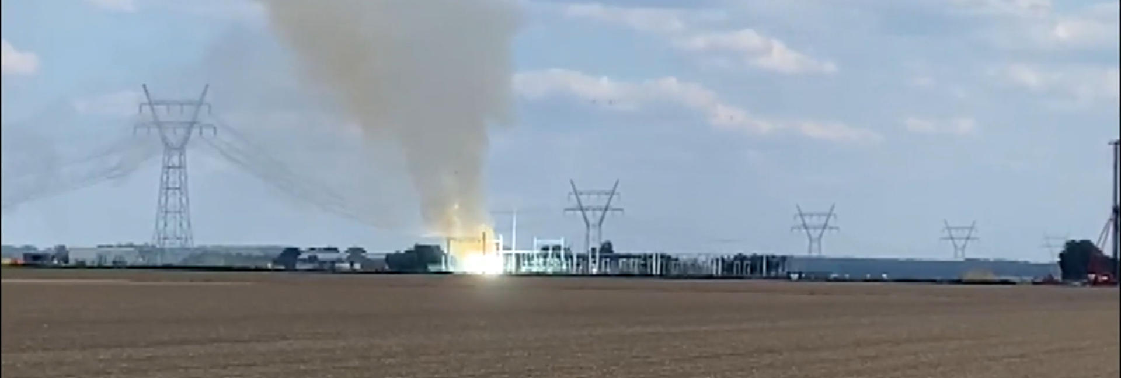
An Interesting Video of an Uncleared Fault
The below video shows an event from September 2 in the Netherlands (Flevoland province) in which a transmission line fault was not cleared. Note the sag and smoke (steam?) coming from the line
https://nos.nl/video/2443017-explosies-en-rokende-kabels-bij-verdeelstation-in-dronten

Slide 5
Quick PowerWorld Simulator Introduction
Class will make extensive use of PowerWorld Simulator, initially using the 42 bus educational version
Start getting familiar with PowerWorld, particularly the power flow basics; free training material is available at
  www.powerworld.com/training/online-training
By way of history, I started developing the power flow code that would become PowerWorld in 1987
I also developed windows code for an power system dynamics short course in 1993
PowerWorld was born in 1994 through the merging of these two code sets, originally to teach power system operators to utility industry non-technicals

Slide 6
Quick PowerWorld Simulator Introduction, cont.
PowerWorld as a company was formed in 1996; the first commercial version was 4.0; current release version is 22 with Version 23 due out in fall
The goal of PowerWorld Simulator (Simulator) is to make power system analysis as easy as possible; it started out mostly as a power flow, but has since gained lots of additional functionality, some of which we’ll discuss in 615
  Mostly it considers balanced, three-phase systems (there is some ability to handle unbalanced systems with fault analysis)

Slide 7
Quick PowerWorld Simulator Introduction, cont.
There are two main types of files: *.pwb files define the power grid model, and *.pwd files contain the display files
It has two main operating modes: Run Mode and Edit Mode; most 615 activities will use the Run Mode
To solve the power flow for HW1
1) Open Simulator, 2) Select File,
Open Case, 3) choose a *.pwb file,
4) Select Tools and click the green
arrow to start the solution process,
5) click on the red (or green) circuit
breakers to toggle the status, 6) right-
click on a device to see details

Slide 8
Y_{bus} General Form
The diagonal terms, Y_{ii}, are the self admittance terms, equal to the sum of the admittances of all devices incident to bus i.
The off-diagonal terms, Y_{ij}, are equal to the negative of the sum of the admittances joining the two buses.
With large systems Y_{bus} is a sparse matrix (that is, most entries are zero)
Shunt terms, such as with the π line model, only affect the diagonal terms.

Slide 9
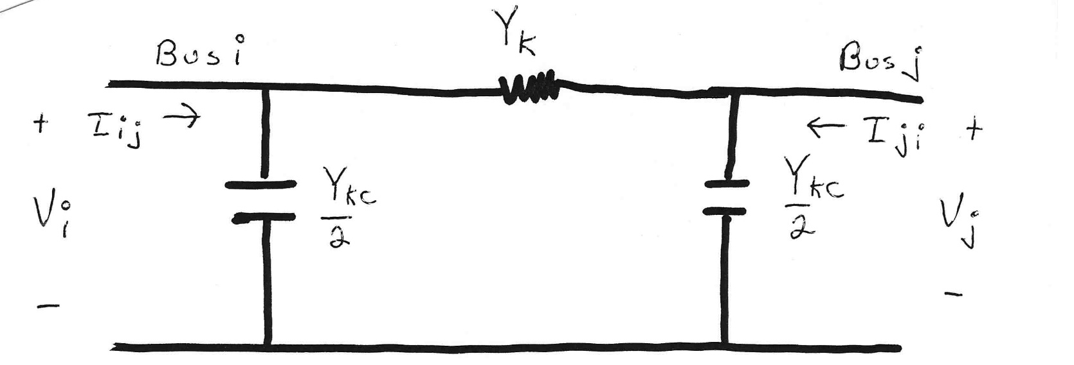
Modeling Shunts in the Y_{bus}

Slide 10
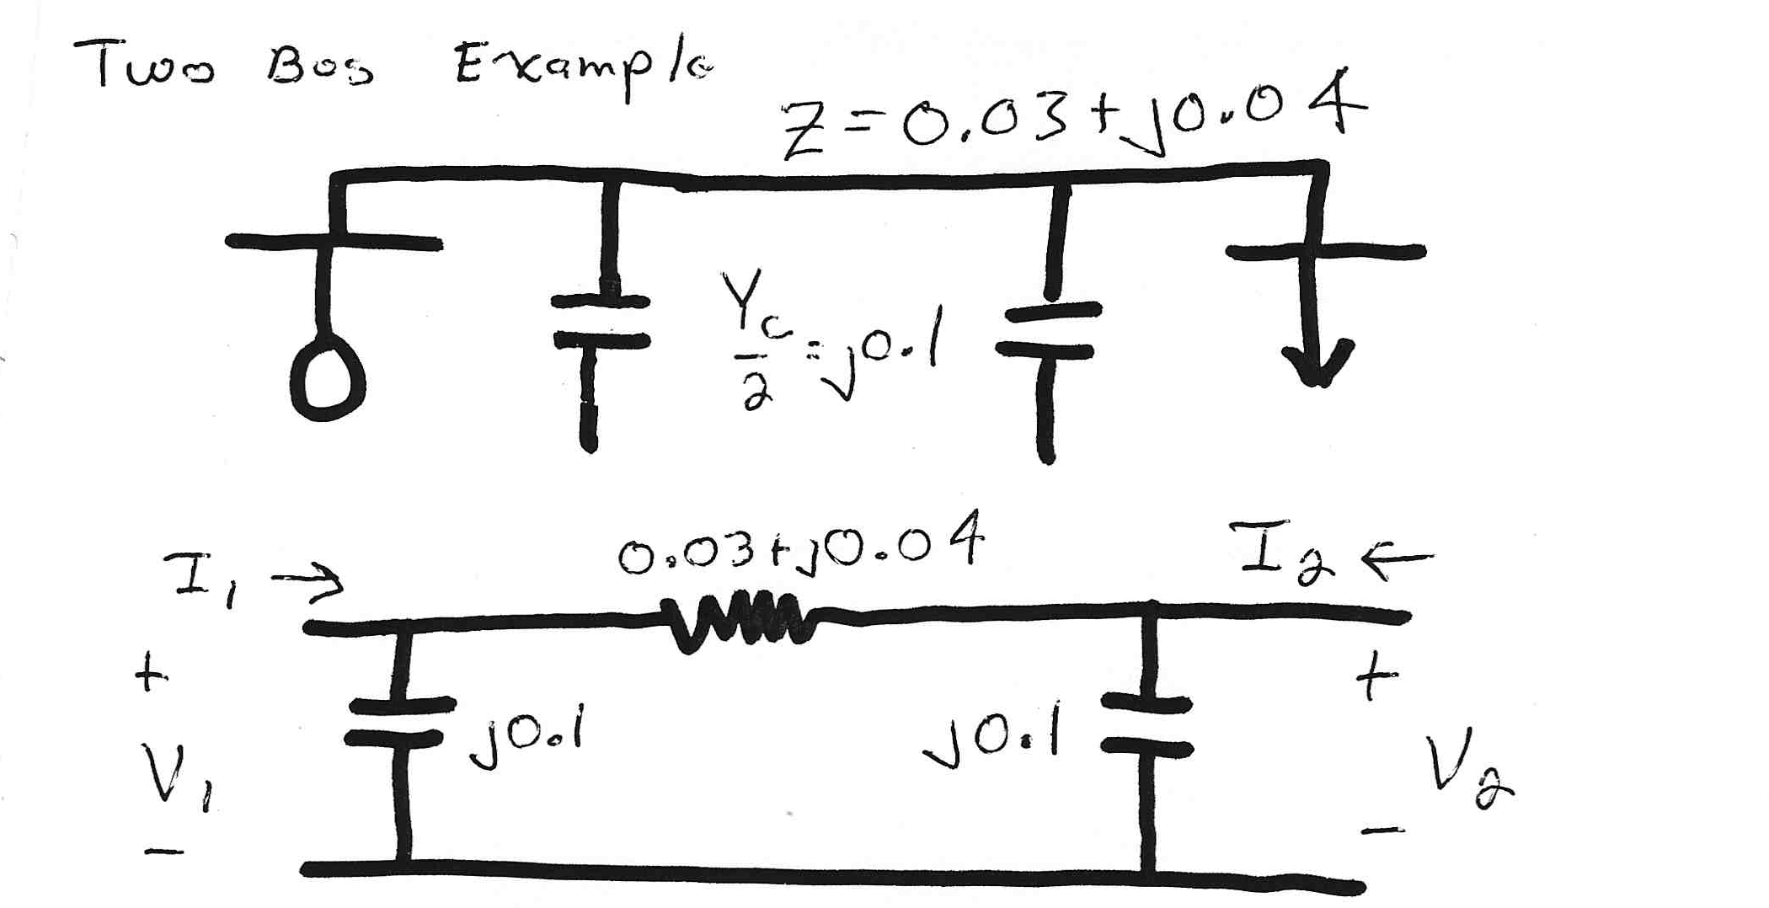
Two Bus System Example

Slide 11
Using the Y_{bus}
However, this requires that Y_{bus} not be singular; note it will be singular if there are no shunt connections!

Slide 12
Solving for Bus Currents

Slide 13
Solving for Bus Voltages

Slide 14
Power Flow Analysis
When analyzing power systems we know neither the complex bus voltages nor the complex current injections
Rather, we know the complex power being consumed by the load, and the power being injected by the generators plus their voltage magnitudes
Therefore we can not directly use the Y_{bus} equations, but rather must use the power balance equations

Slide 15
Power Balance Equations

Slide 16
Power Balance Equations, cont’d

Slide 17
Real Power Balance Equations

Slide 18
Power Flow Analysis
Classic paper for this lecture is W.F. Tinney and C.E. Hart, “Power Flow Solution by Newton’s Method,” IEEE Power App System, Nov 1967
Basic power flow is also covered in essentially any power system analysis textbooks.
We use the term “power flow” not “load flow” since power flows not load. Also, the power flow usage is not new (see title of Tinney’s 1967 paper, and note Tinney references Ward’s 1956 power flow paper)
  A nice history of the power flow is given in an insert by Alvarado and Thomas in T.J. Overbye, J.D. Weber, “Visualizing the Electric Grid,” IEEE Spectrum, Feb 2001.

Slide 19
Early Power Flow System Size
In 1957 Bill Tinney, in a paper titled “Digital Solutions for Large Power Networks,” studied a 100 bus, 200 branch system (with 2 KB of memory)!
In Tinney’s 1963 “Techniques for Exploiting Sparsity of the Network Admittance Matrix” paper (which gave us the Tinney Schemes 1, 2, and 3), uses 32 kB for 1000 nodes.
In Tinney’s classic 1967 “Power Flow Solution by Newton’s Method” paper he applies his method to systems with up to about 1000 buses (with 32 kB of memory) and provides a solution time of 51 seconds for a 487 bus system.

Slide 20
Slack Bus
We can not arbitrarily specify S at all buses because total generation must equal total load + total losses
We also need an angle reference bus.
To solve these problems we define one bus as the "slack" bus. This bus has a fixed voltage magnitude and angle, and a varying real/reactive power injection.
In an actual power system the slack bus does not really exist; frequency changes locally when the power supplied does not match the power consumed

Slide 21
Three Types of Power Flow Buses
There are three main types of power flow buses
  Load (PQ) at which P/Q are fixed; iteration solves for voltage magnitude and angle.
  Slack at which the voltage magnitude and angle are fixed; iteration solves for P/Q injections
  Generator (PV) at which P and |V| are fixed; iteration solves for voltage angle and Q injection

Slide 22
Newton-Raphson Algorithm
Most common technique for solving the power flow problem is to use the Newton-Raphson algorithm
Key idea behind Newton-Raphson is to use sequential linearization

Slide 23
Newton-Raphson Method (scalar)

Slide 24
Newton-Raphson Method, cont’d

Slide 25
Newton-Raphson Example

Slide 26
Newton-Raphson Example, cont’d

Slide 27
Newton-Raphson Power Flow

Slide 28
Power Flow Variables

Slide 29
N-R Power Flow Solution

Slide 30
Power Flow Jacobian Matrix

Slide 31
Power Flow Jacobian Matrix, cont’d

Slide 32
Two Bus Newton-Raphson Example
For the two bus power system shown below, use the Newton-Raphson power flow to determine the voltage magnitude and angle at bus two. Assume that bus one is the slack and S_{Base} = 100 MVA.

Slide 33
Two Bus Example, cont’d

Slide 34
Two Bus Example, cont’d

Slide 35
Two Bus Example, First Iteration

Slide 36
Two Bus Example, Next Iterations

Slide 37
Two Bus Solved Values
Once the voltage angle and magnitude at bus 2 are known we can calculate all the other system values, such as the line flows and the generator reactive power
PowerWorld Case Name: Bus2_Intro
Note, most PowerWorld cases will be available on the course website

