Slide 1
ECEN 615
Methods of Electric Power
Systems Analysis
Lecture 5: Power Flow
Prof. Tom Overbye
Dept. of Electrical and Computer Engineering
Texas A&M University
overbye@tamu.edu

Slide 2
Announcements
Read Chapter 6 from the book
Homework 1 is due on Tuesday September 13
The ECEN Energy and Power Group (EPG) will be having its semester dinner on Saturday October 1st at 5:00 pm at Prof. Davis’s house. The address is 3810 Park Meadow Lane, Bryan, TX 77802.
  All ECEN 615 students are invited with families
  RSVP at https://forms.gle/6aye2butgCLDv6bz5 by Sunday, September 25th.

Slide 3
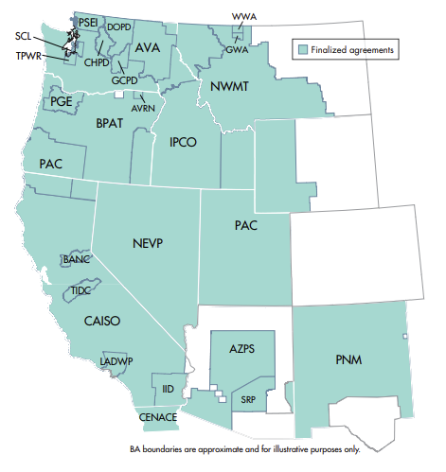
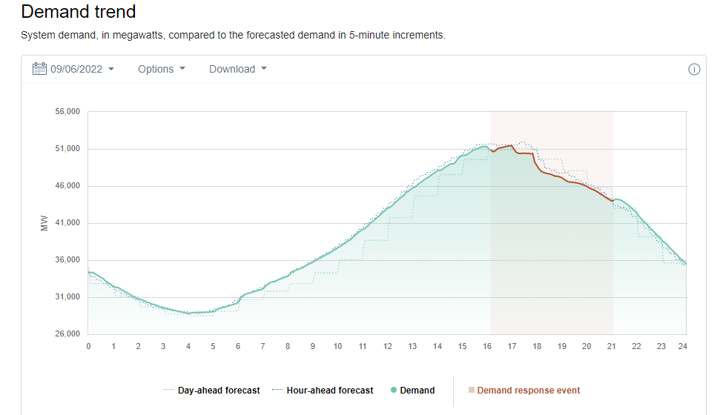
California
Due to high temperatures the electric load in
California has hit record levels (51 GW) on Tuesday, beating their previous 2006 record
Image: www.caiso.com/Documents/RCWestEntities.pdf

Slide 4
Two Bus Solved Values
Once the voltage angle and magnitude at bus 2 are known we can calculate all the other system values, such as the line flows and the generator reactive power
PowerWorld Case Name: Bus2_Intro
Note, most PowerWorld cases will be available on the course website

Slide 5
Two Bus Case Low Voltage Solution

Slide 6
Low Voltage Solution, cont'd

Slide 7
Practical Power Flow Software Note
Most commercial software packages have built in defaults to prevent convergence to low voltage solutions.
  One approach is to automatically change the load model from constant power to constant current or constant impedance when the load bus voltage gets too low
  In PowerWorld these defaults can be modified on the Tools, Simulator Options, Advanced Options page; note you also need to disable the “Initialize from Flat Start Values” option
  The PowerWorld case Bus2_Intro_Low is set solved to the low voltage solution
  Initial bus voltages can be set using the Bus Information Dialog

Slide 8
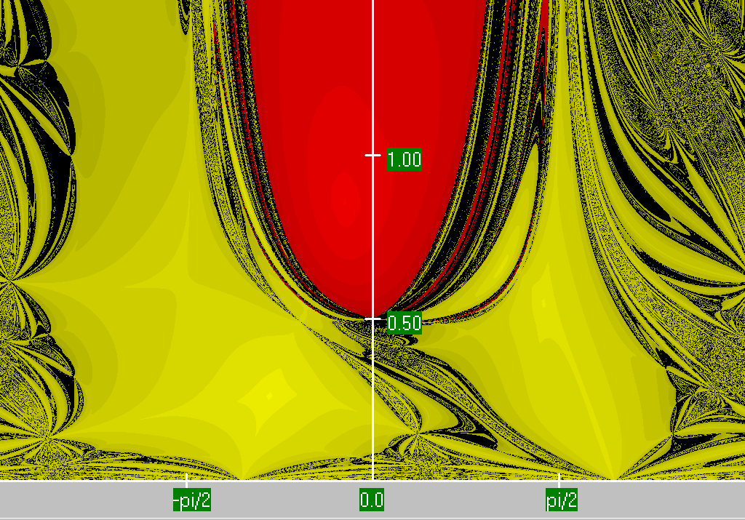
Two Bus Region of Convergence
Slide shows the region of convergence for different initial guesses of bus 2 angle (x-axis) and magnitude (y-axis)
The red region shows the initial guesses that converge to the high voltage solution,
while the yellow region shows the guesses that converge to the low voltage
solution

Slide 9
Power Flow Fractal Region of Convergence
Earliest paper showing fractal power flow regions of convergence is by C.L DeMarco and T.J. Overbye, “Low Voltage Power Flow Solutions and Their Role in Exit Time Bases Security Measures for Voltage Collapse,” Proc. 27th IEEE CDC, December 1988
A more widely known paper is J.S. Thorp, S.A. Naqavi, “Load-Flow Fractals Draw Clues to Erratic Behavior,” IEEE Computer Applications in Power, January 1997

Slide 10
PV Buses
Since the voltage magnitude at PV buses is fixed there is no need to explicitly include these voltages in x or write the reactive power balance equations
  the reactive power output of the generator varies to maintain the fixed terminal voltage (within limits)
  optionally these variations/equations can be included by just writing the explicit voltage constraint for the generator bus
  |V_{i} | – V_{i setpoint} = 0

Slide 11
Three Bus PV Case Example

Slide 12
Modeling Voltage Dependent Load

Slide 13
Voltage Dependent Load Example

Slide 14
Voltage Dependent Load, cont'd

Slide 15
Voltage Dependent Load, cont'd
With constant impedance load the MW/Mvar load at bus 2 varies with the square of the bus 2 voltage magnitude. This if the voltage level is less than 1.0, the load is lower than 200/100 MW/Mvar
PowerWorld Case Name: Bus2_Intro_Z

Slide 16
Generator Reactive Power Limits
The reactive power output of generators varies to maintain the terminal voltage; on a real generator this is done by the exciter
To maintain higher voltages requires more reactive power
Generators have reactive power limits, which are dependent upon the generator's MW output
These limits must be considered during the power flow solution.
During the power flow once a solution is obtained there is a check to make sure the generator reactive power output is within its limits

Slide 17
Generator Reactive Limits, cont'd
During the power flow once a solution is obtained there is a check to make sure the generator reactive power output is within its limits
If the reactive power is outside of the limits, fix Q at the max or min value, and resolve treating the generator as a PQ bus
  this is know as "type-switching"
  also need to check if a PQ generator can again regulate
Rule of thumb: to raise system voltage we need to supply more vars

Slide 18
The N-R Power Flow: 5-bus Example
T2
800 MVA
345/15 kV
1
T1
5
4
3
520 MVA
Line 3 345 kV
50 mi
400 MVA
15 kV
800 MVA
15 kV
400 MVA
15/345 kV
345 kV 100 mi
345 kV 200 mi
40 Mvar
80 MW
Line 2
Line 1
2
280 Mvar
800 MW
This five bus example is taken from Chapter 6 of Power System Analysis and Design by Glover, Overbye, Birchfield and Sarma, 7th Edition, 2022

Slide 19
The N-R Power Flow: 5-bus Example
Bus | Type | V per unit | δ degrees | P_{G} per unit | Q_{G} per unit | P_{L} per unit | Q_{L} per unit | Q_{Gmax} per unit | Q_{Gmin} per unit
1 | Swing | 1.0 | 0 | ⎯ | ⎯ | 0 | 0 | ⎯ | ⎯
2 | Load | ⎯ | ⎯ | 0 | 0 | 8.0 | 2.8 | ⎯ | ⎯
3 | Constant voltage | 1.05 | ⎯ | 5.2 | ⎯ | 0.8 | 0.4 | 4.0 | -2.8
4 | Load | ⎯ | ⎯ | 0 | 0 | 0 | 0 | ⎯ | ⎯
5 | Load | ⎯ | ⎯ | 0 | 0 | 0 | 0 | ⎯ | ⎯
Table 1.
Bus input
data
Table 2.
Line input data
Bus-to-Bus | R’ per unit | X’ per unit | G’ per unit | B’ per unit | Maximum MVA per unit
2-4 | 0.0090 | 0.100 | 0 | 1.72 | 12.0
2-5 | 0.0045 | 0.050 | 0 | 0.88 | 12.0
4-5 | 0.00225 | 0.025 | 0 | 0.44 | 12.0

Slide 20
The N-R Power Flow: 5-bus Example
Bus-to-Bus | R per unit | X per unit | G_{c} per unit | B_{m} per unit | Maximum MVA per unit | Maximum TAP Setting per unit
1-5 | 0.00150 | 0.02 | 0 | 0 | 6.0 | —
3-4 | 0.00075 | 0.01 | 0 | 0 | 10.0 | —
Table 3.
Transformer
input data
Bus | Input Data | Unknowns
1 | V₁ = 1.0, δ₁ = 0 | P₁, Q₁
2 | P₂ = P_{G2}-P_{L2} = -8 Q₂ = Q_{G2}-Q_{L2} = -2.8 | V₂, δ₂
3 | V₃ = 1.05 P₃ = P_{G3}-P_{L3} = 4.4 | Q₃, δ₃
4 | P₄ = 0, Q₄ = 0 | V₄, δ₄
5 | P₅ = 0, Q₅ = 0 | V₅, δ₅
Table 4.
Input data
and
unknowns

Slide 21
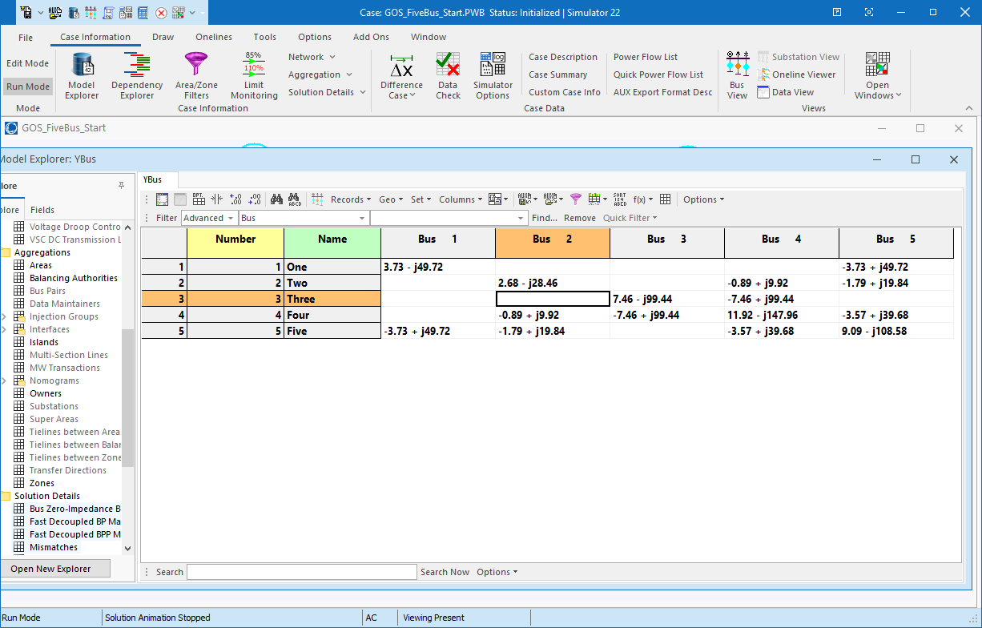
Five Bus Case Ybus
PowerWorld Case Name: GOS_FiveBus

Slide 22
Ybus Calculation Details
Elements of Y_{bus} connected to bus 2

Slide 23
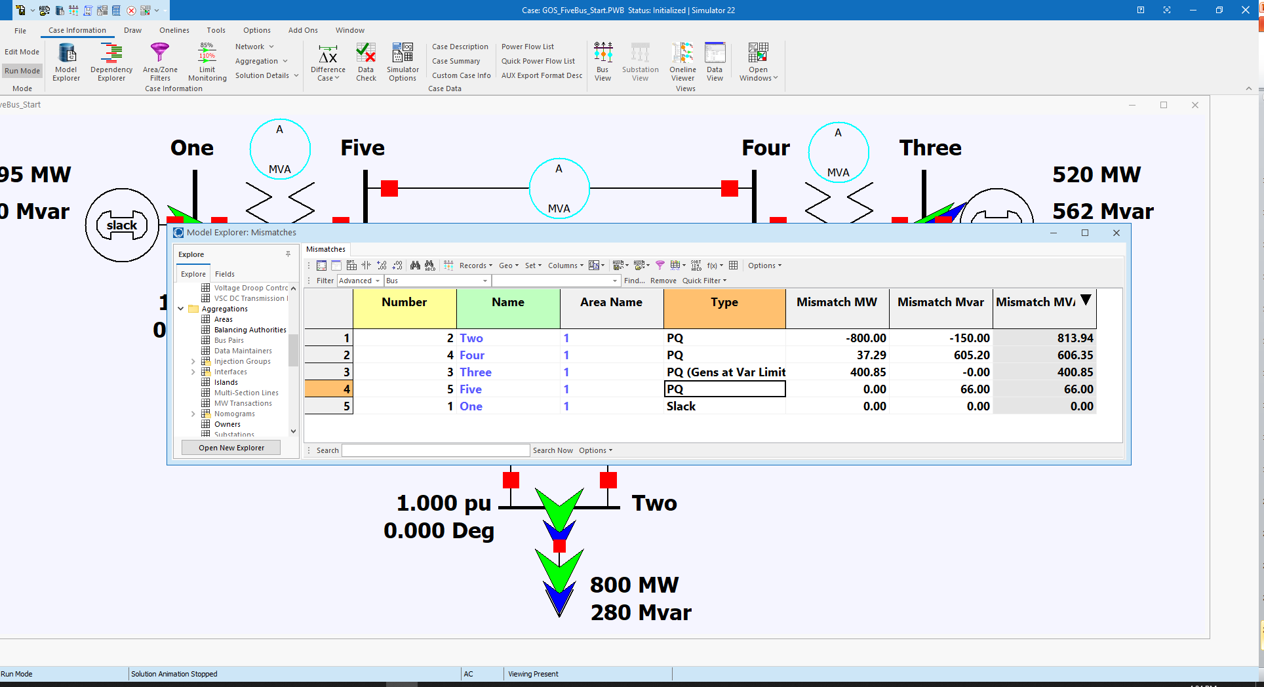
Initial Bus Mismatches

Slide 24
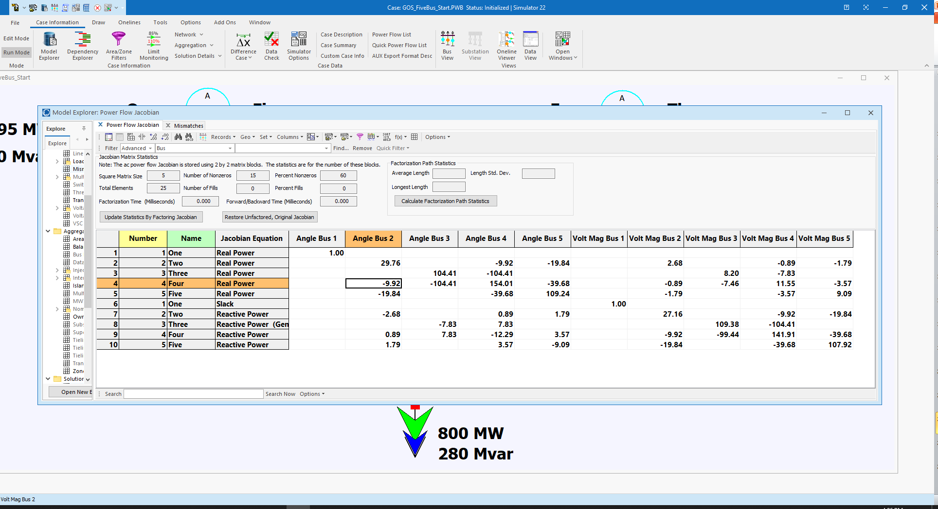
Initial Power Flow Jacobian

Slide 25
Hand Calculation Details

Slide 26
Five Bus Power System Solved

Slide 27
37 Bus Case Example
PowerWorld Case Name:
Aggieland37

Slide 28
Voltage Control Example: 37 Buses
PowerWorld Case Name:
Bus37_VoltageControl

Slide 29
Large System Example: Texas 2000 Bus Synthetic
This case requires the commercial version of PowerWorld
since the GOS Version is limited to 42 Buses

Slide 30
Power System Operations Overview
Goal is to provide an intuitive feel for power system operation
Emphasis will be on the impact of the transmission system
Introduce basic power flow concepts through small system examples

Slide 31
Three Bus PowerWorld Simulator Case
PowerWorld Case Name: B3Slow
Load with
green
arrows
indicating
amount
of MW
flow
Note the
power
balance at
each bus
Used
to control
output of
generator
Direction of green arrow is used to indicate
direction of real power (MW) flow; the blue
arrows show the reactive power

