Slide 1
ECEN 615
Methods of Electric Power
Systems Analysis
Lecture 6: Power Flow
Prof. Tom Overbye
Dept. of Electrical and Computer Engineering
Texas A&M University
overbye@tamu.edu

Slide 2
Announcements
Read Chapter 6 from the book
Homework 1 is due Today
Homework 2 is due on Thursday September 22
  Requires the commercial version of PowerWorld with details sent in an email
The ECEN EPG dinner is Saturday October 1st at 5:00 pm at Prof. Davis’s house. The address is 3810 Park Meadow Lane, Bryan, TX 77802.
  RSVP at https://forms.gle/6aye2butgCLDv6bz5 by Sunday, September 25th.
Notation notes: IEEE has a style manual at
  journals.ieeeauthorcenter.ieee.org/wp-content/uploads/sites/7/IEEE-Editorial-Style-Manual-for-Authors.pdf
  Four digit numbers have no comma; ac and dc are lower case (though upper case abbreviations are common)

Slide 3
Three Bus PowerWorld Simulator Case
PowerWorld Case Name: B3Slow
Load with
green
arrows
indicating
amount
of MW
flow
Note the
power
balance at
each bus
Used
to control
output of
generator
Direction of green arrow is used to indicate
direction of real power (MW) flow; the blue
arrows show the reactive power

Slide 4
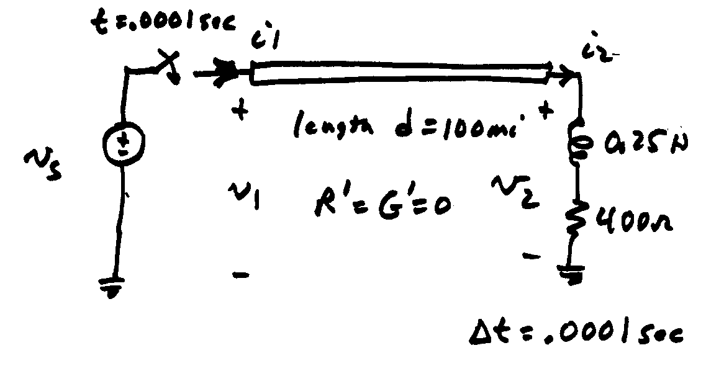
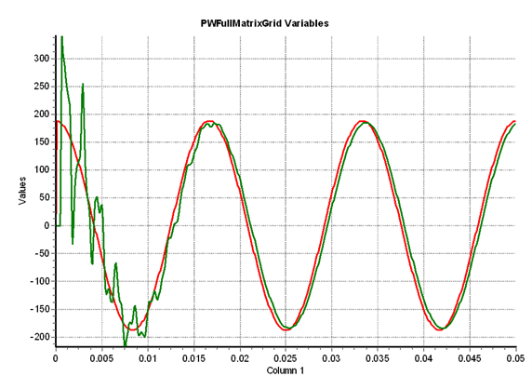
Basic Power Control
Opening a circuit breaker causes the power flow to quickly change.
No other way to directly control power flow in a transmission line.
By changing generation we can indirectly change this flow.
Power flow in transmission line is limited by heating considerations
Losses (I^2 R) can heat up the line,
causing it to sag.
The change isn’t really instantaneous
because of propagation delays, which
are near the speed of light; there also
wave reflection issues
  This is covered in ECEN 616 and 667
Red is the v_{s} end,
green the v₂ end

Slide 5
Transmission Line Limits
Power flow in transmission line is limited by heating considerations.
Losses (I² R) can heat up the line, causing it to sag.
Each line has a limit; many utilities use winter/summer limits.

Slide 6
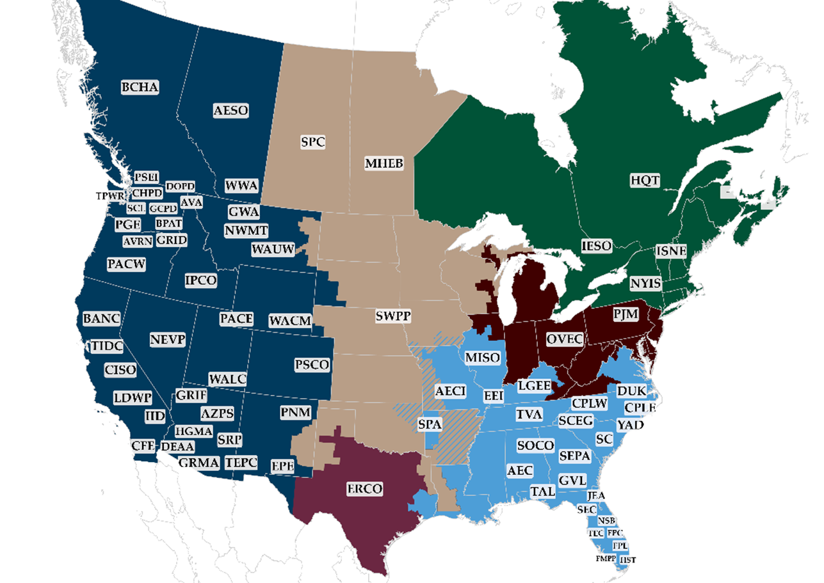
Interconnected Operation Balancing Authority (BA) Areas
North American Eastern and Western grids are divided into balancing authority areas (BA)
  Often just called an area
Transmission lines that join two
areas are known as tie-lines.
The net power out of an area is
the sum of the flow on its tie-lines.
The flow out of an area is equal to
total gen - total load - total losses = tie-flow
Source: www.wecc.org/epubs/StateOfTheInterconnection/Pages/The-Bulk-Power-System.aspx

Slide 7
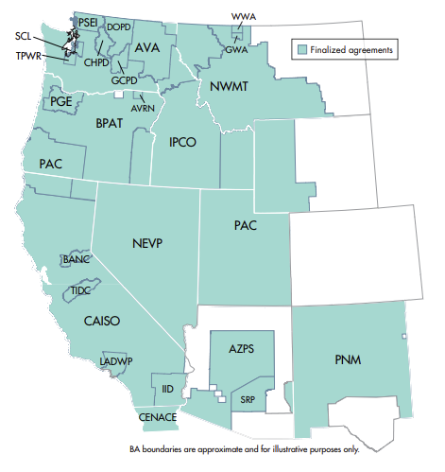
RC West Balancing Authorities
Source: www.caiso.com/Documents/RCWestEntities.pdf

Slide 8
Area Control Error (ACE)
The area control error is the difference between the actual flow out of an area, and the scheduled flow
  ACE also includes a frequency component that we will probably consider later in the semester
Ideally the ACE should always be zero
Because the load is constantly changing, each utility (or ISO) must constantly change its generation to “chase” the ACE
ACE was originally computed by utilities; increasingly it is computed by larger organizations such as ISOs

Slide 9
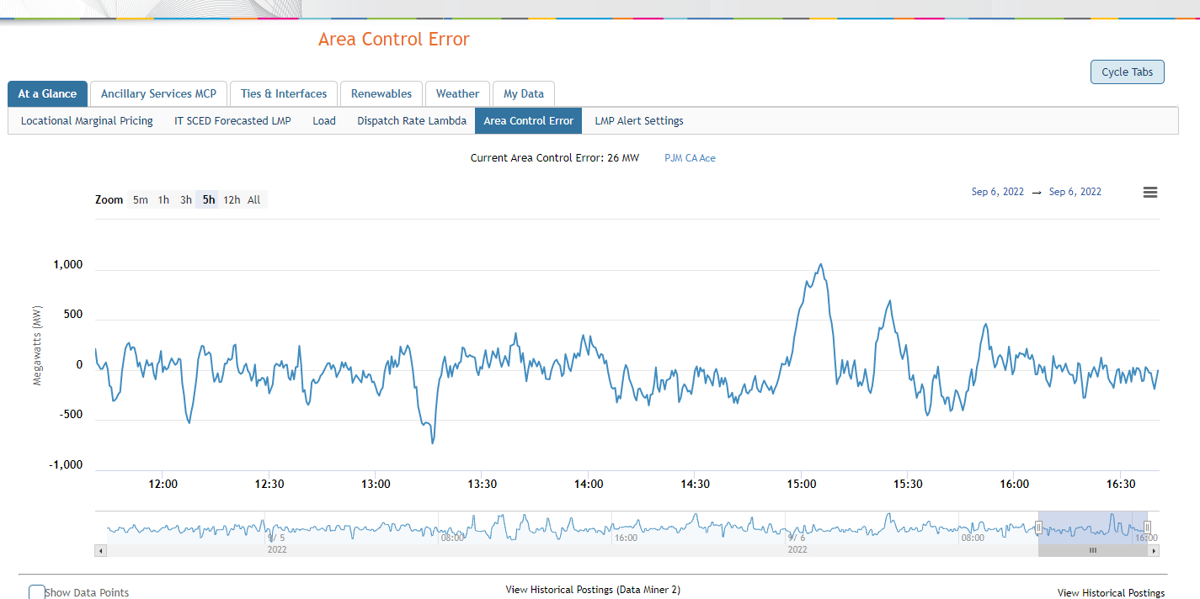
PJM Area Control Error: Sept 9, 2022
Source: dataviewer.pjm.com/dataviewer/pages/public/ace.jsf

Slide 10
Automatic Generation Control
Most utilities (ISOs) use automatic generation control (AGC) to automatically change their generation to keep their ACE close to zero.
Usually the control center calculates ACE based upon tie-line flows; then the AGC module sends control signals out to the generators every couple seconds.

Slide 11
Three Bus Case on AGC
Generation
is automatically
changed to match
change in load
Net tie flow is
close to zero

Slide 12
Generator Costs
There are many fixed and variable costs associated with power system operation
The major variable cost is associated with generation.
Cost to generate a MWh can vary widely
For some types of units (such as hydro and nuclear) it is difficult to quantify
More others such as wind and solar the marginal cost of energy is essentially zero (actually negative for wind!)
For thermal units it is straightforward to determine
Many markets have moved from cost-based to price-based generator costs

Slide 13
Economic Dispatch
Economic dispatch (ED) determines the least cost dispatch of generation for an area.
For a lossless system, the ED occurs when all the generators have equal marginal costs.
IC₁(P_{G,1}) = IC₂(P_{G,2}) = … = IC_{m}(P_{G,m})

Slide 14
Power Transactions
Power transactions are contracts between areas to transfer power
Contracts can be for any amount of time at any price for any amount of power
Scheduled power transactions are implemented by modifying the area ACE:
ACE = P_{actual,tie-flow} - P_{sched}

Slide 15
100 MW Transaction
Net tie-line
flow is now
100 MW
Scheduled 100 MW transaction
from the Home Area to the
Other Area

Slide 16
Security Constrained ED
Transmission constraints often limit system economic operation.
Such limits required a constrained dispatch in order to maintain system security.
In the three bus case the generation at bus 3 must be constrained to avoid overloading the line from bus 2 to bus 3.

Slide 17
Security Constrained Dispatch
Dispatch is no longer optimal due to need to keep the line
from bus 2 to bus 3 from overloading

Slide 18
Multi-Area Operation
If areas have direct interconnections then they may directly transact, up to the capacity of their tie-lines.
Actual power flows through the entire network according to the impedance of the transmission lines.
Flow through other areas is known as “parallel path” or “loop flow.”

Slide 19
Seven Bus Case: One-line
Area Top
has five
buses
System has three areas
Area Left
has one
bus
Area Right has one bus
PowerWorld Case: B7Flat

Slide 20
Seven Bus Case: Area View
Actual
flow
between
areas
System has
40 MW of
“Loop Flow”
Scheduled
flow

Slide 21
Seven Bus - Loop Flow?
Transaction has actually decreased
the loop flow
Note that
Top’s
losses have
increased
from
7.1 MW to
9.6 MW
100 MW Transaction
between Left and Right

Slide 22
Pricing Electricity
Cost to supply electricity to bus is called the locational marginal price (LMP)
Presently some electric markets post LMPs on the web
In an ideal electricity market with no transmission limitations the LMPs are equal
Transmission constraints can segment a market, resulting in differing LMP
Determination of LMPs requires the solution on an Optimal Power Flow (OPF), which will be covered later in the semester

Slide 23
Three Bus LMPs – Constraints Ignored
Gen 2’s
cost
is $12
per
MWh
Gen 1’s
cost
is $10
per
MWh
Line from Bus 1 to Bus 3 is over-loaded; all buses have same marginal cost
PowerWorld Case: B3LP

Slide 24
Three Bus LMPs – Constraint Unforced
Line from 1 to 3 is no longer overloaded, but now
the marginal cost of electricity at bus 3 is $14 / MWh

Slide 25
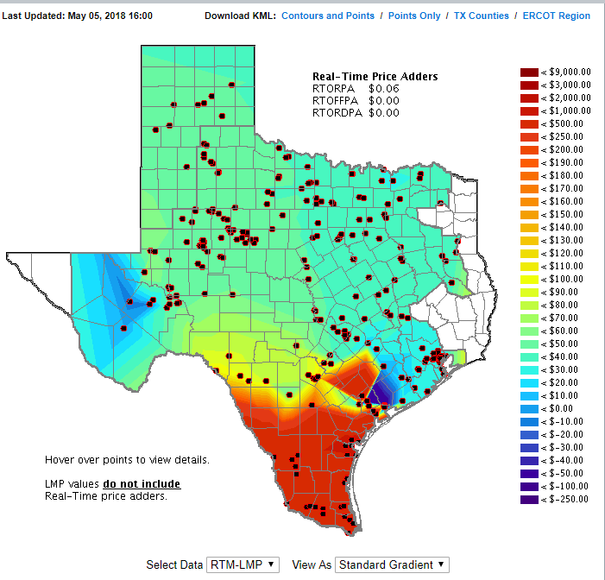
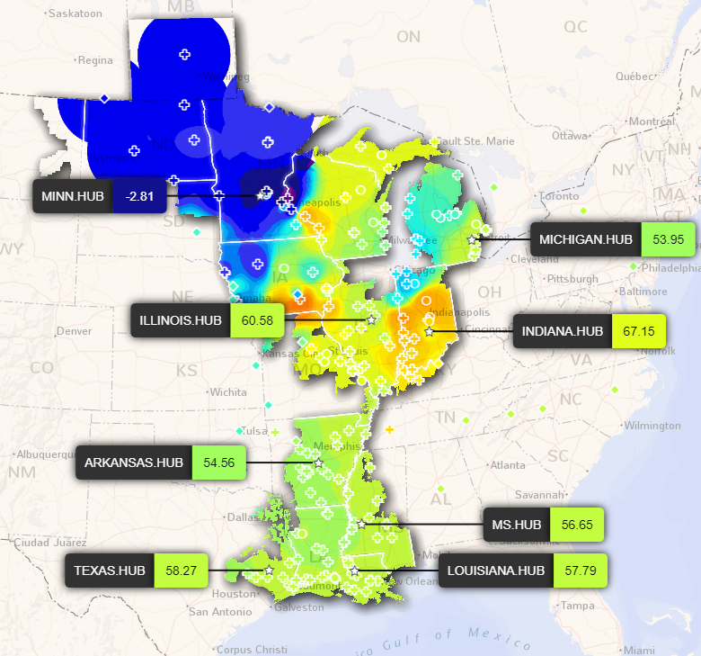
Example Real Grid LMPs
MISO’s from 6/13/2022
Every few minutes
LMPs are
posted online
for several different independent system operators
Image1 Source: http://www.ercot.com/content/cdr/contours/rtmLmp.html
Image2 Source: https://www.misoenergy.org/markets-and-operations/real-time--market-data/real-time-displays/

Slide 26
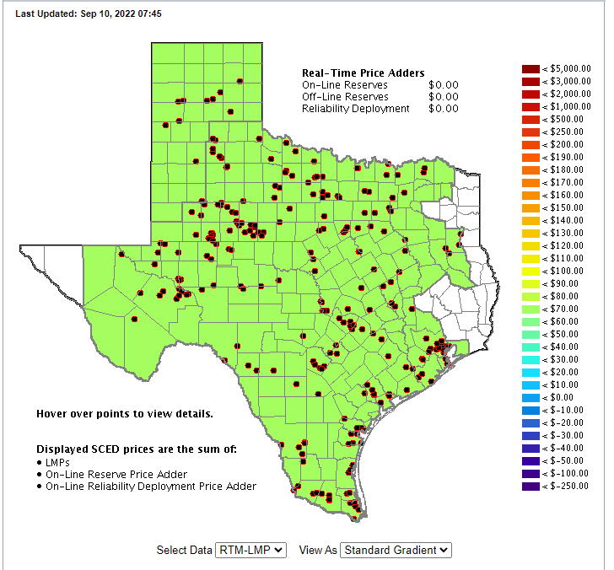
Sometimes There is Not Much LMP Variation
ERCOT from 9/10/2022
Image Source: http://www.ercot.com/content/cdr/contours/rtmLmp.html

Slide 27
Advanced Power Flow
Next slides cover some more advanced power flow topics that need to be considered in many commercial power flow studies
An important consideration in the power flow is the assumed time scale of the response, and the assumed model of operator actions
  Planning power flow studies usually assume automatic modeling of operator actions and a longer time frame of response (controls have time to reach steady-state)
    For example, who is actually doing the volt/var control
  In real-time applications operator actions are usually not automated and controls may be more limited in time

Slide 28
Quasi-Newton Power Flow Methods
First we consider some modified versions of the Newton power flow (NPF)
Since most of the computation in the NPF is associated with building and factoring the Jacobian matrix, J, the focus is on trying to reduce this computation
In a pure NPF J is build and factored each iteration
Over the years pretty much every variation of the NPF has been tried; here we just touch on the most common
Whether a method is effective can be application dependent
  For example, in contingency analysis we are usually just resolving a solved case with an often small perturbation

Slide 29
Quasi-Newton Power Flow Methods
The simplest modification of the NPF results when J is kept constant for a number of iterations, say k iterations
  Sometimes known as the Dishonest Newton
The approach balances increased speed per iteration, with potentially more iterations to perform
There is also an increased possibility for divergence
Since the mismatch equations are not modified, if it converges it should converge to the same solution as the NPF
These methods are not commonly used, except in very short duration, sequential power flows with small mismatches

Slide 30
Dishonest N-R Example
We pay a price
in increased
iterations, but
with decreased
computation
per iteration; that
price is too high
in this example
29

Slide 31
Decoupled Power Flow
Rather than not updating the Jacobian, the decoupled power flow takes advantage of characteristics of the power grid in order to decouple the real and reactive power balance equations
  There is a strong coupling between real power and voltage angle, and reactive power and voltage magnitude
  There is a much weaker coupling between real power and voltage magnitude, and reactive power and voltage angle
Key reference is B. Stott, “Decoupled Newton Load Flow,” IEEE Trans. Power. App and Syst., Sept/Oct. 1972, pp. 1955-1959

Slide 32
Decoupled Power Flow Formulation

