Slide 1
ECEN 667
Power System Stability
Lecture 10: Exciters
Prof. Tom Overbye
Dept. of Electrical and Computer Engineering
Texas A&M University
overbye@tamu.edu

Slide 2
Announcements
Read Chapter 4
Homework 3 is due on Thursday Oct 7
Homework 4 is assigned today, but will not need to be turned in (just done before the first exam)
Exam 1 will be on Oct 14 in class
  For the distance learners we usually use Honorlock (though I know for some that won’t work)
  Exams are closed book, closed notes, but you can bring in one 8.5 by 11 inch note sheet and can use calculators

Slide 3
Dynamic Models in the Physical Structure: Exciters
Mechanical System
Electrical System
Stabilizer
Load
Relay
Line
Relay
Exciter
Supply control
Pressure control
Speed control
Voltage Control
Network control
Load control
Fuel
Source
Furnace and Boiler
Turbine
Generator
Network
Loads
Machine
Load
Char.
Fuel
Steam
Torque
V, I
P, Q
Governor
P. Sauer and M. Pai, Power System Dynamics and Stability, Stipes Publishing, 2006.

Slide 4
Larger Scale Stability Study
An example of a larger scale stability study we did is available on my website
  overbye.engr.tamu.edu/publications/
  See the first paper in 2022 (from HICSS) or the PSERC report (number 18 in 2021)
The study looked a stability aspects of a synchronous connection of the North American East and WECC grids
The power flow model had 110,000 buses and 13,700 generators; for stability it had 246 different types of dynamic models, 61,000 model instances and more than 200,000 differential equations
We also studied an 82,000 bus synthetic grid

Slide 5
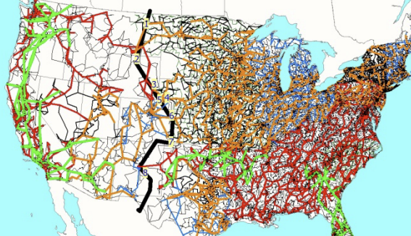
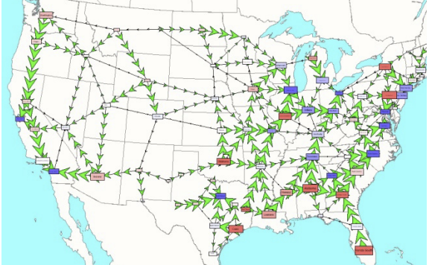
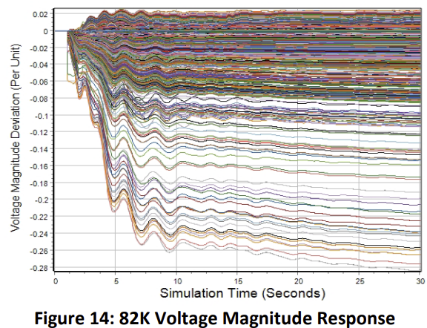
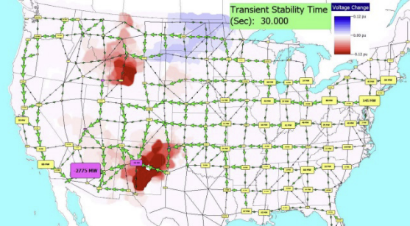
Larger Scale Stability Study
The below figures are for the 82,000 bus synthetic grid

Slide 6
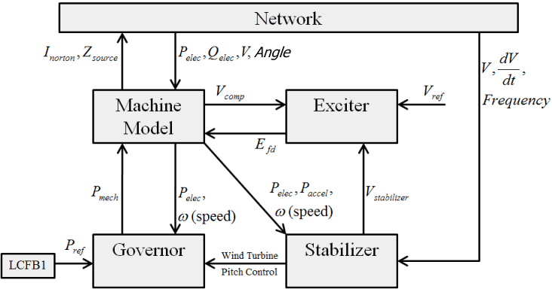
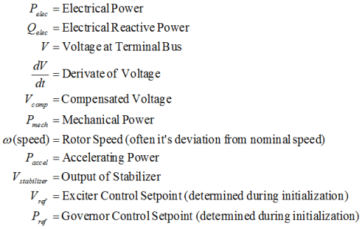
Exciter Models

Slide 7
Exciters, Including AVR
Exciters are used to control the synchronous machine field voltage and current
  Usually modeled with automatic voltage regulator included
A useful reference is IEEE Std 421.5-2016
  Updated from the 2005 edition
  Covers the major types of exciters used in transient stability
  Continuation of standard designs started with "Computer Representation of Excitation Systems," IEEE Trans. Power App. and Syst., vol. pas-87, pp. 1460-1464, June 1968
Another reference is P. Kundur, Power System Stability and Control, EPRI, McGraw-Hill, 1994
  Exciters are covered in Chapter 8 as are block diagram basics

Slide 8
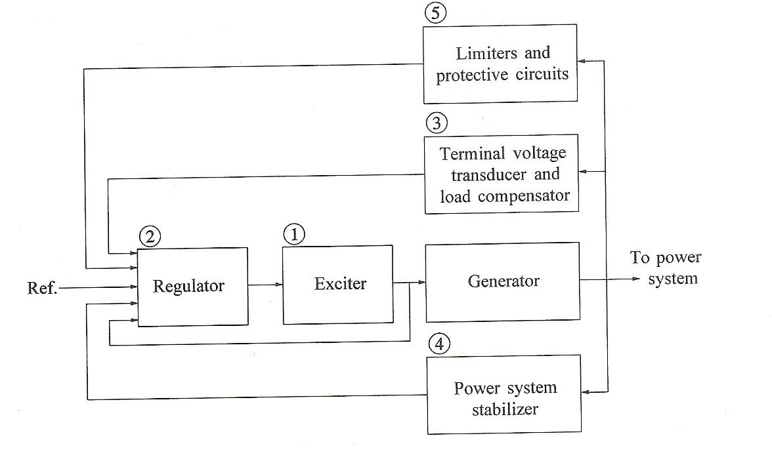
Functional Block Diagram
Image source: Fig 8.1 of Kundur, Power System Stability and Control

Slide 9
Potential Types of Exciters
None, which would be the case for a permanent magnet generator
  primarily used with wind turbines with ac-dc-ac converters
DC: Utilize a dc generator as the source of the field voltage through slip rings
AC: Use an ac generator on the generator shaft, with output rectified to produce the dc field voltage; brushless with a rotating rectifier system
Static: Exciter is static, with field current supplied through slip rings

Slide 10
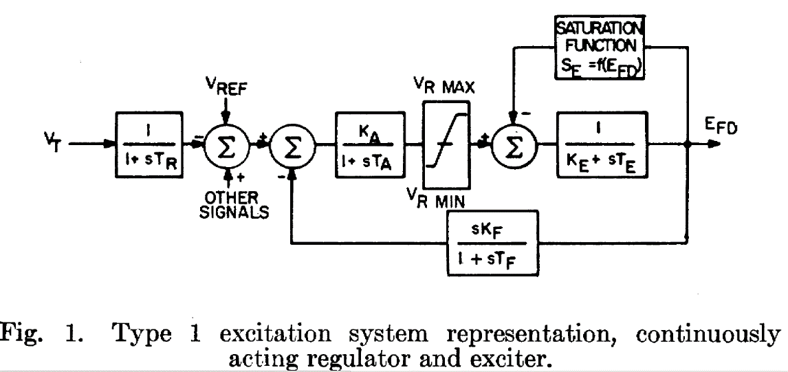
IEEET1 Exciter
We’ll start with a common exciter model, the IEEET1 based on a dc generator, and develop its structure
  This model was standardized in a 1968 IEEE Committee Paper with Fig 1. from the paper shown below

Slide 11
Block Diagram Basics
The following slides will make use of block diagrams to explain some of the models used in power system dynamic analysis. The next few slides cover some of the block diagram basics.
To simulate a model represented as a block diagram, the equations need to be represented as a set of first order differential equations
Also the initial state variable and reference values need to be determined

Slide 12
Integrator Block
Equation for an integrator with u as an input and y as an output is
In steady-state with an initial output of y₀, the initial state is y₀ and the initial input is zero
u
y

Slide 13
First Order Lag Block
Equation with u as an input and y as an output is
In steady-state with an initial output of y₀, the initial state is y₀ and the initial input is y₀/K
Commonly used for measurement delay (e.g., T_{R} block with IEEE T1)
Input
u
y
Output of Lag Block

Slide 14
Derivative Block
Block takes the derivative of the input, with scaling K_{D} and a first order lag with T_{D}
  Physically we can't take the derivative without some lag
  An example is the feedback block in the IEEET1 model
In steady-state the output of the block is zero
State equations require a more general approach
u
y

Slide 15
State Equations for More Complicated Functions
There is not a unique way of obtaining state equations for more complicated functions with a general form
To be physically realizable we need n >= m

Slide 16
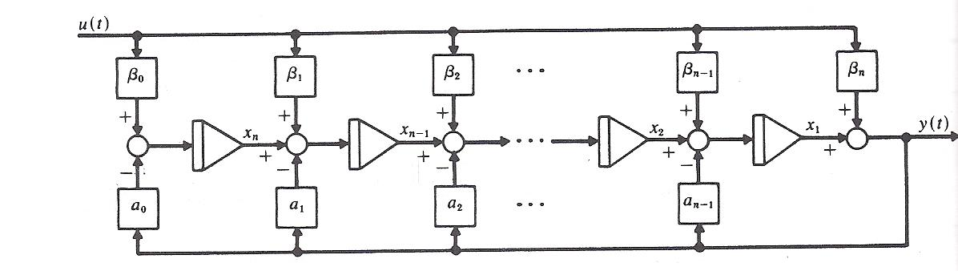
General Block Diagram Approach
One integration approach is illustrated in the below block diagram
Image source: W.L. Brogan, Modern Control Theory, Prentice Hall, 1991, Figure 3.7

Slide 17
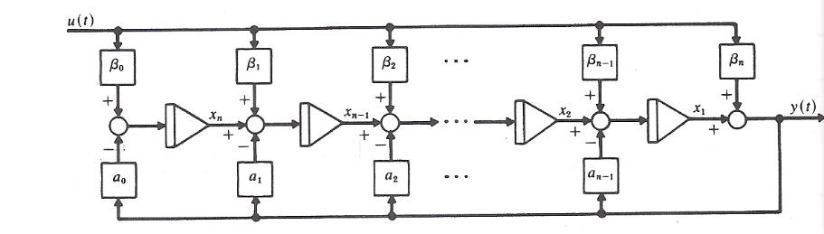
Derivative Example
Write in form
Hence β₀=0, β₁=K_{D}/T_{D}, α₀=1/T_{D}
Define single state variable x, then
Initial value of
x is found by recognizing
y is zero so x = -β₁u

Slide 18
Lead-Lag Block
In exciters such as the EXDC1 the lead-lag block is used to model time constants inherent in the exciter; the values are often zero (or equivalently equal)
In steady-state the input is equal to the output
To get equations write
in form with β₀=1/T_{B}, β₁=T_{A}/T_{B},
α₀=1/T_{B}
input
u
y
Output of Lead/Lag

Slide 19
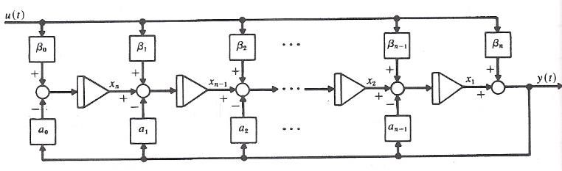
Lead-Lag Block
The equations are with
then
β₀=1/T_{B}, β₁=T_{A}/T_{B},
α₀=1/T_{B}
The steady-state
requirement
that u = y is
readily apparent

Slide 20
Limits: Windup versus Nonwindup
When there is integration, how limits are enforced can have a major impact on simulation results
Two major flavors: windup and non-windup
Windup limit for an integrator block
The value of v is NOT limited, so its value can "windup" beyond the limits, delaying backing
off of the limit
L_{max}
v
u
y
L_{min}
If L_{min} ≤ v ≤ L_{max} then y = v
else If v < L_{min} then y = L_{min},
else if v > L_{max} then y = L_{max}

Slide 21
Limits on First Order Lag
Windup and non-windup limits are handled in a similar manner for a first order lag
L_{max}
v
u
y
If L_{min} ≤ v ≤ L_{max} then y = v
else If v < L_{min} then y = L_{min},
else if v > L_{max} then y = L_{max}
L_{min}
Again the value of v is NOT limited, so its value can "windup" beyond the limits, delaying backing off of the limit

Slide 22
Non-Windup Limit First Order Lag
With a non-windup limit, the value of y is prevented from exceeding its limit
L_{max}
u
y
L_{min}

Slide 23
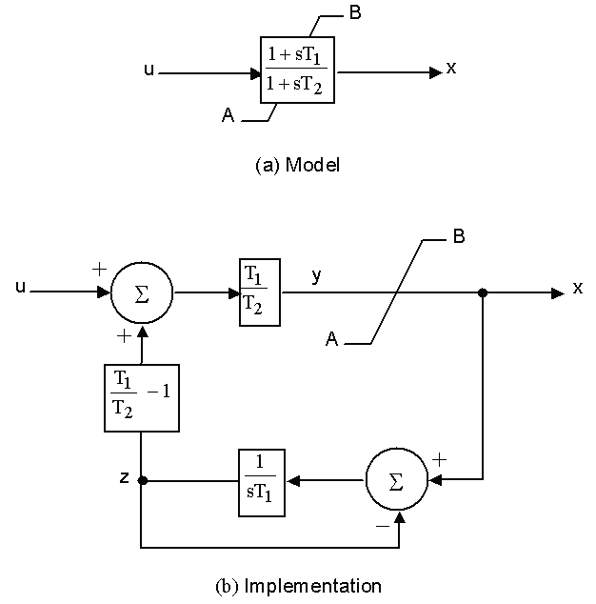
Lead-Lag Non-Windup Limits
There is not a unique way to implement non-windup limits for a lead-lag.
This is the one from
IEEE 421.5-1995
(Figure E.6)
T₂ > T₁, T₁ > 0, T₂ > 0
If y > B, then x = B
If y < A, then x = A
If B ≥y ≥ A, then x = y

Slide 24
Ignored States
When integrating block diagrams often states are ignored, such as a measurement delay with T_{R}=0
In this case the differential equations just become algebraic constraints
Example: For block at right,
as T→0, v=Ku
With lead-lag it is quite common for T_{A}=T_{B}, resulting in the block being ignored
L_{max}
v
u
y
L_{min}

Slide 25
Brief Review of DC Machines
Prior to widespread use of machine drives, dc motors had a important advantage of easy speed control
On its stator a dc machine has either a permanent magnet or a single concentrated winding
Rotor (armature) currents are supplied through brushes and the commutator
Equations are
The f subscript refers to the field, the a to the armature; ω is the machine's speed, G is a constant. In a permanent magnet machine the field flux is constant, the field equation goes away, and the field impact is embedded in a equivalent constant to Gi_{f}
Taken mostly from M.A. Pai, Power Circuits and Electromechanics

Slide 26
Review of DC Machines
The purpose of the next few slides is to provide insight into the source of portions of the block diagrams for various types of exciters

Slide 27
Types of DC Machines
If there is a field winding (i.e., not a permanent magnet machine) then the machine can be connected in the following ways
  Separately-excited: Field and armature windings are connected to separate power sources
    For an exciter, control is provided by varying the field current (which is stationary), which changes the armature voltage
  Series-excited: Field and armature windings are in series
  Shunt-excited: Field and armature windings are in parallel

Slide 28
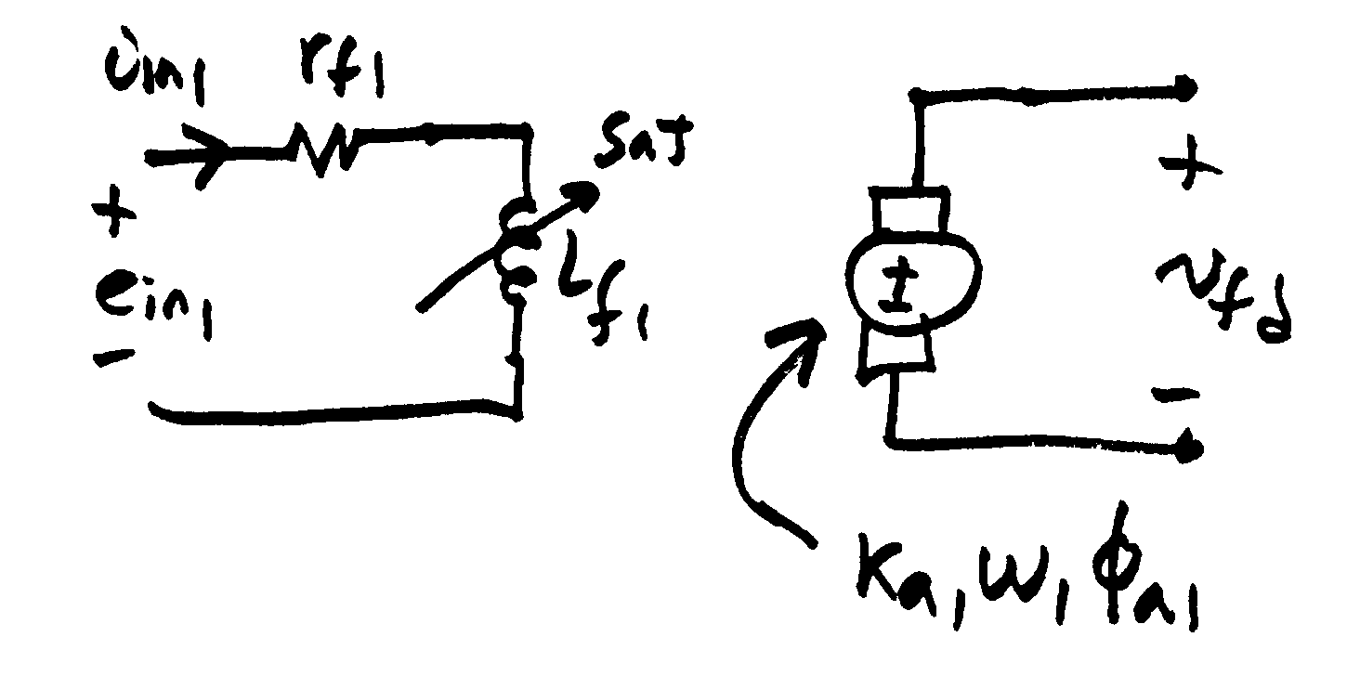
Separately Excited DC Exciter
(to sync
mach)
σ₁ is coefficient of dispersion,
modeling the flux leakage

Slide 29
Separately Excited DC Exciter
Relate the input voltage, e_{in1}, to v_{fd}
Assuming a constant
speed ω₁
Solve above for φ_{f1} which was used
in the previous slide

Slide 30
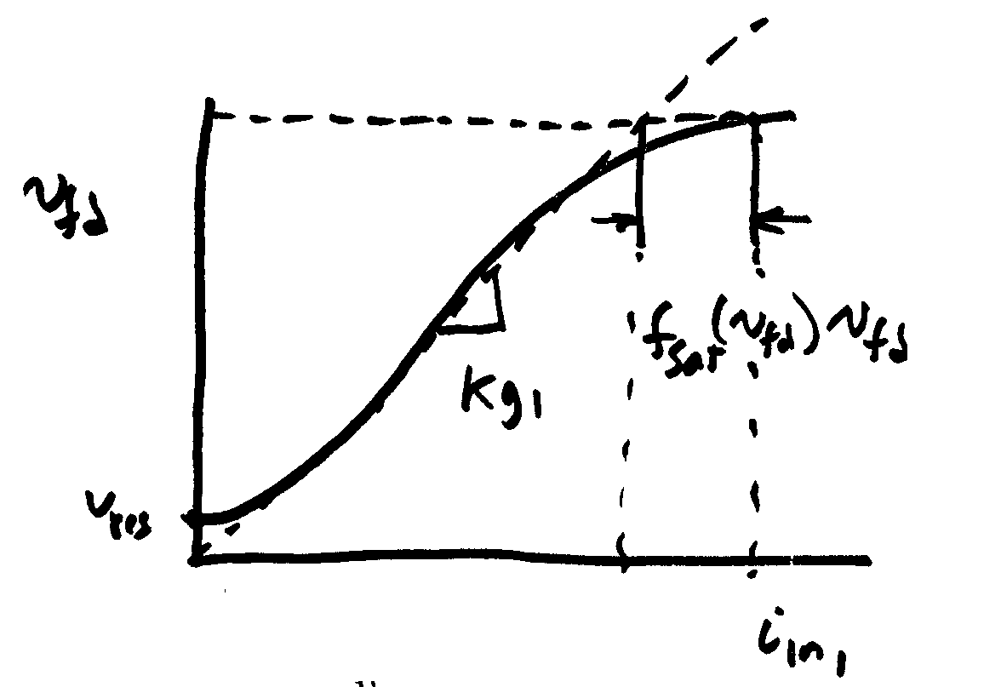
Separately Excited DC Exciter
If it was a linear magnetic circuit, then v_{fd} would be proportional to i_{n1}; for a real system we need to account for saturation
Without saturation we can write

Slide 31
Separately Excited DC Exciter
This equation is then scaled based on the synchronous
machine base values

Slide 32
Separately Excited Scaled Values
V_{R} is the scaled
output of the voltage regulator
amplifier
Thus we have

Slide 33
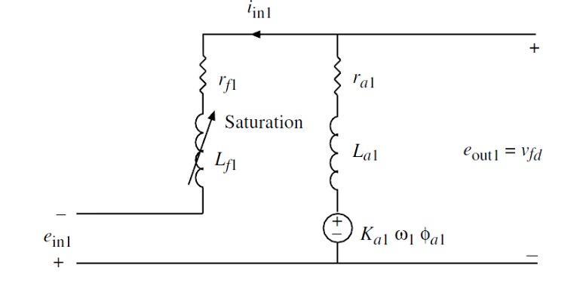
The Self-Excited Exciter
When the exciter is self-excited, the amplifier voltage appears in series with the exciter field
Note the additional
E_{fd} term on the end

Slide 34
Self and Separated Excited Exciters
The same model can be used for both by just modifying the value of K_{E}

Slide 35
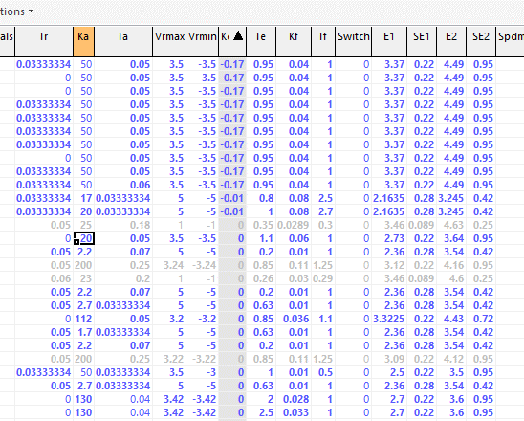
Exciter Model IEEET1 K_{E} Values
Example IEEET1 Values from a large system
The K_{E} equal 1 are separately excited, and K_{E} close to
zero are self excited

Slide 36
Saturation
A number of different functions can be used to represent the saturation
The quadratic approach is now quite common
Exponential function could also be used
This is the
same
function
used with
the machine
models

Slide 37
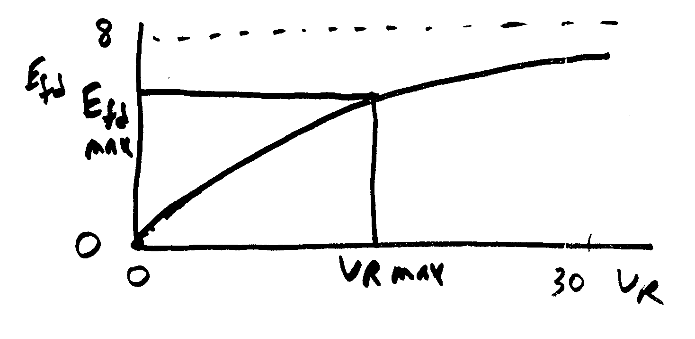
Exponential Saturation
In Steady state

Slide 38
Exponential Saturation Example
Given:
Find:

Slide 39
Voltage Regulator Model
Amplifier
Modeled
as a first
order
differential
equation
In steady state
As K_{A} is increased
There is often a droop in regulation

Slide 40
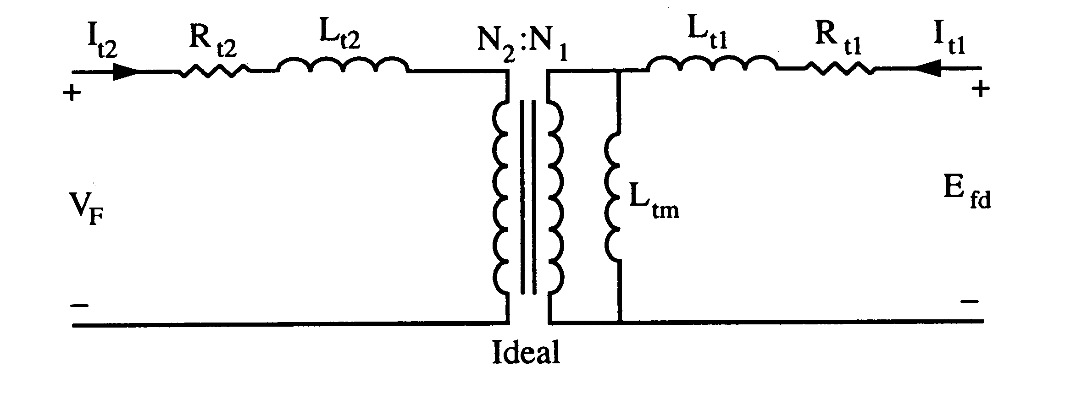
Feedback
This control system can often exhibit instabilities, so some type of feedback is used
One approach is a stabilizing transformer
Designed with a large L_{t2} so I_{t2} ≈ 0

Slide 41
Feedback

Slide 42
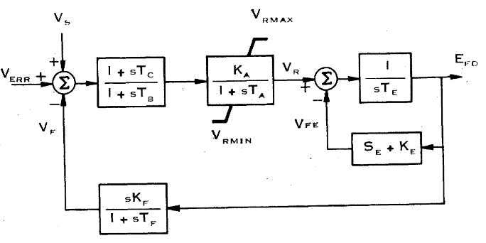
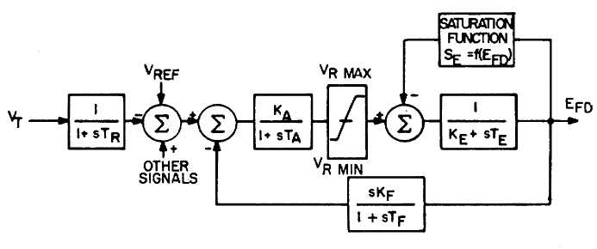
IEEET1 Model Evolution
The original IEEET1, from 1968, evolved into the EXDC1 in 1981
1968
1981
Note, K_{E} in the feedback is the same in both models
Image Source: Fig 3 of "Excitation System Models for Power Stability Studies,"
IEEE Trans. Power App. and Syst., vol. PAS-100, pp. 494-509, February 1981

Slide 43
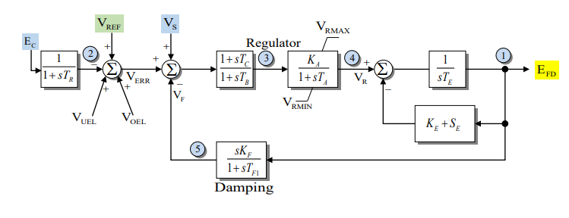
IEEEX1
This is from 1979, and is the EXDC1 with the potential for a measurement delay and inputs for under or over excitation limiters

Slide 44
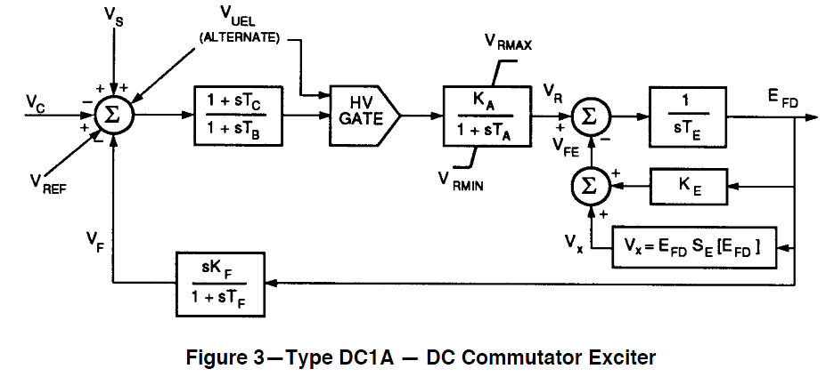
IEEET1 Evolution
In 1992 IEEE Std 421.5-1992 slightly modified the EXDC1, calling it the DC1A (modeled as ESDC1A)
V_{UEL} is a
signal
from an
under-
excitation
limiter,
which
we'll
cover
later
Same model is in 421.5-2005
Image Source: Fig 3 of IEEE Std 421.5-1992

Slide 45
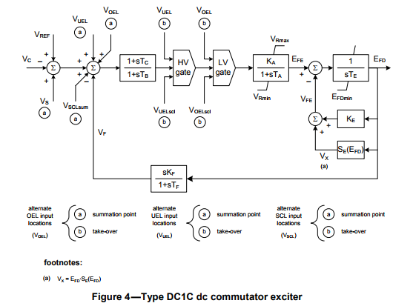
IEEET1 Evolution
Slightly modified in Std 421.5-2016
Note the minimum
limit on E_{FD}
There is also the
addition to the
input of voltages
from a stator
current limiters
(V_{SCL}) or over
excitation limiters
(V_{OEL})

Slide 46
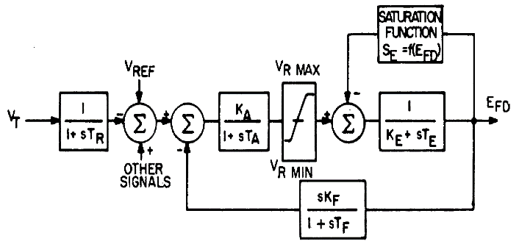
IEEET1 Example
Assume previous GENROU case with saturation. Then add a IEEE T1 exciter with K_{A}=50, T_{A}=0.04, K_{E}=-0.06, T_{E}=0.6, V_{R,max}=1.0, V_{R,min}= -1.0 For saturation assume S_{E}(2.8) = 0.04, S_{E}(3.73)=0.33
Saturation function is 0.1621(E_{FD}-2.303)² (for E_{FD} > 2.303); otherwise zero
E_{FD} is initially 3.22
S_{E}(3.22)*E_{FD}=0.437
(V_{R}-S_{E}*E_{FD})/K_{E}=E_{FD}
V_{R} =0.244
V_{REF} = 0.244/Ka +V_{T} =0.0488 +1.0946=1.09948
Case B4_GENROU_Sat_IEEET1

Slide 47
IEEE T1 Example
For 0.1 second fault (from before), plot of E_{FD} and the terminal voltage is given below
Initial V₄=1.0946, final V₄=1.0973
  Steady-state error depends on the value of K_{A}

Slide 48
IEEET1 Example
Same case, except with K_{A}=500 to decrease steady-state error, no V_{R} limits; this case is actually unstable

Slide 49
IEEET1 Example
With K_{A}=500 and rate feedback, K_{F}=0.05, T_{F}=0.5
Initial V₄=1.0946, final V₄=1.0957

Slide 50
WECC Case Type 1 Exciters
In a recent WECC case with 3519 exciters, 20 are modeled with the IEEE T1, 156 with the EXDC1 20 with the ESDC1A (and none with IEEEX1)
Graph shows K_{E} value for the EXDC1 exciters in case;
about 1/3 are separately
excited, and the rest self
excited
  A value of K_{E} equal zero
  indicates code should
  set K_{E} so V_{r} initializes
  to zero; this is used to mimic
  the operator action of trimming this value

