Slide 1
ECEN 667
Power System Stability
Lecture 11: Exciters and Governors
Prof. Tom Overbye
Dept. of Electrical and Computer Engineering
Texas A&M University
overbye@tamu.edu

Slide 2
Announcements
Read Chapter 4
Homework 3 is due today
Homework 4 will not need to be turned in (just done before the first exam)
Exam 1 will be on Oct 14 in class
  For the distance learners we usually use Honorlock (though I know for some that won’t work)
  Exams are closed book, closed notes, but you can bring in one 8.5 by 11 inch note sheet and can use calculators

Slide 3
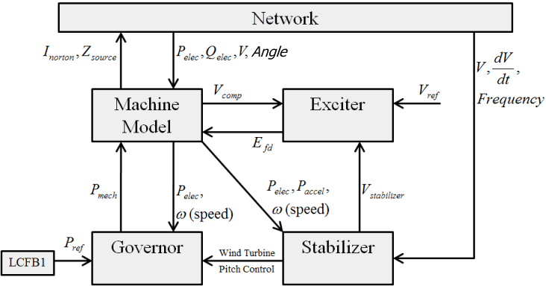
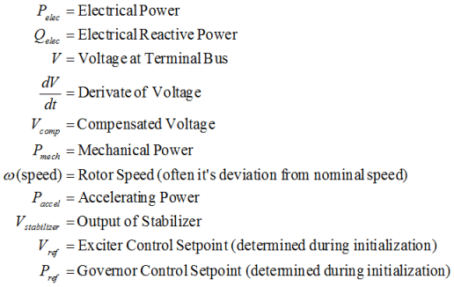
Governor Models

Slide 4
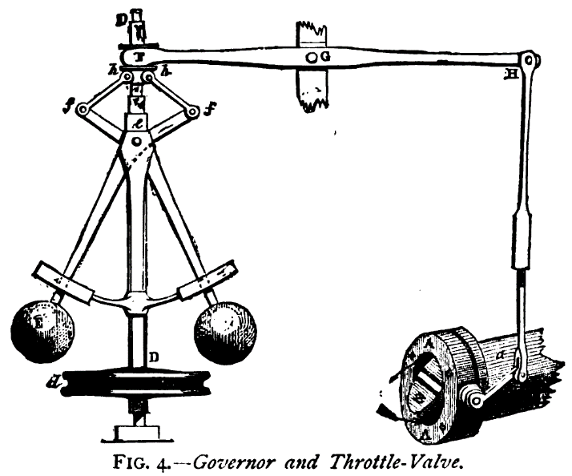
Prime Movers and Governors
Synchronous generator is used to convert mechanical energy from a rotating shaft into electrical energy
The "prime mover" is what converts the orginal energy source into the mechanical energy in the rotating shaft
Possible sources: 1) steam (nuclear, coal, combined cycle, solar thermal), 2) gas turbines, 3) water wheel (hydro turbines), 4) diesel/
gasoline, 5) wind
(which we'll cover separately)
The governor is used
to control the speed
Image source: http://upload.wikimedia.org/wikipedia/commons/1/1e/Centrifugal_governor.png

Slide 5
Prime Movers and Governors
In transient stability collectively the prime mover and the governor are called the "governor"
As has been previously discussed, models need to be appropriate for the application
In transient stability the response of the system for seconds to perhaps minutes is considered
Long-term dynamics, such as those of the boiler and automatic generation control (AGC), are usually not considered
These dynamics would need to be considered in longer simulations (e.g. dispatcher training simulator (DTS)

Slide 6
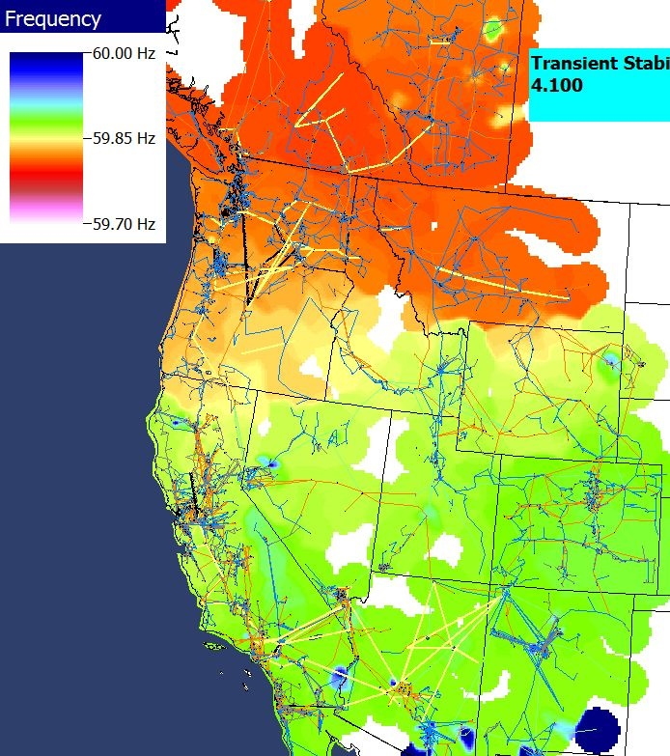
Power Grid Disturbance Example
Figures show the frequency change as a result of the sudden loss of a large amount of generation in the Southern WECC
Freq. Hz)
Time in Seconds
Frequency Contour

Slide 7
Frequency Response for Generation Loss
In response to a rapid loss of generation, in the initial seconds the system frequency will decrease as energy stored in the rotating masses is transformed into electric energy
  Some generation, such as solar PV has no inertia, and for most new wind turbines the inertia is not seen by the system
Within seconds governors respond, increasing the power output of controllable generation
  Many conventional units are operated so they only respond to over frequency situations
  Solar PV and wind are usually operated in North America at maximum power so they have no reserves to contribute

Slide 8
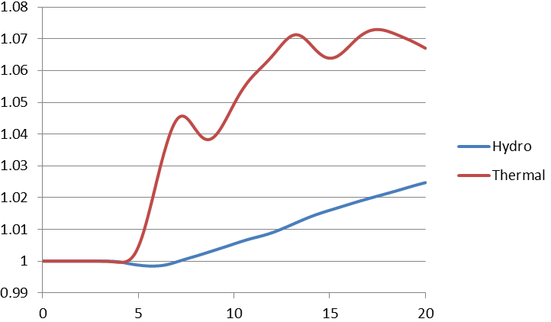
Governor Response:
Thermal Versus Hydro
Thermal units respond quickly, hydro ramps slowly (and goes down initially), wind and solar usually do not respond. And many units are set to not respond!
Normalized
output
Time in Seconds

Slide 9
Some Good References
Kundur, Power System Stability and Control, 1994
Wood, Wollenberg and Sheble, Power Generation, Operation and Control, third edition, 2013
IEEE PES, "Dynamic Models for Turbine-Governors in Power System Studies," Jan 2013
"Dynamic Models for Fossil Fueled Steam Units in Power System Studies," IEEE Trans. Power Syst., May 1991, pp. 753-761
"Hydraulic Turbine and Turbine Control Models for System Dynamic Studies," IEEE Trans. Power Syst., Feb 1992, pp. 167-179

Slide 10
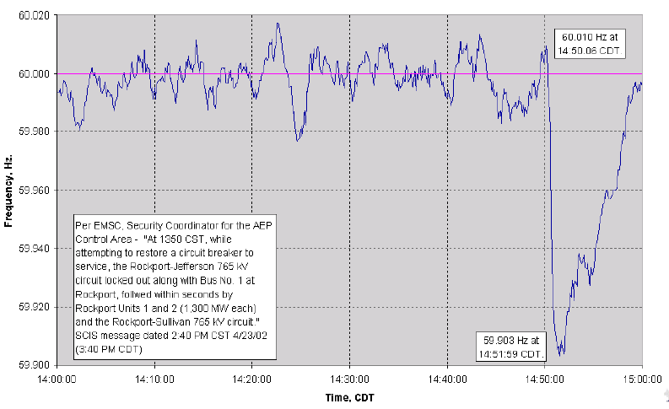
2600 MW Loss Frequency Recovery
Frequency recovers in about ten minutes

Slide 11
Frequency Response Definition
FERC defines in RM13-11: “Frequency response is a measure of an Interconnection’s ability to stabilize frequency immediately following the sudden loss of generation or load, and is a critical component of the reliable operation of the Bulk-Power System, particularly during disturbances and recoveries.”
Design Event for WECC is N-2 (Palo Verde Outage) not to result in UFLS (59.5 Hz in WECC)
Source: wecc.biz/Reliability/Frequency%20Response%20Analysis%20-%20Dmitry%20Kosterev.pdf

Slide 12
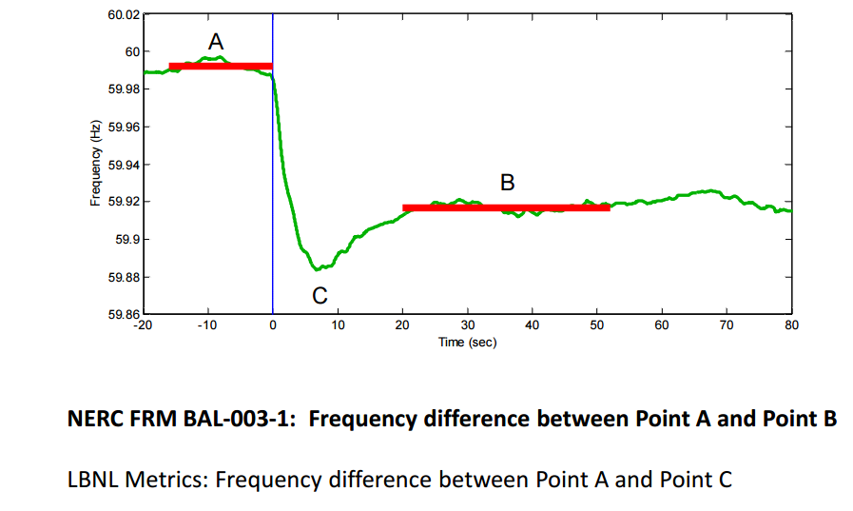
Frequency Response Measure
Source: wecc.biz/Reliability/Frequency%20Response%20Analysis%20-%20Dmitry%20Kosterev.pdf

Slide 13
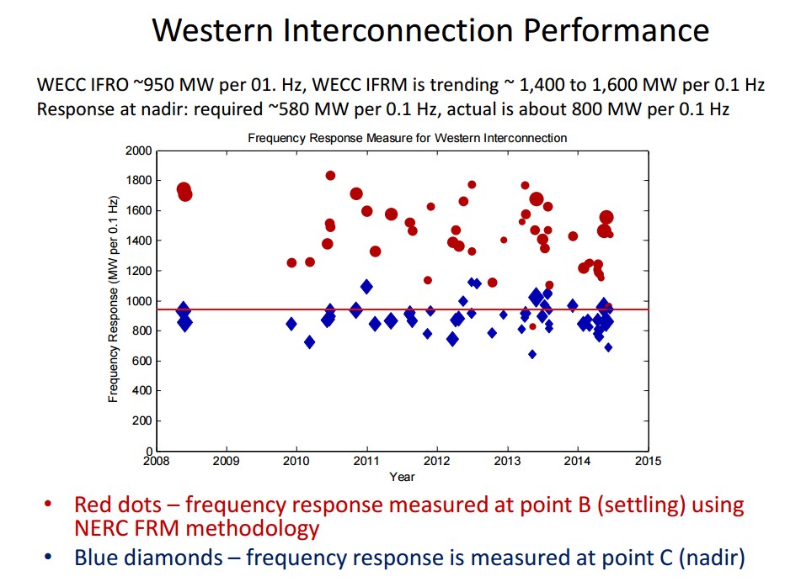
WECC Interconnection Performance
Source: wecc.biz/Reliability/Frequency%20Response%20Analysis%20-%20Dmitry%20Kosterev.pdf

Slide 14
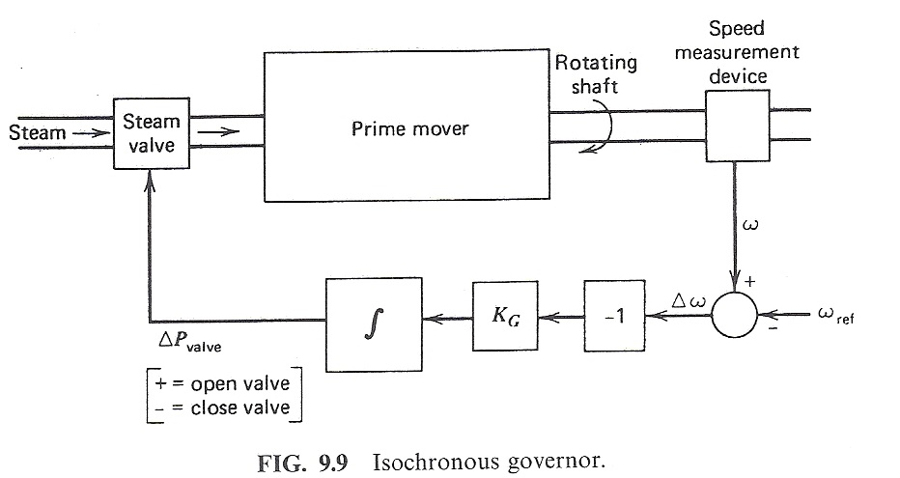
Control of Generation Overview
Goal is to maintain constant frequency with changing load
If there is just a single generator, such with an emergency generator or isolated system, then an isochronous governor is used
  Integrates frequency error to insure frequency goes back to
  the desired value
  Cannot be used with
  interconnected systems
  because of "hunting"
Image source: Wood/Wollenberg, 2nd edition

Slide 15
Generator “Hunting”
Control system “hunting” is oscillation around an equilibrium point
Trying to interconnect multiple isochronous generators will cause hunting because the frequency setpoints of the two generators are never exactly equal
  One will be accumulating a frequency error trying to speed up the system, whereas the other will be trying to slow it down
  The generators will NOT share the power load proportionally

Slide 16
Isochronous Gen Example
WSCC 9 bus from before, gen 3 dropping (85 MW)
  No infinite bus, gen 1 is modeled with an isochronous generator (PW ISOGov1 model)
Gen 2 is modeled with no governor, so its mechanical power stays fixed
Case is wscc_9bus_IsoGov

Slide 17
Isochronous Gen Example
Graph shows the change in the mechanical output
All the change
in MWs due
to the loss of
gen 3 is
being picked
up by
gen 1

Slide 18
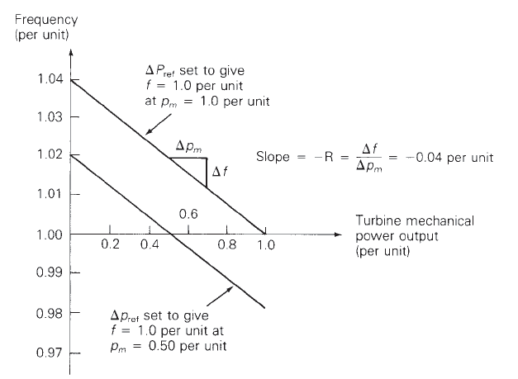
Droop Control
To allow power sharing between generators the solution is to use what is known as droop control, in which the desired set point frequency is dependent upon the generator’s output
R is known as the
regulation constant
or droop; a typical
value is 4 or 5%.
At 60 Hz and a 5% droop, each 0.1 Hz change would change the output by 0.1/(60*0.05)=
3.33%

Slide 19
WSCC 9 Bus Droop Example
Assume the previous gen 3 drop contingency (85 MW), and that gens 1 and 2 have ratings of 500 and 250 MVA respectively and governors with a 5% droop. What is the final frequency (assuming no change in load)?

Slide 20
WSCC 9 Bus Droop Example
The below graphs compare the mechanical power and generator speed; note the steady-state values match the calculated 59.66 Hz value
Case is wscc_9bus_TGOV1

Slide 21
Quick Interconnect Calculation
When studying a system with many generators, each with the same (or close) droop, then the final frequency deviation is
The online generator summation should only include generators that actually have governors that can respond, and does not take into account generators hitting their limits
The online generator group
obviously does not
include the contingency
generator(s) that are opened

Slide 22
Larger System Example
As an example, consider the 37 bus, nine generator example from earlier; assume one generator with 42 MW is opened. The total MVA of the remaining generators is 1132. With R=0.05
Case is Bus37_TGOV1

Slide 23
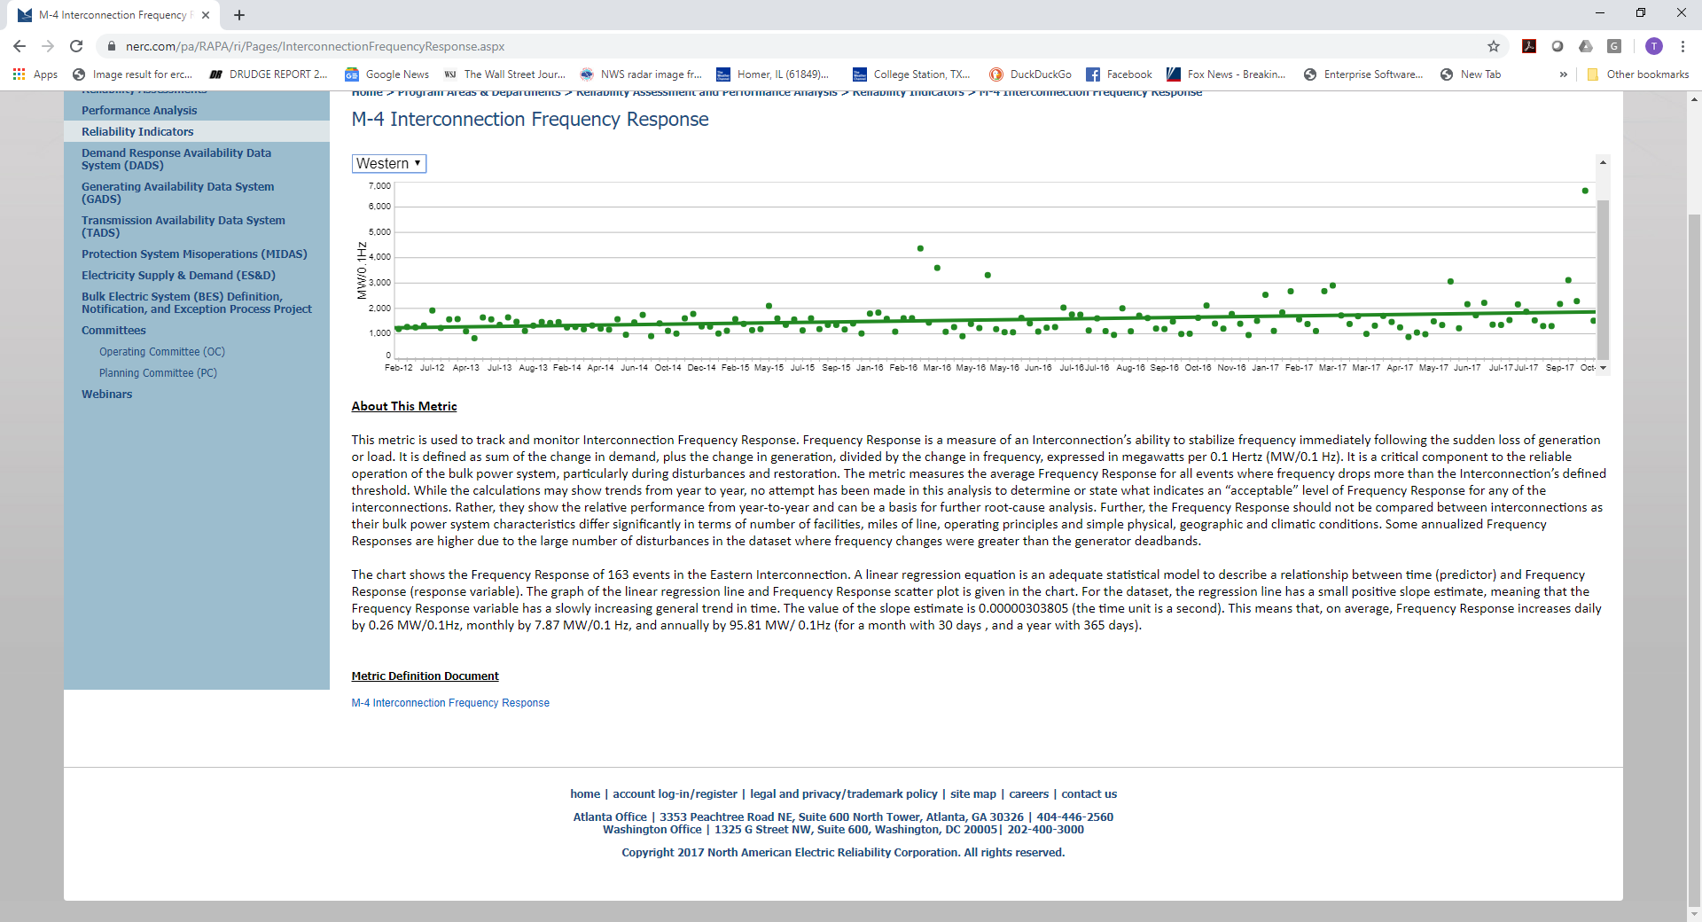
WECC Interconnect
Frequency Response
Data for the four major interconnects is available from NERC; these are the values between points A and B
A higher value is better (more generation for a 0.1 Hz change)
Source: www.nerc.com/pa/RAPA/ri/Pages/InterconnectionFrequencyResponse.aspx

Slide 24
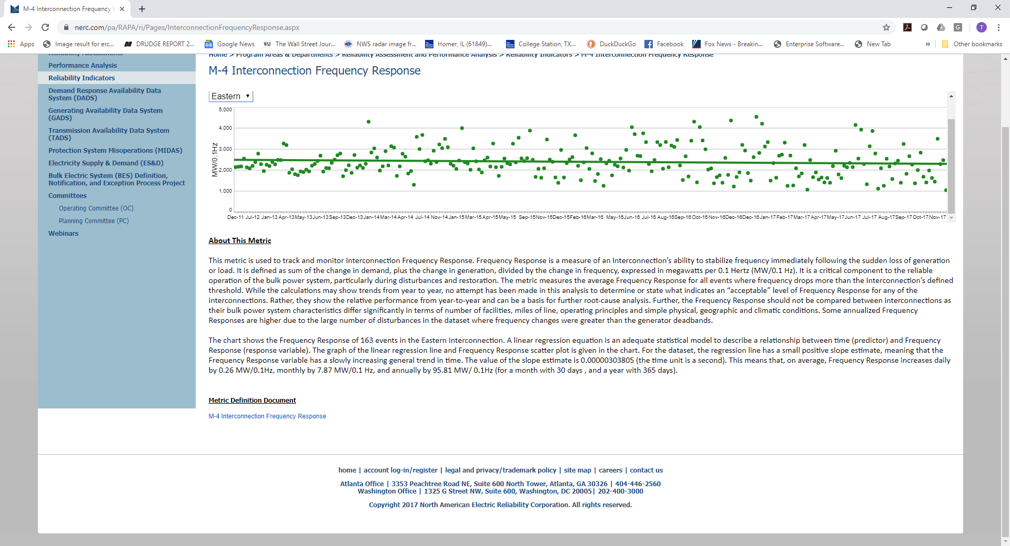
Eastern Interconnect
Frequency Response
The larger Eastern Interconnect on average has a higher value

Slide 25
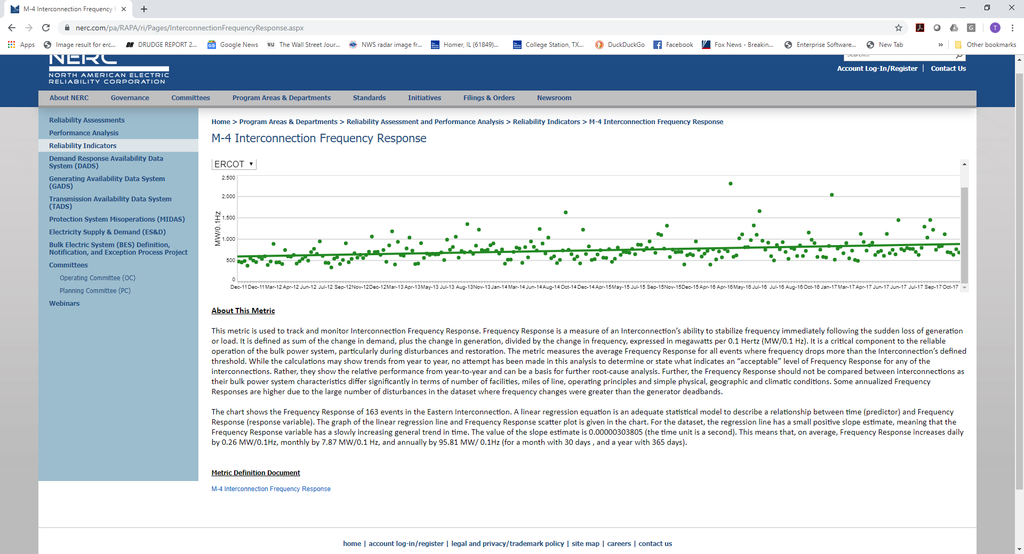
ERCOT Interconnect
Frequency Response
An ERCOT a lower value
Source: www.nerc.com/pa/RAPA/ri/Pages/InterconnectionFrequencyResponse.aspx

Slide 26
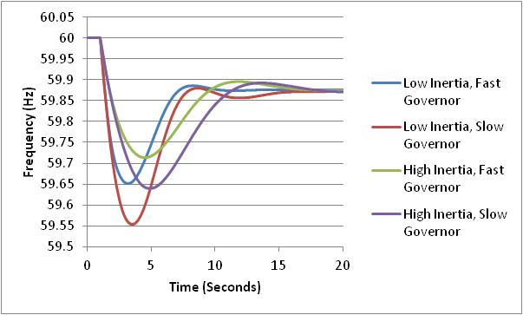
Impact of Inertia (H)
Final frequency is determined by the droop of the responding governors
How quickly the frequency drops depends upon the generator inertia values
The least
frequency
deviation
occurs with
high inertia
and fast
governors

Slide 27
Restoring Frequency to 60 (or 50) Hz
In an interconnected power system the governors to not automatically restore the frequency to 60 Hz
Rather done via the ACE (area control area calculation). Previously we defined ACE as the difference between the actual real power exports from an area and the scheduled exports. But it has an additional term
ACE = P_{actual} - P_{sched} – 10β(freq_{act} - freq_{sched})
β is the balancing authority frequency bias in MW/0.1 Hz with a negative sign. It is about 0.8% of peak load/generation
This slower ACE response is usually
not modeled in transient stability

Slide 28
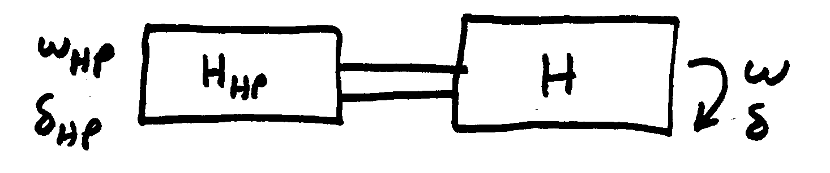
Turbine Models
model shaft “squishiness” as a spring
Usually shaft dynamics
are neglected
High-pressure turbine shaft dynamics

Slide 29
Steam Turbine Models
Boiler supplies a "steam chest" with the steam then
entering the turbine through a value
We are assuming
δ=δ_{HP} and
ω=ω_{HP}

Slide 30
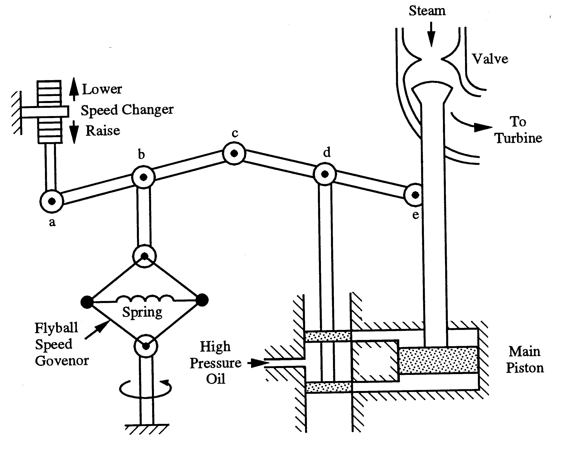
Steam Governor Model

Slide 31
Steam Governor Model
Steam valve limits
R = .05 (5% droop)

Slide 32
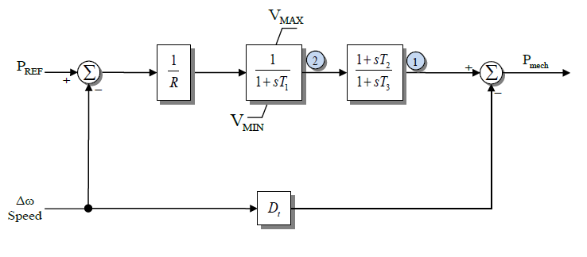
TGOV1 Model
Standard model that is close to this is TGOV1
About 12% of governors in a 2015 EI model are TGOV1;
R = 0.05, T₁ is less than 0.5 (except a few 999’s!), T₃
has an average of 7, average T₂/T₃ is 0.34;
D_{t} is used to model turbine damping and is often zero
(about 80% of time in EI)

Slide 33
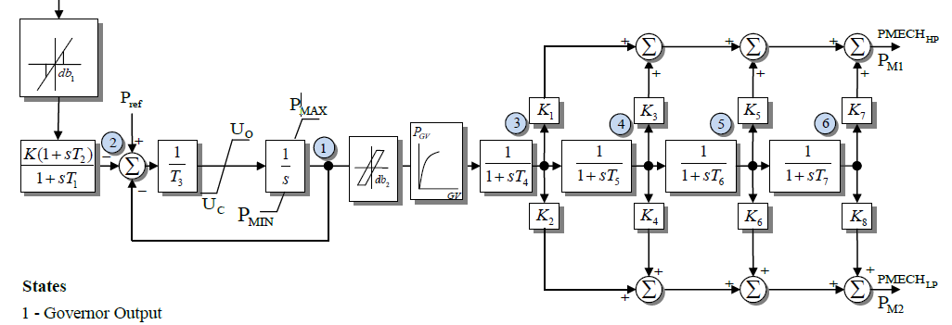
IEEEG1 Model
A common stream turbine model, is the IEEEG1, originally introduced in the below 1973 paper
In this model K=1/R
It can be used to represent
cross-compound units, with
high and low pressure steam
U_{o} and U_{c} are rate limits
IEEE Committee Report, “Dynamic Models for Steam and Hydro Turbines in Power System Studies,” Transactions in Power Apparatus & Systems, volume 92, No. 6, Nov./Dec. 1973, pp 1904-15

Slide 34
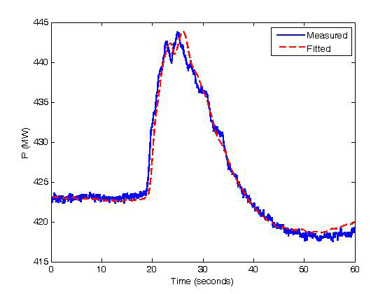
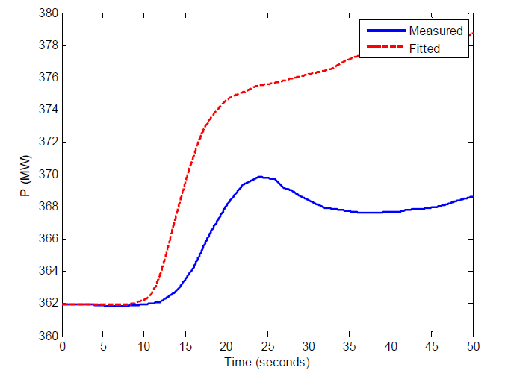
IEEEG1
Blocks on the right model the various steam stages
About 12% of WECC and EI governors are currently IEEEG1s
Below figures show two test comparison with this model
Image Source: Figs 2-4, 2-6 of IEEE PES, "Dynamic Models for Turbine-Governors in Power System Studies," Jan 2013

Slide 35
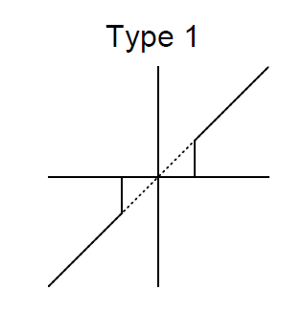
Deadbands
Before going further, it is useful to briefly consider deadbands, with two types shown with IEEEG1 and described in the 2013 IEEE PES Governor Report
The type 1 is an intentional deadband, implemented to prevent excessive response
  Until the deadband activates there is no response, then normal response after that; this can cause a potentially
  large jump in the response
  Also, once activated there is normal
  response coming back into range
  Used on input to IEEEG1

Slide 36
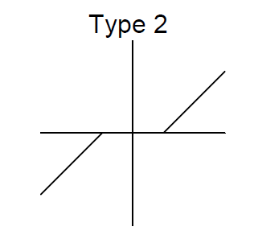
Deadbands
The type 2 is also an intentional deadband, implemented to prevent excessive response
  Difference is response does not jump, but rather only starts once outside of the range
Another type of deadband is the
unintentional, such as will occur
with loose gears
  Until deadband "engages"
  there is no response
  Once engaged there is
  a hysteresis in the
  response
When starting
simulations
deadbands
usually start at
their origin

Slide 37
Frequency Deadbands in ERCOT
In ERCOT NERC BAL-001-TRE-1 (“Primary Frequency Response in the ERCOT Region”) has the purpose “to maintain interconnection steady-state frequency within defined limits”
The deadband requirement is +/- 0.034 Hz for steam and hydro turbines with mechanical governors; +/- 0.017 Hz for all other generating units
The maximum droop setting is 5% for all units except it is 4% for combined cycle combustion turbines
Source: NERC BAL-001-TRE-1 and ERCOT, Demonstration of PFR Improvement, ERCOT Operations Planning, Sept. 2017 presentation

Slide 38
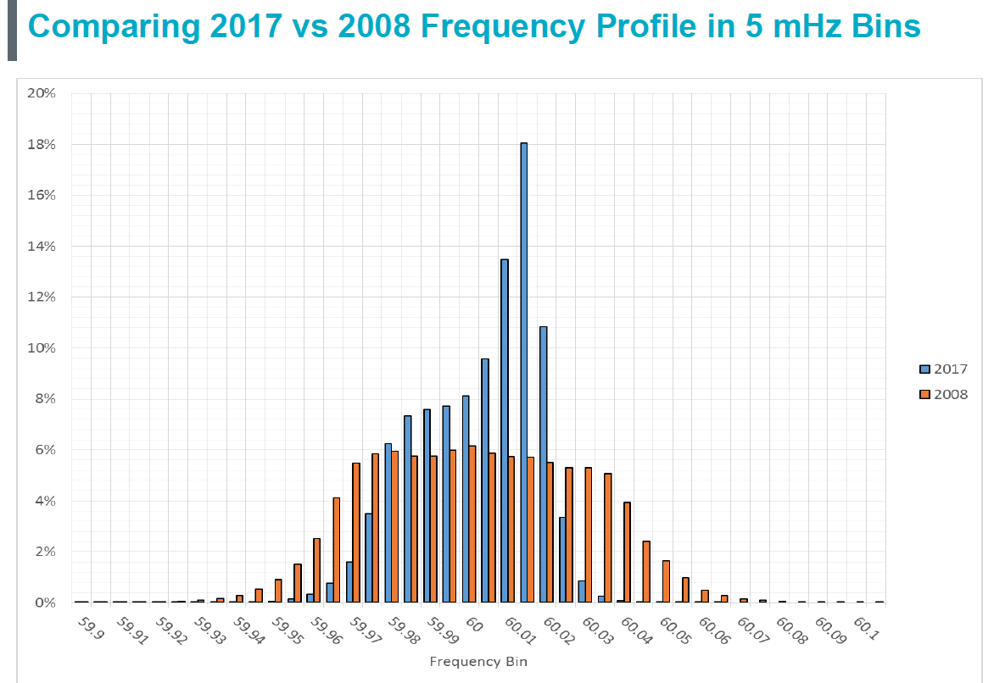
Comparing ERCOT 2017 Versus 2008 Frequency Profile (5 mHz bins)

Slide 39
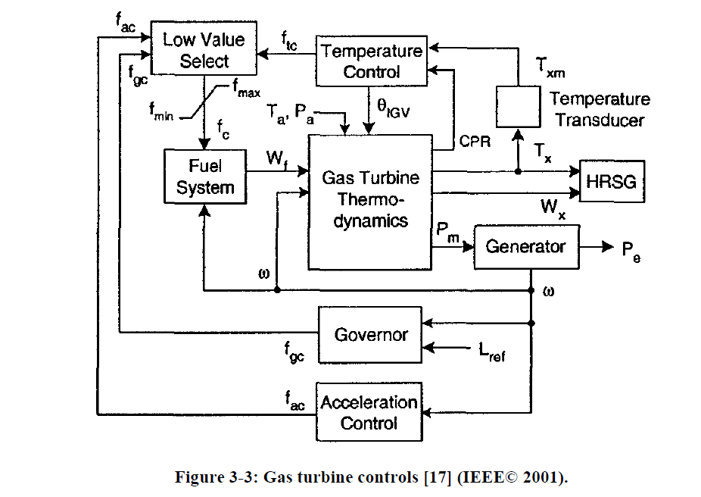
Gas Turbines
A gas turbine (usually using natural gas) has a compressor, a combustion chamber and then a turbine
The below figure gives an overview of the modeling
HRSG is
the heat
recovery
steam
generator
(if it is a
combined
cycle unit)
Image from IEEE PES, "Dynamic Models for Turbine-Governors in Power System Studies," Jan 2013

Slide 40
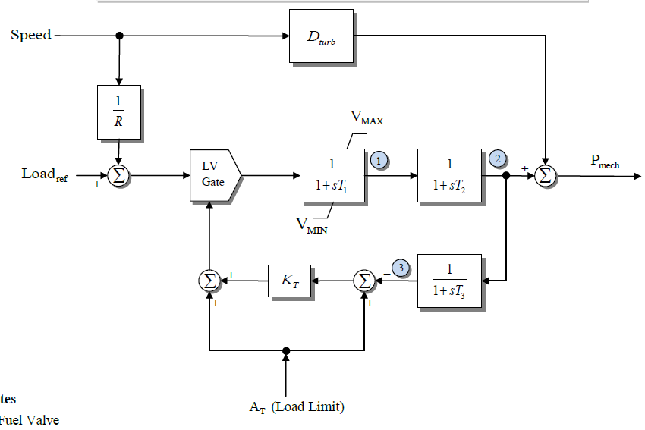
GAST Model
Quite detailed gas turbine models exist; we'll just consider the simplest, which is still used some
It is somewhat similar
to the TGOV1. T₁ is for
the fuel valve, T₂
is for the turbine, and
T₃ is for the load
limit response based
on the ambient
temperature (At);
T₃ is the delay in
measuring the exhaust
temperature
T₁ average is 0.9, T₂ is 0.6 sec

Slide 41
Play-in (Playback) Models
Often time in system simulations there is a desire to test the response of units (or larger parts of the simulation) to particular changes in voltage or frequency
  These values may come from an actual system event
"Play-in" or playback models can be used to vary an infinite bus voltage magnitude and frequency, with data specified in a file
PowerWorld allows both the use of files (for say recorded data) or auto-generated data
  Machine type GENCLS_PLAYBACK can play back a file
  Machine type InfiniteBusSignalGen can auto-generate a signal

Slide 42
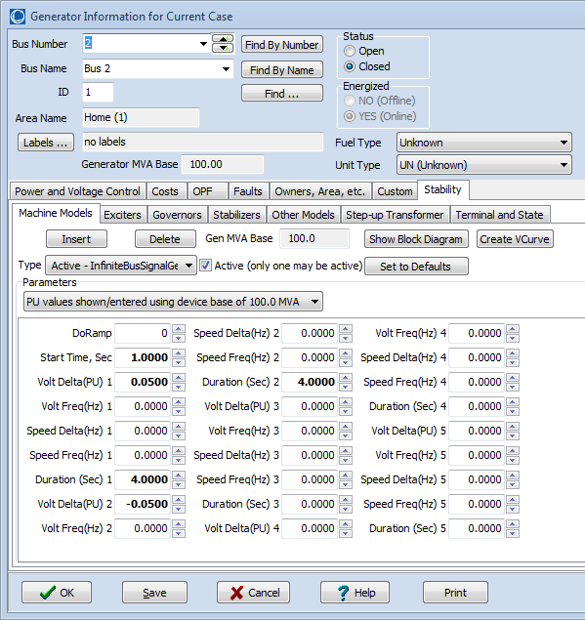
PowerWorld Infinite Bus
Signal Generation
Below dialog shows some options for auto-generation of voltage magnitude and frequency variations
Start Time tells when to start; values are then defined for up to five separate time periods
Volt Delta is the magnitude of the pu voltage deviation; Volt Freq is the frequency of the voltage deviation in Hz (zero for dc)
Speed Delta is the magnitude of the frequency deviation in Hz; Speed Freq is the frequency of the frequency deviation
Duration is the time in seconds for the time period

Slide 43
Example: Step Change in
Voltage Magnitude
Below graph shows the voltage response for the four bus system for a change in the infinite bus voltage
Case name: B4_SignalGen_Voltage

Slide 44
Example: Step Change
Frequency Response
Graph shows response in generator 4 output and speed for a 0.1% increase in system frequency
This is a
100 MVA
unit with
a per unit R
of 0.05

Slide 45
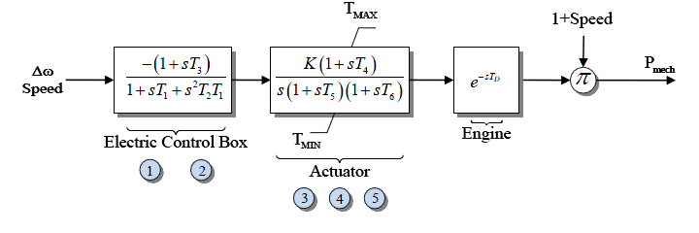
Simple Diesel Model: DEGOV
Sometimes models implement time delays (DEGOV)
  Often delay values are set to zero
Delays can be implemented either by saving the input value or by using a Pade approximation, with a 2nd order given below; a 4th order is also common

Slide 46
DEGOV Delay Approximation
With T_{D} set to 0.5 seconds (which is longer than the normal of about 0.05 seconds in order to illustrate the delay)

Slide 47
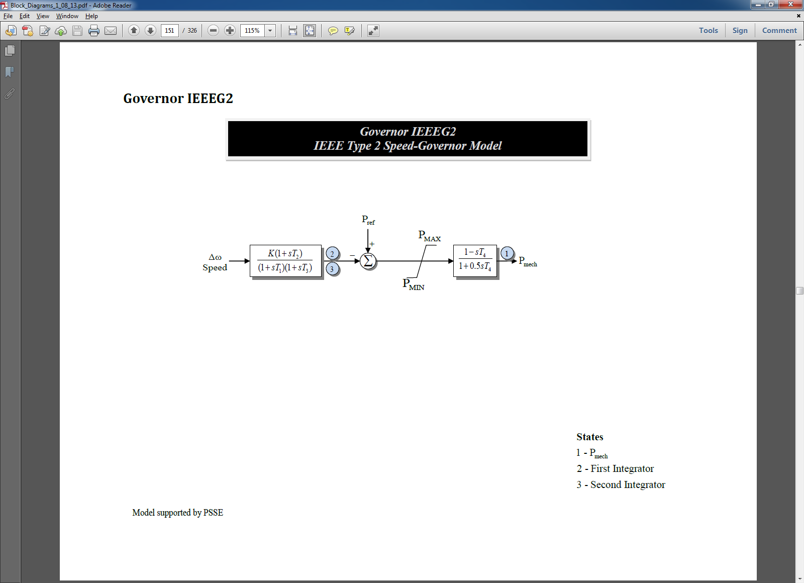
Hydro Units
Hydro units tend to respond slower than steam and gas units; since early transient stability studies focused on just a few seconds (first or second swing instability), detailed hydro units were not used
  The original IEEEG2 and IEEEG3 models just gave the linear response; now considered obsolete
Below is the IEEEG2; left side is the governor, right side is the turbine and water column
For sudden changes
there is actually an
inverse change in
the output power

Slide 48
Four Bus Example with an IEEEG2
Graph below shows the mechanical power output of gen 2 for a unit step decrease in the infinite bus frequency; note the power initially goes down!
This is caused by a
transient decrease in
the water pressure when
the valve is opened to
increase the water
flow; flows does not
change instantaneously
because of the water’s
inertia.
Case name: B4_SignalGen_IEEEG2

Slide 49
Washout Filters
A washout filter is a high pass filter that removes the steady-state response (i.e., it "washes it out") while passing the high frequency response
They are commonly used with hydro governors and (as we shall see) with power system stabilizers
With hydro turbines ballpark values for T_{w} are around one or two seconds

Slide 50
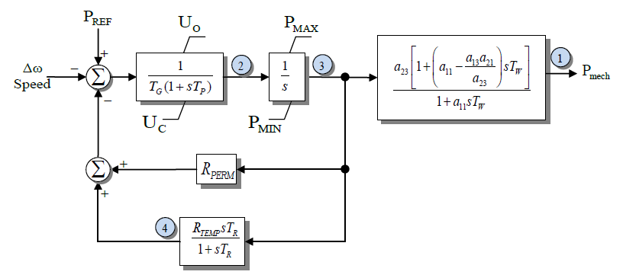
IEEEG3
This model has a more detailed governor model, but the same linearized turbine/water column model
Because of the initial inverse power change, for fast deviations the droop value is transiently set to a larger value (resulting in less of a power change)
Previously WECC had about 10% of their governors modeled with
IEEEG3s; in 2019 it is about 5%
Because of the washout filter at high frequencies R_{TEMP} dominates (on average it is 10 times greater than R_{PERM})

Slide 51
Tuning Hydro Transient Droop
As given in equations 9.41 and 9.42 from Kundar (1994) the transient droop should be tuned so
In comparing an average H is about 4 seconds, so
T_{M} is 8 seconds, an average T_{W} is about 1.3, giving
an calculated average R_{TEMP} of 0.37 and T_{R} of 6.3;
the actual averages in a WECC case are 0.46 and
6.15. So on average this is pretty good! R_{perm} is 0.05
Source: 9.2, Kundur, Power System Stability and Control, 1994

Slide 52
IEEEG3 Four Bus Frequency Change
The two graphs compare the case response for the frequency change with different R_{TEMP} values
Less variation
R_{TEMP} = 0.5, R_{PERM} = 0.05
R_{TEMP} = 0.05, R_{PERM} = 0.05
Case name: B4_SignalGen_IEEEG3

Slide 53
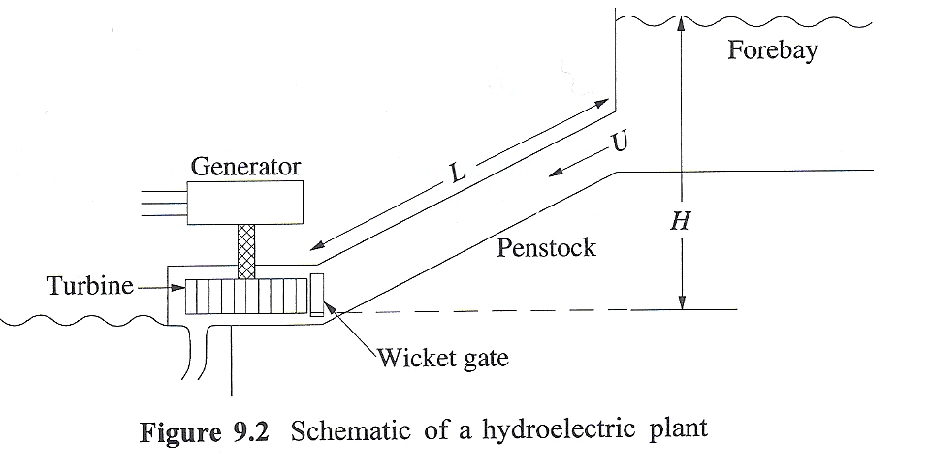
Basic Nonlinear Hydro Turbine Model
Basic hydro system is shown below
  Hydro turbines work be converting the kinetic energy in the water into mechanical energy
  assumes the water is incompressible
At the gate assume a velocity of U, a cross-sectional penstock area of A; then the
volume flow is A*U=Q;
Source: 9.2, Kundur, Power System Stability and Control, 1994

Slide 54
Basic Nonlinear Hydro Turbine Model
From Newton's second law of motion the change in the flow volume Q
As per [a] paper, this equation is normalized to
T_{W} is called the water time
constant, or water starting time
[a] "Hydraulic Turbine and Turbine Control Models for System Dynamic Studies," IEEE Trans. Power Syst., Feb, 92

Slide 55
Basic Nonlinear Hydro Turbine Model
With h_{base} the static head, q_{base} the flow when the gate is fully open, an interpretation of T_{w} is the time (in seconds) taken for the flow to go from stand-still to full flow if the total head is h_{base}
If included, the head losses, h_{loss}, vary with the square of the flow
The flow is assumed to vary as linearly with the gate position (denoted by c)

Slide 56
Basic Nonlinear Hydro Turbine Model
Power developed is proportional to flow rate times the head, with a term q_{nl} added to model the fixed turbine (no load) losses
  The term A_{t} is used to change the per unit scaling to that of the electric generator

Slide 57
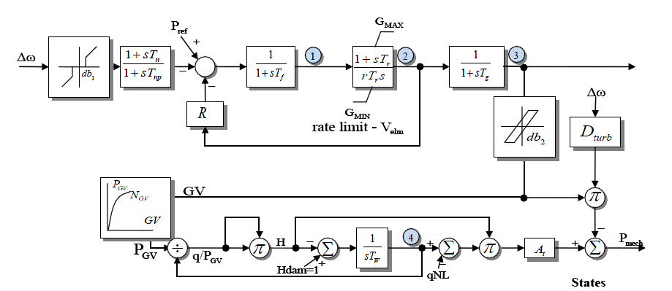
Model HYGOV
This simple model, combined with a governor, is implemented in HYGOV
About
6% of
WECC
governors
use this
model;
average
T_{W} is
2 seconds
H_{loss} is assumed small and not included
The gate position (GV) to gate power (P_{GV})
is sometimes represented with a nonlinear curve

