Slide 1
ECEN 667
Power System Stability
Lecture 15: Time-Domain Simulation Solutions (Transient Stability)
Prof. Tom Overbye
Dept. of Electrical and Computer Engineering
Texas A&M University
overbye@tamu.edu

Slide 2
Announcements
Read Chapter 7
Homework 5 is due on Oct 28.
A classic paper in this area is B. Stott, “Power System Dynamic Response Calculations,” Proc. IEEE February 1979, pp. 219-241
We’ll cover the equal area criteria when we get to Chapter 9

Slide 3
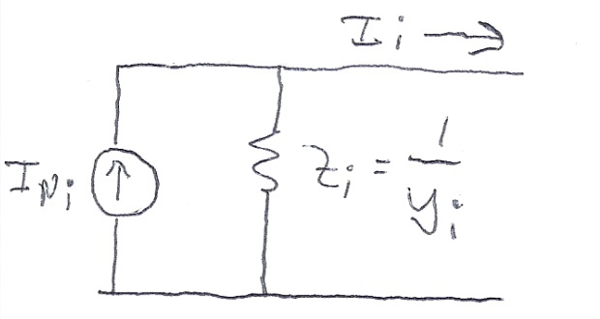
Subtransient Models
The Norton current injection approach is what is commonly used with subtransient models in industry
If subtransient saliency is neglected (as is the case with GENROU and GENSAL in which X"_{d}=X"_{q}) then the current injection is
  Subtransient saliency can be handled with this approach, but it is more involved (see Arrillaga, Computer Analysis of Power Systems, section 6.6.3)

Slide 4
Subtransient Models
Note, the values here are on the dq reference frame
We can now extend the approach introduced for the classical machine model to subtransient models
Initialization is as before, which gives the δ's and other state values
Each time step is as before, except we use the δ's for each generator to transfer values between the network reference frame and each machine's dq reference frame
  The currents provide the coupling

Slide 5
Two Bus Example with Two GENROU Machine Models
Use the same system as before, except with we'll model both generators using GENROUs
  For simplicity we'll make both generators identical except set H₁=3, H₂=6; other values are X_{d}=2.1, X_{q}=0.5, X'_{d}=0.2, X'_{q}=0.5, X"_{q}=X"_{d}=0.18, X_{l}=0.15, T'_{do} = 7.0, T'_{qo}=0.75, T"_{do}=0.035, T"_{qo}=0.05; no saturation
  With no saturation the value of the δ's are determined (as per the earlier lectures) by solving
  Hence for generator 1

Slide 6
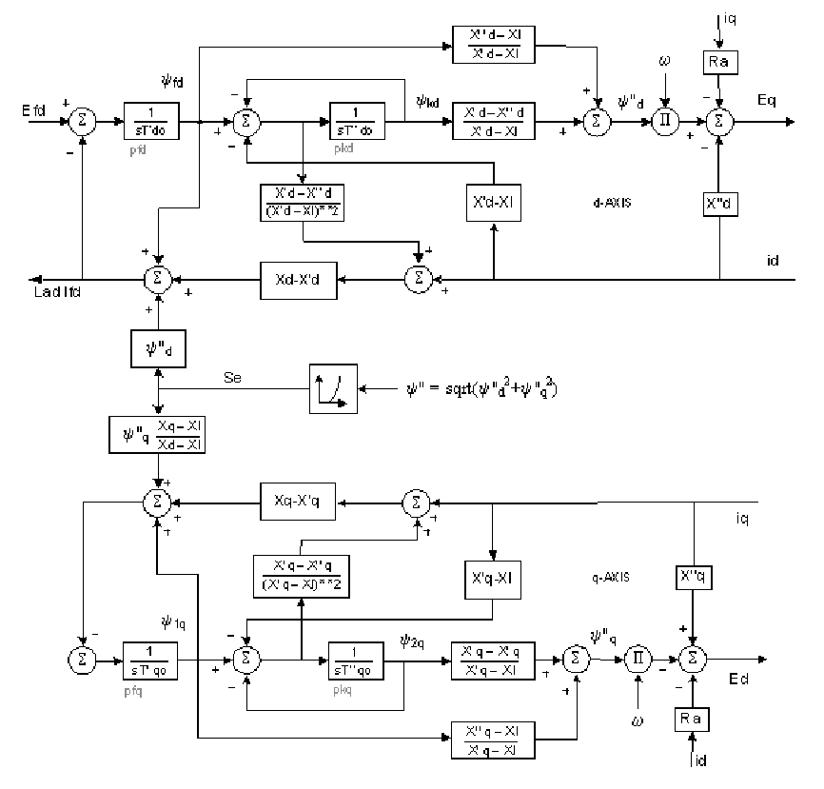
GENROU Block Diagram
E'_{q}
E'_{d}

Slide 7
Two Bus Example with Two GENROU Machine Models
Using the early approach the initial state vector is
Note that this is a salient pole machine with X'_{q}=X_{q}; hence E'_{d} will always be zero
The initial currents in the
dq reference frame are
I_{d1}=0.7872, I_{q1}=0.6988,
I_{d2}=0.2314, I_{q2}=-1.0269
Initial values of ψ"_{q1}= -0.2236,
and ψ"_{d1} = 1.179

Slide 8
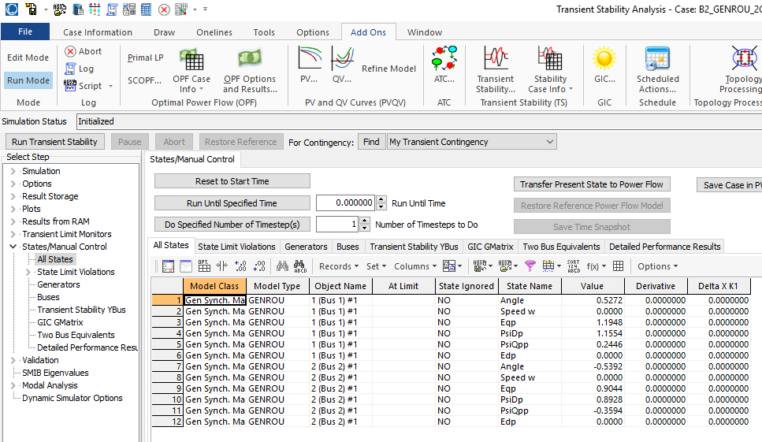
PowerWorld GENROU Initial States

Slide 9
Solving with Euler's
We'll again solve with Euler's, except with Δt set now to 0.01 seconds (because now we have a subtransient model with faster dynamics)
  We'll also clear the fault at t=0.05 seconds
For the more accurate subtransient models the swing equation is written in terms of the torques
Other equations
are solved
based upon
the block
diagram

Slide 10
Norton Equivalent Current Injections
The initial Norton equivalent current injections on the dq base for each machine are
Recall the dq values
are on the machine's
reference frame and
the DQ values are on
the system reference
frame

Slide 11
Moving between DQ and dq
Recall
And
The currents provide
the key coupling
between the
two reference
frames

Slide 12
Bus Admittance Matrix
The bus admittance matrix is as from before for the classical models, except the diagonal elements are augmented using

Slide 13
Algebraic Solution Verification
To check the values solve (in the network reference frame)

Slide 14
Results
The below graph shows the results for four seconds of simulation, using Euler's with Δt=0.01 seconds
PowerWorld case is
B2_GENROU_2GEN_EULER

Slide 15
Results for Longer Time
Simulating out 10 seconds indicates an unstable solution, both using Euler's and RK2 with Δt=0.005, so it is really unstable!
Euler's with Δt=0.01
RK2 with Δt=0.005

Slide 16
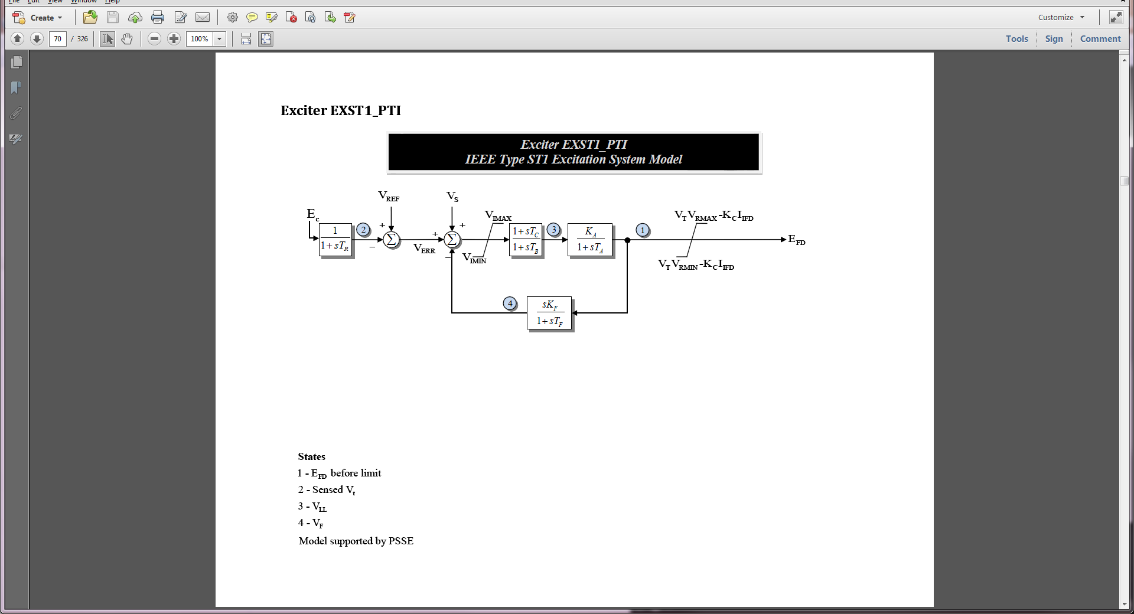
Adding More Models
In this situation the case is unstable because we have not modeled exciters
To each generator add an EXST1 with T_{R}=0, T_{C}=T_{B}=0, K_{f}=0, K_{A}=100, T_{A}=0.1
  This just adds one differential equation per generator

Slide 17
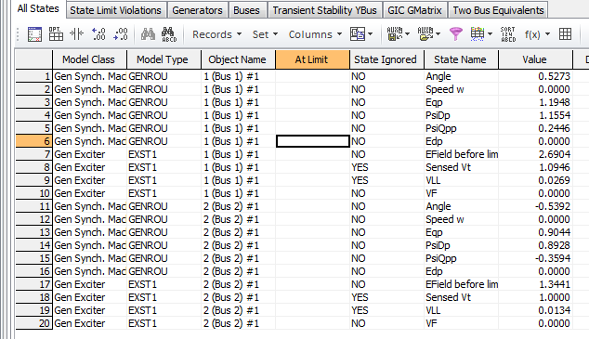
Two Bus, Two Gen With Exciters
Below are the initial values for this case from PowerWorld
Because of the zero values the other differential equations for the exciters are included but treated as ignored
Case is B2_GENROU_2GEN_EXCITER

Slide 18
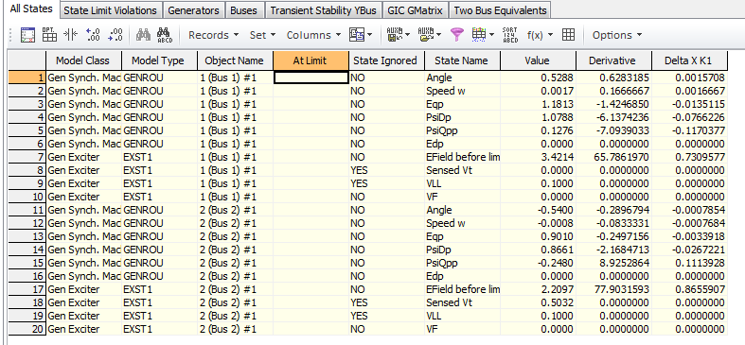
Viewing the States
PowerWorld allows one to single-step through a solution, showing the f(x) and the K₁ values
  This is mostly used for education or model debugging
Derivatives shown are evaluated at the end of the time step

Slide 19
Two Bus Results with Exciters
Below graph shows the angles with Δt=0.01 and a fault clearing at t=0.05 using Euler's
  With the addition of the exciters case is now stable

Slide 20
Load Models Introduced
The simplest approach for modeling the loads is to treat them as constant impedances, embedding them in the bus admittance matrix
  Only impact the Y_{bus} diagonals
The admittances are set based upon their power flow values, scaled by the inverse of the square of the power flow bus voltage
In PowerWorld the
default load model is
specified on Transient
Stability, Options,
Power System Model
page

Slide 21
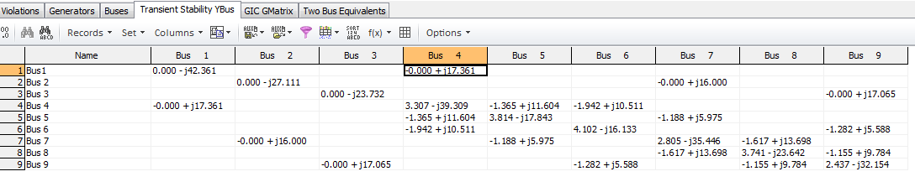
Example 7.4 Case (WSCC 9 Bus)
PowerWorld Case Example_7_4 duplicates the example 7.4 case from the book, with the exception of using different generator models

Slide 22
Nonlinear Network Equations
With constant impedance loads the network equations can usually be written with I independent of V, then they can be solved directly (as we've been doing)
In general this is not the case, with constant power loads one common example. Hence in general a nonlinear solution with Newton's method is used
We'll generalize the dependence on the algebraic variables, replacing V by y since they may include other values beyond just the bus voltages

Slide 23
Nonlinear Network Equations
Just like in the power flow, the complex equations are rewritten, here as a real current and a reactive current
YV – I(x,y) = 0
The values for bus i are
For each bus we add two new variables and two new equations
If an infinite bus is modeled then its variables and equations are omitted since its voltage is fixed
This is a rectangular
formulation; we also
could have written
the equations in
polar form

Slide 24
Nonlinear Network Equations
The network variables and equations are then

Slide 25
Nonlinear Network Equation Newton Solution

Slide 26
Network Equation Jacobian Matrix
The most computationally intensive part of the algorithm is determining and factoring the Jacobian matrix, J(y)

Slide 27
Network Jacobian Matrix
The Jacobian matrix can be stored and computed using a 2 by 2 block matrix structure
The portion of the 2 by 2 entries just from the Y_{bus} are
The major source of the current vector voltage sensitivity comes from non-constant impedance loads; also dc transmission lines
The "hat" was
added to the
g functions to
indicate it is just
the portion from
the Y_{bus}

Slide 28
Example: Constant Current and Constant Power Load
As an example, assume the load at bus k is represented with a ZIP model
Constant impedance could be in the Y_{bus}
Usually solved in per unit on network MVA base
The base load
values are
set from the
power flow

Slide 29
Example: Constant Current and Constant Power Load
The current is then
Multiply the numerator and denominator by V_{DK}+jV_{QK} to write as the real current and the reactive current

Slide 30
Example: Constant Current and Constant Power Load
The Jacobian entries are then found by differentiating with respect to V_{DK} and V_{QK}
  Only affect the 2 by 2 block diagonal values
Usually constant current and constant power models are replaced by a constant impedance model if the voltage goes too low, like during a fault

Slide 31
Example: 7.4 ZIP Case
Example 7.4 is modified so the loads are represented by a model with 30% constant power, 30% constant current and 40% constant impedance
  In PowerWorld load models can be entered in a number of different ways; a tedious but simple approach is to specify a model for each individual load
    Right click on the load symbol to display the Load Options dialog, select Stability, and select WSCC to enter a ZIP model, in which p1&q1 are the normalized about of constant impedance load, p2&q2 the amount of constant current load, and p3&q3 the amount of constant power load
Case is Example_7_4_ZIP

Slide 32
Example 7.4 ZIP One-line

Slide 33
Example 7.4 ZIP Bus 8 Load Values
As an example the values for bus 8 are given (per unit, 100 MVA base)

Slide 34
Example: 7.4 ZIP Case Jacobian
For this case the 2 by 2 block between buses 8 and 7 is
And between 8 and 9 is
The 2 by 2 block for the bus 8 diagonal is
For this case the 2 by 2 block between buses 8 and 7 is
And between 8 and 9 is
The 2 by 2 block for the bus 8 diagonal is
This is referencing slides
6 and 9
These entries are
easily checked
with the Y_{bus}
The check here is
left for the student

Slide 35
Additional Comments
When coding Jacobian values, a good way to check that the entries are correct is to make sure that for a small perturbation about the solution the Newton's method has quadratic convergence
When running the simulation the Jacobian is actually seldom rebuilt and refactored
  If the Jacobian is not too bad it will still converge
To converge Newton's method needs a good initial guess, which is usually the last time step solution
  Convergence can be an issue following large system disturbances, such as a fault

Slide 36
Explicit Method Long-Term Solutions
The explicit method can be used for long-term solutions
  For example in PowerWorld DS we’ve done solutions of large systems for many hours
Numerical errors do not tend to build-up because of the need to satisfy the algebraic equations
However, sometimes models have default parameter values that cause unexpected behavior when run over longer periods of time (such as default trips after 99 seconds below 0.1 Hz).
Some models have slow unstable modes

Slide 37
Simultaneous Implicit
The other major solution approach is the simultaneous implicit in which the algebraic and differential equations are solved simultaneously
This method has the advantage of being numerically stable

Slide 38
Simultaneous Implicit
Recalling an initial lecture, we covered two common implicit integration approaches for solving
  Backward Euler
  Trapezoidal
We'll just consider trapezoidal, but for nonlinear cases

Slide 39
Nonlinear Trapezoidal
We can use Newton's method to solve with
the trapezoidal
We are solving for x(t+Δt); x(t) is known
The Jacobian matrix is
Right now we
are just
considering
the differential
equations;
we'll introduce
the algebraic
equations
shortly
The –I comes
from differentiating
-x(t+Δt)

Slide 40
Nonlinear Trapezoidal using
Newton's Method
The full solution would be at each time step
  Set the initial guess for x(t+Δt) as x(t), and initialize the iteration counter k = 0
  Determine the mismatch at each iteration k as
  Determine the Jacobian matrix
  Solve
  Iterate until done

Slide 41
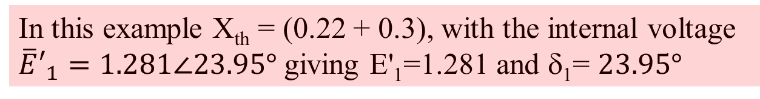
Infinite Bus GENCLS Example
Use the previous two bus system with gen 4 again modeled with a classical model with X_{d}'=0.3, H=3 and D=0
In this example X_{th} = (0.22 + 0.3), with the internal voltage
${\overline{E}′}_{1}=1.281∠23.95°$ giving E'₁=1.281 and δ₁= $23.95°$

Slide 42
Infinite Bus GENCLS Implicit Solution
Assume a solid three phase fault is applied at the bus 1 generator terminal, reducing P_{E1} to zero during the fault, and then the fault is self-cleared at time T^{clear}, resulting in the post-fault system being identical to the pre-fault system
  During the fault-on time the equations reduce to
That is, with a solid fault on the terminal of the generator, during
the fault P_{E1} = 0

Slide 43
Infinite Bus GENCLS Implicit Solution
The initial conditions are
Let Δt = 0.02 seconds
During the fault the Jacobian is
Set the initial guess for x(0.02) as x(0), and

Slide 44
Infinite Bus GENCLS Implicit Solution
Then calculate the initial mismatch
With x(0.02)⁽⁰⁾ = x(0) this becomes
Then

Slide 45
Infinite Bus GENCLS Implicit Solution
Repeating for the next iteration
Hence we have converged with

Slide 46
Infinite Bus GENCLS Implicit Solution
Iteration continues until t = T^{clear}, assumed to be 0.1 seconds in this example
At this point, when the fault is self-cleared, the equations change, requiring a re-evaluation of f(x(T^{clear}))

Slide 47
Infinite Bus GENCLS Implicit Solution
With the change in f(x) the Jacobian also changes
Iteration for x(0.12) is as before, except using the new function and the new Jacobian
This also converges quickly, with one or two iterations

Slide 48
Computational Considerations
As presented for a large system most of the computation is associated with updating and factoring the Jacobian. But the Jacobian actually changes little and hence seldom needs to be rebuilt/factored
Rather than using x(t) as the initial guess for x(t+Δt), prediction can be used when previous values are available

Slide 49
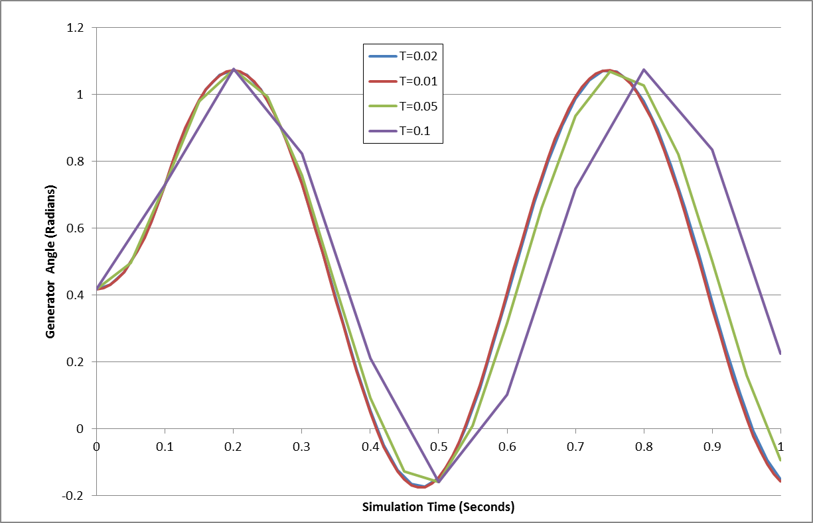
Two Bus System Results
The below graph shows the generator angle for varying values of Δt; recall the implicit method is numerically
stable

Slide 50
Adding the Algebraic Constraints
Since the classical model can be formulated with all the values on the network reference frame, initially we just need to add the network equations
We'll again formulate the network equations using the form
As before the complex equations will be expressed using two real equations, with voltages and currents expressed in rectangular coordinates

Slide 51
Adding the Algebraic Constraints
The network equations are as before

Slide 52
Coupling of x and y with the Classical Model
In the simultaneous implicit method x and y are determined simultaneously; hence in the Jacobian we need to determine the dependence of the network equations on x, and the state equations on y
With the classical model the Norton current depends on x as
Recall with the classical
model E_{i}’ is constant

Slide 53
Coupling of x and y with the Classical Model
In the state equations the coupling with y is recognized by noting
These are the algebraic
equations
Hence we have P_{Ei} written in terms of the voltages (y)

Slide 54
Variables and Mismatch Equations
In solving the Newton algorithm the variables now include x and y (recalling that here y is just the vector of the real and imaginary bus voltages
The mismatch equations now include the state integration equations
And the algebraic equations

Slide 55
Jacobian Matrix
Since the h(x,y) and g(x,y) are coupled, the Jacobian is
  With the classical model the coupling is the Norton current at bus i depends on δ_{i} (i.e., x) and the electrical power (P_{Ei}) in the swing equation depends on V_{Di} and V_{Qi} (i.e., y)

Slide 56

Jacobian Matrix Entries
The dependence of the Norton current injections on δ is
  In the Jacobian the sign is flipped because we defined
$$\left.g\left(x,y\right)=Y V−Ι(x,y\right)$$

Slide 57
Jacobian Matrix Entries
The dependence of the swing equation on the generator terminal voltage is

Slide 58
Two Bus, Two Gen GENCLS Example
We'll reconsider the two bus, two generator case from the previous lecture ; fault at Bus 1, cleared after 0.06 seconds
  Initial conditions and Y_{bus} are as covered in Lecture 16
PowerWorld Case B2_CLS_2Gen

Slide 59
Two Bus, Two Gen GENCLS Example
Initial terminal voltages are

Slide 60
Two Bus, Two Gen Initial Jacobian

Slide 61
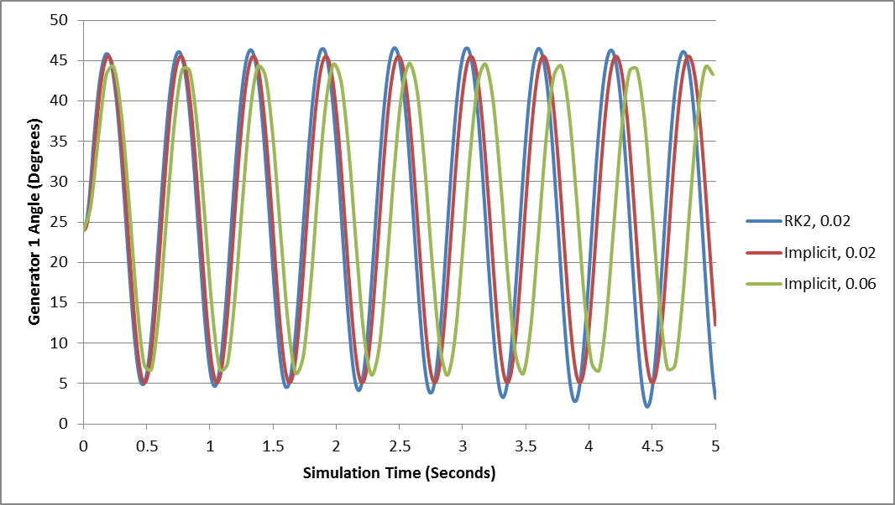
Results Comparison
The below graph compares the angle for the generator at bus 1 using Δt=0.02 between RK2 and the Implicit Trapezoidal; also Implicit with Δt=0.06

Slide 62
Four Bus Comparison

Slide 63
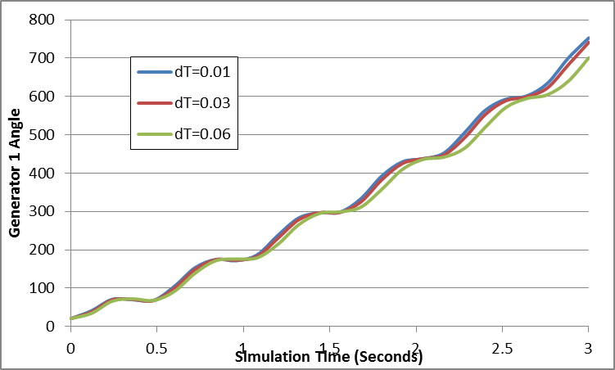
Four Bus Comparison
Fault at Bus 3 for 0.12 seconds; self-cleared

