Slide 1
ECEN 667
Power System Stability
Lecture 16: Load Modeling
Prof. Tom Overbye
Dept. of Electrical and Computer Engineering
Texas A&M University
overbye@tamu.edu

Slide 2
Announcements
Read Chapter 7
Homework 5 is due on Oct 28.

Slide 3
Done with Transient Stability Solutions: On to Load Modeling
Load modeling is certainly challenging!
For large system models an aggregate load can consist of many thousands of individual devices
The load is constantly changing, with key diurnal and temperature variations
  For example, a higher percentage of lighting load at night, more air conditioner load on hot days
Load model behavior can be quite complex during the low voltages that may occur in transient stability
Testing aggregate load models for extreme conditions is not feasible – we need to wait for disturbances!

Slide 4
Load Modeling
Traditionally load models have been divided into two groups
  Static: load is a algebraic function of bus voltage and sometimes frequency
  Dynamic: load is represented with a dynamic model, with induction motor models the most common
The simplest load model is a static constant impedance
  Has been widely used
  Allowed the Y_{bus} to be reduced, eliminating essentially all non-generator buses
  Presents no issues as voltage falls to zero
  No longer commonly used

Slide 5
Load Modeling References
Many papers and reports are available!
A classic reference on load modeling is by the IEEE Task Force on Load Representation for Dynamic Performance, "Load Representation for Dynamic Performance Analysis," IEEE Trans. on Power Systems, May 1993, pp. 472-48
NERC 2016, “Dynamic Load Modeling”; available at https://www.nerc.com/comm/PC/LoadModelingTaskForceDL/Dynamic%20Load%20Modeling%20Tech%20Ref%202016-11-14%20-%20FINAL.PDF
EPRI Technical Guide to Composite Load Modeling, August 2020 (with a draft at the below link)
https://www.wecc.org/Administrative/Mitra%20-%20Technical%20Guide%20on%20Composite%20Load%20Modeling.pdf

Slide 6
ZIP Load Model
Another common static load model is the ZIP, in which the load is represented as
Some models allow more general voltage dependence
The voltage exponent for reactive power is often > 2

Slide 7
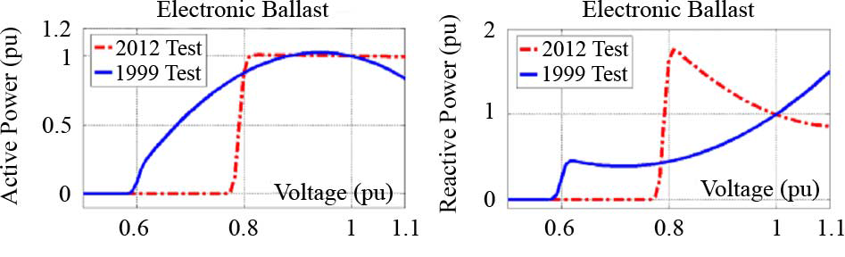
ZIP Model Coefficients
An interesting paper on the experimental determination of the ZIP parameters is A. Bokhari, et. al., "Experimental Determination of the ZIP Coefficients for Modern Residential and Commercial Loads, and Industrial Loads," IEEE Trans. Power Delivery, 2014
  Presents test results for loads as voltage is varied; also highlights that load behavior changes with newer technologies
    Below figure (part of fig 4 of paper), compares real and reactive behavior of light ballast

Slide 8
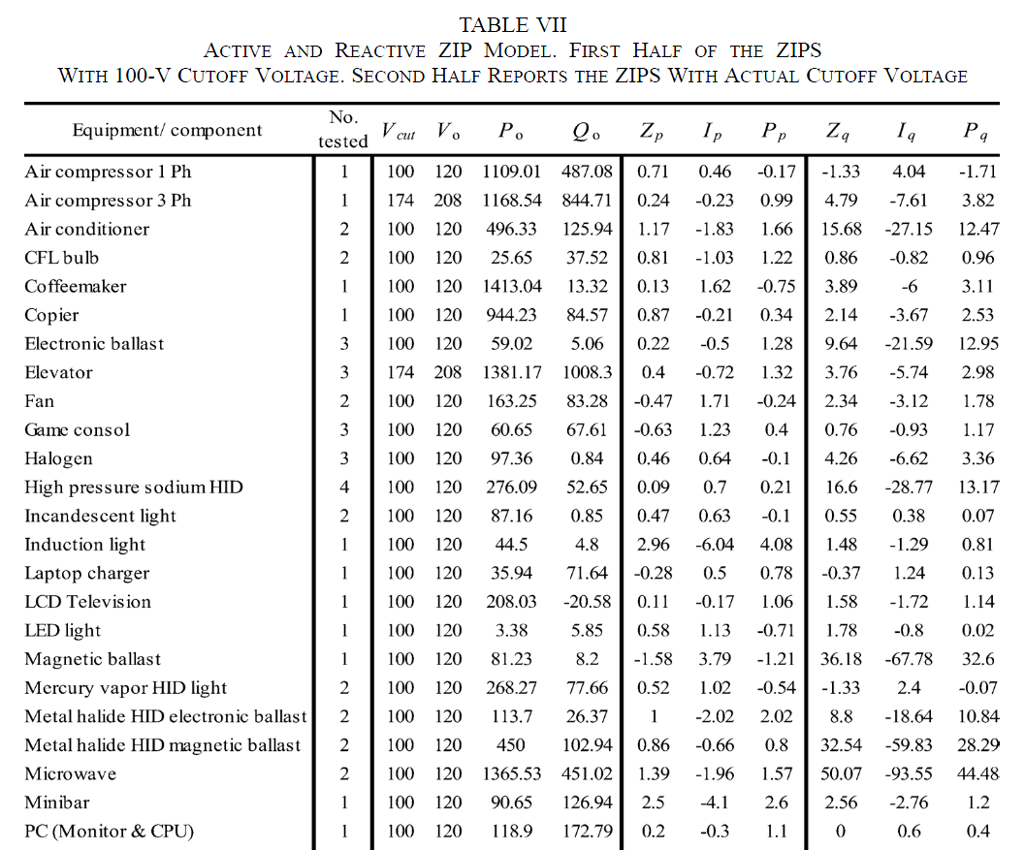


ZIP Model Coefficients
The Z,I,P
coefficients
sum to zero;
note that for
some models
the absolute
values of the
parameters
are quite large,
indicating
a difficult
fit
A portion of Table VII from Bokhari 2014 paper

Slide 9
Discharge Lighting Models
Discharge lighting (such as fluorescent lamps) is a major portion of the load (10-15%)
Discharge lighting has been modeled for sufficiently high voltage with a real power as constant current and reactive power with a high voltage dependence
  Linear reduction for voltage between 0.65 and 0.75 pu
  Extinguished (i.e., no load) for voltages below
May need to change
with newer electronic
ballasts – e.g., reactive
power increasing as
the voltage drops!

Slide 10
Static Load Model
Frequency Dependence
Frequency dependence is sometimes included, to recognize that the load could change with the frequency
Here f_{k} is the per unit bus frequency, which is calculated as
Typical values for P_{f} and Q_{f} are 1 and -1 respectively
A typical value for T is about 0.02
seconds. Some models just have
frequency dependence on the
constant power load

Slide 11
Induction Machines
Term induction machine is used to indicate either generator or motor; most uses are as motors
Induction machines have two major components
  A stationary stator, which is supplied with an ac voltage; windings in stator create a rotating magnetic field
  A rotating rotor, in which an ac current is induced (hence the name)
Two basic design types based on rotor design
  Squirrel-cage: rotor consists of shorted conducting bars laid into magnetic material in a cage structure
  Wound-rotor: rotor has windings similar to stator, with slip rings used to provide external access to the rotor windings

Slide 12
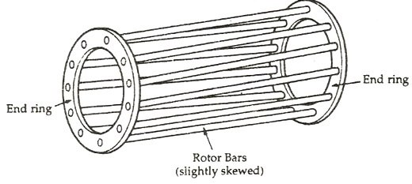
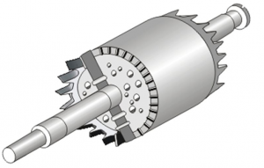
Squirrel Cage Rotor Picture
Image 1 Source: www.quora.com/What-will-happen-If-the-Squirrel-cage-motor-rotor-conductors-are-not-skewed
Embedded in
laminated
magnetic
material
Image 2 Source: www.polytechnichub.com/squirrel-cage-rotor/

Slide 13



Induction Machine Overview
Speed of rotating magnetic field (synchronous speed) depends on number of poles
Frequency of induced currents in rotor depends on frequency difference between the rotating magnetic field and the rotor

Slide 14
Induction Machine Slip
Key value is slip, s, defined as
As defined, when operating as a motor an induction machine will have a positive slip, slip is negative when operating as a generator
  Slip is zero at synchronous speed, a speed at which no rotor current is induced; s=1 at stand still

Slide 15
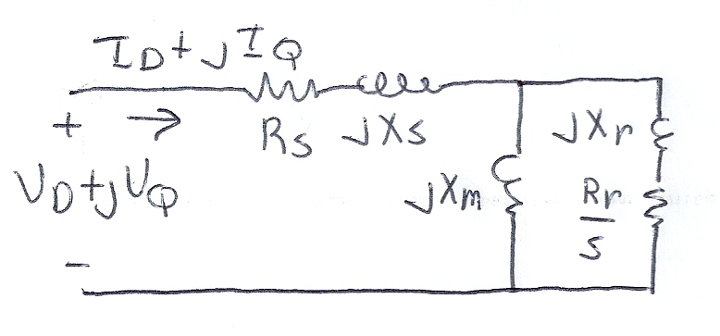
Basic Induction Machine Model
A basic (single cage) induction machine circuit model is given below
  Model is derived in an undergraduate machines class
Circuit is useful for understanding the static behavior of the machine
Effective rotor resistance (R_{r}/s) models the rotor electrical losses (R_{r}) and the mechanical power R_{r}(1-s)/s

Slide 16
Induction Machine Dynamics
Expressing all values in per unit (with the base covered later), the mechanical equation for a machine is
Similar to what was done for a synchronous machine, the induction machine can be modeled as an equivalent voltage behind a stator resistance and transient reactance (later we'll introduce, but not derive, the subtransient model)

Slide 17
Induction Machine Dynamics
Define
Also define the open circuit time constant

Slide 18

Induction Machine Dynamics
Electrically the induction machine is modeled similar to the classical generator model, except here we use the "motor convention" in which I_{D}+jI_{Q} is assumed positive into the machine
All calculations
are done on
the network
reference
frame

Slide 19
Induction Machine Dynamics
The induction machine electrical torque, T_{E}, and terminal electrical load, P_{E}, are then
Similar to a synchronous machine, once the initial values are determined the differential equations are fairly easy to simulate
  Key initial value needed is the slip
Recall we are
using the motor
convention so positive
P_{E} represents load

Slide 20
Specifying Induction Machine Parameters
In transient stability packages induction machine parameters are specified in per unit
  If unit is modeled as a generator in the power flow (such as CIMTR1 or GENWRI) then use the generator's MVA base (as with synchronous machines)
  With loads it is more complicated.
    Sometimes an explicit MVA base is specified. If so, then use this value. But this can be cumbersome since often the same per unit machine values are used for many loads
    The default is to use the MW value for the load, often scaled by a multiplier (say 1.25)

Slide 21
Determining the Initial Values
To determine the initial values, it is important to recognize that for a fixed terminal voltage there is only one independent value: the slip, s
  For a fixed slip, the model is just
  a simple circuit with resistances
  and reactances
The initial slip is chosen to match the power flow real power value. Then to match the reactive power value (for either a load or a generator), the approach is to add a shunt capacitor in parallel with the induction machine
We'll first consider torque-speed curves, then return to determining the initial slip

Slide 22
Torque-Speed Curves
To help understand the behavior of an induction machine it is useful to plot various values as a function of speed (or equivalently, slip)
  Solve the equivalent circuit for a specified terminal voltage, and varying values of slip
  Plot results
  Recall torque times speed = power
    Here speed is the rotor speed
  When using per unit, the per unit speed is just 1-s

Slide 23
Induction Motor Example
Assume the below 60 Hz system, with the entire load modeled as a single cage induction motor with per unit values on a 125 MVA base of H=1.0, R_{s}=0.01, X_{s}=0.06, X_{m}=4.0, R_{r}=0.03, X_{r}=0.04
  In the CIM5 model R₁=R_{r} and X₁=X_{r}
PowerWorld case B2_IndMotor

Slide 24
Induction Motor Example
With a terminal voltage of 0.995∠0°
we can solve the circuit for
specified values of s
The input impedance and current are
Then with s=1 we get
Note, values are per
unit on a 125 MVA base

Slide 25
Induction Motor Example
PowerWorld allows for display of the variation in various induction machine values with respect to speed
  Right click on load, select Load Information Dialog, Stability
  On bottom of display click Show Torque Speed Dialog
  Adjust the terminal voltage and pu scalar as desired; set v=0.995 and the pu scalar to 1.0 to show values on the 125 MVA base used in the previous solution
  Right click on column and select Set/Toggle/Columns, Plot Column to plot the column

Slide 26
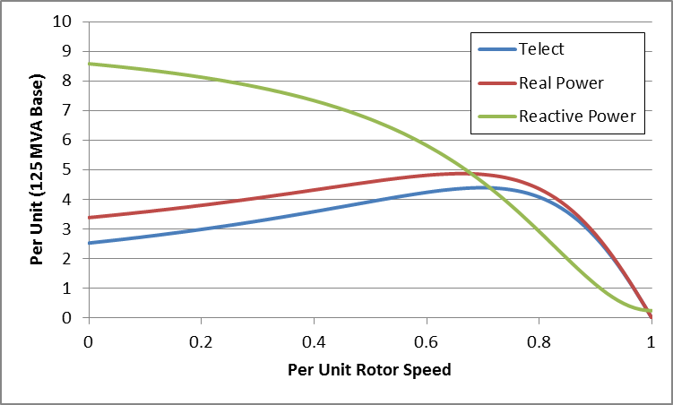
Induction Motor Example
Torque-Speed Curves
The below graph shows the torque-speed curve for this induction machine; note the high reactive power consumption on starting (which is why the lights may dim when starting a cloth dryer!)
From the graph
you can see with
a 100 MW load
(0.8 pu on the
125 MW base),
the slip is about
0.025

Slide 27
Calculating the Initial Slip
One way to calculate the initial slip is to just solve the below five equations for five unknowns (s, I_{D}, I_{Q}, E'_{D},E'_{Q}) with P_{E}, V_{D} and V_{Q} inputs
These are
nonlinear equations
that can have
multiple solutions
so use Newton's
method, with an
initial guess of
s small (say 0.01)
Initial slip in example is 0.0251

Slide 28


Double Cage Induction Machines
In the design of induction machines, there are various tradeoffs, such as between starting torque (obviously one needs enough to start) and operating efficiency
  The highest efficiency possible is 1-slip, so operating at low slip is desirable
A common way to achieve high starting torque with good operating efficiency is to use a double cage design
  E.g., the rotor has two embedded squirrel cages, one with a high R and lower X for starting, and one with lower R and higher X for running
  Modeled by extending our model by having two rotor circuits in parallel; add subtransient values X" and T"_{o}

Slide 29
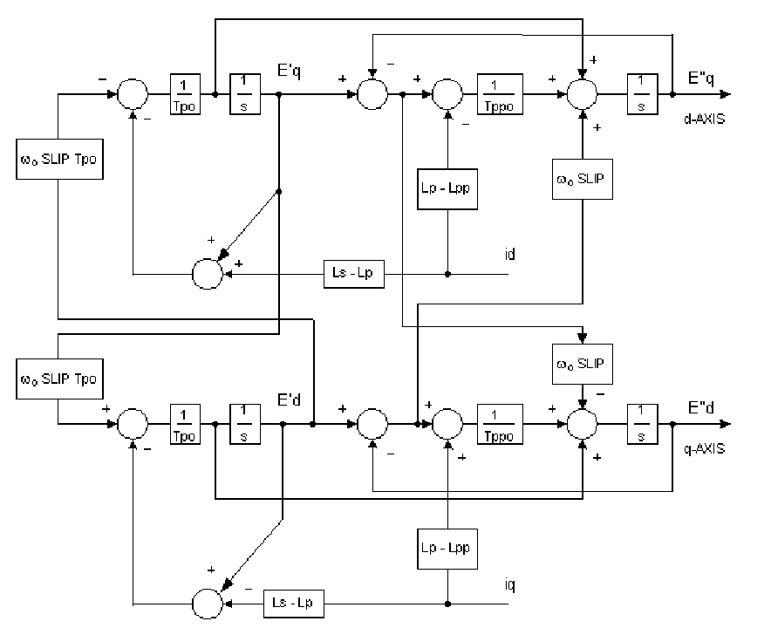
Example Double Cage Model
Double cage rotors are modeled by adding two additional differential equations
Some models
also include
saturation, a
topic that we
will skip
PowerWorld case
B2_IndMotor_DoubleCage
Image source: PSLF Manual, version 18.1_02; MotorW

Slide 30
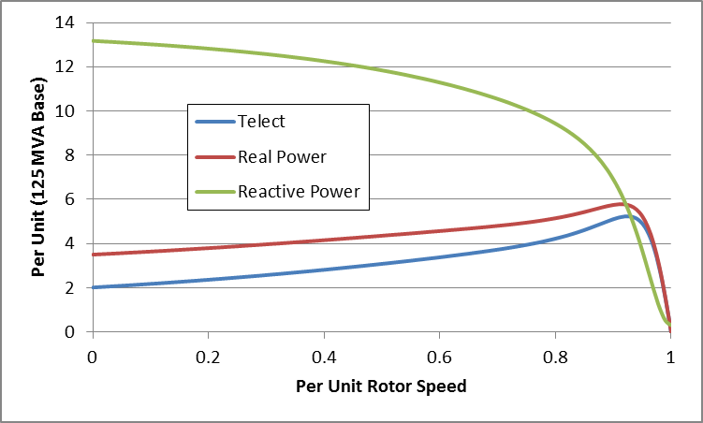
Double Cage Induction
Motor Model
The previous example can be extended to model a double cage rotor by setting R₂=0.01, X₂=0.08
  The below graph shows the modified curves, notice the increase in the slope by s=0, meaning it is operating with higher efficiency (s=0.0063 now!)
The additional
winding does
result in lower initial impedance and hence a higher starting reactive power

Slide 31
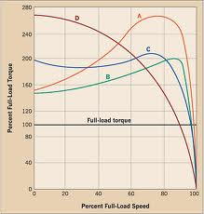
Induction Motor Classes
Four major classes of induction motors, based on application. Key values are starting torque, pull-out torque, full-load torque, and starting current
In steady-state the motor will operate on the right side
of the curve at the point at which the electrical torque
matches the mechanical torque
A: Fans, pumps machine tools
B: Similar to A
C: Compressors, conveyors
D: High inertia such as hoists
Image source: ecmweb.com/motors/understanding-induction-motor-nameplate-information

Slide 32
Induction Motor Stalling
Height of the torque-speed curve varies with the square of the terminal voltage
When the terminal voltage decreases, such as during a fault, the mechanical torque can exceed the electrical torque
  This causes the motor to decelerate, perhaps quite quickly, with the rate proportional to its inertia
  This deceleration causing the slip to increase, perhaps causing the motor to stall with s=1, resulting in a high reactive current draw
  Too many stalled motors can prevent the voltage from recovering

Slide 33
Motor Stalling Example
Using case WSCC_CIM5, which models the WSCC 9 bus case with 100% induction motor load
Change the fault scenario to say a fault midway between buses 5 and 7, cleared by opening the line
Results are for a 0.05 second
fault
Usually
motor load
is much less
than 100%

Slide 34
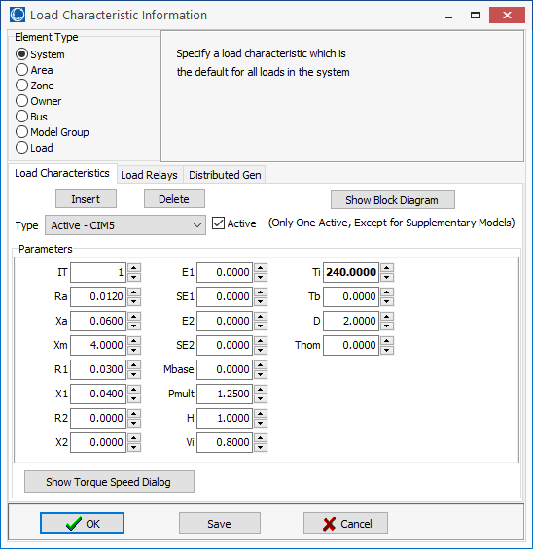

Impact of Model Protection Parameters
Some load models, such
as the CIM5, have built-
in protection system
models. For CIM5
the Vi and Ti fields are
used to disconnect
the load when its voltage
is less than Vi for Ti
cycles
  When running
  simulations you need
  to check for such events

Slide 35
Motor Stalling With Longer Fault
The below image shows the WECC_CIM5 system with the fault clearing extended to 0.12 seconds
The models are
no longer giving
realistic results;
two generators
trip on over speed;
then the load
trips after 4 seconds.

Slide 36
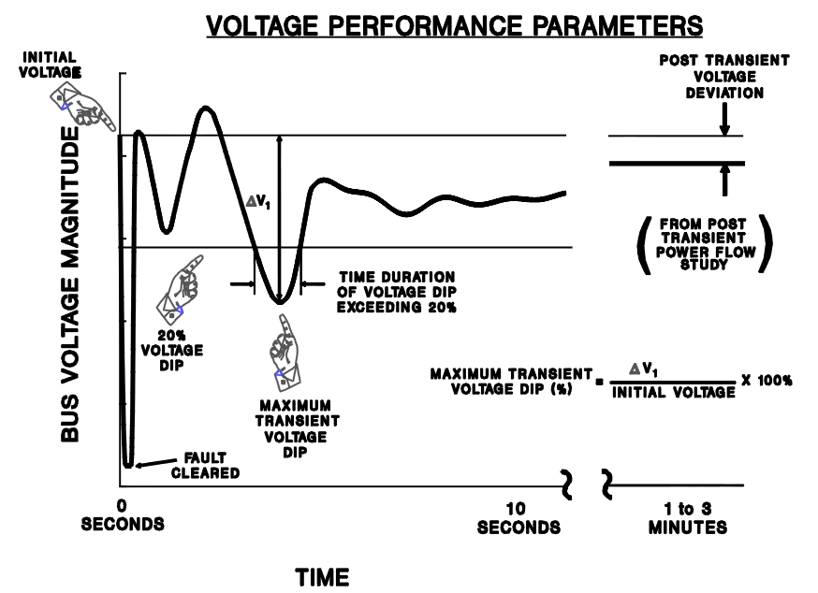
Transient Limit Monitors
There are different performance criteria that need to be met for a scenario
Similar performance criteria exist for frequency
deviations
Image from WECC Planning and Operating Criteria

Slide 37
Motor Starting
Motor starting analysis looks at the impacts of starting a motor or a series of motors (usually quite large motors) on the power grid
  Examples are new load or black start plans
While not all transient stability motor load models allow the motor to start, some do
When energized, the initial condition for the motor is slip of 1.0
Motor starting can generate very small time constants

Slide 38
Motor Starting Example
Case WSCC_MotorStarting takes the previous WSCC case with 100% motor load, and considers starting the motor at bus 8
In the power flow the load at bus 8 is modeled as zero (open) with a CIM5
The contingency is closing the load
  Divided into four loads to stagger the start (we can't start it all at once)
Since power flow load is zero, the CIM5 load must also specify the size of the motor
  This is done in the Tnom field and by setting an MVA base value

Slide 39
Motor Starting Example
Below graph shows the bus voltages for starting the four motors three seconds apart

Slide 40
Motor Starting: Fast Dynamics
One issue with the starting of induction motors is the need to model relatively fast initial electrical dynamics
  Below graph shows E'r for a motor at bus 8 as it is starting
Time scale
is from
1.0 to 1.1
seconds

Slide 41
Motor Starting: Fast Dynamics
These fast dynamics can be seen to vary with slip in the ω_{s}s term
Simulating with the explicit method either requires a small overall Δt or the use of multi-rate methods

Slide 42
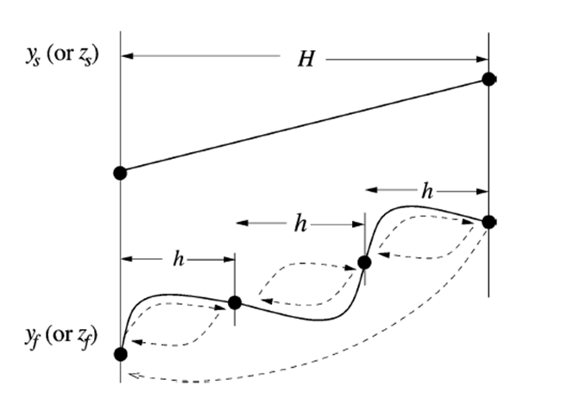
Multi-Rate Explicit Integration
Key idea is to integrate some differential equations with a potentially much faster time step then others
Faster variables are integrated with time step h, slower variable with time step H
  Slower variables assumed fixed or interpolated during the faster time step integration
Figure from Jingjia Chen and M. L. Crow, "A Variable Partitioning Strategy for the Multirate Method in Power Systems," Power Systems, IEEE Transactions on, vol. 23, pp. 259-266, 2008.

Slide 43
Multi-Rate Explicit Integration
First proposed by C. Gear in 1974
Power systems use by M Crow in 1994
In power systems usually applied to some exciters, stabilizers, and to induction motors when their slip is high
Subinterval length can be customized for each model based on its parameters (in range of 4 to 128 times the regular time step)
Tradeoff in computation
C. Gear, Multirate Methods for Ordinary Differential Equations, Univ. Illinois at Urbana-Champaign, Tech. Rep., 1974.
M. Crow and J. G. Chen, “The multirate method for simulation of power system dynamics,” IEEE Trans. Power Syst., vol. 9, no. 3, pp.1684–1690, Aug. 1994.

Slide 44
AC Motor Drives
A historical shortcoming of ac motors was their lack of speed control when supplied by a fixed frequency ac
With advances in power electronics it is now common to use an ac-ac converter to provide the machine with a varying and controllable ac frequency; this allows for variable speed operation
  Known as a variable frequency drives (VFDs)
Variable speed operation can result in significant energy savings – speed becomes on optimization parameter
Commonly use V/Hz control to keep the flux constant

Slide 45
Need for Better Load Modeling: History of Load Modeling in WECC
1990’s – Constant current real, constant impedance reactive models connected to a transmission bus
  IEEE Task Force recommends dynamic load modeling, however it does not get traction in the industry
1996 – Model validation study for July 2 and August 10 system outages:
  Need for motor load modeling to represent oscillations and voltage decline
2000’s – WECC “Interim” Load Model: – 20% of load is represented with induction motors
  Tuned to match inter-area oscillations for August 10 1996 and August 4, 2000 oscillation events …
Source: certs.lbl.gov/sites/all/files/5-6-kosterev-undrill-load-modeling-in-wecc.pdf

Slide 46
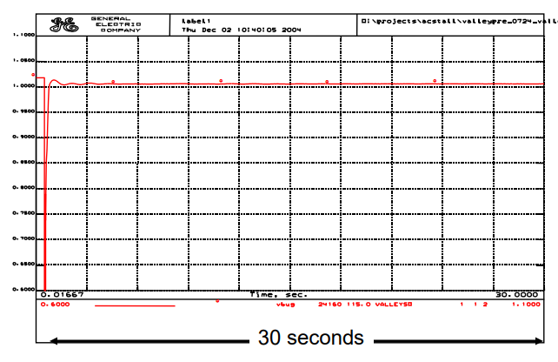
Need for Better Load Modeling: History of Load Modeling in WECC
What the simulations done using the interim load model indicated would occur
Vertical scale
goes down
to about 0.6
per unit
Source: certs.lbl.gov/sites/all/files/5-6-kosterev-undrill-load-modeling-in-wecc.pdf

Slide 47
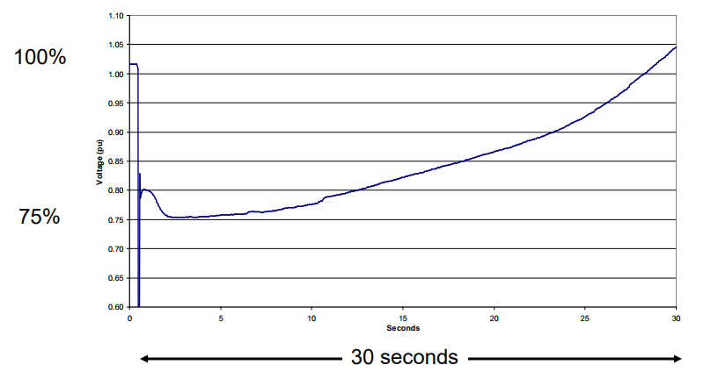
Need for Better Load Modeling: History of Load Modeling in WECC
What was actually sometimes occurring, known as fault induced delayed voltage recovery (FIDVR)
  Seen in 1980’s; traced to stalling air-conditioning load

Slide 48
Single Phase Induction Motor Loads
A new load model is one that explicitly represents the behavior of single phase induction motors, which are quite small and stall very quickly
  Single phase motors also start slower than an equivalent three phase machine
New single phase induction motor model (LD1PAC) is a static model (with the assumption that the dynamics are fast), that algebraically transitions between running and stalled behavior based on the magnitude of the terminal voltage

