Slide 1
ECEN 667
Power System Stability
Lecture 20: SMIB Eigenvalues, Measurement-Based Modal Analysis
Prof. Tom Overbye
Dept. of Electrical and Computer Engineering
Texas A&M University
overbye@tamu.edu

Slide 2
Announcements
Read Chapter 8
Homework 6 is due on November 11
There is a 2019 NERC document on oscillations at www.nerc.com/comm/PC/SMSResourcesDocuments/Interconnection_Oscillation_Analysis.pdf

Slide 3
Single Machine Infinite Bus
A quite useful analysis technique is to consider the small signal stability associated with a single generator connected to the rest of the system through an equivalent transmission line
Driving point impedance looking into the system is used to calculate the equivalent line's impedance
  The Z_{ii} value can be calculated quite quickly using sparse vector methods
Rest of the system is assumed to be an infinite bus with its voltage set to match the generator's real and reactive power injection and voltage

Slide 4
Small SMIB Example
As a small example, consider the 4 bus system shown below, in which bus 2 really is an infinite bus
To get the SMIB for bus 4, first calculate Z₄₄
Z₄₄ is Z_{th} in parallel with jX'_{d,4} (which is j0.3) so Z_{th} is j0.22

Slide 5
Small SMIB Example
The infinite bus voltage is then calculated so as to match the bus i terminal voltage and current
In the example we have
While this was demonstrated
on an extremely small system
for clarity, the approach works
the same for any size system

Slide 6
Calculating the A Matrix
The SMIB model A matrix can then be calculated either analytically or numerically
  The equivalent line's impedance can be embedded in the generator model so the infinite bus looks like the "terminal"
This matrix is calculated in PowerWorld by selecting Transient Stability, SMIB Eigenvalues
  Select Run SMIB to perform an SMIB analysis for all the generators in a case
  Right click on a generator on the SMIB form and select Show SMIB to see the Generator SMIB Eigenvalue Dialog
  These two bus equivalent networks can also be saved, which can be quite useful for understanding the behavior of individual generators

Slide 7
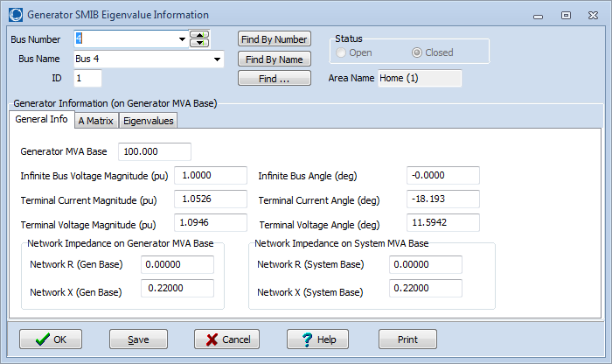
Example: Bus 4 SMIB Dialog
On the SMIB dialog, the General Information tab shows information about the two bus equivalent
PowerWorld case B4_SMIB

Slide 8
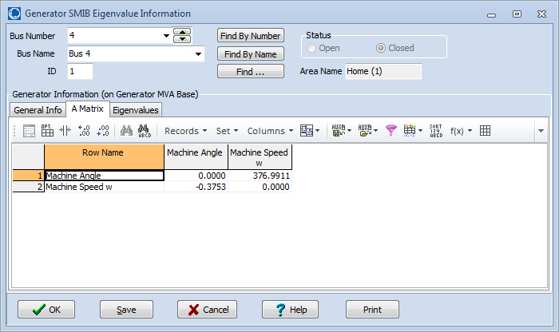
Example: Bus 4 SMIB Dialog
On the SMIB dialog, the A Matrix tab shows the A_{sys} matrix for the SMIB generator
In this example A₂₁ is showing

Slide 9
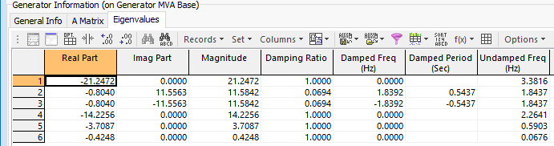
Example: Bus 4 with GENROU
The eigenvalues can be calculated for any set of generator models
This example replaces the bus 4 generator classical machine with a GENROU model
  There are now six eigenvalues, with the dominate response coming from the electro-mechanical mode with a frequency of 1.84 Hz, and damping of 6.9%
PowerWorld case B4_GENROU_Sat_SMIB

Slide 10
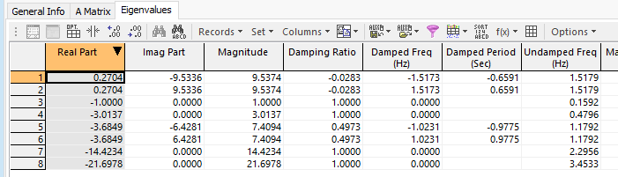
Example: Bus 4 with
GENROU Model and Exciter
Adding an relatively slow EXST1 exciter adds additional states (with K_{A}=200, T_{A}=0.2)
  As the initial reactive power output of the generator is decreased, the system becomes unstable (below example is with a generator reactive power output of 0 Mvar)
PowerWorld case B4_GENROU_Sat_SMIB_QZero

Slide 11
Example: Bus 4 with
GENROU Model and Exciter
The below image shows the system response to a brief bus 4 self-clearing fault

Slide 12
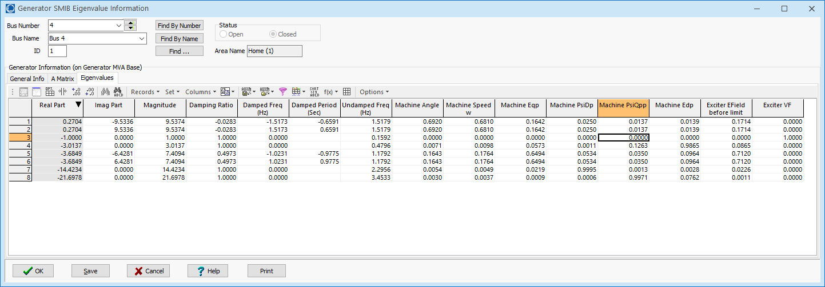
Example: Bus 4 with
GENROU Model and Exciter
The remainder of the Eigenvalues page shows the participation factors for the various states in the modes

Slide 13
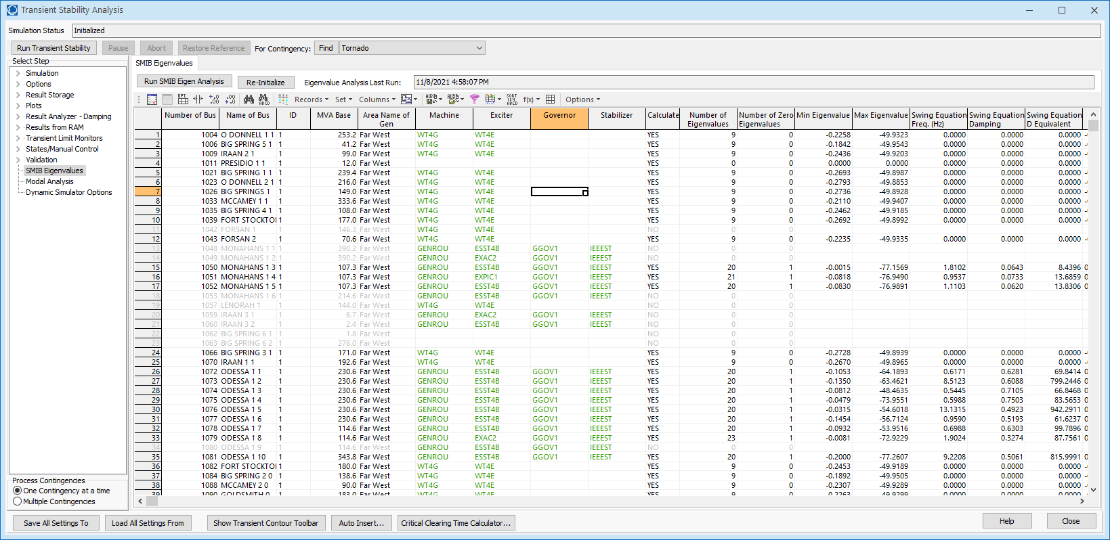
SMIB Eigenvalues for TSGC_2000 Case
All the SMIB eigenvalues can be calculated quickly even for relatively large grids

Slide 14
Saving a Two Bus Equivalent
PowerWorld makes it easy to save a two bus equivalent from the SMIB Eigenvalues page
  Right-click and select Save Two Bus Equivalent
As the name implies, the two bus equivalent is the generator connected to an infinite bus through its driving point impedance
Two bus equivalents provide a convenient way to track down at least some causes of instability issues

Slide 15
Small Signal Analysis and
Measurement-Based Modal Analysis
Small signal analysis has been used for decades to determine power system frequency response
  It is a model-based approach that considers the properties of a power system, linearized about an operating point
Measurement-based modal analysis determines the observed dynamic properties of a system
  Input can either be measurements from devices (such as PMUs) or dynamic simulation results
  The same approach can be used regardless of the measurement source
Focus in this section is on the measurement-based approach

Slide 16
Ring-down Modal Analysis
Ring-down analysis seeks to determine the frequency and damping of key power system modes following some disturbance
There are several different techniques, with the Prony approach the oldest (from 1795); introduced into power in 1990 by Hauer, Demeure and Scharf
Regardless of technique, the goal is to represent the response of a sampled signal as a set of exponentially damped sinusoidals (modes)

Slide 17
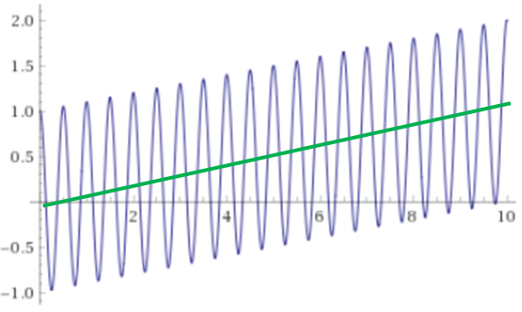

Where We Are Going:
Extracting the Modes from Signals
The goal is to gain information about the electric grid by extracting modal information from its signals
  The frequency and damping of the modes is key
The premise is we’ll be able to reproduce a complex signal, over a period of time, as a set a of sinusoidal modes
  We’ll also allow for linear
  detrending
$$0.1t+cos\left(2π2t\right)$$

Slide 18
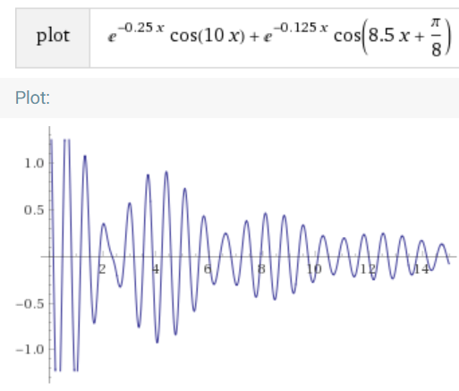
Example: The Summation of two damped exponentials
This example
was created by
going from the
modes to
a signal
We’ll be going
in the opposite
direction (i.e.,
from a
measured
signal to the
modes)

Slide 19
Some Reasonable Expectations
Verifiable to show how well the modes match the original signal(s)
  We’ll show this
Flexible to handle between one and many signals
  We’ll go up to simultaneously considering 40,000 signals
Fast
  What is presented will be, with a discussion of the computational scaling
Easy to use
  This is software implementation specific; results shown here were done using the modal analysis tool integrated into PowerWorld Simulator (version 22)

Slide 20
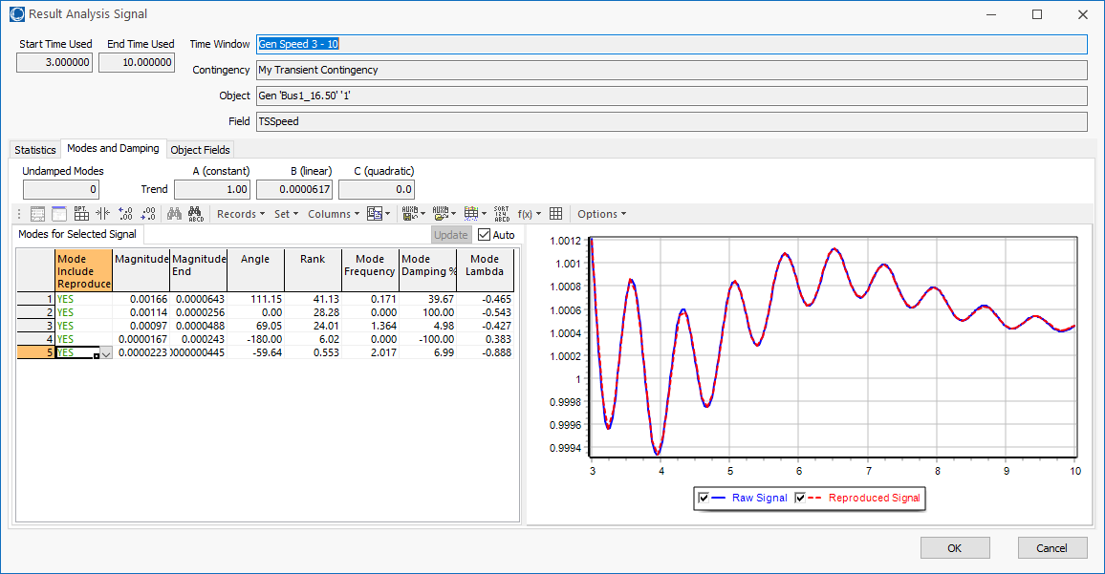
Example: One Signal
This could be any signal; image shows the result of the original signal (blue) and the reproduced signal (red)

Slide 21
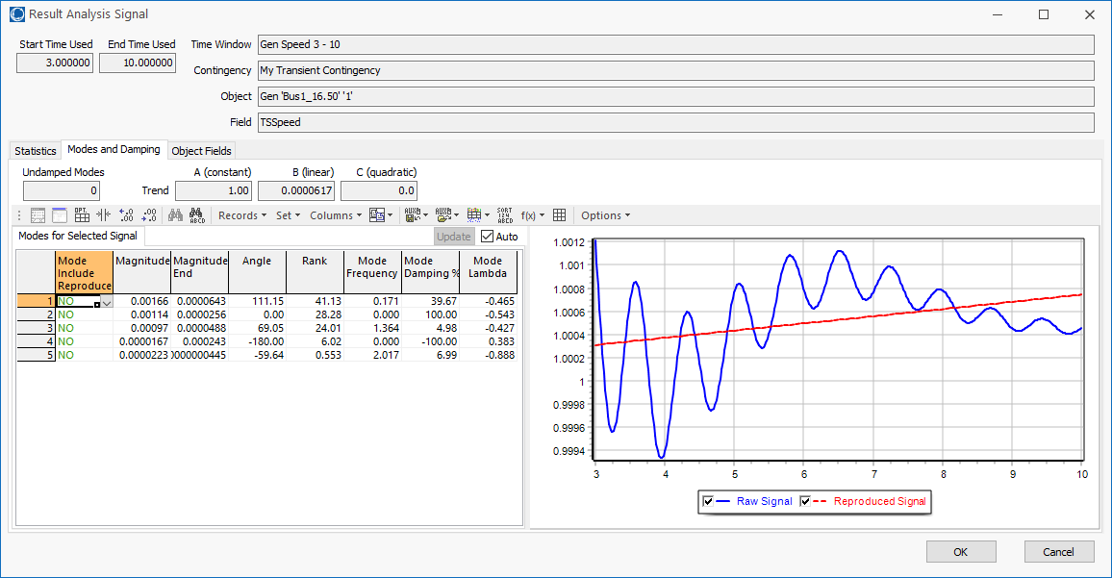
Verification:
Linear Trend Line Only

Slide 22
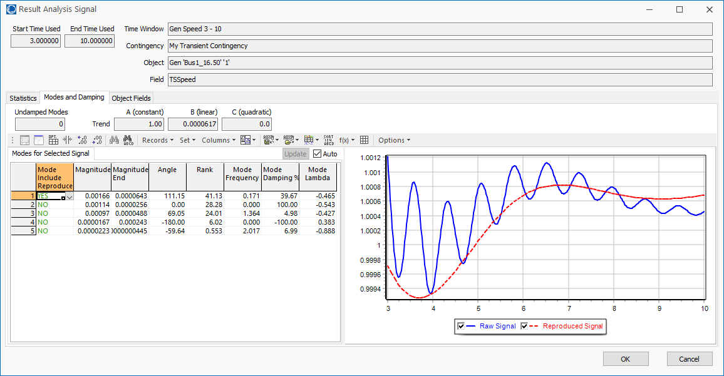
Verification:
Linear Trend Line + One Mode

Slide 23
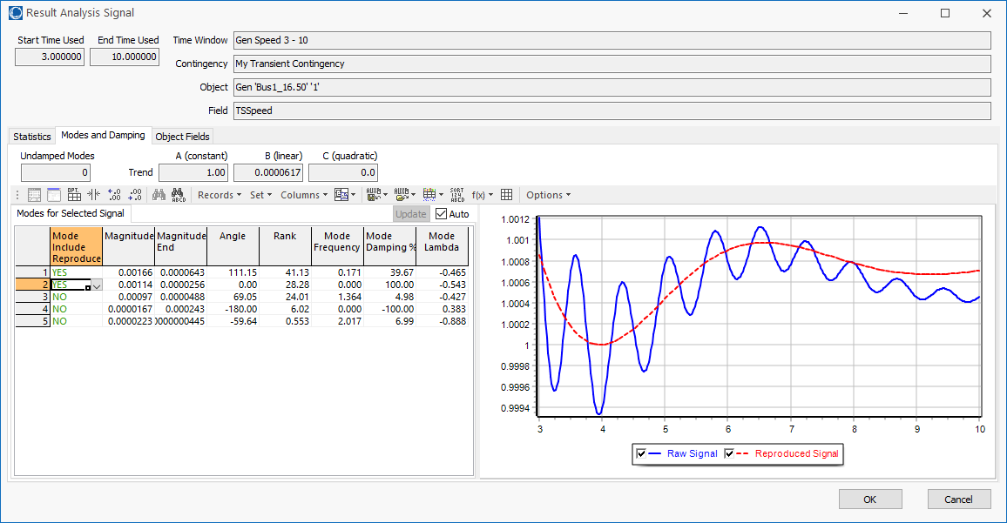
Verification:
Linear Trend Line + Two Modes

Slide 24
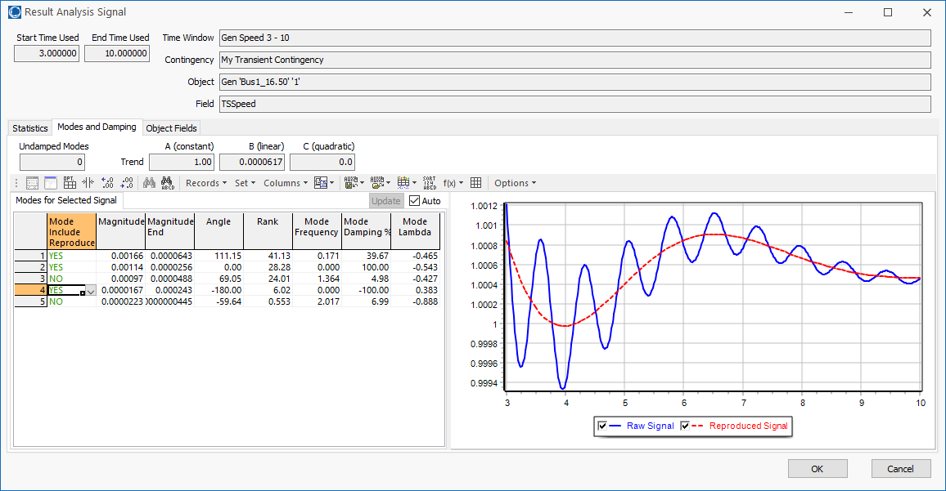
Verification:
Linear Trend Line + Three Modes

Slide 25
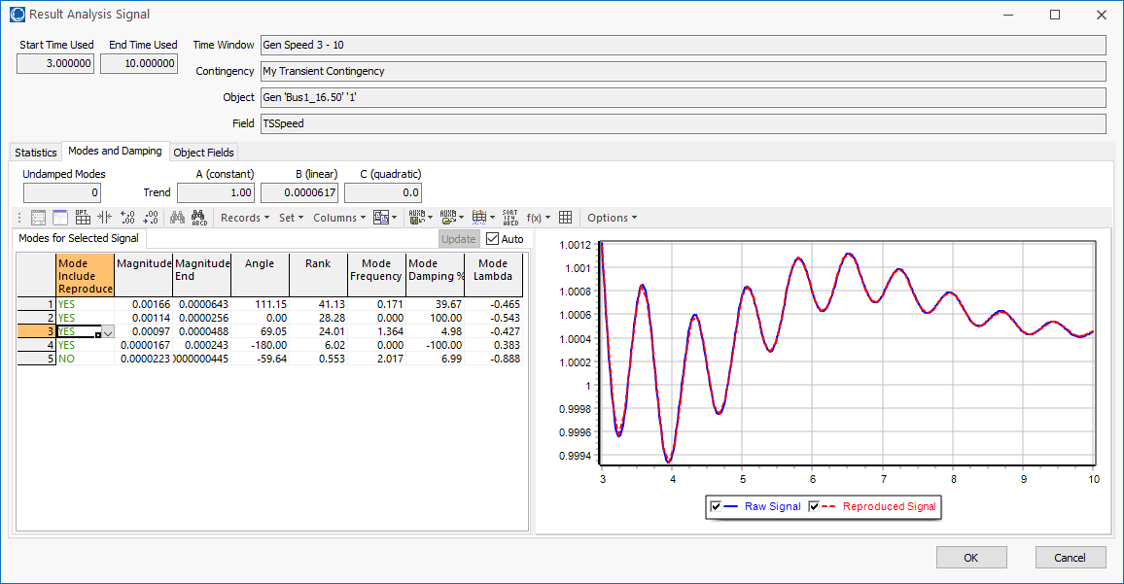
Verification:
Linear Trend Line + Four Modes

Slide 26

Verification:
Linear Trend Line + Five Modes
It is hard to tell a difference
on this one, illustrating that modes manifest differently in different signals

Slide 27
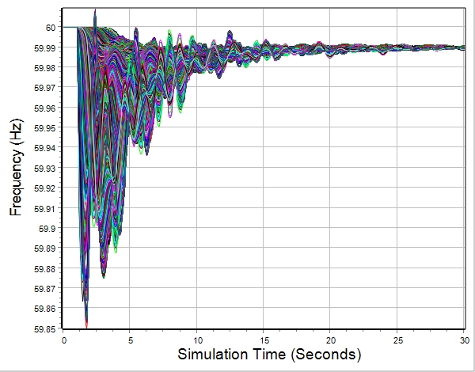
A Larger Example We’ll Finish With
Applying the developed techniques to the response of all 43,400 substation frequencies from an 110,000 bus electric grid(20 million plus values)

Slide 28

Spatial Visualization of Frequency

Slide 29
Measurement-Based Modal Analysis
There are a number of different approaches
The idea of all techniques is to approximate a signal, y_{org}(t), by the sum of other, simpler signals (basis functions)
  Basis functions are usually exponentials, with linear and quadratic functions used to detrend the signal
  Properties of the original signal can be quantified from basis function properties
    Examples are frequency and damping
  Signal is considered over time with t=0 as the start
Approaches sample the original signal y_{org}(t)

Slide 30

Measurement-Based Modal Analysis
Vector y consists of m uniformly sampled points from y_{org}(t) at a sampling value of ΔT, starting with t=0, with values y_{j} for j=1…m
  Times are then t_{j}= (j-1)ΔT
  At each time point j, the approximation of y_{j} is

Slide 31
Measurement-Based Modal Analysis
Error (residual) value at each point j is
The closeness of the fit can be quantified using the Euclidean norm of the residuals
Hence we need to determine α and b

Slide 32
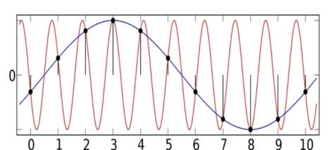
Sampling Rate and Aliasing
The Nyquist-Shannon sampling theory requires sampling at twice the highest desired frequency
  For example, to see a 5 Hz frequency we need to sample the signal at a rate of at least 10 Hz
Sampling shifts the frequency spectrum by 1/T (where T is the sample time), which causes frequency overlap
This is known as aliasing, which
can cause a high frequency
signal to appear to be a lower
frequency signal
  Aliasing can be reduced by fast sampling and/or low
  pass filters
Image: upload.wikimedia.org/wikipedia/commons/thumb/2/28/AliasingSines.svg/2000px-AliasingSines.svg.png

Slide 33
One Solution Approach:
The Matrix Pencil Method
There are several algorithms for finding the modes. We’ll use the Matrix Pencil Method
  This is a newer technique for determining modes from noisy signals (from about 1990, introduced to power system problems in 2005); it is an alternative to the Prony Method
  The Matrix Pencil Method is useful when there is signal noise
Given m samples, with L=m/2, the first step is to form the Hankel Matrix, Y such that
This not a sparse matrix
Reference: A. Singh and M. Crow, "The Matrix Pencil for Power System Modal Extraction," IEEE Transactions on Power Systems, vol. 20, no. 1, pp. 501-502, Institute of Electrical and Electronics Engineers (IEEE), Feb 2005.

Slide 34
Algorithm Details, cont.
Then calculate Y’s singular values
using an economy singular value decomposition (SVD)
The ratio of each singular value
is then compared to the largest
singular value σ_{c}; retain the ones
with a ratio > than a threshold
  This determines the modal order, M
  Assuming V is ordered by singular
  values (highest to lowest), let V_{p} be
  then matrix with the first M columns of V
The computational
complexity increases
with the cube of the number of measurements!
This threshold
is a value that
can be changed;
decrease it to
get more modes.

Slide 35
Aside: The Matrix Singular Value Decomposition (SVD)
The SVD is a factorization of a matrix that generalizes the eigen decomposition to any m by n matrix to produce
where Σ is a diagonal matrix of the singular values
The singular values are non-negative, real numbers that can be used to indicate the major components of a matrix (the gist is they provide a way to decrease the rank of a matrix)
The original concept is more than
100 years old, but has found lots of recent applications

Slide 36
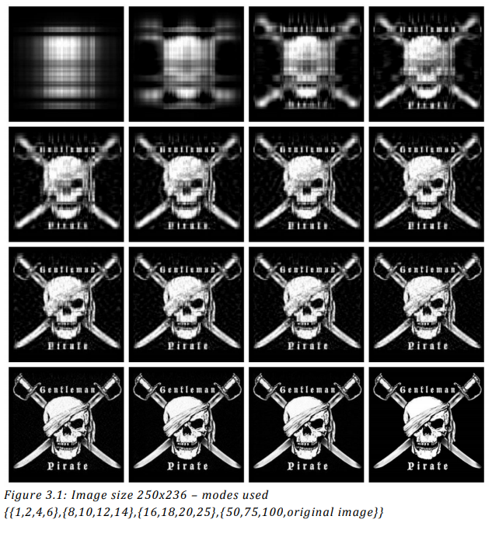
Aside: SVD Image Compression Example
Images can be
represented with
matrices. When
an SVD is applied
and only the
largest singular
values are retained
the image is
compressed.
Image Source: www.math.utah.edu/~goller/F15_M2270/BradyMathews_SVDImage.pdf

Slide 37
Matrix Pencil Algorithm Details, cont.
Then form the matrices V₁ and V₂ such that
  V₁ is the matrix consisting of all but the last row of V_{p}
  V₂ is the matrix consisting of all but the first row of V_{p}
Discrete-time poles are found as the generalized eigenvalues of the pair (V₂^{T}V₁, V₁^{T}V₁) = (A,B)
These eigenvalues are the
discrete-time poles, z_{i} with the
modal eigenvalues then
If B is nonsingular (the situation here) then the generalized eigenvalues are the eigenvalues of
B⁻¹A
The log of a complex
number z=r∠θ is
ln(r) + jθ

Slide 38
Matrix Pencil Method with Many Signals
The Matrix Pencil approach can be used with one signal or with multiple signals
Multiple signals are handled by forming a Y_{k} matrix for each signal k using the measurements for that signal and then combining the matrices
The required computation
scales linearly with the number
of signals

Slide 39
Matrix Pencil Method with Many Signals
However, when dealing with many signals, usually the signals are somewhat correlated, so vary few of the signals are actually need to be included to determine the desired modes
Ultimately we are finding
The α is common to all the signals (i.e., the system modes) while the b vector is signal specific (i.e., how the modes manifest in that signal)

Slide 40
Quickly Determining the b Vectors
A key insight is from an approach known as the Variable Projection Method (from Borden, 2013) that for any signal k
Where m is the number of measurements
and n is the number of modes
A. Borden, B.C. Lesieutre, J. Gronquist, "Power System Modal Analysis Tool Developed for Industry Use," Proc. 2013 North American Power Symposium, Manhattan, KS, Sept. 2013

