Slide 1
ECEN 667
Power System Stability
Lecture 22: North American East-West Interconnection Study
Prof. Tom Overbye
Dept. of Electrical and Computer Engineering
Texas A&M University
overbye@tamu.edu

Slide 2
Announcements
Read Chapter 9
Homework 7 is due on November 30
More details on today’s lecture are available on papers on my website
https://overbye.engr.tamu.edu/publications/

Slide 3
In a Nutshell
This project, which ran from March 2020 to Dec 2020, was done for SPP through PSERC
The focus was primarily on the dynamic aspects of an AC interconnection of the East and WECC
  The study did not consider ERCOT
The study considered nine connection points and used the most detailed dynamic models available
  The grid model size had 110,000 buses
There are no technical showstoppers to doing this interconnection, and a good amount of interchange capability could be achieved with relatively little investment

Slide 4
In a Nutshell, cont.
The study conclusion is technically the grids can be interconnected
  We did not address in-depth whether they should be interconnected (more of a political and economic question)
  Adding ERCOT would be a natural extension
In relation to the large HVDC overlay studies
  Our study results indicate that both AC and HVDC solutions should be considered; synchronizing the grids does not preclude the use of HVDC; it just provides more flexibility since AC lines can also be considered
  These studies can and should consider the impact of power system dynamics

Slide 5
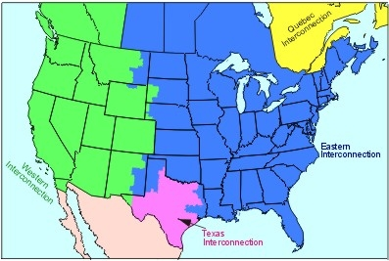
Background: Major North America Interconnects
Image Source: North American Electric Reliability Corporation

Slide 6
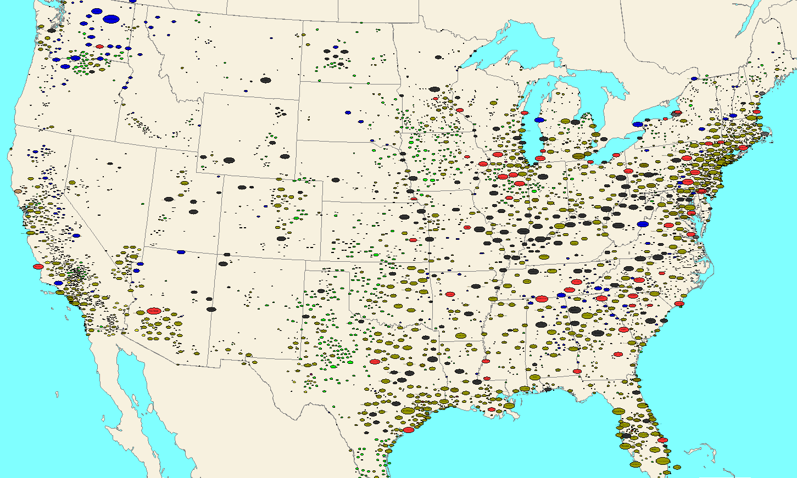
2019 US Generation by Capacity and Fuel
Oval size is proportional to the substation generation capacity, and color indicates primary fuel type (red nuclear, black coal, brown natural gas, blue hydro, green wind, yellow solar). Image shows public data from EIA Form 860; image created using PowerWorld Simulator.

Slide 7
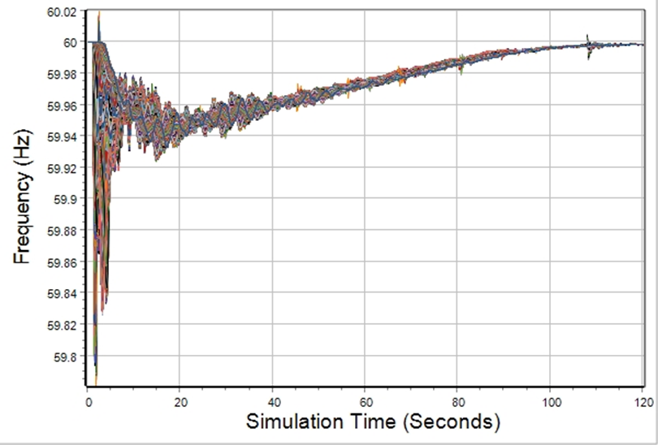
Quick Aside: Power System Dynamic Response to Load/Gen Mismatch
An electric grid frequency is constantly changing, but it usually within a few mHz of desired (e.g., 60 Hz)
Too much generation increases the frequency and
and too little
decreases it
All grid elements
have the same
average frequency
but during
disturbances the
frequency can
oscillate
Automatic Generation Control
Generator governor response
Inertia response and under frequency load shedding

Slide 8
Background: East-West History
The East and the West have been joined in the past, at least from 1967 to the 1970’s
  In the [a] (from 1970), the authors say,
    “The nation’s largest synchronized network now extends from coast to coast and includes 94 percent of United States generating capacity.”
  In a 2018 IEEE Proceedings article Julie Cohn says they were joined from 1967 to 1975; they separated because of problems with maintaining synchronism and the introduction of HVDC
A 1994 WAPA report looked at the reconnection
[a] Cohn, Biddle, Lex, Preston, Ross, Whitten, “On-line Computer Applications in the Electric Power Industry,” IEEE Proc., January 1970, pp. 78-87

Slide 9
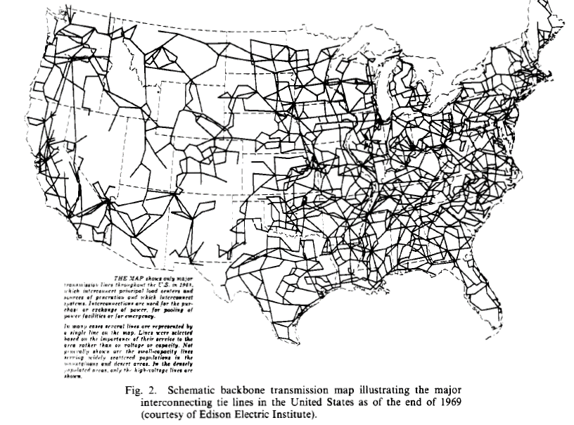
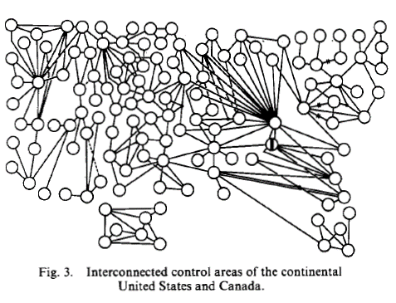
Background: Grid in 1970 (From [a])
[a] Cohn, Biddle, Lex, Preston, Ross, Whitten, “On-line Computer Applications in the Electric Power Industry,” IEEE Proc., January 1970, pp. 78-87
Another good background article is by Julie Cohn in the January 2019 IEEE Proceedings, titled, “When the Grid Was the Grid: The History of North America’s Brief Coast-to-Coast Interconnected Machine”

Slide 10
Details on Combining the Models
The input data for the project was high and low demand power flow and dynamics cases for the Eastern Interconnect and the WECC (West)
  These are the best electric grid models available
Power flow and dynamic data were provided for the East in PSSE format and for the West in PowerWorld format, based on PSLF
  Not all the models are compatible between PSSE and PSLF, but PowerWorld supports both
To avoid overlapping bus numbers the West was renumbered by adding 2 million to the West
A combined case was created in PowerWorld with 110,000 buses

Slide 11
Details on the Models
The grids were combined using nine short ac interconnections at voltages from 161 to 345 kV
There are no showstoppers with doing such an interconnection with the key constraint that during dynamic disturbances with lost generation in the West, about 75-80% of the lost generation will flow East to West; modelling the AGC response is important
The studied also showed that existing, large-scale dynamic models can run stable for long periods of time (up to 360 seconds here)
Some results will be shown with synthetic grids

Slide 12
Base Model 1: Heavy Load Conditions
Substation Generation Sized and Colored by MW Value

Slide 13
Base Model 2: Light Load Conditions
Substation Generation Sized and Colored by MW Value

Slide 14
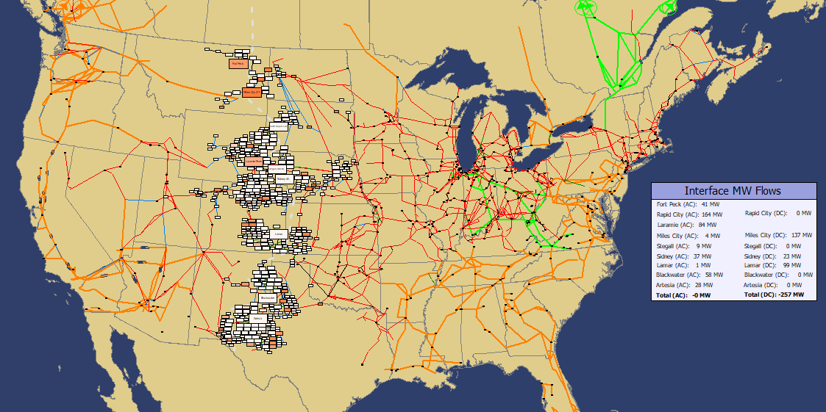
The Combined Grid Overview
The study included Canada but we did not consider any ac interconnections between the grids in Canada

Slide 15
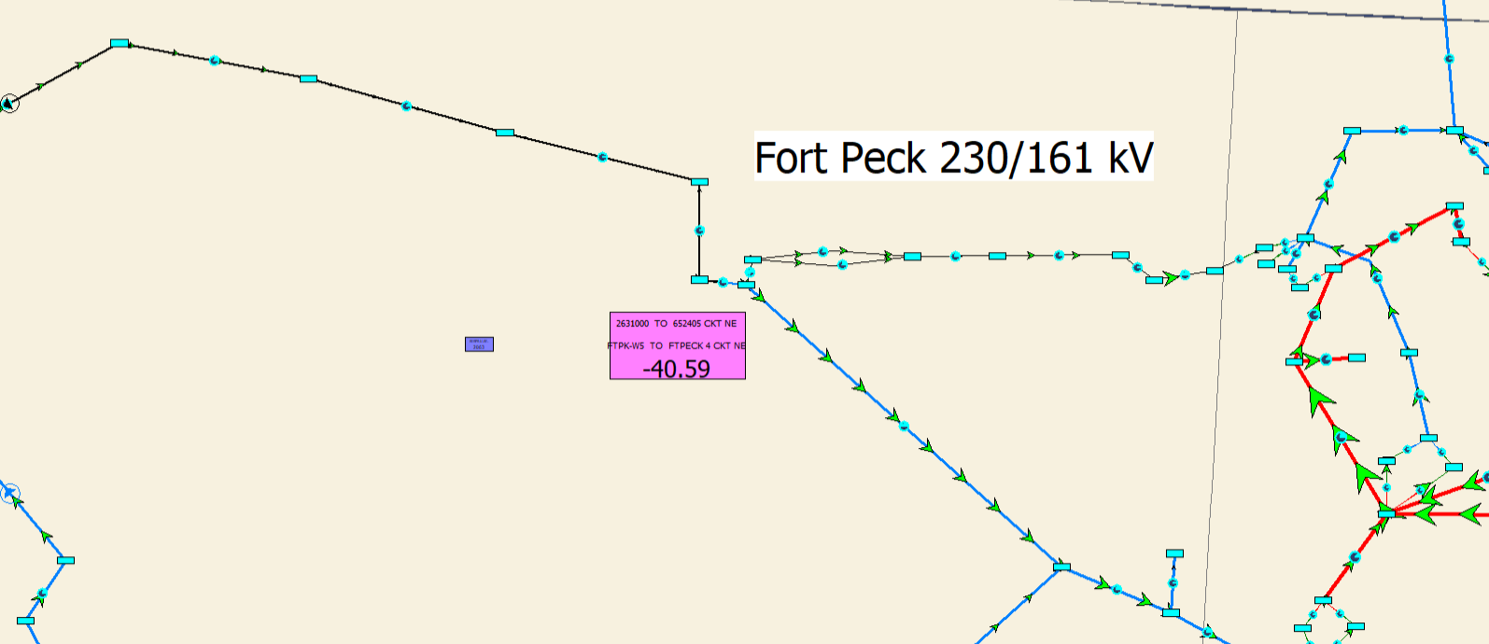
Fort Peck 230/161 kV
Rating of 161 kV to west is 112/123 MVA; rating of 230 kV to east is 160/176 MVA; rating of 115 kV to east is 120 MVA; new transformer was set to 200 MVA
Proposed 230/161 kV transformer; rating set to 200 MVA

Slide 16
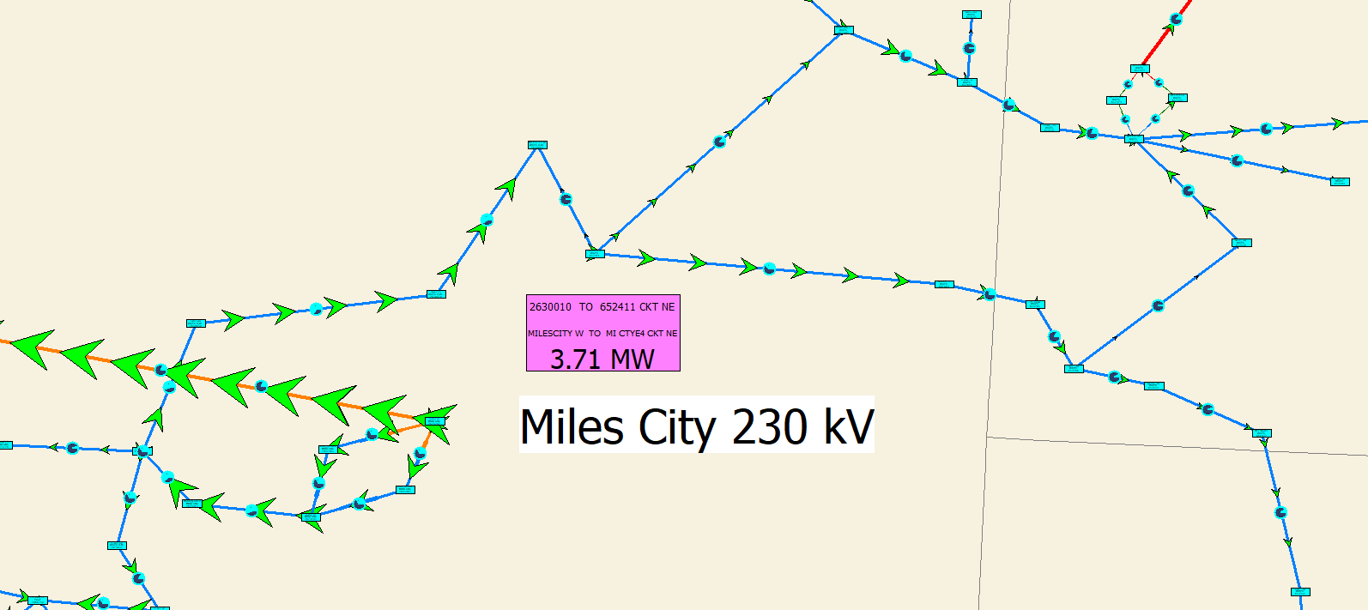
Miles City 230 kV
Rating of 230 kV to west is 239/260 MVA; rating of line to NE is 320 MVA and line to east is 239/260 MVA
Proposed 230 kV ZBR
with a 239 MVA rating
Colstrip

Slide 17
Rapid City 230 kV
There are three 230 kV lines going west, with an MVA of mostly more than 400 MVA each; there are three lines to the east with at least 300 MVA each.
Proposed 230 kV ZBR with a 398 MVA rating

Slide 18
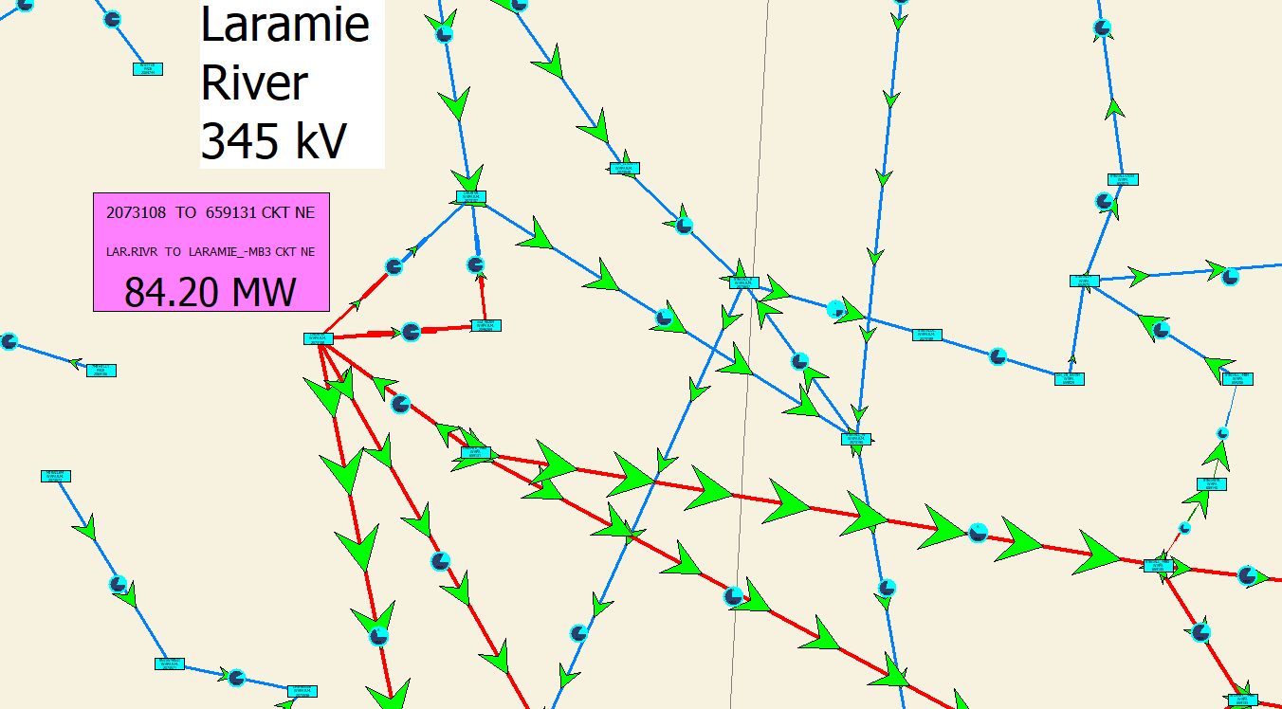
Laramie River 345 kV
In the west two 345 kV, 956 MVA lines go south and in the east two 345 kV, 760 MVA lines go east. There are two 600 MVA 345/230 kV transformers.
The three generators at about 600 MW each
Proposed
345 kV ZBR with a 800 MVA rating

Slide 19
Stegall 230 kV
On the west there are four 230 kV lines with average ratings of about 400 MVA; on East there is a 400 MVA and a 240 MVA 230 kV lines, and a 478 MVA 345/230 kV transformer.
Proposed
230 kV ZBR with a 478 MVA rating

Slide 20
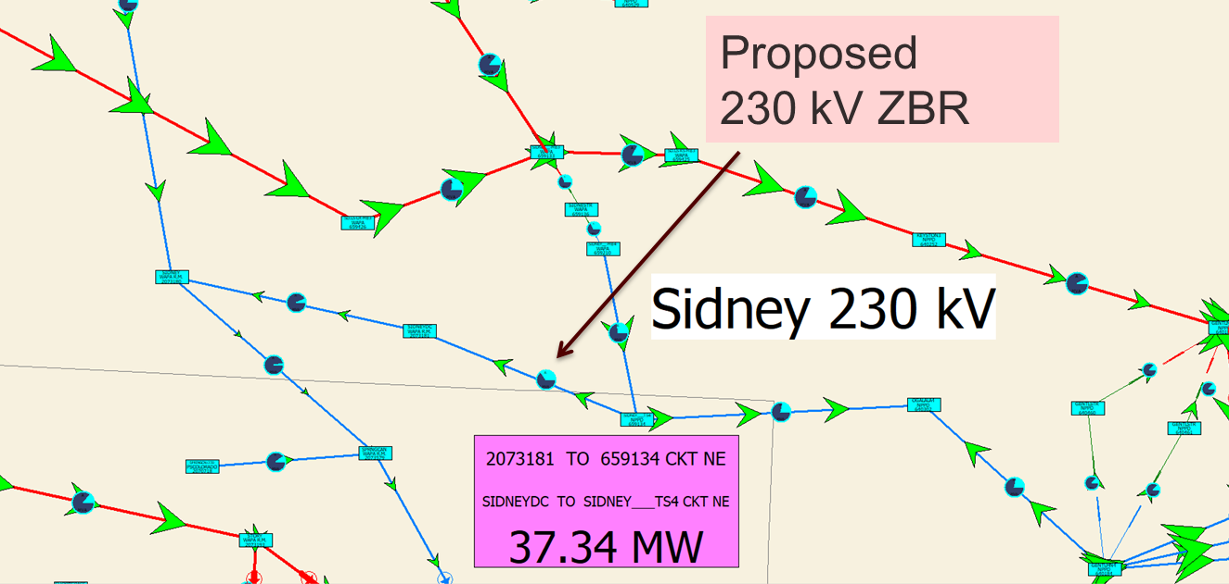
Sidney 230 kV
On the west there are 230 kV lines, with ratings of 318 and 442 MVA; on the east there is a 478 MVA 345/230 kV transformer and a 320 MVA 230 kV line going east which could be upgraded to 478 MVA

Slide 21
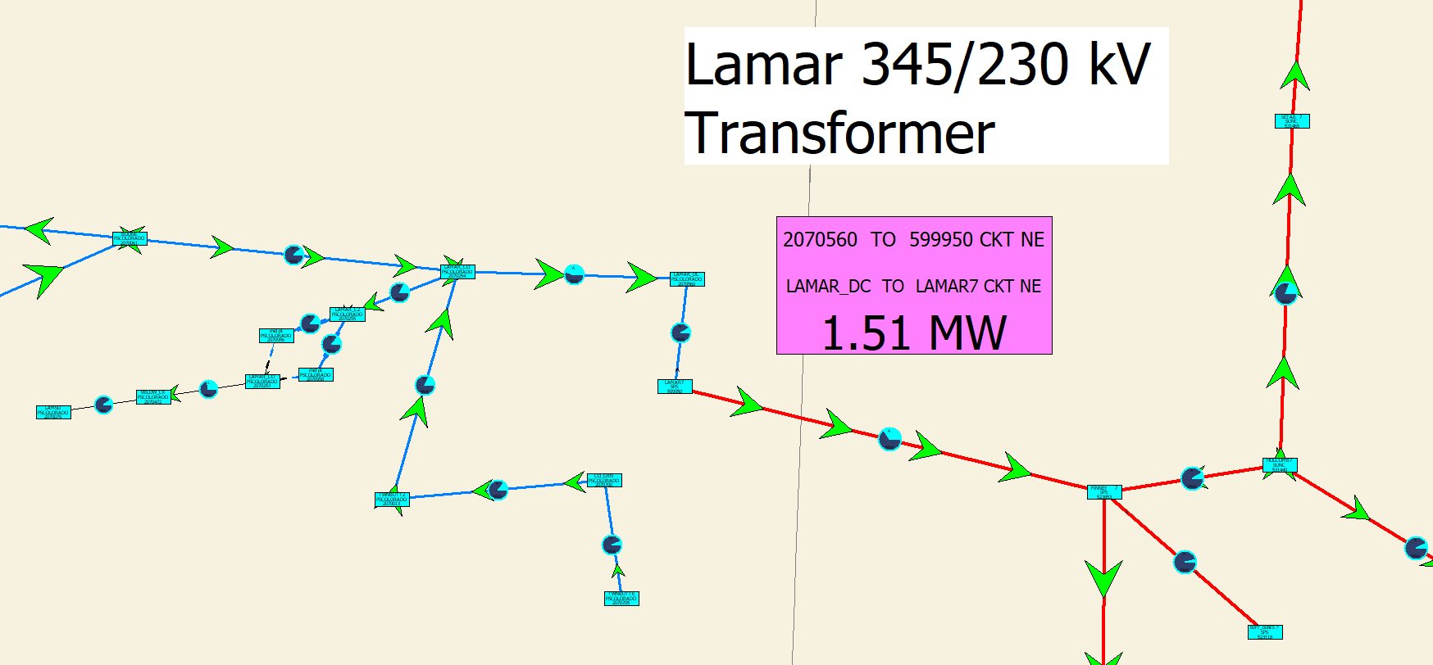
Lamar 345/230 kV Transformer
Rating of the 230 kV line to the west is 478 MVA ; the 345 kV line to the east is rated at 380 MVA; connecting to three much higher rated 345 kV lines (at least 700 MVA)
Proposed
345/230 kV transformer with a 478 MVA rating

Slide 22
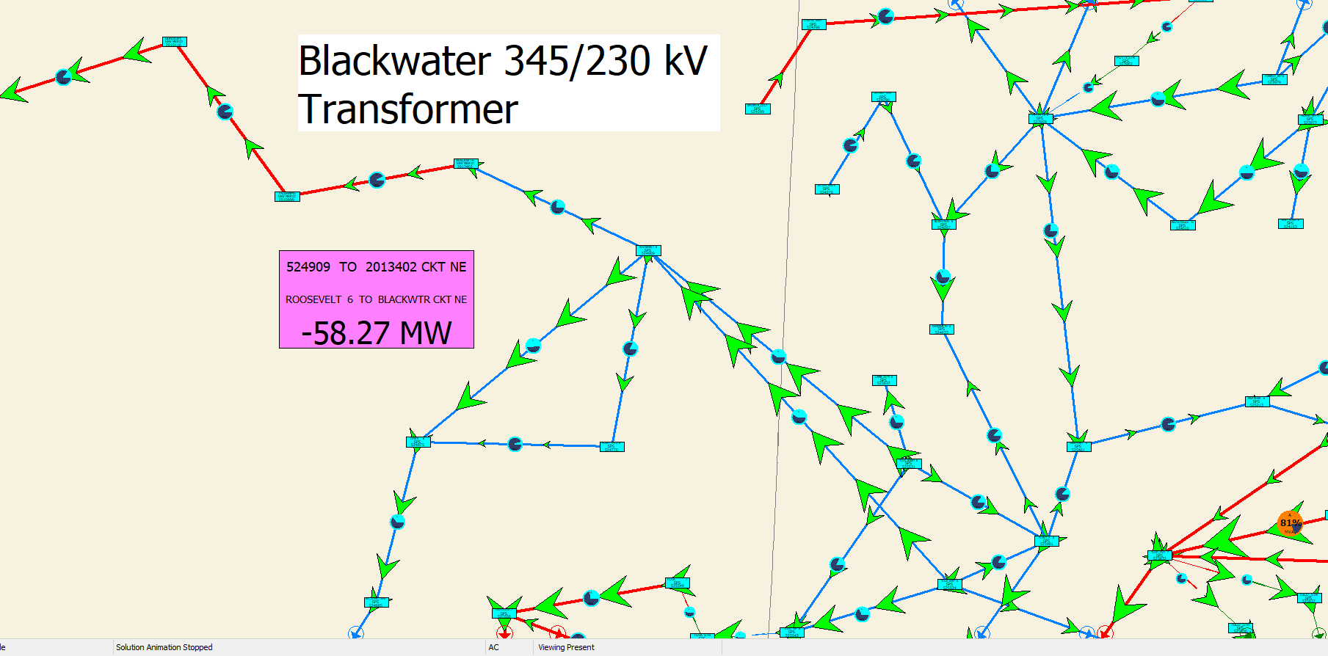
Blackwater 345/230 kV Transformer
Rating of the 345 kV line to the west is 753 MVA; two 230 kV lines go to the east rated at 478 MVA each.
Proposed
345/230 kV transformer with a 753 MVA rating

Slide 23
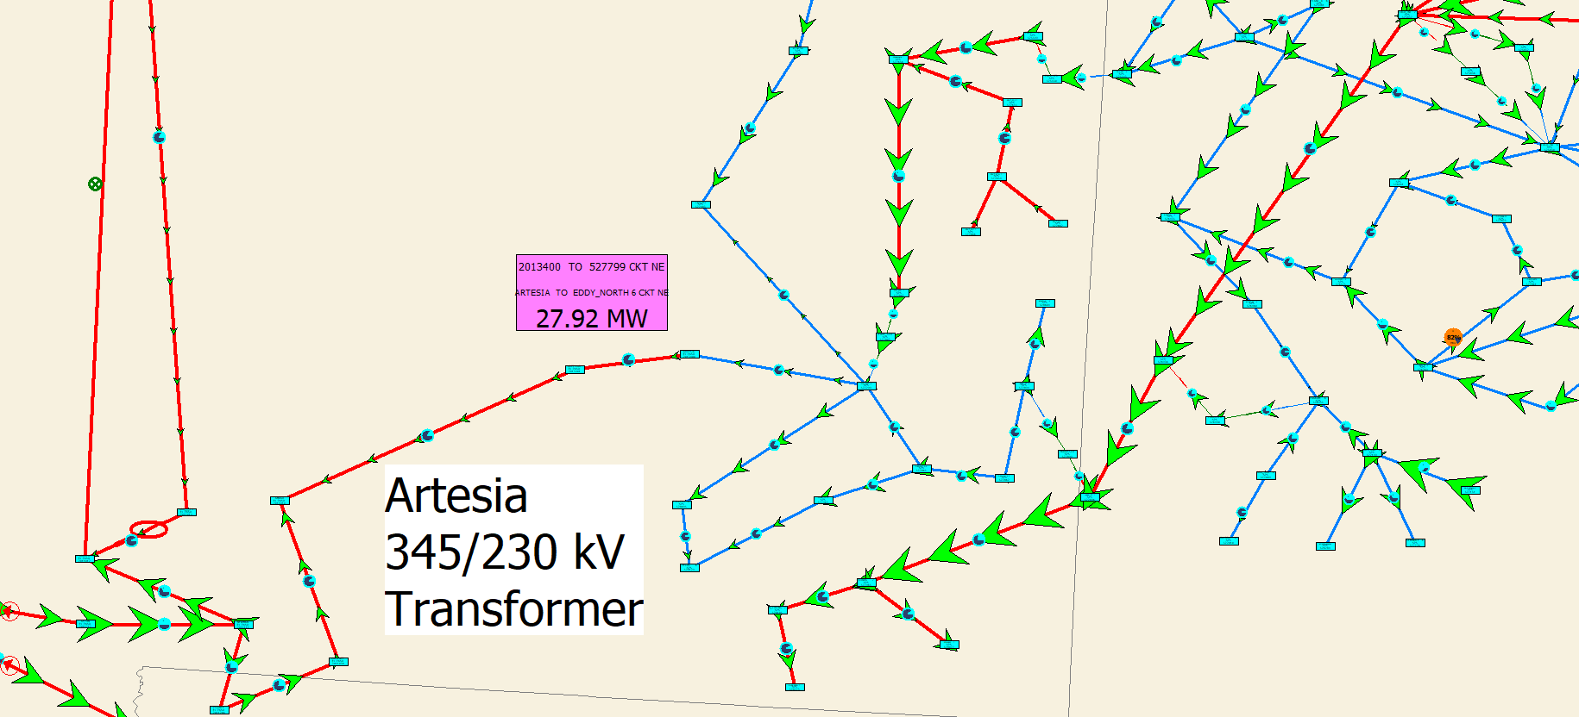
Artesia 345/230 kV Transformer
Rating of the 345 kV line to the west is 277 MVA (though it probably higher); to the east is a 500 MVA 345/230 kV transformer and three 230 kV lines (min of 300 MVA) each
Proposed
345/230 kV transformer with a 516 MVA rating

Slide 24
Dynamic Model Setup
A primary project task was to perform dynamic (transient stability level) studies on the combined grid, and to compare the results with the separate grids
  Key dynamic contingencies were the loss of a large amount of generation (greater than 5000 MW in the East)
  The model has 110,000 buses, 14,000 generators, 37,000 dynamic model devices with 243 different model types
  The Integrations were solved using a ½ cycle time step

Slide 25
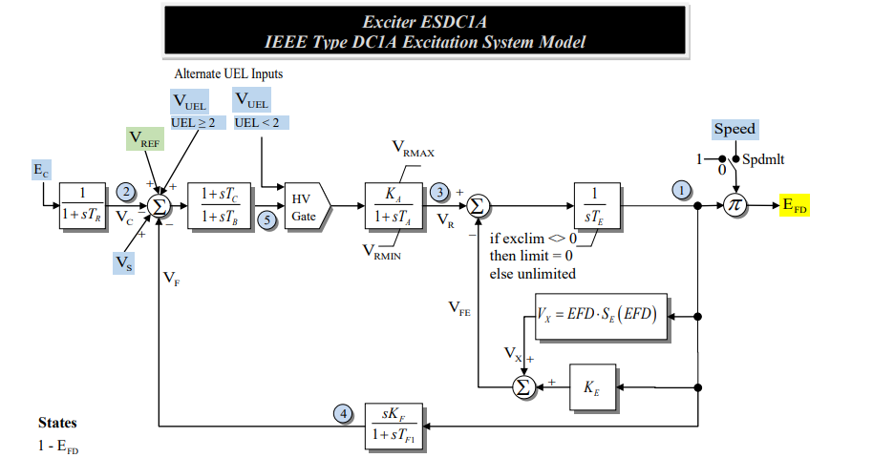
Modeling Considerations
While many of the dynamic models used in the East and West are similar (or identical), there are sometimes subtle differences
  Example is with an ESDC1A exciter in which the Ke value is auto determined by the software when it is set to zero
How this adjustment
occurs differs between
software packages,
and changing the approach
can result in unstable
simulation results.

Slide 26
Dynamic Studies
Over the course of the project we did a large number of simulations, ranging for short (10 second) fault studies to longer (six minute) automatic generation control (AGC) response scenarios
Even for severe events (> 5 GW losses in the East) the interconnected grid maintained synchronism
However, a key issue is for the loss of generation in the West about 80% of the makeup power flows across the interface from East to West
  The converse is true for generation loss in the East, about 20% of the makeup power flows across the interface from West to East

Slide 27
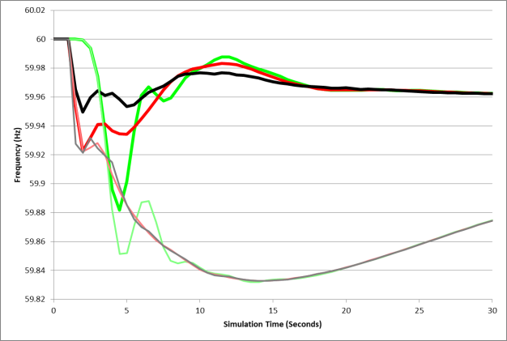
WECC Frequency Response Comparison: With and Without the AC Interconnection
The graph compares the frequency response for three WECC buses for a severe contingency with the interface (thick lines) and without (thin lines)

Slide 28
AC-Tie Interface, Severe Contingency
The large, and seemingly persistent, change in the interface flow required the need for modeling the system’s longer term AGC response.

Slide 29
Adding AGC Modeling
As noted following any disturbance about 80% of the governor response will occur in the East, with the change in flow going across the new ac interface if the disturbance is in the West.
The governors don’t restore the system frequency to its setpoint value; rather this is done by the automatic generation control (AGC) utilizing the balancing authority area control error (ACE) signal
The ACE has a frequency component
  ACE = P_{actual} - P_{sched} – 10β(freq_{act} - freq_{sched})
  β is the frequency bias; it has a negative sign, units of MW/0.1 Hz and is about 1% of the peak load/generation

Slide 30
Example AGC Response
Six minute simulation with severe generator loss, with emergency transactions implemented between several of the utilities
These transactions were initiated and ramped faster than normal to keep the simulation length reasonable (starting at 30 seconds and ramping over four minutes)
Initially much of the makeup generation flowed through the interface, but it ramped down to zero

Slide 31
New Interface Flow
How fast it
returns to
normal depends
on how fast
the MW
transactions
ramp

Slide 32
Situational Awareness
A key challenge with this project was understanding the results of these dynamic studies
  Even a 30 second study produced many GBs of results
Situational awareness (SA) is defined informally as “knowing what’s going on” and more formally as “the perception of the elements in the environment within a volume of time and space, the comprehension of their meaning and the projection of their status in the near future”
In this study we wanted to have good SA to make sure we didn’t miss something

Slide 33
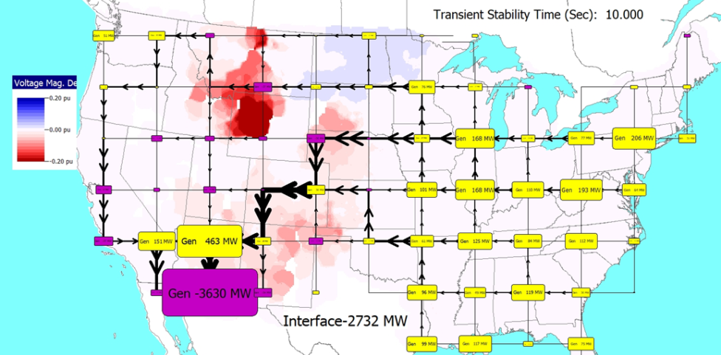
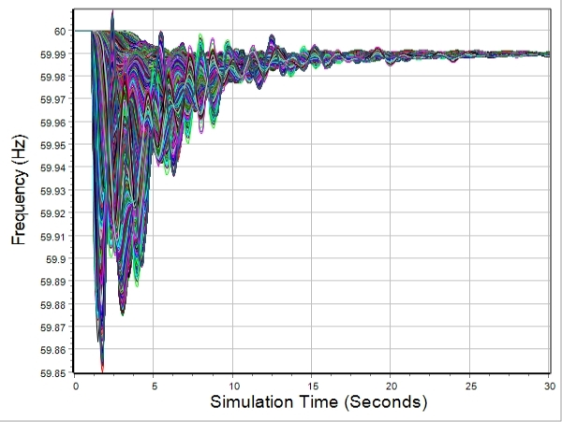
SA Techniques
For this project we leveraged a number of different techniques including
  Time-domain graphs
  Geographic data views including planar flow visualizations
  Contours
  Animation (movies)

Slide 34
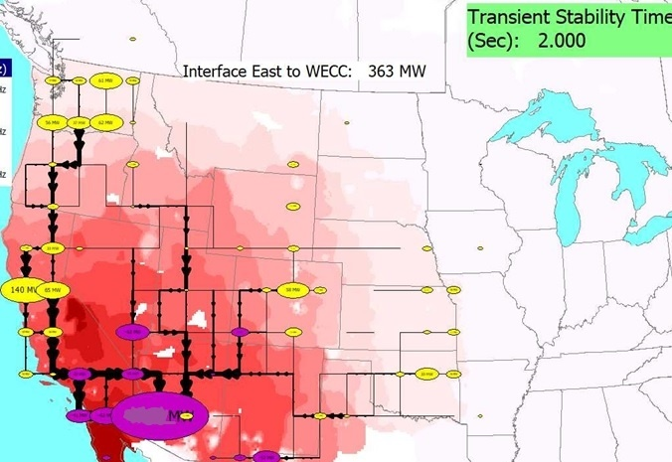
Results Example at 2.0 Seconds
This visualization
is using geographic
data views and a
contour to show
the response of
the 110,000 bus
model; red values
are frequencies
less than 60 Hz
These visualization techniques are presented in the paper by T.J. Overbye, J.L. Wert, K.S. Shetye, F. Safdarian, A.B. Birchfield, “The Use of Geographic Data Views to Help With Wide-Area Electric Grid Situational Awareness,” 2021 IEEE Texas Power and Energy Conference (TPEC), College Station, TX, USA, Feb. 2021; available at overbye.engr.tamu.edu/publications/

Slide 35
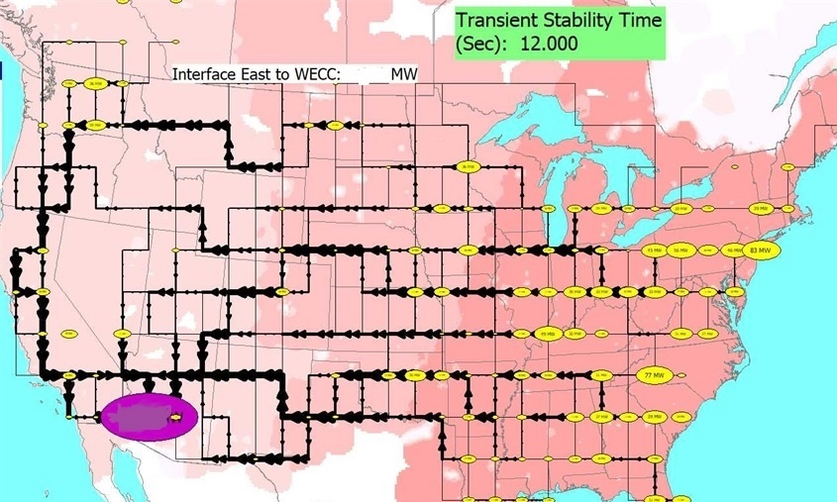
Results Example at 12.0 Seconds

Slide 36
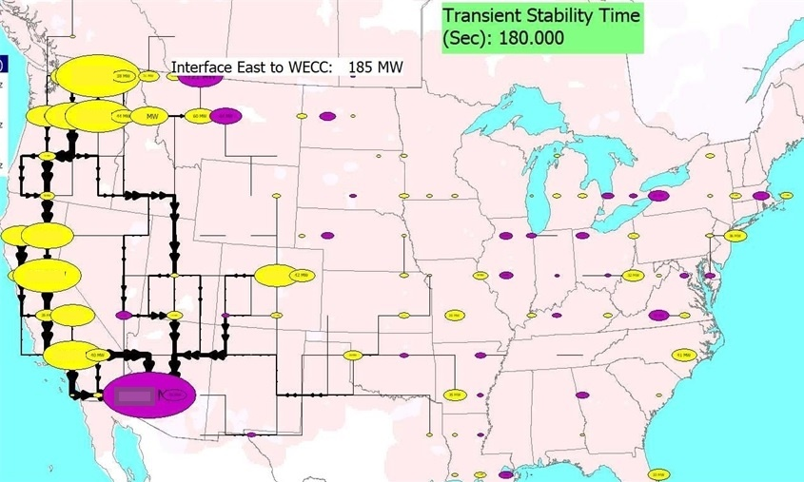
Results Example With AGC Response

Slide 37
Synthetic Electric Grids Models
The project had a synthetic grid component in order to provide access to detailed results while not disclosing any CEII.
Synthetic electric grids and associated datasets are fictional electric grids that are designed to be statistically similar to actual systems
  “Realistic but not real”
Synthetic grids are particularly helpful for visualization research
Kudos to the US DOE ARPA-E for funding work over the last five years in this area

Slide 38
Our Synthetic Grid Approach
Make grids that look real and familiar by siting them geographically (North America for us) and serving a population density the mimics actual
Goal is to leverage widely available public data
  Geography
  Population density (easily available by post office)
  Load by utility (US FERC 714), state-wide averages
  Existing and planned generation (Form US EIA-860, which contains lots of generator information)
Substation locations and transmission system is entirely fictional (but hopefully good fiction!)

Slide 39
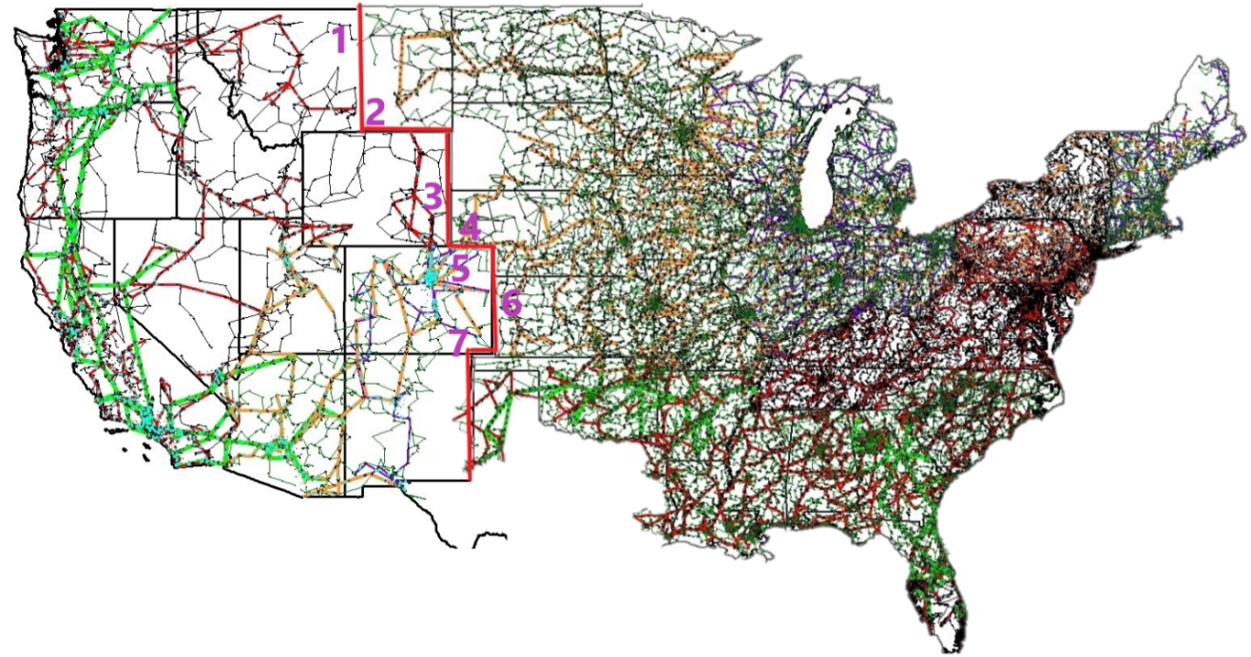
Synthetic Grid Component
  We’re using an 80,000 bus model that can
  be freely shared that has a synthetic East grid joined to a synthetic West grid at seven points

Slide 40
Synthetic Grid Interconnection Points and PTDF Analysis
The power transfer
distribution factors
(PTDFs) tell how
different transactions
impact the interface flows
The maximum transfer
capacity is about 5000 MW West to East and 3500 East to West

Slide 41
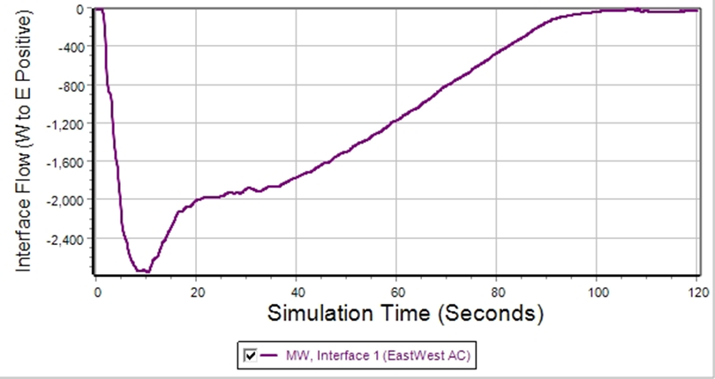
Synthetic Grid Interface Response for a Generator Loss Contingency in the West
The sign convention on the interface is positive flow is from West to East; within seconds large amounts of power flow in!

Slide 42
Synthetic Grid Frequency Response, All Locations

Slide 43
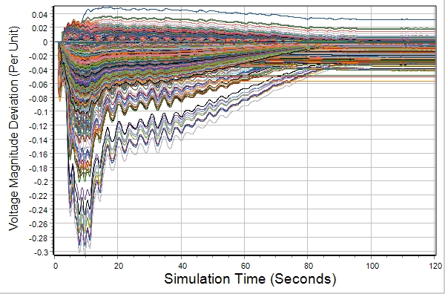
Synthetic Grid Voltage Deviation,
All Locations

Slide 44
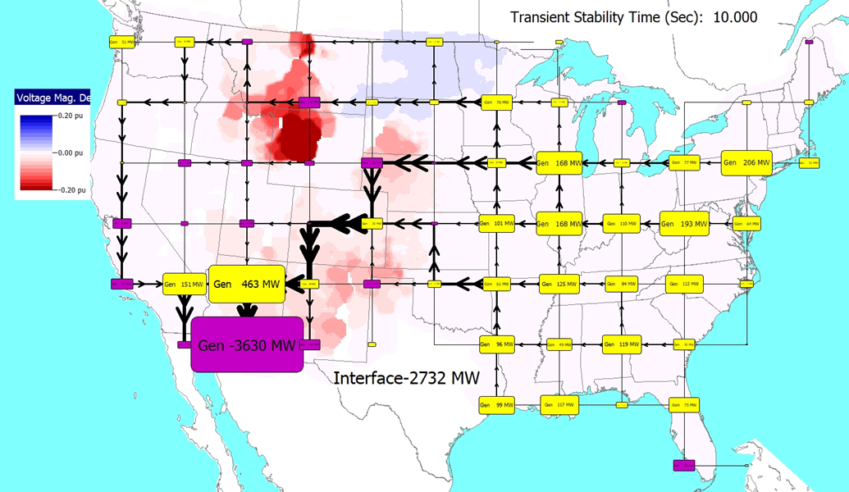
Synthetic Grid Voltage Contour

Slide 45
Summary
The electric grid is rapidly changing and there are lots of engineering opportunities!!
From a technical perspective we believe the North American Eastern and Western grids could be connected with a modest number of ac interties that would allow for stable operation under even quite severe contingencies
A key constraint is that following a generation (or load) disturbance in the West, most of the makeup power would flow through the interface, potentially causing voltage or thermal issues
Visualization of results for large systems is crucial

