Slide 1
ECEN 667
Power System Stability
Lecture 24: Power System Stabilizers (PSSs)
Prof. Tom Overbye
Dept. of Electrical and Computer Engineering
Texas A&M University
overbye@tamu.edu

Slide 2
Announcements
Read Chapter 9
Homework 7 should be done before the second exam but need not be turned in

Slide 3
Dynamic Models in the Physical Structure
Mechanical System
Electrical System
Stabilizer
Load
Relay
Line
Relay
Exciter
Supply control
Pressure control
Speed control
Voltage Control
Network control
Load control
Fuel
Source
Furnace and Boiler
Turbine
Generator
Network
Loads
Machine
Load
Char.
Fuel
Steam
Torque
V, I
P, Q
Governor
P. Sauer and M. Pai, Power System Dynamics and Stability, Stipes Publishing, 2006.

Slide 4
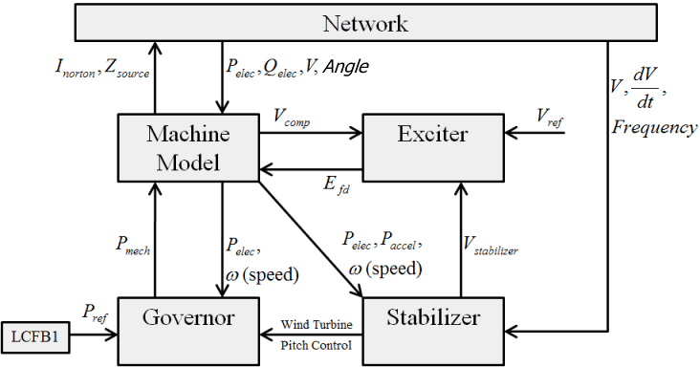
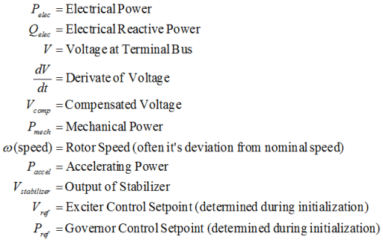
Power System Stabilizer (PSS) Models

Slide 5
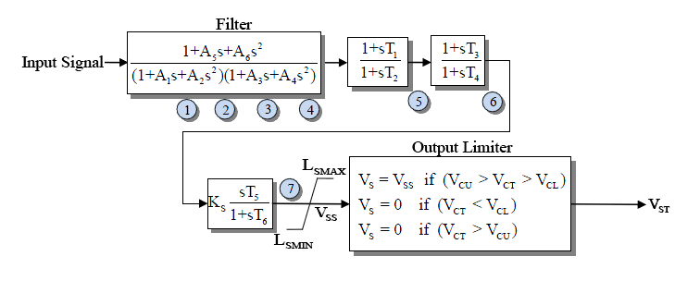
Example PSS
An example single input stabilizer is shown below (IEEEST)
  The input is usually the generator shaft speed deviation, but it could also be the bus frequency deviation, generator electric power or voltage magnitude
The model can be
simplified by setting parameters to zero
V_{ST} is an
input into
the exciter

Slide 6
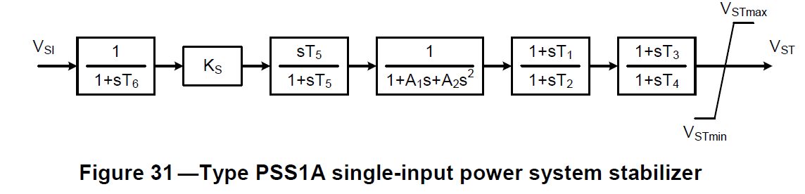
Another Single Input PSS
The PSS1A is very similar to the IEEEST Stabilizer and STAB1
IEEE Std 421.5 describes the common stabilizers

Slide 7
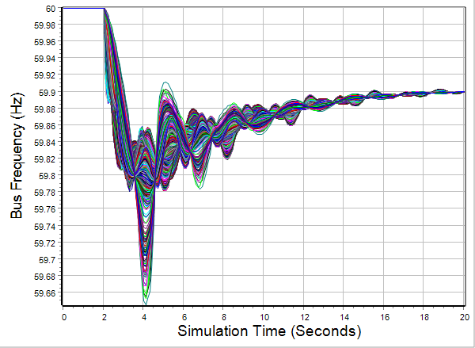
2000 Bus System Results With Stabilizers
The case has 334 IEEST stabilizers, all with the same parameters (which would not be the case in a real system)
Results are
given for the
previous
generator
drop
contingency

Slide 8
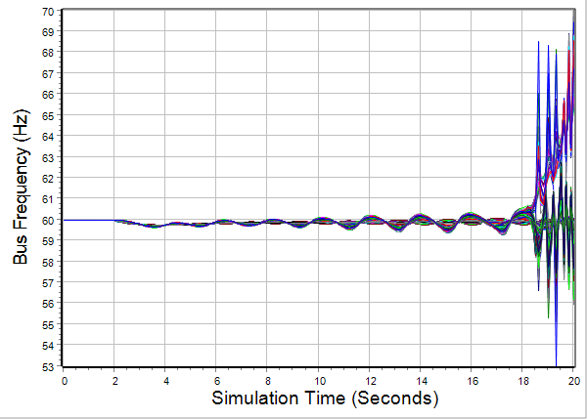
2000 Bus System Results Without Stabilizers
Clearly the case is unstable; note the change in scale

Slide 9
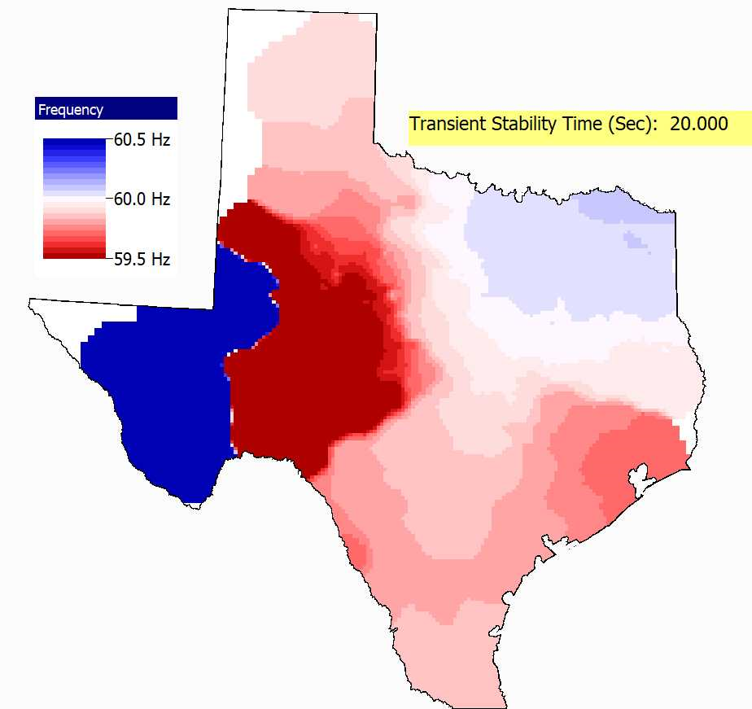
2000 Bus System Results Without Stabilizers Movie
The techniques from the last lecture were used to quickly create a movie showing this frequency response

Slide 10
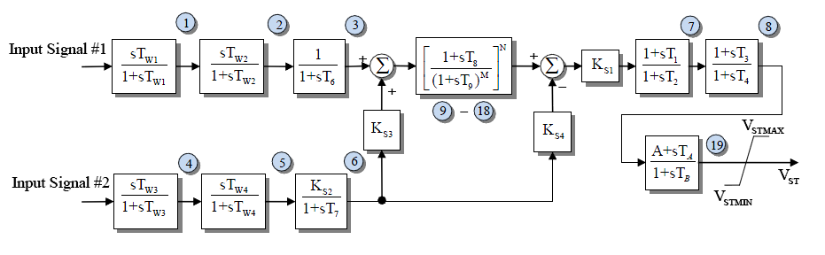
Example Dual Input PSS
Below is an example of a dual input PSS (PSS2A)
  Combining shaft speed deviation with generator electric power is common
  Both inputs have washout filters to remove low frequency components of the input signals
In addition to exciters, IEEE Std 421.5 describes
the common stabilizers

Slide 11
Washout Filters and Lead-Lag Compensators
Two common attributes of PSSs are washout filters and lead-lag compensators
Since PSSs are associated with damping oscillations, they should be immune to slow changes. These low frequency changes are “washed out” by the washout filter; this is a type of high-pass filter.
Lead-lag compensators
Washout filter

Slide 12
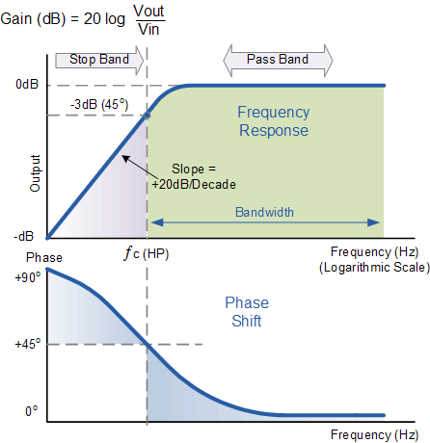
Washout Filter
The filter changes both the
magnitude and angle of the
signal at low frequencies
The breakpoint
frequency is when
the phase shift
is 45 degrees and
the gain is -3 dB
(1/sqrt(2))
A larger T value
shifts the breakpoint
to lower frequencies;
at T=10 the breakpoint
frequency is 0.016 Hz
Image Source: www.electronics-tutorials.ws/filter/filter_3.html

Slide 13
Washout Parameter Variation
The PSS2A is the most common stabilizer in both the 2015 EI and WECC cases. Plots show the variation in T_{W1} for EI (left) and WECC cases (right); for both the x-axis is the number of PSS2A stabilizers sorted by T_{W1}, and the y-axis is T_{W1} in seconds

Slide 14
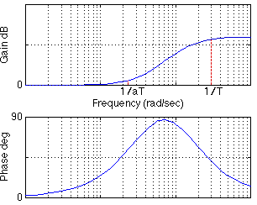
Lead-Lag Compensators
For a lead-lag compensator of the below form with α <= 1 (equivalently a >= 1)
There is no gain or phase
shift at low frequencies,
a gain at high frequencies but
no phase shift
Equations for a design maximum
phase shift α at a frequency f are
given

Slide 15
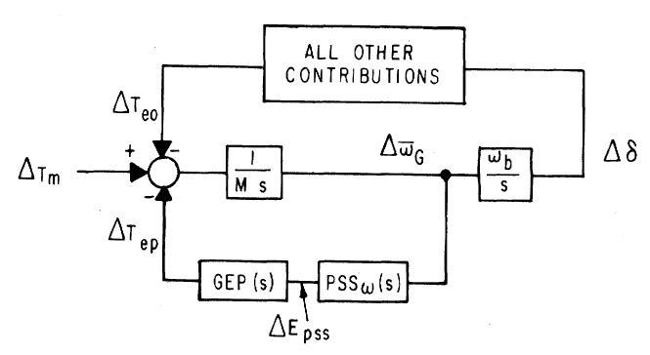
Stabilizer Design
As noted by Larsen, the basic function of stabilizers is to modulate the generator excitation to damp generator oscillations in frequency range of about 0.2 to 2.5 Hz
  This requires adding a torque that is in phase with the speed variation; this requires compensating for the gain and phase characteristics of the generator, excitation system, and power system (GEP(s))
  We need to compensate for the
  phase lag in the GEP
The stabilizer input is
often the shaft speed
Image Source: Figure 1 from Larsen, 1981, Part 1

Slide 16
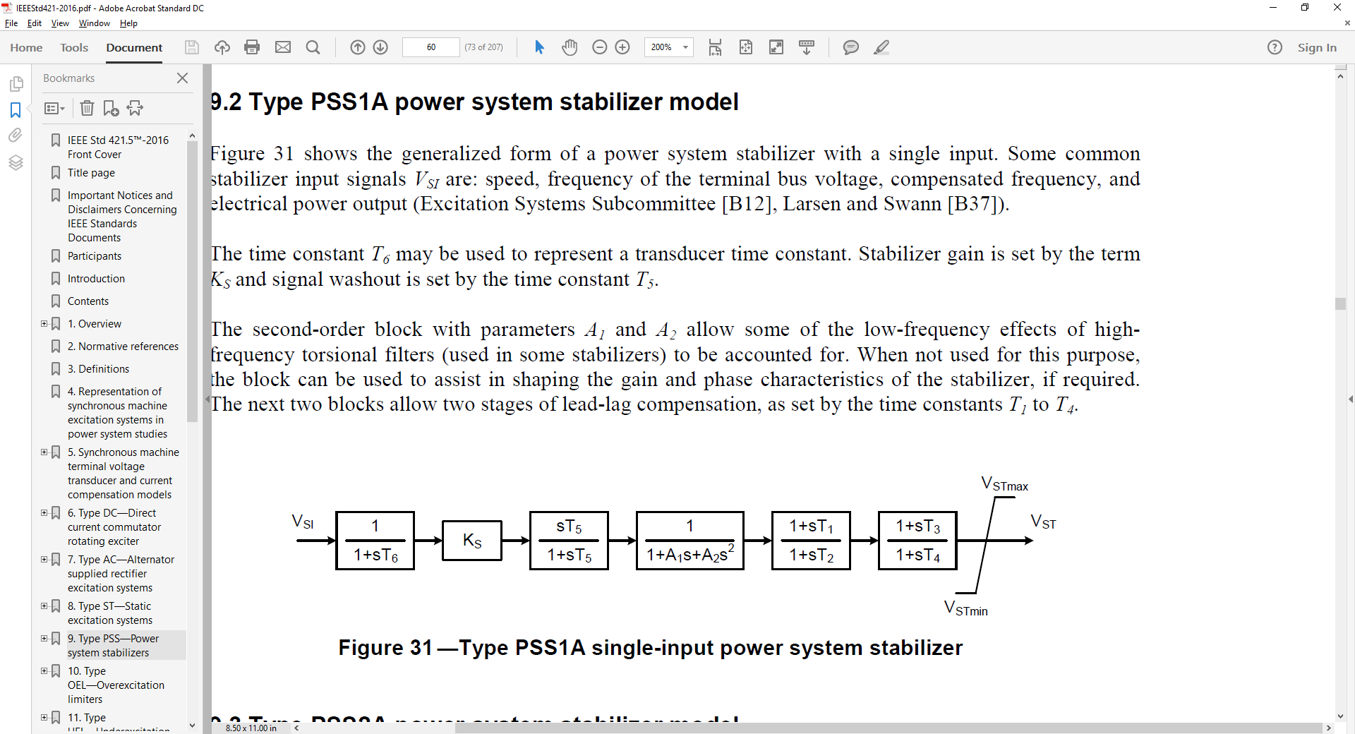
Stabilizer Design
T₆ is used to represent measurement delay; it is usually zero (ignoring the delay) or a small value (< 0.02 sec)
The washout filter removes low frequencies; T₅ is usually several seconds (with an average of say 5)
  Some guidelines say less than ten seconds to quickly remove the low frequency component
  Some stabilizer inputs include two washout filters
Image Source: IEEE Std 421.5-2016

Slide 17
Stabilizer Design Values
With a washout filter value of T₅ = 10 at 0.1 Hz
(s = j0.2π = j0.63) the gain is 0.987; with T₅ = 1 at 0.1 Hz the gain is 0.53
Ignoring the second order block, the values to be tuned are the gain, K_{s}, and the time constants on the two lead-lag blocks to provide phase compensation
  We’ll assume T₁=T₃ and T₂=T₄

Slide 18
Stabilizer Design Phase Compensation
Goal is to move the eigenvalues further into the left-half plane
Initial direction the eigenvalues move as the stabilizer gain is increased from zero depends on the phase at the oscillatory frequency
  If the phase is close to zero, the real component changes significantly but not the imaginary component
  If the phase is around -45° then both change about equally
  If the phase is close to -90° then there is little change in the real component but a large change in the imaginary component

Slide 19
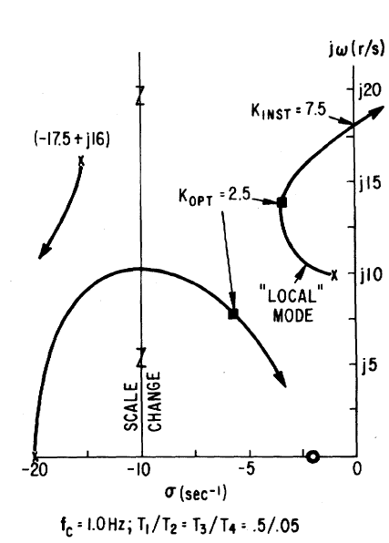
Stabilizer Design Tuning Criteria
Eigenvalues moves as K_{s} increases
A practical method is to find K_{INST}, then set K_{OPT} as about 1/3 to ½ of this value
  K_{OPT} is where the damping is maximized
  K_{INST} is the gain at which sustained oscillations or an instability occur

Slide 20
Stabilizer Design Tuning
Basic approach is to provide enhanced damping at desired frequencies; the challenge is power systems can experience many different types of oscillations, ranging from the high frequency local modes to the slower (< 1.0 Hz usually) inter-area modes
Usually the PSS should be set to compensate the phase so there is little phase lag at inter-area frequencies
  This can get modified slightly if there is a need for local stability enhancement
An approach is to first set the phase compensation, then tune the gain; this should be done at full output

Slide 21
PSS2A Example Values
Based on about 1000 WECC PSS2A models
  T₁=T₃ about 64% of the time and T₂=T₄ about 69% of the time
  The next page has a plot of the T1 and T2 values; the average T1/T2 ratio is about 6.4

Slide 22
Example T₁ and T₂ Values

Slide 23
PSS Tuning Example
Open the case wscc_9bus_Start, apply the default dynamics contingency of a self-clearing fault at Bus 8.
Use Modal Analysis to determine the major modal
frequency
and
damping

Slide 24
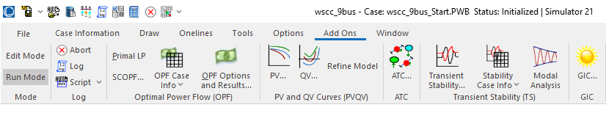
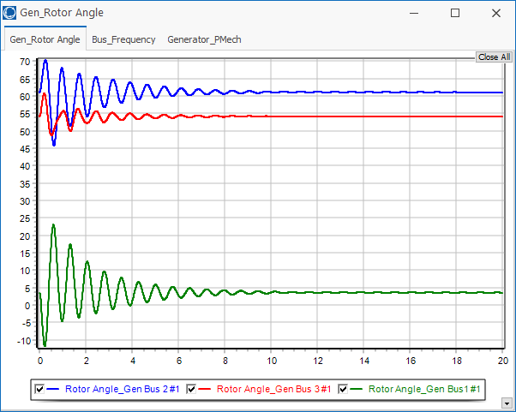
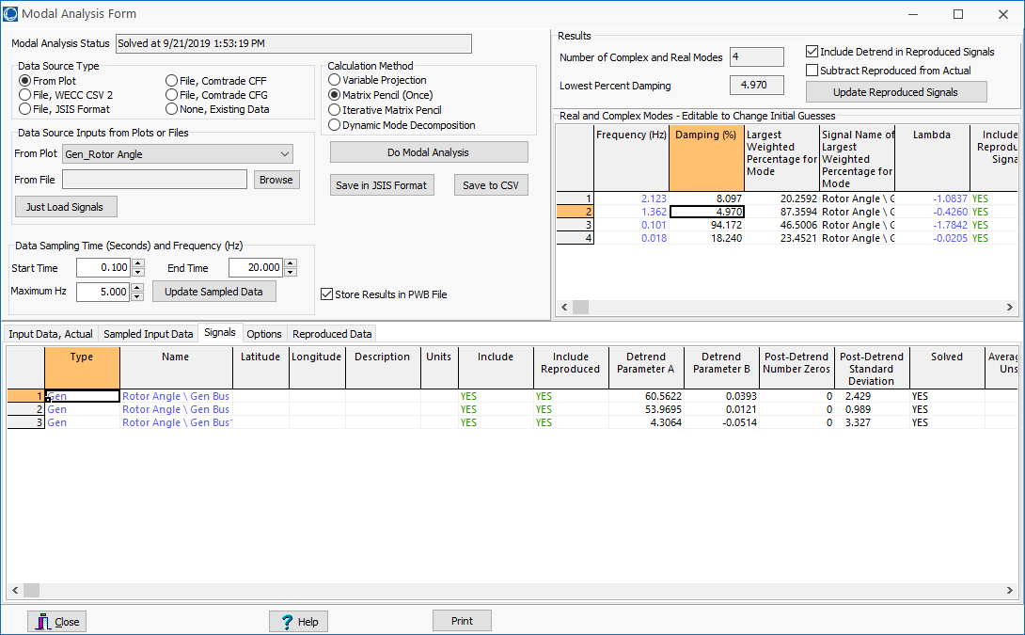
PSS Tuning Example:
Getting Initial Frequency and Damping
The Modal Analysis button provides quick access
  Frequency is
  1.36 Hz with
  5% damping
  Easy access to
  plot data

Slide 25
PSS Tuning Example:
We’ll Add PSS1As at Gens 2 and 3
To increase the generator speed damping, we’ll add PSS1A stabilizers using the local shaft speed as an input
First step is to determine the phase difference between the PSS output and the PSS input; this is the value we’ll need to compensate
This phase can be determined either
analytically, actually testing the
generator or using simulation results
  We’ll use
  simulation
  results

Slide 26
PSS Tuning Example:
Using Stabilizer Reference Signals
PowerWorld now allows reference sinusoidals to be
easily played into the stabilizer input
  This should be done at the desired modal frequency
Modal analysis can then be used to quickly determine the phase delay between the input and the signal we wish to damp
Open the case wscc_9Bus_Stab_Test
  This has SignalStab stabilizers modeled at each generator; these models can play in a fixed frequency signal

Slide 27
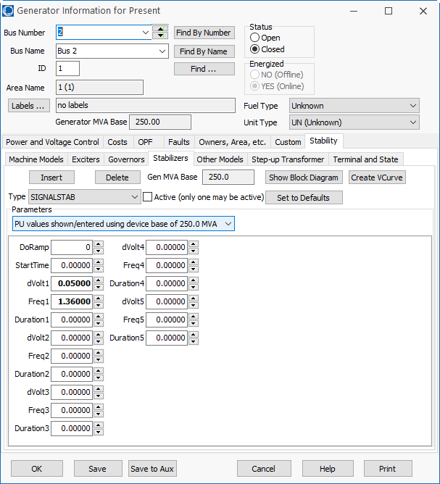
SignalStab Input and Results
Enable the SignalStab stabilizer at the bus 2 generator and run the simulation
  At time=0 the stabilizer receives a sinusoidal input with a magnitude of 0.05 and a frequency of 1.36 Hz

Slide 28
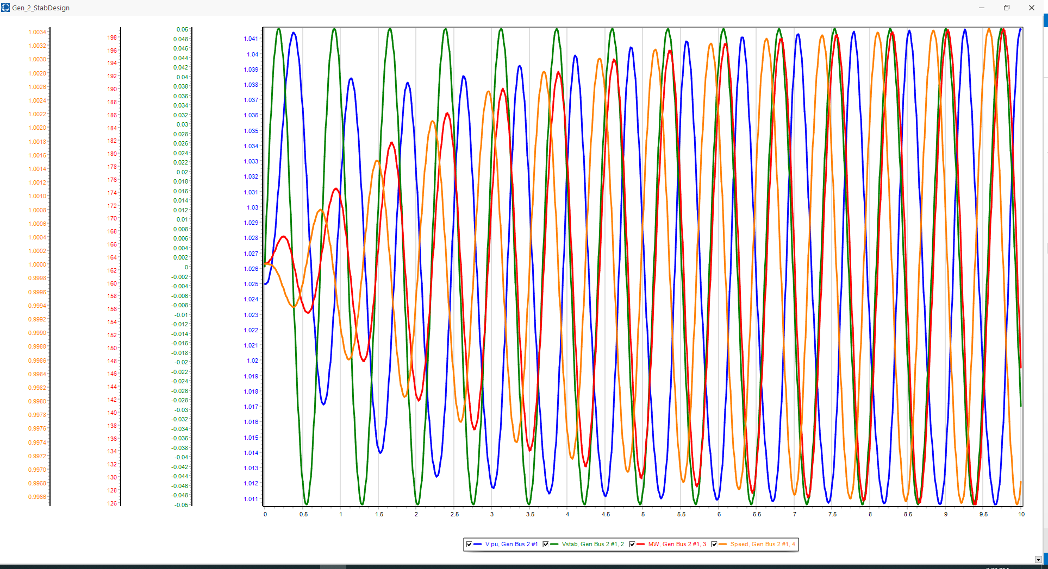
PSS Tuning Example:
Gen2 Reference Signal Results
Graph shows four signals at bus 2, including the stabilizer input and the generator’s speed
  The phase relationships are most important
  Use modal analysis to determine the exact phase values for the 1.36 Hz mode;
  analyze the data between 5 and 10 seconds

Slide 29
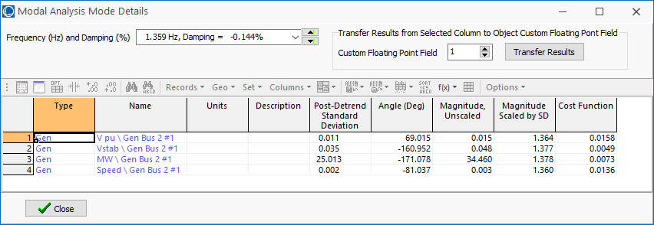
PSS Tuning Example:
1.36 Hz Modal Values
The change in the generator’s speed is driven by the stabilizer input sinusoid, so it will be lagging. The below values show is lags by
(-161+360) – (-81.0) = 280 degrees
  Because we want to damp the speed not increased it, subtract off 180 degrees to flip the sign. So we need 100 degrees of compensation; with two lead-lags it is 50 degrees each

Slide 30
PSS Tuning Example:
1.36 Hz Lead-Lag Values
In designing a lead-lag of the form
to have a specified phase shift of φ at a frequency f
the value of α is
In our example with φ = 50° then

Slide 31
PSS Tuning Example:
1.36 Hz Lead-Lag Values
In designing a lead-lag of the form
to have a specified phase shift of φ at a frequency f
The value of α is
In our example with φ = 50° then

Slide 32
PSS Tuning Example:
1.36 Hz Lead-Lag Values
Hence T₁=T₃=0.321, T₂=T₄=0.042. We’ll assumed T₆=0, and T₅=10, and A₁=A₂=0
The last step is to determine K_{s}. This is done by finding the value of K_{s} at just causes instability (i.e., K_{INST}), and then setting K_{s} to about 1/3 of this value
  Instability is easiest to see by plotting the output (V_{ST}) value for the stabilizer

Slide 33
PSS Tuning Example:
Setting the Values for Gen 2
Instability occurs with KS = 55, hence the optimal value is about 55/3=18.3
This increases the damping from 5% to about 16.7%
  This is saved as case
  WSCC_9bus_Stab

Slide 34
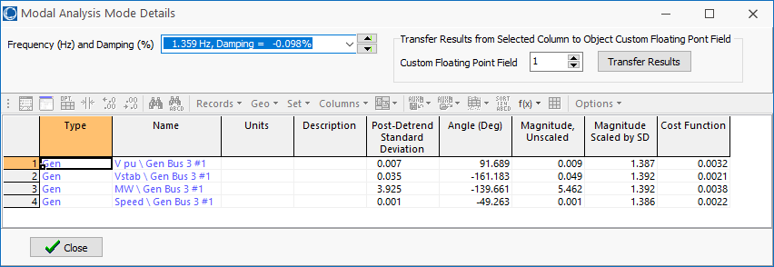
PSS Tuning Example:
Setting the Values for Gen 3
The procedure can be repeated to set the values for the bus 3 generator, where we need a total of 68 degrees of compensation, or 34 per lead-lag
The values are α = 0.283, T₁=0.22, T₂=0.062, K_{S} for the verge of instability is 36, so K_{S} optimal is 12.

Slide 35
PSS Tuning Example:
Final Solution
  With stabilizers at buses 2 and 3 the damping has been increased to 25.7%

Slide 36
Example 2: Adding a PSS to a 42 Bus System
Goal is to try to improve damping by adding one PSS1A at a large generator at Lion345 (bus 42)
  Example event is a three-phase fault is applied to the middle of the 345 kV transmission line between Prairie (bus 22) and Hawk (bus 3) with both ends opened at 0.05 seconds
  The starting case name is
  Bus42_PSS

Slide 37
Example 2: Decide Generators to Tune and Frequency
Generator speeds and rotor angles are observed to have a poorly damped oscillation around 0.6 Hz.

Slide 38
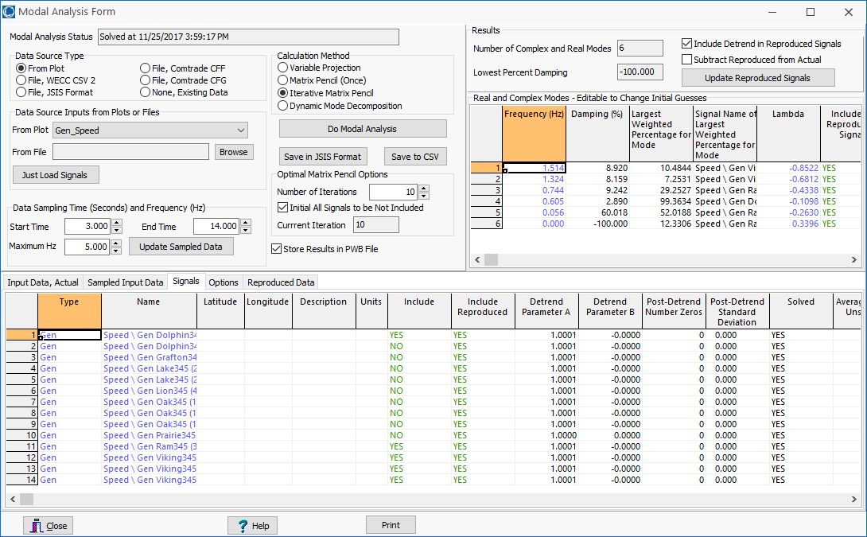
Example 2: Response Quantified Using Modal Analysis
  For 0.6 Hz mode the damping is 2.89%

Slide 39
Example 2: Determine Phase Compensation
Using a SignalStabStabilizer at bus 42 (Lion345), the phase lag of the generator’s speed, relative to the stabilizer input is 199 degrees; flipping the sign requires phase compensation of 19 degrees or 9.5 per lead-lag
Values are α = 0.72; for 0.6 Hz, T₁= 0.313, T₂=0.225; set T₃ and T₄ to match; gain at instability is about 450, so the gain is set to 150.
  The case with the test signal is Bus42_PSS_Test
  Adding this single stabilizer increases the damping to 4.24%

Slide 40
Example 2: Determine Phase Compensation Other Gens
Adding and tuning three more stabilizers (at Grafton345 and the two units at Lake345) increases the damping to 8.16%
  However, these
  changes are impacting
  modes in other
  areas of the system

Slide 41
Stability Phenomena and Tools
Large Disturbance Stability (Non-linear Model)
Small Disturbance Stability (Linear Model)
Structural Stability (Non-linear Model) Loss of stability due to parameter variations.
Tools
  Simulation
  Repetitive time-domain simulations are required to find critical parameter values, such as clearing time of circuit breakers.
  Direct methods using Lyapunov-based theory (Also called Transient Energy Function (TEF) methods)
    Can be useful for screening
  Sensitivity based methods.

Slide 42
Transient Energy Function (TEF) Techniques
No repeated simulations are involved.
Limited somewhat by modeling complexity.
Energy of the system used as Lyapunov function.
Computing energy at the “controlling” unstable equilibrium point (CUEP) (critical energy).
CUEP defines the mode of instability for a particular fault.
Computing critical energy is not easy.

Slide 43
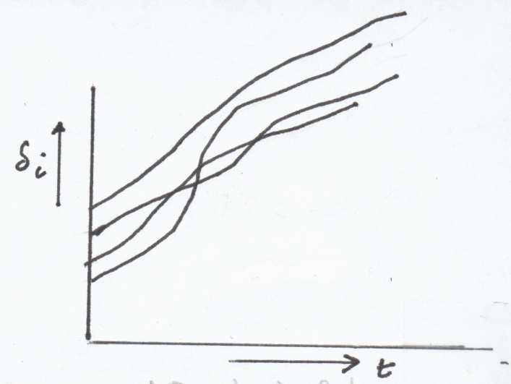
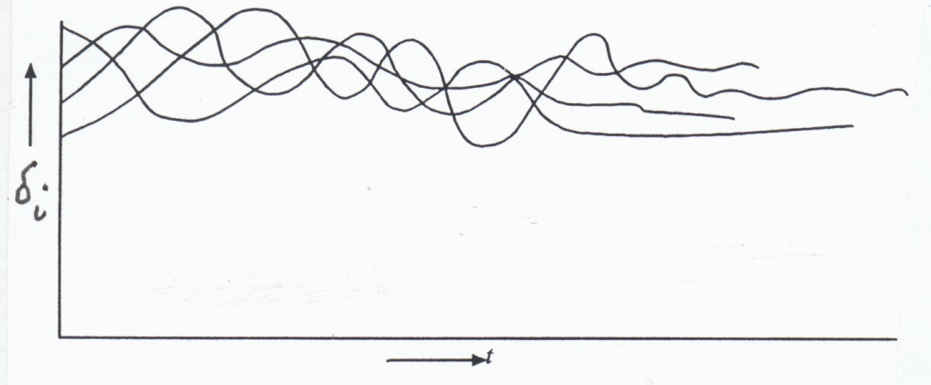
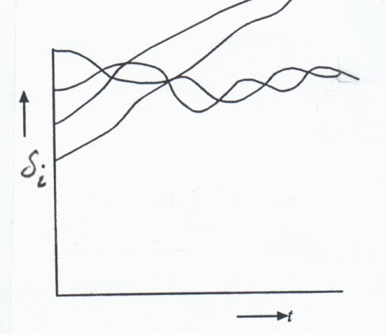
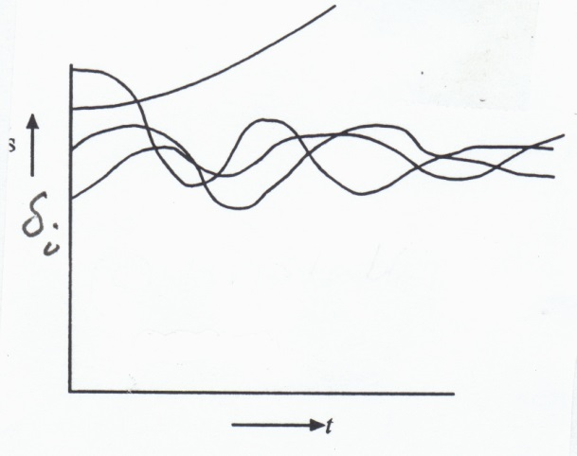
Judging Stability / Instability
Monitor Rotor Angles
(a) Stable
(b) Stable
(c) Unstable
(d) Unstable
Stability is judged by Relative Rotor Angles.

Slide 44
Mathematical Formulation
A power system undergoing a disturbance (fault, etc), followed by clearing of the fault, has the following model
  (1) Prior to fault (Pre-fault)
  (2) During fault (Fault-on or faulted)
  (3) After the fault (Post-fault)
T_{cl} is the clearing time
X
X
Post-Fault
(line-cleared)
Faulted

Slide 45
Critical Clearing Time
Assume the post-fault system has a stable equilibrium point x_{s}
All possible values of x(t_{cl}) for different clearing times provide the initial conditions for the post-fault system
  Question is then will the trajectory of the post fault system, starting at x(t_{cl}), converge to x_{s} as t → ∞
Largest value of t_{cl} for which this is true is called the critical clearing time, t_{cr}
The value of t_{cr} is different for different faults

Slide 46
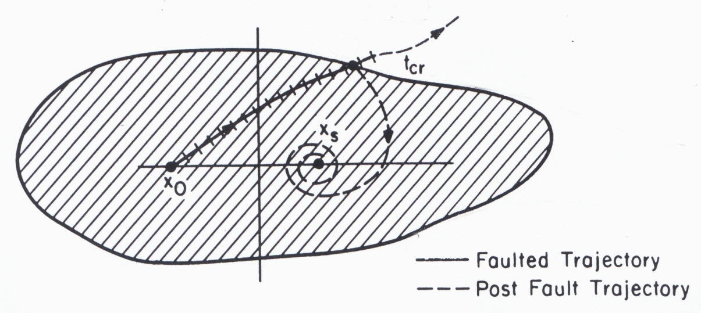
Region of Attraction (ROA)
All faulted trajectories cleared before they reach the
boundary of the ROA will tend to x_{s} as t→∞ (stable)
The region need not be closed; it can be open:
.
.

Slide 47
Methods to Compute RoA
Had been a topic of intense research in power system literature since early 1960’s.
The stable equilibrium point (SEP) of the post-fault system, x_{s}, is generally close to the pre-fault EP, x₀
Surrounding x_{s} there are a number of unstable equilibrium points (UEPs).
The boundary of ROA is characterized via these UEPs

Slide 48
Characterization of RoA
Define a scalar energy function V(x) = sum of the kinetic and potential energy of the post-fault system.
Compute V(x_{u,i}) at each UEP, i=1,2,…
Defined V_{cr} as
  RoA is defined by V(x) < V_{cr}
  But this can be an extremely conservative result.
Alternative method: Depending on the fault, identify the critical UEP, x_{u,cr}, towards which the faulted trajectory is headed; then V(x) < V(x_{u,cr}) is a good estimate of the ROA.

Slide 49
Lyapunov’s Method
Defining the function V(x) is a key challenge
Consider the system defined by
Lyapunov's method: If there exists a scalar function V(x) such that

Slide 50
Ball in Well Analogy
The classic Lyapunov example is the stability of a ball in a well (valley) in which the Lyapunov function is the ball's total energy (kinetic and potential)
For power systems, defining a true Lyapunov function often requires using restrictive models
UEP
UEP
SEP

Slide 51
Power System Example
Consider the classical generator model using an internal node representation (load buses have been equivalenced)
C_{ij} are the susceptance terms,
D_{ij} the conductance terms

Slide 52
Constructing the Transient
Energy Function (TEF)
The reference frame matters. Either relative rotor angle formulation, or COI reference frame.
  COI is preferable since we measure angles with respect to the “mean motion” of the system.
TEF for conservative system (i.e., zero damping)
With center of speed as
where
We then transform the variables to the
COI variables as
It is easy to verify

Slide 53
TEF
We consider the general case in which all M_{i}'s are finite. We have two sets of differential equations:
Let the post fault system has a SEP at
This SEP is found by solving

Slide 54
TEF
Steps for computing the critical clearing time are:
  Construct a Lyapunov (energy) function for the post-fault system.
  Find the critical value of the Lyapunov function (critical energy) for a given fault
  Integrate the faulted equations until the energy is equal to the critical energy; this instant of time is called the critical clearing time
Idea is once the fault is cleared the energy can only decrease, hence the critical clearing time is determined directly
Methods differ as to how to implement steps 2 and 3.

Slide 55
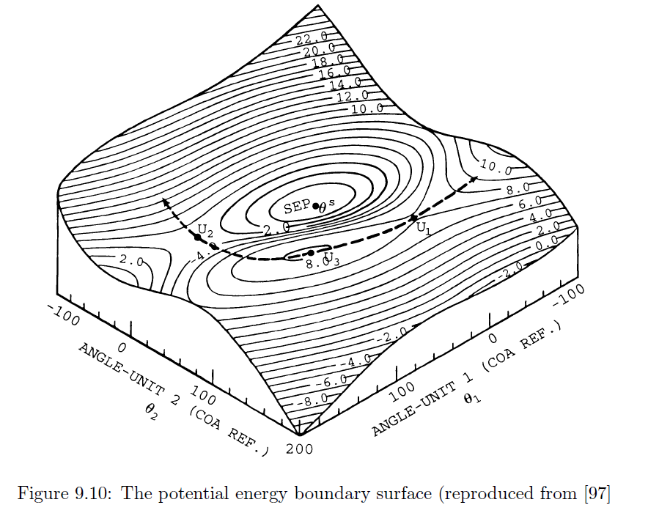
Potential Energy Boundary Surface
Figure from course textbook

