Slide 1
ECEN 667
Power System Stability
Lecture 6: Symmetrical Component Review, Stability Overview
Prof. Tom Overbye
Dept. of Electrical and Computer Engineering
Texas A&M University
overbye@tamu.edu

Slide 2
Announcements
Homework 1 is due today
Homework 2 is due on Thursday September 23
Read Chapter 3
The EPG dinner will again take place this semester, hosted by Dr. Begovic and his wife on Saturday September 25th from 5 to 7:30pm. This is for all EPG Faculty, Staff and Students including families (and anyone in 667 is eligible). The meal will be catered. However you must RSVP by Sept 21 at https://forms.gle/XyN3hc6Md1Mi3YUv9

Slide 3
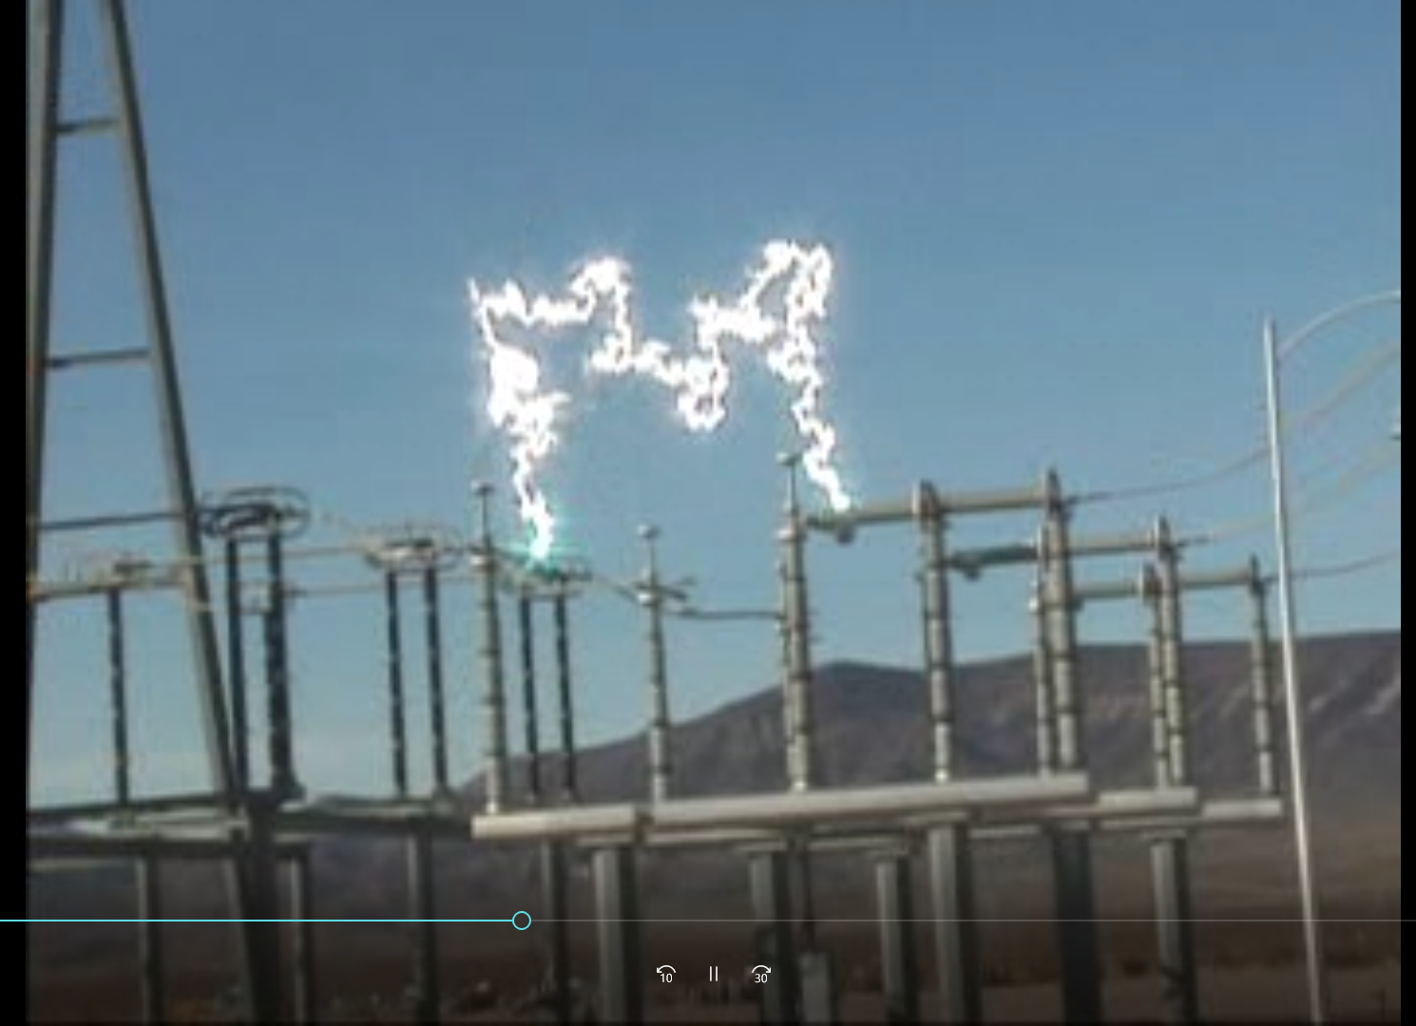
Aside: Ionized Air as a Conductor

Slide 4
2007 CWLP Dallman Accident
In 2007 there was an explosion at the Springfield, IL City Water Light Power (CWLP) 86 MW Dallman 1 generator. The explosion was eventually determined to be caused by a sticky valve that prevented the cutoff of steam into the turbine when the generator went off line. So the generator turbine continued to accelerate up to over 6000 rpm (3600 normal).
  High speed caused parts of the generator to shoot out
  Hydrogen escaped from the cooling system, and eventually escaped causing the explosion
  Repairs took about 18 months, costing more than $52 million

Slide 5
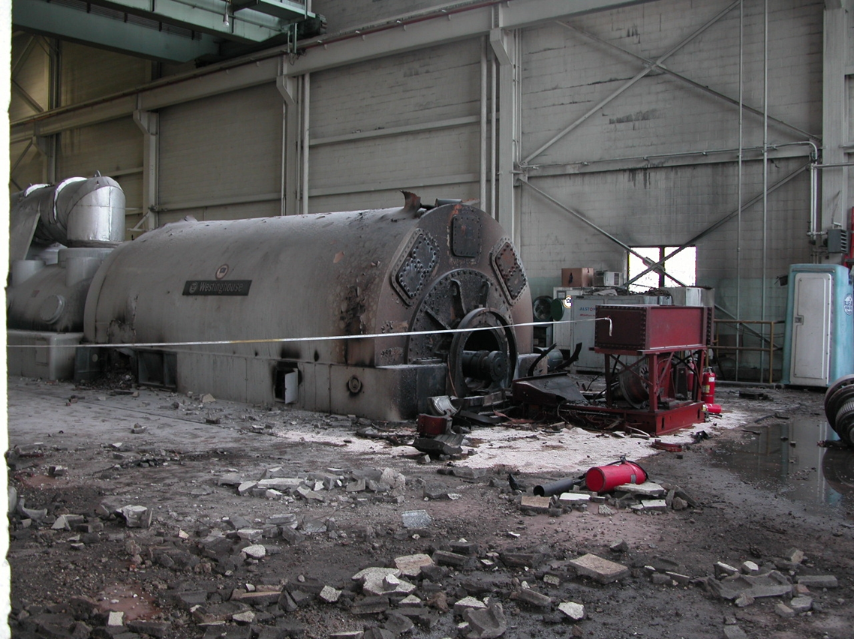
Dallman After the Accident

Slide 6
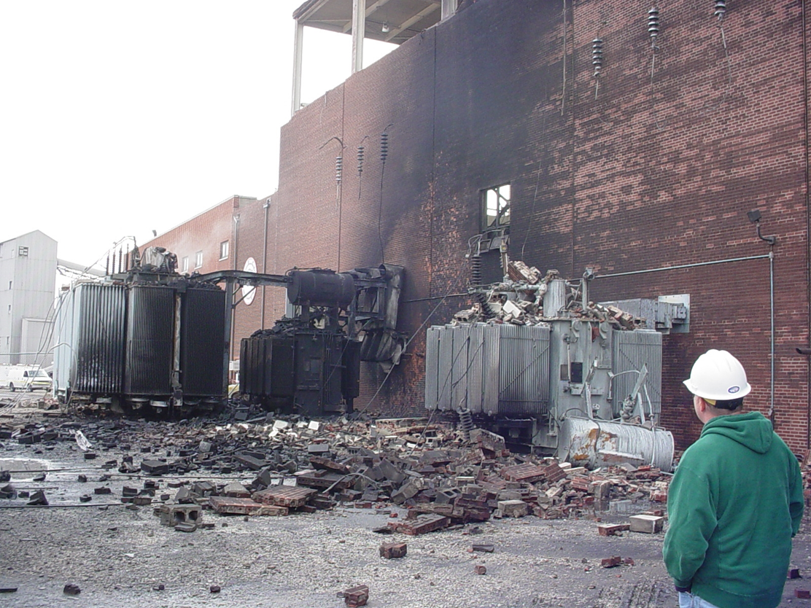
Outside of Dallman
CWLP retired
Dallman 1 and 2 at the end of 2020.

Slide 7
Symmetric Components
In 667 we won’t use symmetrical components once, but it is a key concept so I will briefly cover them
Much of power system dynamic analysis is done assuming the system is operated balanced, three-phase
However, we need to briefly consider unbalanced system operation, which certainly can occur during faults
  The most common fault is a single line-to-ground (SLG) fault, whereas three-phase faults are uncommon
Such systems can be analyzed using symmetrical components

Slide 8
Symmetric Components
The key idea of symmetrical component analysis is to decompose the system into three sequence networks. The networks are then coupled only at the point of the unbalance (i.e., the fault)
The three sequence networks are known as the
  positive sequence (this is the one for balanced systems)
  negative sequence
  zero sequence
Presented in paper by Charles .L Fortescue in 1918 (most important 20th century power paper)
Heydt, G. T.; Venkata, S. S.; Balijepalli, N. (October 24, 2000). "High Impact Papers in Power Engineering, 1900-1999" Proceedings 2000 North American Power Symposium, vol. 1, October 2000. North American Power Symposium (NAPS). Waterloo, Ontario.

Slide 9
Positive, Negative and Zero Sequence Sets
The positive sequence sets have three phase currents/voltages with equal magnitude, with phase b lagging phase a by 120°, and phase c lagging phase b by 120°
The negative sequence sets have three phase currents/voltages with equal magnitude, with phase b leading phase a by 120°, and phase c leading phase b by 120°
Zero sequence sets have three values with equal magnitude and angle

Slide 10
Symmetrical Component Conversion
Voltages and currents can be easily transformed between their phase and sequence values
With α = 1∠120°

Slide 11
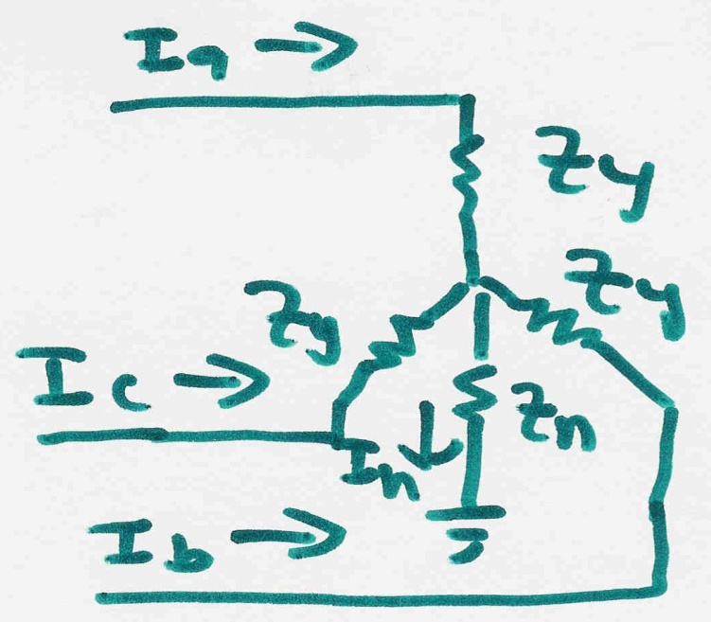
Symmetrical Components to Decouple Unbalanced Networks
Consider the following wye-connected load:

Slide 12
Symmetrical Components to Decouple Unbalanced Networks
This calculation is used in HW 2, Problem 1

Slide 13
Use of Symmetrical Components
Sequence models can be derived for lines, transformers, generators and loads
During normal operation only the positive sequence network is excited
The sequence networks get coupled because of the unbalances caused by faults
Usually we only analyze the positive sequence network; unbalanced faults can be modeled by compensated positive sequence values

Slide 14
Back to Simulations:
Changing the Case
PowerWorld Simulator allows for easy modification of the study system. As a next example we will duplicate example 13.4 from earlier editions of the Glover/Sarma Power System Analysis and Design Book.
Back on the one-line, right-click on the generator and use the Stability/Machine models page to change the Xdp field from 0.2 to 0.3 per unit.
On the Transient Stability Simulation page, change the contingency to be a solid three phase fault at Bus 3, cleared by opening both the line between buses 1 and 3 and the line between buses 2 and 3 at time = 1.34 seconds.

Slide 15
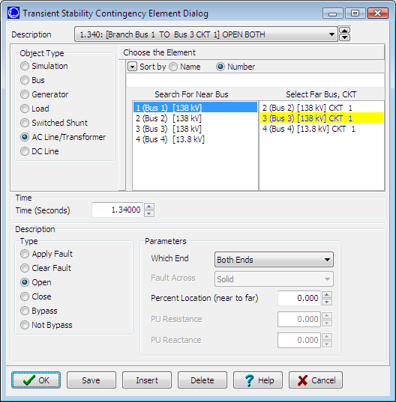
Changing the Contingency Elements
Change object type to AC Line/Transformer, select the right line,
and change the element type to “Open”.

Slide 16
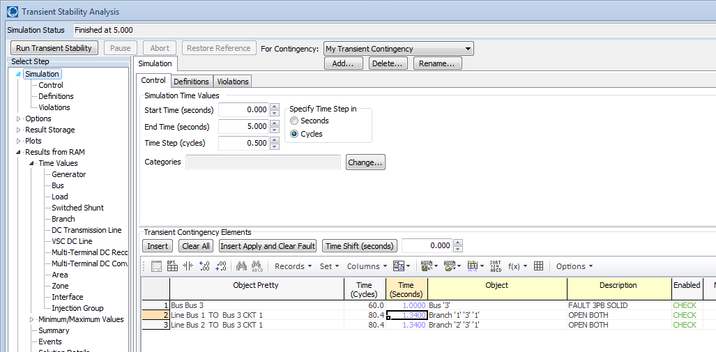
Changing the Contingency Elements
Contingency Elements displays should eventually look like this.
Note fault is at bus 3, not at bus 1.
Case Name: Example_13_4_Bus3Fault

Slide 17
Results: On Verge of Instability
Also note
that the
oscillation
frequency
has
decreased

Slide 18
A More Realistic Generator Model
The classical model is considered in section 5.6 of the book, as the simplest but also the hardest to justify
  Had been widely used, but is not rapidly falling from use
PowerWorld Simulator includes a number of much more realistic models that can be easily used
  Coverage of these models is beyond the scope of this intro
To replace the classical model with a detailed solid rotor, subtransient model, go to the generator dialog Machine Models, click “Delete” to delete the existing model, select “Insert” to display the Model Type dialog and select the GENROU model; accept the defaults.

Slide 19
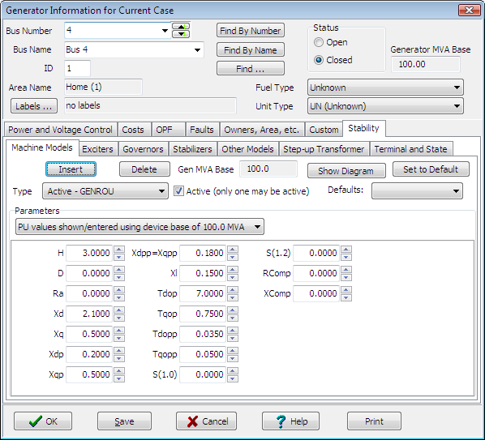
GENROU Model
The GENROU model
provides a good
approximation for the
behavior of a synchronous
generator over the dynamics
of interest during a
transient stability study
(up to about 10 Hz).
It is used to represent a
solid rotor machine with
three damper windings.
Notes:
18
18

Slide 20
Repeat of Example 13.1 with GENROU
This plot repeats the previous example with the bus 3 fault. The generator response is now damped due to the damper windings included in the GENROU model. Case is saved in examples as Example_13_4_GENROU.

Slide 21
Saving Results Every n Timesteps
Before moving on it will be useful to save some additional fields. On the Transient Stability Analysis form select the “Result Storage” page. Then on the Generator tab toggle the generator 4 “Field Voltage” field to Yes. On the Bus tab toggle the bus 4 “V (pu)” field to Yes.
At the top of the “Result Storage” page, change the “Save Results Every n Timesteps” to 6.
  PowerWorld Simulator allows you to store as many fields as desired. On large cases one way to save on memory is to save the field values only every n timesteps with 6 a typical value (i.e., with a ½ cycle time step 6 saves 20 values per second)

Slide 22
Plotting Bus Voltage
Change the end time to 10 seconds on the “Simulation” page, and rerun the previous. Then on “Results” page, “Time Values from RAM”, “Bus”, plot the bus 4 per unit voltage. The results are shown below.
Notice following
the fault the
voltage does
not recover to
its pre-fault value.
This is because
we have not
yet modeled an
exciter.

Slide 23
Adding a Generator Exciter
The purpose of the generator excitation system (exciter) is to adjust the generator field current to maintain a constant terminal voltage.
PowerWorld Simulator includes many different types of exciter models. One simple exciter is the IEEET1. To add this exciter to the generator at bus 4 go to the generator dialog, “Stability” tab, “Exciters” page. Click Insert and then select IEEET1 from the list. Use the default values.
Exciters will be covered in the first part of Chapter 4

Slide 24
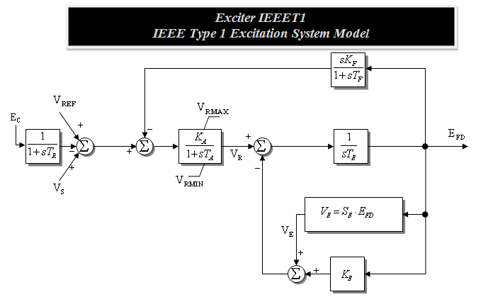
IEEET1 Exciter
Once you have inserted the IEEET1 exciter you can view its block diagram by clicking on the “Show Diagram” button. This opens a PDF file in Adobe Reader to the page with that block diagram. The block diagram for this exciter is also shown below.
The input to the exciter, E_{c},is usually the terminal
voltage. The output, E_{FD}, is the machine field voltage.

Slide 25
Voltage Response with Exciter
Re-do the run. The terminal time response of the terminal voltage is shown below. Notice that now with the exciter it returns to its pre-fault voltage.
Case Name: Example_13_4_GenROU_IEEET1

Slide 26
Defining Plots
Because time plots are commonly used to show transient stability results, PowerWorld Simulator makes it easy to define commonly used plots.
  Plot definitions are saved with the case, and can be set to automatically display at the end of a transient stability run.
To define some plots on the Transient Stability Analysis form select the “Plots” page. Initially we’ll setup a plot to show the bus voltage.
  Use the Plot Designer to choose a Device Type (Bus), Field, (Vpu), and an Object (Bus 4). Then click the “Add” button. Next click on the Plot Series tab (far right) to customize the plot’s appearance; set Color to black and Thickness to 2.

Slide 27
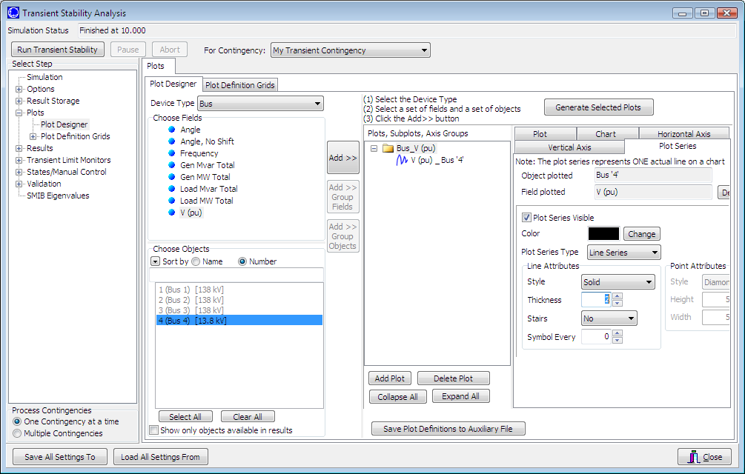
Defining Plots
Plot Designer tab
Plot Series tab
Plots Page
Customize
the plot
line.
Device
Type
Field
Object; note multiple objects and/or fields can be simultaneously
selected.
Notes:
26
26

Slide 28
Adding Multiple Axes
Once the plot is designed, save the case and rerun the simulation. The plot should now automatically appear.
In order to compare the time behavior of various fields an important feature is the ability to show different values using different y-axes on the same plot.
To add a new Vertical Axis to the plot, close the plot, go back to the “Plots” page, select the Vertical Axis tab (immediately to the left of the Plot Series tab). Then click “Add Axis Group”. Next, change the Device Type to Generator, the Field to Rotor Angle, and choose the Bus 4 generator as the Object. Click the “Add” button. Customize as desired. There are now two axis groups.

Slide 29
A Two Axes Plot
The resultant plot is shown below. To copy the plot to the windows clipboard, or to save the plot, right click towards the bottom of the plot. You can re-do the plot without re-running the simulation by clicking on “Generate Selected Plots” button.
Many plot options
are available
This case is saved as
Example_13_4_WithPlot

Slide 30
Setting the Angle Reference
Infinite buses do not exist, and should not usually be used except for small, academic cases.
  An infinite bus has a fixed frequency (e.g. 60 Hz), providing a convenient reference frame for the display of bus angles.
Without an infinite bus the overall system frequency is allowed to deviate from the base frequency
  With a varying frequency we need to define a reference frame
  PowerWorld Simulator provides several reference frames with the default being average of bus frequency.
  Go to the “Options”, “Power System Model” page. Change Infinite Bus Model to “No Infinite Buses”; Under “Options, Result Options”, set the Angle Reference to “Average of Generator Angles.”

Slide 31
Setting Models for the Bus 2 Gen
Without an infinite bus we need to set up models for the generator at bus 2. Use the same procedure of adding a GENROU machine and an IEEET1 exciter.
  Accept all the defaults, except set the H field for the GENROU model to 30 to simulate a large machine.
  Go to the Plot Designer, click on PlotVertAxisGroup2 and use the “Add” button to show the rotor angle for Generator 2. Note that the object may be grayed out but you can still add it to the plot.
  Without an infinite bus the case is no longer stable with a 0.34 second fault; on the main Simulation page change the event time for the opening on the lines to be 1.10 seconds (you can directly overwrite the seconds field on the display).
  Case is saved as Example_13_4_NoInfiniteBus

Slide 32
No Infinite Bus Case Results
Plot shows the
rotor angles for
the generators
at buses 2 and 4, along with the
voltage at bus 1.
Notice the two
generators
are swinging
against each other.

Slide 33
Impact of Angle Reference on Results
  To see the impact of the reference frame on the angles results, go to the “Options”, “Power System Model” page. Under “Options, Result Options”, set the Angle Reference to “Synchronous Reference Frame.”
This shows the more expected
results, but it is
not “more correct.” Both are equally correct.

Slide 34
WSCC Nine Bus, Three Machine Case
As a next step in complexity we consider the WSCC (now WECC) nine bus case, three machine case.
  This case is described in several locations including EPRI Report EL-484 (1977), the Anderson/Fouad book (1977). Here we use the case as presented as Example 7.1 in the Sauer/Pai text except the generators are modeled using the subtransient GENROU model, and data is in per unit on generator MVA base (see next slide).
  The Sauer/Pai book contains a derivation of the system models, and a fully worked initial solution for this case.
Case Name: WSCC_9Bus

Slide 35
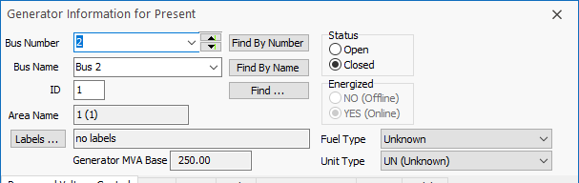
Generator MVA Base
Like most transient stability programs, generator transient stability data in PowerWorld Simulator is entered in per unit using the generator MVA base.
The generator MVA base can be modified in the “Edit Mode” (upper left portion of the ribbon), using the Generator Information Dialog. You will see the MVA Base in “Run Mode” but not be able to modify it.

Slide 36
WSCC Case One-line
The initial contingency
is to trip the generator
at bus 3. Select
Run Transient Stability
to get the results.

Slide 37
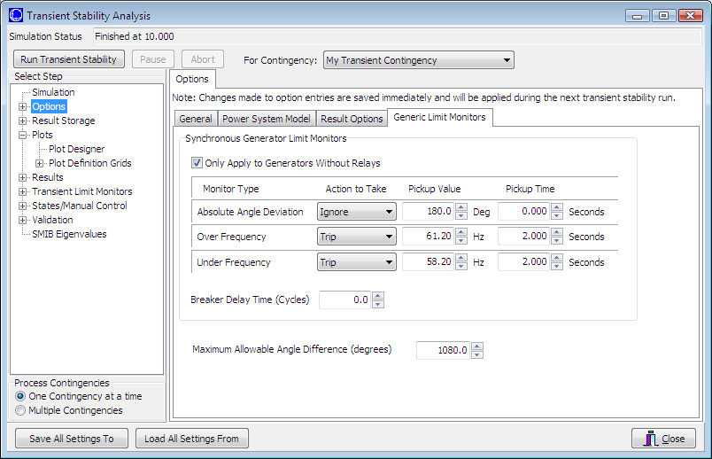
Automatic Generator Tripping
Sometimes unseen errors may lurk in a simulation!
Because this case has no governors and no infinite bus, the bus frequency keeps rising throughout the simulation, even though the rotor angles are stable. Users may set the generators to automatically trip in “Options”, “Generic Limit Monitors”.

Slide 38
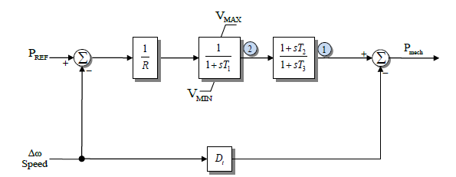
Generator Governors
Governors are used to control the generator power outputs, helping the maintain a desired frequency
Covered in sections 4.4 and 4.5
As was the case with machine models and exciters, governors can be entered using the Generator Dialog.
Add TGOV1 models for all three generators using the default values.

Slide 39
Additional WSCC Case Changes
Use the “Add Plot” button on the plot designer to insert new plots to show 1) the generator speeds, and 2) the generator mechanical input power.
Change contingency to be the opening of the bus 3 generator at time t=1 second. There is no “fault” to be cleared in this example, the only event is opening the generator. Run case for 20 seconds.
Case Name: WSCC_9Bus_WithGovernors

Slide 40
Generator Angles on Different Reference Frames
Average of Generator Angles
Reference Frame
Synchronous Reference
Frame
Both are equally “correct”, but it is much easier
to see the rotor angle variation when using the
average of generator angles reference frame

Slide 41
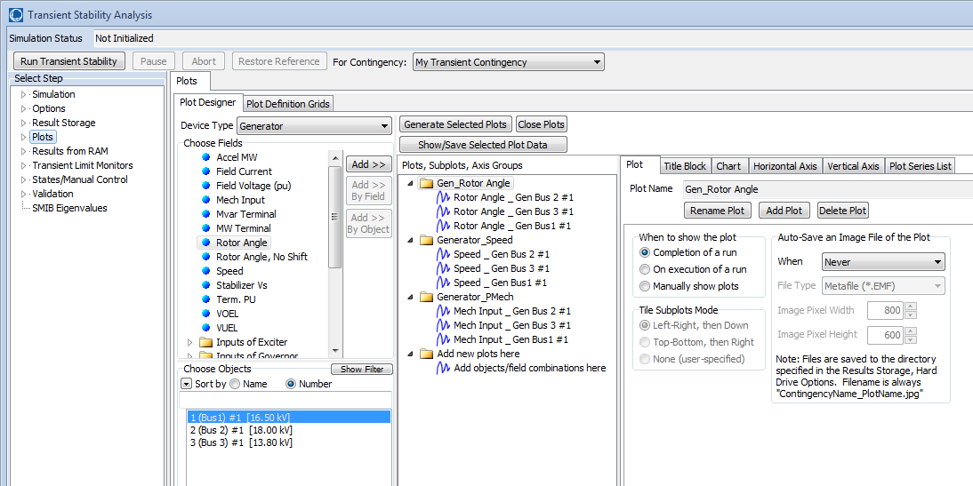
Plot Designer with New Plots
Note that when new plots are added using “Add Plot”, new Folders appear in the plot list. This will result in separate plots for each group

Slide 42
Gen 3 Open Contingency Results
The left figure shows the generator speed, while the right figure shows the generator mechanical power inputs for the loss of generator 3. This is a severe contingency since more than 25% of the system generation is lost, resulting in a frequency dip of almost one Hz. Notice frequency does not return to 60 Hz.

