Slide 1

Do North American Electric Grids have Distinct Inter-Area Electro-Mechanical Oscillation Modes?
Thomas J. Overbye
Department of Electrical and Computer Engineering
Texas A&M University
overbye@tamu.edu
Texas A&M Smart Grid Center Webinar
June 21, 2023

Slide 2
Overview
Electric grids are in a time of rapid transition, with lots of positive developments. It is a very exciting time to be in the field! However, there are also lots of challenges.
To meet these challenges, we need to widely leverage tools from other domains and make them useful
We also need to better understand our changing electric grids, following a quote widely attributed to Einstein that, “Everything should be made a simple as possible, but no simpler.”
This presentation looks into whether the electro-mechanical behavior of large-scale electric grids simulations can be adequately described by just a few linear modes
All simulations and visualizations are done with PowerWorld Simulator Version 23

Slide 3
Background
There is lots of prior work describing electric grid oscillations. A few examples for North American grid oscillations include
  F.R. Schleif, J.H. White, “Damping for the Northwest – Southwest Tieline Oscillations – An Analog Study,” IEEE Trans. Power App. & Syst., vol. PAS-85, pp. 1239-1247, Dec. 1966.
  Interconnection Oscillation Analysis, NERC, July 2019.
  J. Follum, T. Becejac, R. Huang, "Estimation of Electromechanical Modes of Oscillation in the Eastern Interconnection from Ambient PMU Data," 2021 IEEE Power & Energy Society Innovative Smart Grid Technologies Conference, Washington, DC, USA, Feb. 2021.
  Modes of Inter-Area Oscillations in the Western Interconnection, Western Interconnection Modes Review Group, WECC, 2021.
  R.T. Elliott, D.A. Schoenwald, “Visualizing the Inter-Area Modes of the Western Interconnection,” IEEE PES 2022 General Meeting, Denver, CO, July 2022.
  J. Follum, N. Nayak, J. Eto, “Online Tracking of Two Dominant Inter-Area Modes of Oscillation in the Eastern Interconnect,” 56th Hawaii International Conference on System Sciences, Lahaina, HI, Jan. 2023.

Slide 4
Background, cont.
In North American grids there are identified modes that have names, examples include
  WECC North-South A (NSA): Alberta vs System (0.20 to 0.30 Hz) (10 - 25% damping)
  WECC North-South B (NSB): Alberta vs BC+N US vs S US (0.35 to 0.45 Hz) (5-10%)
  WECC East-West A (EWA): Colorado + E. Wyoming vs System (0.35 to 0.45 Hz)
  WECC British Columbia A (BCA): BC vs N. US vs S. US (0.50 to 0.72 Hz)
  WECC BCB W. edge vs System vs E. edge (0.60 to 0.72 Hz)
  Eastern Interconnect (EI) Northeast vs South (NE-S) (0.15 to 0.22 Hz) (10 – 25%)
  EI Northeast vs Midwest (NE-MW) (0.18 to 0.27 Hz) (10 – 25%)
If they exist, at a particular operating point a mode will have a frequency, a damping and a shape, with these values changing some as the operating point changes

Slide 5
Background, cont.
Since the modes have been observed under many different conditions they have quite a bit of variability in their values. There could be two explanations for this, both of which are consistent with the observed results
  One explanation: at a particular operating point the North American grids have a few well-defined modes, with each mode having a frequency, damping and shape. As long as a disturbance excites the mode, it should be observed. The goal is to find these modes
  An alternative explanation: at a particular operating point the North American grids do not have a few well-defined modes. They certainly have oscillation patterns, but the frequency, damping and especially the shapes of these oscillations are disturbance dependent.
This presentation uses a simulation-based approach to try to answer this question. Simulations have lots of advantages, but the results are only as good as the simulation models

Slide 6
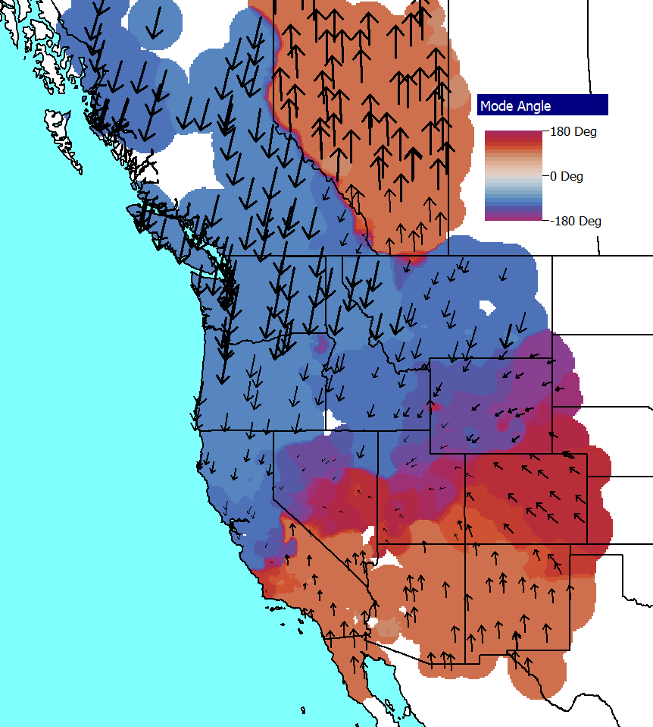
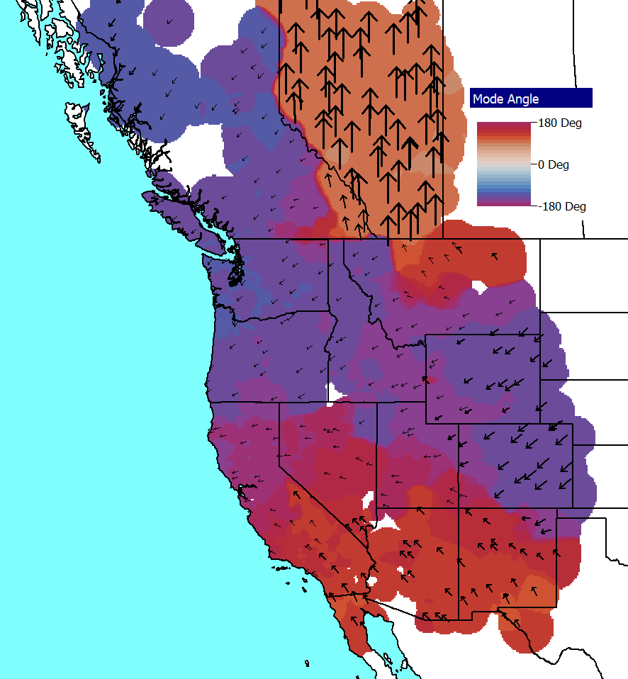
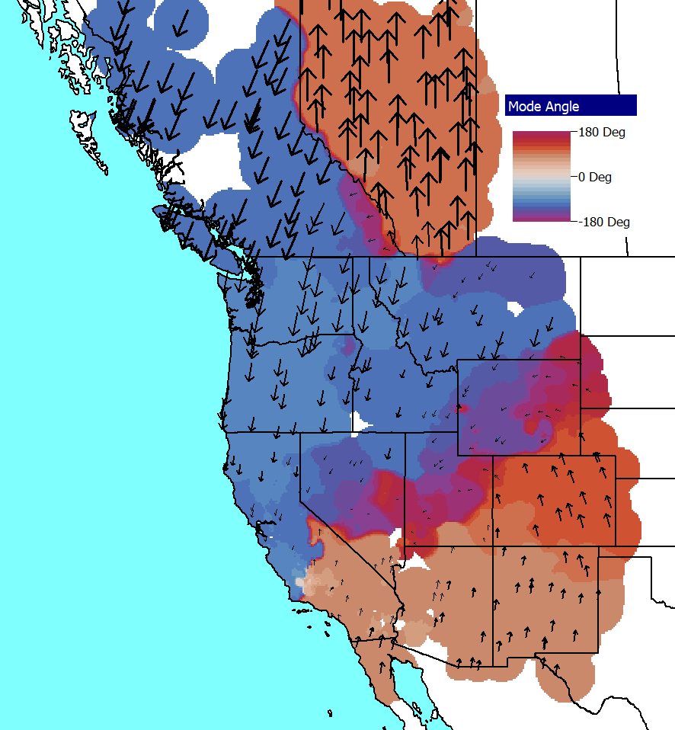
Motivating Example 1
Using a 2022 series, 25,000 bus WECC case at the same operating point for three different disturbances, the below modes are observed
Disturbance A,
0.35 Hz, 12.6%
Disturbance B, 0.34 Hz, 10.0%
Disturbance C,
0.37 Hz, 8.8%
What is required to say the grid has a particular mode?

Slide 7
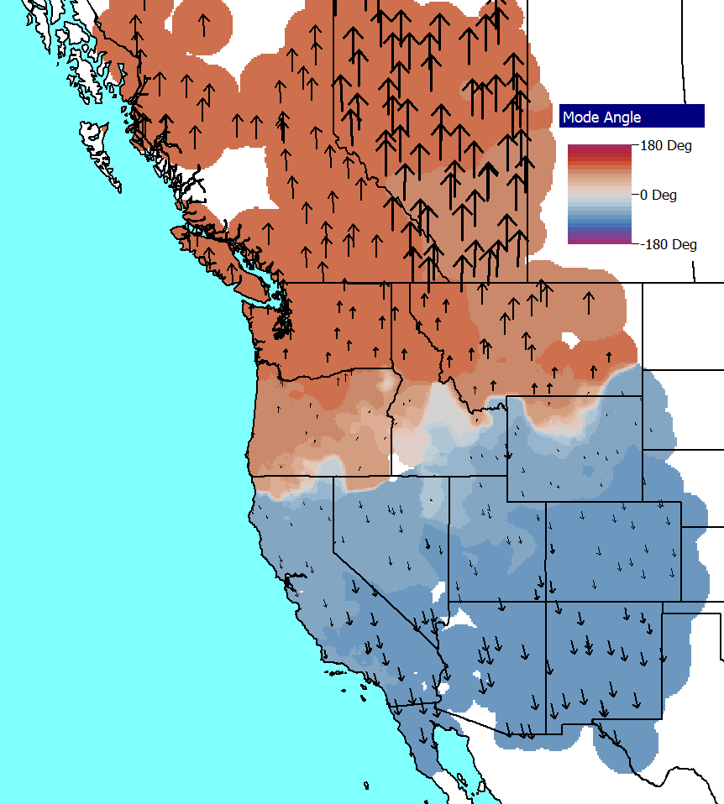
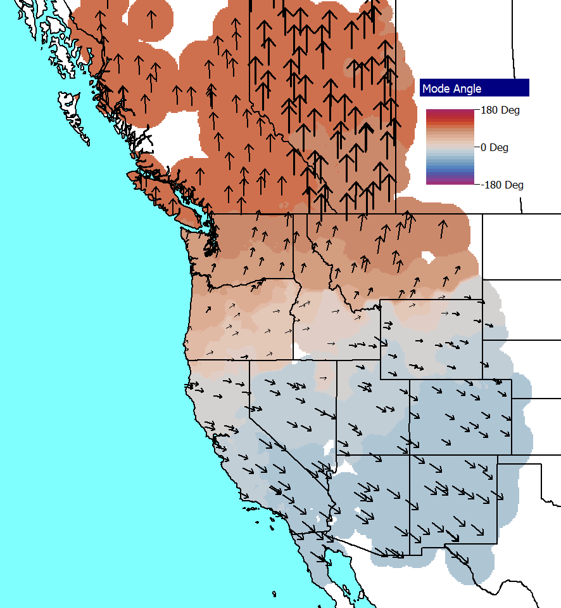
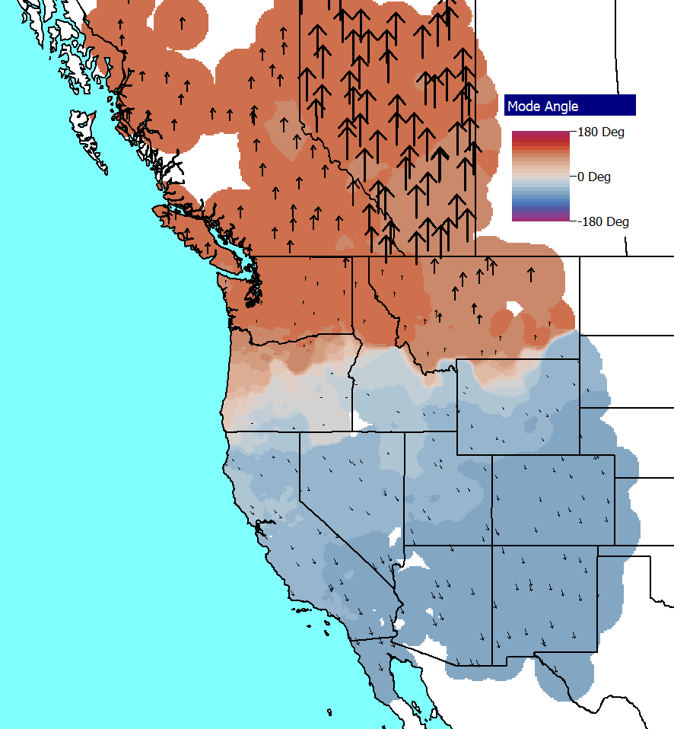
Motivating Example 2
Same operating point as Example 1
Disturbance A,
0.24 Hz, 15.5%
Disturbance B,
0.23 Hz, 11.6%
Disturbance C,
0.25 Hz, 5.0%
The results for these two examples are showing fairly consistent modes; these are the best observed ones in the WECC simulations

Slide 8
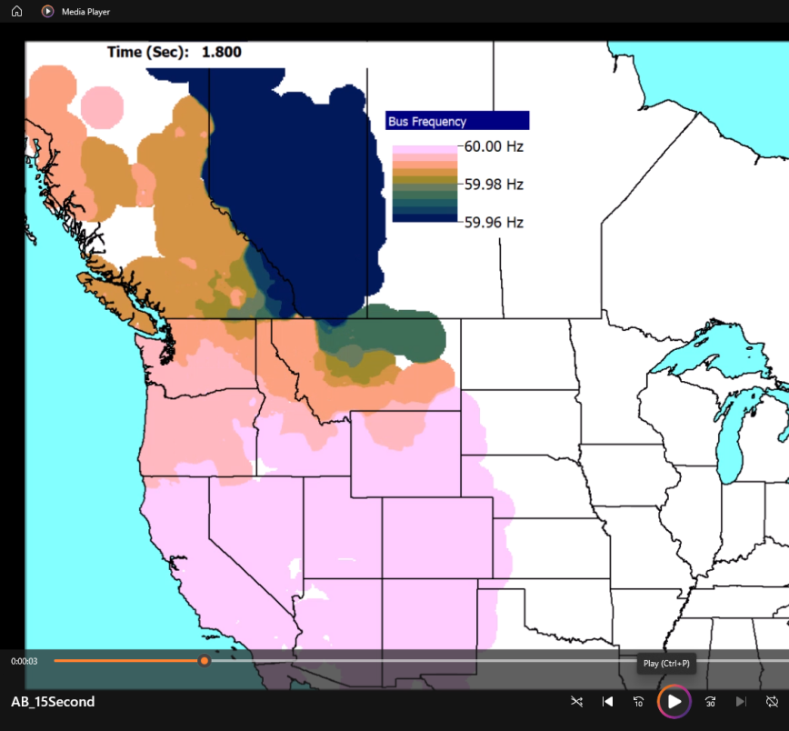
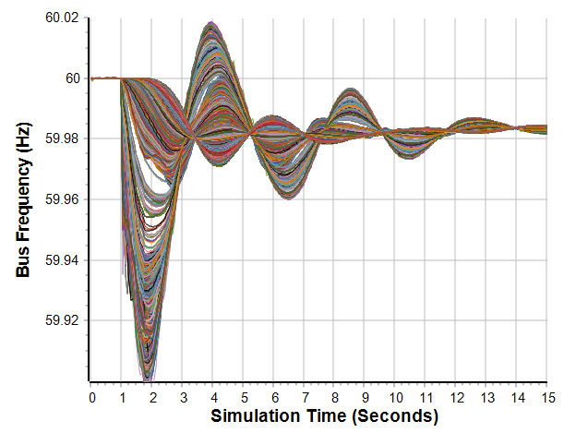
Motivating Example: WECC Disturbance Movie

Slide 9
Signals and Oscillations
The term “signal,” which has several definitions
  A definition from Merriam-Webster is “A detectable physical quantity or impulse by which messages or information can be transmitted.”
  A common electrical engineering definition is “any time-varying quantity”
The focus is on signals associated with electric grid oscillations
An oscillation is just a repetitive motion that can be either undamped, positively damped (decaying with time) or negatively damped
If the oscillation can be written as a sinusoid then
With damping
The percent damping is just the damping ratio multiplied by 100; goal is to have sufficient positive damping

Slide 10
Power System Oscillations
Power systems can experience a wide range of oscillations, ranging from highly damped and high frequency switching transients to sustained low frequency (< 2 Hz) inter-area oscillations affecting an entire interconnect
Types of oscillations include
  Transients: Usually high frequency and
  highly damped
  Local plant: Usually from 1 to 5 Hz
  Inter-area oscillations: From 0.15 to 1 Hz
  (the focus in this presentation)
  Slower dynamics: Such as AGC, less
  than 0.15 Hz
  Subsynchronous resonance: 10 to 50 Hz
  (less than synchronous)
Oscillation observed during 1996 WECC Blackout

Slide 11
Electric Grid Small Signal Analysis and Modes
Small signal analysis has been used for decades to help understand power system stability
  It is a model-based approach that considers the properties of a power system, linearized about an operating point
The method starts by assuming a power system is modeled as
If the system can be linearized about an equilibrium point, then
Eliminating Δy gives
Then look at the eigenvalues and vectors of A_{sys}

Slide 12
Electric Grid Small Signal Analysis
Assume A_{sys} has λ₁…λ_{n} as distinct eigenvalues (no repeated ones)
For each eigenvalue λ_{i} there exists an eigenvector such that
v_{i} is called a right eigenvector
If λ_{i} is complex, which is common with grids, then v_{i} has complex entries
For a disturbance, the deviation from an equilibrium is given as
The z_{i} terms are transformed state variables

Slide 13
Linear System Modes and Electric Grids
For each eigenvalue (or usually complex conjugate pair), the associated right eigenvector gives the mode shape, whereas the eigenvalue gives the associated frequency and damping
In a large grid there are many eigenvalues and hence many modes
However, most of these modes are local and not of concern here
The focus here is on the modes associated with the inter-area oscillations
  These modes have non-trivial values at many locations in a grid
Modes have been used to describe the behavior of some grids for decades
So why this presentation? Or stated another way, what assumptions in the previous description might not be true for an actual grid?

Slide 14
Electric Grids are Non-linear Systems
Electric grids are non-linear systems, and are likely becoming more non-linear with the rapid growth of inverter-based resources and other controls
  An increasing number of controls are either operated at limits, or will quickly reach a limit, meaning there might not be a valid linearization
  Deadbands and other nonlinear controls mean that the grid’s response to small perturbations can be quite different than its response to large disturbances
Hence there is a need to question the degree to which linear analysis techniques can be used to explain the behavior of modern grids
Even the linear system model has a number of modes that could be interacting
This questioning is facilitated by recent developments in measurement-based modal analysis

Slide 15
Measurement-Based Modal Analysis
In contrast to model-based small signal analysis, measurement-based modal analysis determines properties of a system from observations
  The inputs can either be measurements from devices (such as PMUs) or, as is the case here, stability simulation results
  The same approach can be used regardless of the measurement source
Measurement-based modal analysis approximates a signal by uniformly sampling it and then fitting it with a set of exponentials

Slide 16
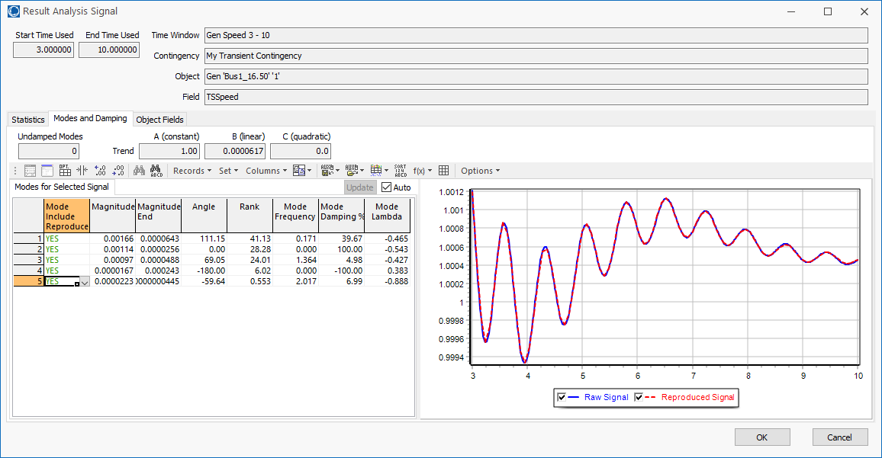
The Iterative Matrix Pencil (IMP) Method
There are several techniques for doing measurement-based modal analysis, with the Prony approach the oldest (from 1795)
If there is one signal each mode will have a 1) a frequency, 2) a damping, and 3) a complex number indicating the signal participation in the mode
For multiple signals the
participation is a vector
telling how each signal
participates in the mode(s)
The presentation uses the
Iterative Matrix Pencil (IMP)
method, which extends the
Matrix Pencil approach to
work well with a large
numbers of related signals

Slide 17
Approach: Use Ring-down to Test for Modes
Ring-down analysis seeks to determine the frequency and damping of key power system modes following some disturbance
If the modes exist, provided the disturbance excites the mode, it should be observed; the observed mode should not vary with the disturbance
Presentation tests this by doing modal analysis on a 2000 bus synthetic grid covering most of Texas, a 25,00 bus model of the WECC, and an 87,000 bus model of the North American Eastern Interconnect (EI)
  The WECC results uses a 2022 series model; the EI results are from 2019 series models
  For each grid different disturbances are applied to the same operating point

Slide 18
A Simulation-Based Approach
The advantage of using a simulation-based approach is a wide variety of disturbances can be applied to the same operating point; also all desired signals are available, with a focus here on the bus frequencies
In the presentation three types of disturbances are used
  Outage of one or more generators. The advantage is this is similar to actual grid disturbances, but a disadvantage is the outages are changing the operating point.
  Discrete change to one or more state variables, with the change here limited to the generator frequency. Then the grid rings-down to the same operating point. The advantage is the operating point is not changing.
  Inducing a forced oscillation at a specified frequency. The advantage is this can provide additional insight into the mode shape. A disadvantage is the mode damping cannot be determined and the frequency is the forced value.

Slide 19
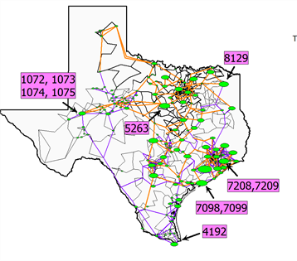
2000 Bus Synthetic Grid Example
The first example is on a 2000 bus synthetic (fictional) grid that covers most of Texas
  Grid has 544 generators and a
  total load of 67 GW
  It is designed using a 500/230/
  161/115 kV transmission system
  (the actual ERCOT grid uses
  345/138 kV transmission); orange
  lines show the 500 kV, purple the
  230 kV, and black for lower voltages
  In the oneline the green ovals show
  the location of the major generation,
  with the oval size proportional to the
  MW capacity
Available at electricgrids.engr.tamu.edu/

Slide 20
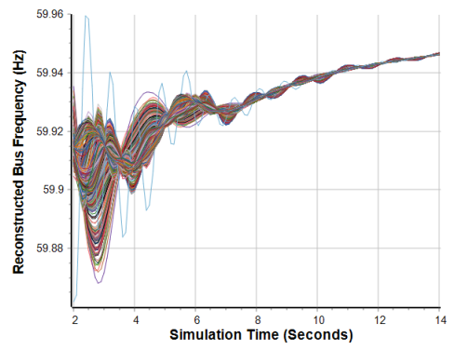
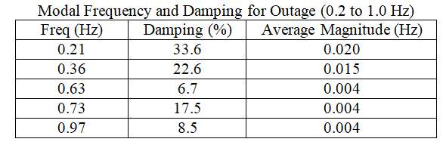
2000 Bus Example (1239 MW Gen at 7098 Outage)
Reproduced Frequencies
Over 2 to 14 Seconds
2000 Bus Frequencies
Visualized shape of the 0.36 Hz mode

Slide 21
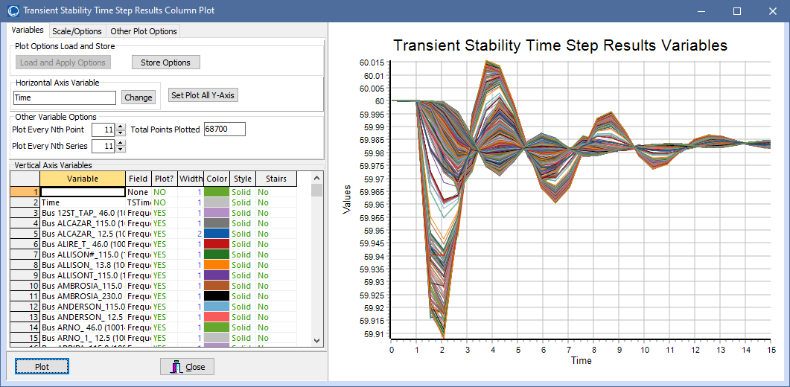
Aside: Show Graphs with Lots of Curves
This presentation makes use of graphs that show lots of curves (2000 in the below example, and tens of thousands later)
Purposes are to 1) show the overall response, and 2) verify there are no outliers; the purpose is obviously not to show any particular signal
In PowerWorld Simulator
a handy way to create
these graphs is to use
the Plot Every Nth Point
and Series values to
preview a plot with
much fewer points

Slide 22
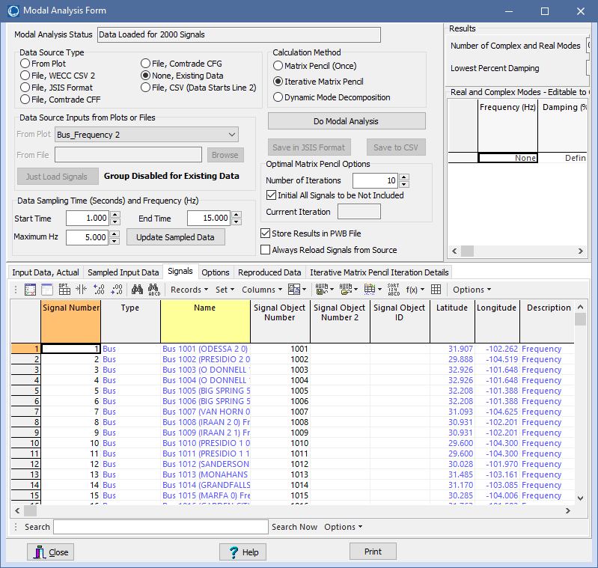
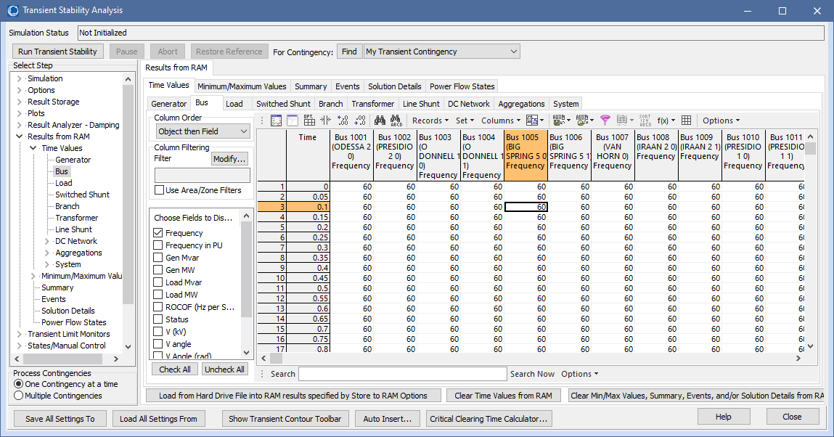
Using the Iterative Matrix Pencil to Get the Modes
In PowerWorld once a simulation is run, the modes can be easily determined using the build-in Iterative Matrix Pencil (IMP) tool
From the stability results right-click and select Modal Analysis All Columns to display the Modal Analysis Form

Slide 23
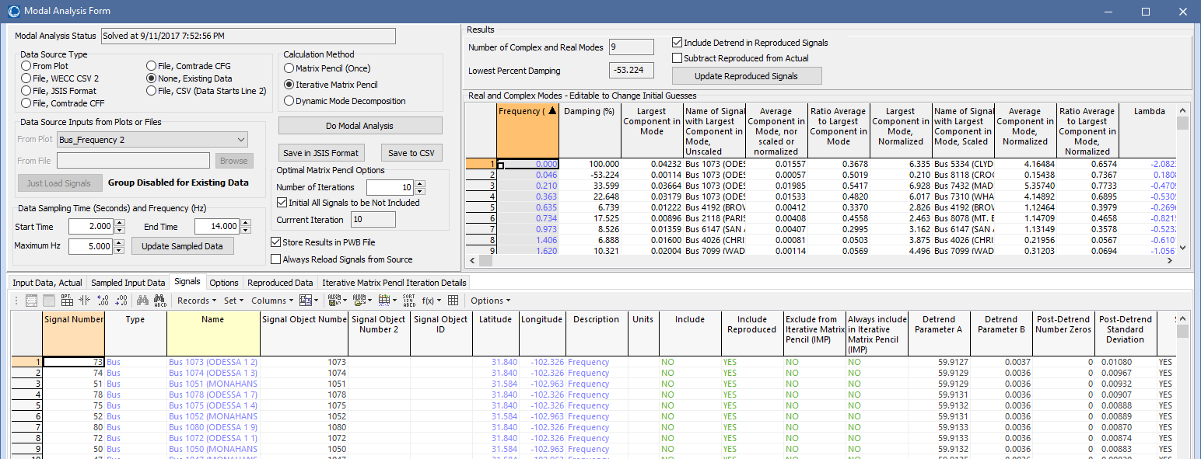
Modal Analysis Form
This form is used to do the IMP and visualize the results
The results are somewhat dependent upon the assumed start and end time
Click on a mode or signal for more details

Slide 24
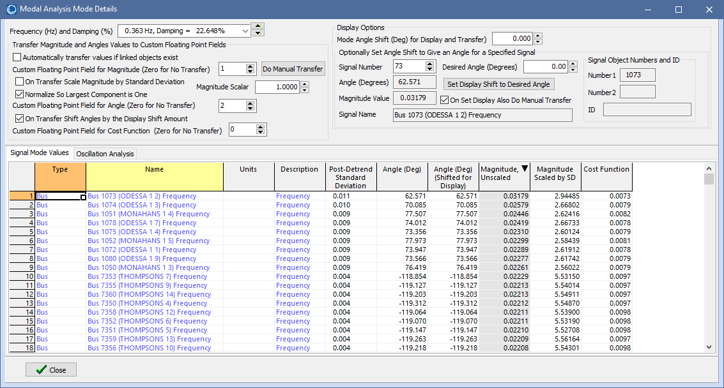
2000 Bus 0.36 Hz Mode
Allows an arbitrary shift for all the angles
This dialog allows transferring of the results back to the bus objects so they can be visualized using a geographic data view (GDV) including a bus angle contour

Slide 25
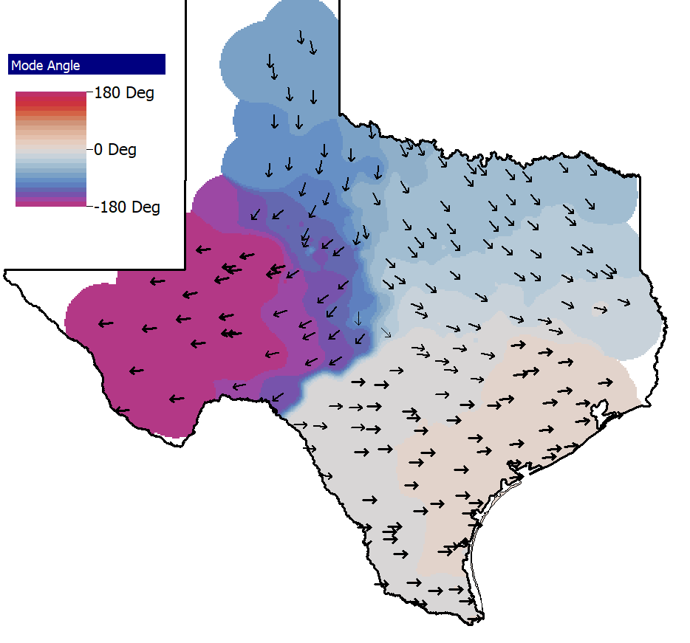
GDV Mode Visualization (Includes All 2000 Buses)
Displays show how the specified mode (0.363 Hz, 22.6% damping here) manifests in each signal. Left display it is showing data for all 2000 buses, which is too much information. The right display uses the “pruning” functionality to limit the number of displayed angles. Also it adds a contour and an arbitrary shift applied to all the angles.
Arrows are shifted
so the ones in South Texas point east (right)

Slide 26
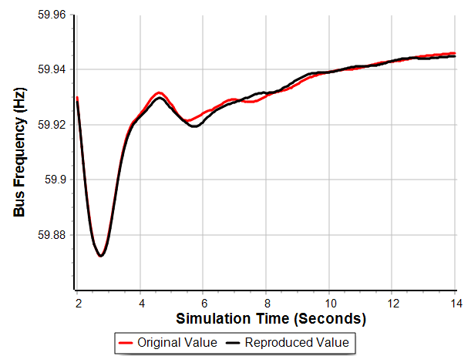
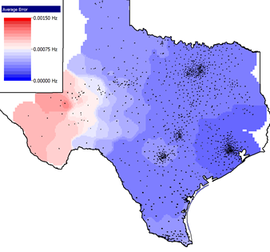
Quantifying the Error
Since the IMP calculates coefficients for each signal, an error for each can be defined as
For this example the
average error was
0.00025 Hz, with a
maximum of 0.0007 Hz
at Bus 1051
Bus 1051 comparison
(location of highest error)

Slide 27
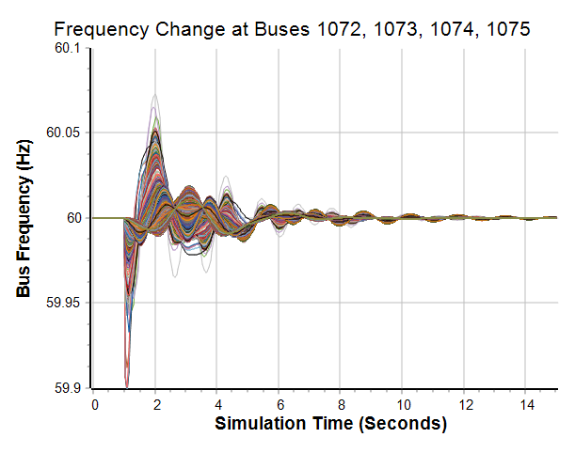
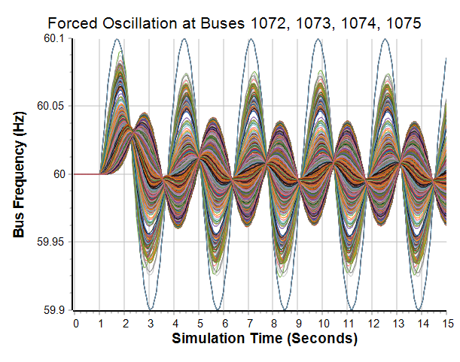
Other disturbances looking at 0.36 Hz Oscillation
The below examples show 1) frequency change at 1072-1075, and
2) a -0.1 Hz forced oscillation at 1072-1075
0.36 Hz, 25.2%
0.36 Hz, Forced
The right image is substantially changing the grid

Slide 28
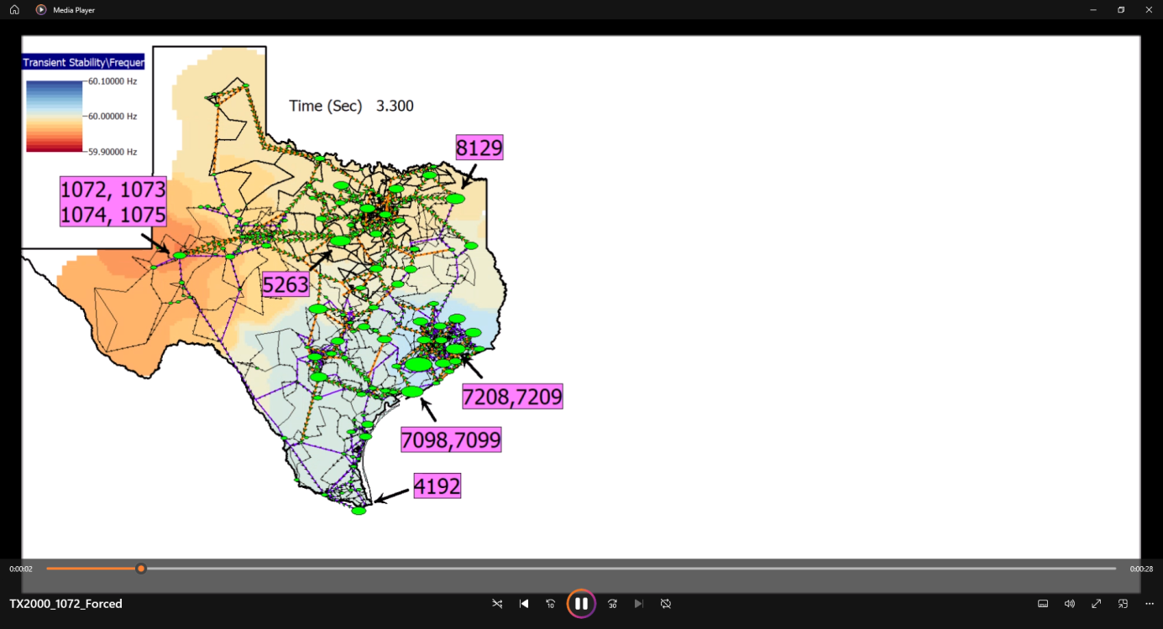
Far West Texas Forced Oscillation Movie

Slide 29
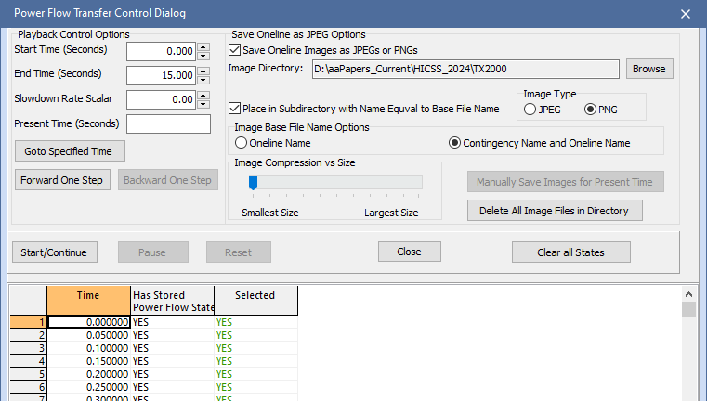
Making a Movie in PowerWorld
Create the desired movie oneline, often using bus or substation GDVs
On the Transient Stability Analysis Form, Options, General page, select Store Full Power Flow State on Update
  This stores the full power flow state as a specified frequency; required storage is about 100 bytes per bus per stored time point (2000*100*20*15 = 60MB)
Once the simulation is run, go to
Results From RAM, Power Flow
States and select Show Power
Flow Transfer Control Dialog
  Select the Save Oneline; best
  to use the *.png format
  Show oneline including its contour
  Click Start/Continue

Slide 30
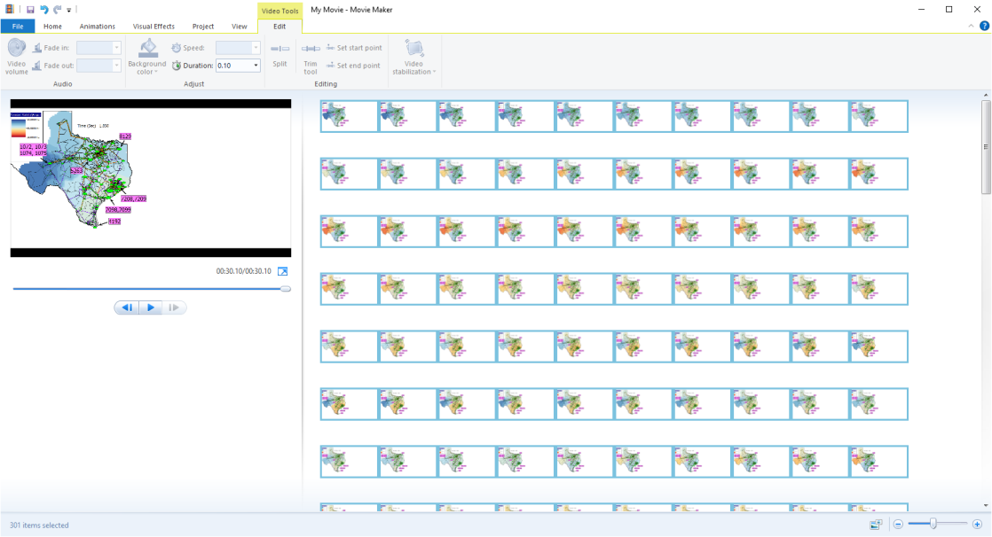
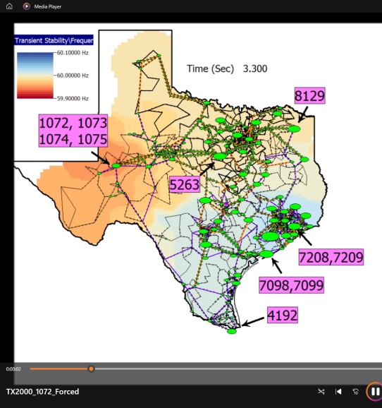
Making a Movie in PowerWorld, cont.
This stores a series of images (*.png files here) with the time in the filename. They can then be converted into a movie using a third-party tool (I have been using the old Microsoft Movie Maker, but there are many other newer tools)

Slide 31
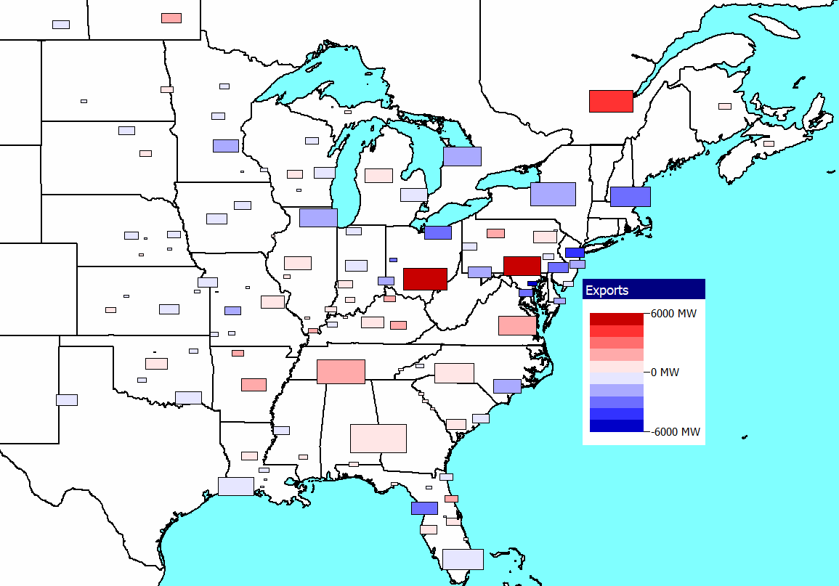
North American Eastern Interconnect Examples
The next examples are done using an 87,000 bus, 9500 generator, 130 area model of the North American Eastern Interconnect (EI). The stability simulations use 150 different mode types, 18,000 model instances and about 104,000 state variables
  Simulations are only done in the main island, so Quebec, while modeled, does not play a role
GDV visualization of the areas, with rectangle area proportional to generation, color indicates interchange

Slide 32
A Particular Focus is on Distinct Mode Existence
Earlier literature mentions
  Northeast vs South(NE-S) mode with a frequency of between 0.15 to 0.22 Hz,
  (10 – 25% damping)
  Northeast vs Midwest (NE-MW) mode with a frequency of between 0.18 to 0.27 Hz, (10 – 25% damping
Same procedure as before is used. That is, to apply a series of disturbances to the same operating point, calculate the modes using the IMP, and see if distinct modes are observed
  The same previous three disturbance types are used

Slide 33
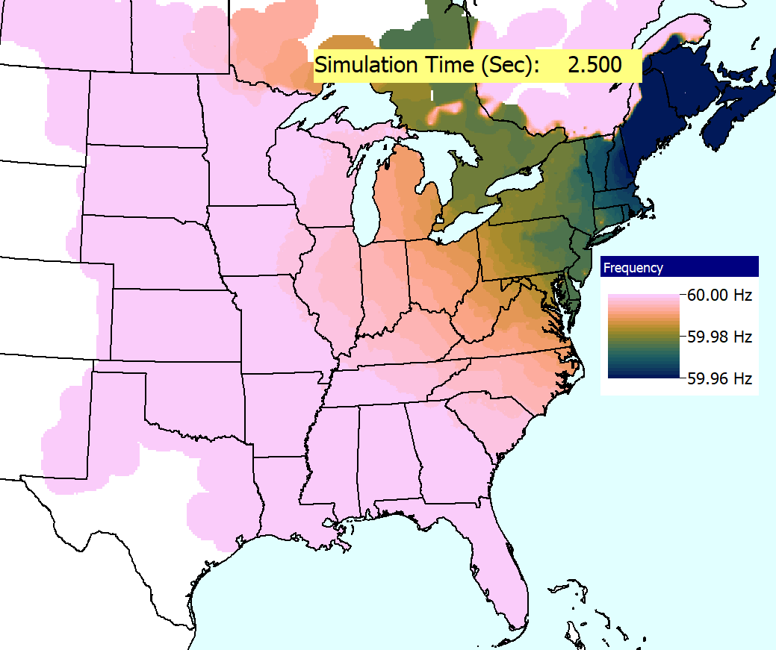
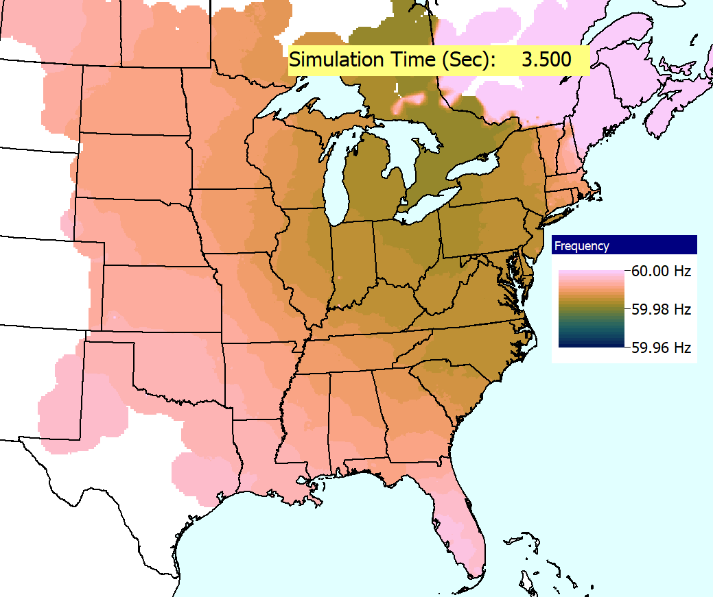
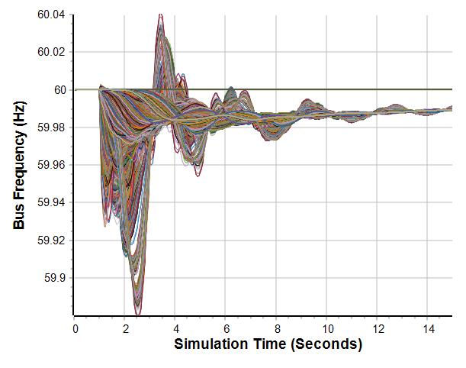
EI New England Generator Outage
First disturbance is the outage of a large generator in New England
Graph shows all 85,600
bus frequencies (Quebec was removed);
image has more than 20 million data points
Contour visualization of the spatial variation in the bus frequencies

Slide 34
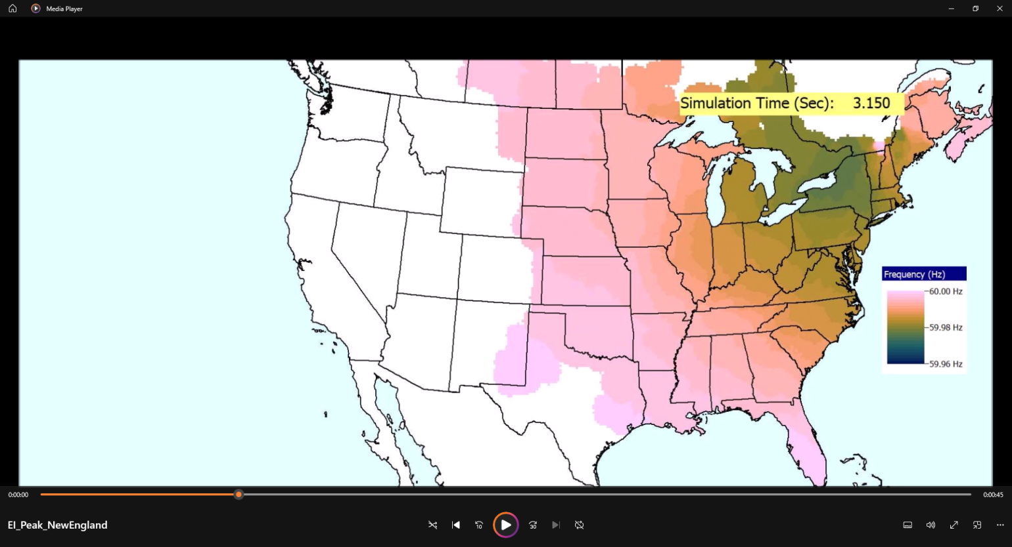
New England Disturbance Movie

Slide 35
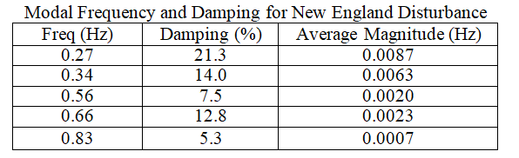
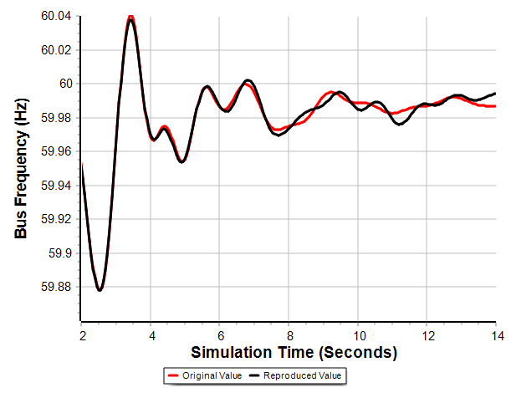
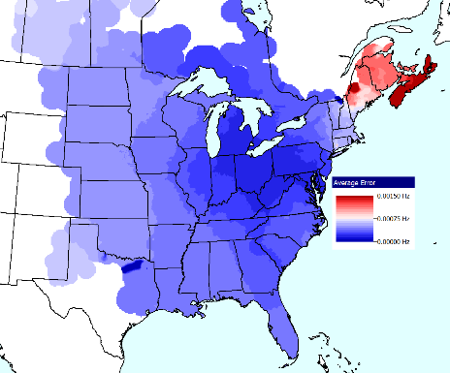
Iterative Matrix Pencil (IMP) Analysis
As before the IMP is used to determine the modes, using an analysis time of between 2.0 and 14.0 seconds
The average error was 0.00036 Hz with a high value of 0.0021 Hz (the 2K values were 0.00025 Hz and a high of 0.0007 Hz)
  Given it is a nonlinear model, we would not expect these to be zero
Error Contour
Bus with Worst Error

Slide 36
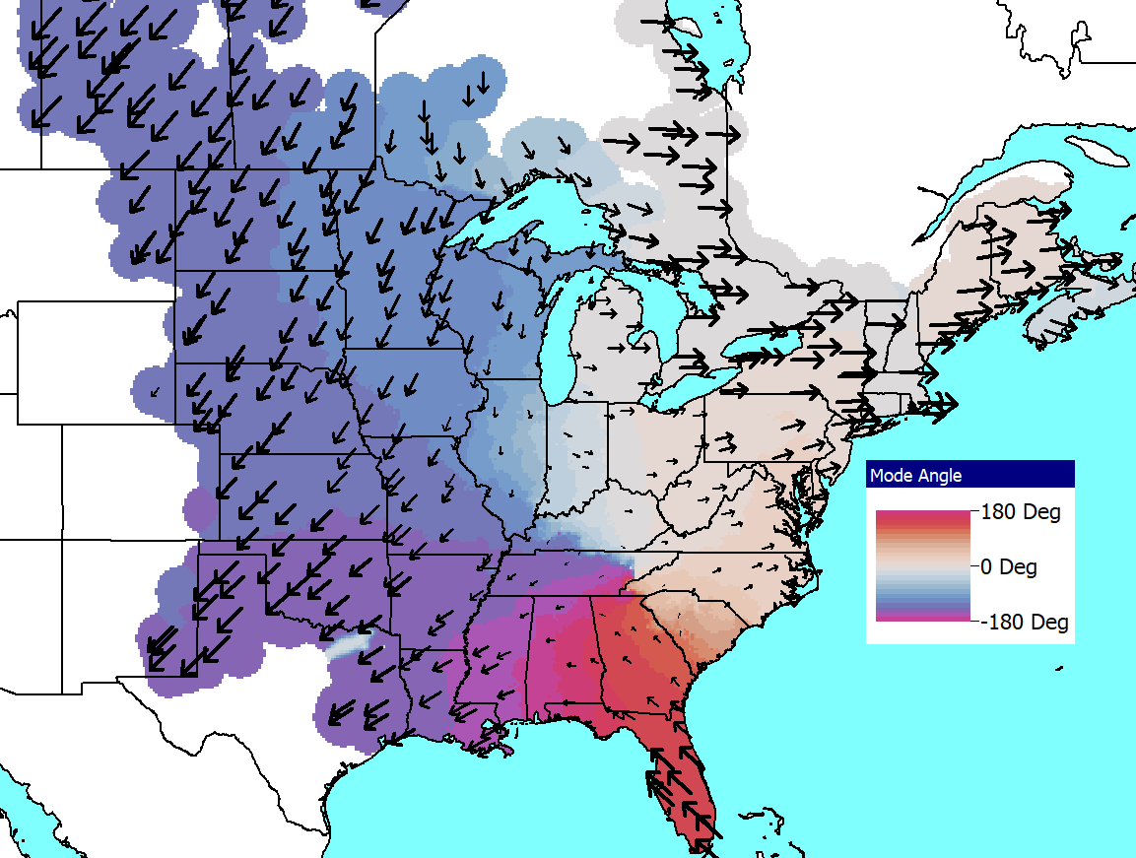
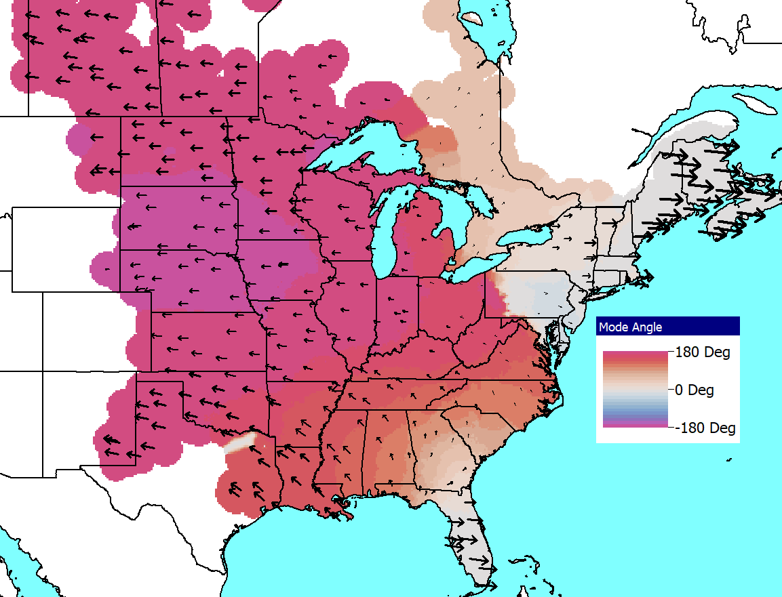
IMP Analysis of Potential 0.27 Hz Mode
Left image shows visualization of the 0.27 Hz mode (21.3%), while the right image shows a 0.25 Hz mode (20.2%) that is observed when the disturbance is changed to opening a generator in Nebraska

Slide 37
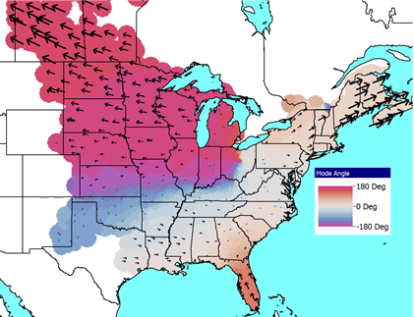
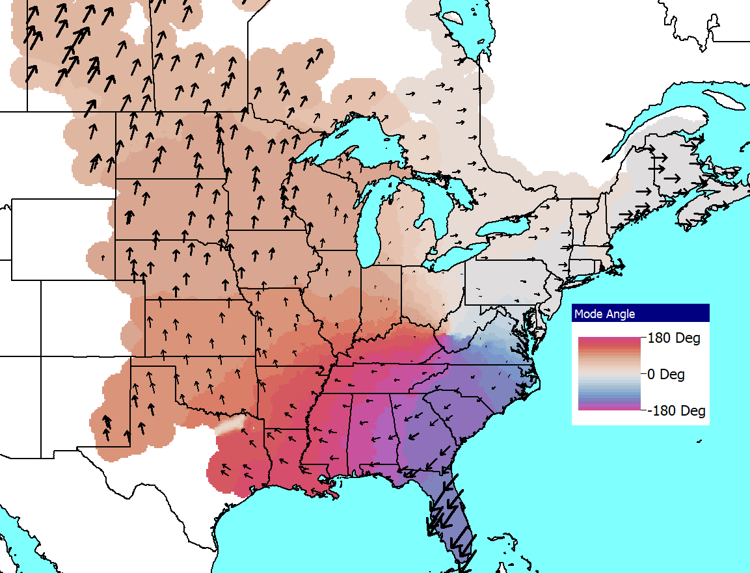
IMP Analysis of Mississippi and Florida
The same approach is applied to opening large generators in Mississippi (0.25 Hz with 23.5%) and Florida (0.23 Hz with 21.5%)

Slide 38
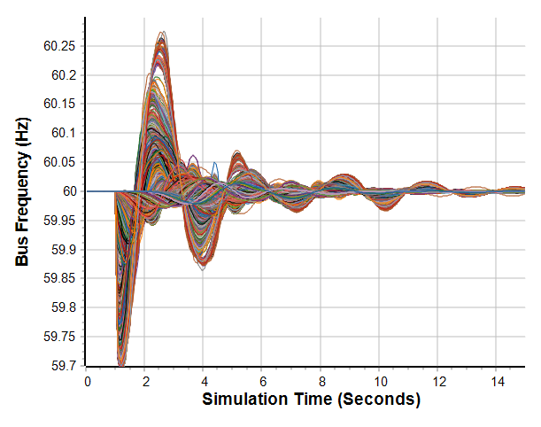
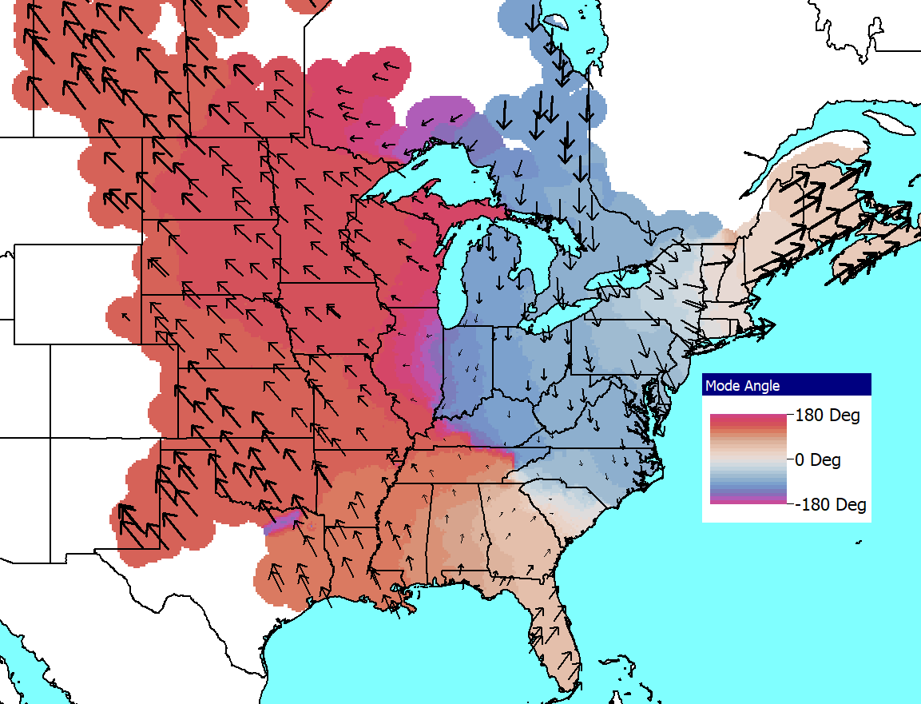
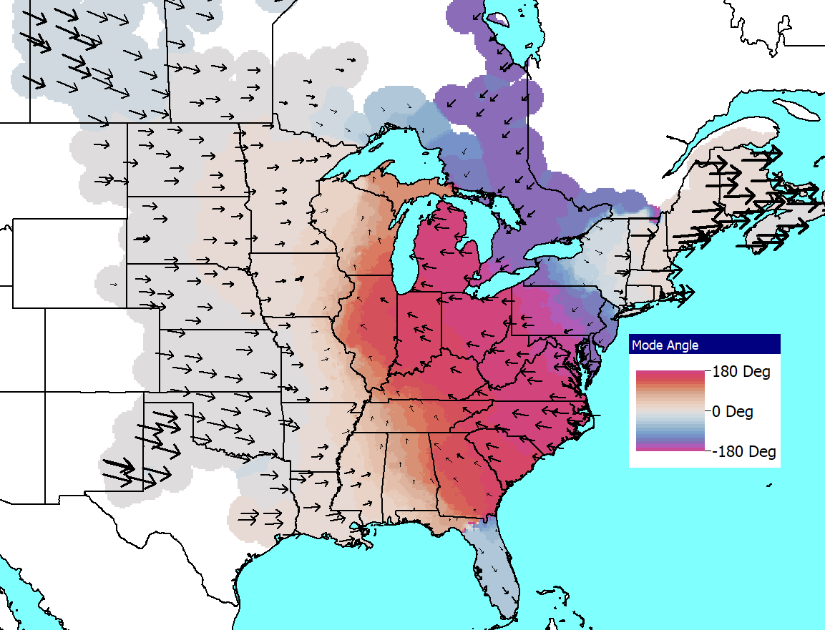
IMP New England, Just Frequency Change
Since opening generators changes the grid (albeit slightly in such a large grid), the frequency change disturbance can be used
0.22 Hz, 27.1% Damping
0.35 Hz, 15.0% Damping

Slide 39
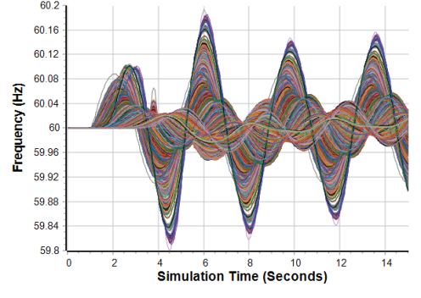
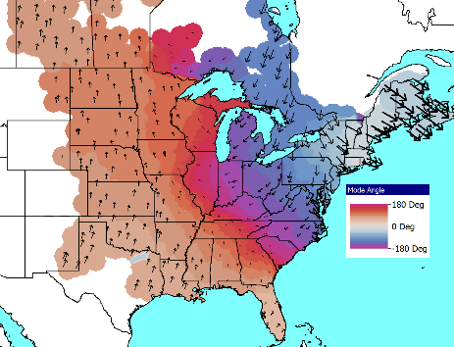
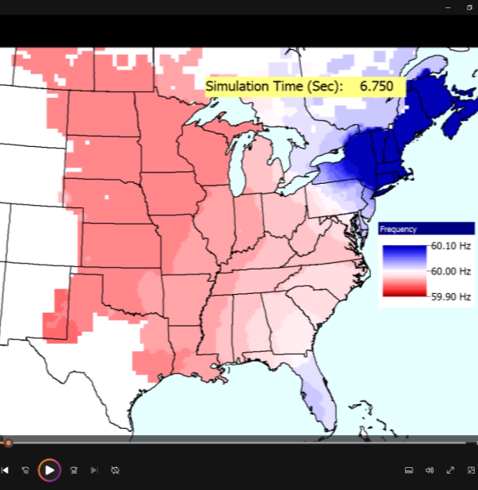
New England 0.27 Hz Forced Oscillation
The last disturbance is a 0.27 Hz forced oscillation in New England

Slide 40
Conclusion and Future Directions
Analyzing the dynamic respond of electric grids using the concept of modes has been a helpful approach for many years
The presentation used a measurement-based approach to test for the existence of modes in grids of sizes ranging from 2000 to 87,000 buses
There is good evidence for the existence of at least some distinct modes in the 2000 bus case and in the WECC; there is not strong evidence for the existence of such distinct modes in the EI, though there are certainly oscillations around the 0.21 to 0.27 Hz range with general patterns
Future work should 1) further explore the existence of modes, and look at if the modes are changing as more inverter-based resources are modeled, and 2) develop better large-scale synthetic grids with dynamics that mimic the complexity of the actual grids to allow broader research

Slide 41
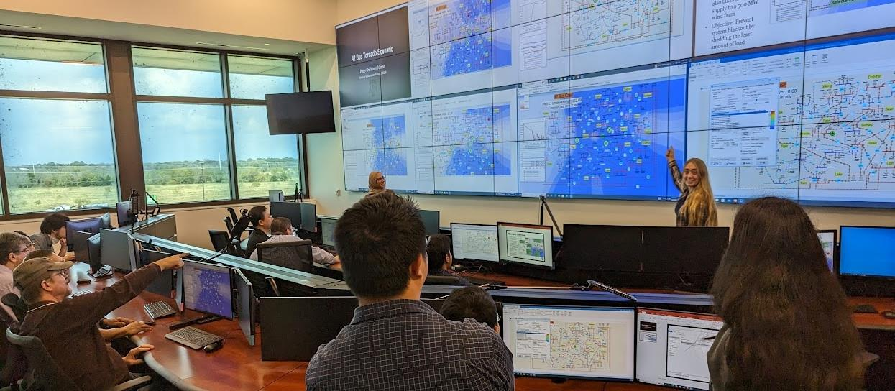
Thank You! Questions?
Related papers are available at overbye.engr.tamu.edu/publications/
(some of this works in our KPEC 2023 paper (number 3 in 2023 on the above site)

