Slide 1
ECEN 667
Power System Stability
Lecture 2: Numeric Solution of Differential Equations
Prof. Tom Overbye
Dept. of Electrical and Computer Engineering
Texas A&M University
overbye@tamu.edu

Slide 2
Announcements
Start reading Chapters 1 and 2 from the book (Chapter 1 is Introduction, Chapter 2 is Electromagnetic Transients)
EPG Dinner is on September 9 at 5pm; please RSVP using the link that was emailed to all.

Slide 3
Sources of Technical Information
There are many sources of technical information, with many students are most familiar with textbooks and courses
Journals, conferences, reports, and presentations (e.g., webinars) are extremely useful additional sources
In rough order of the newest of the information (from oldest to newest)
  Books including textbooks; often lectures (depending on the instructor); reports
  Journals, Conferences; both can have peer review
  Webinars, and industry periodicals
Many are available open access. However, the challenge is ultimately someone needs to cover the publication expenses.
TAMU students can access IEEE Xplore at ieeexplore.ieee.org/Xplore/home.jsp

Slide 4
Slow versus Fast Dynamics
Key analysis question in setting up and solving models is to determine the time frame of interest
Values that change slowing (relative to the time frame of interest) can be assumed as constant
  Power flow example is the load real and reactive values are assumed constant (sometimes voltage dependence is included)
Values that change quickly (relative to the time frame of interest) can be assumed to be algebraic
  A generator's terminal voltage in power flow is an algebraic constraint, but not in transient stability
  In power flow and transient stability the network power balance equations are assumed algebraic

Slide 5
Dynamics Example 1
1996: Transient Stability Model Errors Lead to Blackouts
4

Slide 6
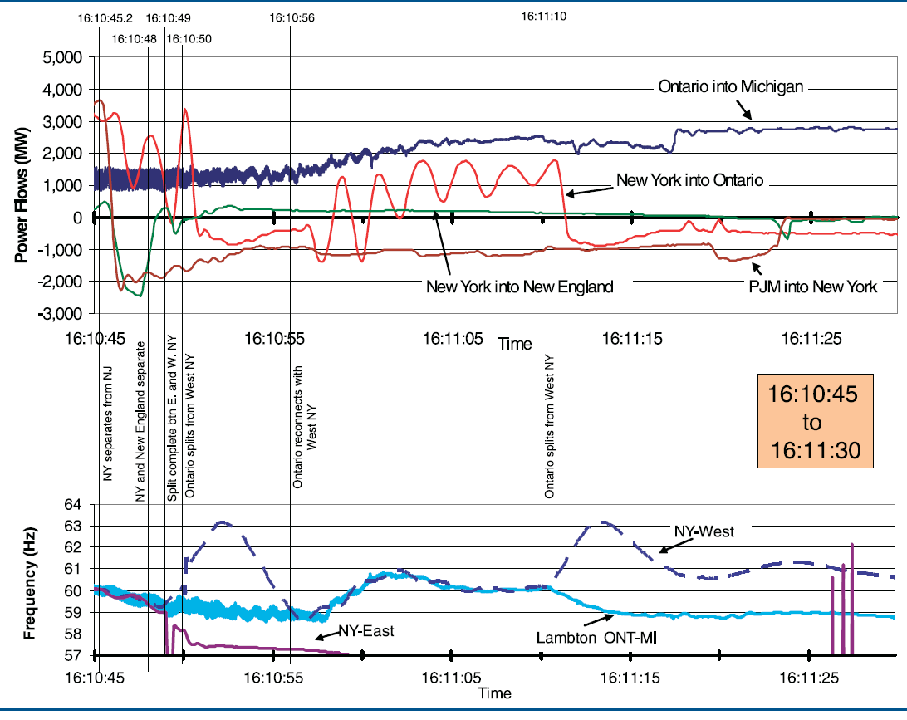
Dynamics Example: August 14 Blackout
Image from August 14, 2003 Blackout Final Report, energy.gov, Figure 6.26
5

Slide 7
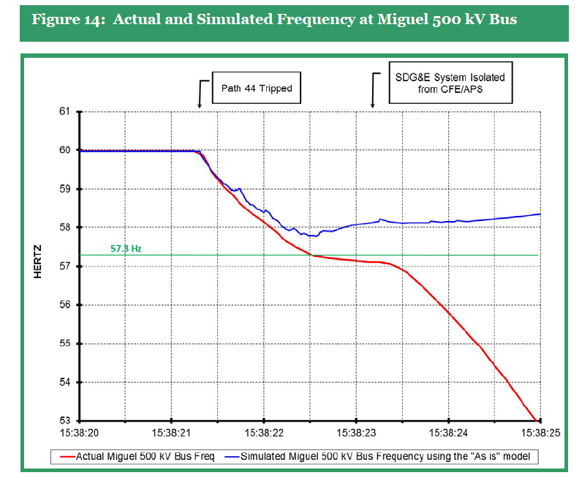
Dynamics Example 3
We’ve come a long ways since 1996 towards improved simulations. Still,
a finding from the 2011 Blackout is the simulations
didn’t match the actual system response and need to be improved.
Source: Arizona-Southern California Outages n September 8, 2011 Report, FERC and NERC, April 2012
6

Slide 8
Models and Their Parameters
Models and their parameters are often tightly coupled
  The parameters for a particular model might have been derived from actual results on the object of interest
Changing the model (even correcting an "incorrect" simulation implementation) can result in unexpected results!
Using a more detailed simulation approach without changing the model can also result in incorrect results
  More detailed models are not necessarily more accurate
7

Slide 9
Positive Sequence Versus Full Three-Phase
Large-scale electrical systems are almost exclusively three-phase. Common analysis tools such as power flow and transient stability often assume balanced operation
  This allows modeling of just the positive sequence though full three-phase models are sometimes used particularly for distribution systems
  Course assumes knowledge of sequence analysis
Other applications, such as electromagnetic transients (commonly known as electromagnetic transients programs [EMTP]) consider the full three-phase models
8

Slide 10
Power Flow Versus Dynamics
The power flow is used to determine a quasi steady-state operating condition for a power system
  Goal is to solve a set of algebraic equations g(x) = 0
  Models employed reflect the steady-state assumption, such as generator PV buses, constant power loads, LTC transformers
Dynamic analysis is used to determine how the system changes with time, usually after some disturbance perturbs it away from a quasi-steady state equilibrium point
9

Slide 11
Example: Transient Stability
Transient stability is used to determine whether following a disturbance (contingency) the power system returns to a steady-state operating point
  Goal is to solve a set of differential and algebraic equations, dx/dt = f(x,y), g(x,y) = 0
  Starts in steady-state, and hopefully returns to steady-state.
  Models reflect the transient stability time frame (up to dozens of seconds), with some values assumed to be slow enough to hold constant (LTC tap changing), while others are still fast enough to treat as algebraic (synchronous machine stator dynamics, voltage source converter dynamics).
10

Slide 12
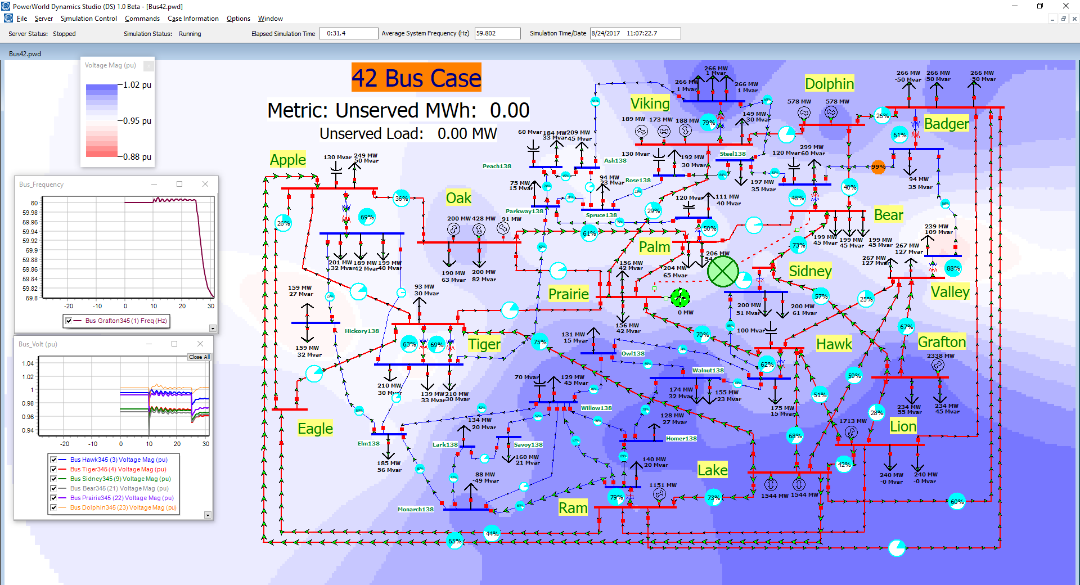
Interactive Simulation: PowerWorld Dynamics Studio (DS)
11

Slide 13
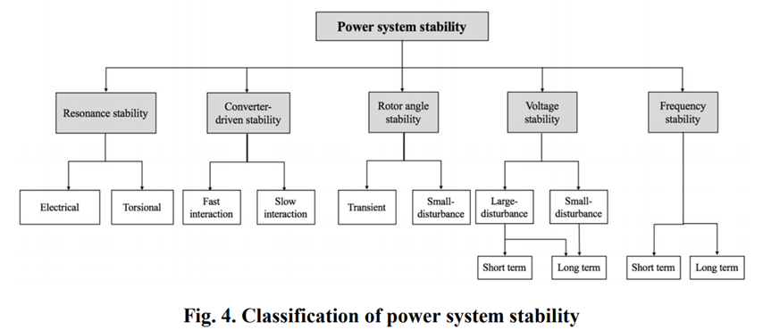
Power System Stability Terms
Terms continue to evolve, but a good reference is [1]; image shows Figure 4 from this reference
[1] IEEE/PES Power System Dynamic Performance Committee, “Stability definitions and characterization of dynamic behavior in systems with high penetration of power electronic interfaced technologies”, PES-TR77, April 2020
12

Slide 14
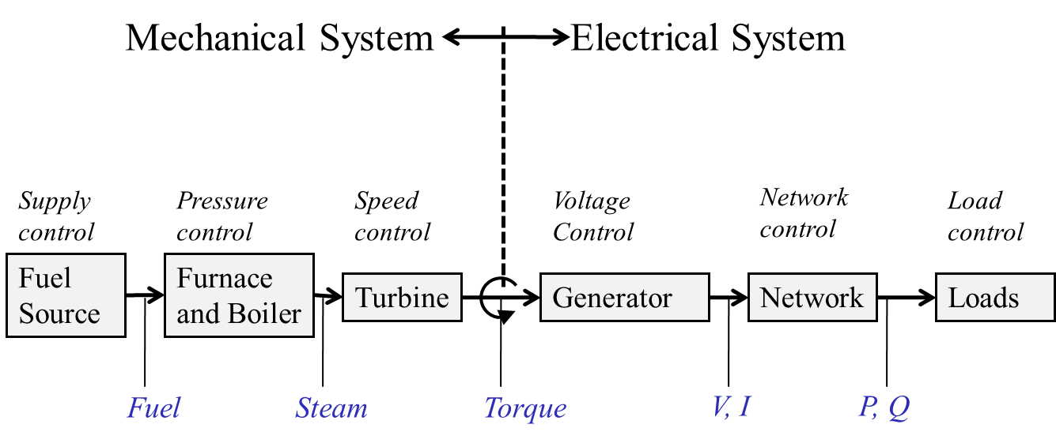
Physical Structure Power System Components
We’ll also be covering wind and solar!
P. Sauer and M. Pai, Power System Dynamics and Stability
13

Slide 15
Physical Structure Power System Components
Mechanical System
Electrical System
Stabilizer
Load
Relay
Line
Relay
Exciter
Supply control
Pressure control
Speed control
Voltage Control
Network control
Load control
Fuel
Source
Furnace and Boiler
Turbine
Generator
Network
Loads
Machine
Load
Char.
Fuel
Steam
Torque
V, I
P, Q
Governor
14

Slide 16
Differential Algebraic Equations
Many problems, including many in the power area, can be formulated as a set of differential, algebraic equations (DAE) of the form
A power example is transient stability, in which f represents (primarily) the generator dynamics, and g (primarily) the bus power balance equations
We'll initially consider the simpler problem of just
15

Slide 17
Ordinary Differential Equations (ODEs)
Assume we have a problem of the form
This is known as an initial value problem, since the initial value of x is given at some time t₀
  We need to determine x(t) for future time
  Initial value, x₀, must be either be given or determined by solving for an equilibrium point, f(x) = 0
  Higher-order systems can be put into this first order form
Except for special cases, such as linear systems, an analytic solution is usually not possible – numerical methods must be used
16

Slide 18
Equilibrium Points
An equilibrium point x* satisfies
An equilibrium point is stable if the response to a small disturbance remains small
  This is known as Lyapunov stability
  Formally, if for every ε > 0, there exists a δ = δ(ε) > 0 such that if x(0) – x* < δ, then x(t) – x* < ε for t ≥ 0
An equilibrium point has asymptotic stability if there exists a δ > 0 such that if x(0) – x* < δ, then
17

Slide 19
Power System Application
A typical power system application is to assume the power flow solution represents an equilibrium point
Back solve to determine the initial state variables, x(0)
At some point a contingency occurs, perturbing the state away from the equilibrium point
Time domain simulation is used to determine whether the system returns to the equilibrium point
18

Slide 20

Initial value Problem Examples
19

Slide 21
Numerical Solution Methods
Numerical solution methods do not generate exact solutions; they practically always introduce some error
  Methods assume time advances in discrete increments, called a stepsize (or time step), Δt
  Speed accuracy tradeoff: a smaller Δt usually gives a better solution, but it takes longer to compute
  Numeric roundoff error due to finite computer word size
Key issue is the derivative of x, f(x) depends on x, the value we are trying to determine
A solution exists as long as f(x) is continuously differentiable
20

Slide 22
Numerical Solution Methods
There are a wide variety of different solution approaches, we will only touch on several
One-step methods: require information about solution just at one point, x(t)
  Forward Euler
  Runge-Kutta
Multi-step methods: make use of information at more than one point, x(t), x(t-Δt), x(t-Δ2t)…
  Adams-Bashforth
Predictor-Corrector Methods: implicit
  Backward Euler
21

Slide 23
Error Propagation
At each time step the total round-off error is the sum of the local round-off at time and the propagated error from steps 1, 2 , … , k − 1
An algorithm with the desirable property that local round-off error decays with increasing number of steps is said to be numerically stable
Otherwise, the algorithm is numerically unstable
Numerically unstable algorithms can nevertheless give quite good performance if appropriate time steps are used
  This is particularly true when coupled with algebraic equations
22

Slide 24
Forward Euler’s Method
The simplest technique for numerically integrating such equations is known as the Euler's Method (sometimes the Forward Euler's Method)
Key idea is to approximate
In general, the smaller the Δt, the more accurate the solution, but it also takes more time steps
23

Slide 25
Euler’s Method Algorithm
24

Slide 26
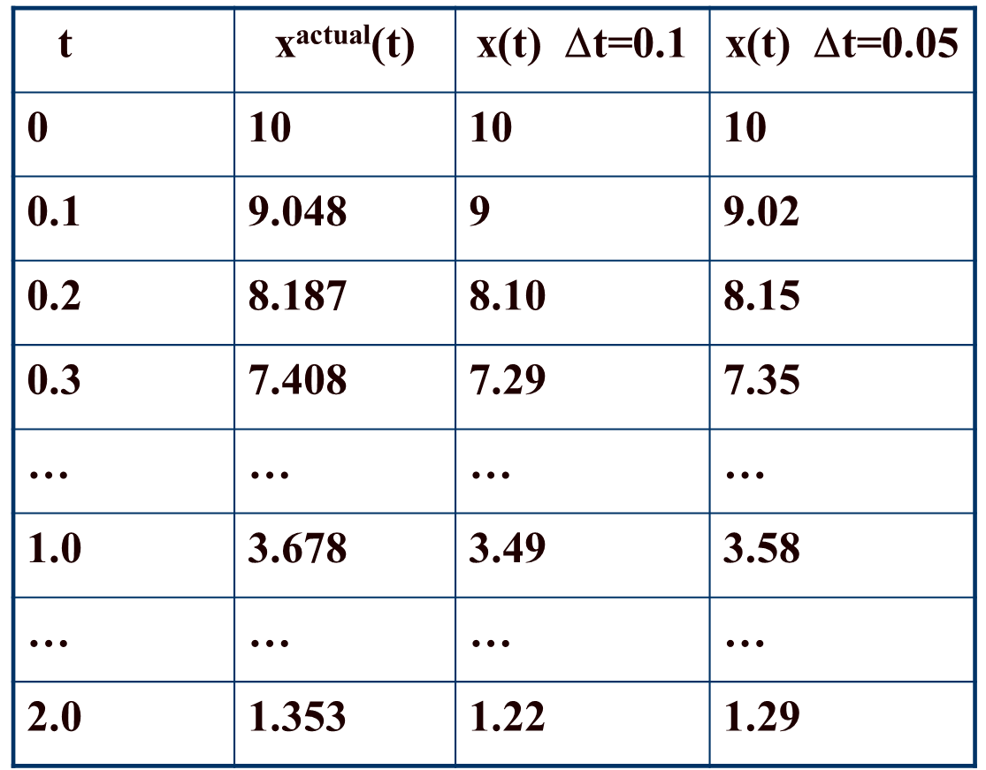
Euler’s Method Example 1
25

Slide 27
Euler’s Method Example 2
26

Slide 28
Euler's Method Example 2, cont'd
27

Slide 29
Euler's Method Example 2, cont'd
t | x₁^{actual}(t) | x₁(t) Δt=0.25
0 | 1 | 1
0.25 | 0.9689 | 1
0.50 | 0.8776 | 0.9375
0.75 | 0.7317 | 0.8125
1.00 | 0.5403 | 0.6289
… | … | …
10.0 | -0.8391 | -3.129
100.0 | 0.8623 | -151,983
Since we know from
the exact solution that
x₁ is bounded between
-1 and 1, clearly the
method is numerically
unstable
28

Slide 30
Euler's Method Example 2, cont'd
Below is a comparison of the solution values for x₁(t) at time t = 10 seconds
Δt | x₁(10)
actual | -0.8391
0.25 | -3.129
0.10 | -1.4088
0.01 | -0.8823
0.001 | -0.8423
29

Slide 31
Second Order Runge-Kutta Method
Runge-Kutta methods improve on Euler's method by evaluating f(x) at selected points over the time step
Simplest method is the second order method in which
That is, k₁ is what we get from Euler's; k₂ improves on this by reevaluating at the estimated end of the time step
30

Slide 32
Second Order Runge-Kutta Algorithm
t = 0, x(0) = x₀, Δt = step size
While t ≤ t^{final} Do
k1 = Δt f(x(t))
k2 = Δt f(x(t) + k1)
x(t+Δt) = x(t) + ( k1 + k2)/2
t = t + Δt
End While
31

Slide 33
RK2 Oscillating Cart
Consider the same example from before the position of a cart attached to a lossless spring. Again, with initial conditions of x₁(0) =1 and x₂(0) = 0, the analytic solution is x₁(t) = cos(t)
With Δt=0.25
at t = 0
32

Slide 34
Comparison
The below table compares the numeric and exact solutions for x₁(t) using the RK2 algorithm
time | actual x₁(t) | x₁(t) with RK2 Δt=0.25
0 | 1 | 1
0.25 | 0.9689 | 0.969
0.50 | 0.8776 | 0.876
0.75 | 0.7317 | 0.728
1.00 | 0.5403 | 0.533
10.0 | -0.8391 | -0.795
100.0 | 0.8623 | 1.072
33

Slide 35
Comparison of x₁(10) for varying Δt
The below table compares the x₁(10) values for different values of Δt; recall with Euler's with Δt=0.1 was -1.41 and with 0.01 was -0.8823
Δt | x₁(10)
actual | -0.8391
0.25 | -0.7946
0.10 | -0.8310
0.01 | -0.8390
0.001 | -0.8391
34

Slide 36
RK2 Versus Euler's
RK2 requires twice the function evaluations per iteration, but gives much better results
With RK2 the error tends to vary with the cube of the step size, compared with the square of the step size for Euler's
The smaller error allows for larger step sizes compared to Euler's
35

Slide 37
Fourth Order Runge-Kutta
Other Runge-Kutta algorithms are possible, including the fourth order
36

Slide 38
RK4 Oscillating Cart Example
RK4 gives much better results, with error varying with the time step to the fifth power
time | actual x₁(t) | x₁(t) with RK4 Δt=0.25
0 | 1 | 1
0.25 | 0.9689 | 0.9689
0.50 | 0.8776 | 0.8776
0.75 | 0.7317 | 0.7317
1.00 | 0.5403 | 0.5403
10.0 | -0.8391 | -0.8392
100.0 | 0.8623 | 0.8601
37

