Slide 1
ECEN 667
Power System Stability
Lecture 3: Electromagnetic Transients
Prof. Tom Overbye
Dept. of Electrical and Computer Engineering
Texas A&M University
overbye@tamu.edu

Slide 2
Announcements
Start reading Chapters 1 and 2 from the book (Chapter 1 is Introduction, Chapter 2 is Electromagnetic Transients)
EPG Dinner is on September 9 at 5pm; please RSVP using the link that was emailed to all.
Homework 1 is due on Thursday September 7
Classic reference paper on EMTP is H.W. Dommel, "Digital Computer Solution of Electromagnetic Transients in Single- and Multiphase Networks," IEEE Trans. Power App. and Syst., vol. PAS-88, pp. 388-399, April 1969

Slide 3
Multistep Methods
Euler's and Runge-Kutta methods are single step approaches, in that they only use information at x(t) to determine its value at the next time step
Multistep methods take advantage of the fact that using we have information about previous time steps x(t-Δt), x(t-2Δt), etc
These methods can be explicit or implicit (dependent on x(t+Δt) values; we'll just consider the explicit Adams-Bashforth approach
2

Slide 4
Multistep Motivation
In determining x(t+Δt) we could use a Taylor series expansion about x(t)
(note Euler's is just the first two terms on the right-hand side)
3

Slide 5
Adams-Bashforth
What we derived is the second order Adams-Bashforth approach. Higher order methods are also possible, by approximating subsequent derivatives. Here we also present the third order Adams-Bashforth
4

Slide 6
Adams-Bashforth Versus Runge-Kutta
The key Adams-Bashforth advantage is the approach only requires one function evaluation per time step while the RK methods require multiple evaluations
A key disadvantage is when discontinuities are encountered, such as with limit violations
  In some simulations limits can be hit often
  Another method needs to be used until there are sufficient past solutions
They also have difficulties if variable time steps are used
5

Slide 7
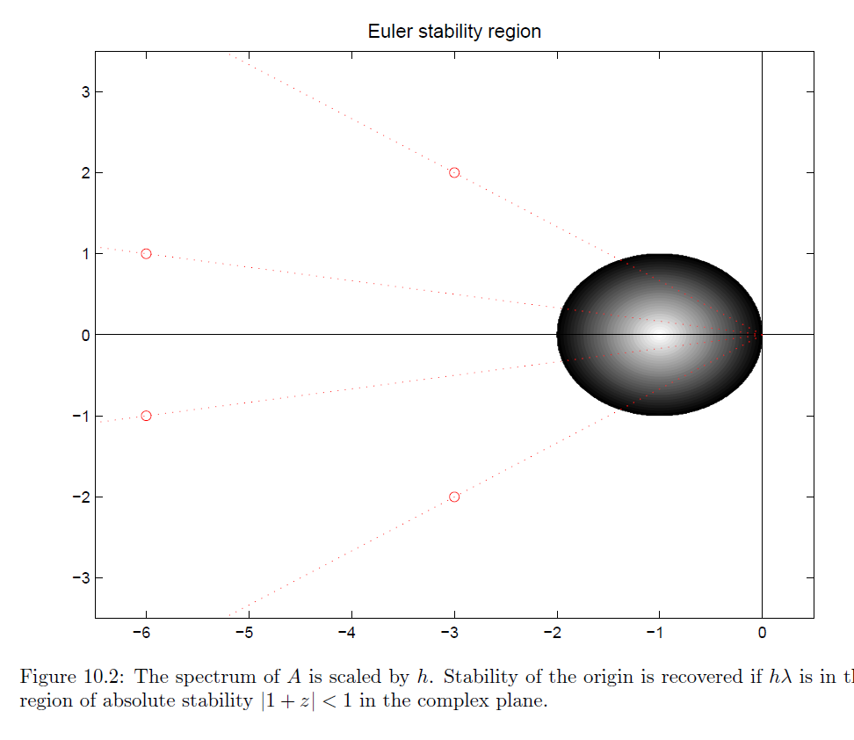
Numerical Instability
All explicit methods can suffer from numerical instability if the time step is not correctly chosen for the problem eigenvalues
Values are scaled by the time step; the shape for RK2 has similar dimensions but is closer to a square. Key point is to make sure the time step is small enough relative to the eigenvalues.
Image source: http://www.staff.science.uu.nl/~frank011/Classes/numwisk/ch10.pdf
6

Slide 8
Stiff Differential Equations
Stiff differential equations are ones in which the desired solution has components the vary quite rapidly relative to the solution
Stiffness is associated with solution efficiency: in order to account for these fast dynamics we need to take quite small time steps
Stiff differential equations are common in power systems, but there are efficient techniques for handling them
7

Slide 9
Implicit Methods
Implicit solution methods have the advantage of being numerically stable over the entire left half plane
Only methods considered here are the is the Backward Euler and Trapezoidal
Initially we’ll assume
linear equations
8

Slide 10
Backward Euler Cart Example
Returning to the cart example
9

Slide 11
Backward Euler Cart Example
Results with Δt = 0.25 and 0.05
time | actual x₁(t) | x₁(t) with Δt=0.25 | x₁(t) with Δt=0.05
0 | 1 | 1 | 1
0.25 | 0.9689 | 0.9411 | 0.9629
0.50 | 0.8776 | 0.8304 | 0.8700
0.75 | 0.7317 | 0.6774 | 0.7185
1.00 | 0.5403 | 0.4935 | 0.5277
2.00 | -0.416 | -0.298 | -0.3944
Note: Just because the method is numerically stable doesn't mean it is error free! RK2 is more accurate than backward Euler.
10

Slide 12
Trapezoidal Linear Case
For the trapezoidal with a linear system we have
11

Slide 13
Trapezoidal Cart Example
Results with Δt = 0.25, comparing between backward Euler and trapezoidal
time | actual x₁(t) | Backward Euler | Trapezoidal
0 | 1 | 1 | 1
0.25 | 0.9689 | 0.9411 | 0.9692
0.50 | 0.8776 | 0.8304 | 0.8788
0.75 | 0.7317 | 0.6774 | 0.7343
1.00 | 0.5403 | 0.4935 | 0.5446
2.00 | -0.416 | -0.298 | -0.4067
12

Slide 14
The Best Numerical Integration Approach Depends on the Application
There is no single best numerical integration method, with all approaches having advantages and disadvantages
Issues to consider include
  Speed
  Accuracy
  Numerical stability
  Code complexity; with power system stability this includes the ability to support a wide, and growing list of models
Explicit methods are commonly used with great success, with numerical instability methods managed through effective engineering
  An analogy is airplane, which through engineering can be made to effectively fly even though there are conditions in which they can crash

Slide 15
Electromagnetic Transients
The modeling of very fast power system dynamics (much less than one cycle) is known as electromagnetics transients program (EMTP) analysis
  Covers issues such as lightning propagation and switching surges; they can also be used with inverter-based controls
Concept originally developed by Prof. Hermann Dommel for his PhD in the 1960's (now emeritus at Univ. British Columbia)
  After his PhD work Dr. Dommel worked at BPA where he was joined by Scott Meyer in the early 1970's
  Alternative Transients Program (ATP) developed in response to commercialization of the BPA code
14

Slide 16
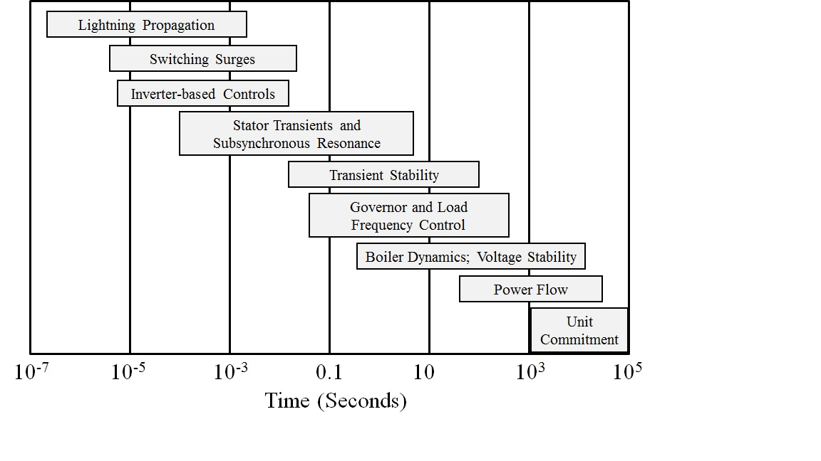
Power System Time Frames
Image source: P.W. Sauer, M.A. Pai, Power System Dynamics and Stability, 1997, Fig 1.2, modified
15

Slide 17
Transmission Line Modeling
In power flow and transient stability transmission lines are modeled using a lumped parameter approach
  Changes in voltages and current in the line are assumed to occur instantaneously
  Transient stability time steps are usually a few ms (1/4 cycle is common, equal to 4.167ms for 60Hz)
In EMTP time-frame this is no longer the case; speed of light is 300,000km/sec or 300km/ms or 300m/μs
  Change in voltage and/or current at one end of a transmission cannot instantaneously affect the other end
16

Slide 18
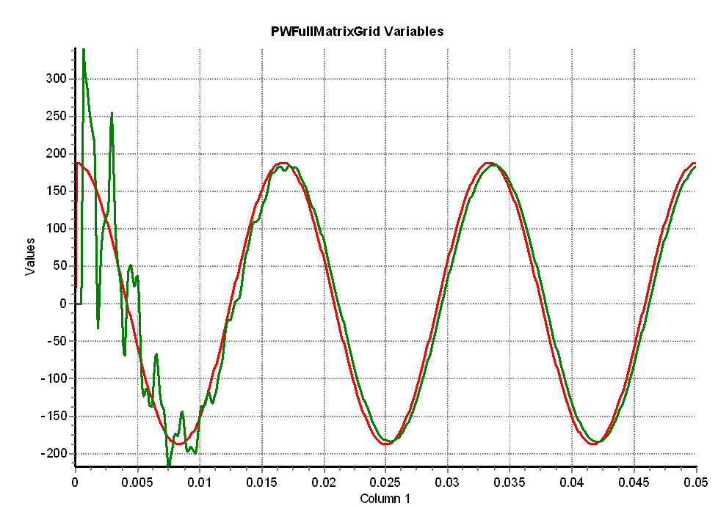
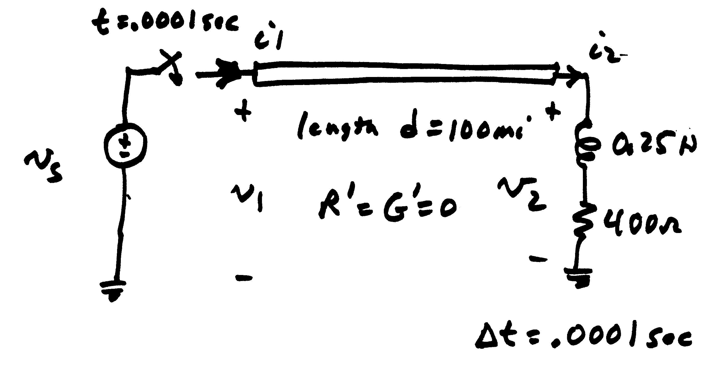
Need for EMTP
The change isn’t instantaneous because of propagation delays, which are near the speed of light; there also wave reflection issues
Red is the v_{s} end, green the v₂ end
17

Slide 19
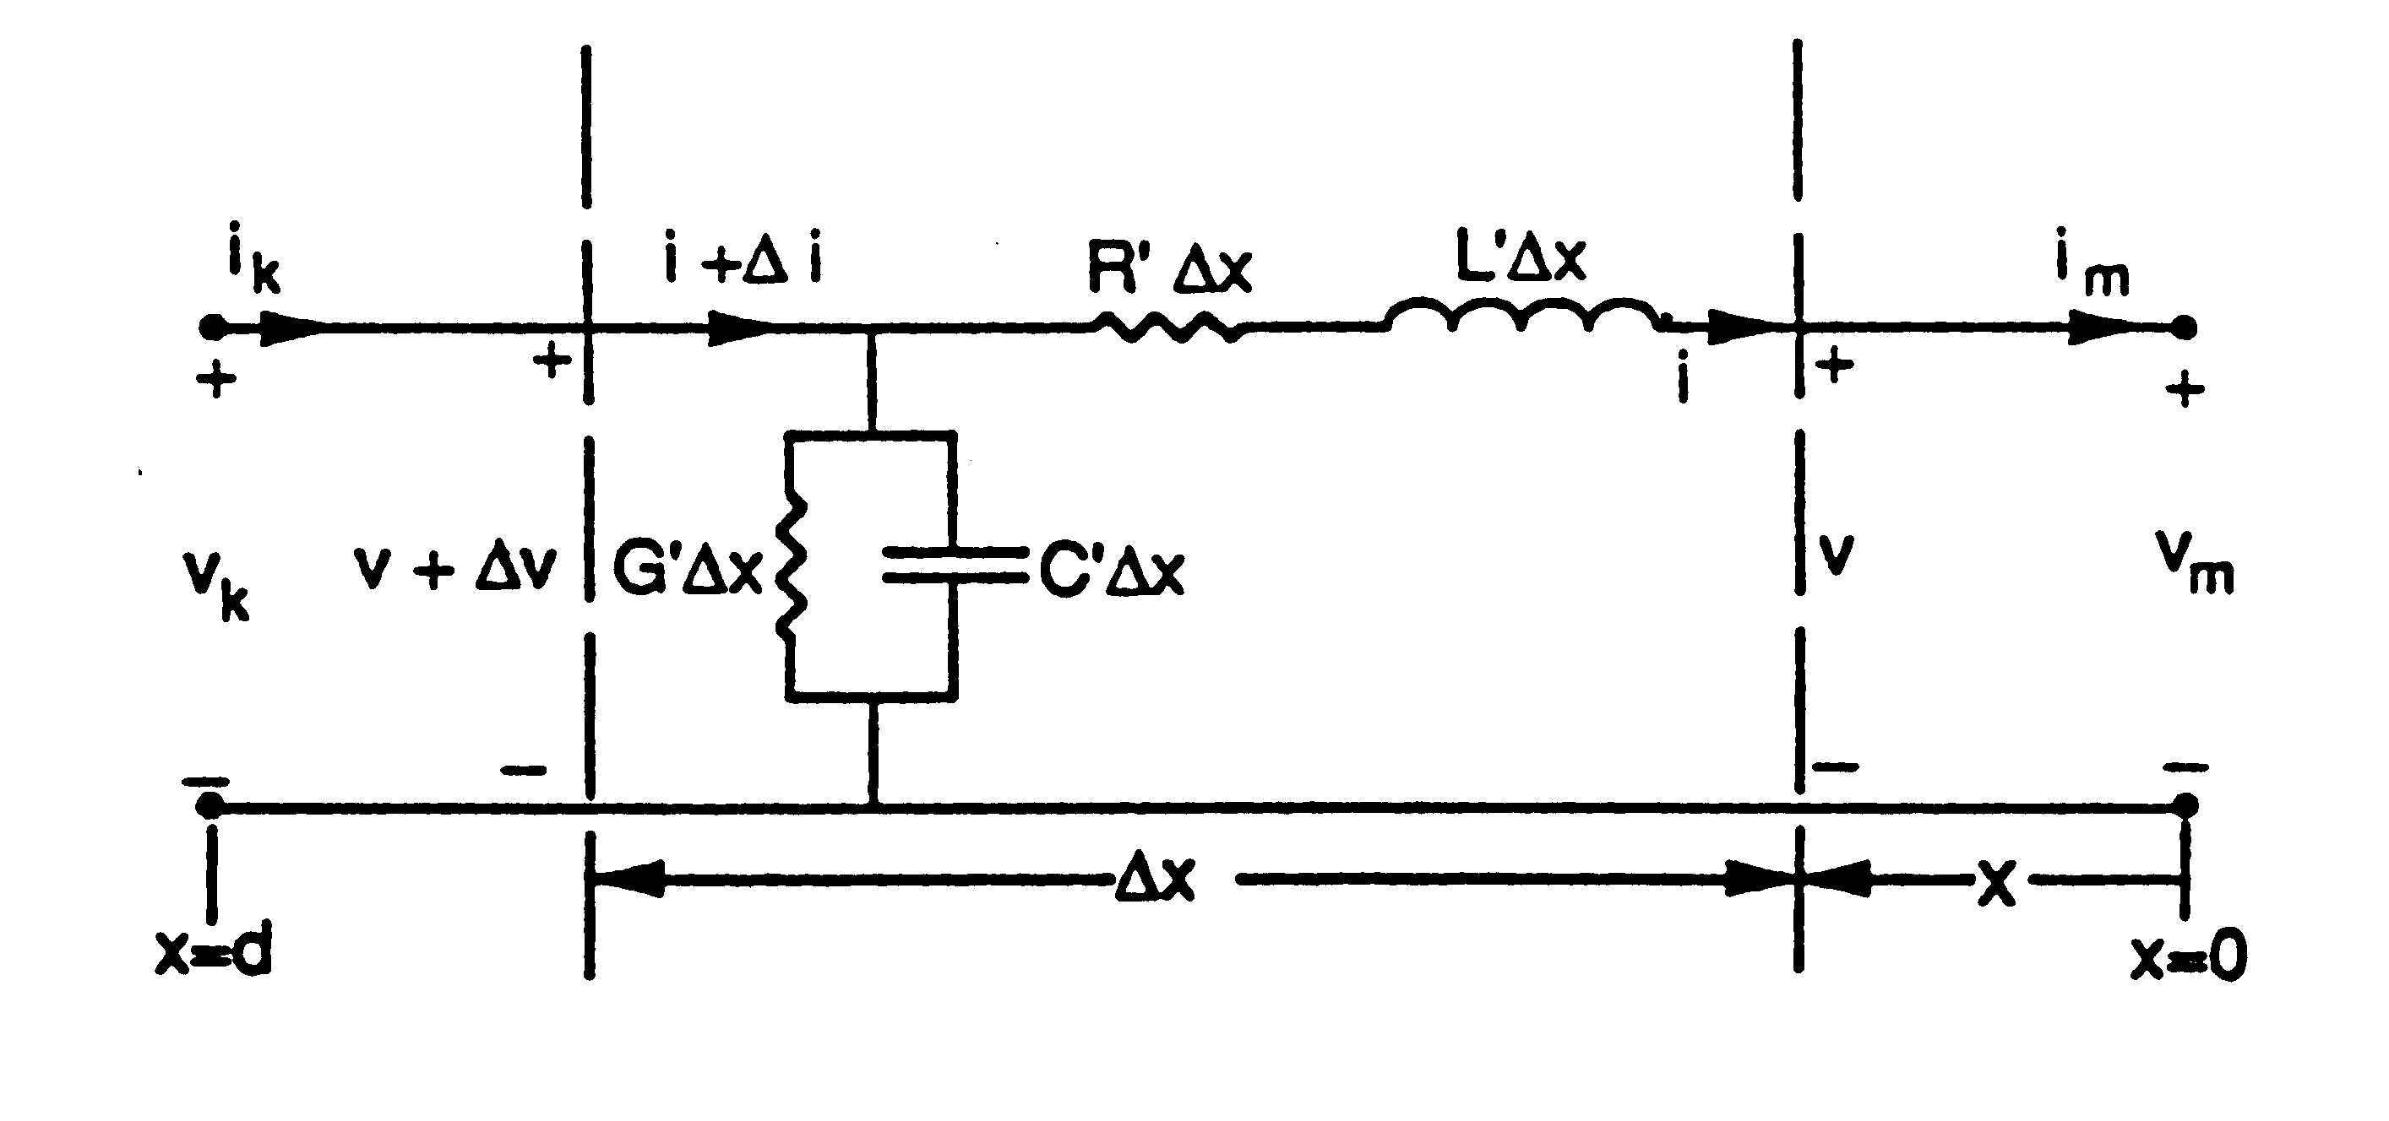
Incremental Transmission Line Modeling
Define the receiving end as bus m (x=0) and the sending end as bus k (x=d)
18

Slide 20
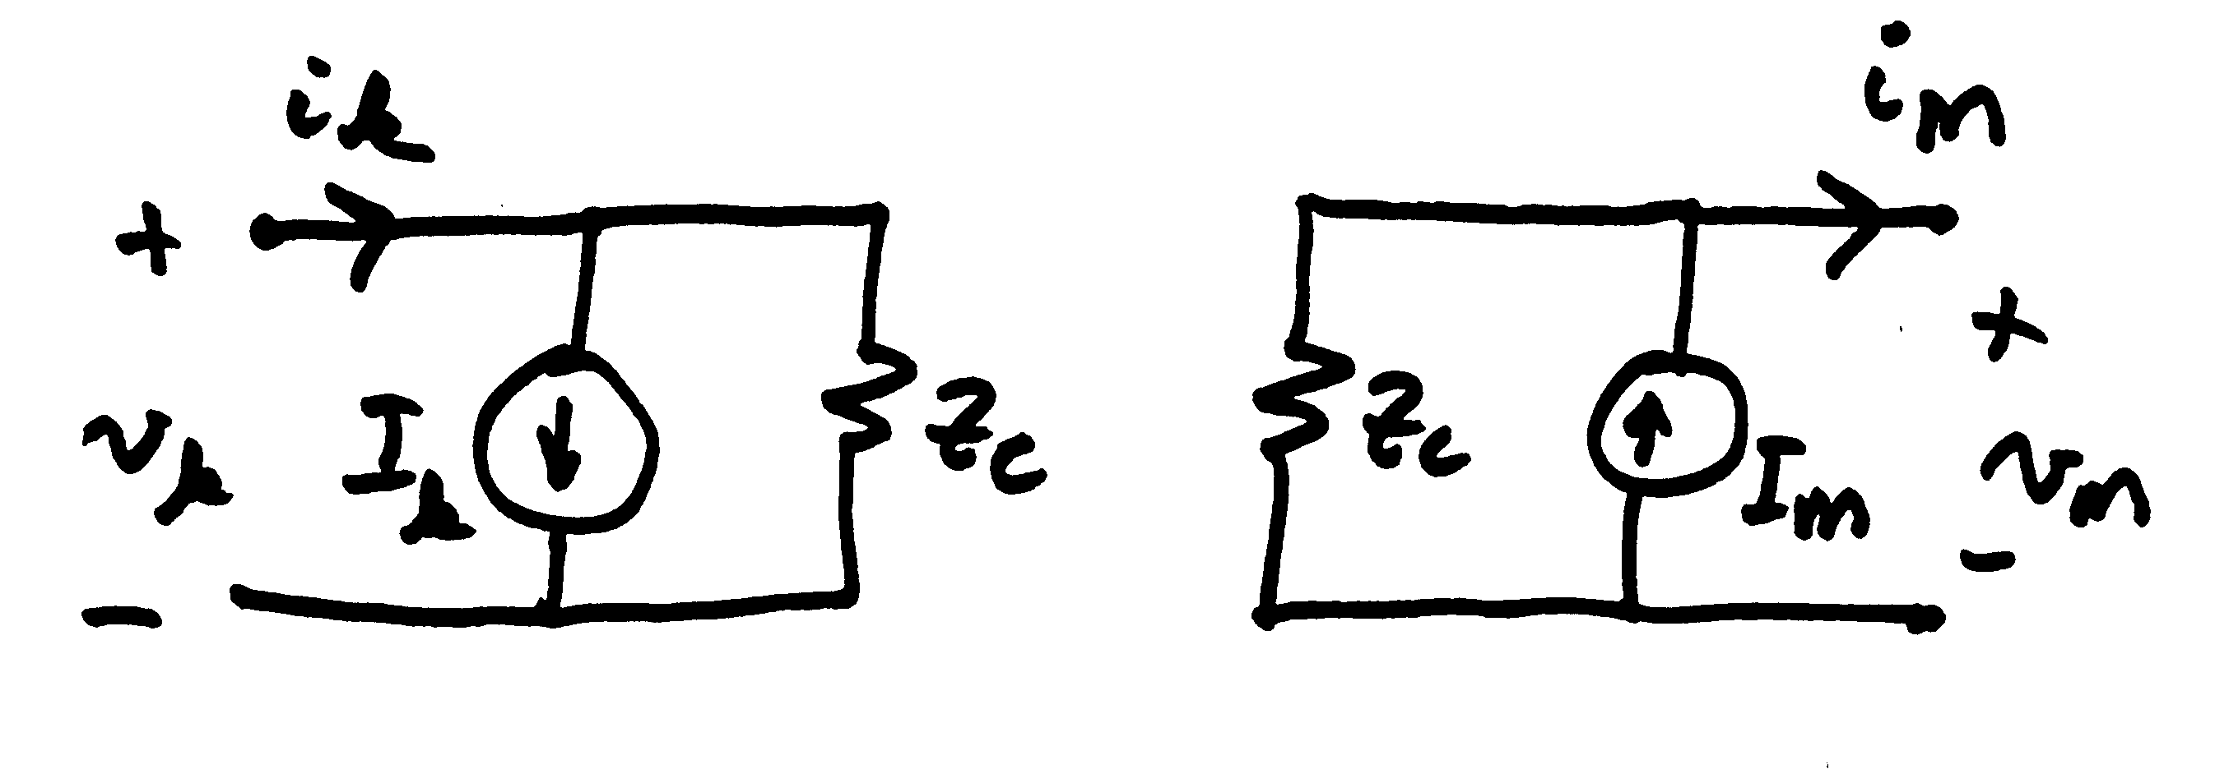
Where We Will End Up
Goal is to come up with model of transmission line suitable for numeric studies on this time frame
Both ends of the line are
represented by Norton
equivalents
Assumption is we don’t care about what occurs along the line
19

Slide 21
Incremental Transmission Line Modeling
We are looking to determine v(x,t) and i(x,t)
20

Slide 22
Incremental Transmission Line Modeling
Taking the limit we get
Some authors have a negative sign with these equations; it just depends on the direction of increasing x; note that the values are function of both x and t
21

Slide 23
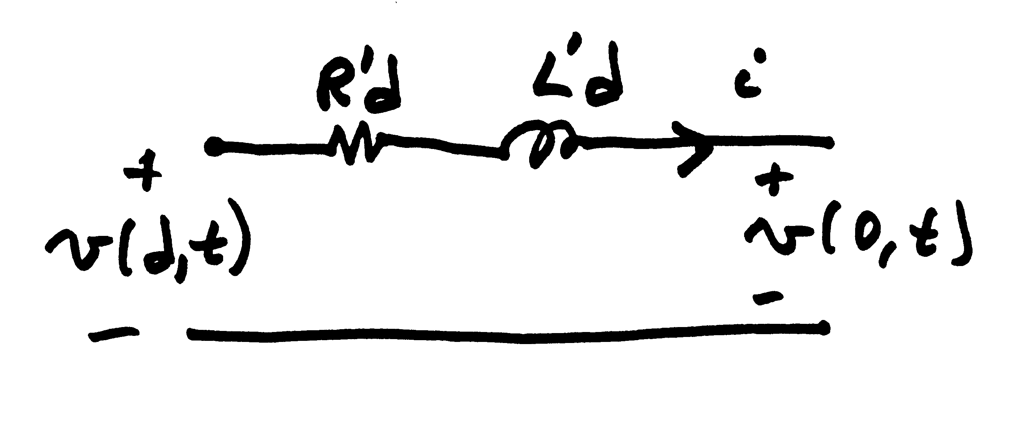
Special Case 1
C' = G' = 0 (neglect shunts)
This just gives a lumped parameter model, with all electric field effects neglected
22

Slide 24
Special Case 2: Wave Equation
The lossless line (R'=0, G'=0), which gives
This is the wave equation with a general solution of
Z_{c} is the characteristic
impedance and v_{p} is the velocity of propagation
23

Slide 25
Special Case 2: Wave Equation
This can be thought of as two waves, one traveling in the positive x direction with velocity v_{p}, and one in the opposite direction
The values of f₁ and f₂ depend upon the boundary (terminal) conditions
Boundaries are receiving end with x=0 and the sending end with x=d
24

Slide 26
Calculating v_{p}
To calculate v_{p} for a line in air we go back to the definition of L' and C'
With r'=0.78r this is very close to the speed of light
25

Slide 27
Important Insight
The amount of time for the wave to go between the terminals is d/v_{p}= τ seconds
  To an observer traveling along the line with the wave, x+v_{p}t, will appear constant
What appears at one end of the line impacts the other end τ seconds later
Both sides of
the bottom equation are constant when x+v_{p}t is
constant
26

Slide 28
Determining the Constants
If just the terminal characteristics are desired, then an approach known as Bergeron's method can be used.
Knowing the values at the receiving end m (x=0) we get
This can be
used to
eliminate f₁
27

Slide 29
Determining the Constants
Eliminating f₁ we get
Solve for f₁ and replace it in the equation from the previous slide
28

Slide 30
Determining the Constants
To solve for f₂ we need to look at what is going on at the sending end (i.e., k at which x=d) τ = d/v_{p} seconds in the past
29

Slide 31
Determining the Constants
Dividing v_{k} by z_{c}, and then adding it with i_{k} gives
Then substituting for f₂ in i_{m} gives
Hence i_{m}(t) depends on current conditions at m and past conditions at k
30

Slide 32
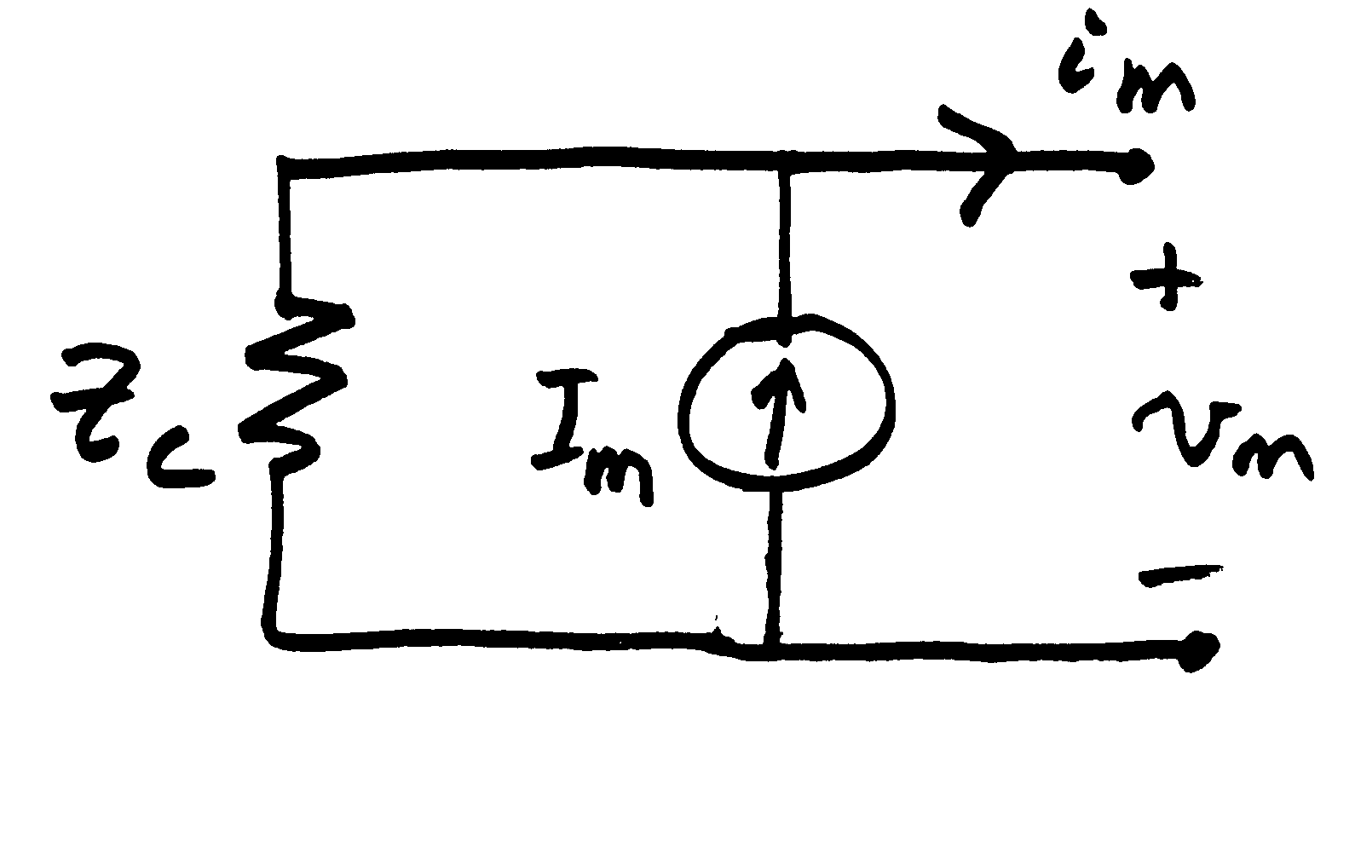
Equivalent Circuit Representation
The receiving end can be represented in circuit form as
Since τ = d/v_{p}, I_{m} just depends on the voltage and current at the other end of the line from τ seconds in the past. Since these are known values, it looks like a time-varying current source.
31

Slide 33
Repeating for the Sending End
The sending end has a similar representation
Both ends of the line are
represented by Norton
equivalents
32

Slide 34
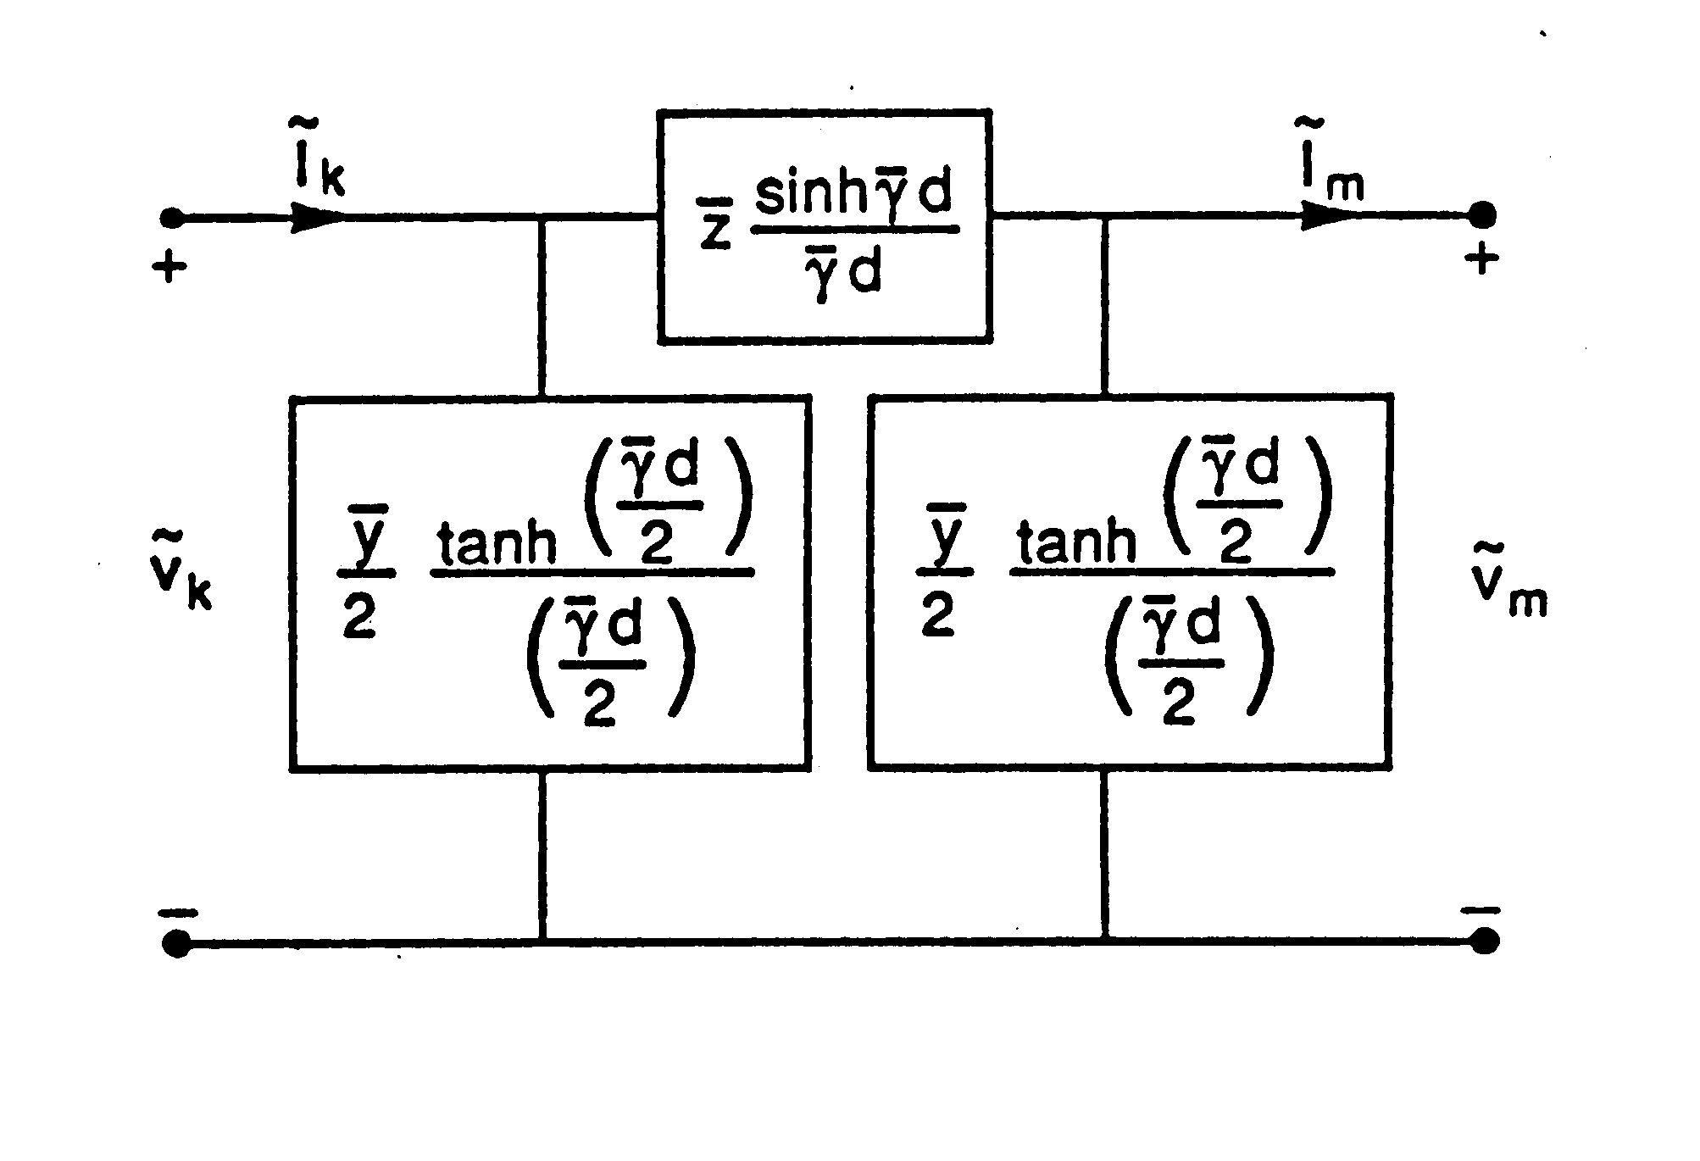
Lumped Parameter Model
In the special case of constant frequency, book shows the derivation of the common lumped parameter model
This is used in power flow and transient stability; in EMTP the frequency is not constant
33

Slide 35
Including Line Resistance
An approach for adding line resistance, while keeping the simplicity of the lossless line model, is to just to place ½ of the resistance at each end of the line
  Another, more accurate approach, is to place ¼ at each end, and ½ in the middle
Standalone resistance, such as modeling the resistance of a switch, is just represented as an algebraic equation
34

Slide 36
Numerical Integration with Trapezoidal Method
Numerical integration is often done using the trapezoidal method discussed last time
  Here we show how it can be applied to inductors and capacitors
For a general function the trapezoidal approach is
Trapezoidal integration introduces error on the order of Δt³, but it is numerically stable
35

Slide 37
Trapezoidal Applied to Inductor with Resistance
For a lossless inductor,
This can be represented as a Norton equivalent with current into the equivalent defined as positive (the last two terms are the current source)
This is a linear equation
36

Slide 38
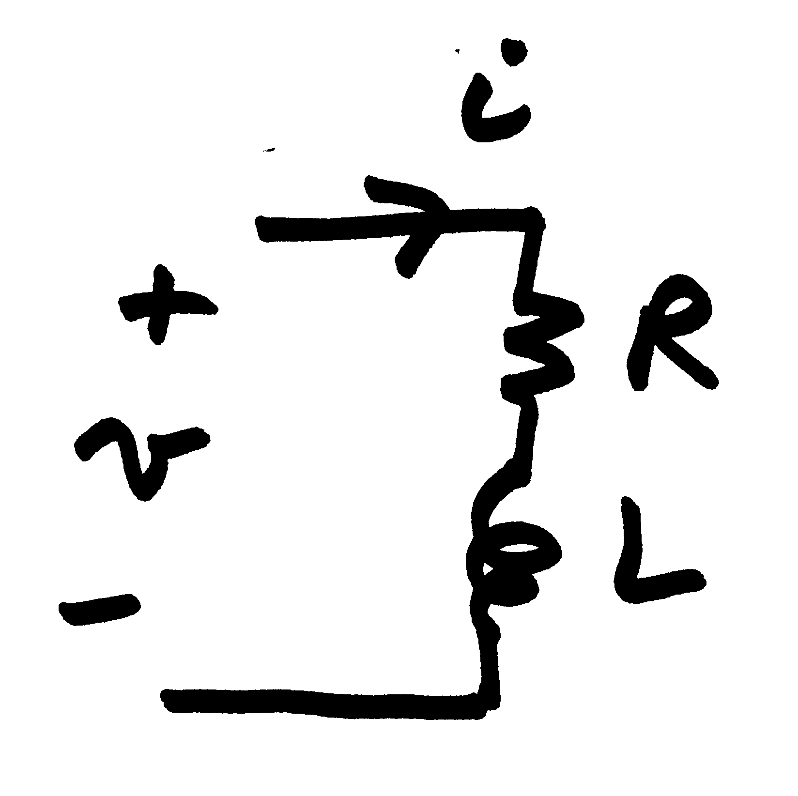
Trapezoidal Applied to Inductor with Resistance
For an inductor in series with a resistance we have
37

Slide 39
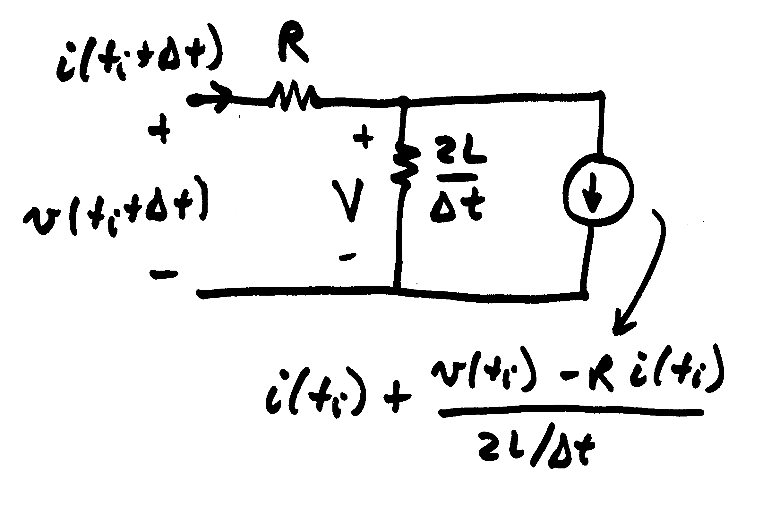
Trapezoidal Applied to Inductor with Resistance
This also becomes a Norton equivalent. A similar expression will be developed for capacitors.
38

Slide 40
RL Example
Assume a series RL circuit with an open switch with R= 200Ω and L = 0.3H, connected to a voltage source with
Assume the switch is closed at t=0
The exact solution is
R/L=667, so the dc offset decays relatively quickly
39

Slide 41
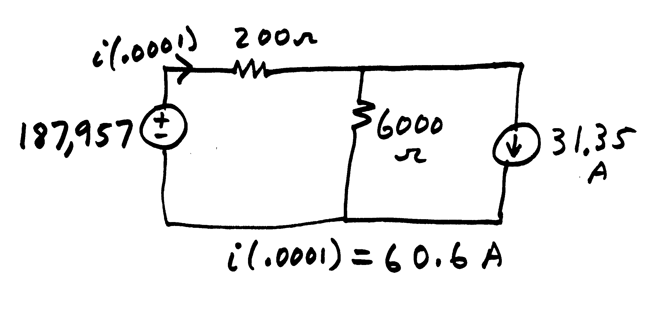
RL Example Trapezoidal Solution
Numeric solution:
Exact solution:
40

Slide 42
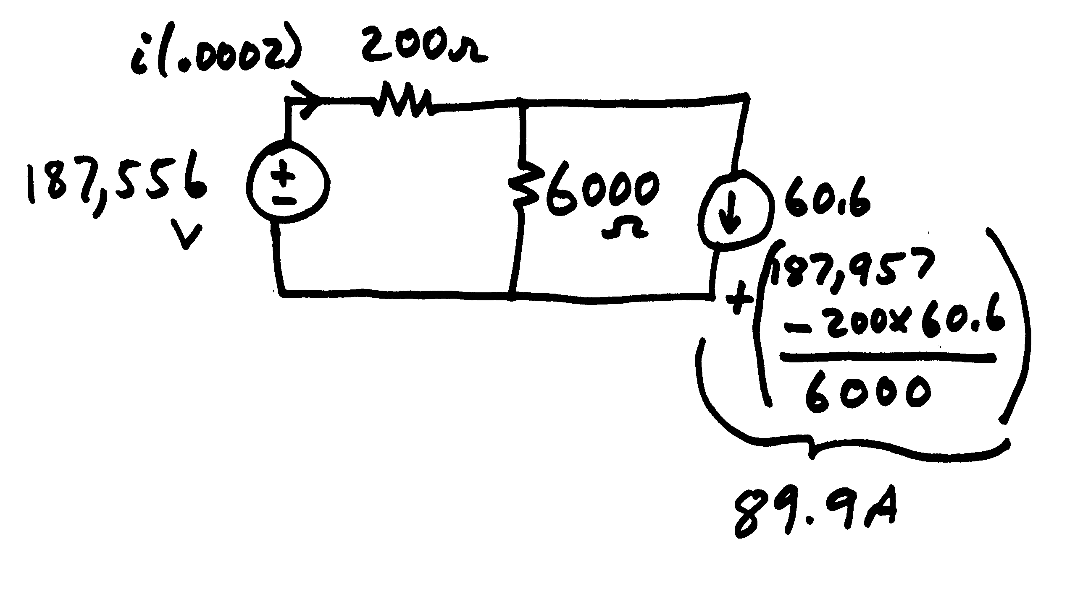
RL Example Trapezoidal Solution
t = 0.0002
Solving for i(0.0002)
i(0.0002) = 117.3A
Compare to the exact solution
i(0.0002) = 117.3A
41

Slide 43
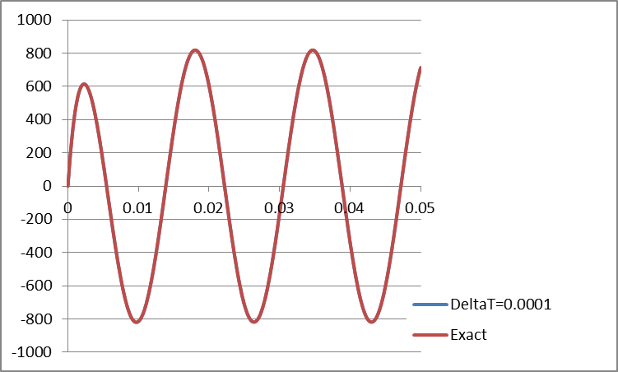
Full Solution Over Three Cycles
42

Slide 44
A Favorite Problem: R=0 Case, with v(t) = Sin(2*pi*60)
Note that the current is never negative!
43

Slide 45
Lumped Capacitance Model
The trapezoidal approach can also be applied to model lumped capacitors
Integrating over a time step gives
Which can be approximated by the trapezoidal as
44

Slide 46
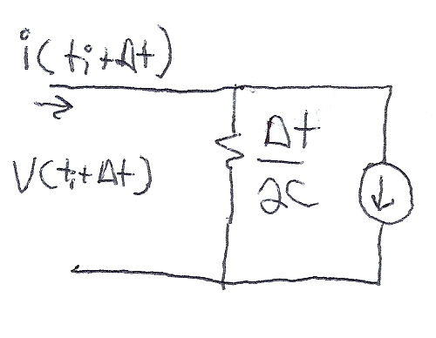
Lumped Capacitance Model
Hence we can derive a circuit model similar to what was done for the inductor
This is a current
source that depends
on the past values
45

Slide 47
Example 2.1: Line Closing
Switch is closed at
time t = 0.0001 sec
46

Slide 48
Example 2.1: Line Closing
Initial conditions: i₁ = i₂ = v₁ = v₂ =0
for t < 0.0001 sec
Because of finite propagation speed, the receiving end of the line will not respond to energizing the sending end for at least 0.00055 seconds.
47

Slide 49
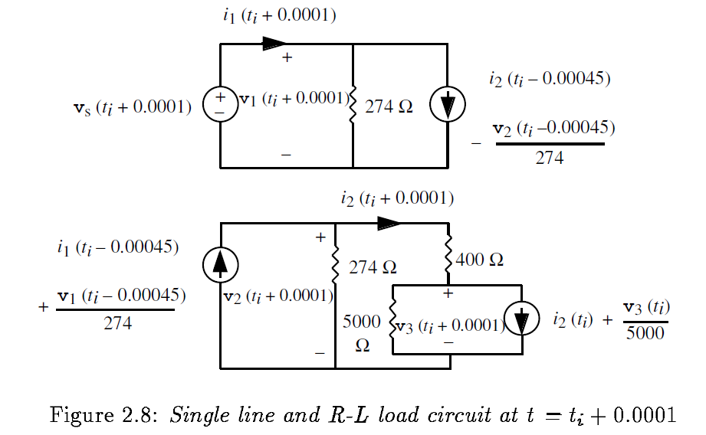
Example 2.1: Line Closing
This is v₃(t_{i}) =
v₂(t_{i}) - 400*i₂(t_{i})
Note we have two separate circuits, coupled together only by past values.
48

Slide 50
Example 2.1: t=0.0001
Need:
49

Slide 51
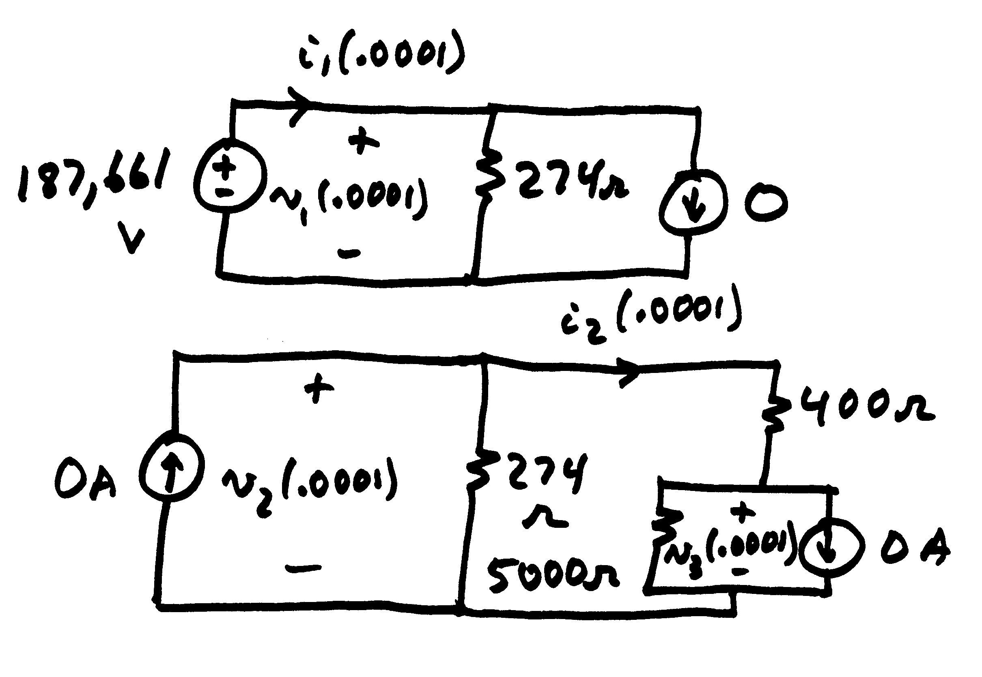
Example 2.1: t=0.0001
Sending End
Receiving End
50

Slide 52
Example 2.1: t=0.0001
Instantaneously changed from zero at t = 0.0001 sec.
51

Slide 53
Example 2.1: t=0.0002
Need:
Circuit is essentially
the same
Wave is traveling
down the line
52

Slide 54
Example 2.1: t=0.0002 to 0.006
switch closed
With interpolation receiving end will see wave
53

Slide 55
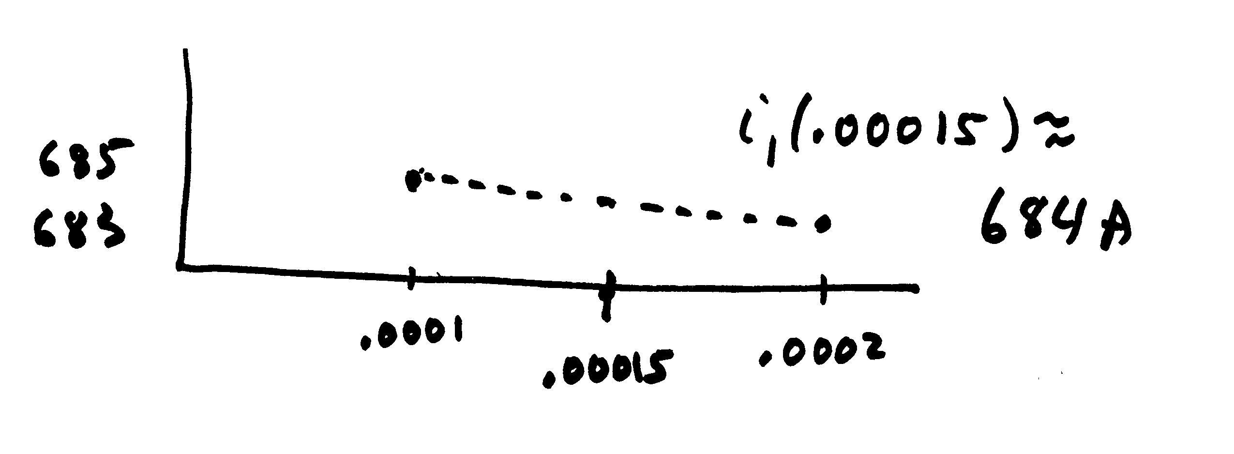
Example 2.1: t=0.0007
Need:
(linear interpolation)
54

Slide 56
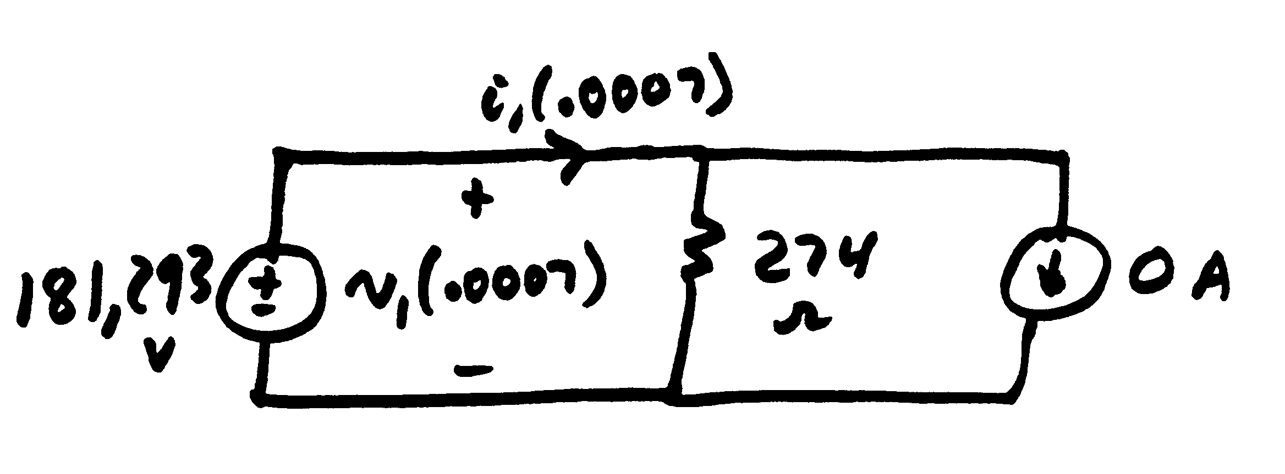
Example 2.1: t=0.0007
For t_{i} = .0006 (t = .0007 sec) at the sending end
This current source will stay zero until we get a response from the receiving end, at about 2τ seconds
55

Slide 57
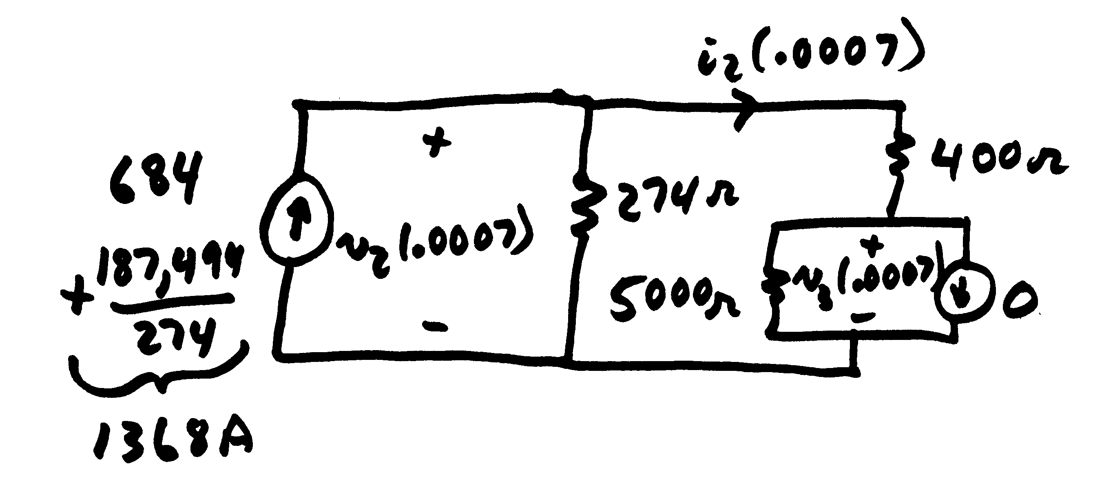
Example 2.1: t=0.0007
For t_{i} = .0006 (t = .0007 sec) at the receiving end
56

Slide 58
Example 2.1: First Three Cycles
Red is the sending end voltage (in kv), while green is the receiving end voltage. Note the approximate voltage doubling at the receiving end.
57

Slide 59
Example 2.1: First Three Cycles
Graph shows the current (in amps) into the RL load over the first three cycles.
To get a ballpark value on the expected current, solve the
simple circuit assuming the transmission line is just an inductor
58

