Slide 1
ECEN 667 Power System Stability
Lecture 5: Stability Overview with PowerWorld Simulator
Prof. Tom Overbye
Dept. of Electrical and Computer Engineering
Texas A&M University
overbye@tamu.edu

Slide 2
Announcements
Start reading Chapters 3
Homework 1 is due on Thursday September 7
1

Slide 3
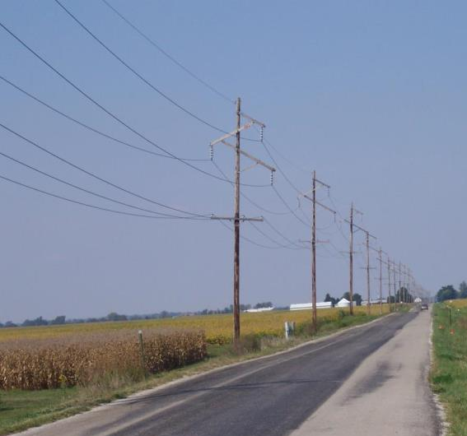
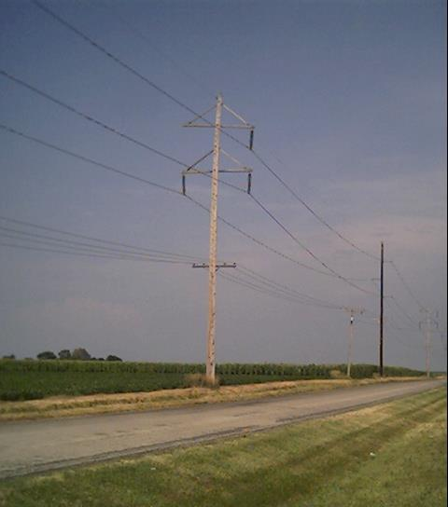
Three-Phase Transmission Lines
2

Slide 4
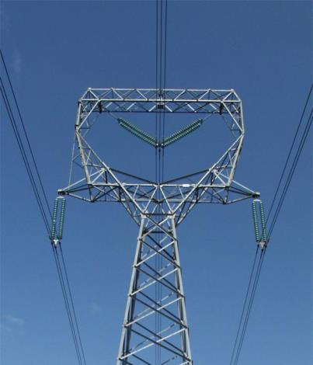
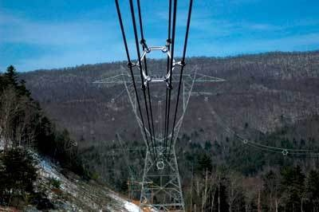
Bundled Conductor Pictures
The AEP Wyoming-Jackson Ferry 765 kV line uses 6-bundle conductors. Conductors in a bundle are at the same voltage!
Photo Source: BPA and American Electric Power
3

Slide 5

Large-Scale Electric Grid Interconnects (50 or 60 Hz)
The map is a little out-of-date (e.g., with Ukraine).
The largest grids by GW: 1) State Grid of China (1700) 2) Continental Europe (860), 3) Eastern NA (610), 4) India (400), 5) former Soviet Union (350 GW), 6) China Southern Grid (320), 7) WECC (265)
Image Source: i.redd.it/krkhdfslrjh61.jpg
Data: en.wikipedia.org/wiki/Wide_area_synchronous_grid
4

Slide 6
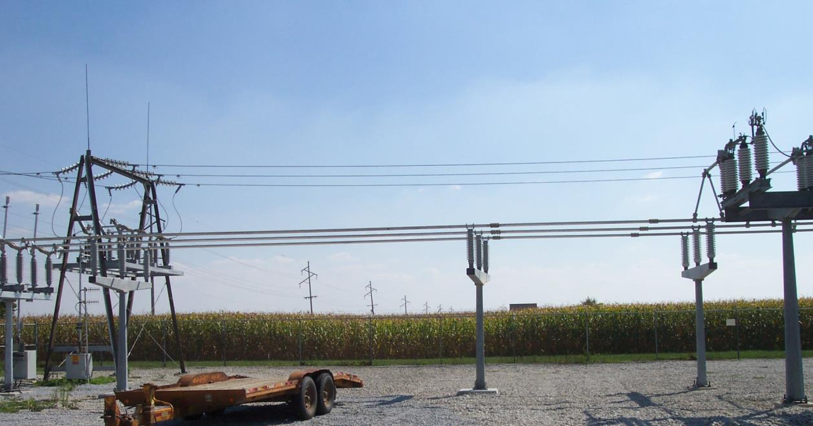
Key Power System Terms: Bus and One-Line
Most power systems are (mostly) balanced three-phase systems
A balanced three-phase system can be modeled as a single (or one) line
One-lines show the major power system components, such as generators, loads, transmission lines
Components join together at a bus
Electric grid Bus (note the three phases)
5

Slide 7
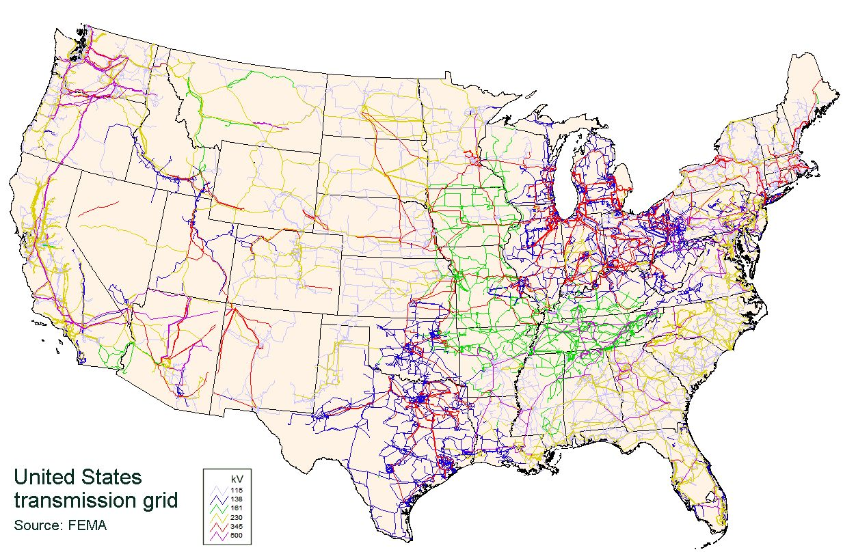
Power System One-line Diagrams
We will be using these a lot in 667
6

Slide 8
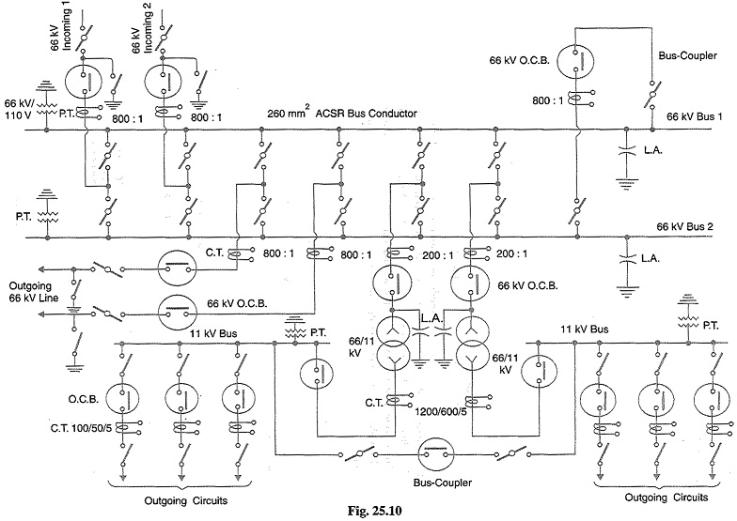
A More Detailed Oneline (Single Line) Diagram
Mostly we won’t get into this level of detail in 667
Image Source: www.eeeguide.com/key-diagram-of-substation/
7

Slide 9
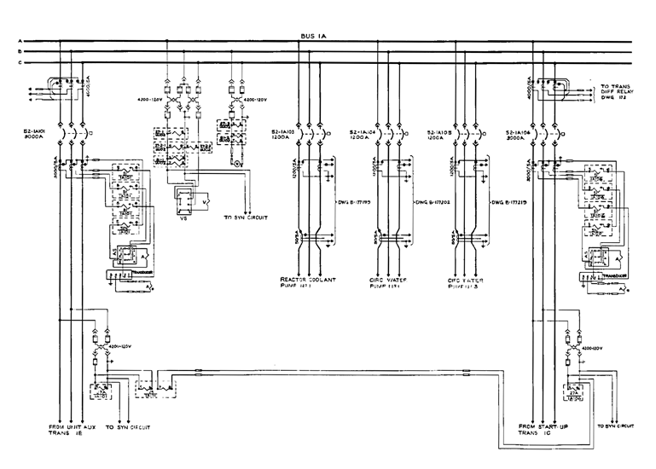
Three Line Diagram
We won’t be using these in 667
8

Slide 10
Quick Review of Symmetric Components
In 667 we won’t use symmetrical components much but it is a key concept so I will briefly cover them
Much of power system dynamic analysis is done assuming the system is operated balanced, three-phase
However, we need to briefly consider unbalanced system operation, which certainly can occur during faults
The most common fault is a single line-to-ground (SLG) fault, whereas three-phase faults are uncommon
Such systems can be analyzed using symmetrical components
9

Slide 11
Symmetric Components
The key idea of symmetrical component analysis is to decompose the system into three sequence networks. The networks are then coupled only at the point of the unbalance (i.e., the fault)
The three sequence networks are known as the
positive sequence (this is the one for balanced systems)
negative sequence
zero sequence
Presented in paper by Charles L. Fortescue in 1918 (most important 20th century power paper)
Heydt, G. T.; Venkata, S. S.; Balijepalli, N. (October 24, 2000). "High Impact Papers in Power Engineering, 1900-1999" Proceedings 2000 North American Power Symposium, vol. 1, October 2000. North American Power Symposium (NAPS). Waterloo, Ontario.
10

Slide 12
Positive, Negative and Zero Sequence Sets
The positive sequence sets have three phase currents/voltages with equal magnitude, with phase b lagging phase a by 120°, and phase c lagging phase b by 120°
The negative sequence sets have three phase currents/voltages with equal magnitude, with phase b leading phase a by 120°, and phase c leading phase b by 120°
Zero sequence sets have three values with equal magnitude and angle
11

Slide 13
Symmetrical Component Conversion
Voltages and currents can be easily transformed between their phase and sequence values
With α = 1∠120°
12

Slide 14
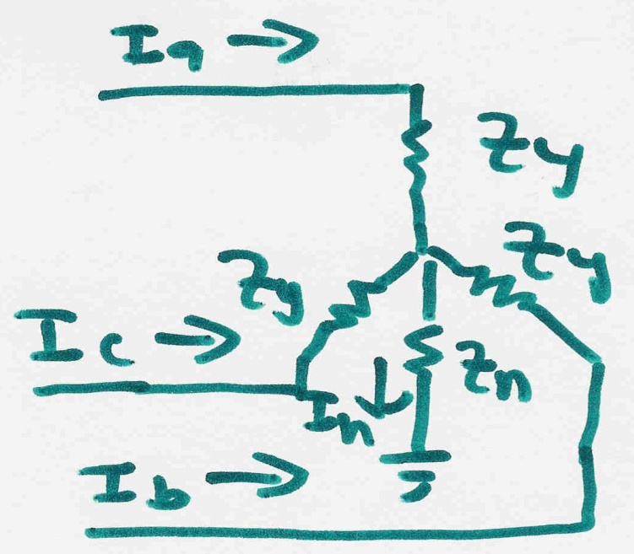
Symmetrical Components to Decouple Unbalanced Networks
Consider the following wye-connected load:
13

Slide 15
Symmetrical Components to Decouple Unbalanced Networks
14

Slide 16
Use of Symmetrical Components
Sequence models can be derived for lines, transformers, generators and loads
During normal operation only the positive sequence network is excited
The sequence networks get coupled because of the unbalances caused by faults
Usually we only analyze the positive sequence network; unbalanced faults can be modeled by compensated positive sequence values
15

Slide 17
Power System Overvoltages
Line switching can cause transient overvoltages
Resistors (200 to 800Ω) are preinserted in EHV circuit breakers to reduce over voltages, and subsequently shorted
Common overvoltage cause is lightning strikes
Lightning strikes themselves are quite fast, with rise times of 1 to 20 μs, with a falloff to ½ current within less than 100 μs
Peak current is usually less than 100kA
Shield wires above the transmission line greatly reduce the current that gets into the phase conductors
EMTP studies can show how these overvoltage propagate down the line
16

Slide 18
Insulation Coordination
Insulation coordination is the process of correlating electric equipment insulation strength with expected overvoltages
The expected overvoltages are time-varying, with a peak value and a decay characteristic
Transformers are particularly vulnerable
Surge arrestors are placed in parallel (phase to ground) to cap the overvoltages
They have high impedance during normal voltages, and low impedance during overvoltages; airgap devices have been common, though gapless designs are also used
17

Slide 19
Stability Simulation Overview
In next several lectures we'll be deriving models used primarily in time-domain stability analysis (covering from cycles to dozens of seconds)
Goal is to provide a good understanding of 1) the theoretical foundations, 2) applications and 3) some familiarity the commercial packages
Next several slides provide an overview using PowerWorld Simulator
Learning by doing!
Background on modeling power systems is given in my 460 or 615 slides, both of which can be accessed from my website
https://overbye.engr.tamu.edu/course-2/
18

Slide 20
PowerWorld Simulator
Class will make extensive use of PowerWorld Simulator. If you do not have a copy of v23, the free 42 bus student version is available for download at http://www.powerworld.com/gloveroverbyesarma
Start getting familiar with this package, particularly the power flow basics. Stability aspects will be covered in class
Free training material is available at http://www.powerworld.com/training/online-training
19

Slide 21
PowerWorld Simulator History
I started developing the power flow code that would become PowerWorld in 1987 on an 8088 computer with 128 kB of RAM and a 360 KB floppy drive, later also with a 3.5 inch 720 KB floppy drive
I improved this code throughout graduate school
I also developed windows code for a power system dynamics short course in 1993
PowerWorld was born in 1994 through the merging of these two code sets, originally to teach power system operators to utility industry non-technicals.
PowerWorld as a company was formed in 1996; the first commercial version was 4.0; current release is Version is 23
The goal of PowerWorld Simulator (Simulator) is to make power system analysis as easy as possible
20

Slide 22
Power Flow and Dynamics Introduction
The most common power system analysis tool is the power flow (also known as the load flow) with digital algorithms dating back to the 1950’s
Power flow tells how the power flows in a network assuming a balanced three-phase system (known as positive sequence)
It is also used to calculate all bus (node) voltages and all currents
Power flow is a steady-state analysis tool
Due to constant power models the power flow is a nonlinear analysis technique
A nice history of the power flow is given in an insert by Alvarado and Thomas in T.J. Overbye, J.D. Weber, “Visualizing the Electric Grid,” IEEE Spectrum, Feb 2001
Power flow is used to initialize dynamic simulations
21

Slide 23
Newton-Raphson Power Flow Algorithm
Most common technique for solving the power flow problem is to use the Newton-Raphson algorithm
Classic paper is W.F. Tinney and C.E. Hart, “Power Flow Solution by Newton’s Method,” IEEE Power App System, Nov 1967
Key idea behind Newton-Raphson is to use sequential linearization
In the power flow f is the power balance equations and x is the voltage angles and magnitudes
22

Slide 24
Power Balance Equations at Bus i
The power balance equations are used to specify that at every bus in a grid, the sum of the power into the bus must be zero
23

Slide 25
Per Unit Calculations
A key problem in analyzing power systems is the large number of transformers.
It would be very difficult to continually have to refer impedances to the different sides of the transformers
This problem is avoided by a normalization of all variables.
This normalization is known as per unit analysis
Power engineers using give voltages in per unit (e.g., 1.02 per unit [pu], as opposed to the actual voltage
24

Slide 26
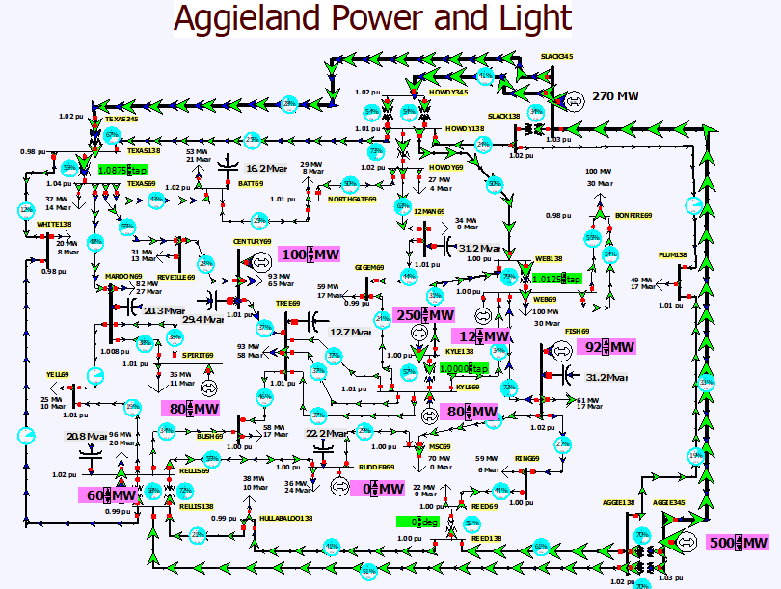
Power Flow Example in PowerWorld Simulator
The power flow concepts can be illustrated using a 37 bus grid
In PowerWorld Simulator are two main types of files: *.pwb files define the power grid model, and *.pwd files contain the display files
It has two main operating modes: Run Mode and Edit Mode; most 667 activities will use the Run Mode
Demo starts by opening case AGL_Bus37_PowerFlow
25

Slide 27
Slack (or Reference) Bus
In the power flow we can not arbitrarily specify S at all buses because total generation must equal total load + total losses
We also need an angle reference bus
To solve these problems we define one bus as the slack bus; this bus has a fixed voltage magnitude and angle, and a varying real/reactive power injection
The slack bus will not be needed in dynamic simulations though we will still need an angle reference
26

Slide 28
Three Traditional Types of Power Flow Buses
There are three traditional types of power flow buses
Load (PQ) at which P/Q are fixed; iteration solves for voltage magnitude and angle.
Slack at which the voltage magnitude and angle are fixed; iteration solves for P/Q injections
Generator (PV) at which P and |V| are fixed; iteration solves for voltage angle and Q injection
In dynamic simulations there will no longer be slack and PV buses
27

Slide 29
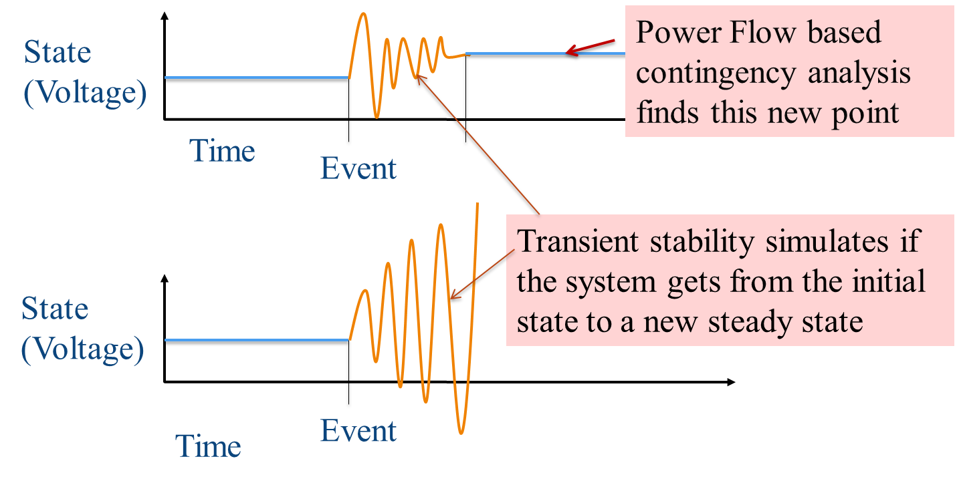
Power Flow and Dynamics
Power flow characterizes quasi-static equilibrium points in which the system frequency is nominal (e.g., 60 Hz0
28

Slide 30
Power Flow and Dynamics
Power flow determines quasi-steady state solution and provides the dynamics initial conditions
Transient stability is used to determine whether following a contingency the power system returns to a steady-state operating point
Goal is to solve a set of differential and algebraic equations, dx/dt = f(x,y) g(x,y) = 0
Starts in steady-state; hopefully returns to steady-state.
Models reflect the transient stability time frame (up to dozens of seconds), with some values assumed to be slow enough to hold constant while others are still fast enough to treat as algebraic
29

Slide 31
Power Flow to Transient Stability
With PowerWorld Simulator a power flow case can be quickly transformed into a transient stability case
This requires the addition of at least one dynamic model
PowerWorld Simulator supports hundreds of different dynamic models. ECEN 667 covers the major ones, with more being continually add
Default values are provided for most models allowing easy experimentation
Creating a new transient stability case from a power flow case would usually only be done for training/academic purposes; for commercial studies the dynamic models from existing datasets would be used.
30

Slide 32
First Example Case
Open the case Example_13_4_NoModels
Cases are on the class website
Add a dynamic generator model to an existing “no model” power flow case by:
In run mode, right-click on the generator symbol for bus 4, then select Generator Information Dialog” from the local menu
This displays the Generator Information Dialog, select the Stability tab to view the transient stability models; none are initially defined.
Select the Machine Models tab to enter a dynamic machine model for the generator at bus 4. Click Insert to enter a machine model. From the Model Type list select GENCLS, which represents a simple “Classical” machine model. Use the default values. Values are per unit using the generator MVA base.
31

Slide 33
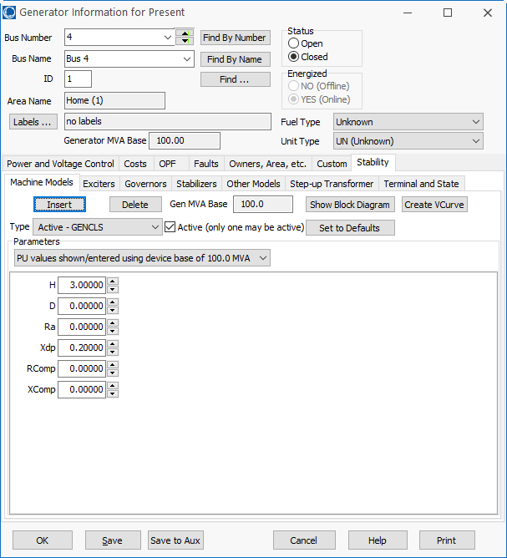
Adding a Machine Model
The GENCLS model represents the machine dynamics as a fixed voltage magnitude behind a transient impedance Ra + jXdp.
Press Ok when done to save the data and close the dialog
32

Slide 34
Transient Stability Form Overview
Most of the PowerWorld Simulator transient stability functionality is accessed using the Transient Stability Analysis Form. To view this form, from the ribbon select Add Ons, Transient Stability
Key pages of form for quick start examples (listed under Select Step)
Simulation page: Used for specifying the starting and ending time for the simulation, the time step, defining the transient stability fault (contingency) events, and running the simulation
Options: Various options associated with transient stability
Result Storage: Used to specify the fields to save and where they should be saved
Plots: Used to plot results
Results: Used to view the results (actual numbers, not plots)
33

Slide 35
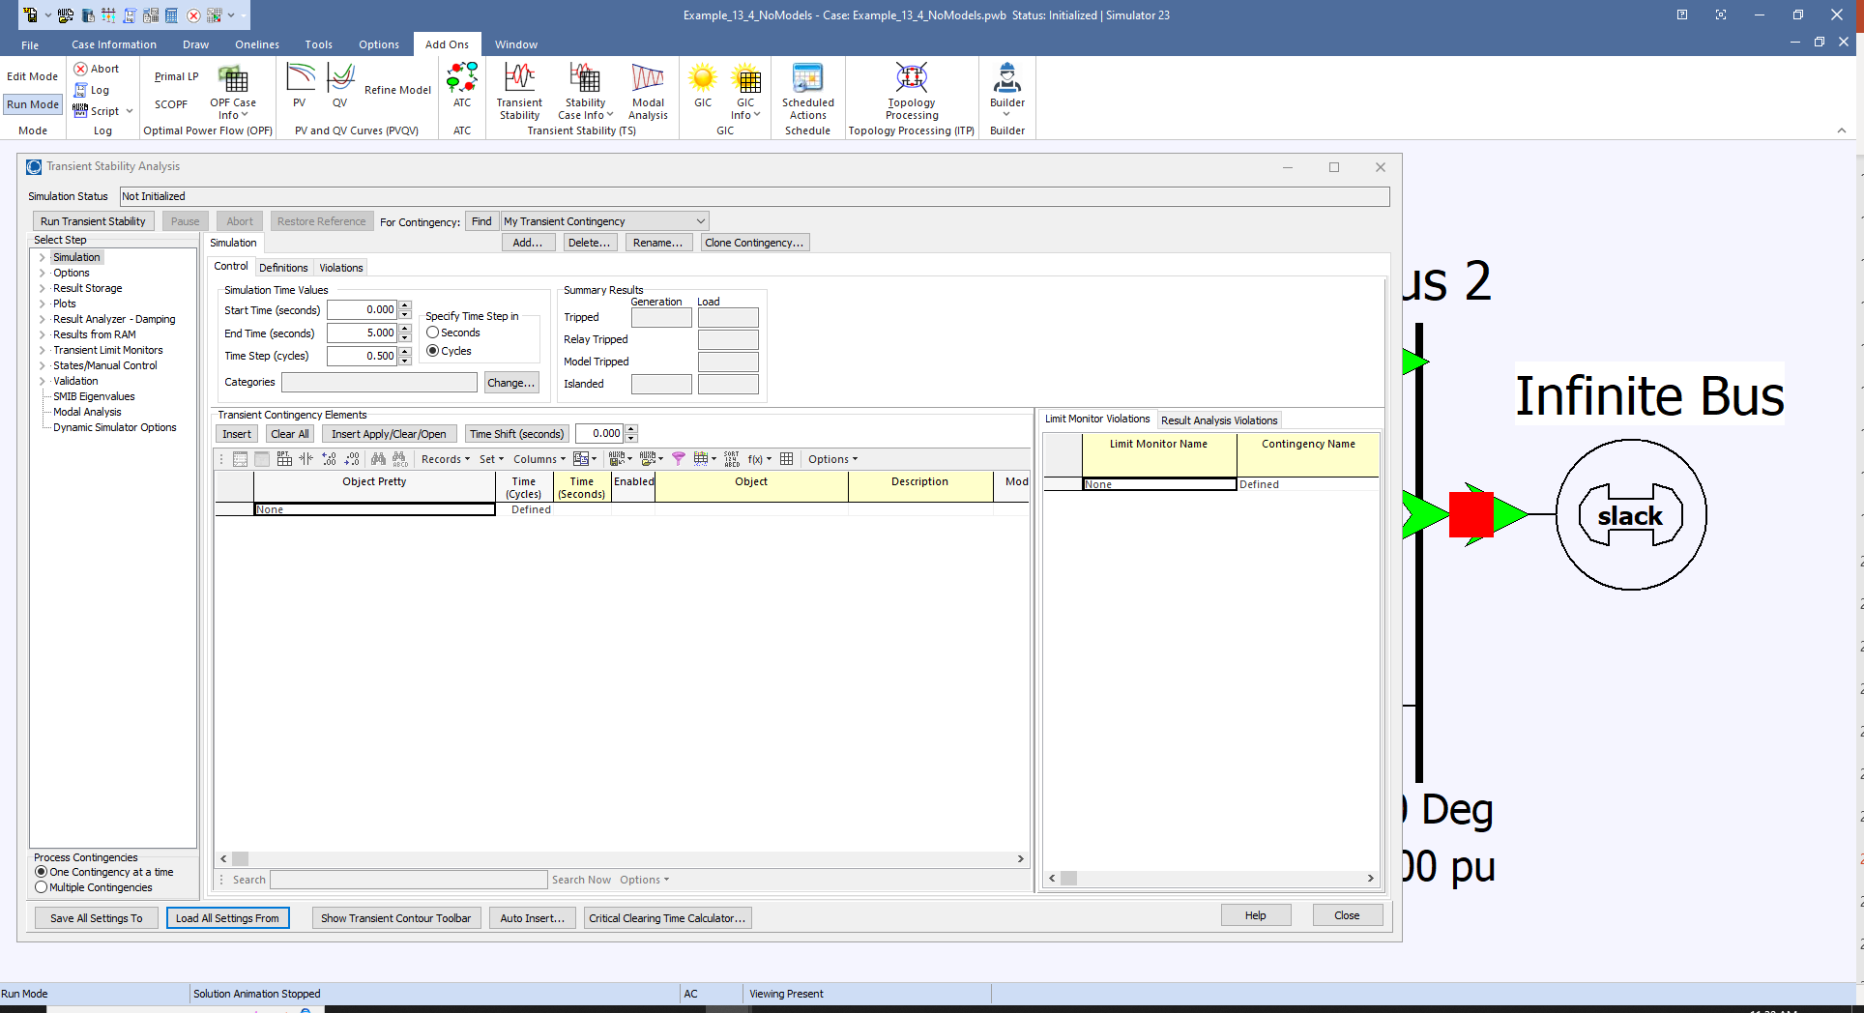
Transient Stability Overview Form
34

Slide 36
Infinite Bus Modeling
Before doing the first transient stability run, it is useful to discuss the concept of an infinite bus. As noted earlier, in the power flow an infinite bus is assumed to have a fixed voltage magnitude and angle; hence its frequency is also fixed at the nominal value
In real systems infinite buses obviously do not exist, but they can be a useful concept when learning about transient stability.
By default PowerWorld Simulator does NOT treat the slack bus as an infinite bus, but does provide this as an option.
For this first example we will use the option to treat the slack bus as an infinite bus. To do this select “Options” from the “Select Step” list. This displays the option page. Select the “Power System Model” tab, and then set Infinite Bus Modeling to “Model the power flow slack bus(es) as infinite buses” if it is not already set to do so.
35

