Slide 1
ECEN 667
Power System Stability
Lecture 11: Exciter Modeling
Prof. Tom Overbye
Dept. of Electrical and Computer Engineering
Texas A&M University
overbye@tamu.edu

Slide 2
Announcements
Read Chapter 5; look at Appendix A
Homework 3 should be done before the first exam, but does not need to be turned in.
First exam is on Tuesday October 3 during class (except for the distance education students)
  It is closed-book and closed-notes, but one 8.5 by 11 inch hand written note sheet and calculators allowed
  My first exam from ECEN 667 in Fall 2021 has been posted to Canvas
1

Slide 3
Block Diagram Basics
The following slides will make use of block diagrams to explain some of the models used in power system dynamic analysis. The next few slides cover some of the block diagram basics.
To simulate a model represented as a block diagram, the equations need to be represented as a set of first order differential equations
Also the initial state variable and reference values need to be determined
2

Slide 4
Integrator Block
Equation for an integrator with u as an input and y as an output is
In steady-state with an initial output of y₀, the initial state is y₀ and the initial input is zero
u
y
3

Slide 5
First Order Lag Block
Equation with u as an input and y as an output is
In steady-state with an initial output of y₀, the initial state is y₀ and the initial input is y₀/K
Commonly used for measurement delay (e.g., T_{R} block with IEEE T1)
Input
u
y
Output of Lag Block
4

Slide 6
Derivative Block
Block takes the derivative of the input, with scaling K_{D} and a first order lag with T_{D}
  Physically we can't take the derivative without some lag
  An example is the feedback block in the IEEET1 model
In steady-state the output of the block is zero
State equations require a more general approach
u
y
5

Slide 7
State Equations for More Complicated Functions
There is not a unique way of obtaining state equations for more complicated functions with a general form
To be physically realizable we need n >= m
6

Slide 8
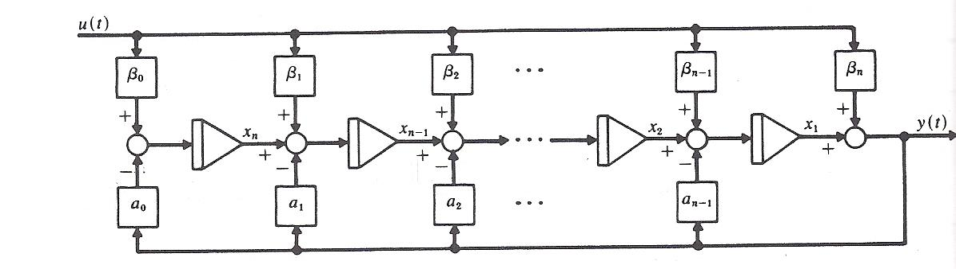
General Block Diagram Approach
One integration approach is illustrated in the below block diagram
Image source: W.L. Brogan, Modern Control Theory, Prentice Hall, 1991, Figure 3.7
7

Slide 9
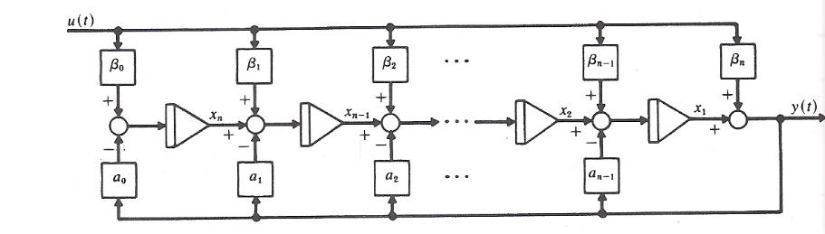
Derivative Example
Write in form
Hence β₀=0, β₁=K_{D}/T_{D}, α₀=1/T_{D}
Define single state variable x, then
Initial value of
x is found by recognizing
y is zero so x = -β₁u
8

Slide 10
Lead-Lag Block
In exciters such as the EXDC1 the lead-lag block is used to model time constants inherent in the exciter; the values are often zero (or equivalently equal)
In steady-state the input is equal to the output
To get equations write
in form with β₀=1/T_{B}, β₁=T_{A}/T_{B},
α₀=1/T_{B}
input
The steady-state requirement that u = y is readily apparent
u
y
Output of Lead/Lag
9

Slide 11
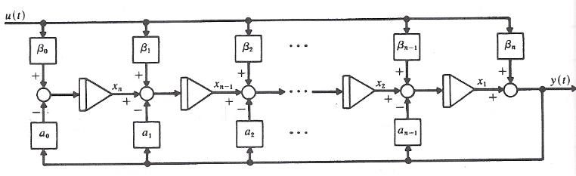
Lead-Lag Block
The equations are with
then
β₀=1/T_{B}, β₁=T_{A}/T_{B},
α₀=1/T_{B}
10

Slide 12
Limits: Windup versus Nonwindup
When there is integration, how limits are enforced can have a major impact on simulation results
Two major flavors: windup and non-windup
Windup limit for an integrator block
The value of v is NOT limited, so its value can "windup" beyond the limits, delaying backing off of the limit
L_{max}
v
u
y
L_{min}
If L_{min} ≤ v ≤ L_{max} then y = v
else If v < L_{min} then y = L_{min},
else if v > L_{max} then y = L_{max}
11

Slide 13
Limits on First Order Lag
Windup and non-windup limits are handled in a similar manner for a first order lag
L_{max}
v
u
y
If L_{min} ≤ v ≤ L_{max} then y = v
else If v < L_{min} then y = L_{min},
else if v > L_{max} then y = L_{max}
L_{min}
Again the value of v is NOT limited, so its value can "windup" beyond the limits, delaying backing off of the limit
12

Slide 14
Non-Windup Limit First Order Lag
With a non-windup limit, the value of y is prevented from exceeding its limit
L_{max}
u
y
L_{min}
13

Slide 15
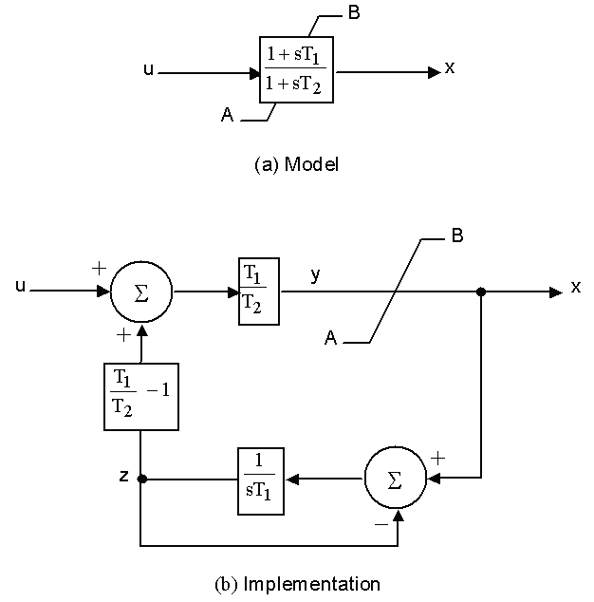
Lead-Lag Non-Windup Limits
There is not a unique way to implement non-windup limits for a lead-lag. This is the one from
IEEE 421.5-1995 (Figure E.6)
T₂ > T₁, T₁ > 0, T₂ > 0
If y > B, then x = B
If y < A, then x = A
If B ≥y ≥ A, then x = y
14

Slide 16
Ignored States
When integrating block diagrams often states are ignored, such as a measurement delay with T_{R}=0
In this case the differential equations just become algebraic constraints
Example: For block at right,
as T→0, v=Ku
With lead-lag it is quite common for T_{A}=T_{B}, resulting in the block being ignored
L_{max}
v
u
y
L_{min}
15

Slide 17
Brief Review of DC Machines
Prior to widespread use of machine drives, dc motors had a important advantage of easy speed control
On its stator a dc machine has either a permanent magnet or a single concentrated winding
Rotor (armature) currents are supplied through brushes and the commutator
Equations are
The f subscript refers to the field, the a to the armature; ω_{m} is the machine's speed, G is a constant. In a permanent magnet machine the field flux is constant, the field equation goes away, and the field impact is embedded in a equivalent constant to G i_{f}
Taken mostly from M.A. Pai, Power Circuits and Electromechanics
16

Slide 18
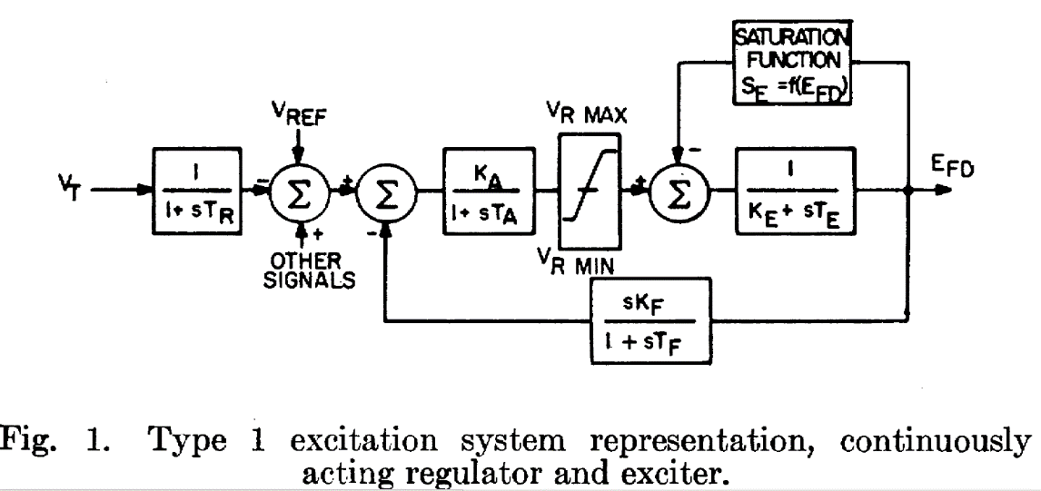
Review of DC Machines
The purpose of the next few slides is to provide insight into the source of portions of the block diagrams for various types of exciters
17

Slide 19
Types of DC Machines
If there is a field winding (i.e., not a permanent magnet machine) then the machine can be connected in the following ways
  Separately-excited: Field and armature windings are connected to separate power sources
    For an exciter, control is provided by varying the field current (which is stationary), which changes the armature voltage
  Series-excited: Field and armature windings are in series
  Shunt-excited: Field and armature windings are in parallel
18

Slide 20
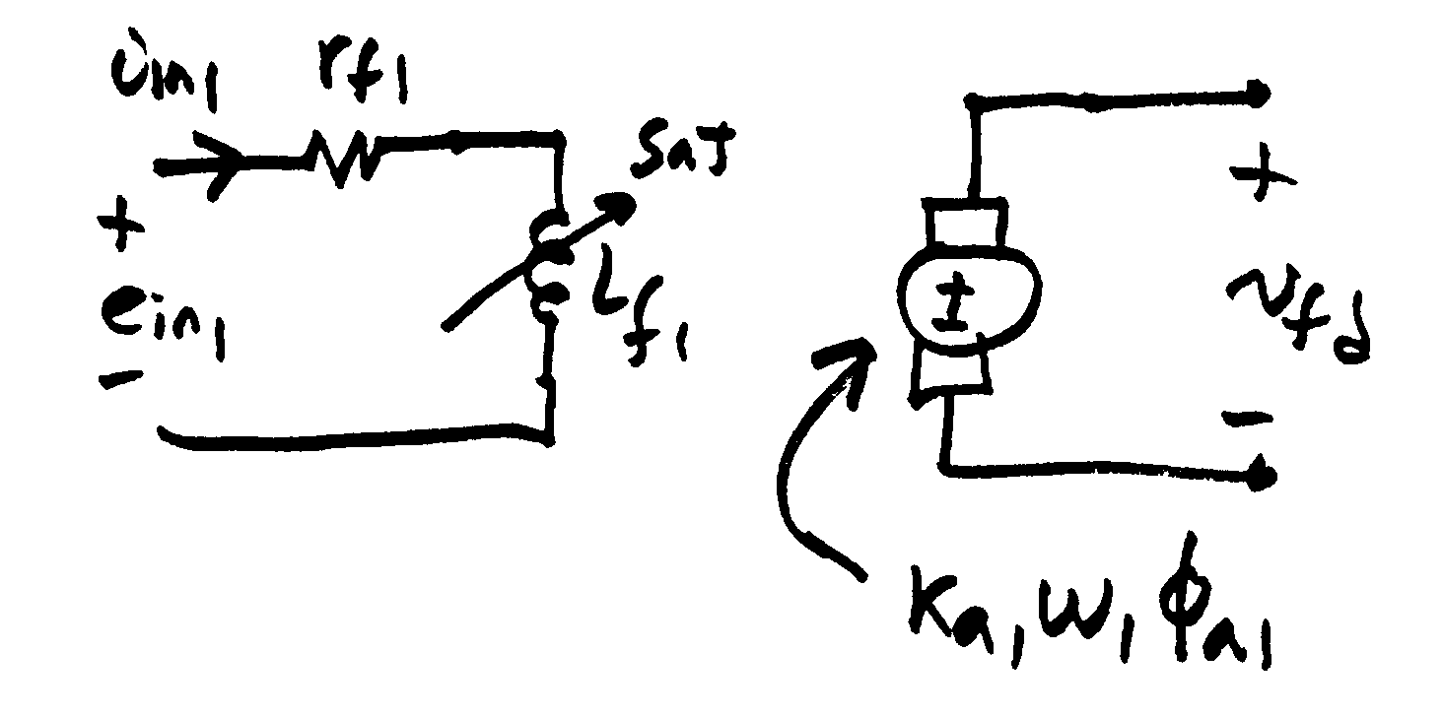
Separately Excited DC Exciter
(to the synchronous machine)
σ₁ is coefficient of dispersion,
modeling the flux leakage
19

Slide 21
Separately Excited DC Exciter
Relate the input voltage, e_{in1}, to v_{fd}
Assuming a constant speed ω₁
Solve above for φ_{f1} which was used
in the previous slide
20

Slide 22
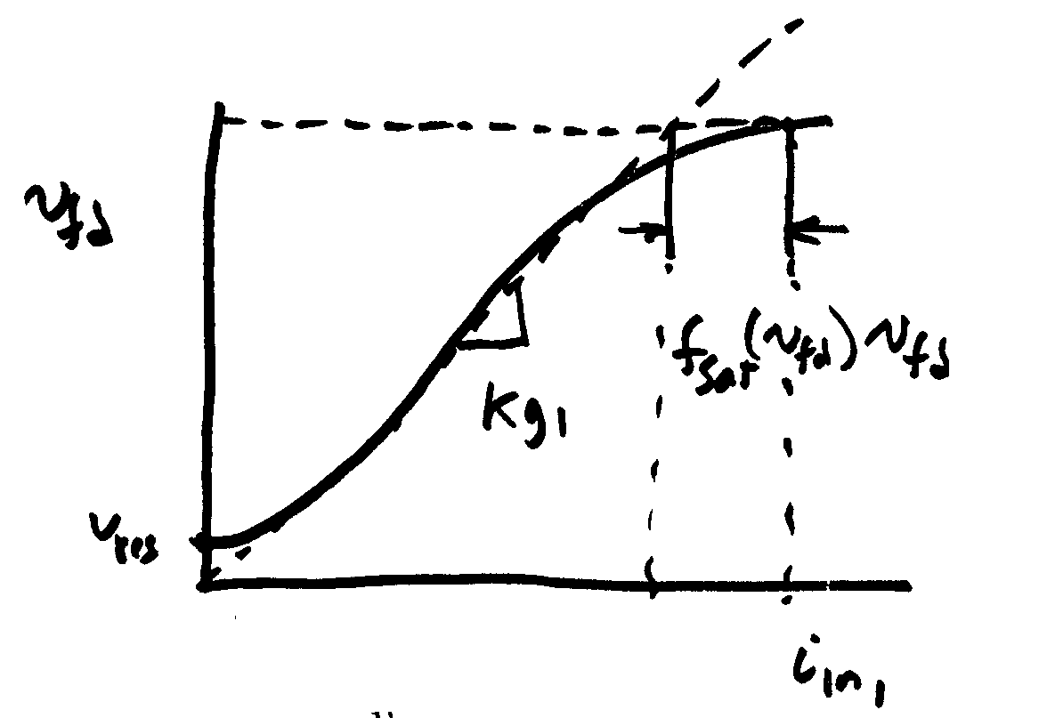
Separately Excited DC Exciter
If it was a linear magnetic circuit, then v_{fd} would be proportional to i_{n1}; for a real system we need to account for saturation
Without saturation we can write
21

Slide 23
Separately Excited DC Exciter
This equation is then scaled based on the synchronous
machine base values
22

Slide 24
Separately Excited Scaled Values
V_{R} is the scaled output of the
voltage regulator amplifier
Thus we have
23

Slide 25
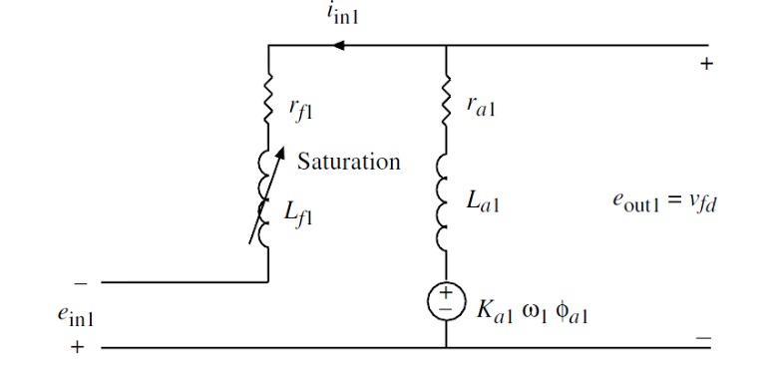
The Self-Excited Exciter
When the exciter is self-excited, the amplifier voltage appears in series with the exciter field
Note the additional
E_{fd} term on the end
24

Slide 26
Self and Separated Excited Exciters
The same model can be used for both by just modifying the value of K_{E}
25

Slide 27
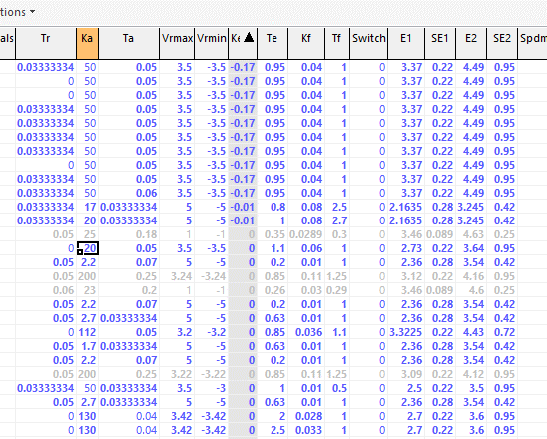
Exciter Model IEEET1 K_{E} Values
Example IEEET1 Values from a large system
The K_{E} equal 1 are separately excited, and K_{E} close to zero are self excited
26

Slide 28
Saturation
A number of different functions can be used to represent the saturation
The quadratic approach is now quite common
Exponential function could also be used
This is the same
function used with
the machine models
27

Slide 29
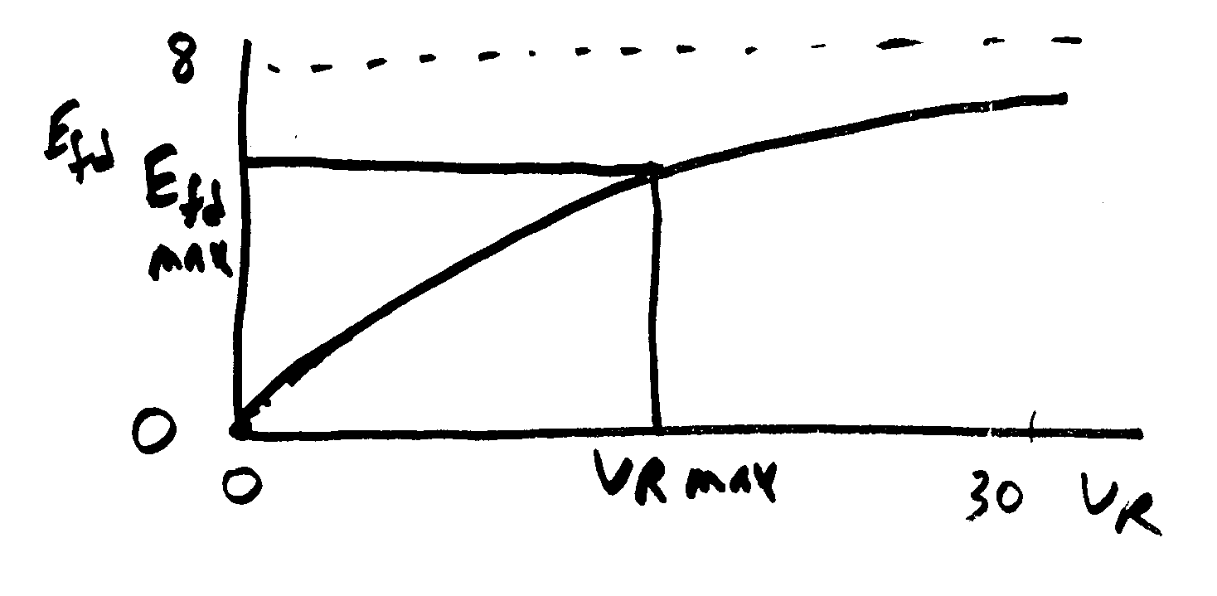
Exponential Saturation
In Steady state
28

Slide 30
Exponential Saturation Example
Given:
Find:
29

Slide 31
Voltage Regulator Model
Amplifier
Modeled as a first
order differential equation
In steady state
As K_{A} is increased
There is often a droop in regulation
30

Slide 32
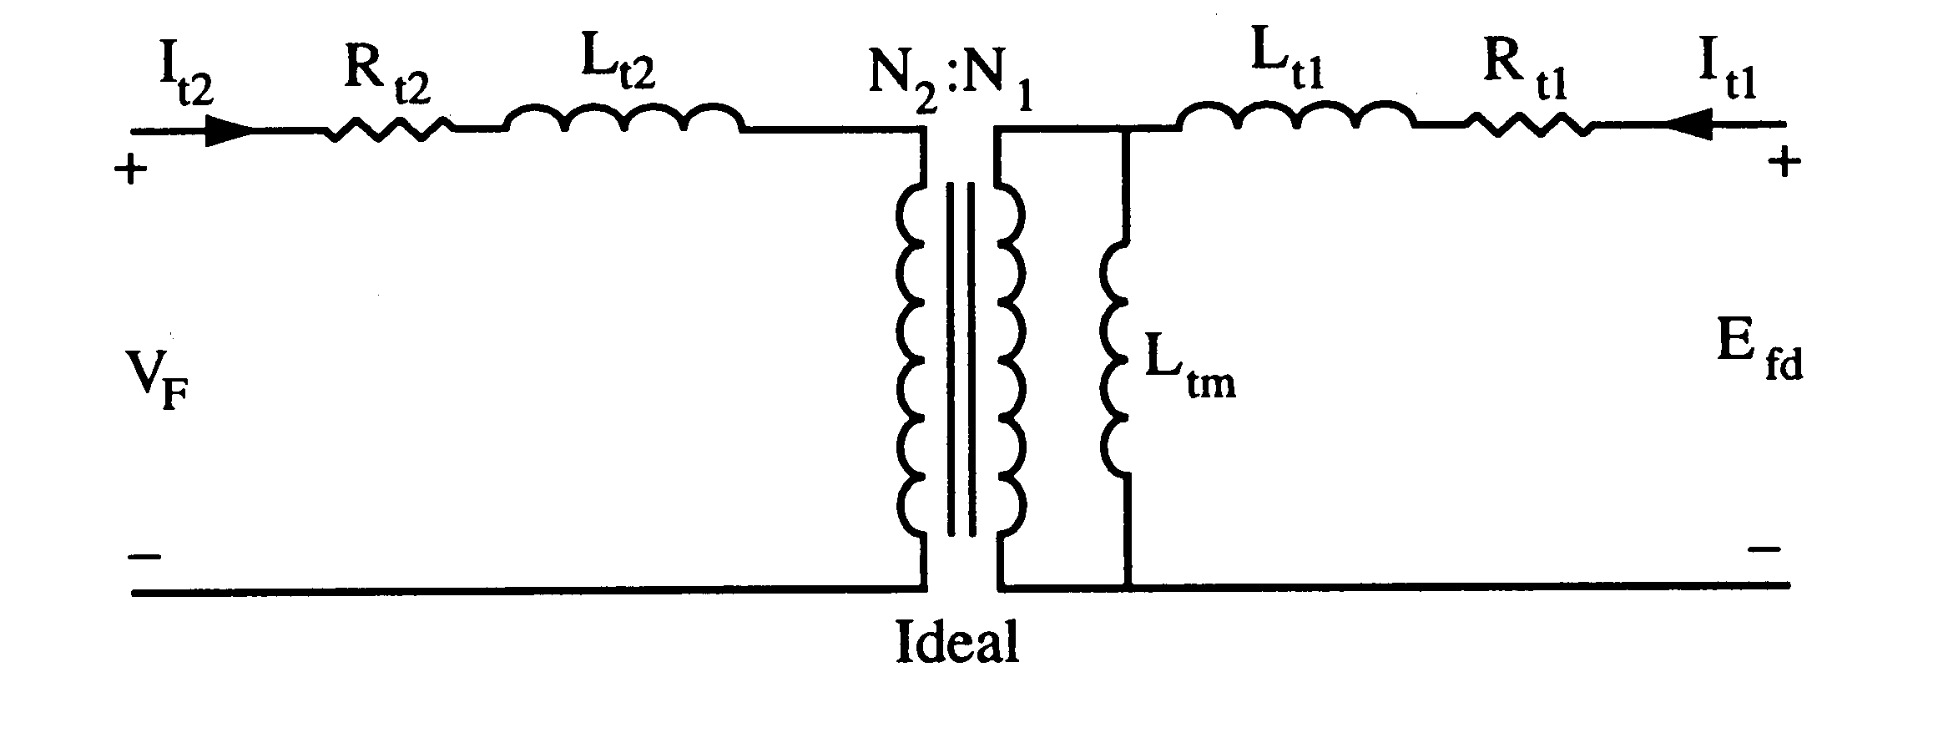
Feedback
This control system can often exhibit instabilities, so some type of feedback is used
One approach is a stabilizing transformer
Designed with a large L_{t2} so I_{t2} ≈ 0
31

Slide 33
Feedback
32

Slide 34
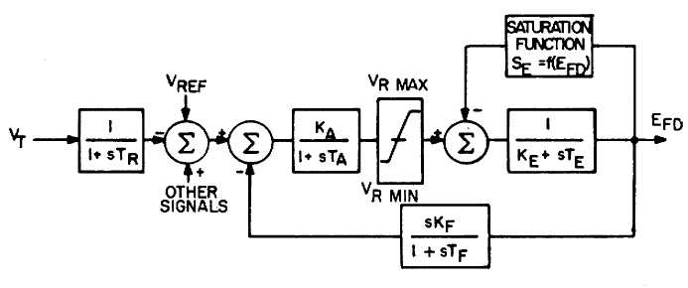
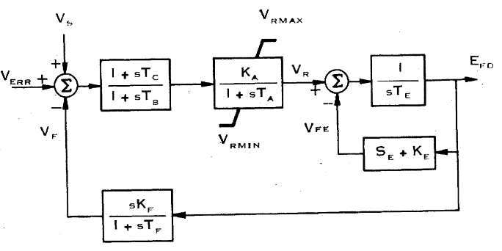
IEEET1 Model Evolution
The original IEEET1, from 1968, evolved into the EXDC1 in 1981
1968
1981
Note, K_{E} in the feedback is the same in both models
Image Source: Fig 3 of "Excitation System Models for Power Stability Studies," IEEE Trans. Power App. and Syst., vol. PAS-100, pp. 494-509, February 1981
33

Slide 35
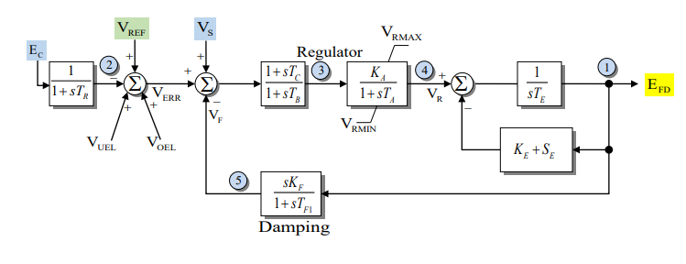
IEEEX1
This is from 1979, and is the EXDC1 with the potential for a measurement delay and inputs for under or over excitation limiters
34

Slide 36
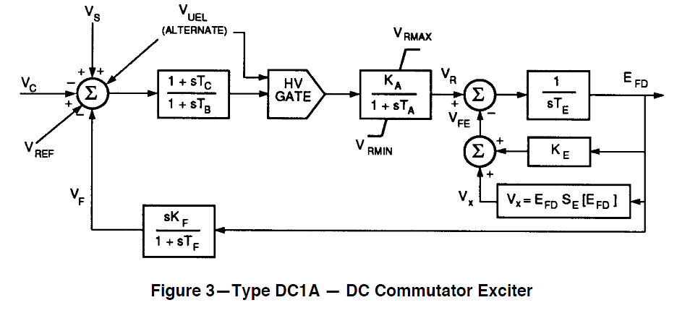
IEEET1 Evolution
In 1992 IEEE Std 421.5-1992 slightly modified the EXDC1, calling it the DC1A (modeled as ESDC1A)
V_{UEL} is a signal
from an under-
excitation limiter,
which we'll cover later
Same model is in 421.5-2005
Image Source: Fig 3 of IEEE Std 421.5-1992
35

Slide 37
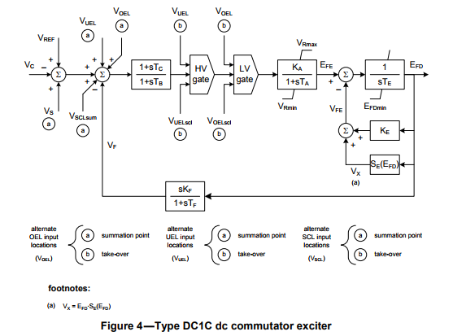
IEEET1 Evolution
Slightly modified in Std 421.5-2016
Note the minimum
limit on E_{FD}
There is also the addition to the input of voltages from a stator current limiters (V_{SCL}) or over excitation limiters (V_{OEL})
36

Slide 38
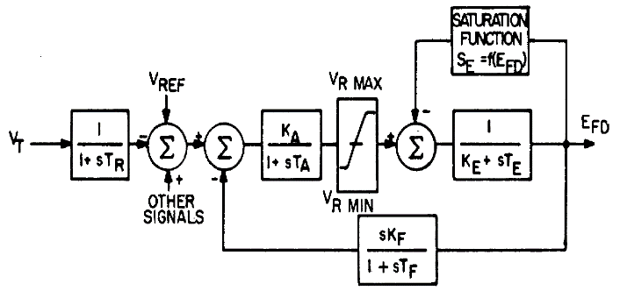
IEEET1 Example
Assume previous GENROU case with saturation. Then add a IEEE T1 exciter with K_{A}=50, T_{A}=0.04, K_{E}=-0.06, T_{E}=0.6, V_{R,max}=1.0, V_{R,min}= -1.0 For saturation assume S_{E}(2.8) = 0.04, S_{E}(3.73)=0.33
Saturation function is 0.1621(E_{FD}-2.303)² (for E_{FD} > 2.303); otherwise zero
E_{FD} is initially 3.22
S_{E}(3.22)*E_{FD}=0.437
(V_{R}-S_{E}*E_{FD})/K_{E}=E_{FD}
V_{R} =0.244
V_{REF} = 0.244/Ka +V_{T} =0.0488 +1.0946=1.09948
Case B4_GENROU_Sat_IEEET1
37

Slide 39
IEEE T1 Example
For 0.1 second fault (from before), plot of E_{FD} and the terminal voltage is given below
Initial V₄=1.0946, final V₄=1.0973
  Steady-state error depends on the value of K_{A}
38

Slide 40
IEEET1 Example
Same case, except with K_{A}=500 to decrease steady-state error, no V_{R} limits; this case is actually unstable
39

Slide 41
IEEET1 Example
With K_{A}=500 and rate feedback, K_{F}=0.05, T_{F}=0.5
Initial V₄=1.0946, final V₄=1.0957
40

Slide 42
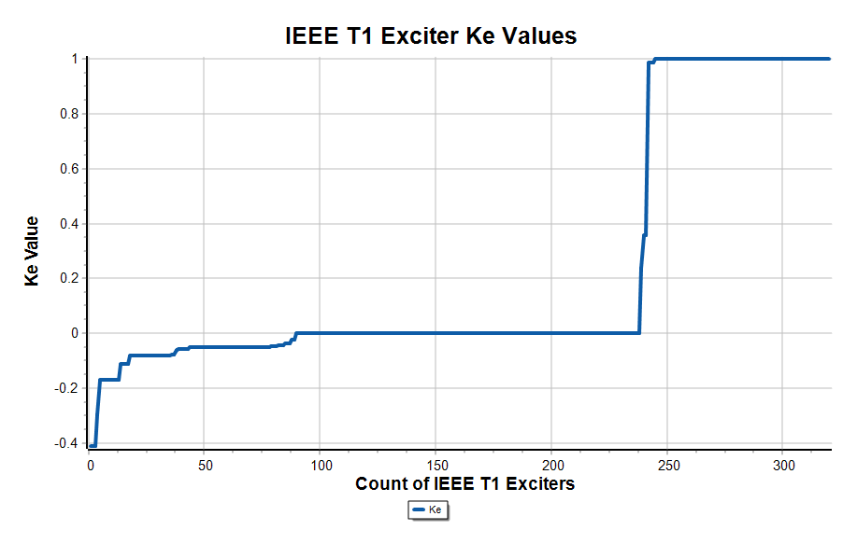
Combined EI/WECC Case Type 1 Exciters
In a recent combined EI/WECC case with about 11,000 exciters, 320 are modeled with the IEEE T1, 129 with IEEE X1, 147 with the EXDC1, and 162 with the ESDC1A
Graph shows K_{E} value for the IEEE T1 exciters in case; about 1/4 are separately excited (K_{E} =1, and
the rest self excited
  A value of K_{E} equal zero
  indicates code should
  set K_{E} so V_{r} initializes
  to zero; this is used to mimic
  the operator action of trimming
  this value
41

Slide 43
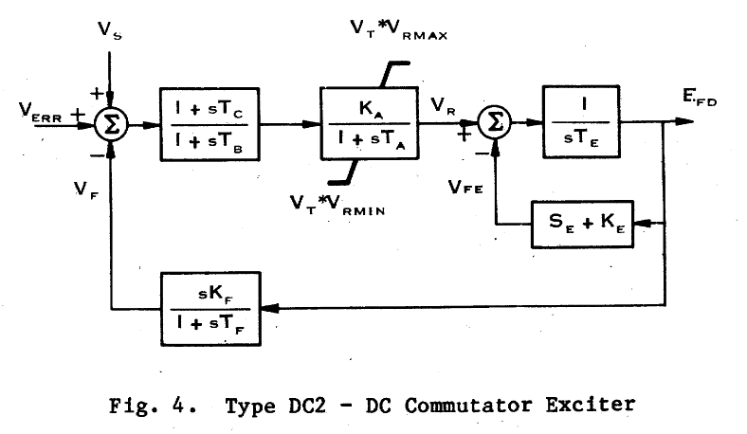
DC2 Exciters
Other dc exciters exist, such as the EXDC2, which is quite similar to the EXDC1
Vr limits are
multiplied by the terminal voltage
Image Source: Fig 4 of "Excitation System Models for Power Stability Studies," IEEE Trans. Power App. and Syst., vol. PAS-100, pp. 494-509, February 1981
42

Slide 44
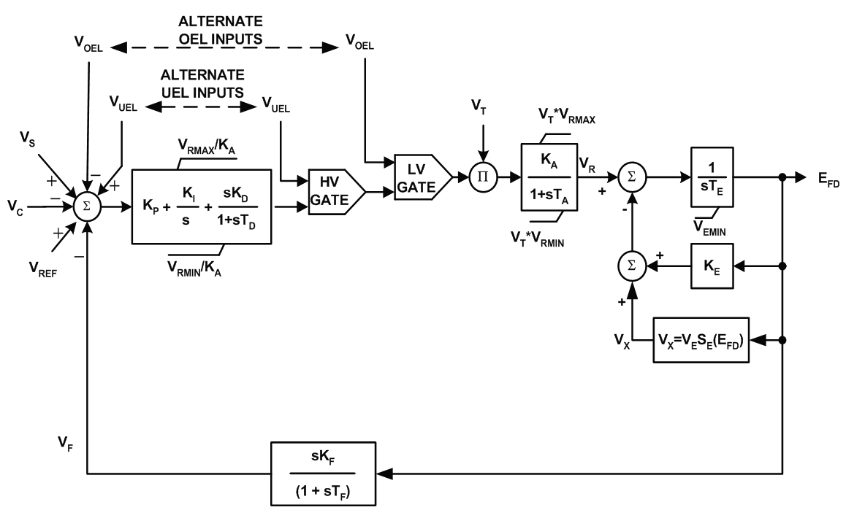
ESDC4B
A newer dc model introduced in 421.5-2005 in which a PID controller is added; might represent a retrofit
Image Source: Fig 5-4 of IEEE Std 421.5-2005
43

Slide 45
AC Exciters
Almost all new exciters use an ac source with an associated rectifier (either from a machine or static)
AC exciters use an ac generator and either stationary or rotating rectifiers to produce the field current
  In stationary systems the field current is provided through slip rings
  In rotating systems since the rectifier is rotating there is no need for slip rings to provide the field current
  Brushless systems avoid the anticipated problem of supplying high field current through brushes, but these problems have not really developed
44

Slide 46
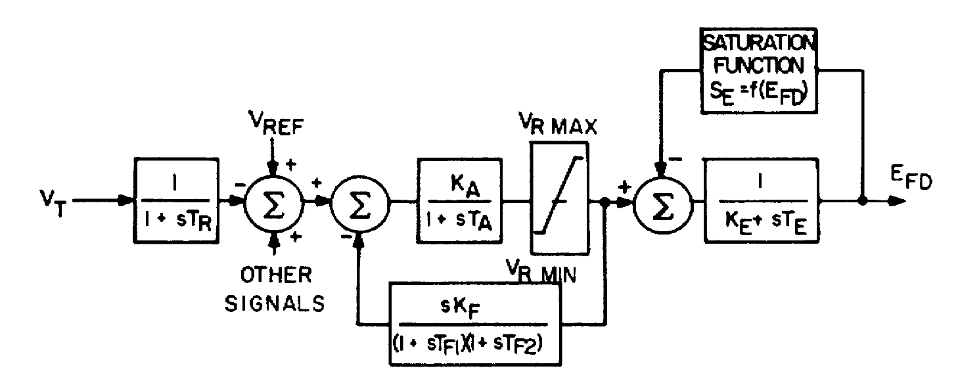
AC Exciter Modeling
  Originally represented by IEEE T2 shown below
Exciter model is quite
similar to IEEE T1; in the EI/WECC case there are 105 IEEE T2 exciters (about 1%)
Image Source: Fig 2 of "Computer Representation of Excitation Systems," IEEE Trans. Power App. and Syst., vol. PAS-87, pp. 1460-1464, June 1968
45

Slide 47
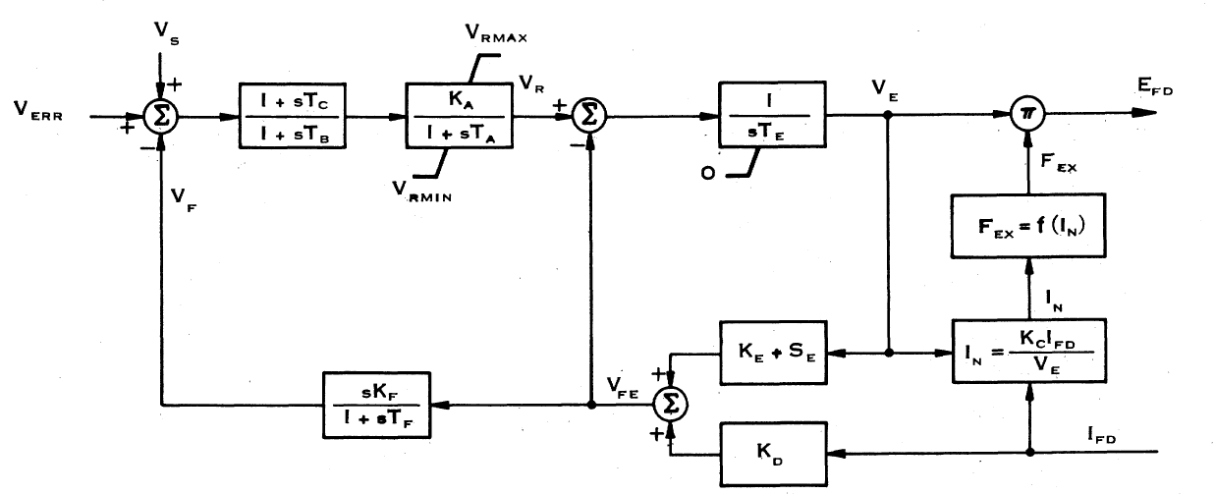
EXAC1 Exciter
The F_{EX} function represent the rectifier regulation, which results in a decrease in output voltage as the field current is increased
About 1% of the EI/WECC exciters
are EXAC1
K_{D} models the exciter machine reactance
Image Source: Fig 6 of "Excitation System Models for Power Stability Studies," IEEE Trans. Power App. and Syst., vol. PAS-100, pp. 494-509, February 1981
46

Slide 48
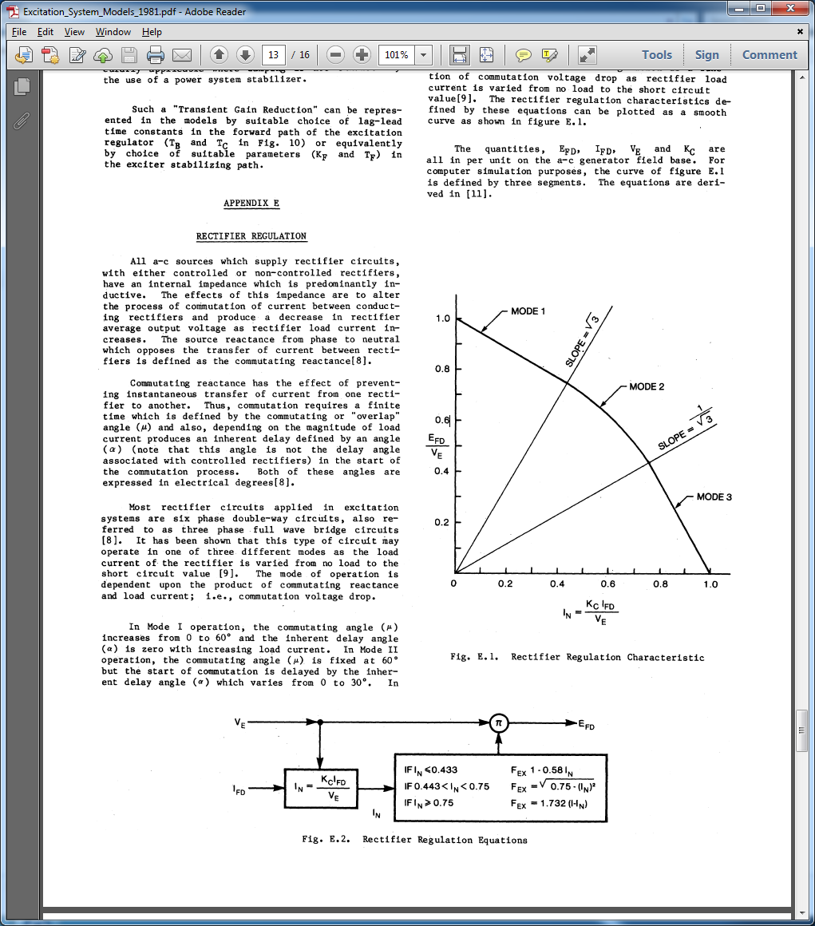
EXAC1 Rectifier Regulation
Kc represents the
commuting reactance
There are about 6 or 7 main types of ac exciter models
Image Source: Figures E.1 and E.2 of "Excitation System Models for Power Stability Studies," IEEE Trans. Power App. and Syst., vol. PAS-100, pp. 494-509, February 1981
47

Slide 49
Initial State Determination, EXAC1
To get initial states E_{fd}
and I_{fd} would be known
and equal
Solve V_{e}*F_{ex}(I_{fd},V_{e}) = E_{fd}
  Easy if Kc=0, then In=0 and F_{ex} =1
  Otherwise the F_{EX} function is represented
  by three piecewise functions; need to figure out the correct segment; for example for Mode 3
Need to check to make sure we are on this segment
48

Slide 50
Static Exciters
In static exciters the field current is supplied from a three phase source that is rectified (i.e., there is no separate machine)
Rectifier can be either controlled or uncontrolled
Current is supplied through slip rings
Response can be quite rapid
49

Slide 51
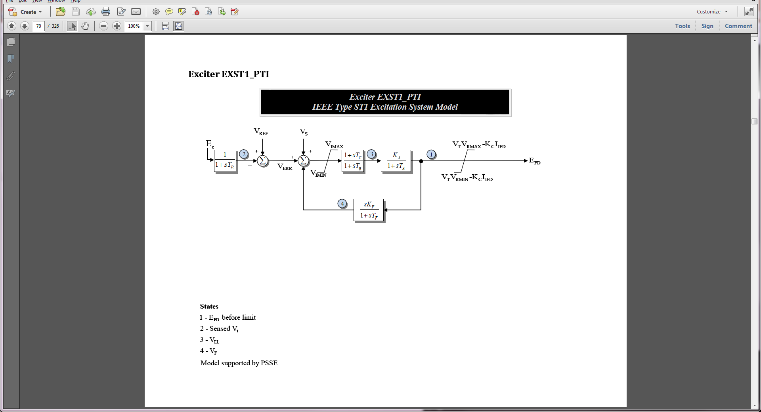
EXST1 Block Diagram
The EXST1 is intended to model rectifier in which the power is supplied by the generator's terminals via a transformer
  Potential-source controlled-rectifier excitation system
The exciter time constants are assumed to be so small they are not represented
This (and the related ESST1A) is a very common exciter (about 14% of EI/WECC total)
Kc represents the commuting reactance
50

Slide 52
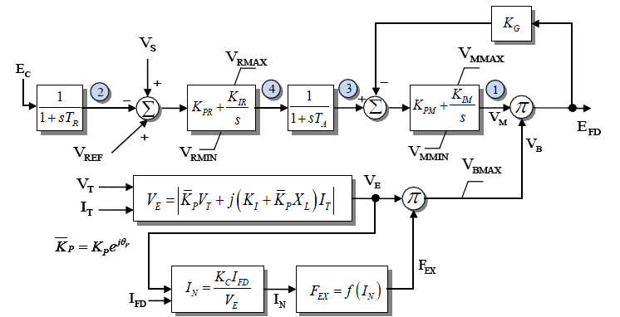
EXST4B
EXST4B models a controlled rectifier design; field voltage loop is used to make output independent of supply voltage
This (and the related ESST4B) are the most common exciters (about 20% of the total); V_{e} is
almost always independent of I_{T}
51

Slide 53
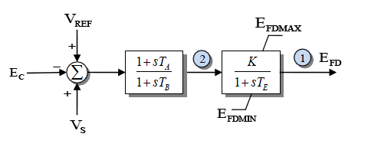
Simplified Excitation System Model
A very simple model call Simplified EX System (SEXS) is available
  Not now commonly used; also other, more detailed models, can match this behavior by setting various parameters to zero
52

Slide 54
Desired Performance
A discussion of the desired performance of exciters is contained in IEEE Std. 421.2-2014 (update from 1990)
Concerned with
  large signal performance: large, often discrete change in the voltage such as due to a fault; nonlinearities are significant
    Limits can play a significant role
  small signal performance: small disturbances in which close to linear behavior can be assumed
Increasingly exciters have inputs from power system stabilizers, so performance with these signals is important
53

Slide 55
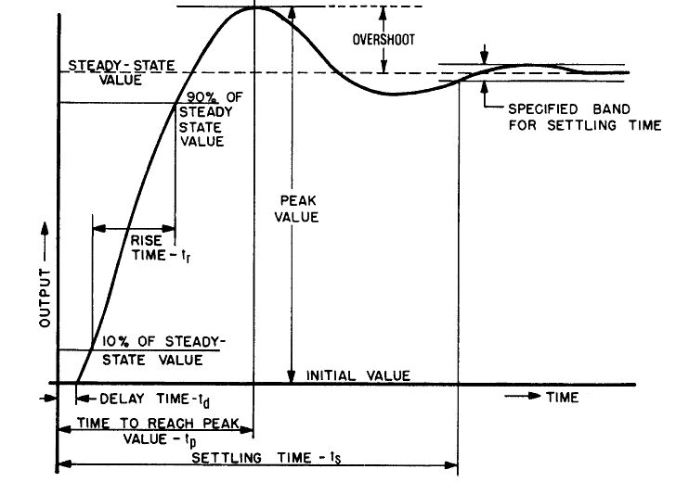
Transient Response
Figure shows typical transient response performance to a step change in input
Image Source: IEEE Std 421.2-1990, Figure 3
54

Slide 56
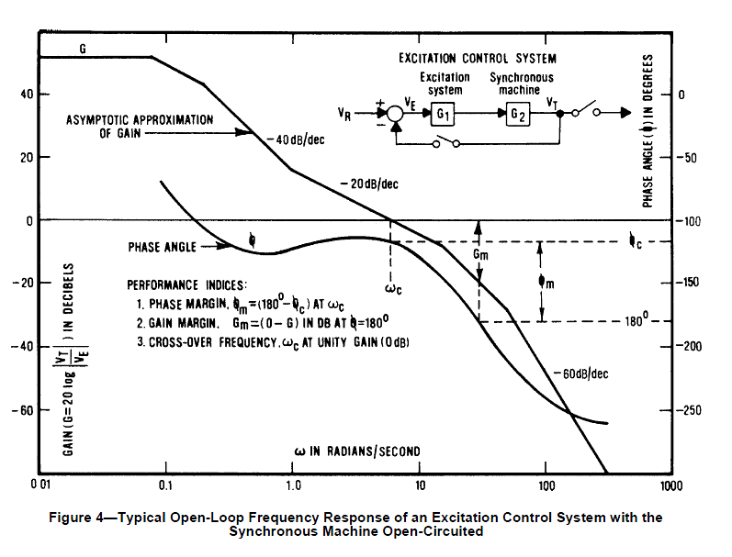
Small Signal Performance
Small signal performance can be assessed by either the time responses, frequency response, or eigenvalue analysis
Figure shows the
typical open loop
performance of
an exciter and
machine in
the frequency
domain
Image Source: IEEE Std 421.2-1990, Figure 4
55

