Slide 1
ECEN 667
Power System Stability
Lecture 15: Time-Domain Simulation Solutions (Transient Stability)
Prof. Tom Overbye
Dept. of Electrical and Computer Engineering
Texas A&M University
overbye@tamu.edu

Slide 2
Announcements
Read Chapters 4 and 7
Homework 4 is due today
Homework 5 is due on Tuesday Oct 31
IEEE Spectrum did have a nice biographical article on Charlie Concordia in 1999 (when he won the IEEE Medal of Honor at age 91)
  He joined GE in 1926; his best contribution (he noted) was, “to increase the understanding of the dynamics of power systems”
1

Slide 3

Energy and Power Group Seminar on Oct 20

Slide 4

A Power System Dynamics Giant: Charlie Concordia
IEEE Spectrum did have a nice
biographical article on Charlie
Concordia in 1999 (when he won the
IEEE Medal of Honor at age 91)
  He joined GE in 1926; his best contribution (he
  noted) was, “to increase the understanding of
  the dynamics of power systems”
  Image at right is from the IEEE Spectrum
  article; he passed away in 2003 at age 95
  Thomas Edison, who founded a company
  that became part of GE at its founding,
  died in 1931

Slide 5
Classical Swing Equation
Often in an introductory coverage of transient stability with the classical model the assumption is ω ≈ ω_{s} so the swing equation for the classical model is given as
We'll use this simplification for our initial example
As an example of this initial approach see Anderson and Fouad, Power System Control and Stability, 2nd Edition, Chapter 2 (with a newer version third edition of this book now available adding Vijay Vittal and Jim McCalley as authors).
4

Slide 6
Numerical Solution
There are two main approaches for solving
  Partitioned-explicit: Solve the differential and algebraic equations separately (alternating between the two) using an explicit integration approach
  Simultaneous-implicit: Solve the differential and algebraic equations together using an implicit integration approach
5

Slide 7
Outline of the Solution Process
The next group of slides will provide basic coverage of the solution process, partitioned explicit, then the simultaneous-implicit approach
We'll start out with a classical model supplying an infinite bus, which can be solved by embedded the algebraic constraint into the differential equations
6

Slide 8
Classical Swing Equation with Power Balance
With a classical generator at bus i supplying an infinite bus with voltage magnitude V_{inf}, we can write the problem without algebraic constraints as
Note we are using the per unit speed approach
7

Slide 9
Explicit Integration Methods
As covered during the first week of class, there are a wide variety of explicit integration methods
  We considered Forward Euler, Runge-Kutta, Adams-Bashforth
Here we will just consider Euler's, which is easy to explain but not too useful, and a second order Runge-Kutta, which is commonly used
8

Slide 10
Forward Euler
Recall the Forward Euler approach is approximate
Error with Euler's varies with the square of the time step
9

Slide 11
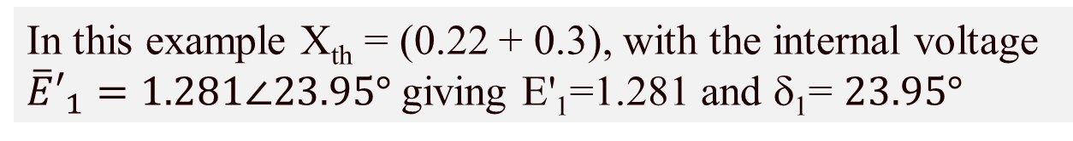
Infinite Bus GENCLS Example using the Forward Euler's Method
Use the four bus system from before, except now gen 4 is modeled with a classical model with X_{d}'=0.3, H=3 and D=0; also we'll reduce to two buses with equivalent line reactance, moving the gen from bus 4 to 1
In this example X_{th} = (0.22 + 0.3), with the internal voltage
${\overline{E}′}_{1}=1.281∠23.95°$ giving E'₁=1.281 and δ₁= $23.95°$
10

Slide 12
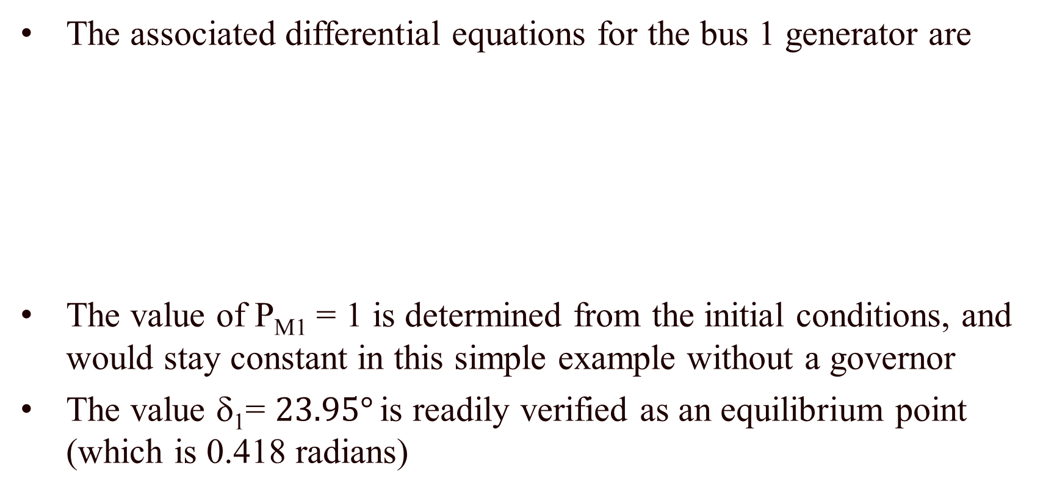
Infinite Bus GENCLS Example
The associated differential equations for the bus 1 generator are
The value of P_{M1} = 1 is determined from the initial conditions, and would stay constant in this simple example without a governor
The value δ₁= $23.95°$ is readily verified as an equilibrium point (which is 0.418 radians)
11

Slide 13
Infinite Bus GENCLS Example
Assume a solid three phase fault is applied at the generator terminal, reducing P_{E1} to zero during the fault, and then the fault is self-cleared at time T^{clear}, resulting in the post-fault system being identical to the pre-fault system
  During the fault-on time the equations reduce to
That is, with a solid fault on the terminal of the generator, during
the fault P_{E1} = 0
12

Slide 14
Euler's Solution
The initial value of x is
Assuming a time step Δt = 0.02 seconds, and a T^{clear} of 0.1 seconds, then using Euler’s
Iteration continues until t = T^{clear}
Note Euler's assumes
δ stays constant during the first time step
13

Slide 15
Euler's Solution
At t = T^{clear} the fault is self-cleared, with the equations changing to
The integration continues using the new equations
14

Slide 16
Euler's Solution Results (Δt=0.02)
The below table gives the results using Δt = 0.02 for the beginning time steps
This is saved as PowerWorld case
B2_CLS_Infinite. The integration
method is set to Euler's on the Transient Stability, Options, Power System Model page
Time | Gen 1 Rotor Angle, Degrees | Gen 1 Speed (Hz)
0 | 23.9462 | 60
0.02 | 23.9462 | 60.2
0.04 | 25.3862 | 60.4
0.06 | 28.2662 | 60.6
0.08 | 32.5862 | 60.8
0.1 | 38.3462 | 61
0.1 | 38.3462 | 61
0.12 | 45.5462 | 60.8943
0.14 | 51.9851 | 60.7425
0.16 | 57.3314 | 60.5543
0.18 | 61.3226 | 60.3395
0.2 | 63.7672 | 60.1072
0.22 | 64.5391 | 59.8652
0.24 | 63.5686 | 59.6203
0.26 | 60.8348 | 59.3791
0.28 | 56.3641 | 59.1488
15

Slide 17
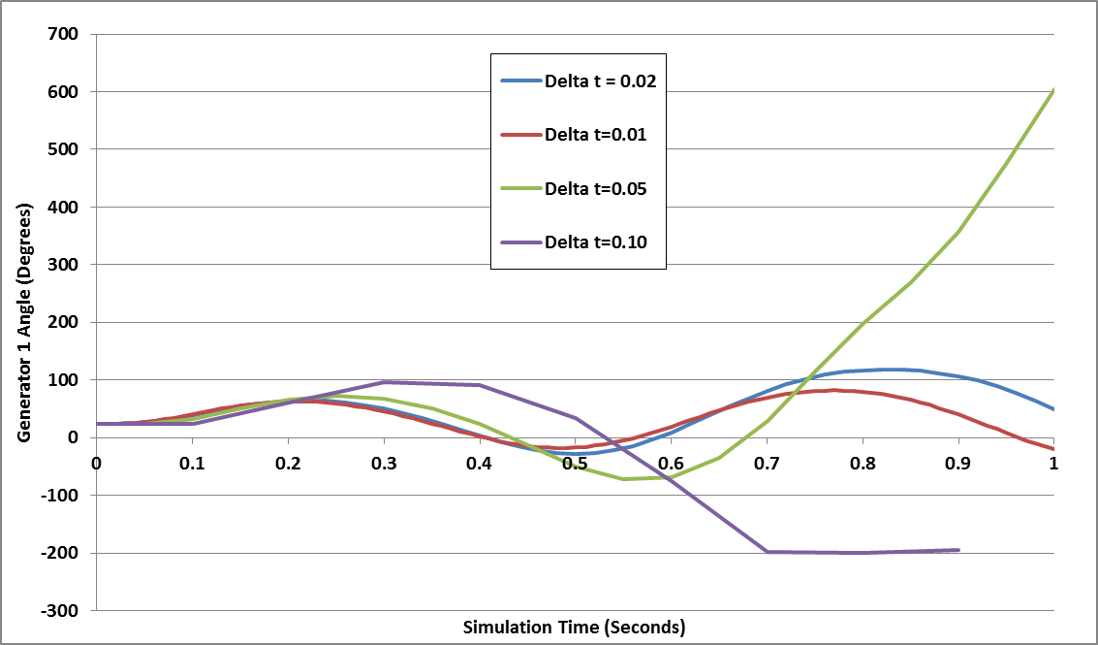
Generator 1 Delta: Euler's
The below graph shows the generator angle for varying values of Δt; numerical instability is clearly seen
16

Slide 18
Second Order Runge-Kutta
Runge-Kutta methods improve on Euler's method by evaluating f(x) at selected points over the time step
One approach is a second order method (RK2) in which
That is, k₁ is what we get from Euler's; k₂ improves on this by reevaluating at the estimated end of the time step
Error varies with the cubic of the time step
This is also known as Heun's method or as the Improved Euler's or Modified Euler's Method
17

Slide 19
Second Order Runge-Kutta (RK2)
Again assuming a time step Δt = 0.02 seconds, and a T^{clear} of 0.1 seconds, then using Heun's approach
18

Slide 20
RK2 Solution Results (Δt=0.02)
The below table gives the results using Δt = 0.02 for the beginning time steps
Time | Gen 1 Rotor Angle, Degrees | Gen 1 Speed (Hz)
0 | 23.9462 | 60
0.02 | 24.6662 | 60.2
0.04 | 26.8262 | 60.4
0.06 | 30.4262 | 60.6
0.08 | 35.4662 | 60.8
0.1 | 41.9462 | 61
0.1 | 41.9462 | 61
0.12 | 48.6805 | 60.849
0.14 | 54.1807 | 60.6626
0.16 | 58.233 | 60.4517
0.18 | 60.6974 | 60.2258
0.2 | 61.4961 | 59.9927
0.22 | 60.605 | 59.7598
0.24 | 58.0502 | 59.5343
0.26 | 53.9116 | 59.3241
0.28 | 48.3318 | 59.139
This is saved as PowerWorld case
B2_CLS_Infinite. The integration
method should be changed to Second Order Runge-Kutta on the Transient Stability, Options, Power System Model page
19

Slide 21
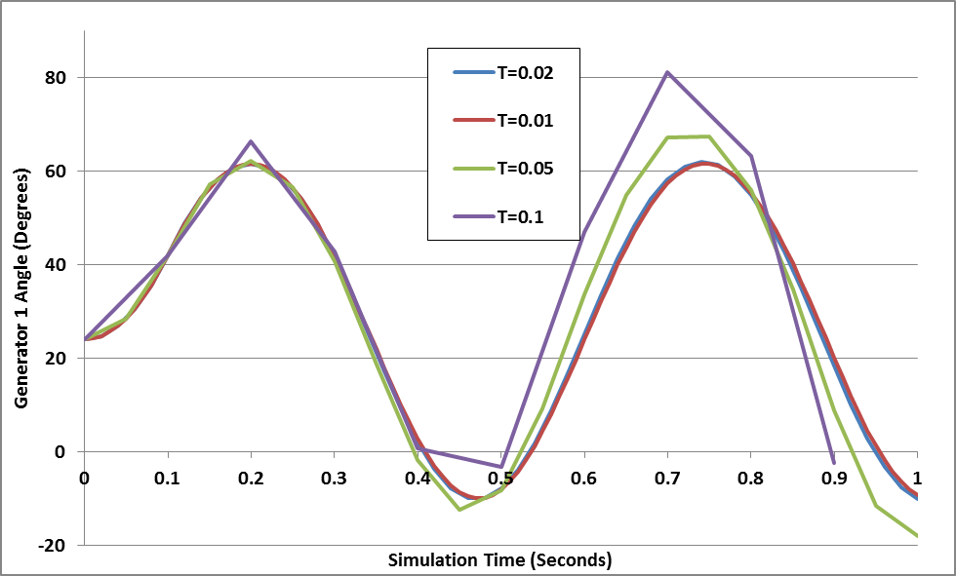
Generator 1 Delta: RK2
The below graph shows the generator angle for varying values of Δt; much better than Euler's but still the beginning of numerical instability with larger values of Δt
20

Slide 22
Adding Network Equations
Previous slides with the network equations embedded in the differential equations were a special case
In general with the explicit approach we'll be alternating between solving the differential equations and solving the algebraic equations
Voltages and currents in the network reference frame can be expressed using either polar or rectangular coordinates
In rectangular with the book's notation we have
21

Slide 23
Adding Network Equations
Network equations will be written as Y V- I(x,V) = 0
  Here Y is as from the power flow, except augmented to include the impact of the generator's internal impedance
  Constant impedance loads are also embedded in Y; non-constant impedance loads are included in I(x,V)
If I is independent of V then this can be solved directly: V = Y⁻¹I(x)
In general an iterative solution is required, which we'll cover shortly, but initially we'll go with just the direct solution
22

Slide 24
Two Bus Example, Except with No Infinite Bus
To introduce the inclusion of the network equations, the previous example is extended by replacing the infinite bus at bus 2 with a classical model with X_{d2}'=0.2, H₂=6.0
PowerWorld Case is B2_CLS_2Gen
23

Slide 25
Bus Admittance Matrix
The network admittance matrix is
This is augmented to represent the Norton admittances associated with the generator models (X_{d1}'=0.3, X_{d2}'=0.2)
In PowerWorld you can see this matrix by selecting Transient Stability, States/Manual Control, Transient Stability Ybus
24

Slide 26
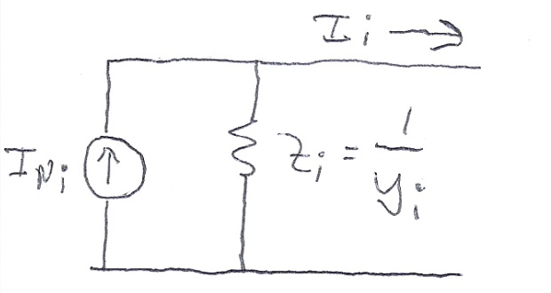
Current Vector
For the classical model the Norton currents are given by
The initial values of the currents come from the power flow solution
As the states change (δ_{i} for the classical model), the Norton current injections also change
25

Slide 27
B2_CLS_Gen Initial Values
The internal voltage for generator 1 is as before
We likewise solve for the generator 2 internal voltage
The Norton current injections are then
0.4179 radians
0.2108 radians
Keep in mind the Norton current injections are not the current out of the generator
26

Slide 28
B2_CLS_Gen Initial Values
To check the values, solve for the voltages, with the values matching the power flow values
27

Slide 29
Swing Equations
With the network constraints modeled, the swing equations are modified to represent the electrical power in terms of the generator's state and current values
Then swing equation is then
I_{Di}+jl_{Qi} is the current being injected into the network by the generator
28

Slide 30
Two Bus, Two Generator Differential Equations
The differential equations for the two generators are
In this example
P_{M1} = 1 and P_{M2} = -1
29

Slide 31
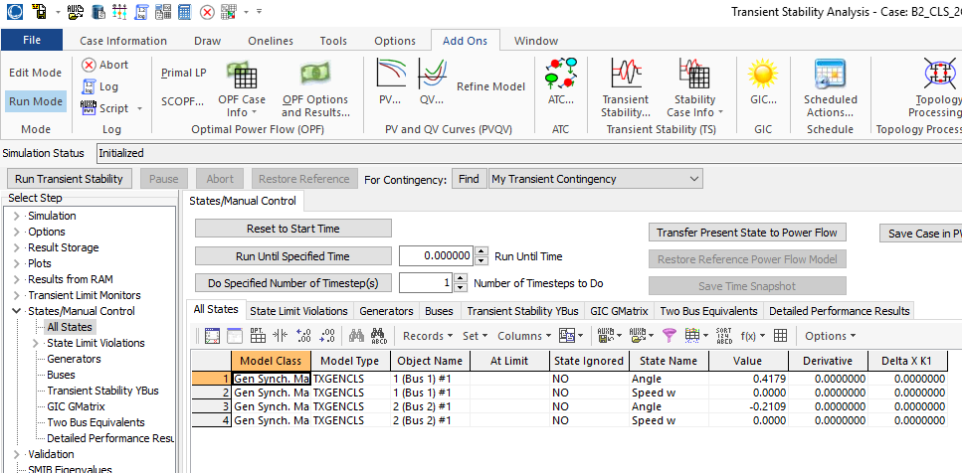
PowerWorld GENCLS Initial States
30

Slide 32
Solution at t=0.02
Usually a time step begins by solving the differential equations. However, in the case of an event, such as the solid fault at the terminal of bus 1, the network equations need to be first solved
Solid faults can be simulated by adding a large shunt at the fault location
  Amount is somewhat arbitrary, it just needs to be large enough to drive the faulted bus voltage to zero
With Euler's the solution after the first time step is found by first solving the differential equations, then resolving the network equations
31

Slide 33
Solution at t=0.02
Using Y_{fault} = -j1000, the fault-on conditions become
32

Slide 34
Solution at t=0.02
Then the differential equations are evaluated, using the new voltages and currents
  These impact the calculation of P_{Ei} with P_{E1}=0, P_{E2}=0
If solving with Euler's this is the final state value; using these state values the network equations are resolved, with the solution the same here since the δ's didn't vary
33

Slide 35
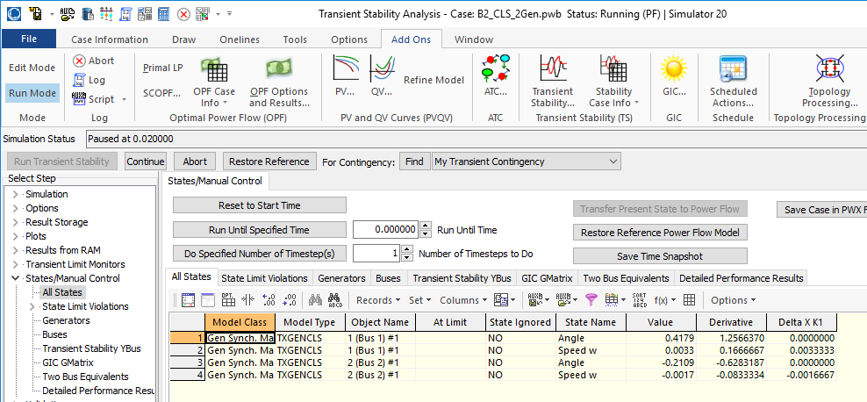
PowerWorld GENCLS at t=0.02
34

Slide 36
Solution Values Using Euler's
The below table gives the results using Δt = 0.02 for the beginning time steps
Time (Sec) | Gen 1 Rotor Angle | Gen 1 Speed (Hz) | Gen 2 Rotor Angle | Gen2 Speed (Hz)
0 | 23.9462 | 60 | -12.0829 | 60
0.02 | 23.9462 | 60.2 | -12.0829 | 59.9
0.04 | 25.3862 | 60.4 | -12.8029 | 59.8
0.06 | 28.2662 | 60.6 | -14.2429 | 59.7
0.08 | 32.5862 | 60.8 | -16.4029 | 59.6
0.1 | 38.3462 | 61 | -19.2829 | 59.5
0.1 | 38.3462 | 61 | -19.2829 | 59.5
0.12 | 45.5462 | 60.9128 | -22.8829 | 59.5436
0.14 | 52.1185 | 60.7966 | -26.169 | 59.6017
0.16 | 57.8541 | 60.6637 | -29.0368 | 59.6682
0.18 | 62.6325 | 60.5241 | -31.426 | 59.7379
0.2 | 66.4064 | 60.385 | -33.3129 | 59.8075
0.22 | 69.1782 | 60.2498 | -34.6988 | 59.8751
0.24 | 70.9771 | 60.1197 | -35.5982 | 59.9401
0.26 | 71.8392 | 59.9938 | -36.0292 | 60.0031
0.28 | 71.7949 | 59.8702 | -36.0071 | 60.0649
35

Slide 37
Solution at t=0.02 with RK2
With RK2 the first part of the time step is the same as Euler's, that is solving the network equations with
Then calculate k2 and get a final value for x(t+Δt)
Finally solve the network equations using the final value for x(t+Δt)
36

Slide 38
Solution at t=0.02 with RK2
From the first half of the time step
Then
37

Slide 39
Solution at t=0.02 with RK2
The new values for the Norton currents are
38

Slide 40
Solution Values Using RK2
The below table gives the results using Δt = 0.02 for the beginning time steps
Time (Sec) | Gen 1 Rotor Angle | Gen 1 Speed (Hz) | Gen 2 Rotor Angle | Gen2 Speed (Hz)
0 | 23.9462 | 60 | -12.0829 | 60
0.02 | 24.6662 | 60.2 | -12.4429 | 59.9
0.04 | 26.8262 | 60.4 | -13.5229 | 59.8
0.06 | 30.4262 | 60.6 | -15.3175 | 59.7008
0.08 | 35.4662 | 60.8 | -17.8321 | 59.6008
0.1 | 41.9462 | 61 | -21.0667 | 59.5008
0.1 | 41.9462 | 61 | -21.0667 | 59.5008
0.12 | 48.7754 | 60.8852 | -24.4759 | 59.5581
0.14 | 54.697 | 60.7538 | -27.4312 | 59.6239
0.16 | 59.6315 | 60.6153 | -29.8931 | 59.6931
0.18 | 63.558 | 60.4763 | -31.8509 | 59.7626
0.2 | 66.4888 | 60.3399 | -33.3109 | 59.8308
0.22 | 68.4501 | 60.2071 | -34.286 | 59.8972
0.24 | 69.4669 | 60.077 | -34.789 | 59.9623
0.26 | 69.5548 | 59.9481 | -34.8275 | 60.0267
0.28 | 68.7151 | 59.8183 | -34.4022 | 60.0916
39

Slide 41
Angle Reference
The initial angles are given by the angles from the power flow, which are based on the slack bus's angle
As presented the transient stability angles are with respect to a synchronous reference frame
  Sometimes this is fine, such as for either shorter studies, or ones in which there is little speed variation
  Oftentimes this is not best since the when the frequencies are not nominal, the angles shift from the reference frame
Other reference frames can be used, such as with respect to a particular generator's value, which mimics the power flow approach; the selected reference has no impact on the solution
40

Slide 42
Subtransient Models
The Norton current injection approach is what is commonly used with subtransient models in industry
If subtransient saliency is neglected (as is the case with GENROU and GENSAL in which X"_{d}=X"_{q}) then the current injection is
  Subtransient saliency can be handled with this approach, but it is more involved (see Arrillaga, Computer Analysis of Power Systems, section 6.6.3)
41

Slide 43
Subtransient Models
Note, the values here are on the dq reference frame
We can now extend the approach introduced for the classical machine model to subtransient models
Initialization is as before, which gives the δ's and other state values
Each time step is as before, except we use the δ's for each generator to transfer values between the network reference frame and each machine's dq reference frame
  The currents provide the coupling
42

Slide 44
Two Bus Example with Two GENROU Models
Use the same system as before, except with we'll model both generators using GENROUs
  For simplicity we'll make both generators identical except set H₁=3, H₂=6; other values are X_{d}=2.1, X_{q}=0.5, X'_{d}=0.2, X'_{q}=0.5, X"_{q}=X"_{d}=0.18, X_{l}=0.15, T'_{do} = 7.0, T'_{qo}=0.75, T"_{do}=0.035, T"_{qo}=0.05; no saturation
  With no saturation the value of the δ's are determined (as per the earlier lectures) by solving
  Hence for generator 1
43

Slide 45
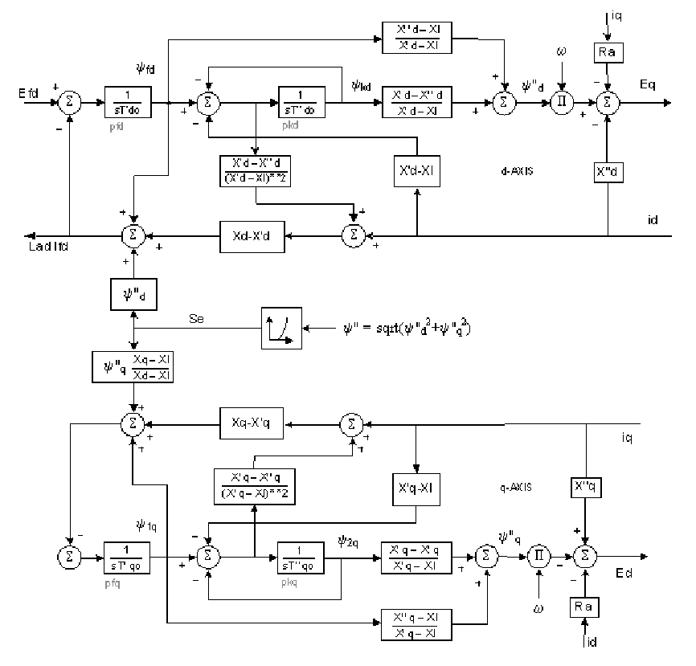
GENROU Block Diagram
E'_{q}
E'_{d}
44

Slide 46
Two Bus Example with Two GENROU Models
Using the early approach the initial state vector is
Note that this is a salient pole machine with X'_{q}=X_{q}; hence E'_{d} will always be zero
The initial currents in the dq reference frame are I_{d1}=0.7872, I_{q1}=0.6988, I_{d2}=0.2314, I_{q2}=-1.0269
Initial values of ψ"_{q1}= -0.2236,
and ψ"_{d1} = 1.179
45

Slide 47
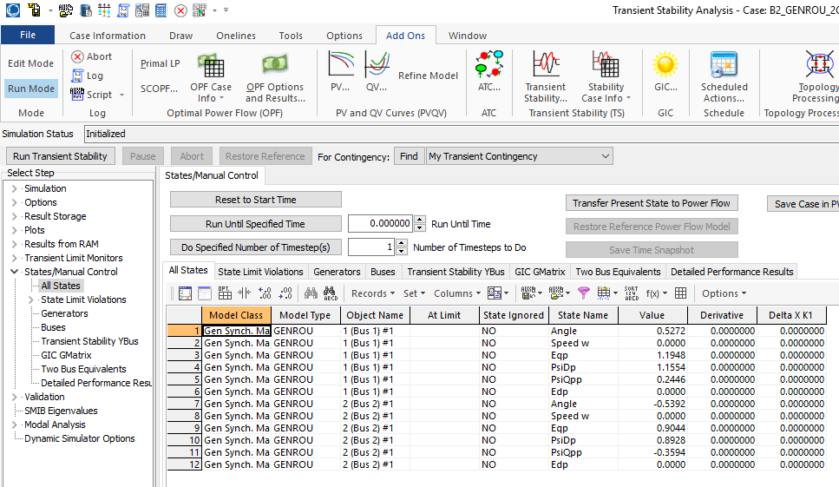
PowerWorld GENROU Initial States
46

Slide 48
Solving with Euler's
We'll again solve with Euler's, except with Δt set now to 0.01 seconds (because now we have a subtransient model with faster dynamics)
  We'll also clear the fault at t=0.05 seconds
For the more accurate subtransient models the swing equation is written in terms of the torques
Other equations are solved
based upon the block diagram
47

Slide 49
Norton Equivalent Current Injections
The initial Norton equivalent current injections on the dq base for each machine are
Recall the dq values are on the machine’s reference frame and
the DQ values are on the system reference frame
48

Slide 50
Moving between DQ and dq
Recall
And
The currents provide the key coupling between the
two reference frames
49

Slide 51
Bus Admittance Matrix
The bus admittance matrix is as from before for the classical models, except the diagonal elements are augmented using
50

Slide 52
Algebraic Solution Verification
To check the values solve (in the network reference frame)
51

Slide 53
Results
The below graph shows the results for four seconds of simulation, using Euler's with Δt=0.01 seconds
PowerWorld case is
B2_GENROU_2GEN_EULER
52

Slide 54
Results for Longer Time
Simulating out 10 seconds indicates an unstable solution, both using Euler's and RK2 with Δt=0.005, so it is really unstable!
Euler's with Δt=0.01
RK2 with Δt=0.005
53

