Slide 1
ECEN 667 Power System Stability
Lecture 23: Inter-Area Modes, Stabilizers
Prof. Tom Overbye
Dept. of Electrical and Computer Engineering
Texas A&M University
overbye@tamu.edu

Slide 2
Announcements
Read Chapters 8 and 9 (8.6 covers stabilizers)
Homework 6 is due today
Homework 7 should be done before the second exam
As noted in the syllabus, the second exam is on Thursday Nov 30, 2023
On campus students will take it during class (80 minutes) whereas distance learning students should contact Sanjana.
The exam is comprehensive, but emphasizes the material since the first exam; it will be of similar form to the first exam
Two 8.5 by 11 inch hand written note sheets are allowed, front and back, as are calculators
1

Slide 3
Large Grid Inter-Area Modes
Analyzing the wide-area dynamic respond of electric grids using the concept of modes has been a helpful approach for many years
In North America much of the work has been done in the WECC, with several identified distinct Inter-Area modes
Less work has been done on the Eastern Interconnect (EI) and ERCOT, but there are still some identified modes
Recent research has questioned the extent to which a few distinct modes exist particularly for the EI

Slide 4
A Few North America Grid Oscillation Publications
There is lots of prior work describing electric grid oscillations. A few examples for North American grid oscillations include
F.R. Schleif, J.H. White, “Damping for the Northwest – Southwest Tieline Oscillations – An Analog Study,” IEEE Trans. Power App. & Syst., vol. PAS-85, pp. 1239-1247, Dec. 1966.
Interconnection Oscillation Analysis, NERC, July 2019.
J. Follum, T. Becejac, R. Huang, "Estimation of Electromechanical Modes of Oscillation in the Eastern Interconnection from Ambient PMU Data," 2021 IEEE Power & Energy Society Innovative Smart Grid Technologies Conference, Washington, DC, USA, Feb. 2021.
Modes of Inter-Area Oscillations in the Western Interconnection, Western Interconnection Modes Review Group, WECC, 2021.
R.T. Elliott, D.A. Schoenwald, “Visualizing the Inter-Area Modes of the Western Interconnection,” IEEE PES 2022 General Meeting, Denver, CO, July 2022.
J. Follum, N. Nayak, J. Eto, “Online Tracking of Two Dominant Inter-Area Modes of Oscillation in the Eastern Interconnect,” 56th Hawaii International Conference on System Sciences, Lahaina, HI, Jan. 2023.
T.J. Overbye, S. Kunkolienkar, F. Safdarian, A. Birchfield, “On the Existence of Dominant Inter-Area Oscillation Modes in the North American Eastern Interconnect Stability Simulations”, 57th Hawaii International Conference on System Sciences, Honolulu, HI, January 2024.

Slide 5
North America Grid Oscillation Modes
In North American grids there are identified modes that have names, examples include
WECC North-South A (NSA): Alberta vs System (0.20 to 0.30 Hz) (10 - 25% damping)
WECC North-South B (NSB): Alberta vs BC+N US vs S US (0.35 to 0.45 Hz) (5-10%)
WECC East-West A (EWA): Colorado + E. Wyoming vs System (0.35 to 0.45 Hz)
WECC British Columbia A (BCA): BC vs N. US vs S. US (0.50 to 0.72 Hz)
WECC BCB W. edge vs System vs E. edge (0.60 to 0.72 Hz)
Eastern Interconnect (EI) Northeast vs South (NE-S) (0.15 to 0.22 Hz) (10 – 25%)
EI Northeast vs Midwest (NE-MW) (0.18 to 0.27 Hz) (10 – 25%)
If they exist, at a particular operating point a mode will have a frequency, a damping and a shape, with these values changing some as the operating point changes

Slide 6
Do Distinct Inter-Area Modes Exist?
Since the modes have been observed under many different conditions they have quite a bit of variability in their values. There could be two explanations for this, both of which are consistent with the observed results
One explanation: at a particular operating point the North American grids have a few well-defined modes, with each mode having a frequency, damping and shape. As long as a disturbance excites the mode, it should be observed. The goal is to find these modes
An alternative explanation: at a particular operating point the North American grids do not have a few well-defined modes. They certainly have oscillation patterns, but the frequency, damping and especially the shapes of these oscillations are disturbance dependent.

Slide 7
Electric Grids are Non-linear Systems
Electric grids are non-linear systems, and are likely becoming more non-linear with the rapid growth of inverter-based resources and other controls
An increasing number of controls are either operated at limits, or will quickly reach a limit, meaning there might not be a valid linearization
Deadbands and other nonlinear controls mean that the grid’s response to small perturbations can be quite different than its response to large disturbances
Hence there is a need to question the degree to which linear analysis techniques can be used to explain the behavior of modern grids
Even the linear system model has a number of modes that could be interacting
This questioning is facilitated by recent developments in measurement-based modal analysis

Slide 8
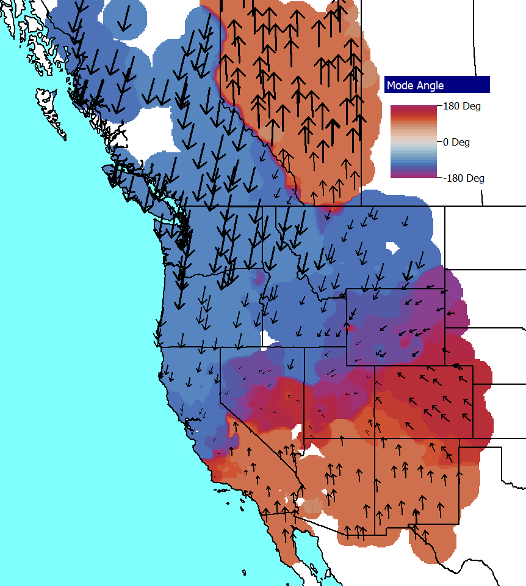
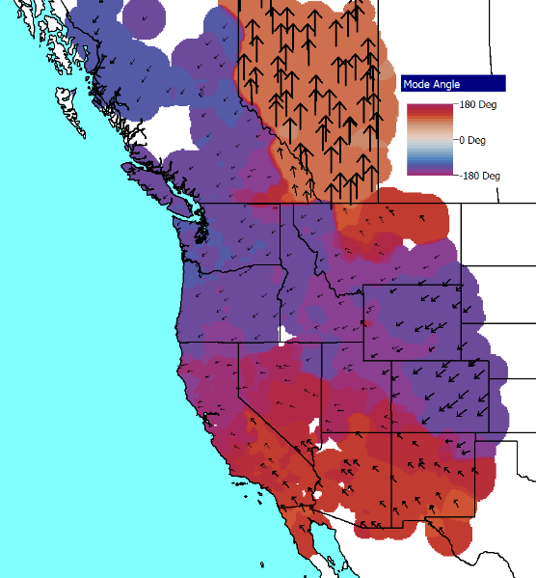
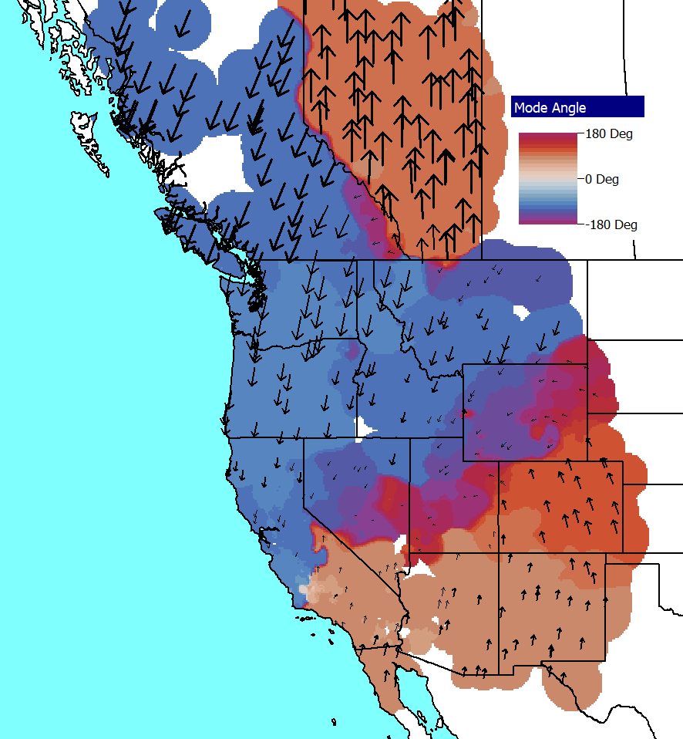
WECC Example 1
Using a 2022 series, 25,000 bus WECC case at the same operating point for three different disturbances, the below modes are observed
Disturbance A, 0.35 Hz, 12.6%
Disturbance B, 0.34 Hz, 10.0%
Disturbance C,
0.37 Hz, 8.8%
What is required to say the grid has a particular mode?

Slide 9
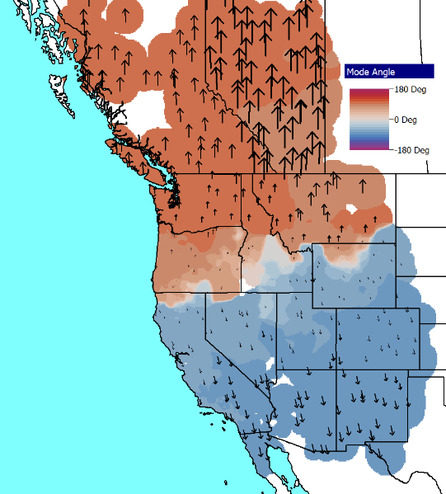
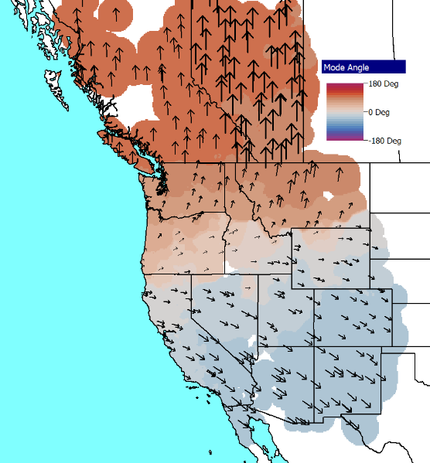
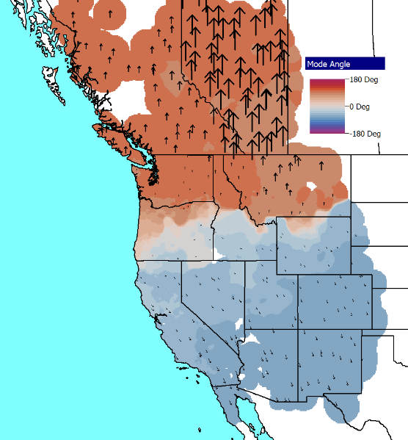
WECC Example 2
Same operating point as Example 1
Disturbance A,
0.24 Hz, 15.5%
Disturbance B,
0.23 Hz, 11.6%
Disturbance C, 0.25 Hz, 5.0%
The results for these two examples are showing fairly consistent modes; these are the best observed ones in the WECC simulations

Slide 10
A Particular Focus is on Distinct Mode Existence
Earlier literature mentions
Northeast vs South(NE-S) mode with a frequency of between 0.15 to 0.22 Hz, (10 – 25% damping)
Northeast vs Midwest (NE-MW) mode with a frequency of between 0.18 to 0.27 Hz, (10 – 25% damping
Same procedure as before is used. That is, to apply a series of disturbances to the same operating point, calculate the modes using the IMP, and see if distinct modes are observed
The same previous three disturbance types are used

Slide 11
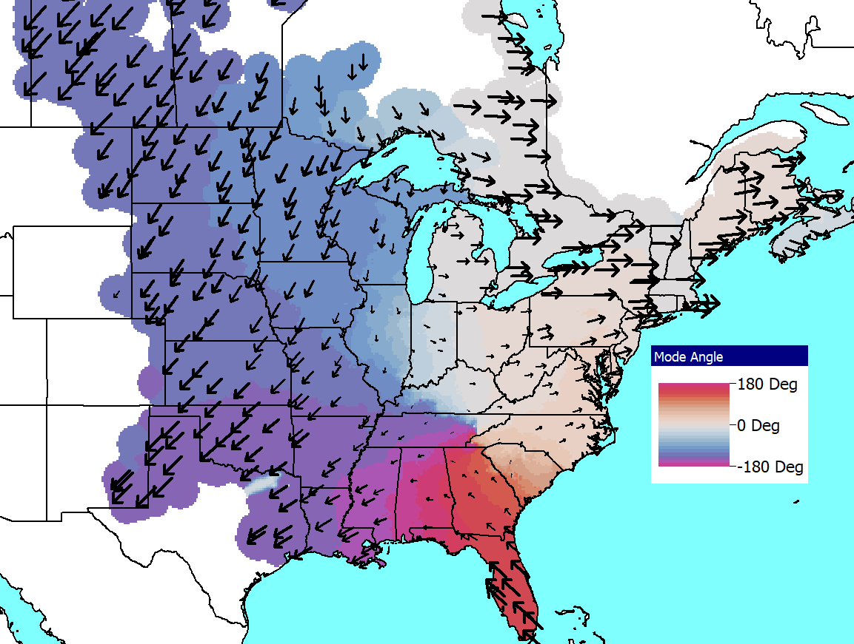
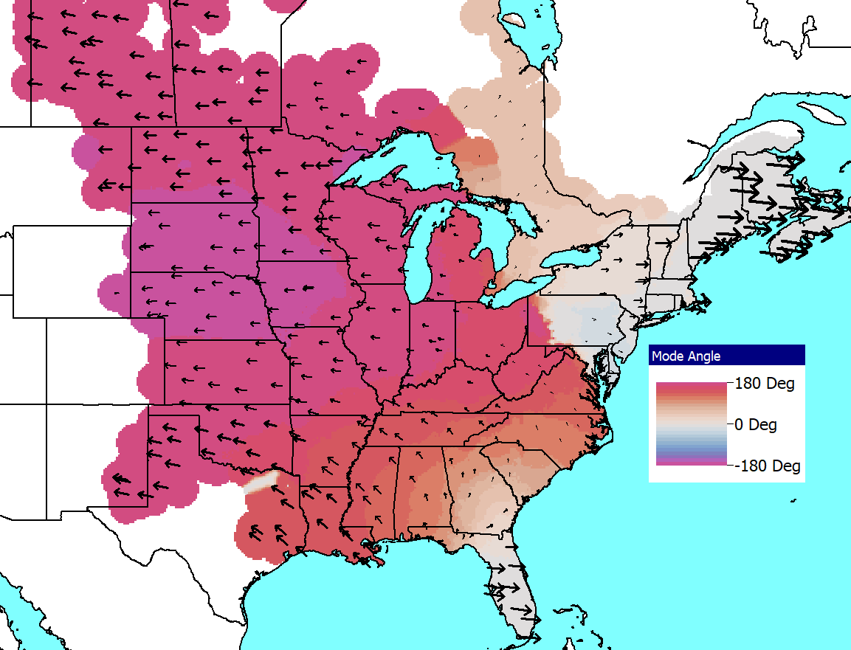
Analysis of Potential 0.27 Hz Mode
Left image shows visualization of the 0.27 Hz mode (21.3%), while the right image shows a 0.25 Hz mode (20.2%) that is observed when the disturbance is changed to opening a generator in Nebraska

Slide 12
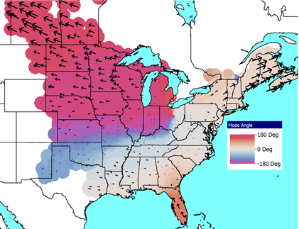
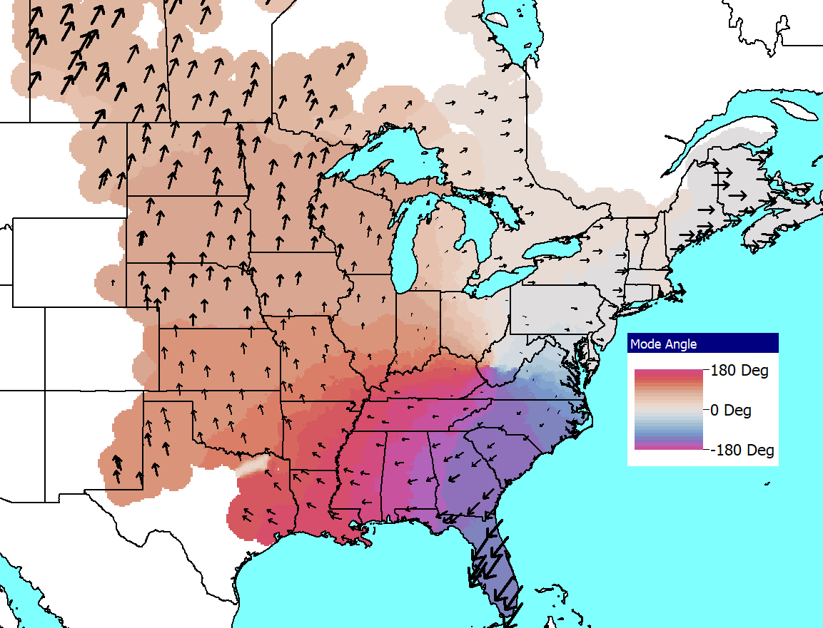
Analysis of Mississippi and Florida
The same approach is applied to opening large generators in Mississippi (0.25 Hz with 23.5%) and Florida (0.23 Hz with 21.5%)

Slide 13
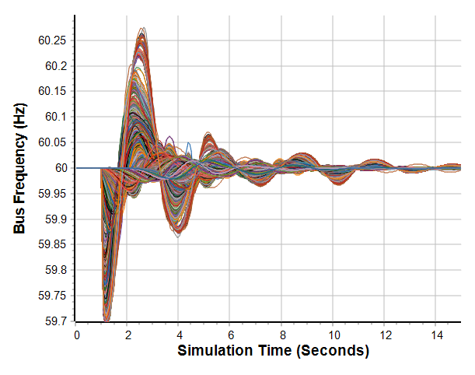
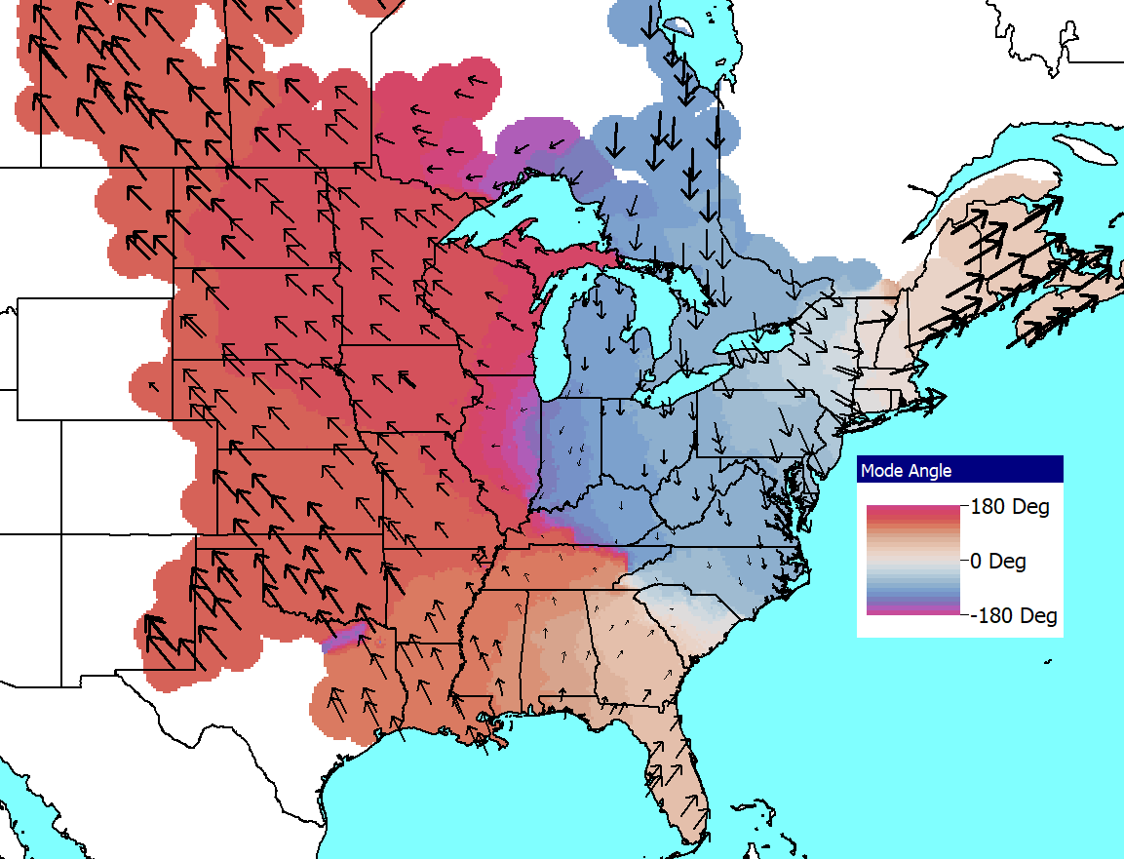
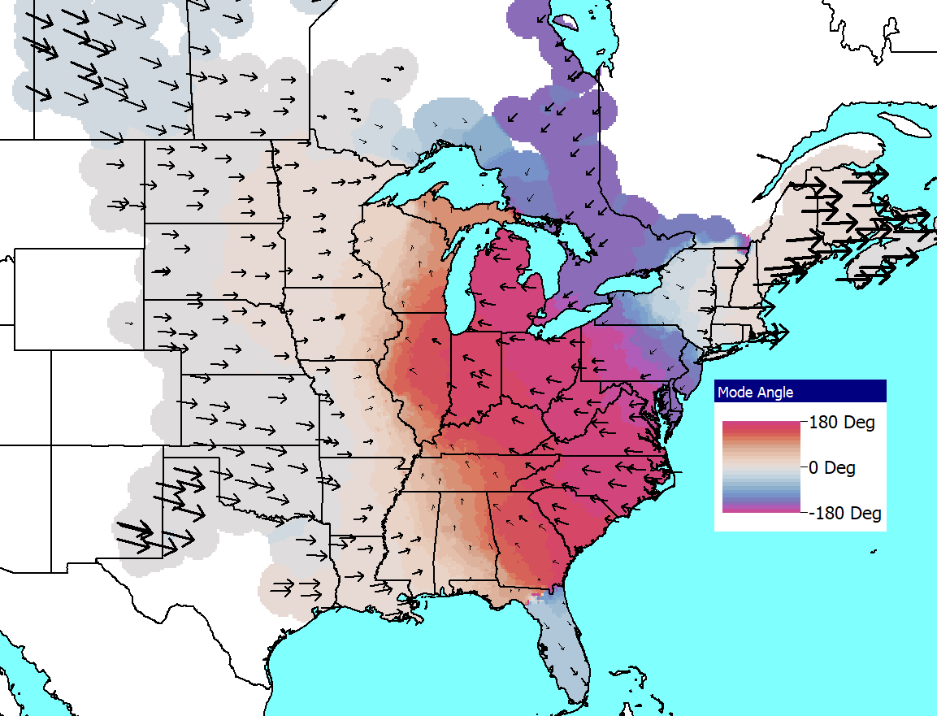
New England, Just Frequency Change
Since opening generators changes the grid (albeit slightly in such a large grid), the frequency change disturbance can be used
0.22 Hz, 27.1% Damping
0.35 Hz, 15.0% Damping

Slide 14
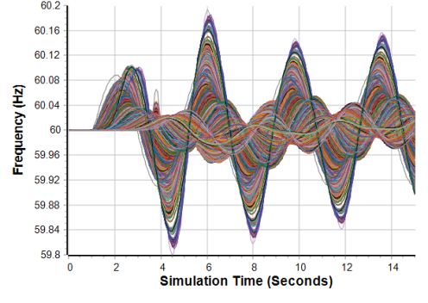
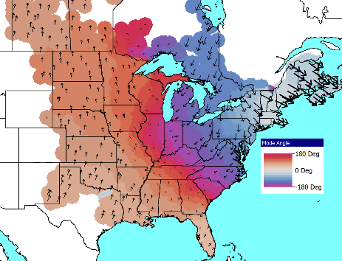
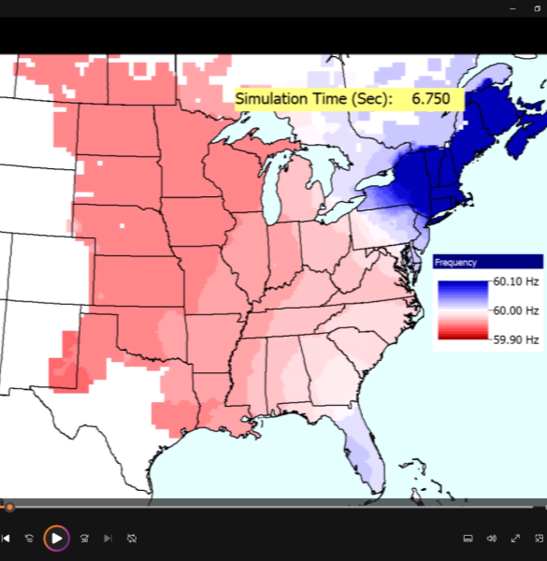
New England 0.27 Hz Forced Oscillation
The last disturbance is a 0.27 Hz forced oscillation in New England

Slide 15
Damping Oscillations: Power System Stabilizers (PSSs)
A PSS adds a signal to the excitation system to improve damping
A common signal is proportional to the generator’s speed; other inputs, such as like power, voltage or acceleration, can be used
The signal is usually measured locally (e.g. from the shaft)
Both local modes and inter-area modes can be damped.
Regular tuning of PSSs is important
Fully considering power system stabilizers can get quite involved
Here we’ll just focus on covering the basics, and doing a simple PSS design. The goal is providing insight and tools that can help power system engineers understand the PSS models, determine whether there is likely bad data, understand the basic functionality, and do simple planning level design

Slide 16
Stabilizer References
A few references on power system stabilizers
E. V. Larsen and D. A. Swann, "Applying Power System Stabilizers Part I: General Concepts," in IEEE Transactions on Power Apparatus and Systems, vol.100, no. 6, pp. 3017-3024, June 1981.
E. V. Larsen and D. A. Swann, "Applying Power System Stabilizers Part II: Performance Objectives and Tuning Concepts," in IEEE Transactions on Power Apparatus and Systems, vol.100, no. 6, pp. 3025-3033, June 1981.
E. V. Larsen and D. A. Swann, "Applying Power System Stabilizers Part III: Practical Considerations," in IEEE Transactions on Power Apparatus and Systems, vol.100, no. 6, pp. 3034-3046, June 1981.
Power System Coherency and Model Reduction, Joe Chow Editor, Springer, 2013

Slide 17
Dynamic Models in the Physical Structure
Mechanical System
Electrical System
Stabilizer
Load
Relay
Line
Relay
Exciter
Supply control
Pressure control
Speed control
Voltage Control
Network control
Load control
Fuel
Source
Furnace and Boiler
Turbine
Generator
Network
Loads
Machine
Load
Char.
Fuel
Steam
Torque
V, I
P, Q
Governor
P. Sauer and M. Pai, Power System Dynamics and Stability, Stipes Publishing, 2006.

Slide 18
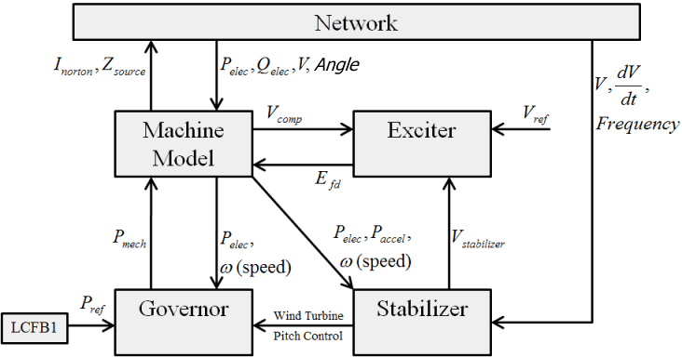
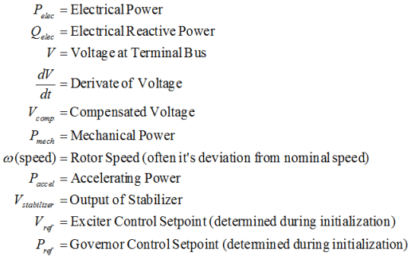
Power System Stabilizer (PSS) Models

Slide 19
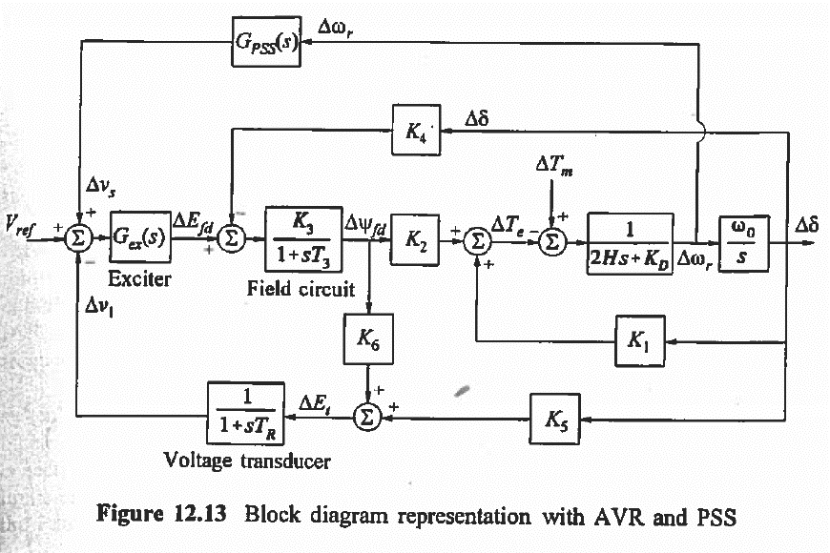
Classic Block Diagram of a System with a PSS
PSS is here
Image Source: Kundur, Power System Stability and Control

Slide 20
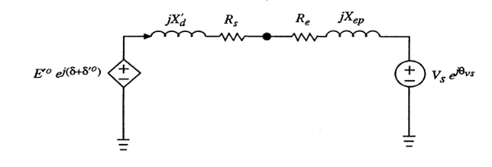
PSS Basics
Stabilizers can be motivated by considering a classical model supplying an infinite bus
Assume internal voltage has an additional component
This can add additional damping if sin(δ) is positive
In a real system there is delay, which requires compensation

Slide 21
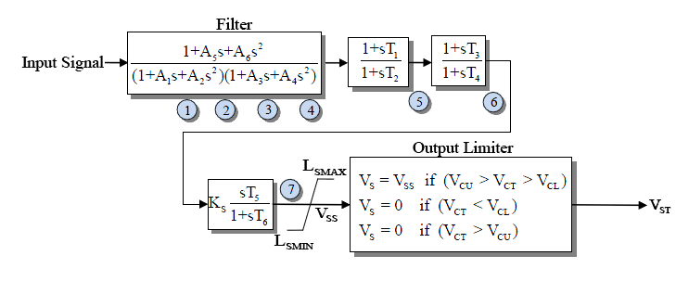
Example PSS
An example single input stabilizer is shown below (IEEEST)
The input is usually the generator shaft speed deviation, but it could also be the bus frequency deviation, generator electric power or voltage magnitude
The model can be simplified by setting some parameters to zero
V_{ST} is an input into the exciter

Slide 22
Example PSS
An example single input stabilizer is shown below (IEEEST)
The input is usually the generator shaft speed deviation, but it could also be the bus frequency deviation, generator electric power or voltage magnitude
The model can be simplified by setting parameters to zero
V_{ST} is an input into the exciter

Slide 23
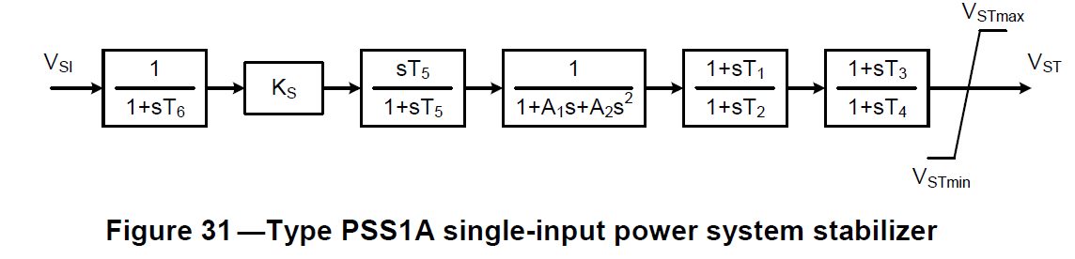
Another Single Input PSS
The PSS1A is very similar to the IEEEST Stabilizer and STAB1
IEEE Std 421.5 describes the common stabilizers

Slide 24
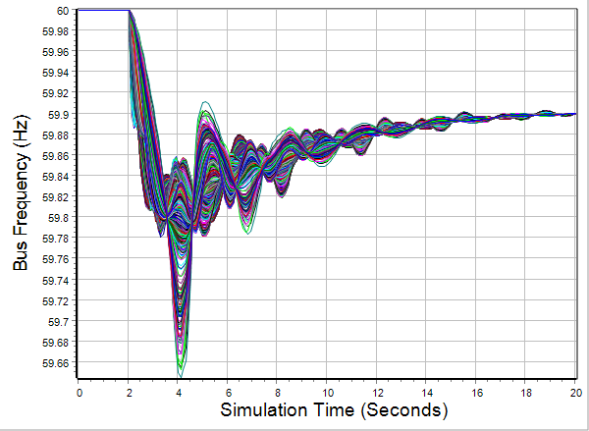
2000 Bus System Results With Stabilizers
The case has 334 IEEST stabilizers, all with the same parameters (which would not be the case in a real system)
Results are given for the previous generator drop contingency

Slide 25
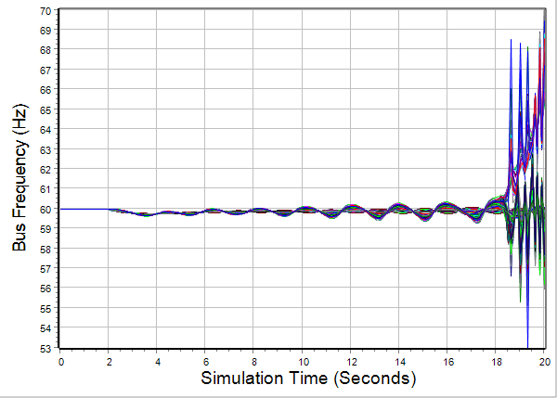
2000 Bus System Results Without Stabilizers
Clearly the case is unstable; note the change in scale

Slide 26
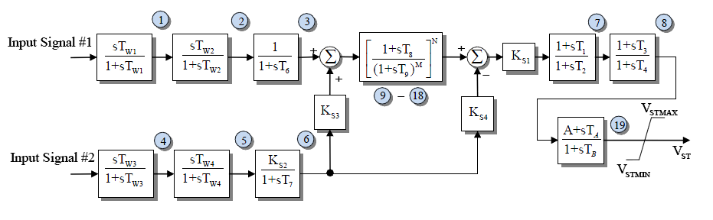
Example Dual Input PSS
Below is an example of a dual input PSS (PSS2A)
Combining shaft speed deviation with generator electric power is common
Both inputs have washout filters to remove low frequency components of the input signals
In addition to exciters, IEEE Std 421.5 describes the common stabilizers

Slide 27
Washout Filters and Lead-Lag Compensators
Two common attributes of PSSs are washout filters and lead-lag compensators
Since PSSs are associated with damping oscillations, they should be immune to slow changes. These low frequency changes are “washed out” by the washout filter; this is a type of high-pass filter.
Lead-lag compensators
Washout filter

Slide 28
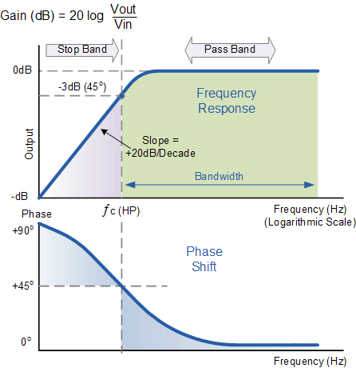
Washout Filter
The filter changes both the magnitude and angle of the signal at low frequencies
The breakpoint frequency is when the phase shift is 45 degrees and the gain is -3 dB (1/sqrt(2))
A larger T value shifts the breakpoint to lower frequencies; at T=10 the breakpoint frequency is 0.016 Hz
Image Source: www.electronics-tutorials.ws/filter/filter_3.html

Slide 29
Washout Parameter Variation
The PSS2A is the most common stabilizer in both the EI and WECC cases. Plots show the variation in T_{W1} for EI (left) and WECC cases (right); for both the x-axis is the number of PSS2A stabilizers sorted by T_{W1}, and the y-axis is T_{W1} in seconds

Slide 30
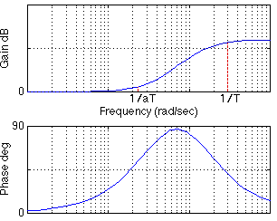
Lead-Lag Compensators
For a lead-lag compensator of the below form with α <= 1 (equivalently a >= 1)
There is no gain or phase shift at low frequencies, a gain at high frequencies but no phase shift
Equations for a design maximum phase shift α at a frequency f are given

Slide 31
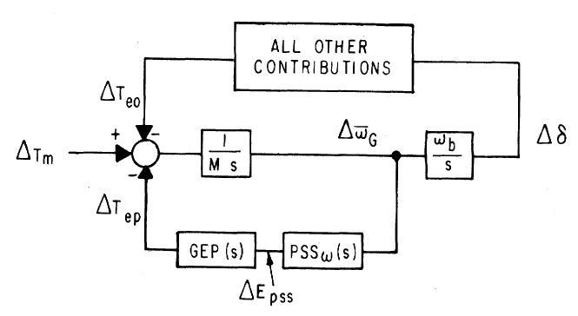
Stabilizer Design
As noted by Larsen, the basic function of stabilizers is to modulate the generator excitation to damp generator oscillations in frequency range of about 0.2 to 2.5 Hz
This requires adding a torque that is in phase with the speed variation; this requires compensating for the gain and phase characteristics of the generator, excitation system, and power system (GEP(s))
We need to compensate for the phase lag in the GEP
The stabilizer input is often the shaft speed
Image Source: Figure 1 from Larsen, 1981, Part 1

Slide 32
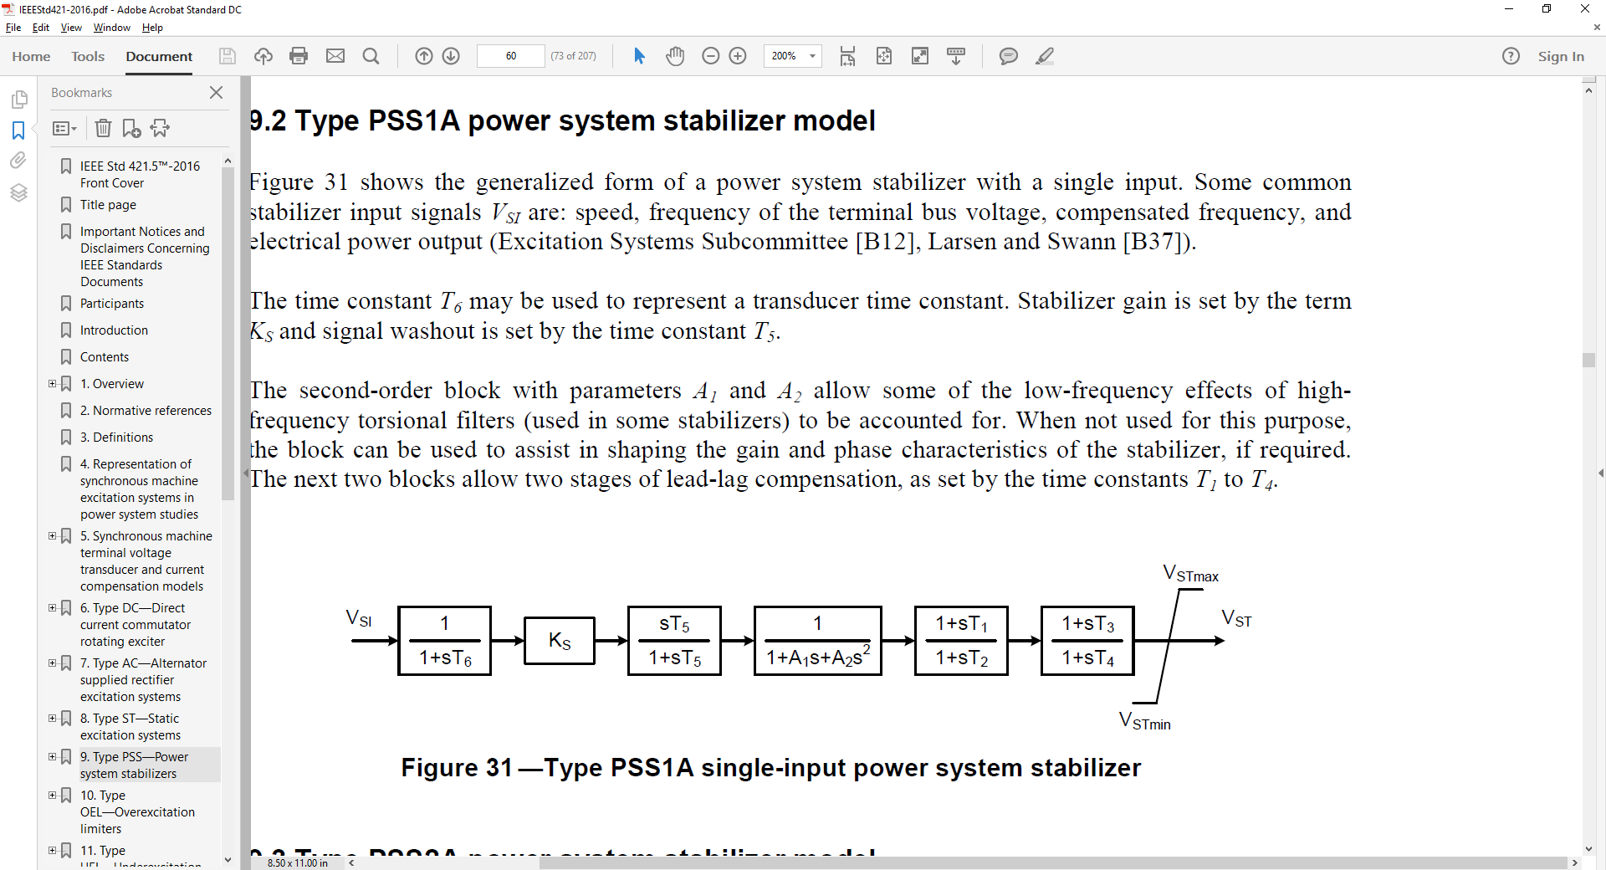
Stabilizer Design
T₆ is used to represent measurement delay; it is usually zero (ignoring the delay) or a small value (< 0.02 sec)
The washout filter removes low frequencies; T₅ is usually several seconds (with an average of say 5)
Some guidelines say less than ten seconds to quickly remove the low frequency component
Some stabilizer inputs include two washout filters
Image Source: EEE Std 421.5-2016

Slide 33
Stabilizer Design Values
With a washout filter value of T₅ = 10 at 0.1 Hz (s = j0.2π = j0.63) the gain is 0.987; with T₅ = 1 at 0.1 Hz the gain is 0.53
Ignoring the second order block, the values to be tuned are the gain, K_{s}, and the time constants on the two lead-lag blocks to provide phase compensation
We’ll assume T₁=T₃ and T₂=T₄

Slide 34
Stabilizer Design Phase Compensation
Goal is to move the eigenvalues further into the left-half plane
Initial direction the eigenvalues move as the stabilizer gain is increased from zero depends on the phase at the oscillatory frequency
If the phase is close to zero, the real component changes significantly but not the imaginary component
If the phase is around -45° then both change about equally
If the phase is close to -90° then there is little change in the real component but a large change in the imaginary component

Slide 35
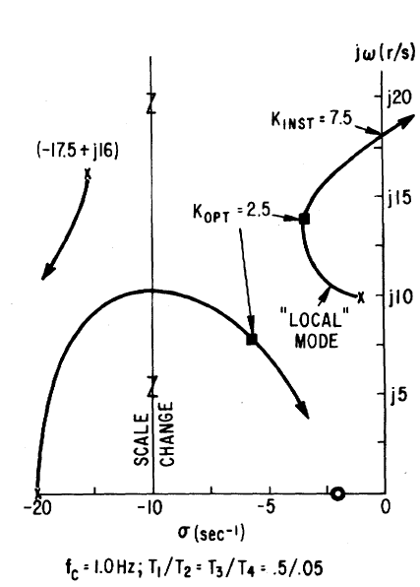
Stabilizer Design Tuning Criteria
Eigenvalues moves as K_{s} increases
A practical method is to find K_{INST}, then set K_{OPT} as about 1/3 to ½ of this value
K_{OPT} is where the damping is maximized; K_{INST} is the gain at which sustained oscillations or an instability occur

Slide 36
Stabilizer Design Tuning
Basic approach is to provide enhanced damping at desired frequencies; the challenge is power systems can experience many different types of oscillations, ranging from the high frequency local modes to the slower (< 1.0 Hz usually) inter-area modes
Usually the PSS should be set to compensate the phase so there is little phase lag at inter-area frequencies
This can get modified slightly if there is a need for local stability enhancement
An approach is to first set the phase compensation, then tune the gain; this should be done at full output

Slide 37
PSS2A Example Values
Based on about 1000 WECC PSS2A models
T₁=T₃ about 64% of the time and T₂=T₄ about 69% of the time
The next page has a plot of the T1 and T2 values; the average T1/T2 ratio is about 6.4

Slide 38
Example T₁ and T₂ Values

Slide 39
PSS Tuning Example
Open the case wscc_9bus_Start, apply the default dynamics contingency of a self-clearing fault at Bus 8.
Use Modal Analysis to determine the major modal frequency and damping

Slide 40
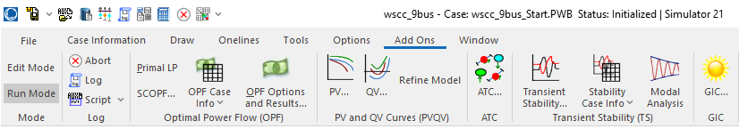
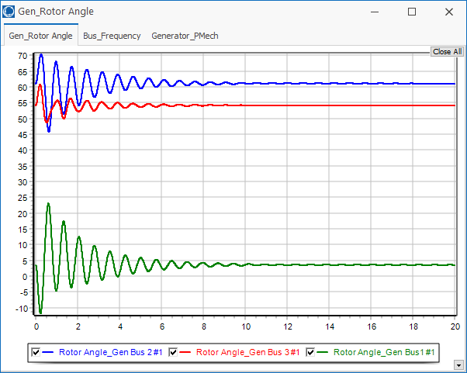
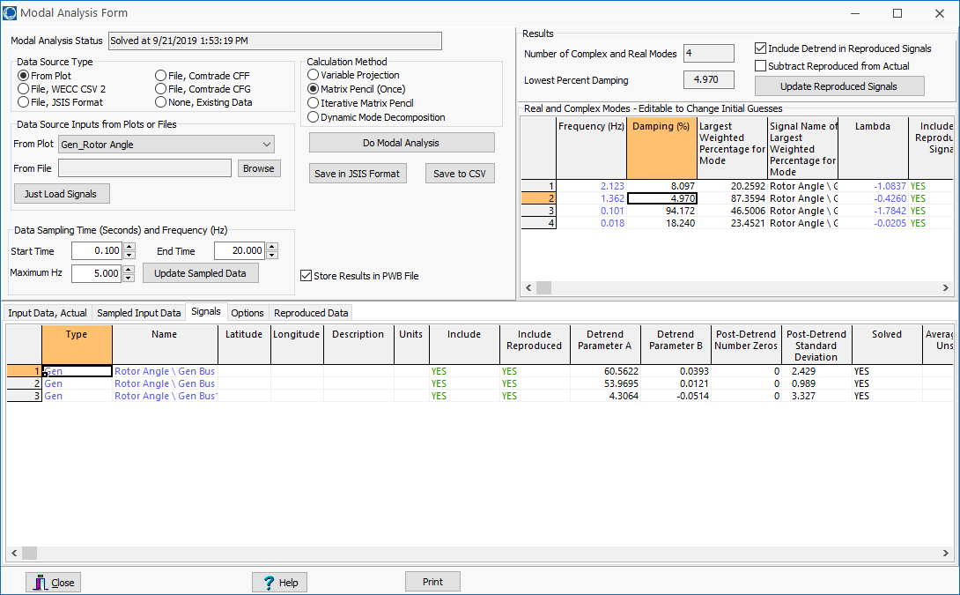
PSS Example: Getting Initial Frequency, Damping
The Modal Analysis button provides quick access
Frequency is 1.36 Hz with 5% damping
Easy access to plot data

Slide 41
PSS Tuning Example: Add PSS1As at Gens 2 and 3
To increase the generator speed damping, we’ll add PSS1A stabilizers using the local shaft speed as an input
First step is to determine the phase difference between the PSS output and the PSS input; this is the value we’ll need to compensate
This phase can be determined either analytically, actually testing the generator or using simulation results
We’ll use simulation results

Slide 42
PSS Example: Using Stabilizer Reference Signals
PowerWorld now allows reference sinusoidals to be easily played into the stabilizer input
This should be done at the desired modal frequency
Modal analysis can then be used to quickly determine the phase delay between the input and the signal we wish to damp
Open the case wscc_9Bus_Stab_Test
This has SignalStab stabilizers modeled at each generator; these models can play in a fixed frequency signal

Slide 43
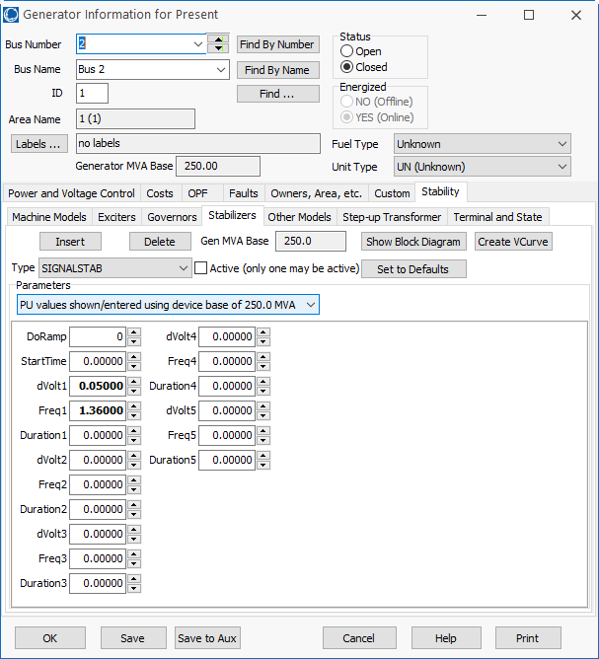
SignalStab Input and Results
Enable the SignalStab stabilizer at the bus 2 generator and run the simulation
At time=0 the stabilizer receives a sinusoidal input with a magnitude of 0.05 and a frequency of 1.36 Hz

Slide 44
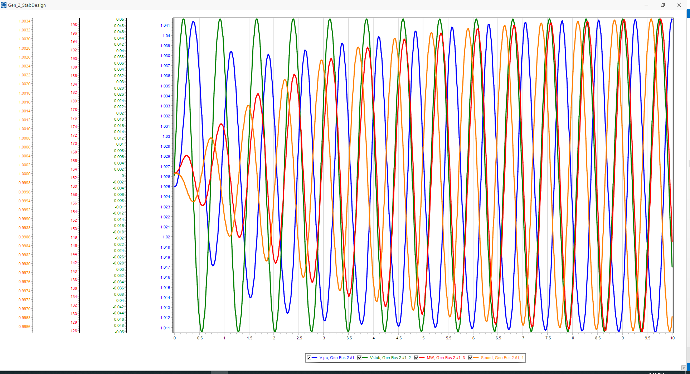
PSS Example: Gen2 Reference Signal Results
Graph shows four signals at bus 2, including the stabilizer input and the generator’s speed
The phase relationships are most important
Use modal analysis to determine the exact phase values for the 1.36 Hz mode; analyze the data between 5 and 10 seconds

Slide 45
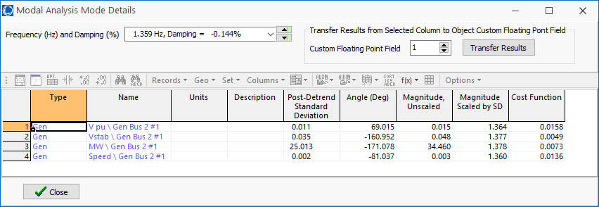
PSS Tuning Example: 1.36 Hz Modal Values
The change in the generator’s speed is driven by the stabilizer input sinusoid, so it will be lagging. The below values show is lags by (-161+360) – (-81.0) = 280 degrees
Because we want to damp the speed not increased it, subtract off 180 degrees to flip the sign. So we need 100 degrees of compensation; with two lead-lags it is 50 degrees each

Slide 46
PSS Tuning Example: 1.36 Hz Lead-Lag Values
In designing a lead-lag of the form to have a specified phase shift of φ at a frequency f the value of α is
In our example with φ = 50° then

Slide 47
PSS Tuning Example: 1.36 Hz Lead-Lag Values
Hence T₁=T₃=0.321, T₂=T₄=0.042. We’ll assumed T₆=0, and T₅=10, and A₁=A₂=0
The last step is to determine K_{s}. This is done by finding the value of K_{s} at just causes instability (i.e., K_{INST}), and then setting K_{s} to about 1/3 of this value
Instability is easiest to see by plotting the output (V_{ST}) value for the stabilizer

Slide 48
PSS Tuning Example: Setting the Values for Gen 2
Instability occurs with KS = 55, hence the optimal value is about 55/3=18.3
This increases the damping from 5% to about 16.7%
This is saved as case WSCC_9bus_Stab

Slide 49
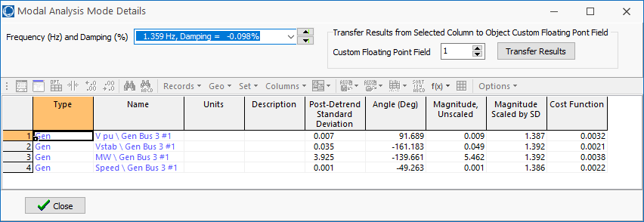
PSS Tuning Example: Setting the Values for Gen 3
The procedure can be repeated to set the values for the bus 3 generator, where we need a total of 68 degrees of compensation, or 34 per lead-lag
The values are α = 0.283, T₁=0.22, T₂=0.062, K_{S} for the verge of instability is 36, so K_{S} optimal is 12.

Slide 50
PSS Tuning Example: Final Solution
With stabilizers at buses 2 and 3 the damping has been increased to 25.7%

Slide 51
Example 2: Adding a PSS to a 42 Bus System
Goal is to try to improve damping by adding one PSS1A at a large generator at Lion345 (bus 42)
Example event is a three-phase fault is applied to the middle of the 345 kV transmission line between Prairie (bus 22) and Hawk (bus 3) with both ends opened at 0.05 seconds
The starting case name is Bus42_PSS

Slide 52
Example 2: Decide Generators to Tune, Frequency
Generator speeds and rotor angles are observed to have a poorly damped oscillation around 0.6 Hz.

Slide 53
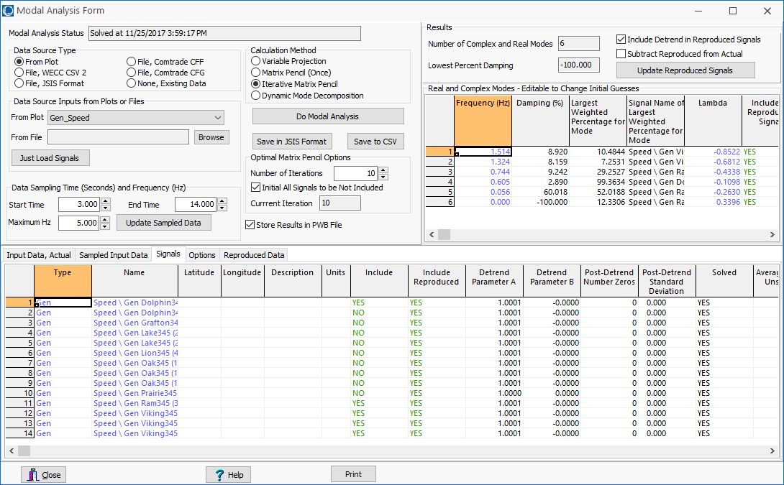
Example 2: Quantified Using Modal Analysis
For 0.6 Hz mode the damping is 2.89%

Slide 54
Example 2: Determine Phase Compensation
Using a SignalStabStabilizer at bus 42 (Lion345), the phase lag of the generator’s speed, relative to the stabilizer input is 199 degrees; flipping the sign requires phase compensation of 19 degrees or 9.5 per lead-lag
Values are α = 0.72; for 0.6 Hz, T₁= 0.313, T₂=0.225; set T₃ and T₄ to match; gain at instability is about 450, so the gain is set to 150.
The case with the test signal is Bus42_PSS_Test
Adding this single stabilizer increases the damping to 4.24%

Slide 55
Example 2: Determine Phase Compensation for the Other Gens
Adding and tuning three more stabilizers (at Grafton345 and the two units at Lake345) increases the damping to 8.16%
However, these changes are impacting modes in other areas of the system

