Slide 1
New Developments in the Application of Weather Information in Electric Grid Analysis
Thomas J. Overbye
O’Donnell Foundation Chair III
Texas A&M University, overbye@tamu.edu
Webinar Given to US FERC
April 4, 2024

Slide 2
Acknowledgments
Work presented here has been supported by a variety of sources including the Texas A&M Smart Grid Center (SGC), PSERC, ARPA-E, NSF, many utilities and ISOs (particularly SPP!), and PowerWorld. Their support is gratefully acknowledged!
Slides also include contributions from many of my students, postdocs, staff and colleagues at TAMU
Some of the results are contained in recent papers available at
  overbye.engr.tamu.edu/publications/
The simulations and visualizations shown here are done using the PowerWorld Simulator Version 23

Slide 3

Some of the TAMU Power and Energy Group
This is from the Fall 2023 EPG dinner at Miroslav’s house in September 2023

Slide 4
Overview
The purpose of this presentation is to show the benefits of having weather information become a standard part of power flow analysis and more broadly electric grid planning, and to show how everyone can easily begin using weather data today (at least for North America)
  The results also apply to related applications such as optimal power flow (OPF), contingency analysis, security-constrained OPF
All the weather data used in the presentation (hourly data for North America) going back to January 1940 is available for immediate download
The presentation also touches on non-weather related resiliency events

Slide 5

Aside: Texas A&M SGC Short Courses
Building on its success from last semester, the SGC will be offering four more short courses this spring and summer at our control lab/training facility; more information is at
epg.engr.tamu.edu/short-courses-main/
  Electric Grid Dynamics and Stability
  (April 9 to 11)
  Fundamentals of Grid-Connected
  Photovoltaic Systems (April 24-26)
  Energizing Electric Grid Analysis with
  PowerWorld Simulator (April 30-May 2)
  Primer on the Planning and Operation
  of Large-Scale Electric Grids
  (June 25-27)

Slide 6
Motivation: US Electric Generators by Fuel Type
Specific motivation was from our ARPA-E Grid Optimization (GO) Project and an SPP project looking at an ac interconnection of the EI and WECC
The size of the ovals
is proportional to
the substation generation
and the color is the
fuel type (red: nuclear,
black: coal, brown:
natural gas, blue: hydro,
green: wind, yellow: solar).
Wind and solar are weather
dependent, and need to
be set for a power flow
solution

Slide 7
Weather in Electric Grid Planning and Operations
Weather information has been used in electric grid planning and operations going back to the initial grids in the 1880’s
In operations real-time weather information has been long used in control rooms, with computerized information used at least since the 1980’s; current applications are quite sophisticated
In planning weather information plays many roles, including load forecasting, outage scheduling and in the development of planning power flow cases (summer, winter, spring, fall)
The focus of this talk is on new developments in using weather (and related external resiliency events) in the power flow (and related applications), and shows how you can get started today

Slide 8
The Power Flow and Weather
Human activity depends on the weather, and this has always been reflected in the electric load
Traditionally some power flow parameters have depended on the weather (e.g., line ratings, turbine max MW, line resistance)
Over the last several decades this dependence has grown substantially with the increase in wind and solar generation
  They now provide about 17% of US electric energy (> 30% in ERCOT); there are times when most of the electricity in regions is supplied by these sources
  They are extremely dependent on the weather
Major power system input parameters are now heavily weather dependent (e.g., wind and solar generator Max MW)

Slide 9
Using Weather and Related Data in the Power Flow
To use weather data in the power flow requires
  The availability of geographic information mapping buses to substations, and then geocoordinates for the substations
    This is now mostly available for North American grids
    Large-scale synthetic grids with geographic information are also available
  Convenient access to available weather information; hourly historical data is now available going back to 1940; real-time information and forecast data is also available; presentation discusses the new Power Weather (pww) format
  The availability of models that represent the impact of weather and other events on electric grid components
    This is done using an expanding number of PFW (power flow weather, or power flow whatever) models

Slide 10
Availability of Historical Weather Information
We started using historical weather station measurements (mostly identified by their ICAOs [International Civil Aviation Organization], e.g. KLIT, KCLL)
  We had lots of data, but much of it had missing values; we also only had surface wind values and no direct solar measurements
  Such measurements at specific locations are very useful (e.g., at electrical substations)
We have also started using ERA5 data, which is state-of-the art (fifth generation) reanalysis of global climate and weather since 1940
  It is available hourly on a 0.25 degree grid and includes 10m and 100m wind, and solar global horizontal irradiance and direct horizontal irradiance
  ERA5 comes from European Centre for Medium-Range Weather Forecasts (ECMWF), (ERA = ECMWF Re-Analysis) with more details on ERA5 available at rmets.onlinelibrary.wiley.com/doi/10.1002/qj.3803

Slide 11
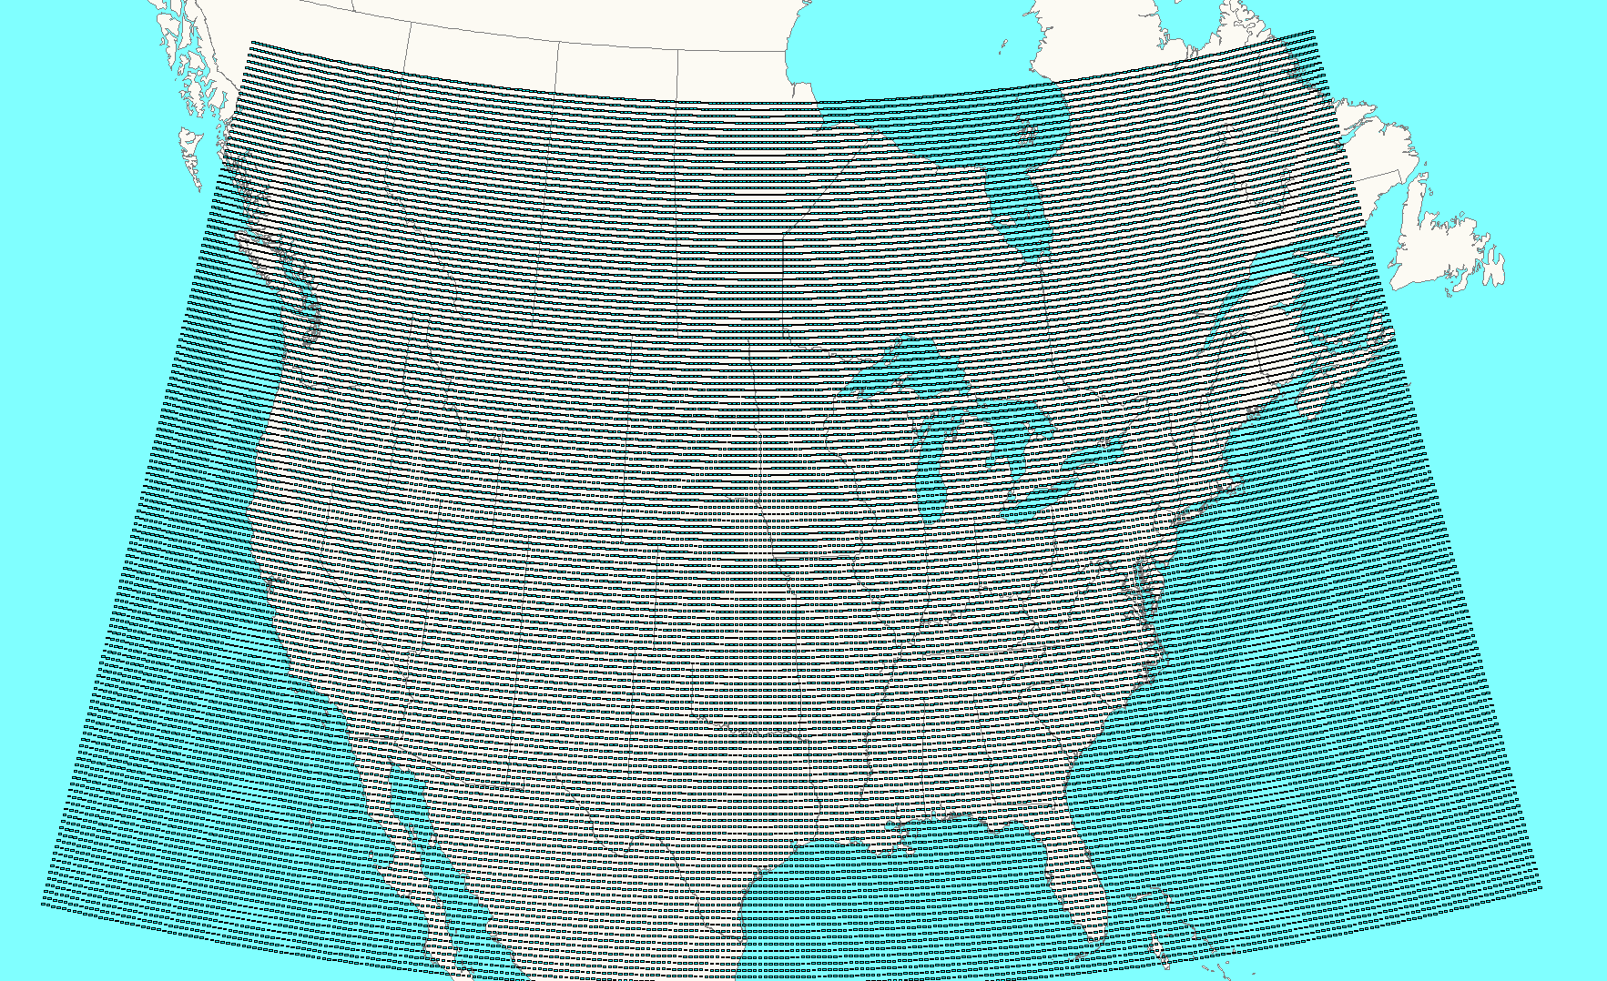
Easy Power Flow Access to ERA5
ERA5 is available worldwide about five days behind real-time
We convert it to pww format files, and place it at
electricgrids.engr.tamu.edu/weather-data/
Currently we provided data for most of North
America and then smaller files for just Texas
  For each hour the pww files store eight weather
  values (temperature, dew point, cloud cover percent,
  wind speed (10m), wind direction (100m), wind speed
  (100m), global horizontal irradiance, and direct horizontal irradiance
  The North America pww files have 38,497 data points; with 8 values per hour, this is about 220 MB per month, or about 225 GB for the total set

Slide 12
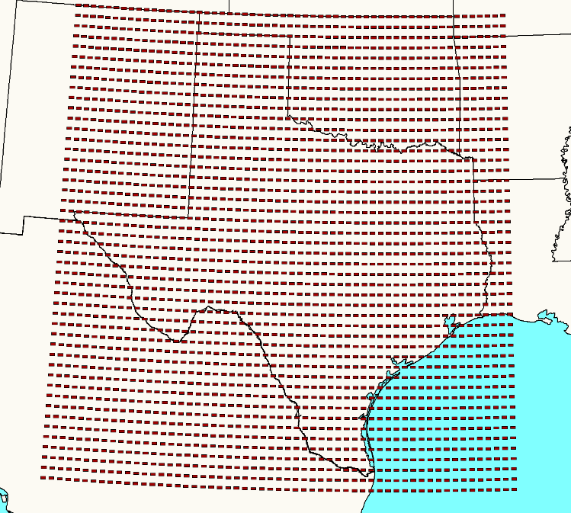
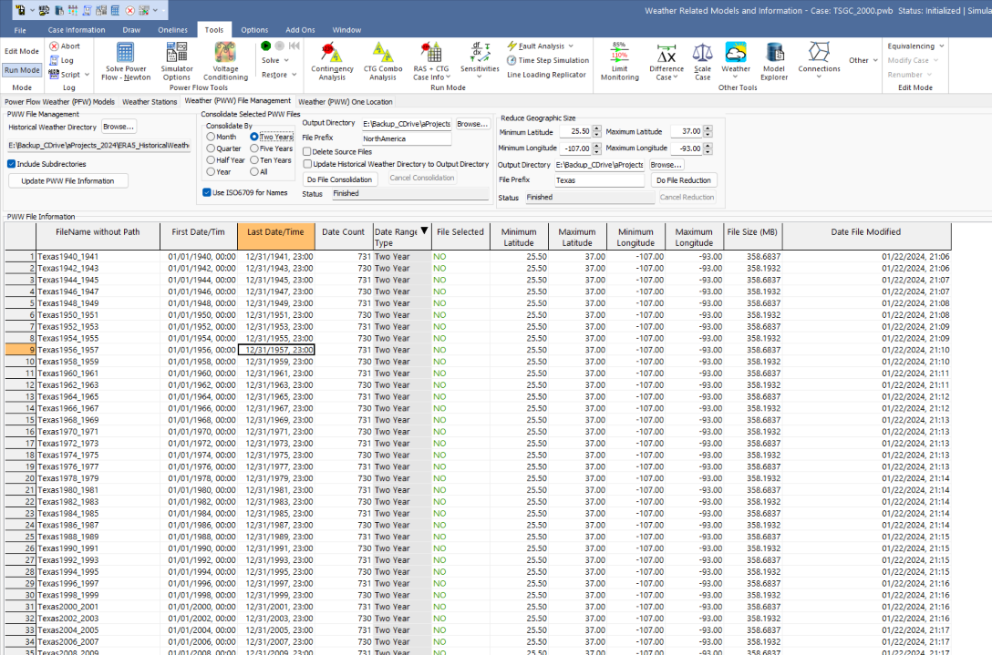
Example Texas PWW Files, Stored Every Two Years
The Texas pww files have 2679 grid points; each file stores two years of data with a size of 367 MB; total set (1940-2024) is 15 GB
Tool for reducing or consolidating pww files

Slide 13
Getting the Weather Details
Go to electricgrids.engr.tamu.edu/weather-data/
Click on View Available Weather for Download and click on either the Texas or North America links
  For Texas you can download it all at once (6 GB, which took about 3 minutes to download on my home computer)
  For North America you can download it by either decades (with one decade taking about 5 minutes for me) or by quarter
  New weather will be posted as it becomes available

Slide 14
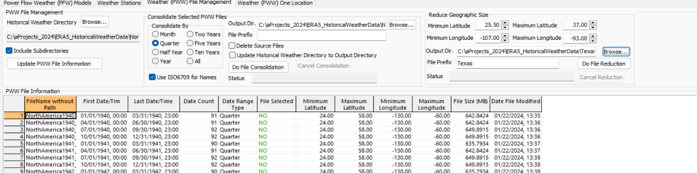
Reducing the Geographic Footprint
Using data for all of North America is not recommended
  Smaller footprints use less memory and require
  less computation
  We are supplying data more most of North America to make sure all data is available for subsequent reduction
PowerWorld has a tool to make it easy to
reduce the footprint by specifying a new
geographic rectangle

Slide 15
Availability of Forecasted Weather Information
Forecasted weather information is also available from a variety of sources; here we use the free forecasts provided by US National Oceanic and Atmospheric Administration (NOAA) National Centers for Environmental Prediction (NCEP) NCEP Central Operations
  nco.ncep.noaa.gov/pmb/products/gfs/
  Specifically we’re using the 0.25 degree resolution Global Forecast System (GFS) results, which provide four global forecasts per day going out for 16 days
  Forecasts are also be pww files, so all of the existing tools can be used, though the forecasts to not have the solar irradiance values

Slide 16
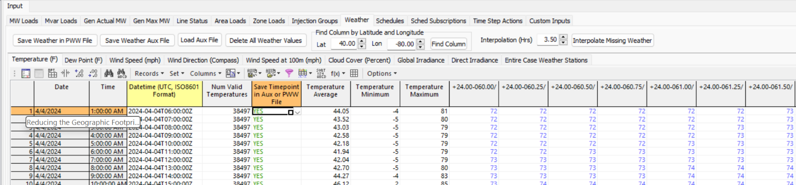
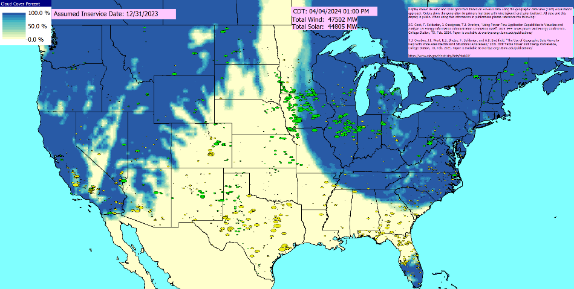
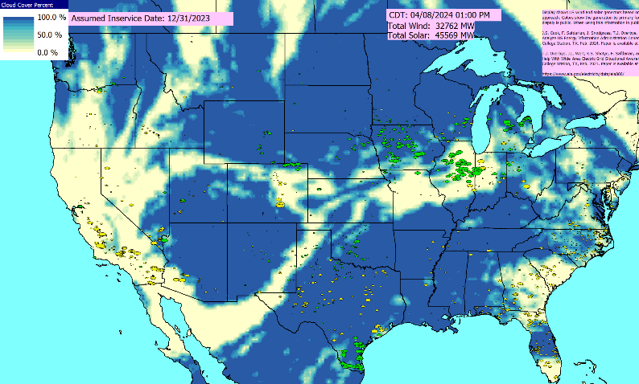
Availability of Forecasted Weather Information
Estimate of Current Conditions (based on a forecast from 6am UTC on April 4, 2024)
Estimated Eclipse Cloud Cover

Slide 17
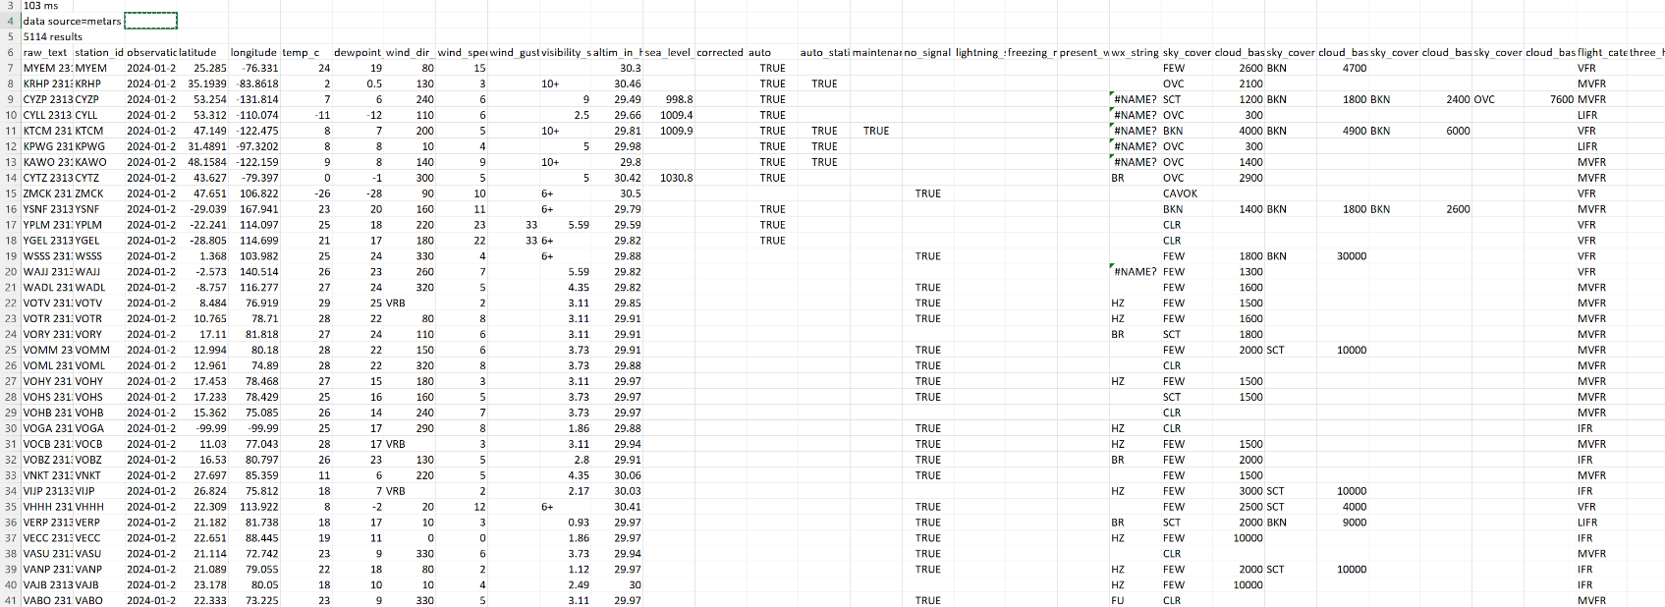
Current Weather
If desired, to supplement forecasted weather, current weather is available for download at https://aviationweather.gov/data/cache/metars.cache.csv
  METAR data comes from METeorological Aerodrome Reports; the weather here is from January 23, 2024
  However, data from a recent forecast is probably at good, and is certainly more complete

Slide 18
Models of Grid Weather Impacts
Key focus here isn’t weather per se, but modeling the impacts of weather on electric grid components (e.g., generators, lines)
Certainly a number of models already exist, and undoubtedly more will be created given that weather data is now conveniently available
The approach used here for handling a growing list of models is to mimic what has been done with power system stability – start small and expand
  Early (1960) stability codes just had a handful of models, whereas current codes support many hundreds of different model types
PowerWorld implements this using PFW Models

Slide 19
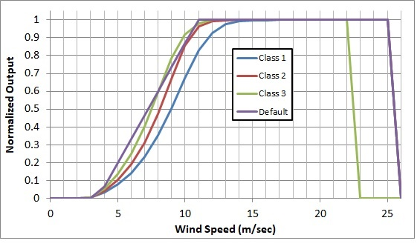
Example: Gen MaxMW Wind and Solar
An example is modeling the impact of wind speed on wind turbine output, or solar irradiation on PV output
  The image on the right shows
  several of the generic wind turbine
  models are based on the turbine
  classes using data from [a]
  A simple solar PV model uses either
  provided solar irradiation or the
  standard equations for insolation
  based on location and time of day
  including cloud cover; this is
  combined with whether the solar
  has tracking and, if needed, its tilt
  and azimuth
[a] C. Draxl, A. Clifton, B. Hodge, J. McCaa, “The Wind Integration National Dataset (WIND) Toolkit,” Applied Energy, vol. 151, pp. 355-366, 2015.

Slide 20
Making it Easy to Get Started: Using EIA-860 Data
For those who do not have access to models, to make it easy to get started we’ve setup copper plate (i.e., no transmission) power flow cases with PFW models based the data provided by the US Energy Information Administration (EIA) in their Form EIA-860 datasets
  EIA-860 provides data on every generator in the US with 1 MW or more capacity
  Available at www.eia.gov/electricity/data/eia860/; it is released yearly with monthly updates available; we post data quarterly
We take this data and convert it into a copper plate power flow model, with the resultant cases publicly available at
  electricgrids.engr.tamu.edu/eia-860-generator-data-cases/
  Details on this process are in a 2024 TPEC paper (available as 2024 paper 3 at overbye.engr.tamu.edu/publications/)

Slide 21
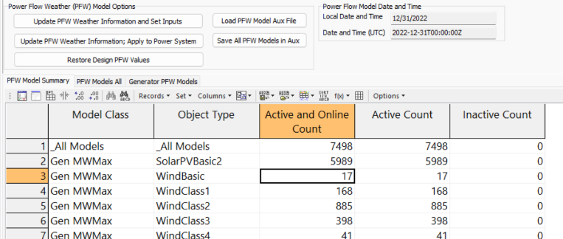
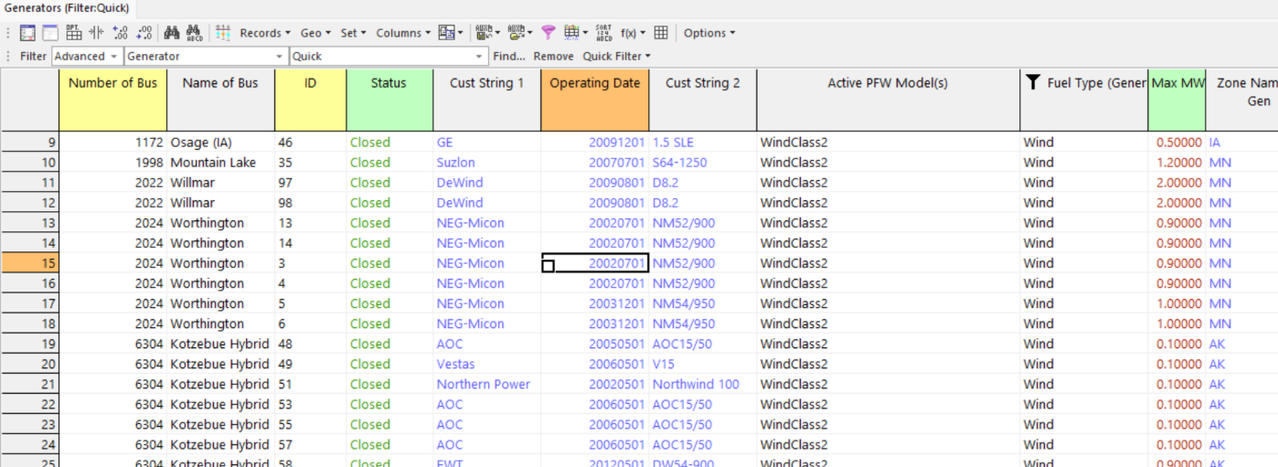
Example EIA-860 Wind Generator Data
Bottom image shows some EIA-860
wind generators with turbine information
Right image shows the PFW models to
map weather (wind speed) to MW Max
  For the CEII grids we have bus mapping for more than 95% of the generator capacity

Slide 22
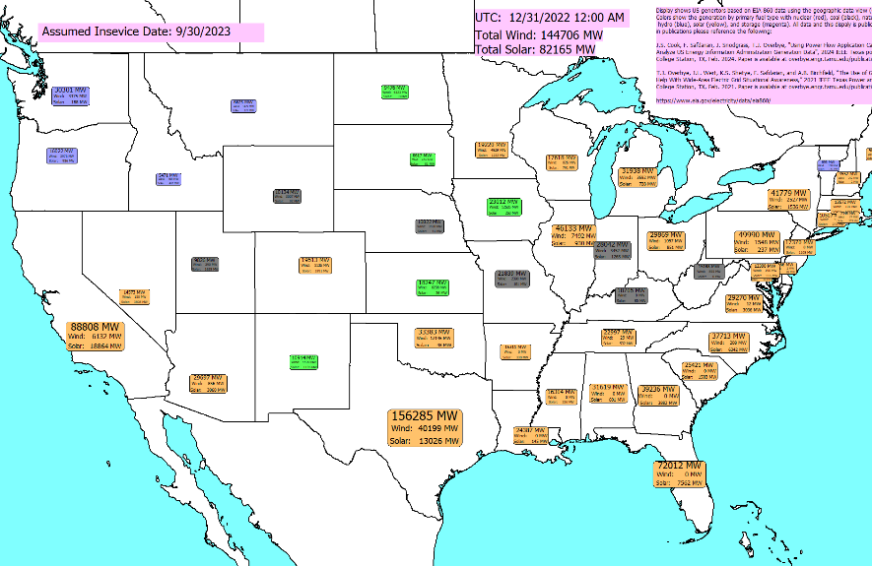
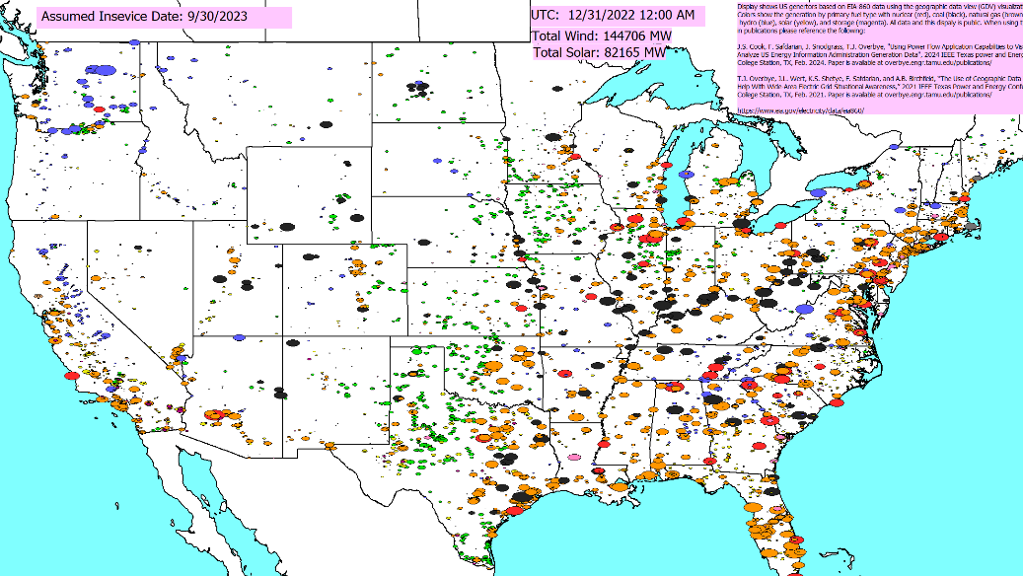
EIA-860 Generator Displays
  Generation Summary By State
  Generation by Primary Fuel Type

Slide 23
Mapping Weather to the Electric Grid Components
While the newer weather datasets have lots of points, there is still usually at least some distance between power grid components and the nearest weather measurement, requiring interpolation
There is no single best algorithm for doing the needed 2D scattered data interpolation, but there are a number of good and fast algorithms (grid-based, closest neighbor, Delaunay Triangulation, Shepherd’s)
  Since the weather values have an associated elevation, if the power grid component’s elevation (or profile for a line) is known this could be considered
Usually places in which the weather changes rapidly with geography (e.g., mountains) don’t have much electric infrastructure (the exceptions are covered next)

Slide 24
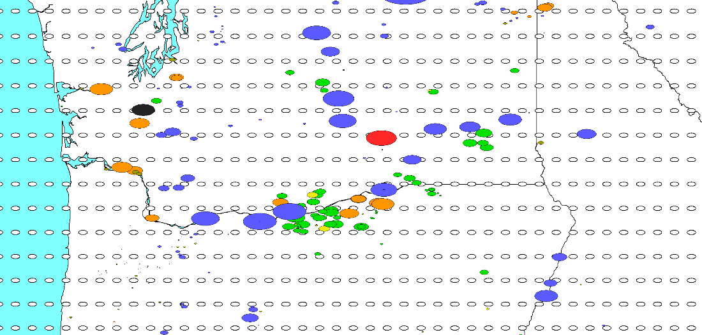
Mapping Weather to the Electric Grid Components
In situations in which interpolation does not work well (e.g., valleys, mountains, some coastal regions), specific weather stations could be assigned to the electric grid devices (e.g., a wind farm)
  An example is the Columbia River Gorge with a length of 190 km and an average width of 5 km;
  the gorge has a unique
  and complex climate often
  with high winds
  Image shows the generation
  (ovals, with green for wind
  and blue for hydro) and the
  weather data points
  (as white ovals)

Slide 25
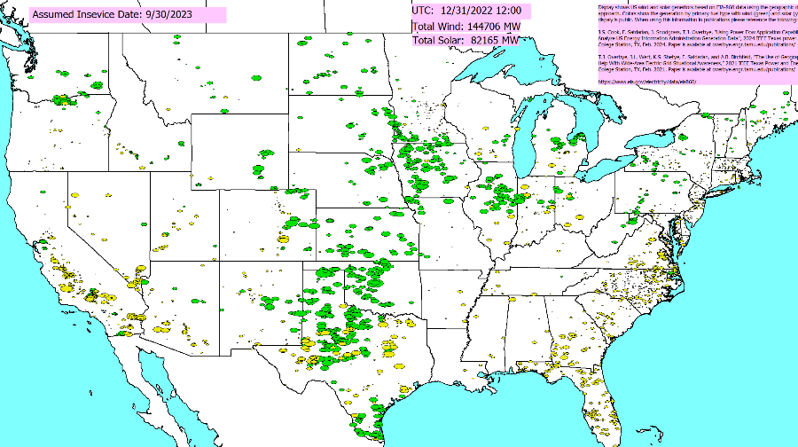
Applying the Weather
Weather can be applied to a power flow case using the pww files in multiple ways
  At a specified point in time
  As a summary of a large amount of weather at a single location (e.g., a generator) or at a few locations (a transmission line)
  As a time series, sequentially
  solving lots of different time points
The next few slides
demonstrate each of these,
showing the change
in the wind and solar outputs

Slide 26
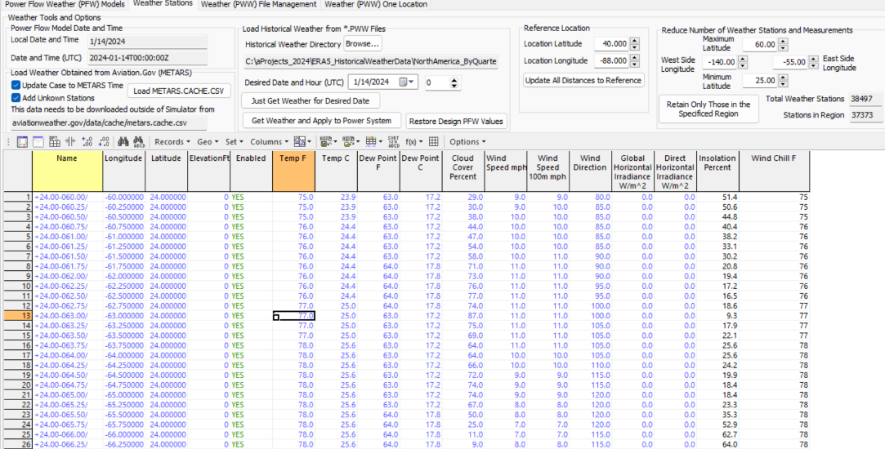
Applying Weather for a single time point
With the provided pww files, any time going back to 1940 can be simulated. The pww files are designed for quick searching, and for providing direct access to all the data for a particular time.
Getting the access to the weather for all of North America takes about a second;
optionally the
weather can also
be applied to the
power flow

Slide 27
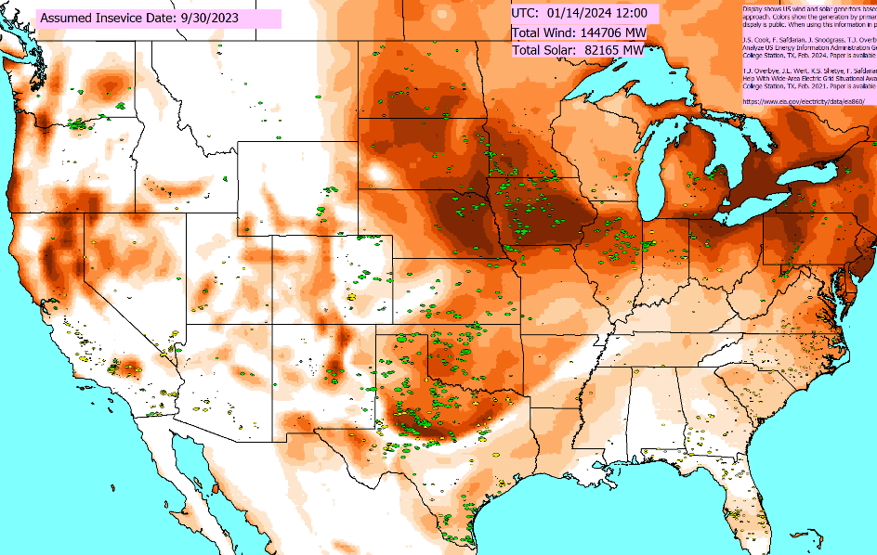
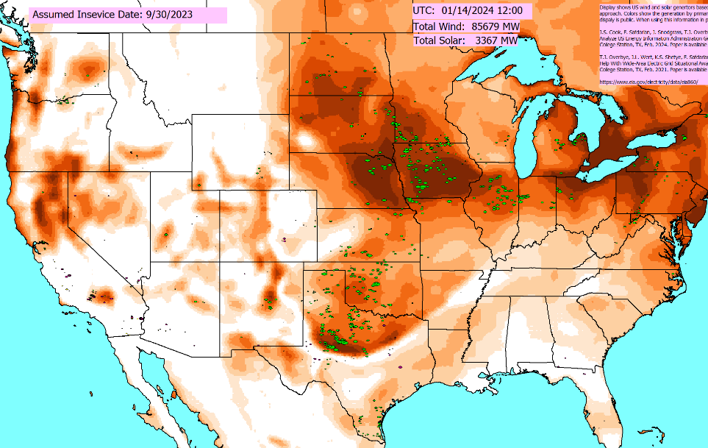
Applying Weather Without and With Updating the PFW Models and the Power Flow
Left image just shows the weather, without updating the PFW models (i.e., not changing the power flow values) whereas the right one also updates the PFW models (note the very low solar)

Slide 28
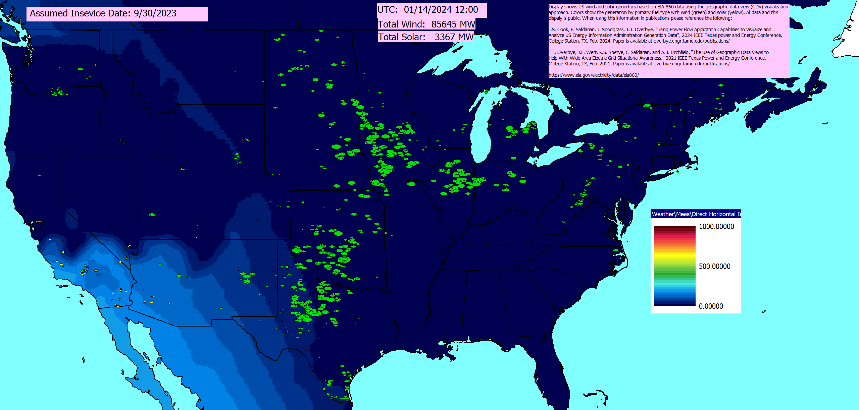
Previous Example Direct Horizontal Irradiance
  The EIA-860 grids do include Alaska and Hawaii, so there can be solar quite late in the day (from a Continental US perspective)

Slide 29
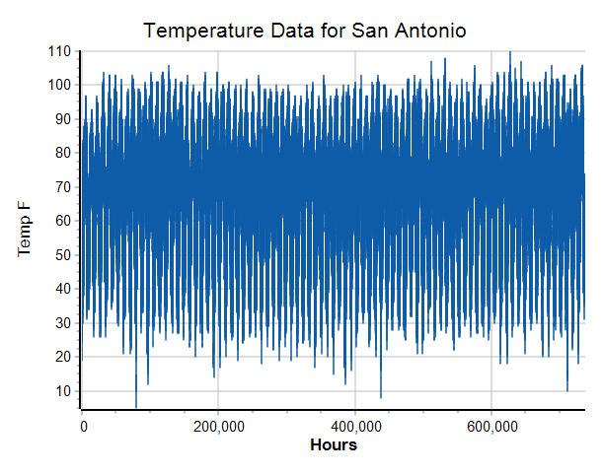
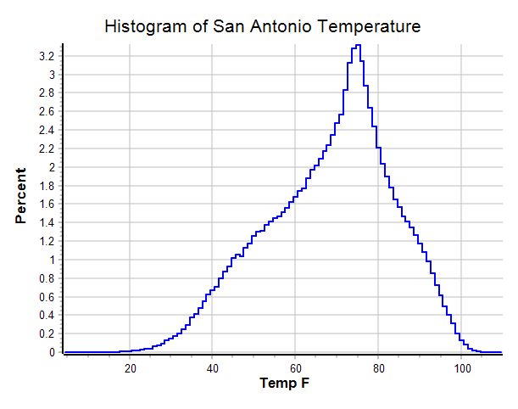
Getting Lots of Weather for a Single Location
By automatically parsing through the pww files, weather for a single location can be quickly determined
  For the Texas cases this takes on the order of 4 seconds, returning data for more than 700,000 hours; below data is for San Antonio, TX

Slide 30
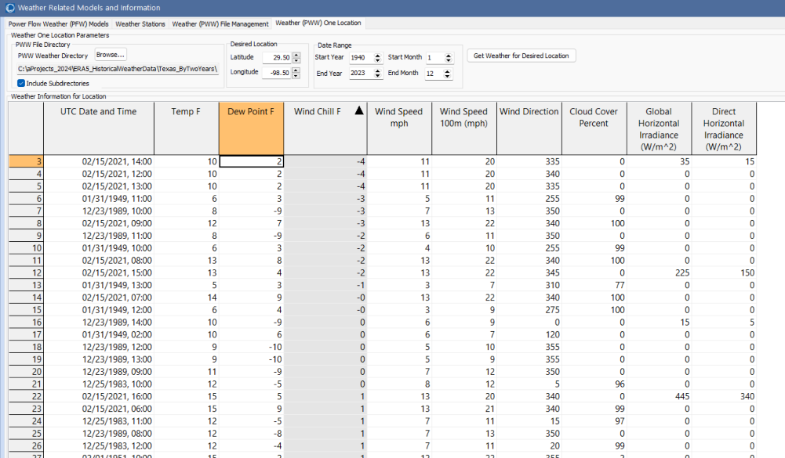
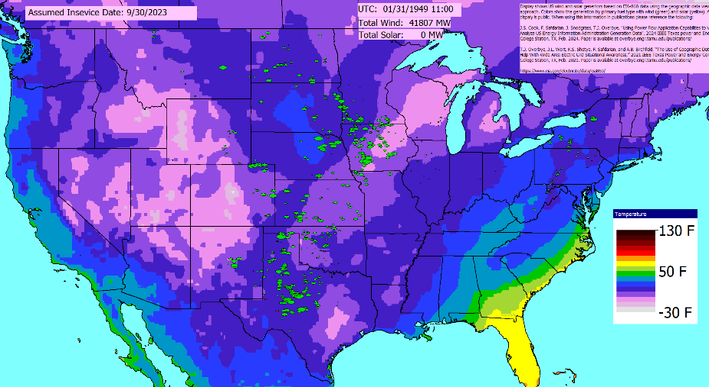
One Application is Looking for Outliers
Lower left image shows lowest wind chills in San Antonio; the lower right contours temperatures for Jan 31, 1949 at 11am (UTC)
  This allows engineers to rapidly find some of the worst conditions for a location and doing more in-depth analysis

Slide 31
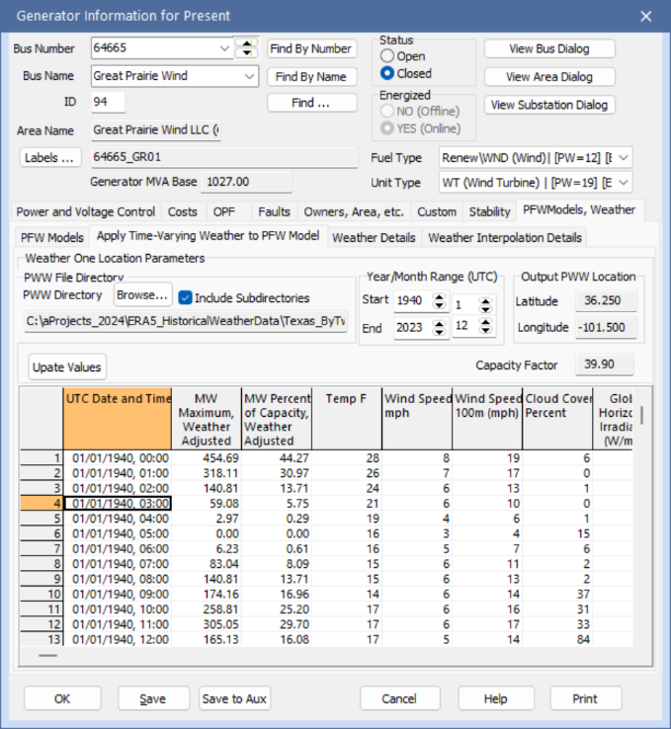
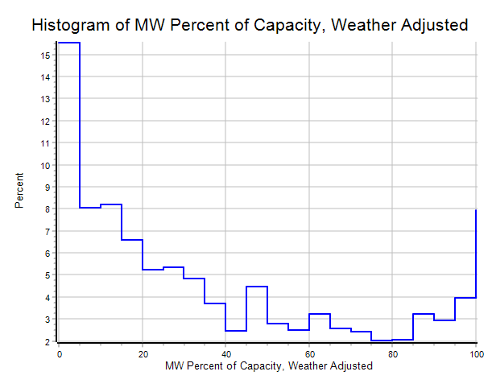
Anticipated Performance of Wind or Solar Generation Can Also Be Determined
Hourly weather data can also be
repeated applied to individual devices,
such as generators. This allows
the capacity factor to be estimated
for any location (existing or new)
  The impacts of changing model parameters can also be easily determined; for example changing the hub height to
  100 m increases the capacity factor to from 39.5% to 44.5%

Slide 32
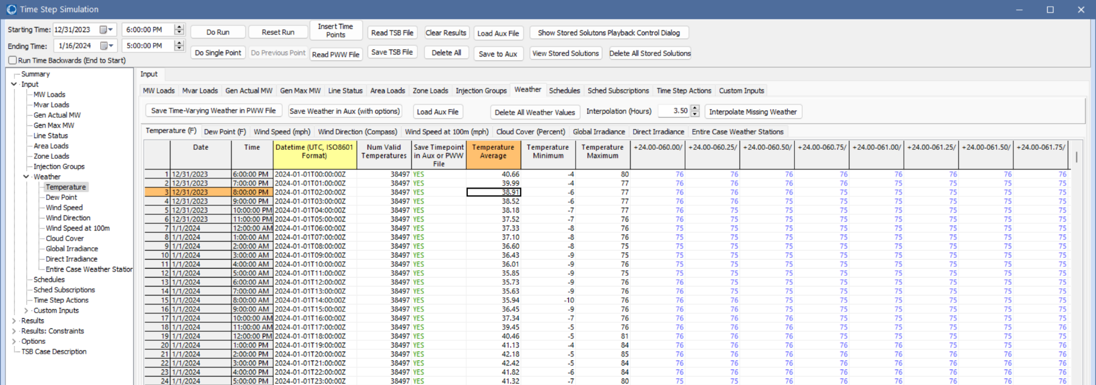
Simulating Large Amounts of Weather Information
To easily view and simulate many time values, the pww files can be loaded into the PowerWorld Time Step simulation

Slide 33
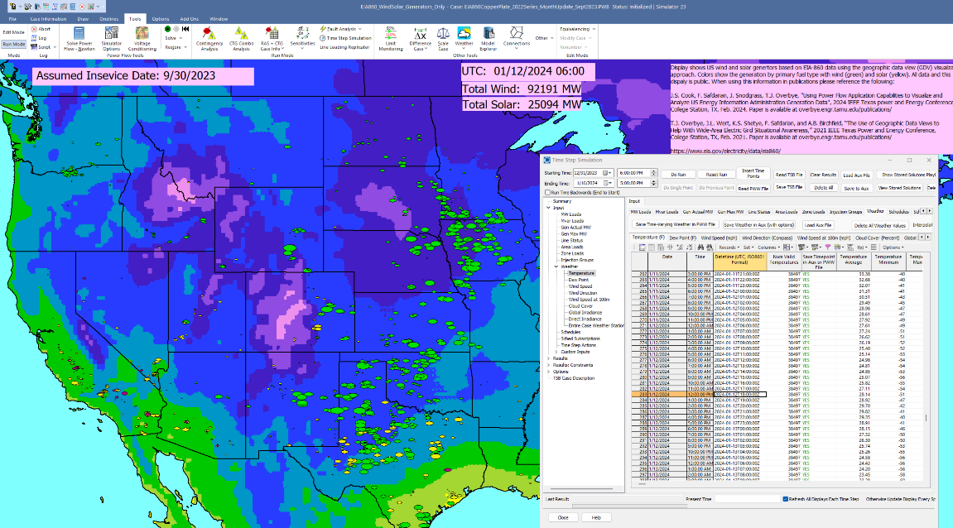
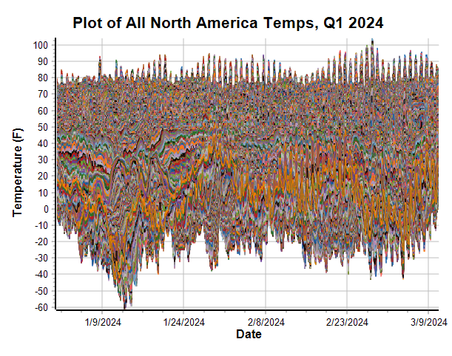
Applying Individual Times
The weather for any hourly value can be easily applied by selecting the timepoint, right-clicking and selecting Time Point Record, Apply Timepoint (With Weather Update)

Slide 34
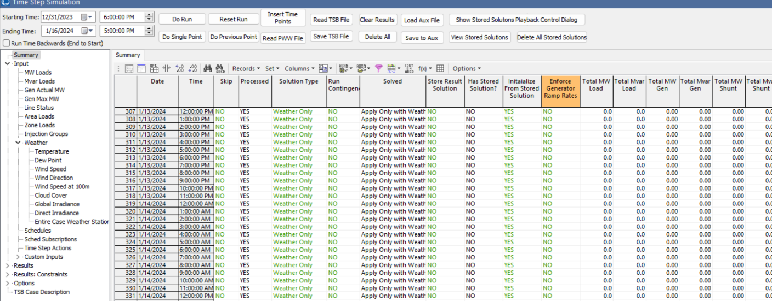
Running All Timepoints
When running all timepoints there are many options for applying inputs, storing results, and the associated solution type
Here just the weather is applying, and the solar/wind results for the entire case and the individual states saved

Slide 35
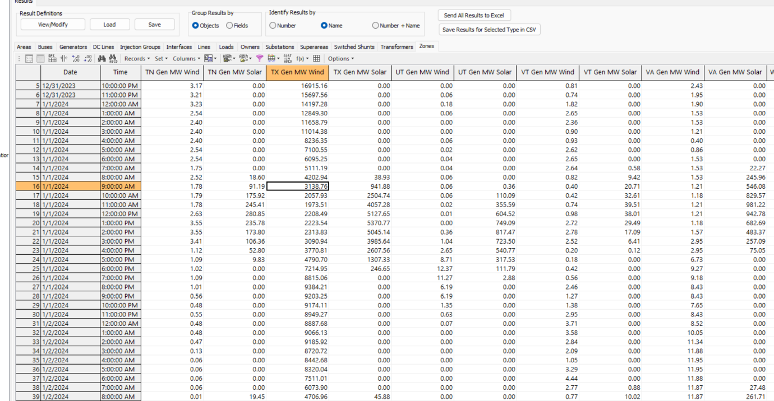
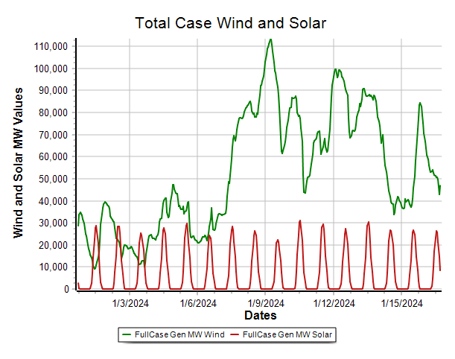
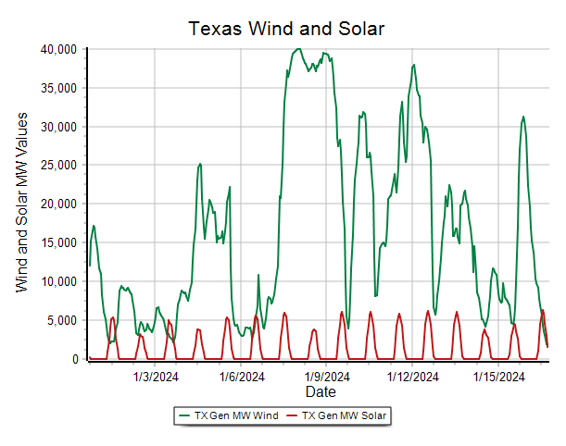
Results
The results can be viewed in either tabular displays or with graphs
  This naturally leads to validation! Of course with the EIA-860 case we won’t expect to fully match actuals.

Slide 36
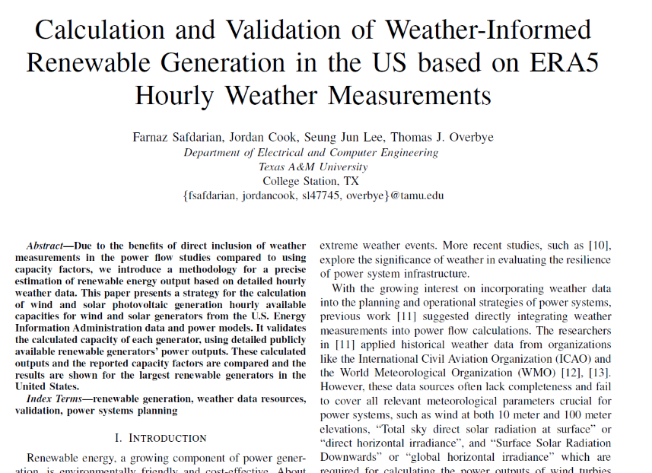
Validation
An important aspect of this work is validating the results by comparing the simulated values with actual results
  This can be at an aggregate level (e.g.,
  state level using EIA data) or at
  an individual plant level using
  Errors can arise because of actual
  weather differences and because
  of inaccurate models
We will be presenting a paper on
generator output validation later
in April at the Power and Energy
Conference at Illinois (PECI)

Slide 37
Some Potential Additional Models
With weather information a part of the power flow a wide variety of additional power flow model enhancements become possible. Some examples are given below, recognizing that many are already done using external analysis
  Transmission line limits that depend on temperature, wind and insolation along the right-of-way
  Transformer limits
  Load models (recognizing that the load depends on many factors, initial models could be linearizations about a specified value)
  Line resistance (though this would be more complex since it is operating point dependent
  Etc.

Slide 38
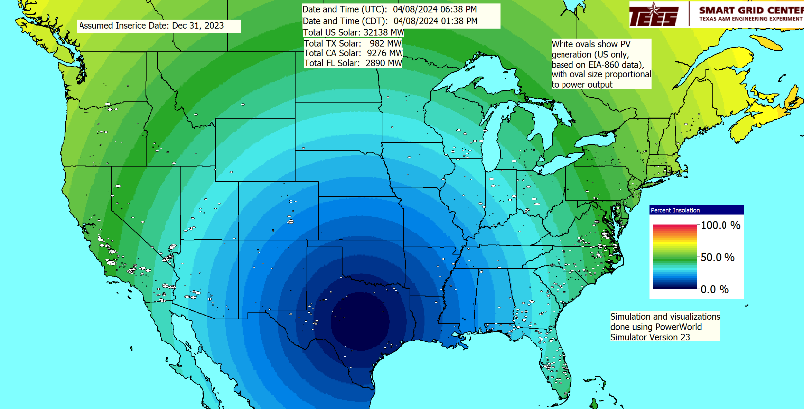
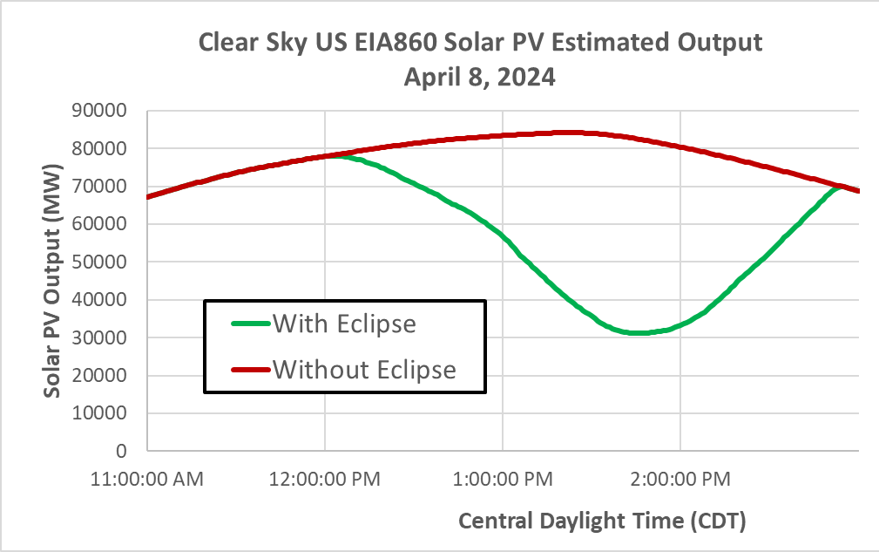
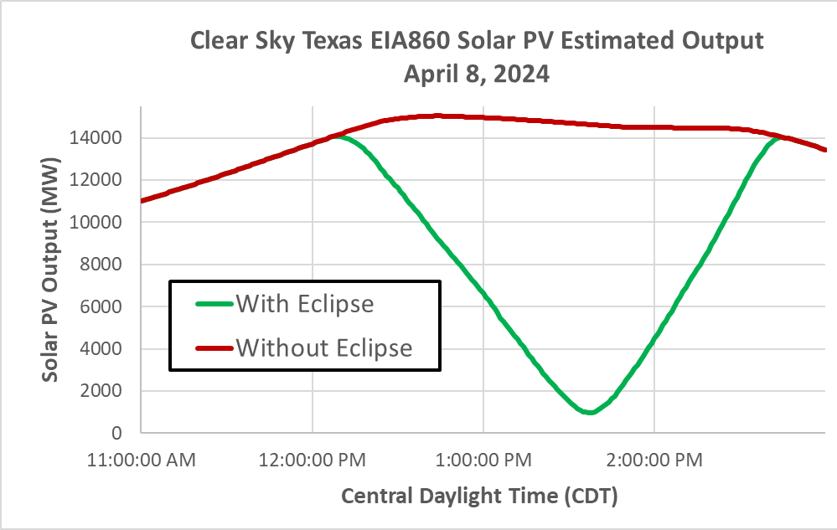
Other Resiliency Events
A similar process can be used for modeling the impacts of other resiliency events
An example of a relatively benign event is Monday’s (04/08/24) total solar eclipse

Slide 39
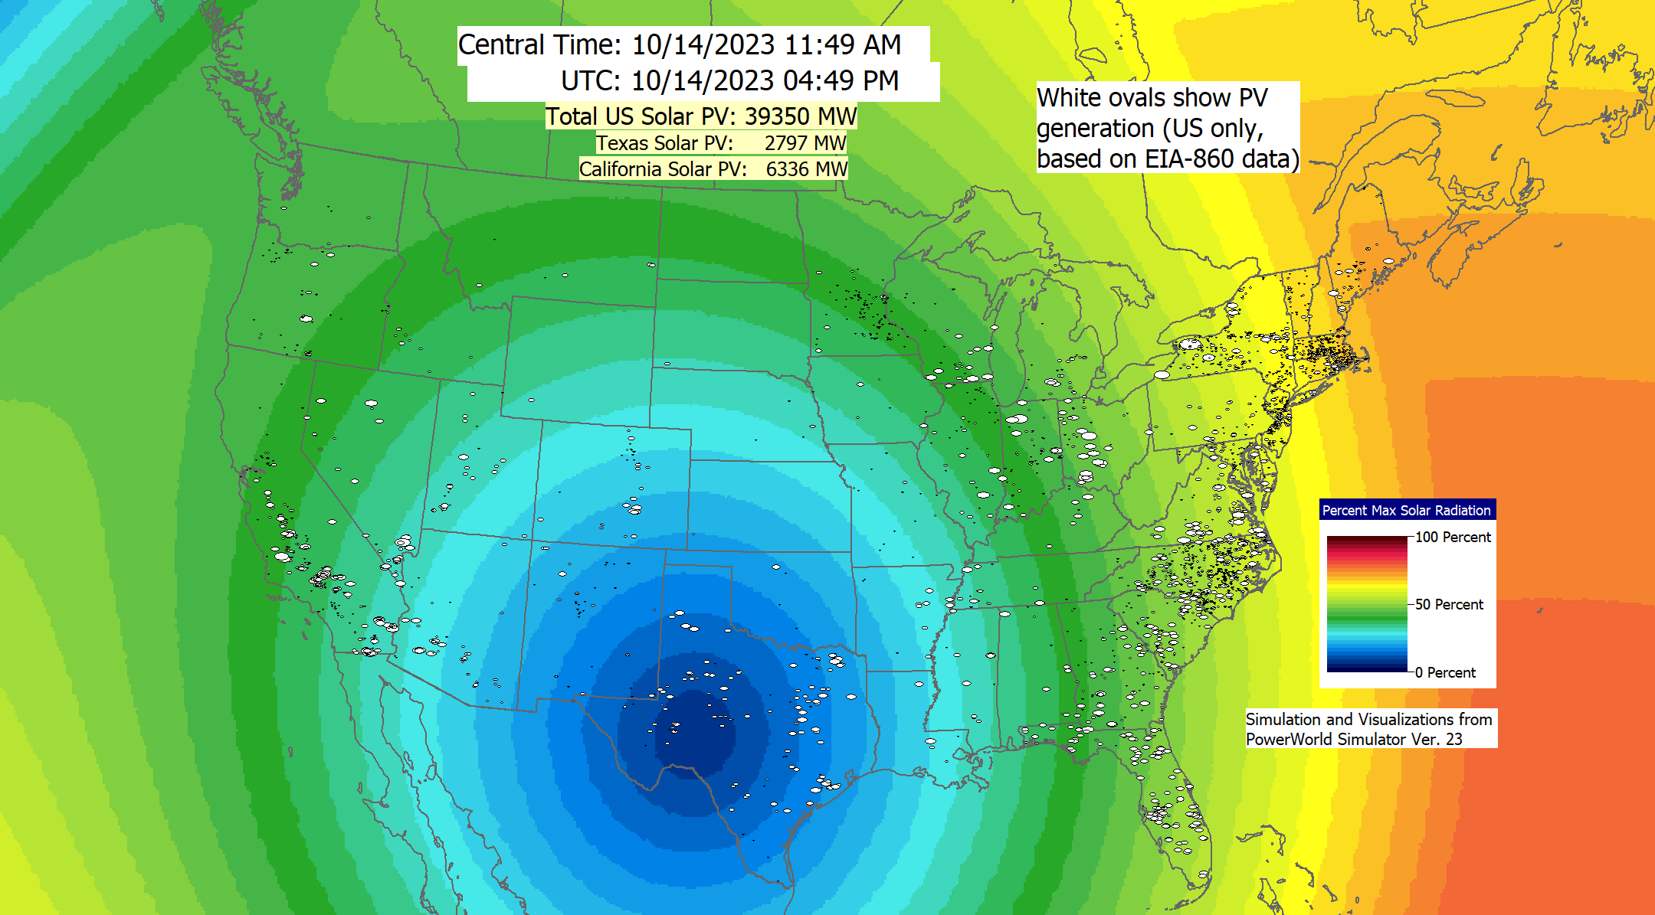
Other Resiliency Events, Eclipse, cont.
Video visualizes the eclipse impact (also available at www.youtube.com/watch?v=clccRdPfvTU&t=4s)

Slide 40
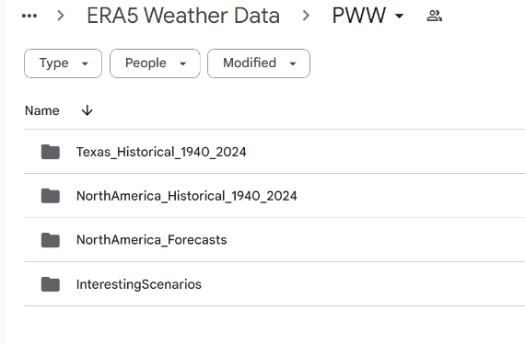
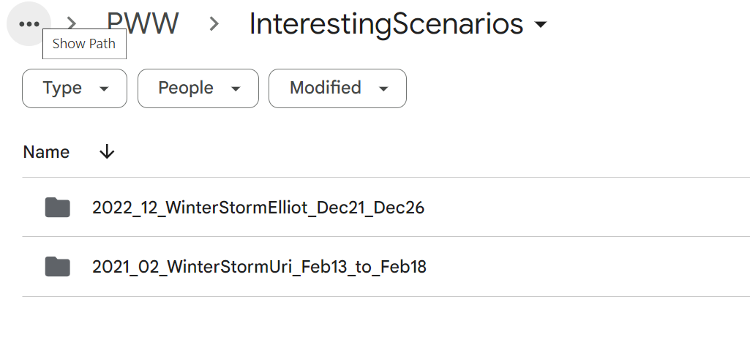
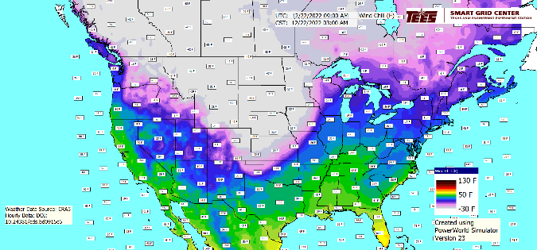
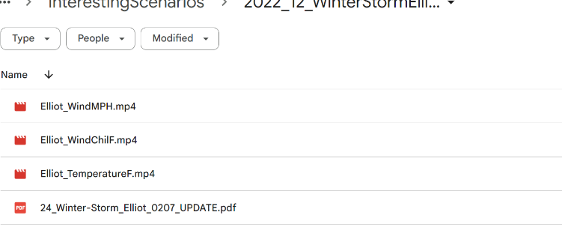
We have Just Started Making a Public Library of Interesting Grid Scenarios
More scenarios are going to be added very soon; the site will link public reports with our weather/grid simulations

Slide 41
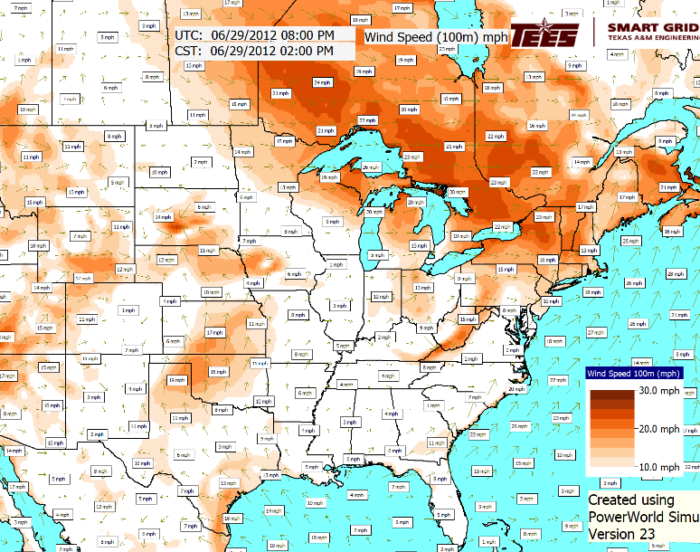
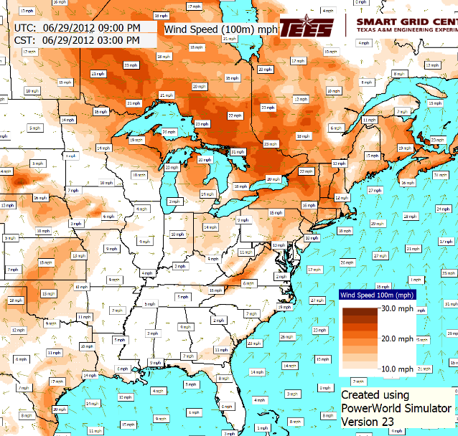
A Need for Higher Resolution on Some Scenarios
The ERA5 data is great for slower events, but for faster events (like the June 29, 2012 Derecho) we need higher resolution data, both spatially and temporally

Slide 42
Future Directions
A number of models that relate weather to electric grid values already exist, but more certainly should be developed
More validation!!
Increased automation of the updating process; maybe more footprints
Machine learning applications given lots of potential operating points
Determining the required level of weather details; higher resolution datasets are available
Using the data sets to search for outlier conditions such as renewable resource droughts or times of rapid changes in values
Expanding the set of available weather variables, such as ones related to icing and storms, and the set of interesting scenarios
Applying the techniques to other potentially severe resiliency events

Slide 43

Thank You! Questions?
Recent papers are at overbye.engr.tamu.edu/publications/
For questions afterwards email me at overbye@tamu.edu

