Slide 1
Modeling and Enhancing the Resilience of Electric Grids to Large-Scale Disturbances
Prof. Tom Overbye
Dept. of Electrical and Computer Engineering
Texas A&M University
overbye@tamu.edu
May 15, 2024

Slide 2
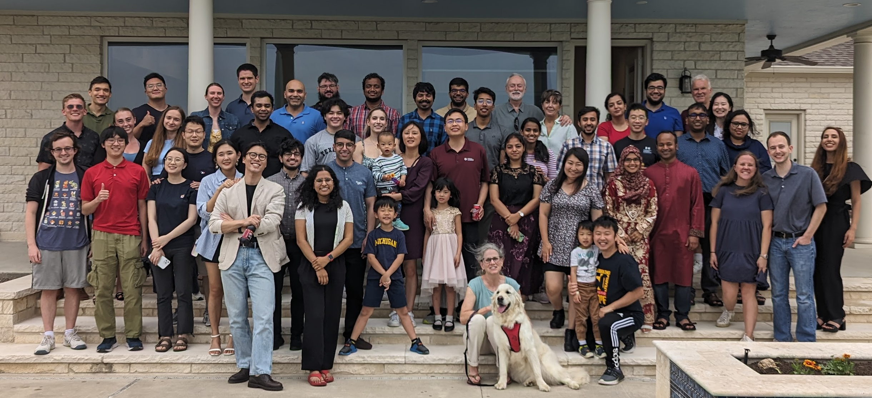
Greetings from the Texas A&M Electric Power Group

Slide 3
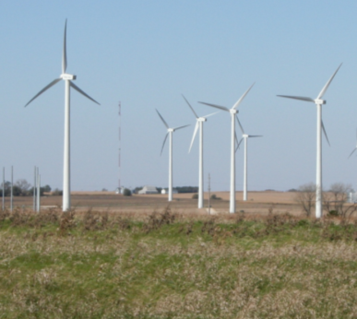
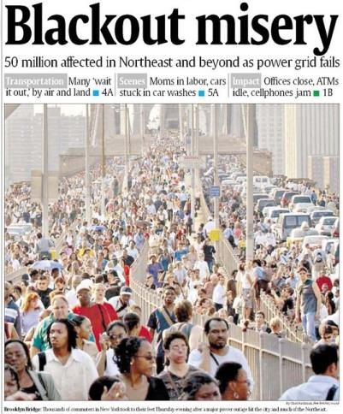
Overview
Our modern society depends on a reliable
electric grid with 40% of our energy transported
in the form of electricity including most renewables
Blackouts are costly, with some estimates of costs
above$100 billion/year in the US.
  Growing risk of catastrophic, long-term blackouts
  Blackouts cannot be completely eliminated, but risk
  and impact can be reduced with a more resilient grid
The electric grid is coupled with many other
infrastructures and with the weather, and these
couplings are becoming even stronger

Slide 4
Reliability and Resiliency
Keeping the lights on involves designing and operating the electric grid with a goal of simultaneously increasing two related but ultimately different concepts: reliability and resiliency
Reliability: suitable or fit to be relied on: dependable
  One of the key benefits of interconnected electric grids
Resiliency: an ability to recover from or adjust easily to misfortune or change
  A key focus of electric grid protection systems almost from day one, but there is a more recent focus on acknowledging that large-scale blackouts cannot be totally prevented, so we must be able to bounce back
3

Slide 5
High-Impact, Low-Frequency Events
In order to enhance electric grid resiliency we need to consider the almost unthinkable events
These include what the
North American Electric
Reliability Corporation
(NERC) calls High-Impact,
Low-Frequency Events
(HILFs); others call them
black sky days, or severe resiliency events (SREs)
  Large-scale, potentially long duration blackouts
  HILFs identified by NERC were 1) a coordinated cyber, physical or blended attacks, 2) pandemics, 3) geomagnetic disturbances (GMDs), and 4) HEMPs
Image Source: NERC, 2012

Slide 6
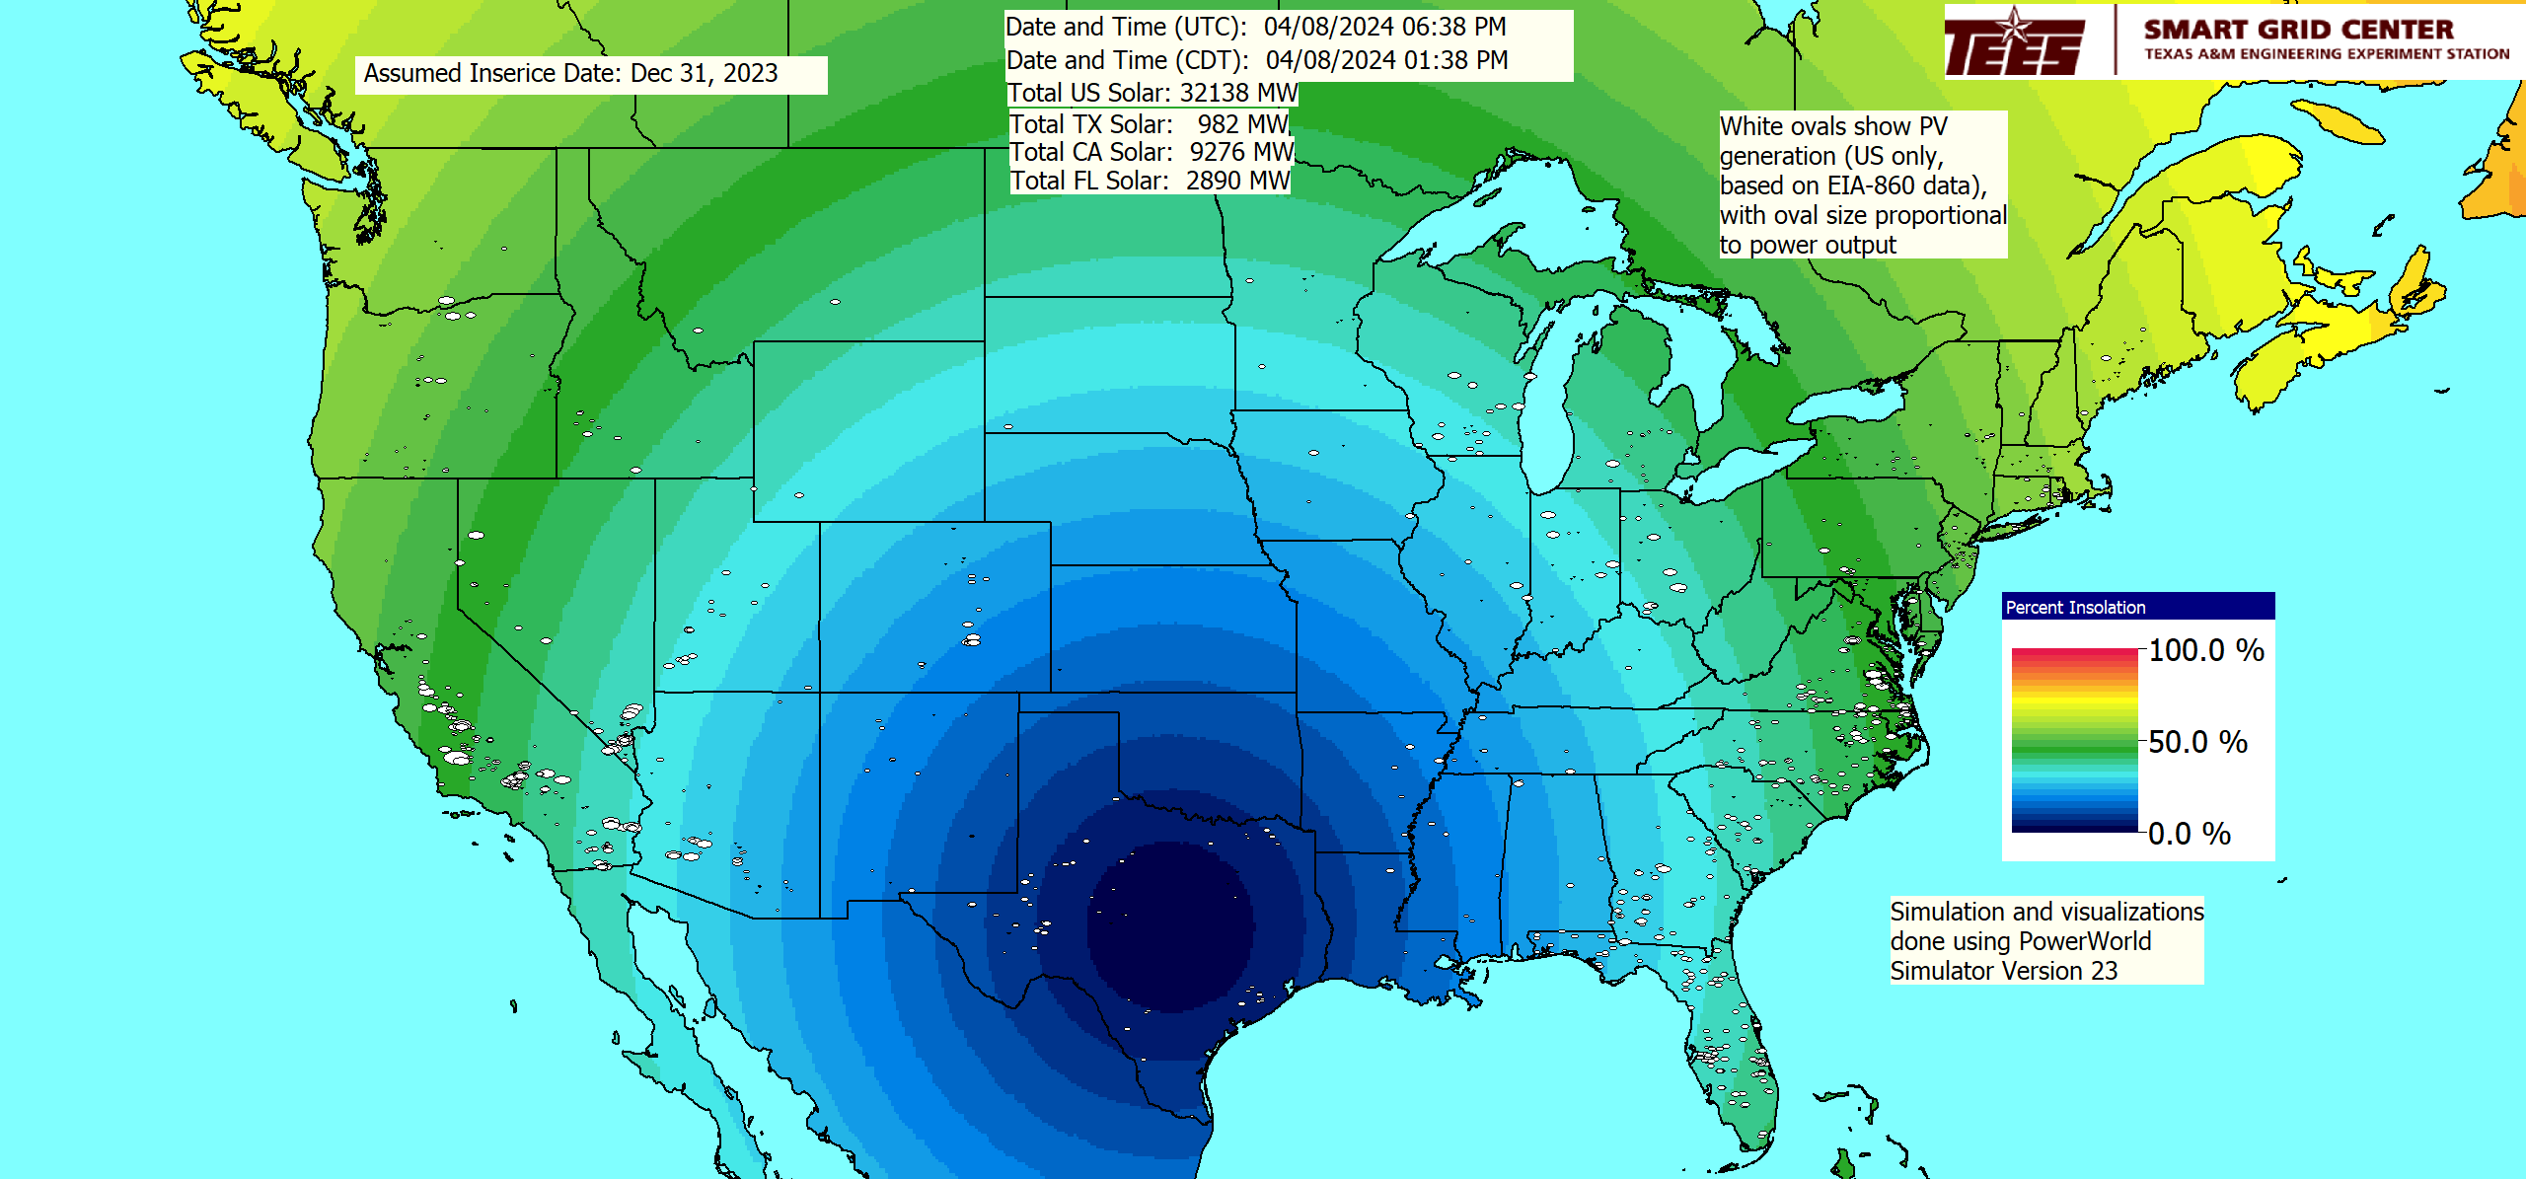
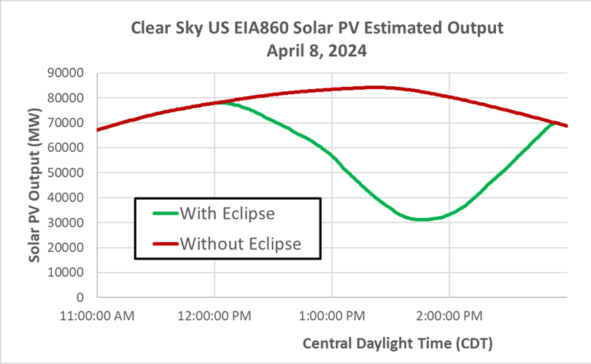
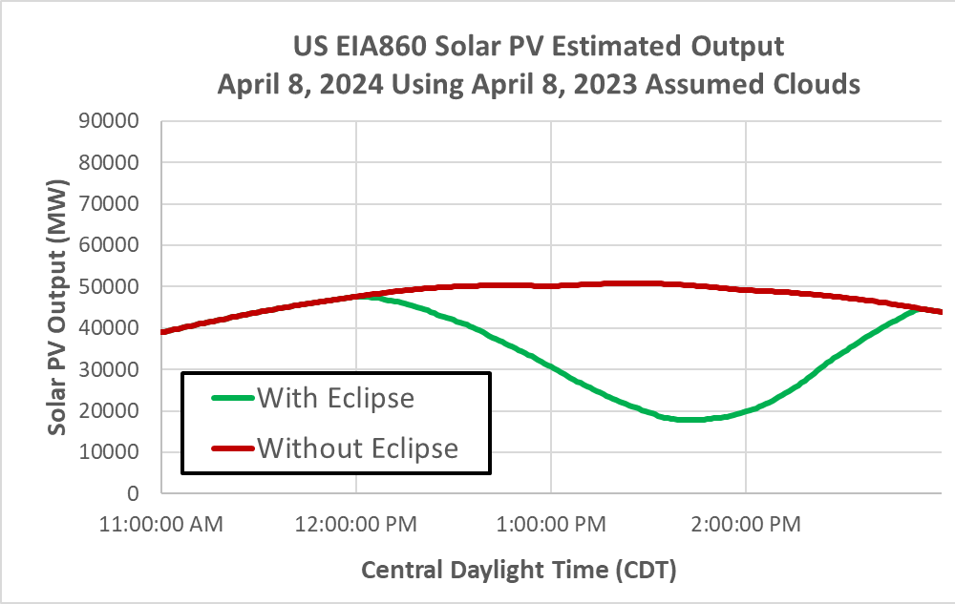
A Benign, Slightly High Impact, Low Frequency Event
There was a total eclipse on April 8, 2024 that passed over much of the US; in March we released a video showing the estimated impact on US PV generation

Slide 7
What is Grid Resilience?
Merriam Webster Dictionary (resilience in general)
  “An ability to recover from or adjust easily to misfortune or change”
EPRI & North American Transmission Forum (NATF)
  The ability of the system and its components (… equipment and human …) to minimize damage and improve recovery from non-routine disruptions, including High Impact, Low Frequency (HILF) events, in a reasonable amount of time”
The impact of blackouts is not linear!
  Having 100 million people out of service can be more than tens times worse than 10 million out. A ten day blackout can be more than tens times worse than a one day blackout.
These definitions are from the 53rd North American Power Symposium keynote address by Dan Smith of Lower Colorado River Authority, November 2021

Slide 8
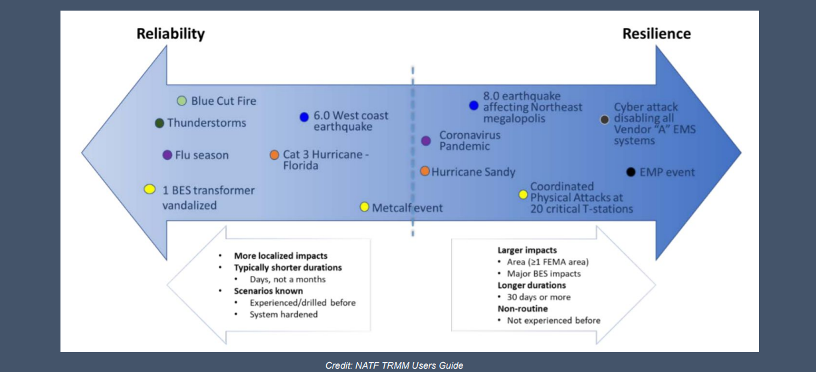
Reliability – Resilience Continuum
Slide is from the 53rd North American Power Symposium keynote address by Dan Smith of Lower Colorado River Authority, November 2021; credit NATF

Slide 9
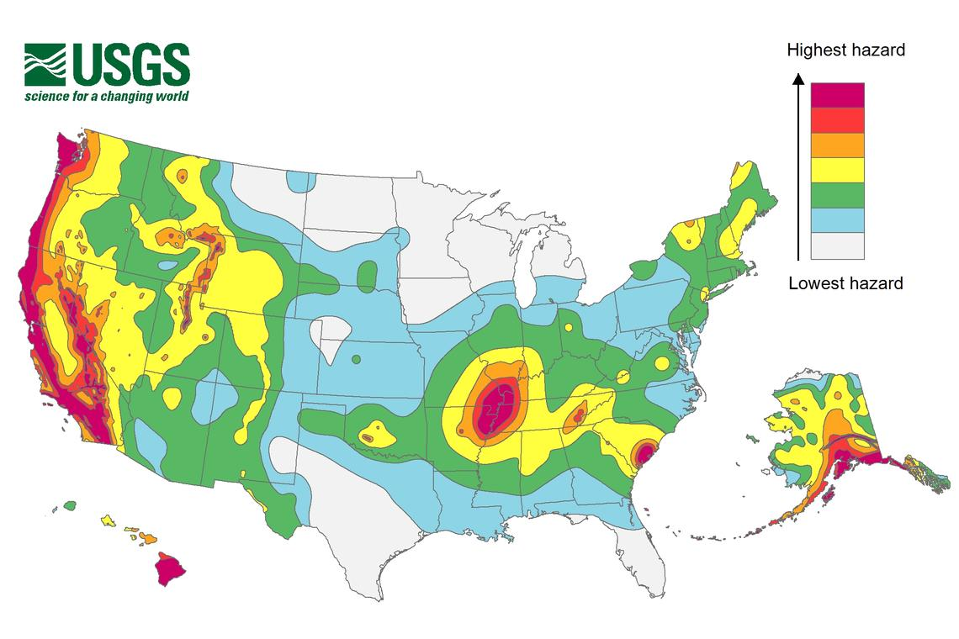
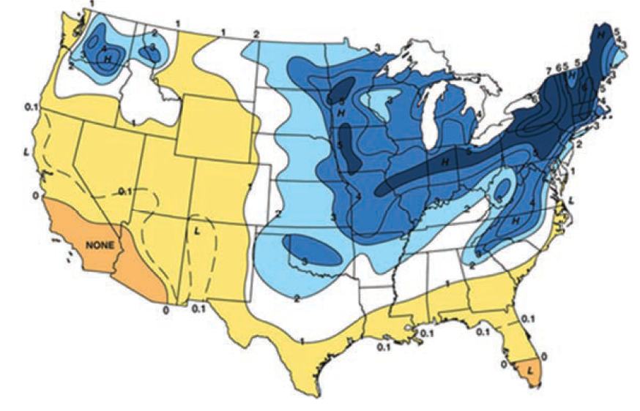
Resilient to What?
A key question on resiliency is to determine the likely threats
  Some are geographic, and may are hard to quantify
Earthquake Risk
Freezing Rain Risk
The impact of wind and solar output on the weather is also a growing concern
Source: Enhancing the Resilience of the Nation’s Electricity System, 2017

Slide 10
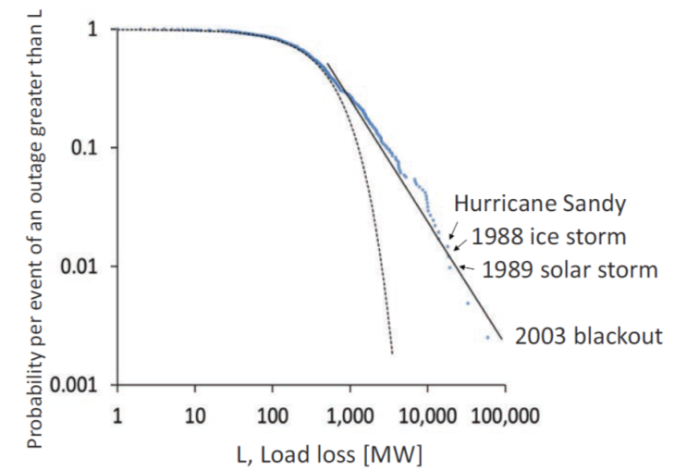
Resilient to What?
Electric grids are complex, and they are subject to a wide variety of different disturbances. Many occur regularly and some have never occurred
The image shows the frequency
of US bulk outages from 1984-2015;
large events are more common than
an exponential distribution would
indicate
Blackouts have been shown to
have a power-law distribution so
there is scale invariance

Slide 11
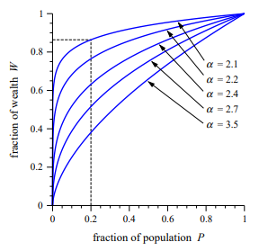
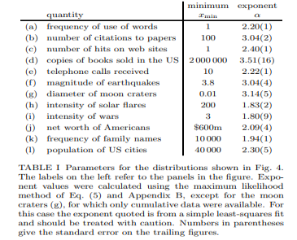
Aside: Power Law Distributions
When considering a phenomena, it is useful to known 1) does it follow a power law, 2) if so over what range, and 3) what is it’s α exponent
With power laws, extremes are more frequent than we expect
There is not a well defined average if α is less than 2
Images Source: www-personal.umich.edu/~mejn/courses/2006/cmplxsys899/powerlaws.pdf

Slide 12
Power Law Application to Grid Resiliency
Blackouts have been shown to have a power law distribution with an α of close to the critical value of 2
  This provides justification for devoting a substantial amount of resources to minimizing the likelihood of large events even though they seem unlikely
Grid resiliency needs to consider rare events, but some of these events also have power law distributions
  Geomagnetic disturbance size, earthquakes
  However, some do not (EMPs, physical and/or cyber attacks)
  Wind and solar resource droughts?
The grid is becoming even more essential, and is becoming increasing coupled to other infrastructures and with the weather

Slide 13
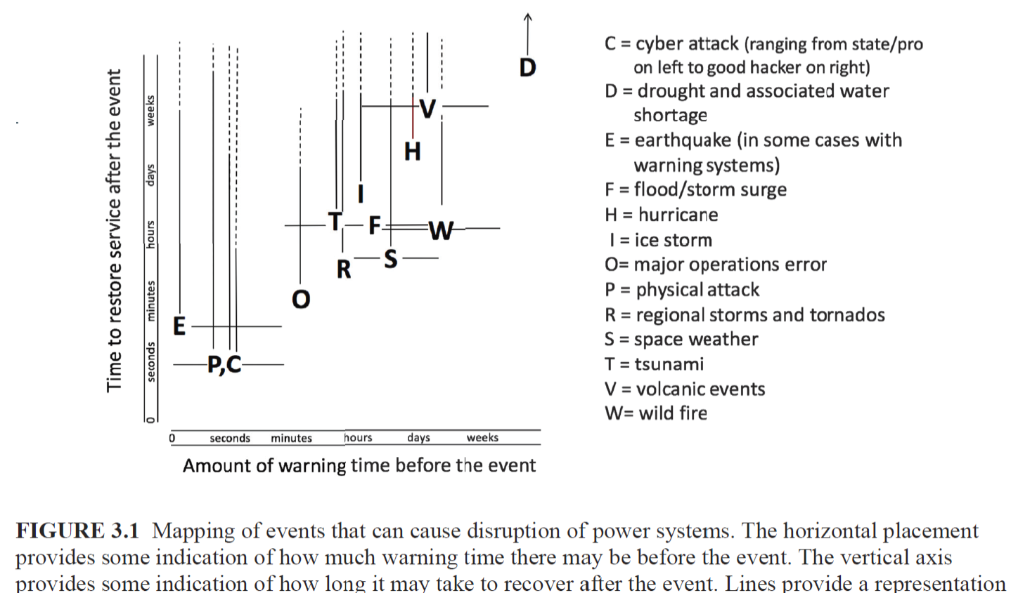
Some Electric Grid Risks
Source: Enhancing the Resilience of the Nation’s Electricity System, 2017

Slide 14
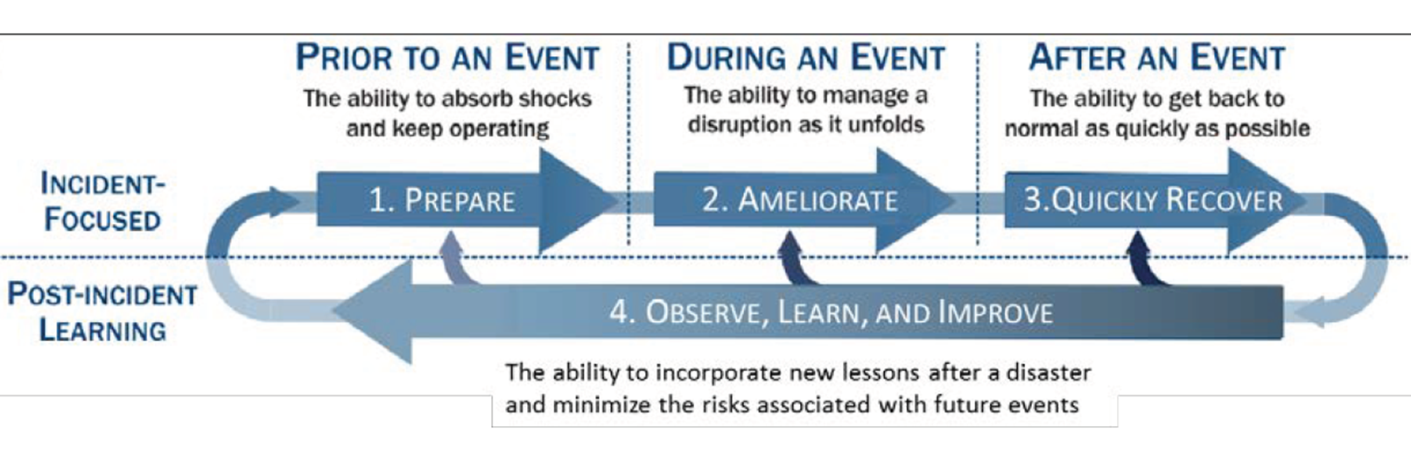
Major Considerations with Resiliency
Understanding, and ultimately enhancing resiliency, requires consideration during three periods
  Prior to an event
  During an event
  After an event
All three require
planning
ahead of time and
flexibility
as events unfold
This is presented as Figure 1.2a in the National Academies’ Enhancing the Resilience of the Nation’s Electricity System report (2017), and is originally from
S.E. Flynn, “America the resilient: Defying terrorism and mitigating
natural disasters.” Foreign Affairs, vol. 87: 2–8 (2008) and as illustrated by the National Infrastructure Advisory Council (NIAC) in 2010.

Slide 15
How to Approach HILF Events
The goal in studying HILFs is seldom to replicate a specific event
  Many have not occurred, and within each class there can be great variability (e.g., a physical attack)
Nor is it to ensure there is no loss of service
Rather, it is to be broadly prepared, and to be able to do at least a reasonable cost/benefit analysis
HILF simulations can help in preparing for the unexpected
Several techniques, such as improved control room rare event situational awareness and better black start procedures, are generally applicable

Slide 16
Challenges
An all hazards approach to considering resiliency is crucial, but there is no a “one-size-fits-all” solution
Identifying particular strategies to improve resiliency, to at least some degree, is relatively easy
The challenge is developing appropriate priorities for actions, and determining the appropriate political and organizational support to make it happen
  Just expecting electric utilities to make the investments necessary, while many are losing customer revenue to self-generation, might not be realistic
HILFs (or perhaps Severe Resiliency Events [SREs] is better) come in a continuum of frequencies and impacts

Slide 17
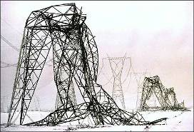
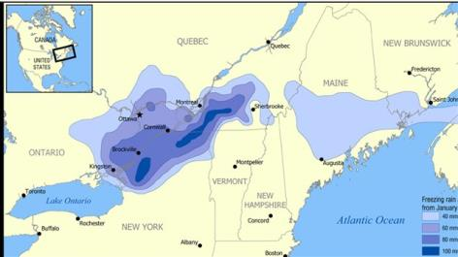
Examples of Larger-Scale or Long Duration Outages
Quebec geomagnetic disturbance blackout of 1989
Auckland, NZ 1998 five week blackout due
to cable failures
Northeast ice storm of 1998: A week
long ice storm that resulted in more
than three inches of ice on high
voltage transmission lines,
causing the collapse of 770
transmission towers and the
replacement of 26,000
distribution poles

Slide 18
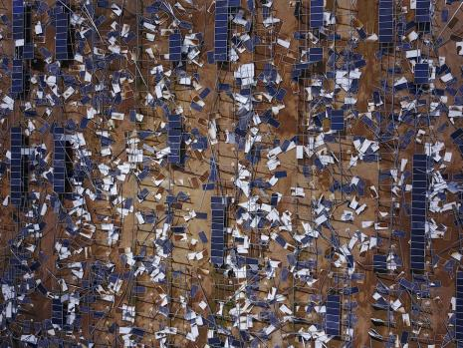
Examples of Larger-Scale or Long Duration Outages, cont.
Northeast blackout from August 14, 2003
Hurricane Katrina (2005) with loss of service to 2.7 million customers, with 250,000 still out after 4 weeks
Superstorm Sandy (2012) with more than 8 million customers out, and about 10% still out after ten days
Cyber attack on Ukrainian
Electric Grid (2015)
Hurricane Maria (2017) in
Puerto Rico, with essentially a
total loss of the grid
Image Source: IEEE Spectrum, P. Fairley, “Why Solar Microgrids May Fall Short in Replacing the Caribbean’s Devastated Power Systems”, October 2017

Slide 19
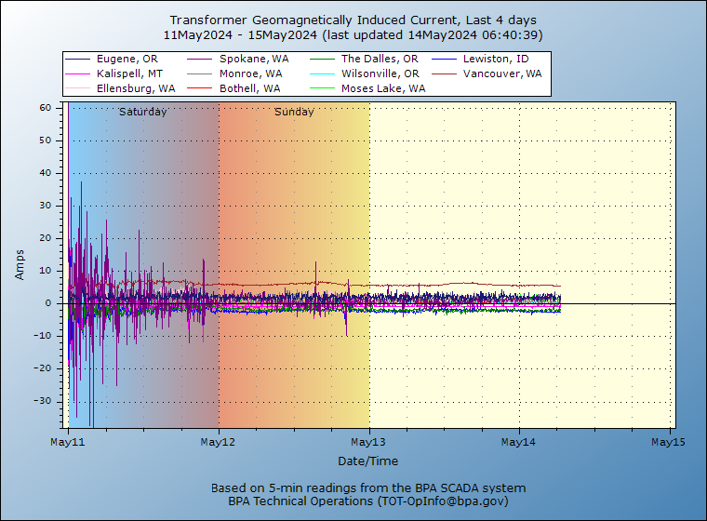
May 10 to 13, 2024 Geomagnetic Disturbance
The recent GMD caused just
barely visible northern lights
as far south as College Station,
TX (latitude of 30.6°)
While the Kp-index went up
to its max value (9), it was not
an overly severe GMD
  nT/minute of < 100, where 500
  would be a 1989 event, and
  2500 for Carrington
Image: transmission.bpa.gov/Business/Operations/gic/gic.aspx

Slide 20
HILF Two Main Categories
HILF events can be divided into two broad categories: 1) those not caused by human agents, and 2) those caused by human agents
Modeling the non-human events is somewhat easier because the goal is to (at least generally) replicate what has occurred, or what could occur
With human agent events the challenge is to protect the grid from potential events, without exposing vulnerabilities to an adversary or giving out potential mechanisms of attack
Synthetic grids are good for both

Slide 21
Synthetic Electric Grids
Synthetic electric grids are completely fictional grids that have the characteristics and complexities of actual grids
Synthetic grids are very helpful for resiliency research since they allow algorithms to be developed and tested without revealing vulnerabilities of actual grids
Over the last ten years there has been tremendous progress on developing high-quality, geographically-based synthetic grids, with much of this work funded by ARPA-E and some by NSF
Still more work is needed, particularly for modeling the grid in the stability time frame, and in representing the protection systems

Slide 22
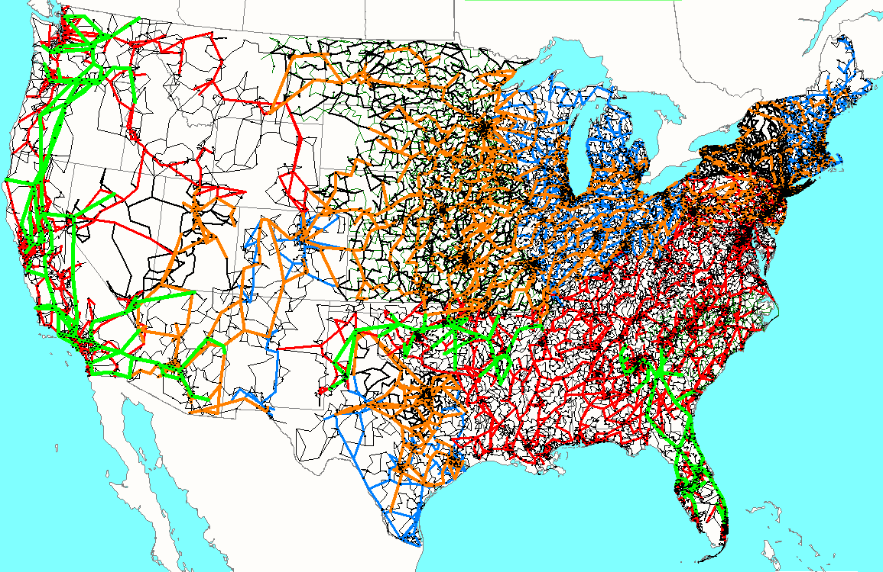
82K Synthetic Grid Covering the Contiguous US
The different colors indicate different nominal kV voltages, with green 765, orange 500, red 345, blue 230, black lower.
This grid has stability models
The grid does need to be updated, in part because when it was built the amount of renewable generation was much lower than today

Slide 23
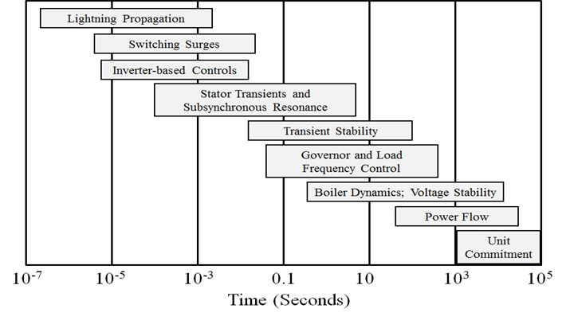
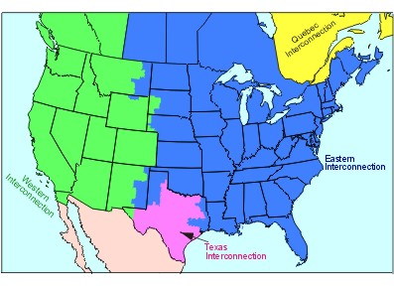
Electric Grid Resiliency Modeling Challenges
When considering resiliency events stability-level models often need to be used; this requires considering many different types of models
  We’re doing a study modeling a combined East-West grid, and it has 250 types of models
The grid’s operating point is constantly changing including the load, and generator and line/transformer statuses
Top Image: Sauer, P.W., M. A. Pai, Power System Dynamics and Stability, Stripes Publishing, 2007

Slide 24
General Grid Resilience Comments
Understanding resilience requires considering how grids will respond to particular disturbances
Substantially changing the topologies of existing grids is not an option
In contrast to cyber security, there are seldom easy “patches” that can be applied to fix vulnerabilities
Simplistic studies of how a grid disturbance could cascade often lead to incorrect conclusions; sequential power flows, sequentially taking out overloaded devices are not particularly helpful
Full detail models of large-scale actual grids including the protection system usually don’t exist and modeling them would requiring knowing the associated remedial action schemes

Slide 25
Economic Valuation of Resilience
While certainly challenging, metrics are needed to help
determine the value of resilience to society
  If we need to improve resiliency, someone needs to pay
This is becoming a more challenging problem as more
customers provide self-generation
  Is the ability of some customers to self generate, at least for a period of
  time, a net gain to the grid’s resiliency? How does one assess the
  resiliency of their systems?
Given that both reliability and resilience are often desired,
their needs to be a co-optimization of their benefits.

Slide 26
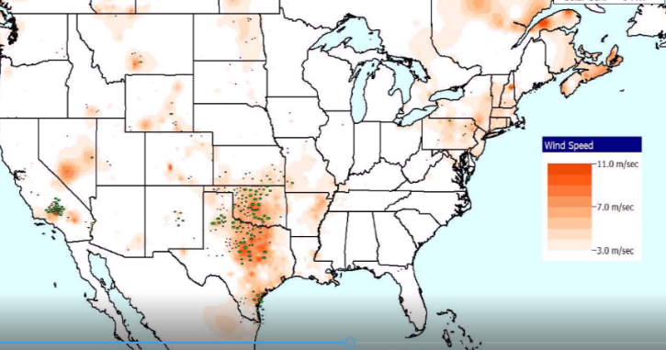
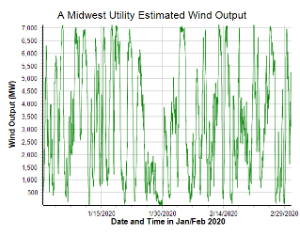
Example: Renewable Resource Droughts
With the rapid growth in wind and solar resources, a growing concern is how to handle wind and solar “droughts” with the generic term of renewable resource droughts used to describe them
The below example is a wind drought that occurred in the Midwest in late January 2020

Slide 27
Example: Geomagnetic Disturbances (GMDs)
GMDs are caused by solar corona mass ejections (CMEs), and range from minor and frequent to severe and extremely rare
A GMD caused a blackout in 1989 of Quebec
They have the potential to severely disrupt the electric grid by causing quasi-dc geomagnetically induced currents (GICs) in the high voltage grid
Until recently power engineers had few tools to help them assess the impact of GMDs
GMD assessment tools are now moving into the realm of power system planning and operations engineers
26

Slide 28
GMDs and the Kp-index
The earth’s magnetic field is constantly changing, though usually the variations are not significant
  Larger changes tend to occur closer to the earth’s poles
  The variation can be expressed different ways, such as nT/minute field variation
The magnitude of the variation at any particular location is quantified with a K-index
  Ranges from 0 to 9, with the value dependent on nT variation in horizontal direction over a three hour period; higher values are more severe
  This is station specific; higher variations are required to get a k=9 closer to the poles
The Kp-index is a weighted average of individual station K-indices; the G scale values are Kp – 4, so they have a maximum of 5.

Slide 29
Electric Fields and Geomagnetically Induced Currents (GICs)
The induced electric field at the surface is dependent on deep earth (hundreds of km) conductivity
  Electric fields are vectors (magnitude and angle); values expressed in units of volts/mile (or volts/km);
  A 2500 nT/minute storm could produce 5 to 10 volts/km
The electric fields cause GICs to flow in the high voltage transmission grid
The induced voltages that drive the GICs can be modeled as dc voltages in the transmission lines.
  The magnitude of the dc voltage is determined by integrating the electric field variation over the line length
  Both magnitude and direction of electric field is important
28

Slide 30
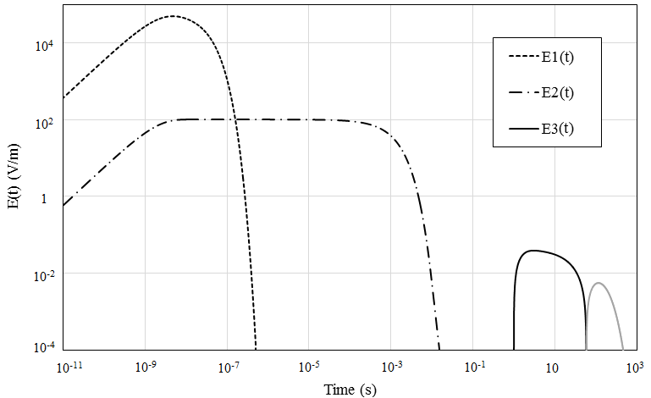
HILF Example: Nuclear EMPs
Broadly defined, an electromagnetic pulse (EMP) is any transient burst of electromagnetic energy
High altitude nuclear explosions can produce continental scale EMPs; called HEMPs
The impacts of an HEMP
are typically divided into
three time frames:
E1, E2 and E3
  E1 impacts electronics,
  E2 is similar to
  lightning, E3 is similar
  to a very large, but short duration GMD

Slide 31
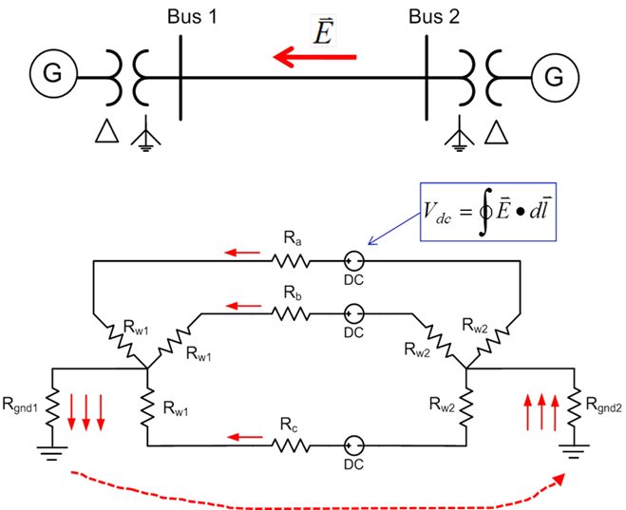
Geomagnetically Induced Currents (GICs)
Both GMDs and HEMPs cause electric fields, with values dependent on the deep earth conductivity
Along length of a high voltage transmission line, electric fields can be modeled as a dc voltage source superimposed on the lines
These voltage sources produce quasi-dc
geomagnetically induced currents (GICs)
that are superimposed on the ac
(60 Hz) flows
30

Slide 32
Simulated GICs in High Voltage Transmission Grid

Slide 33
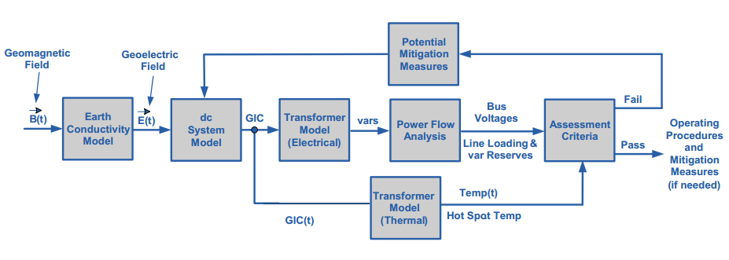
Overview of GMD Assessments
In is a quite interdisciplinary problem
The two key concerns from a big storm are 1) large-scale blackout
due to voltage collapse, 2) permanent transformer damage due to
overheating; similar concerns due to HEMPs
Image Source: http://www.nerc.com/pa/Stand/WebinarLibrary/GMD_standards_update_june26_ec.pdf
32

Slide 34
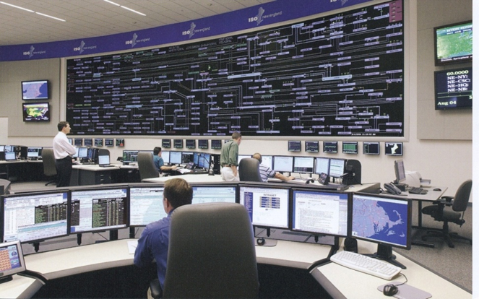
The Impact of a Large GMD From an Operations Perspective
Would be maybe a day warning but without specifics
  Satellite at Lagrange point one million miles
  from earth would give more details, but
  with less than 30 minutes lead time
  Could strike quickly; rise time of minutes,
  rapidly covering a good chunk of the continent
Reactive power loadings on hundreds of
high voltage transformers could rapidly rise
Increased transformer reactive loading causes heating issues and potential large-scale voltage collapses
Control room personnel would be overwhelmed
The storm could last for days with varying intensity
33

Slide 35
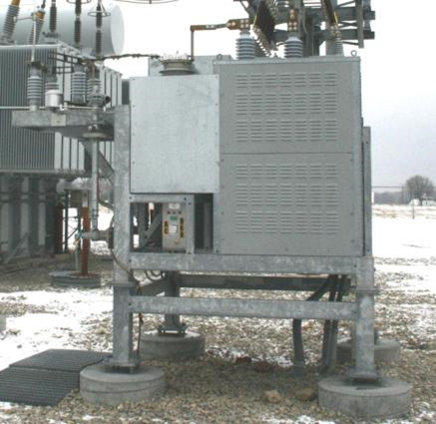
GIC Mitigation
Tools are needed to determine mitigation strategies
  Cost-benefit analysis
GIC flows can be reduced both through operational strategies such as opening lines, and through
longer term approaches such as
installing blocking devices
Redispatching the system can
change transformer loadings,
providing margins for GICs
Algorithms are needed to provide real-time
situational awareness for use during GMDs
34

Slide 36
Weather in Electric Grid Planning and Operations
Weather information has been used in electric grid planning and operations going back to the initial grids in the 1880’s
In operations real-time weather information has been long used in control rooms, with computerized information used at least since the 1980’s; current applications are quite sophisticated
In planning weather information plays many roles, including load forecasting, outage scheduling and in the development of planning power flow cases (summer, winter, spring, fall)
The next few slides show some new developments in using weather (and related external resiliency events) in the planning (and related applications)

Slide 37
The Power Flow and Weather
Human activity depends on the weather, and this has always been reflected in the electric load
Traditionally some power flow parameters have depended on the weather (e.g., line ratings, turbine max MW, line resistance)
Over the last several decades this dependence has grown substantially with the increase in wind and solar generation
  They now provide about 17% of US electric energy (> 30% in ERCOT); there are times when most of the electricity in regions is supplied by these sources
  They are extremely dependent on the weather
Major power system input parameters are now heavily weather dependent (e.g., wind and solar generator Max MW)

Slide 38
Using Weather Information in PowerWorld Simulator
Over the last 18 months PowerWorld has gained a lot of weather modeling related capability, and is continuing to gain more
Currently
  Past, present and future weather data can be loaded into Simulator
    This can be done using *.pww, *.aux, or *.csv files
    Hourly past data is available from 1940 to five days behind real time; present data is available from measurements; future is hourly up to 16 days
  The weather can impact the power system devices using PFW (Power Flow Weather or Power Flow Whatever) models; PFW models can be thought of like the stability models: they are applied to power system objects (e.g., a generator or line) and different classes of models can be defined
  PFW models can be applied automatically in the Time Step Simulation, and applied (currently) on demand in the other applications like power flow

Slide 39
Availability of Historical Weather Information
When this effort started we were using historical weather station measurements (mostly identified by their ICAOs [International Civil Aviation Organization], e.g. KLIT, KCLL)
  We had lots of data, but much of it had missing values; we also only had surface wind values and no direct solar measurements
  Such measurements at specific locations are very useful (e.g., at electrical substations)
We are also now using ERA5 data, which is state-of-the art (fifth generation) reanalysis of global climate and weather since 1940
  It is available hourly on a 0.25 degree grid and includes 10m and 100m wind, and solar global horizontal irradiance and direct horizontal irradiance
  ERA5 comes from European Centre for Medium-Range Weather Forecasts (ECMWF), (ERA = ECMWF Re-Analysis) with more details on ERA5 available at rmets.onlinelibrary.wiley.com/doi/10.1002/qj.3803

Slide 40
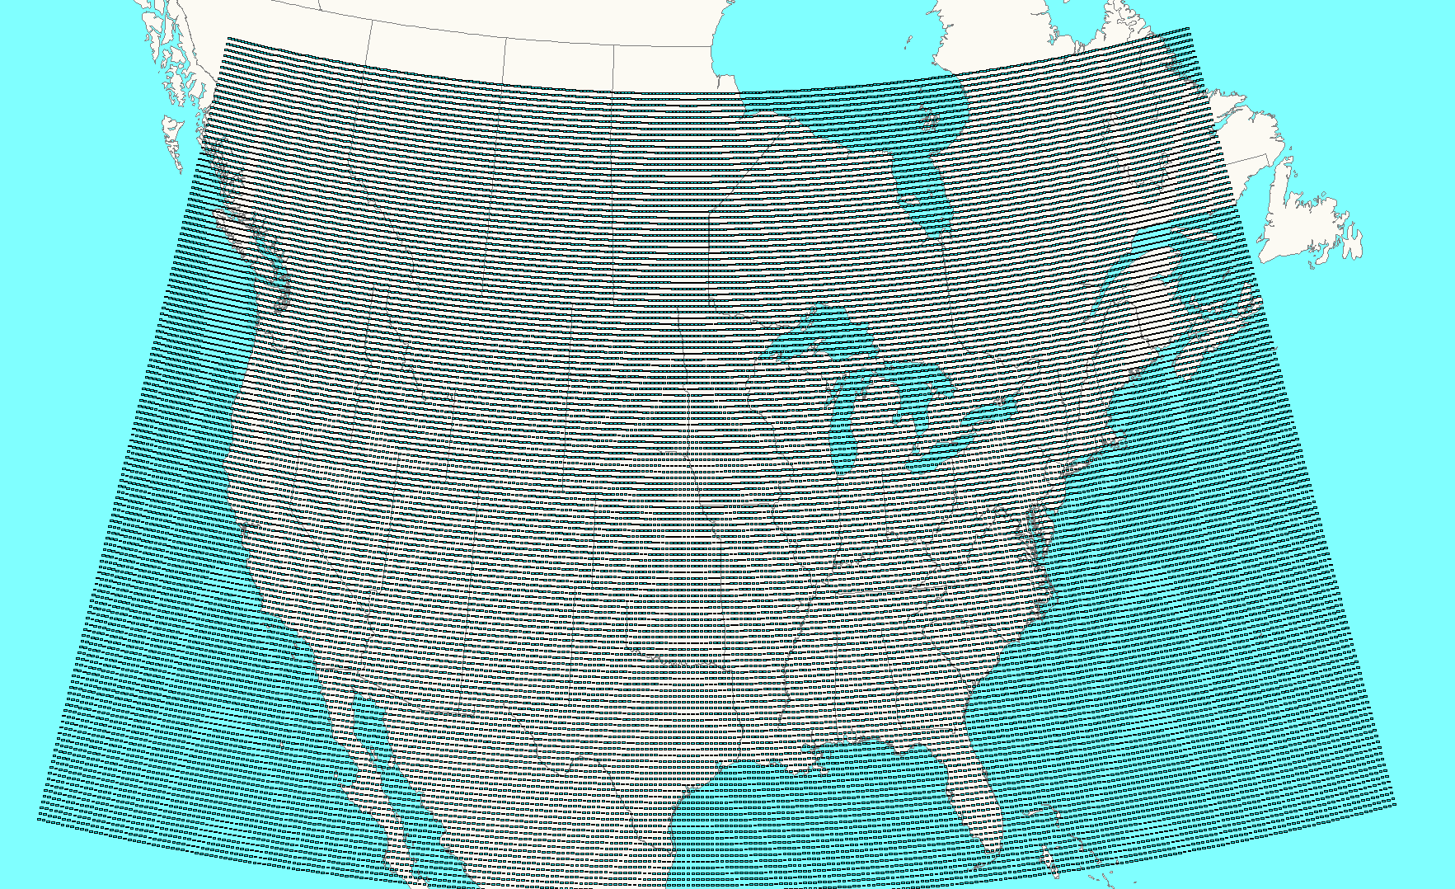
Easy Power Flow Access to ERA5
ERA5 is available worldwide about five days behind real-time
We convert it to pww format files, and place it at
electricgrids.engr.tamu.edu/weather-data/
Currently we provided data for most of North
America and then smaller files for just Texas
  For each hour the pww files store eight weather
  values (temperature, dew point, cloud cover percent,
  wind speed (10m), wind direction (10m), wind speed
  (100m), global horizontal irradiance, and direct horizontal irradiance
  The North America pww files have 38,497 data points; with 8 values per hour, this is about 220 MB per month, or about 225 GB for the total set
This data is public so it can be freely used and shared

Slide 41
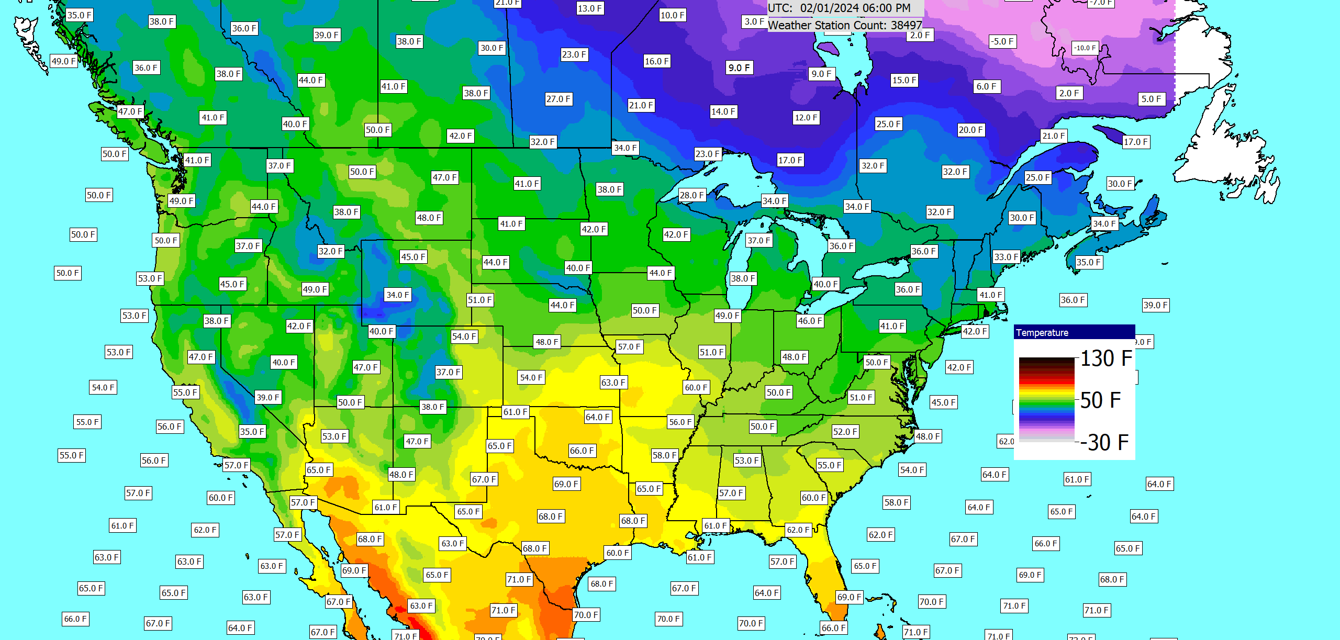
Example Weather Contour
The contour labels can easily be customized or removed

Slide 42
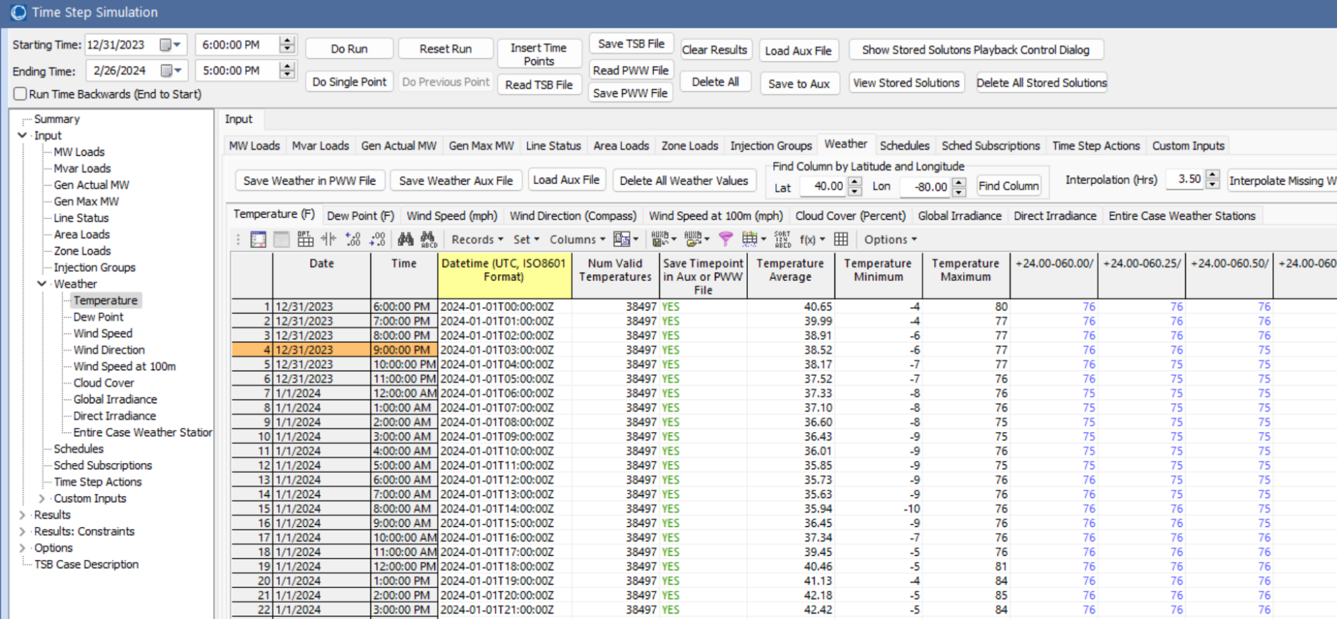
Simulating Large Amounts of Weather Information
To easily view and simulate many time values, the pww files can be loaded into the Time Step simulation (Tools, Time Step Simulation)
  Select Read PWW File to load the desired file
Allows a weather location to be easily located (Seattle here)
Like any PowerWorld case information grid, the data can be easily plotted and exported

Slide 43
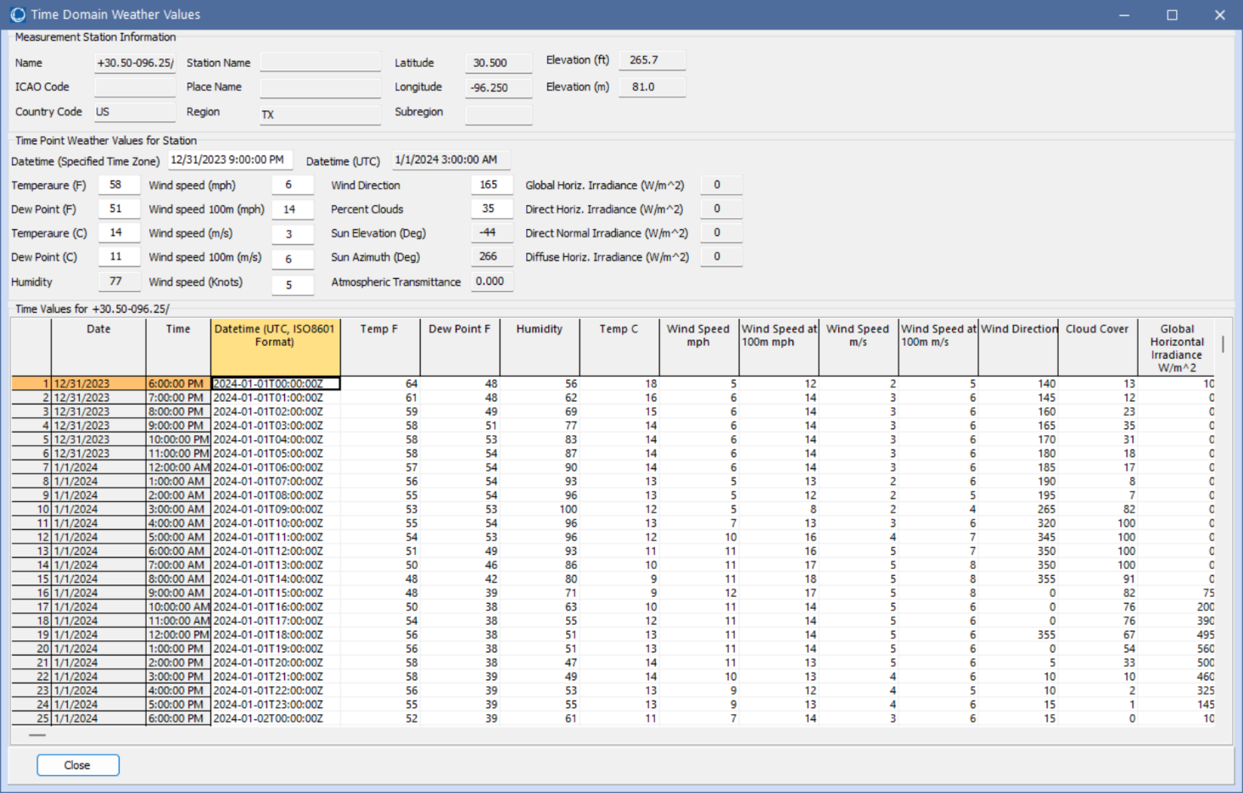
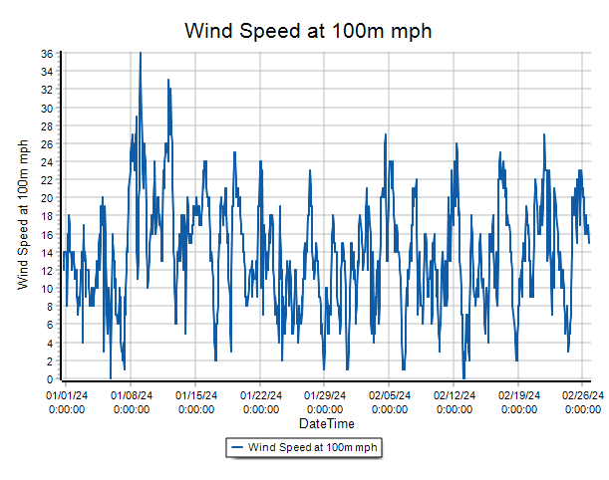
Seeing All Weather Data for a Location
To see all the weather data for a location, just right-click on the column and select Show Dialog
College Station 100m Wind Speed

Slide 44
Models of Grid Weather Impacts
Key focus here isn’t weather per se, but modeling the impacts of weather on electric grid components (e.g., generators, lines)
Certainly a number of models already exist, and undoubtedly more will be created given that weather data is now conveniently available
The approach used here for handling a growing list of models is to mimic what has been done with power system stability – start small and expand
  Early (1960) stability codes just had a handful of models, whereas current codes support many hundreds of different model types
PowerWorld implements this using PFW Models
  PFW = Power Flow Weather or Power Flow Whatever models

Slide 45
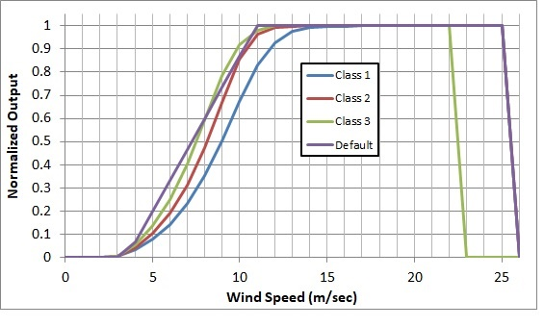
Example: Gen MaxMW Wind and Solar
An example is modeling the impact of wind speed on wind turbine output, or solar irradiation on PV output
  The image on the right shows
  several of the generic wind turbine
  models are based on the turbine
  classes using data from [a]
  A simple solar PV model uses either
  provided solar irradiation or the
  standard equations for insolation
  based on location and time of day
  including cloud cover; this is
  combined with whether the solar
  has tracking and, if needed, its tilt
  and azimuth
[a] C. Draxl, A. Clifton, B. Hodge, J. McCaa, “The Wind Integration National Dataset (WIND) Toolkit,” Applied Energy, vol. 151, pp. 355-366, 2015.

Slide 46
Mapping Weather to the Electric Grid Components
While the newer weather datasets have lots of points, there is still usually at least some distance between power grid components and the nearest weather measurement, requiring interpolation
There is no single best algorithm for doing the needed 2D scattered data interpolation, but there are a number of good and fast algorithms (grid-based, closest neighbor, Delaunay Triangulation, Shepherd’s)
  Since the weather values have an associated elevation, if the power grid component’s elevation (or profile for a line) is known this could be considered
Usually places in which the weather changes rapidly with geography (e.g., mountains) don’t have much electric infrastructure (the exceptions are covered next)

Slide 47
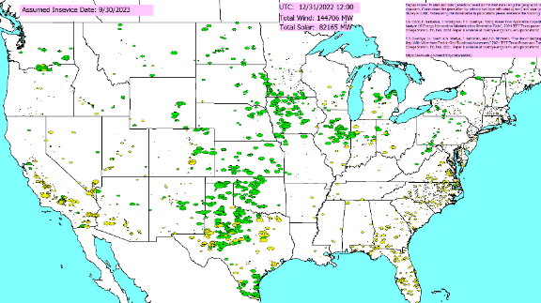
Applying the Weather
Weather can be applied to a power flow case using the pww files in multiple ways
  At a specified point in time
  As a summary of a large
  amount of weather at a single
  location (e.g., a generator) or at
  a few locations (a transmission
  line)
  As a time series, sequentially
  solving lots of
  different time points

Slide 48
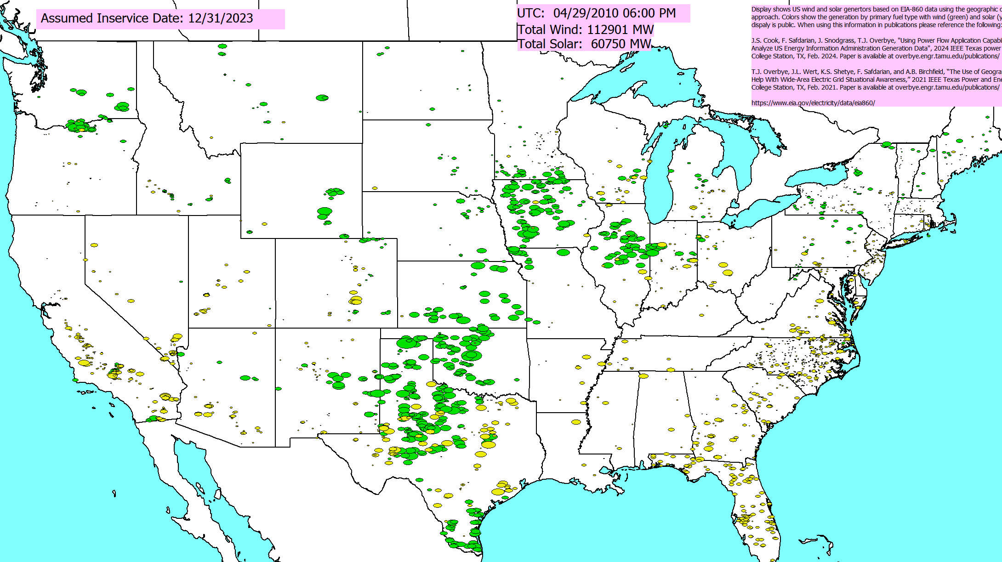
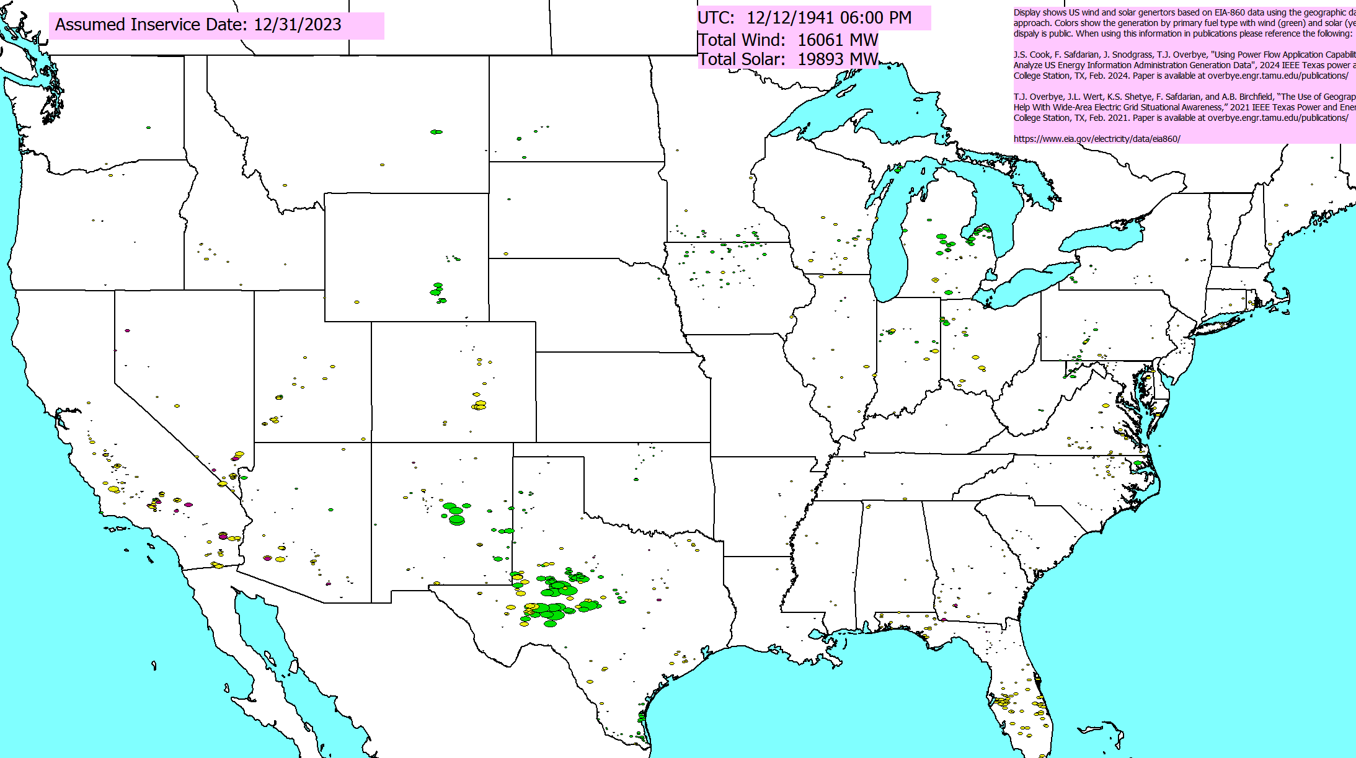
Contrasting Two Days: 4/29/2010 and 12/12/1941
Assuming the 12/31/2023 renewable generation (147 GW wind, 90 GW solar), we determined a few outlier days. At noon (Central) weather for 4/29/2010 would have an 73% available, while 12/12/1941 weather would have 15%
  Applying the weather and getting the values is quick

Slide 49
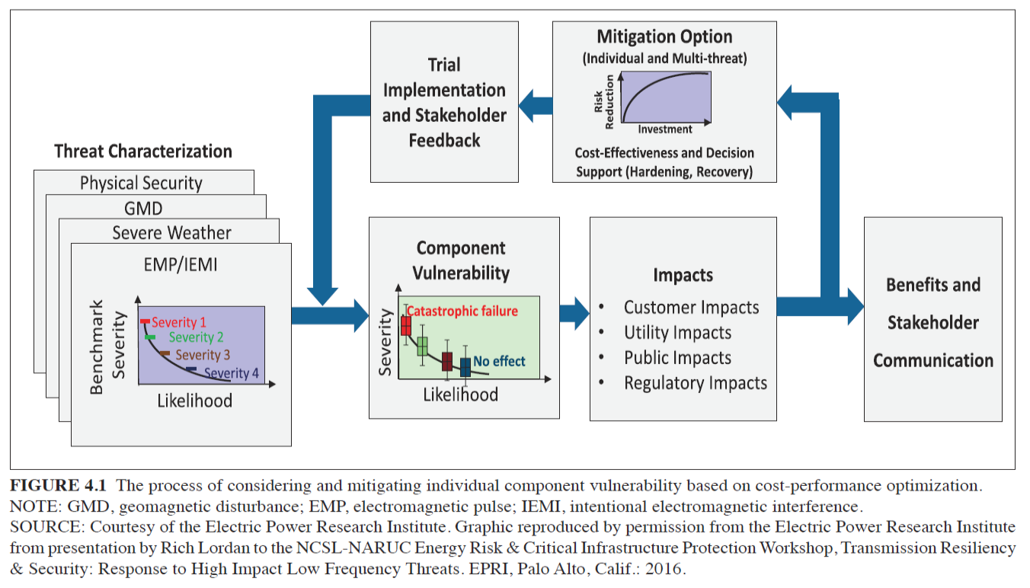
Strategies to Prepare For and Mitigate Large- Area, Long-Duration Blackouts
While events may vary, there a number of broad approaches that can be used to help improve resilience
Image Source: Figure 4.1, NAS, 2017

Slide 50
Component Hardening, Physical Security
Electric grids are comprised of components, and resiliency can be enhanced by hardening particularly vulnerable components
  Transmission lines in likely icing location, undergrounding some lines, transformers with better handling of geomagnetically induced currents (GICs), water protection
  This needs to be done considering the cost versus benefit
  Vegetation management should also be considered
Physical security is an area of increased concern, with unmanned aerial vehicles being a fast rising threat

Slide 51
Enhancing Bulk Grid Simulations to Handle HILF Scenarios
The stressed operation associated with the high impact, low frequency events presents modeling challenges
Luckily, over the last several years the software is being enhanced to deal with these situations
  My next presentation goes in-depth on geomagnetic disturbance (GMD) and high altitude electromagnetic pulse (HEMP) modeling
There is also a need to consider high voltage transmission system design that lessens the likelihood of cascading outages

Slide 52
Adaptive Islanding
One promising resiliency technique is to design interconnected grids to split (island)
  This is known as controlled islanding and can be enhanced to be adaptive islanding
  A distribution system example is a microgrid
The islands need to be chosen so they have sufficient generation to match load
Often control is still centralized
A more involved islanding issue is to setup the grid so smaller parts can function with full autonomy

Slide 53
Resiliency and Coupled Infrastructures
As our societies become more dependent on electricity, short and small duration blackouts become more concerning, and large-scale, long duration outages can be catastrophic
There are many couplings between electric grids and other infrastructures such as natural gas, water, cyber, and increasing transportation
These couples need to be more fully considered in electric grid resiliency modeling and simulation

Slide 54
Some Specific Recommendations to Enhance Resilience
A “visioning” process is needed to imaging and assessing plausible high impact events
The electric grid operators need to do exercises to better simulate high impact scenarios
More physical components are needed, including replacement transformers and backup power
More research, development and demonstration is needed, including a focus on cyber and HILFs
Resilience groups are needed throughout the industry and government to raise awareness
Source: National Academies 2017 “Enhancing the Resilience of the Nation’s Electricity System”
53

Slide 55
Porting PowerWorld Simulator to Linux
Simulator was started in 1990s as a Windows only program. It’s design and implementation reflect that.
  Simulator has an object-oriented design
  Simulator makes use of windows specific (WinAPI) features
  Uses Delphi forms library (VCL)
  In some cases the computational code and the code to support the GUI are in the same unit (file)
    This makes perfect sense in Windows, but it means you can’t create the object without also creating the form.
    To compile in Linux, these must be separated
    This is relatively straight forward, but scoping can be an issue because in Delphi everything is in scope within a unit
Goal is to port at least key parts of the computational capabilities to Linux

Slide 56
Conclusion and Questions?
The electric grid is crucial to societies worldwide, and for decades into the future we will be relying on it
A perfect electric grid is impossible, and we need to be prepared for long-term, wide-area blackouts
However, much can and should be done to reduce to reduce this risk
A broad, sustained effort is needed in this area including the entire electric grid sector
Synthetic electric grids will play a crucial role in this effort
55

Slide 57
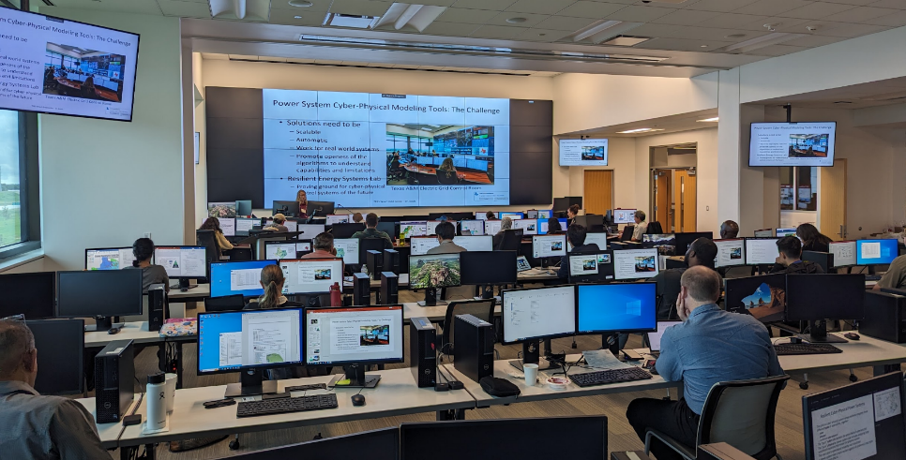
Thank You! Questions?

