Slide 1


New Developments in the Application of Weather Information in Electric Grid Analysis
2024 PSERC Summer Tutorials
Thomas J. Overbye
O’Donnell Foundation Chair III
Texas A&M University
overbye@tamu.edu
June 19, 2024

Slide 2
Acknowledgments
Work presented here has been supported by a variety of sources including PSERC (especially projects S-92G, S-99 S-102G)
  Others include the Texas A&M Smart Grid Center (SGC), ARPA-E, NSF, many utilities and ISOs (particularly SPP!), and PowerWorld. Their support is gratefully acknowledged!
Slides also include contributions from many of my students, postdocs, staff and colleagues at TAMU
Some of the results are contained in recent papers available at
  overbye.engr.tamu.edu/publications/
Most of the simulations and visualizations shown here have been done using the PowerWorld Simulator Version 23

Slide 3

Greetings from the Texas A&M Energy Power Group
This is from our Spring 2024 EPG group dinner

Slide 4
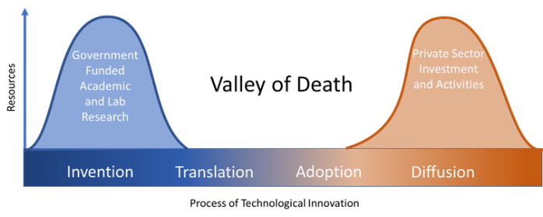
A Little PSERC History on Tech Transfer
Over its almost 30 year history, PSERC has been an academic leader in the transferring of research results
into practice, crossing the “Valley of
Death”. Some examples include
  The Flagship project, the development
  of electric grid markets, power system visualization, help with the 08/14/03 Blackout, the development of geomagnetic disturbance software, the development of synthetic grids, actual grids studies, and several other areas
  The application of weather in grid analysis will be another PSERC success
Some information on the early history of PSERC is given in Chapter 8 of Analytic Foundations for the Next Generation Electric Grid (available at nap.nationalacademies.org/download/21919)
Image: ETTA WONG/INFORMATION TECHNOLOGY & INNOVATION FOUNDATION, CC BY-SA

Slide 5
Tutorial Overview
The purpose of this tutorial is to show the benefits of having weather information become a standard part of power flow analysis and more broadly electric grid planning, and to show how everyone can easily begin using weather data today (at least for North America)
  The results also apply to related applications such as optimal power flow (OPF), contingency analysis, security-constrained OPF
All the weather data used in the presentation (hourly data for North America) going back to January 1940 is available for immediate download
The presentation also touches on some non-weather related resiliency events

Slide 6
Motivation: US Electric Generators by Fuel Type
Specific motivation was from our ARPA-E Grid Optimization (GO) Project and two PSERC SPP projects looking at an ac interconnection of the EI and WECC
The size of the ovals
is proportional to
the substation generation
and the color is the
fuel type (red: nuclear,
black: coal, brown:
natural gas, blue: hydro,
green: wind, yellow: solar).
Wind and solar are weather
dependent, and need to
be set for a power flow
solution

Slide 7
Weather in Electric Grid Planning and Operations
Weather information has been used in electric grid planning and operations going back to the initial grids in the 1880’s
In operations real-time weather information has been long used in control rooms, with computerized information used at least since the 1980’s; current applications are quite sophisticated
  I worked on helping to bring weather data into a utility control room in the 80’s
In planning weather information plays many roles, including load forecasting, outage scheduling and in the development of planning power flow cases (summer, winter, spring, fall)
The focus of this tutorial is to both lay the foundation and cover new developments in using weather (and related external resiliency events) in the power flow (and related applications)

Slide 8
The Power Flow and Weather
Human activity depends on the weather, and this has always been reflected in the electric load
Traditionally some power flow parameters have depended on the weather (e.g., line ratings, turbine max MW, line resistance)
Over the last several decades this dependence has grown substantially with the increase in wind and solar generation
  They now (last 12 months, 3/24) provide about 16% of US electric energy; there are times when most of the electricity in regions is supplied by these sources
  They are extremely dependent on the weather
Major power system input parameters are now heavily weather dependent (e.g., wind and solar generator Max MW)

Slide 9
Managing Accuracy Expectations
How much accuracy is required in any engineering study is application dependent; a key focus here is transmission and generation planning
Two useful quotes (both from [a]) are
  “Remember that all models are wrong; the practical question is how wrong do they have to be to not be useful.” [pp 74]
  “Essentially, all models are wrong, but some are useful. However, the approximate nature of the model must always be borne in mind.” [pp 424]
The power flow has approximations (e.g. positive sequence vs three-phase, no resistance temperature dependence)
Likewise, there will be approximations with using weather data
[a] G.E.P Box, N.R. Draper, Empirical Model-Building and Response Surfaces, John Wiley & Sons, New York, NY, 1987

Slide 10
Planning, Weather and Other Resiliency Events
As defined by NERC, planning assessment for large-scale grids is, “Documented evaluation of future transmission system performance and corrective action plans to remedy identified deficiencies”
  Planning is forward looking, leveraging historical information
Planning can consider timeframes from near real-time to decades
Weather and other resiliency considerations can include
  Inputs to set weather dependent power flow values such as wind, solar (irradiation), temperature for transmission line and transfer limits
  Extreme weather including hurricanes, ice storms, derechos, tornados
  Other events such as earthquakes, wildfires, geomagnetic disturbances (GMDs), volcanic events, eclipses
  This are collectively referred to here as Environmental Inputs (ENIs)

Slide 11
Using Weather and Related Data in the Power Flow
To use weather data and other ENIs in the power flow requires
  The availability of geographic information mapping buses to substations, and then geocoordinates for the substations
    This is now mostly available for North American grids
    Large-scale synthetic grids with geographic information are also available
  Convenient access to available ENIs (e.g., weather information) over the footprint of interest
    For planning often the footprint is large, beyond a single utility
  The availability of models that represent the impact of weather and other ENIs on electric grid components

Slide 12
Availability of Weather Information
We started this effort two plus years back by using historical weather station measurements (mostly identified by their ICAOs [International Civil Aviation Organization], e.g. KLIT, KCLL)
  We had lots of data, but much of it had missing values; we also only had surface wind values and no direct solar measurements
  Such measurements at specific locations can be very useful (e.g., at electrical substations)
There are many other sources of free weather information, with good coverage provided by Weather DataSet Needs for Planning and Analyzing Modern Power Systems, Energy Systems Integration Group (ESIG), October 2023 (Ann Dyreson was an author)
  www.esig.energy/wp-content/uploads/2023/10/ESIG-Weather-Datasets-summary-report-2023.pdf

Slide 13
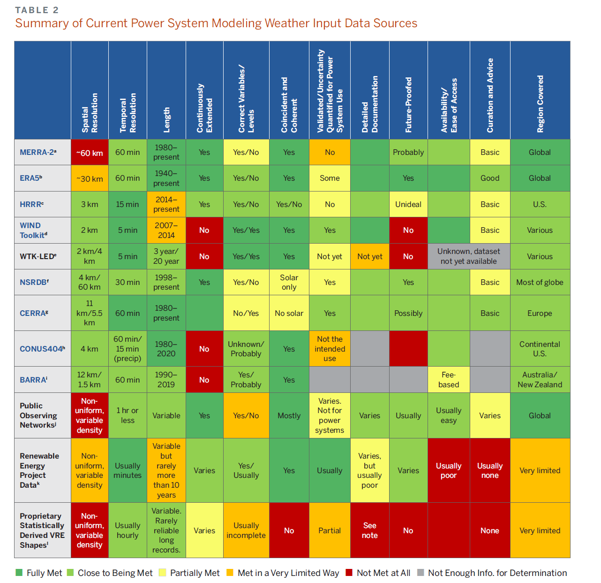
ESIG Report (10/2023)
“These widespread changes lead to the increasing weather-dependence of supply and demand, making power system planning dramatically more complex and requiring much more comprehensive weather data for robust system planning.”
“The work required to achieve a long-term solution to weather data needs is not trivial, but it is manageable and is much less costly than blindly building trillions of dollars of infrastructure without the basic tools to cost effectively optimize it and assess its reliability.”
These tools are now moving out of research labs into commercial products!

Slide 14
Availability of Weather Information, cont.
We are now using ERA5 data, which is state-of-the art (fifth generation) reanalysis of global climate and weather since 1940
  It is available hourly on a 0.25 degree grid and includes 10m and 100m wind, and solar global horizontal irradiance and direct horizontal irradiance
  ERA5 comes from European Centre for Medium-Range Weather Forecasts (ECMWF), (ERA = ECMWF Re-Analysis) with more details on ERA5 available at rmets.onlinelibrary.wiley.com/doi/10.1002/qj.3803
The ESIG comment on ERA5 is,
  “However, while ERA5 is unquestionably the best global reanalysis dataset currently available, it is not a panacea. Average validation statistics are very good, but the horizontal grid spacing of 30 km is insufficient to produce detailed meteorological fields present in complex topography, fields that are crucial to resolve for estimating
  renewable generation in these areas.”
The issue of compensating for the ERA5 spatial resolution is addressed later

Slide 15
The PWW Format
There are many ENI datasets, with ERA5 just one example
To utilize these in the power flow, our approach is to convert them into a common format, and then input just that format.
Since the datasets are often quite large, a binary format is used
That format is known a *.pww (“PoWer Weather” or “PoWer Whatever” since it can be used with many ENIs including time-varying electric fields, earthquakes, smoke, eclipses and almost all others”
The pww format supports both gridded datasets (like ERA5) and/or a combination of individual data points (e.g., local measurements)
It is an easy format to implement in code, with a public description at
electricgrids.engr.tamu.edu/weather-data/

Slide 16
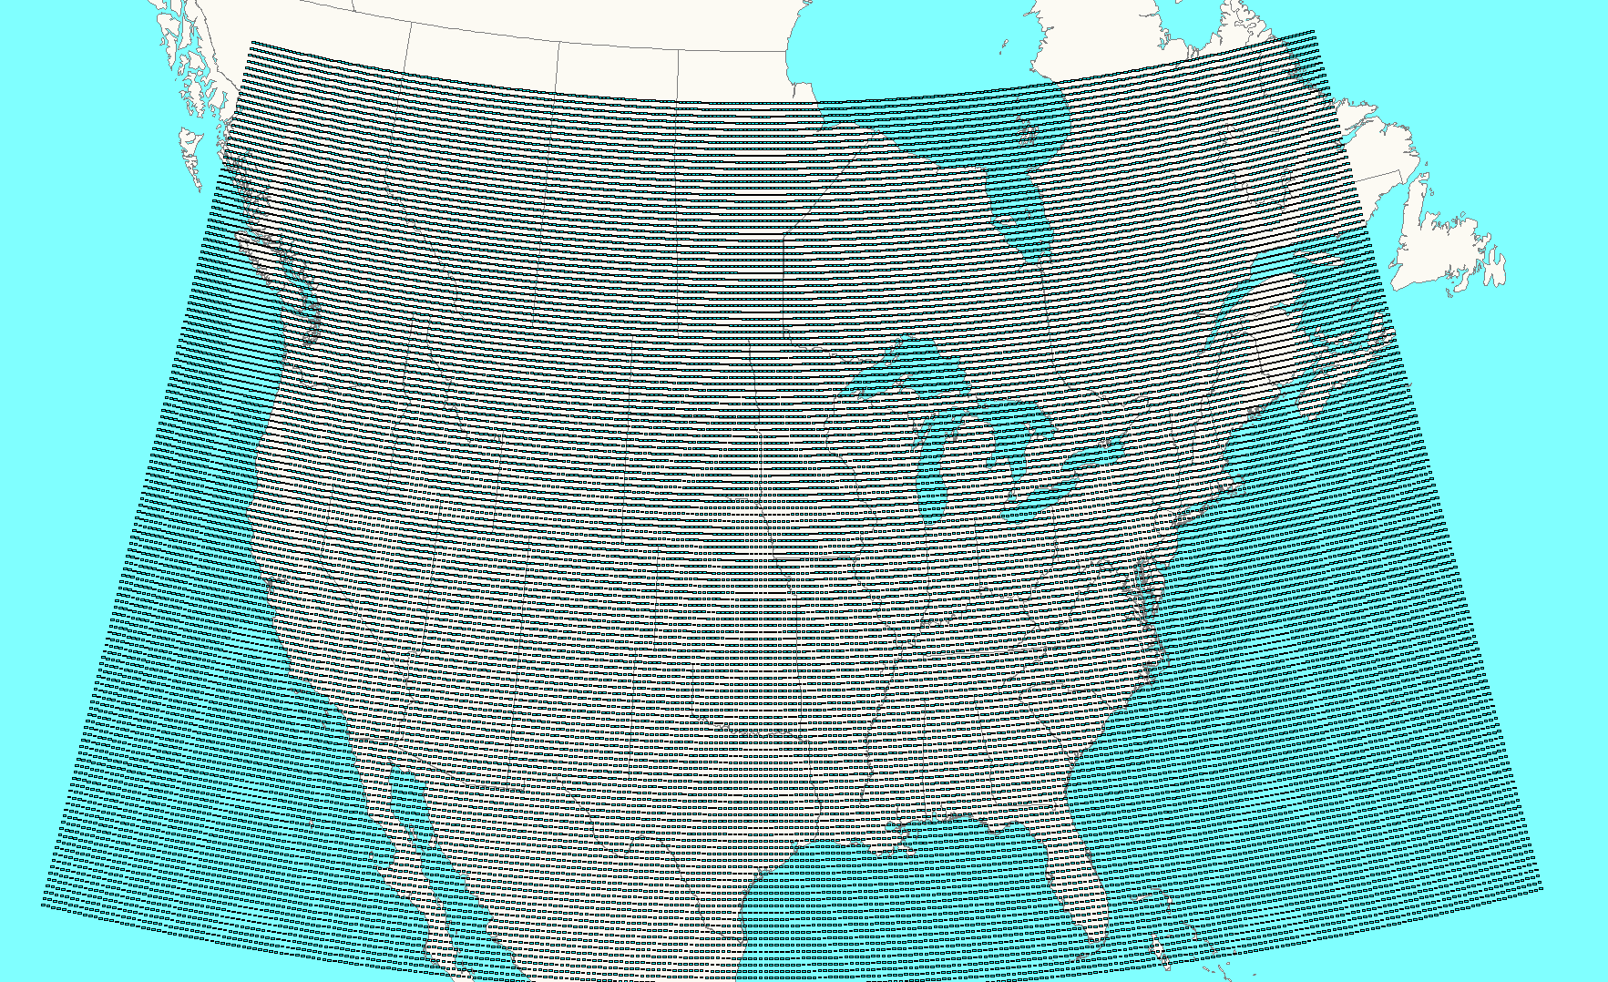
Easy Power Flow Access to ERA5
ERA5 is available worldwide about five days behind real-time
We convert it to pww format files, and place it at
electricgrids.engr.tamu.edu/weather-data/
Currently we provided data for most of North
America and then smaller files for just Texas
  For each hour the pww files store eight weather
  values (temperature, dew point, cloud cover percent,
  wind speed (10m), wind direction (100m), wind speed
  (100m), global horizontal irradiance, and direct horizontal irradiance
  The North America pww files have 38,497 data points; with 8 values per hour, this is about 220 MB per month, or about 225 GB for the total set

Slide 17
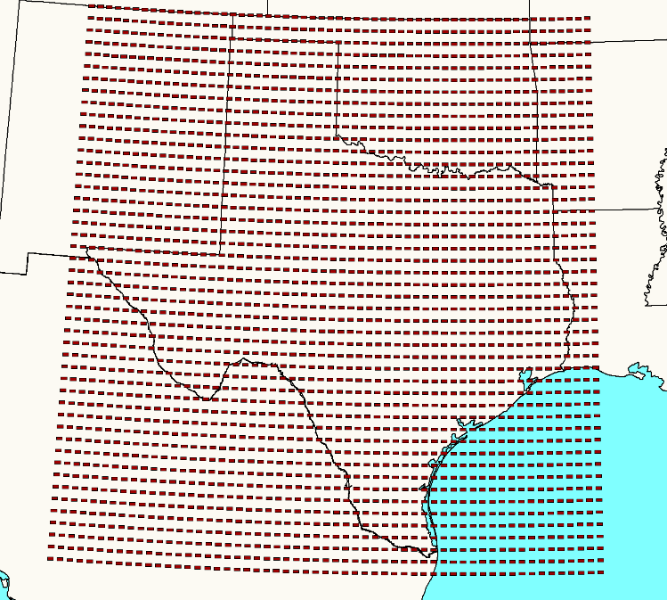
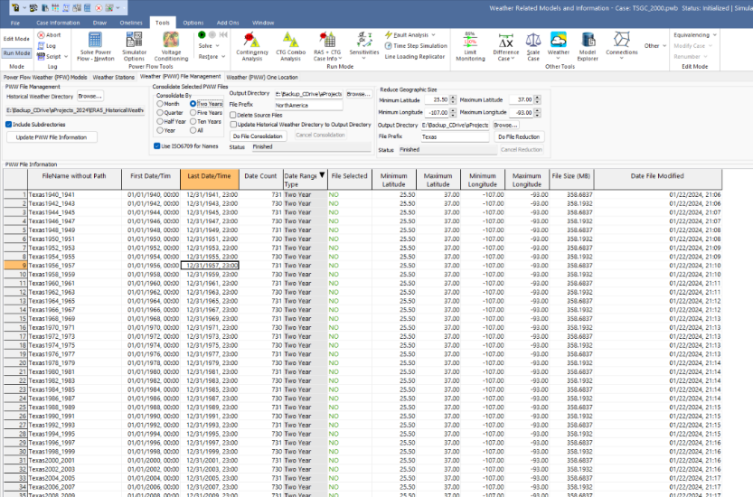
Example Texas PWW Files, Stored Every Two Years
The Texas pww files have 2679 grid points; each file stores two years of data with a size of 367 MB; total set (1940-2024) is 15 GB
On my home computer I update
the North Americ *.pww occasionally,
reducing as needed (like yearly CONUS files)
Tool for reducing or consolidating pww files

Slide 18
Getting the Weather Details
Go to electricgrids.engr.tamu.edu/weather-data/
Click on View Available Weather for Download and click on either the Texas or North America links
  For Texas you can download it all at once (6 GB, which took about 3 minutes to download on my home computer)
  For North America you can download it by either decades (with one decade taking about 5 minutes for me) or by quarter
  New weather is posted as it becomes available

Slide 19
Availability of Forecasted Weather Information
Forecasted weather information is also available from a variety of sources; here we use the free forecasts provided by US National Oceanic and Atmospheric Administration (NOAA) National Centers for Environmental Prediction (NCEP) NCEP Central Operations
  nco.ncep.noaa.gov/pmb/products/gfs/
  Specifically we’re using the 0.25 degree resolution GFS results, which provide four global forecasts per day going out for 16 days
  Forecasts will also be pww files, so all of the existing tools can be used, though the forecasts to not have the solar irradiance values

Slide 20
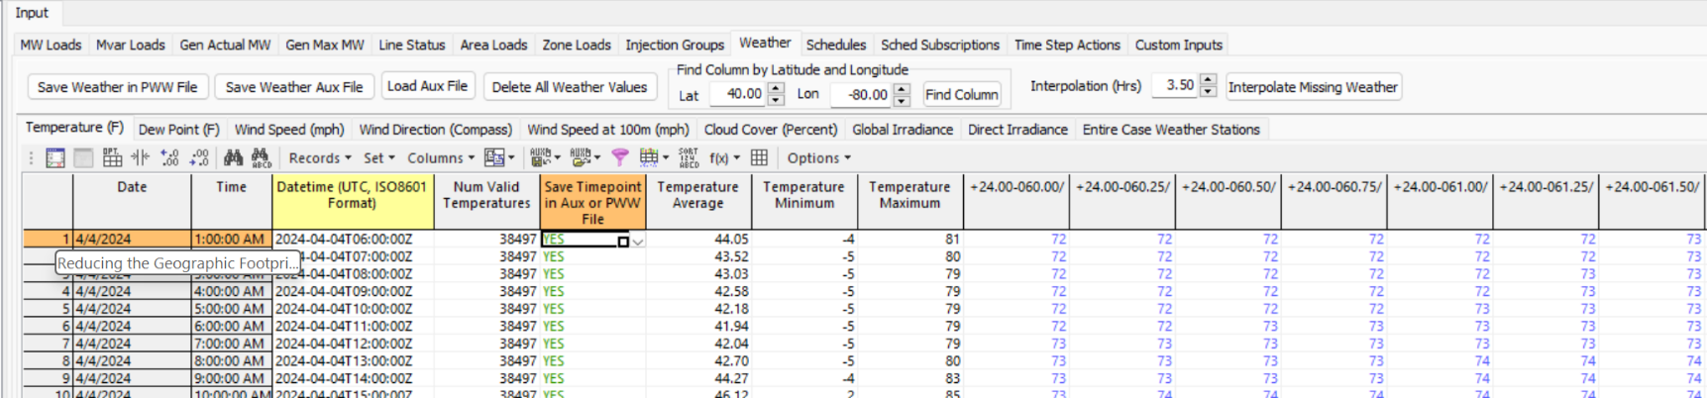
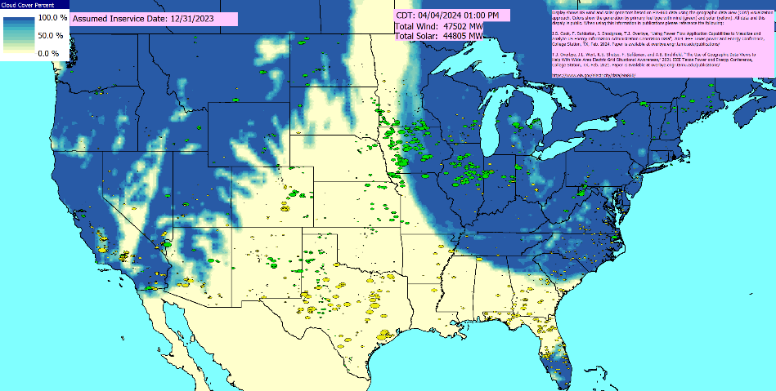
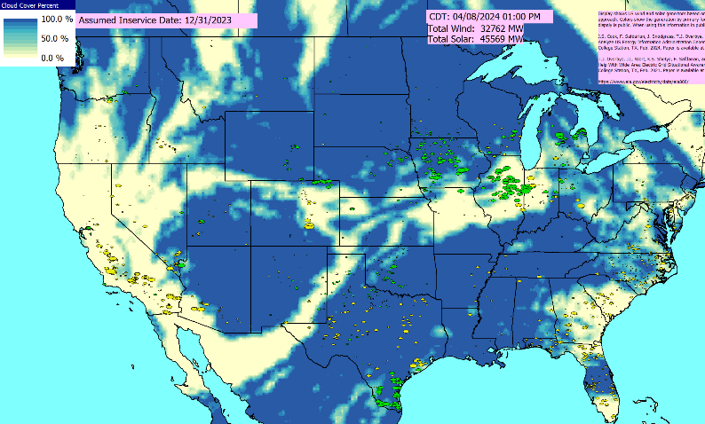
Availability of Forecasted Weather Information
Example forecast data
Estimated 4/8/24 (eclipse time) Cloud Cover

Slide 21
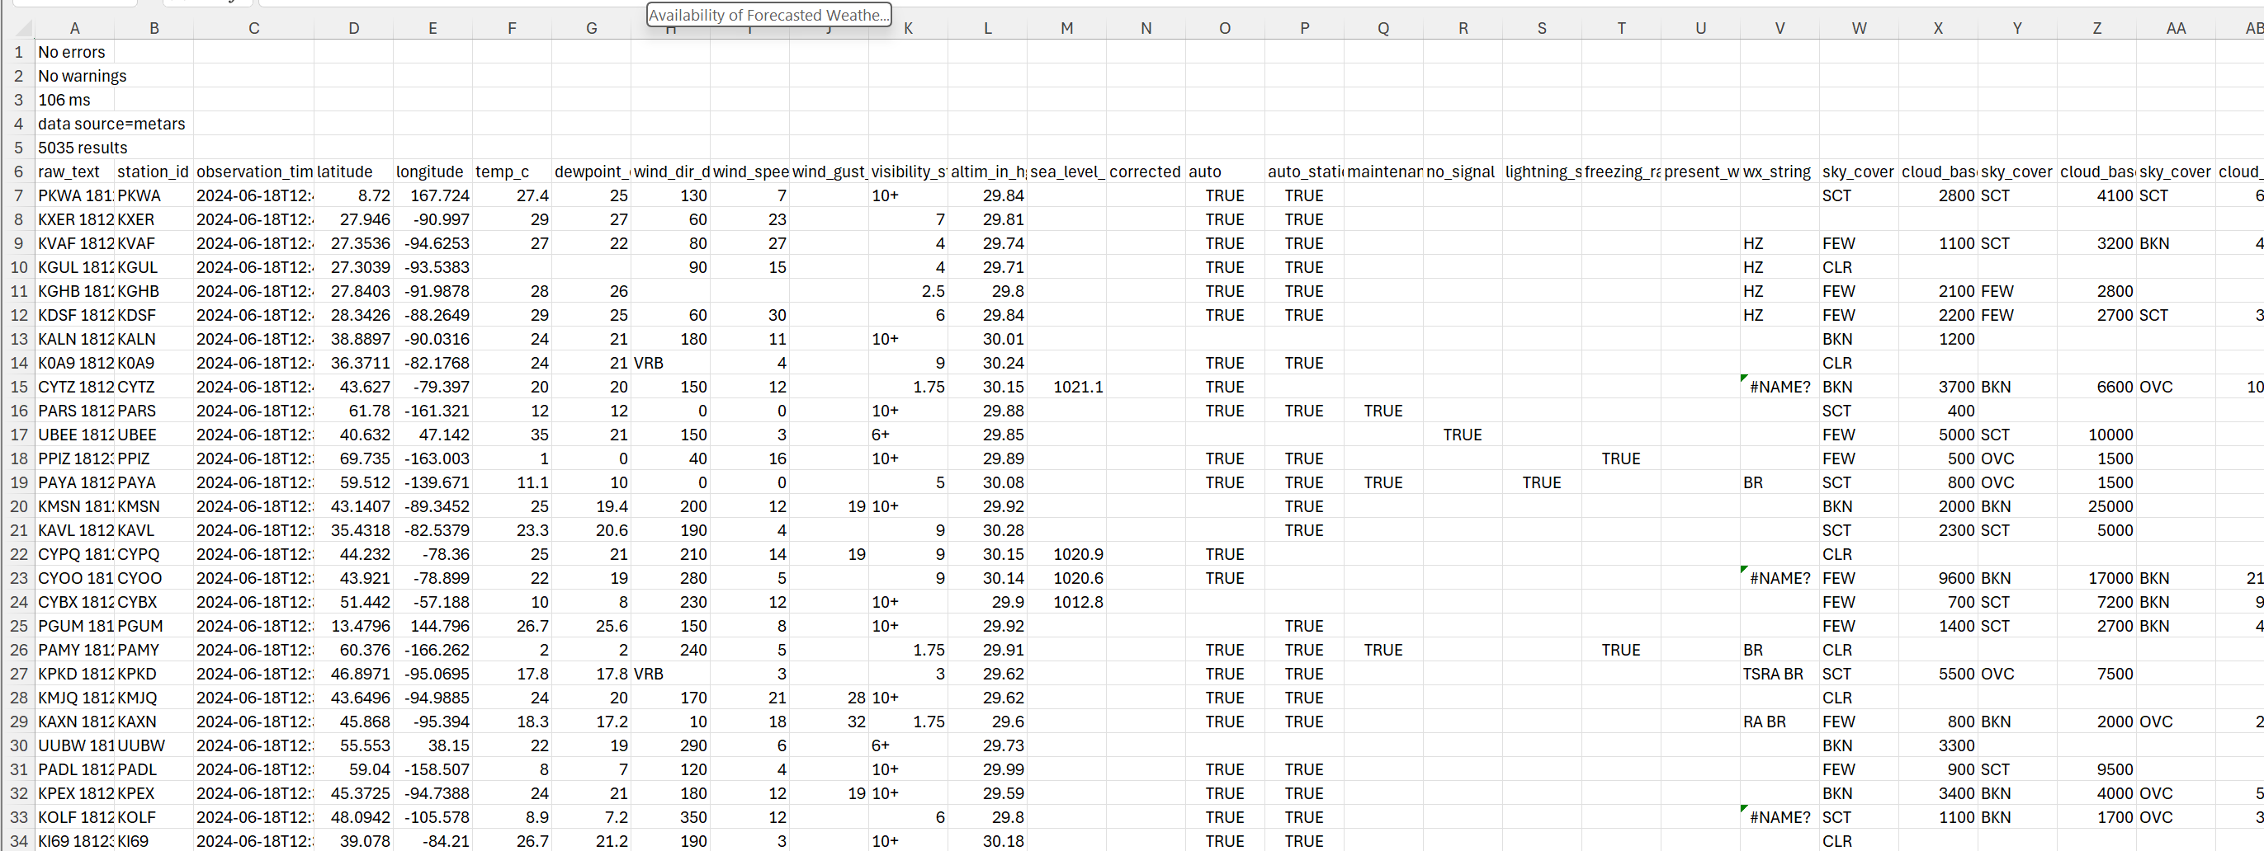
Current Weather
If desired, to supplement forecasted weather, current weather is available for download at https://aviationweather.gov/data/cache/metars.cache.csv
  METAR data comes from METeorological Aerodrome Reports; the weather here is from June 18, 2024 at about 8am Central Time

Slide 22
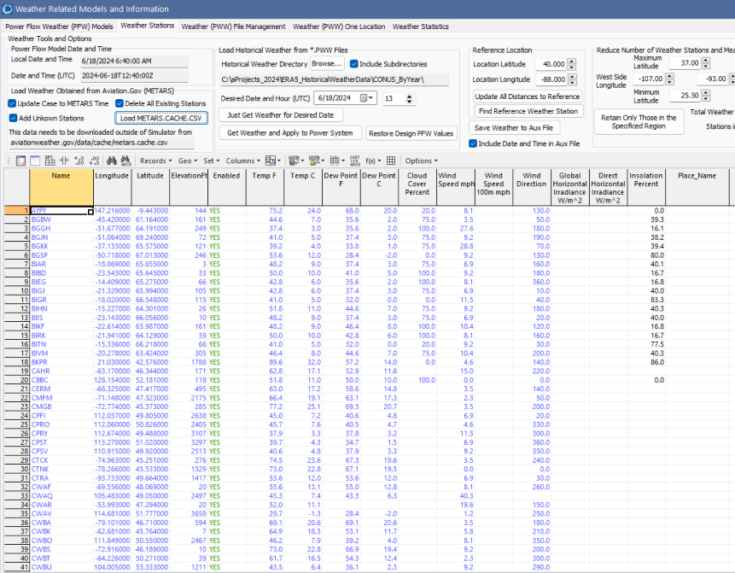
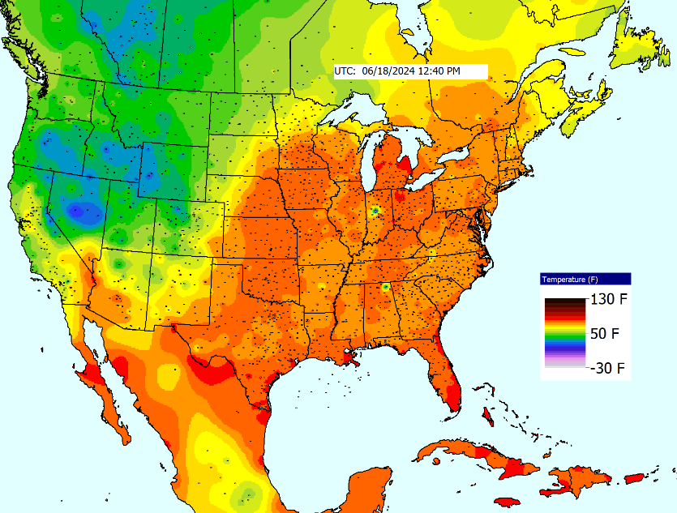
Loading METAR data in a Power Flow Program
The METAR *.csv file can be quickly loaded in PowerWorld, and if desired, the values visualized using auto-updating GDV displays
  Previous slide *.csv has about 5000 stations, though not all have full data

Slide 23
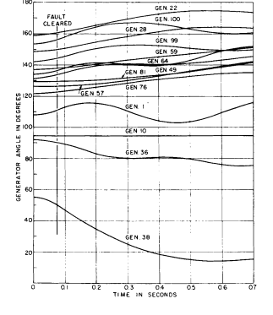
Models of Grid Weather Impacts
Key focus here isn’t weather per se, but modeling the impacts of weather on electric grid components (e.g., generators, lines)
Certainly a number of models already exist, and undoubtedly more will be created given that weather data is now conveniently available
The approach used here for handling a growing list of models is to mimic what has been done with power system stability – start small and expand
  Early (1960) stability codes had just a handful of models
  and still gave useful results, whereas current codes support
  many hundreds of different model types
The approach implements this using PFW (Power
Flow Weather or Whatever) Models
[a] M. S. Dyrkacz, C. C. Young, and F. J. Maginniss, "," AIEE Trans. (Power App. & Syst.), vol. 79, pp. 1245-1257, Feb. 1961.

Slide 24
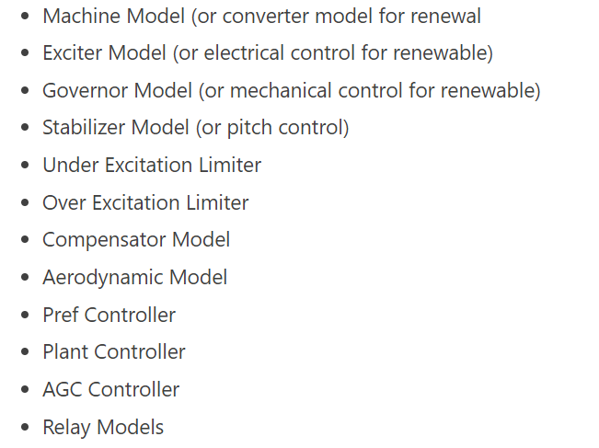
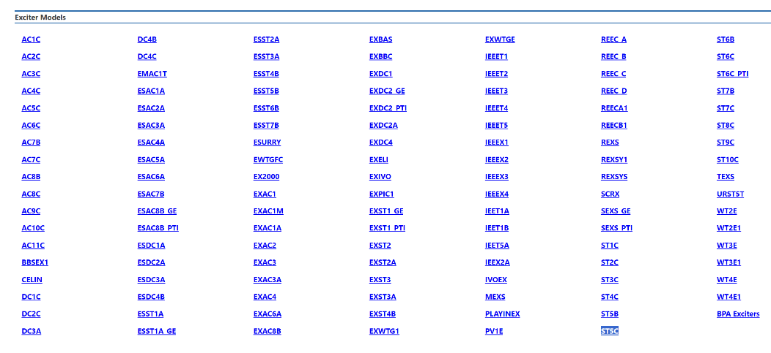
PFW Model Approach Based on Stability Models
The PFW model approach can use the same structure used with stability; that is, individual component models assigned to devices such as generators, loads, lines, transformers, switched shunts, areas, etc.
E.g., in stability for a generator there are a number model classes
Just exciter model types

Slide 25
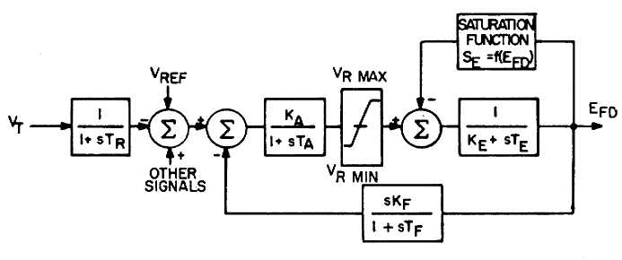
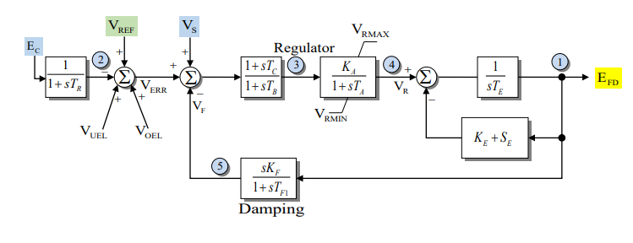
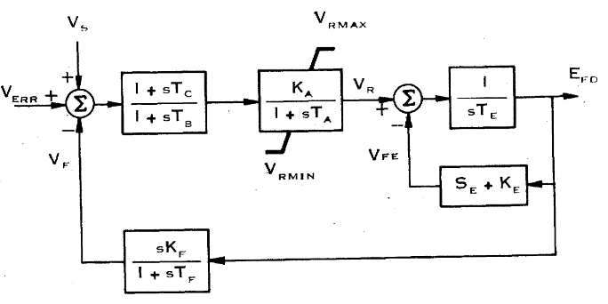
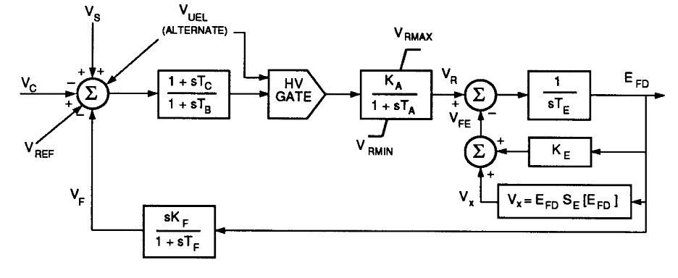
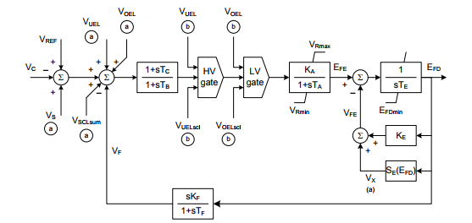
PFW Model Flexibility
Using this approach, new PFW models can be introduced as needed to cover new device types or new ways of representing an existing device (e.g., a wind generator)
This is similar to stability. Consider the evolution of the IEEET1 exciter
IEEET1 1968
IEEEX1 1979
EXDC1 1981
ESDC1A 1992
DC1C 2016
All are still used in stability simulations

Slide 26
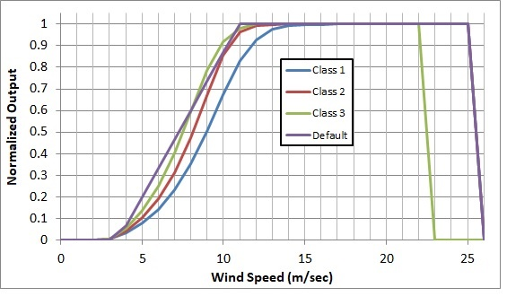
Example: Gen MaxMW Wind and Solar
An example is modeling the impact of wind speed on wind turbine output, or solar irradiation on PV output
  The image on the right shows
  several of the generic wind turbine
  models are based on the turbine
  classes using data from [a]
  A simple solar PV model uses either
  provided solar irradiation or the
  standard equations for insolation
  based on location and time of day
  including cloud cover; this is
  combined with whether the solar
  has tracking and, if needed, its tilt
  and azimuth
[a] C. Draxl, A. Clifton, B. Hodge, J. McCaa, “The Wind Integration National Dataset (WIND) Toolkit,” Applied Energy, vol. 151, pp. 355-366, 2015.

Slide 27
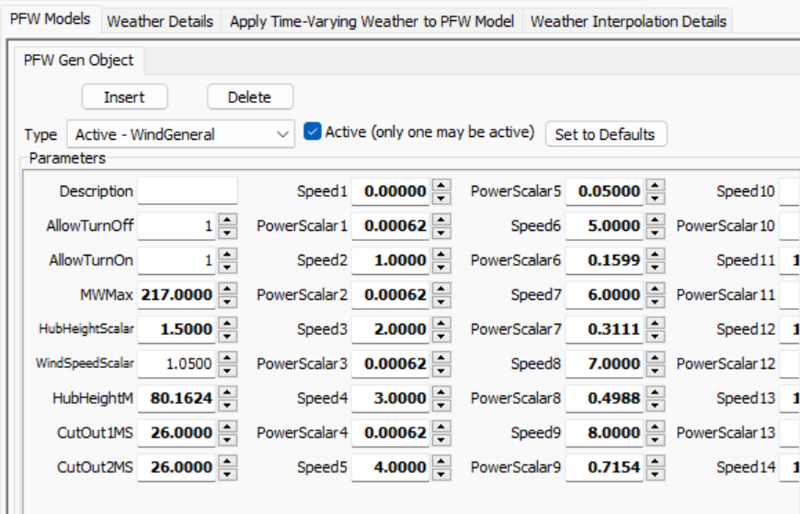
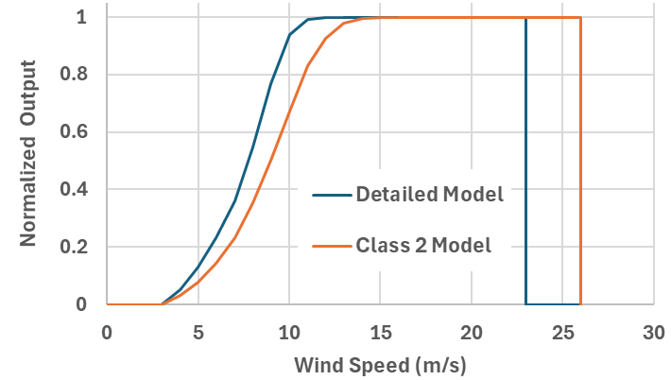
Example: Customized Wind Power Curve Model
Customized wind power curve models can also be defined

Slide 28
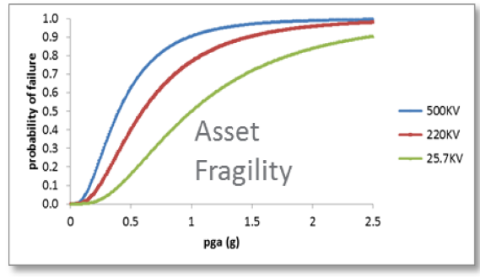
Additional PFWs, Including Stochastic Models
Many different PFW models are possible and they could certainly be stochastic
Examples include ambient-adjusted line ratings, dynamic line ratings, thermal generator output variation with temperature, line outage due to wind gusts, asset failure during
earthquakes (see figure with pga=Peak Ground
Acceleration), incremental impacts of
temperature on load, etc.
Many such models exist in the literature, with
others needing to be developed
Image source: Figure 2.1 of A. Veeramany, G.A. Coles, S.D. Unwin, T.B. Nguyen, J.E Dagle, “Trial Implementation of the High Impact, Low-Frequency Power Grid Event Risk Framework to Support Informed Decision-Making,” PNNL-25667, October 2016.

Slide 29
Making it Easy to Get Started: Using EIA-860 Data
For those who do not have access to models, to make it easy to get started we’ve setup copper plate (i.e., no transmission) power flow cases with PFW models based the data provided by the US Energy Information Administration (EIA) in their Form EIA-860 datasets
  EIA-860 provides data on every generator in the US with 1 MW or more capacity
  Available at www.eia.gov/electricity/data/eia860/; it is released yearly with monthly updates available
We take this data and convert it into a copper plate power flow model, with the resultant cases publicly available at
  electricgrids.engr.tamu.edu/eia-860-generator-data-cases/
  Details on this process are in a 2024 TPEC paper (available as 2024 paper 12 at overbye.engr.tamu.edu/publications/)

Slide 30
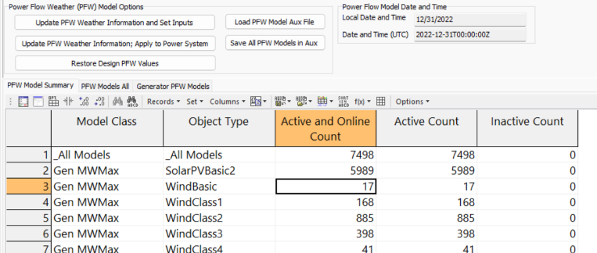
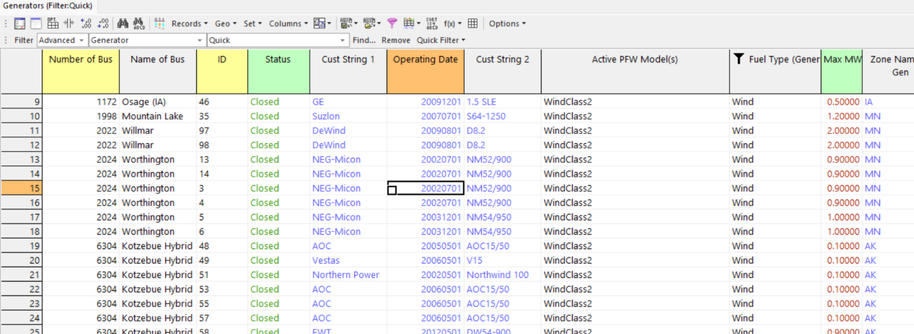
Example EIA-860 Wind Generator Data
Bottom image shows some EIA-860
wind generators with turbine information
Right image shows the PFW models to
map weather (wind speed) to MW Max
  For the CEII grids we have bus mapping for more than 95% of the generator capacity

Slide 31
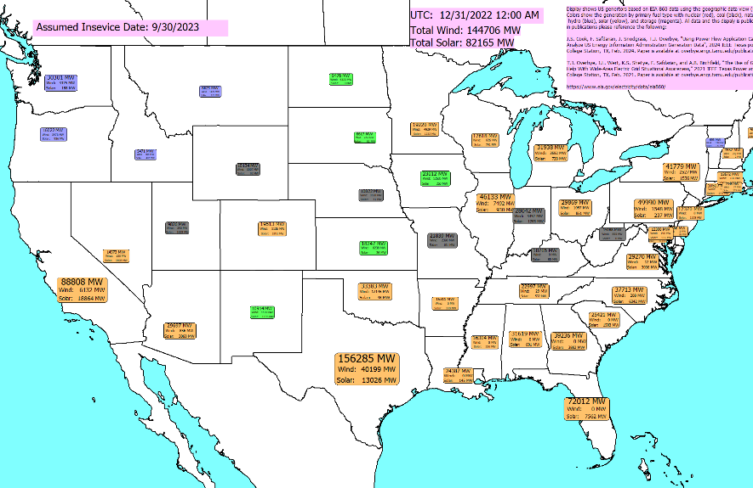
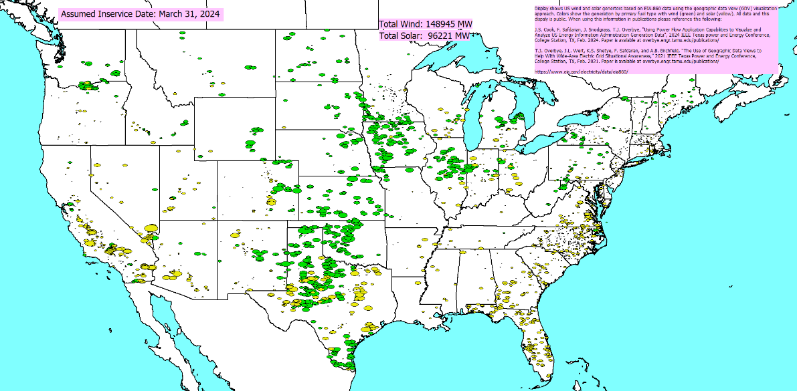
EIA-860 Generator Displays
  Generation Summary By State
  Generation by Primary Fuel Type: Wind and Solar

Slide 32
Mapping Weather to the Electric Grid Components
While the newer weather datasets have lots of points, there is still usually at least some distance between power grid components and the nearest weather measurement, requiring interpolation
There is no single best algorithm for doing the needed 2D scattered data interpolation, but there are a number of good and fast algorithms (grid-based, closest neighbor, Delaunay Triangulation, Shepherd’s)
  Since the weather values have an associated elevation, if the power grid component’s elevation (or profile for a line) is known this could be considered
Often places in which the weather changes rapidly with geography (e.g., mountains) don’t have much electric infrastructure, but there are many exceptions (covered next)

Slide 33
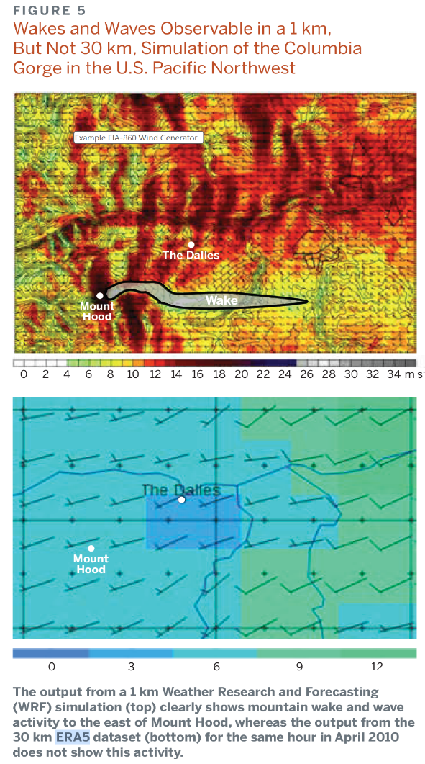
Dealing with Local Terrain
In some situations, particularly wind, the local
terrain variation can be significant, meaning that by themselves datasets like ERA5 may not be sufficient
  Even high resolution (2 to 4 km) datasets may not have enough detail
It is important to keep in mind the ultimate goal of using weather in the power flow; often quite acceptable results can be obtained including compensation terms in the PFW models that only need to be set once

Slide 34
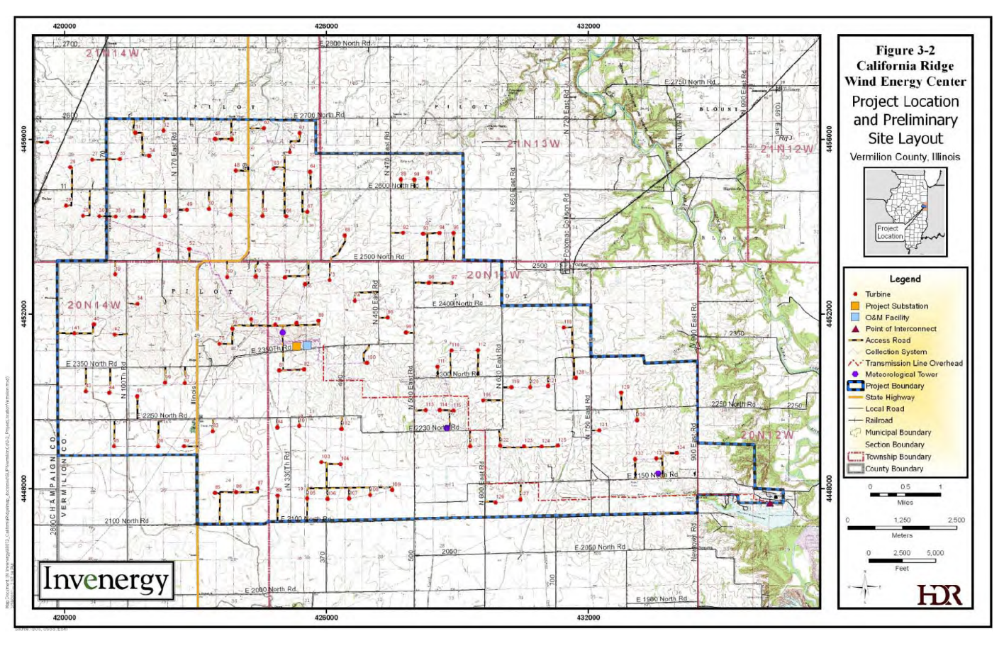
California Ridge Wind Farm, Vermillion County, IL
  The image shows a wind farm in Vermillion County, IL. While Central Illinois is pretty flat, there are narrow ridges, which are often the sites for wind farms. Even high resolution (2-4 km) datasets are not going to capture all the wind variations. For transmission planning compensated ERA5 data may be sufficient.
  Source: Invenergy California Wind Energy Project Build Permit Application, June 2011

Slide 35
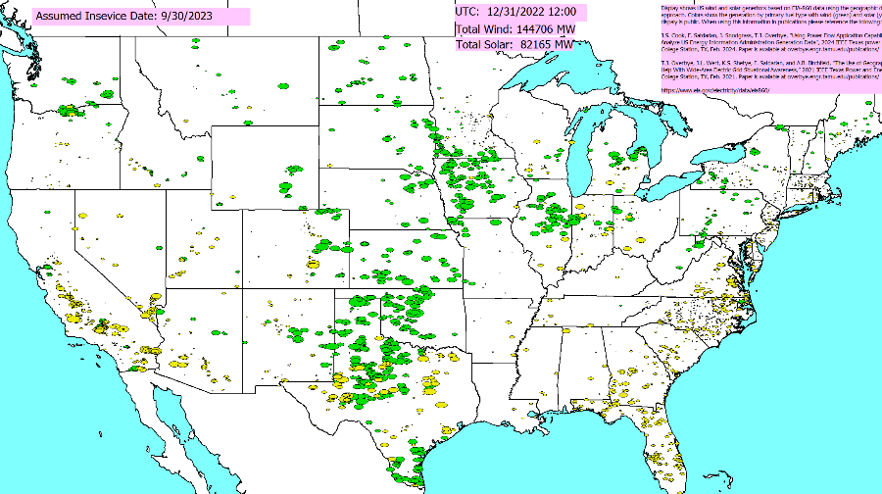
Applying the Weather
Weather can be applied to a power flow case using the pww files in multiple ways
  At a specified point in time
  As a summary of a large amount of weather at a single location (e.g., a generator) or at a few locations (a transmission line)
  As a time series, sequentially
  solving lots of different time points
The next few slides
demonstrate each of these,
showing the change
in the wind and solar outputs

Slide 36
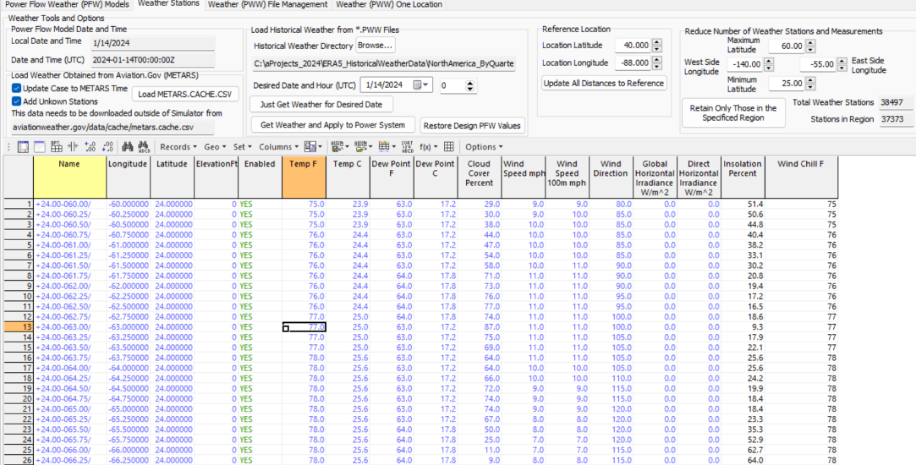
Applying Weather for a single time point
With the provided pww files, any time going back to 1940 can be simulated. The pww files are designed for quick searching, and for providing direct access to all the data for a particular time.
Getting the access to the weather for all of North America takes about a second;
optionally the
weather can also
be applied to the
power flow

Slide 37
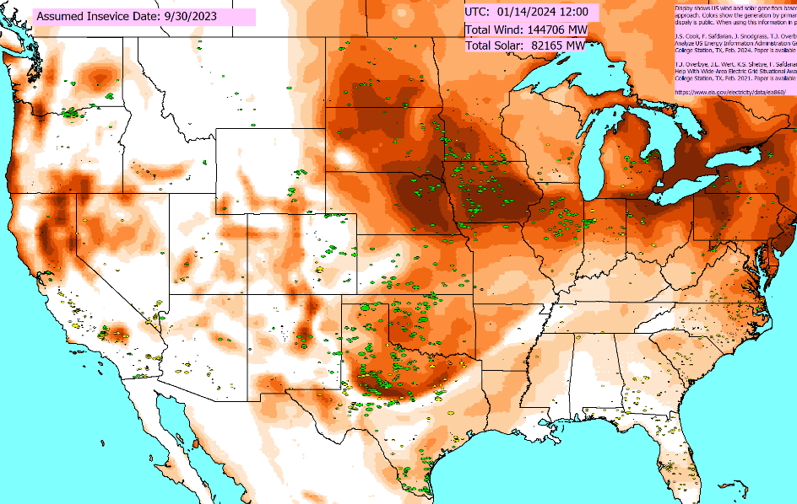
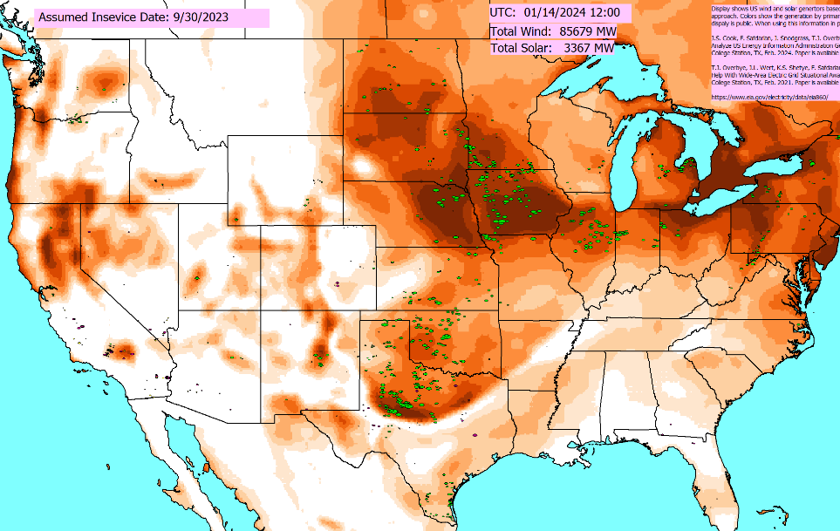
Applying Weather Without and With Updating the PFW Models and the Power Flow
Left image just shows the weather, without updating the PFW models (i.e., not changing the power flow values) whereas the right one also updates the PFW models (note the very low solar)

Slide 38
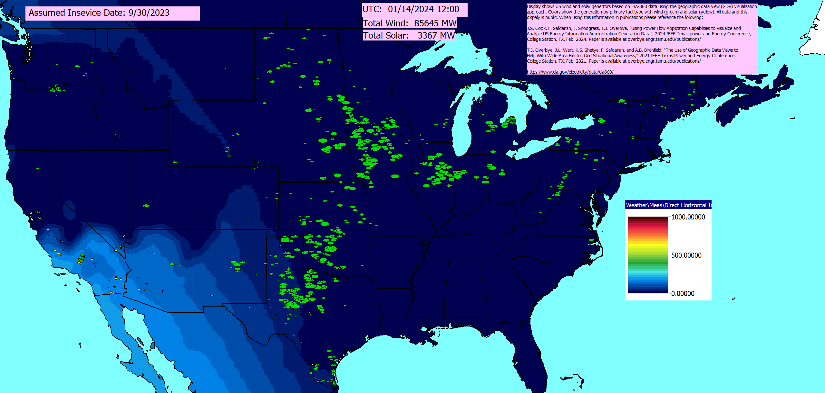
Previous Example Direct Horizontal Irradiance
  The EIA-860 grids do include Alaska and Hawaii, so there can be solar quite late in the day (from a Continental US perspective)

Slide 39
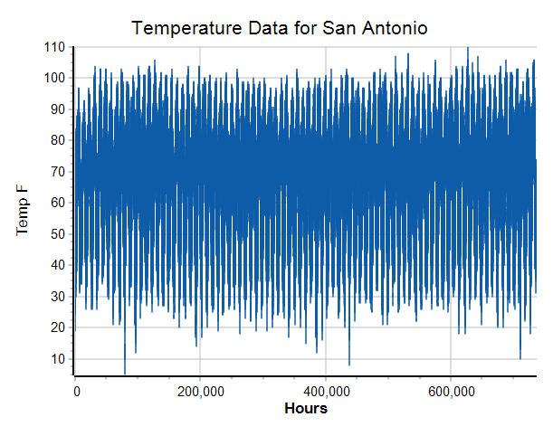
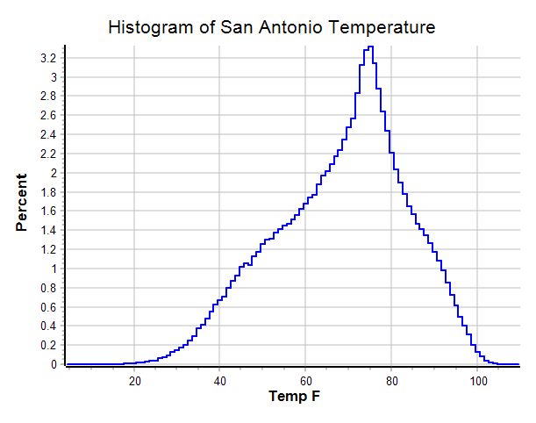
Getting Lots of Weather for a Single Location
By automatically parsing through the pww files, weather for a single location can be quickly determined
  For the Texas cases this takes on the order of 4 seconds, returning data for more than 700,000 hours; below data is for San Antonio, TX

Slide 40
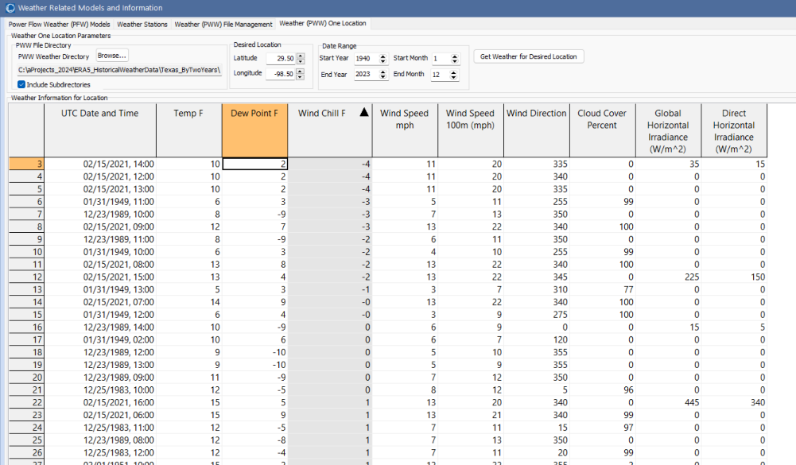
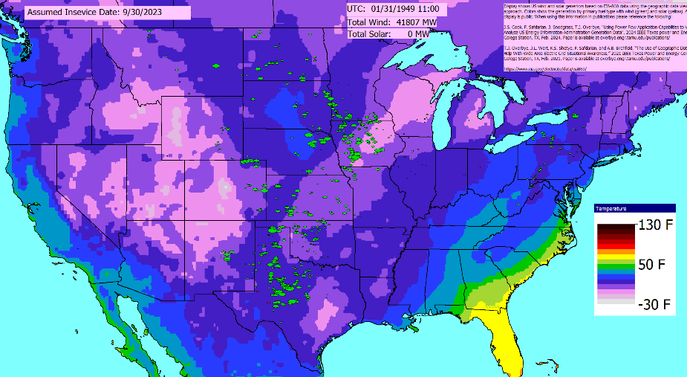
One Application is Looking for Outliers
Lower left image shows lowest wind chills in San Antonio; the lower right contours temperatures for Jan 31, 1949 at 11am (UTC)
  This allows planners to rapidly find some of the worst conditions for a location and doing more in-depth analysis

Slide 41
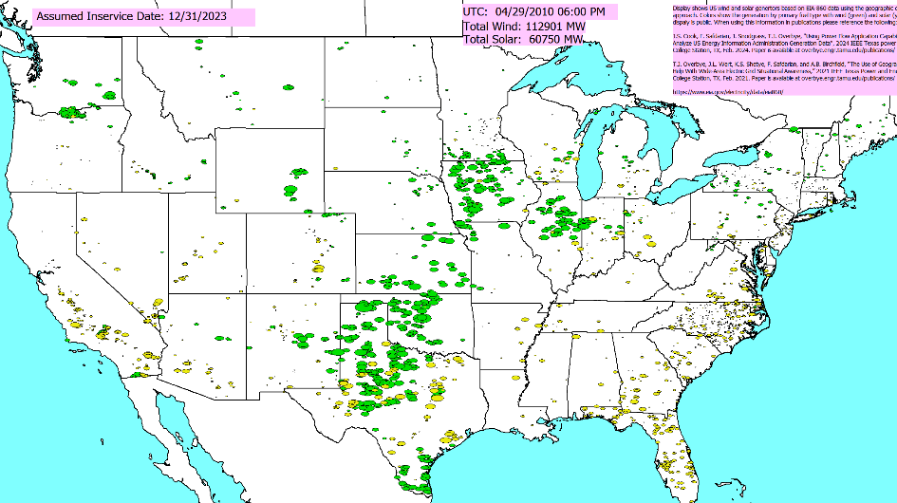
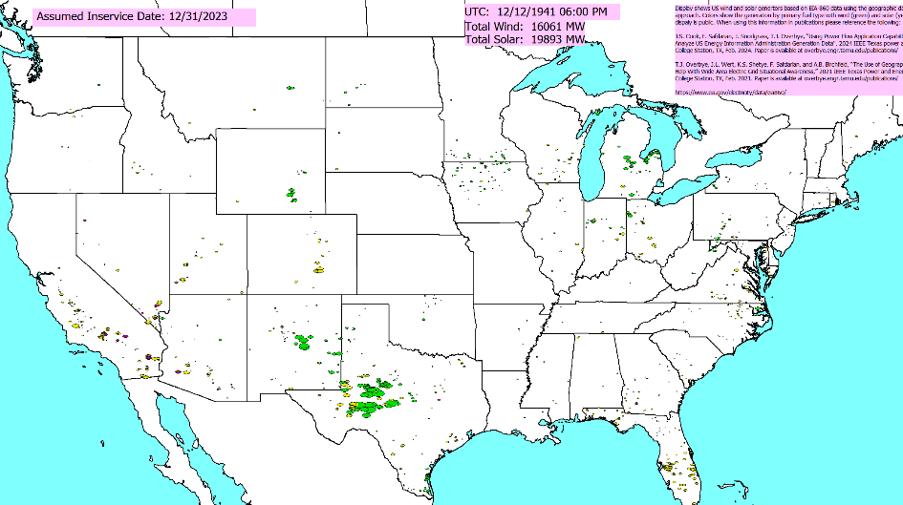
Contrasting Two Days: 4/29/2010 and 12/12/1941
Assuming the 12/31/2023 renewable generation (147 GW wind, 90 GW solar), we determined a few outlier days. At noon (Central) weather for 4/29/2010 would have an 73% to total wind and solar available, while 12/12/1941 weather would have had just 15%

Slide 42
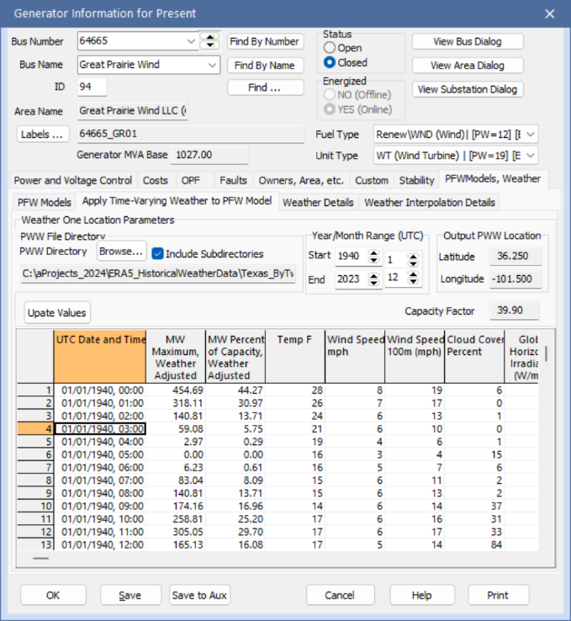
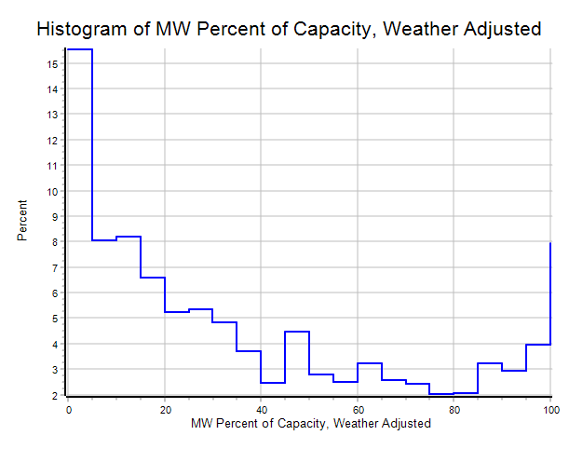
Anticipated Performance of Wind or Solar Generation Can Also Be Determined
Hourly weather data can also be
repeated applied to individual devices,
such as generators. This allows
the capacity factor to be estimated
for any location (existing or new)
  The impacts of changing model parameters can also be easily determined; for example changing the hub height to
  100 m increases the capacity factor to from 39.5% to 44.5%

Slide 43
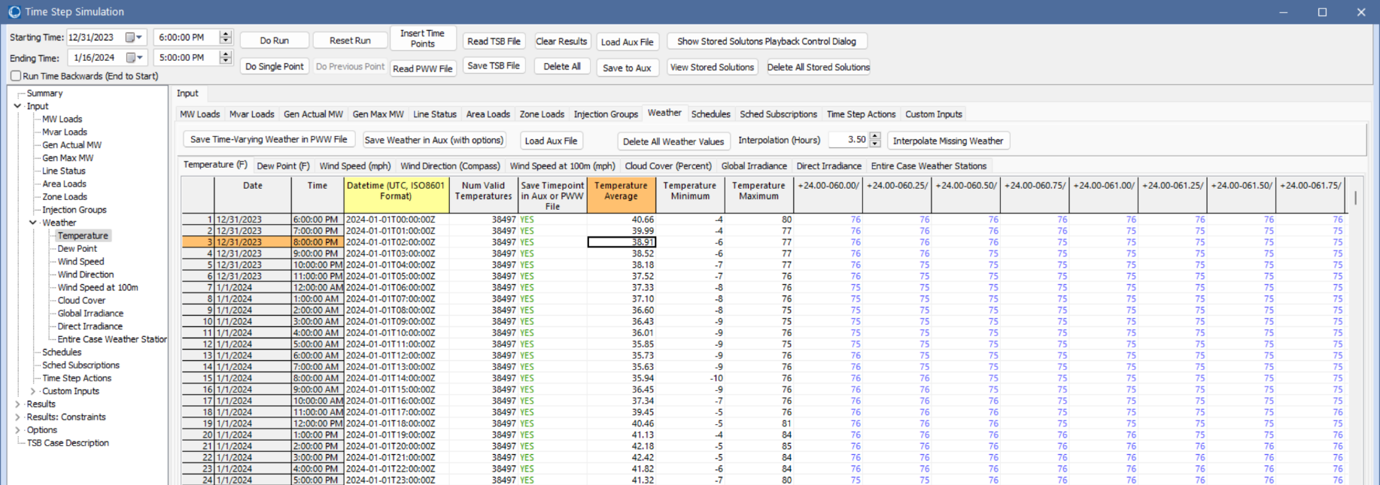
Simulating Large Amounts of Weather Information
To easily view and simulate many time values, the pww files can be loaded into time step simulations

Slide 44
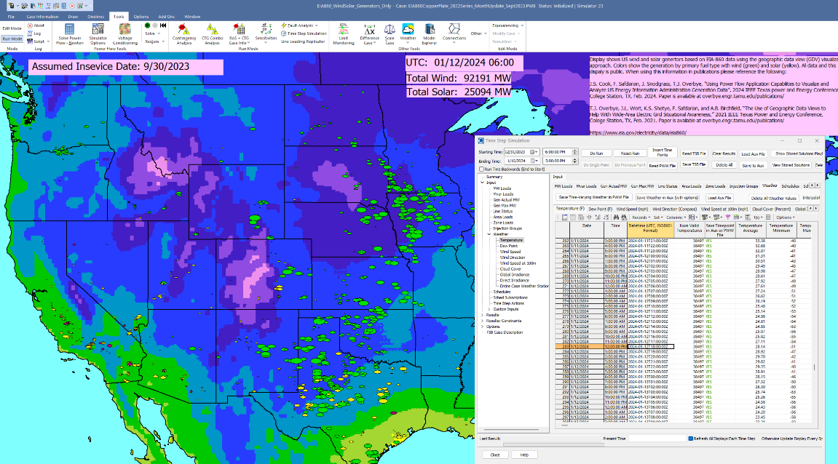
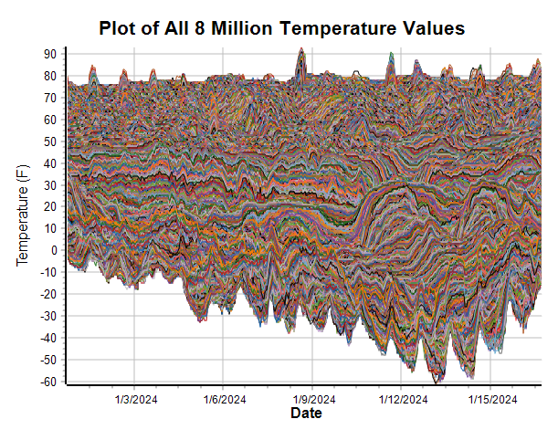
Applying Individual Times
The weather for any hourly value can be easily applied by selecting the timepoint, right-clicking and selecting Time Point Record, Apply Timepoint (With Weather Update)

Slide 45
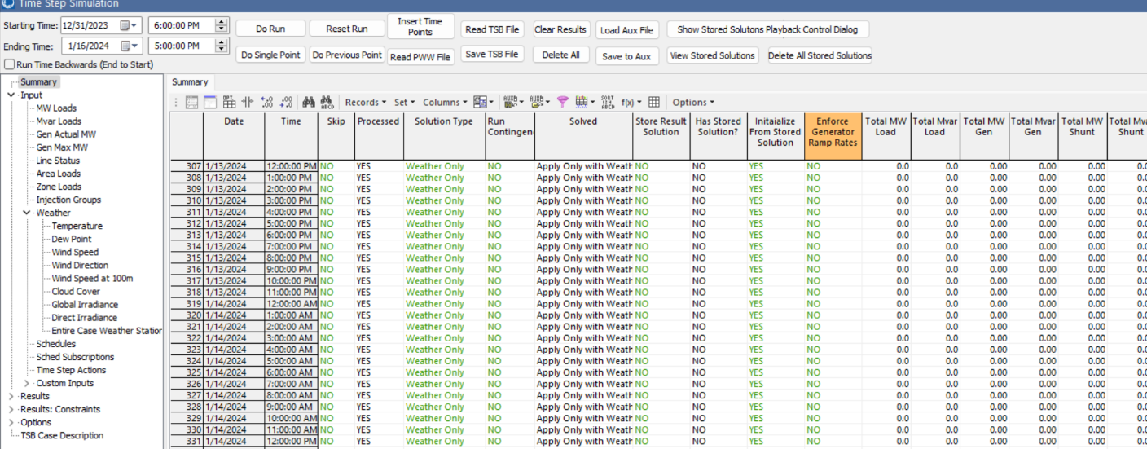
Running All Timepoints
When running all timepoints there are many options for applying inputs, storing results, and the associated solution type
Here just the weather is applied, and the solar/wind results for the entire case and the individual states saved

Slide 46
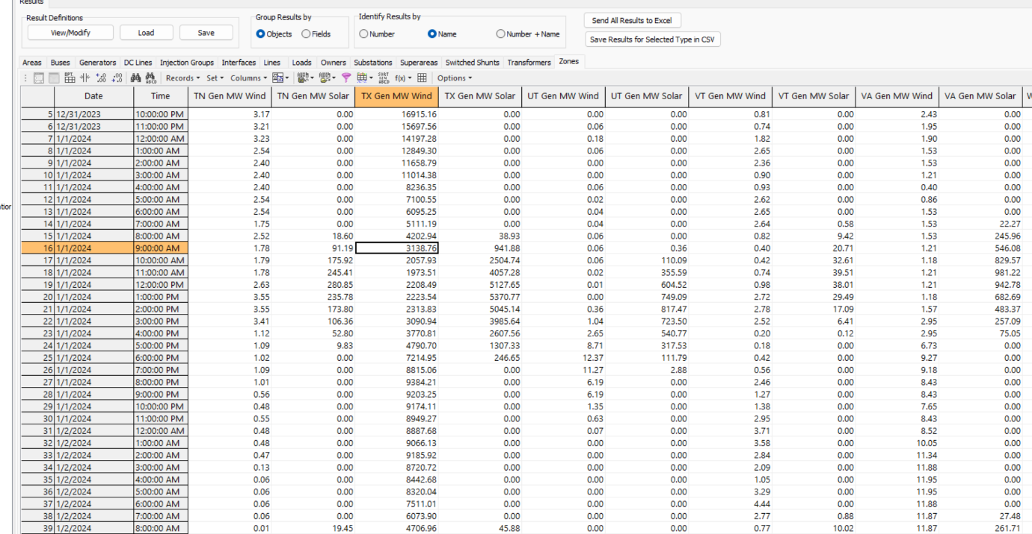
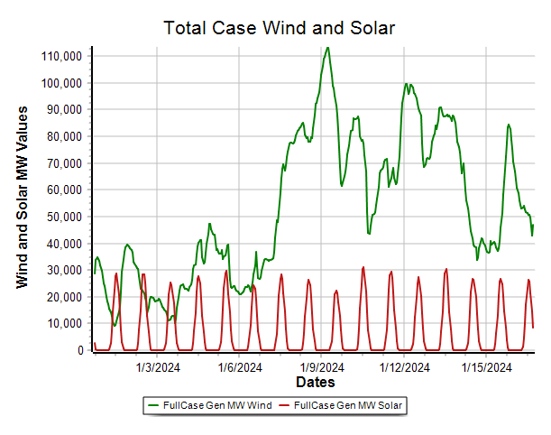
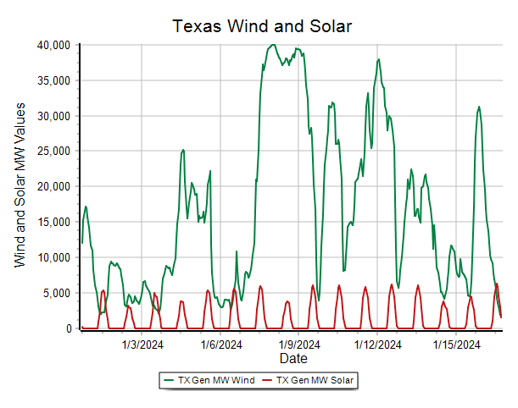
Results
The results can be viewed in either tabular displays or with graphs
  This naturally leads to validation! Of course with the EIA-860 case we won’t expect to fully match actuals.

Slide 47
Validation
An important aspect of this work is validating the results by comparing the simulated values with actual results
From a modeling and simulation (M&S) perspective, validation is used to determine the degree to which the M&S accurately represents the real world from the perspective of the intended users
  This is a US DoD definition
  The focus here is mostly planner sof large-scale electric grids
With planning being forward looking, validation is focused on ensuring the ENIs are adequately modeled and the PFW models can adequately represent the impact of ENIs on future grids

Slide 48
Validation, cont.
From an electric grid perspective validation is focused on 1) determining the accuracy of the PFW models to represent the impact of the ENIs on the electric grid be at an aggregate level, and 2) ensuring the ENIs are being adequately represented at the location of the electric grid components of interest
  Not covered here is determining whether the ENI itself is modeled correctly (e.g., looking at the adequacy of the algorithms used to get the ERA5 data)
For the PFW models, validation can be used to help set the model parameters, and in some cases determine whether a new model or model parameter is needed
This will be an ongoing effort, like has been the case for the last 60 plus years with stability models

Slide 49
Validation Example and An Improved PFW Model
Example uses actual and calculated annual capacity factor (CF) information to compare and improve the PFW models for the previously mentioned California Ridge wind farm (EIA-860 plant code 58008); actual 2017 data is available at [a]; the wind power curve is available from [b]
The 2017 CF values are: Actual: 0.44, Calculated: 0.38
Sources of errors would be 1) the assumed wind power curve, 2) the ERA5 hub height wind speed, 3) possible temperature dependence in the wind power curve, 4) the actual wind farm would have had turbines out of service
[a] US Wind Energy Performance (Capacity Factors) in 2017, WindExchange, windexchange.energy.gov/maps-data/332
[b] C. Bracken, S. Underwood, A. Campbell, T.B. Thurber, N. Voisin, Hourly wind and solar generation profiles for every EIA 2020 plant in the CONUS, 2023, dx.doi.org/10.5281/zenodo.7901615

Slide 50
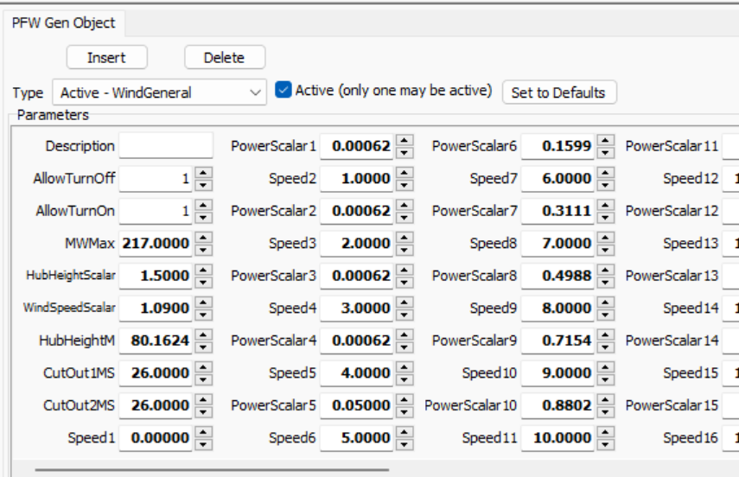
Validation Example & An Improved PFW Model, cont.
As a result of this validation, the WindGeneral PFW model was changed to include an additional parameter, the WindSpeedScalar, that scales the hub height wind speed to account for the wind farm
being in a more windy
location than indicated by
the ERA5 data
  Usually a linear scaling
  would not be the only
  approach, but it can certainly
  give better results
  It would just need to be set
  once

Slide 51
Example Weather Application:
Renewable Resource Droughts
Renewable resource droughts are times of significantly lower than normal wind and/or cloudy conditions over regions with significant wind and/or solar generation capacity
The severity of the drought depends on 1) its length, 2) the amount of reduction, and 3) its geographic size taking into account the electric transmission system
  They can be very system specific, and depend on how much wind and/or solar generation is actually installed
  Sometimes even short-term shortages can be important
By including weather with the power flow, planners have tools to study the potential for droughts to occur on their systems

Slide 52


Example North American RRD Papers
Below images show some results for Texas from [a]; the goal is to make it easy for planners to do their own studies
  The figures take current wind generation and apply 50 years of weather data
[a] J. L. Wert, T. Chen, F. Safdarian, J. Snodgrass, and T. J. Overbye, “Calculation and Validation of Weather-Informed Renewable Generator Capacities in the Identification of Renewable Resource Droughts,” IEEE PowerTech 2023, Belgrade, Serbia, June 2023.
[b] C. Bracken, N. Voisin, C.D. Burleyson, A.M. Campbell, Z.J. Hou, D. Broman, “Standardized benchmark of historical compound wind and solar energy droughts across the Continental United States,” Renewable Energy, vol. 220, 2024.
[c] F. Safdarian, J. L. Wert, D. Cyr, T. J. Overbye, “Power System Resiliency and Reliability Issues from Renewable Resource Droughts”, Kansas Power and Energy Conference 2024, April 2024.

Slide 53

Example: Long-Term Yearly Capacity Factor
Using this approach it is very easy to apply historical weather to existing or proposed facilities; here errors would tend to cancel out
  This particular wind farm became operational in 2014, so it would have actual results for only 10 years; that information could be used for validation results from earlier years

Slide 54



Other Resiliency Events
A similar process can be used for modeling the impacts of a number of other resiliency events (e.g., earthquakes, wildfires, GMDs)
An example of a relatively benign event was the total solar eclipse that occurred on April 08, 2024 or the annular one from October 14, 2023
  In CONUS there will be another partial eclipse on 1/14/29, a total eclipse on 8/12/45, and an annular eclipse on 6/11/49

Slide 55




We have Just Started Making a Public Library of Interesting Grid Scenarios
More scenarios are going to be added very soon; the site will link public reports with our weather/grid simulations

Slide 56


A Need for Higher Resolution on Some Scenarios
The ERA5 data is great for slower events, but for faster events (like the June 29, 2012 Derecho) we need higher resolution data both spatially and temporally

Slide 57
Future Directions
A number of models that relate weather and other ENIs to the electric grid values already exist, but more certainly should be developed
More validation!!
Increased automation of the updating process; maybe more footprints
Machine learning applications given lots of potential operating points
Determining the required level of weather details; higher resolution datasets are available
Using the data sets to search for outlier conditions such as renewable resource droughts or times of rapid changes in values
Expanding the set of available weather variables, such as ones related to icing and storms, and the set of interesting scenarios
Applying the techniques to other potentially severe resiliency events

Slide 58

Thank You! Questions?
Recent papers are at overbye.engr.tamu.edu/publications/
For questions afterwards email me at overbye@tamu.edu

