Slide 1
ECEN 460
Power System Operation and Control
Spring 2025
Lecture 1: Overview
Prof. Tom Overbye
Dept. of Electrical and Computer Engineering
Texas A&M University
overbye@tamu.edu

Slide 2
Welcome and Course Mechanics
In Spring 2025 ECEN 460 is offered with lectures in Zach 241 on Mondays and Wednesdays from 5:45 to 7 pm
  There are also six two hour lab sections meeting in Zach 326, with 16 students each:
  501 on Wed 8 to 950 am, 502 Fri 11:10 to 1pm, 503 Fri 1:30 to 3:20 pm, 504 Friday 4:10 to 6pm, 505 Wed 11:10 to 1 pm, and 506 Wed 1:30 to 3:20 pm
The course has a public website as well as a private Canvas website
  We’ll post all material on Canvas; all should be able to login to Canvas at canvas.tamu.edu (also from lms.tamu.edu)
  Slides will be available on Canvas before each lecture, with often updated slides posted after the lecture
  Much of the material will be on the public website, included the ppts of the lectures
1

Slide 3
Syllabus Material
The syllabus is posted in several locations, including Canvas, Howdy and on the public website
The public website is
  overbye.engr.tamu.edu/course-2/ecen460sp25/
    Slides from the last time I taught the class (2017) are at
    overbye.engr.tamu.edu/course-2/ecen460fa2017/
Canvas access (TAMU students only) is lms.tamu.edu
The assumed background is knowledge of TAMU ECEN 214 material with 340 helpful
Course staff is Prof. Tom Overbye and three TAs: Nicole Logiudice (lead) (502 and 505), Lyric Haylow (501, 506), and Brian Lee (503, 504)
  Contact information is on the syllabus (TAMU only)
2

Slide 4
Syllabus Material, cont.
The course will have homework (seldom graded), a project, labs, and two in class exams
  Final grade is based 30% from the first exam, 30% from the second exam, 25% from the lab, and 15% homework and the project
  Your two lowest lab scores will be dropped, but this does not apply to lab 11 (associated with the project)
  In class exams are on March 5 and April 23; final exam date is Thursday May 1 from 7:30 to 9:30 am; there will not be a final exam, but the final project is due on May 1.
  All grading in the course is based on a percentage, with final grades determined based on this percentage. If your final average falls within the below ranges you are guaranteed to receive at least the letter grad indicated: A: 90-100; B: 80-89; C: 70-79; D: 60-69; F: 59 or lower
Last day of class for 460 is Monday April 28
3

Slide 5
Course Text and Slides
The course text is Glover, Overbye, Birchfield and Sarma, Power System Analysis and Design 7th Edition, Cengage Learning, 2023 (ISBN-13: 978-0357676189)
Much of the Course Material will be presented via PowerPoint Slides
Prior to each lecture the draft slides will be available in Canvas
After each lecture an updated version of the slides will be posted in Canvas
  Usually modified based on the number of slides we actually covered
Student questions are greatly encouraged!
4

Slide 6
Course Topics
Introduction and review of phasors & three-phase
Transmission line and transformer modeling
Models for generators, and loads
Power flow analysis and control
Economic system operation, optimal power flow, power markets
Power system stability, oscillations and control
Renewable generation including weather impacts modelings
Transients
Emerging topics
5

Slide 7
Contrasting ECEN 459 and 460
ECEN 459 (Power System Faculty Analysis and Projection) is not required for ECEN 460; they are two independent, complimentary courses that cover different aspects of electric power system analysis and design
ECEN 459, last taught in Fall 2024 by Dr. Butler-Purry, covers mostly detailed modeling of transmission lines, transformers, faults (both symmetric and unsymmetric), and power system protection
  Book chapters 1-5, 8, 10 and 11
ECEN 460 uses some of the models developed in 459 without going into the details of their derivation
The overlap is mostly associated with three-phase system modeling, per unit, and a little bit on the formation of the bus admittance matrix
6

Slide 8
About Me: Professional
Received BSEE, MSEE, and Ph.D. from UW-Madison
Worked for eight years as engineer for Madison Gas & Electric
Was at UIUC from 1991 to 2016, doing teaching and doing research in the area of electric power systems
Joined TAMU in January 2017; Taught many power systems classes over last 34 years, including 460 material at least 12 times
Developed commercial power system analysis package, known now as PowerWorld Simulator. This package has been sold to about 1000 different corporate entities worldwide
DOE investigator for 8/14/2003 blackout
Member US National Academy of Engineering; now Section 6 Chair
7

Slide 9

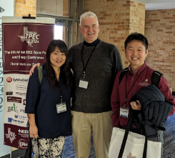
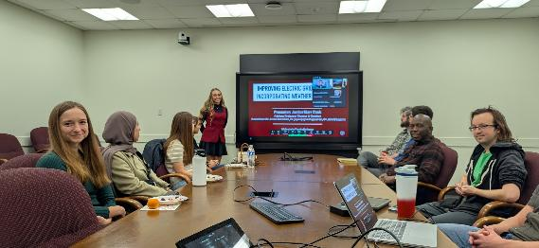
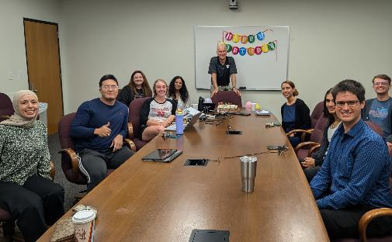
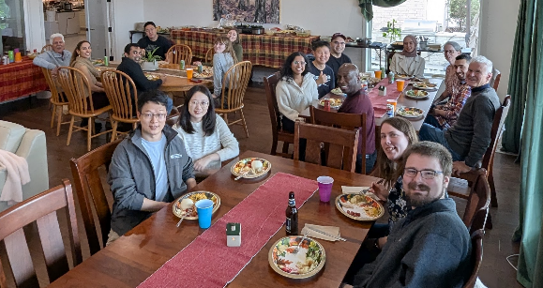
About Me: TAMU Research Group
8

Slide 10
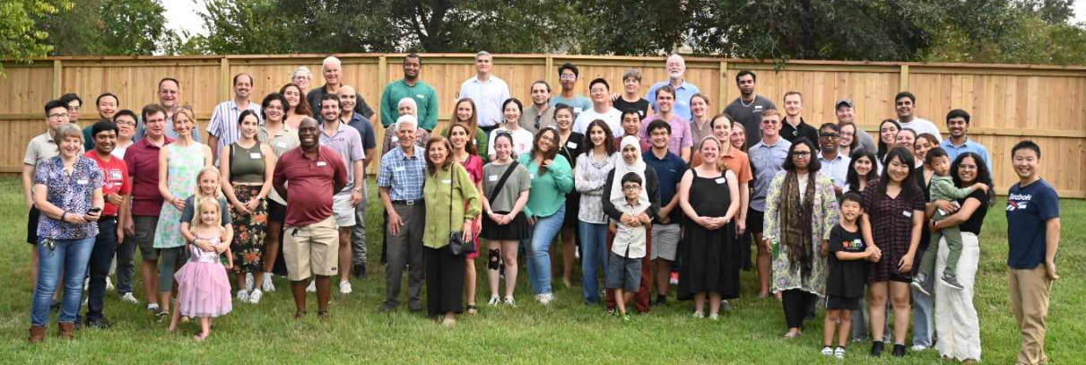
TAMU Energy and Power Group Fall 2024 Dinner
Held at Dr. Davis’s house in September
9

Slide 11

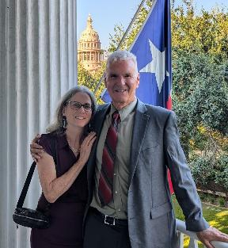
About Me: Nonprofessional
Married to Jo; and have three children:
Tim (now with Megan), Hannah (now with
Will) and Amanda
We homeschooled our kids with Tim now
a 2023 TAMU alumni (PhD) working for
ARL, Hannah doing a PhD at UCSB in
communications, and Amanda also at UCSB doing a Master’s in Environmental Data Science
Jo is a counselor (LPC), we attend Grace Bible Church in College Station and teach 4th graders class (Creekside)
I am the faculty advisor for Christian Engineering Leaders; I also like swimming, watching football
10
10

Slide 12
Announcements
Please read Chapters 1, 2
Labs will start next week (January 22 or 24)
Of course, no class next Monday (January 20) because of the campus holiday
11

Slide 13
ECEN 460 Motivation: A Vision for a Long-Term Sustainable Electric Future
Electric grids worldwide are in a time of rapid transition with lots of positive developments including the addition of large amounts of renewable generation and the electrification of transportation; the impact of artificial intelligence is a big unknown (both its application and high electricity use)
Our electric energy future should be quite bright
However, there are lots of concerns with this transition, particularly in dealing with electric grid resilience
  The result is there are lots of great engineering challenges, and lots of need for new engineers to enter the field!
The goal of 460 is to help develop future electric power engineers
  Its focus on design and operation of large-scale electric grids will help even if you do not get a job directly in the power engineering field
12

Slide 14
Power System Examples
Electric utility: can range from quite small, such as an island, to one covering half the continent
  there are four major interconnected ac power systems in North American, each operating at 60 Hz ac; 50 Hz is used in some other countries.
Microgrids can power smaller areas (like a campus) and can be optionally connected to the main grid
Airplanes and Spaceships: reduction in weight is primary consideration; frequency is 400 Hz.
Ships and submarines
Automobiles: dc 12 V standard; 360-376 V for electric
Battery operated portable systems
13

Slide 15
Electric Grid Overview
Generation – source of electric energy
  Coal had provided over half of the U.S. electric energy, but now natural gas leads, with renewable sources rapidly growing
Load – consumes electric energy
  Consumers are in complete control of
  the switch; utilities must supply
  enough power to meet load
Transmission and Distribution –
the wires that carry the power from
generation to load
  Operating at voltages up to 765 kV (kilovolt),
  with 500 kV, 345 kV, 230 kV 161 kV and 138 kV common
Image source is US DOE, www.energy.gov/indianenergy/articles/united-states-electricity-industry-primer
14

Slide 16
Power and Energy
Power is the instantaneous transfer of energy; expressed in watts (W), kW, MW, GW
  US installed generation capacity is about 1000 GW
Energy is the integration of power over time; expressed in units of joules (J = 1 W-sec), kWh (3.6 x 10⁶ J), or btu (1055 J; 1 Mbtu = 0.292 MWh)
U.S. electric energy consumption is about 4350 billion kWh (about 13,000 kWh per person; 1.4 kW continuous per person on average)
For many people the word “energy” has better connotations compared to power; in 2008 the IEEE Power Engineering Society (PES) changed its name to the IEEE Power and Energy Society (PES)
15

Slide 17
Electric Power Engineering: A Great Career!
A good definition of power engineering is provided by the IEEE PES field of interest:
  “to develop standards and empower development of technology, software, and best practices in all areas of electric power and energy including generation, transmission, distribution and utilization to provide a reliable, resilient, safe, cost-effective and sustainable AC and DC electricity supply system to the end-user”
A nice aspect of electric power engineering is its breadth (“all areas”) since the focus is on providing reliable, resilient, safe cost effective, and sustainable electricity to people
Since electricity touches most aspects of human society, electric power engineering does as well
16

Slide 18
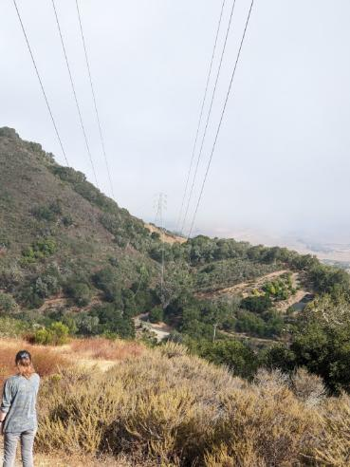
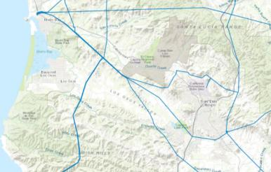
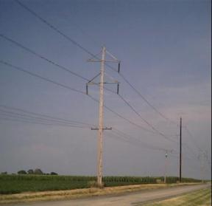
Three-Phase Systems
Essentially all large-scale electric grids are three-phase
  Three wires, with the same
  voltage magnitude and a phase
  shift of 120 degrees
Usually the high voltage
electric grid is “balanced,”
  This means that it can be very
  well modeled as an equivalent
  single-phase system
  The three-phase lines are often
  shown with a single line, what
  is known as a oneline
230 kV dual
circuit
138 kV
17

Slide 19
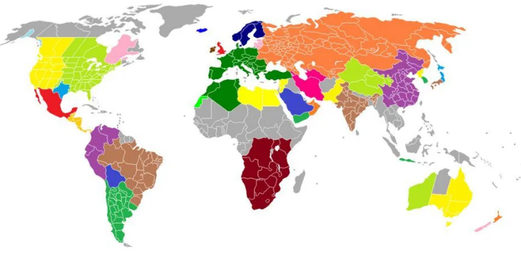
Synchronous Electric Grids
Much of the electricity in the developed world is supplied by large-scale, 60 or 50 Hz synchronous electric grids
  Such grids can provide improved reliability, larger electricity markets and often economics of scale
  However, they add planning
  complexities
  Power can be transferred
  between synchronous grids by
  first converting it to dc,
  with HVDC lines one example
Islands, and other parts of
the world are supplied by
smaller electric grids
Large-Scale Electric Grid Interconnections
Image Source: i.redd.it/krkhdfslrjh61.jpg
18

Slide 20
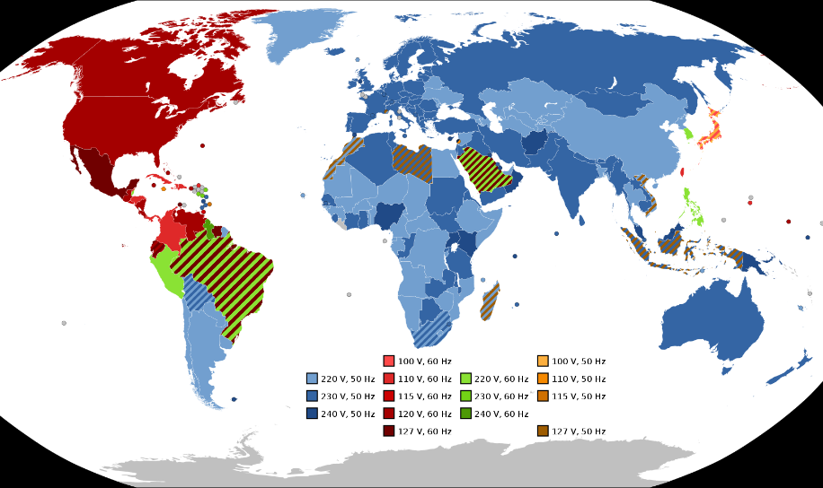
Electric Frequencies and Residential Voltages Worldwide
In the US the supplied residential voltage should be 120 V, with a 5% range allowed
Image Source: en.wikipedia.org/wiki/Mains_electricity_by_country#/media/File:World_Map_of_Mains_Voltages_and_Frequencies,_Detailed.svg
19

Slide 21
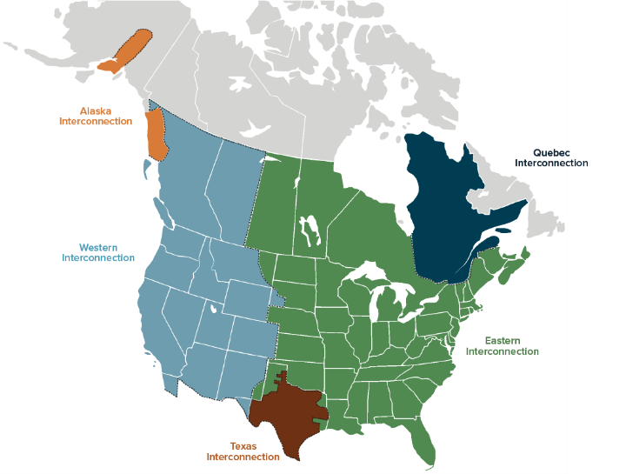
North America Interconnections
The term US includes all 50 states and other areas like DC and Puerto Rico; the continental US includes only the parts of the US in North America (49 states plus DC), the contiguous US (or CONUS) is the 48 connected states plus DC; OCONUS is everything outside of CONUS
20

Slide 22
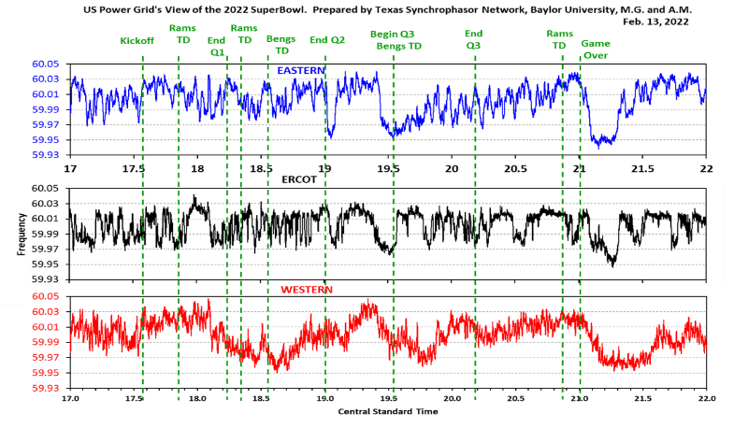
All Three US Grids Are 60 Hz, But Are Not Usually At the Same Value
Images show the frequency during the 2022 Super Bowl (2/13/22)
Image from Prof. Mack Grady of Baylor University
21

Slide 23
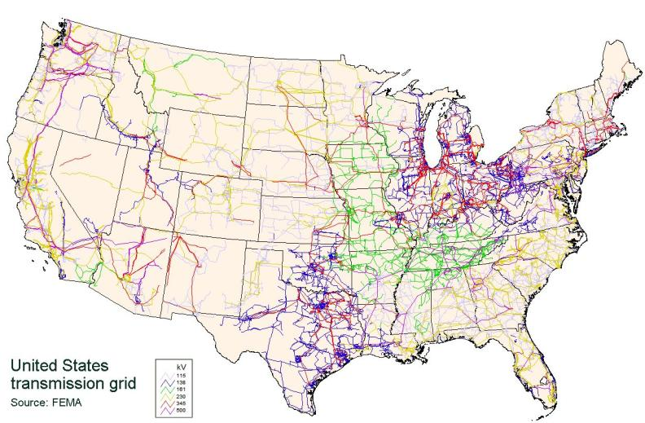
CONUS Transmission Grid
The CONUS Grid is interconnected with
Canada and parts of Mexico
22

Slide 24
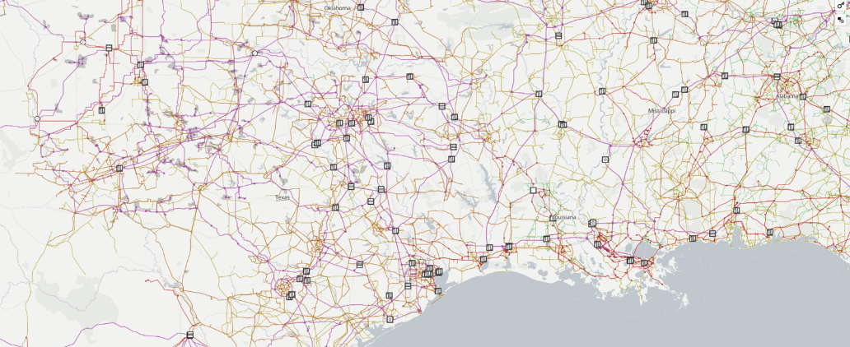
A Nice Visualization of Worldwide Electric Grids
The website openinframap.org visualizes the worldwide electric grid information contained in the OpenStreetMap database
23

Slide 25
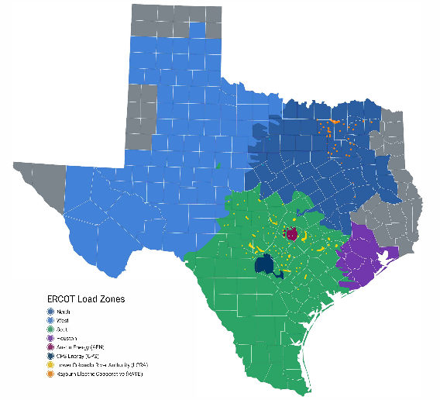
Electric Interconnections in Texas
El Paso is in the Western Interconnect (WECC) and parts of North and East Texas are in the Eastern Interconnect (EI) (with the boundaries in the image just approximate)
Lubbock Power and Light customers joined ERCOT in May 2021
Source: www.ercot.com/news/mediakit/maps
24

Slide 26
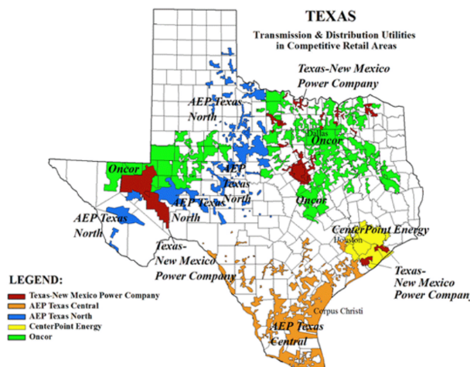
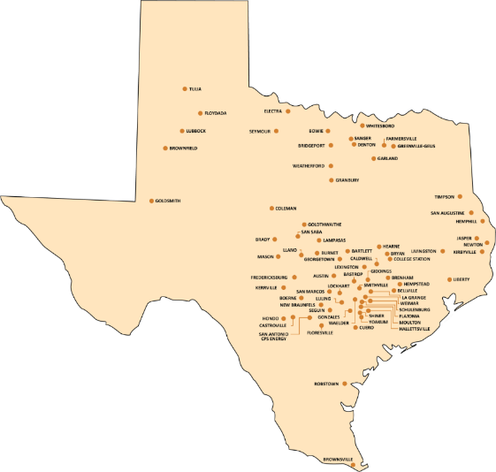
Electric Utilities in Texas (IOUs and Municipals)
25

Slide 27
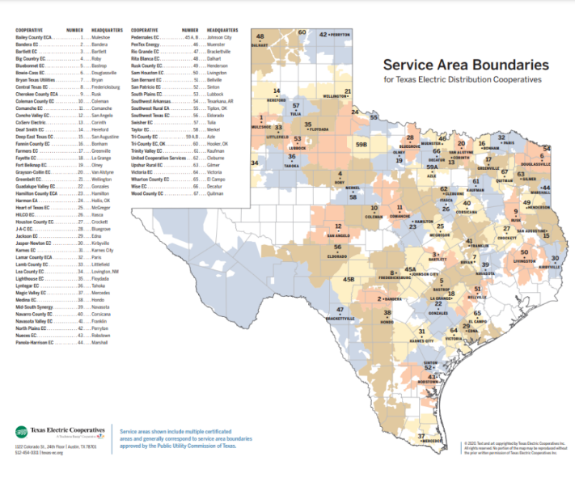
Electric Utilities in Texas (Coops)
26

Slide 28
Electric Systems in an Energy Context
Class focuses on electric power systems, but we first need to put the electric system in context of the total energy delivery system
Electricity is used primarily as a means for energy transportation
  Use other sources of energy to create it, and it is usually converted into another form of energy when used
About 40% of US energy is transported in electric form
Concerns about need to reduce CO2 emissions and potential fossil fuel depletion are main drivers for change in world energy infrastructure
27

Slide 29
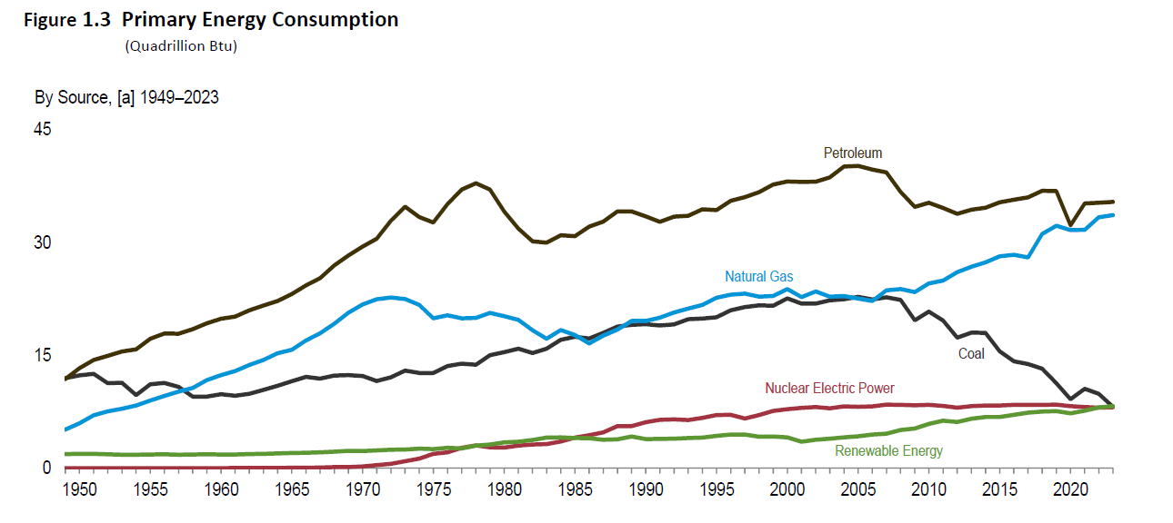
Looking at the 2023 Energy Pie: Where the USA Got Its Energy
The below graph shows the total US energy consumption by source, with one 1 Quad = a quadrillion btu; the total in 2023 was 93.7 quad, which hasn’t changed substantially in more than 20 years (2005 was 98 quad)
EIA is the US Energy Information Administration, which is a semi-independent agency under the US Department of Energy (DOE)
Source: EIA Monthly Energy Review, December 2024
28

Slide 30
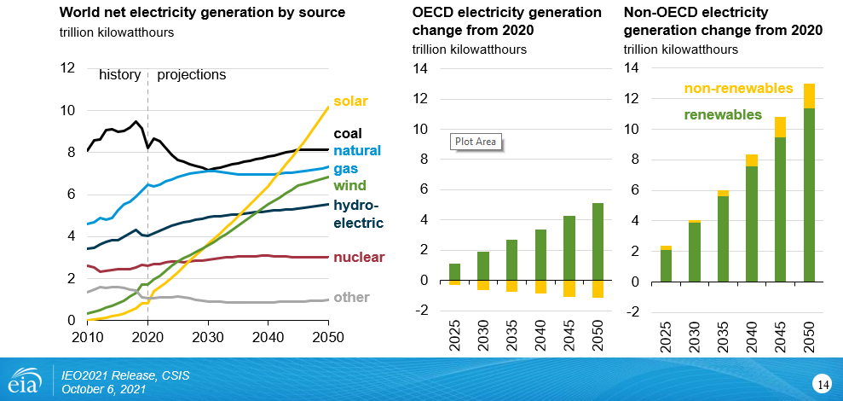
The World: Electricity Consumption by Source
29

Slide 31
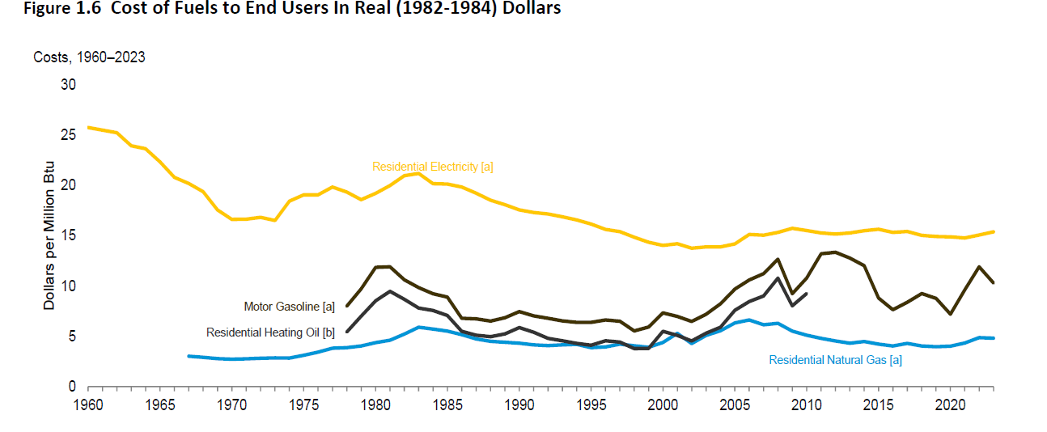
Cost of Energy to the End Users
Overall energy prices have stayed relatively constant over the last 20 years
  When comparing costs over time the way to remove the impact of inflation is to use dollars adjusted for inflation (constant or real dollars) as opposed to current dollars
30

Slide 32
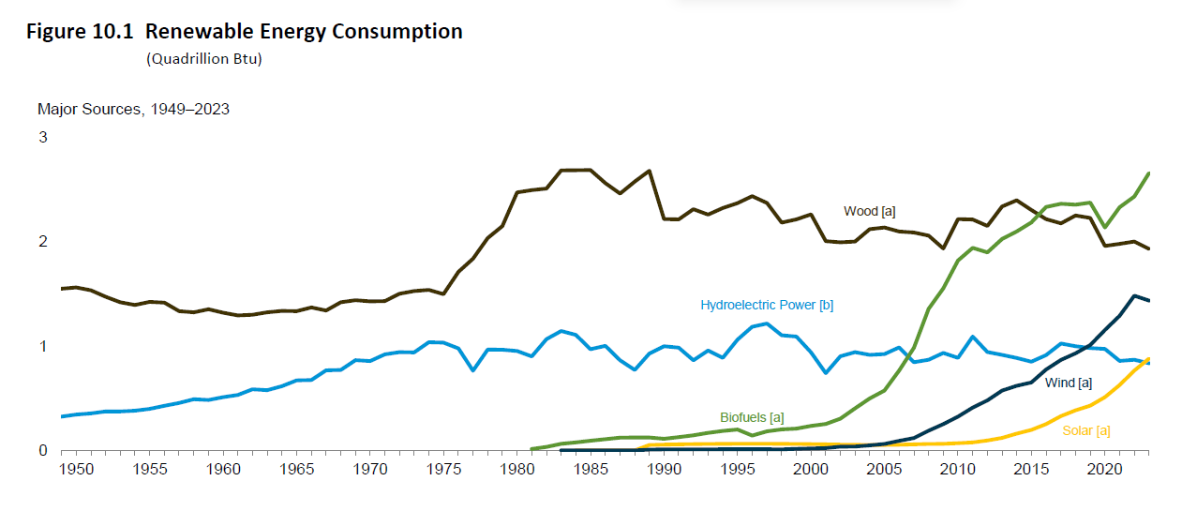
US Renewable Energy Consumption
Most of the renewable energy is transported in the form of electricity, with biofuels (e.g., ethanol and biodiesel) the major exceptions
Source: EIA Monthly Energy Review, December 2024
31

Slide 33
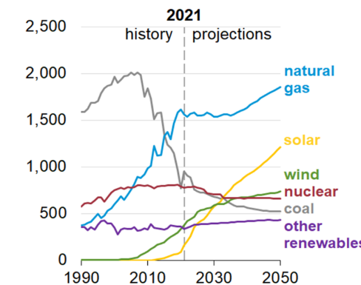
US Electricity Generation
Natural Gas (42.5%) and nuclear (18.3%) are most common sources, followed by coal (15.8%), wind (10.4), solar (6.3) and hydro (5.6%)
  Wood is 0.8%, geothermal 0.4%
  Coal was at least 50% of the total up to 2007
New construction mostly wind,
solar and natural gas (with wind and
solar energy costs now quite low)
When looking at predictions keep in mind
the Yogi Berra quote, “It’s tough to make
predictions, especially about the future”
US Generator Capacity Additions
Sources are by energy (not capacity), source US EIA, August 2024
32

Slide 34
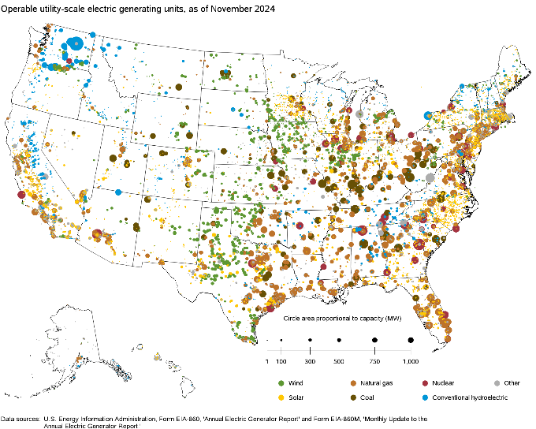
US Generation (November 2024) by Fuel Type
The sources variety substantially by state
Image Source: www.eia.gov/electricity/data/eia860m/
33

