Slide 1
ECEN 460 Power System Operation and Control Spring 2025
Lecture 4: Power System Operations
Prof. Tom Overbye
Dept. of Electrical and Computer Engineering
Texas A&M University
overbye@tamu.edu

Slide 2
Per Unit
A problem in analyzing power systems is the large number of transformers.
It would be very difficult to continually have to refer transformer values (like their impedances) to the different sides of the transformers
This problem is avoided by a normalization of all variables.
This normalization is known as per unit analysis
Engineers commonly talk about voltages in per unit. A 138 kV (base) transmission line operating at 140 kV is 140/138 = 1.022 p.u.
We will cover this more once we cover the transformer models
1

Slide 3
Power System Operations Overview
Goal is to provide an intuitive feel for power system operation
Emphasis will be on the impact of the transmission system
Introduce basic power flow concepts through small system examples
2

Slide 4
PowerWorld Simulator Basic Operation
PowerWorld Simulator (PowerWorld) has lots of power system simulation capabilities. Initially we’ll just use it to simulate the steady-state (quasi-static) operation of small electric grids
PowerWorld power system cases are stored using two file types: 1) a *.pwb file to store the power system itself, and 2) a *.pwd file to store the displays. Often when opening a *.pwb it automatically opens a pwd file
PowerWorld can run as a time-varying simulation; while this isn’t the most common way it is used, it is a good place to start
Start PowerWorld, and select File, Open Case and then use the dialog to select the case B3Slow.pwb
3

Slide 5
Three Bus PowerWorld Simulator Case
PowerWorld Case Name: B3Slow
Load with
green
arrows
indicating
amount
of MW
flow
Note the
power
balance at
each bus
Used
to control
output of
generator
Direction of green arrow is used to indicate
direction of real power (MW) flow; the blue arrows show the reactive power
4

Slide 6
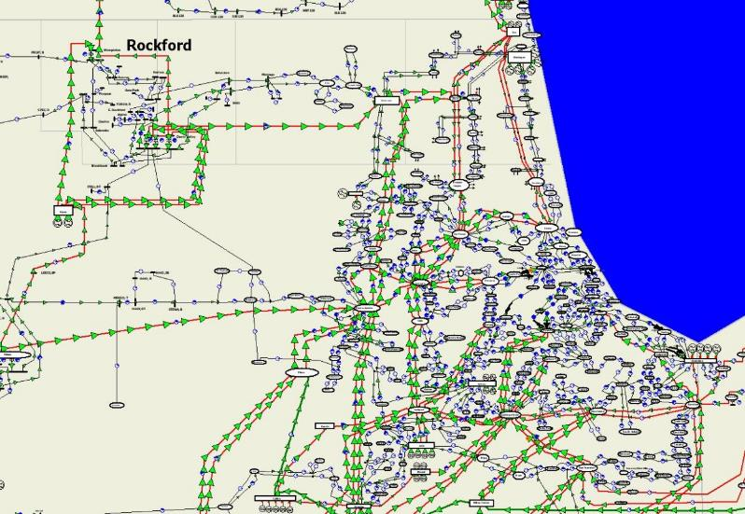
A Larger Example: Metro Chicago Electric Network
5

Slide 7
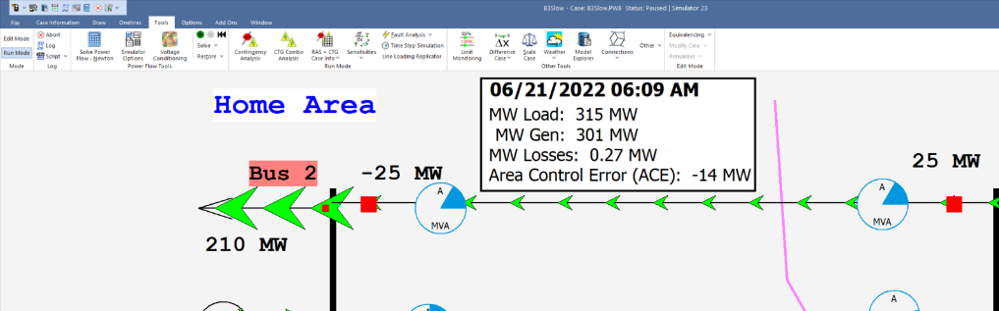
Starting the Simulation
Click the green arrow button to start the simulation; this is a very small grid the models the increase in the electric load that would occur in the morning
6

Slide 8
Basic Power Control
Opening a red circuit breaker causes the power flow to quickly change.
There is no other way to directly control power flow in a transmission line.
By changing generation we can indirectly change this flow.
Power flow in transmission line is limited by heating considerations
Losses (I^2 R) can heat up the line, causing it to sag.
The change isn’t really instantaneous because of propagation delays, which are near the speed of light; there also wave reflection issues; however, in the power flow time frame it looks to be instanteous
7

Slide 9
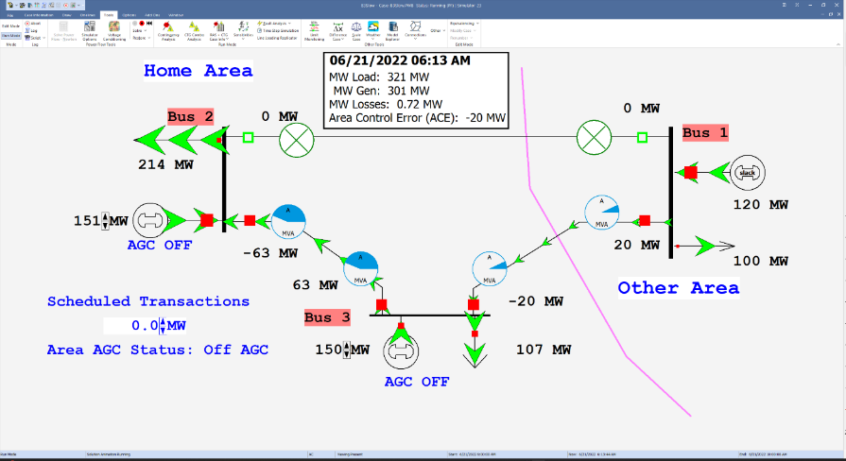
B3Slow Case with Open Line
When open the circuit breaker changes to a hollow green square; click it again to put the line back into service;
8

Slide 10
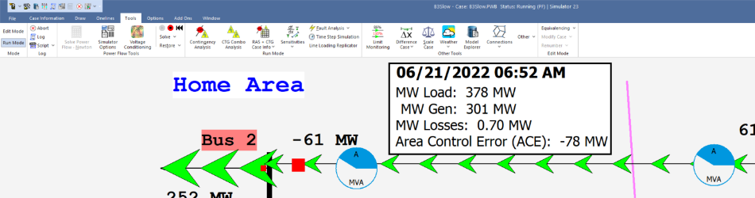
Resetting the Simulation
The B3Slow simulation runs at 60 times real-time (one minute per second) and goes for 4 hours of simulation time. At any point it can be paused by clicking on the red button or reset using the reset button
9

Slide 11
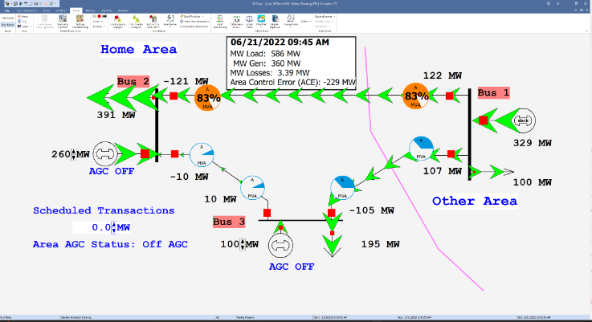
Indirect Line Flow Control By Changing Generation
The flow on the transmission lines can be indirectly controlled by changing the power output of the generators; click on the arrows next to the Bus 2 and Bus 3 generator to change their outputs
10

Slide 12
Transmission Line Limits
Power flow in transmission line is limited by heating considerations
Losses (I² R) can heat up the line, causing it to sag
Each line has a set of limits; many utilities use winter/summer limits and normal/emergency limits (there are other limits we’ll consider later)
11

Slide 13
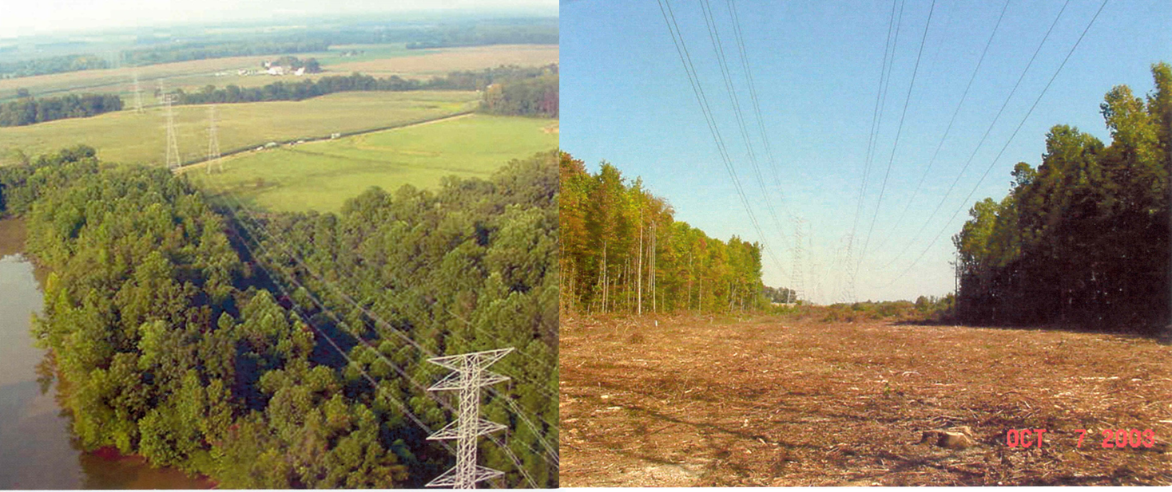
Transmission Lines and Trees
We like trees, and they grow; but when trees get close to lines bad things can occur
After “Trimming”
Before “Trimming”
12

Slide 14
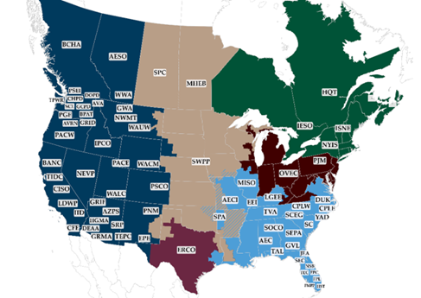
Interconnected Operations
Power systems are interconnected, with North America having the previously mentioned four large interconnects
Interconnects are divided into smaller portions, called balancing authority areas (previously called control areas); the power flow between these areas is controlled by a process known as automatic generation control
ERCOT is just a single area
13

Slide 15
Area Control Error (ACE)
The area control error is the difference between the actual flow out of an area, and the scheduled flow
ACE also includes a frequency component that we will probably consider later in the semester
Ideally the ACE should always be zero
Because the load is constantly changing, each utility (or ISO) must constantly change its generation to “chase” the ACE
ACE was originally computed by utilities; increasingly it is computed by larger organizations such as ISOs
In the B3Slow simulation, to visualize the Home Area ACE right click on the Area Control Error field and select Show Strip Chart
14

Slide 16
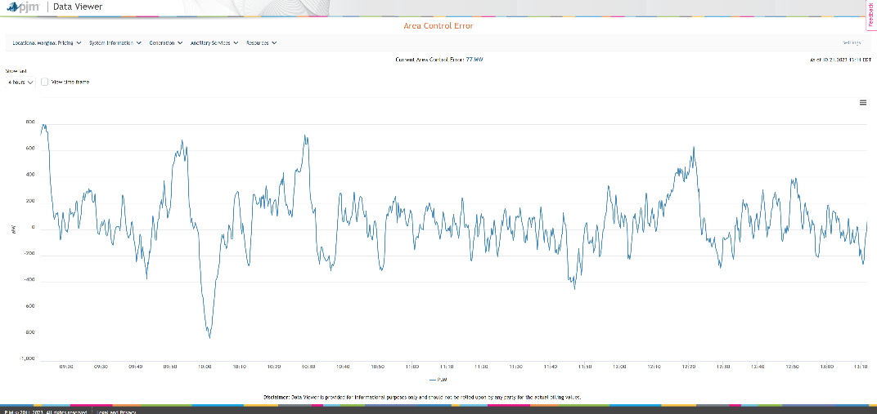
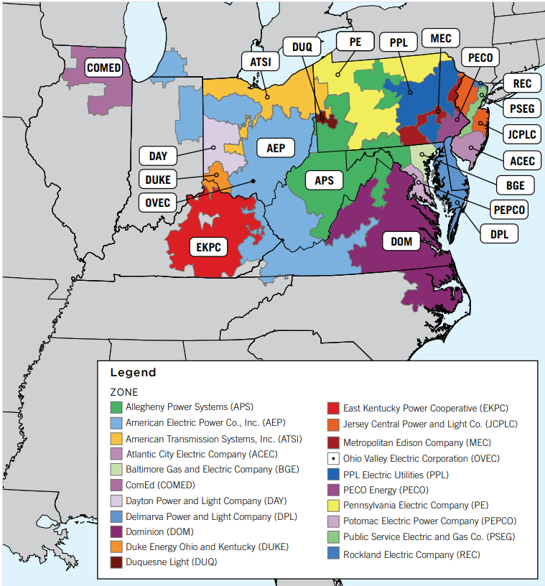
PJM Area Control Error on Oct 21, 2023
PJM Utility Map
15

Slide 17
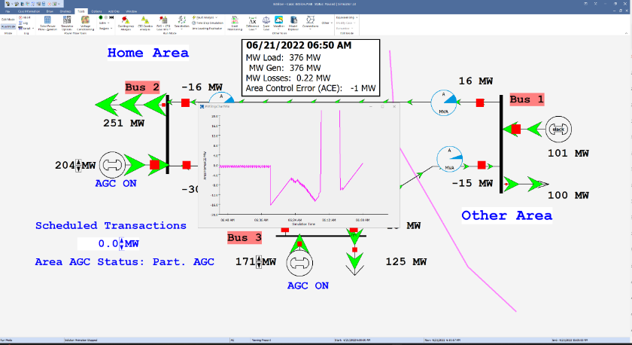
Three Bus Case Showing ACE Strip Chart
Net tie flow is
close to zero
Strip Chart
Generation is automatically changed to match change in load
16

Slide 18
Automatic Generation Control
In PowerWorld one way the ACE can be changed by manually varying the generation in the area, for example increasing it as the load increases
Most utilities (ISOs) use automatic generation control (AGC) to automatically change their generation to keep their ACE close to zero.
Usually the control center calculates ACE based upon tie-line flows; then the AGC module sends control signals out to the generators every couple seconds.
17

Slide 19
Generator Costs
There are many fixed and variable costs associated with power system operation
The major variable cost is associated with generation.
Cost to generate a MWh can vary widely
For some types of units (such as hydro and nuclear) it is difficult to quantify
More others such as wind and solar the marginal cost of energy is essentially zero (actually negative for wind!)
For thermal units it is straightforward to determine
Many markets have moved from cost-based to price-based generator costs
18

Slide 20
Economic Dispatch
Economic dispatch (ED) determines the least cost dispatch of generation for an area.
For a lossless system, the ED occurs when all the generators have equal marginal costs. IC₁(P_{G,1}) = IC₂(P_{G,2}) = … = IC_{m}(P_{G,m})
19

Slide 21
Power Transactions
Power transactions are contracts between areas to transfer power
Contracts can be for any amount of time at any price for any amount of power
Scheduled power transactions are implemented by modifying the area ACE: ACE = P_{actual,tie-flow} - P_{sched}
20

Slide 22
100 MW Transaction
Net tie-line
flow is now
100 MW
Scheduled 100 MW transaction from the Home Area to the Other Area
21

Slide 23
Security Constrained ED
Transmission constraints often limit system economic operation.
Such limits required a constrained dispatch in order to maintain system security.
In the three bus case the generation at bus 3 must be constrained to avoid overloading the line from bus 2 to bus 3.
22

Slide 24
Security Constrained Dispatch
Dispatch is no longer optimal due to need to keep the line
from bus 2 to bus 3 from overloading
23

Slide 25
Multi-Area Operation
If areas have direct interconnections then they may directly transact, up to the capacity of their tie-lines.
Actual power flows through the entire network according to the impedance of the transmission lines.
Flow through other areas is known as “parallel path” or “loop flow.”
24

Slide 26
Seven Bus Case: One-line
Area Top
has five
buses
System has three areas
Area Left
has one
bus
Area Right has one bus
PowerWorld Case: B7Flat
25

Slide 27
Seven Bus Case: Area View
Actual
flow
between
areas
System has
40 MW of
“Loop Flow”
Scheduled
flow
26

Slide 28
Seven Bus - Loop Flow?
Transaction has actually decreased
the loop flow
Note that
Top’s
losses have
increased
from
7.1 MW to
9.6 MW
100 MW Transaction
between Left and Right
27

Slide 29
Reactive Power
Reactive (or imaginary) power doesn’t really exist, but is rather only defined mathematically. However, power system analysis is much simpler if we think of it as existing
Hence it is thought of as similar to real power; it is supplied by
generators, capacitors, transmission lines
Reactive power is consumed by
loads
transmission lines/transformers (high losses)
Reactive power doesn’t travel well - must be supplied locally.
Reactive must satisfy Kirchhoff’s law - total reactive power into a bus MUST be zero.
28

Slide 30
Voltage Magnitude
Power systems must supply electric power within a narrow voltage range, typically with 5% of a nominal value.
For example, wall outlet should supply 120 volts, with an acceptable range from 114 to 126 volts.
Voltage regulation performed mostly by generators, LTC transformers and capacitors
Reactive power and voltage magnitude are quite closely coupled; this is illustrated using the case Bus5
29

Slide 31
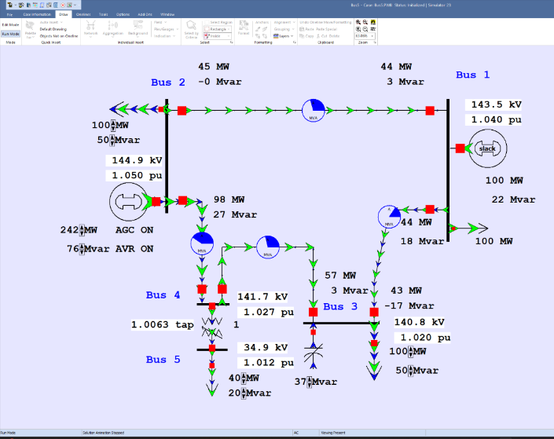
Bus 5 Case Illustrating Reactive Power and Voltage
Voltage magnitude in actual kV and per unit
Reactive power supplied by generator
LTC transformer controlling voltage
Voltage magnitude controlled by capacitor
30

Slide 32
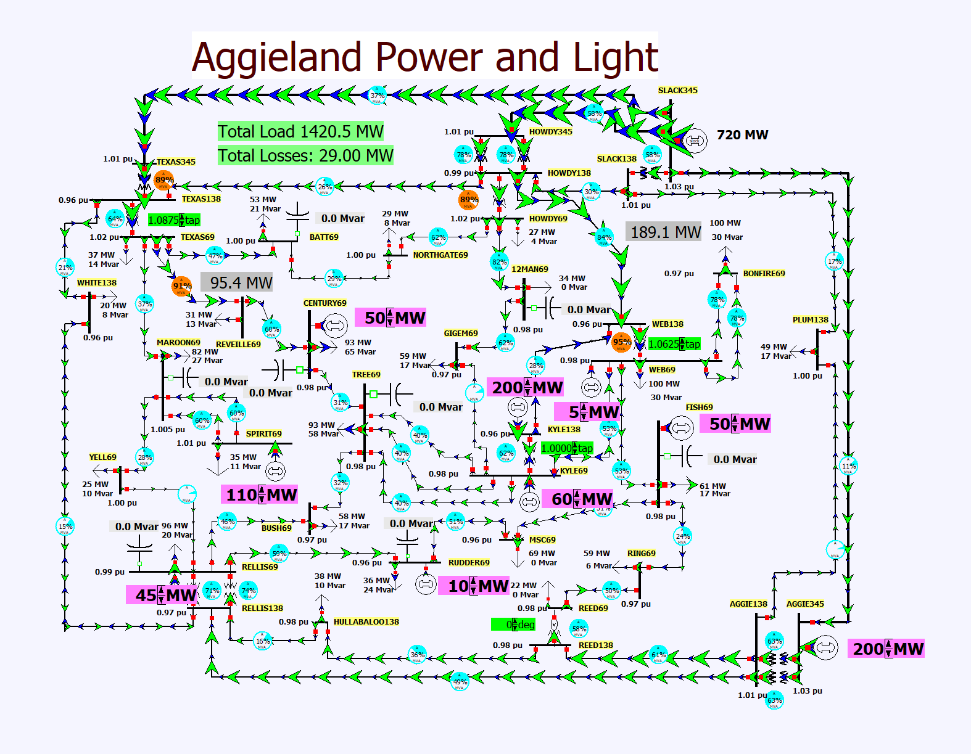
37-Bus Grid
This is the smaller Lab 2 case, before the initial contingency
31

Slide 33
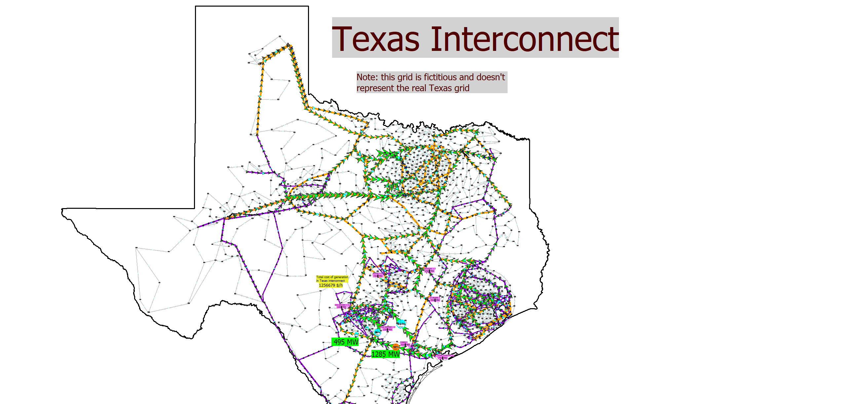
2000-Bus Case
This is the larger Lab 2 case before the initial contingency
32

