Slide 1
ECEN 460 Power System Operation and Control Spring 2025
Lecture 5: Transmission Line and Transformer Models
Prof. Tom Overbye
Dept. of Electrical and Computer Engineering
Texas A&M University
overbye@tamu.edu

Slide 2
Announcements
Please read Chapters 3.3 (per unit); skim the rest of Chapter 3, and Chapters 4 and 5
In 460 we will be using the models developed in these chapters, but not deriving them since that is covered in 459
By Feb 5 do book probs. 3.14, 3.19, 3.28, 4.18, 4.23, 4.39, 5.1, 5.12 (does not need to be turned in)
The procedure for getting PowerWorld Simulator is now in Canvas
1

Slide 3
Power System Models, Cases and Islands
Before moving forward it is helpful to clarify a three terms that commonly come up related to power flow
In an engineering context the term “model”, as defined by Merriam-Webster is, “A system of postulates, data, and inferences presented as a mathematical description of an entity or state of affairs.”
Models for the same devices can vary in complexity, and (as noted by George Box), “All models are wrong but some models are useful.”
For example models for a resistor are V = R₀I or V = R₀(1 + 0.004*(T – T₀)) I
The values of the parameters (e.g. R₀ and T₀) then denote a particular model instance
In power flow the term model if often used more generically to indicate a particular electric grid with the associated parameters for the more static electric grid components (e.g., the transmission lines and transformers)
2

Slide 4
Power System Models, Cases and Islands, cont.
The term “case” is usually used to a particular electric grid operating point including all values needed to solve the power flow
There is a fuzzy line between what is relatively constant (e.g., the impedance of a transformer) and what commonly changes (e.g., the amount of bus load, whether a particular transmission line is in-service)
The term “base case” is often used to refer a starting case that is used for additional studies, such as with contingency analysis
The term “island” refers to a set of ac-interconnected buses.
A small power flow case usually has just a single island, though they can certainly have multiple islands.
The number of islands can change as a result of topology changes
Large electric grid cases often have multiple islands; islands often connected via HVDC.
3

Slide 5
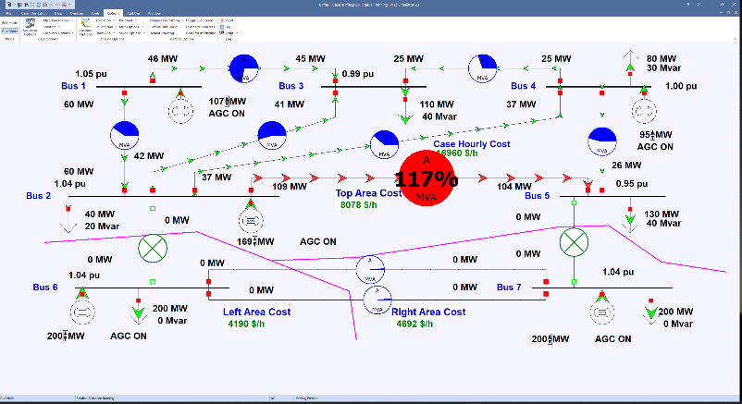
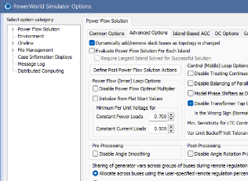
B7Flat Case Divided into Two Islands
When the two tielines joining Area Top to Areas Left and Right are opened, the grid becomes two electrical islands
Allowing new islands might require setting an option
4

Slide 6
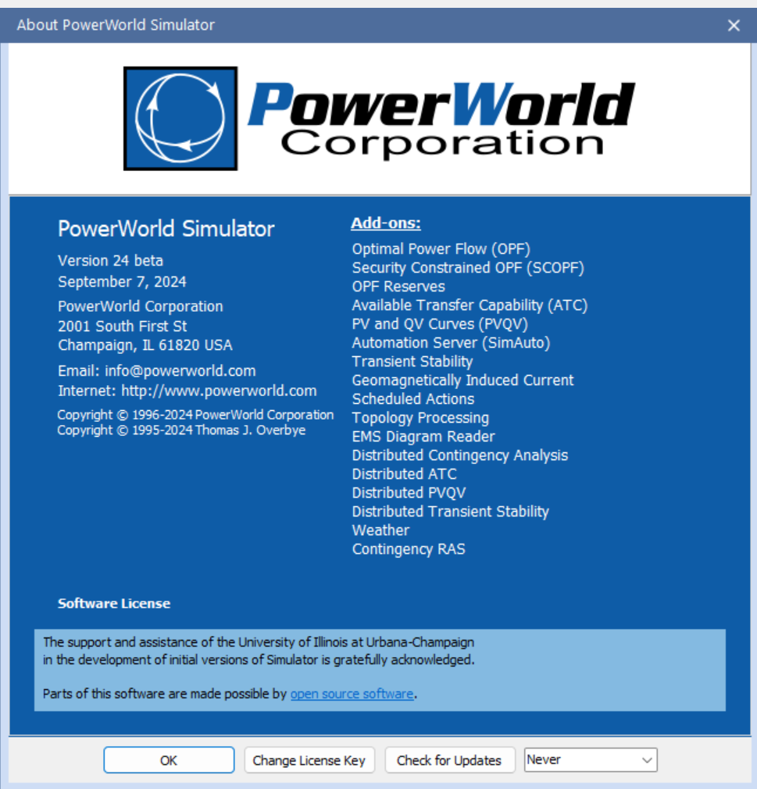
PowerWorld Version, Build Date and Add-Ons
Open PowerWorld Simulator; to see your version and build date select Window, About
Simulator stores information about the power system in *.pwb files and information about the onelines in *.pwd files
PowerWorld Simulator has the ability to read and write current and previous versions of its *.pwb and *.pwd files, but cannot read future versions
5

Slide 7
Development of Line and Transformer Models
Goal of next few lectures is to introduce the models we’ll be using in later parts of the class for power flow and transient stability analysis
More detailed coverage of some models is in ECEN 459
Primary Methods for Long Distance Electric Power Transfer
overhead ac
underground ac
overhead dc
underground dc
other
6

Slide 8
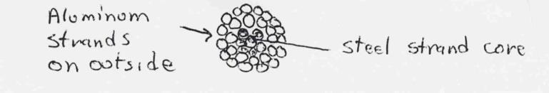
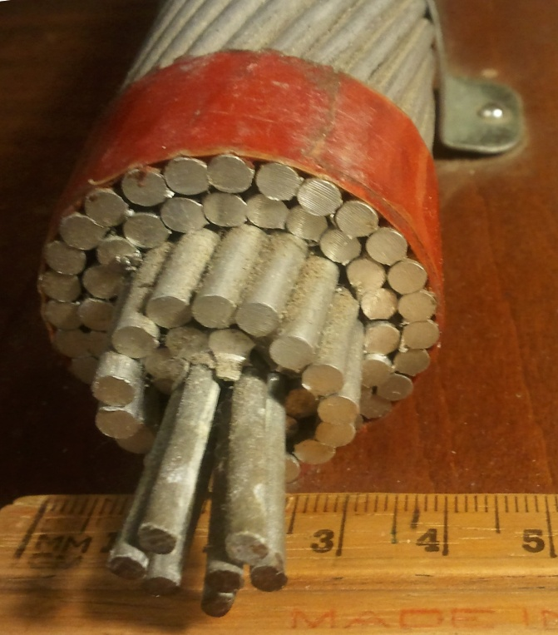
Line Conductors
Typical transmission lines use multi-strand conductors
ACSR (aluminum conductor steel reinforced) conductors are most common. A typical Al. to St. ratio is about 4 to 1.
AAC (all aluminum conductors) are lighter but have less strength; used in urban areas with shorter spans
Copper is heavier, but has better conductance; used in cables where weight is not an issue
Image source: wikipedia
7

Slide 9
Line Conductors, cont’d
Total conductor area is given in circular mils. One circular mil is the area of a circle with a diameter of 0.001 = π × 0.0005² square inches
Example: what is the the area of a solid, 1” diameter circular wire? Answer: 1000 kcmil (kilo circular mils)
Because conductors are stranded, the equivalent radius must be provided by the manufacturer. In tables this value is known as the GMR and is usually expressed in feet.
8

Slide 10
Line Resistance
9

Slide 11
Line Resistance, cont’d
Because ac current tends to flow towards the surface of a conductor, the resistance of a line at 60 Hz is slightly higher than at dc.
Resistivity and hence line resistance increase linearly as conductor temperature increases (changes is about 0.4% per degree C)
In some locations conductor temperatures can vary by up to 100° C!
Because ACSR conductors are stranded, actual resistance, inductance and capacitance needs to be determined from tables.
10

Slide 12
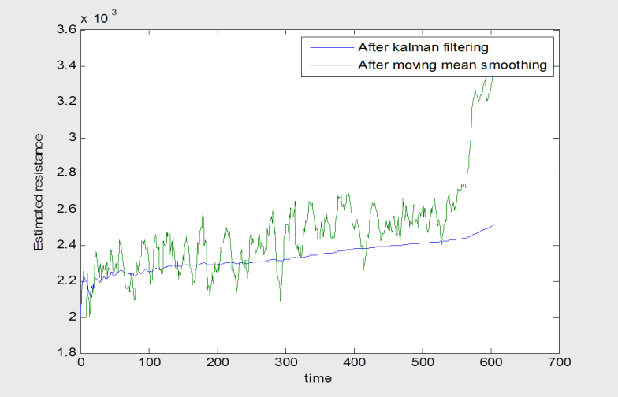
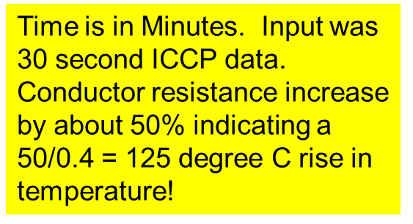
Variation in Line Resistance Example
11

Slide 13
Magnetics Review
Ampere’s circuital law:
H is a vector
12

Slide 14
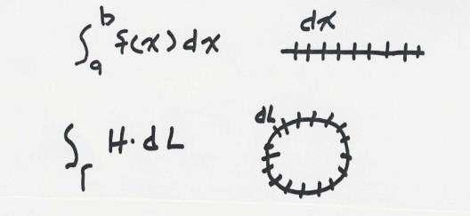
Line Integrals
Line integrals are a generalization of traditional integration
Integration along the x-axis
Integration along a general path, which
may be closed
Ampere’s law is most useful in cases of symmetry, such as with an infinitely long line
13

Slide 15
Magnetic Flux Density
Magnetic fields are usually measured in terms of flux density
B is also a vector
14

Slide 16
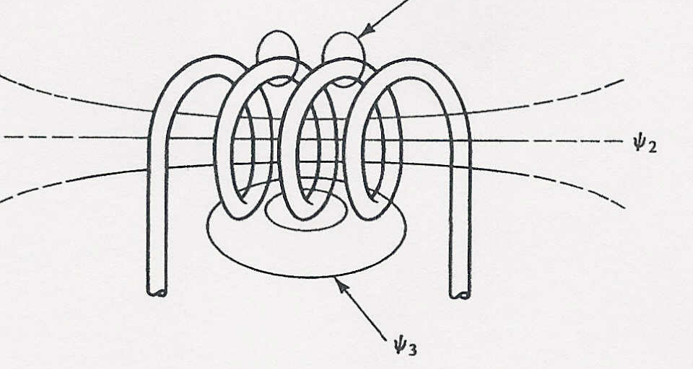
Flux Linkages, Faraday’s Law and Inductance
Flux linkages are defined from Faraday’s law
The flux linkages tell how much flux is linking an N turn coil
For a linear magnetic system (where B = μ H) then inductance, L, is defined at λ = L I
L has units of Henrys (H)
If all flux links every coil then λ = N φ
If there is a single wire then λ = φ

Slide 17
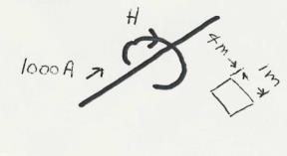
Magnetic Fields from Single Wire
Assume we have an infinitely long wire with current of 1000A. How much magnetic flux passes through a 1 meter square, located between 4 and 5 meters from the wire?
Direction of H is given by the “Right-hand” Rule
Easiest way to solve the problem is to take advantage of symmetry. For an integration path we’ll choose a circle with a radius of x.
16

Slide 18
Single Wire Example, cont’d
As x increases the total flux goes to infinity
Units of x are meters; for reference, the earth’s magnetic field is about 0.6 Gauss (Central US)

Slide 19
Two Conductor Line Inductance
Key problem with the previous derivation is we assumed no return path for the current. Now consider the case of two wires, each carrying the same current I, but in opposite directions; assume the wires are separated by distance R.
To determine the inductance of each
conductor we integrate as before; however, now we get some field cancellation
R
We also need to consider what occurs inside the wire
Creates counter-
clockwise field
Creates a
clockwise field
18

Slide 20
Two Conductor Case, cont’d
R
R
Rp
Direction of integration
Key Point: As we integrate for the left line, at distance 2R from the left line the net flux linked due to the Right line is zero! Use superposition to get total flux linkage.
Left Current
Right Current
19

Slide 21
Flux Linkages Inside the Wire
Current inside a conductor tends to travel on the outside due to the skin effect; the penetration of current into a conductor is approximated using the skin depth
Assuming uniform current density the flux linkage inside a wire is
For a nonmagnetic wire (μ_{r}=1) this accounted for in the formula by using r′ ≈ 0.78 r
For copper at 60 Hz the skin depth is about 0.33 inches
x
r
20

Slide 22
Two Conductor Inductance
21

Slide 23
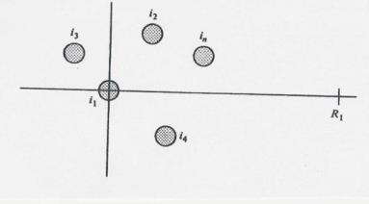
Many-Conductor Case
Now assume we now have k conductors, each with current i_{k}, arranged in some specified geometry. We’d like to find flux linkages of each conductor.
Each conductor’s flux linkage, λ_{k}, depends upon its own current and the current in all the other
conductors.
To derive λ₁ we’ll be integrating from conductor 1 (at origin)
to the right along the x-axis.
22

Slide 24
Many-Conductor Case, cont’d
23

Slide 25
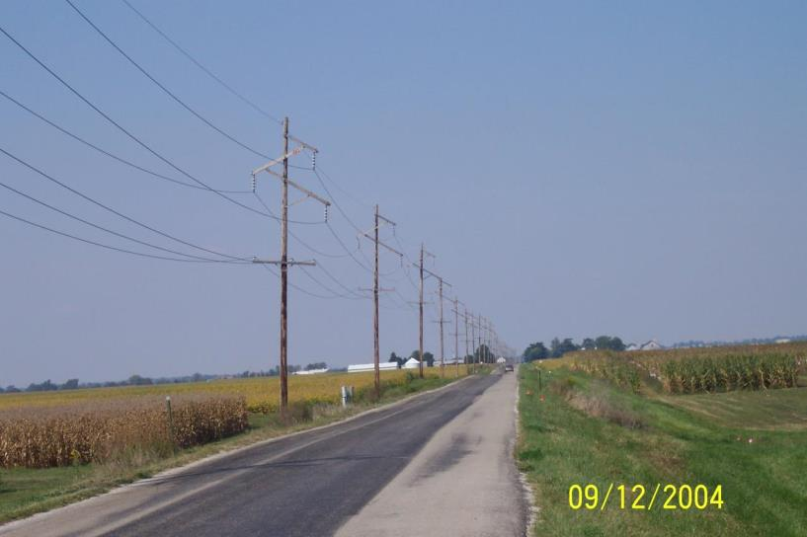
Symmetric Line Spacing – 69 kV
24

Slide 26
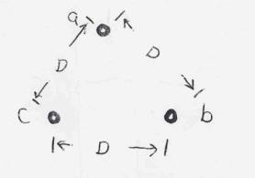
Line Inductance Example
Calculate the reactance for a balanced 3φ, 60Hz transmission line with a conductor geometry of an equilateral triangle with D = 5m, r = 1.24 cm (Rook conductor) and a length of 5 miles.
25

Slide 27
Line Inductance Example, cont’d
This is the equation we need for ECEN 460 (almost!)
26

Slide 28
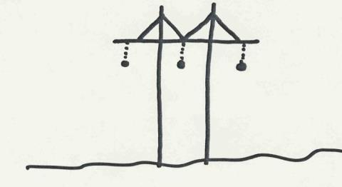
Transmission Tower Configurations
The problem with the line analysis we’ve done so far is we have assumed a symmetrical tower configuration. Such a tower figuration is seldom practical.
Therefore in general D_{ab} ≠ D_{ac} ≠ D_{bc}
Unless something was done this would result in unbalanced phases
Typical Transmission Tower
Configuration
27

Slide 29
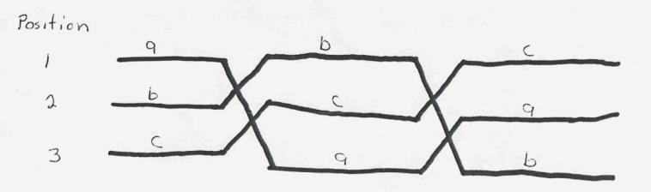
Transposition
To keep system balanced, over the length of a transmission line the conductors are rotated so each phase occupies each position on tower for an equal distance. This is known as transposition.
Aerial or side view of conductor positions over the length of the transmission line.
28

Slide 30
Inductance of Transposed Line
This is the equation we need for ECEN 460 (almost!)
29

Slide 31
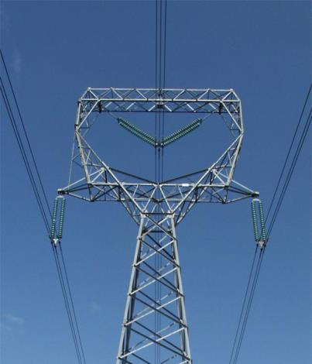
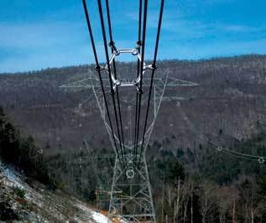
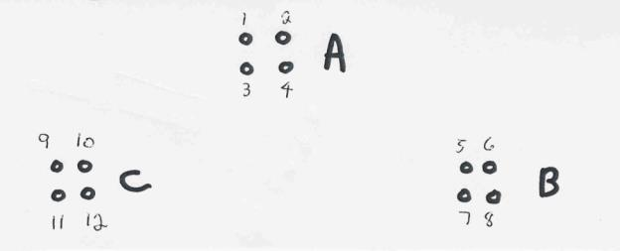
Conductor Bundling
To increase the capacity of high voltage transmission lines it is very common to use a number of conductors per phase. This is known as conductor bundling. Typical values are two conductors for 345 kV lines, three for 500 kV and four for 765 kV.
Conductors in the bundle have the same voltage
Photo Sources: BPA (three conductor 500 kV bundling) and American Electric Power (six conductor 765 kV)
30

Slide 32
Inductance of Lines with Bundled Conductors
The per phase inductance is
When calculating the per phase resistance of bundled lines, the total resistance is R per conductor divided by b, where b is the number of conductors in the bundle
This is the equation we need for ECEN 460
31

Slide 33
Bundled Conductor Inductance Example
Consider the previous example of the three phases symmetrically spaced 5 meters apart using wire with a radius of r = 1.24 cm. Except now assume each phase has 4 conductors in a square bundle, spaced 0.25 meters apart. What is the new inductance per meter?
0.25 M
0.25 M
0.25 M
32

Slide 34
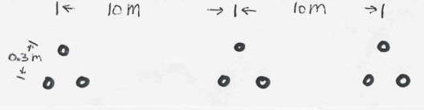
Second Inductance Example
Calculate the per phase inductance and reactance of a balanced 3φ, 60 Hz, line with horizontal phase spacing of 10m using three conductor bundling with a spacing between conductors in the bundle of 0.3m. Assume the line is uniformly transposed and the conductors have a 1cm radius.
Answer: D_{m} = 12.6 m, R_{b}= 0.0889 m Inductance = 9.9 x 10⁻⁷ H/m, Reactance = 0.6 Ω/Mile
33

Slide 35
Line Capacitance
High voltage transmission lines and cables can have significant capacitance; capacitance increases as the lines get closer (e.g., in cables)
For the case of uniformly transposed lines we use the same Dm and a similar GMR as with inductance
This is the equation we need for ECEN 460; if interested, see the book for the derivation
34

Slide 36
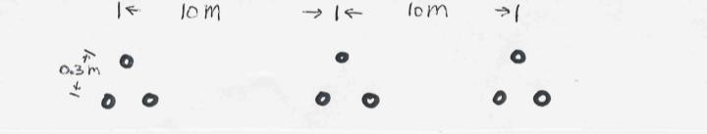
Line Capacitance Example
Calculate the per phase capacitance and susceptance of a balanced 3φ, 60 Hz, transmission line with horizontal phase spacing of 10m using three conductor bundling with a spacing between conductors in the bundle of 0.3m. Assume the line is uniformly transposed and the conductors have a a 1cm radius.
35

Slide 37
Line Capacitance Example, cont’d
36

Slide 38
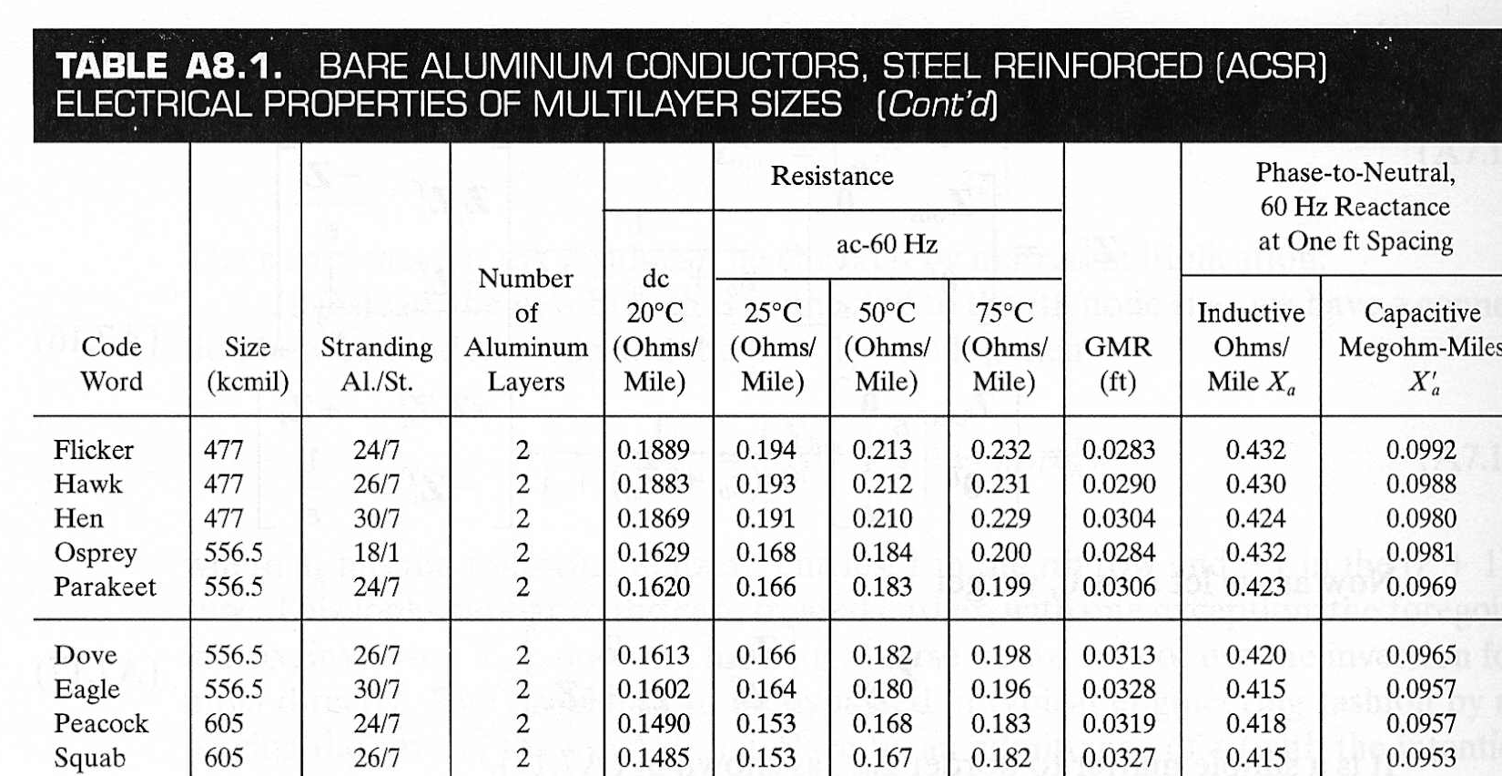
ACSR Table Data (Similar to Table A.4)
Inductance and Capacitance assume a Dm of 1 ft.
GMR is equivalent to r'
37

Slide 39
Dove Example
38

Slide 40
Additional Transmission Topics
Multi-circuit lines: Multiple lines often share a common transmission right-of-way. This does cause mutual inductance and capacitance, but is often ignored in system analysis.
Cables: There are about 3000 miles of underground ac cables in U.S (out of a total of about 500,000 miles (100 kV and above). Cables are primarily used in urban areas. In a cable the conductors are tightly spaced, (< 1ft) with oil impregnated paper commonly used to provide insulation
inductance is lower
capacitance is higher, grealy limiting cable length
Total miles source is North American Reliability Corporation (NERC), 2024 State of Reliability, June 2024
39

Slide 41
Additional Transmission Topics
Ground wires: Transmission lines are usually protected from lightning strikes with a ground wire. This topmost wire (or wires) helps to attenuate the transient voltages/currents that arise during a lighting strike. The ground wire is typically grounded at each pole.
Corona discharge: Due to high electric fields around lines, the air molecules become ionized. This causes a crackling sound and may cause the line to glow!
Shunt conductance: Usually ignored. A small current may flow through contaminants on insulators.
40

Slide 42
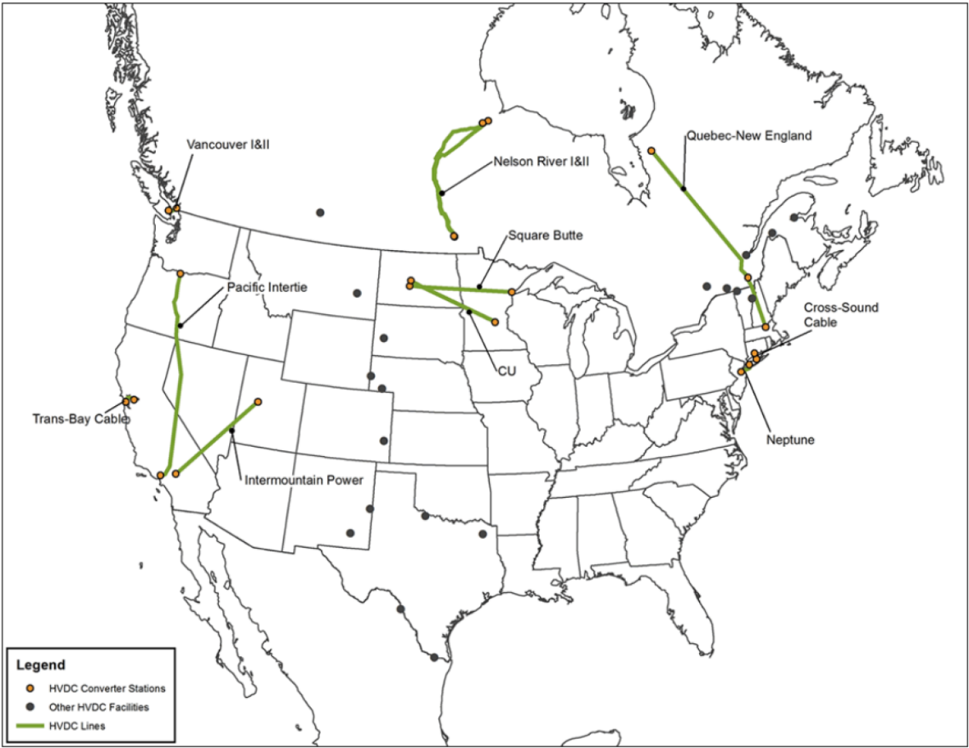
Additional Transmission Topics
DC Transmission: Because of the large fixed cost necessary to convert ac to dc and then back to ac, dc transmission is only practical for several specialized applications
long distance overhead power transfer (> 400 miles)
long cable power transfer such as underwater
providing an asynchronous means of joining different power systems (such as ERCOT to Eastern or Western grids)
ERCOT currently has two HVDC interconnections with the EI (820 MW total) and two with Mexico (400 MW)
Image source (September 2023): www.energy.gov/oe/articles/connecting-country-hvdc
41

Slide 43
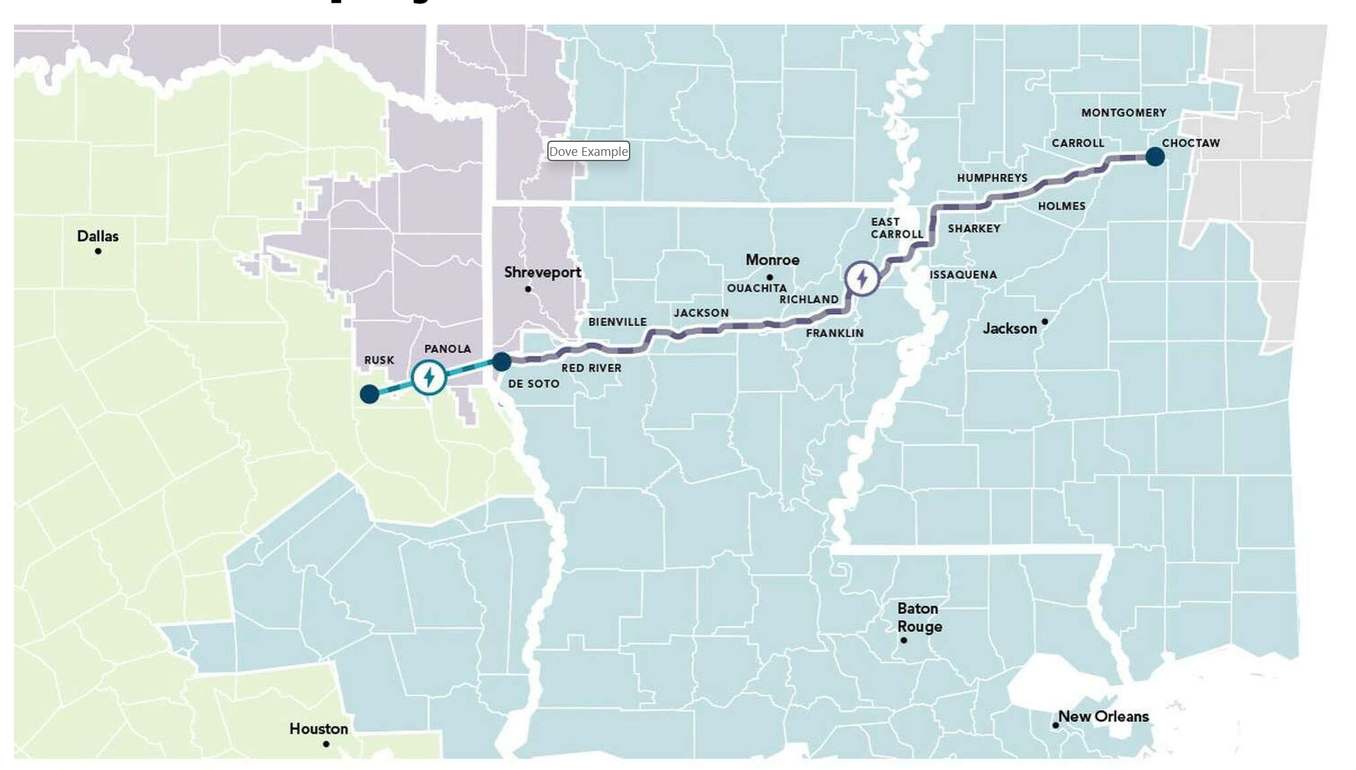
In the News: Southern Spirit HVDC
There are plans to build a 3000 MW, 320 mile long HVDC transmission line (operating at about 500 kV) to transfer power between Texas [ERCOT] and Mississippi)
This would more than triple the amount of transfer capacity between ERCOT and the Eastern Interconnect (EI)
Such an HVDC line has been in the works for more than a decade; the current target is to begin construction by 2028
www.houstonchronicle.com/projects/2025/southern-spirit-transmission-line-texas/ (Claire Hao, Jan 2025)
42

Slide 44
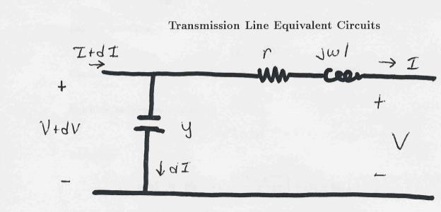
Transmission Line Models: An Equivalent Circuit
Our current model of a transmission line is shown below
Units on z and y are
per unit length
43

Slide 45
Propagation Constant, Characteristic and Surge Impedance
44

Slide 46
Lossless Transmission Lines
45

