Slide 1
ECEN 460
Power System Operation and Control
Spring 2025
Lecture 6: Transmission Lines, Transformers, Per Unit
Prof. Tom Overbye
Dept. of Electrical and Computer Engineering
Texas A&M University
overbye@tamu.edu

Slide 2
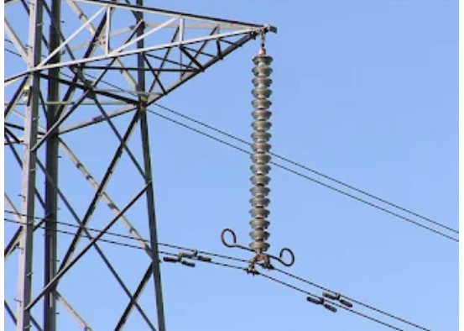
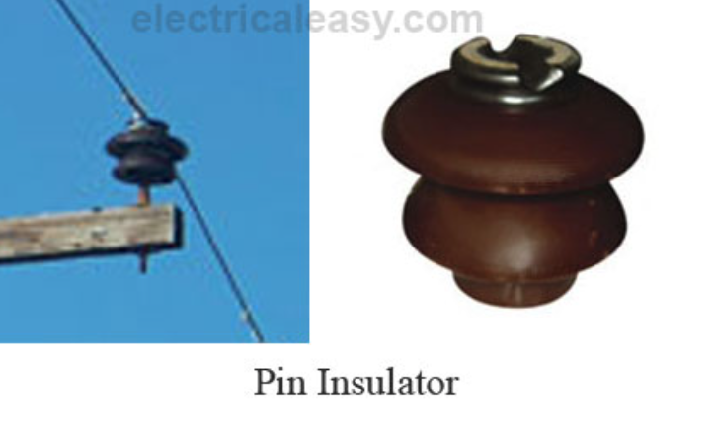
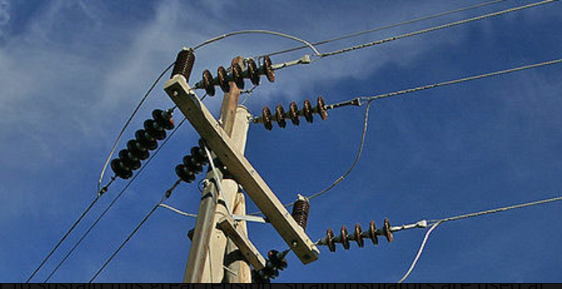
Transmission Line Insulators
The overhead transmission distribution lines are bare conductors, so they need to be connected to the grounded towers using insulators
Different types of insulators are used depending
on the application. Examples include
  Pin insulators for low voltage
  (up to 33 kV) applications
  Suspension insulators, which
  have a number of porcelain
  disks connected together, with
  each having about 11 kV of insulation
  Strain insulators, which are designed for corners, in which
  they have to handle the line strain; they are an assembly of
  suspension insulators
Suspension and strain insulators
Image source: www.electricaleasy.com/2016/10/insulators-used-in-overhead-power-lines.html
1

Slide 3
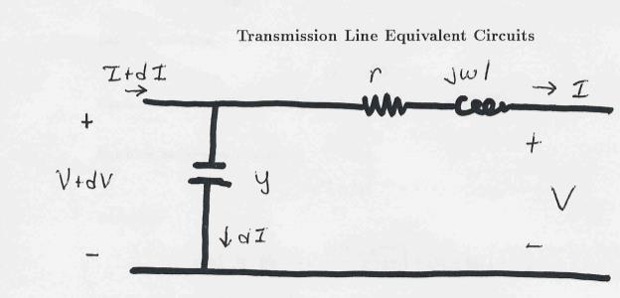
Transmission Line Models: An Equivalent Circuit
Our current model of a transmission line is shown below
Units on z and y are
per unit length
2

Slide 4
Propagation Constant, Characteristic and Surge Impedance
3

Slide 5
Lossless Transmission Lines
4

Slide 6
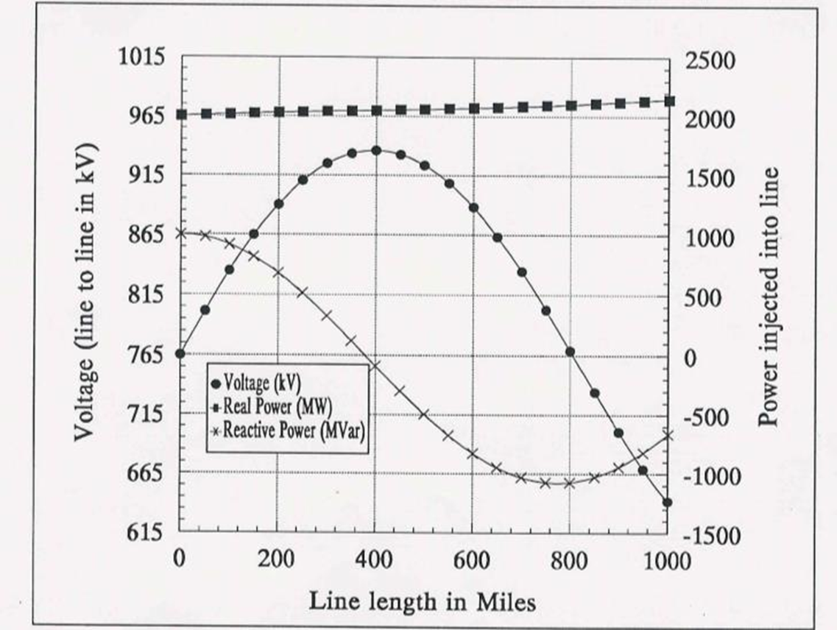
Lossless Transmission Lines
Derived in Chapter 5,
but this derivation
is not part of ECEN 460
If P > SIL then line consumes
vars; otherwise line generates vars.
5

Slide 7
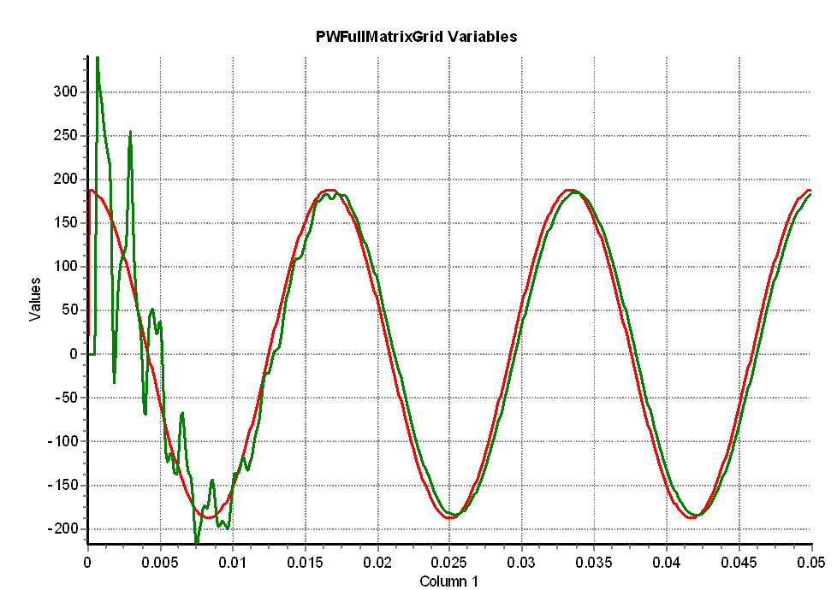
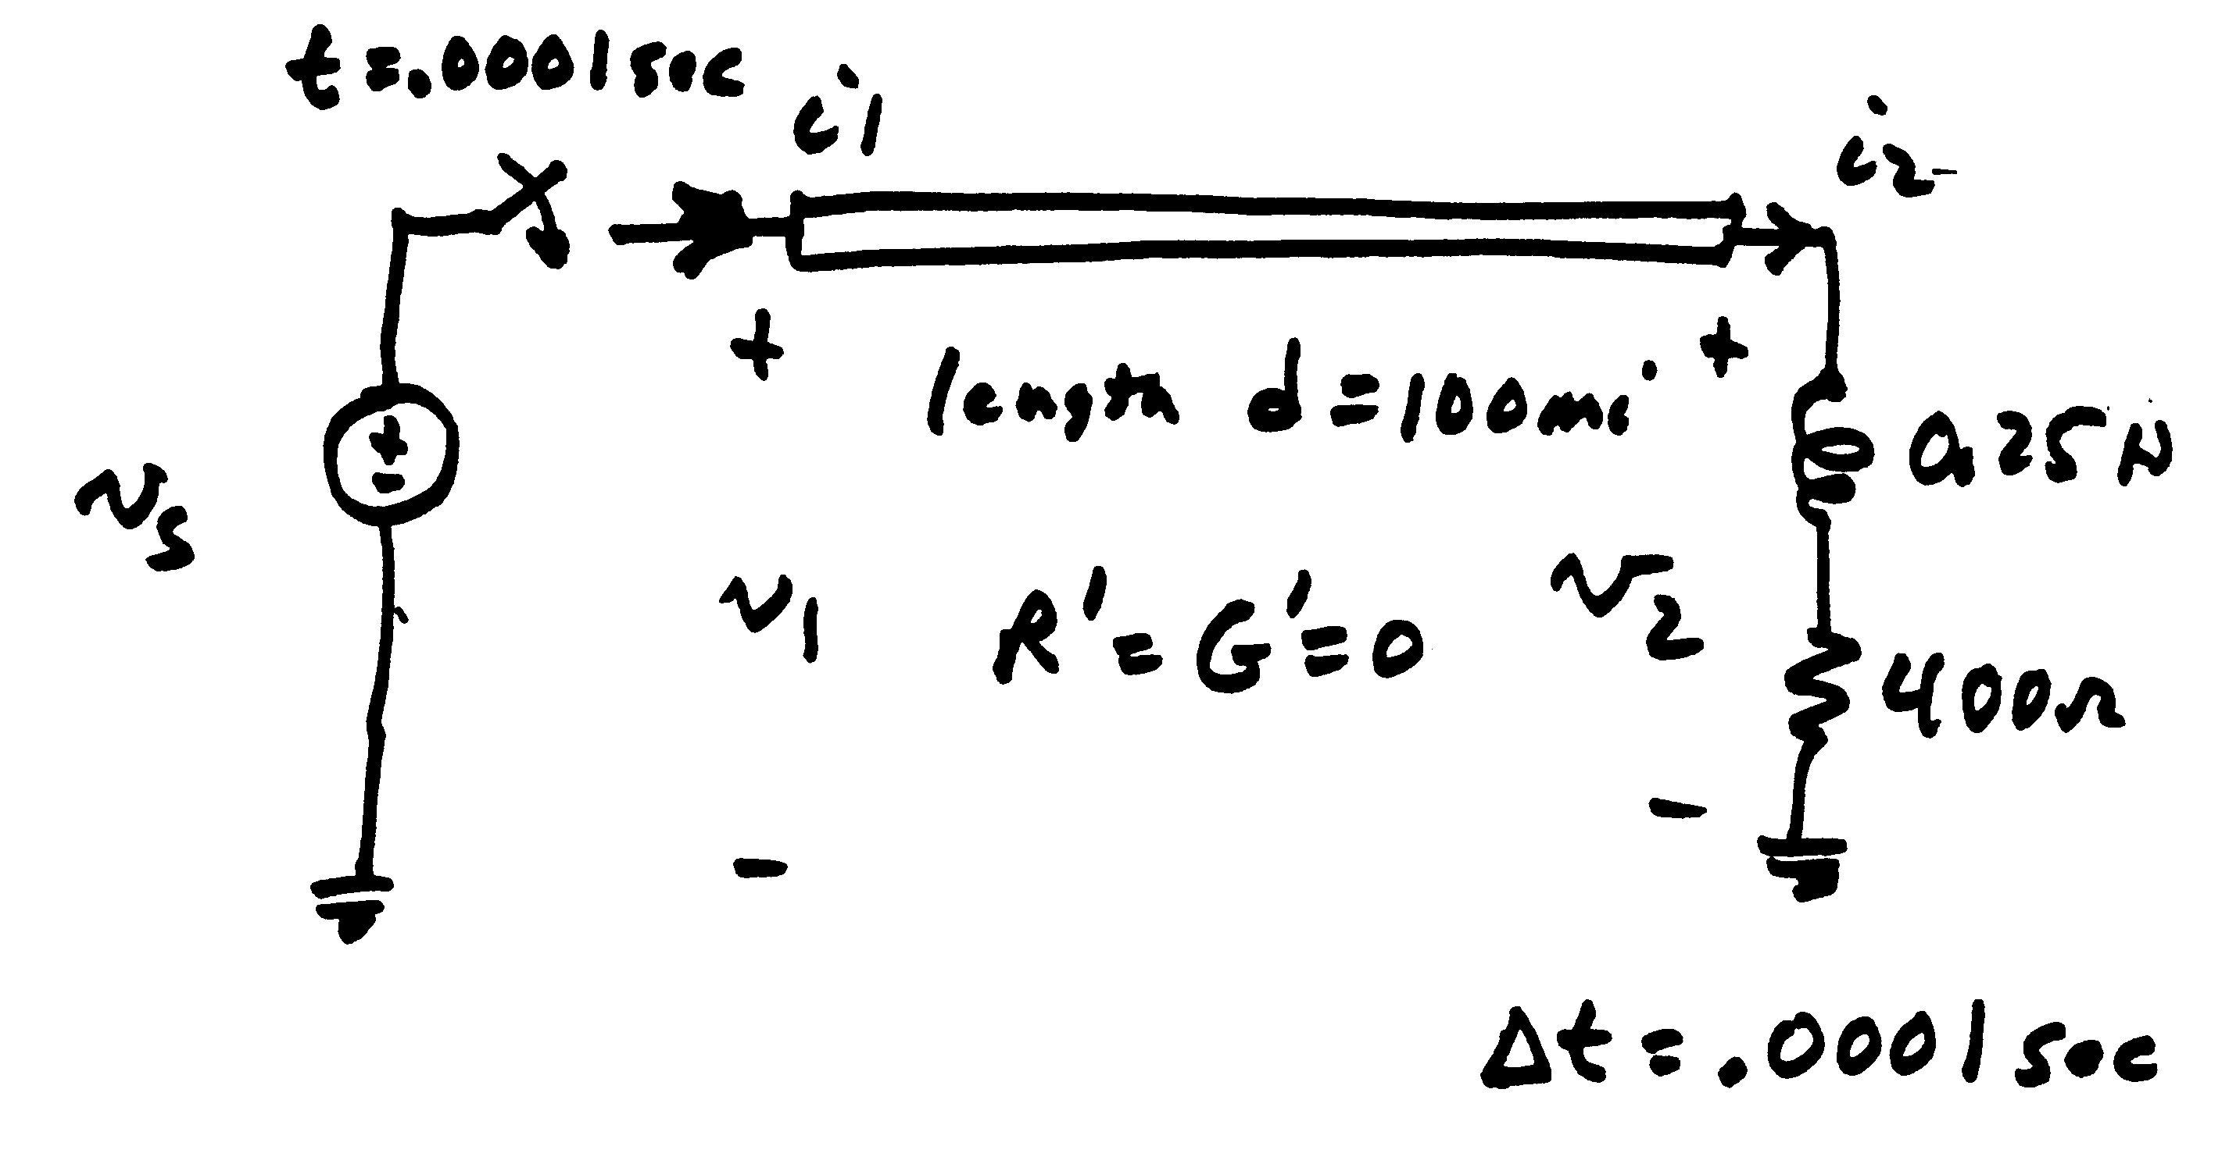
Velocity of Propagation in a Lossless line
Switching dynamics (outside of 460, more 616)
Velocity of propagation is close to the speed of light, but slightly less
6

Slide 8
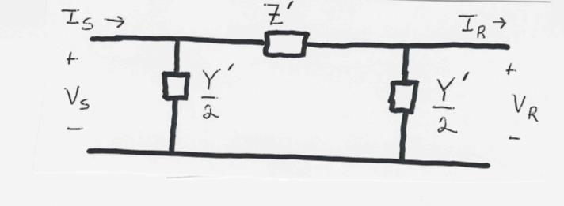
Equivalent Circuit Model
Next, we’ll quickly cover simplified ways to determine the parameters Z' and Y'
7

Slide 9
Simplified Parameters
8

Slide 10
Simplified Parameters, cont.

Slide 11
Three Line Models
Once the parameters have been derived, the Long and Medium models are the same; on ECEN 460 we will almost exclusively be using the Medium Line Model
10

Slide 12
Power Transfer in Short Lines
Often we'd like to know the maximum power that could be transferred through a short transmission line
I₁
I₁
+
Transmission
Line with
Impedance Z
+
V₁
S₁₂
S₂₁
V₂
-
-
11

Slide 13
Power Transfer in Lossless Lines
12

Slide 14
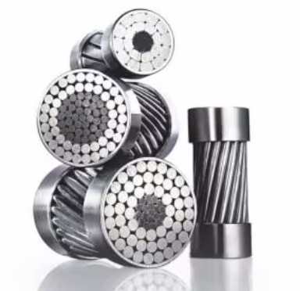
Limits Affecting Max. Power Transfer
Thermal limits
  limit is due to heating of conductor and hence depends heavily on ambient conditions.
  For many lines, sagging is the limiting constraint.
  Newer conductors limit can limit sag, carrying more current
  and hence increasing the ratings for existing lines (once they
  are reconductored)
    for example, 3M has ACCR (Aluminum Conductor Composite
    Reinforced) with the outer wires composed of a hardened aluminum-
    zirconium alloy, and the core having fiber-reinforced metal; they have
    half the thermal expansion and can operate continuously above 200° C!
    Higher currents and operating temperatures mean higher losses!
  Trees grow, and many will eventually hit lines if they are planted under the line.
Image source: www.3m.com/3M/en_US/p/d/b00014620/
13

Slide 15
Other Limits Affecting Power Transfer
Angle limits
  while the maximum power transfer occurs when line angle difference is 90 degrees, actual limit is substantially less due to multiple lines in the system
Voltage stability limits
  as power transfers increases, reactive losses increase as I²X. As reactive power increases the voltage falls, resulting in a potentially cascading voltage collapse.
In cables the higher charging capacitance, which increases with the length of the line, limits the amount of current that can be transferred through the line since some of the current is associated with the charging capacitance
  Cables can be very sensitive to overloads since it is more of a challenge to dissipate heat
14

Slide 16
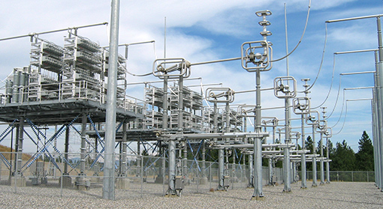
Transmission Line Series Compensation
One way to increase the transmission capacity of a transmission line that is limited by its reactance is to add series compensation
  Capacitors are placed in series with the transmission line
Subsynchronous oscillations can be a concern; the natural frequency of a series LC circuit is given below; in the right equation where f₀ is the system frequency
Image shows BPA series capacitors in a 500 kV line
Image: https://www.bpa.gov/news/newsroom/Pages/Chief-engineers-reunite-reminisce-for-BPAs-75th.aspx
15

Slide 17
Transformers Overview
Power systems are characterized by many different voltage levels, ranging from 765 kV down to 240/120 volts.
Transformers are used to transfer power between different voltage levels.
The ability to inexpensively change voltage levels is a key advantage of ac systems over dc systems.
In this section we’ll development models for the transformer and discuss various ways of connecting three phase transformers.
16

Slide 18
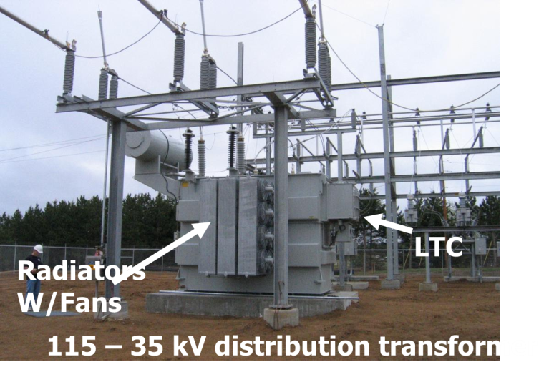
Transmission to Distribution Transformer
17

Slide 19
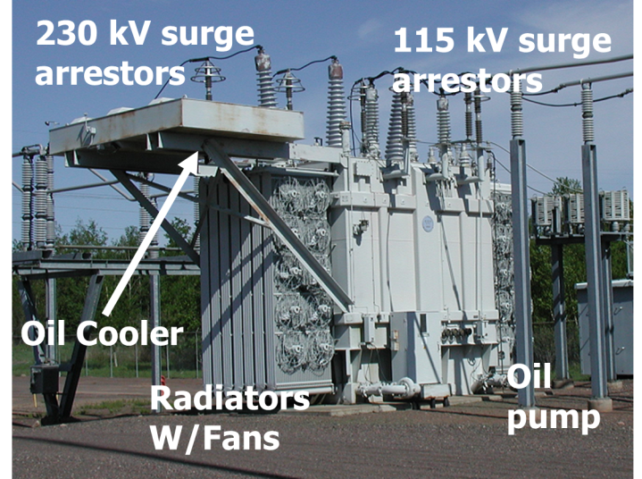
Transmission Level Transformer
18

Slide 20
Ideal Transformer
First we review the voltage/current relationships for an ideal transformer
  no real power losses
  magnetic core has infinite permeability
  no leakage flux
We’ll define the “primary” side of the transformer as the side that usually takes power, and the secondary as the side that usually delivers power.
  primary is usually the side with the higher voltage, but may be the low voltage side on a generator step-up transformer.
19

Slide 21
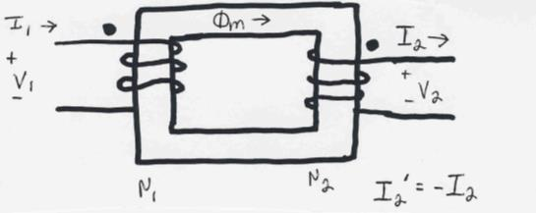
Ideal Transformer Relationships
20

Slide 22
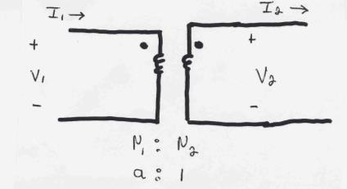
Current/Voltage Relationships
21

Slide 23
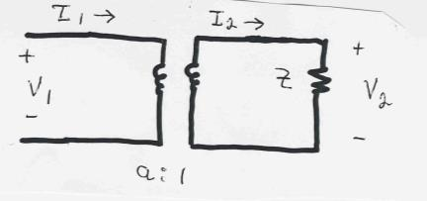
Impedance Transformation Example
Example: Calculate the primary voltage and current for an impedance load on the secondary
22

Slide 24
Real Transformers
Real transformers
  have losses
  have leakage flux
  have finite permeability of magnetic core
Real power losses
  resistance in windings (i² R)
  core losses due to eddy currents and hysteresis
23

Slide 25
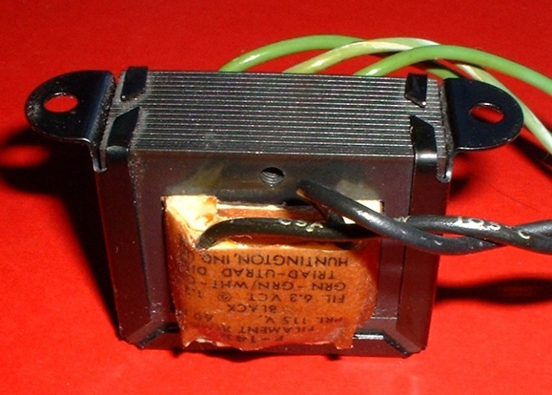
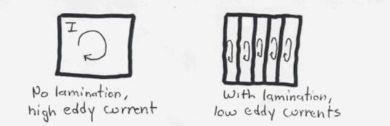
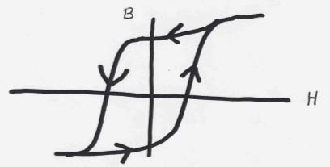
Transformer Core losses
Eddy currents arise because of changing flux in core.
Eddy currents are reduced by laminating the core
Hysteresis losses are proportional to area of
BH curve and the frequency
These losses are reduced by using material with a thin BH curve
24
Image: en.wikipedia.org/wiki/Transformer_types#/media/File:Transformer.filament.agr.jpg

Slide 26
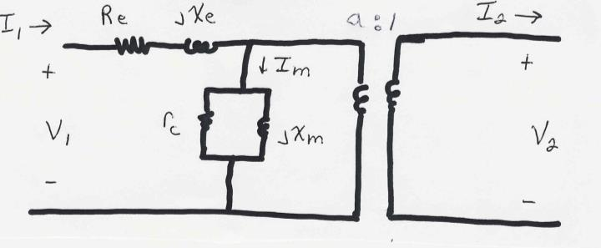
Simplified Equivalent Circuit
Often the shunt elements are assumed to have
such high impedance that they are ignored
25

Slide 27
Calculation of Model Parameters
The parameters of the model are determined based upon
  nameplate data: gives the rated voltages and power
  open circuit test: rated voltage is applied to primary with secondary open; measure the primary current and losses (the test may also be done applying the voltage to the secondary, calculating the values, then referring the values back to the primary side).
  short circuit test: with secondary shorted, apply voltage to primary to get rated current to flow; measure voltage and losses.
This topic is mostly outside the scope of ECEN 460, covered in ECEN 459

Slide 28
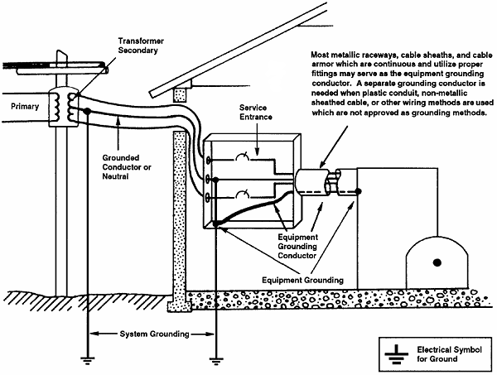
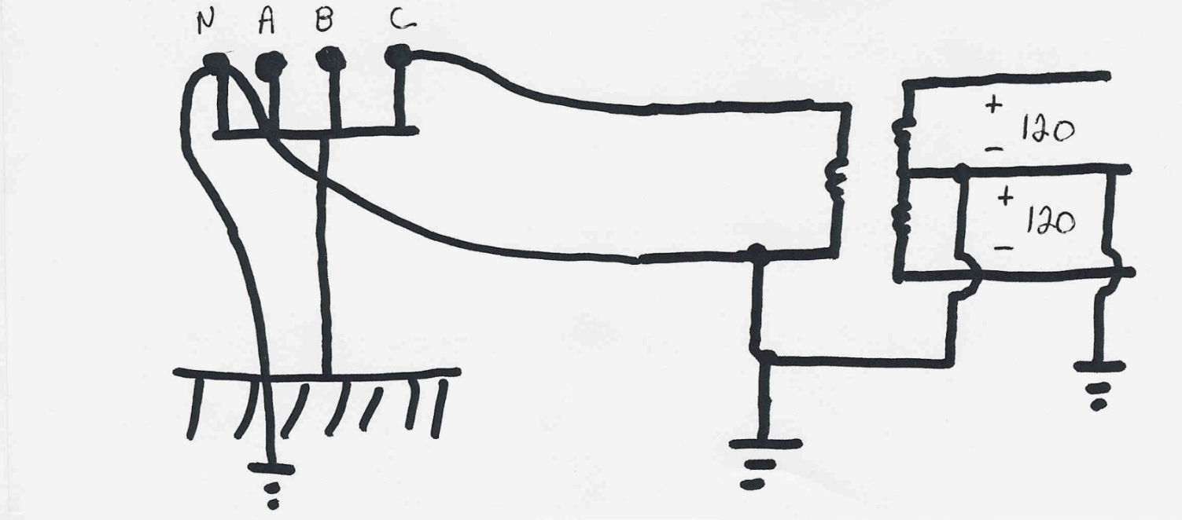
Residential Distribution Transformers
Single phase transformers are commonly used in residential distribution systems. Most distribution systems are 4 wire, with a multi-grounded, common neutral.
Image: www.osha.gov/dte/library/electrical/electrical_10.gif

Slide 29
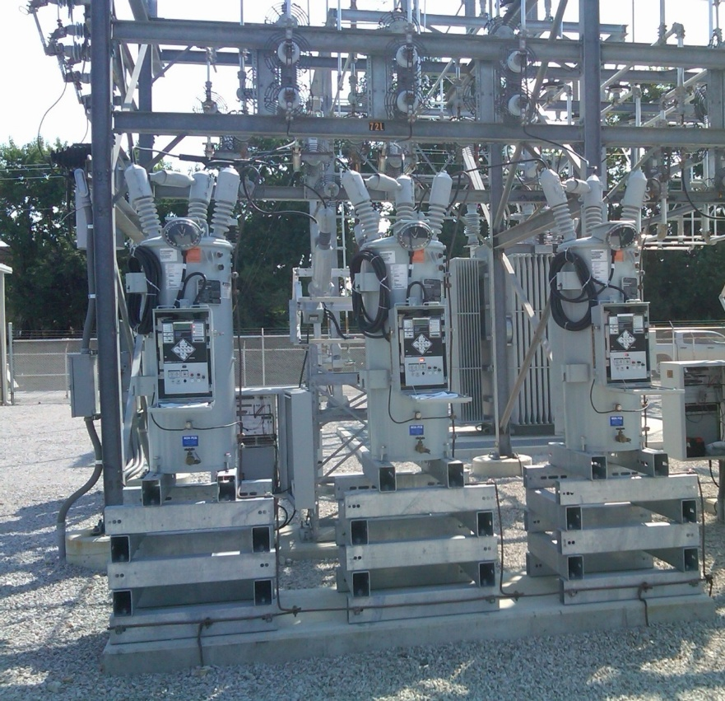
Load Tap-Changing Transformers
LTC transformers have tap ratios that can be varied to regulate bus voltages
  Sometimes called on-load tap-changing transformers (OLTCs) or under-load tap-changing transformers (ULTCs); on the distribution system called voltage regulators
The typical range of variation is ±10% from
the nominal values, usually in 33 discrete
steps (0.0625% per step).
Because tap changing is a mechanical
process, LTC transformers usually have
a time delay deadband to avoid repeated
changes (e.g., 30 seconds)

Slide 30
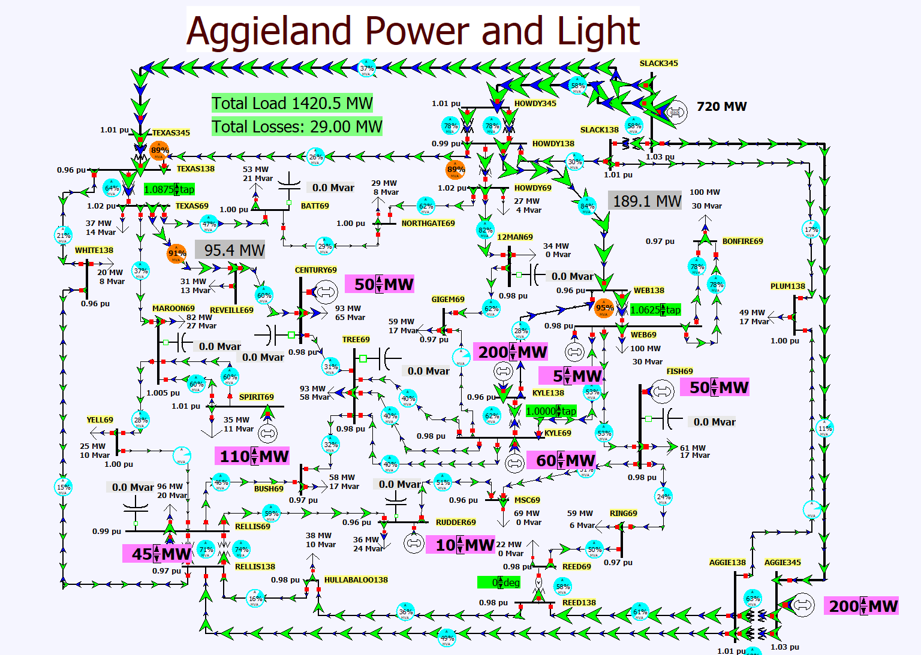
Lab Three LTC Example
29

Slide 31
LTCs and Circulating Vars
Unbalanced transformer taps can cause large amounts of reactive power to circulate, increasing power system losses and overloading transformers
30

Slide 32
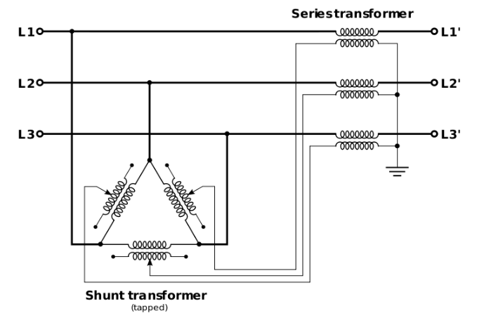
Phase Shifting Transformers (PSTs)
Phase shifting transformers are used to control the phase angle across the transformer
  Also called phase angle regulators (PARs) or quadrature booster transformers (British usage)
Since power flow through the transformer depends upon phase angle, this allows the transformer to regulate the power flow
through the transformer
Phase shifters can be used to
prevent inadvertent "loop
flow" and to prevent line overloads.
I believe there are nine PSTs in ERCOT
Image Source: en.wikipedia.org/wiki/Quadrature_booster#/media/File:Qb-3ph.svg
31

Slide 33
Phase Shifter Example 3.13
32

Slide 34
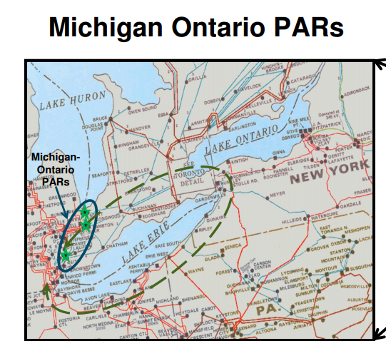
Phase Shifter Example: Lake Erie Loop Flow
There are five phase shifters (called phase angle regulators [PARs] here) at the border between Michigan and Ontario. They are used to control how much electricity travels
between the US and
Canada
By adjusting the PARs the
flow of electricity that
“loops” around Lake
Erie can be controlled
Source: MISO Board of Directors Market Committee Update, 9/30/13

Slide 35
Lab Three Phase Shifter Example
34

Slide 36
Per Unit Calculations
A key problem in analyzing power systems is the large number of transformers.
  It would be very difficult to continually have to refer impedances to the different sides of the transformers
This problem is avoided by a normalization of all variables.
This normalization is known as per unit analysis.

Slide 37
Per Unit Conversion Procedure, Single-Phase
Pick a single-phase VA base for the entire system, S_{B}
Pick a voltage base for each different voltage level, V_{B}. Voltage bases are related by transformer turns ratios. Voltages are line to neutral.
Calculate the impedance base, Z_{B}= (V_{B})²/S_{B}
Calculate the current base, I_{B} = V_{B}/Z_{B}
Convert actual values to per unit
Note, per unit conversion on affects magnitudes, not the angles. Also, per unit quantities no longer have units (i.e., a voltage is 1.0 p.u., not 1 p.u. volts)

Slide 38
Per Unit Solution Procedure
Convert to per unit (p.u.) (many problems are already in per unit)
Solve
Convert back to actual as necessary

Slide 39
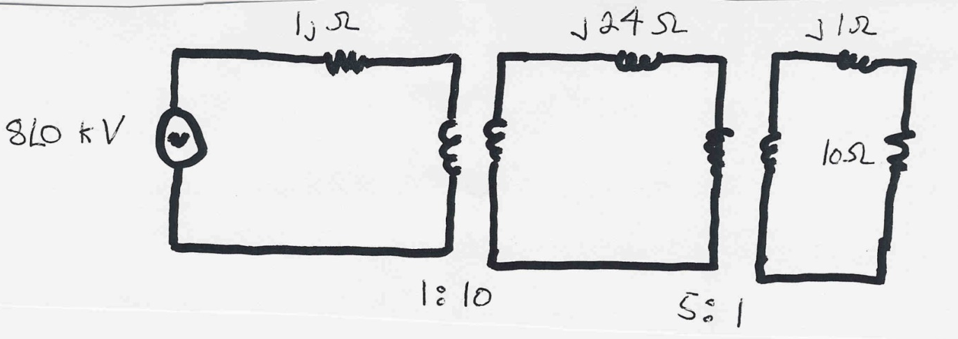
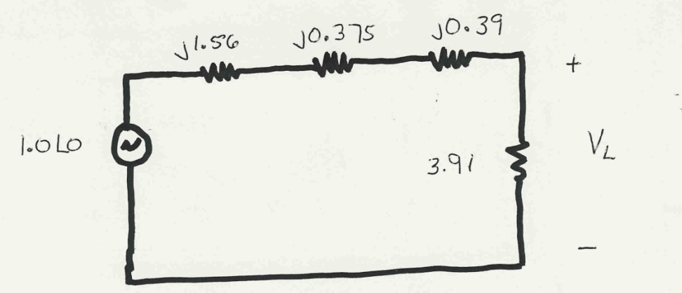
Per Unit Example
Solve for the current, load voltage and load power in the circuit shown
below using per unit analysis with an S_{B} of 100 MVA, and
voltage bases of 8 kV, 80 kV and 16 kV
Same circuit, with
values expressed
in per unit.

Slide 40
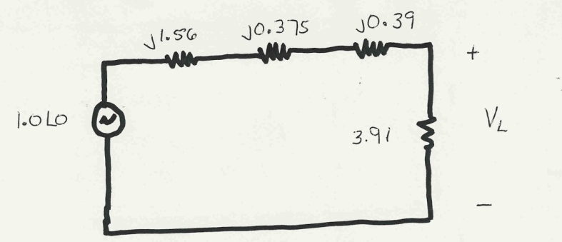
Per Unit Example, cont’d

Slide 41
Per Unit Example, cont’d
To convert back to actual values just multiply the per unit values by their per unit base

Slide 42
Procedure for Balanced Three-Phase Circuits
Procedure is very similar to single-phase except we use a three-phase VA base, and use line to line voltage bases
Pick a 3φ VA base for the entire system,
Pick a voltage base for each different voltage level, V_{B}. Voltages are line to line.
Calculate the impedance base
Exactly the same impedance bases as with single phase!

Slide 43
Three-Phase Per Unit, cont'd
Calculate the current base, I_{B}
Convert actual values to per unit

Slide 44

Three-Phase Per Unit Example
Solve for the current, load voltage and load power in the previous circuit, assuming a 3φ power base of 300 MVA, and line to line voltage bases of 13.8 kV, 138 kV and 27.6 kV (square root of 3 larger than the 1φ example voltages). Also assume the generator is Y-connected so its line to line voltage is 13.8 kV.
Convert to per unit
as before. Note the
system is exactly the
same!

Slide 45
Three-Phase Per Unit Example, cont.
Again, analysis is exactly the same!

Slide 46
Three-Phase Per Unit Example, cont'd
Differences appear when we convert back to actual values

Slide 47
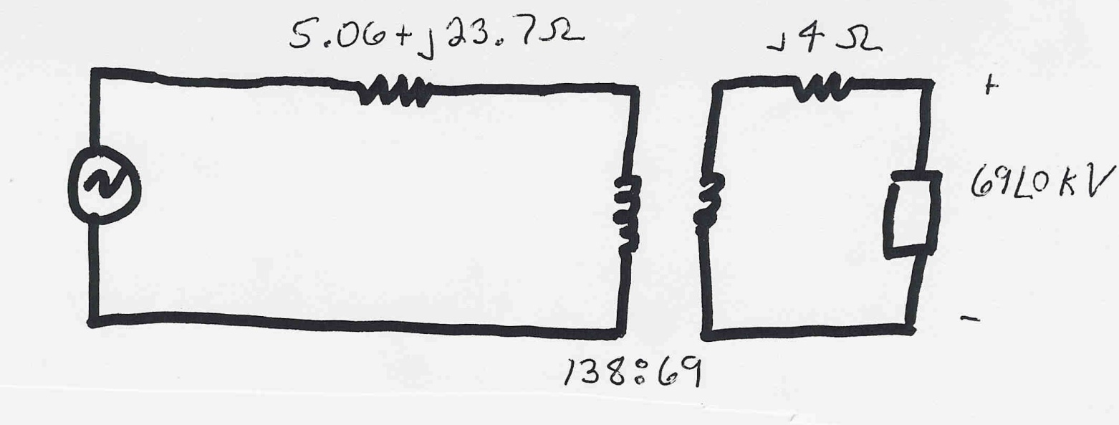
Three-Phase Per Unit Example 2
Assume a three-phase load of 100+j50 MVA with V_{LL} of 69 kV is connected to a source through the below network:
What is the supply current and complex power?
Answer: I=467 amps, S = 103.3 + j76.0 MVA

Slide 48
Per Unit Change of MVA Base
Parameters for equipment are often given using power rating of equipment as the MVA base
To analyze a system all per unit data must be on a common power base

Slide 49
Transformer Reactance
Transformer reactance is often specified as a percentage, say 10%. This is a per unit value (divide by 100) on the power base of the transformer.
Example: A 350 MVA, 230/20 kV transformer has leakage reactance of 10%. What is p.u. value on 100 MVA base? What is value in ohms (230 kV)?
48

