Slide 1
ECEN 460
Power System Operation and Control
Spring 2025
Lecture 7: Generator and Load Models, Bus Admittance Matrix
Prof. Tom Overbye
Dept. of Electrical and Computer Engineering
Texas A&M University
overbye@tamu.edu

Slide 2

Book Chapter 2 Picture
1

Slide 3
Per Unit Change of MVA Base
Parameters for equipment are often given using power rating of equipment as the MVA base
To analyze a system all per unit data must be on a common power base

Slide 4
Transformer Reactance
Transformer reactance is often specified as a percentage, say 10%. This is a per unit value (divide by 100) on the power base of the transformer.
Example: A 350 MVA, 230/20 kV transformer has leakage reactance of 10%. What is p.u. value on 100 MVA base? What is value in ohms (230 kV)?
3

Slide 5
Three Phase Transformers
There are 4 different ways to connect 3φ transformers:
Y-Y, Δ-Δ, Y-Δ, Δ-Y
  The reasons have to do with grounding and harmonics, which are outside of the ECEN 460 scope
  Only Y connections can be grounded
  Mixing Y and Δ introduces a 30 degree phase shift
Most high voltage generator step-up transformers (GSUs) are Δ on the generator side, grounded Y on the transmission side
Most transmission to distribution is Δ on the transmission side, grounded Y on the distribution side

Slide 6
Autotransformers
Autotransformers are transformers in which the primary and secondary windings are coupled magnetically and electrically.
This results in lower cost, and smaller size and weight.
Most transmission level transformers are autotransformers, connected Y-Y with the low side grounded
The key disadvantage is loss of electrical isolation between the voltage levels; not used when a is large. For example in stepping down 7160/240 V we do not ever want 7160 on the low side!

Slide 7
Three Winding Transformers
Many high voltage transformers have a third winding, called the tertiary winding; called three winding transformers
There are a number of benefits in having 3 windings
  Tertiary can be used to provide lower voltage electric service, including providing substation service for remote transmission substations; sometimes capacitors are connected to the tertiary
  Helps with fault protection by reducing the zero sequence current providing higher zero sequence currents (beyond ECEN 460 scope)
  When Δ-connected helps to reduce unbalanced and third harmonic issues (again beyond ECEN 460 scope)

Slide 8
Load Modeling
We need a model for the aggregate electric load. Challenges are 1) the heterogeneity of the load (i.e., there are lots of different devices), and 2) the load keeps changing
Traditionally load models have been divided into two groups
  Static: load is a algebraic function of bus voltage and sometimes frequency; covered now
  Dynamic: load is represented with a dynamic model, with induction motor models the most common; covered when we get to stability
The simplest load model is a static constant impedance, but it is not commonly used; what is commonly used is a constant power load
7

Slide 9
Justification for the Common Power Flow Constant Power Model
While many loads do exhibit voltage dependence, there is good justification for using a constant power model in the power flow
A major justification is since the power flow is a steady-state analysis tool and is usually focused on representing load at the transmission system level, the assumption is the distribution tap-changing transformers have had enough time to respond so that in steady-state the voltage magnitude seen by the load is mostly independent of the transmission level voltage
Another justification is that in the longer term power flow time frame since many loads have external controllers (i.e., thermostats for heating) when their behavior is aggregated over time they tend to look like constant power
8

Slide 10
Generator Models
Engineering models depend upon application
Generators have traditionally been synchronous machines, but they increasingly include inverter-based resources (e.g., solar PV and wind) in which the power electronics are used to connect the generator to the system
For generators we will use two different models:
  a steady-state model, treating the generator as a constant power source operating at a fixed voltage; this model will be used for power flow and economic analysis; we’ll also consider reactive power limits
  a short term model treating the generator with its dynamics, covered later when we get to stability
9

Slide 11
Power Flow Analysis
We now have the necessary models to start to develop the power system analysis tools
The most common power system analysis tool is the power flow (also known sometimes as the load flow, terms that have been used interchangeably for at least 60 years!)
  power flow determines how the power flows in a network
  also used to determine all bus voltages and all currents
  because of constant power models, power flow is a nonlinear analysis technique
  power flow is a quasi steady-state analysis tool

Slide 12

Book Chapter 6 Photo
11

Slide 13
Linear versus Nonlinear Systems
A function H is linear if
H(α₁μ₁ + α₂μ₂) = α₁H(μ₁) + α₂H(μ₂)
That is
1) the output is proportional to the input
2) the principle of superposition holds
Linear Example: y = H(x) = c x
y = c(x₁+x₂) = cx₁ + c x₂
Nonlinear Example: y = H(x) = c x²
y = c(x₁+x₂)² ≠ (cx₁)² + (c x₂)²

Slide 14
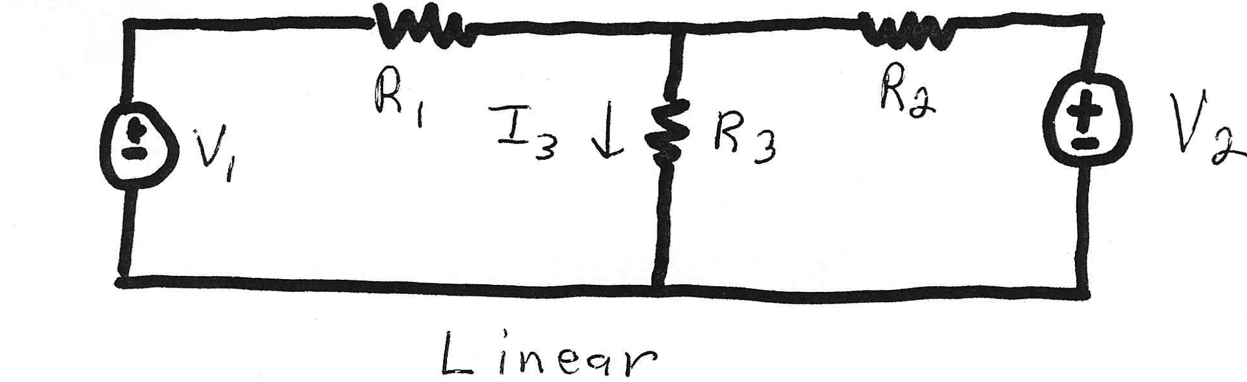
Linear Power System Elements

Slide 15
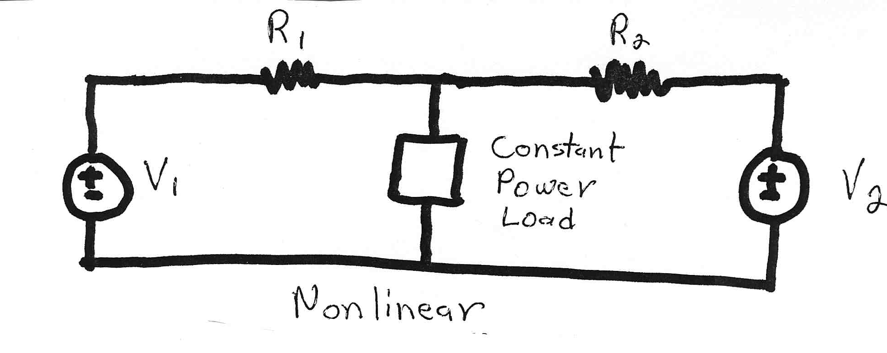
Nonlinear System Example
Constant power loads and generator injections are nonlinear and hence systems with these elements can not be analyzed by superposition
Nonlinear problems can be very difficult to solve,
and usually require an iterative approach

Slide 16
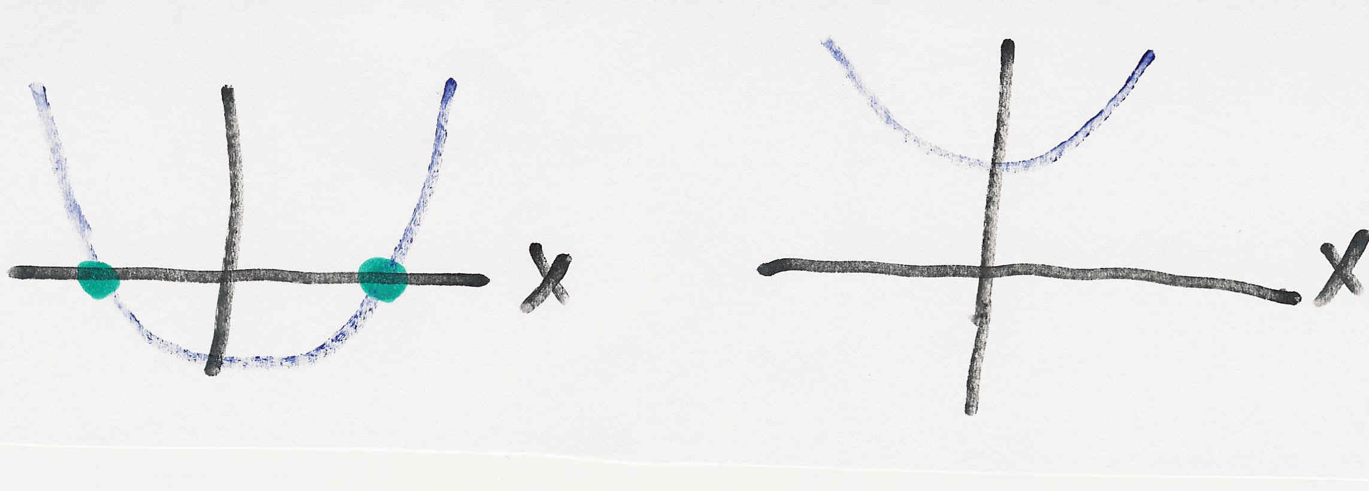
Nonlinear Systems May Have Multiple Solutions or No Solution
Example 1: x² - 2 = 0 has solutions x = ±1.414…
Example 2: x² + 2 = 0 has no real solution
f(x) = x² - 2
f(x) = x² + 2
two solutions where f(x) = 0
no solution f(x) = 0

Slide 17
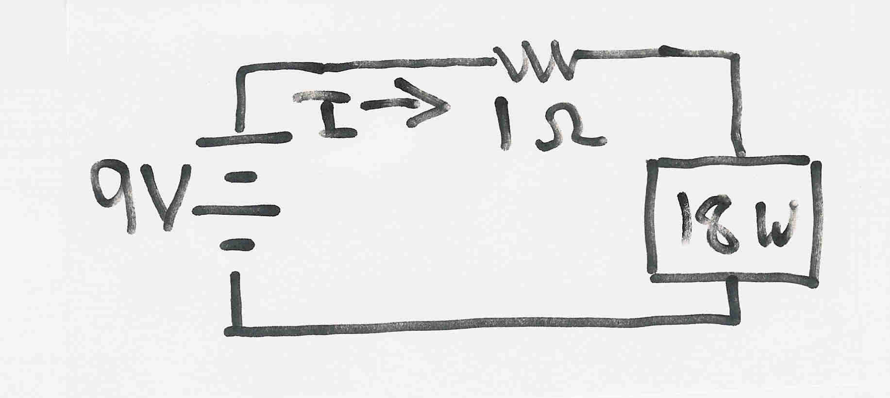
Multiple Solution Example
The dc system shown below has two solutions:
where the 18 watt
load is a resistive
load
What is the
maximum
P_{Load}?

Slide 18
Bus Admittance Matrix or Y_{bus}
First step in solving the power flow is to create what is known as the bus admittance matrix, often call the Y_{bus}.
The Y_{bus} gives the relationships between all the bus current injections, I, and all the bus voltages, V,
I = Y_{bus} V
The Y_{bus} is developed by applying KCL at each bus in the system to relate the bus current injections, the bus voltages, and the branch impedances and admittances

Slide 19
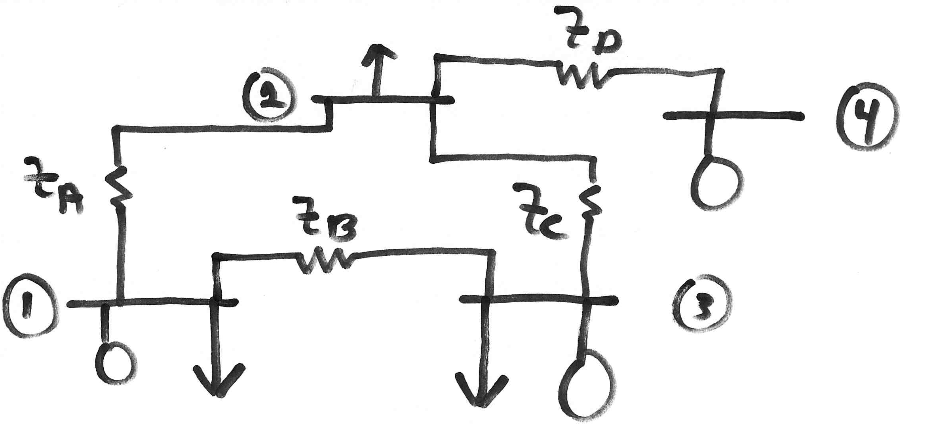
Y_{bus} Example
Determine the bus admittance matrix for the network shown below, assuming the current injection at each bus i is I_{i} = I_{Gi} - I_{Di} where I_{Gi} is the current injection into the bus from the generator and I_{Di} is the current flowing into the load

Slide 20
Y_{bus} Example, cont’d

Slide 21
Y_{bus} Example, cont’d
For a system with n buses the Y_{bus} is an n by n symmetric matrix (i.e., one where A_{ij} = A_{ji}); however this will not be true in general when we consider phase shifting transformers

Slide 22
Y_{bus} General Form
The diagonal terms, Y_{ii}, are the self admittance terms, equal to the sum of the admittances of all devices incident to bus i.
The off-diagonal terms, Y_{ij}, are equal to the negative of the sum of the admittances joining the two buses.
With large systems Y_{bus} is a sparse matrix (that is, most entries are zero)
Shunt terms, such as with the π line model, only affect the diagonal terms.

Slide 23
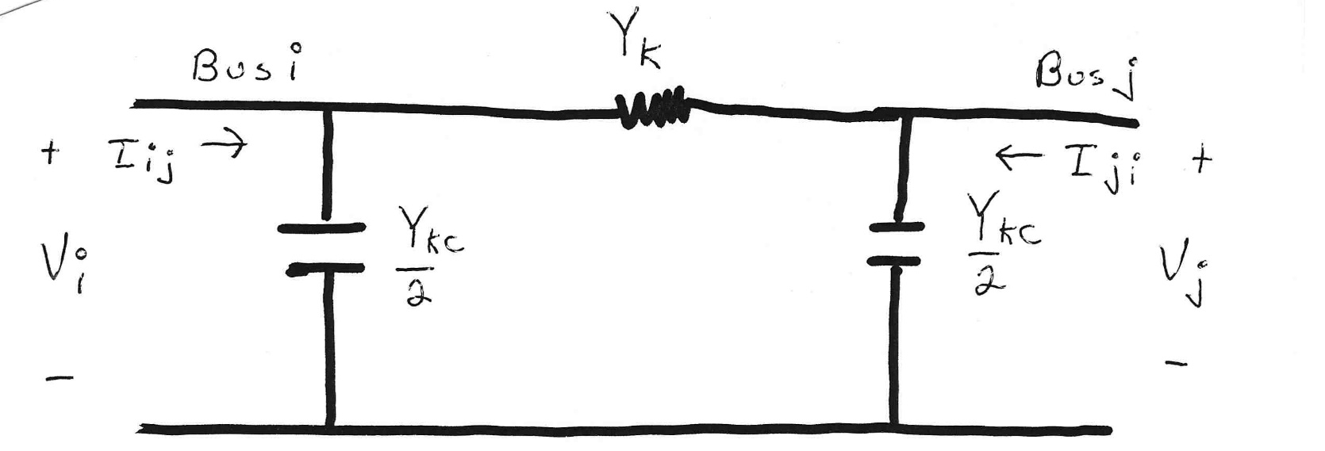
Modeling Shunts in the Y_{bus}

Slide 24
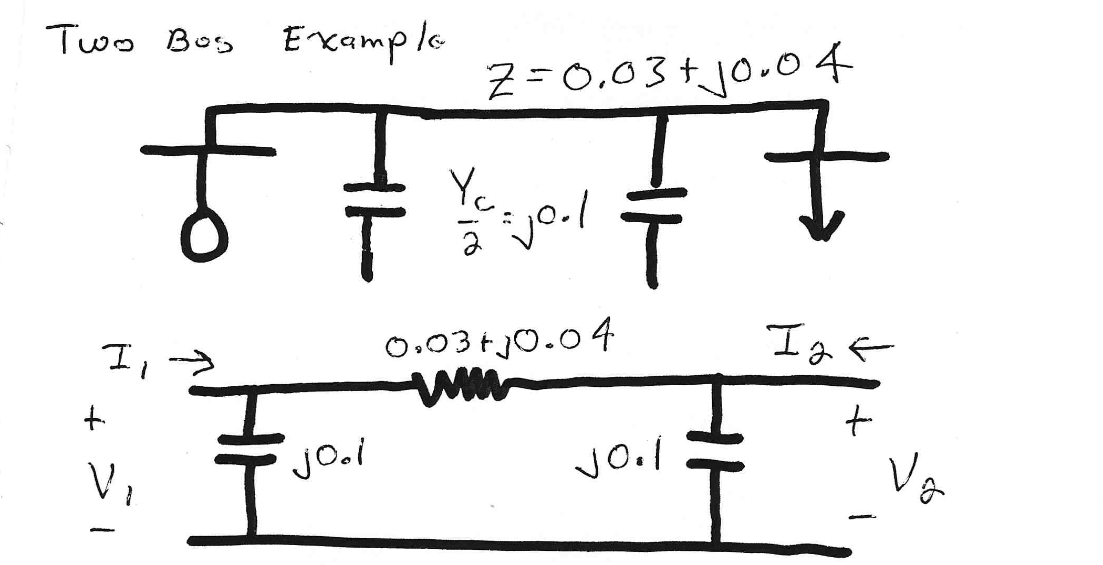
Two Bus System Example

Slide 25
Using the Y_{bus}
However, this requires that Y_{bus} not be singular; note it will be singular if there are no shunt connections!

Slide 26
Solving for Bus Currents

Slide 27
Solving for Bus Voltages

Slide 28
Power Flow Analysis
When analyzing power systems we know neither the complex bus voltages nor the complex current injections
Rather, we know the complex power being consumed by the load, and the power being injected by the generators plus their voltage magnitudes
Therefore we can not directly use the Y_{bus} equations, but rather must use the power balance equations

Slide 29
Power Balance Equations

Slide 30
Power Balance Equations, cont’d

Slide 31
Real Power Balance Equations
These are probably the most important power system analysis equations!!!
There are different ways to show them (e.g., 6.4.10 and 6.4.11, and 6.4.12 and 6.4.13)

Slide 32
Slack Bus
We can not arbitrarily specify S at all buses because total generation must equal total load + total losses
We also need an angle reference bus.
To solve these problems we define one bus as the "slack" bus. This bus has a fixed voltage magnitude and angle, and a varying real/reactive power injection.
In an actual power system the slack bus does not really exist; frequency changes locally when the power supplied does not match the power consumed

Slide 33
Three Types of Power Flow Buses
There are three main types of power flow buses
  Load (PQ) at which P/Q are fixed; iteration solves for voltage magnitude and angle.
  Slack at which the voltage magnitude and angle are fixed; iteration solves for P/Q injections
  Generator (PV) at which P and |V| are fixed; iteration solves for voltage angle and Q injection

Slide 34
Newton-Raphson Algorithm
The book gives two approaches for solving the power flow: Gauss-Seidel (Section 6.5) and Newton-Raphson (Section 6.6)
Gauss-Seidel is included because it is easy to explain, but it is no longer used commercially and won’t be covered here
Most common technique for solving the power flow problem is to use the Newton-Raphson algorithm
Key idea behind Newton-Raphson is to use sequential linearization

Slide 35
Newton-Raphson Method (scalar)

Slide 36
Newton-Raphson Method, cont’d

Slide 37
Newton-Raphson Example

Slide 38
Newton-Raphson Example, cont’d

