Slide 1
ECEN 460
Power System Operation and Control
Spring 2025
Lecture 8: Power Flow
Prof. Tom Overbye
Dept. of Electrical and Computer Engineering
Texas A&M University
overbye@tamu.edu

Slide 2
Lab 4 Comments
In the power flow the cases are usually divided into areas and zones. Areas can control their interchange, whereas zones are just a convenient way to subdivide the grid
  Super areas, which are groups of areas, can also be used
In Lab 4 you’ll be working with the 2000-bus synthetic Texas Footprint grid that has eight areas and 24 zones
  Often a zone is completely within an area, but this does not need to be true
PowerWorld provides many was to “filter” what is shown in the case information (tabular) displays. A main one is the area/zone filters, which can be used by limit what is shown by the buses’s areas and/or zones
Select Case Information, Area/Zone Filters to use this display
1

Slide 3
Scalar Newton-Raphson Example, cont’d

Slide 4
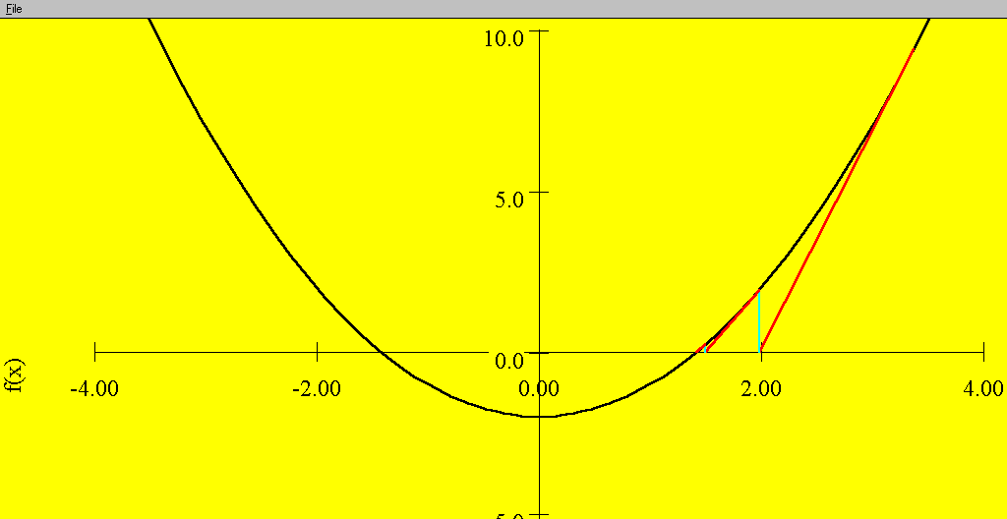
Sequential Linear Approximations
At each iteration the
N-R method uses a linear approximation
to determine the next value for x
Function is f(x) = x² - 2 = 0. Solutions are points where
f(x) intersects the f(x) = 0 axis
3

Slide 5
Newton-Raphson Comments
When close to the solution the error decreases quite quickly -- method has quadratic convergence
f(x^{(v)}) is known as the mismatch, which we would like to drive to zero
Stopping criteria is when ⏐f(x^{(v)}) ⏐ < ε
Results are dependent upon the initial guess. What if we had guessed x⁽⁰⁾ = 0, or x ⁽⁰⁾ = -1?
A solution’s region of attraction (ROA) is the set of initial guesses that converge to the particular solution. The ROA is often hard to determine.
4

Slide 6
Multi-Variable Newton-Raphson
5

Slide 7
Multi-Variable Case, cont’d
6

Slide 8
Multi-Variable Case, cont’d
7

Slide 9
Jacobian Matrix
8

Slide 10
Multi-Variable Example
9

Slide 11
Multi-variable Example, cont’d
10

Slide 12
Multi-variable Example, cont’d
11

Slide 13
Newton-Raphson Power Flow
12

Slide 14
Power Flow Variables
13

Slide 15
N-R Power Flow Solution
14

Slide 16
Power Flow Jacobian Matrix
15

Slide 17
Power Flow Jacobian Matrix, cont’d
16

Slide 18
Two Bus Newton-Raphson Example
For the two bus power system shown below, use the Newton-Raphson power flow to determine the voltage magnitude and angle at bus two. Assume that bus one is the slack and S_{Base} = 100 MVA.
17

Slide 19
Two Bus Example, cont’d
18

Slide 20
Two Bus Example, cont’d
19

Slide 21
Two Bus Example, First Iteration
20

Slide 22
Two Bus Example, Next Iterations
21

Slide 23
Two Bus Solved Values
Once the voltage angle and magnitude at bus 2 are known we can calculate all the other system values, such as the line flows and the generator reactive power
PowerWorld Case Name: Bus2_Intro
22

Slide 24
Two Bus Case Low Voltage Solution
23

Slide 25
Low Voltage Solution, cont'd
24

Slide 26
An Important Low Voltage Solution
The day ahead model had
65 energized 115,138, or 230 kV buses with voltages below 0.90 pu
The lowest 138 kV voltage was 0.836 pu; lowest 34.5 kV was 0.621 pu; the case contained 42,766 buses
25

Slide 27
Practical Power Flow Software Note
Most commercial software packages have built in defaults to prevent convergence to low voltage solutions.
  One approach is to automatically change the load model from constant power to constant current or constant impedance when the load bus voltage gets too low
  In PowerWorld these defaults can be modified on the Tools, Simulator Options, Advanced Options page; note you also need to disable the “Initialize from Flat Start Values” option
  The PowerWorld case Bus2_Intro_Low is set solved to the low voltage solution
  Initial bus voltages can be set using the Bus Information Dialog
26

Slide 28
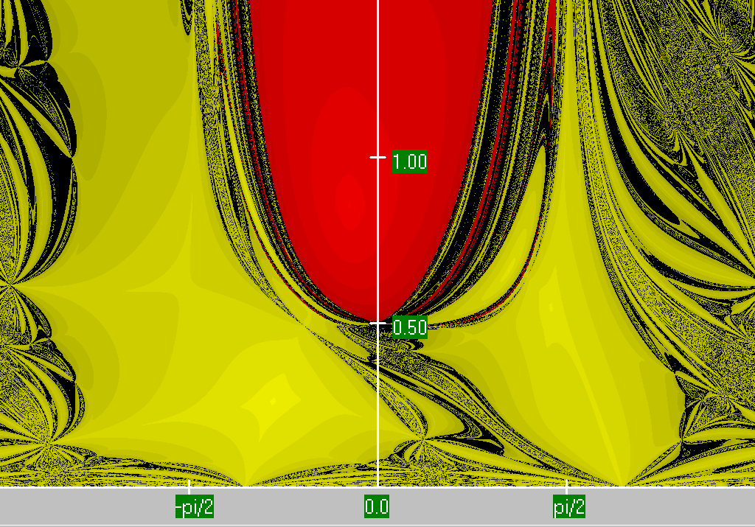
Two Bus Region of Convergence
Slide shows the region of convergence for different initial guesses of bus 2 angle (x-axis) and magnitude (y-axis)
The red region shows the initial guesses that converge to the high voltage solution,
while the yellow region shows the guesses that converge to the low voltage
solution
27

Slide 29
PV Buses
Since the voltage magnitude at PV buses is fixed there is no need to explicitly include these voltages in x or write the reactive power balance equations
  the reactive power output of the generator varies to maintain the fixed terminal voltage (within limits)
  optionally these variations/equations can be included by just writing the explicit voltage constraint for the generator bus
  |V_{i} | – V_{i setpoint} = 0
28

Slide 30
Three Bus PV Case Example
29

Slide 31
Modeling Voltage Dependent Load
30

Slide 32
Voltage Dependent Load Example
31

Slide 33
Voltage Dependent Load, cont'd
32

Slide 34
Voltage Dependent Load, cont'd
With constant impedance load the MW/Mvar load at bus 2 varies with the square of the bus 2 voltage magnitude. This if the voltage level is less than 1.0, the load is lower than 200/100 MW/Mvar
PowerWorld Case Name: Bus2_Intro_Z
33

