Slide 1
High Altitude Electromagnetic Pulse (HEMP) E3 Impacts on Large-Scale Electric Grids
Thomas J. Overbye
O’Donnell Foundation Chair III
Texas A&M University
overbye@tamu.edu
January 22, 2025

Slide 2
Overview
The purpose of this presentation is to show the potential impacts that high altitude electromagnetic pulses (HEMPs) can have on large-scale electric grids, and to offer some guidance on how these impacts could be potentially mitigated
HEMPs are caused by nuclear explosions at high altitudes (i.e., from 30 km up to 100’s of km)
The presentation demonstrates techniques on synthetic (fictional ) electric grids using public, or publicly derived synthetic HEMP scenarios
The presentation does not provide any commentary on the HEMP vulnerability of any actual electric grid

Slide 3
Acknowledgments
Work presented here has been supported by a variety of sources including PSERC, the Texas A&M Smart Grid Center, DOE, ARPA-E, NSF, EPRI, BPA, PowerWorld, and others. Their support is gratefully acknowledged!
Slides also include contributions from many of my students, postdocs, staff and colleagues at TAMU, and at PowerWorld Corporation
Simulation results presented here are done using PowerWorld Simulator Version 24 (beta)

Slide 4
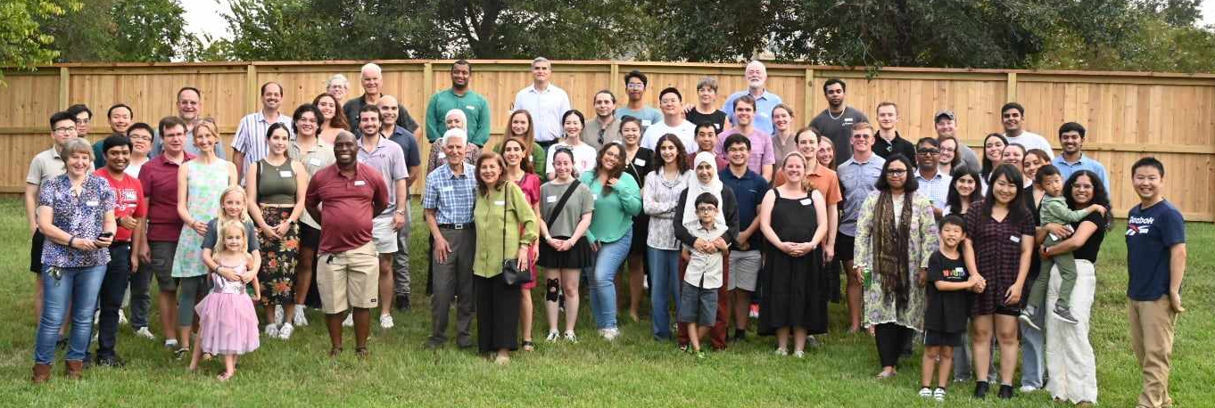
Some of the TAMU Power and Energy Group (EPG)
This is from the Fall 2024 EPG dinner at Kate Davis’s house in September 2024

Slide 5
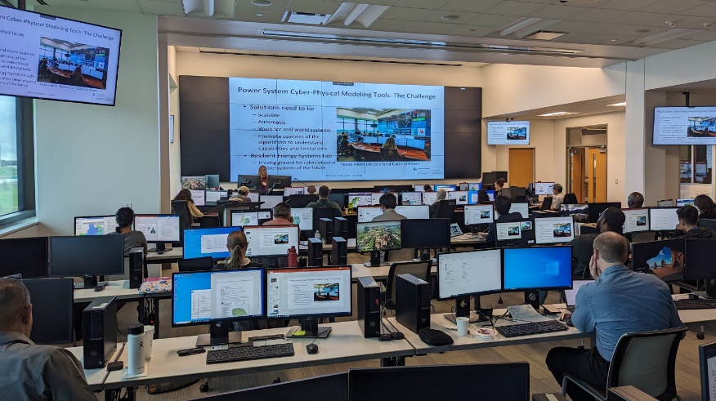
Aside 1: Texas A&M SGC Electric Power Short Courses
Building on its success from prior semesters, the SGC will be offering at least three more short courses in Spring 2025 at our control lab/training facility; more information is at
epg.engr.tamu.edu/short-courses-main/
  Primer on the Planning and Operation
  of Large-Scale Electric Grids
  (February 4 to 6)
  Fundamental of Electric Transmission
  Planning (February 18 to 20)
  Electric grid Impacts of Geomagnetic
  Disturbances (March 18 to 19)
  Fundamentals of Grid-Connected
  Photovoltaic Systems (Spring 2025)

Slide 6

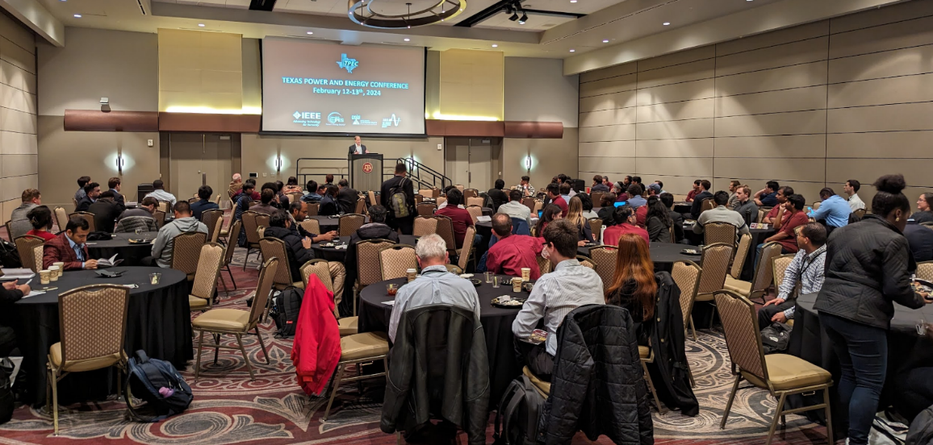
Aside 2: 2025 Texas Power and Energy Conference
Every year since 2017 Texas A&M has
held the Texas Power and Energy
Conference (TPEC) in February, which
brings together industry and academia
  All papers appear in IEEE Xplore
TPEC 2025 will be on Feb 10-11
at Texas A&M in College Station, TX
We invite all to attend, with more details
and the registration link at
tpec.engr.tamu.edu/

Slide 7
Our Energy Future Could be Bright!
My professional goal is to help in the development of a sustainable and resilient electric infrastructure for the entire world.
Electric grids are in a time of rapid transition, with lots of positive developments.
I think our electric energy future could be quite bright! But there are lots of challenges with this transition, including dealing with severe events, with this presentation covering one of them: the potential impacts of High Altitude Electromagnetic Pulses (HEMPs)
  In Texas the need to protect critical infrastructures from electromagnetic threats is mentioned in Executive Order GA-49 (November 2024)

Slide 8
Interconnected Electric Grids
Interconnected electric grids are going to play a key role in the development of a sustainable energy future
  In the North America about 40% of the energy transported as electricity, a value that should be increasing as transportation becomes more electrified
In order to achieve this
vision of a bright future,
we need to increase the
reliability and resiliency
of the electric grid
as we become more
sustainable
Electric Grid Overview – HEMPS can impact all aspects of the grid
Image source is US DOE, www.energy.gov/indianenergy/articles/united-states-electricity-industry-primer

Slide 9
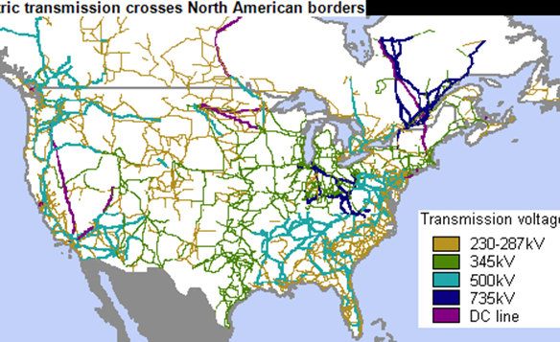
Important Electric Grid Considerations
Electricity cannot be economically stored
  Generation must be continually adjusted to
  match changes in electric load and losses
Electric power flows on high voltage
transmission lines cannot usually be
directly controlled
  Control is mostly indirect, by changing
  generation
Customers have been in control
of their load
Transmission systems have finite limits and are often operated close to its limit for economic reasons

Slide 10
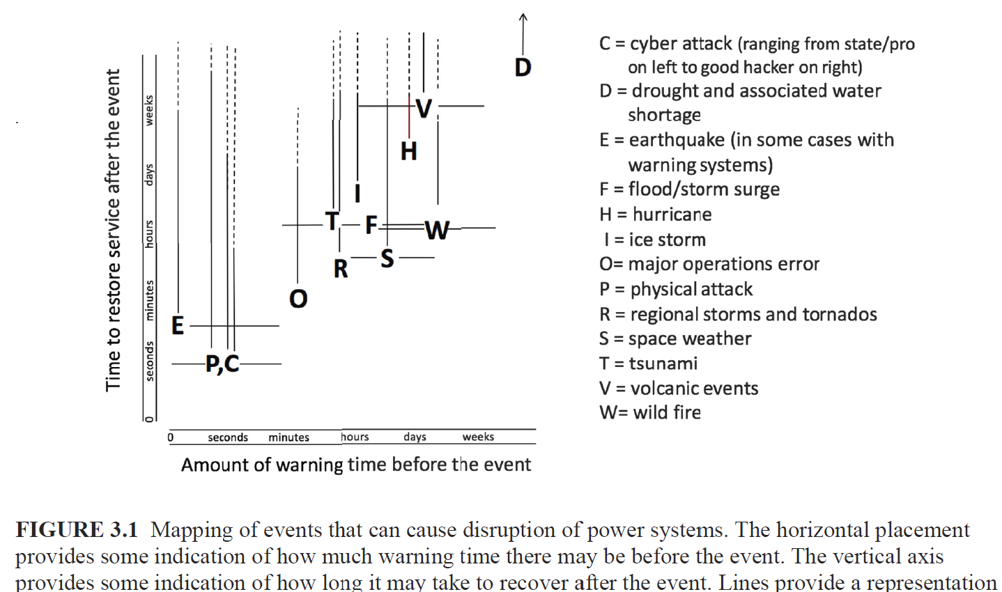
Some Electric Grid Risks
Figure is from a 2017 National Academy Report, Enhancing the Resilience of the Nation’s Electricity System
“While minimizing the likelihood of large-area, long-duration outages is important, a resilient system is one that acknowledges that such outages can occur, prepares to deal with them, minimizes their impact when they occur, is able to restore service quickly, and draws lessons from the experience to improve performance in the future”
This certainly applies to HEMPs

Slide 11
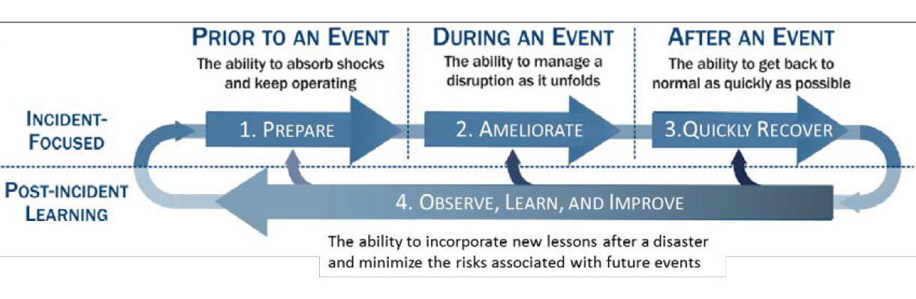
Four Stage Resilience Process
This from Figure 1.2a in the 2017 National Academies’ report, and is originally from
S.E. Flynn, “America the resilient: Defying terrorism and mitigating
natural disasters.” Foreign Affairs, vol. 87: 2–8 (2008) and as illustrated
by the National Infrastructure Advisory Council (NIAC) in 2010

Slide 12
How to Approach HILF Events
High-Impact, Low-Frequency (HILF) events are ones that could cause large-scale, long duration blackouts; HEMPs are HILFs
The goal in studying HILFs is seldom to replicate a specific event
  Many have not occurred, and within each class there can be great variability (e.g., a physical attack)
Nor is it to ensure there is no loss of service
Rather, it is to be broadly prepared, and to be able to do at least a reasonable cost/benefit analysis
HILF simulations can help in preparing for the unexpected
Techniques such as improved control room rare event situational awareness and better black start procedures, are generally applicable

Slide 13
Electromagnetic Pulses (EMPs)
Broadly defined, an electromagnetic pulse is any transient burst of electromagnet energy
Characterized by their magnitude, frequencies, footprint, and type of energy
There are many different types, such as static electricity sparks, interference from gasoline engine sparks, lightning, electric switching, geomagnetic disturbances (GMDs) cause by solar corona mass ejections (CMEs), nuclear electromagnetic pulses, and non-nuclear EMP weapons
Talk focuses primarily on the impact of nuclear EMPs on the grid, mostly caused by high altitude explosions

Slide 14
Nuclear EMPs
A good recent public HEMP documents is from the from the US DOE CESER Office (2023), High-Altitude Electromagnetic Pulse Waveform Application Guide [a]
The primary concern about nuclear EMPS is the impacts caused by high altitude EMPs (HEMPs)
  From 30 to 100’s of km in altitude
  With a high altitude explosion the other common nuclear impacts (blast, thermal, radiation) do not occur at the ground
  Scope of a single HEMP impact could be large, perhaps 1000 km, but the magnitude of the event would vary widely in the footprint
Multiple, near simultaneous events could occur
[a] www.energy.gov/sites/default/files/2023-08/CESER-Waveform-Application-Guide-2023-07_0.pdf

Slide 15
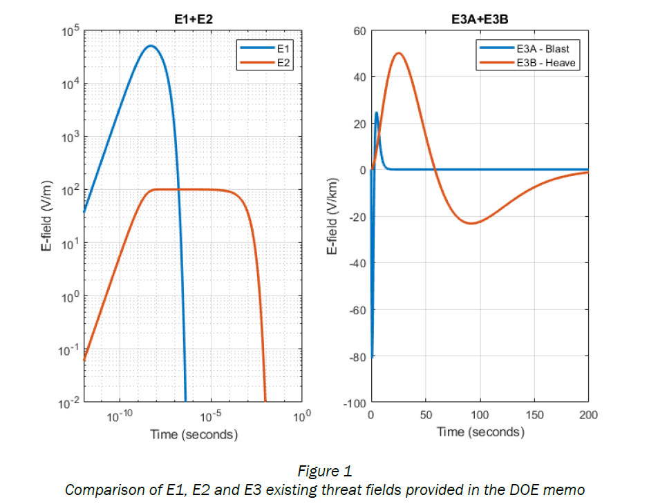
HEMP Time Frames
The impacts of an HEMP are typically divided into three time frames: E1, E2 and E3
The quickest, E1 with maximum
electric fields of 10’s of kV
per meter, can impact unshielded
electronics
E2, with electric fields
of up to 100 volts per meter, is similar
to lightning
Much of talk is on E3, which has impacts
somewhat akin to geomagnetic disturbances (GMDs)
DOE CESAR 2023

Slide 16
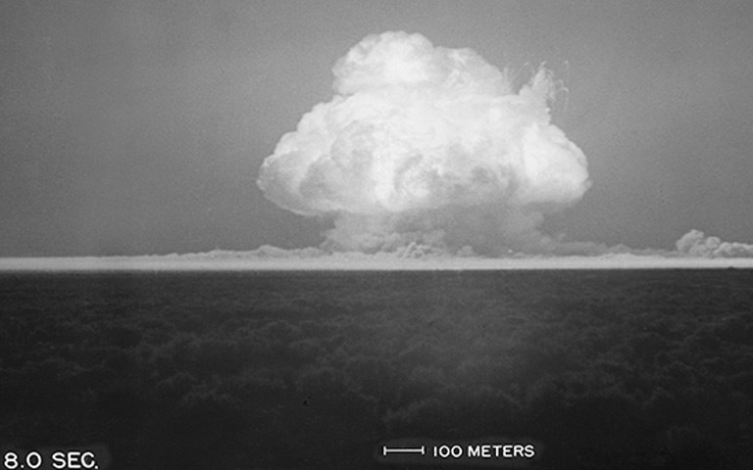
Nuclear EMP History
The presence of EMPs was
theorized by Enrico Fermi prior to
the first explosion in July 1945
  Many wires were shielded, but still
  some data was lost due to EMP
British called it “radioflash” in their
tests in early 1950’s due to the
presence of “clicks” heard on radios
Operation Hardtack tests in 1958
(up to 80 km in altitude) further
demonstrated HEMP impacts
Trinity Explosion, July 16, 1945, 18.6 kilotons of TNT (Army White Sands Missile Range photo, source: www.afnwc.af.mil/About-Us/History/Trinity-Nuclear-Test/)

Slide 17

Nuclear EMP History: Starfish Prime
Starfish Prime was an explosion of a 1.44 megaton nuclear weapon at an altitude of 400 km over the Pacific Ocean in July 1962
  Part of series of tests known as
  Operation Fishbowl
  The EMPs were much larger than
  expected, driving instruments off scale
  Impacts seen in Honolulu (1445 km
  away), including knocking out about
  300 streetlights, setting off alarms, and
  damaging a microwave link
  Some low earth orbit satellites were
  also damaged
Starfish Prime observed on Maui in 1962: Source: US EMP Commission Report from July 2017 [a]; from Los Alamos Lab
[a] apps.dtic.mil/sti/pdfs/AD1051492.pdf

Slide 18
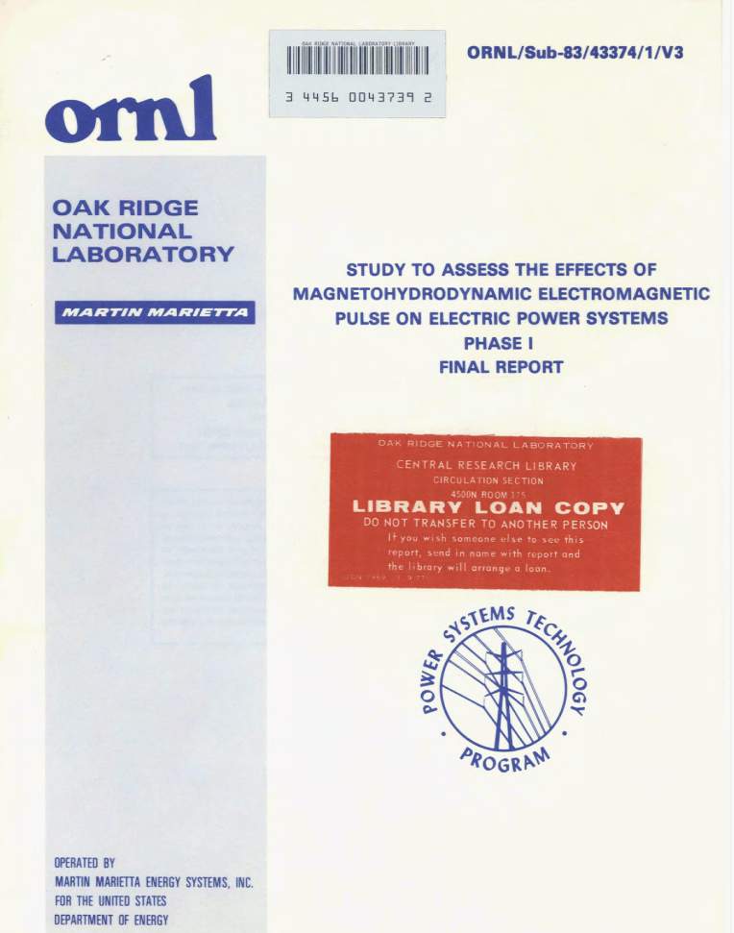
Nuclear EMP History
Soviet HEMP tests in the early 1960’s were reported to have damaged power equipment
Nuclear tests in the atmosphere, space and under water were banned in 1963
  There has been a United Nations underground
  test ban from 1996, though not all countries
  have agreed to it
The impact of HEMPs on the electric
grid has been an area of research for at
least 40 years; report on right is from
1985

Slide 19
Overview of HEMP Threats to Electric Grids
E1: Partial loss of load and generation, possible damage to protection system (< one microsecond)
E2: Voltage impulses on transmission lines and possible insulator flashover (< 0.1 second)
E3: GIC → half-cycle transformer core saturation →
  harmonics → excess reactive power losses → possible voltage or transient instability → immediate loss of critical loads; harmonics could damage equipment
  excess transformer heat → possible damage or long-term degradation to individual components → long-term power supply constraints for critical loads
Longer-term: potential cascading grid collapse and/or equipment damage

Slide 20
Example E1, E2, and E3 Waveforms
There are several sources for example or recommended waveforms
  Previously mentioned 2023 DOE CESAR document;
  www.energy.gov/sites/default/files/2023-08/CESER-Waveform-Application-Guide-2023-07_0.pdf
  www.firstempcommission.org/uploads/1/1/9/5/119571849/recommended_e3_waveform_for_critical_infrastructures_-_final_april2018.pdf (EMP Commission, E3)
  apps.dtic.mil/sti/pdfs/AD1067769.pdf US Defense Threat Reduction Agency, E1)
  apps.dtic.mil/sti/pdfs/AD1082958.pdf (US Defense Threat Reduction Agency, E3)
  https://www.cisa.gov/sites/default/files/publications/19_0307_CISA_EMP-Protection-Resilience-Guidelines.pdf
HEMPs impact the electric grid by causing spatially and time-varying electric fields that are superimposed on the electric grid; to the study their impacts both the time and spatial variation are used
Here public sources are used to develop synthetic test electric fields for the longer E3B time frame

Slide 21
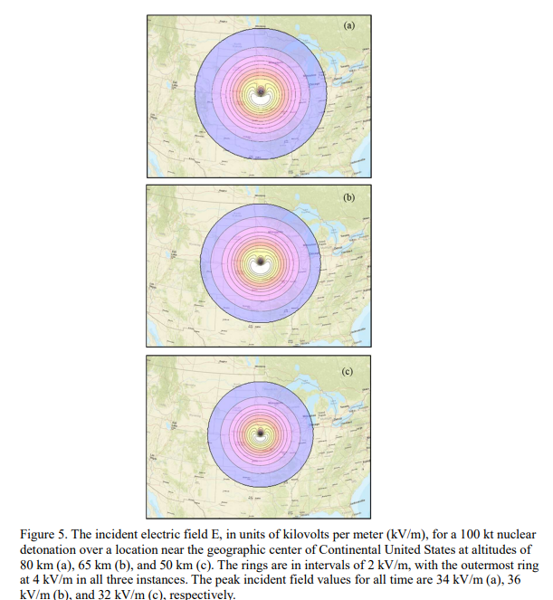
DOE/DTRA E1 Waveforms
Normalized peak E1 electric field for a 1 MT detonation at 100s of km; sometimes known as a “smile diagram”
Images show E1 footprint for a 100 kt detonation at altitude of 85 km, 60 km and 50 km
Left Source: DOE CESEAR 2023, Figure 4; Right apps.dtic.mil/sti/pdfs/AD1067769.pdf (2019), Figure 5

Slide 22
E1 Impacts On Bulk Electric Grid
The focus here is on E3, not E1, but the impact of E1 on the electric grid needs to be considered when doing E3 studies
The impacted E1 footprint grows with height of burst, but the impact falls off with distance away from the burst
There are direct electric grid infrastructure impacts (such as relays, communication systems, and SCADA), but this can be reduced with shielding
  Device impacts include 0) none, 1) disruption but resumes normal operation without intervention, 2) manual intervention required, 3) destroyed
There could be other grid impacts, such as from lost load and generation, potentially causing frequency issues

Slide 23
EMP E3 Electric Grid Modeling
The EMP E3 impacts are caused by the burst perturbing the earth’s magnetic field
  This is similar to the naturally occurring geomagnetic disturbances (caused by solar corona mass ejections)
  The dB/dt change is usually expressed in nT/minute
The dB/dt induces a non-uniform, time-varying electric field (E-field) at the Earth’s surface
  The magnitude of the induced E-field depends upon the conductivity of Earth's crust going down 100s of km; this conductivity can vary widely!
  On a 60-Hz timescale, the induced E-fields seen by high voltage transmission lines are essentially dc

Slide 24
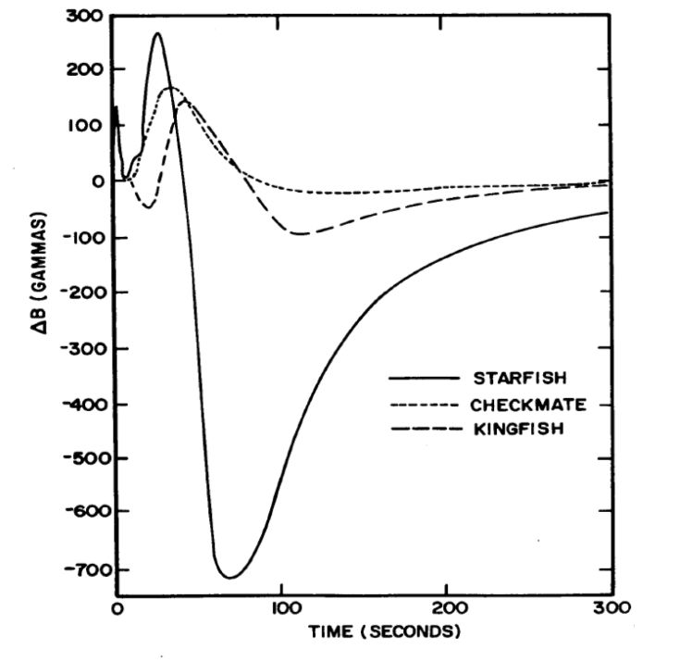
Measured Change in the Earth’s Magnetic Field During Fishbowl Tests
Checkmate and Kingfish were nuclear tests that were part of Operation Fishbowl. A gamma is one nT. For reference the Quebec GMD had 500 nT/minute and the 1859 Carrington GMD event is estimated have had a variation of perhaps 2500 nT/minute
Image: 1985 ORNL “Study to Assess the Effects of Magnetohydrodynamic Electromagnetic Pulse on
Electric Power Systems Phase I Final Report,” May 1985, Figure 1

Slide 25
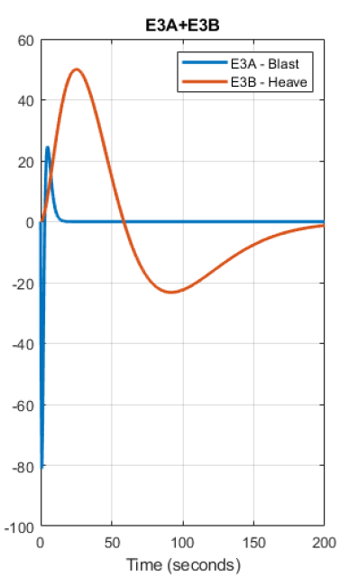
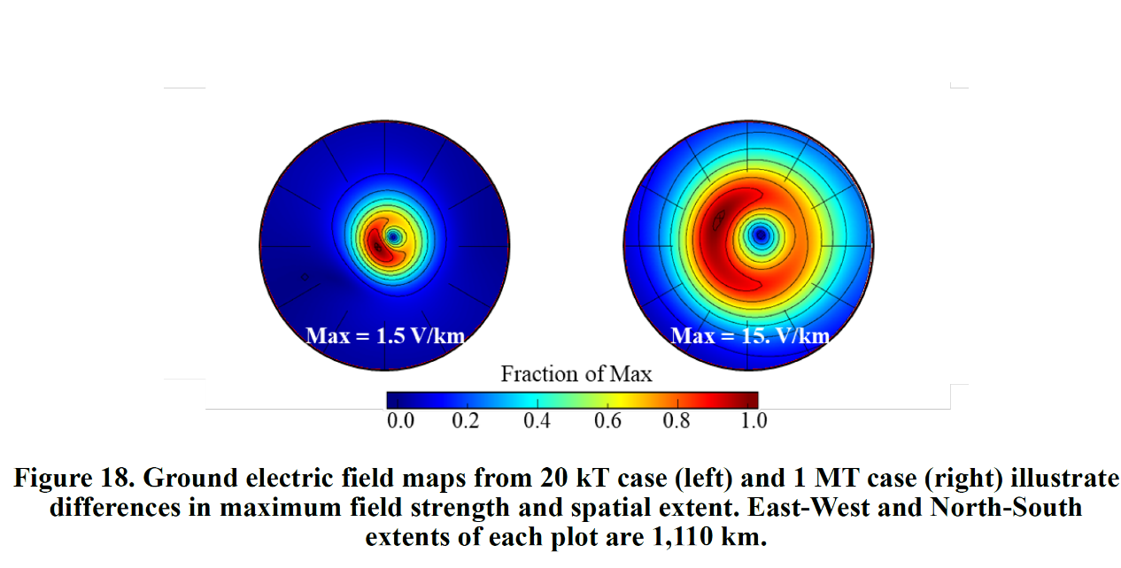
DOE Application Guide E3 Waveform (2023)
The E3 waveform is considered as two separate waveforms that are summed together: E3A (blast waveform), E3B (heave waveform)
  Both have a magnitude and time-varying spatial footprint
Figure from
apps.dtic.mil/sti/pdfs/AD1082958.pdf;
each circle is 688 miles (DC to St. Louis)
Figures from CESAR (2023) Report

Slide 26
Waveforms Depend on the Earth Conductance
If the earth is assumed to have a single conductance, σ, then
The magnitude relationship is then

Slide 27
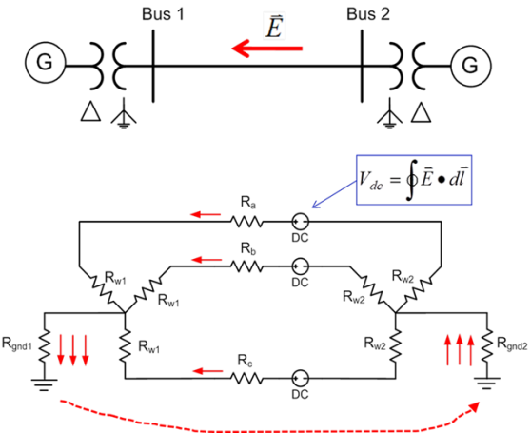
Geomagnetically Induced Currents (GICs)
Along length of a high voltage transmission line, electric fields can be modeled as a dc voltage source superimposed on the lines
The dc voltage is calculated by integrating the electric field along the line's
right-of-way
  If electric field is uniform
  (over the line) the integration
  is path independent
The GICs are
superimposed on the ac
(60 Hz) flows

Slide 28
GIC Calculations for Large Systems
With knowledge of the pertinent transmission system parameters and the GMD-induced line voltages, the dc bus voltages and flows are found by solving a linear equation I = G V (or J = G U)
  J and U may be used to emphasize these are dc values, not the power flow ac values
  The G matrix is similar to the Y_{bus} except 1) it is augmented to include substation neutrals, and 2) it is just resistive values (conductances)
  Being a linear equation, superposition holds
  The current vector contains the Norton injections associated with the GMD-induced line voltages
In North America utilities now have the needed information because of doing the NERC TPL-007 GMD studies

Slide 29
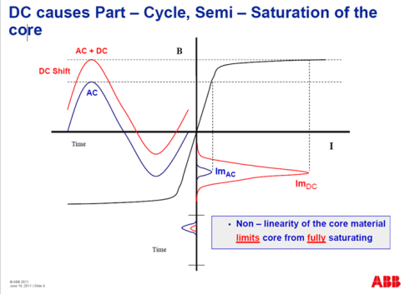
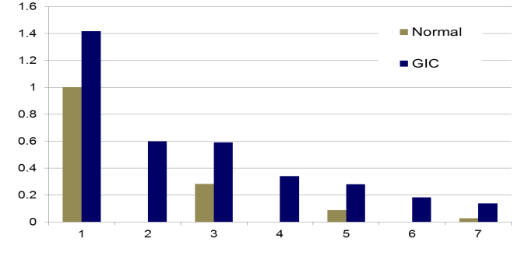
GIC Transformer Impacts
The superimposed dc GICs
can push transformers into
saturation for part of the ac cycle
This can cause large harmonics; in
the positive sequence (e.g., power flow
and dynamics) these
harmonics can be
represented by increased
reactive power losses
in the transformers and heating
Harmonics
Images: Craig Stiegemeier and Ed Schweitzer, JASON Presentations, June 2011

Slide 30
GICs to Grid Impacts
Transformer positive sequence reactive power losses vary as a function of both the GICs in the transformer coils and the ac voltage
A common approach is to use a linear model
The I_{GIC,Eff} is an effective current that is a function of the GICs in both coils; whether auto or regular the equation is
A non-linear model could also be used

Slide 31
Doing Large-Scale Grid E3 Impact Studies
Because of the faster E3 timeframes detailed grid studies can be done using time-domain stability simulations
  These allow for fuller representation of the grid’s protection system
More approximate solutions can be done using sequential power flow simulations, or by just calculating the time-varying GICs and transformer losses without a power flow solution
All approaches require a model of the E3 waveform, which is often provided using a *.b3d (binary, 3D file) that contains the spatial and time variation in the electric field
Since the E3 waveform can cause low voltages, the assumed load model can have a major impact on the results

Slide 32
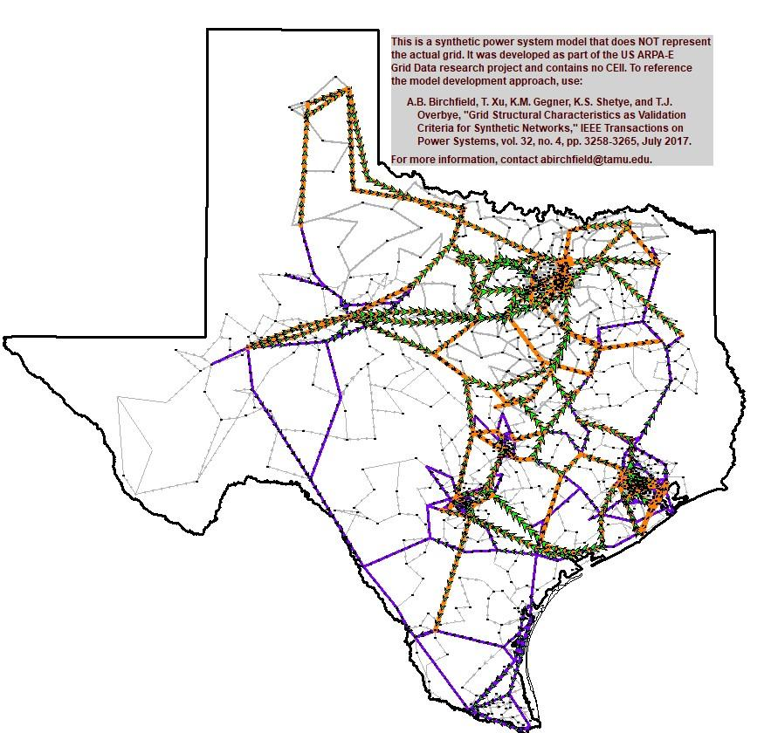
Example: 2000-Bus Synthetic Grid
This is a 2000-Bus synthetic grid covering the Texas footprint using a 500 kV, 230 kV, 161 kV, 115 kV transmission system
More details on this example are in T. J. Overbye, J. Snodgrass, A. Birchfield, and M. Stevens, “Towards Developing Implementable High Altitude Electromagnetic Pulse E3 Mitigation Strategies for Large-Scale Electric Grids,” IEEE. Texas Power and Energy Conference (TPEC), March 2022; available online at
overbye.engr.tamu.edu/publications/

Slide 33
Example EMP GIC Visualization for a 2000 Bus Synthetic Grid
Image shows the GICs during an EMP event. The black/white contour shows the spatial variation in the electric field, the yellow arrows the aggregated GIC flows (using the technique of [a]), and the green/red boxes the GICs flowing out of and into the ground.
[a] T.J. Overbye, J. Wert, K. Shetye, F. Safdarian, and A. Birchfield, “Delaunay Triangulation Based Wide-Area Visualization of Electric Transmission Grids,” Kansas Power and Energy Conference (KPEC), Apr. 2021; available oneline at overbye.engr.tamu.edu/publications/

Slide 34
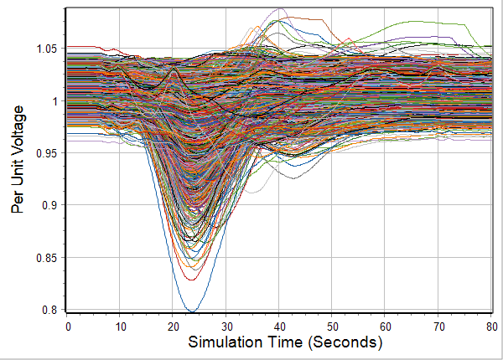
2000 Bus Voltage Variation
Higher assumed electric fields can cause a voltage collapse

Slide 35
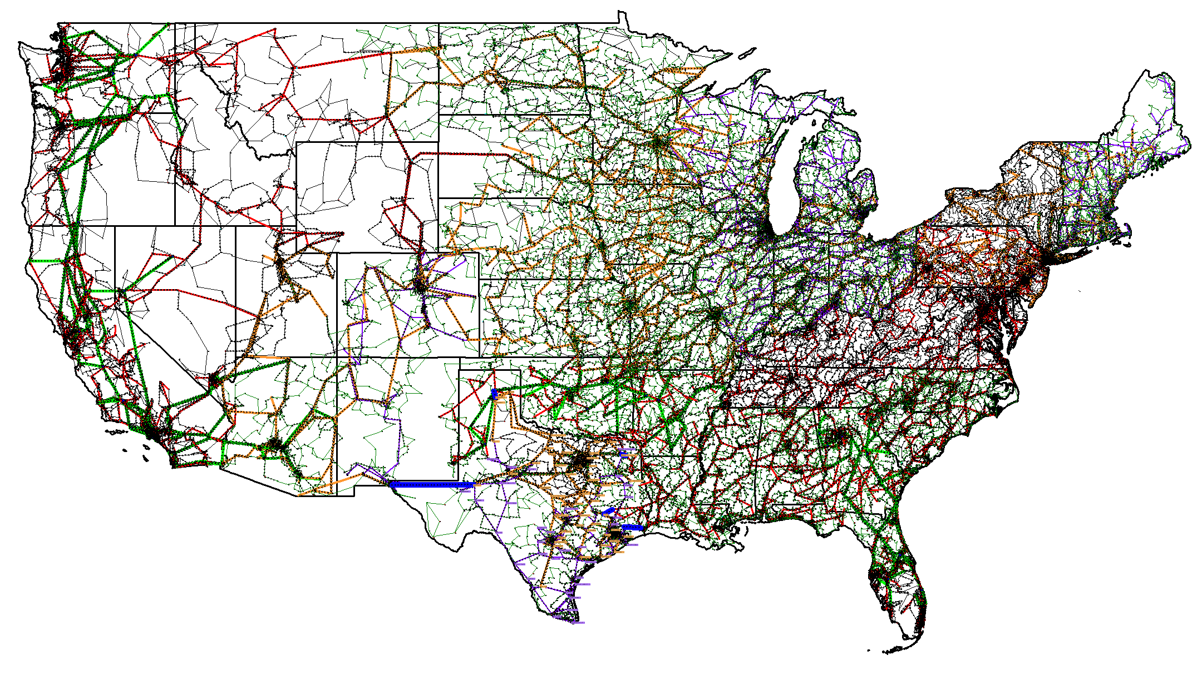
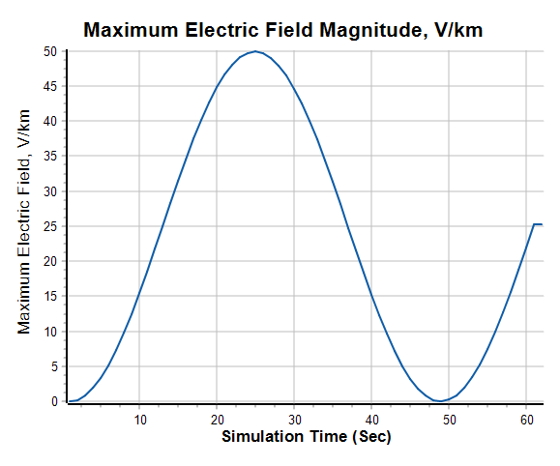
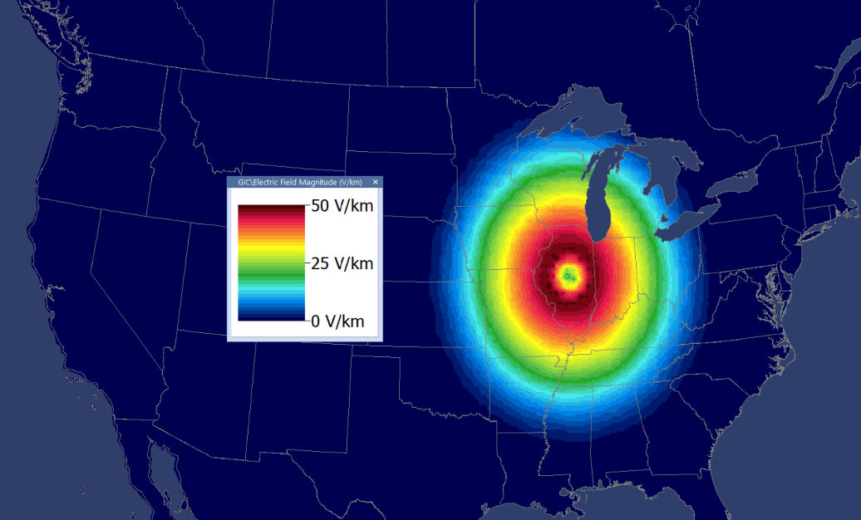
Example: 82,000 Bus US Synthetic Grid
Example with synthetic electric field motivated by the DOE waveform

Slide 36
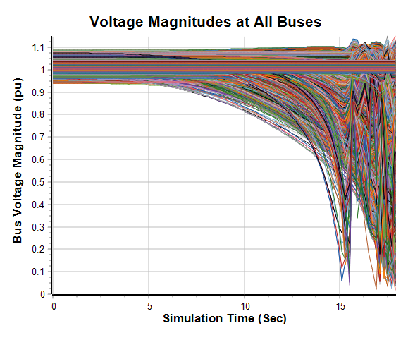
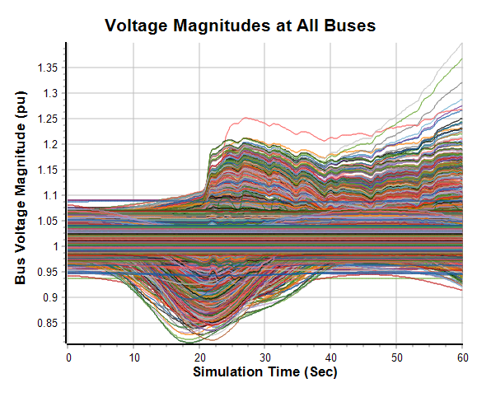
Example: 82,000 Bus US Synthetic Grid, cont.
Time-domain stability aborts at 17.9 seconds with a maximum of 50 V/km, but runs fine with a maximum of 25 V/km
Max 50 V/km
Max 25 V/km

Slide 37
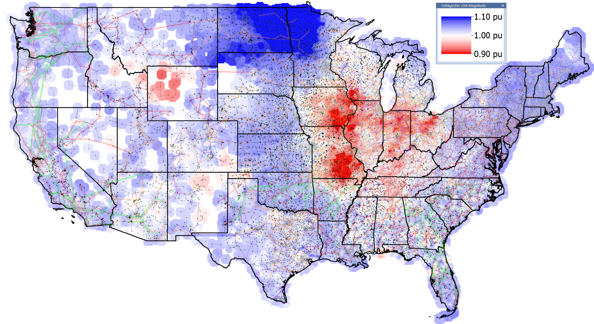
Example: 82,000 Bus US Synthetic Grid, cont.
Voltage Contour for Max 25 V/km Scenario, 24 Seconds

Slide 38
When There is No Solution
During either the time-domain stability runs, or the sequential power flow solutions, if the electric field magnitudes are large enough over a sufficiently large area, then there may be no solution to the associated algebraic equations
Assuming the models are reasonably correct, these could represent a situation in which an inter-connect wide voltage collapse is likely
Just running a calculation of the GIC values can show the impacted area, and provide metrics

Slide 39
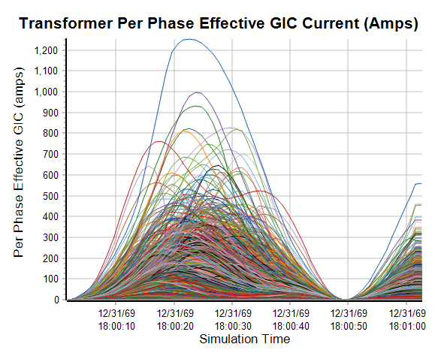
Example: 82,000 Bus US Synthetic Grid, cont.
Figures shows estimates of the per phase transformer effective GICs that would flow during the 50 V/km max scenario

Slide 40
What Could Occur During an HEMP
There might be little or no warning
  This is in contrast to a GMD in which there would have at least a day warning that something might be about to occur
The time, location and number of events might not be arbitrary (again, in contrast to a GMD)
The system state could change quite abruptly, with little time for initial operator or engineer intervention
GIC monitors and/or magnetometers would show the event
The extent of a subsequent cascade and/or equipment damage could depend upon heavily on whether there is effective intervention, including automatic controls and potential operator intervention

Slide 41
How to Improve the Electric Grid’s Resiliency to HEMPs
With E1 the hardening of components and their associated communication and controls is ongoing
There is a need to develop better event simulators so that the power community (engineers, operators, researchers) can experience HEMP and other HILF scenarios
  This work is ongoing at the Smart Grid Center
Setup alarms to determine if an HEMP has likely occurred (even harmonics, GICs in transformers, etc.), and if so its likely impact, which could range from very little to a potential system wide collapse

Slide 42
How to Improve the Electric Grid’s Resiliency to HEMPs, cont.
Real-time monitoring would be important to potentially triggering corrective control
Better electric grid visualization to help with situational awareness during HILF events
  A potential subsequent cascade, which could damage equipment and result in much larger outages, could be preventable
The use of tools to allow bulk electric system owners and operators to better broadly simulate the event impacts, and develop (at least to some degree) mitigation techniques
Possible selective use of GIC blocking devices
More research into HILFs, including more robust analysis tools and wide-area situational awareness

Slide 43
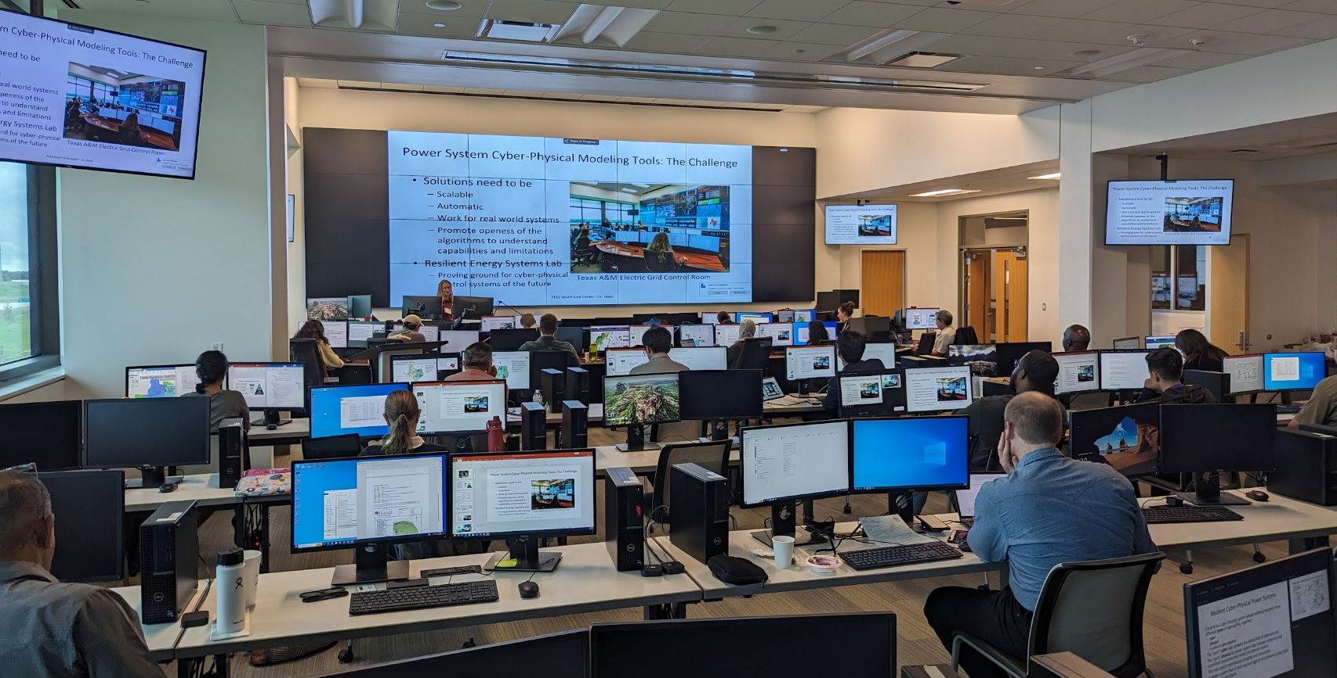
Thank You! Questions?
Recent papers are at overbye.engr.tamu.edu/publications/
For questions afterwards email at overbye@tamu.edu

