Slide 1
ECEN 460
Power System Operation and Control
Spring 2025
Lecture 9: More Power Flow
Prof. Tom Overbye
Dept. of Electrical and Computer Engineering
Texas A&M University
overbye@tamu.edu

Slide 2
Sources of Technical Information
There are many sources of technical information, with many students most familiar with textbooks and courses
Journals, conferences, reports, presentations (e.g., webinars), patents, standards and software are extremely useful additional sources
In rough order of the newest of the information (from oldest to newest)
  Books including textbooks; often lectures (depending on the instructor); reports
  Journals, Conferences; both can have peer review; software, patents
  Webinars, and industry periodicals
Many are publications are available open access. However, the challenge is ultimately someone needs to cover the publication expenses.
TAMU IEEE Xplore access at ieeexplore.ieee.org/Xplore/home.jsp
1

Slide 3

My Research Publications
My more recent publications are linked on my website at https://overbye.engr.tamu.edu/publications/
The paper I presented at TPEC on
Feb 11, 2025 provided results
from a survey looking to identify
the top papers of the last 50 years
Google scholar provides
information on how often particular
papers are referenced by other
papers
  It is a useful, but certainly not
  perfect metric
2

Slide 4
N-R Power Flow Solution
3

Slide 5
PV Buses
Since the voltage magnitude at PV buses is fixed there is no need to explicitly include these voltages in x or write the reactive power balance equations
  the reactive power output of the generator varies to maintain the fixed terminal voltage (within limits)
  optionally these variations/equations can be included by just writing the explicit voltage constraint for the generator bus
  |V_{i} | – V_{i setpoint} = 0
4

Slide 6
Three Bus PV Case Example
5

Slide 7
Generator Reactive Power Limits
The reactive power output of generators varies to maintain the terminal voltage; on a real generator this is done by the exciter
To maintain higher voltages requires more reactive power
Generators have reactive power limits, which are dependent upon the generator's MW output
These limits must be considered during the power flow solution.
During the power flow once a solution is obtained there is a check to make sure the generator reactive power output is within its limits
6

Slide 8
Generator Reactive Limits, cont'd
During the power flow once a solution is obtained there is a check to make sure the generator reactive power output is within its limits
If the reactive power is outside of the limits, fix Q at the max or min value, and resolve treating the generator as a PQ bus
  this is know as "type-switching"
  also need to check if a PQ generator can again regulate
Rule of thumb: to raise system voltage we need to supply more reactive power
7

Slide 9
The N-R Power Flow: 5-bus Example
T2
800 MVA
345/15 kV
1
T1
5
4
3
520 MVA
Line 3 345 kV
50 mi
400 MVA
15 kV
800 MVA
15 kV
400 MVA
15/345 kV
345 kV 100 mi
345 kV 200 mi
40 Mvar
80 MW
Line 2
Line 1
2
280 Mvar
800 MW
This five-bus grid is Example 6.9 from the book
8

Slide 10
The N-R Power Flow: 5-bus Example
Bus | Type | V per unit | δ degrees | P_{G} per unit | Q_{G} per unit | P_{L} per unit | Q_{L} per unit | Q_{Gmax} per unit | Q_{Gmin} per unit
1 | Swing | 1.0 | 0 | ⎯ | ⎯ | 0 | 0 | ⎯ | ⎯
2 | Load | ⎯ | ⎯ | 0 | 0 | 8.0 | 2.8 | ⎯ | ⎯
3 | Constant voltage | 1.05 | ⎯ | 5.2 | ⎯ | 0.8 | 0.4 | 4.0 | -2.8
4 | Load | ⎯ | ⎯ | 0 | 0 | 0 | 0 | ⎯ | ⎯
5 | Load | ⎯ | ⎯ | 0 | 0 | 0 | 0 | ⎯ | ⎯
Table 1.
Bus input data
Table 2.
Line input data
Bus-to-Bus | R’ per unit | X’ per unit | G’ per unit | B’ per unit | Maximum MVA per unit
2-4 | 0.0090 | 0.100 | 0 | 1.72 | 12.0
2-5 | 0.0045 | 0.050 | 0 | 0.88 | 12.0
4-5 | 0.00225 | 0.025 | 0 | 0.44 | 12.0
In this example δ, as opposed to θ, is used to indicate the bus angle
9

Slide 11
The N-R Power Flow: 5-bus Example
Bus-to-Bus | R per unit | X per unit | G_{c} per unit | B_{m} per unit | Maximum MVA per unit | Maximum TAP Setting per unit
1-5 | 0.00150 | 0.02 | 0 | 0 | 6.0 | —
3-4 | 0.00075 | 0.01 | 0 | 0 | 10.0 | —
Table 3.
Transformer
input data
Bus | Input Data | Unknowns
1 | V₁ = 1.0, δ₁ = 0 | P₁, Q₁
2 | P₂ = P_{G2}-P_{L2} = -8 Q₂ = Q_{G2}-Q_{L2} = -2.8 | V₂, δ₂
3 | V₃ = 1.05 P₃ = P_{G3}-P_{L3} = 4.4 | Q₃, δ₃
4 | P₄ = 0, Q₄ = 0 | V₄, δ₄
5 | P₅ = 0, Q₅ = 0 | V₅, δ₅
Table 4.
Input data
and
unknowns
In this example δ, as opposed to θ, is used to indicate the bus angle
10

Slide 12
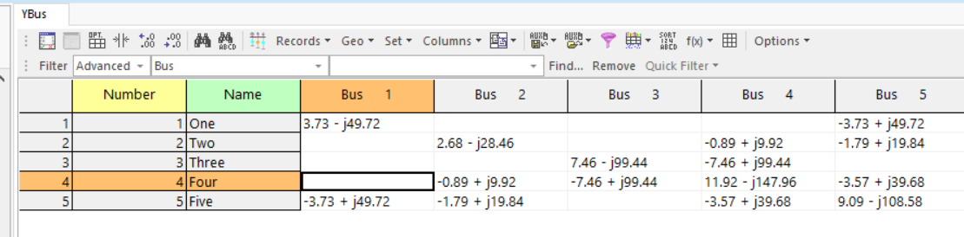
Bus Admittance Matrix
To see the Ybus, select Case Information, Solution Details, Ybus
PowerWorld Case Name: GOS_FiveBus
11

Slide 13
Ybus Calculation Details
Elements of Y_{bus} connected to bus 2
12

Slide 14
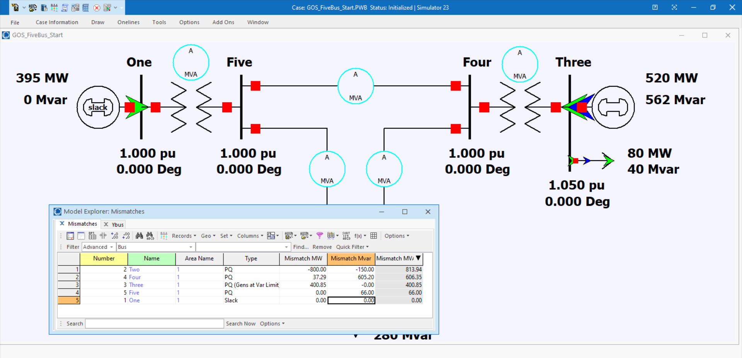
Initial Bus Mismatches
PowerWorld Case Name: GOS_FiveBus_Start
13

Slide 15
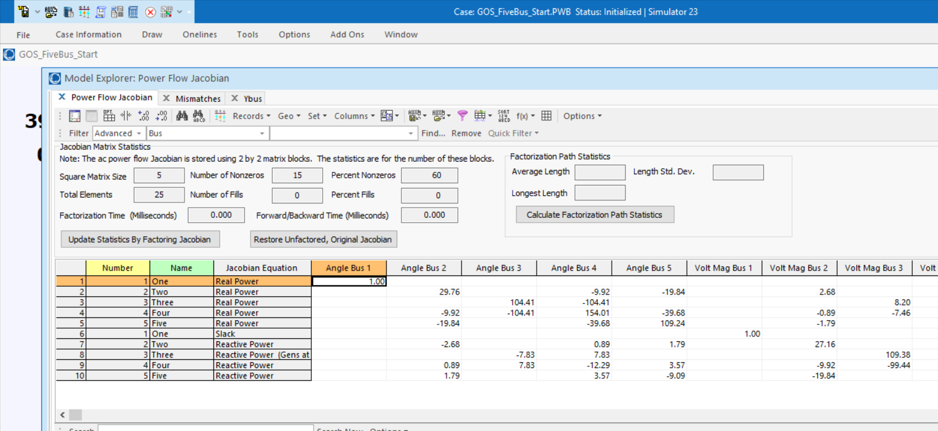
Initial Power Flow Jacobian
14

Slide 16
Hand Calculation Details
15

Slide 17
Five Bus Power System Solved
16

Slide 18
Additional Power Flow
Next slides cover some more advanced power flow topics that need to be considered in many commercial power flow studies
An important consideration in the power flow is the assumed time scale of the response, and the assumed model of operator actions
  Planning power flow studies usually assume automatic modeling of operator actions and a longer time frame of response (controls have time to reach steady-state)
    For example, who is actually doing the volt/var control
  In real-time applications operator actions are usually not automated and controls may be more limited in time
17

Slide 19
Quasi-Newton Power Flow Methods
First we consider some modified versions of the Newton power flow (NPF)
Since most of the computation in the NPF is associated with building and factoring the Jacobian matrix, J, the focus is on trying to reduce this computation
In a pure NPF J is build and factored each iteration
Over the years pretty much every variation of the NPF has been tried; here we just touch on the most common
Whether a method is effective can be application dependent
  For example, in contingency analysis we are usually just resolving a solved case with an often small perturbation
18

Slide 20
Quasi-Newton Power Flow Methods
The simplest modification of the NPF results when J is kept constant for a number of iterations, say k iterations
  Sometimes known as the Dishonest Newton
The approach balances increased speed per iteration, with potentially more iterations to perform
There is also an increased possibility for divergence
Since the mismatch equations are not modified, if it converges it should converge to the same solution as the NPF
These methods are not commonly used, except in very short duration, sequential power flows with small mismatches
19

Slide 21
Dishonest N-R Example
We pay a price in increased
iterations, but with decreased
computation per iteration; that
price is too high in this example and in the power flow in general so it is not used.
20

Slide 22
Decoupled Power Flow
Rather than not updating the Jacobian, the decoupled power flow takes advantage of characteristics of the power grid in order to decouple the real and reactive power balance equations
  There is a strong coupling between real power and voltage angle, and reactive power and voltage magnitude
  There is a much weaker coupling between real power and voltage magnitude, and reactive power and voltage angle
21

Slide 23
Decoupled Power Flow Formulation
22

Slide 24
Decoupling Approximation
23

Slide 25
Off-diagonal Jacobian Terms
By assuming half the elements are zero, we only have to do half the computations
24

Slide 26
Fast Decoupled Power Flow, cont.
By continuing with Jacobian approximations we can obtain a reasonable approximation that is independent of the voltage magnitudes/angles.
  This means the Jacobian need only be built/inverted once per power flow solution
This approach is known as the fast decoupled power flow (FDPF)
FDPF uses the same mismatch equations as standard power flow (just scaled) so it should have same solution
The FDPF had been widely used, though usually only for an approximate solution; it is less commonly used now
25

Slide 27
FDPF Approximations
To see the impact on the real power equations recall
26

Slide 28
FDPF Approximations
With the approximations for the diagonal term we get
Hence the Jacobian for the real equations can be approximated as –B
27

Slide 29
FPDF Approximations
For the reactive power equations we also scale by V_{i}
For the Jacobian off-diagonals we get
28

Slide 30
FDPF Approximations
And for the reactive power Jacobian diagonal we get
As derived the real and reactive equations have a constant Jacobian equal to –B
  Usually modifications are made to omit from the real power matrix elements that affect reactive flow (like shunts) and from the reactive power matrix elements that affect real power flow, like phase shifters
  We’ll call the real power matrix B’ and the reactive B”
29

Slide 31
DC Power Flow
The “DC” power flow makes the most severe approximations:
  completely ignore reactive power, assume all the voltages are always 1.0 per unit, ignore line conductance
This makes the power flow a linear set of equations, which can be solved directly
The term dc power flow actually dates from the time of the old network analyzers (going back into the 1930’s)
  Not to be confused with the inclusion of HVDC lines in the standard Newton power flow
DC power flow is widely used in electric power market analysis
P sign convention is that generation is positive
30

Slide 32
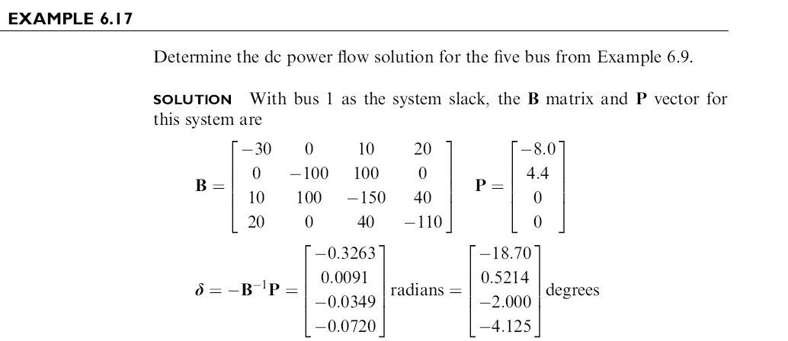
Book DC Power Flow Example
31

Slide 33
DC Power Flow in PowerWorld
PowerWorld allows for easy switching between the dc and ac power flows (case Aggieland37)
To use the dc approach
in PowerWorld select Tools, Solve, DC Power Flow
Notice there are no losses
32

Slide 34
Additional Power Flow Modeling Topics
Over the years power flow algorithms have grown increasingly complicated, with this complication driven by a desire to better replicate the complexity of the actual power grid
The next several slides cover some of these topics, with more details covered later in the semester (like modeling renewable generation)
I cover more on solving large grids once we’ve covered the Chapter 7 material
33

Slide 35
Transformer Taps and Impedance Correction Tables
With taps the impedance of the transformer changes; sometimes the changes are relatively minor and sometimes they are dramatic
  A unity turns ratio phase shifter is a good example with essentially no impedance when the phase shift is zero
  Often modeled with piecewise linear function with impedance correction varying with tap ratio or phase shift
  Next lines give several examples, with format being (phase shift or tap ratio, impedance correction)
    (-60,1), (0,0.01), (60,1)
    (-25,2.43),(0,1),(25,2.43)
    (0.941,0.5), (1.04,1), (1.15,2.45)
    (0.937,1.64), (1,1), (1.1, 1.427)
34

Slide 36
Switched Shunt Control
The status of switched shunts can be handled in an outer loop algorithm, similar to what is done for LTCs and phase shifters
  Because they are discrete they need to regulate a value to a voltage range
Switches shunts often have multiple levels that need to be simulated
Switched shunt control also interacts with the LTC and PV control
The power flow modeling needs to take into account the control time delays associated with the various devices
35

Slide 37
Switched Shunt System Design
Because switched shunts tend to have a local impact, there needs to be a coordinated design in their implementation at the transmission level
  Shunt capacitors used to raise the voltage, shunt reactors used to lower the voltage; used with LTCs and gens
Often in the transmission system they are switched manually by a system operator
The size and number of banks depends
  Change in the system voltages caused by bank switching
  The availability of different sizes
  Cost for the associated switchgear and protection system
36

Slide 38
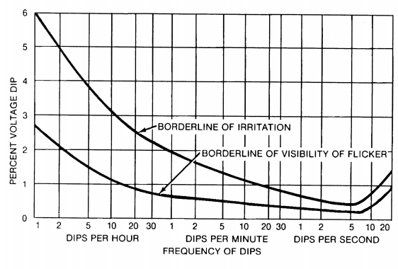
Switched Shunt Sizing
A goal with switched shunt sizing is to avoid human irritation caused by excessive changes in lighting
IEEE Std 1453-2015 gives guidance on the percentage of voltage changes as a
function of time; Table 3
of the standard suggests
keeping the voltage
changes below about 3%
We determine analytic
methods to calculate this
percentage later in the semester
There is a new version of this standard, 1453-2022
Image from IEEE Std. 1453-2015, “IEEE Recommended Practice for Measurement and Limits of Voltage Fluctuations
and Associated Light Flicker on AC Power Systems”
37

Slide 39
Dynamic Reactive Capability
Switched shunts are often used to maintain adequate dynamic reactive power from generators and SVCs
FERC Order 827 (from June 2016, titled “Reactive Power Requirements for Non-Synchronous Generation”) states that the power factor of generators should be between 0.95 leading to 0.95 lagging
  Hence the absolute value of the Mvar output of the machines should be no more than 31% of the MW output
  Often a value substantially better for reactive reserves
Switched shunts are used to keep the generator power factor within this range
38

Slide 40
Area Interchange Control
The purpose of area interchange control is to regulate or control the interchange of real power between specified areas of the network
Under area interchange control, the mutually exclusive subnetworks, the so-called areas, that make up a power system need to be explicitly represented
These areas may be particular subnetworks of a power grid or may represent various interconnected systems
The specified net power out of each area is controlled by the generators within the area
A power flow may have many more areas than balancing authority areas
39

Slide 41
Area Interchange Control
The net power interchange for an area is the algebraic sum of all its tie line real power flows
We denote the real power flow across the tie line from bus k to bus m by P_{km}
We use the convention that P_{km} > 0 if power leaves node k and P_{km} ≤ 0 otherwise
Thus the net area interchange S_{i} of area i is positive (negative) if area i exports (imports)
Consider the two areas i and j that are directly connected by the single tie line (k, m) with the node k in area i and the node m in area j
40

Slide 42
Net Power Interchange
Then, for the complex power interchange S_{i}, we have a sum in which P_{km} appears with a positive sign; for the area j power interchange it appears with a negative sign
Area i
Area j
k
m
P_{km}
Area i exports P_{km} and Area j imports P_{km}
41

Slide 43
Net Power Interchange
Since each tie line flow appears twice in the net interchange equations, it follows that if the power system as a distinct areas, then
Consequently, the specification of S_{i} for a collection of (a-1) areas determines the system interchange; we must leave the interchange for one area unspecified
  This is usually (but not always) the area with the system slack bus
42

Slide 44
Modeling Area Interchange
Area interchange is usually modeled using an outer loop control
The net generation imbalance for an area can be handled using several different approach
  Specify a single area slack bus, and the entire generation change is picked up by this bus; this may work if the interchange difference is small
  Pick up the change at a set of generators in the area using constant participation factors; each generator gets a share
  Use some sort of economic dispatch algorithm, so how generation is picked up depends on an assumed cost curve
  Min/max limits need to be enforced
43

Slide 45
Generator Volt/Reactive Control
Simplest situation is a single generator at a bus regulating its own terminal
  Either PV, modeled as a voltage magnitude constraint, or as a PQ with reactive power fixed at a limit value. If PQ the reactive power limits can vary with the generator MW output
Next simplest is multiple generators at a bus. Obviously they need to be regulating the bus to the same voltage magnitude
  From a power flow solution perspective, it is similar to a single generator, with limits being the total of the individual units
  Options for allocation of vars among generators; this can affect the transient stability results
44

Slide 46
Generator Voltage Control
This example uses the case PSC_37Bus with a voltage contour. Try
varying the voltage
setpoint for the generator at PEAR69
45

Slide 47
Generator Remote Bus Voltage Control
Next complication is generators at a single bus regulating a remote bus; usually this is the high side of their generator step-up (GSU) transformer
  When multiple generators regulate a single point their exciters need to have a dual input
  This can be implemented in the power flow for the generators at bus j regulating the voltage at bus k by changing the bus j voltage constraint equation to be
  (however, this does create a zero on the diagonal of the Jacobian)
  Helps with power system voltage stability
46

Slide 48
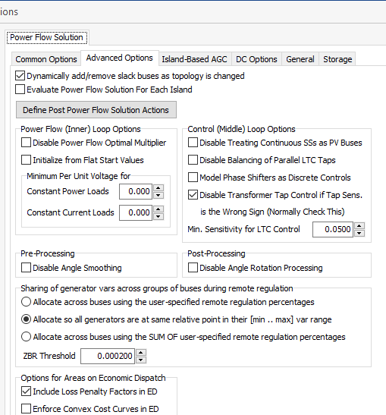
Reactive Power Sharing Options
Different software packages use
different approaches for allocating the reactive power;
PowerWorld has several options.
47

Slide 49
Reactive Power Sharing
In this example, case PSC_37Bus_Varsharing,
the two generators at
Elm345 are jointly controlling Elms138
48

Slide 50
Generator Remote Bus Voltage Control
The next complication is to have the generators at multiple buses doing coordinated voltage control
  Controlled bus may or may not be one of the terminal buses
There must be an a priori decision about how much reactive power is supplied by each bus; example allocations are a fixed percentage or placing all generators at the same place in their regulation range
Implemented by designating one bus as the master; this bus models the voltage constraint
All other buses are treated as PQ, with the equation including a percent of the total reactive power output of all the controlling bus generators
49

