Slide 1
ECEN 460 Power System Operation and Control Spring 2025
Lecture 10: Contingency Analysis, Economic Dispatch
Prof. Tom Overbye
Dept. of Electrical and Computer Engineering
Texas A&M University
overbye@tamu.edu

Slide 2
In the News: The Coming Cold Weather
With the low temperatures forecasted for February 19, 2025, the ERCOT grid will be stressed; here is the six day forecast (as of Feb 17)
The forecasted demand of 78.5 GW would be a new ERCOT Winter Peak, with the current value 78.1 GW from Jan 16, 2024

Slide 3
Power Flow Topology Processing
Commercial power flow software must have algorithms to determine the number of asynchronous, interconnected systems in the model
These separate systems are known as Islands
In large system models such as the Eastern Interconnect it is common to have multiple islands in the base case (one recent EI model had nine islands)
Islands can also form unexpectedly as a result of contingencies
Power can be transferred between islands using dc lines
Each island must have a slack bus
2

Slide 4
Power Flow Topology Processing
Anytime a status change occurs the power flow must perform topology processing to determine whether there are either 1) new islands or 2) islands have merged
Determination is needed to determine whether the island is “viable.” That is, could it truly function as an independent system, or should the buses just be marked as dead
A quite common occurrence is when a single load or generator is isolated; in the case of a load it can be immediately killed; generators are more tricky
3

Slide 5
Topology Processing Algorithm
Since topology processing is performed often, it must be quick (order n ln(n))!
Simple, yet quick topology processing algoritm
Set all buses as being in their own island (equal to bus number)
Set ChangeInIslandStatus true
While ChangeInIslandStatus Do
Go through all the in-service lines, setting the islands for each of the buses to be the smaller island number; if the island numbers are different set ChangeInIslandStatus true
Determine which islands are viable, assigning a slack bus as necessary
This algorithm does depend on the depth of the system
4

Slide 6
Bus Branch versus Node Breaker
Due to a variety of issues during the 1970’s and 1980’s the real-time operations and planning stages of power systems adopted different modeling approaches
Real-Time Operations
Use detailed node/breaker model
EMS system as a set of integrated applications and processes
Real-time operating system
Real-time databases
Planning
Use simplified bus/branch model
PC approach
Use of files
Stand-alone applications
Entire data sets and software tools developed around these two distinct power system models
5

Slide 7
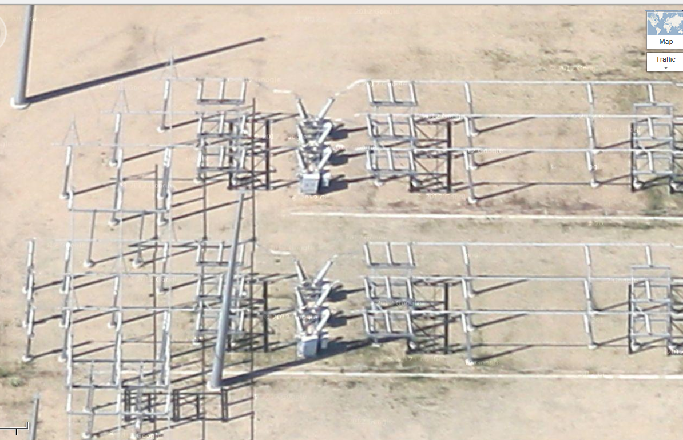
Google View of a 345 kV Substation
6

Slide 8
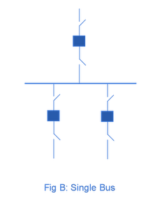
Substation Configurations
Several different substation breaker/disconnect configurations are common:
Single bus: simple but a fault any where requires taking out the entire substation; also doing breaker or disconnect maintenance requires taking out the associated line
Source: http://www.skm-eleksys.com/2011/09/substation-bus-schemes.html
7

Slide 9
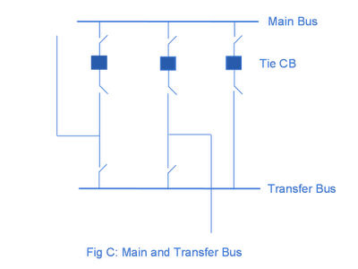
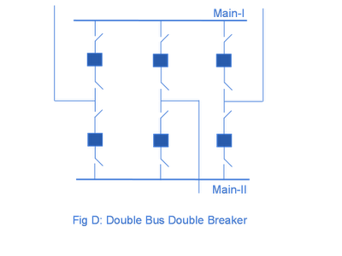
Substation Configurations, cont.
Main and Transfer Bus: Now the breakers can be taken out for maintenance without taking out a line, but protection is more difficult, and a fault on one line will take out at least two
Double Bus Breaker: Now each line is fully protected when a breaker is out, so high reliability, but more costly
Source: http://www.skm-eleksys.com/2011/09/substation-bus-schemes.html
8

Slide 10
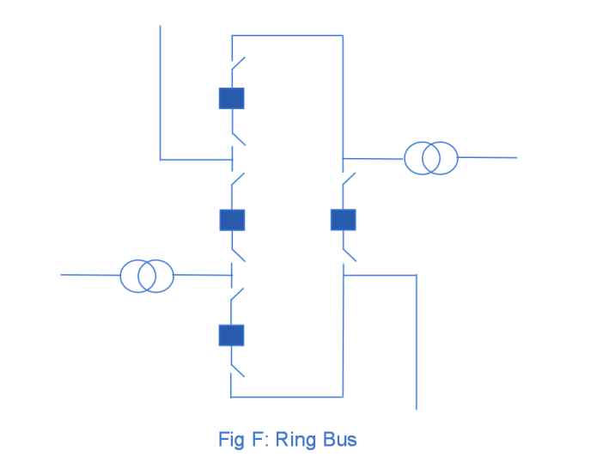
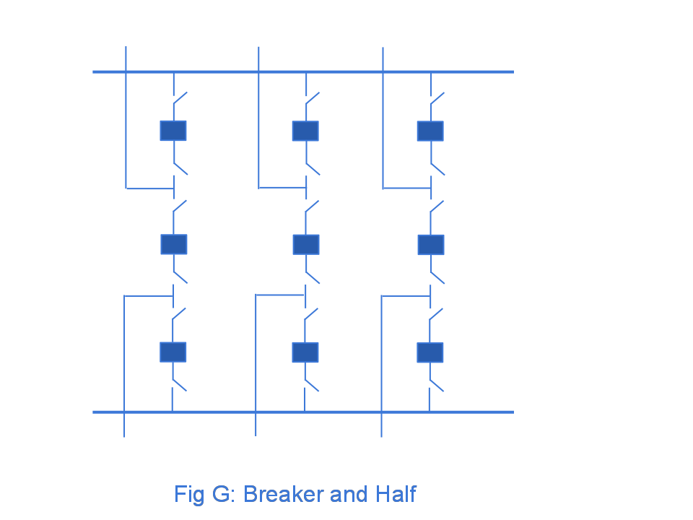
Ring Bus, Breaker and Half
As the name implies with a ring bus the breakers form a ring; number of breakers is same as number of devices; any breaker can be removed for maintenance
The breaker and half has two buses and uses three breakers for two devices; both breakers and buses can be removed for maintenance
Source: http://www.skm-eleksys.com/2011/09/substation-bus-schemes.html
9

Slide 11
EMS and Planning Models
EMS Model
Used for real-time operations
Called full topology model
Has node-breaker detail
Planning Model
Used for off-line analysis
Called consolidated model by PowerWorld
Has bus/branch detail
-30 MW
-18 Mvar
50 MW
20 Mvar
-30 MW
-18 Mvar
10 MW
3 Mvar
10 MW
3 Mvar
-40 MW
-10 Mvar
10 MW
5 Mvar
-40 MW
-10 Mvar
10 MW
5 Mvar
10

Slide 12
Node-Breaker Consolidation
One approach to modeling systems with large numbers of ZBRs (zero branch reactances, such as from circuit breakers) is to just assume a small reactance and solve
This results in lots of buses and branches, resulting in a much larger problem
This can cause numerical problems in the solution
The alterative is to consolidate the nodes that are connected by ZBRs into a smaller number of buses
After solution all nodes have the same voltage; use logic to determine the device flows
11

Slide 13
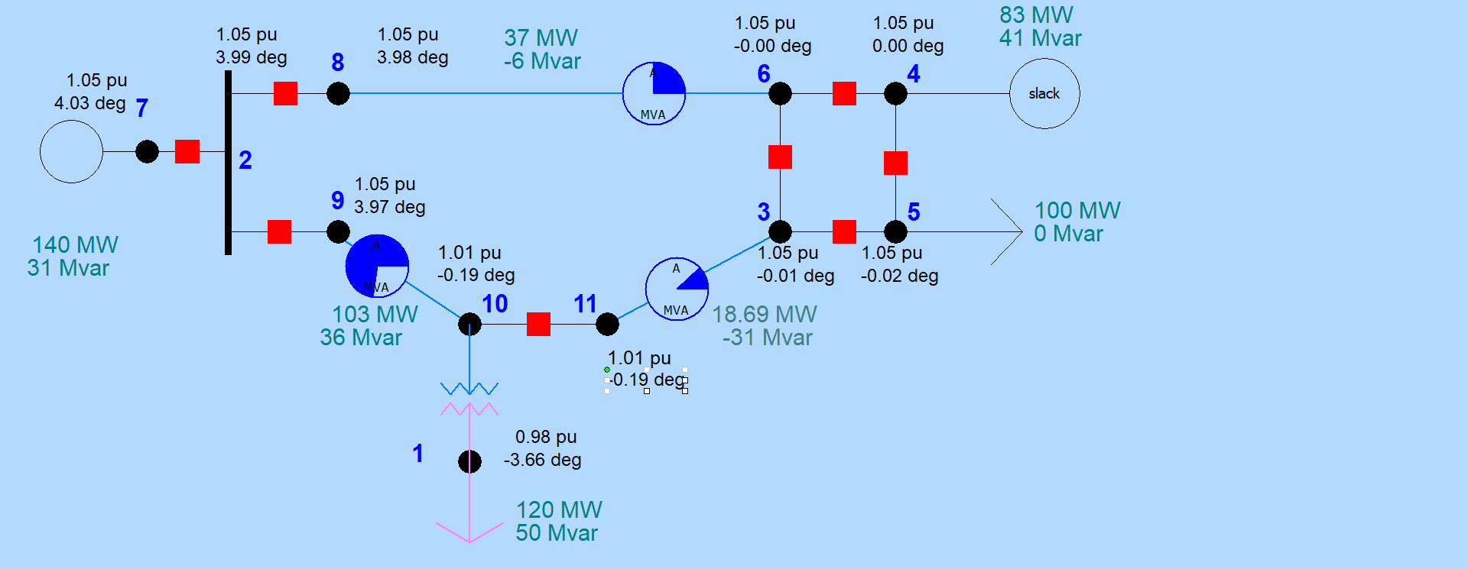
Node-Breaker Example
Case name is FT_11Node. PowerWorld consolidates nodes (buses) into super buses; available in the Model Explorer: Solution, Details, Superbuses.
12

Slide 14
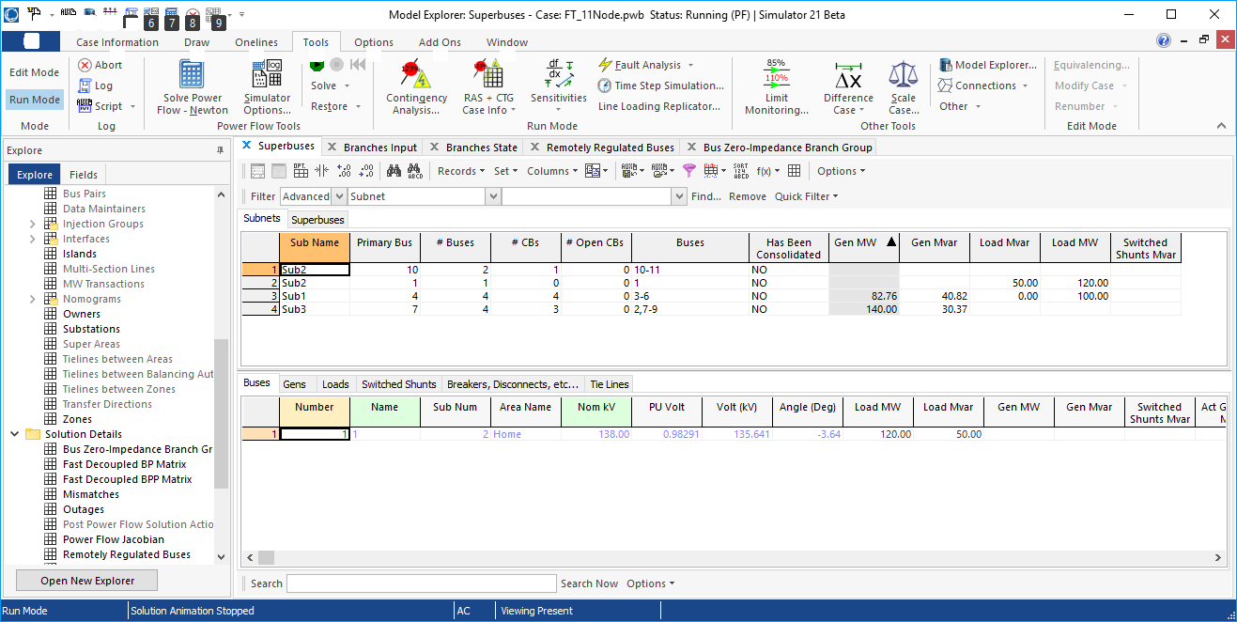
Node-Breaker Example
Note there is ambiguity on how much power is flowing in each device in the ring bus (assuming each device really has essentially no impedance)
13

Slide 15
Contingency Analysis
Contingency analysis is the process of checking the impact of statistically likely contingencies
Example contingencies include the loss of a generator, the loss of a transmission line or the loss of all transmission lines in a common corridor
Statistically likely contingencies can be quite involved, and might include automatic or operator actions
Reliable power system operation requires that the system be able to operate with no unacceptable violations even when these contingencies occur
N-1 reliable operation considers single elements
14

Slide 16
Contingency Analysis
This process can be automated with the usual approach of first defining a contingency set, and then sequentially applying the contingencies and checking for violations
This process can naturally be done in parallel
Contingency sets can get quite large, especially if one considers N-2 (outages of two elements) or N-1-1 (initial outage, followed by adjustment, then second outage
The assumption is usually most contingencies will not cause problems, so screening methods can be used to quickly eliminate many
15

Slide 17
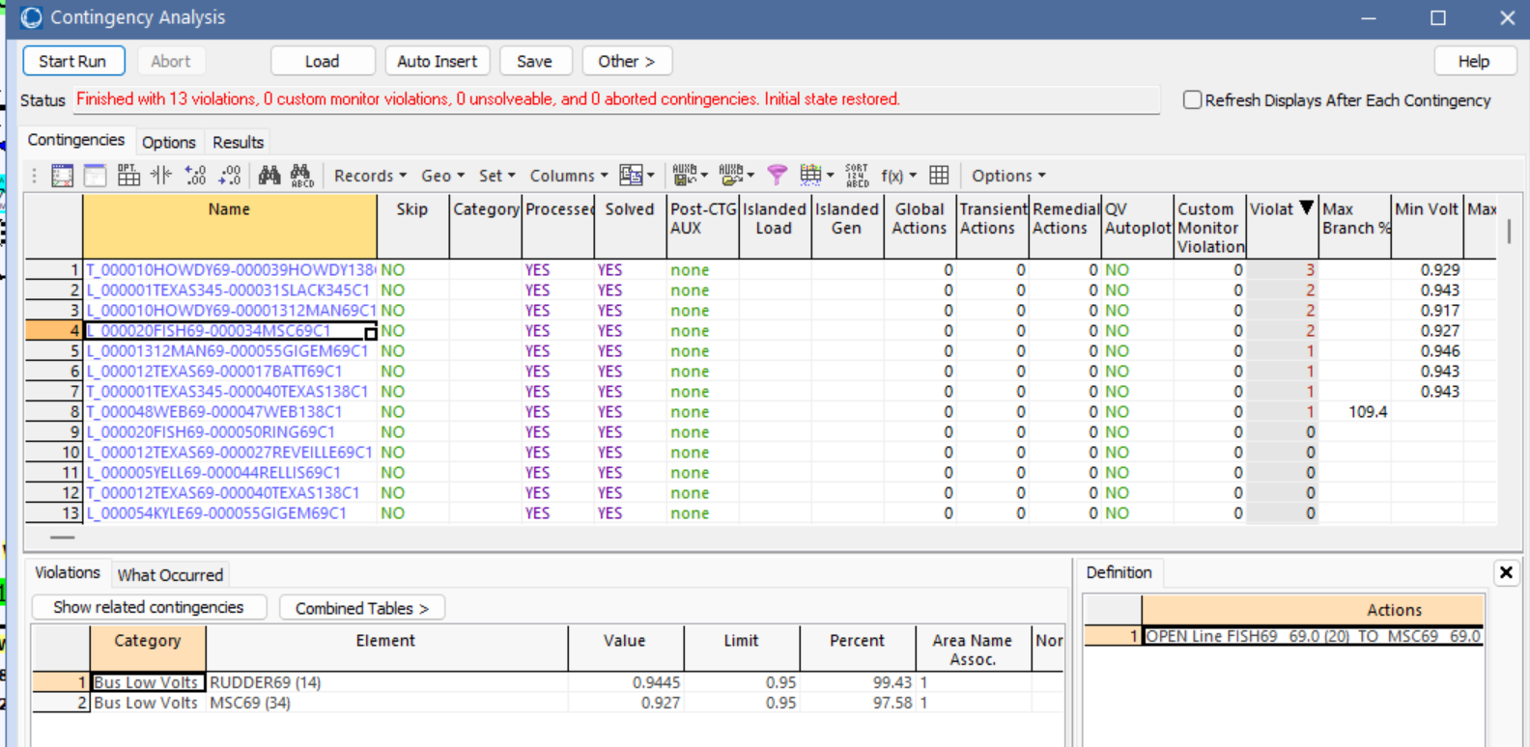
Contingency Example: Small System
The example here is the LabEcon_Bus37_Start case, which will be in Lab 5. To view contingency analysis select Tools, Contingency Analysis
The load has been increased to a multiplier of 0.85
While contingency analysis is simple to describe, many issues need to be considered in a contingent solution. For example, how much time is assumed for post-contingent control actions.
16

Slide 18
Contingency Example: Small System, cont.
To see a particular contingency, right-click on the desired contingency and select Contingency Records, Solve Selected Contingency
For the WEB138-WEB69 contingency, the single violation can be easily fixed by reducing the generation at WEB69
17

Slide 19
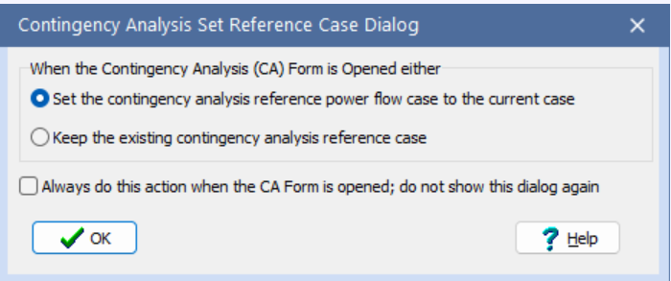
Contingency Analysis, cont.
When doing contingency analysis in Simulator, the base case (starting case) is stored in memory, so it can be easily restored. This is known as the reference case
This makes it easy to examine particular contingencies, but in can cause ambiguity when contingency analysis is restarted
When doing this the below dialog sometimes appears, asking which power flow case should be used as the contingency analysis reference case, either the current one, or the stored reference one
18

Slide 20
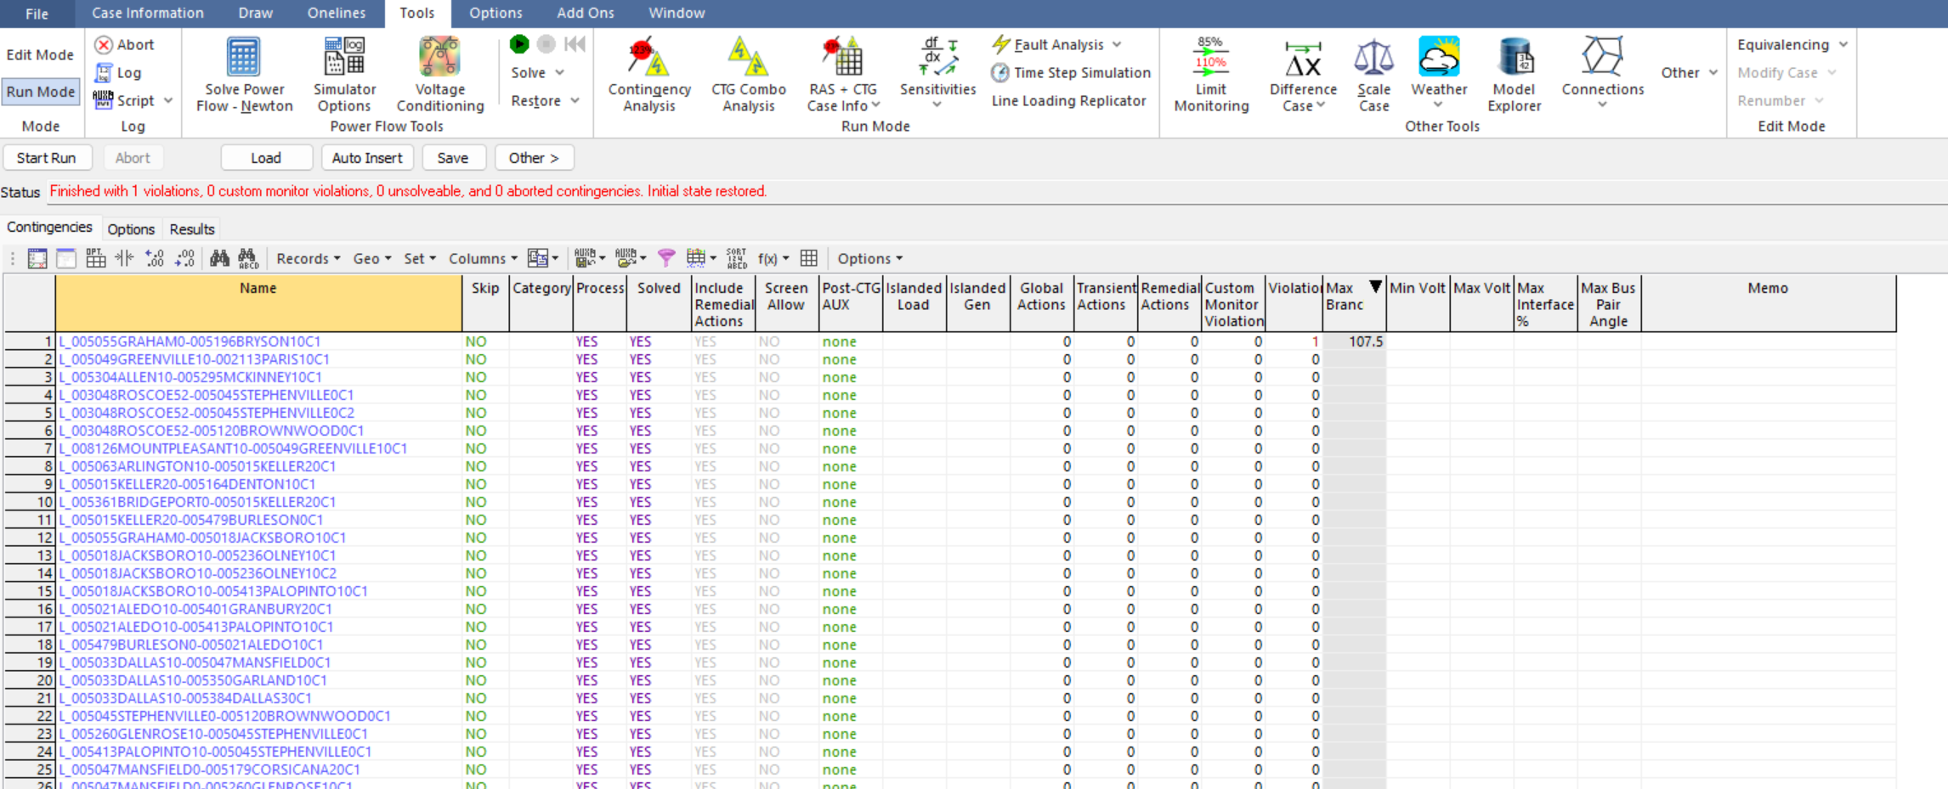
Contingency Example: 2000 Bus System
Next, open the LabEcon_Texas_Start case, which has 77 contingencies defined
Contingency analysis is a naturally parallel application; computation can also be reduced using approximate techniques
19

Slide 21
NERC
The North American Electric Reliability Corporation (NERC) is a nonprofit corporation that is charged with ensuring the reliability and adequacy of the North American electric grid
NERC formed in 2006, succeeding the North American Electric Reliability Council, which dates to 1968; it is now based in Atlanta, GA
The formation of the new NERC and the old NERC were both driven by blackouts (1965 and August 14, 2003)
As a result of the Energy Policy Act of 2005 an entity (i.e., the new NERC) needs to develop and enforce mandatory reliability standards
These standards cover many things, including operations and planning, and do require contingency analysis
20

Slide 22
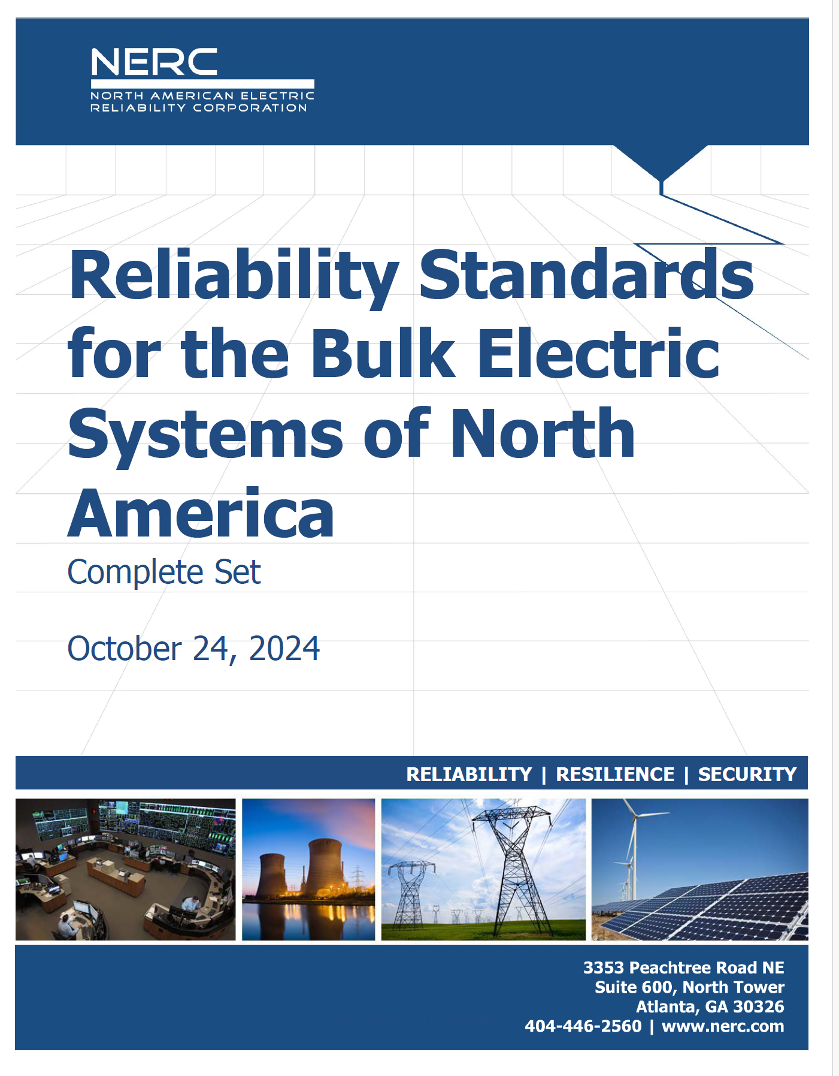
NERC and Reliability Standards
You can download the full set at
www.nerc.com/pa/Stand/Reliability%20Standards%20Complete%20Set/RSCompleteSet.pdf
This document has 3641 pages!
TOP-001-3 covers Transmission Operations, with the purpose, “to prevent instability, uncontrolled separation, or Cascading outages that adversely impact the reliability of the Interconnection by ensuring prompt action to prevent or mitigate such occurrences.”
Requirement R13 says the, “Each Transmission Operator shall ensure that a Real-time Assessment is performed at least once every 30 minutes.”
This includes doing real-time contingency analysis
21

Slide 23
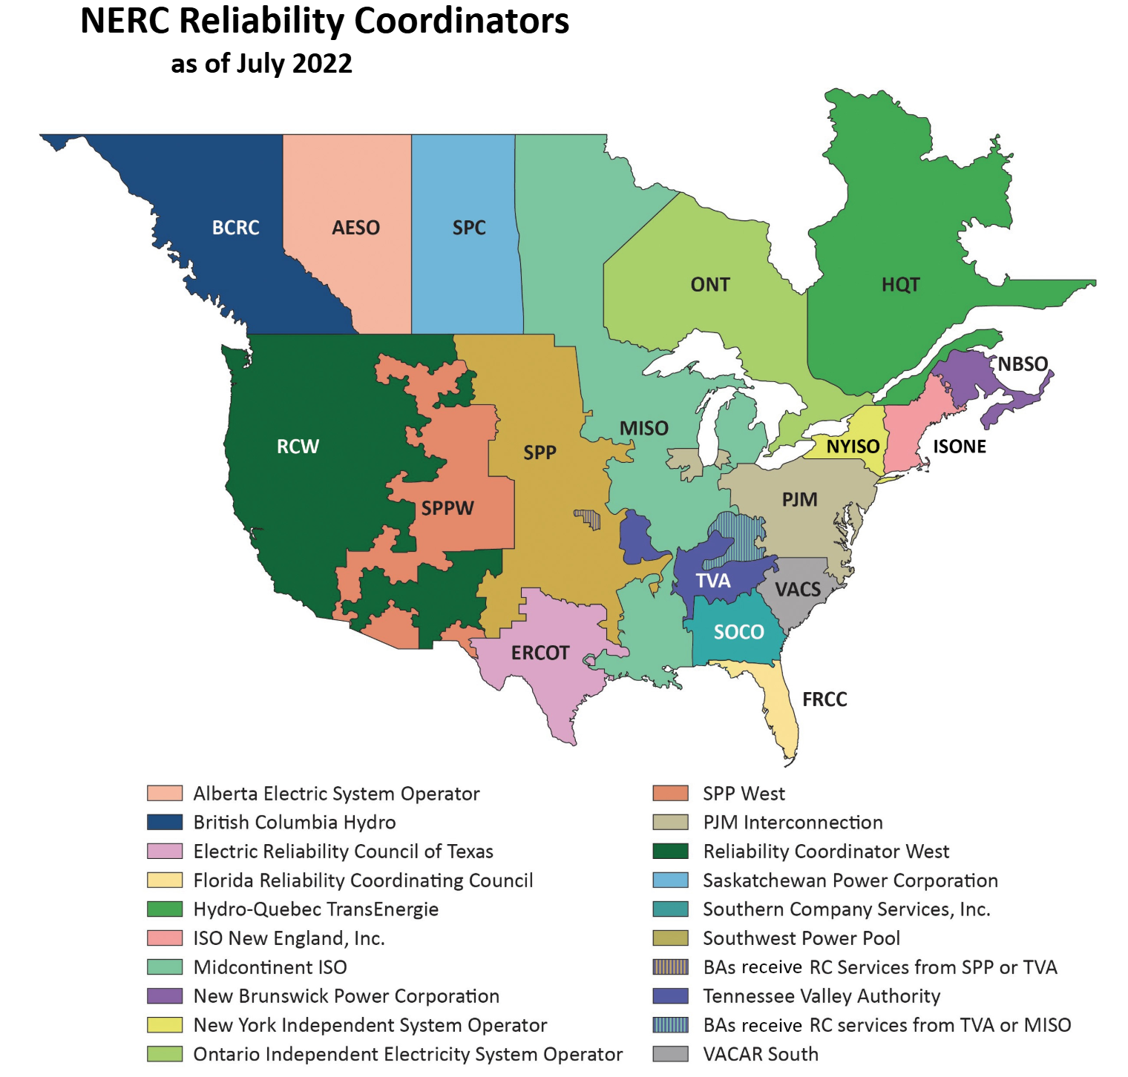
NERC Reliability Coordinators
The Reliability Coordinator (RC) is the entity with the “highest level of authority who is responsible for the Reliable Operation of the Bulk Electric System (BES) and has the authority to prevent or mitigate emergency operating situations in both next‐day analysis and real‐time operations.”
www.nerc.com/pa/Stand/Functional%20Model%20Advisory%20Group%20DL/FM_Technical_Document_V5-1_clean_10082019.pdf
22

Slide 24
Engineering Study Situational Awareness
A common human factors term is “Situation Awareness” or “Situational Awareness” (SA)
SA is formally defined as, “the perception of the elements in the environment within a volume of time and space, the comprehension of their meaning and the projection of their status in the near future”
The informal definition is “knowing what’s going on” [1]
The SA term started being used in the electric grid community after the August 14, 2003 blackout, with lack of SA noted as being two of the four primary causes of the event
[1] Quotes source: C.L. Wickens, “Situation Awareness: Review of Mica Endsley’s 1995 Articles on Situation Awareness Theory and Measurement,” Human Factors, Vol. 50, pp. 397-403, June 2008.
23

Slide 25
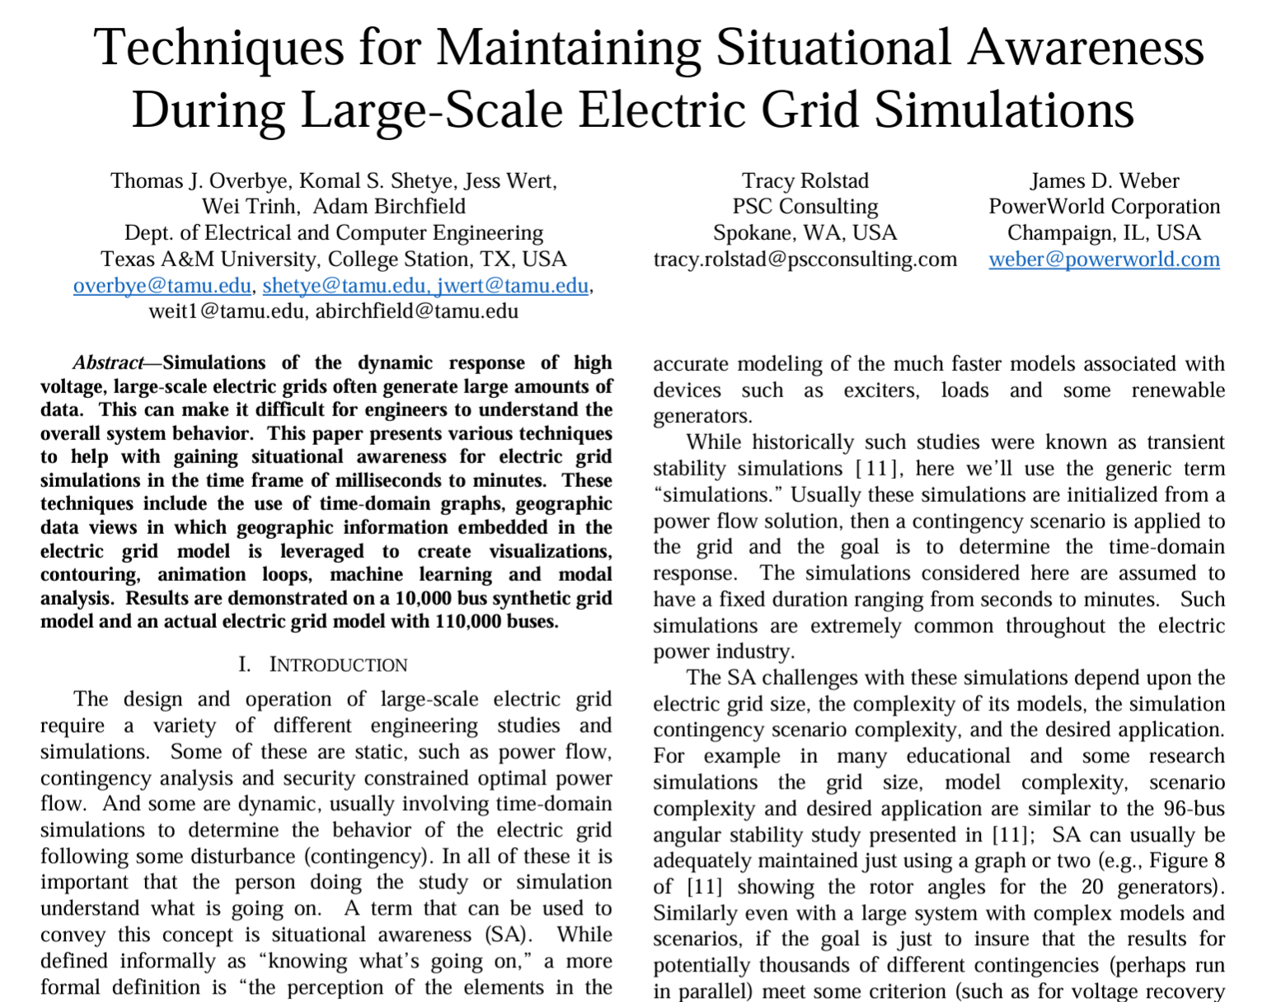
Engineering Study Situational Awareness, cont.
While SA is mostly associated with operations, the same term certainly applies to engineering studies as well, such as with large grids
The models and software used in these studies have lots of parameters, and options; the engineer doing the studies needs to understand “what is going on”
Paper: T.J. Overbye, K.S. Shetye, J.L. Wert, W. Trinh, A. Birchfield, Tracy Rolstad, Jamie Weber, “Techniques for Maintaining Situational Awareness During Large-Scale Electric Grid Simulations,” IEEE Power and Energy Conference at Illinois (PECI), Champaign, IL, April 2021. Available at overbye.engr.tamu.edu/publications/
24

Slide 26
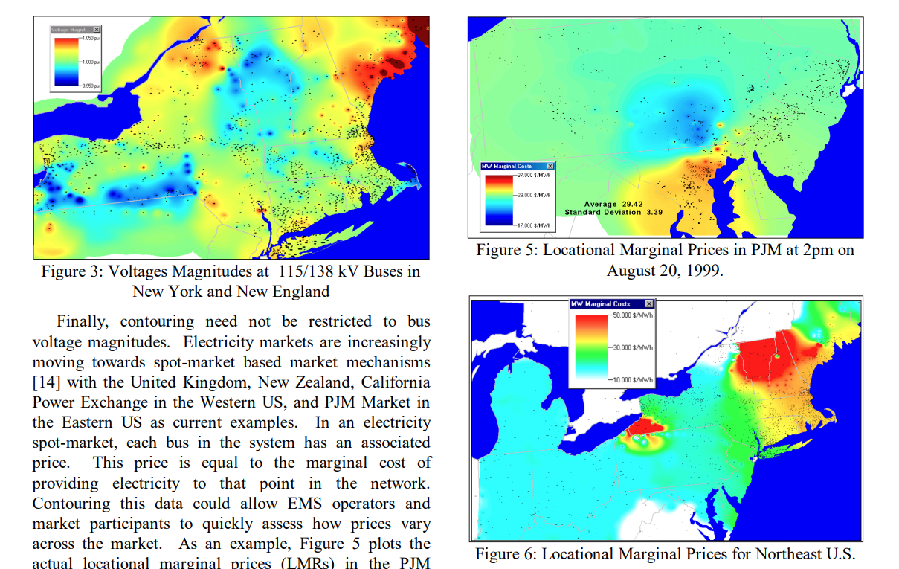
Color Contouring Power System Information
Jamie Weber and I popularized color contouring in the power system community starting in 1998
A few years prior to our work, EPRI had looked at contouring, and concluded it was not a useful approach
There are some valid objections to using on contouring, but we concluded the benefits out weighted the problems
Images from: T. J. Overbye and J. D. Weber, "Visualization of power system data," Proceedings of the 33rd Annual Hawaii International Conference on System Sciences, Maui, HI, USA, 2000, pp. 7 pp.-, doi: 10.1109/HICSS.2000.926744
25

Slide 27
Book Chapter 7 Photo
This is our utility control center test facility out at the Texas A&M RELLIS campus, Center for Infrastructure Renewal (CIR) building
26

Slide 28
Power System Economic Dispatch
Generators can have vastly different incremental (also called marginal) operational costs
Some are essentially free or low cost (wind, solar, hydro, nuclear)
Because of the large amount of natural gas generation, electricity prices are very dependent on natural gas prices
Marginal cost is a general economic concept
When there are multiple sources for a product (electricity here), and each has an increasing marginal production cost, the optimal solution (dispatch) is when all the sources have equal marginal cost
Economic dispatch is concerned with determining the best dispatch for generators that minimizes cost without changing their commitment
27

Slide 29
Lab 5 Intro: Economic Dispatch in PowerWorld
In power systems economic dispatch has mostly been replaced by a more general optimal power flow (OPF) solution, which we’ll cover next. However, we’ll cover economic dispatch first since 1) it is simpler, and 2) sets the stage of OPF
Economic dispatch in power systems uses the standard economics concept of equal marginal cost, but with two main caveats
Economic dispatch is done on each balancing authority area (areas in the power flow)
Economic dispatch usually considers system losses, recognizing that as the generation dispatch is changed the losses also change; this is represented by penalty factors applied to the generator marginal cost curves
Since it is used in Lab 5, I’ll first show you how to do it in PowerWorld, and then present the modeling and solution algorithms
28

Slide 30
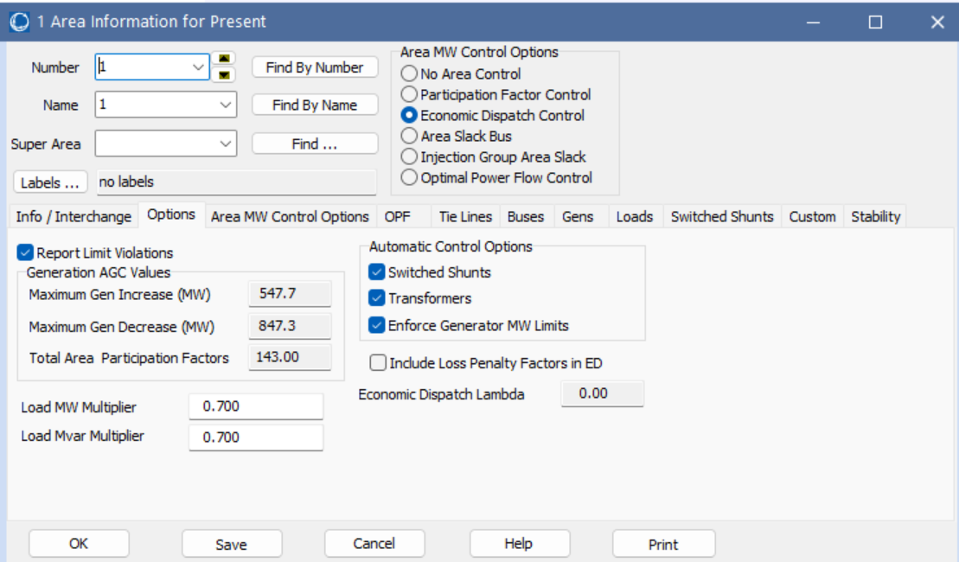
Lab 5 Intro: Economic Dispatch in PowerWorld
Lab 5 37-bus case, showing turning on/off inclusion of the penalty factors
29

Slide 31
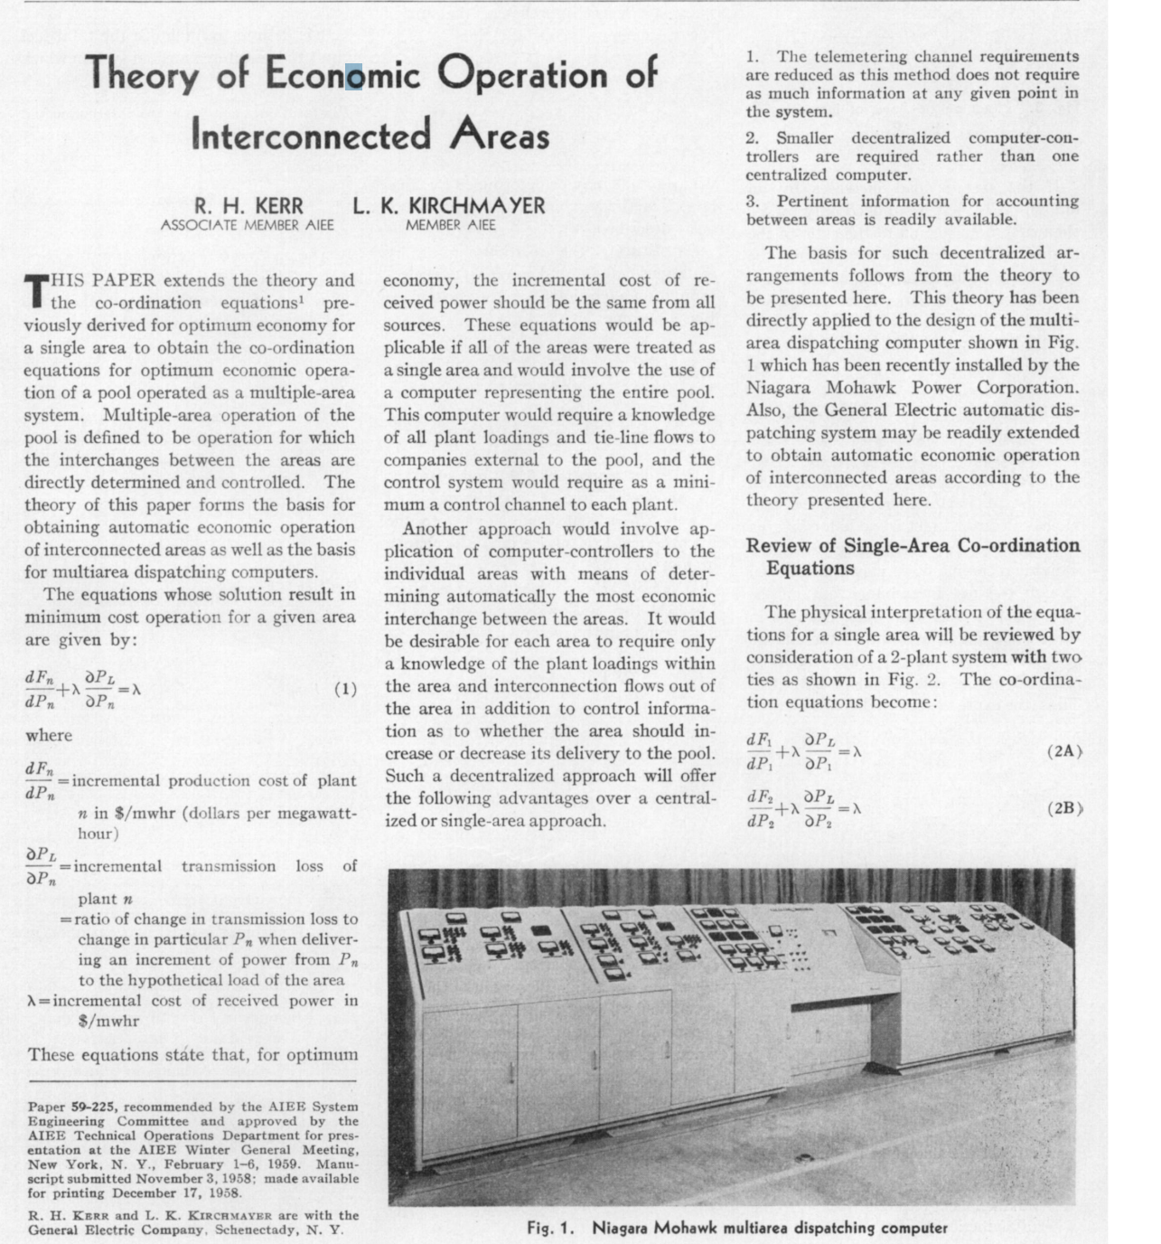
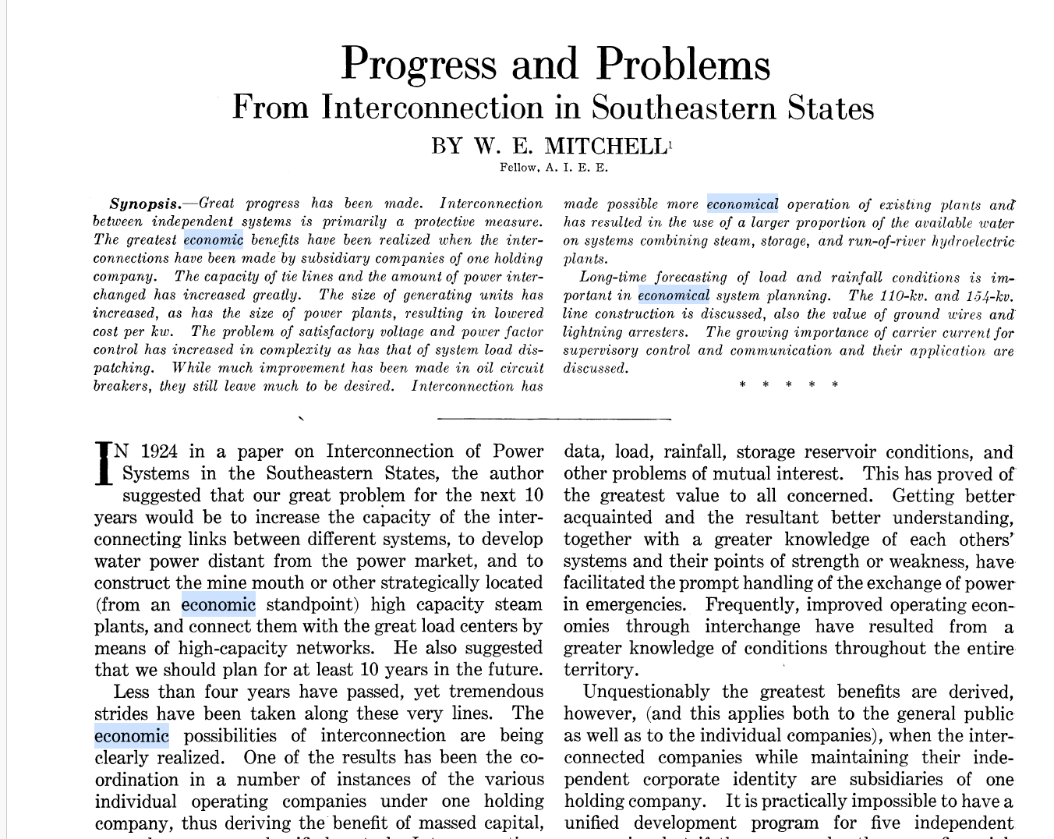
Electric Grid Economic Operation
Electric grid operations have been optimized for many decades!
1958
1928
30

Slide 32
Unit Commitment: Quick Coverage
Before covering economic dispatch, we’ll first touch on unit commitment
Unit commitment is used to determine which generator units should be committed to meet the load
The electric load varies substantially so there is almost always more generator capacity available than load
Units have availability constraints
Minimum up time, time to start, cost to start
Minimum down time, time to shutdown, cost to shutdown
Ramp rates, minimum MW output
Scheduled and unscheduled outages
System constraints including load, reserve, emissions, network
31

Slide 33
Solving Unit Commitment
Unit commitment involves a potentially large number of integer and continuous variables
Not just the status of each unit, but also the amount of time it has been in a particular state (i.e., off or on)
Solved for a set of discrete time periods, which at each time period there are lots of different potential states
Solution approaches include
Dynamic programming
Lagrangian relaxation
Mixed Integer Programming (MIP) (currently state-of-the-art)
the idea is some or all of the variables are restricted to being integers; it is widely used in many applications, with a power application looking at generator statuses (on=1, off=0)
32

