Slide 1
ECEN 460
Power System Operation and Control
Spring 2025
Lecture 11: Economic Dispatch and Optimal Power Flow (OPF)
Prof. Tom Overbye
Dept. of Electrical and Computer Engineering
Texas A&M University
overbye@tamu.edu

Slide 2
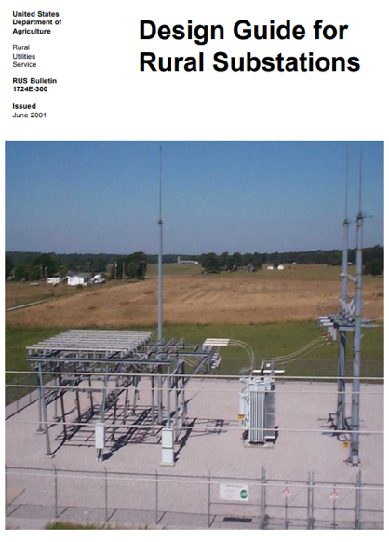
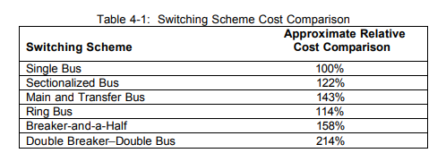
Breaker Configurations Relative Costs (from Tracy Rolstad)
What is best depends on application, with double breaker, double bus common
Single Bus—Single Breaker
Main and Transfer Bus
Ring Bus
Breaker and a half
Double Bus—Double Breaker
1

Slide 3
Unit Commitment: Quick Coverage
Before covering economic dispatch, we’ll first touch on unit commitment
Unit commitment is used to determine which generator units should be committed to meet the load
The electric load varies substantially so there is almost always more generator capacity available than load
Units have availability constraints
  Minimum up time, time to start, cost to start
  Minimum down time, time to shutdown, cost to shutdown
  Ramp rates, minimum MW output
  Scheduled and unscheduled outages
System constraints including load, reserve, emissions, network
2

Slide 4
Solving Unit Commitment
Unit commitment involves a potentially large number of integer and continuous variables
  Not just the status of each unit, but also the amount of time it has been in a particular state (i.e., off or on)
Solved for a set of discrete time periods, which at each time period there are lots of different potential states
Solution approaches include
  Dynamic programming
  Lagrangian relaxation
  Mixed Integer Programming (MIP) (currently state-of-the-art)
    the idea is some or all of the variables are restricted to being integers; it is widely used in many applications, with a power application looking at generator statuses (on=1, off=0)
3

Slide 5
Longer Term Optimization: Quicker Coverage
Longer term optimization is a key consideration in hydro systems with significant reservoir storage
  Use the water when it is the most valuable taking into account potentially many other constraints
Generator maintenance scheduling
Building generation often involves large upfront capital costs to create an asset that will last 20 to 40 years; long-term contracts provide a way to share the risk
Take-or-pay contracts obligate a purchaser to purchase so much of a product over a given time period
4

Slide 6
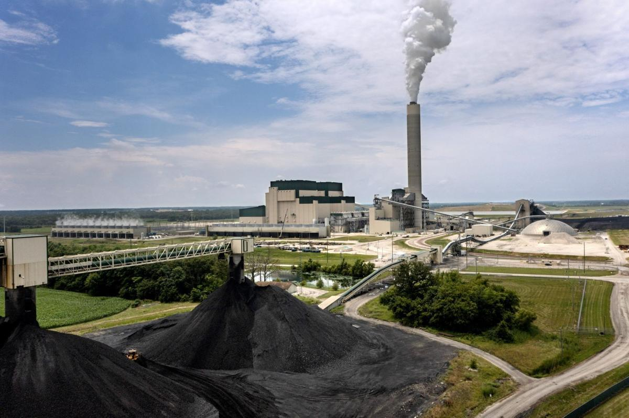
Example: Prairie State Energy Campus
The Prairie State Energy Campus (PSEC) is a 1600 MW coal plant in Southern Illinois with its own coal mine
that opened in 2012
  It is owned by municipals and coops (my former
  coop got >60% of the energy from PSEC)
  While relatively efficient, it is one of the US’s
  largest sources of CO2 emissions
  It cost an estimate $4 billion to build; if it sells
  its power at $30/MWh then maximum yearly
  income would be $30*1600*8760=$420 million
Illinois’s new clean energy law requires PSEC to reduce carbon emissions by 45% by 1/1/35 and be 100% carbon free by the end of 2045
Image: Pantagraph.com
5

Slide 7
Generation Dispatch
Since the load is variable and there must be enough generation to meet the load, almost always there is more generation capacity available than load
Optimally determining which generators to use can be a complicated task due to many different constraints
  For generators with low or no cost fuel (e.g., wind and solar PV) it is “use it or lose it”
  For others like hydro there may be limited energy for the year
  Some fossil has shut down and start times of many hours
Economic dispatch looks at the best way to instantaneously dispatch the generation with the assumption of a fixed number of available generators
  Unit commitment determines which generators are on
6

Slide 8
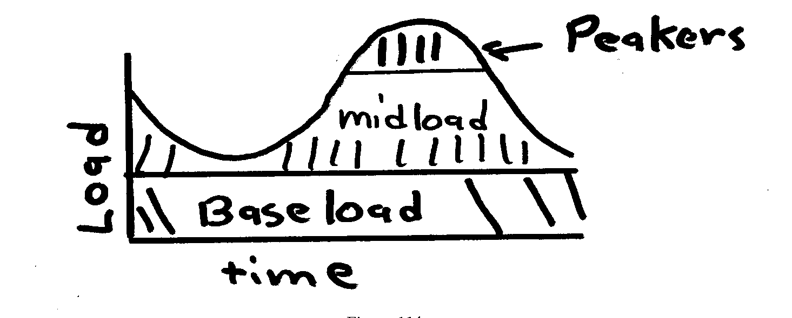
Generator Types (Traditional)
Traditionally utilities have had three broad groups of generators
  baseload units: large coal/nuclear; always on at max.
  midload units: smaller coal that cycle on/off daily
  peaker units: combustion turbines used only for several hours during periods of high demand
Wind and solar PV can be
quite variable; usually they are operated at maximum available power
7

Slide 9
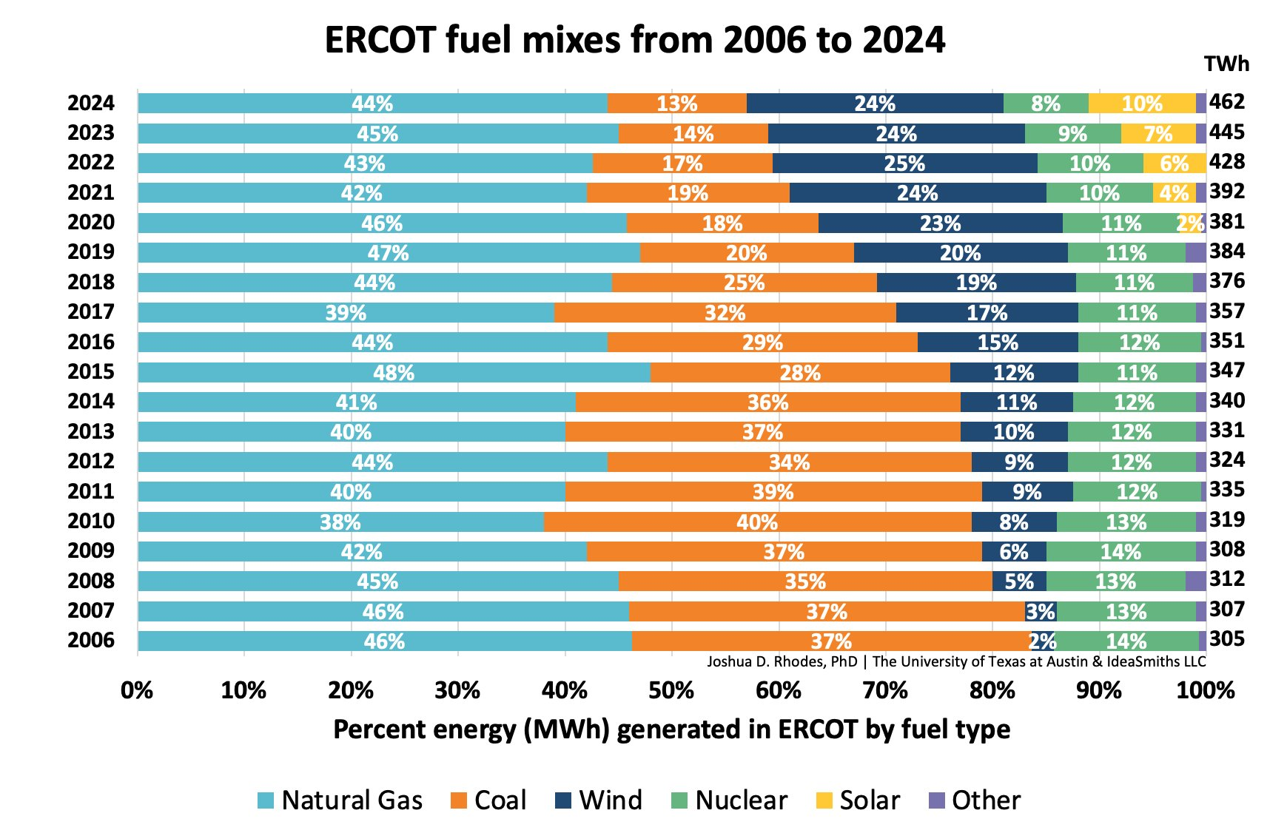
Generation Types (ERCOT)
8
Image source: x.com/joshdr83/status/1882809452820332564?mx=2 (with the data ultimately from ERCOT)

Slide 10
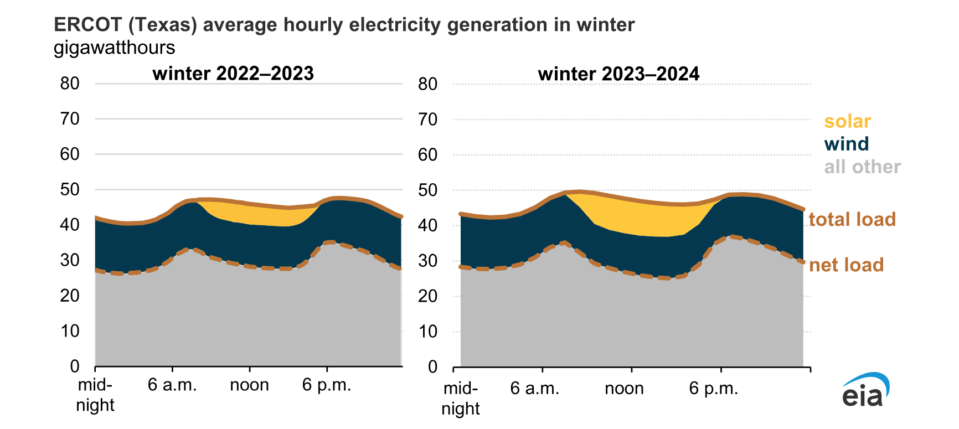
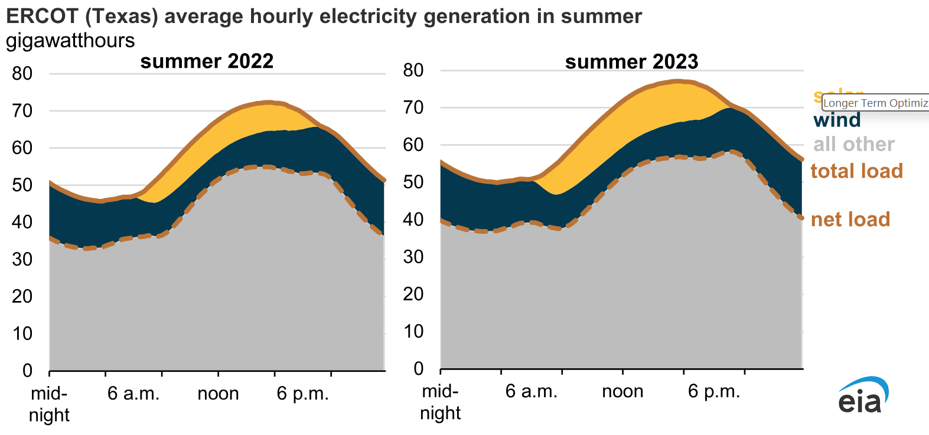
ERCOT Typical Daily Curves
9

Slide 11
Thermal versus Hydro Generation
The two main types of generating units are thermal and hydro, with wind and solar rapidly growing
For hydro the fuel (water) is free but there may be many constraints on operation
  fixed amounts of water available
  reservoir levels must be managed and coordinated
  downstream flow rates for fish and navigation
Some countries get a large percentage of their generation from hydro including Brazil, Canada, Norway and Sweden
Hydro optimization is typically longer term (many months or years)
In 460 we will concentrate on thermal units and some wind and solar, looking at short-term optimization
10

Slide 12
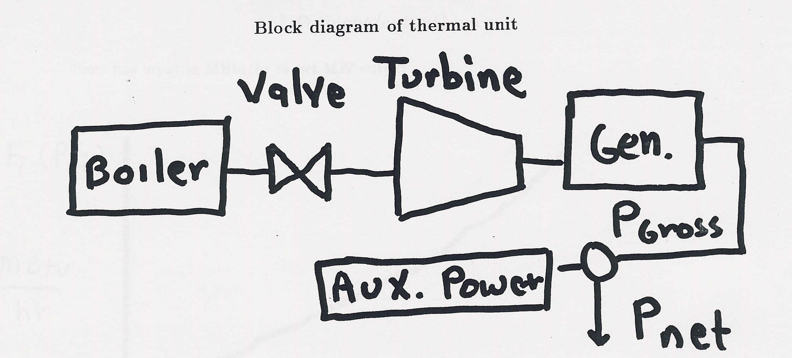
Block Diagram of Thermal Unit
To optimize generation costs we need to develop cost relationships between net power out and operating costs. Between 2-6% of power is used within the generating plant; this is known as the auxiliary power
11

Slide 13
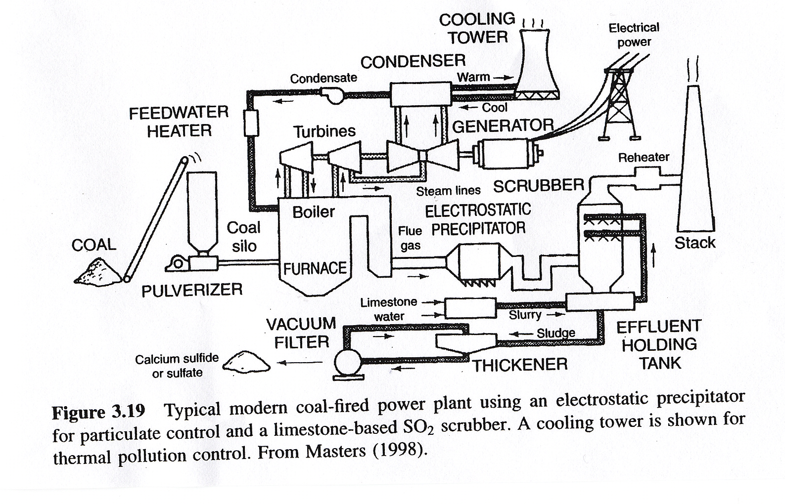
Coal Plant Diagram
Source: Masters, Renewable and Efficient Electric Power Systems, 2004
12

Slide 14
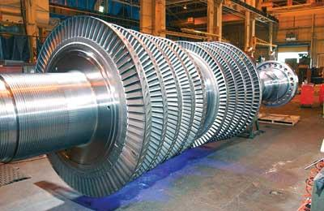
Turbine for Nuclear Power Plant
Source: images.pennnet.com/articles/pe/cap/cap_gephoto.jpg
13

Slide 15
Basic Gas Turbine
Most common fuel is natural gas
Typical efficiency is around 30 to 35%
14

Slide 16
Combined Cycle Power Plant
Efficiencies of up to 60% can be achieved, with even higher values when the steam is used for heating; fuel is usually natural gas
15

Slide 17
Generator Cost Curves
Generator costs are typically represented by up to four different curves
  input/output (I/O) curve
  fuel-cost curve
  heat-rate curve
  incremental cost curve
For reference
  1 Btu (British thermal unit) = 1054 J
  1 MBtu = 1x10⁶ Btu
  1 MBtu = 0.293 MWh
  3.41 Mbtu = 1 MWh
16

Slide 18
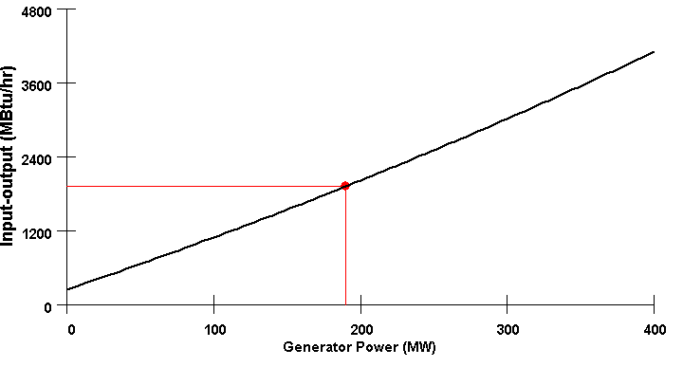
I/O Curve
The IO curve plots fuel input (in MBtu/hr) versus net MW output.
17

Slide 19
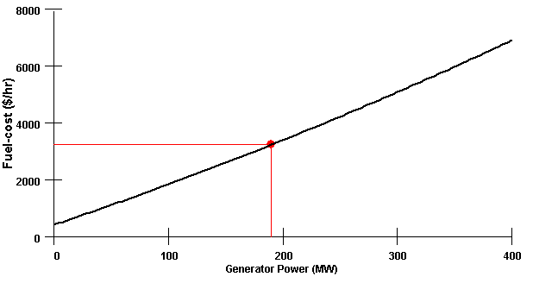
Fuel-cost Curve
The fuel-cost curve is the I/O curve scaled by fuel cost. Fuel costs vary (with the latest values in Chapter 4 of EIA’s Electricity Monthly)
For 11/2024, coal in
Texas was $1.80 per
Mbtu, while natural
gas was at $1.96;
natural gas was about
$4/Mbtu in California
18

Slide 20
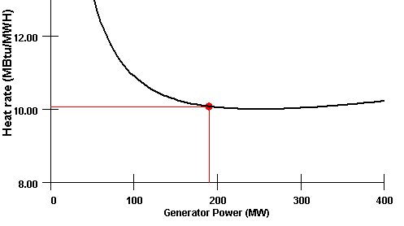
Heat-rate Curve
Plots the average number of MBtu/hr of fuel input needed per MW of output.
Heat-rate curve is the I/O curve scaled by MW; often heat rates are given in
Btu/kWh, which is the Mbtu/MWh value multiplied by 1000
Coal and nuclear heat rates are around 10 (MBtu/MWh), and get down to 6.2 for highly efficient combined cycle plants
19

Slide 21
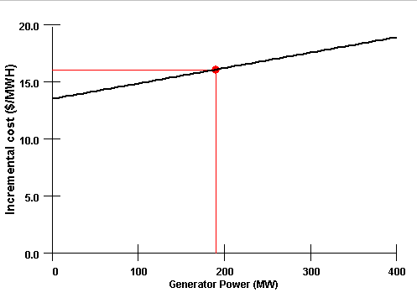
Incremental (Marginal) cost Curve
Plots the incremental $/MWh as a function of MW.
Found by differentiating the cost curve
20

Slide 22
Mathematical Formulation of Costs
Generator cost curves are usually not smooth. However the curves can usually be adequately approximated using piece-wise smooth, functions.
Two representations predominate
  quadratic or cubic functions
  piecewise linear functions
In 460 we'll assume a quadratic representation
21

Slide 23
Coal Usage Example 1
A 500 MW (net) generator is 35% efficient. It is being supplied with Western grade coal, which costs $1.70 per MBtu and has 9000 Btu per pound. What is the coal usage in lbs/hr? What is the cost?
22

Slide 24
Coal Usage Example 2
Assume a lights with a total power consumption of 100W are left on by mistake for 8 hours, and that the electricity is supplied by the previous coal plant and that transmission and distribution losses are 20%. How coal has been used?
23

Slide 25
Incremental Cost Example
24

Slide 26
Incremental Cost Example, cont'd
25

Slide 27
Power System Economic Dispatch
Economic dispatch is formulated as a constrained minimization
  The cost function is often total generation cost in an area
  Single equality constraint is the real power balance equation
Solved by setting up the Lagrangian (with P_{D} the load and P_{L} the losses, which are a function the generation)
A necessary condition for a minimum is that the gradient is zero. Without losses this occurs when all generators are dispatched at the same marginal cost (except when they hit a limit)
26

Slide 28
Power System Economic Dispatch
If losses are neglected then there is a single marginal cost (lambda); if losses are included then each bus could have a different marginal cost
27

Slide 29
Economic Dispatch Penalty Factors
The penalty factor
at the slack bus is
always unity!
28

Slide 30
Economic Dispatch Example
Case is Example7_3 from the book; use Power Flow Solution
Options, Advanced Options to set penalty factor options
29

Slide 31
Unconstrained Minimization
Assume we have a function f(x) and wish to determine its minimum. This is an unconstrained minimization. A necessary (but not sufficient) condition for a minimum is the gradient of the function must be zero.
The gradient generalizes the first derivative for multi-variable problems:
This is not sufficient since the gradient is also zero at the maximum and at any saddle points
30

Slide 32
Minimization with Equality Constraint
When the minimization is constrained with one or more equality constraints we can solve the problem using the method of Lagrange Multipliers
Key idea is to modify a constrained minimization problem to be an unconstrained problem
31

Slide 33
Economic Dispatch Lagrangian
32

Slide 34
Economic Dispatch Example
33

Slide 35
Economic Dispatch Example, cont’d
34

Slide 36
Lambda-Iteration Solution Method
The direct solution only works well if the incremental cost curves are linear and no generators are at their limits
A more general method is known as the lambda-iteration
  the method requires that there be a unique mapping between a value of lambda and each generator’s MW output
  the method then starts with values of lambda below and above the optimal value, and then iteratively brackets the optimal value
35

Slide 37
Lambda-Iteration Algorithm
36

Slide 38
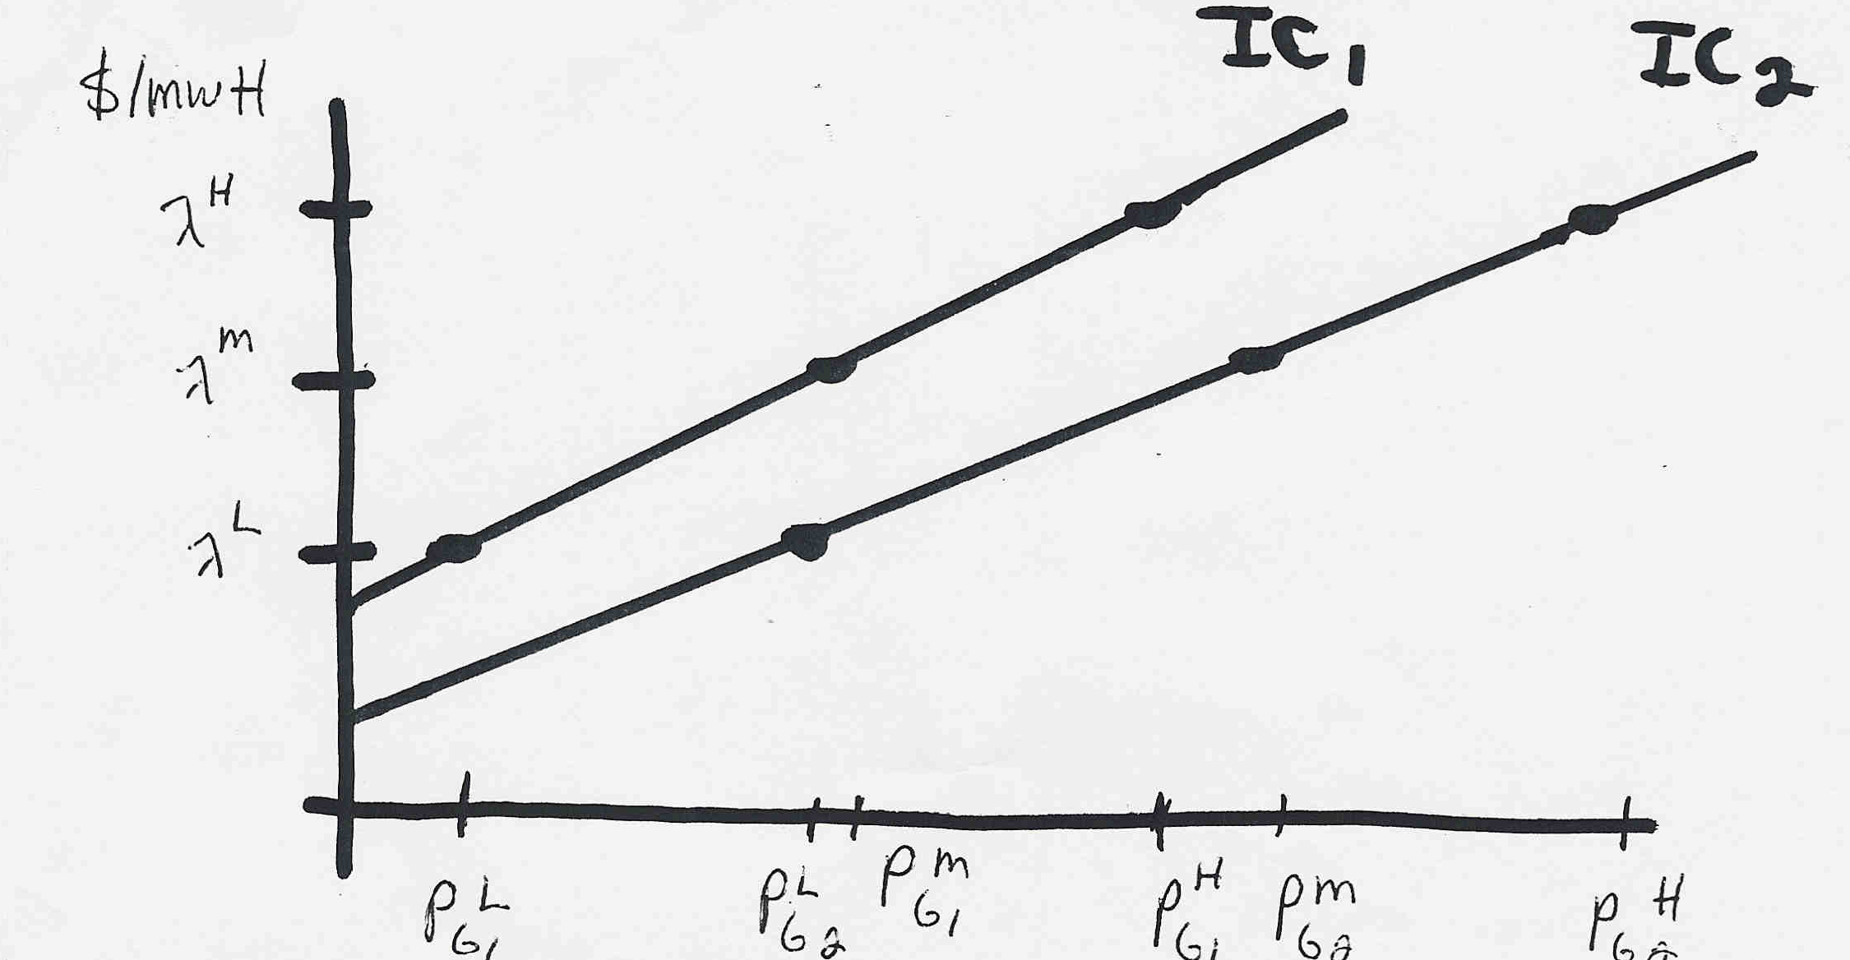
Lambda-Iteration: Graphical View
In the graph shown below for each value of lambda there is a unique P_{Gi} for each generator. This relationship is the P_{Gi}(λ) function.
37

Slide 39
Lambda-Iteration Example
38

Slide 40
Lambda-Iteration Example, cont’d
39

Slide 41
Lambda-Iteration Example, cont’d
40

Slide 42
Lambda-Iteration Example, cont’d
41

Slide 43
Generator MW Limits
Generators have limits on the minimum and maximum amount of power they can produce
Often times the minimum limit is not zero. This represents a limit on the generator’s operation with the desired fuel type
Because of varying system economics usually many generators in a system are operated at their maximum MW limits.
42

Slide 44
Area Supply Curve
The area supply curve shows how the marginal cost for an area (or the entire case) varies assuming an economic dispatch
  The curves for an area or super area are available in their case information displays by right-clicking and selecting Plot
  then one of its options
  This is a quick way to get an overall
  feel for a case
Texas2000 Supply Curve
PSC_37Bus Supply Curve

Slide 45
Electric Grid Terminology: Security vs Reliability
Historically electric grid design used the term security to mean the reliable operation of the electric grid. However, after Sept 11th, the term has been changed (mostly) to reliability
  [From NERC History Book, page 62] The World Trade Center and the Pentagon were attacked by terrorists on September 11, 2001. Shortly after the attack, Mr. Richard Clarke, then national coordinator for Security, Infrastructure Protection, and Counterterrorism, met with NERC officials to discuss ways of protecting the electric system from acts of terrorism. After hearing NERC references to “security coordinators,” Mr. Clarke interrupted to say, “Wait a minute— I’m the security coordinator.” Shortly thereafter, NERC began to use the term “operating reliability” in place of “security,” and “Reliability Coordinators” in place of “security coordinators.”
Quote source: www.nerc.com/news/Documents/NERCHistoryBook.pdf
44

Slide 46
Optimal Power Flow (OPF)
OPF functionally combines the power flow with economic dispatch
Security Constrained OPF (SCOPF) adds in contingency analysis
Goal of OPF and SCOPF is to minimize a cost function, such as operating cost, taking into account realistic equality and inequality constraints
Equality constraints
  bus real and reactive power balance
  generator voltage setpoints
  area MW interchange
45

