Slide 1
ECEN 460
Power System Operation and Control
Spring 2025
Lecture 12: Optimal Power Flow (OPF) and Security-Constrained OPF (SCOPF)
Prof. Tom Overbye
Dept. of Electrical and Computer Engineering
Texas A&M University
overbye@tamu.edu

Slide 2
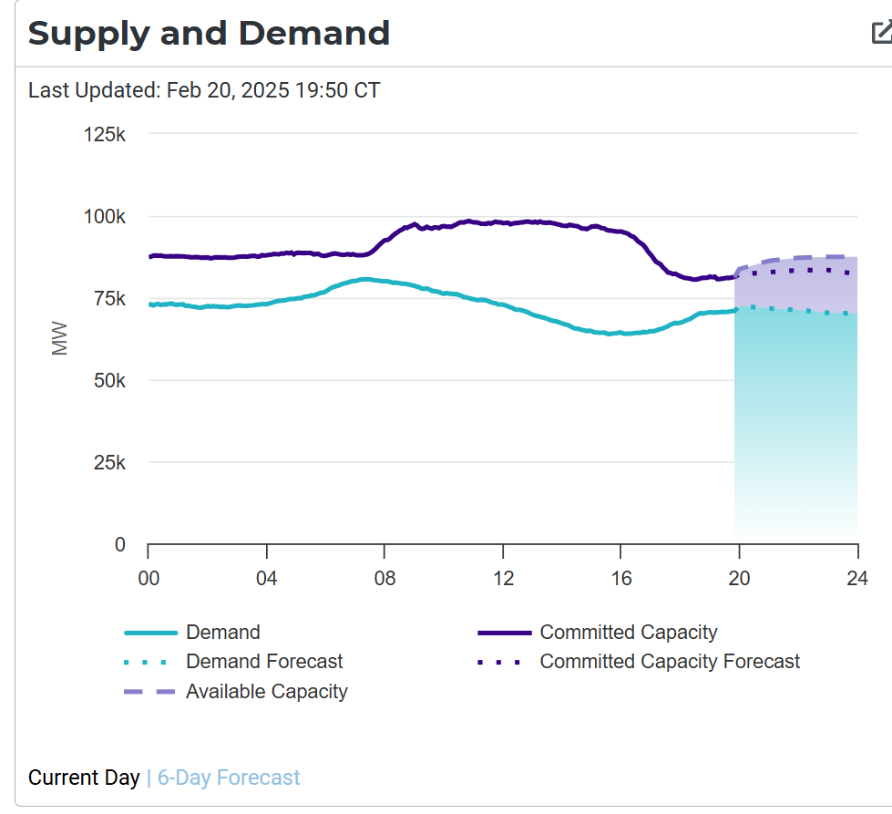
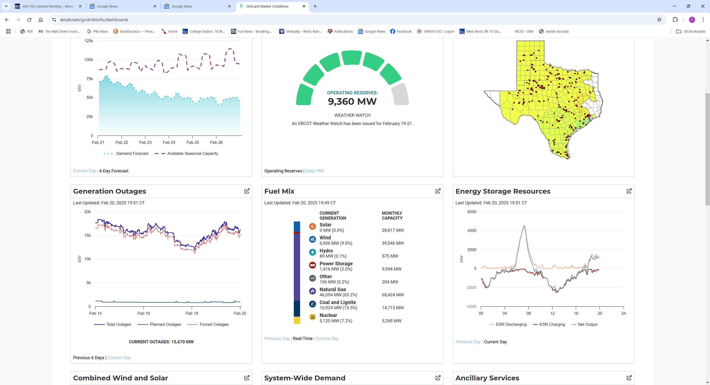
ERCOT, Feb 20 2025 (New Winter Peak Load)
Maximum load of 80.6 GW, a new winter peak for ERCOT
1

Slide 3
Optimal Power Flow (OPF)
OPF functionally combines the power flow with economic dispatch
Security Constrained OPF (SCOPF) adds in contingency analysis
Goal of OPF and SCOPF is to minimize a cost function, such as operating cost, taking into account realistic equality and inequality constraints
Equality constraints
  bus real and reactive power balance
  generator voltage setpoints
  area MW interchange
2

Slide 4
OPF, cont.
Inequality constraints
  transmission line/transformer/interface flow limits
  generator MW limits
  generator reactive power capability curves
  bus voltage magnitudes (not yet implemented in Simulator OPF)
Available Controls
  generator MW outputs
  transformer taps and phase angles
  reactive power controls
3

Slide 5
Key SCOPF Application: Locational Marginal Prices (LMPs)
When OPF includes contingency analysis it is known as the Security-Constrained OPF (SCOPF)
OPF dates back to 1960’s with thousands of papers
The locational marginal price (LMP) tells the cost of providing electricity to a given location (bus) in the system
Concept introduced by Schweppe in 1985
  F.C. Schweppe, M. Caramanis, R. Tabors, “Evaluation of Spot Price Based Electricity Rates,” IEEE Trans. Power App and Syst., July 1985
LMPs are a direct result of an SCOPF, and are widely used in many electricity markets worldwide both ahead and in real-time
The exact calculations are market specific
4

Slide 6
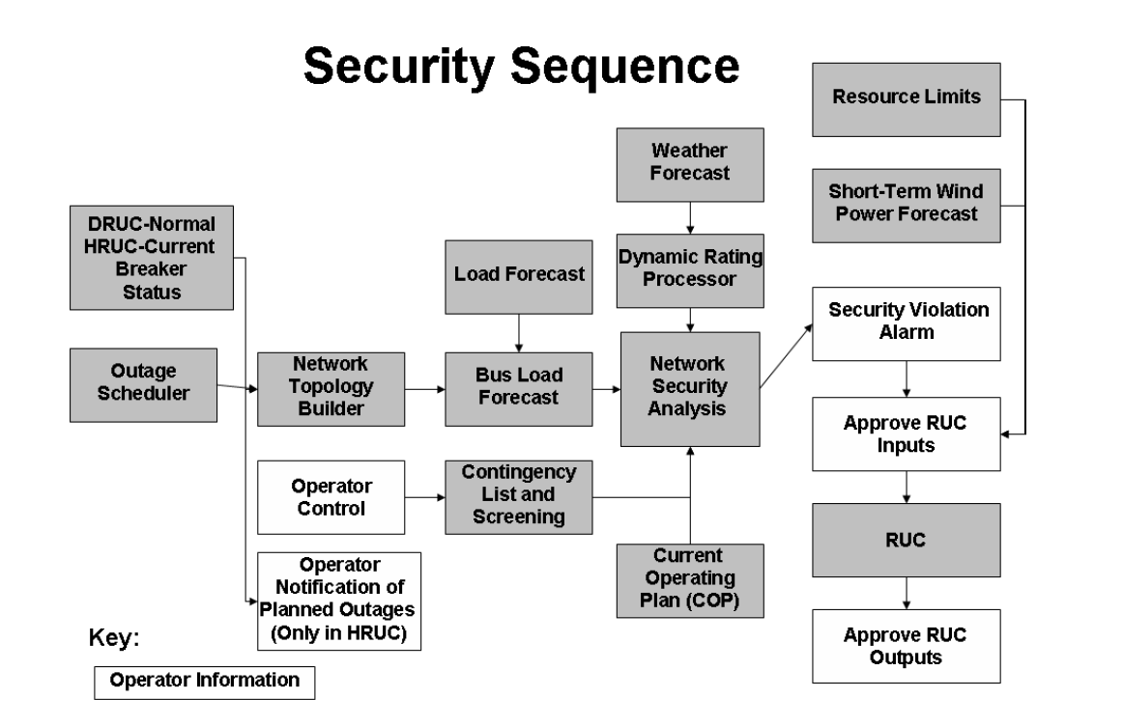
Example: ERCOT Security Sequence
The ERCOT Nodal Protocols document details the process used by ERCOT
  RUC is Reliability Unit
  Commitment
  DRUC is the Day-Ahead
  Reliability Unit Commitment
  HRUC is the Hourly
  Reliability Unit Commitment
The most recent documents
are at
www.ercot.com/mktrules/nprotocols/current

Slide 7
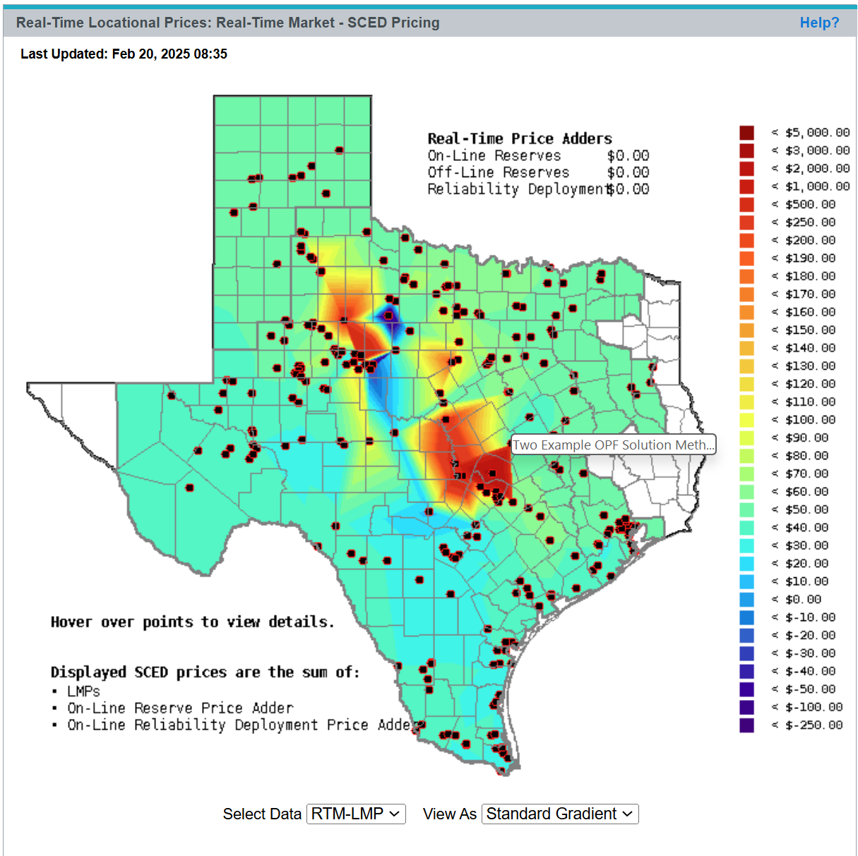
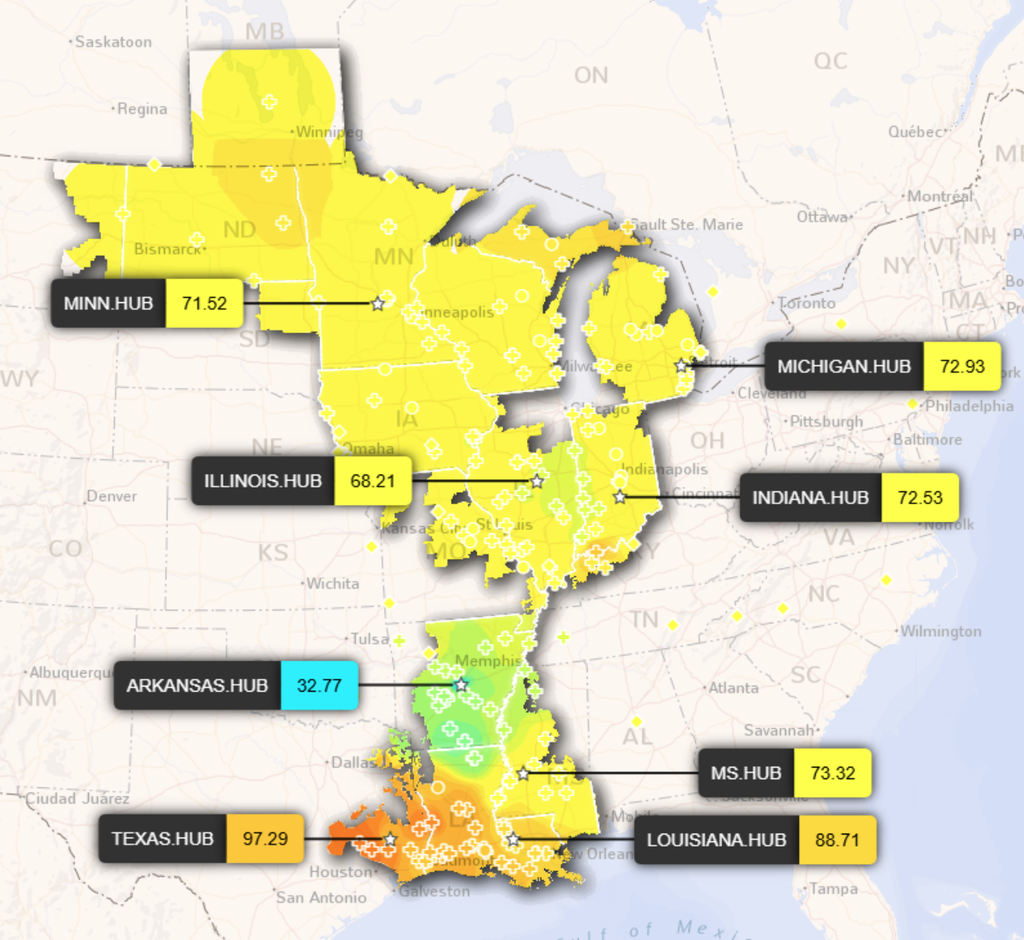
ERCOT and MISO LMPs, Feb 20, 2025 at about 9am
Images: www.ercot.com/content/cdr/contours/rtmLmp.html, api.misoenergy.org/misortwd/lmpcontourmap.html
6

Slide 8
OPF Problem Formulation
The OPF is usually formulated as a minimization with equality and inequality constraints
where x is a vector of dependent variables (such as the bus voltage magnitudes and angles), u is a vector of the control variables, F(x,u) is the scalar objective function, g is a set of equality constraints (e.g., the power balance equations) and h is a set of inequality
constraints (such as line flows)
7

Slide 9
Two Example OPF Solution Methods
Non-linear approach using Newton’s method
  handles marginal losses well, but is relatively slow and has problems determining binding constraints
  Generation costs (and other costs) represented by quadratic or cubic functions
Linear Programming
  fast and efficient in determining binding constraints, but can have difficulty with marginal losses.
  used in PowerWorld Simulator
  generation costs (and other costs) represented by piecewise linear functions
Both can be implemented using an ac or dc power flow
8

Slide 10
LP OPF Solution Method
Solution iterates between
  solving a full ac or dc power flow solution
    enforces real/reactive power balance at each bus
    enforces generator reactive limits
    system controls are assumed fixed
    takes into account non-linearities
  solving a primal LP
    changes system controls to enforce linearized constraints while minimizing cost

Slide 11
Two Bus with Unconstrained Line
With no overloads the OPF matches
the economic
dispatch
Transmission line is not overloaded
Marginal cost of supplying power to each bus (locational marginal costs)
10

Slide 12
Two Bus with Constrained Line
With the line loaded to its limit, additional load at Bus A must be supplied locally, causing the marginal costs to diverge.
11

Slide 13
Three Bus (B3) Example
Consider a three bus case (Bus 1 is system slack), with all buses connected through 0.1 pu reactance lines, each with a 100 MVA limit
Let the generator marginal costs be
  Bus 1: 10 $ / MWhr; Range = 0 to 400 MW
  Bus 2: 12 $ / MWhr; Range = 0 to 400 MW
  Bus 3: 20 $ / MWhr; Range = 0 to 400 MW
Assume a single 180 MW load at bus 2
12

Slide 14
B3 with Line Limits NOT Enforced
Line between
Bus 1and Bus 3
is overloaded;
all buses have
the same
marginal cost
13

Slide 15
B3 with Line Limits Enforced
LP OPF changes
generation to
remove violation.
Bus marginal
costs are now
different.
14

Slide 16
Verify Bus 3 Marginal Cost
One additional MW
of load at bus 3
raised total cost by
14 $/hr, as G2 went
up by 2 MW and G1
went down by 1MW
15

Slide 17
Why is bus 3 LMP = $14 /MWh
All lines have equal impedance. Power flow in a simple network distributes inversely to impedance of path.
  For bus 1 to supply 1 MW to bus 3, 2/3 MW would take direct path from 1 to 3, while 1/3 MW would “loop around” from 1 to 2 to 3.
  Likewise, for bus 2 to supply 1 MW to bus 3, 2/3MW would go from 2 to 3, while 1/3 MW would go from 2 to 1to 3.
16

Slide 18
Why is bus 3 LMP $ 14 / MWh, cont’d
With the line from 1 to 3 limited, no additional power flows are allowed on it.
To supply 1 more MW to bus 3 we need
  ΔP_{G1} + ΔP_{G2} = 1 MW
  2/3 Δ P_{G1} + 1/3 Δ P_{G2} = 0; (no more flow on 1-3)
Solving requires we up P_{G2} by 2 MW and drop P_{G1} by 1 MW -- a net increase of $24 – $10 = $14.
17

Slide 19
Both lines into Bus 3 Congested
For bus 3 loads
above 200 MW,
the load must be
supplied locally.
Then what if the
bus 3 generator
opens?
18

Slide 20
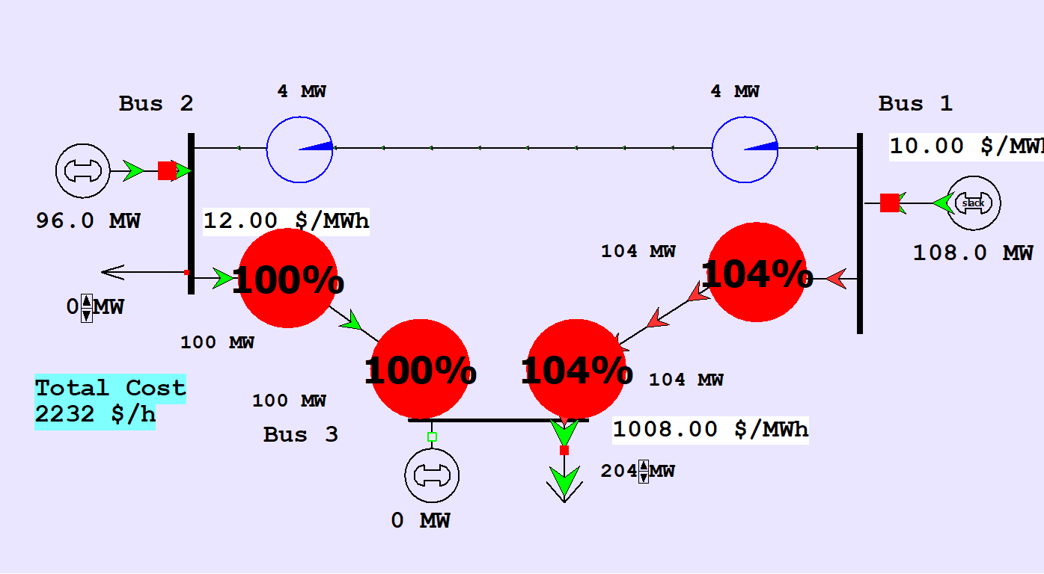
Both lines into Bus 3 Congested
An infeasible example can be created by opening the generator at Bus 3 with the Bus 3 load above 200 MW. There is no way to serve the load without overloading a transmission line.
19

Slide 21
Lab 6 Comments
Key inputs for the OPF and the SCOPF are the assumed generator costs. In PowerWorld these values can be specified either using a 4th order polynomial (with the cubic function from economic dispatch a special case), or as a piecewise linear curve (which is more common in power markets)
In Lab 6, which at OPF and SCOPF, you’ll be using and modifying these values; in the lab you’ll just be scaling the provided cost curves
OPF and SCOPF can be solved using either an ac power flow or a dc power flow; in the lab you’ll be using both
20

Slide 22
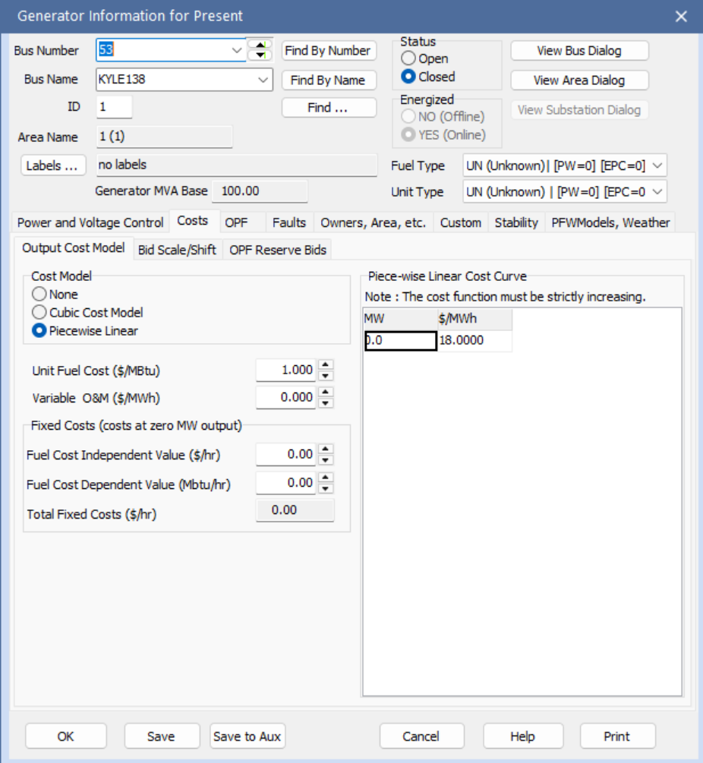
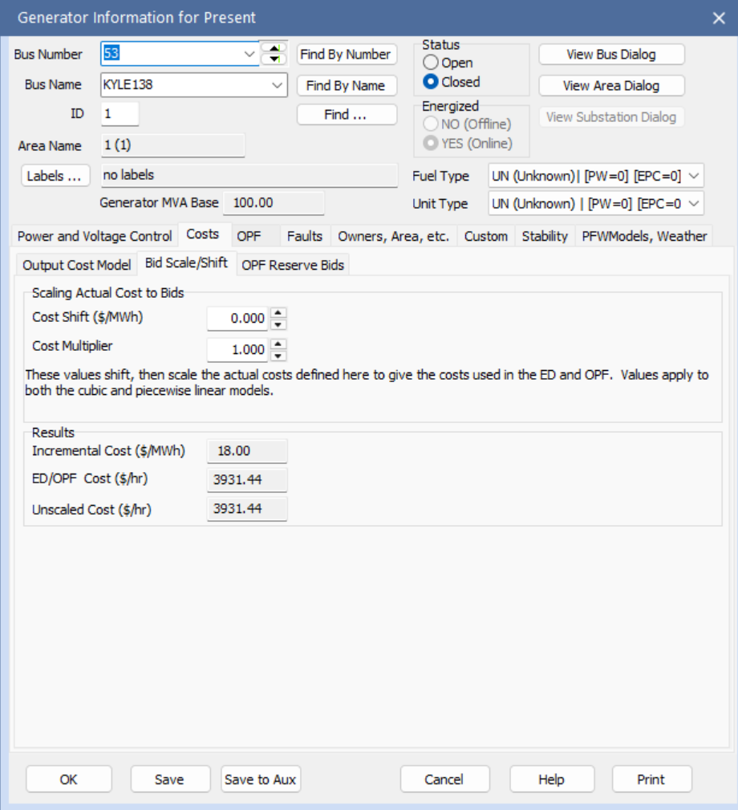
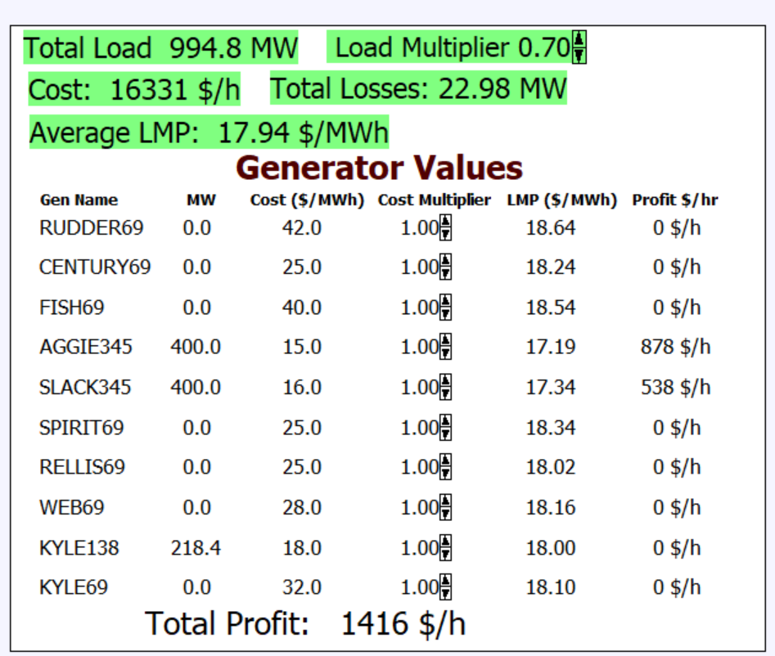
Lab 6 Comments, cont.
Below example is from the lab’s 37 bus case
21

Slide 23
Quick Coverage of Linear Programming (LP)
LP is probably the most widely used mathematical programming technique
It is used to solve linear, constrained minimization (or maximization) problems in which the objective function and the constraints can be written as linear functions
Linear programming got its start during WWII but it was secret throughout the war
George Dantzig published the simplex method in 1947, and John von Neuman developed the theory of duality around the same time; it became widely used
22

Slide 24
Example Problem 1
Assume that you operate a lumber mill which makes both construction-grade and finish-grade boards from the logs it receives. Suppose it takes 2 hours to rough-saw and 3 hours to plane each 1000 board feet of construction-grade boards. Finish-grade boards take 2 hours to rough-saw and 5 hours to plane for each 1000 board feet. Assume that the saw is available 8 hours per day, while the plane is available 15 hours per day. If the profit per 1000 board feet is $100 for construction-grade and $120 for finish-grade, how many board feet of each should you make per day to maximize your profit?
23

Slide 25
Problem 1 Setup
Notice that all of the equations are linear, but they are inequality, as opposed to equality, constraints; we are seeking to determine the values of x₁ and x₂
24

Slide 26
Example Problem 2 (Nutritionist Problem)
A nutritionist is planning a meal with 2 foods: A and B. Each ounce of A costs $ 0.20, and has 2 units of fat, 1 of carbohydrate, and 4 of protein. Each ounce of B costs $0.25, and has 3 units of fat, 3 of carbohydrate, and 3 of protein. Provide the least cost meal which has no more than 20 units of fat, but with at least 12 units of carbohydrates and 24 units of protein.
Again all of the equations are linear, but they are inequality, as opposed to equality, constraints; we are again seeking to determine the values of x₁ and x₂; notice there are also more constraints than solution variables
25

Slide 27
Three Bus Case Formulation
For the earlier three bus system given the initial condition of an overloaded transmission line, minimize the cost of generation such that the change in generation
is zero, and the flow
on the line between
buses 1 and 3 is not
violating its limit
Can be setup consider-
ing the change in
generation, (ΔP_{G1}, ΔP_{G2}, ΔP_{G3})
26

Slide 28
Three Bus Case Problem Setup
Line flow constraint
Power balance constraint
27

Slide 29
LP Standard Form
Maximum problems can be treated as minimizing the negative
The previous examples were not in this form!
28

Slide 30
Replacing Inequality Constraints with Equality Constraints
The LP standard form does not allow inequality constraints
Inequality constraints can be replaced with equality constraints through the introduction of slack variables, each of which must be greater than or equal to zero
Slack variables have no cost associated with them; they merely tell how far a constraint is from being binding, which will occur when its slack variable is zero
29

Slide 31
Lumber Mill Example with Slack Variables
Let the slack variables be x₃ and x₄, so
Minimize the negative
30

Slide 32
LP Definitions
This is a key LP concept!
A_{B} is called the basis matrix
31

Slide 33
Fundamental LP Theorem
Given an LP in standard form with A of rank m then
  If there is a feasible solution, there is a basic feasible solution
  If there is an optimal, feasible solution, then there is an optimal, basic feasible solution
Note, there could be a LARGE number of basic, feasible solutions
  Simplex algorithm determines the optimal,
  basic feasible solution usually very quickly
32

Slide 34
Simplex Algorithm
The key is to move intelligently from one basic feasible solution (i.e., a vertex) to another, with the goal of continually decreasing the cost function
The algorithm does this by determining the “best” variable to bring into the basis; this requires that another variable exit the basis, while always retaining a basic, feasible solution
This is called pivoting
For more details on the solution process take an optimization classes, or for those continuing on ECEN 615 next semester (which I’ll be teaching)
33

Slide 35
Marginal Costs of Constraint Enforcement in LP
The marginal costs will be used to determine the OPF locational marginal costs (LMPs)
34

Slide 36
Nutrition Problem Marginal Costs
In this problem we had basic variables 1, 2, 3; nonbasic variables of 4 and 5
There is no marginal cost with the first constraint since it is not binding; values tell how cost changes if the b values were changed
35

Slide 37
Lumber Mill Example Solution
Economic interpretation of λ is the profit is increased by
35 for every hour we up the first constraint (the saw) and
by 10 for every hour we up the second constraint (plane)
36

Slide 38
Marginal Cost of Constraint Enforcement
In an LP solution the marginal costs of enforcing each constraint are provided by the λ vector
Marginal costs are only associated with enforcing binding constraints; inequality constraints that are not binding have no associated cost
If there are no binding limit constraints, then the only constraint is associated with the power balance for each area (or the whole system)
  The bus costs might be different because of the impact of marginal losses

Slide 39
Locational Marginal Prices (LMPs)
In an OPF solution, the bus LMPs tell the marginal cost of supplying electricity to that bus
The term “congestion” is used to indicate when there are elements (such as transmission lines or transformers) that are at their limits; that is, the constraint is binding
Without losses and without congestion, all the LMPs would be the same
Congestion or losses causes unequal LMPs
The LMPs are calculated using the marginal costs of enforcing each constraint

Slide 40
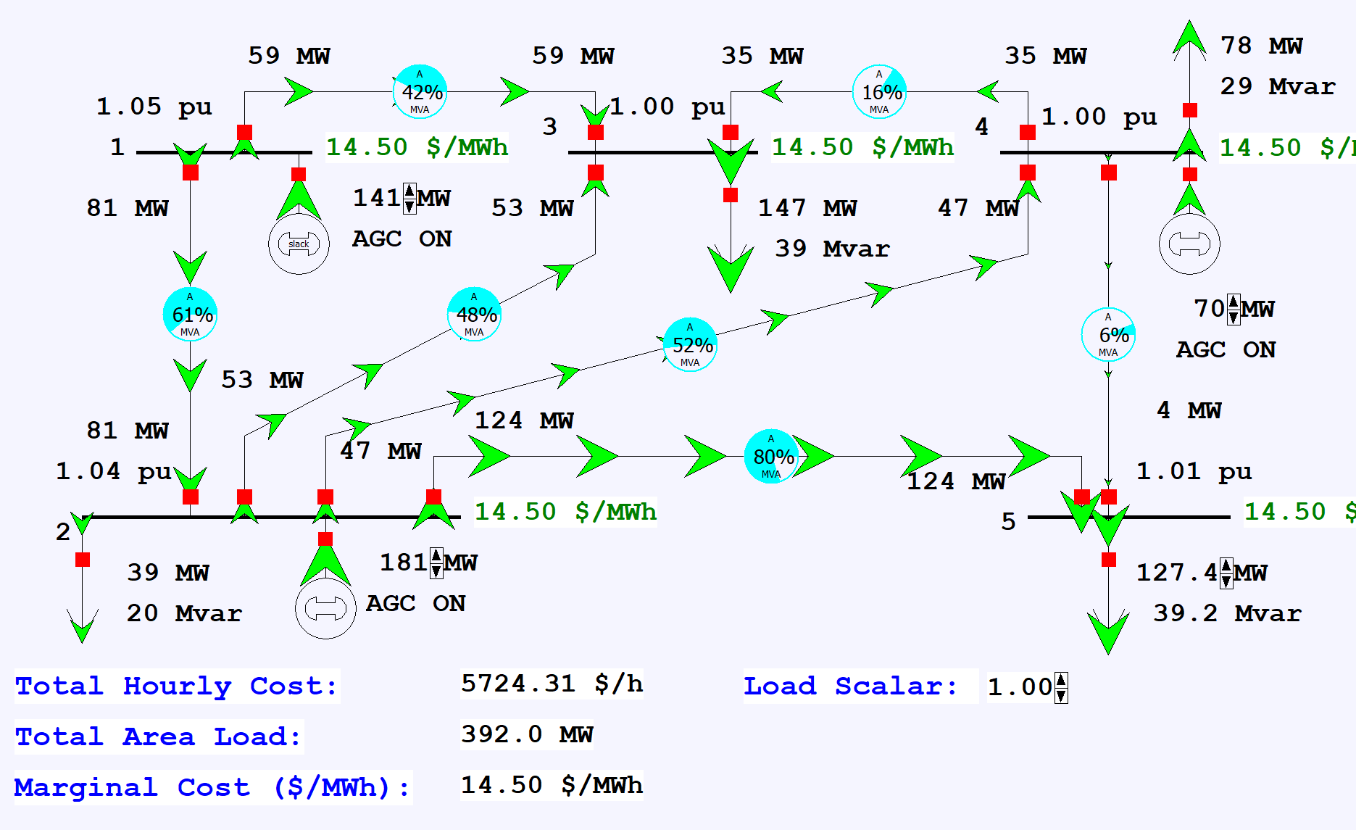
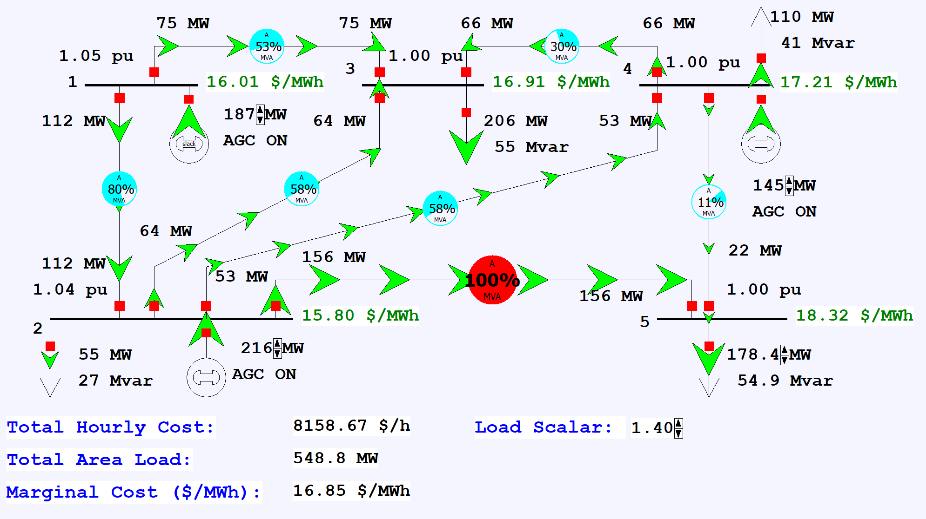
Five Bus Case Optimal Power Flow Example
Load the case Example7_7. Start the simulation and gradually increase the load; watch the variation in the LMP values
  In Simulator a case can be automatically solved using the OPF by 1) setting the area AGC Status to OPF, and 2) in Simulator Options, Environment page setting the Play Animation/Solution Method to Optimal Power Flow
39

Slide 41
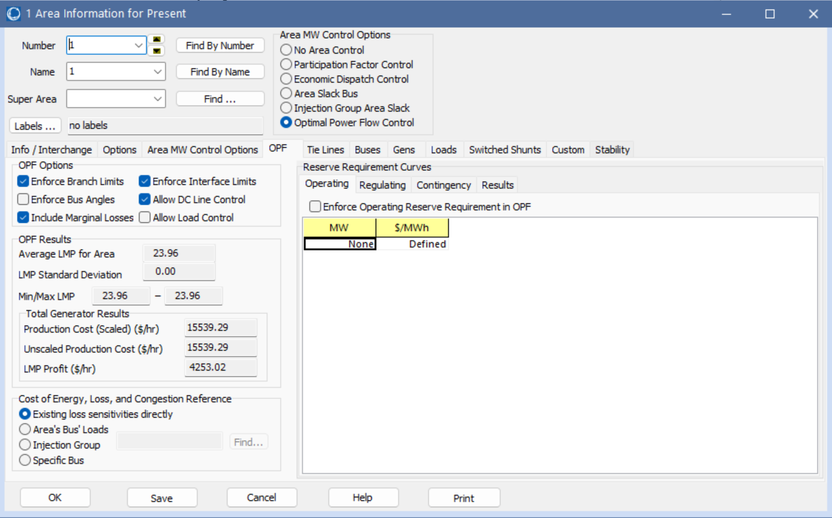
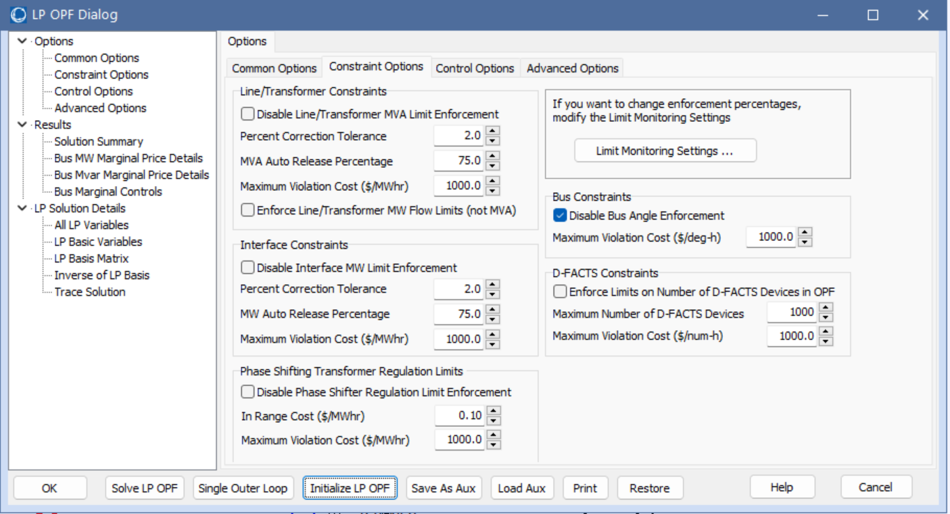
Solving the OPF in Planning Software
When solving an OPF in any planning software there will likely be lots of options; key values control 1) which constraints to enforce, and 2) which controls to use to enforce those constraints
In Simulator some options are available by selecting Add Ons, OPF Case Info, OPF Options and Results; other options are available on the OPF page of the Area Information dialog
40

Slide 42
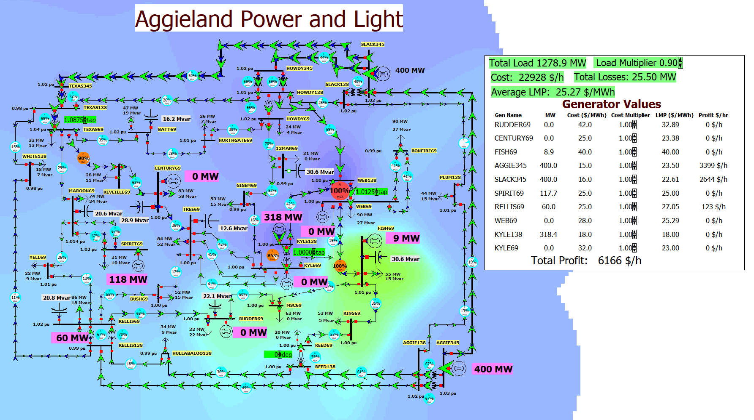
37 Bus Example
Repeat the previous
example with the 37
bus case used in Lab6
(Lab_AGLOPF);
if desired display the
contour to show the
LMPs; try opening
some of the
transmission lines

Slide 43
Security Constrained OPF
Security constrained optimal power flow (SCOPF) is similar to OPF except it also includes contingency constraints
  Again the goal is to minimize some objective function, usually the current system cost, subject to a variety of equality and inequality constraints
  This adds significantly more computation, but is required to simulate how the system is actually operated (with N-1 reliability)
A common solution is to alternate between solving a power flow and contingency analysis, and an LP

Slide 44
Security Constrained OPF, cont.
With the inclusion of contingencies, there needs to be a distinction between what control actions must be done pre-contingent, and which ones can be done post-contingent
  The advantage of post-contingent control actions is they would only need to be done in the unlikely event the contingency actually occurs
Pre-contingent control actions are usually done for line overloads, while post-contingent control actions are done for most reactive power control and generator outage re-dispatch

Slide 45
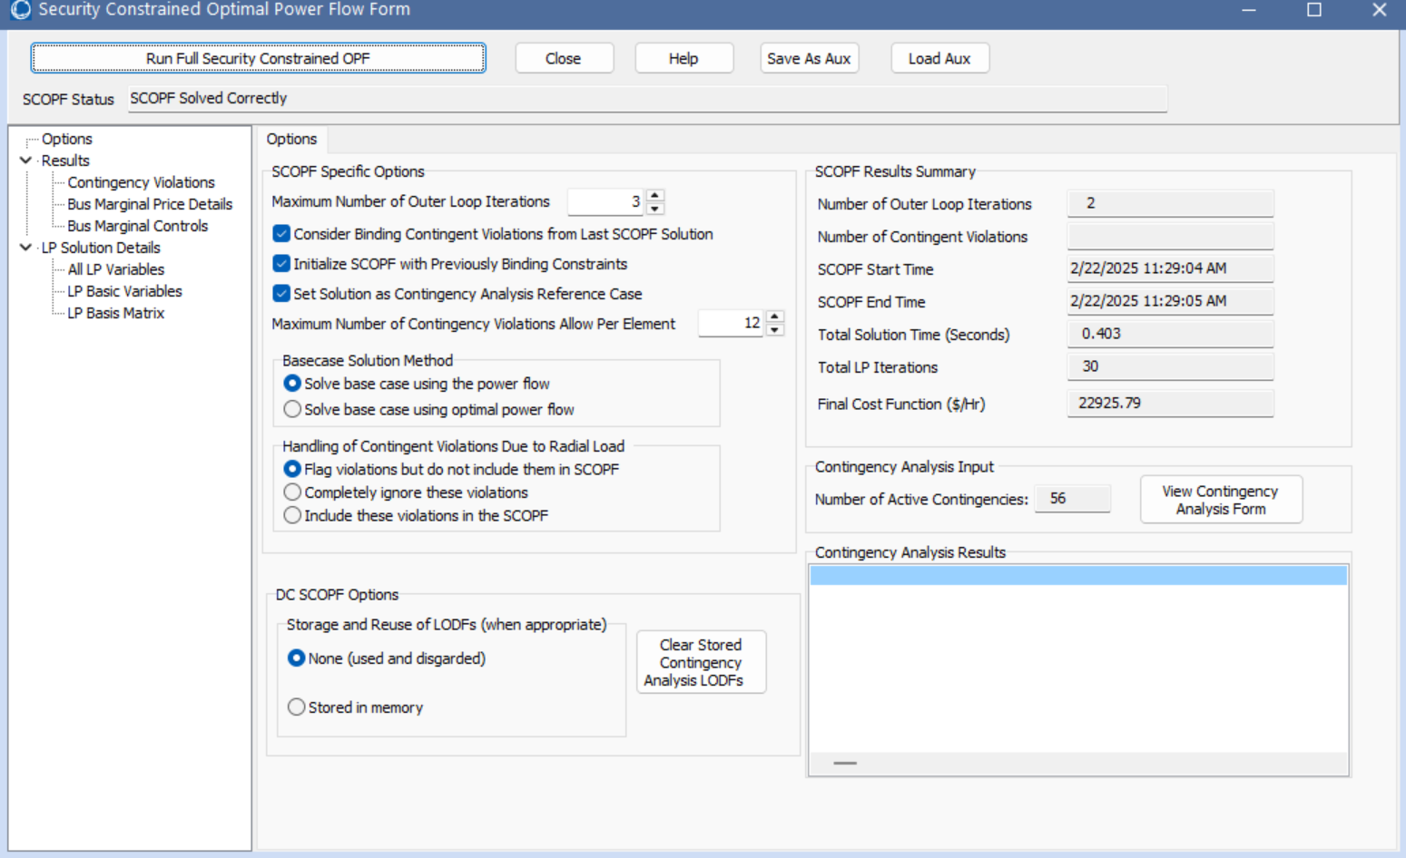
PowerWorld SCOPF Application
To see the PowerWorld SCOPF application, first open the Lab_AGCSCOPF case and set the load multiplier to 0.9 and solve the case with the OPF; look at the results
Then select Tools, Contingency Analysis to verify that some contingencies have been defined
  On the Contingency Analysis form
  click Start Run to do the contingency
  analysis; note the violations
Select Add Ons, SCOPF to
open the SCOPF
Click Run Full Security
Constrained OPF

Slide 46
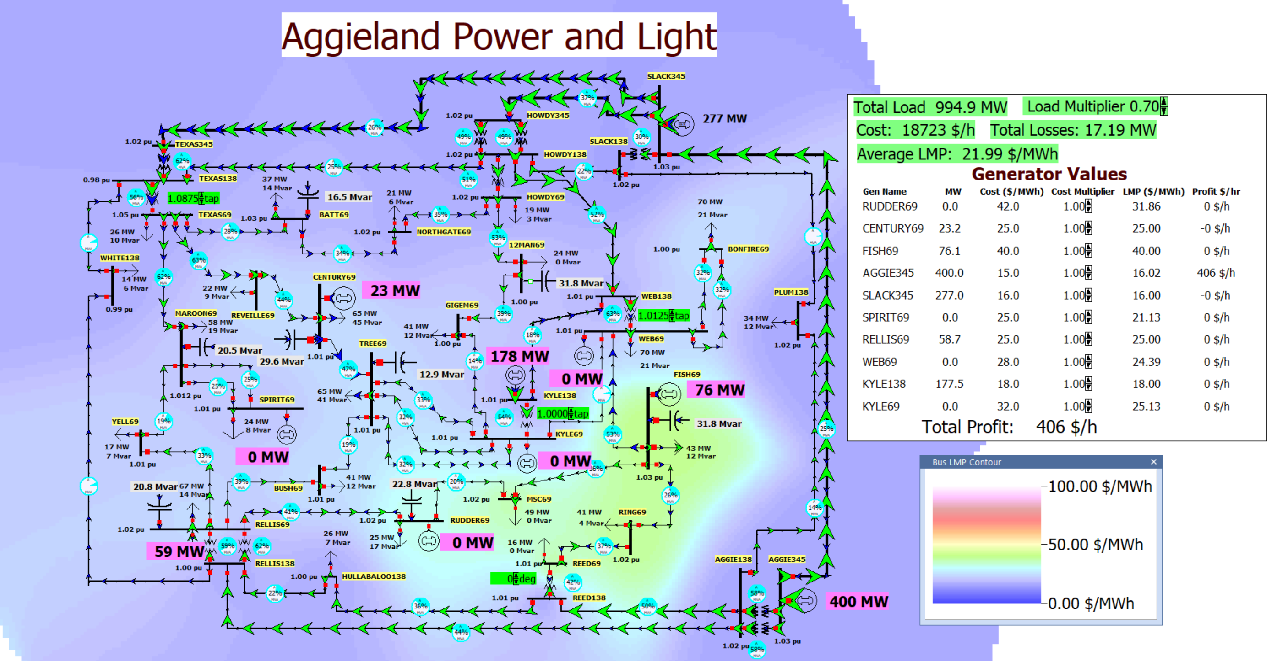
37 Bus Case SCOPF Results
Keeping the SCOPF form open, contour the bus LMPs
What had been a
relatively boring
OPF solution indicates
some major issues
Looking at the SCOPF
form Results,
Contingency
Violations indicates
there are some
contingencies with
unenforceable constraints

Slide 47
LP OPF and SCOPF Issues
The LP approach is widely used for the OPF and SCOPF, particularly when implementing a dc power flow approach
A key issue is determining the number of binding constraints to enforce in the LP tableau
  Enforcing too many is time-consuming, enforcing too few results in excessive iterations
The LP approach is limited by the degree of linearity in the power system
  Real power constraints are fairly linear, reactive power constraints much less so

Slide 48
Additional OPF and SCOPF Solution Methods
There are several additional approaches for solving the OPF and SCOPF
It continues to be an area of active research
More general commercial optimization packages are being applied to the problem, including Gurobi and CPLEX
  Over the years there has been great progress in this area, including with the solution of mixed-integer programming problems (speedups of up to 1 million times have been reported since 1991 with new algorithms and faster computers)

