Slide 1
ECEN 460
Power System Operation and Control
Spring 2025
Lecture 13: Security-Constrained OPF (SCOPF), Power Markets
Prof. Tom Overbye
Dept. of Electrical and Computer Engineering
Texas A&M University
overbye@tamu.edu

Slide 2
Security Constrained OPF
Security constrained optimal power flow (SCOPF) is similar to OPF except it also includes contingency constraints
  Again the goal is to minimize some objective function, usually the current system cost, subject to a variety of equality and inequality constraints
  This adds significantly more computation, but is required to simulate how the system is actually operated (with N-1 reliability)
A common solution is to alternate between solving a power flow and contingency analysis, and an LP

Slide 3
Security Constrained OPF, cont.
With the inclusion of contingencies, there needs to be a distinction between what control actions must be done pre-contingent, and which ones can be done post-contingent
  The advantage of post-contingent control actions is they would only need to be done in the unlikely event the contingency actually occurs
Pre-contingent control actions are usually done for line overloads, while post-contingent control actions are done for most reactive power control and generator outage re-dispatch

Slide 4
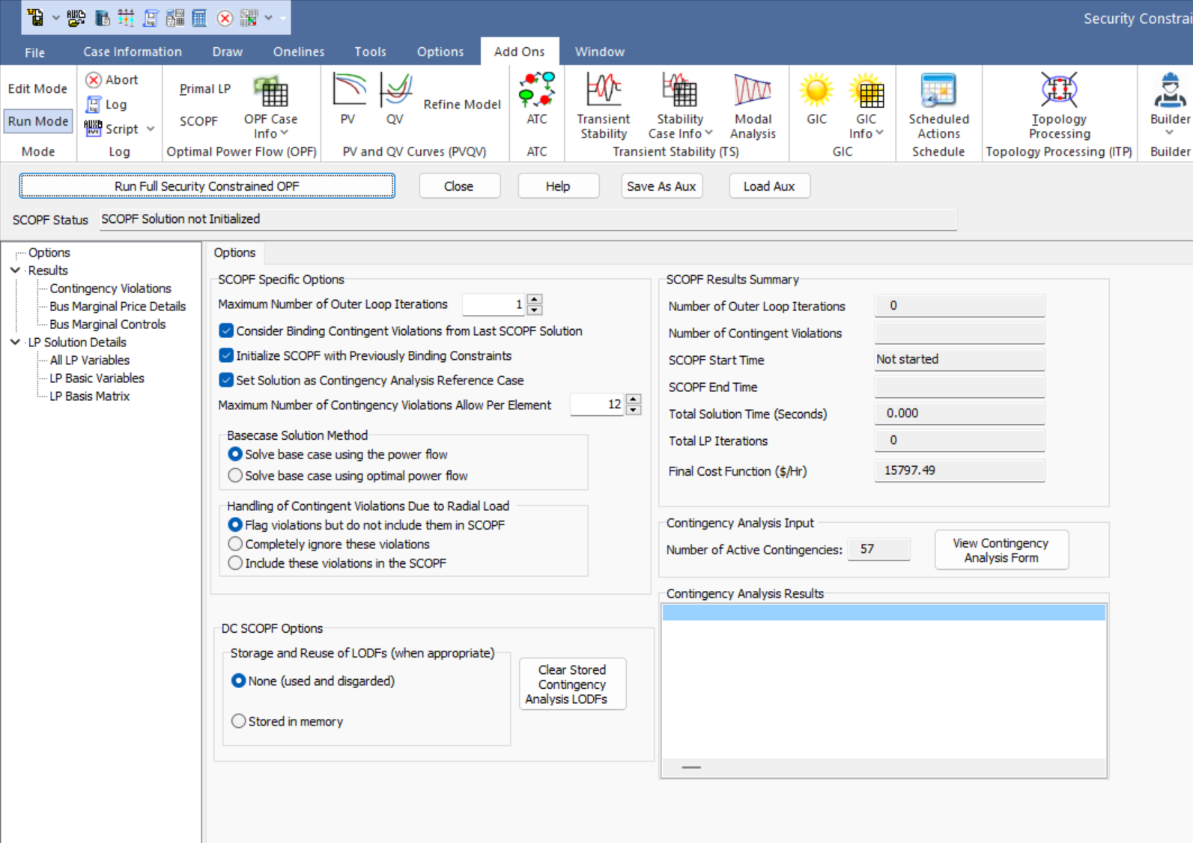
PowerWorld SCOPF Application
To see the PowerWorld SCOPF application, first open the Lab_AGLSCOPF case; then select Tools, Contingency Analysis to verify that some contingencies have been defined; change the load multiplier to 0.85
  On the Contingency Analysis form
  click Start Run to do the contingency
  analysis; verify there are some
  violations
Select Add Ons, SCOPF to
open the SCOPF
Click Run Full Security
Constrained OPF

Slide 5
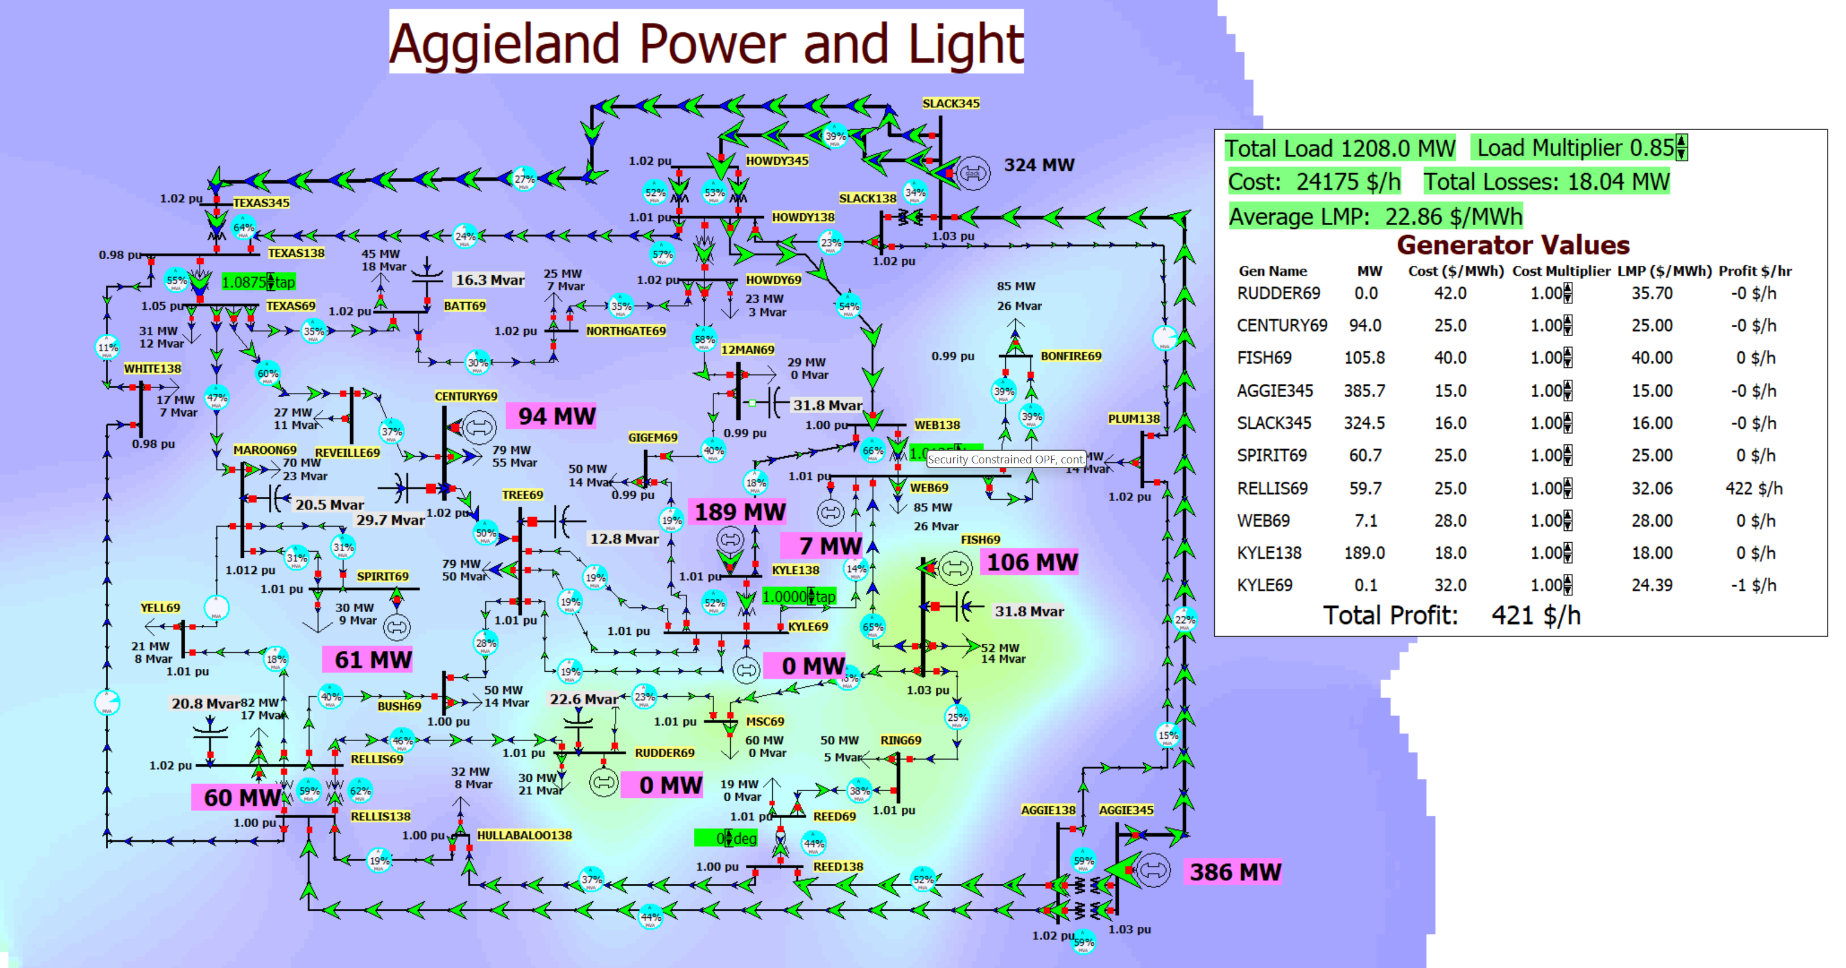
37 Bus Case SCOPF Results
Keeping the SCOPF form open, contour the bus LMPs
What had been a
relatively boring
OPF solution indicates
some major issues
Looking at the SCOPF
form Results,
Contingency Violations
indicates there are
some contingencies
with unenforceable
constraints

Slide 6
LP OPF and SCOPF Issues
The LP approach is widely used for the OPF and SCOPF, particularly when implementing a dc power flow approach
A key issue is determining the number of binding constraints to enforce in the LP tableau
  Enforcing too many is time-consuming, enforcing too few results in excessive iterations
The LP approach is limited by the degree of linearity in the power system
  Real power constraints are fairly linear, reactive power constraints much less so

Slide 7
Additional OPF and SCOPF Solution Methods
There are several additional approaches for solving the OPF and SCOPF
It continues to be an area of active research
More general commercial optimization packages are being applied to the problem, including Gurobi and CPLEX
  Over the years there has been great progress in this area, including with the solution of mixed-integer programming problems (speedups of up to 1 million times have been reported since 1991 with new algorithms and faster computers)

Slide 8
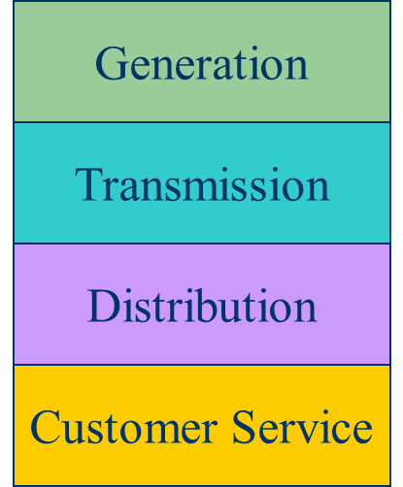
Electricity Markets History
For decades electric utilities operated as vertical monopolies, with their rates set by state regulators
Utilities had an obligation to serve
and customers had no choice
  There was little third party generation
Major change in US occurred in 1992
with the National Energy Policy Act
that mandated utilities provide
“nondiscriminatory” access to the high
voltage grid
Goal was to setup true competition in generation

Slide 9
Markets Versus Centralized Planning
With the vertically integrated utility, a small number of entities (typically utilities) did most of the planning
  For example, which new generators and/or lines to build
  Planning was coordinated and governed by regulators
  Regulators needed to know the utilities actual costs so they could provide them with a fixed rate of return
With markets the larger number of participants often make individual decisions in reaction to prices
  For example, whether to build new generation
  Generator owners in general to not need to reveal their true costs; rather they make offers into the market

Slide 10
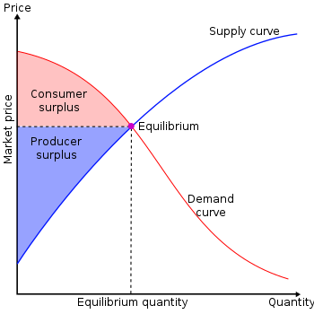
Overall Goal
Goal is to maximize the economic surplus (or total welfare), which is the sum of the consumer surplus and the producer surplus (i.e., their profit)
Generation owners have to
decide their offer prices
If their price is too high, they
are not selected to generate
At the wholesale level, the
consumers often just see a
price, though there can be price
responsive load bids
Image Source: en.wikipedia.org/wiki/Economic_surplus#/media/File:Economic-surpluses.svg

Slide 11
Electricity Market History
Power pools have been used for almost 100 years, in which utilities created agreements to buy and sell electricity with their neighbors
  PJM (originally Pennsylvania-New Jersey-Maryland) formed in 1927
The methodology used to determine the price was the production cost; each utility calculated how much it would cost them to produce more power (sell price), or how much they would say if they produced less (buy price); if the sell price for one utility was less than the buy price for another, then they would transact, usually splitting the savings
In the 1990’s there was a goal of creating more flexible electricity markets

Slide 12

Multidisciplinary Research in Power and Economics
The development of true power markets required collaboration between power engineers and economists with the nice description of
how some of this developed within the Power Systems
Engineering Research Center (PSERC, with Texas A&M
a member) described in Chapter 8 of [1]
  One of the challenges was agreeing on notation, with the power
  engineers treating P and Q as power, and the economics as price
  and quanity
The Hawaiian International Conference on Science Sciences (HICSS) also played a major role, with one of the participants winning the Nobel Price for Economics in 2002 (Vernon Smith) (he was a TAMU Hagler Fellow in class of 2012-2013)
[1] US National Academies, Analytic Research Foundations for the Next-Generation Electric Grid, 2016

Slide 13
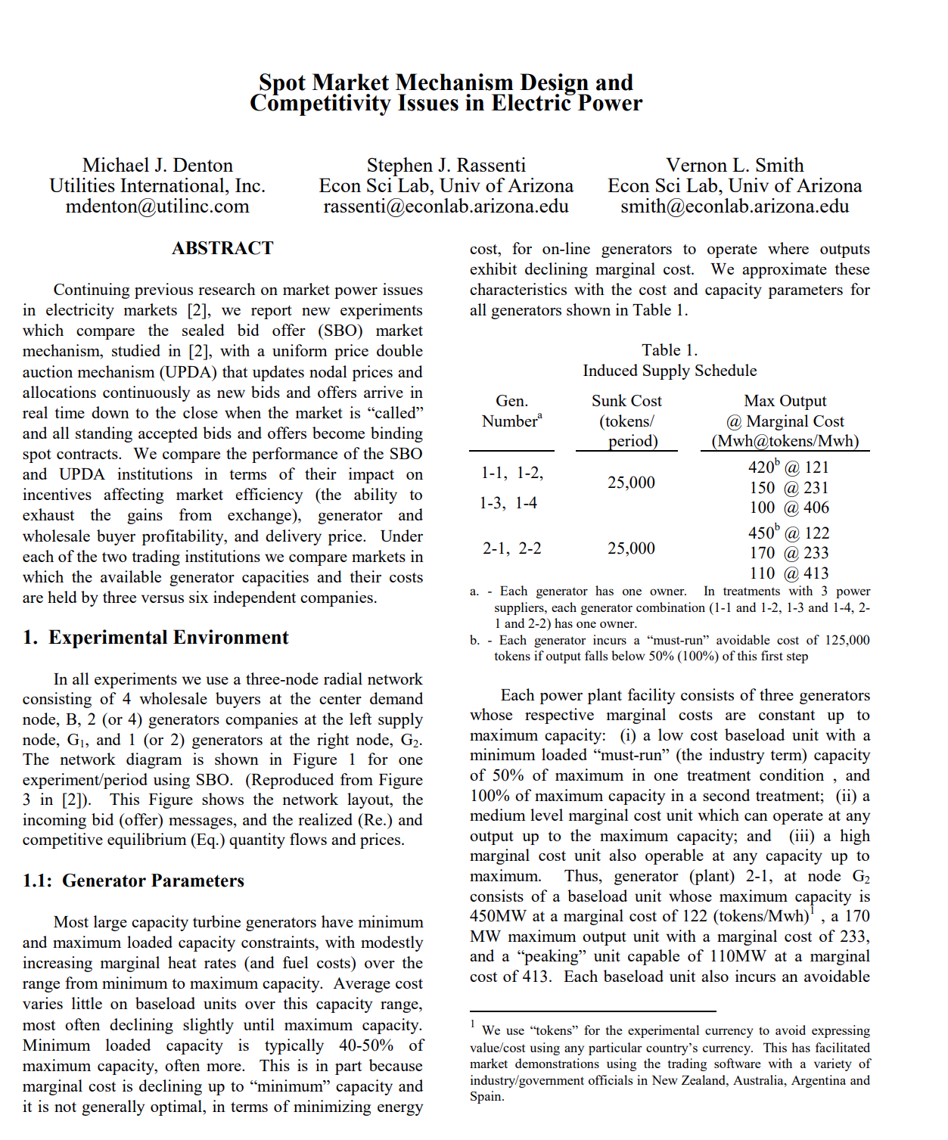
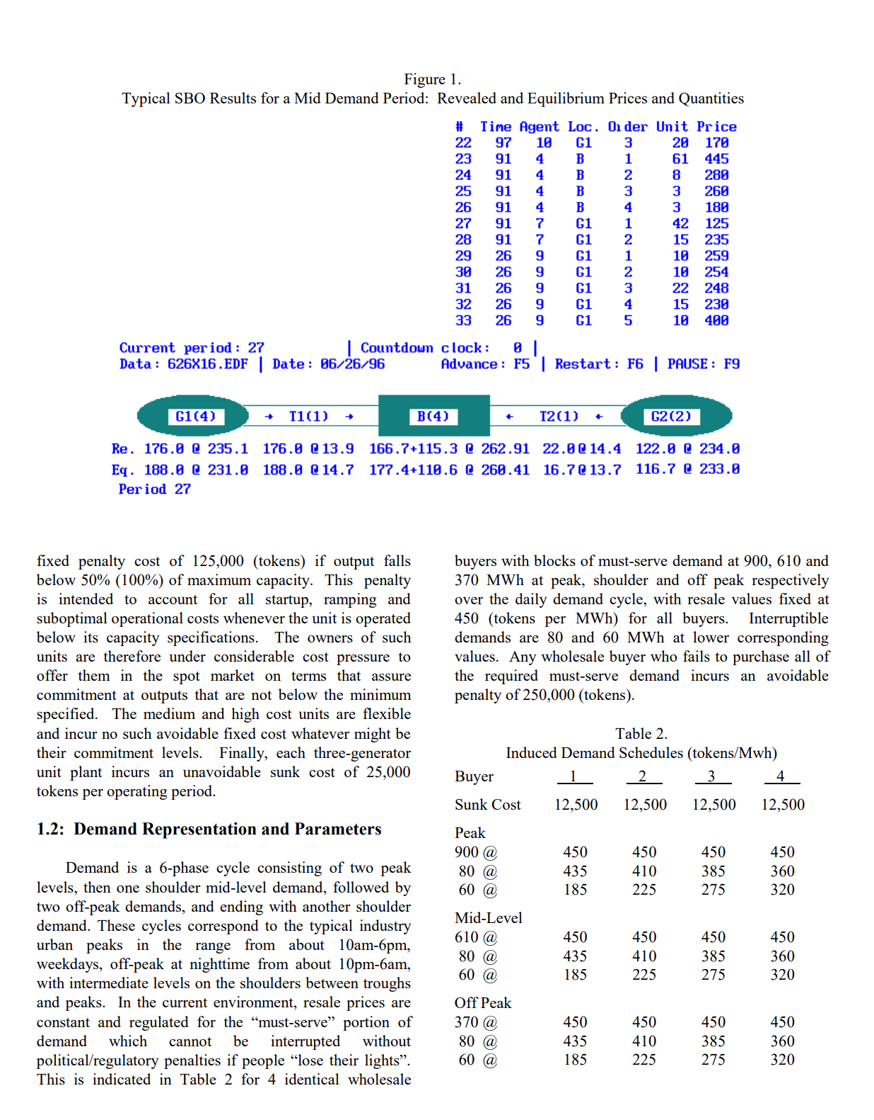
Example Vernon Smith Paper from HICSS (1998)
First two pages

Slide 14
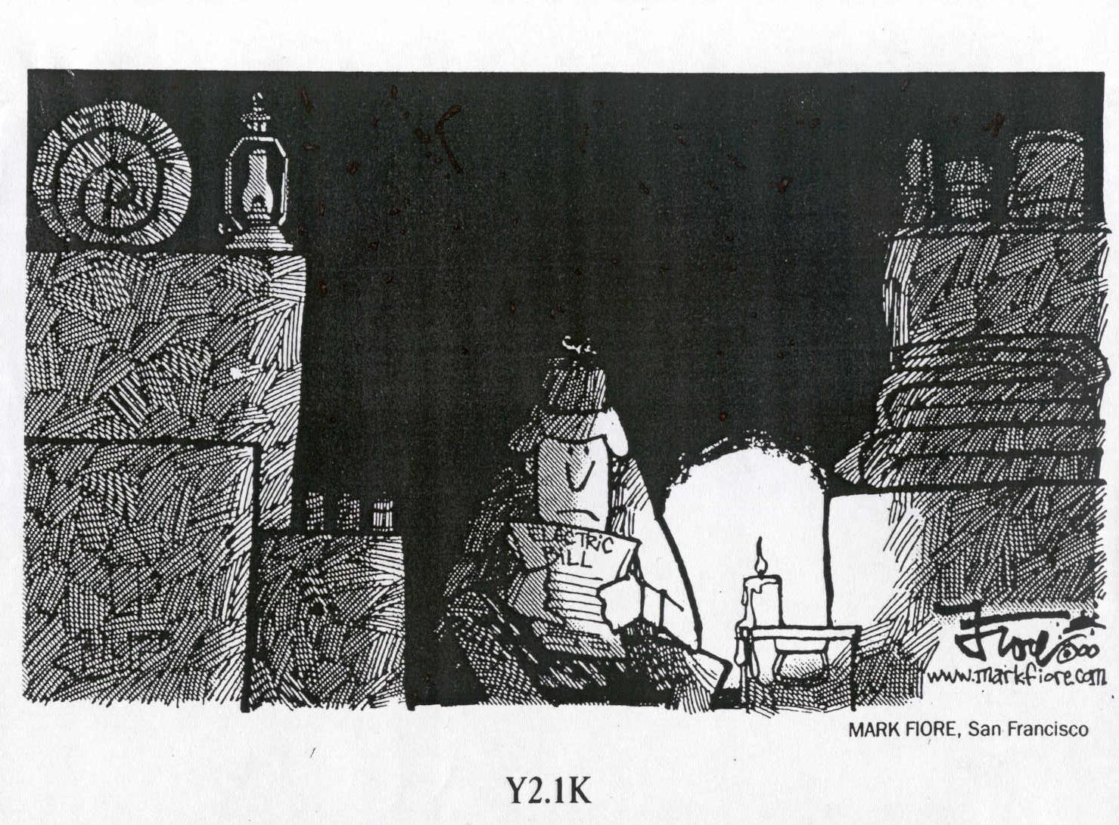
The California Politicians Ran Ahead of the Research, Resulting in Their 2000-2001 Crisis
In 1996 California decided to create an electricity market even though the risks in doing this were not fully known
During 2000 their
wholesale electricity
prices jumped by
800% due in part to
market manipulation
OFF
OFF

Slide 15
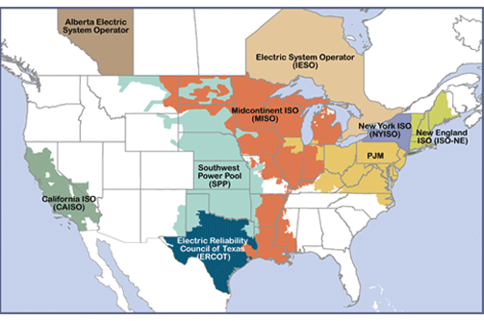
Electricity Markets Today in North America
Starting in about 1995 electricity markets gradually started to develop, both in the US and elsewhere
In North America
more than 60% of the
load is supplied via
wholesale electricity
markets; markets differ
but they all have certain
common features
  The terms regional transmission organizations (RTOs) and independent system operators (ISOs) are used (RTOs are more functionality and most are actually RTOs
Image source: www.ferc.gov/industries-data/electric/power-sales-and-markets/rtos-and-isos

Slide 16
Electricity Markets Common Features
Day ahead market – this is needed because time is required to make decisions about committing generators
  Generation owners submit offers for how much generation they can supply and at what price; accepted offers are binding
Real-time energy market – needed because day ahead forecasts are never perfect, and unexpected events can occur
Co-optimization with other “ancillary services” such as reserves
The source for much of this material “Analytic Research Foundations for the Next-Generation Electric
Grid” (Chapter 2), The National Academies Press, 2016 (free download available)

Slide 17
Electricity Markets Common Features
Pricing is done using locational marginal prices, determined by an SCOPF
  Most markets include a marginal losses component
LMP markets are designed to send transparent price signals so people can make short and long-term decisions
  Generators are free to offer their electricity at whatever price they desire; they do not have to reveal their “true” costs
  Most of the times markets work as planned (competitive prices)
  During times of shortages (scarcity) there are limits on LMPs; ERCOT’s had been $9000/MWh prior to Uri; now it is $5000/MWh
  Markets are run by independent system operators (ISOs)

Slide 18
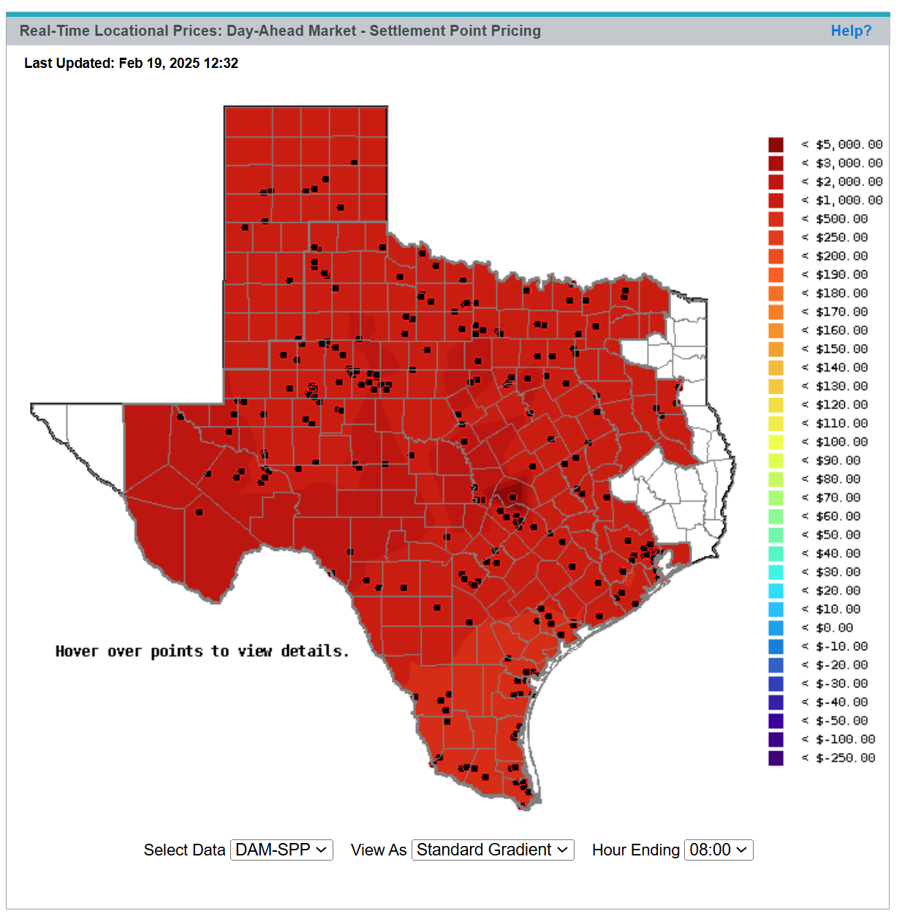
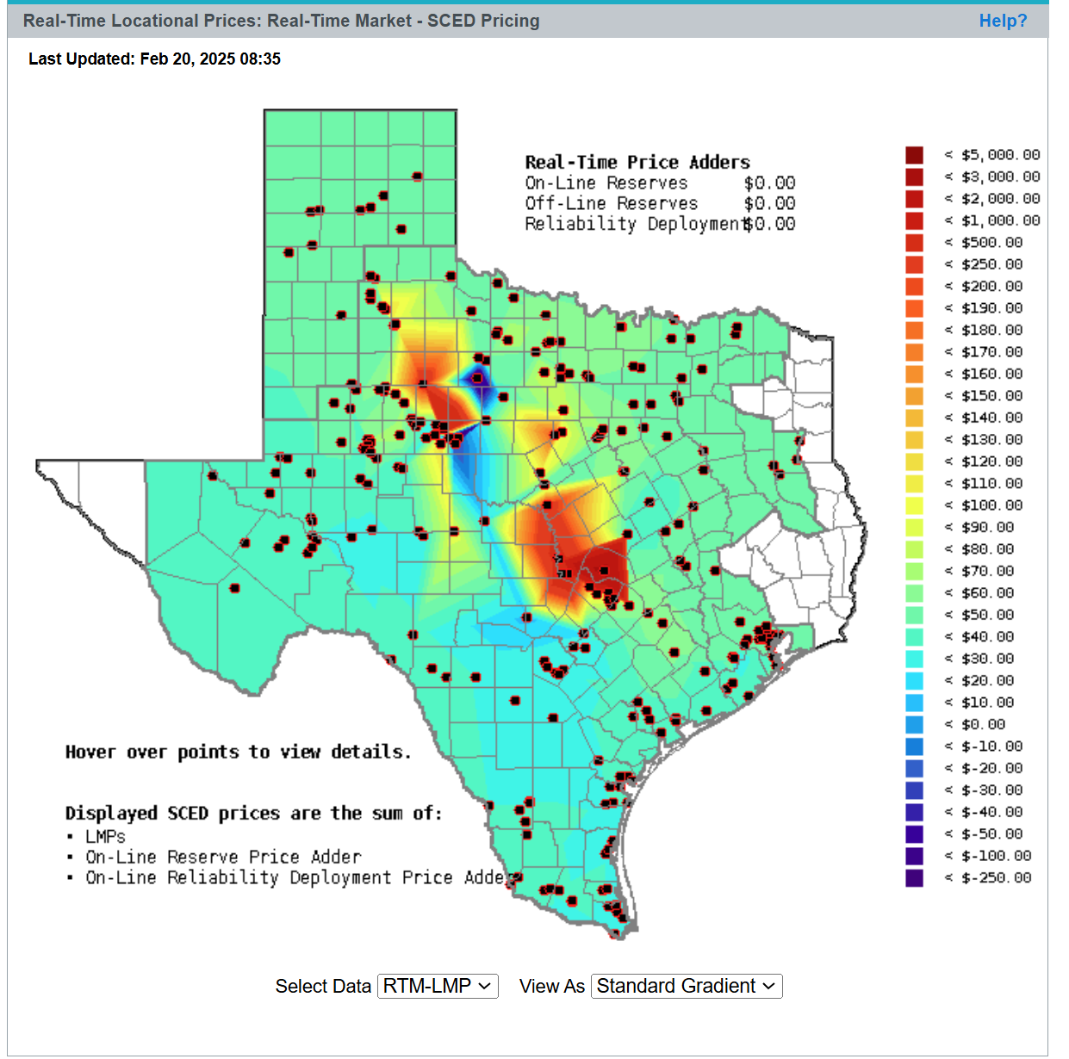
ERCOT Feb 20, 2025 LMPs
Day Ahead Market
Real-Time Market
17

Slide 19
LMP Energy Markets
In an LMP energy market the generation is paid the LMP at the bus, and the loads pay the LMP at the bus
  This is done in both the day ahead market and in the real-time market (which makes up the differences between actual and the day ahead)
The generator surplus (profit) is the difference between the LMP and the actual cost of generation
Generators that offer too high are not selected to run, and hence make no profit
A key decision for the generation owners is what values to offer

Slide 20
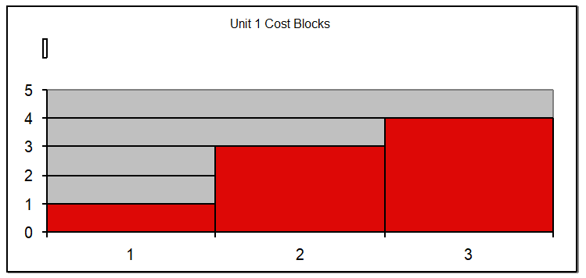
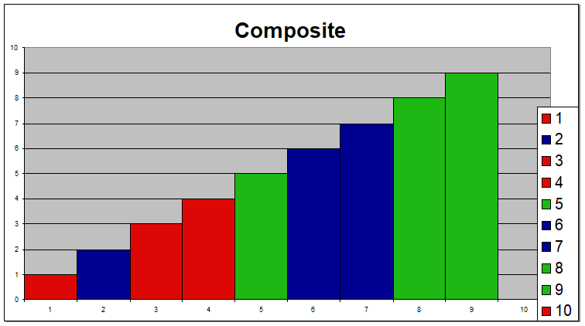
Generator Offers
Generator offers are given in piecewise linear curves; that is, a fixed $/MWh for so much power for a time period
In the absence of constraints (congestion) the ISO would just select the lowest offers to meet the anticipated load
Actual dispatch is determined using an SCOPF

Slide 21
General Guidelines
Generators with high fixed costs and low operating costs (e.g., wind, solar, nuclear) benefit from running many hours
  Usually they should submit offers close to their marginal costs
  Wind (and some others) receive a production tax credit (PTC) for their first ten years of operation
    $23/MWh for systems starting construction before 1/1/2017; $18/MWh 2017, $14/MWh in 2018, $10/MWh in 2019; It was suppose to end in 2019, but was extended in 12/2019 through 2020 at $15MWh; then it got extended through the end of 2021 at $18/MWh
    On 8/16/22 then President Biden signed the Inflation Reduction Act of 2022 that extended the PTC through at least 2024; then it got broadened to clean energy facilities with details from the IRS issued on Jan 15, 2025; what will happen with the new administration isn’t yet known
  Generators with low fixed costs and high operating cost can do fine operating fewer hours (at higher prices)

Slide 22
Trading Electricity Using Auctions
In its simplest form, an auction is a mechanism of allocating scarce goods based upon competition
  a seller wishes to obtain as much money as possible, and a buyer wants to pay as little as necessary.
An auction is usually considered efficient if resources accrue to those who value them most highly
Auctions can be either one-sided with a single monopolist seller/buyer or a double auction with multiple parties in each category
  bid to buy, offer to sell
Most people’s experience is with one-side auctions with one seller and multiple buyers

Slide 23
Auctions, cont.
Electricity markets can be one-sided, with the ISO functioning as a monopolist buyer, while multiple generating companies make offers to sell their generation, or two-sided with load participation
Auctions provide mechanisms for participants to reveal their true costs while satisfying their desires to buy low and/or sell high.
Auctions differ on the price participants receive and the information they see along the way
22

Slide 24
Types of Single-Sided Auctions with Multiple Buyers, One Seller
Simultaneous auctions
  English (ascending price to buy)
  Dutch (descending price to buy)
Sealed-bid auctions (all participants submit offers simultaneously)
  First price sealed bid (pay highest price if one, discriminatory prices if multiple)
  Vickrey (uniform second price) (pay the second highest price if one, all pay highest losing price if many); this approach gives people incentive to bid their true value

Slide 25
Uniform Price Auctions: Multiple Sellers, One Buyer
Uniform price auctions are sealed offer auctions in which sellers make simultaneous decisions (done when submitting offers).
Generators are paid the last accepted offer
Provides incentive to offer at marginal cost since higher values cause offers to be rejected
  reigning price should match marginal cost
Price caps are needed to prevent prices from rising up to infinity during shortages
Some generators offering above their marginal costs are needed to cover their fixed costs

Slide 26
What to Offer Example
Below example shows 3 generator case, in which the bus 2 generator can vary its offer to maximize profit
Note, this example makes the unrealistic assumption that the other generators do not vary their offers in response

Slide 27
Horizontal Market Power
One issue is whether a particular group of generators has market power
Market power is the antithesis of competition
    It is the ability of a particular group of sellers to maintain prices above competitive levels, usually by withholding supply
  The extreme case is a single supplier of a product (i.e., a monopoly)
  In the short run what a monopolistic producer can charge depends upon the price elasticity of the demand
  Sometimes market power can result in decreased prices in the long-term by quickening the entry of new players or new innovation

Slide 28
Market Power and Scarcity Rents
A generator owner exercises market power when it is unwilling to make energy available at a price that is equal to that unit’s variable cost of production, even thought there is currently unloaded generation capacity (i.e., there is no scarcity).
Scarcity rents occur when the level of electric demand is such that there is little, if any, unused capacity
Scarcity rents are used to recover fixed costs
No market power is required to earn scarcity rents
  a corn farmer earns scarcity rents when the price of corn exceeds the marginal cost of supply
High prices do not necessarily indicate market power; there may just be a scarcity

Slide 29
June 1998 Heat Storm: Two Constraints Caused a Price Spike
Price of electricity
in Central Illinois went
to $7500 per MWh!
Contoured areas could NOT sell into Midwest because of constraints on a line in Northern Wisconsin and on a transformer in Ohio

Slide 30
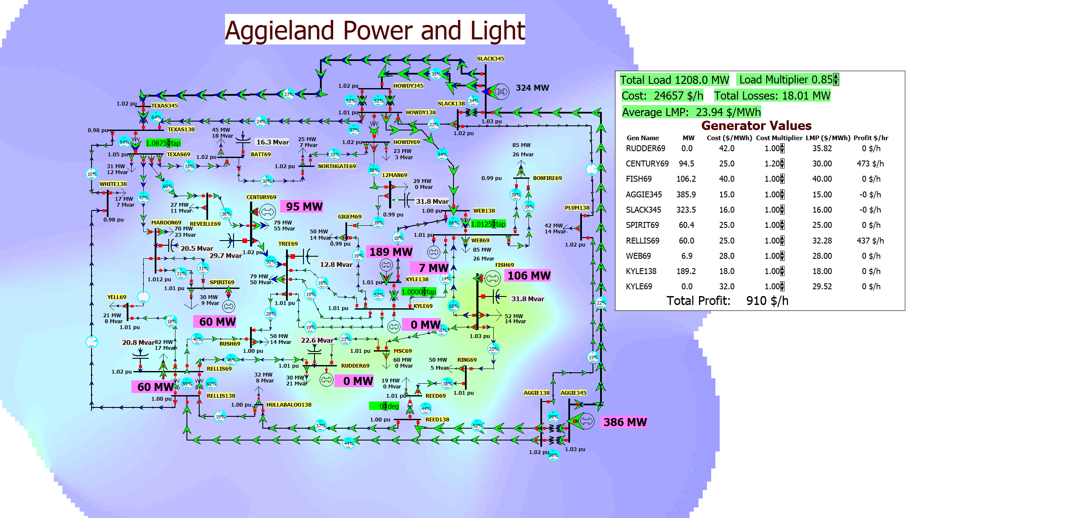
37 Bus Profit Maximization Example
To try maximizing profits, open the previous lab case and change the cost multiplier for one or more generators

Slide 31
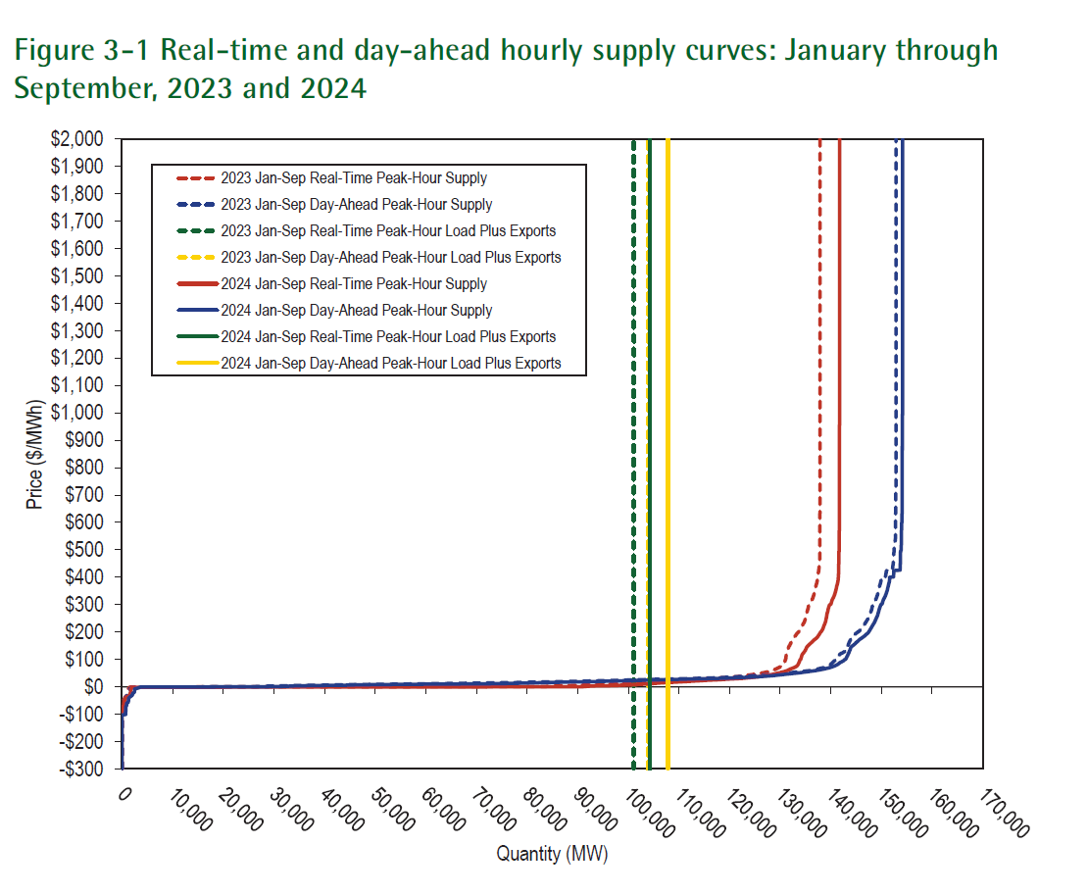
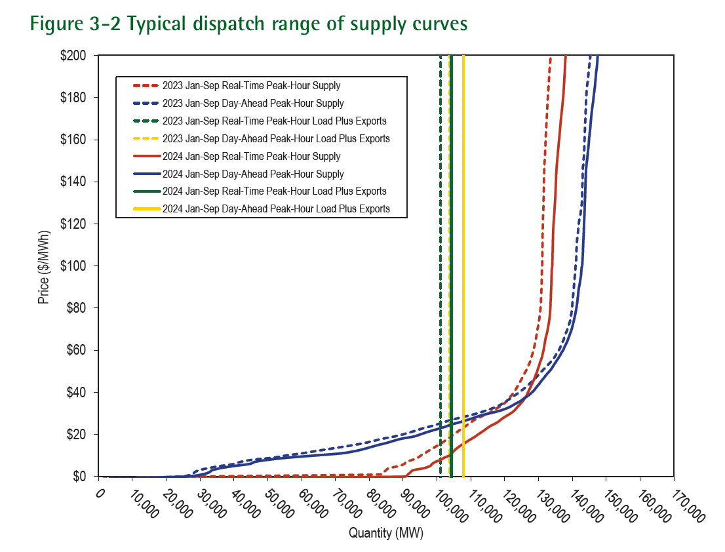
Example Generator Supply Curves
Image source: State of the Market Report for PJM, November 2024

Slide 32
Symptoms of Market Power
Economic theory tells us that in a market with perfect competition, prices should be equal to the marginal cost to supply the product
Therefore prices above marginal cost can indicate market power
Justification: Let the amount of product = q, price = p, the supply cost = C(s), and Profit = P=q*p – C(s)

Slide 33
Market Power Analysis
In general market power analysis requires three steps
  Identify relevant product or service (e.g., non-firm energy, capacity)
  Identify relevant geographic market
    Challenge in electric grids is the market can change with transmission system loading
  Evaluate market concentration
    One general measure of market power is the Herfindahl-Hirshman Index (HHI)

Slide 34
HHI Examples
For a monopoly the HHI = 10,000
If N=4, q₁=40%, q₂=25%, q₃=25%, q₄=10%, then HHI = 2950
DOJ/FTC standards, adopted by FERC in 1992 for merger analysis
  HHI below 1000 is considered to represent an unconcentrated market
  anything above 1800 is considered concentrated
  values were updated in 2010 to < 1500 for unconcentrated, and > 2500 highly concentrated, but 2024 guidelines seem to go with 1800 for highly concentrated
www.justice.gov/atr/herfindahl-hirschman-index

Slide 35
HHI Examples
A company with 15 GW of generation seeks to merge with a company with 5 GW of generation in an 80 GW market. Assuming the new company is the largest in the market, what is the largest possible value for the new HHI?
  The new company would have 25% market share. Since it is the largest, the highest HHI would be if there were three other companies almost as large (say close to 25% each). So the HHI in this case would be 4 × 25² = 2500. Of course if there are lots of other small companies it would be substantially less.

Slide 36
Collusion and Price Fixing
Sherman Antitrust Act of 1890 attempts to prevent the artificial rising of prices by restriction of trade or supply
  Goal is to preserve a competitive marketplace and prevent consumers from abuses
  An “innocent monopoly” is allowed, but trying to artificially maintain that status is not; an innocent monopoly is where a company has achieved a monopoly position solely through its superior skills, innovation or market efficiency
Agreements between competitors to tamper with prices (price fixing) could be a Sherman Act violation
Competitors often need to collaborate but cannot collude (which is defined as acting together in secret to achieve an illegal purpose)

Slide 37
Profit Optimization in Markets
When studying markets we’d like to determine an equilibrium point with the assumption each player is trying to maximize their profit
This is called the Nash Equilibrium, which has the following definition:
  An individual looks at what its opponents are presently doing
  The individual’s best response to its opponents’ behavior is to continue its present behavior
  This is true for ALL individuals in the market
The 2001 movie “A Beautiful Mind” is about John Nash’s Life

Slide 38
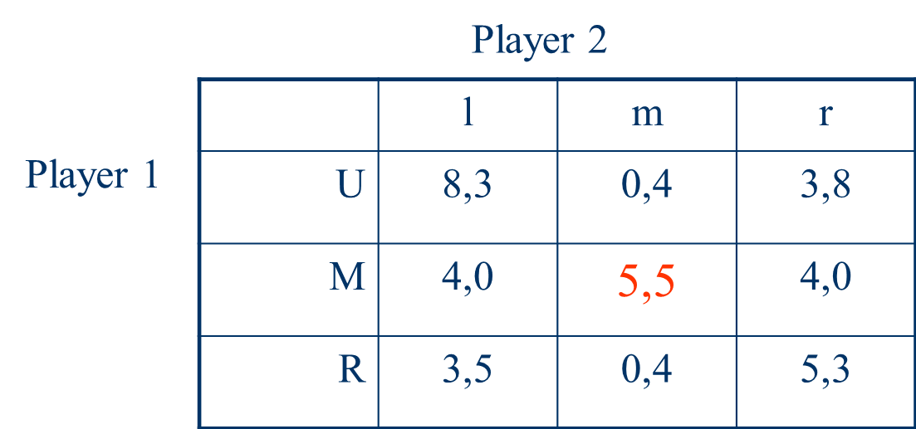
Nash Equilibrium Example
Consider a two player game, where each player has three choices. The table summaries the payoff for each player (player 1, player 2). The Nash equilibrium is shown in red.
A Nash equilibrium requires players have mutually correct assumptions.

Slide 39
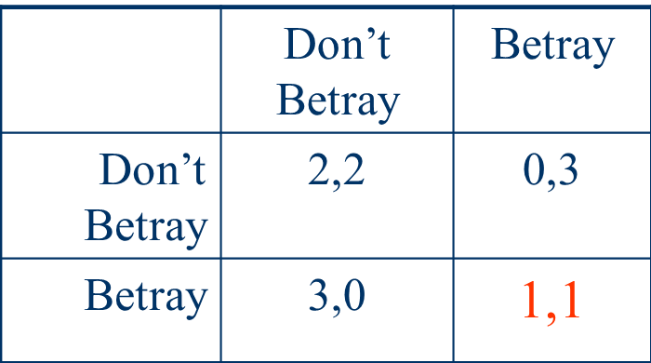
Nash Equilibrium and the Prisoner’s Dilemma
Two prisoners are being interrogated simultaneously. If they betray their fellow criminal then they will get a lighter sentence, unless both of them betray each other. Then both serve a long sentence. If neither talks then the sentences will be lighter.
Here a higher number is better, but the
Nash Equilibrium is actually worse for both

Slide 40
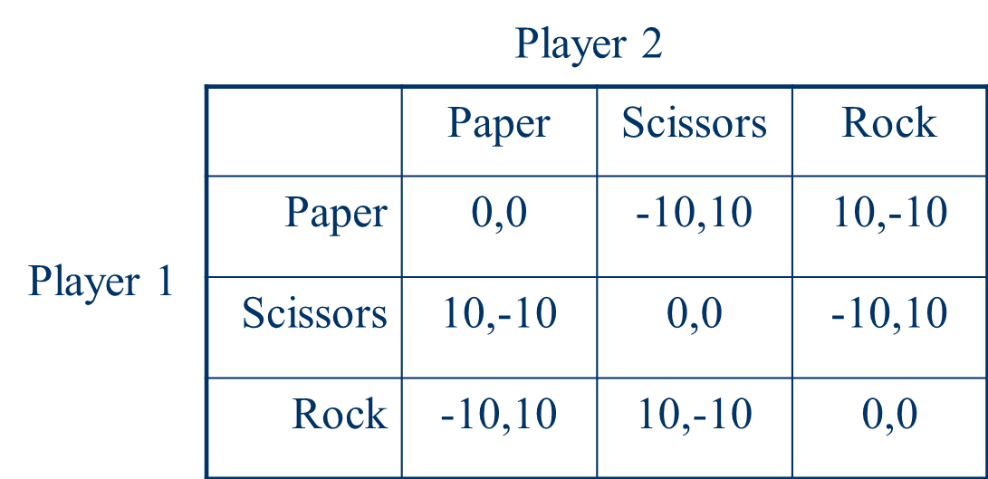
Nash Equilibrium in Which a Mixed Strategy is Best
Consider the Nash Equilibrium for the game paper, scissors & rock. This game has no Nash Equilibrium, indicating that a mixed strategy is best

