Slide 1
ECEN 460
Power System Operation and Control
Spring 2025
Lecture 14: August 14, 2003 Blackout and Winter Storm Uri
Prof. Tom Overbye
Dept. of Electrical and Computer Engineering
Texas A&M University
overbye@tamu.edu

Slide 2
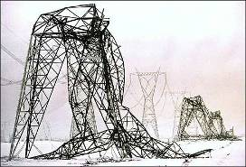
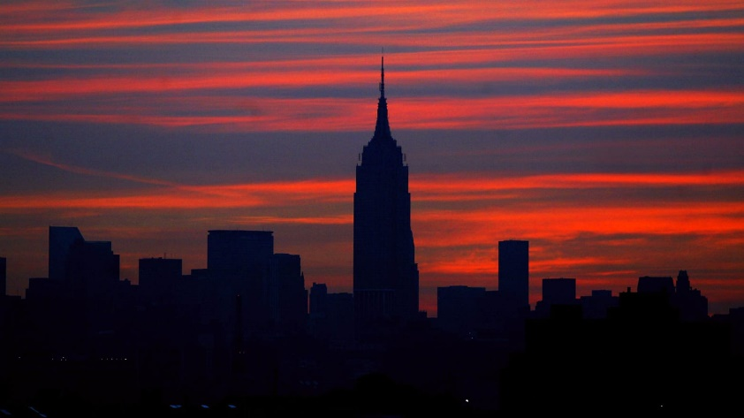
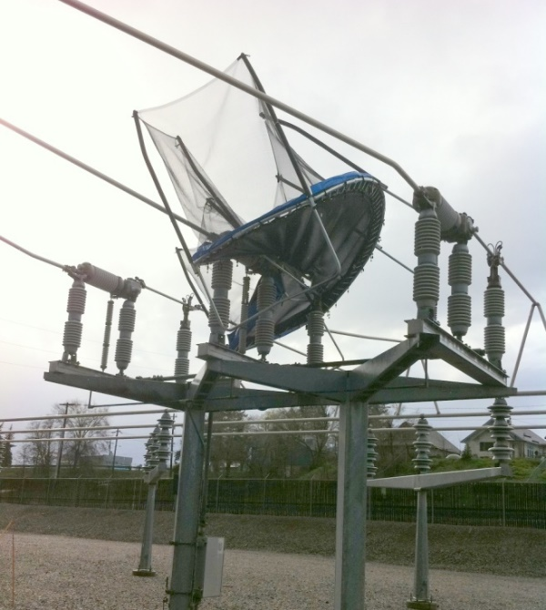
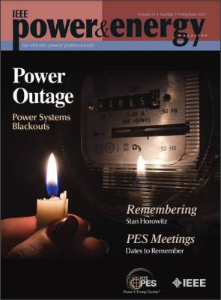
Blackouts and Restoration
Modern society depends on a
reliable electric grid.
Blackouts are costly, with
some estimates of costs above
$100 billion/year in the US.
Blackouts can differ substantially in their impact, with most caused by local, lower voltage distribution issues.
In May/June 2023 Jeff Dagle and I edited
a special IEEE Power and Energy
Magazine issue on blackouts
  It is free for IEEE PES members
Upper right image: New York Daily News Archive
1

Slide 3
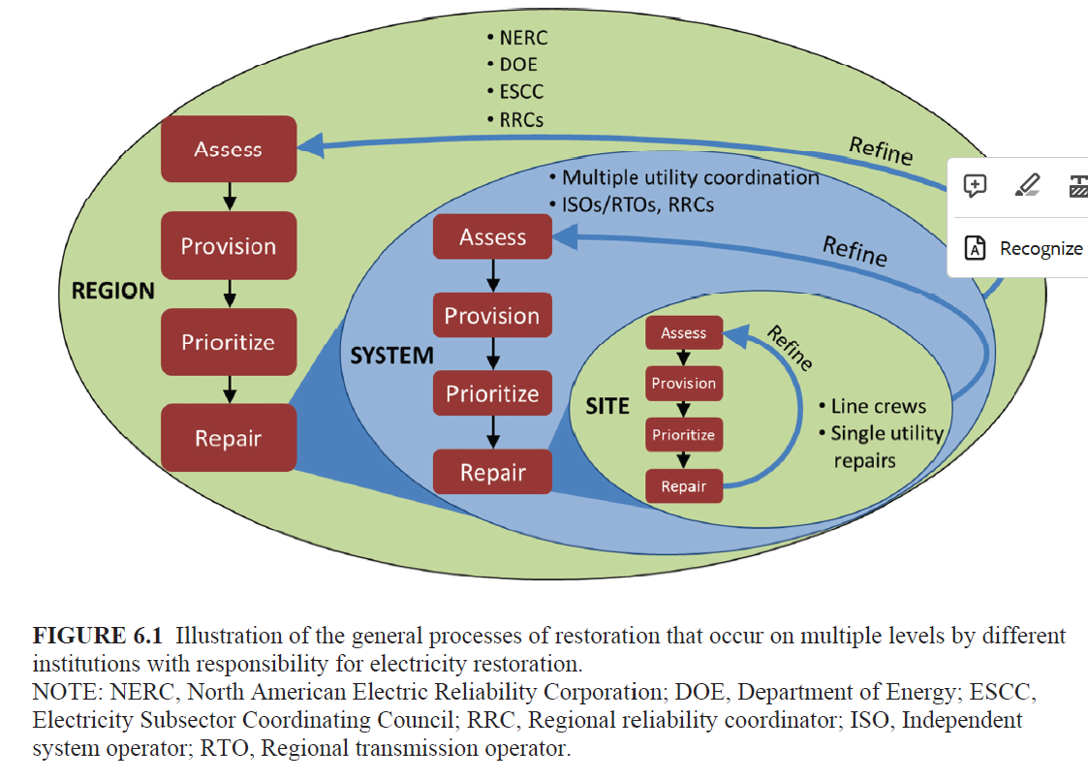
Electric Grid Operating States
The goal of electric grid planning and operations is to prevent blackouts. Still, they do occur, and when they do the focus switches to restoration
Blackouts come in all different
sizes, with the vast majority
local issues in the distribution
system that can be quickly
fixed with resources the utility
already has
There is a much greater
challenge for large-scale
blackouts, especially with equipment damage
Image source: US National Academies 2017, Enhancing Resilience of US Electric Grid Report
2

Slide 4

The Real Cause of Most Blackouts!
Most outages occur in the distribution system, and many of those are caused by animals
Photo source: http://save-the-squirrels.com
3

Slide 5
Standard Indices for Small Events (IEEE Std 1366-2022)
System Average Interruption Duration Index (SAIDI) represents the average amount of time the supply to a customer is interrupted per year (expressed in minutes per year)
System Average Interruption Frequency Index (SAIFI) represents the average number of times per year the supply to a customer is interrupted per year (expressed in interruptions per year)
  Both are averages for a system, so some people have higher values, some lower
4

Slide 6
IEEE Std 1366-2022 Major Event Days (MED)
A MED is a day in which the SAIDI exceeds a threshold; all indices are calculated with the MEDs removed
  Typically one per year (give or take)
  Purpose of removal is to allow indices to give good indication of normal operational and design stress
  MEDs are analyzed separately
  Just looking at standard indices doesn’t indicate what is really going on.
5

Slide 7
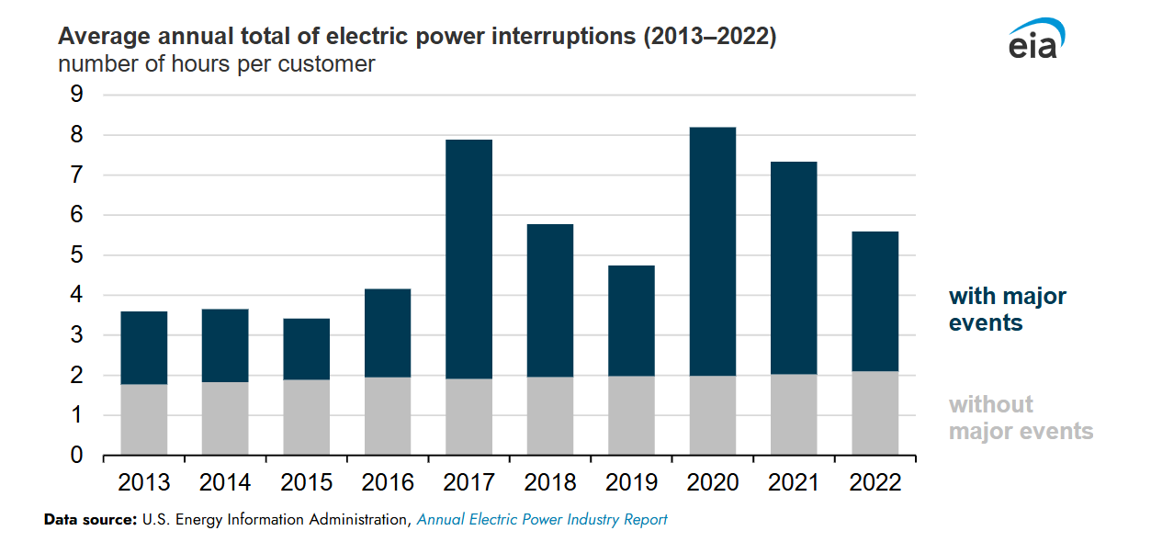
US Blackout Averages

Slide 8
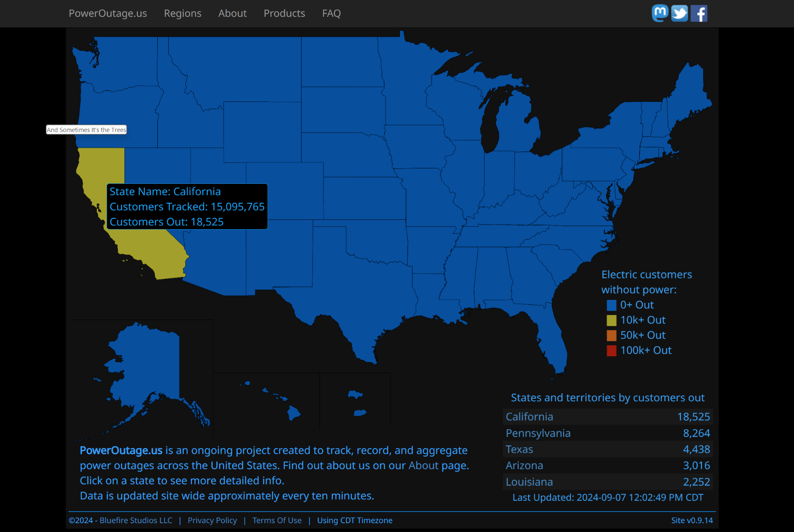
A Good Source for Real-Time US Power Outage Information: https://poweroutage.us
7

Slide 9
Cost of Blackouts
Electricity has varying value and hence the costs associated with blackouts can vary substantially
  Momentary (less than five minutes) can have almost no impact for residential customers (certainly with exceptions!) while costing industrials potentially millions if production is interrupted
Costs impact are sensitive to the duration and extent of the blackout as well
  Long duration blackouts impacting a wide area are the worst case scenarios
8

Slide 10
Larger Scale Blackouts
The North American Electric Reliability Corporation (NERC) requires reporting of events the interrupt more than 300 MWs or affect at least 50,000 customers
  From 1984 to 2006 there were 861 events reported, but only about 300 met the criteria
  Average of blackouts that met the criteria affected several hundred thousand customers, but large outages affected many more (like August 14, 2003 with more than 50 million people).
This data is now kind of dated, partially because of changes in the availability of information to researchers
Source: www.uvm.edu/~phines/publications/2008/Hines_2008_blackouts.pdf
9

Slide 11
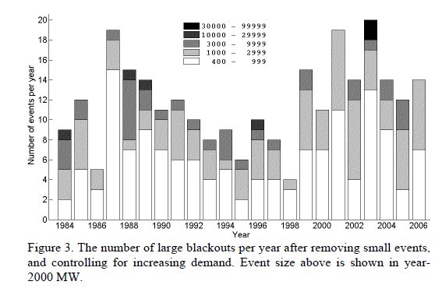
Large Blackouts in North America By Event Size
10

Slide 12
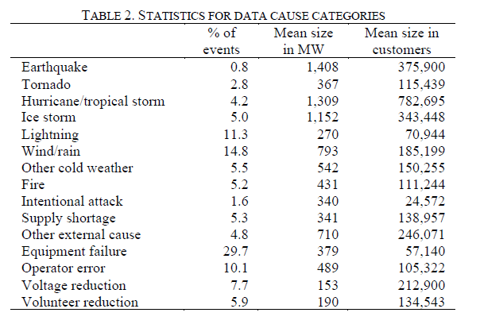
Causes of Large Blackouts
11

Slide 13
Avoidable Transmission Level Blackouts
Many major blackouts can be prevented.
Time frames of the blackouts, minutes to hours, allow for operator intervention
  Tokyo 1987 (20 minutes), WECC 1996 (six minutes), Eastern Interconnect 2003 (about an hour), Italy 2003 (25 minutes), India 2012
And of course many are prevented, and hence do not make the news. For example, near voltage collapse in Delmarva Peninsula, 1999.
12

Slide 14
Restoration
The cost of blackouts certainly increases the longer the power is out
How quickly power can be restored depends on whether there was equipment damage
  Downed lines take time to rebuild
  Houses damaged by flooding need to be disconnected before service can be restored
  Some generation, such as nuclear plants, can take days to restart
  Damage to HEV transformers could be catastrophic!
13

Slide 15
August 14th 2003 Blackout and Winter Storm Uri 2001
The August 14th 2003 blackout is now more than 20 years in the past yet it still has much to teach us.
This talk is about the past and the future: what can we learn from the past to help us prepare for the future
  But not so much about what are the immediate lessons from the Blackout since many recommendations have already been put into practice.
The blackout final report is very readable and available by googling “August 14 2003 Blackout Report”
We’ll also briefly cover Winter Storm Uri, which resulted in rotating blackouts in Texas
14

Slide 16
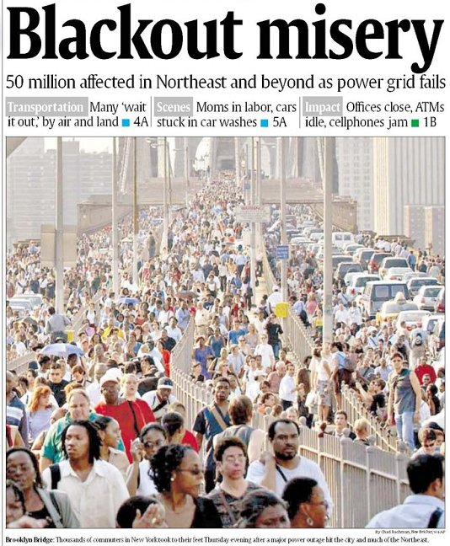
The August 14 2003 Blackout affected about 50 million people in the US and Canada. There have been much larger blackouts, including one in 2012 that affected more than 620 million people in India, and one in 2023 in Pakistan affecting more than 200 million. The 8/14/2003 one is still the largest in North America; the New York 1965 one affected 30 million, while Winter Storm Uri affected more than 15 million people in Texas in 2021 with at least rotating outages.
15

Slide 17
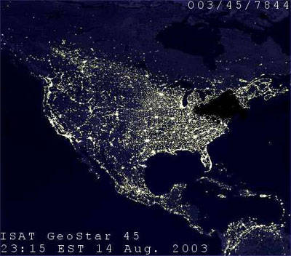
August 14, 2003 Hoax Image
This image was widely circulated immediately after
the blackout, even appearing for a time on a DOE website. It was quickly shown to be a hoax. What might immediately give it away?
16

Slide 18
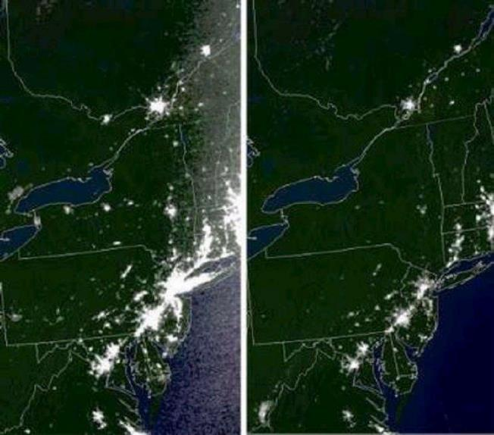
Actual Before and After Images
17

Slide 19
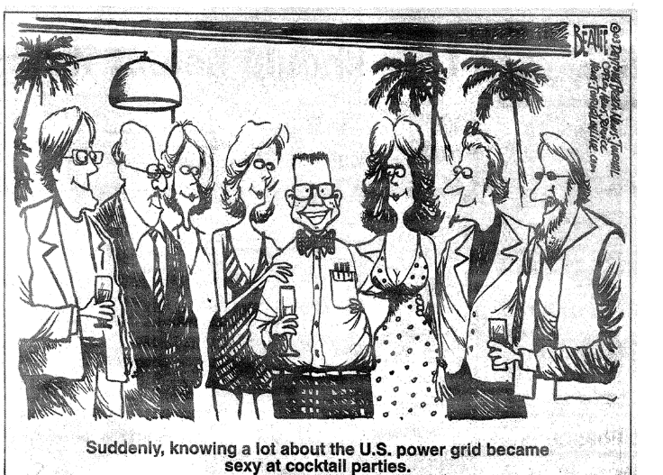
My Favorite August 14, 2003 Cartoon
18

Slide 20
Causes of the Blackout
Blackout Final Report listed four causes
  FirstEnergy (FE) did not understand inadequacies of their system, particularly with respect to voltage instability.
  Inadequate situational awareness by FE
  FE failed to adequately manage their tree growth
  Failure of the grid reliability organizations (primarily MISO) to provide effective diagnostic support
Human/cyber interactions played a key role
19

Slide 21
We’ve Come Quite a Ways Since 2003
Report included 46 recommendations, many of which have dramatically changed the operation of the interconnected power grid
  Thirteen were focused on physical and cyber security
Focus of talk is what can 8/14/03 teach us to help with the grid in 2025
Need to keep in mind economic impact of 8/14/03 was above $5 billion; yearly impact of blackouts could be above $100 billion
20

Slide 22
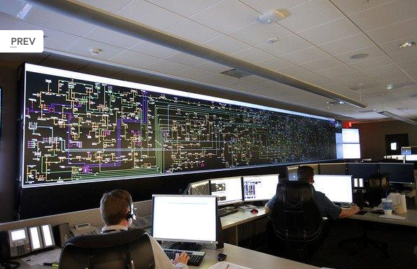
First Energy Control Center, (2013)
Image Source: www.wksu.org/news/story/365
21

Slide 23

My Involvement in Blackout Investigation
I spend a lot of time talking to reporters on 8/14 to 8/16, before I knew what happened
Tasked by DOE to do onsite visit to FE on 8/19 to 8/21 with Doug Wiegmann; did similar visit to MISO the next week.
Did return visit in Oct
Many folks played far
larger roles; I was only
involved extensively early
on
22

Slide 24
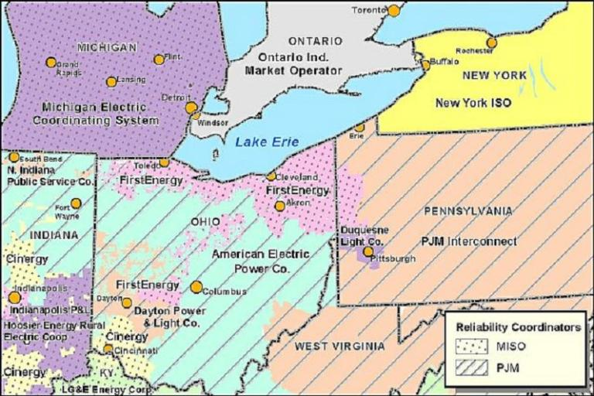
Footprints of Reliability Coordinators in Midwest
In 2003 the Ohio portion of First Energy was in MISO; they have since moved to being in PJM.
23

Slide 25
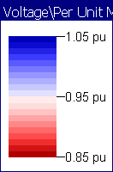
August 13, 2003
It is important to realize that immediately before the blackout few people thought the system was on the verge of a catastrophe.
NERC 2003 Summer
Assessment did not
list Ohio as an area
of particular concern
NERC 2003 Summer Assessment is available at http://www.nerc.com/files/summer2003.pdf
24

Slide 26
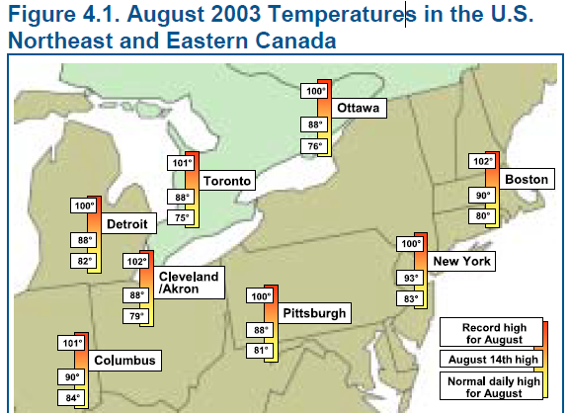
August 14, 2003: Pre-blackout (before 14:30 EDT)
It had mostly been a normal summer day at First Energy
  Most generation was available though the 883 MW Davis-Besse Nuclear unit was on a long-term outage
  At 13:31 EDT the Eastlake 5 unit (a 597 MW plant on Lake Erie) tripped when the operator tried to up is reactive output, but this was not seen as a severe event
It had been a busy day at MISO, with
their reliability coordinators dealing
with a relatively small outage in Indiana
around noon
  Their state estimator failed at 1215 EDT but
  no one know this
25

Slide 27
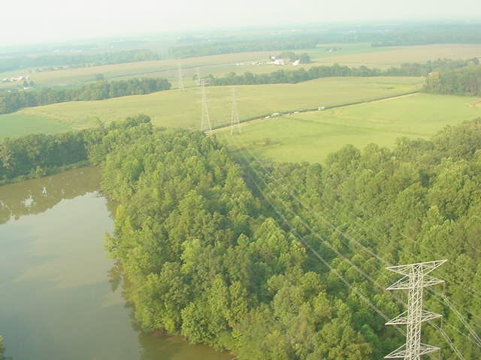
Cinergy Bedford-Columbus 345 kV Line Tree Contact at 12:08 EDT
26

Slide 28
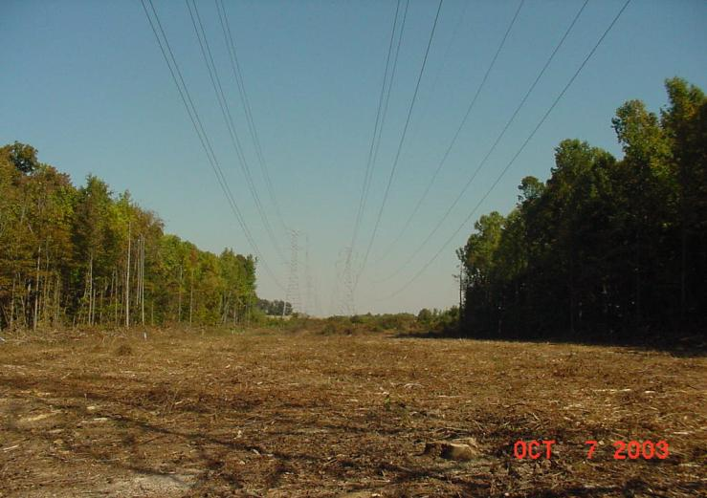
Trees were Finally “Trimmed” Two Months Later
27

Slide 29
At 14:27 EDT Star-South Canton 345 kV Line Trips and Recloses
Star-South Canton is a tie between AEP & FE
FE missed seeing this event since their alarms had hung several minutes earlier (14:14)
    Line was back in service so it appeared normal in SCADA
    FE IT folks knew about computer problems
AEP called FE at 14:32 to check on event; FE says they saw nothing. A repeat call by AEP to FE at 15:19 also discusses event indicating ground current was detected.
28

Slide 30
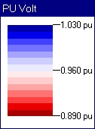
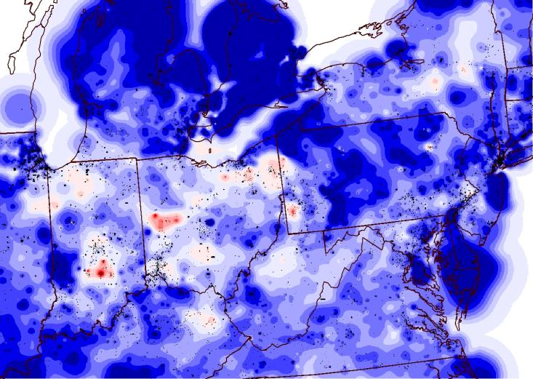
Estimated High Level Voltage Profile at 15:00 EDT
29

Slide 31
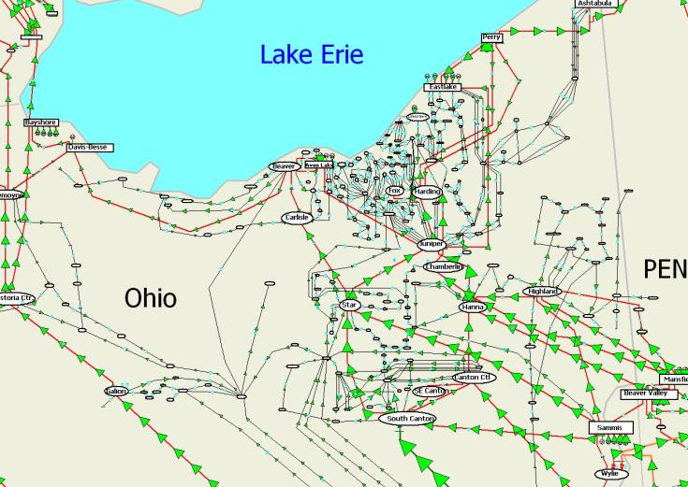
Estimated Flows in Northeast Ohio at 15:00 EDT on August 14th 2003
Chamberlin-Harding
345 kV Line trips at 15:05, an event
that was missed by
both FE and MISO
30

Slide 32
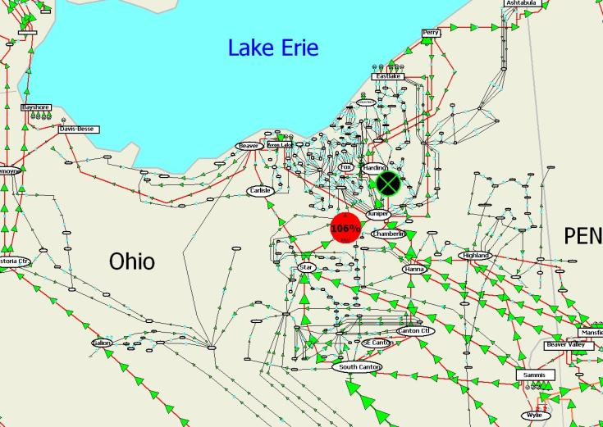
Estimated Flows in Northeast Ohio at 15:06 EDT
31

Slide 33
Line Outage Distribution Factors (LODFs)
LODFs are used to approximate the change in the flow on one line caused by the outage of a second line
  Typically they are only used to determine the change in the MW flow
  LODFs are used extensively in real-time operations
  LODFs are state-independent (calculated using dc power flow approximations) but do dependent on the assumed network topology
  Below value tells change of real power flow on line  for the assumed outage of line k; ƒ_{k}⁰ is (obviously) pre-contingent
32

Slide 34
Flowgates
The real-time loading of the power grid is accessed via “flowgates”
A flowgate “flow” is the real power flow on one or more transmission element for either base case conditions or a single contingency
  Contingent flows are determined using LODFs
Flowgates can be used as proxies for other types of limits, such as voltage or stability limits
Flowgates in 2003 were calculated using a spreadsheet
33

Slide 35
Flowgate #2265
Flowgate 2265 monitors the flow on FE’s Star-Juniper 345 kV line for contingent loss of the Hanna-Juniper 345 Line
  normally the LODF for this flowgate is 0.361
  flowgate has a limit of 1080 MW
  at 15:05 EDT the flow as 517 MW on Star-Juniper, 1004 MW on Hanna-Juniper, giving a flowgate value of 520+0.361*1007=884 (82%)
  Chamberlin-Harding 345 opened at 15:05; FE and MISO all missed seeing this
Information on PJM’s current flowgates is available at
www.pjm.com/markets-and-operations/etools/oasis/atc-information
34

Slide 36
The Bad LODF that Maybe Blacked Out the Northeast
At 15:06 EDT (after loss of Chamberlin-Harding 345) #2265 has an incorrect value because its LODF was not automatically updated.
  Value should be 633+0.463*1174=1176 (109%)
  Value was 633 + 0.361*1174=1057 (98%)
At 15:32 the flowgate’s contingent line opened, causing the flowgate to again show the correct value, about 107%
35

Slide 37
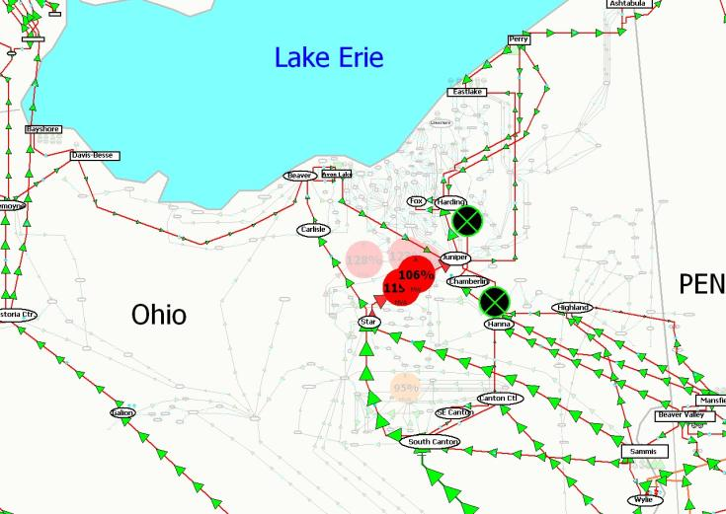
Flows at 15:33 EDT
36

Slide 38
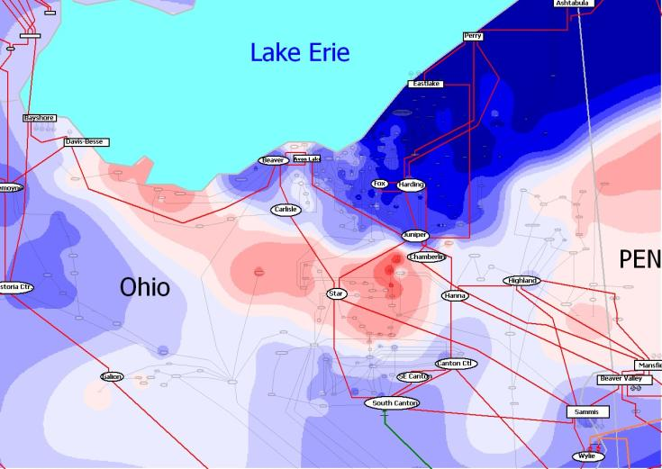
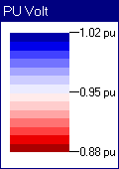
Estimated Northeast Ohio 138 kV Voltage Contour: 15:33 EDT
37

Slide 39
IT Issues
MISO RCs had gotten many hundreds of “alarms”
Contingency analysis results were giving pages of violations.
SE would fail because of severe system stress
Inadequate procedures for dealing with SE failure.
FE control center would get “many phone calls;” information was not effectively shared.
38

Slide 40
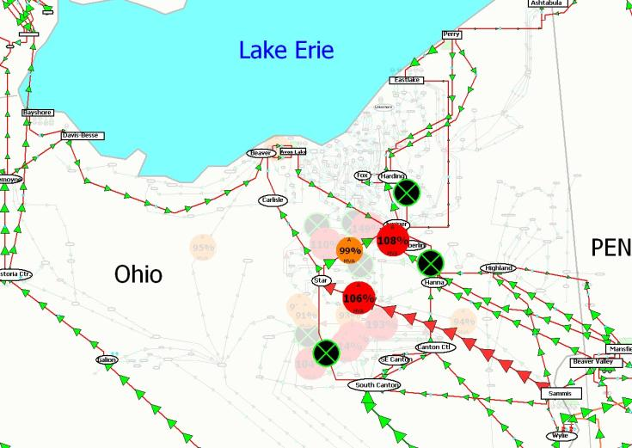
Estimated Flows in Northeast Ohio at
15:46 EDT on August 14th 2003
39

Slide 41
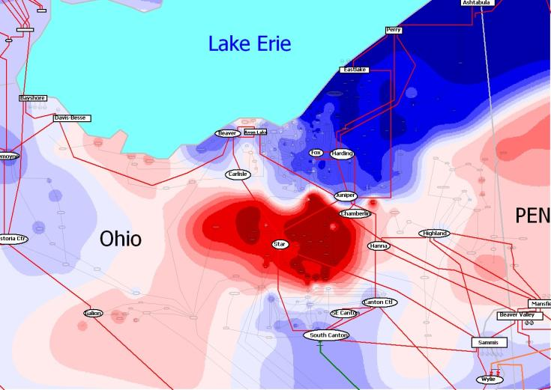
Estimated Northeast Ohio 138 kV Voltage Contour: 15:46 EDT
40

Slide 42
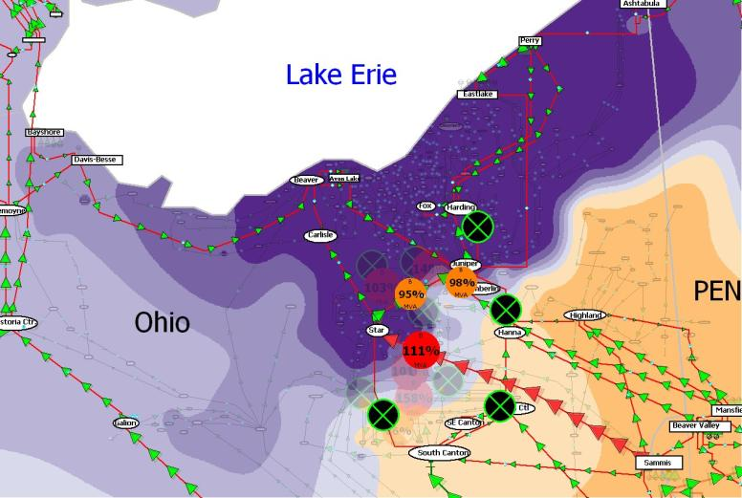
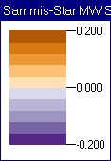
What Could Have Been Done?
Sammis-Star Flow Sensitivities
DOE/NERC
report said
about
1500 MW
of load
shed would
have been
needed
41

Slide 43
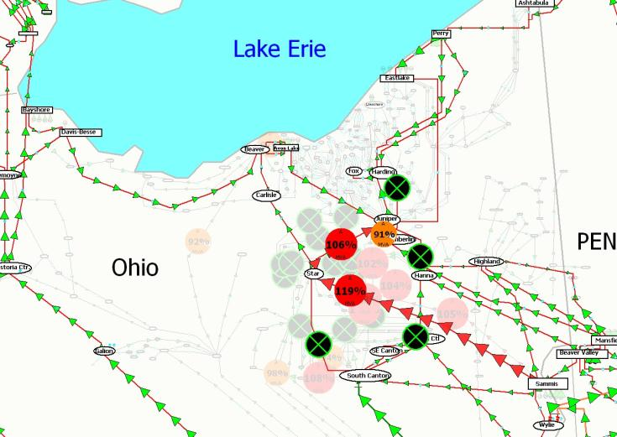
Estimated Flows in Northeast Ohio at
16:05 EDT on August 14th 2003
42

Slide 44
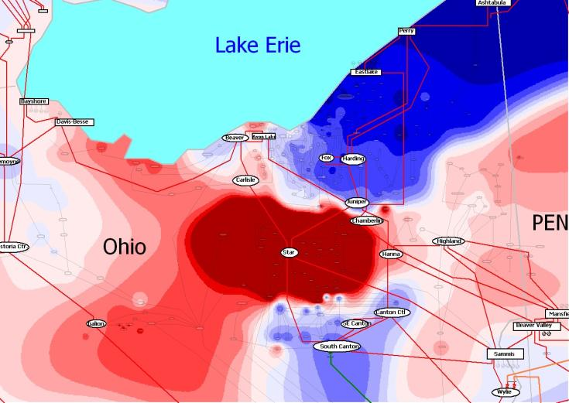
Estimated Northeast Ohio 138 kV Voltage Contour: 16:05 EDT
43

Slide 45
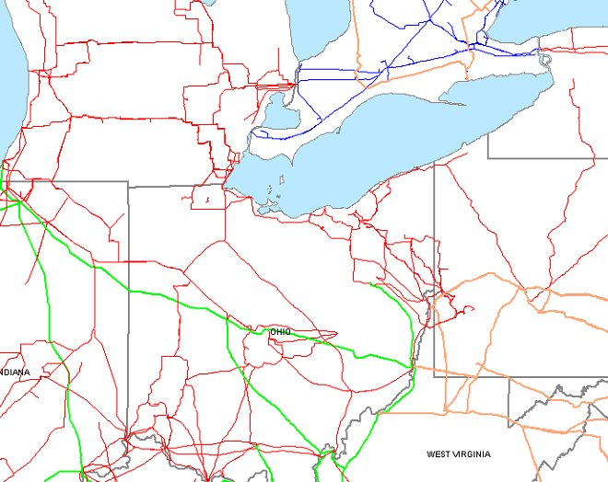
Path to Cleveland Blocked after Loss of Sammis-Star 16:05:57
Remaining
Paths
Image Source: August 14
2003 Blackout Final Report
44

Slide 46
345 kV Lines Trip Across Ohio to West at 16:09
ONTARIO
45

Slide 47
Generation Trips 16:09:08 – 16:10:27
ONTARIO
Image Source: August 14 2003 Blackout Final Report
46

Slide 48
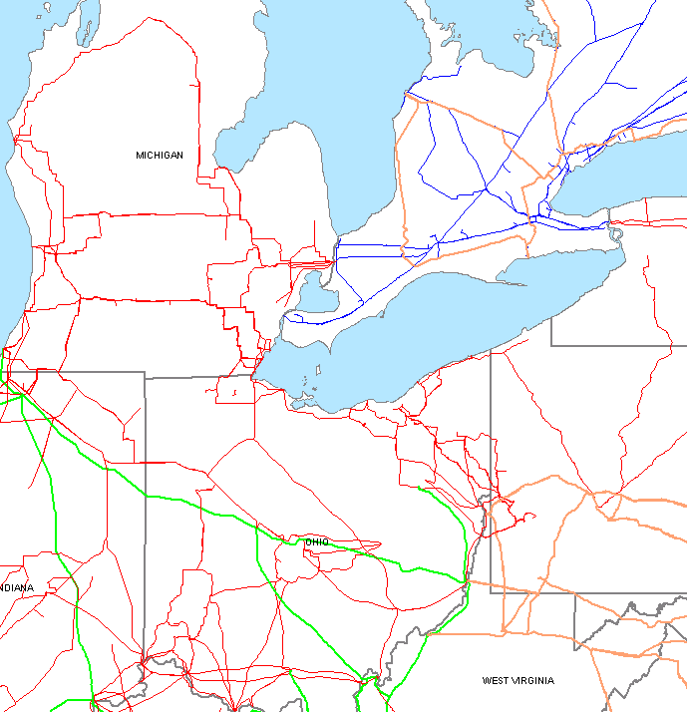
Parts of Ohio/Michigan Served Only from Ontario after 16:10:37
Image Source: August 14
2003 Blackout Final Report
47

Slide 49
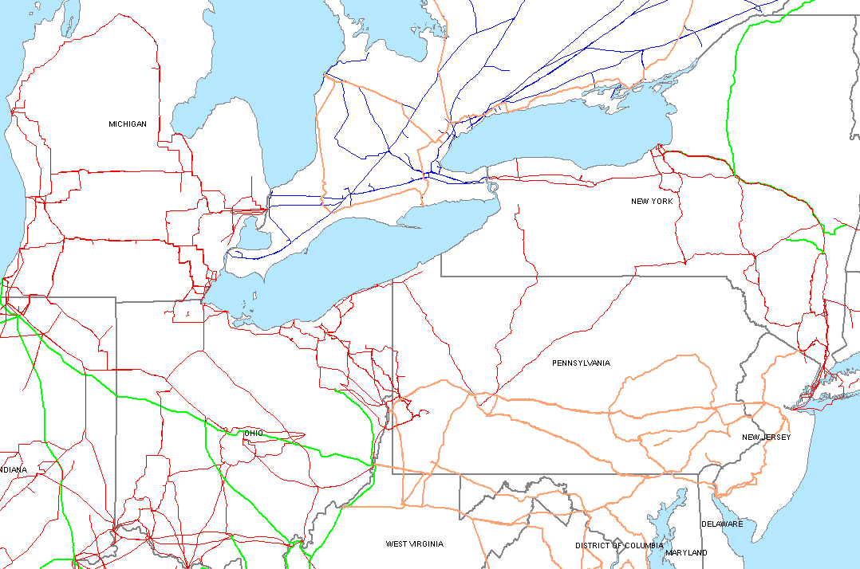
Major Power Reversal: 16:10:38
Image Source: August 14
2003 Blackout Final Report
48

Slide 50
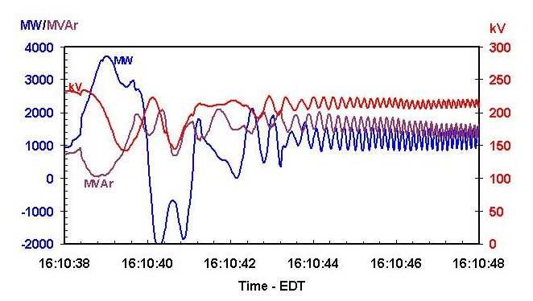
Ontario/Michigan Interface Flows and Voltage
Image Source: August 14 2003 Blackout Final Report
49

Slide 51
Ties from PJM to New York Open: 16:10:44 (North Ohio Black)
Image Source: August 14 2003 Blackout Final Report
50

Slide 52
System Islands Break Up and Collapse: 16:10-16:13
Image Source: August 14 2003 Blackout Final Report
Some Local Load Interrupted
Areas Affected by the Blackout
Service maintained
in some area
51

Slide 53
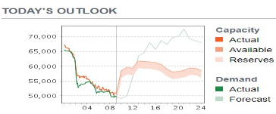
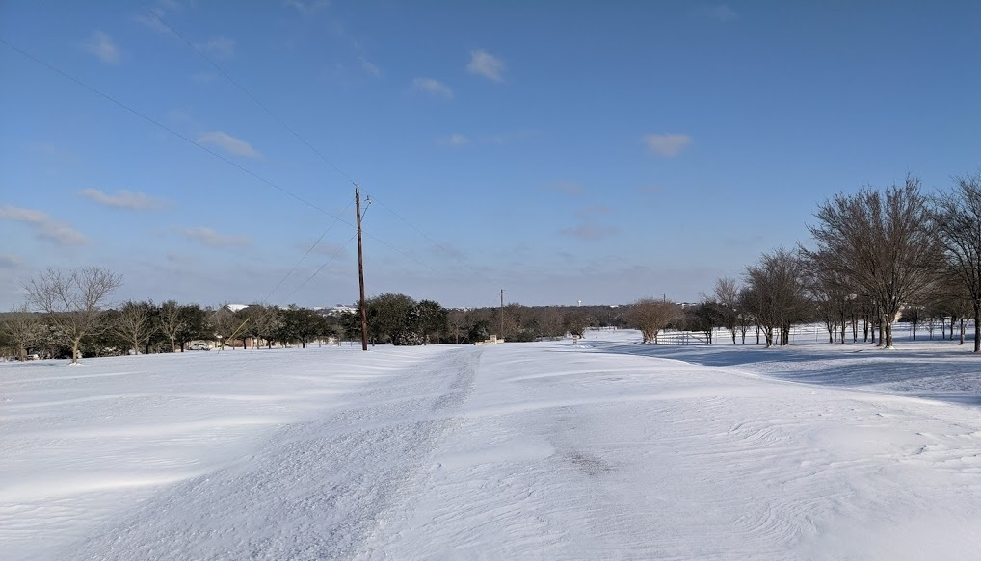
Texas Near Blackout, February 2021
Unfortunately, electric grids often make the news for all the wrong reasons!
Starting on Feb 14, 2021 statewide
Texas had temperatures much
below avg., though not record cold
  In College Station on Feb 15 is low was 9°F and very windy (and 5°F on Feb 16); avg. high is 65°F and low of 45°F
  Our record low is -3°F (1/31/1949), our
  coldest February temperature was 5°F
  (2/5/1951) and last single digit was 9°F
  (12/22/1989)
This stressed many infrastructures
including the ERCOT electric grid

Slide 54
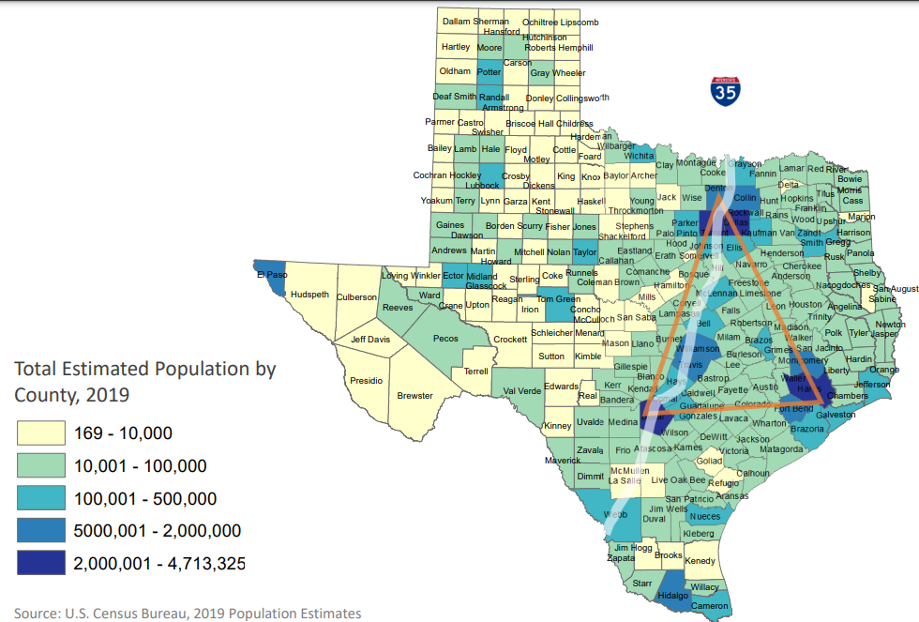
Texas Population Density
85% of population is along or east of the I35 corridor (DFW to Waco to Austin to San Antonio to Laredo)

Slide 55
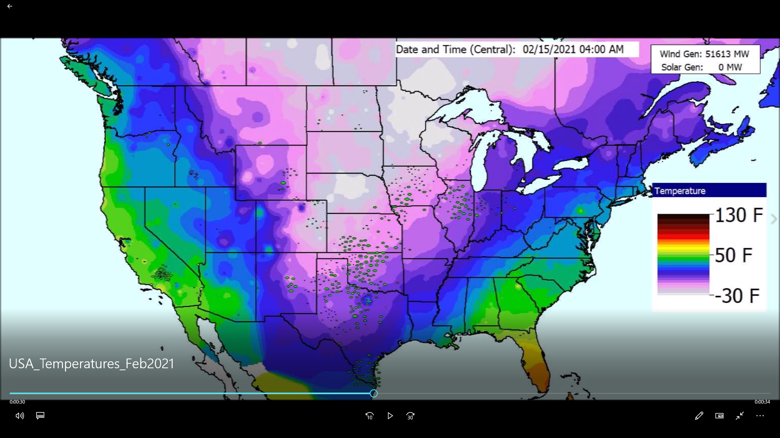
Visualization of Temperatures, Feb 11 to 18, 2021

Slide 56
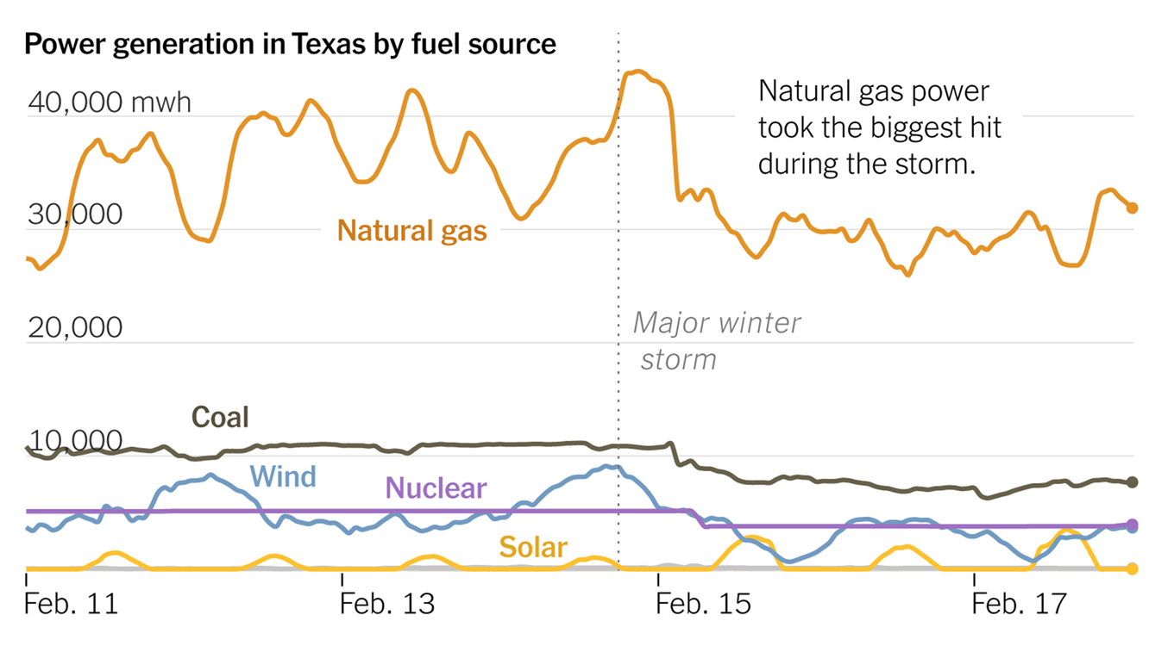
ERCOT Generation Feb 11-18, 2021
Image source: New York Times, Feb 23, 2021

Slide 57
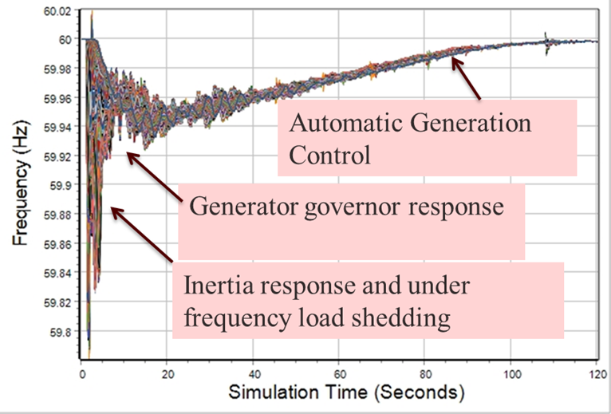
Quick Aside: Power System Dynamic Response to Load/Gen Mismatch
An electric grid frequency is constantly changing, but it usually within a few mHz of desired (e.g., 60 Hz)
Too much generation
increases the frequency
and too little decreases it
All grid elements have
the same average frequency
but during disturbances the
frequency can oscillate

Slide 58
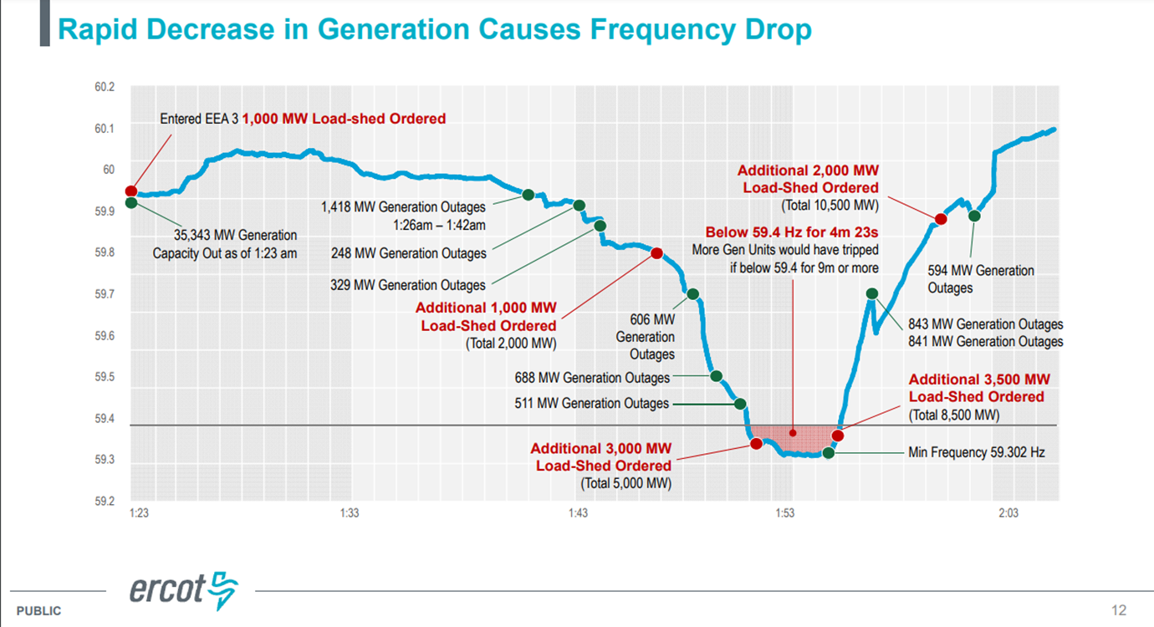
ERCOT Frequency, Feb 15, 2021
Image source: ERCOT Presentation by Bill Magness, February 25, 2021

Slide 59
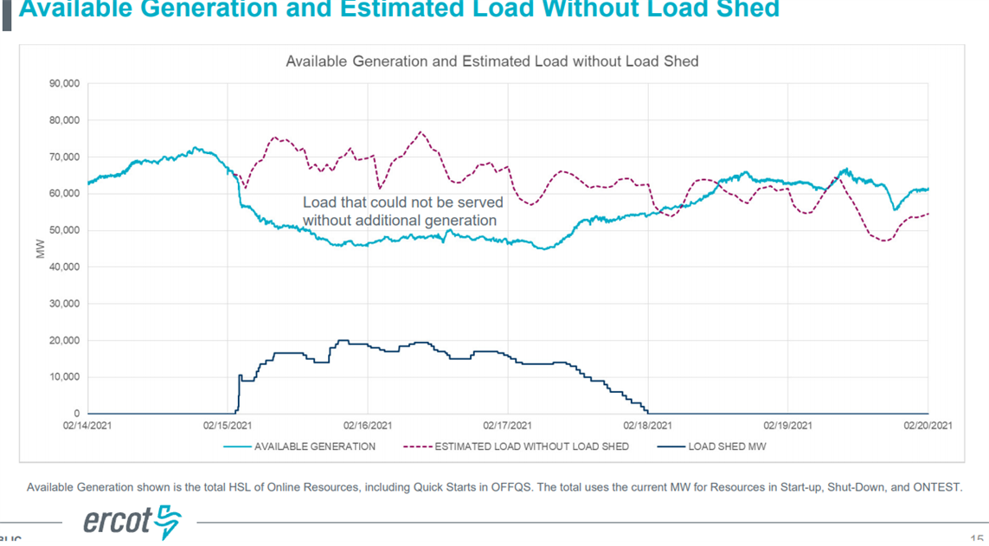
ERCOT Load Shed and Rotating Blackouts
The vast majority of the lost load was due to load shed and then rotating blackouts
At the time the ERCOT peak load had been 74.8 GW (summer); winter peak of 69.2 GW was set on 2/14/21 (previous winter peak was 65.9 GW). A new winter peak of 80.6 GW was set in Feb 2025.
Image source: ERCOT Presentation by Bill Magness, February 25, 2021

Slide 60

How can Grids Cascade?
ERCOT reported that they were minutes away from a catastrophic blackout that would have taken down the entire grid, requiring many days to restore
Grids can cascade due to a number of different reasons with many related to the transmission grid flows and voltages
For ERCOT the situation was the
prolonged (minutes) low frequency
would have result in generators
tripping due to under frequency
resulting in a cascading collapse
in the frequency and hence the entire system

Slide 61
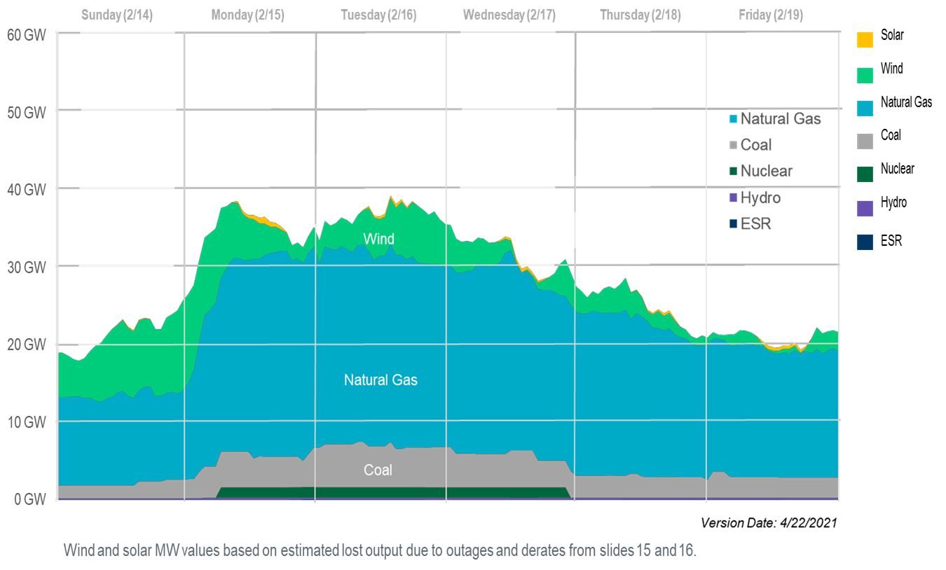
How Much Generation was Lost?
This slide correctly recognizes that much of the wind capacity that was not available due to the cold, would not have been generating much because of low wind.

Slide 62
Winterizing Wind Turbines
In general wind turbines can operate in quite low temperatures
However, most of the wind turbines in Texas were not configured with the systems needed to deal with low temperatures
  They mostly were not available because of turbine blade icing
Wind turbines can be winterized with systems such as heated blades or coatings; packages can also be installed to protect the gearbox and motors, such as adding heating to the nacelle

Slide 63
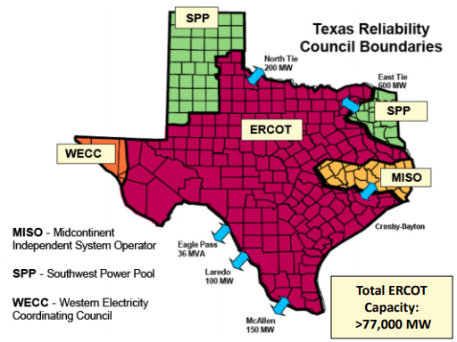
Background: Why is ERCOT Separate?
ERCOT operates asynchronous from the rest of North America, but has high voltage dc (HVDC) ties with the Eastern Interconnect and Mexico
The advantage is ERCOT avoids some federal
regulation. The legal basis for
this is complex, based on
the US Constitution, the Federal
Power Act, the 5/4/76 midnight
connection, other legislation,
court rulings, and FERC decisions
Image Source: aect.net/documents/2017/AECT%20LSB%20012617.pdf

Slide 64
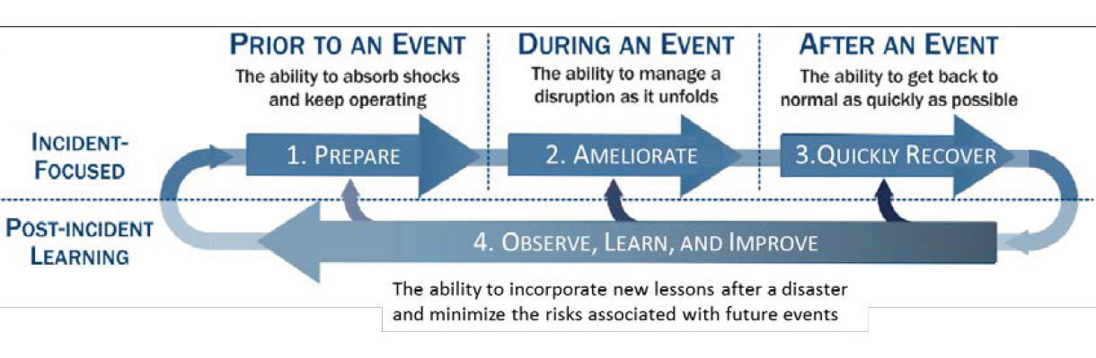
General Grid Resilience: The Four Stage Process
This is presented as Figure 1.2a in the National Academies’ Enhancing the Resilience of the Nation’s Electricity System report (2017), and is originally from
S.E. Flynn, “America the resilient: Defying terrorism and mitigating
natural disasters.” Foreign Affairs, vol. 87: 2–8 (2008) and as illustrated by the National Infrastructure Advisory Council (NIAC) in 2010.

